Slide 1
Instructions for use
This resource aligns to the learning in Stage 2 Year A Unit 15 and revisits content from earlier sample units.
Classroom teachers are encouraged to add and adapt slides as required to meet the needs of their students.
Save a copy of the file to make changes to the slide deck. Go to File > Download a Copy (this downloads a copy to the computer to edit in the PowerPoint app).
To convert the PowerPoint to Google Slides:
  Upload the file into Google Drive and open it.
  Go to File > Save as Google Slides.
  (Note – conversion may cause formatting changes in the slides.)

Slide 2

Review of Learning
Mathematics Stage 2 – Unit 15
Notes:
Reviews may include a combination of question types, requiring students to recall facts and key ideas, as well as apply their knowledge to solve problems and answer questions. To support active engagement, a mix of techniques should be employed.” (AERO, 2024).
This Review of Learning slide deck revisits key concepts from the following units:
Stage 2 Year A Unit 15
Stage 2 Year A Unit 14
Stage 2 Year A Unit 13
It also includes opportunities to review prior learning in non-number content, supporting consolidation across focus areas.
The review of learning resources include three key task types that support the development of mathematical proficiency through retrieval, spaced practice, and active participation. These practices complement the review phase (activating prior knowledge) embedded within the beginning of each lesson.
1.
Multiple-choice questions/True or false: Designed to promote active retrieval of key concepts and identify common misconceptions in number, supporting consolidation, understanding and fluency.
These questions:
support spaced and interleaved practice
help identify and address common misconceptions
support active recall and immediate feedback
support whole class participation
identify areas requiring reteach
2.
Short-response question sets: Carefully grouped questions that encourage spaced and interleaved practice across multiple focus areas, helping students revisit and apply knowledge from different points in time.
These questions:
have a combination of question types
address a range of focus areas
build automaticity and fluency
support active recall
allow for immediate feedback
identify content requiring reteach
3.
Developing number sense activities: A variety of practical, purposeful tasks that reinforce current learning and build on prior knowledge. These activities promote reasoning, problem-solving and conceptual understanding.
The review of learning resources are designed to work support teaching and learning in mathematics. For the most effective implementation, use the resources flexibly, adapting to meet student learning needs and individual classroom contexts.

Slide 3
Lessons
1
Review of learning 1
5
Review of learning 5
2
Review of learning 2
6
Review of learning 6
3
Review of learning 3
7
Review of learning 7
4
Review of learning 4
8
Review of learning 8
Notes:
Teacher notes:
Click lesson titles to go to specific lessons
Interactive features can be viewed in slide show

Slide 4
Review of learning 1

Slide 5
Multiple choice (1)
23 + 15 =
A
33 + 25
B
40 - 2
C
30 + 7
D
23 - 15
Notes:
This question connects to the content in the developing number sense activity (Activity 1)
Syllabus focus area:
Additive relations A

Slide 6

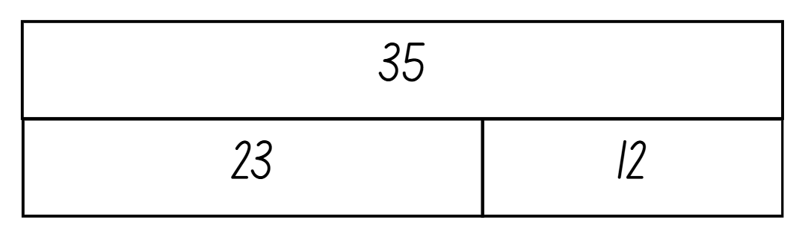
Short response (1)
Record addition and subtraction number sentences for this bar model.
Notes:
Short response questions provide brisk paced questions focussing on review of current and previous content to support spaced and interleaved practice.
Syllabus focus area:
Additive relations A

Slide 7
Short response (2)
Record an object in the classroom that weighs:
less than one kilogram
about the same as one kilogram
more than one kilogram.
Notes:
Short response questions provide brisk paced questions focussing on review of current and previous content to support spaced and interleaved practice.
Syllabus focus area:
Non-spatial measure A

Slide 8
Short response (3)
Record whether the following numbers are odd or even.
35
26
51
Communicate your reasoning.
Notes:
Short response questions provide brisk paced questions focussing on review of current and previous content to support spaced and interleaved practice.
Syllabus focus area:
Multiplicative relations A

Slide 9
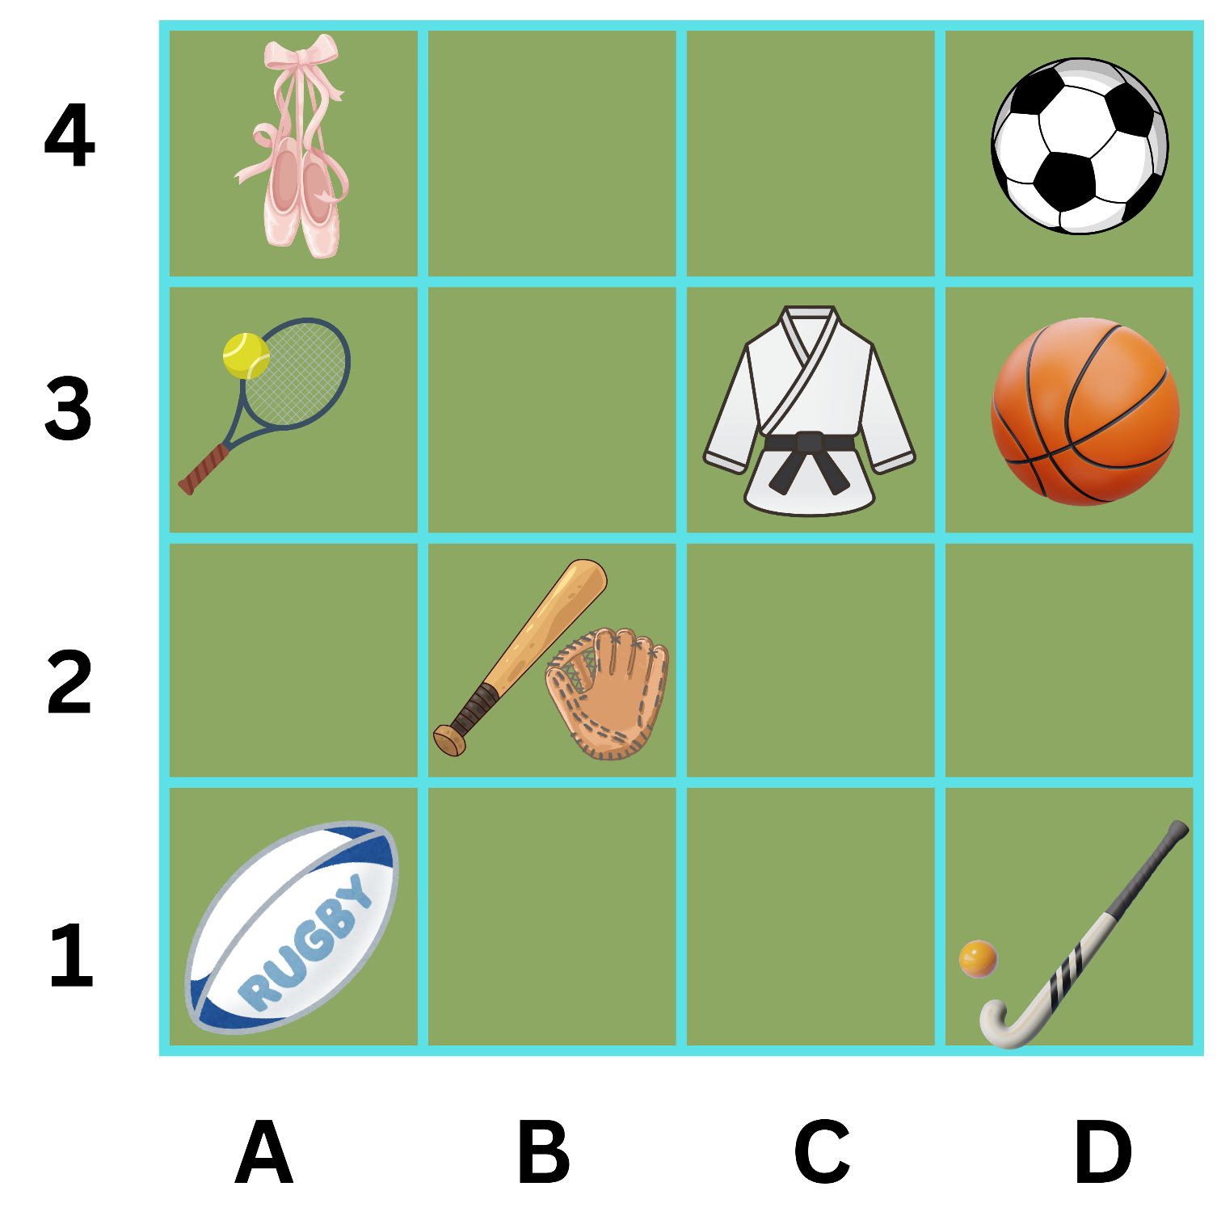
Short response (4)
Record the sporting equipment found in D4.
Record the grid reference for the position of the baseball bat and glove.
Notes:
Short response questions provide brisk paced questions focussing on review of current and previous content to support spaced and interleaved practice.
Syllabus focus area:
Geometric measure A

Slide 10


Activity 1 – the equals sign means ‘the same as’
Notes:
This is a developing number sense activity.
Number sense refers to a deep understanding of numbers, including their magnitude, relationships, and the effects of operations on them. It supports fluency and understanding, estimation, flexible thinking, and efficient problem-solving. Number sense activities 1–4 ‘activate’ prior number knowledge and support the learning of new content in the unit. Number sense activities 5–8 ‘loop’ back and provide opportunity for spaced practice with concepts and procedures covered in previous units.
Syllabus focus area:
Additive relations A
The equals sign means ‘the same as’
This activity is an adaptation of ‘Equivalent number’ sentences by the State of New South Wales (Department of Education) and ‘Make it equal’ by Rawding from the Open Middle website. This activity supports students to gain a deeper understanding of the structure of related, equivalent number sentences.
This image corresponds to Figure 10 – make it equal in Stage 2 Year A Unit 15.
Students work in pairs to record equivalent number sentences.
Explain the rules:
- You can only use the digits 1–9.
- You can only use a digit once in each number sentence.
- You can only put one digit in each box.
Allow students time to find as many different equivalent number sentences as possible.
Students share their responses in small groups.
Record a collection of class solution (see Figure 11 – example solutions in Stage 2 Year A Unit 15).

Slide 11
Review of learning 2

Slide 12

True or false (1)
45 - 23 = 30 - 8
True | False
Notes:
The question on this slide connects to the content being explored in the developing number sense activity (Activity 2)
Syllabus focus area:
Additive relations A

Slide 13
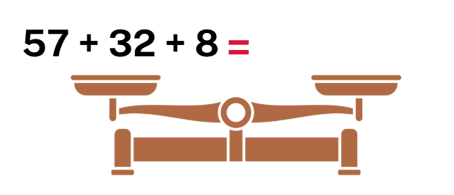
Short response (5)
Apply the associative property to balance these scales.
Notes:
Short response questions provide brisk paced questions focussing on review of current and previous content to support spaced and interleaved practice.
Syllabus focus area:
Additive relations A

Slide 14
Short response (6)
Record the following masses using the abbreviation for kilograms:
five kilograms
twelve kilograms
seventy-five kilograms.
Notes:
Short response questions provide brisk paced questions focussing on review of current and previous content to support spaced and interleaved practice.
Syllabus focus area:
Non-spatial measure A

Slide 15
Short response (7)
Draw arrays to model that
9 and 16
are square numbers.
Notes:
Short response questions provide brisk paced questions focussing on review of current and previous content to support spaced and interleaved practice.
Syllabus focus area:
Multiplicative relations A

Slide 16
Short response (8)
Record the missing words:
An angle is the amount of
t _ _ _ between two
a _ _ _.
Notes:
Short response questions provide brisk paced questions focussing on review of current and previous content to support spaced and interleaved practice.
Syllabus focus area:
Geometric measure A

Slide 17
Activity 2 – equal differences
25 - 7 = 18
32 - 14 = 18
25 - 7 = 32 - 14
Notes:
Note: this slide is designed to be viewed in presentation mode.
This is a developing number sense activity.
Number sense refers to a deep understanding of numbers, including their magnitude, relationships, and the effects of operations on them. It supports fluency and understanding, estimation, flexible thinking, and efficient problem-solving. Number sense activities 1–4 ‘activate’ prior number knowledge and support the learning of new content in the unit. Number sense activities 5–8 ‘loop’ back and provide opportunity for spaced practice with concepts and procedures covered in previous units.
Syllabus focus area:
Additive relations A
Equal differences
Revise the term difference with students.
Display 25 − 7 = 18 on the board
Ask students to find another subtraction number sentence with a difference of 18. For example, 32 − 14.
Click to display these number sentences on the board to highlight equal differences, for example 25 − 7 = 32 − 14.
Students work in pairs to create number sentences which show equal differences.
Partner one records a subtraction number sentence and partner 2 records a different subtraction number sentence with an equal difference.
Students swap roles until 6 number sentences have been created.
Regroup as a class to share examples of number sentences with equal differences.

Slide 18
Review of learning 3

Slide 19
Multiple choice (2)
54 - 31=
A
19 + 3
B
31 + 54
C
55 - 30
D
44 - 41
Notes:
This question connects to the content in the developing number sense activity (Activity 3)
Syllabus focus area:
Additive relations A

Slide 20
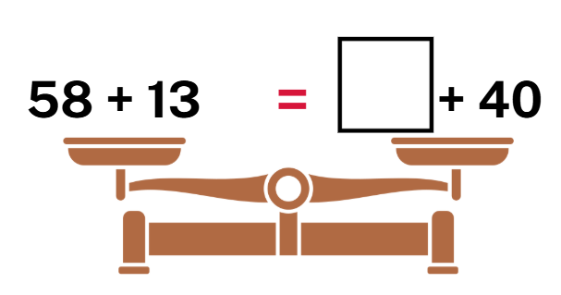
Short response (9)
Record the missing number to balance the scales.
Notes:
Short response questions provide brisk paced questions focussing on review of current and previous content to support spaced and interleaved practice.
Syllabus focus area:
Additive relations B

Slide 21
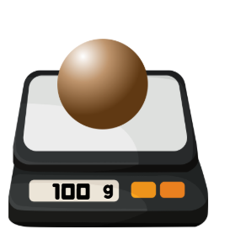
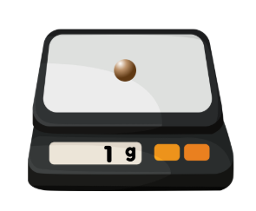
Short response (10)
How many clay balls measuring
one gram
100 grams
make one kilogram?
Notes:
Short response questions provide brisk paced questions focussing on review of current and previous content to support spaced and interleaved practice.
Syllabus focus area:
Non-spatial measure B

Slide 22

Short response (11)
Record the total of this partially covered array.
Notes:
Short response questions provide brisk paced questions focussing on review of current and previous content to support spaced and interleaved practice.
Syllabus focus area:
Multiplicative relations A

Slide 23

Short response (12)
Record the two-dimensional shapes that have right angles.
A
B
C
D
Notes:
Short response questions provide brisk paced questions focussing on review of current and previous content to support spaced and interleaved practice.
Syllabus focus area:
Two-dimensional spatial structure A

Slide 24
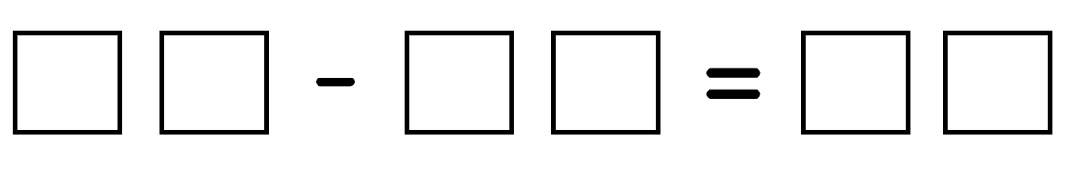
Activity 3 – make it equal
Notes:
This is a developing number sense activity.
Number sense refers to a deep understanding of numbers, including their magnitude, relationships, and the effects of operations on them. It supports fluency and understanding, estimation, flexible thinking, and efficient problem-solving. Number sense activities 1–4 ‘activate’ prior number knowledge and support the learning of new content in the unit. Number sense activities 5–8 ‘loop’ back and provide opportunity for spaced practice with concepts and procedures covered in previous units.
Syllabus focus area:
Additive relations A
Make it equal
This activity is an adaptation of ‘Make it equal’ by Rawding from the Open Middle website.
This image corresponds to Figure 12 – make it equal subtraction in Stage 2 Year A Unit 15.
Instruct students to place a digit in each box to make subtraction number sentences. They can only use the digits 1–9 once.
Students record all the possible solutions on an individual whiteboard.
As a class, share all possible solutions. Ask:
- Which strategy helped you solve the subtraction problem efficiently?
- Which digits were used most often? Which were harder to place? Why?
- How did changing one digit affect the rest of the number sentence?
- How did you adjust numbers while keeping the subtraction equivalent?
- What patterns helped you to find new solutions quickly?
- When solving the problem, how did you make sure your answers were accurate? How did you check your work?

Slide 25
Review of learning 4

Slide 26
True or false (2)
24 + 13 + 6 = 24 + 6 + 13 = 30 + 13 = 43
True | False
Notes:
The question on this slide connects to the content being explored in the developing number sense activity (Activity 4)
Syllabus focus area:
Additive relations A

Slide 27
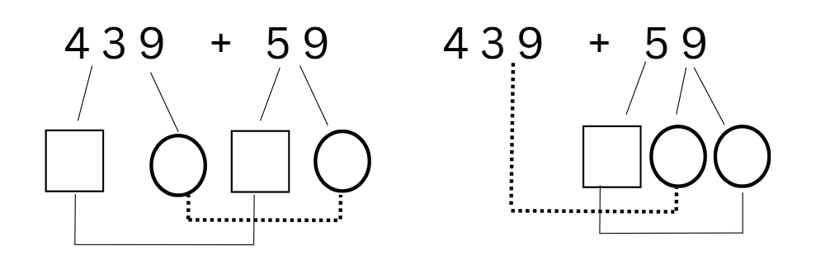
Short response (13)
Use standard and non-standard partitioning to solve:
Which strategy made the calculation easier? Communicate your reasoning.
Notes:
Short response questions provide brisk paced questions focussing on review of current and previous content to support spaced and interleaved practice.
Syllabus focus area:
Additive relations B

Slide 28


Short response (14)
Record the masses of the objects using the abbreviation for kilograms:
bag of flour
b) pumpkin
Notes:
Short response questions provide brisk paced questions focussing on review of current and previous content to support spaced and interleaved practice.
Syllabus focus area:
Non-spatial measure B

Slide 29
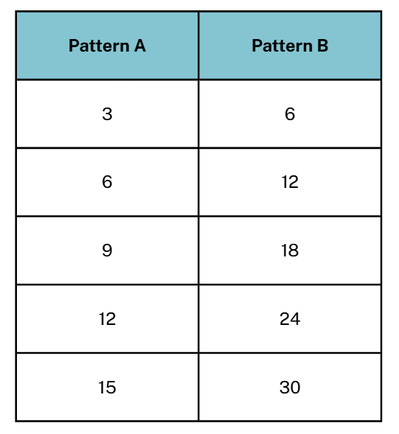
Short response (15)
What is the relationship between the patterns:
across the rows?
down each column?
Notes:
Short response questions provide brisk paced questions focussing on review of current and previous content to support spaced and interleaved practice.
Syllabus focus area:
Multiplicative relations B

Slide 30
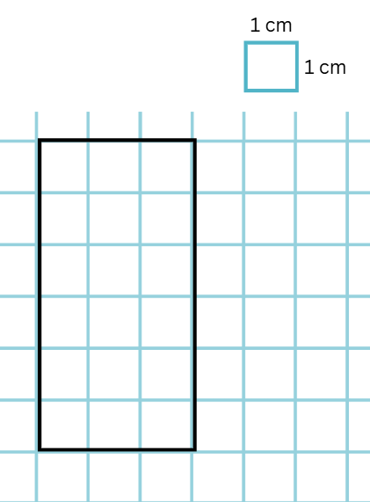
Short response (16)
Record the length and width of the rectangle in centimetres.
Record the area of the rectangle in square centimetres.
Notes:
Short response questions provide brisk paced questions focussing on review of current and previous content to support spaced and interleaved practice.
Syllabus focus area:
Two-dimensional spatial structure A

Slide 31
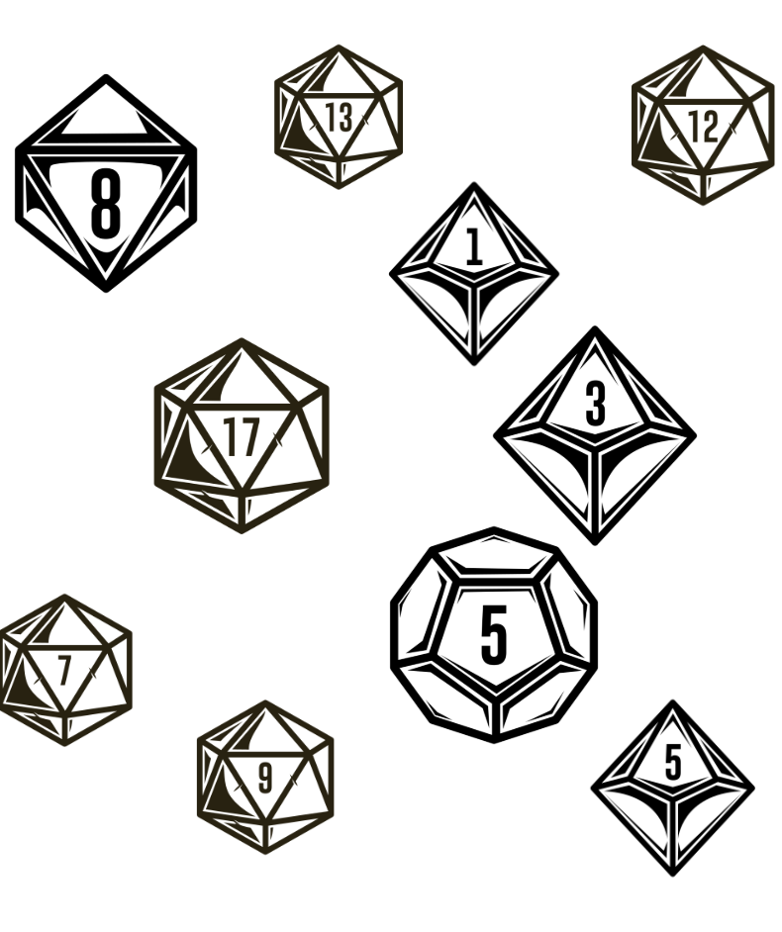
Activity 4 – dice roll – applying the associative property
Notes:
This is a developing number sense activity.
Number sense refers to a deep understanding of numbers, including their magnitude, relationships, and the effects of operations on them. It supports fluency and understanding, estimation, flexible thinking, and efficient problem-solving. Number sense activities 1–4 ‘activate’ prior number knowledge and support the learning of new content in the unit. Number sense activities 5–8 ‘loop’ back and provide opportunity for spaced practice with concepts and procedures covered in previous units.
Syllabus focus area:
Additive relations A
Dice roll – applying the associative property
This resource corresponds to Resource 17 – dice roll in Stage 2 Year A Unit 15.
Read the scenario: Samantha is playing a dice game with her friends. The winner is the player who rolls the highest total. Here are the numbers Samantha rolled. Can you help her calculate her total score?
Instruct students to use an efficient strategy to find the total of all 10 dice. Prompt them to rearrange the dice values to help with the calculation.
Instruct students to record their thinking using numbers or diagrams to show how they combined the dice.
Regroup and select students to share different methods for finding the total.
Ask:
- How did you group the dice to make the calculation easier?
- Which dice did you combine to make multiples of 10?
- What do you notice about the order of the numbers?

Slide 32
Review of learning 5

Slide 33
Multiple choice (3)
The number sentence 3 × 5 = can be used to solve:
A
Michelle baked 3 cakes for each of her 5 friends.
B
Michelle baked 3 cakes and 5 cookies.
C
Michelle baked 5 cakes and ate 3.
D
Michelle baked 5 cakes and cut each into thirds.
Notes:
This question connects to the content in the developing number sense activity (Activity 5)
Syllabus focus area:
Multiplicative relations A

Slide 34
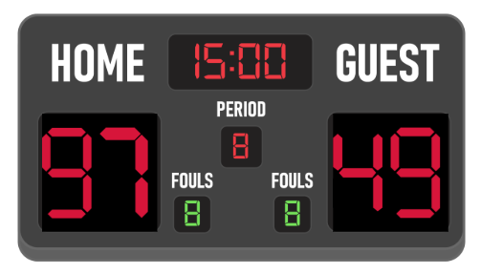
Short response (17)
Choose an efficient strategy to find the difference between the teams’ scores.
Communicate your reasoning for the choice of strategy.
Notes:
Short response questions provide brisk paced questions focussing on review of current and previous content to support spaced and interleaved practice.
Syllabus focus area:
Additive relations A

Slide 35
Short response (18)
Order the lengths from shortest to longest:
15 m 5 cm
1 m 95 cm
5 m 51 cm
Notes:
Short response questions provide brisk paced questions focussing on review of current and previous content to support spaced and interleaved practice.
Syllabus focus area:
Geometric measure A

Slide 36
Short response (19)
If 10 × 7 = 70, what is 9 × 7?
If 3 × 7 = 21, what is 6 × 7?
If 4 × 6 = 24, what is 8 × 6?
Notes:
Short response questions provide brisk paced questions focussing on review of current and previous content to support spaced and interleaved practice.
Syllabus focus area:
Multiplicative relations B

Slide 37
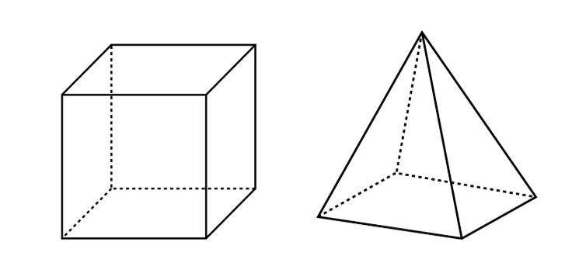
Short response (20)
List 3 differences between a cube and a square pyramid.
Notes:
Short response questions provide brisk paced questions focussing on review of current and previous content to support spaced and interleaved practice.
Syllabus focus area:
Three-dimensional spatial structure A

Slide 38
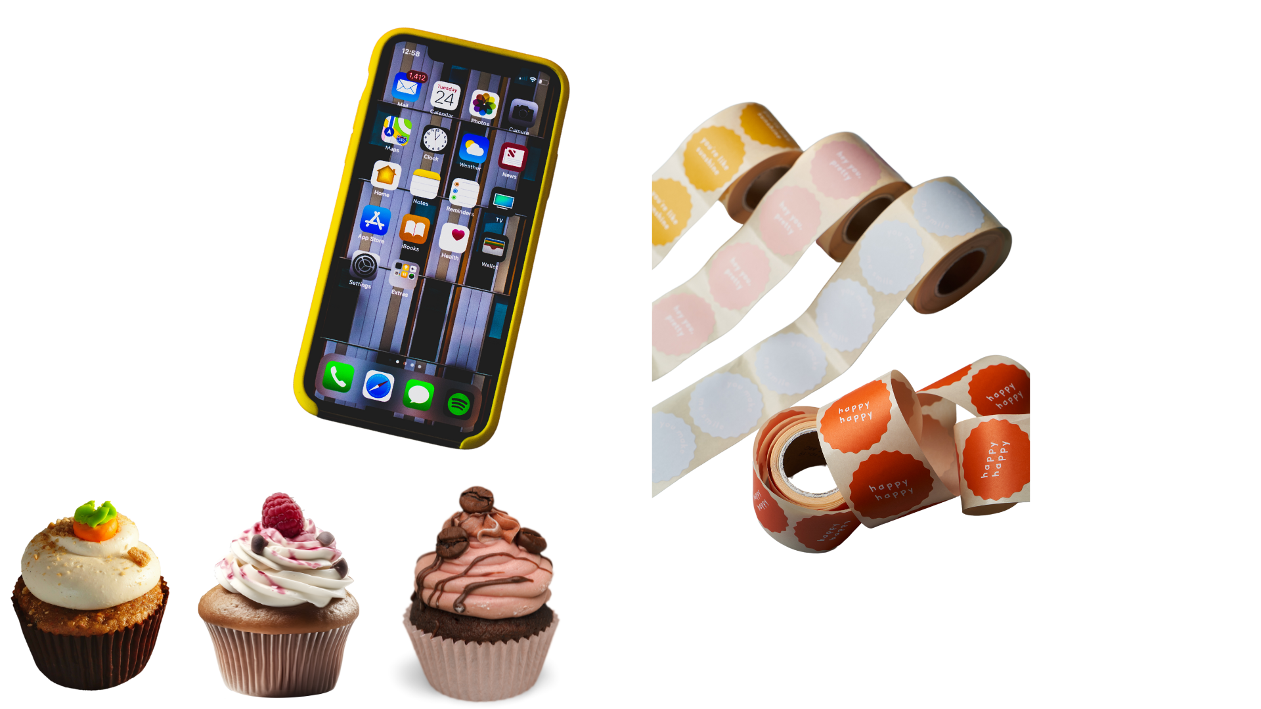
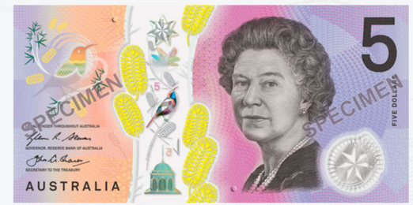
Activity 5 – three times as many chores
Sam is saving up to buy a smartphone and plans to earn the money by doing household chores.
On Saturday, he completes 3 chores.
On Sunday, he does 3 times as many chores as he did on Saturday.
If each chore pays $5, how much money does Sam earn in total for these 2 days?
Notes:
This is a developing number sense activity.
Number sense refers to a deep understanding of numbers, including their magnitude, relationships, and the effects of operations on them. It supports fluency and understanding, estimation, flexible thinking, and efficient problem-solving. Number sense activities 1–4 ‘activate’ prior number knowledge and support the learning of new content in the unit. Number sense activities 5–8 ‘loop’ back and provide opportunity for spaced practice with concepts and procedures covered in previous units.
Syllabus focus area:
Multiplicative relations A
Three times as many chores
Read the scenario to students: Sam is saving up to buy a smartphone and plans to earn the money by doing household chores. On Saturday, he completes 3 chores. On Sunday, he does 3 times as many chores as he did on Saturday. If each chore pays $5, how much money does Sam earn in total for these 2 days?
Note: vary the challenge by adjusting the amount per chore.
Independently or in pairs, students work on whiteboards to solve the problem.
Prompt students to use diagrams, words or symbols to record their answer.
Regroup and select students to share their solutions and representations. Ask:
-How did you record your thinking?
- Is there another way of working it out?
- How could you check that your calculations are accurate?

Slide 39
Review of learning 6

Slide 40
True or false (3)
Mia has 5 stickers and Sam has 3 times as many. Sam has 8 stickers because 5 + 3 = 8.
True | False
Notes:
The question on this slide connects to the content being explored in the developing number sense activity (Activity 6)
Syllabus focus area:
Multiplicative relations A

Slide 41
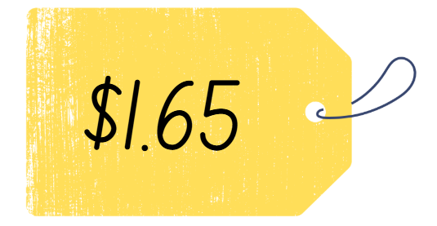
Short response (21)
Record 2 different ways to make $1.65 with coins.
Notes:
Short response questions provide brisk paced questions focussing on review of current and previous content to support spaced and interleaved practice.
Syllabus focus area:
Additive relations A

Slide 42
Short response (22)
Record an appropriate scaled instrument to measure:
the length of a highlighter
the width of the whiteboard
the length of a basketball court.
Notes:
Short response questions provide brisk paced questions focussing on review of current and previous content to support spaced and interleaved practice.
Syllabus focus area:
Geometric measure B

Slide 43

Short response (23)
How can you split this array to help you answer 8 × 6?
Record the number sentence to match the split array.
Notes:
Short response questions provide brisk paced questions focussing on review of current and previous content to support spaced and interleaved practice.
Syllabus focus area:
Multiplicative relations B

Slide 44
Short response (24)
Can 2 containers with different shapes both have a 1 litre capacity?
Communicate your reasoning.
Notes:
Short response questions provide brisk paced questions focussing on review of current and previous content to support spaced and interleaved practice.
Syllabus focus area:
Three-dimensional spatial structure A

Slide 45
Activity 6 – four times as many cupcakes
A baker sells cupcakes for $4 each.
In the morning, she sold 6 cupcakes.
In the afternoon, she sold 4 times as many cupcakes as she did in the morning.
How much money did the baker make from selling cupcakes that day?
Notes:
This is a developing number sense activity.
Number sense refers to a deep understanding of numbers, including their magnitude, relationships, and the effects of operations on them. It supports fluency and understanding, estimation, flexible thinking, and efficient problem-solving. Number sense activities 1–4 ‘activate’ prior number knowledge and support the learning of new content in the unit. Number sense activities 5–8 ‘loop’ back and provide opportunity for spaced practice with concepts and procedures covered in previous units.
Syllabus focus area:
Multiplicative relations A
Four times as many cupcakes
Read the scenario to students: A baker sells cupcakes for $4 each. In the morning, she sold 6 cupcakes. In the afternoon, she sold 4 times as many cupcakes as she did in the morning. How much money did the baker make from selling cupcakes that day?
Independently or in pairs, students work on whiteboards to solve the problem.
Prompt students to use diagrams, words or symbols to record their answer.
Regroup and select students to share their solutions and representations. Ask:
- How did you work out the number of cupcakes sold in the afternoon?
- How did you find the total number of cupcakes sold?
- What operation did you use first? Why?
- How does your diagram/model show the relationship between morning and afternoon sales?
- Can you write a number sentence to match each step of your thinking?

Slide 46
Review of learning 7

Slide 47
Multiple choice (4)
The division sentence that demonstrates the inverse relationship of 7 × 8 = 56 is:
A
8 × 7 = 56
B
56 ÷ 7 = 7
C
8 ÷ 56 = 7
D
56 ÷ 7 = 8
Notes:
This question connects to the content in the developing number sense activity (Activity 7)
Syllabus focus area:
Multiplicative relations A

Slide 48
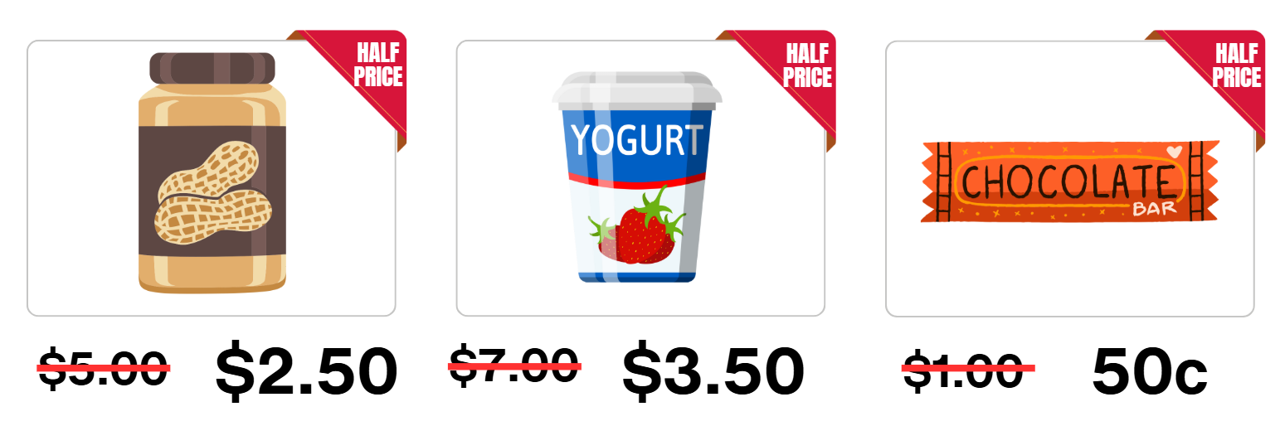
Short response (25)
a) What is the total cost to buy these items?
b) What would the change from $10 be?
Notes:
Short response questions provide brisk paced questions focussing on review of current and previous content to support spaced and interleaved practice.
Syllabus focus area:
Additive relations A

Slide 49
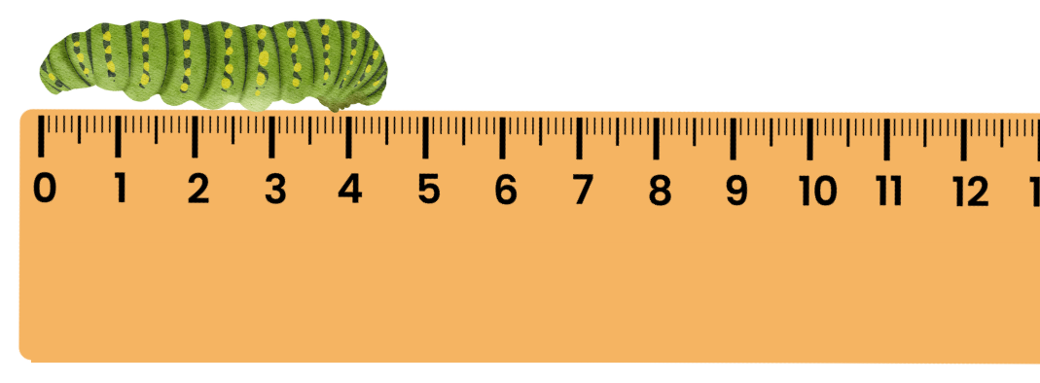
Short response (26)
Record the length of the caterpillar in millimetres.
Notes:
Short response questions provide brisk paced questions focussing on review of current and previous content to support spaced and interleaved practice.
Syllabus focus area:
Geometric measure A

Slide 50
Short response (27)
Record the missing number to complete the number sentence:
___ × 8 = 64
Communicate your strategy.
Notes:
Short response questions provide brisk paced questions focussing on review of current and previous content to support spaced and interleaved practice.
Syllabus focus area:
Multiplicative relations B

Slide 51
Short response (28)
Match these objects to their capacities:
milk carton
juice box
teaspoon
250 mL
5 mL
1 L
Notes:
Short response questions provide brisk paced questions focussing on review of current and previous content to support spaced and interleaved practice.
Syllabus focus area:
Three-dimensional spatial structure B

Slide 52

Activity 7 – inverse relationships
5 × 6 = 30
30 ÷ 6 = 5
Notes:
Note: this slide is designed to be viewed in presentation mode.
This is a developing number sense activity.
Number sense refers to a deep understanding of numbers, including their magnitude, relationships, and the effects of operations on them. It supports fluency and understanding, estimation, flexible thinking, and efficient problem-solving. Number sense activities 1–4 ‘activate’ prior number knowledge and support the learning of new content in the unit. Number sense activities 5–8 ‘loop’ back and provide opportunity for spaced practice with concepts and procedures covered in previous units.
Syllabus focus area:
Multiplicative relations A
Inverse relationships
In pairs, provide students with a two 10-sided dice.
Partner one rolls the 2 dice and multiplies the numbers together. They record the total with a number sentence on a whiteboard. For example, if 5 and 6 are rolled, 5 × 6 = 30 is recorded.
Partner 2 records a matching division sentence to demonstrate the inverse relationship. For example, 30 ÷ 6 = 5.
Students swap roles to record 6 different sets of multiplication and division number sentences.
Regroup as a class and ask:
- How did knowing the multiplication facts help you determine the division number sentence?
- How are multiplication and division related?

Slide 53
Review of learning 8

Slide 54
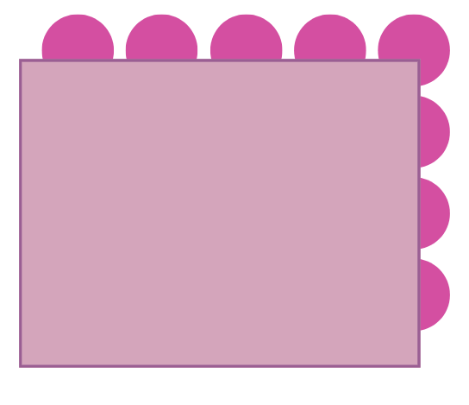
True or false (4)
The total of this partially covered array is 24.
True | False
Notes:
The question on this slide connects to the content being explored in the developing number sense activity (Activity 8)
Syllabus focus area:
Multiplicative relations A

Slide 55
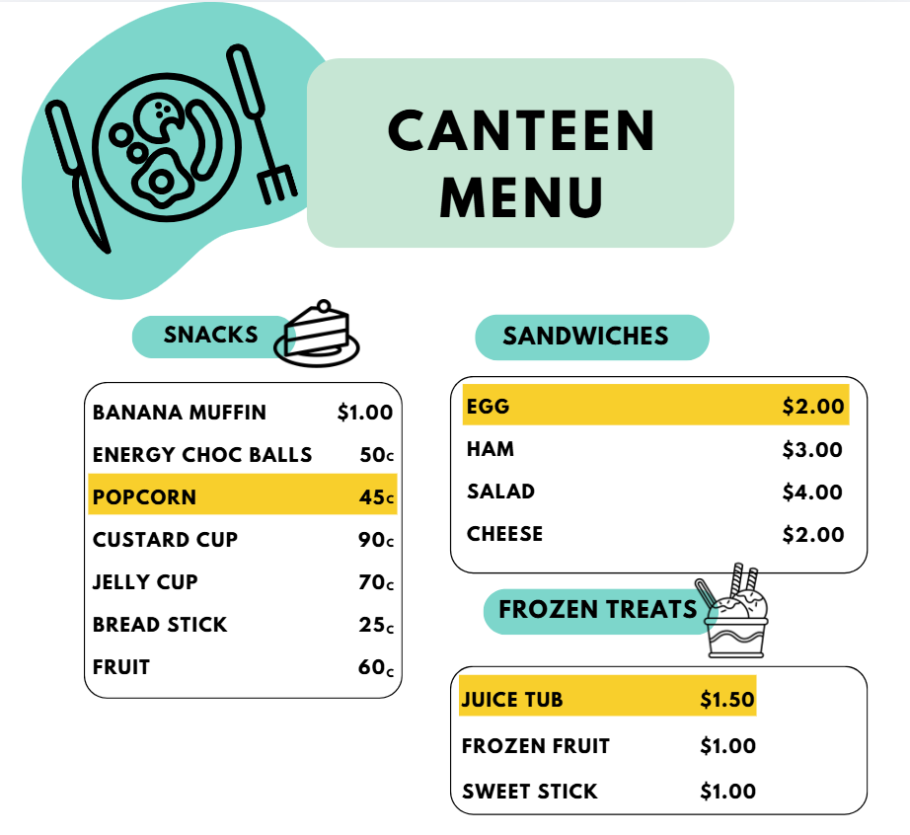
Short response (29)
Calculate the total cost of:
popcorn
egg sandwich
juice tub.
How much change would you receive from $5?
Notes:
Short response questions provide brisk paced questions focussing on review of current and previous content to support spaced and interleaved practice.
Syllabus focus area:
Additive relations A

Slide 56
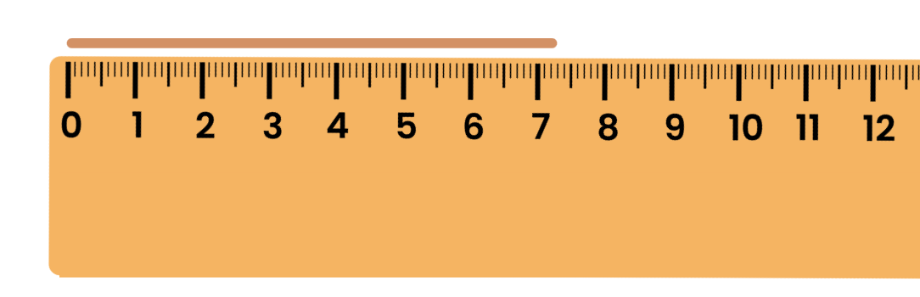
Short response (30)
Record the length of the clay snake in:
millimetres
centimetres and millimetres.
Notes:
Short response questions provide brisk paced questions focussing on review of current and previous content to support spaced and interleaved practice.
Syllabus focus area:
Geometric measure A

Slide 57
Short response (31)
Record the number sentence and solve:
A tree has 9 branches.
Each branch has 6 leaves.
How many leaves altogether?
Notes:
Short response questions provide brisk paced questions focussing on review of current and previous content to support spaced and interleaved practice.
Syllabus focus area:
Multiplicative relations B

Slide 58
Short response (32)
Match the time to the nearest 5-minute mark on an analog clock:
5:48 is about…
5:44 is about…
11:18 is about…
11:28 is about…
20 past 11
10 to 6
half-past 11
quarter-to 6
Notes:
Short response questions provide brisk paced questions focussing on review of current and previous content to support spaced and interleaved practice.
Syllabus focus area:
Non- spatial measure A

Slide 59

Activity 8 – partially covered arrays
Notes:
This is a developing number sense activity.
Number sense refers to a deep understanding of numbers, including their magnitude, relationships, and the effects of operations on them. It supports fluency and understanding, estimation, flexible thinking, and efficient problem-solving. Number sense activities 1–4 ‘activate’ prior number knowledge and support the learning of new content in the unit. Number sense activities 5–8 ‘loop’ back and provide opportunity for spaced practice with concepts and procedures covered in previous units.
Syllabus focus area:
Multiplicative relations A
Partially covered arrays
This image corresponds to Figure 13 – partially covered array in Stage 2 Year A Unit 15.
Provide pairs of students with 30 counters and a piece of cardboard.
Note: alternatively, use plastic Australian coins to strengthen links to money and its value. If doing so, ensure that students understand they must use coins of the same denomination.
To set up the task, Student A arranges some counters in an array form, before partially covering the array with the cardboard so that only the top of one row and one column can be seen. Student A does this without Student B seeing.
Student A shows the partially covered array to Student B.
Student B uses the information that can be seen to record the total number of counters on an individual whiteboard as a sentence, for example, 4 rows of 6 is 24.
Student A uncovers the array and Student B checks the accuracy of their answer.
Repeat the activity with students swapping roles.

Slide 60
Double Venn diagram
Object 1
Object 2
Features similar to both objects
Features of object 1
Features of object 2

Slide 61
Frayer
Definition
Facts/Characteristics
Word, term, concept
Examples
Non-examples

Slide 62
Spider map
Idea
Subject

Slide 63
Cline
Concept 1
Concept 2
Word
Word
Word
Word
Word
Word
Word
Word
Word
Word
Word

Slide 64
Compare and contrast

Slide 65
Multiple choice (5)
A
B
C
D

Slide 66
Multiple choice
A
B
C
D
Notes:
This question connects to the content in the developing number sense activity (Activity 3)
Syllabus focus area:
[Focus area A/B]

Slide 67
References (1)
This presentation contains NSW Curriculum and syllabus content. The NSW Curriculum is developed by the NSW Education Standards Authority. This content is prepared by NESA for and on behalf of the Crown in the right of the State of New South Wales. The material is protected by Crown copyright.
Please refer to the NESA Copyright Disclaimer for more information https://educationstandards.nsw.edu.au/wps/portal/nesa/mini-footer/copyright.
NESA holds the only official and up-to-date versions of the NSW Curriculum and syllabus documents. Please visit the NSW Education Standards Authority (NESA) website https://educationstandards.nsw.edu.au/wps/portal/nesa/home and the NSW Curriculum website https://curriculum.nsw.edu.au.
Mathematics K–10 Syllabus © NSW Education Standards Authority (NESA) for and on behalf of the Crown in right of the State of New South Wales, 2022.
National Numeracy Learning Progression © Australian Curriculum, Assessment and Reporting Authority (ACARA) 2010 to present, unless otherwise indicated. This material was downloaded from the Australian Curriculum website (National Numeracy Learning Progression) (accessed 13 February 2026) and was not modified.
Australian Broadcasting Corporation (ABC) (2020) Money Maths with the Royal Australian Mint ABC website, accessed 13 February 2026.
Didax (n.d.) Math Balance, Didax website, accessed 13 February 2026.
Rawding M (n.d.) Make it Equal, Open Middle website, accessed 13 February 2026.
State of New South Wales (Department of Education) (2023) Let’s talk – number talk (230 minus 190), NSW Department of Education website, accessed 13 February 2026.

Slide 68
References (2)
This presentation contains NSW Curriculum and syllabus content. The NSW Curriculum is developed by the NSW Education Standards Authority. This content is prepared by NESA for and on behalf of the Crown in the right of the State of New South Wales. The material is protected by Crown copyright.
Please refer to the NESA Copyright Disclaimer for more information https://educationstandards.nsw.edu.au/wps/portal/nesa/mini-footer/copyright.
NESA holds the only official and up-to-date versions of the NSW Curriculum and syllabus documents. Please visit the NSW Education Standards Authority (NESA) website https://educationstandards.nsw.edu.au/wps/portal/nesa/home and the NSW Curriculum website https://curriculum.nsw.edu.au.
——(2023) Math mobiles – Stage 2, NSW Department of Education website, accessed 13 February 2026.
——(2024) Equivalent number sentences, Universal Resources Hub, accessed 13 February 2026.
——(2024) Stage 2 Addition and subtraction with money, Universal Resources Hub, accessed 13 February 2026.
Sullivan P and Lilburn P (2017) Open-ended maths activities: using ‘good’ questions to enhance learning in mathematics, Oxford University Press, Australia.
University of Cambridge (n.d) Buying a Balloon, NRICH website, accessed 13 February 2026.
——(n.d) Fruity Pairs, NRICH website, accessed 13 February 2026.
——(n.d.) How Much? , NRICH website, accessed 13 February 2026.

Slide 69
Copyright
© State of New South Wales (Department of Education), 2025
The copyright material published in this resource is subject to the Copyright Act 1968 (Cth) and is owned by the NSW Department of Education or, where indicated, by a party other than the NSW Department of Education (third-party material).
Copyright material available in this resource and owned by the NSW Department of Education is licensed under a Creative Commons Attribution 4.0 International (CC BY 4.0) license.
This license allows you to share and adapt the material for any purpose, even commercially.
Attribution should be given to © State of New South Wales (Department of Education), 2025.
Material in this resource not available under a Creative Commons license:
the NSW Department of Education logo, other logos and trademark-protected material
Material owned by a third party that has been reproduced with permission. You will need to obtain permission from the third party to reuse its material.
Links to third-party material and websites
Please note that the provided (reading/viewing material/list/links/texts) are a suggestion only and implies no endorsement, by the New South Wales Department of Education, of any author, publisher, or book title. School principals and teachers are best placed to assess the suitability of resources that would complement the curriculum and reflect the needs and interests of their students.
If you use the links provided in this document to access a third party’s website, you acknowledge that the terms of use, including licence terms set out on the third-party’s website apply to the use which may be made of the materials on that third-party website or where permitted by the Copyright Act 1968 (Cth). The department accepts no responsibility for content on third-party websites.

