Slide 1
Instructions for use
This resource aligns to the learning in Stage 2 Year B Unit 38 and revisits content from earlier sample units.
Classroom teachers are encouraged to add, edit and adapt to meet the needs of their students.
Save a copy of the file to make changes to the slide deck. Go to File > Download a Copy (this downloads a copy to the computer to edit in the PowerPoint app).
To convert the PowerPoint to Google Slides:
  Upload the file into Google Drive and open it.
  Go to File > Save as Google Slides.
  (Note – conversion may cause formatting changes in the slides.)

Slide 2
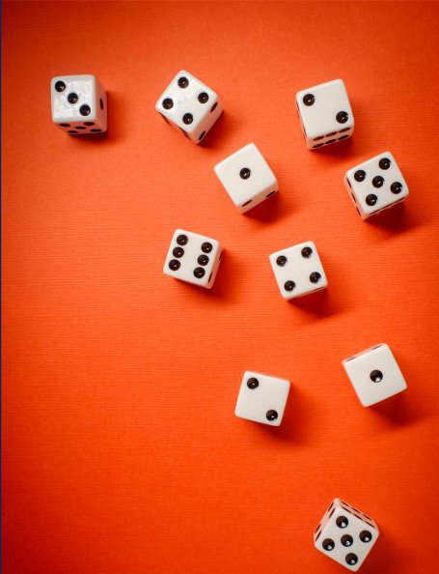
Review of Learning
Mathematics Stage 2 – Unit 38
Notes:
Reviews may include a combination of question types, requiring students to recall facts and key ideas, as well as apply their knowledge to solve problems and answer questions. To support active engagement, a mix of techniques should be employed.” (AERO, 2024).
This Review of Learning slide deck revisits key concepts from the following units:
Stage 2 Year B Unit 38
Stage 2 Year B Unit 37
Stage 2 Year B Unit 36
It also includes opportunities to review prior learning in non-number content, supporting consolidation across focus areas.
The review of learning resources include three key task types that support the development of mathematical proficiency through retrieval, spaced practice, and active participation. These practices complement the review phase (activating prior knowledge) embedded within the beginning of each lesson.
1.
Multiple-choice questions/True or false: Designed to promote active retrieval of key concepts and identify common misconceptions in number, supporting consolidation, understanding and fluency.
These questions:
support spaced and interleaved practice
help identify and address common misconceptions
support active recall and immediate feedback
support whole class participation
identify areas requiring reteach
2.
Short-response question sets: Carefully grouped questions that encourage spaced and interleaved practice across multiple focus areas, helping students revisit and apply knowledge from different points in time.
These questions:
have a combination of question types
address a range of focus areas
build automaticity and fluency
support active recall
allow for immediate feedback
identify content requiring reteach
3.
Developing number sense activities: A variety of practical, purposeful tasks that reinforce current learning and build on prior knowledge. These activities promote reasoning, problem-solving and conceptual understanding.
The review of learning resources are designed to work support teaching and learning in mathematics. For the most effective implementation, use the resources flexibly, adapting to meet student learning needs and individual classroom contexts.

Slide 3
Lessons
1
Review of learning 1
5
Review of learning 5
2
Review of learning 2
6
Review of learning 6
3
Review of learning 3
7
Review of learning 7
4
Review of learning 4
8
Review of learning 8
Notes:
Teacher notes:
Click lesson numbers to go to specific lessons
Interactive features can be viewed in slide show

Slide 4
Review of learning 1

Slide 5

Multiple choice (1)
An apple costs $2.50, a banana costs $1.20 and an orange costs $1.45. Which is the closest estimate of the total cost?
A | B | C | D
$4.50 | $5.00 | $5.50 | $6.00
Notes:
This question connects to the content in the developing number sense activity (Activity 1)
Syllabus focus area:
Additive relations B

Slide 6

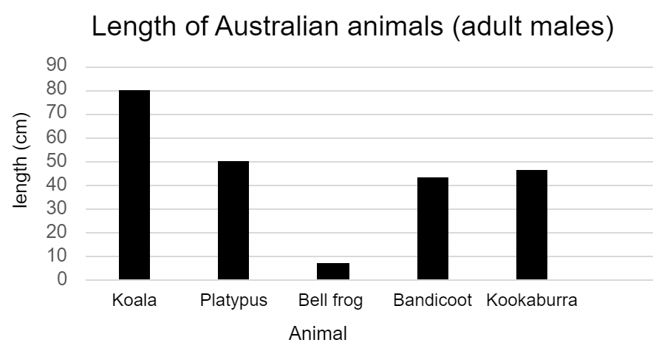
Short response (1)
What is the length of the adult male platypus?
Data sourced from State of New South Wales (Department of Planning and Environment) 2020.
Notes:
Short response questions provide brisk paced questions focussing on review of current and previous content to support spaced and interleaved practice.
Syllabus focus area:
Data A

Slide 7
Short response (2)
Which number sequence doesn’t belong?
Explain your reasoning.
A | B | C | D
3, 6, 12 | 4, 8, 16 | 4, 8, 15 | 6, 12, 24
Notes:
Short response questions provide brisk paced questions focussing on review of current and previous content to support spaced and interleaved practice.
Syllabus focus area:
Multiplicative relations B

Slide 8
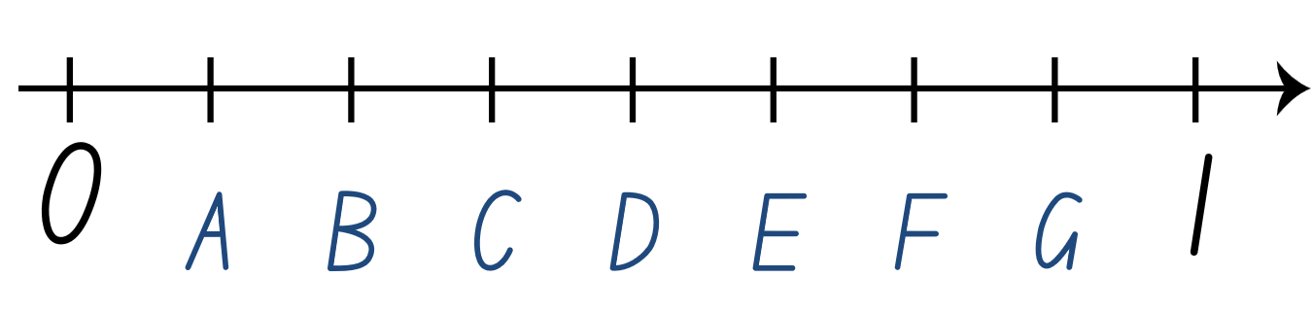
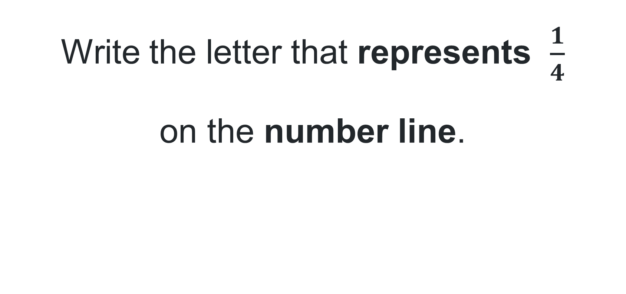
Short response (3)
Write the letter that represents $\frac{1}{4}$
on the number line.
Notes:
Short response questions provide brisk paced questions focussing on review of current and previous content to support spaced and interleaved practice.
Syllabus focus area:
Partitioned Fractions B

Slide 9
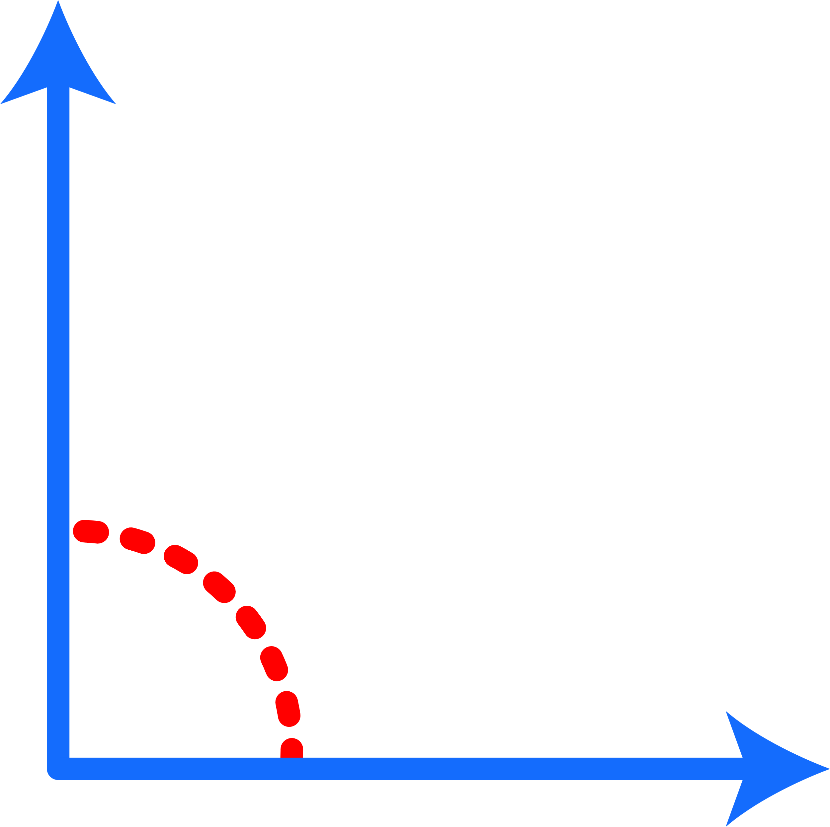
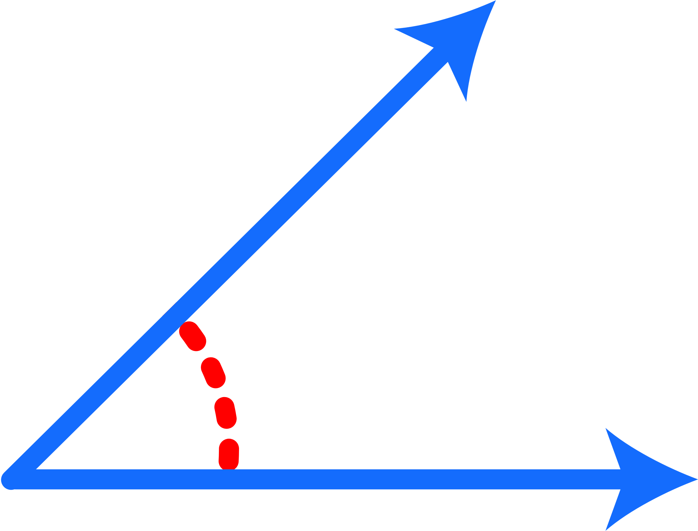
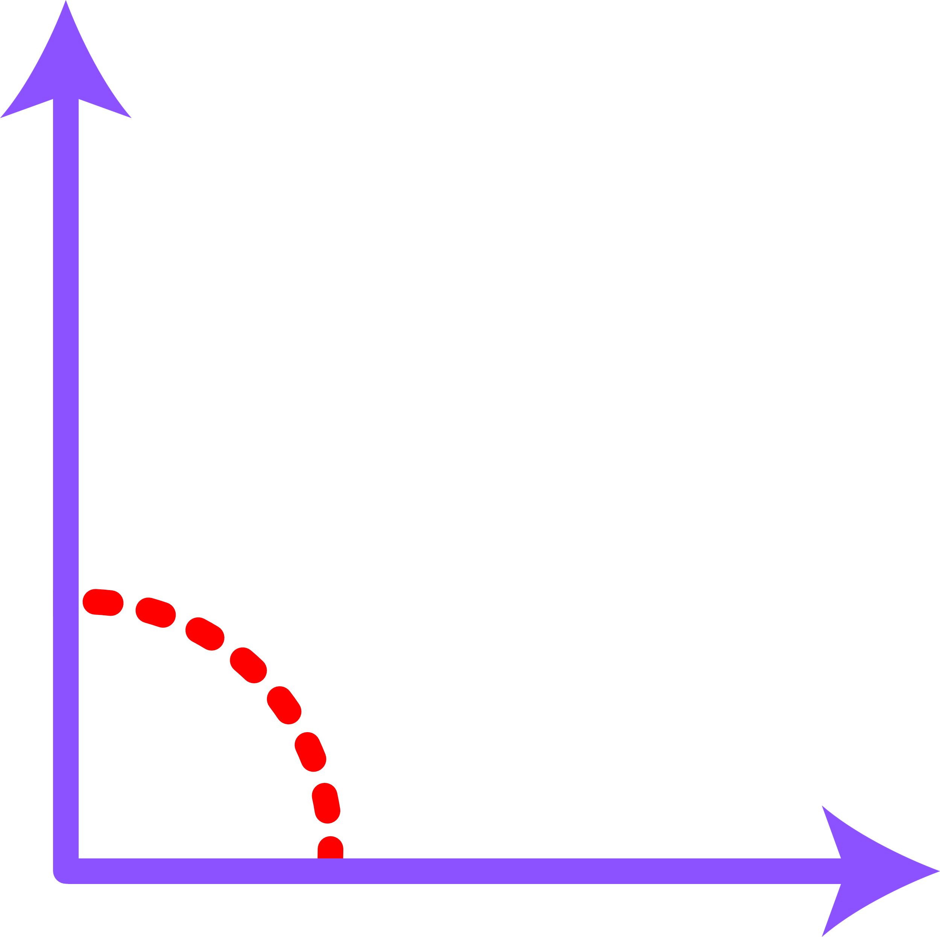
Short response (4)
Which of these is not a right angle?
A | B | C | D
Communicate your reasoning.
Notes:
Short response questions provide brisk paced questions focussing on review of current and previous content to support spaced and interleaved practice.
Syllabus focus area:
Geometric measure B: Angles

Slide 10

Activity 1 – estimating using money
You have $9 to spend at the canteen.
A drink costs $2.60, a packet of popcorn costs $1.40, a sausage roll costs $4.55 and tomato sauce costs 50 cents.
What items do you estimate that you could buy?
Notes:
This is a developing number sense activity.
Number sense refers to a deep understanding of numbers, including their magnitude, relationships, and the effects of operations on them. It supports fluency and understanding, estimation, flexible thinking, and efficient problem-solving. Number sense activities 1–4 ‘activate’ prior number knowledge and support the learning of new content in the unit. Number sense activities 5–8 ‘loop’ back and provide opportunity for spaced practice with concepts and procedures covered in previous units.
Syllabus focus area:
Additive relations B
This resource corresponds to Activity 1 – estimating using money in Stage 2 Year B Unit 38
Pose the problem: You have $9 to spend at the canteen. A drink costs $2.60, a packet of popcorn costs $1.40, a sausage roll costs $4.55 and tomato sauce costs 50 cents. What items do you estimate that you could buy?
Remind students to use rounding to estimate the cost of the items.
Students turn and talk to share their thinking.
Ask:
How did you estimate which items you could buy?
Do you think $9 would be enough money to buy all the items listed? If not, what item would you choose not to purchase from the list given? Why?
Can you estimate how much money you would need to purchase all the items listed?
Provide students with individual whiteboards to check the validity of their calculations.
Ask students to share the validity of their calculations.

Slide 11
Review of learning 2

Slide 12
True or false (1)
A movie ticket costs $15.50, a drink costs $5.50 and a snack costs $3.50. Sienna has $20.00 and says she can buy one of each.
True | False
Notes:
The question on this slide connects to the content being explored in the developing number sense activity (Activity 2)
Syllabus focus area:
Additive relations B

Slide 13
Short response (5)
Year 4 students are planning a survey
about a cake stall for the school fair.
Write an example of an open question
they could ask about the cake stall.
Notes:
Short response questions provide brisk paced questions focussing on review of current and previous content to support spaced and interleaved practice.
Syllabus focus area:
Data A

Slide 14
Short response (6)
Which number are these multiples of?
How do you know?
12, 18, 21, 36, 48
Notes:
Short response questions provide brisk paced questions focussing on review of current and previous content to support spaced and interleaved practice.
Syllabus focus area:
Multiplicative relations B

Slide 15
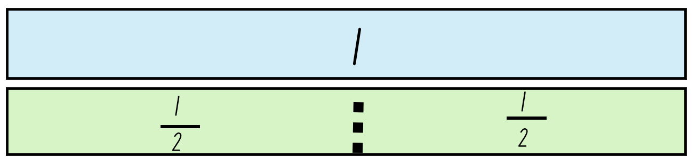
Short response (7)
Copy the bar models on this fraction wall. Draw and label 2 more bars showing quarters and eighths.
Notes:
Short response questions provide brisk paced questions focussing on review of current and previous content to support spaced and interleaved practice.
Syllabus focus area:
Partitioned Fractions B

Slide 16
Short response (8)
Which unit of measure is most useful for measuring the perimeter of a playground?
Explain your thinking.
A centimetres | B kilograms | C millimetres | D metres
Notes:
Short response questions provide brisk paced questions focussing on review of current and previous content to support spaced and interleaved practice.
Syllabus focus area:
Geometric measure B: Length

Slide 17
Activity 2 – rounding to help estimation
Meggie’s friend gave her $30 for her birthday.
Meggie wants to buy a pencil case for $4.50, a pair of sunglasses for $6.25, a boardgame for $15 and a lollipop for 75c.
Can you estimate if Meggie has enough money to purchase these items?
Notes:
This is a developing number sense activity.
Number sense refers to a deep understanding of numbers, including their magnitude, relationships, and the effects of operations on them. It supports fluency and understanding, estimation, flexible thinking, and efficient problem-solving. Number sense activities 1–4 ‘activate’ prior number knowledge and support the learning of new content in the unit. Number sense activities 5–8 ‘loop’ back and provide opportunity for spaced practice with concepts and procedures covered in previous units.
Syllabus focus area:
Additive relations B
This resource corresponds to Activity 2 – rounding to help estimation in Stage 2 Year B Unit 38
Pose the problem: Meggie’s friend gave her $30 for her birthday. Meggie wants to buy a pencil case for $4.50, a pair of sunglasses for $6.25, a boardgame for $15 and a lollipop for 75c. Can you estimate if Meggie has enough money to purchase these items?
Remind students to use rounding to estimate the cost of the items to find if Meggie has enough money.
Students turn and talk to share their thinking.
Ask:
How did you estimate the total of Meggie’s purchases?
Would $30 be enough money to buy all the items listed?
Can you estimate how much change Meggie would get from $30 if she purchased all the items listed?
Provide students with individual whiteboards to check the validity of their calculations.
Ask students to share the validity of their calculations.

Slide 18
Review of learning 3

Slide 19
Multiple choice (2)
A customer used a $10 note for 2 drinks costing $4.70. Which of these shows the correct change?
A | B | C | D
50 cents | 60 cents | 70 cents | 80 cents
Notes:
This question connects to the content in the developing number sense activity (Activity 3)
Syllabus focus area:
Additive relations B

Slide 20
Short response (9)
Students were surveyed about sports they play.
There were 30 responses, and 4 sports identified.
Create a table showing how the data might look using tally marks.
Notes:
Short response questions provide brisk paced questions focussing on review of current and previous content to support spaced and interleaved practice.
Syllabus focus area:
Data A

Slide 21
Short response (10)
Complete the number sentences.
How did you find the solutions?
36 ÷ 2 = ? ? × 2 = 36
42 ÷ 2 = ? ? × 2 = 42
Notes:
Short response questions provide brisk paced questions focussing on review of current and previous content to support spaced and interleaved practice.
Syllabus focus area:
Multiplicative relations A

Slide 22
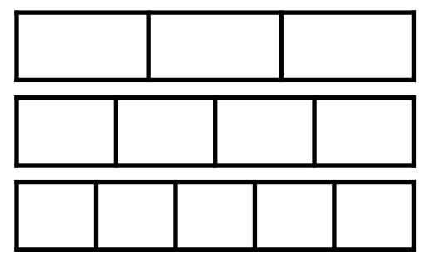
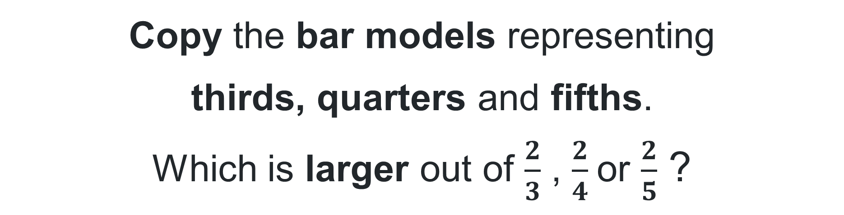
Short response (11)
Copy the bar models representing
thirds, quarters and fifths.
Which is larger out of $\frac{2}{3}$ , $\frac{2}{4}$or $\frac{2}{5}$ ?
Shade and label the bars to show your reasoning.
Notes:
Short response questions provide brisk paced questions focussing on review of current and previous content to support spaced and interleaved practice.
Syllabus focus area:
Partitioned Fractions B

Slide 23
Short response (12)
Draw a regular hexagon.
Draw straight lines to split your hexagon into smaller shapes you know.
What shapes did you make?
Notes:
Short response questions provide brisk paced questions focussing on review of current and previous content to support spaced and interleaved practice.
Syllabus focus area:
Two-dimensional spatial structure B: 2D Shapes

Slide 24
Activity 3 – interpreting a problem involving money 1
Mike is helping his Mum and Dad for the day at the post office. Mike’s first customer is buying a birthday card for $4.25 and a set of stamps for $12.
The customer gives Mike a $20 note.
How much change does he need to give back to the customer?
Notes:
This is a developing number sense activity.
Number sense refers to a deep understanding of numbers, including their magnitude, relationships, and the effects of operations on them. It supports fluency and understanding, estimation, flexible thinking, and efficient problem-solving. Number sense activities 1–4 ‘activate’ prior number knowledge and support the learning of new content in the unit. Number sense activities 5–8 ‘loop’ back and provide opportunity for spaced practice with concepts and procedures covered in previous units.
Syllabus focus area:
Additive relations B
This resource corresponds to Resource 25 – covered grid in Stage 2 Year B Unit 37.
Pose the problem: Mike is helping his Mum and Dad for the day at the post office. Mike’s first customer is buying a birthday card for $4.25 and a set of stamps for $12. The customer gives Mike a $20 note. How much change does he needs to give back to the customer?
Students record their thinking on individual whiteboards.
Note: monitor the different strategies that students use to solve the problem. For example, the shopkeeper’s method or other addition and subtraction methods. Make a note of the students who have used different strategies to share with the class in the next step.
Students share the strategies they used to solve the problem.
Students reflect on their chosen strategy. Encourage them to consider whether their strategy or a different strategy shared by a student would be more effective to solve the problem.
Pose the problem: Mike’s next customer is buying a notepad for $2.90, coloured markers for $4.20 and a pair of scissors for $4.50. The customer gives Mike $15.
Explain the ‘shopkeeper’ method of counting change from the price of an item to the value of the amount tendered to pay for it. Explain that this is a counting on strategy. For example, if a customer gave a $5 note for a packet of chips costing $2.75, a shopkeeper could count the $2.25 change as:
$2.80 (providing 5c)
$3.00 (providing 20c)
$5.00 (providing $2).
Ask students to use the shopkeeper method to help Mike work out the change he needs to give back to the customer.
Remind students to consider whether to use the same strategy as before or if they are going to choose a more effective strategy.
Students record their thinking on individual whiteboards.
Students turn and talk to share the strategy they chose to use and explain the reason for their choice.

Slide 25
Review of learning 4

Slide 26
True or false (2)
Lina bought 8 lollies for 20 cents each.
She said she only needed 3 coins
to pay for the lollies.
True | False
Notes:
The question on this slide connects to the content being explored in the developing number sense activity (Activity 4)
Syllabus focus area:
Additive relations B

Slide 27
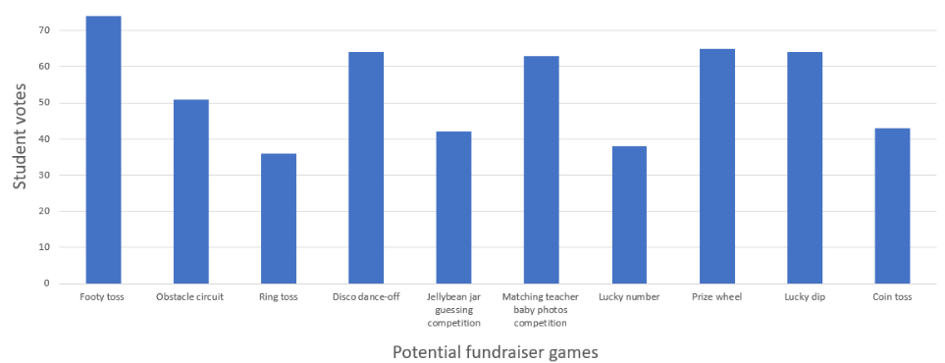
Short response (13)
What title could be given to this column graph?
Notes:
Short response questions provide brisk paced questions focussing on review of current and previous content to support spaced and interleaved practice.
Syllabus focus area:
Data A

Slide 28
Short response (14)
This shape is made of square centimetres. What is the area of the shape?
Explain how you know.
Notes:
Short response questions provide brisk paced questions focussing on review of current and previous content to support spaced and interleaved practice.
Syllabus focus area:
Two-dimensional spatial structure A: Area

Slide 29
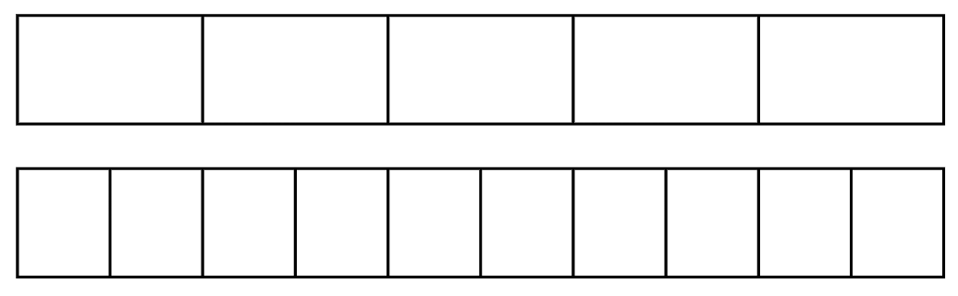

Short response (15)
Copy the bar models representing
fifths and tenths.
Shade and label the bars to find
which is greater: $\frac{4}{5}$ or $\frac{7}{10}$ ?
Notes:
Short response questions provide brisk paced questions focussing on review of current and previous content to support spaced and interleaved practice.
Syllabus focus area:
Partitioned Fractions B

Slide 30
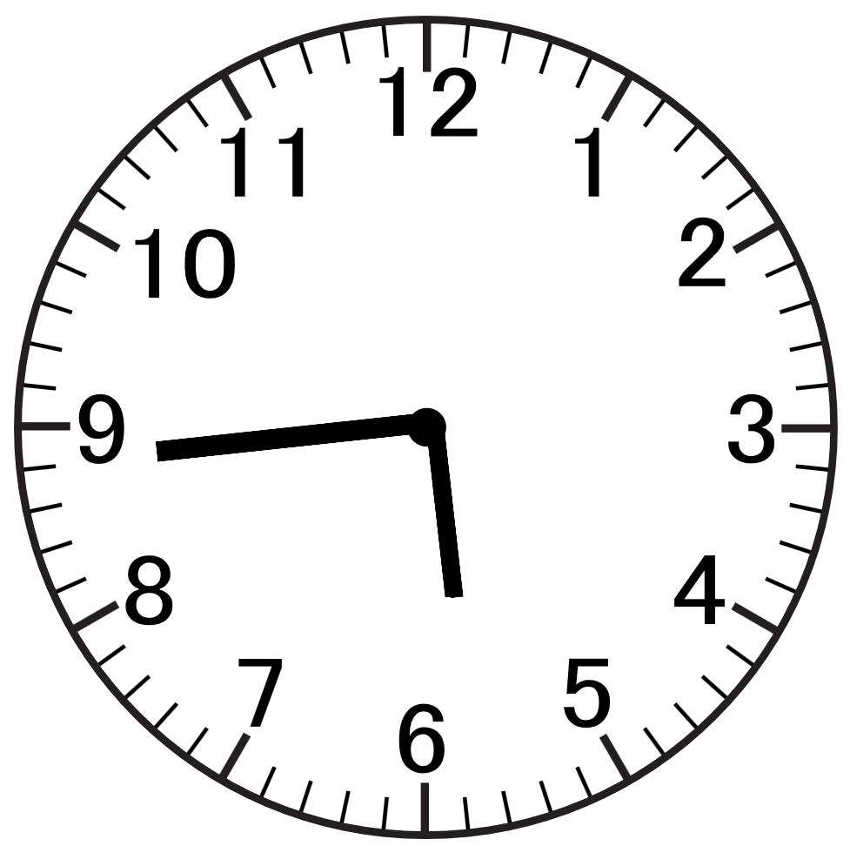
Short response (16)
Record this time using digital notation. How many minutes until 7 o’clock?
Notes:
Short response questions provide brisk paced questions focussing on review of current and previous content to support spaced and interleaved practice.
Syllabus focus area:
Non-spatial measure B: Time

Slide 31
Activity 4 – interpreting a problem involving money 2
A father bought balloons for his 4 children at the community fair. He paid for the balloons using 2 notes and 4 coins.
31
Notes:
This is a developing number sense activity.
Number sense refers to a deep understanding of numbers, including their magnitude, relationships, and the effects of operations on them. It supports fluency and understanding, estimation, flexible thinking, and efficient problem-solving. Number sense activities 1–4 ‘activate’ prior number knowledge and support the learning of new content in the unit. Number sense activities 5–8 ‘loop’ back and provide opportunity for spaced practice with concepts and procedures covered in previous units.
Syllabus focus area:
Additive relations B
This resource corresponds to Activity 4 – interpreting a problem involving money 2 in Stage 2 Year B Unit 38.
Display the following scenario: A father bought balloons for his 4 children at the community fair. He paid for the balloons using 2 notes and 4 coins.
Provide students with whiteboards to record responses.
Ask:
How much might the balloons have cost?
What is the largest amount the father could have paid?
What is the smallest amount the father could have paid?
Imagine that he used 2 different notes and 2 different coins?
How much might the balloons cost now?
Can you find all the possible prices?
How do you know you have found them all?
Which of your answers seems a reasonable amount to pay for a balloon?
Ask students to share their responses and explain the strategy they used.

Slide 32
Review of learning 5

Slide 33
Multiple choice (3)
Which decimal number is the largest?
A | B | C | D
0.65 | 0.2 | 0.03 | 0.40
Explain your reasoning.
Notes:
This question connects to the content in the developing number sense activity (Activity 5)
Syllabus focus area:
Representing numbers using place value B: Decimals

Slide 34
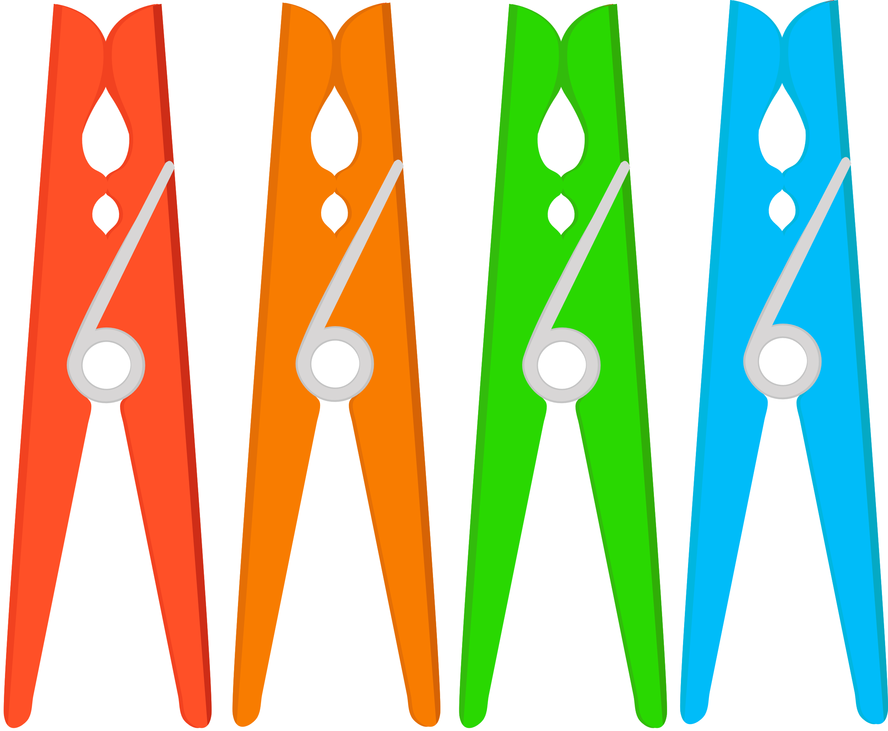
Short response (17)
Jamilla randomly selected 3 of these pegs. What is the other possible combinations
of colours?
                3 blue pegs
                2 blue and 1 green
                1 blue and 2 green
                ?
Notes:
Short response questions provide brisk paced questions focussing on review of current and previous content to support spaced and interleaved practice.
Syllabus focus area:
Chance A

Slide 35
Short response (18)
This shape is made of square metres.
What is the area of the shape?
Explain how you know.
Notes:
Short response questions provide brisk paced questions focussing on review of current and previous content to support spaced and interleaved practice.
Syllabus focus area:
Two-dimensional spatial structure A: Area

Slide 36
Short response (19)
Write the missing multiples for each sequence:
9, __ , 15, 18, __ , 24
12, __ , 24, 30, __ , 42
__ , 24, __ , 40, __ , 56
Notes:
Short response questions provide brisk paced questions focussing on review of current and previous content to support spaced and interleaved practice.
Syllabus focus area:
Multiplicative Relations B

Slide 37
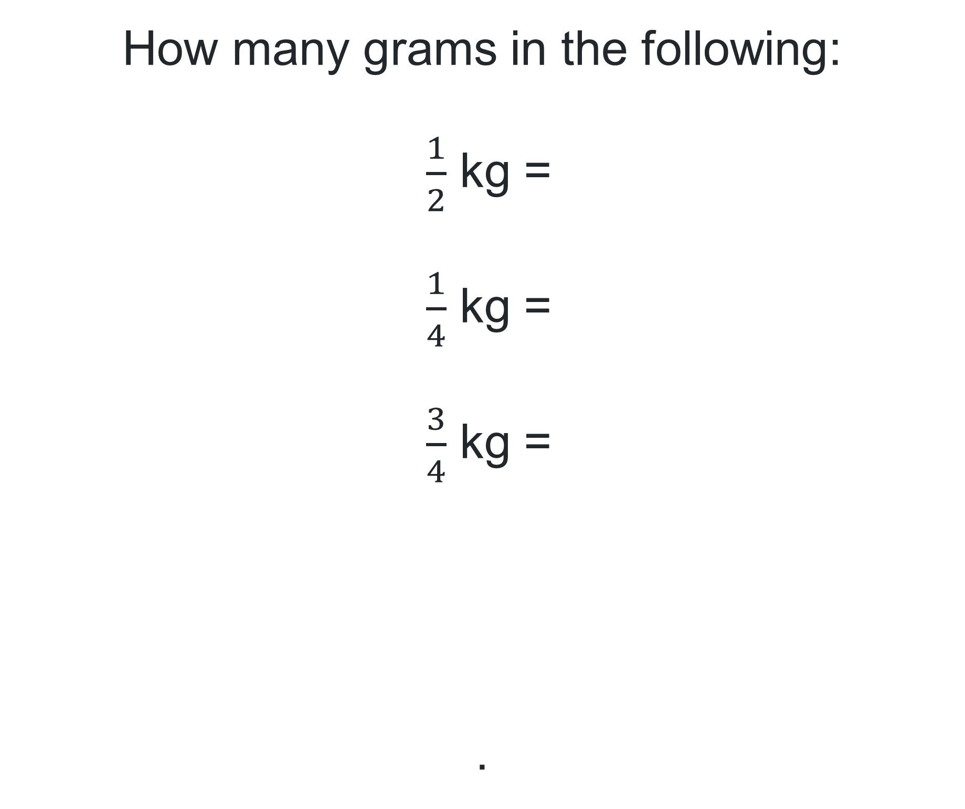
Short response (20)
How many grams in the following:
$\frac{1}{2}$ kg =
$\frac{1}{4}$ kg =
$\frac{3}{4}$ kg =
.
Notes:
Short response questions provide brisk paced questions focussing on review of current and previous content to support spaced and interleaved practice.
Syllabus focus area:
Non-spatial measure B: Mass

Slide 38
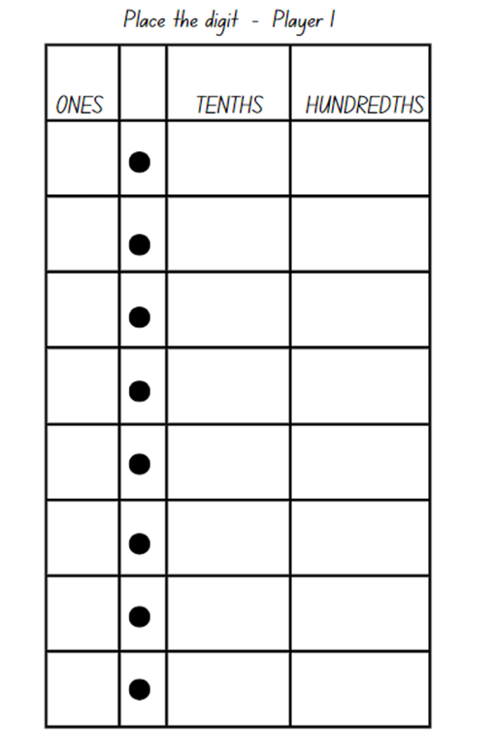
Activity 5 – role of zero – largest number
Aim of the game
The objective of the game is to make the largest decimal after drawing 3 cards.
Rules:
each player takes turns drawing a card and places the digit in the ones, tenths, or hundredths column.
each player returns the drawn cards to the bottom of the deck
continue until both players have filled all three columns
players say their decimals aloud for example, 2.45 is read aloud as 2 and 45 hundredths
the player with the largest decimal wins the round and gets 1 point.
Notes:
This is a developing number sense activity.
Number sense refers to a deep understanding of numbers, including their magnitude, relationships, and the effects of operations on them. It supports fluency and understanding, estimation, flexible thinking, and efficient problem-solving. Number sense activities 1–4 ‘activate’ prior number knowledge and support the learning of new content in the unit. Number sense activities 5–8 ‘loop’ back and provide opportunity for spaced practice with concepts and procedures covered in previous units.
Syllabus focus area:
Representing numbers using place value B
This resource corresponds to Resource 21 – place the digits and Resource 22 – number cards in Stage 2 Year B Unit 38.
This activity is an adaptation of Place the Digits from Tāhūrangi - New Zealand Curriculum by New Zealand Ministry of Education.
Provide pairs of students with Resource 21 – place the digits and Resource 22 – number cards.
Note: revisit the impact zero has on a number when it is in different place value positions. The placement of the zero in these examples changes how we say, write and understand decimals. For example, 0.78, 7.08 or 7.80.
Explain the objective of the game is to make the largest decimal after drawing 3 cards.
To play the game:
Player 1 draws a card from the deck and records the digit in the ones, tenths or hundredths column on Resource 20 – place the digits.
Player 1 returns the drawn card to the bottom of the deck before the next player draws a card and records their digit. Repeat until each player has drawn 3 cards.
Before concluding each round, players must say their decimal aloud. For example, 2.45 is read aloud as 2 and 45 hundredths.
The winner gets one point for making the largest decimal.
Note: to allow for Resource 20 – place the digits to be used multiple times, place the game board in a plastic sleeve and provide students with non-permanent markers and an eraser.

Slide 39
Review of learning 6

Slide 40
True or false (3)
0.78 is a smaller decimal than 0.09
True | False
Communicate your reasoning.
Notes:
The question on this slide connects to the content being explored in the developing number sense activity (Activity 6)
Syllabus focus area:
Representing numbers using place value B: Decimals

Slide 41
Short response (21)
Write these words on a line in order of
increasing likelihood:
impossible, certain, likely, unlikely, equally likely
Notes:
Short response questions provide brisk paced questions focussing on review of current and previous content to support spaced and interleaved practice.
Syllabus focus area:
Chance B

Slide 42
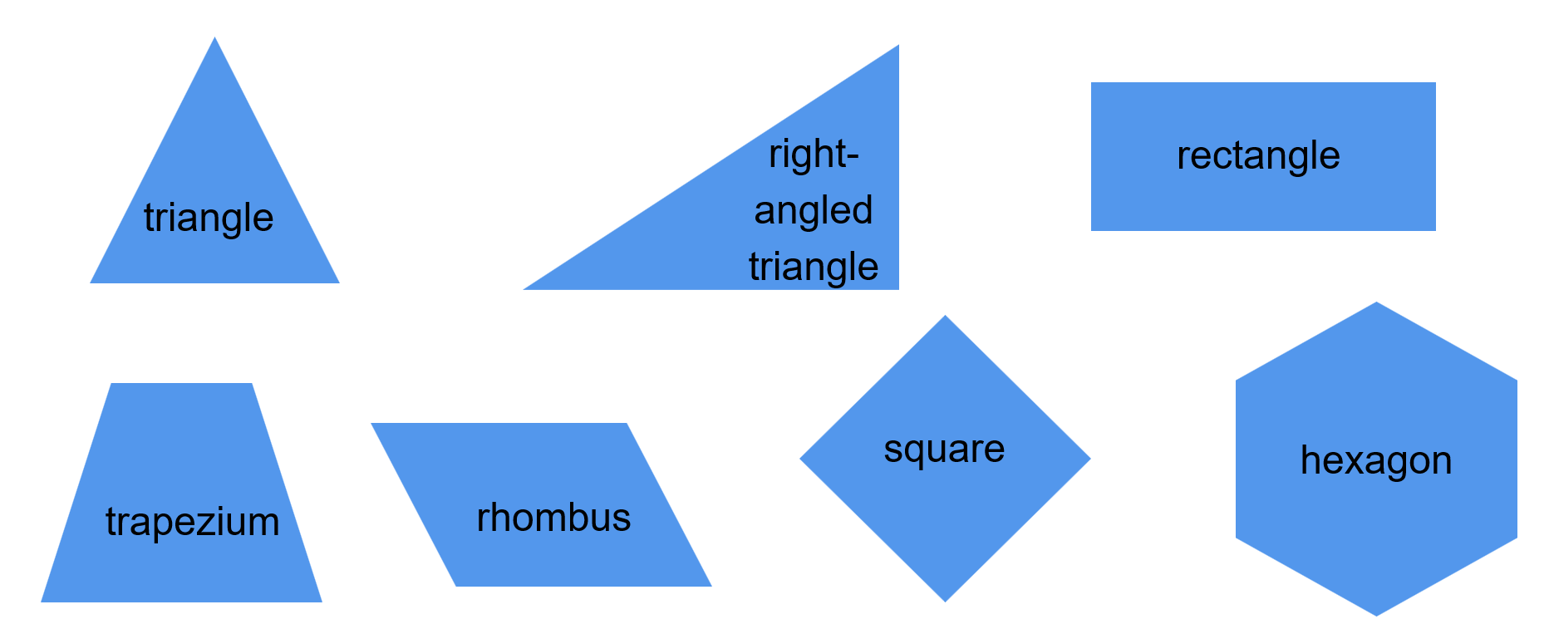
Short response (22)
Which 4 shapes only have parallel lines?
Notes:
Short response questions provide brisk paced questions focussing on review of current and previous content to support spaced and interleaved practice.
Syllabus focus area:
Two-dimensional spatial structure A: 2D shapes

Slide 43
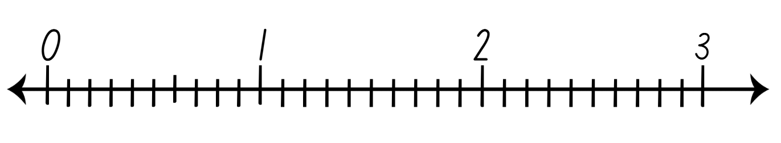
Short response (23)
How many whole numbers are represented in this model?
How many tenths are represented?
Notes:
Short response questions provide brisk paced questions focussing on review of current and previous content to support spaced and interleaved practice.
Syllabus focus area:
Representing numbers using place value B: Decimals

Slide 44
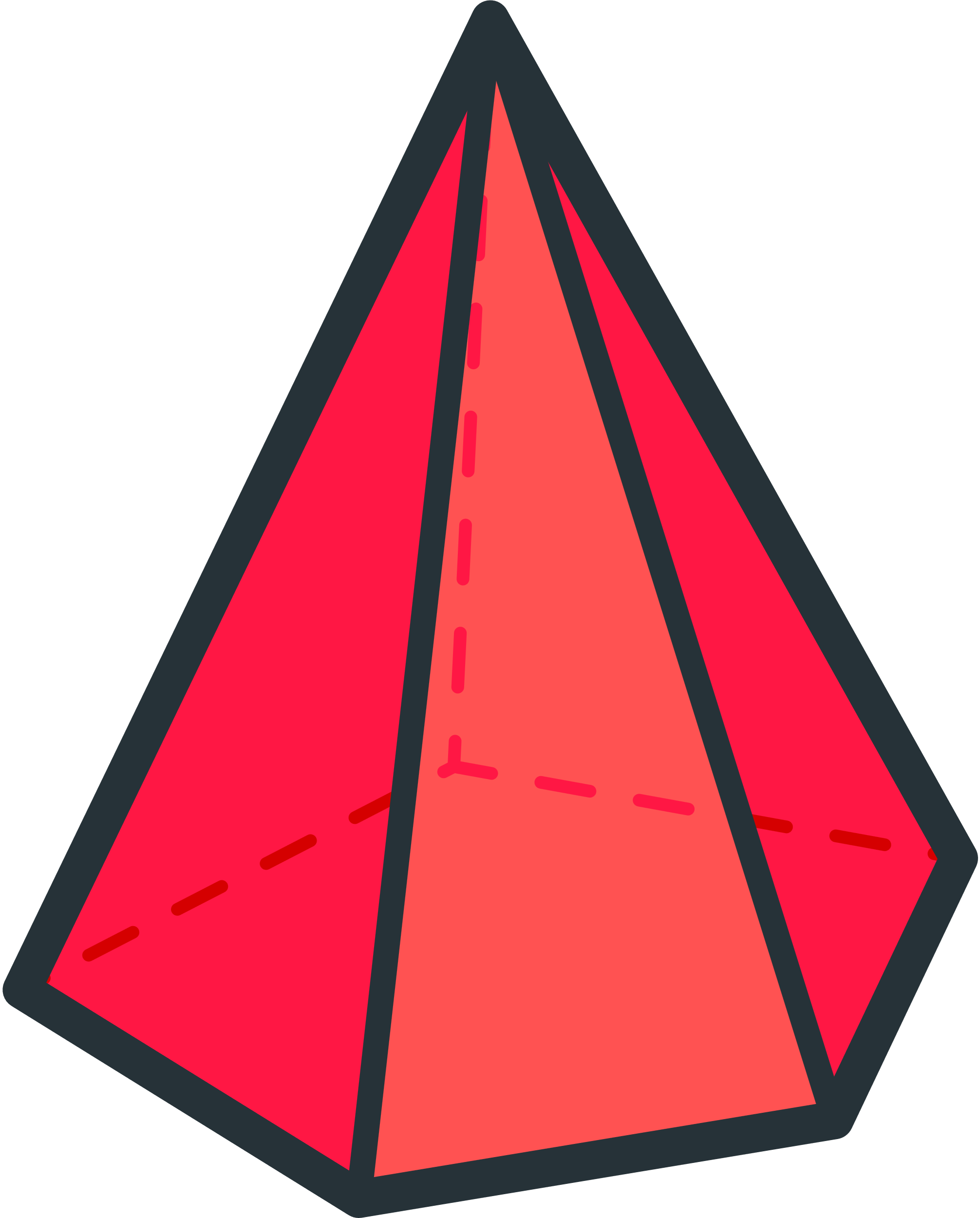
Short response (24)
How many faces does this 3D object have?
How many edges does it have?
Notes:
Short response questions provide brisk paced questions focussing on review of current and previous content to support spaced and interleaved practice.
Syllabus focus area:
Three-dimensional spatial structure B: 3D Objects

Slide 45
Activity 6 – role of zero – smallest number
Aim of the game
The objective of the game is to make the smallest decimal after drawing 3 cards.
Rules:
each player takes turns drawing a card and places the digit in the ones, tenths, or hundredths column.
each player returns the drawn cards to the bottom of the deck
continue until both players have filled all three columns
players say their decimals aloud for example, 2.45 is read aloud as 2 and 45 hundredths
the player with the smallest decimal wins the round and gets 1 point.
Notes:
This is a developing number sense activity.
Number sense refers to a deep understanding of numbers, including their magnitude, relationships, and the effects of operations on them. It supports fluency and understanding, estimation, flexible thinking, and efficient problem-solving. Number sense activities 1–4 ‘activate’ prior number knowledge and support the learning of new content in the unit. Number sense activities 5–8 ‘loop’ back and provide opportunity for spaced practice with concepts and procedures covered in previous units.
Syllabus focus area:
Representing numbers using place value B
This resource corresponds to Resource 21 – place the digits and Resource 22 – number cards in Stage 2 Year B Unit 38.
This activity is an adaptation of Place the Digits from from Tāhūrangi - New Zealand Curriculum by New Zealand Ministry of Education.
Provide pairs of students with Resource 20 – place the digits and Resource 21 – number cards.
Note: revisit the impact zero has on a number when it is in different place value positions. The placement of the zero in these examples changes how we say, write and understand decimals. For example, 0.78, 7.08 or 7.80.
Explain the objective of the game is to make the smallest decimal after drawing 3 cards.
To play the game:
Player 1 draws a card from the deck and records the digit in the ones, tenths or hundredths column on Resource 20 – place the digits.
Player 1 returns the drawn card to the bottom of the deck before the next player draws a card and records their digit. Repeat until each player has drawn 3 cards.
Before concluding each round, players must say their decimal aloud. For example, 2.45 is read aloud as 2 and 45 hundredths.
The winner gets one point for making the smallest decimal.

Slide 46
Review of learning 7

Slide 47
Multiple choice (4)
Which has the decimal numbers in the correct ascending order?
A 3.57, 3.75, 5.75, 5.53
B 3.57, 3.75, 7.35, 7.73
C 3.57, 3.75, 5.73, 7.53
D 3.57, 3.75, 5.37, 7.35
47
Notes:
This question connects to the content in the developing number sense activity (Activity 7)
Syllabus focus area:
Representing numbers using place value B: Decimals

Slide 48


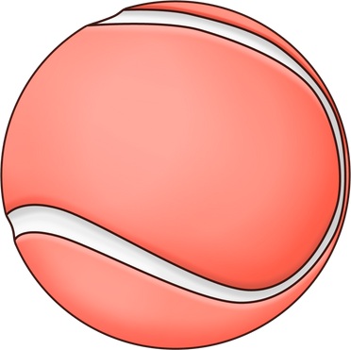

Short response (25)
Which colour of tennis ball has the second highest chance of being randomly selected? Explain your thinking.
Notes:
Short response questions provide brisk paced questions focussing on review of current and previous content to support spaced and interleaved practice.
Syllabus focus area:
Chance B

Slide 49
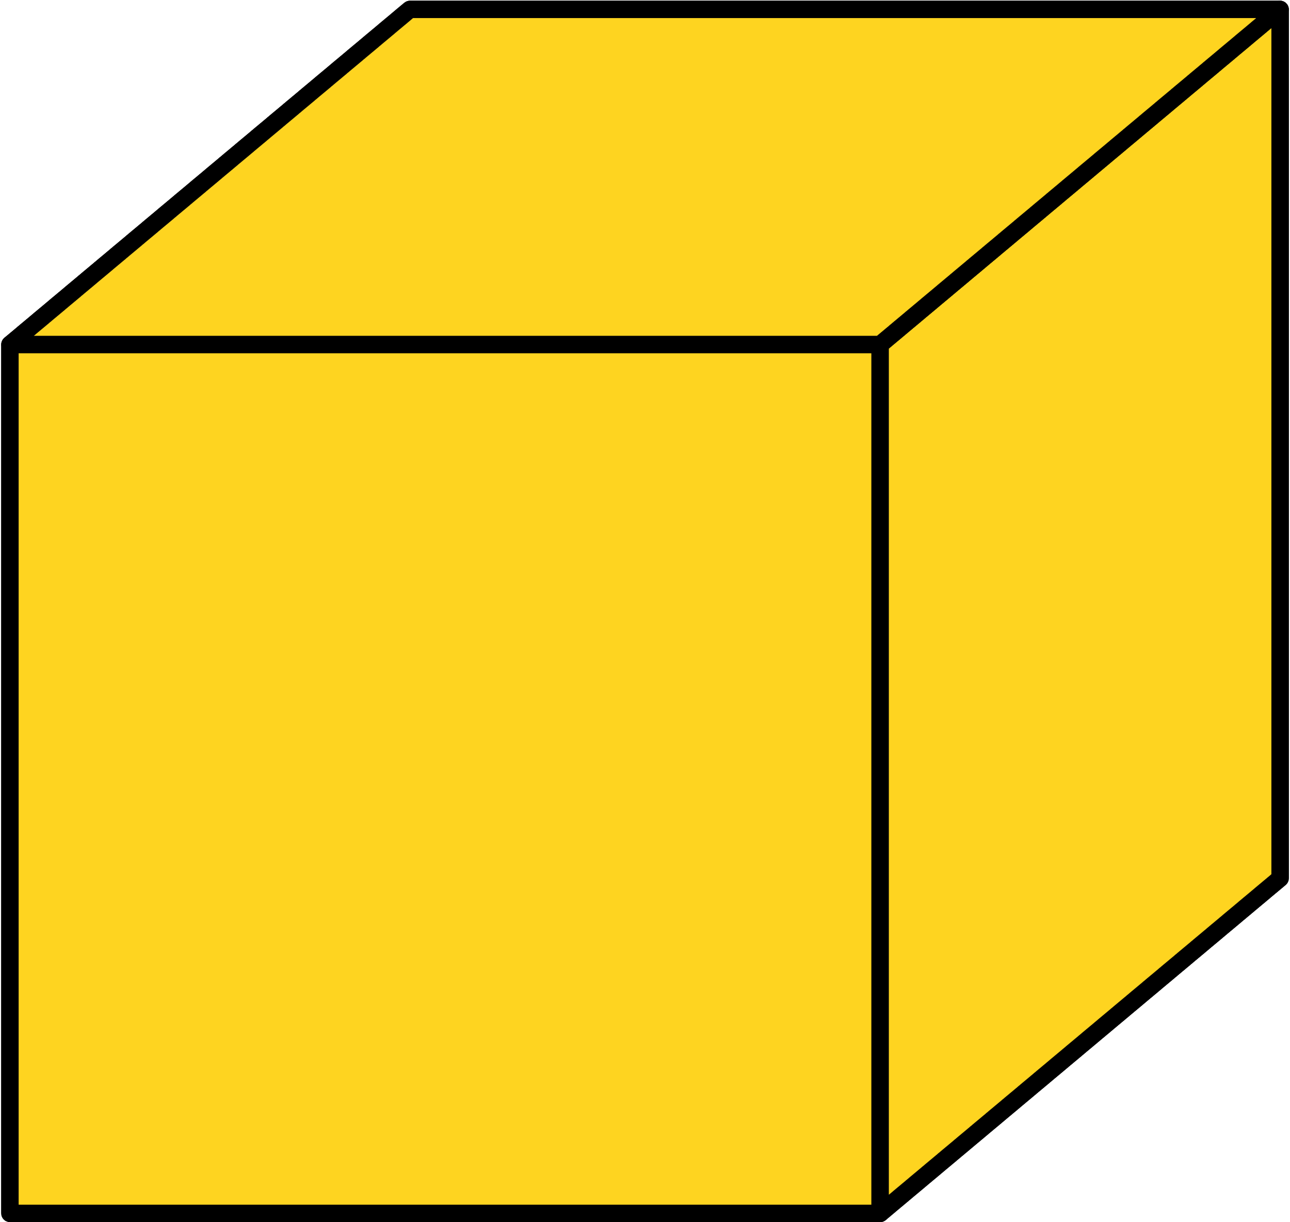
Short response (26)
Which of these is not a top, front or side view of the 3D object?
A | B | C | D
Notes:
Short response questions provide brisk paced questions focussing on review of current and previous content to support spaced and interleaved practice.
Syllabus focus area:
Three-dimensional spatial structure B: 3D objects

Slide 50
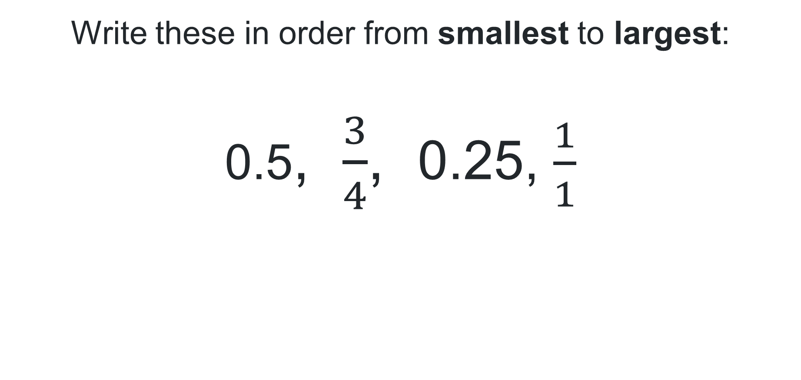
Short response (27)
Write these in order from smallest to largest:
0.5, $\frac{3}{4}$, 0.25, $\frac{1}{1}$
Notes:
Short response questions provide brisk paced questions focussing on review of current and previous content to support spaced and interleaved practice.
Syllabus focus area:
Representing numbers using place value B: Decimals

Slide 51
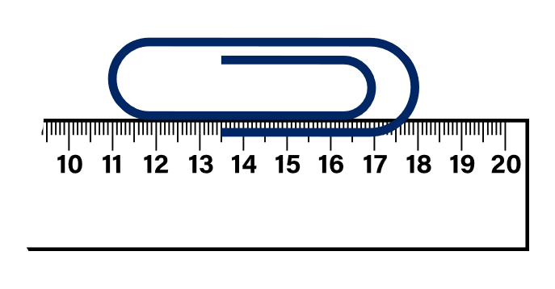
Short response (28)
Jeremy needs to measure a paperclip with a broken ruler. What is the paperclip’s length? Explain how you measured it.
Notes:
Short response questions provide brisk paced questions focussing on review of current and previous content to support spaced and interleaved practice.
Syllabus focus area:
Geometric measure B: Length

Slide 52

Activity 7 – place value using whole numbers, tenths and hundredths
The printer has broken and the decimal points did not print properly. Place the decimals in ascending order on the number line.
378
375
372
370
374
371
376
380
373
379
377
52
Notes:
This is a developing number sense activity.
Number sense refers to a deep understanding of numbers, including their magnitude, relationships, and the effects of operations on them. It supports fluency and understanding, estimation, flexible thinking, and efficient problem-solving. Number sense activities 1–4 ‘activate’ prior number knowledge and support the learning of new content in the unit. Number sense activities 5–8 ‘loop’ back and provide opportunity for spaced practice with concepts and procedures covered in previous units.
Syllabus focus area:
Representing numbers using place value B
This resource corresponds to Resource 23 – mixed-up decimals in Stage 2 Year B Unit 38.
Display Resource 23 – mixed-up decimals. Explain that the printer has broken and the decimal points did not print properly.
Explain that the decimals need to be placed in ascending order on a number line.
Provide students with Resource 23 – mixed-up decimals and individual whiteboards.
Ask:
How many possibilities are there for where the decimal point can go in each of the numbers?
How could the numbers be arranged on a number line? Explain.
As a class, discuss possible strategies and solutions to arrange the decimals on a number line.
Ensure students justify their reasoning by explaining:
how the markers are equally spaced on the number line
that the decimal point is consistently placed to show the place value for each digit
that the decimals are recorded in ascending order.
Each student selects a decimal on the number line and renames it in multiple ways. For example, 37.3 is 3 tens, 7 ones and 3 tenths or 37 and 3 tenths or 3.73 is 3 and 7 tenths and 3 hundredths or 3 and 73 hundredths.

Slide 53
Review of learning 8

Slide 54
True or false (4)
Adding a zero to the end of a decimal number makes it 10 times larger.
True | False
Communicate your reasoning.
Notes:
The question on this slide connects to the content being explored in the developing number sense activity (Activity 8)
Syllabus focus area:
Representing numbers using place value B: Decimals

Slide 55
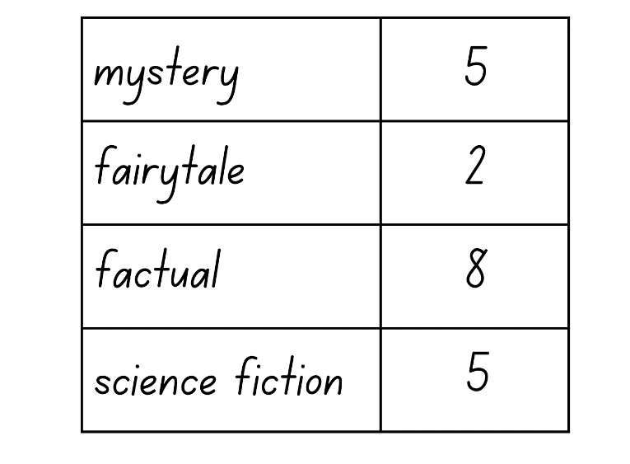
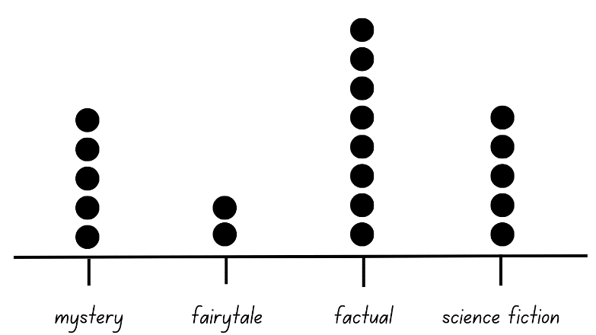
Short response (29)
Is the table or dot plot easier to interpret? Explain your thinking.
Notes:
Short response questions provide brisk paced questions focussing on review of current and previous content to support spaced and interleaved practice.
Syllabus focus area:
Data A

Slide 56

Short response (30)
This prism has been made using cubic-centimetre blocks.
Describe this prism using the term layers.
What is the volume of this prism in cubic centimetres?
Notes:
Short response questions provide brisk paced questions focussing on review of current and previous content to support spaced and interleaved practice.
Syllabus focus area:
Three-dimensional spatial structure A: Volume

Slide 57
Short response (31)
Is 3.7 larger or smaller than 3.58?
Explain your reasoning.
Notes:
Short response questions provide brisk paced questions focussing on review of current and previous content to support spaced and interleaved practice.
Syllabus focus area:
Representing numbers using place value B: Decimals

Slide 58
Short response (32)
Which of these times is closest to midday? How do you know?
Shape B
A 9:15 am | B 12:35 pm | C 1:07 pm | D 11:45 pm
Notes:
Short response questions provide brisk paced questions focussing on review of current and previous content to support spaced and interleaved practice.
Syllabus focus area:
Non-spatial measure B: Time

Slide 59
Activity 8 – locating and ordering decimals on a number line
Aim of the game​
The objective of Decimal Dash is to practise locating and ordering decimals on a number line while reinforcing an understanding of the relative sizes of decimals.​
Rules​:
form small groups and each group has a set of decimal cards
each student draws a large number line on a whiteboard or paper and labels key intervals (for example, 0, 1, 2, ..., 10)
shuffle the cards and split them in 2 equal piles
turn a card over from their pile and record the decimal on your number line
for every correct placement, a point is given
Note: If you do not agree with the placement of the card, ask your peer to justify their placements by explaining the relative size of the decimals.
reshuffle the cards and play again.
Notes:
This is a developing number sense activity.
Number sense refers to a deep understanding of numbers, including their magnitude, relationships, and the effects of operations on them. It supports fluency and understanding, estimation, flexible thinking, and efficient problem-solving. Number sense activities 1–4 ‘activate’ prior number knowledge and support the learning of new content in the unit. Number sense activities 5–8 ‘loop’ back and provide opportunity for spaced practice with concepts and procedures covered in previous units.
Syllabus focus area:
Representing numbers using place value B
This resource corresponds to Resource 24 – decimal cards in Stage 2 Year B Unit 38.
Explain the aim of this activity is to practise locating and ordering decimals on a number line. It will also reinforce students’ understanding of relative sizes of decimals.
In small groups provide students with Resource 23 – decimal cards.
Using a whiteboard or paper, students draw a large number line and label key intervals. For example, 0, 1, 2, ..., 10.
To play the game:
Students shuffle the cards and split them in 2 equal piles.
Students turn a card over from their pile and record the decimal on their number line.
For every correct placement, a student gets a point. If a student does not agree with the placement of the card, they ask their partner to justify their placements by explaining the relative size of the decimals.
Reshuffle the cards and play again.
Ask:
What patterns did you notice while placing decimals on the number line?
Can you share any strategies you used to accurately position the decimals?
What challenges did you encounter while placing decimals on the number line?
How did you overcome these challenges during the game?

Slide 60
Double Venn diagram
Object 1
Object 2
Features similar to both objects
Features of object 1
Features of object 2

Slide 61
Frayer
Definition
Facts/Characteristics
Word, term, concept
Examples
Non-examples

Slide 62
Spider map
Idea
Subject

Slide 63
Cline
Concept 1
Concept 2
Word
Word
Word
Word
Word
Word
Word
Word
Word
Word
Word

Slide 64

Compare and contrast
Notes:
Use the arrows to navigate between related activities.
Hyperlink each arrow to compare between related slides.

Slide 65
Multiple choice (1)
A
B
C
D
Notes:
This question connects to the content in the developing number sense activity (Activity 1)
This question can:
support spaced and interleaved practice
help identify and address common misconceptions
support active recall and immediate feedback
support whole class participation
identify areas requiring reteach
Teachers are encouraged to adapt and contextualise for their contexts.

Slide 66
Multiple choice (2)
A
B
C
D
Notes:
This question connects to the content in the developing number sense activity (Activity 1)
Syllabus focus area:
Multiplicative relations A
This question can:
support spaced and interleaved practice
help identify and address common misconceptions
support active recall and immediate feedback
support whole class participation
identify areas requiring reteach
Teachers are encouraged to adapt and contextualise for their contexts.

Slide 67
References
This presentation contains NSW Curriculum and syllabus content. The NSW Curriculum is developed by the NSW Education Standards Authority. This content is prepared by NESA for and on behalf of the Crown in the right of the State of New South Wales. The material is protected by Crown copyright.
Please refer to the NESA Copyright Disclaimer for more information https://educationstandards.nsw.edu.au/wps/portal/nesa/mini-footer/copyright.
NESA holds the only official and up-to-date versions of the NSW Curriculum and syllabus documents. Please visit the NSW Education Standards Authority (NESA) website https://educationstandards.nsw.edu.au/wps/portal/nesa/home and the NSW Curriculum website https://curriculum.nsw.edu.au.
Mathematics K–10 Syllabus © NSW Education Standards Authority (NESA) for and on behalf of the Crown in right of the State of New South Wales, 2022.
State of New South Wales (Department of Planning and Environment) (2020) ‘Native animal facts’, Native animals, NSW Department of Planning and Environment website, accessed 24 June 2023.

Slide 68
Copyright
© State of New South Wales (Department of Education), 2025
The copyright material published in this resource is subject to the Copyright Act 1968 (Cth) and is owned by the NSW Department of Education or, where indicated, by a party other than the NSW Department of Education (third-party material).
Copyright material available in this resource and owned by the NSW Department of Education is licensed under a Creative Commons Attribution 4.0 International (CC BY 4.0) license.
This license allows you to share and adapt the material for any purpose, even commercially.
Attribution should be given to © State of New South Wales (Department of Education), 2025.
Material in this resource not available under a Creative Commons license:
the NSW Department of Education logo, other logos and trademark-protected material
Material owned by a third party that has been reproduced with permission. You will need to obtain permission from the third party to reuse its material.
Links to third-party material and websites
Please note that the provided (reading/viewing material/list/links/texts) are a suggestion only and implies no endorsement, by the New South Wales Department of Education, of any author, publisher, or book title. School principals and teachers are best placed to assess the suitability of resources that would complement the curriculum and reflect the needs and interests of their students.
If you use the links provided in this document to access a third party’s website, you acknowledge that the terms of use, including licence terms set out on the third-party’s website apply to the use which may be made of the materials on that third-party website or where permitted by the Copyright Act 1968 (Cth). The department accepts no responsibility for content on third-party websites.

