Slide 1
Instructions for use
This resource aligns to the learning in Stage 2 Year B Unit 39 and revisits content from earlier sample units.
Classroom teachers are encouraged to add, edit and adapt to meet the needs of their students.
Save a copy of the file to make changes to the slide deck. Go to File > Download a Copy (this downloads a copy to the computer to edit in the PowerPoint app).
To convert the PowerPoint to Google Slides:
  Upload the file into Google Drive and open it.
  Go to File > Save as Google Slides.
  (Note – conversion may cause formatting changes in the slides.)

Slide 2

Review of Learning
Mathematics Stage 2 – Unit 39
Notes:
Reviews may include a combination of question types, requiring students to recall facts and key ideas, as well as apply their knowledge to solve problems and answer questions. To support active engagement, a mix of techniques should be employed.” (AERO, 2024).
This Review of Learning slide deck revisits key concepts from the following units:
Stage 2 Year B Unit 37
Stage 2 Year B Unit 38
Stage 2 Year B Unit 39
It also includes opportunities to review prior learning in non-number content, supporting consolidation across focus areas.
The review of learning resources include three key task types that support the development of mathematical proficiency through retrieval, spaced practice, and active participation. These practices complement the review phase (activating prior knowledge) embedded within the beginning of each lesson.
1.
Multiple-choice questions/True or false: Designed to promote active retrieval of key concepts and identify common misconceptions in number, supporting consolidation, understanding and fluency.
These questions:
support spaced and interleaved practice
help identify and address common misconceptions
support active recall and immediate feedback
support whole class participation
identify areas requiring reteach
2.
Short-response question sets: Carefully grouped questions that encourage spaced and interleaved practice across multiple focus areas, helping students revisit and apply knowledge from different points in time.
These questions:
have a combination of question types
address a range of focus areas
build automaticity and fluency
support active recall
allow for immediate feedback
identify content requiring reteach
3.
Developing number sense activities: A variety of practical, purposeful tasks that reinforce current learning and build on prior knowledge. These activities promote reasoning, problem-solving and conceptual understanding.
The review of learning resources are designed to work support teaching and learning in mathematics. For the most effective implementation, use the resources flexibly, adapting to meet student learning needs and individual classroom contexts.

Slide 3
Lessons
1
Review of learning 1
5
Review of learning 5
2
Review of learning 2
6
Review of learning 6
3
Review of learning 3
7
Review of learning 7
4
Review of learning 4
8
Review of learning 8
Notes:
Teacher notes:
Click lesson numbers to go to specific lessons
Interactive features can be viewed in slide show

Slide 4
Review of learning 1

Slide 5

Multiple choice (1)
The expanded form for 3678 is:
A
3000 + 7000 + 60 + 8
B
8000 + 7000 + 60 + 3
C
3000 + 6000 + 70 + 7
D
3000 + 6000 + 70 + 8
Notes:
This question connects to the content in the developing number sense activity (Activity 1)
Syllabus focus area:
Representing numbers using place value B

Slide 6


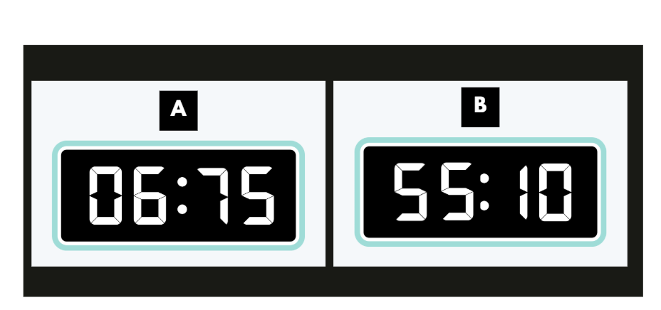
Short response (1)
Explain why these times are incorrect.
Notes:
Short response questions provide brisk paced questions focussing on review of current and previous content to support spaced and interleaved practice.
Syllabus focus area:
Non-spatial measure B: Time

Slide 7
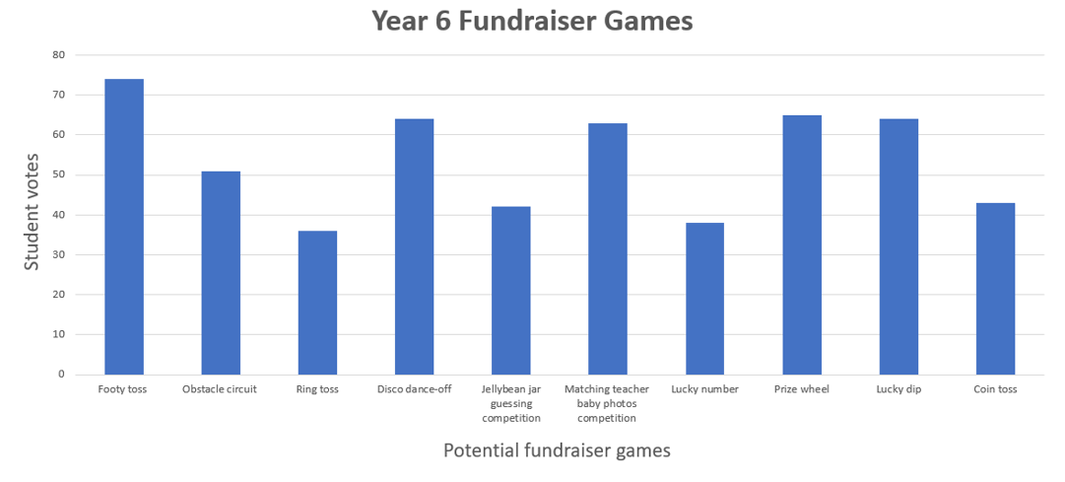
Short response (2)
Identify 3 pieces of information from this data.
Notes:
Short response questions provide brisk paced questions focussing on review of current and previous content to support spaced and interleaved practice.
Syllabus focus area:
Data A

Slide 8
Short response (3)
If you know that 3 × 5 = 15, how could you use that understanding to quickly work out 6 × 5?
Notes:
Short response questions provide brisk paced questions focussing on review of current and previous content to support spaced and interleaved practice.
Syllabus focus area:
Multiplicative relations B

Slide 9
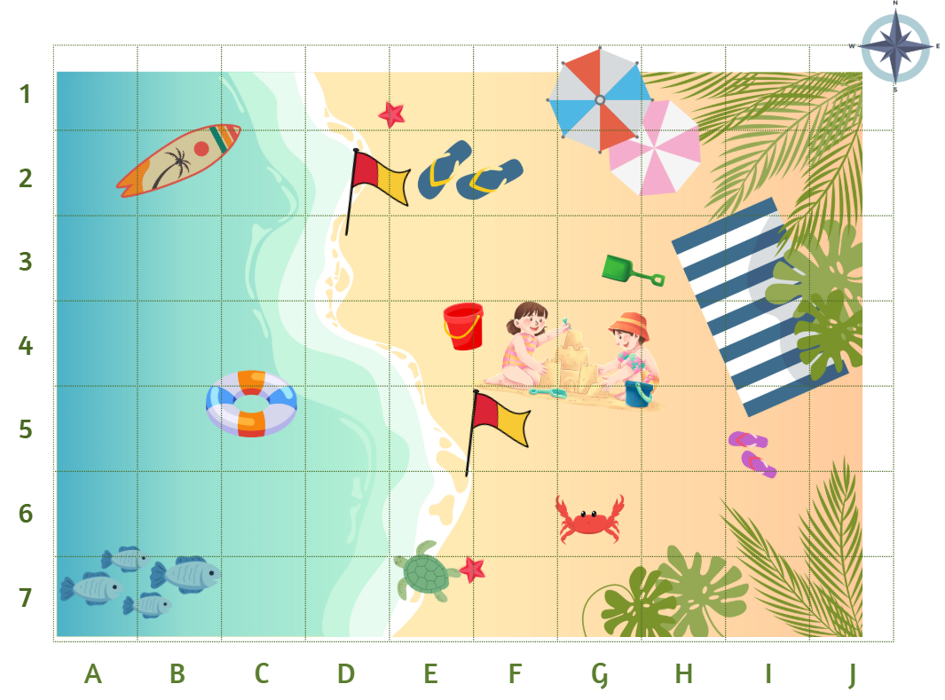
Short response (4)
Use compass directions to describe the route from the surfboard to the crab.
Notes:
Short response questions provide brisk paced questions focussing on review of current and previous content to support spaced and interleaved practice.
Syllabus focus area:
Geometric measure B: Position

Slide 10

Activity 1 – expanded form memory
285 379
400 000 + 30 000 + 2000 + 500 + 2
Notes:
This is a developing number sense activity.
Number sense refers to a deep understanding of numbers, including their magnitude, relationships, and the effects of operations on them. It supports fluency and understanding, estimation, flexible thinking, and efficient problem-solving. Number sense activities 1–4 ‘activate’ prior number knowledge and support the learning of new content in the unit. Number sense activities 5–8 ‘loop’ back and provide opportunity for spaced practice with concepts and procedures covered in previous units.
Syllabus focus area:
Representing numbers using place value B
Record the number 285 379 on the board. Ask students to turn and talk to verbally expand the number using standard partitioning.
Record the number sentence 400 000 + 30 000 + 2000 + 500 + 50 + 2 on the board. Students turn and talk to regroup and rename the 6-digit number.
Explain that students will play a memory game, matching each number to its corresponding expanded notation.
Provide pairs with Resource 23 – expanded form memory (this resource corresponds to Resource 23 – expanded form memory in Stage 2, Year B Unit 39). Students cut out the cards, shuffle them and place them face down.
Student A selects 2 cards. If the cards match, the student keeps them and has another turn. If there is no match the student returns the cards face down and Student B takes a turn.
Play continues until there are no cards left. The student with the greatest number of cards at the end of the game wins.

Slide 11
Review of learning 2

Slide 12
True or false (1)
Stacey said the value of the 7 in 4789 is 700.
True | False
Notes:
The question on this slide connects to the content being explored in the developing number sense activity (Activity 2)
Syllabus focus area:
Representing numbers using place value B

Slide 13
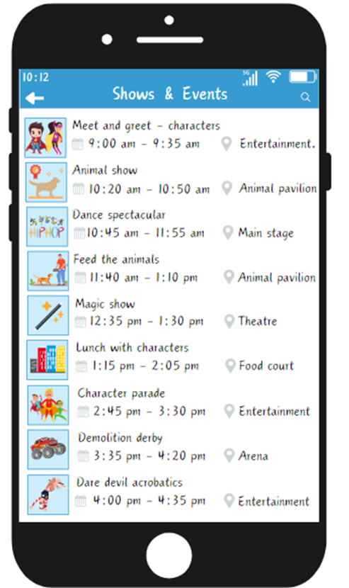
Short response (5)
It is 3:47 pm. Maggie wants to attend the Dare Devil Acrobatics at 4 pm. How many minutes until 4pm?
Notes:
Short response questions provide brisk paced questions focussing on review of current and previous content to support spaced and interleaved practice.
Syllabus focus area:
Non-spatial measure B: Time

Slide 14
Short response (5)
Create a list of categories to sort this data.
Banana | Socks | Elephant | Dog | Carrot
Train | Helicopter | School bag | T-Shirt | Spoon
Orange juice | Chair | Fish | Truck | Shoes
Hat | Watermelon | Bike | Gloves | Penguin
Notes:
Short response questions provide brisk paced questions focussing on review of current and previous content to support spaced and interleaved practice.
Syllabus focus area:
Data A

Slide 15
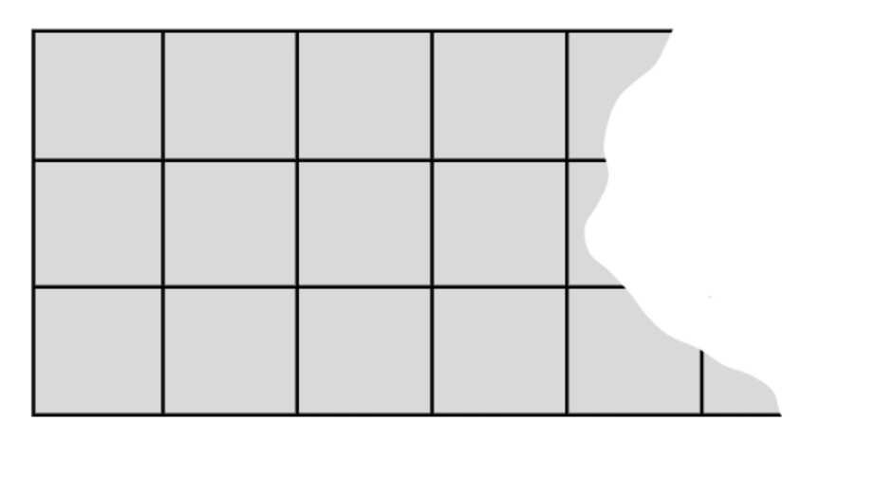
Short response (7)
Find the total of this partially covered array.
Notes:
Short response questions provide brisk paced questions focussing on review of current and previous content to support spaced and interleaved practice.
Syllabus focus area:
Multiplicative relations A

Slide 16
Short response (8)
Explain the term perimeter and how it is calculated.
Notes:
Short response questions provide brisk paced questions focussing on review of current and previous content to support spaced and interleaved practice.
Syllabus focus area:
Geometric measure B: Length

Slide 17
Activity 2 – expanded form cards
694 258
300 000 + 20 000 + 2000 + 700 + 20 +6
Notes:
This is a developing number sense activity.
Number sense refers to a deep understanding of numbers, including their magnitude, relationships, and the effects of operations on them. It supports fluency and understanding, estimation, flexible thinking, and efficient problem-solving. Number sense activities 1–4 ‘activate’ prior number knowledge and support the learning of new content in the unit. Number sense activities 5–8 ‘loop’ back and provide opportunity for spaced practice with concepts and procedures covered in previous units.
Syllabus focus area:
Representing numbers using place value B
Record the number 694 258 on the board. Ask students to turn and talk to verbally expand the number using standard partitioning.
Record the number sentence 300 000 + 20 000 + 2000 + 700 + 20 + 6 on the board. Students turn and talk to regroup and rename the 6-digit number.
Explain that students will use the cards from activity one and record the expanded number notation on their whiteboards.
Provide pairs with Resource 23 – expanded form memory (this resource corresponds to Resource 23 – expanded form memory in Stage 2, Year B Unit 39). Students use the number cards. The expanded notation cards can be placed in a pile.
Student A selects a number card and records the expanded notation on their whiteboard. Student B finds the notation card to match and marks their partner’s work.
Partner A and B swap roles.

Slide 18
Review of learning 3

Slide 19
Multiple choice (2)
40 000 + 8000 + 50 + 6 can be renamed as:
A | B | C | D
4853 | 56 704 | 48 056 | 48 675
Notes:
This question connects to the content in the developing number sense activity (Activity 3)
Syllabus focus area:
Representing numbers using place value B

Slide 20
Short response (9)
Match the following terms to am or pm: Midnight
Midday
Noon
Notes:
Short response questions provide brisk paced questions focussing on review of current and previous content to support spaced and interleaved practice.
Syllabus focus area:
Non-spatial measure B: Time

Slide 21





Short response (10)
Record the missing data in this table.
Food | Tally | Responses
Pizza
Burger
Pasta
Fish
Soup
Notes:
Short response questions provide brisk paced questions focussing on review of current and previous content to support spaced and interleaved practice.
Syllabus focus area:
Data A

Slide 22
Short response (11)
Rewrite the following number sentences using the associative property.
10 x 6
7 x 8
6 x 4
Notes:
Short response questions provide brisk paced questions focussing on review of current and previous content to support spaced and interleaved practice.
Syllabus focus area:
Multiplicative relations B

Slide 23
Short response (12)
Does obtaining heads when tossing a coin affect the chance of obtaining heads on the next toss?
Explain your thinking to a partner.
Notes:
Short response questions provide brisk paced questions focussing on review of current and previous content to support spaced and interleaved practice.
Syllabus focus area:
Chance B

Slide 24
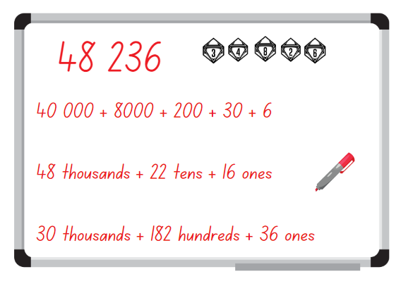
Activity 3 – renaming numbers
Notes:
This is a developing number sense activity.
Number sense refers to a deep understanding of numbers, including their magnitude, relationships, and the effects of operations on them. It supports fluency and understanding, estimation, flexible thinking, and efficient problem-solving. Number sense activities 1–4 ‘activate’ prior number knowledge and support the learning of new content in the unit. Number sense activities 5–8 ‘loop’ back and provide opportunity for spaced practice with concepts and procedures covered in previous units.
Syllabus focus area:
Representing numbers using place value B
Provide students with a 10-sided (0–9) die and a whiteboard.
Students roll the die 5 times to generate a 5-digit number.
Students record their 5-digit number on their whiteboard in expanded notation.
Students then use non-standard partitioning to regroup and rename their number in 2 different ways
Students think pair share to see if they can identify another way to partition their partner’s number using non-standard partitioning.

Slide 25
Review of learning 4

Slide 26
True or false (2)
Josh said the expanded notation of 5674 is 5000 + 600+ 40 + 7.
True | False
Notes:
The question on this slide connects to the content being explored in the developing number sense activity (Activity 4)
Syllabus focus area:
Representing numbers using place value B

Slide 27
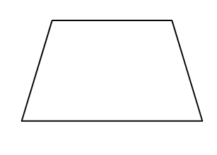
Short response (13)
Draw the different ways can you split a trapezium into 2 or more shapes?
Notes:
Short response questions provide brisk paced questions focussing on review of current and previous content to support spaced and interleaved practice.
Syllabus focus area:
Two-dimensional spatial structure B: 2D shape

Slide 28
Short response (14)
What are all the possible outcomes when rolling two 6-sided dice?
Notes:
Short response questions provide brisk paced questions focussing on review of current and previous content to support spaced and interleaved practice.
Syllabus focus area:
Chance A

Slide 29
Short response (15)
Calculate the area of the following two playgrounds:
Playground 1: Length = 10 m Width = 4 m
Playground 2: Length = 5 m Width = 8 m
What do you notice?
Notes:
Short response questions provide brisk paced questions focussing on review of current and previous content to support spaced and interleaved practice.
Syllabus focus area:
Two-dimensional spatial structure B: Area

Slide 30
Short response (16)
Name some everyday objects that are measured in grams.
Why are grams used instead of kilograms to measure these objects?
Notes:
Short response questions provide brisk paced questions focussing on review of current and previous content to support spaced and interleaved practice.
Syllabus focus area:
Non-spatial measure B: Mass

Slide 31








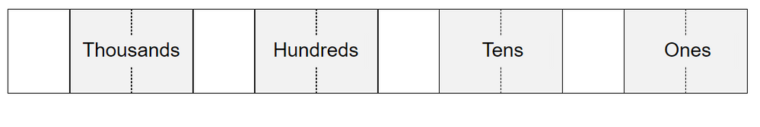
Activity 4 – number expander
Dice rolled
My number is: 246 895
My number in expanded notation
200 000 + 40 000 + 6000 + 800 + 90 + 5
Number expander - standard partitioning
2
Hundred
4
Ten
6
8
9
5
thousands
thousands
Thousands
Hundreds
Tens
Ones
Non-standard partitioning
246
7
18
15
Notes:
This is a developing number sense activity.
Number sense refers to a deep understanding of numbers, including their magnitude, relationships, and the effects of operations on them. It supports fluency and understanding, estimation, flexible thinking, and efficient problem-solving. Number sense activities 1–4 ‘activate’ prior number knowledge and support the learning of new content in the unit. Number sense activities 5–8 ‘loop’ back and provide opportunity for spaced practice with concepts and procedures covered in previous units.
Syllabus focus area:
Representing numbers using place value B
Display Resource 24 – student number expander (this resource corresponds to Resource 49 – student number expander in Stage 2, Year B Unit 39) and explain to students that Mark used a number expander to partition a 6-digit number in a standard and non-standard form.
Ask:
What do you notice?
Can you think of another way Mark could partition his number in non-standard forms?
Provide students with a 10-sided (0–9) die, writing materials and Resource 25 – number expander worksheet (this resource corresponds to Resource 25 – number expander worksheet in Stage 2, Year B Unit 39).
Students roll the die 6 times to generate a 6-digit number.
Students use the 6-digit number to complete Resource 25 – number expander worksheet (this resource corresponds to Resource 25 – number expander worksheet in Stage 2, Year B Unit 39).
Students think pair share with a partner to see if they can identify another way to partition their partner’s number using non-standard partitioning.

Slide 32
Review of learning 5

Slide 33

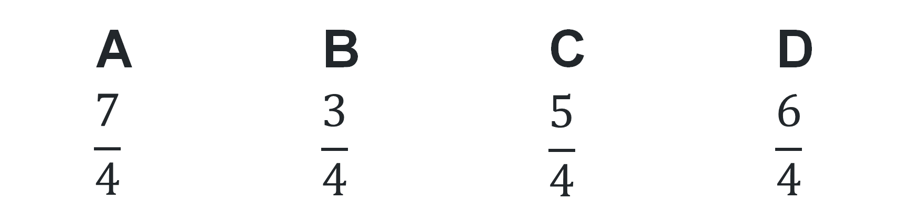
Multiple choice (3)
1$\frac{1}{4 }$ can be renamed as:
A | B | C | D
$$\frac{7}{4}$$ | $$\frac{3}{4}$$ | $$\frac{5}{4}$$ | $$\frac{6}{4}$$
Notes:
This question connects to the content in the developing number sense activity (Activity 5)
Syllabus focus area:
Partitioned Fractions B

Slide 34


Short response (17)
.
Meg rotated the triangle a half-turn each turn.
Describe the error in her transformation.
Notes:
Short response questions provide brisk paced questions focussing on review of current and previous content to support spaced and interleaved practice.
Syllabus focus area:
Two-dimensional spatial structure B: 2D shape

Slide 35
Short response (18)
A bag has 10 red marbles and 12 blue. Erin removed one red marble. Are the chances of selecting a blue marble still the same?
Explain your reasoning.
Notes:
Short response questions provide brisk paced questions focussing on review of current and previous content to support spaced and interleaved practice.
Syllabus focus area:
Chance B

Slide 36
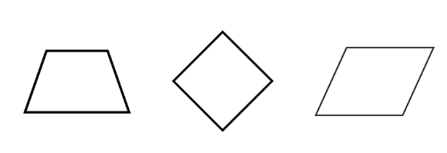
Short response (19)
Which one doesn’t belong?
Communicate your reasoning.
Notes:
Short response questions provide brisk paced questions focussing on review of current and previous content to support spaced and interleaved practice.
Syllabus focus area:
Two-dimensional spatial structure A :2D shape

Slide 37
Short response (20)
Order the capacities from smallest to largest.
950 mL | 876 mL
120 mL | 4856 mL
95 mL | 762 mL
Notes:
Short response questions provide brisk paced questions focussing on review of current and previous content to support spaced and interleaved practice.
Syllabus focus area:
Three-dimensional spatial structure B: Volume

Slide 38
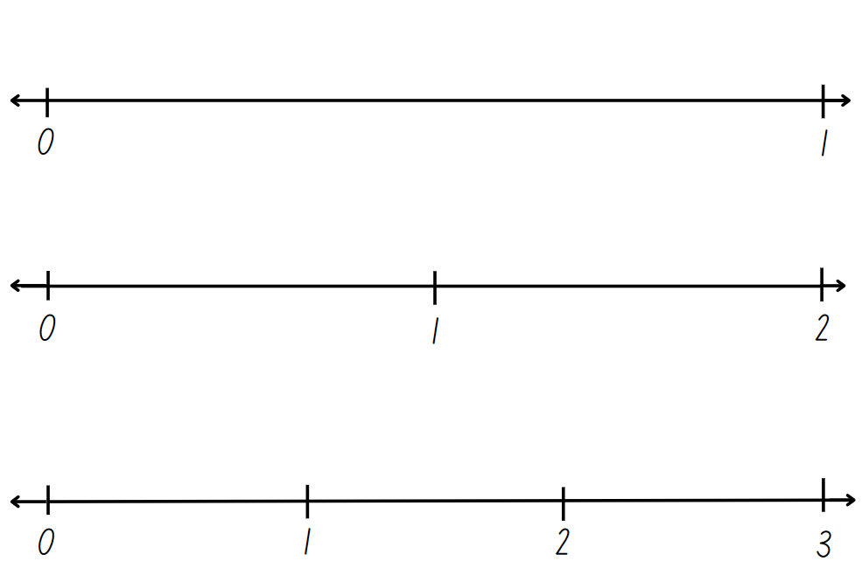
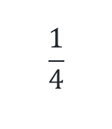
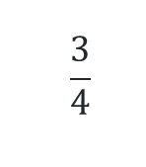
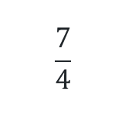
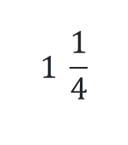
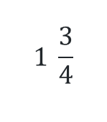
Activity 5 – blank number lines
$$\frac{1}{4}$$
$$1 \frac{3}{4}$$
$$1 \frac{1}{4}$$
$$\frac{7}{4}$$
$$\frac{3}{4}$$
Notes:
This is a developing number sense activity.
Number sense refers to a deep understanding of numbers, including their magnitude, relationships, and the effects of operations on them. It supports fluency and understanding, estimation, flexible thinking, and efficient problem-solving. Number sense activities 1–4 ‘activate’ prior number knowledge and support the learning of new content in the unit. Number sense activities 5–8 ‘loop’ back and provide opportunity for spaced practice with concepts and procedures covered in previous units.
Syllabus focus area:
Partitioned fractions B
Display Resource 26 – blank number lines (this resource corresponds to Resource 26 – blank number lines in Stage 2, Year B Unit 39).
Draw students attention to the 3 different-sized number lines, as indicated by the position of the 1 on each line which represents one whole.
Pose the following scenario: Two students were dividing their number lines into quarters. Jack said he would draw 4 lines in between each whole number and Harriet said she would draw 3. Ask the following questions:
Who is correct and why?
How many quarters are there in 2 wholes?
Can you draw a number line to prove it?
Students copy the 3 number lines from the board and partition each number line into quarters by marking equal spaces between each whole number.
Students label the following fractions on each number line (see Figure 12): $\frac{1}{4}$, $1 \frac{3}{4}$, $1 \frac{1}{4}$, $\frac{7}{4}$, $\frac{3}{4}$.
Regroup and ask students to compare their fraction number lines with a partner.
Ask:
Did you place the fractions at the same points on the number lines as your partner?
How could 2 be renamed as a fraction?
How can $1 \frac{3}{4}$ be renamed? ( $\frac{7}{4}$).

Slide 39
Review of learning 6

Slide 40
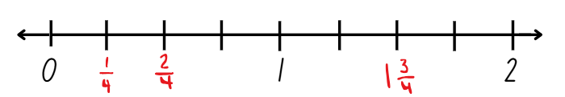
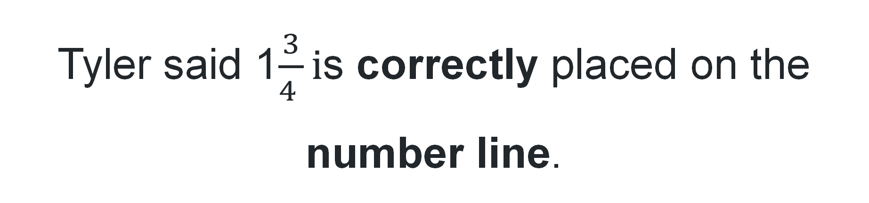
True or false (3)
Tyler said 1$\frac{3}{4 }i$s correctly placed on the number line.
True | False
Notes:
This question connects to the content in the developing number sense activity (Activity 5)
Syllabus focus area:
Partitioned Fractions B

Slide 41
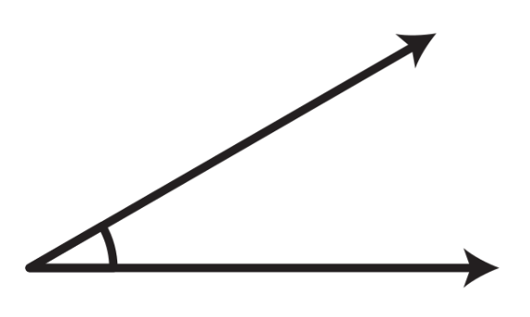
Short response (21)
Describe this angle compared to a right-angle.
Notes:
Short response questions provide brisk paced questions focussing on review of current and previous content to support spaced and interleaved practice.
Syllabus focus area:
Geometric Measure B: Angles

Slide 42
Short response (22)
Using the chance words on the scale below, describe how likely these events could happen:
A thunderstorm today
An ice-cream van visiting school tomorrow
A coin toss landing on heads
Turning a year older each year
Notes:
Short response questions provide brisk paced questions focussing on review of current and previous content to support spaced and interleaved practice.
Syllabus focus area:
Chance B

Slide 43
Short response (23)
Draw the top, front and side view of a cube. Record the volume in cubic centimeters.
Notes:
Short response questions provide brisk paced questions focussing on review of current and previous content to support spaced and interleaved practice.
Syllabus focus area:
Three-dimensional spatial structure B

Slide 44
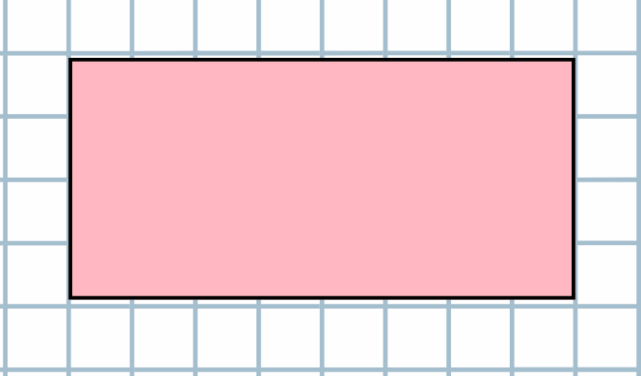
Short response (24)
Calculate the area of this rectangle in square centimeters.
Notes:
Short response questions provide brisk paced questions focussing on review of current and previous content to support spaced and interleaved practice.
Syllabus focus area:
Two-dimensional spatial structure B: Area

Slide 45
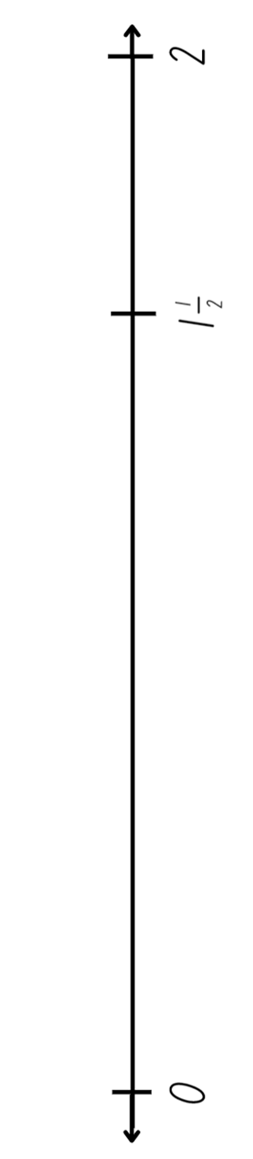
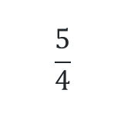
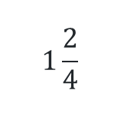
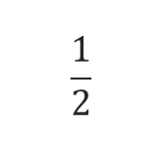
Activity 6 – fraction line beyond 1
$$\frac{1}{4}$$
$$1 \frac{3}{4}$$
$$\frac{1}{2}$$
$$1\frac{2}{4}$$
$$\frac{5}{4}$$
Notes:
This is a developing number sense activity.
Number sense refers to a deep understanding of numbers, including their magnitude, relationships, and the effects of operations on them. It supports fluency and understanding, estimation, flexible thinking, and efficient problem-solving. Number sense activities 1–4 ‘activate’ prior number knowledge and support the learning of new content in the unit. Number sense activities 5–8 ‘loop’ back and provide opportunity for spaced practice with concepts and procedures covered in previous units.
Syllabus focus area:
Partitioned fractions B
Provide students with a copy of Resource 27 – number line (this resource corresponds to Resource 27 – number line in Stage 2, Year B Unit 39).
Ask students to use the numbers provided on the number line to determine the location of the following fractions: $\frac{1}{4}$, $1\frac{3}{4}$, $\frac{1}{2}$, $1\frac{2}{4}$, $\frac{5}{4}$.
Students record the fractions on their number line. Ask:
How did you place these fractions on the number line? (First identifying where 1 is placed on the number line, visualising half and half again to find quarters.)
What knowledge did you need to draw on to identify and label $\frac{5}{4}$? (Renaming and regrouping fractions equal to and greater than one.)
How could the fraction $\frac{5}{4}$ be renamed? ($1\frac{1}{4}$)
Can you place any additional fractions on this number line?
Regroup and ask students to compare the position of the fractions on their number lines with a partner.

Slide 46
Review of learning 7

Slide 47
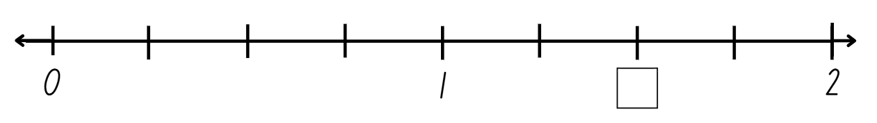
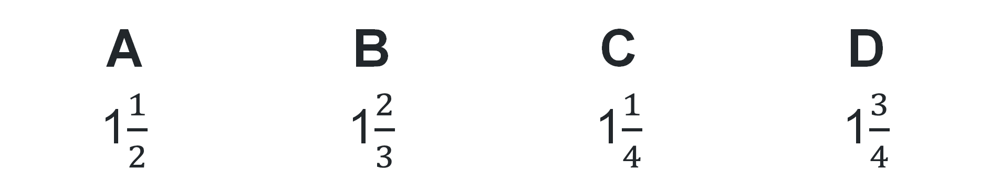
Multiple choice (4)
Which fraction should be recorded in the box?
A | B | C | D
1$\frac{1}{2}$ | 1$\frac{2}{3}$ | 1$\frac{1}{4}$ | 1$\frac{3}{4}$
Notes:
This question connects to the content in the developing number sense activity (Activity 7)
Syllabus focus area:
Partitioned Fractions B

Slide 48
Short response (25)
Fill in the spaces with ‘more’, ‘less’ or ‘the same as’
An acute angle is _____ than a quarter turn.
A right angle is ______ a quarter turn.
An obtuse angle is ______ than a quarter turn.
Notes:
Short response questions provide brisk paced questions focussing on review of current and previous content to support spaced and interleaved practice.
Syllabus focus area:
Geometric Measure B: Angles

Slide 49
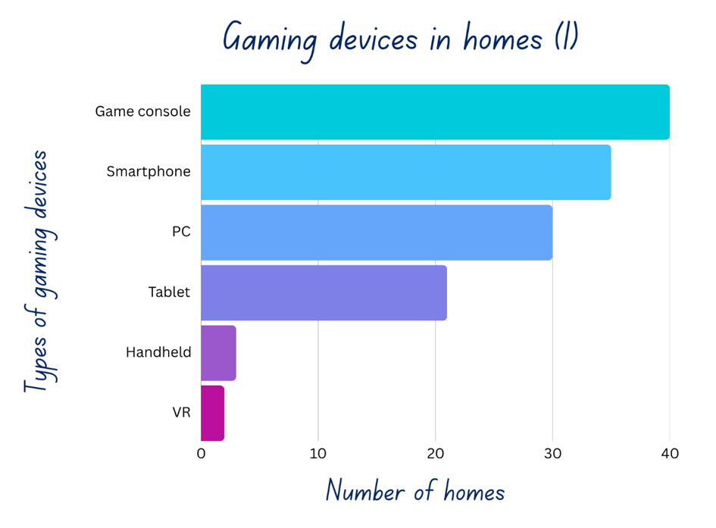
Short response (26)
Identify 3 pieces of information from this data?
Notes:
Short response questions provide brisk paced questions focussing on review of current and previous content to support spaced and interleaved practice.
Syllabus focus area:
Data A

Slide 50
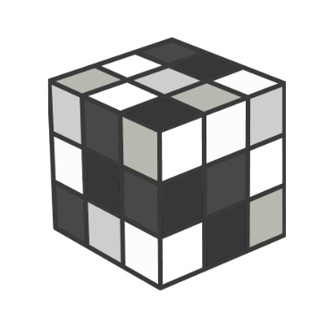
Short response (27)
Calculate the volume of this prism using cubic centimeters.
Notes:
Short response questions provide brisk paced questions focussing on review of current and previous content to support spaced and interleaved practice.
Syllabus focus area:
Three-dimensional spatial structure B: Volume

Slide 51
Short response (28)
Identify four situations where duration is measured in seconds.
Notes:
Short response questions provide brisk paced questions focussing on review of current and previous content to support spaced and interleaved practice.
Syllabus focus area:
Non-spatial measure B: Time

Slide 52
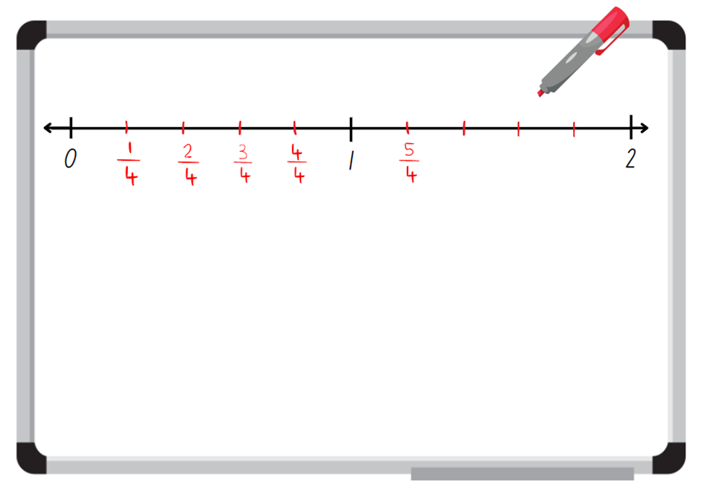
Activity 7 – number line 0-2
Notes:
This is a developing number sense activity.
Number sense refers to a deep understanding of numbers, including their magnitude, relationships, and the effects of operations on them. It supports fluency and understanding, estimation, flexible thinking, and efficient problem-solving. Number sense activities 1–4 ‘activate’ prior number knowledge and support the learning of new content in the unit. Number sense activities 5–8 ‘loop’ back and provide opportunity for spaced practice with concepts and procedures covered in previous units.
Syllabus focus area:
Partitioned fractions B
Display Resource 28 – Ollie’s misconceptions (this resource corresponds to Resource 28 – Ollie’s misconceptions in Stage 2, Year B Unit 39). Explain that a teacher asked their class to label a 0–2 number line with as many fractions as they could. Ollie completed the task however he made some mistakes.
Students think pair share to discuss what they notice. Ask students prompting questions from the table below to generate discussion.
Prompts
Anticipated student responses
What mistakes did Ollie make and why do you think he made them?
Ollie has incorrectly labelled the fractions as quarters rather than fifths. It looks like he was confused by the 4 equal-spaced marks that were recorded between the whole numbers.
Ollie wrote $\frac{5}{4}$ instead of $1\frac{1}{5}$ or $\frac{6}{5}$. Ollie may not realise how to rename five-fifths as one whole.
If you were the teacher, how would you explain and support Ollie to correct his mistakes?
Ollie may need help to identify fifths as fractional parts created when a number line is partitioned into 5 equal parts.
He may need help representing fractional quantities greater than one.
Ask students to correctly draw and label the 0–2 number line on their whiteboard.

Slide 53
Review of learning 8

Slide 54
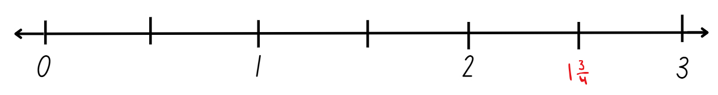
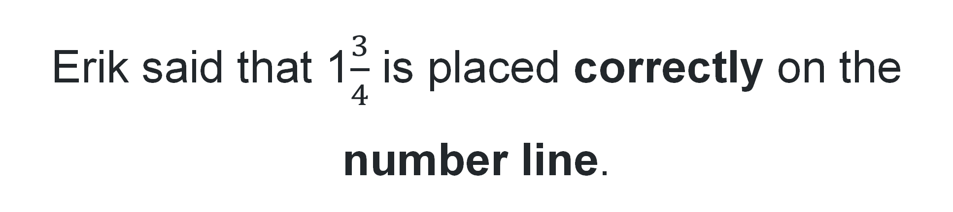
True or false (4)
Erik said that 1$\frac{3}{4}$ is placed correctly on the number line.
True | False
Notes:
This question connects to the content in the developing number sense activity (Activity 7)
Syllabus focus area:
Partitioned Fractions B

Slide 55
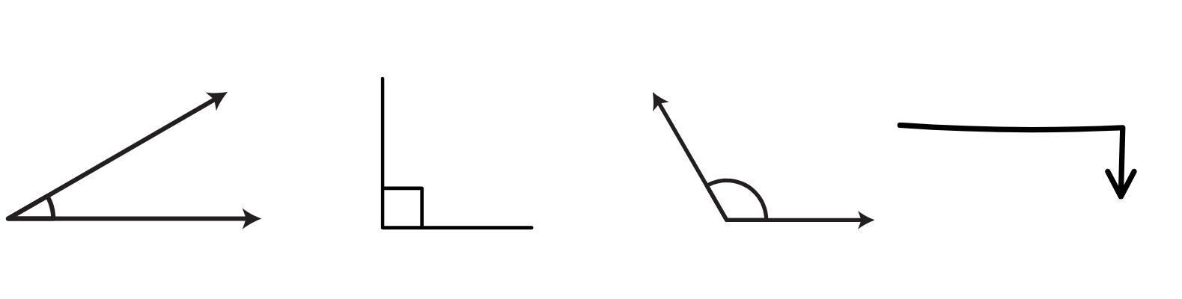
Short response (29)
Describe the following angles as less than, equal to, about the same as or greater than a right angle.
1.
2.
3.
4.
Notes:
Short response questions provide brisk paced questions focussing on review of current and previous content to support spaced and interleaved practice.
Syllabus focus area:
Geometric Measure B: Angles

Slide 56
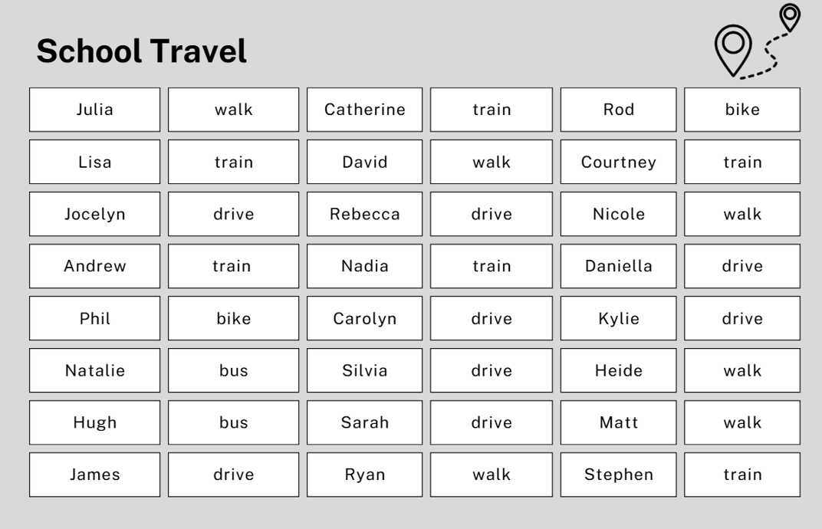
Short response (30)
Explain why this is not an efficient way to represent this data.
Notes:
Short response questions provide brisk paced questions focussing on review of current and previous content to support spaced and interleaved practice.
Syllabus focus area:
Data B

Slide 57
Short response (31)
Jo made a rectangular prism out of 72 centimetre cubes. It has a base of 8 centimetre cubes.
How many layers high is it?
Notes:
Short response questions provide brisk paced questions focussing on review of current and previous content to support spaced and interleaved practice.
Syllabus focus area:
Three-dimensional spatial structure B: Volume

Slide 58

Short response (32)
How many ways can you split this trapezium into other shapes?
Shape B
Notes:
Short response questions provide brisk paced questions focussing on review of current and previous content to support spaced and interleaved practice.
Syllabus focus area:
Two-dimensional spatial structure B: 2D shape

Slide 59
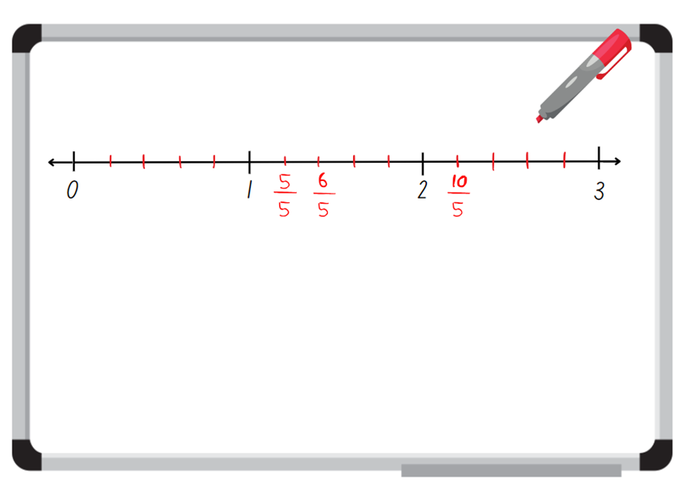
Activity 8 – number line 0-3
Notes:
This is a developing number sense activity.
Number sense refers to a deep understanding of numbers, including their magnitude, relationships, and the effects of operations on them. It supports fluency and understanding, estimation, flexible thinking, and efficient problem-solving. Number sense activities 1–4 ‘activate’ prior number knowledge and support the learning of new content in the unit. Number sense activities 5–8 ‘loop’ back and provide opportunity for spaced practice with concepts and procedures covered in previous units.
Syllabus focus area:
Partitioned fractions B
Display Resource 29 – Charlie’s misconceptions (this resource corresponds to Resource 29 – Charlie’s misconceptions in Stage 2, Year B Unit 39). Explain that Charlie labelled a 0–3 number line with as many fractions as she could but made some mistakes.
Prompt students to turn and talk to identify Charlie’s mistakes.
Ask students to record the correct way of labelling the 0–3 number line on an individual whiteboard.
Regroup and select students to correctly add their fractions to the 0–3 number line on the teacher board.
Students contribute and check their own work

Slide 60
Double Venn diagram
Object 1
Object 2
Features similar to both objects
Features of object 1
Features of object 2

Slide 61
Frayer
Definition
Facts/Characteristics
Word, term, concept
Examples
Non-examples

Slide 62
Spider map
Idea
Subject

Slide 63
Cline
Concept 1
Concept 2
Word
Word
Word
Word
Word
Word
Word
Word
Word
Word
Word

Slide 64

Compare and contrast
Notes:
Use the arrows to navigate between related activities.
Hyperlink each arrow to compare between related slides.

Slide 65
Multiple choice (5)
A
B
C
D
Notes:
This question connects to the content in the developing number sense activity (Activity 1)
This question can:
support spaced and interleaved practice
help identify and address common misconceptions
support active recall and immediate feedback
support whole class participation
identify areas requiring reteach
Teachers are encouraged to adapt and contextualise for their contexts.

Slide 66
Multiple choice (6)
A
B
C
D
Notes:
This question connects to the content in the developing number sense activity (Activity 1)
Syllabus focus area:
Multiplicative relations A
This question can:
support spaced and interleaved practice
help identify and address common misconceptions
support active recall and immediate feedback
support whole class participation
identify areas requiring reteach
Teachers are encouraged to adapt and contextualise for their contexts.

Slide 67
References (1)
This presentation contains NSW Curriculum and syllabus content. The NSW Curriculum is developed by the NSW Education Standards Authority. This content is prepared by NESA for and on behalf of the Crown in the right of the State of New South Wales. The material is protected by Crown copyright.
Please refer to the NESA Copyright Disclaimer for more information https://educationstandards.nsw.edu.au/wps/portal/nesa/mini-footer/copyright.
NESA holds the only official and up-to-date versions of the NSW Curriculum and syllabus documents. Please visit the NSW Education Standards Authority (NESA) website https://educationstandards.nsw.edu.au/wps/portal/nesa/home and the NSW Curriculum website https://curriculum.nsw.edu.au.
Mathematics K–10 Syllabus © NSW Education Standards Authority (NESA) for and on behalf of the Crown in right of the State of New South Wales, 2022.
National Numeracy Learning Progression © Australian Curriculum, Assessment and Reporting Authority (ACARA) 2010 to present, unless otherwise indicated. This material was downloaded from the Australian Curriculum website (National Numeracy Learning Progression) (accessed 20 May 2024) and was not modified.
Headout Inc (n.d.) Top 15 facts about the London Eye that you must know, London Tickets by Headout website, accessed 19 June 2024.
Kiddle.co (2024a) George Washington Gale Ferris Jr. facts for kids, Kiddle Encyclopedia website, accessed 19 June 2024.
(2024b) High Roller (Ferris wheel) facts for kids, Kiddle Encyclopedia website, accessed 19 June 2024.
(2024c) Luna Park Sydney facts for kids, Kiddle Encyclopedia website, accessed 19 June 2024.
(2024d) Melbourne Star facts for kids, Kiddle Encyclopedia website, accessed 19 June 2024.

Slide 68
References (2)(2)
This presentation contains NSW Curriculum and syllabus content. The NSW Curriculum is developed by the NSW Education Standards Authority. This content is prepared by NESA for and on behalf of the Crown in the right of the State of New South Wales. The material is protected by Crown copyright.
Please refer to the NESA Copyright Disclaimer for more information https://educationstandards.nsw.edu.au/wps/portal/nesa/mini-footer/copyright.
NESA holds the only official and up-to-date versions of the NSW Curriculum and syllabus documents. Please visit the NSW Education Standards Authority (NESA) website https://educationstandards.nsw.edu.au/wps/portal/nesa/home and the NSW Curriculum website https://curriculum.nsw.edu.au.
(2024e) Singapore Flyer facts for kids, Kiddle Encyclopedia website, accessed 19 June 2024.
Oxford University Press (2024) Oxford Learner’s Dictionaries, Oxford Learner's Dictionaries website, accessed 20 May 2024.
Sunrise-Sunset (2014–2024) Sunset and Sunrise times, Sunrise Sunset website, accessed 20 May 2024.
The Math Learning Center (2024) Pattern shapes, Math Learning Center website, accessed 20 May 2024.
Toy Theater (2001–2024) ‘Interactive Clock’, Time manipulatives, Toy Theater website, accessed 20 May 2024.
Travel China Guide (1998-2024) Tianjin Eye (Tientsin Eye), Travel China Guide website, accessed 19 June 2024
University of Cambridge (n.d.) Tessellating Transformations, NRICH website, accessed 20 May 2024.
Van de Walle J, Karp K, Bay-Williams JM, Brass A, Bentley B, Ferguson S, Goff W, Livy S, Marshman M, Martin D, Pearn C, Prodromou T, Symons D and Wilkie K (2019) Primary and Middle Years Mathematics: Teaching Developmentally, 1st Australian edn, Pearson Education Australia, Melbourne.

Slide 69
Copyright
© State of New South Wales (Department of Education), 2024
The copyright material published in this resource is subject to the Copyright Act 1968 (Cth) and is owned by the NSW Department of Education or, where indicated, by a party other than the NSW Department of Education (third-party material).
Copyright material available in this resource and owned by the NSW Department of Education is licensed under a Creative Commons Attribution 4.0 International (CC BY 4.0) license.
This license allows you to share and adapt the material for any purpose, even commercially.
Attribution should be given to © State of New South Wales (Department of Education), 2024.
Material in this resource not available under a Creative Commons license:
the NSW Department of Education logo, other logos and trademark-protected material
Material owned by a third party that has been reproduced with permission. You will need to obtain permission from the third party to reuse its material.
Links to third-party material and websites
Please note that the provided (reading/viewing material/list/links/texts) are a suggestion only and implies no endorsement, by the New South Wales Department of Education, of any author, publisher, or book title. School principals and teachers are best placed to assess the suitability of resources that would complement the curriculum and reflect the needs and interests of their students.
If you use the links provided in this document to access a third party’s website, you acknowledge that the terms of use, including licence terms set out on the third-party’s website apply to the use which may be made of the materials on that third-party website or where permitted by the Copyright Act 1968 (Cth). The department accepts no responsibility for content on third-party websites.

