Slide 1
Instructions for use
This resource aligns to the learning in Stage 2 Year B Unit 40 and revisits content from earlier sample units.
Classroom teachers are encouraged to add, edit and adapt to meet the needs of their students.
Save a copy of the file to make changes to the slide deck. Go to File > Download a Copy (this downloads a copy to the computer to edit in the PowerPoint app).
To convert the PowerPoint to Google Slides:
  Upload the file into Google Drive and open it.
  Go to File > Save as Google Slides.
  (Note – conversion may cause formatting changes in the slides.)

Slide 2

Review of Learning
Mathematics Stage 2 – Unit 40
Notes:
Reviews may include a combination of question types, requiring students to recall facts and key ideas, as well as apply their knowledge to solve problems and answer questions. To support active engagement, a mix of techniques should be employed.” (AERO, 2024).
This Review of Learning slide deck revisits key concepts from the following units:
Stage 2 Year B Unit 40
Stage 2 Year B Unit 39
Stage 2 Year B Unit 38
It also includes opportunities to review prior learning in non-number content, supporting consolidation across focus areas.
The review of learning resources include three key task types that support the development of mathematical proficiency through retrieval, spaced practice, and active participation. These practices complement the review phase (activating prior knowledge) embedded within the beginning of each lesson.
1.
Multiple-choice questions/True or false: Designed to promote active retrieval of key concepts and identify common misconceptions in number, supporting consolidation, understanding and fluency.
These questions:
support spaced and interleaved practice
help identify and address common misconceptions
support active recall and immediate feedback
support whole class participation
identify areas requiring reteach
2.
Short-response question sets: Carefully grouped questions that encourage spaced and interleaved practice across multiple focus areas, helping students revisit and apply knowledge from different points in time.
These questions:
have a combination of question types
address a range of focus areas
build automaticity and fluency
support active recall
allow for immediate feedback
identify content requiring reteach
3.
Developing number sense activities: A variety of practical, purposeful tasks that reinforce current learning and build on prior knowledge. These activities promote reasoning, problem-solving and conceptual understanding.
The review of learning resources are designed to work support teaching and learning in mathematics. For the most effective implementation, use the resources flexibly, adapting to meet student learning needs and individual classroom contexts.

Slide 3
Lessons
1
Review of learning 1
5
Review of learning 5
2
Review of learning 2
6
Review of learning 6
3
Review of learning 3
7
Review of learning 7
4
Review of learning 4
8
Review of learning 8
Notes:
Teacher notes:
Click lesson numbers to go to specific lessons
Interactive features can be viewed in slide show

Slide 4
Review of learning 1

Slide 5

Multiple choice (1)
Which answer shows the correct number sentence? Communicate your thinking.
A
249 + 368 = 500 + 100 + 17
B
249 + 368 = 200 + 300 + 40 + 60 + 9 + 8
C
249 +368 = 7 + 10 + 100 + 500
D
368 + 249 = 300 + 200 + 68 + 49
Notes:
This question connects to the content in the developing number sense activity (Activity 1)
Syllabus focus area:
Additive relations B

Slide 6

Short response (1)
Partition and record the following number using non-standard form.
57 403
Notes:
Short response questions provide brisk paced questions focussing on review of current and previous content to support spaced and interleaved practice.
Syllabus focus area:
Representing numbers using place value B

Slide 7
Short response (2)
Record 3 situations where the duration would be measured in seconds.
Notes:
Short response questions provide brisk paced questions focussing on review of current and previous content to support spaced and interleaved practice.
Syllabus focus area:
Non-spatial measure B

Slide 8
Short response (3)
Write a question you could ask to collect data from your class.
For example: What is your favourite animal?
Notes:
Short response questions provide brisk paced questions focussing on review of current and previous content to support spaced and interleaved practice.
Syllabus focus area:
Data A

Slide 9
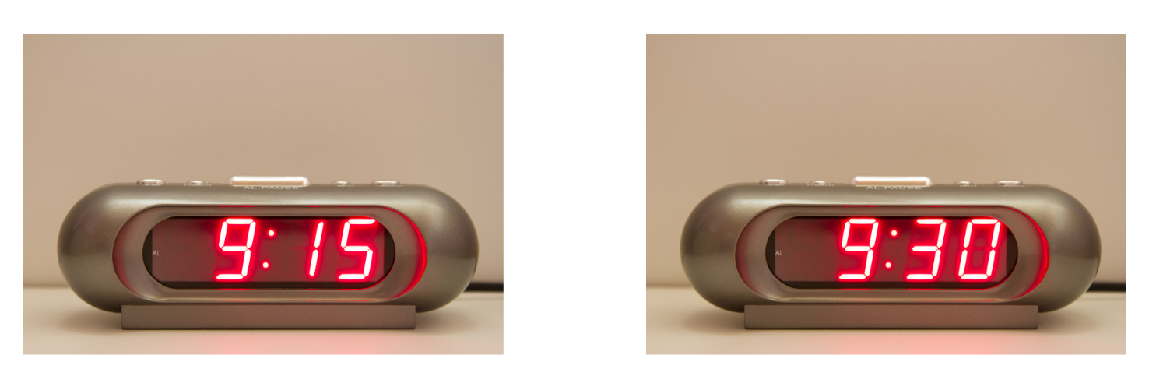
Short response (4)
Read the following times.
Notes:
Short response questions provide brisk paced questions focussing on review of current and previous content to support spaced and interleaved practice.
Syllabus focus area:
Non-spatial measure B

Slide 10

Activity 1 – efficient strategies for addition.
Choose two strategies to solve 249 + 368?
Communicate your thinking.
Notes:
This is a developing number sense activity.
Number sense refers to a deep understanding of numbers, including their magnitude, relationships, and the effects of operations on them. It supports fluency and understanding, estimation, flexible thinking, and efficient problem-solving. Number sense activities 1–4 ‘activate’ prior number knowledge and support the learning of new content in the unit. Number sense activities 5–8 ‘loop’ back and provide opportunity for spaced practice with concepts and procedures covered in previous units.
Syllabus focus area: Additive relations B
This resource corresponds to Resource 29 – efficient strategies for addition in Stage 2 Year B Unit 40.
Display Resource 29 – efficient strategies for addition and ask: What are some strategies we could use to find the answer?
Prompt students to share their thinking and display the strategies.
Students solve the number sentence in 2 ways, recording an algorithm and one other strategy on an individual whiteboard. For example, a flexible strategy might be 250 + 350 + 17.
In pairs, students explain their strategies and reason about the efficiency of each.
Regroup to share and record various strategies on the board. Name each strategy and reflect on the efficiency for solving the additive example.

Slide 11
Review of learning 2

Slide 12
True or false (1)
An algorithm is the most efficient strategy to solve:
873 – 73
True |  | False
Communicate your thinking.
Notes:
The question on this slide connects to the content being explored in the developing number sense activity (Activity 2)
Syllabus focus area:
Additive relations B

Slide 13
Short response (5)
Partition and record the following number using non-standard form.
75 301
Notes:
Short response questions provide brisk paced questions focussing on review of current and previous content to support spaced and interleaved practice.
Syllabus focus area:
Representing numbers using place value B

Slide 14
Short response (6)
Lachlan must be home by 8:00pm. How much time does he have to get home?
6:36 pm
Notes:
Short response questions provide brisk paced questions focussing on review of current and previous content to support spaced and interleaved practice.
Syllabus focus area:
Non-spatial measure B

Slide 15
Short response (7)
.
List some ways that data can be collected?
Notes:
Short response questions provide brisk paced questions focussing on review of current and previous content to support spaced and interleaved practice.
Syllabus focus area:
Data A

Slide 16
Short response (8)
What strategies could be used to estimate the area of this rectangle in square centimetres?
Record your thinking.
Notes:
Short response questions provide brisk paced questions focussing on review of current and previous content to support spaced and interleaved practice.
Syllabus focus area:
Two-dimensional spatial structure A: Area

Slide 17
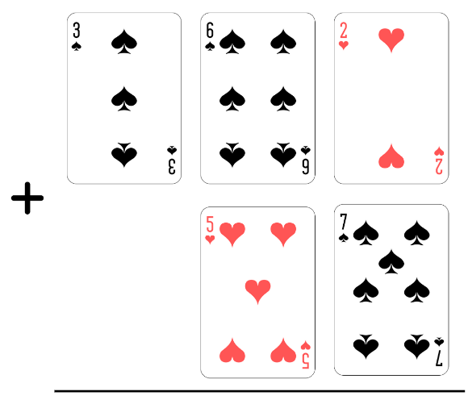
Activity 2 – 3-digit algorithms
Notes:
This is a developing number sense activity.
Number sense refers to a deep understanding of numbers, including their magnitude, relationships, and the effects of operations on them. It supports fluency and understanding, estimation, flexible thinking, and efficient problem-solving. Number sense activities 1–4 ‘activate’ prior number knowledge and support the learning of new content in the unit. Number sense activities 5–8 ‘loop’ back and provide opportunity for spaced practice with concepts and procedures covered in previous units.
Syllabus focus area: Additive relations B
This resource corresponds to Resource 30- addition algorithms in Stage 2 Year B Unit 40.
Provide pairs of students with their workbooks and a deck of playing cards with the tens and picture cards removed.
Display Resource 30 – addition algorithms and explain how to play:
Shuffle the cards and deal 5 cards to each player.
Players arrange the cards to form a 3-digit plus 2-digit algorithm.
Each player records and solves the algorithm in their workbook.
The largest sum recorded wins.
Once each pair has completed 2 addition algorithms, students then create, record and solve subtraction algorithms. The smallest difference of the recorded algorithms wins.

Slide 18
Review of learning 3

Slide 19
Multiple choice (2)
745 - ___ = 227
The missing number is:
525
518
508
962
A B C D
Notes:
Syllabus focus area:
Additive relations B
This resource corresponds to Resource 31- missing digit algorithm in Stage 2 Year B Unit 40.
Refer to the prompt table in Stage 2 Year B Unit 40 for questions and anticipated student responses.

Slide 20
Short response (9)
Copy the number line.
Order and record as decimals on the line: 14 tenths
12 tenths
18 tenths
0 1 2
Notes:
Short response questions provide brisk paced questions focussing on review of current and previous content to support spaced and interleaved practice.
Syllabus focus area:
Representing numbers using place value B

Slide 21
Short response (10)
At which time would you eat breakfast?
7:00 am or 7:00 pm
What time would you eat lunch?
12:00 am or 12:00 pm
Notes:
Short response questions provide brisk paced questions focussing on review of current and previous content to support spaced and interleaved practice.
Syllabus focus area:
Non-spatial measure B

Slide 22
Short response (11)
Data was collected from 60 students about their favourite ice cream flavour.
Chocolate swirl | 24
Strawberry dream | 21
Sweet caramel | 12
Vanilla Surprise | 3
Represent this data using a column graph.
Notes:
Short response questions provide brisk paced questions focussing on review of current and previous content to support spaced and interleaved practice.
Syllabus focus area:
Data A

Slide 23
Short response (12)
Sketch a rectangular prism to show its depth.
Notes:
Short response questions provide brisk paced questions focussing on review of current and previous content to support spaced and interleaved practice.
Syllabus focus area:
Three-dimensional spatial structure B: volume

Slide 24
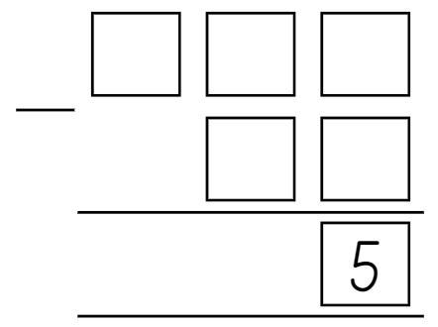
Activity 3 – missing digit subtraction 1
Notes:
This is a developing number sense activity.
Number sense refers to a deep understanding of numbers, including their magnitude, relationships, and the effects of operations on them. It supports fluency and understanding, estimation, flexible thinking, and efficient problem-solving. Number sense activities 1–4 ‘activate’ prior number knowledge and support the learning of new content in the unit. Number sense activities 5–8 ‘loop’ back and provide opportunity for spaced practice with concepts and procedures covered in previous units.
Syllabus focus area:
Additive relations B
This resource corresponds to Resource 31- missing digit subtraction algorithm in Stage 2 Year B Unit 40.
Display Resource 31 – missing digits subtraction algorithm.
Explain that students will try to find the possible missing 2-digit and 3-digit numbers to make the subtraction equation true.
Students consider the possible missing 2-digit and 3-digit numbers. They record their solutions on individual whiteboards.
Regroup and prompt students to share their solutions and explain their reasoning.

Slide 25
Review of learning 4

Slide 26
True or false (2)
731 – ___ = 209
The missing number is 508.
True | False
Notes:
The question on this slide connects to the content being explored in the developing number sense activity (Activity 4)
Syllabus focus area:
Additive relations B

Slide 27
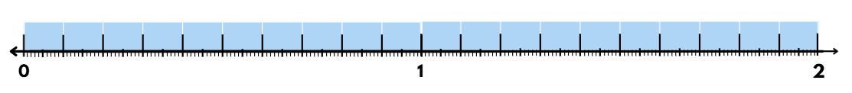

Short response (13))
Draw a number line and record the missing fractions and decimals for A, B and C.
$\frac{1}{2}$ 1 C __
A __ B __ 1.5
Notes:
Short response questions provide brisk paced questions focussing on review of current and previous content to support spaced and interleaved practice.
Syllabus focus area:
Representing numbers using place value B

Slide 28
Short response (14))
Copy the hexagon.
Divide it into two or more different shapes.
Label the shapes.
Notes:
Short response questions provide brisk paced questions focussing on review of current and previous content to support spaced and interleaved practice.
Syllabus focus area:
Two-dimensional spatial structure B

Slide 29
Short response (15)
Write a definition for the words:
outcome
chance
trial
Notes:
Short response questions provide brisk paced questions focussing on review of current and previous content to support spaced and interleaved practice.
Syllabus focus area:
Chance A

Slide 30

Short response (16)
Create and record a tessellating design by reflecting, translating and rotating the triangle.
Notes:
Short response questions provide brisk paced questions focussing on review of current and previous content to support spaced and interleaved practice.
Syllabus focus area:
Two-dimensional spatial structure B: 2DS Shapes

Slide 31
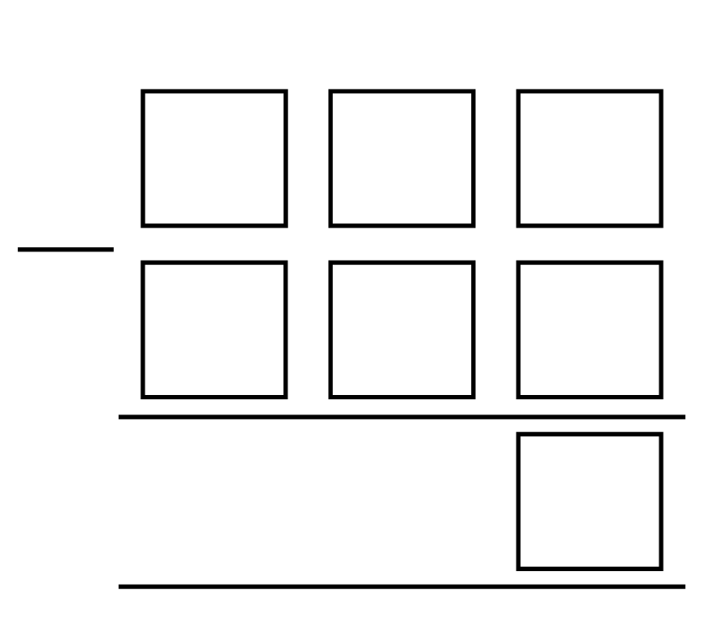
Activity 4 – missing digits subtraction
Notes:
This is a developing number sense activity.
Number sense refers to a deep understanding of numbers, including their magnitude, relationships, and the effects of operations on them. It supports fluency and understanding, estimation, flexible thinking, and efficient problem-solving. Number sense activities 1–4 ‘activate’ prior number knowledge and support the learning of new content in the unit. Number sense activities 5–8 ‘loop’ back and provide opportunity for spaced practice with concepts and procedures covered in previous units.
Syllabus focus area: Additive relations B
This resource corresponds to Resource 32- missing digit subtraction algorithm in Stage 2 Year B Unit 40.
Display Resource 32 – more missing digits subtraction algorithm. Choose a one-digit number to write in the single box in the third row as the answer.
Explain that the goal of the activity is to find the possible missing numbers to make the subtraction algorithm true.
Students consider the possible missing 3-digit numbers. They record their solutions on individual whiteboards.
Regroup and prompt students to share their solutions and explain their reasoning.

Slide 32
Review of learning 5

Slide 33
Multiple choice (3)
Find the correct related facts.
A | B | C | D
4 X 7 = 28 7 x 4 = 28 28 - 7 = 4 28 = 4 x 7 | 4 x 7 = 24 24 = 4 x 7 24 = 7 x 4 7 x 4 = 24 | 28 ÷ 7 = 4 4 x 7 = 28 28 ÷ 4 = 7 7 x 4 = 28 | 12 + 12 =24 12 x 2 = 24 24 ÷ 12 = 2 24 ÷ 2 = 12
Notes:
This question connects to the content in the developing number sense activity (Activity 5)
Syllabus focus area:
Multiplicative relations A

Slide 34
Short response (17)
Solve this problem using the most efficient strategy.
Communicate your thinking.
127 + 55 + 63 =
Notes:
Short response questions provide brisk paced questions focussing on review of current and previous content to support spaced and interleaved practice.
Syllabus focus area:
Additive relations A

Slide 35
Short response (18)
Copy the parallelogram, then draw its reflection.
Notes:
Short response questions provide brisk paced questions focussing on review of current and previous content to support spaced and interleaved practice.
Syllabus focus area:
Two-dimensional spatial structure B

Slide 36
Short response (19)
If you roll a 10-sided dice, what is the chance you will roll a 10?
If you have 2 dice, what is the chance you will roll two 10s?
Notes:
Short response questions provide brisk paced questions focussing on review of current and previous content to support spaced and interleaved practice.
Syllabus focus area:
Chance A

Slide 37
Short response (20)
In a collection of 15 green counters and 35 red counters, what is the chance of choosing a red counter?
Notes:
Short response questions provide brisk paced questions focussing on review of current and previous content to support spaced and interleaved practice.
Syllabus focus area:
Chance B

Slide 38
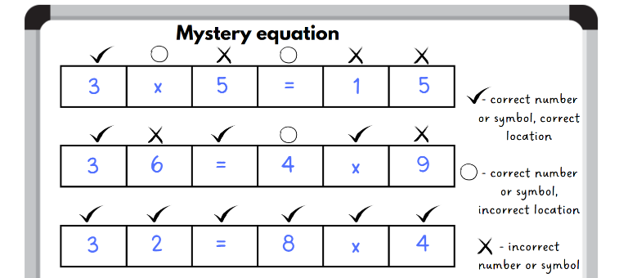
Activity 5 – mystery equations 1
Notes:
This is a developing number sense activity.
Number sense refers to a deep understanding of numbers, including their magnitude, relationships, and the effects of operations on them. It supports fluency and understanding, estimation, flexible thinking, and efficient problem-solving. Number sense activities 1–4 ‘activate’ prior number knowledge and support the learning of new content in the unit. Number sense activities 5–8 ‘loop’ back and provide opportunity for spaced practice with concepts and procedures covered in previous units.
Syllabus focus area:
Multiplicative relations B
This resource corresponds to Resource 33- mystery equation examples in Stage 2 Year B Unit 40.
1. Display Resource 33 – mystery equation examples. Explain that students will be playing ‘Mystery equation’ using multiplication (×) and division (÷), in pairs.
2. Review the instructions:
a. Prepare the playing board by drawing 6 boxes on an individual whiteboard.
b. Student A secretly writes a multiplication or division equation with 6 elements to fit in the boxes.
c. Student B guesses what the equation may be by writing each element in the boxes.
d. Student A places a tick above any numbers or symbols that are correct in the correct place, an ‘o’ above any correct numbers or symbols in the wrong place and an ‘x’ above any incorrect numbers or symbols.
e. Student B continues to guess until the correct equation is discovered.
f. Repeat this process, swapping roles.
3. In pairs, students play ‘Mystery equation’ using multiplication (×) and division (÷).
4. Regroup and discuss how students’ knowledge of multiplication facts was helpful when playing the game.
5. Ask students to share any other strategies they used in the game.

Slide 39
Review of learning 6

Slide 40
True or false (3)
A number ending in zero is always a multiple of 10.
True | False
Communicate your reasoning.
Notes:
Syllabus focus area:
Multiplicative relations A

Slide 41
Short response (21)
Shania has $20.00 to buy her lunch. She wants a pie, a chocolate milk and an orange. How much did Shania spend? How much change will she get?
Pies $5.50
Sausage rolls $4.50
Flavoured milk $3.00
All fruit 80c
Yoghurt $2.50
Notes:
Short response questions provide brisk paced questions focussing on review of current and previous content to support spaced and interleaved practice.
Syllabus focus area:
Additive relations B

Slide 42

Short response (22)
Draw an angle that could be created by the open door and label the arms and the vertex.
Notes:
Short response questions provide brisk paced questions focussing on review of current and previous content to support spaced and interleaved practice.
Syllabus focus area:
Geometric measure B

Slide 43
Short response (23)
Write an event that:
is likely to happen today.
is unlikely to happen today.
Notes:
Short response questions provide brisk paced questions focussing on review of current and previous content to support spaced and interleaved practice.
Syllabus focus area:
Chance B

Slide 44
Short response (24)
Draw the top view of a cube.
Notes:
Short response questions provide brisk paced questions focussing on review of current and previous content to support spaced and interleaved practice.
Syllabus focus area:
Three-dimensional spatial structure B: 3DS Objects

Slide 45
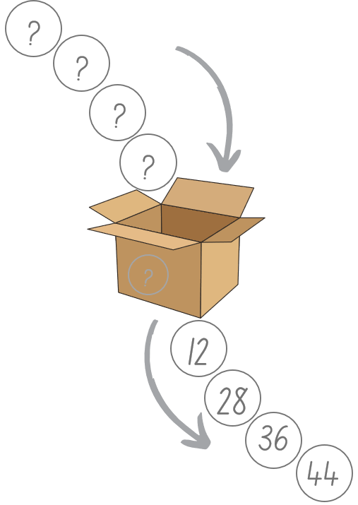
Activity 6 – find the numbers
Notes:
This is a developing number sense activity.
Number sense refers to a deep understanding of numbers, including their magnitude, relationships, and the effects of operations on them. It supports fluency and understanding, estimation, flexible thinking, and efficient problem-solving. Number sense activities 1–4 ‘activate’ prior number knowledge and support the learning of new content in the unit. Number sense activities 5–8 ‘loop’ back and provide opportunity for spaced practice with concepts and procedures covered in previous units.
Syllabus focus area:
Multiplicative relations B
This resource corresponds to Resource 34- find the numbers in Stage 2 Year B Unit 40.
Display Resource 34 – find the numbers and pose the scenario: I placed 4 numbers into a box. This box multiplied these numbers by a secret number and 4 new numbers came out. The new numbers that came out were 12, 28, 36 and 44. What 4 numbers did I place in the box to begin with? What is the secret number in the box that is multiplying to make 4 new numbers?
Students think-pair-share how they would solve this problem.
Ask:
What secret number multiplication happened inside the box to get the answers in the picture above? (2 or 4)
Is there more than one possibility for the secret number inside the box? How do you know? (Yes, the secret number could be 2 or 4.)
Can you identify 4 more numbers to go into the box and determine what would come out?
How can you check your answer using division?
Can you generate a fact family triangle for each of the numbers? Can you give an example of this?
In pairs, students choose their own set of 4 numbers that will be placed in the box, along with a secret number. They swap with another pair to solve the problem.

Slide 46
Review of learning 7

Slide 47
Multiple choice (4)
Which facts match the fact family?
A | B | C | D
24 ÷ 4 = 24 4 ÷ 24 = 6 6 x 4 = 24 4 x 24 = 6 | 6 ÷ 4 = 24 4 x 6 = 24 4 ÷ 24 = 6 24 ÷ 6 = 4 | 6 + 4 = 24 24 - 6 = 4 4 x 6 = 24 6 x 4 = 24 | 6 x 4 = 24 24 ÷ 4 = 6 4 x 6 = 24 24 ÷ 6 = 4
24
6
4
Notes:
This question connects to the content in the developing number sense activity (Activity 7)
Syllabus focus area:
Multiplicative relations A

Slide 48
Short response (25)
Use your knowledge of multiples of 10 to solve:
70 x 4
Communicate your thinking
Notes:
Short response questions provide brisk paced questions focussing on review of current and previous content to support spaced and interleaved practice.
Syllabus focus area:
Multiplicative relations B

Slide 49
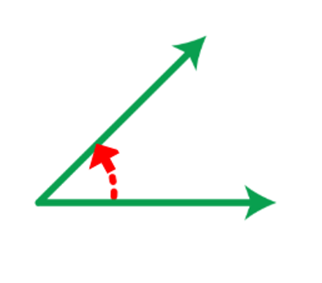
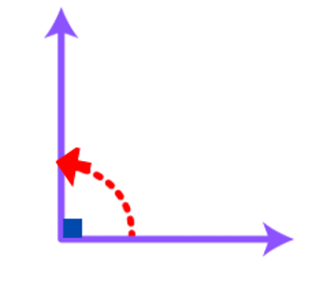
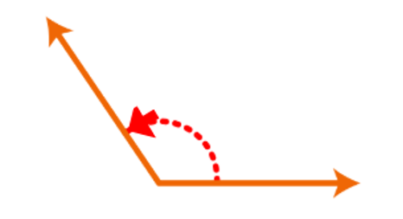
Short response (26)
For each angle, decide if it is less than, equal to, about the same as, or greater than a right angle.
A
B
C
Notes:
Short response questions provide brisk paced questions focussing on review of current and previous content to support spaced and interleaved practice.
Syllabus focus area:
Geometric measure B

Slide 50
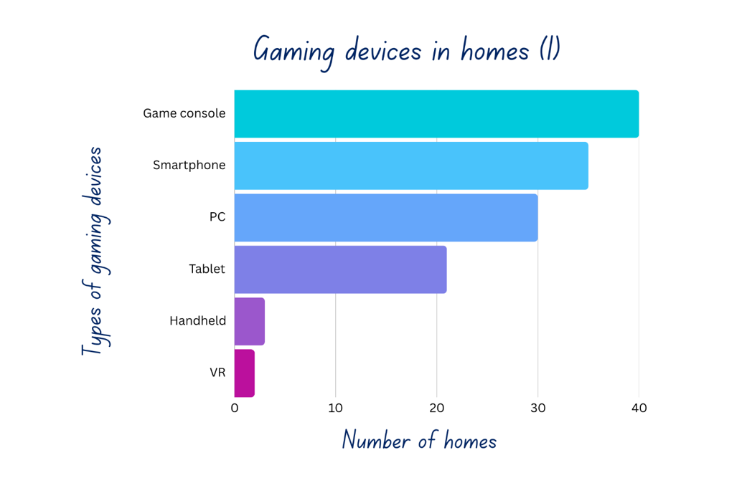
Short response (29)
Create a list or table to organise the data.
Notes:
Short response questions provide brisk paced questions focussing on review of current and previous content to support spaced and interleaved practice.
Syllabus focus area:
Data A

Slide 51
Short response (30)
Record 5 items that have right angles that you can see in the classroom.
Notes:
Short response questions provide brisk paced questions focussing on review of current and previous content to support spaced and interleaved practice.
Syllabus focus area:
Geometric measure B: Angles

Slide 52
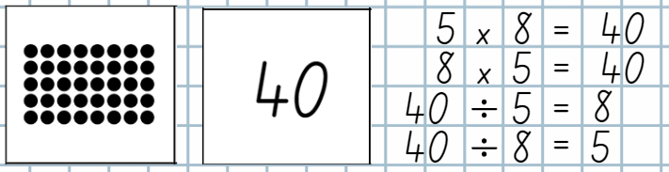
Activity 7 – array fact families
Notes:
This is a developing number sense activity.
Number sense refers to a deep understanding of numbers, including their magnitude, relationships, and the effects of operations on them. It supports fluency and understanding, estimation, flexible thinking, and efficient problem-solving. Number sense activities 1–4 ‘activate’ prior number knowledge and support the learning of new content in the unit. Number sense activities 5–8 ‘loop’ back and provide opportunity for spaced practice with concepts and procedures covered in previous units.
Syllabus focus area:
Multiplicative relations B
This resource corresponds to Resource 36 – product worked example in Stage 2 Year B Unit 40.
Provide pairs of students with Resource 35 – arrays and products, scissors, glue and a piece of paper. They cut out the arrays and number cards.
Display Resource 36 – product worked example and revise that arrays link to multiplication and division fact families.
Students use Resource 35 – arrays and products to match each array with its product. They glue it onto paper, recording the multiplication and division number sentences linked to each.
After recording an array, its product and its multiplication and division number sentences, students take turns to describe each of the arrays. For example, 5 rows of 8 is 40, 8 columns of 5 is 40, 40 shared into 5 rows is 8 and 40 shared into 8 columns is 5.

Slide 53
Review of learning 8

Slide 54
True or false (4)
Fact families help us recall number facts quickly. They show the inverse relationship between multiplication and division.
32
8
4
True | False
Notes:
Syllabus focus area:
Multiplicative relations A

Slide 55
Short response (31)
48 students are arranged into teams with the same number in each.
How many teams are there and how many students might be in each?
Notes:
Short response questions provide brisk paced questions focussing on review of current and previous content to support spaced and interleaved practice.
Syllabus focus area:
Multiplicative relations B

Slide 56

Short response (32)
How many angles are there are in a single door in your classroom?
Communicate your reasoning.
Notes:
Short response questions provide brisk paced questions focussing on review of current and previous content to support spaced and interleaved practice.
Syllabus focus area:
Geometric measure B

Slide 57
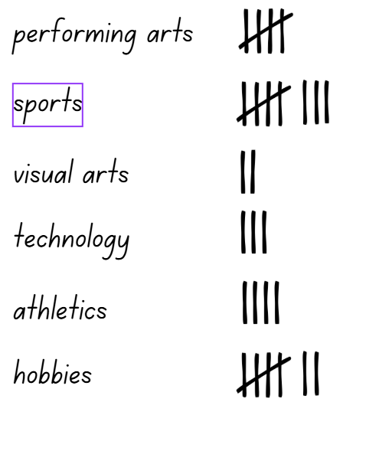
Short response (33)
Use the tally marks to about to create a dot plot.
Notes:
Short response questions provide brisk paced questions focussing on review of current and previous content to support spaced and interleaved practice.
Syllabus focus area:
Data A

Slide 58
Short response (34)
John said the time was quarter past 10. How many minutes is that past 10?
Shape B
Sandreen said the time was quarter to 10. How many minutes is that before 10?
Notes:
Short response questions provide brisk paced questions focussing on review of current and previous content to support spaced and interleaved practice.
Syllabus focus area:
Non-spatial measure A: Time

Slide 59
Activity 8 – mystery equations 2
Notes:
This is a developing number sense activity.
Number sense refers to a deep understanding of numbers, including their magnitude, relationships, and the effects of operations on them. It supports fluency and understanding, estimation, flexible thinking, and efficient problem-solving. Number sense activities 1–4 ‘activate’ prior number knowledge and support the learning of new content in the unit. Number sense activities 5–8 ‘loop’ back and provide opportunity for spaced practice with concepts and procedures covered in previous units.
Syllabus focus area:
Multiplicative relations B
This resource corresponds to Resource 33 – mystery equation examples in Stage 2 Year B Unit 40.
Display Resource 33– mystery equation examples. Explain that students will be playing ‘Mystery equation’ using multiplication (×) and division (÷), in pairs.
Revise the instructions:
Prepare the playing board by drawing 6 boxes on an individual whiteboard.
Student A secretly writes a multiplication or division equation with 6 elements to fit in the boxes.
Student B guesses what the equation may be by writing each element in the boxes.
Student A places a tick above any numbers or symbols that are correct in the correct place, an ‘o’ above any correct numbers or symbols in the wrong place and an ‘x’ above any incorrect numbers or symbols.
Student B continues to guess until the correct equation is discovered.
Repeat this process, swapping roles.
Ask students to share any strategies they used when they played the game previously. Record the strategies and encourage students to use a new strategy when playing the game.
In pairs, students play ‘Mystery equation’ using multiplication (×) and division (÷).
Regroup and discuss how students’ knowledge of multiplication facts and use of strategies was helpful when playing the game.

Slide 60
Double Venn diagram
Object 1
Object 2
Features similar to both objects
Features of object 1
Features of object 2

Slide 61
Frayer
Definition
Facts/Characteristics
Word, term, concept
Examples
Non-examples

Slide 62
Spider map
Idea
Subject

Slide 63
Cline
Concept 1
Concept 2
Word
Word
Word
Word
Word
Word
Word
Word
Word
Word
Word

Slide 64

Compare and contrast
Notes:
Use the arrows to navigate between related activities.
Hyperlink each arrow to compare between related slides.

Slide 65
Multiple choice (1)
A
B
C
D
Notes:
This question connects to the content in the developing number sense activity (Activity 1)
This question can:
support spaced and interleaved practice
help identify and address common misconceptions
support active recall and immediate feedback
support whole class participation
identify areas requiring reteach
Teachers are encouraged to adapt and contextualise for their contexts.

Slide 66
Multiple choice (1)
A
B
C
D
Notes:
This question connects to the content in the developing number sense activity (Activity 1)
Syllabus focus area:
Multiplicative relations A
This question can:
support spaced and interleaved practice
help identify and address common misconceptions
support active recall and immediate feedback
support whole class participation
identify areas requiring reteach
Teachers are encouraged to adapt and contextualise for their contexts.

Slide 67
References
This presentation contains NSW Curriculum and syllabus content. The NSW Curriculum is developed by the NSW Education Standards Authority. This content is prepared by NESA for and on behalf of the Crown in the right of the State of New South Wales. The material is protected by Crown copyright.
Please refer to the NESA Copyright Disclaimer for more information https://educationstandards.nsw.edu.au/wps/portal/nesa/mini-footer/copyright.
NESA holds the only official and up-to-date versions of the NSW Curriculum and syllabus documents. Please visit the NSW Education Standards Authority (NESA) website https://educationstandards.nsw.edu.au/wps/portal/nesa/home and the NSW Curriculum website https://curriculum.nsw.edu.au.
Mathematics K–10 Syllabus © NSW Education Standards Authority (NESA) for and on behalf of the Crown in right of the State of New South Wales, 2022.
Numeracy-learning-progression.pdf © Australian Curriculum, Assessment and Reporting Authority (ACARA) 2010 to present, unless otherwise indicated. This material was downloaded from the Australian Curriculum website (National Literacy Learning Progression) (accessed 7 August 2025 and was not modified.
Barton C (2019) Volume of a cuboid 1, Maths Venns Website, accessed 8 April 2024.
NESA (NSW Education Standards Authority) (2024) ‘Teaching advice for Three-dimensional spatial structure A’, Stage 3, NESA website, accessed 30 May 2024.
State of New South Wales (Department of Education) (2023) ‘Factors fun’, Mathematics K–6 resources, NSW Department of Education website, accessed 3 April 2024.

Slide 68
References
This presentation contains NSW Curriculum and syllabus content. The NSW Curriculum is developed by the NSW Education Standards Authority. This content is prepared by NESA for and on behalf of the Crown in the right of the State of New South Wales. The material is protected by Crown copyright.
Please refer to the NESA Copyright Disclaimer for more information https://educationstandards.nsw.edu.au/wps/portal/nesa/mini-footer/copyright.
NESA holds the only official and up-to-date versions of the NSW Curriculum and syllabus documents. Please visit the NSW Education Standards Authority (NESA) website https://educationstandards.nsw.edu.au/wps/portal/nesa/home and the NSW Curriculum website https://curriculum.nsw.edu.au.
Sullivan P (2018) Challenging Mathematical Tasks, Oxford University Press Australia and New Zealand.
University of Cambridge (n.d.a) Area and Perimeter, NRICH website, accessed 4 April 2024.
——(n.d.b) Factor-multiple Chains, NRICH website, accessed 4 April 2024.
——(n.d.c) Rod Area, NRICH website, accessed 4 April 2024.
——(n.d.d) Route Product, NRICH website, accessed 4 April 2024.

Slide 69
Copyright
© State of New South Wales (Department of Education), 2025
The copyright material published in this resource is subject to the Copyright Act 1968 (Cth) and is owned by the NSW Department of Education or, where indicated, by a party other than the NSW Department of Education (third-party material).
Copyright material available in this resource and owned by the NSW Department of Education is licensed under a Creative Commons Attribution 4.0 International (CC BY 4.0) license.
This license allows you to share and adapt the material for any purpose, even commercially.
Attribution should be given to © State of New South Wales (Department of Education), 2025.
Material in this resource not available under a Creative Commons license:
the NSW Department of Education logo, other logos and trademark-protected material
Material owned by a third party that has been reproduced with permission. You will need to obtain permission from the third party to reuse its material.
Links to third-party material and websites
Please note that the provided (reading/viewing material/list/links/texts) are a suggestion only and implies no endorsement, by the New South Wales Department of Education, of any author, publisher, or book title. School principals and teachers are best placed to assess the suitability of resources that would complement the curriculum and reflect the needs and interests of their students.
If you use the links provided in this document to access a third party’s website, you acknowledge that the terms of use, including licence terms set out on the third-party’s website apply to the use which may be made of the materials on that third-party website or where permitted by the Copyright Act 1968 (Cth). The department accepts no responsibility for content on third-party websites.

