Slide 1
Instructions for use
Review of learning
This resource aligns to the learning in Stage 3 Year A Unit 1 and revisits content from earlier sample units.
Classroom teachers are encouraged to add, edit and adapt to meet the needs of their students.
Save a copy of the file to make changes to the slide deck. Go to File > Download a Copy (this downloads a copy to the computer to edit in the PowerPoint app).
To convert the PowerPoint to Google Slides:
  Upload the file into Google Drive and open it.
  Go to File > Save as Google Slides.
  (Note – conversion may cause formatting changes in the slides.)

Slide 2

Review of Learning
Mathematics Stage 3 – Unit 1
Notes:
Reviews may include a combination of question types, requiring students to recall facts and key ideas, as well as apply their knowledge to solve problems and answer questions. To support active engagement, a mix of techniques should be employed.” (AERO, 2024).
This Review of Learning slide deck revisits key concepts from the following units:
Stage 3 Year A Unit 1
Stage 2 Year B Unit 40
Stage 2 Year B Unit 39
It also includes opportunities to review prior learning in non-number content, supporting consolidation across focus areas.
The review of learning resources include three key task types that support the development of mathematical proficiency through retrieval, spaced practice, and active participation. These practices complement the review phase (activating prior knowledge) embedded within the beginning of each lesson.
1.
Multiple-choice questions/True or false: Designed to promote active retrieval of key concepts and identify common misconceptions in number, supporting consolidation, understanding and fluency.
These questions:
support spaced and interleaved practice
help identify and address common misconceptions
support active recall and immediate feedback
support whole class participation
identify areas requiring reteach
2.
Short-response question sets: Carefully grouped questions that encourage spaced and interleaved practice across multiple focus areas, helping students revisit and apply knowledge from different points in time.
These questions:
have a combination of question types
address a range of focus areas
build automaticity and fluency
support active recall
allow for immediate feedback
identify content requiring reteach
3.
Developing number sense activities: A variety of practical, purposeful tasks that reinforce current learning and build on prior knowledge. These activities promote reasoning, problem-solving and conceptual understanding.
The review of learning resources are designed to work support teaching and learning in mathematics. For the most effective implementation, use the resources flexibly, adapting to meet student learning needs and individual classroom contexts.

Slide 3
Lessons
1
Review of learning 1
5
Review of learning 5
2
Review of learning 2
6
Review of learning 6
3
Review of learning 3
7
Review of learning 7
4
Review of learning 4
8
Review of learning 8
Notes:
Teacher notes:
Click lesson numbers to go to specific lessons
Interactive features can be viewed in slide show

Slide 4
Review of learning 1

Slide 5

Multiple choice (1) (1)
Which number pattern is descending by 10’s
A
1078, 1088, 1098, 2008…
6, 16, 26, 36, 46, 56…
B
C
548, 448, 348, 248…
D
1056, 1046, 1036, 1026…
Notes:
This question connects to the content in the developing number sense activity (Activity 1)
Syllabus focus area:
Representing numbers using place value A: Whole numbers
(Note: Stage 2 content is reviewed)

Slide 6

Short response (1) (1)
Record numbers in ascending order:
100 009
121 001
101 987
Notes:
Short response questions provide brisk paced questions focussing on review of current and previous content to support spaced and interleaved practice.
Syllabus focus area:
Represents numbers A: Whole numbers

Slide 7
Short response (2))
Partition the following numbers in
non-standard form.
25 698
104 789
604 601
Notes:
Short response questions provide brisk paced questions focussing on review of current and previous content to support spaced and interleaved practice.
Syllabus focus area:
Representing numbers using place value B (Note: Stage 2 content is reviewed)

Slide 8
Short response (4)
The time is
2:37
How many minutes until 3:00?
Notes:
Short response questions provide brisk paced questions focussing on review of current and previous content to support spaced and interleaved practice.
Syllabus focus area:
Non-spatial measure B: Time (Note: Stage 2 content is reviewed)

Slide 9
Short response (4)
What is the perimeter of the field?
20 m
50 m
Notes:
Short response questions provide brisk paced questions focussing on review of current and previous content to support spaced and interleaved practice.
Syllabus focus area:
Geometric measure B: Length (Note: Stage 2 content is reviewed)

Slide 10

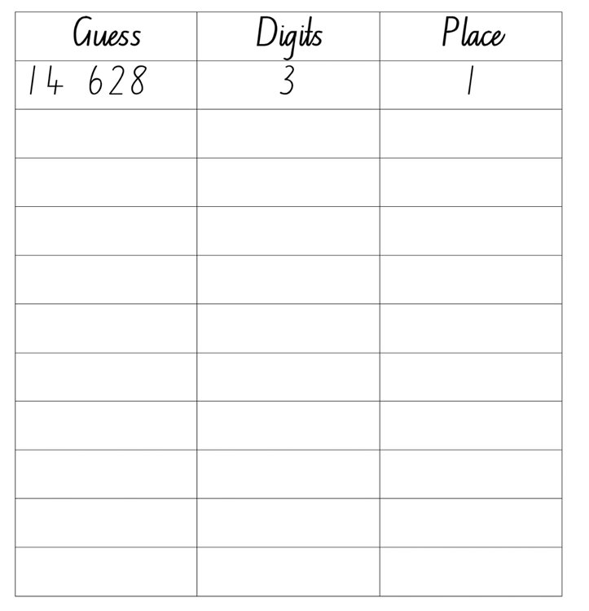
Aim of the game- To use mental strategies to correctly guess their opponent’s number.
Activity 1 – 5-digit numbers
Notes:
This is a developing number sense activity.
Number sense refers to a deep understanding of numbers, including their magnitude, relationships, and the effects of operations on them. It supports fluency and understanding, estimation, flexible thinking, and efficient problem-solving. Number sense activities 1–4 ‘activate’ prior number knowledge and support the learning of new content in the unit. Number sense activities 5–8 ‘loop’ back and provide opportunity for spaced practice with concepts and procedures covered in previous units.
Syllabus focus area:
Representing numbers using place value A (Note: Stage 2 content is reviewed)
Mastermind
Aim of the game- To use mental strategies to correctly guess their opponent’s number
Rules:
Students play in pairs. Each player writes down a 5-digit number without showing the other player.
Each player then creates a gameboard, consisting of a table with 3 columns. The columns are titled ‘Guess’, ‘Digits’ and ‘Place’ (see Figure 20 – Mastermind example)
Players take it in turns to guess their opponent’s 5-digit number. Guessed numbers should be said aloud and named correctly using place value language.
After each guess, the player’s opponent tells them how many digits are correct and how many are in the correct place.
Players record their guess, the number of digits that are correct and the number of digits that are in the right place. For example, if the number is 15 384 and the guess is 14 628, there are 3 correct digits and there is one digit in the right place. Players then use this information to refine their guesses.
The first player to correctly guess their opponent’s number is the winner.

Slide 11
Review of learning 2

Slide 12
True or false (1)
These numbers are in ascending order.
909, 999, 99 788, 1089, 9009
True | False
Notes:
The question on this slide connects to the content being explored in the developing number sense activity (Activity 2)
Syllabus focus area:
Representing numbers using place value A: Whole numbers (Note: Stage 2 content is reviewed)

Slide 13
Short response (1)
Read the following numbers aloud:
5 709 852
6 475 200
1 111 870
4 098 654
Notes:
Short response questions provide brisk paced questions focussing on review of current and previous content to support spaced and interleaved practice.
Syllabus focus area:
Represent numbers A: Whole numbers

Slide 14
Short response (2)
Record as a number:
one hundred and twenty hundreds, forty tens and one.
Notes:
Short response questions provide brisk paced questions focussing on review of current and previous content to support spaced and interleaved practice.
Syllabus focus area:
Representing numbers using place value B: Whole numbers (Note: Stage 2 content revised)

Slide 15
Short response (3)
Lunch begins at 12:00pm
It is 33 minutes until lunch.
What is the time now?
Notes:
Short response questions provide brisk paced questions focussing on review of current and previous content to support spaced and interleaved practice.
Syllabus focus area:
Non-spatial measure B: Time (Note: Stage 2 content is reviewed)

Slide 16
Short response (4)
Draw an angle you can see in the classroom that is less than a right angle.
Notes:
Short response questions provide brisk paced questions focussing on review of current and previous content to support spaced and interleaved practice.
Syllabus focus area:
Geometric measure B: Angles (Note: Stage 2 content is reviewed)

Slide 17
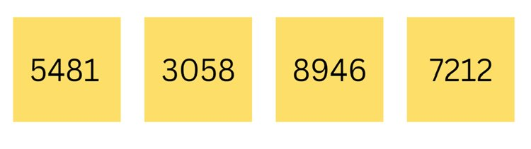
Activity 2 – Ordering numbers
Rearrange the sticky notes so the numbers are in ascending order in the fewest moves possible.
Notes:
This is a developing number sense activity.
Number sense refers to a deep understanding of numbers, including their magnitude, relationships, and the effects of operations on them. It supports fluency and understanding, estimation, flexible thinking, and efficient problem-solving. Number sense activities 1–4 ‘activate’ prior number knowledge and support the learning of new content in the unit. Number sense activities 5–8 ‘loop’ back and provide opportunity for spaced practice with concepts and procedures covered in previous units.
Syllabus focus area:
Representing numbers using place value A (Note: Stage 2 content is reviewed)
Ordering numbers
Aim of the game
-rearrange the sticky notes so that numbers are in ascending order in the fewest moves possible.
Rules
This game may be played individually, in pairs or in small groups.
Use 0–9 dice, a spinner or playing cards to generate 4 digits. The 4 digits are then combined to create a 4-digit number which is recorded on a sticky note. This process is repeated to make 4 different 4-digit numbers.
The aim of the game is to rearrange the sticky notes, so the numbers are in ascending order in the fewest moves possible, moving adjacent sticky notes only and recording the number of moves required.
Repeat with 4 new numbers arranging the sticky notes so the numbers are in descending order.
Observe students and ask questions, such as:
What will your next move be? Why?
What is the largest number? How do you know?
What is the smallest number? How do you know?
How many moves have you made so far?
After the game, students turn and talk to compare how many moves they took.

Slide 18
Review of learning 3

Slide 19
Multiple choice (1)
I am a number with 43 hundreds and 3 ones. Which number am I?
A | B | C | D
4300 | 433 | 4331 | 4303
Notes:
This question connects to the content in the developing number sense activity (Activity 3)
Syllabus focus area:
Representing numbers using place value A: Whole numbers
(Note: Stage 2 content is reviewed)

Slide 20
Short response (1)
Rewrite 4 563 927 using standard partitioning and non-standard partitioning.
Notes:
Short response questions provide brisk paced questions focussing on review of current and previous content to support spaced and interleaved practice.
Syllabus focus area:
Represents numbers A: Whole numbers

Slide 21
Short response (2)
Draw a 0-10 number line and record the following decimals in order:
3.5
5.75
8.09
Notes:
Short response questions provide brisk paced questions focussing on review of current and previous content to support spaced and interleaved practice.
Syllabus focus area:
Representing numbers using place value B: Decimals (Note: Stage 2 content is reviewed)

Slide 22
Short response (3)
School finishes at 3:20 pm
It is now midday.
How much longer until school finishes?
Notes:
Short response questions provide brisk paced questions focussing on review of current and previous content to support spaced and interleaved practice.
Syllabus focus area:
Non-spatial measure B: Time (Note: Stage 2 content is reviewed)

Slide 23
Short response (2)
Each square is 1cm x 1cm
What is the area of the shape?
Notes:
Short response questions provide brisk paced questions focussing on review of current and previous content to support spaced and interleaved practice.
Syllabus focus area:
Area (Note: Stage 2 content is reviewed)

Slide 24
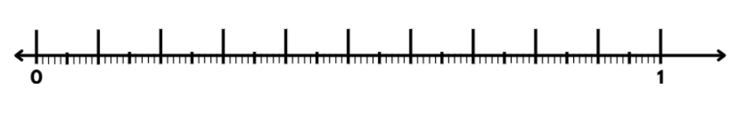
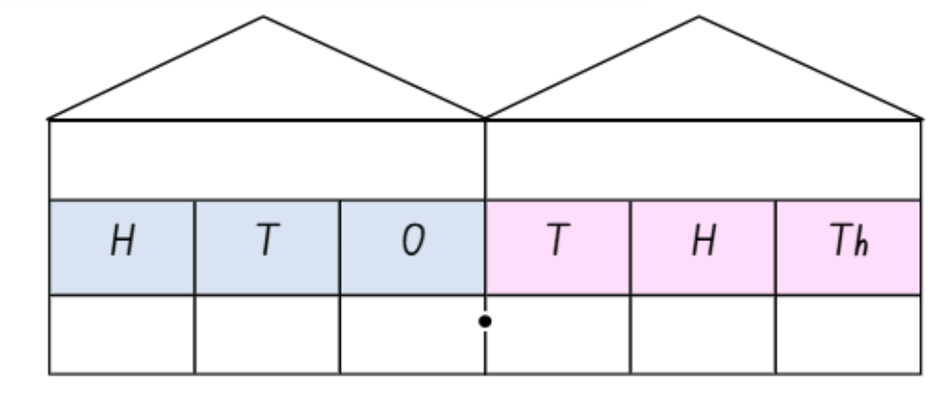
Activity 3 – decimals on a number line
Notes:
This is a developing number sense activity.
Number sense refers to a deep understanding of numbers, including their magnitude, relationships, and the effects of operations on them. It supports fluency and understanding, estimation, flexible thinking, and efficient problem-solving. Number sense activities 1–4 ‘activate’ prior number knowledge and support the learning of new content in the unit. Number sense activities 5–8 ‘loop’ back and provide opportunity for spaced practice with concepts and procedures covered in previous units.
Syllabus focus area:
Representing numbers using place value A (Note: Stage 2 content is reviewed)
Decimals game
Aim of the game- to be the player who records 3 decimals next to each other on the number line first.
Rules of the game
Provide pairs of students Resource 21: straight line, Resource 22: decimal number grid and 2 different coloured pencils from Stage 3 Unit 1
Students take turns picking numbers from Resource 10: decimal number grid and marking their number down on Resource 9: straight line.
Students take turns until one student has recorded 3 decimals next to each other on the number line, making them the winner. Repeat.

Slide 25
Review of learning 4

Slide 26
True or false (1)
3000 can be partitioned as 3 thousands, 30 hundreds or 3000 ones.
True | False
Notes:
The question on this slide connects to the content being explored in the developing number sense activity (Activity 4)
Syllabus focus area:
Representing numbers using place value A: Whole numbers (Note: Stage 2 content is reviewed)

Slide 27
Short response (1)
Record as decimals:
6 tenths
30 hundredths
425 thousandths
Notes:
Short response questions provide brisk paced questions focussing on review of current and previous content to support spaced and interleaved practice.
Syllabus focus area:
Represents numbers A: Decimals and Percentages

Slide 28
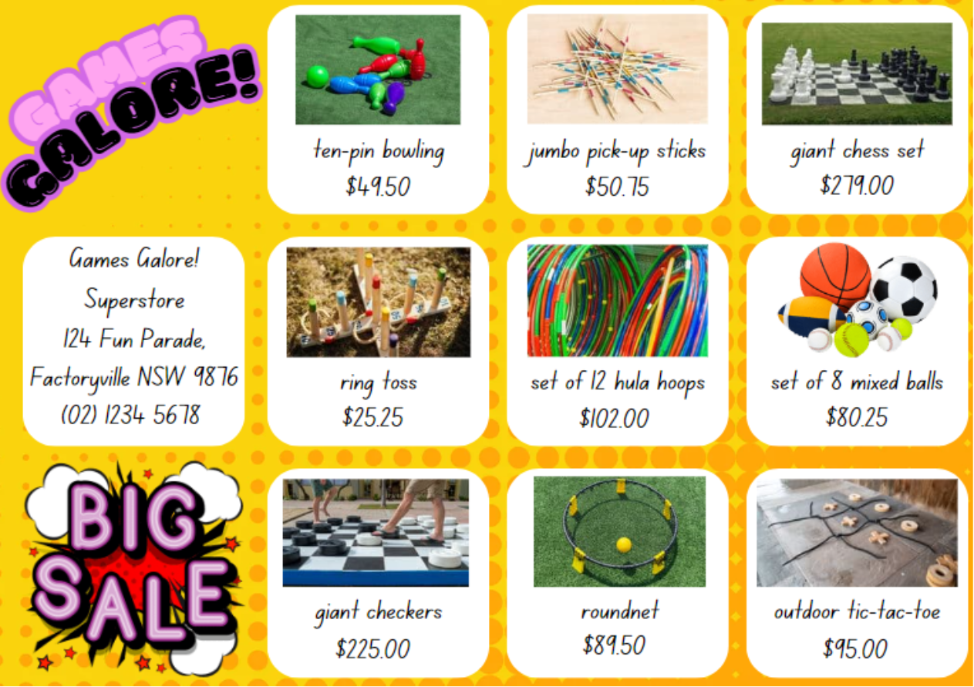
Short response (2)
Choose 3 items to purchase.
Show the total cost of your items using an appropriate strategy.
Notes:
Short response questions provide brisk paced questions focussing on review of current and previous content to support spaced and interleaved practice.
Syllabus focus area:
Additive relations B (Note: Stage 2 content is reviewed)

Slide 29
Short response (3)
Draw this shape and split it into 3 triangles.
Notes:
Short response questions provide brisk paced questions focussing on review of current and previous content to support spaced and interleaved practice.
Syllabus focus area:
Two-dimensional spatial structure B (Note: Stage 2 content is reviewed)

Slide 30

Short response (4)
Draw the net of a rectangular prism.
Notes:
Short response questions provide brisk paced questions focussing on review of current and previous content to support spaced and interleaved practice.
Syllabus focus area:
Three-dimensional spatial structure: 3D objects (Note: Stage 2 content is reviewed)

Slide 31
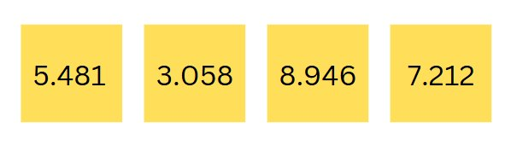
Activity 4 – ordering decimal numbers
Aim of the game- to rearrange the sticky notes so the numbers are in ascending order in the fewest moves possible.​
Notes:
This is a developing number sense activity.
Number sense refers to a deep understanding of numbers, including their magnitude, relationships, and the effects of operations on them. It supports fluency and understanding, estimation, flexible thinking, and efficient problem-solving. Number sense activities 1–4 ‘activate’ prior number knowledge and support the learning of new content in the unit. Number sense activities 5–8 ‘loop’ back and provide opportunity for spaced practice with concepts and procedures covered in previous units.
Syllabus focus area:
Representing numbers using place value A (Note: Stage 2 content is reviewed)
Aim of the game- to rearrange the sticky notes so the numbers are in ascending order in the fewest moves possible.
Rules of the game
This game may be played individually, in pairs or in small groups.
Use 0–9 dice, a spinner or playing cards to generate 4 digits. The 4 digits are then combined to create a 4-digit number which is recorded on a sticky note.
Players place a decimal point after the first digit. This process is repeated to make 4 different numbers with three decimal places.
The aim of the game is to rearrange the sticky notes so the numbers are in ascending order in the fewest moves possible, moving adjacent sticky notes only and recording the number of moves required.
Repeat with 4 new numbers arranging the sticky notes so the numbers are in descending order.
Observe students and ask questions, such as:
What will your next move be? Why?
What is the largest number? How do you know?
What is the smallest number? How do you know?
How many moves have you made so far?
After the game, students turn and talk to compare how many moves they took.

Slide 32
Review of learning 5

Slide 33
Multiple choice (1)
Subtract 1010 from 1109.
A | B | C | D
999 | 109 | 99 | 1099
Notes:
This question connects to the content in the developing number sense activity (Activity 5)
Syllabus focus area:
Additive relations A (Note: Stage 2 content is reviewed)

Slide 34
Short response (1)
Partition the following decimal in 2 different ways:
7.459
Communicate your reasoning.
Notes:
Short response questions provide brisk paced questions focussing on review of current and previous content to support spaced and interleaved practice.
Syllabus focus area:
Represents numbers A: Decimals and percentages

Slide 35
Short response (2)
You have a budget of $375.
What items could you buy that total as close to $375 as possible?
Notes:
Short response questions provide brisk paced questions focussing on review of current and previous content to support spaced and interleaved practice.
Syllabus focus area:
Additive relations B (Note: Stage 2 content is reviewed)

Slide 36
Short response (3)
Combine at least 2 different 2D shapes to sketch a trapezium.
Notes:
Short response questions provide brisk paced questions focussing on review of current and previous content to support spaced and interleaved practice.
Syllabus focus area:
Two-dimensional spatial structure B (Note: Stage 2 content is reviewed)

Slide 37
Short response (4)
Draw and label several objects that would be about 1 litre in capacity.
Notes:
Short response questions provide brisk paced questions focussing on review of current and previous content to support spaced and interleaved practice.
Syllabus focus area:
Three-dimensional spatial structure: Volume (Note: Stage 2 content is reviewed)

Slide 38
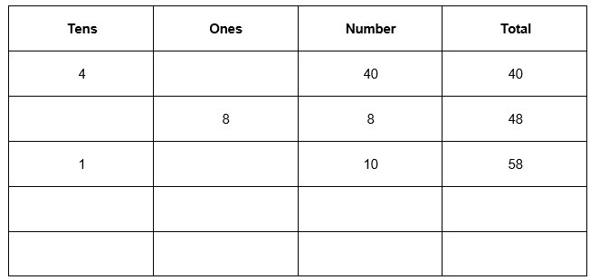

Activity 5 – partitioning for addition
Notes:
This is a developing number sense activity.
Number sense refers to a deep understanding of numbers, including their magnitude, relationships, and the effects of operations on them. It supports fluency and understanding, estimation, flexible thinking, and efficient problem-solving. Number sense activities 1–4 ‘activate’ prior number knowledge and support the learning of new content in the unit. Number sense activities 5–8 ‘loop’ back and provide opportunity for spaced practice with concepts and procedures covered in previous units.
Syllabus focus area: Additive relations A (Note: Stage 2 content is reviewed)
Aim of the game- to get to 100 without going over.
Rules:
In pairs, students make a game board by drawing a table with 4 columns and 7 rows. Label the columns from left to right as ‘tens’, ‘ones, ‘number’ and ‘total’. Using a 0–9 die or spinner, players take turns to roll or spin.
After every roll, each player decides whether to write the number in the tens or ones column. For example, if a 4 is rolled, players can either write it in the tens
column to indicate 40 or in the ones column to indicate 4.
The game concludes after 6 rolls or spins. The winner is
the player whose sum is closest to 100 without going over.

Slide 39
Review of learning 6

Slide 40
True or false (1)
107 + 574 = 103 + 571
True | False
Communicate your reasoning.
Notes:
The question on this slide connects to the content being explored in the developing number sense activity (Activity 6)
Syllabus focus area:
Additive relations A (Note: Stage 2 content is reviewed)

Slide 41
Short response (1)
Record all the factors of 54?
Remember: a factor is a number that divides another number without a remainder.
Notes:
Short response questions provide brisk paced questions focussing on review of current and previous content to support spaced and interleaved practice.
Syllabus focus area:
Multiplicative relations A

Slide 42
Short response (2)
Use the associative property of addition to regroup and solve:
123 + 78 + 57 + 12
Notes:
Short response questions provide brisk paced questions focussing on review of current and previous content to support spaced and interleaved practice.
Syllabus focus area:
Additive relations B (Note: Stage 2 content is reviewed)

Slide 43
Short response (3)
Draw an angle that is:
greater than a right angle
less than a right angle
about the same as a right angle.
Notes:
Short response questions provide brisk paced questions focussing on review of current and previous content to support spaced and interleaved practice.
Syllabus focus area:
Geometric measure B (Note: Stage 2 content is reviewed)

Slide 44
Short response (4)
This structure of a prism has 2 layers of 16 cubic centimetre blocks.
What is the total volume?
Notes:
Short response questions provide brisk paced questions focussing on review of current and previous content to support spaced and interleaved practice.
Syllabus focus area:
Three-dimensional spatial structure: Volume (Note: Stage 2 content is reviewed)

Slide 45
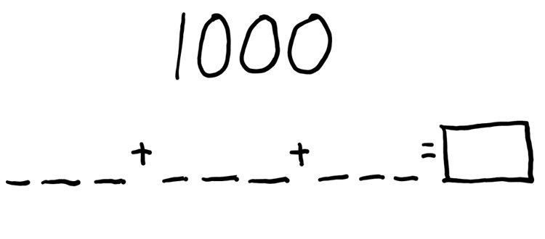
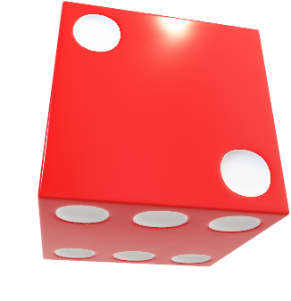
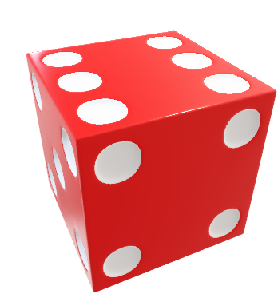
Activity 6 – addition with and without regrouping
Notes:
This is a developing number sense activity.
Number sense refers to a deep understanding of numbers, including their magnitude, relationships, and the effects of operations on them. It supports fluency and understanding, estimation, flexible thinking, and efficient problem-solving. Number sense activities 1–4 ‘activate’ prior number knowledge and support the learning of new content in the unit. Number sense activities 5–8 ‘loop’ back and provide opportunity for spaced practice with concepts and procedures covered in previous units.
Syllabus focus area:
Additive relations A (Note: Stage 2 content is reviewed)
Aim of the game- to get the closest to 1000
Rules:
In pairs, students draw an identical gameboard for each player. Ensure that each pair has a 0–9 die or spinner.
Each player will have 9 turns. The player whose sum is closest to 1000 is the winner.
Players take turns to roll the die or spin the spinner and decide where to write that digit in the equation.

Slide 46
Review of learning 7

Slide 47
Multiple choice (1)
678 - 231= 231 + 447
Which other number sentence is related?
A
447 + 231 = 678
B
447 + 678 =
C
231 + 678 =
D
678 – 231 = 231
Notes:
This question connects to the content in the developing number sense activity (Activity 7)
Syllabus focus area:
Additive relations A (Note: Stage 2 content is reviewed)

Slide 48
Short response (2)
Record the answers to the following:
4 x 70
6 x 300
9 x 8000
Notes:
Short response questions provide brisk paced questions focussing on review of current and previous content to support spaced and interleaved practice.
Syllabus focus area:
Multiplicative relations A

Slide 49
Short response (1)
Solve
32 = ___ x 4
Explain what strategy you used.
Notes:
Short response questions provide brisk paced questions focussing on review of current and previous content to support spaced and interleaved practice.
Syllabus focus area:
Multiplicative relations B

Slide 50
Short response (3)
Draw and label an angle:
less than a quarter turn
greater than a quarter turn
the same as a quarter turn
Notes:
Short response questions provide brisk paced questions focussing on review of current and previous content to support spaced and interleaved practice.
Syllabus focus area:
Geometric measure B (Note: Stage 2 content is reviewed)

Slide 51
Short response (3)
Record how many minutes in:
half an hour
a quarter of an hour
1 hour
Notes:
Short response questions provide brisk paced questions focussing on review of current and previous content to support spaced and interleaved practice.
Syllabus focus area:
Non-spatial measure A: Time (Note: Stage 2 content is reviewed)

Slide 52
Review of learning 8

Slide 53
True or false (1)
543 + 245 = 500 + 200 + 88
True | False
Notes:
The question on this slide connects to the content being explored in the developing number sense activity (Activity 8)
Syllabus focus area:
Additive relations A (Note: Stage 2 content is reviewed)

Slide 54
Short response (1)
Record 3 number sentences using multiples of 10 to get an answer of 180.
For example: 10 x 18 = 180
Notes:
Short response questions provide brisk paced questions focussing on review of current and previous content to support spaced and interleaved practice.
Syllabus focus area:
Multiplicative relations A

Slide 55
Short response (2)
I buy 7 tennis balls, and the total cost is $35.
What is the cost of each tennis ball?
Create a number sentence to show your thinking.
Notes:
Short response questions provide brisk paced questions focussing on review of current and previous content to support spaced and interleaved practice.
Syllabus focus area:
Multiplicative relations B (Note: Stage 2 content is reviewed)

Slide 56
Short response (3)
Identify and record 3 objects in the classroom that have a right angle.
Notes:
Short response questions provide brisk paced questions focussing on review of current and previous content to support spaced and interleaved practice.
Syllabus focus area:
Geometric measure B (Note: Stage 2 content is reviewed)

Slide 57
Short response (4)
The time is
1:26 pm
How many minutes until it is 2:00 pm?
Shape B
Notes:
Short response questions provide brisk paced questions focussing on review of current and previous content to support spaced and interleaved practice.
Syllabus focus area:
Non-spatial measure B: Time (Note: Stage 2 content is reviewed)

Slide 58
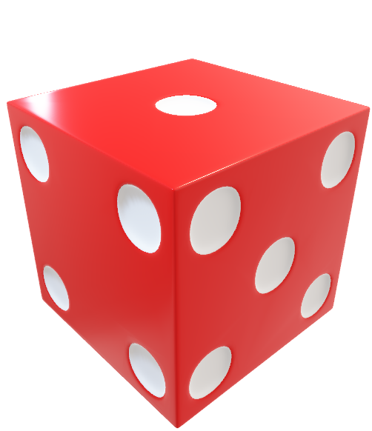
Activity 8 – addition and subtraction with and without regrouping )
Notes:
This is a developing number sense activity.
Number sense refers to a deep understanding of numbers, including their magnitude, relationships, and the effects of operations on them. It supports fluency and understanding, estimation, flexible thinking, and efficient problem-solving. Number sense activities 1–4 ‘activate’ prior number knowledge and support the learning of new content in the unit. Number sense activities 5–8 ‘loop’ back and provide opportunity for spaced practice with concepts and procedures covered in previous units.
Syllabus focus area:
Additive relations A (Note: Stage 2 content is reviewed)
Aim – to use addition or subtraction to get as close to the target number as possible.​
Rules:​
Each pair sets a target number between 800 and 1200 ​
Each player rolls the die twelve times to build three 3-digit numbers.​
Players then use addition or subtraction in any order to get as close as possible to the target number, using regrouping where necessary.​
The player closest to the target wins the round.​

Slide 59
Double Venn diagram
Object 1
Object 2
Features similar to both objects
Features of object 1
Features of object 2

Slide 60
Frayer
Definition
Facts/Characteristics
Word, term, concept
Examples
Non-examples

Slide 61
Spider map
Idea
Subject

Slide 62
Cline
Concept 1
Concept 2
Word
Word
Word
Word
Word
Word
Word
Word
Word
Word
Word

Slide 63

Compare and contrast
Notes:
Use the arrows to navigate between related activities.
Hyperlink each arrow to compare between related slides.

Slide 64
Multiple choice
A
B
C
D
Notes:
This question connects to the content in the developing number sense activity (Activity 1)
This question can:
support spaced and interleaved practice
help identify and address common misconceptions
support active recall and immediate feedback
support whole class participation
identify areas requiring reteach
Teachers are encouraged to adapt and contextualise for their contexts.

Slide 65
Multiple choice
A
B
C
D
Notes:
This question connects to the content in the developing number sense activity (Activity 1)
Syllabus focus area:
Multiplicative relations A
This question can:
support spaced and interleaved practice
help identify and address common misconceptions
support active recall and immediate feedback
support whole class participation
identify areas requiring reteach
Teachers are encouraged to adapt and contextualise for their contexts.

Slide 66
References
This presentation contains NSW Curriculum and syllabus content. The NSW Curriculum is developed by the NSW Education Standards Authority. This content is prepared by NESA for and on behalf of the Crown in the right of the State of New South Wales. The material is protected by Crown copyright.
Please refer to the NESA Copyright Disclaimer for more information https://educationstandards.nsw.edu.au/wps/portal/nesa/mini-footer/copyright.
NESA holds the only official and up-to-date versions of the NSW Curriculum and syllabus documents. Please visit the NSW Education Standards Authority (NESA) website https://educationstandards.nsw.edu.au/wps/portal/nesa/home and the NSW Curriculum website https://curriculum.nsw.edu.au.
  ABC Education. (2020). ‘Goat Busters (area model for multiplication)’, GOAT Maths games website, Accessed 18/05/2023.
  NSW Department of Education (2023) ‘101 and you’re out (2-digit-addition)’, Mathematics K-6 resources website, accessed 18/05/2023.
  NSW Department of Education (2023) ‘Dicey addition (3-digit addition)’, Mathematics K-6 resources website, accessed 18/05/2023.
  NSW Department of Education (2023) ‘Mastermind’, Mathematics K-6 resources website, accessed 18/05/2023.
  NSW Department of Education (2023) ‘Order! Order! (four-digit numbers)’, Mathematics K-6 resources website, accessed 18/05/2023.
  New Zealand Ministry of Education (n.d) ‘Place value with whole numbers’, NZ Maths website, accessed 18/05/2023.
  New Zealand Ministry of Education (n.d) ‘Place value with whole numbers and decimals’, NZ Maths website, accessed 18/05/2023.
  New Zealand Ministry of Education (n.d) ‘Prime Numbers’, NZ Maths website, accessed 18/05/2023.

Slide 67
References
This presentation contains NSW Curriculum and syllabus content. The NSW Curriculum is developed by the NSW Education Standards Authority. This content is prepared by NESA for and on behalf of the Crown in the right of the State of New South Wales. The material is protected by Crown copyright.
Please refer to the NESA Copyright Disclaimer for more information https://educationstandards.nsw.edu.au/wps/portal/nesa/mini-footer/copyright.
NESA holds the only official and up-to-date versions of the NSW Curriculum and syllabus documents. Please visit the NSW Education Standards Authority (NESA) website https://educationstandards.nsw.edu.au/wps/portal/nesa/home and the NSW Curriculum website https://curriculum.nsw.edu.au.
  University of Cambridge (Faculty of Mathematics) (2023) ‘Factors and Multiples Game’, NRICH website, accessed18/05/2023.
  University of Cambridge (Faculty of Mathematics) (2023) ‘Multiply Multiples 1’, NRICH website, accessed 18/05/2023.
  University of Cambridge (Faculty of Mathematics) (2023) ‘Multiply Multiples 2’, NRICH website, accessed 18/05/2023.

Slide 68
Copyright
© State of New South Wales (Department of Education), 2025
The copyright material published in this resource is subject to the Copyright Act 1968 (Cth) and is owned by the NSW Department of Education or, where indicated, by a party other than the NSW Department of Education (third-party material).
Copyright material available in this resource and owned by the NSW Department of Education is licensed under a Creative Commons Attribution 4.0 International (CC BY 4.0) license.
This license allows you to share and adapt the material for any purpose, even commercially.
Attribution should be given to © State of New South Wales (Department of Education), 2025.
Material in this resource not available under a Creative Commons license:
the NSW Department of Education logo, other logos and trademark-protected material
Material owned by a third party that has been reproduced with permission. You will need to obtain permission from the third party to reuse its material.
Links to third-party material and websites
Please note that the provided (reading/viewing material/list/links/texts) are a suggestion only and implies no endorsement, by the New South Wales Department of Education, of any author, publisher, or book title. School principals and teachers are best placed to assess the suitability of resources that would complement the curriculum and reflect the needs and interests of their students.
If you use the links provided in this document to access a third party’s website, you acknowledge that the terms of use, including licence terms set out on the third-party’s website apply to the use which may be made of the materials on that third-party website or where permitted by the Copyright Act 1968 (Cth). The department accepts no responsibility for content on third-party websites.

