Slide 1
Instructions for use
This resource is not a teaching and learning program. It should be used in conjunction with Stage 3 Year A Unit 2.
Classroom teachers are encouraged to add and adapt slides as required to meet the needs of their students.
Save a copy of the file to make changes to the slide deck. Go to File > Download a Copy (this downloads a copy to the computer to edit in the PowerPoint app).
To convert the PowerPoint to Google Slides:
  Upload the file into Google Drive and open it.
  Go to File > Save as Google Slides.
  (Note – conversion may cause formatting changes in the slides.)

Slide 2

Review of Learning
Mathematics Stage 3 – Unit 2
Notes:
Reviews may include a combination of question types, requiring students to recall facts and key ideas, as well as apply their knowledge to solve problems and answer questions. To support active engagement, a mix of techniques should be employed.” (AERO, 2024).
This Review of Learning slide deck revisits key concepts from the following units:
Stage 3 Year A Unit 2
Stage 3 Year A Unit 1
Stage 2 Year B Unit 40
It also includes opportunities to review prior learning in non-number content, supporting consolidation across focus areas.
The review of learning resources include three key task types that support the development of mathematical proficiency through retrieval, spaced practice, and active participation. These practices complement the review phase (activating prior knowledge) embedded within the beginning of each lesson.
1.
Multiple-choice questions/True or false: Designed to promote active retrieval of key concepts and identify common misconceptions in number, supporting consolidation, understanding and fluency.
These questions:
support spaced and interleaved practice
help identify and address common misconceptions
support active recall and immediate feedback
support whole class participation
identify areas requiring reteach
2.
Short-response question sets: Carefully grouped questions that encourage spaced and interleaved practice across multiple focus areas, helping students revisit and apply knowledge from different points in time.
These questions:
have a combination of question types
address a range of focus areas
build automaticity and fluency
support active recall
allow for immediate feedback
identify content requiring reteach
3.
Developing number sense activities: A variety of practical, purposeful tasks that reinforce current learning and build on prior knowledge. These activities promote reasoning, problem-solving and conceptual understanding.
The review of learning resources are designed to work support teaching and learning in mathematics. For the most effective implementation, use the resources flexibly, adapting to meet student learning needs and individual classroom contexts.

Slide 3
Lessons
1
Review of Learning 1
5
Review of Learning 5
2
Review of Learning 2
6
Review of Learning 6
3
Review of Learning 3
7
Review of Learning 7
4
Review of Learning 4
8
Review of Learning 8
Notes:
Teacher notes:
Click lesson numbers to go to specific lessons
Interactive features can be viewed in slide show

Slide 4
Review of learning 1

Slide 5

Multiple choice (1)
Which of the following are in ascending order?
A
48 379, 46 208, 43 752
41 625, 43 752, 46 208
B
C
43 752, 41 625, 46 208
D
41 625, 46 208, 43 752
Notes:
This question connects to the content in the developing number sense activity (Activity 1)
Syllabus focus area:
Representing numbers using place value B (Note: Stage 2 content is reviewed)

Slide 6

Short response (1)
Arrange these numbers in
descending order:
48 275, 52 194, 49 836, 51 420
Notes:
Short response questions provide brisk paced questions focussing on review of current and previous content to support spaced and interleaved practice.
Syllabus focus area:
Representing numbers using place value B (Note: Stage 2 content is reviewed)

Slide 7
Short response (2)
Use place value to record 318 905
in expanded notation.
Notes:
Short response questions provide brisk paced questions focussing on review of current and previous content to support spaced and interleaved practice.
Syllabus focus area:
Representing numbers using place value B (Note: Stage 2 content is reviewed)

Slide 8
Short response (3)
Partition 254 307 in a non-standard form.
Communicate your reasoning.
Notes:
Short response questions provide brisk paced questions focussing on review of current and previous content to support spaced and interleaved practice.
Syllabus focus area:
Representing numbers using place value B (Note: Stage 2 content is reviewed)

Slide 9
Short response (4)
A pencil is 11 and a half centimetres long.
Record the length of the pencil using millimetres (mm).
Notes:
Short response questions provide brisk paced questions focussing on review of current and previous content to support spaced and interleaved practice.
Syllabus focus area:
Geometric measure B: Length (Note: Stage 2 content is reviewed)

Slide 10


Activity 1 – ordering numbers
64 758
75 124
70 192
99 413
Notes:
This is a developing number sense activity.
Number sense refers to a deep understanding of numbers, including their magnitude, relationships, and the effects of operations on them. It supports fluency and understanding, estimation, flexible thinking, and efficient problem-solving. Number sense activities 1–4 ‘activate’ prior number knowledge and support the learning of new content in the unit. Number sense activities 5–8 ‘loop’ back and provide opportunity for spaced practice with concepts and procedures covered in previous units.
Syllabus focus area:
Representing numbers using place value B (Note: Stage 2 content is reviewed)
Ordering numbers
Observe students and regroup as a class. Ask:
What was your least number of moves?
What strategies did you use for ordering your numbers?
How would you place the numbers in descending order?
Were presented with any challenges? How did you overcome them?
Repeat the process with 6-digit numbers.
The level of difficulty can change by increasing or decreasing the digits.

Slide 11
Review of learning 2

Slide 12
True or false (1)
The number 46 827 rounded to the nearest thousand is 47 000.
True | False
Notes:
The question on this slide connects to the content being explored in the developing number sense activity (Activity 2)
Syllabus focus area:
Representing numbers using place value B (Note: Stage 2 content is reviewed)

Slide 13
Short response (5)
865 472 can be partitioned in multiple ways.
Record how to partition in standard form and non-standard form.
Explain why both partitions represent the same number.
Notes:
Short response questions provide brisk paced questions focussing on review of current and previous content to support spaced and interleaved practice.
Syllabus focus area:
Represents numbers A

Slide 14
Short response (6)
Write the following number in digits:
Six million, two hundred and eight thousand, four hundred and fifteen.
Notes:
Short response questions provide brisk paced questions focussing on review of current and previous content to support spaced and interleaved practice.
Syllabus focus area:
Represents numbers A

Slide 15
Short response (7)
Partition 731 408 using non-standard form.
Communicate your reasoning.
Notes:
Short response questions provide brisk paced questions focussing on review of current and previous content to support spaced and interleaved practice.
Syllabus focus area:
Representing numbers using place value B (Note: Stage 2 content is reviewed)

Slide 16
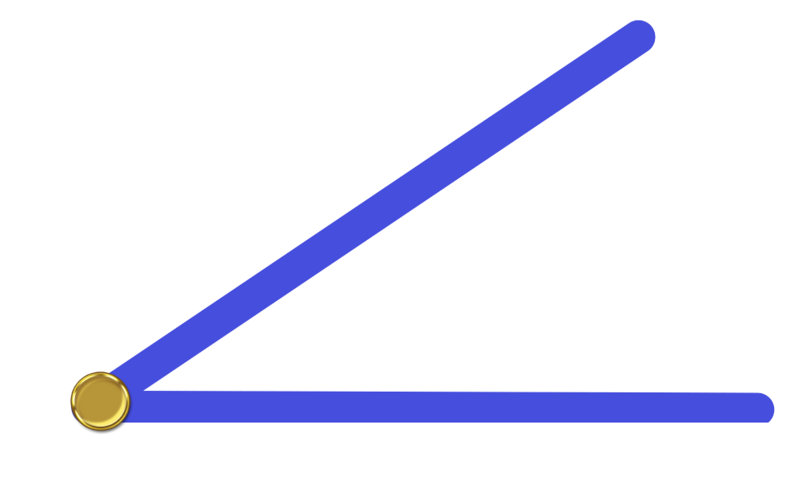
Short response (8)
Describe this acute angle compared to a quarter turn.
Notes:
Short response questions provide brisk paced questions focussing on review of current and previous content to support spaced and interleaved practice.
Syllabus focus area:
Geometric measure B: Angles (Note: Stage 2 content is reviewed)

Slide 17
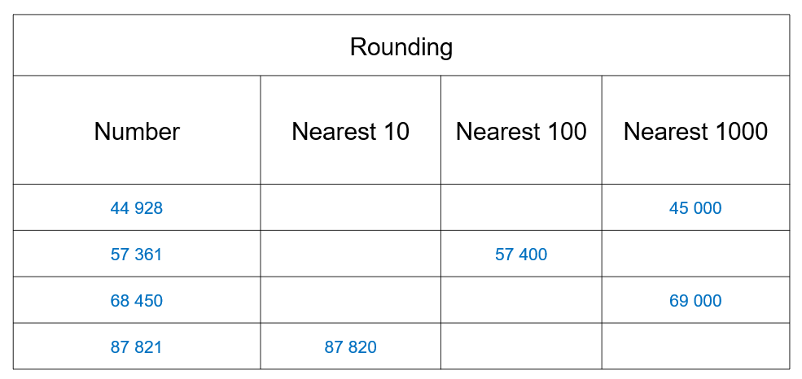
Activity 2 – rounding numbers
Notes:
This is a developing number sense activity.
Number sense refers to a deep understanding of numbers, including their magnitude, relationships, and the effects of operations on them. It supports fluency and understanding, estimation, flexible thinking, and efficient problem-solving. Number sense activities 1–4 ‘activate’ prior number knowledge and support the learning of new content in the unit. Number sense activities 5–8 ‘loop’ back and provide opportunity for spaced practice with concepts and procedures covered in previous units.
Syllabus focus area:
Represents numbers A (Note: Stage 2 content is reviewed)
Rounding numbers
This resource corresponds to Resource 15 in Stage 3 Year A Unit 2.
Provide students with five 0–9 dice and Resource 15 – rounding record.
Students roll the dice and create a 5-digit number.
Students record the number and repeat the process until there are seven 5-digit numbers.
Students all the numbers to the nearest 10, nearest 100 and nearest 1000.
Once finished, students swap Resource 15 – rounding record with a partner and check each other's answers.
Regroup as a class and ask:
Why do we round numbers?
How would you explain rounding to someone else?
Can you provide examples of real-life situations where rounding is commonly used?

Slide 18
Review of learning 3

Slide 19
Multiple choice (2)
Round 48 726 to the nearest ten thousand.
A
40 000
48 000
B
C
50 000
D
48 700
Notes:
This question connects to the content in the developing number sense activity (Activity 3)
Syllabus focus area:
Representing numbers using place value B (Note: Stage 2 content is reviewed)

Slide 20
Short response (9)
Find the total of
4 326 + 258
Communicate your reasoning.
Notes:
Short response questions provide brisk paced questions focussing on review of current and previous content to support spaced and interleaved practice.
Syllabus focus area:
Additive relations A

Slide 21
Short response (10)
Record different ways to partition the number 34 327 416 in non-standard form.
Notes:
Short response questions provide brisk paced questions focussing on review of current and previous content to support spaced and interleaved practice.
Syllabus focus area:
Represents numbers A

Slide 22
Short response (11)
Place the following on a number line.
2.46
1.32
2.08
Communicate your reasoning.
Notes:
Short response questions provide brisk paced questions focussing on review of current and previous content to support spaced and interleaved practice.
Syllabus focus area:
Representing numbers using place value B (Note: Stage 2 content is reviewed)

Slide 23
Short response (12)
A rectangle is drawn onto square-centimetre paper. The rectangle covers 5 rows and 7 columns of squares.
Calculate the area of the rectangle in square centimetres.
Communicate your reasoning.
Notes:
Short response questions provide brisk paced questions focussing on review of current and previous content to support spaced and interleaved practice.
Syllabus focus area:
Two-dimensional spatial structure B: Area (Note: Stage 2 content is reviewed)

Slide 24
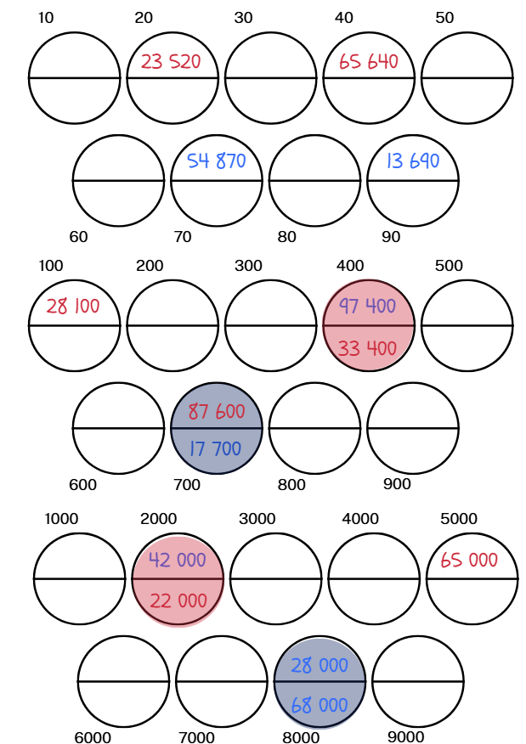
Activity 3 – rounding numbers game
Notes:
This is a developing number sense activity.
Number sense refers to a deep understanding of numbers, including their magnitude, relationships, and the effects of operations on them. It supports fluency and understanding, estimation, flexible thinking, and efficient problem-solving. Number sense activities 1–4 ‘activate’ prior number knowledge and support the learning of new content in the unit. Number sense activities 5–8 ‘loop’ back and provide opportunity for spaced practice with concepts and procedures covered in previous units.
Syllabus focus area:
Represents numbers A (Note: Stage 2 content is reviewed)
Rounding numbers game
This resource corresponds Resource 16 and Resource 17 in Stage 3 Year A Unit 2.
This activity is an adaptation of ‘Reasoned rounding’ from NRICH by University of Cambridge.
Provide pairs with five 0–9 dice and Resource 16 – rounding game and Resource 17 – rounding cards in Stage 3 Year A Unit 2. Place the cards face down in a pile.
Player 1 rolls the dice and creates a 5-digit number. After making their number, they select a card from the pile.
Player 1 rounds their number to the nearest 10, 100 or 1000 according to their selected card.
Player 1 finds the matching circle on Resource 20 – rounding game in Stage 3 Year A unit 3 and records their 5-digit number in one of the spaces in that circle
Player 2 has their turn and the process is repeated.
When a circle is complete, this scores a point for the player who wrote the second number in. (Even if the first number was written in by the other player.)
The winner is the player who scores the most points after a suitable amount of time.

Slide 25
Review of learning 4

Slide 26
True or false (2)
34 256, 42 183, 50 324, 58 762
are arranged in ascending order.
True | False
Notes:
The question on this slide connects to the content being explored in the developing number sense activity (Activity 4)
Syllabus focus area:
Representing numbers using place value B (Note: Stage 2 content is reviewed)

Slide 27
Short response (13)
Use an efficient mental strategy to solve 7025 − 4897
Which strategy did you use?
Communicate your reasoning.
Notes:
Short response questions provide brisk paced questions focussing on review of current and previous content to support spaced and interleaved practice.
Syllabus focus area:
Additive relations A

Slide 28
Short response (14)
Partition the decimal 4.326 using
place value.
Explain what the digits represent in
ones, tenths, hundredths, and thousandths.
Notes:
Short response questions provide brisk paced questions focussing on review of current and previous content to support spaced and interleaved practice.
Syllabus focus area:
Represents numbers A

Slide 29
Short response (15)
Sophie ran 1.46 km and Ella ran 1.39 km.
Who ran the greater distance and by how much?
Notes:
Short response questions provide brisk paced questions focussing on review of current and previous content to support spaced and interleaved practice.
Syllabus focus area:
Representing numbers using place value B (Note: Stage 2 content is reviewed)

Slide 30
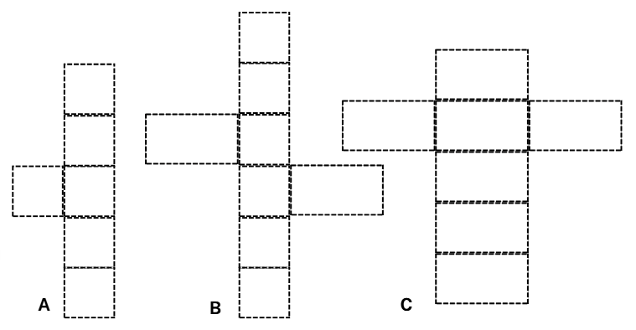
Short response (16)
Which nets can be folded to make a rectangular prism?
Communicate your reasoning.
Notes:
Short response questions provide brisk paced questions focussing on review of current and previous content to support spaced and interleaved practice.
Syllabus focus area:
Three-dimensional spatial structure A (Note: Stage 2 content is reviewed)

Slide 31
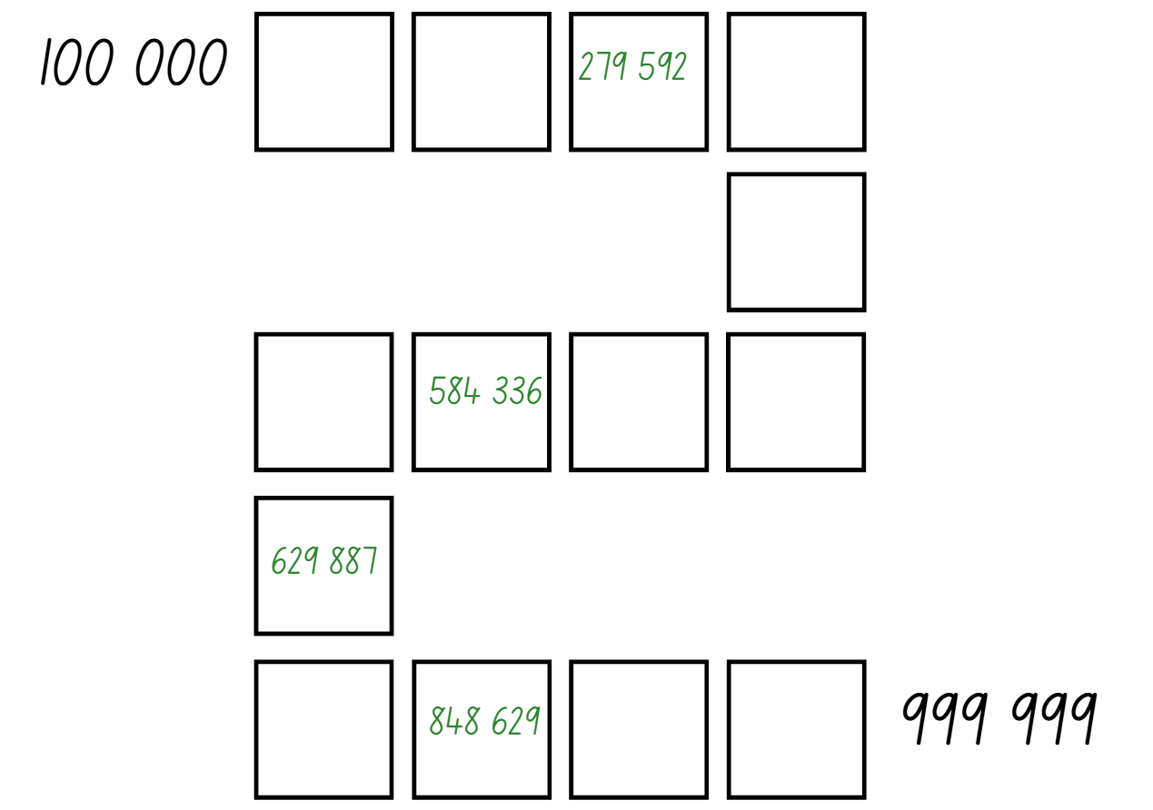
Activity 4 – place value game
Notes:
This is a developing number sense activity.
Number sense refers to a deep understanding of numbers, including their magnitude, relationships, and the effects of operations on them. It supports fluency and understanding, estimation, flexible thinking, and efficient problem-solving. Number sense activities 1–4 ‘activate’ prior number knowledge and support the learning of new content in the unit. Number sense activities 5–8 ‘loop’ back and provide opportunity for spaced practice with concepts and procedures covered in previous units.
Syllabus focus area:
Represents numbers A (Note: Stage 2 content is reviewed)
Place value game
This resource corresponds to Figure 23 – sample gameboard in Stage 3 Year A Unit 2.
This lesson is an adaptation of ‘The place value game’ from Mathematics K-6 resources by State of New South Wales (Department of Education).
The aim of the game is to position 6-digit numbers in sequence on a gameboard.
Provide pairs with six 0–9-sided dice and Resource 18 – place value game for each player.
Students roll the dice and create a 6-digit number. For example, 1, 5, 6, 6, 2 and a 9 could be recorded as 156 629, 692 615, 296 156, 165 269 and so on. Players record their chosen number in the most appropriate position between 100 000 and 999 999 on the gameboard.
If numbers cannot be placed, students miss their turn. Play continues until all boxes are filled.
Note: the game can also be played as whole class. Use dice that have a zero as it is important to understand that the zero is a placeholder and does not have a value. Using a reusable sleeve for the gameboard will allow students to play multiple games.

Slide 32
Review of learning 5

Slide 33
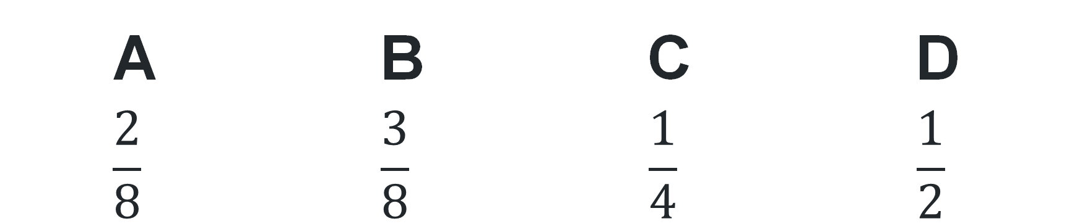
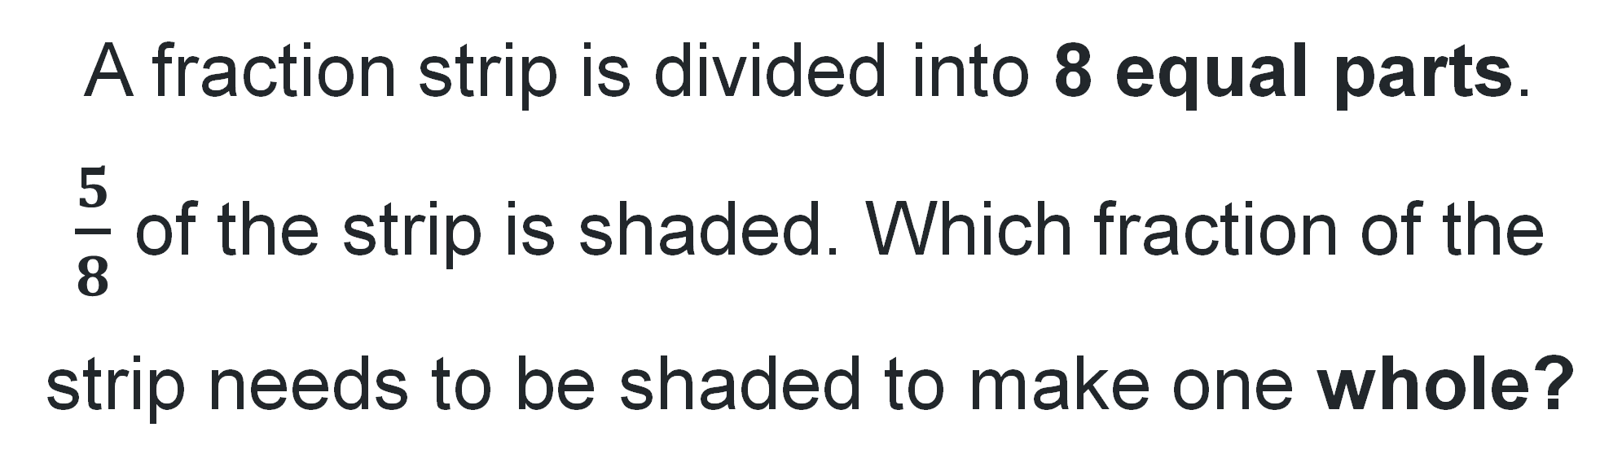
Multiple choice (3)
A fraction strip is divided into 8 equal parts.
$\frac{5}{8}$ of the strip is shaded. Which fraction of the
strip needs to be shaded to make one whole?
A | B | C | D
$$\frac{2}{8}$$ | $$\frac{3}{8}$$ | $$\frac{1}{4}$$ | $$\frac{1}{2}$$
Notes:
This question connects to the content in the developing number sense activity (Activity 5)
Syllabus focus area:
Partitioned fractions A (Note: Stage 2 content is reviewed)

Slide 34
Short response (17)
Use an efficient mental strategy to solve 678 − 121 − 22
Which strategy did you use?
Explain your reasoning.
Notes:
Short response questions provide brisk paced questions focussing on review of current and previous content to support spaced and interleaved practice.
Syllabus focus area:
Additive relations A

Slide 35
Short response (18)
Partition the decimal 2.306 using
place value.
Explain what the digits represent in
ones, tenths, hundredths, and thousandths.
Notes:
Short response questions provide brisk paced questions focussing on review of current and previous content to support spaced and interleaved practice.
Syllabus focus area:
Represents numbers A

Slide 36
Short response (19)
Use and compare the efficiency of 2 different strategies to solve
27 + 13 + 20
Communicate your reasoning.
Notes:
Short response questions provide brisk paced questions focussing on review of current and previous content to support spaced and interleaved practice.
Syllabus focus area:
Additive relations A (Note: Stage 2 content is reviewed)

Slide 37
Short response (20)
Write the capacity of each container using the abbreviation for litres:
    A tank holds twenty-three litres of water.
    A bottle holds five litres of water.
How many litres of water do they hold altogether?
Notes:
Short response questions provide brisk paced questions focussing on review of current and previous content to support spaced and interleaved practice.
Syllabus focus area:
Three-dimensional spatial structure A: Volume (Note: Stage 2 content is reviewed)

Slide 38
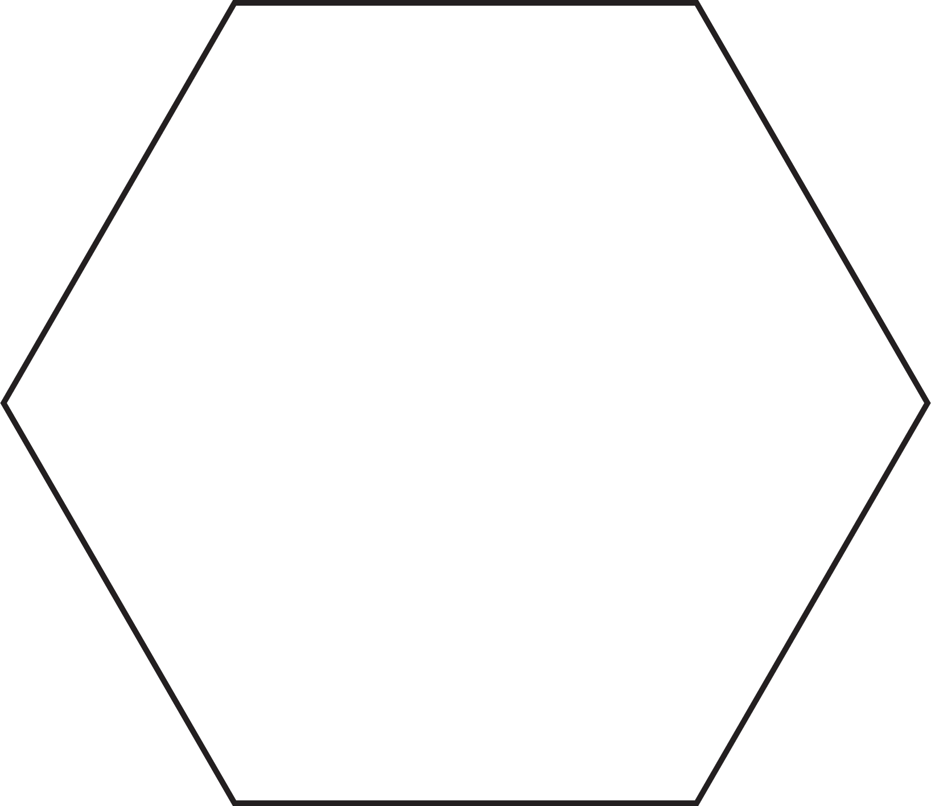
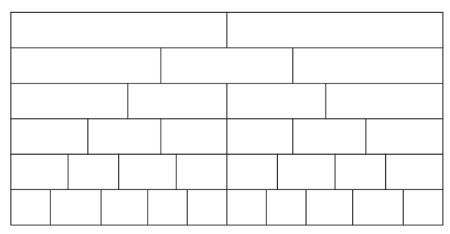




Activity 5 – representing fractions
3
halves
1
4
twelfths
*
2
$$−$$
thirds
*
12
*
3
$$−$$
$$−$$
2
2
eighths
*
8
*
4
3
$$−$$
$$−$$
*
6
fourths /quarters
$$−$$
sixths
Notes:
This is a developing number sense activity.
Number sense refers to a deep understanding of numbers, including their magnitude, relationships, and the effects of operations on them. It supports fluency and understanding, estimation, flexible thinking, and efficient problem-solving. Number sense activities 1–4 ‘activate’ prior number knowledge and support the learning of new content in the unit. Number sense activities 5–8 ‘loop’ back and provide opportunity for spaced practice with concepts and procedures covered in previous units.
Syllabus focus area:
Partitioned fractions A (Note: Stage 2 content is reviewed)
Representing fractions
This resource corresponds to Resource 19 and Resource 20 in Stage 3 Year A Unit 2.
This activity is an adaptation of ‘Colour in fractions’ from K-6 Mathematics resources by State of New South Wales (Department of Education).
Provide students with one die labelled 1, 2, 2, 3, 3, 4 in one colour and another die labelled $\frac{1}{2}$, $\frac{1}{3}$, $\frac{1}{4}$, $\frac{1}{6}$, $\frac{1}{8}$, $\frac{1}{12}$ in another colour or use Resource 19 – spinners. Also provide students with Resource 20 – fraction wall and coloured pencils or markers.
Players take turns to throw both dice or have a spin on their spinners. Students make a fraction, using the first die or spinner as the numerator. Students then colour the equivalent of the fraction.
For each roll or spin, students should use a different colour pencil or marker. If a player is unable to use their turn, they ‘pass’.
Players take turns to roll or spin and make fractions, marking them on their fraction wall. If the fraction rolled or its equivalence cannot be shaded, that player misses a turn. This becomes more frequent later in the game.
Players are not allowed to break up a ‘brick’ on the fraction wall.
To finish the game, a player must have had 18 turns or have filled their wall. A larger fraction is not acceptable to finish.
The first player to colour in their whole wall is the winner. They should encourage the other player to keep filling their fraction wall or make the greatest number of wholes.
If after 18 turns neither player has coloured in their whole wall, the player with the greatest number wins.

Slide 39
Review of learning 6

Slide 40
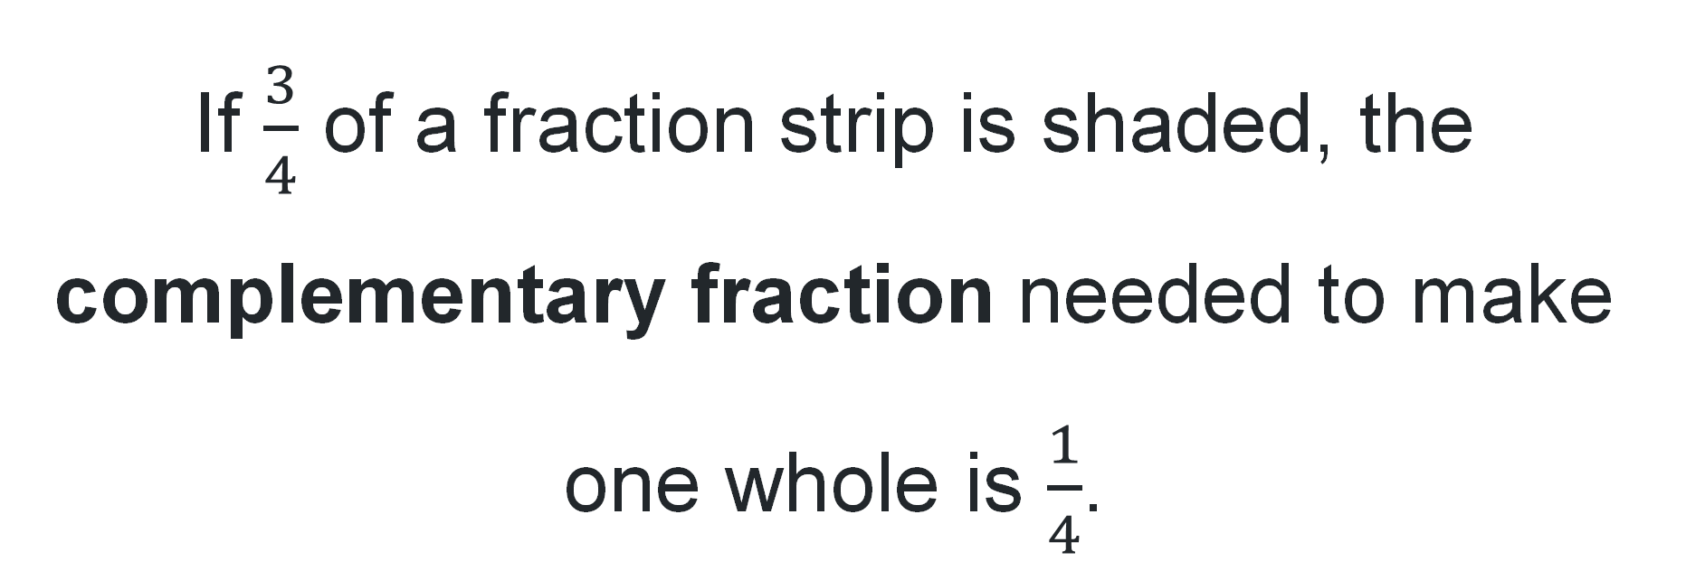
True or false (3)
If $\frac{3}{4}$ of a fraction strip is shaded, the complementary fraction needed to make one whole is $\frac{1}{4}$.
True | False
Notes:
The question on this slide connects to the content being explored in the developing number sense activity (Activity 6)
Syllabus focus area:
Partitioned fractions A (Note: Stage 2 content is reviewed)

Slide 41
Short response (21)
Amira says, “To solve 4267 + 358, I added 4267 + 360 and then subtracted 2.”
Which strategy is Amira using?
Is this an efficient way to solve the problem?
Explain your reasoning.
Notes:
Short response questions provide brisk paced questions focussing on review of current and previous content to support spaced and interleaved practice.
Syllabus focus area:
Additive relations A

Slide 42
Short response (22)
What is the product of 8 and 7?
Explain what the word product means in your answer.
Notes:
Short response questions provide brisk paced questions focussing on review of current and previous content to support spaced and interleaved practice.
Syllabus focus area:
Multiplicative relations A

Slide 43
Short response (23)
Liam buys a bike and a helmet for $425. The bike costs $392.
How much is the helmet?
Communicate your reasoning.
Notes:
Short response questions provide brisk paced questions focussing on review of current and previous content to support spaced and interleaved practice.
Syllabus focus area:
Additive relations B (Note: Stage 2 content is reviewed)

Slide 44
Short response (24)
Object A is built with 12 cubic-centimetre blocks. Object B is built with 15 cubic-centimetre blocks.
Which object has the greater volume, and by how many cubic centimetres?
Notes:
Short response questions provide brisk paced questions focussing on review of current and previous content to support spaced and interleaved practice.
Syllabus focus area:
Three-dimensional spatial structure A: Volume (Note: Stage 2 content is reviewed)

Slide 45

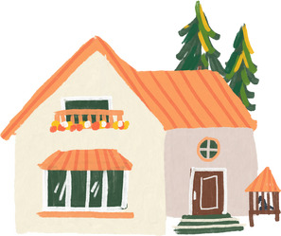

Activity 6 – fractions on a number line
A
0
1
Nicole's distance
B
0
1
Nicole's distance
C
0
1
Nicole's distance
Notes:
This is a developing number sense activity.
Number sense refers to a deep understanding of numbers, including their magnitude, relationships, and the effects of operations on them. It supports fluency and understanding, estimation, flexible thinking, and efficient problem-solving. Number sense activities 1–4 ‘activate’ prior number knowledge and support the learning of new content in the unit. Number sense activities 5–8 ‘loop’ back and provide opportunity for spaced practice with concepts and procedures covered in previous units.
Syllabus focus area:
Partitioned fractions A (Note: Stage 2 content is reviewed)
Fractions on a number line
This resource corresponds to Resource 25 in Stage 3 Year A Unit 2.
Explain Nicole is walking to school and the 3 number lines represent the distance she has travelled.
Ask:
How far has Nicole gone?
How do you know?
What parts of the number line helped you answer the questions?
Which number line represents the furthest distance travelled? How do you know?
How far as a fraction does Nicole need to travel to get to school on each number line? (Determine the complement fractional part of each number line).
3. Students record the fractions and reasoning on an individual whiteboard.

Slide 46
Review of learning 7

Slide 47
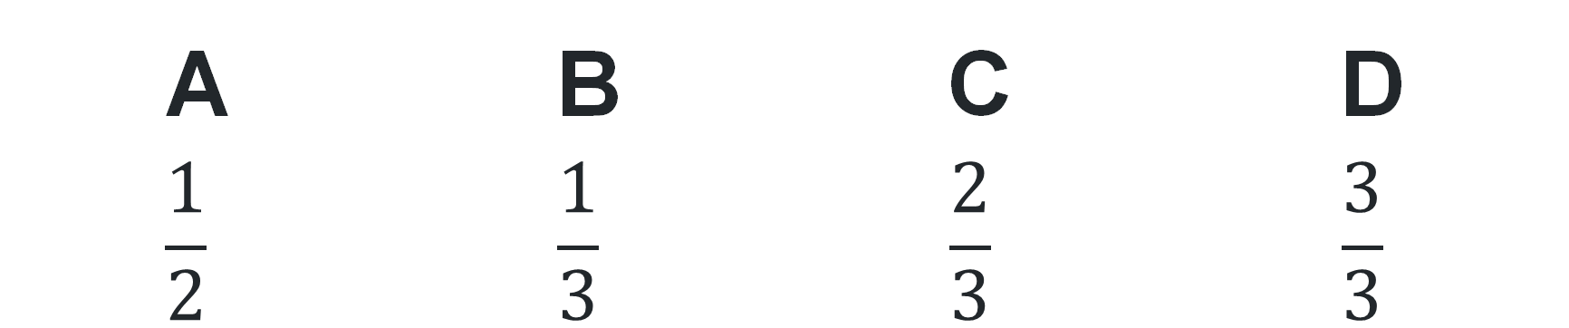
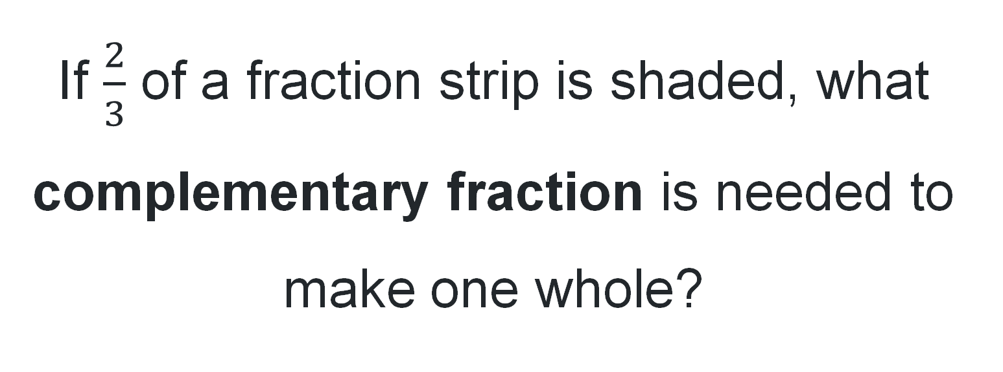
Multiple choice (4)
If $\frac{2}{3}$ of a fraction strip is shaded, what complementary fraction is needed to make one whole?
A | B | C | D
$$\frac{1}{2}$$ | $$\frac{1}{3}$$ | $$\frac{2}{3}$$ | $$\frac{3}{3}$$
Notes:
This question connects to the content in the developing number sense activity (Activity 7)
Syllabus focus area:
Partitioned fractions A (Note: Stage 2 content is reviewed)

Slide 48
Short response (25)
Record your calculations using a vertical algorithm
4 215 − 387
Notes:
Short response questions provide brisk paced questions focussing on review of current and previous content to support spaced and interleaved practice.
Syllabus focus area:
Additive relations A

Slide 49
Short response (26)
Use an efficient strategy to solve:
7 × 42
Explain which strategy you chose and why it was efficient.
Notes:
Short response questions provide brisk paced questions focussing on review of current and previous content to support spaced and interleaved practice.
Syllabus focus area:
Multiplicative relations A

Slide 50
Short response (27)
Record how you solve 30 × 4 using place value or the associative property.
Communicate your reasoning.
Notes:
Short response questions provide brisk paced questions focussing on review of current and previous content to support spaced and interleaved practice.
Syllabus focus area:
Multiplicative relations B (Note: Stage 2 content is reviewed)

Slide 51
Short response (28)
How many minutes are in 2 and a half hours?
Communicate your reasoning.
Notes:
Short response questions provide brisk paced questions focussing on review of current and previous content to support spaced and interleaved practice.
Syllabus focus area:
Non-spatial measure A: Time(Note: Stage 2 content is reviewed)

Slide 52






Activity 7 – complementary fractions
1
1
1
1
1
0
0
0
0
0
Brody:
1
Alby
3
Jacob
2
Jayden
7
Flynn
2
4
8
3
8
4
Complement:
Complement:
Complement:
Complement:
Complement:
Notes:
This is a developing number sense activity.
Number sense refers to a deep understanding of numbers, including their magnitude, relationships, and the effects of operations on them. It supports fluency and understanding, estimation, flexible thinking, and efficient problem-solving. Number sense activities 1–4 ‘activate’ prior number knowledge and support the learning of new content in the unit. Number sense activities 5–8 ‘loop’ back and provide opportunity for spaced practice with concepts and procedures covered in previous units.
Syllabus focus area:
Partitioned fractions A (Note: Stage 2 content is reviewed)
Complementary fractions
This resource corresponds to Resource 22 in Stage 3 Year A Unit 2.
Read the following scenario: during a soccer game, each player on the team placed their drink bottle along the sideline. As the game went on, some players drank more water than others. The fraction shown below each player’s name tells you how much water is left in their drink bottle.
Ask students to shade and label the fraction on the number line for each drink bottle.
Explain that a complementary fraction is the fractional part needed to complete the whole. In this scenario, the complementary fraction is the amount of water that was consumed throughout the game.
Ask students to label the complementary fraction for each drink bottle

Slide 53
Review of learning 8

Slide 54
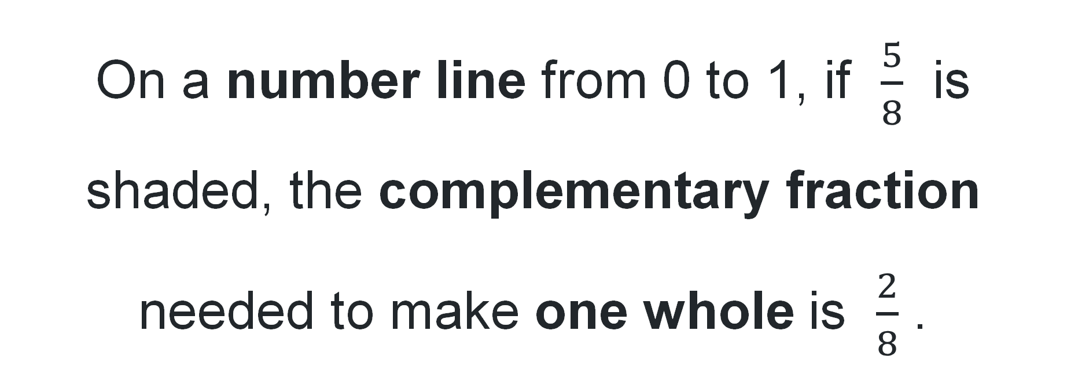
True or false (4)
On a number line from 0 to 1, if $\frac{5}{8}$ is shaded, the complementary fraction needed to make one whole is $\frac{2}{8}$ .
True | False
Notes:
The question on this slide connects to the content being explored in the developing number sense activity (Activity 8)
Syllabus focus area:
Partitioned fractions A (Note: Stage 2 content is reviewed)

Slide 55
Short response (29)
Luca has raised $4216 for charity. He spends $387 on advertising.
How much money does Luca have left?
Communicate your strategy.
Notes:
Short response questions provide brisk paced questions focussing on review of current and previous content to support spaced and interleaved practice.
Syllabus focus area:
Additive relations A

Slide 56
Short response (30)
Use an efficient strategy to solve:
5 × 246
Explain which strategy you chose and why it was efficient.
Notes:
Short response questions provide brisk paced questions focussing on review of current and previous content to support spaced and interleaved practice.
Syllabus focus area:
Multiplicative relations A

Slide 57
Short response (31)
Complete the number sentence
? × 6 = 48
What strategies did you use to find the missing factor?
Notes:
Short response questions provide brisk paced questions focussing on review of current and previous content to support spaced and interleaved practice.
Syllabus focus area:
Multiplicative relations B (Note: Stage 2 content is reviewed)

Slide 58
Short response (32)
A swimming carnival begins at 9:05 am and finishes at 11:15 am.
Use minutes to describe the total duration of the carnival.
Notes:
Short response questions provide brisk paced questions focussing on review of current and previous content to support spaced and interleaved practice.
Syllabus focus area:
Non-spatial measure A: Time (Note: Stage 2 content is reviewed)

Slide 59


Activity 8 – modelling fractions with fraction strips (1) (1)
Tim has folded his paper into 2 equal parts. Yani has folded his paper into 4 equal parts. Rocco has folded his paper into 3 equal parts.
Using strips of paper, explain who has the shortest and longest strip of paper.
Tim
Yani
Rocco
Notes:
This is a developing number sense activity.
Number sense refers to a deep understanding of numbers, including their magnitude, relationships, and the effects of operations on them. It supports fluency and understanding, estimation, flexible thinking, and efficient problem-solving. Number sense activities 1–4 ‘activate’ prior number knowledge and support the learning of new content in the unit. Number sense activities 5–8 ‘loop’ back and provide opportunity for spaced practice with concepts and procedures covered in previous units.
Syllabus focus area:
Partitioned fractions A (Note: Stage 2 content is reviewed)
Modelling fractions with fraction strips
This resource corresponds to Resource 23 and resource 24 in Stage 3 Year A Unit 2.
Present the following problem: Tim has folded his paper into 2 equal parts. Yani has folded his paper into 4 equal parts. Rocco has folded his paper into 3 equal parts.
Explain that the strips of paper represent one whole. Provide each student with strips of paper and ask them to explain who has the shortest and longest strip of paper.
Students can justify their reasoning by modelling each partition and comparing the whole strip. Discuss the complementary fractional part needed to complete the whole for each child
Display Resource 24 – answer strips.
Students turn and talk and discuss their responses in comparison to Resource 28 – answer strips in Stage 3 Year A unit 2. .

Slide 60
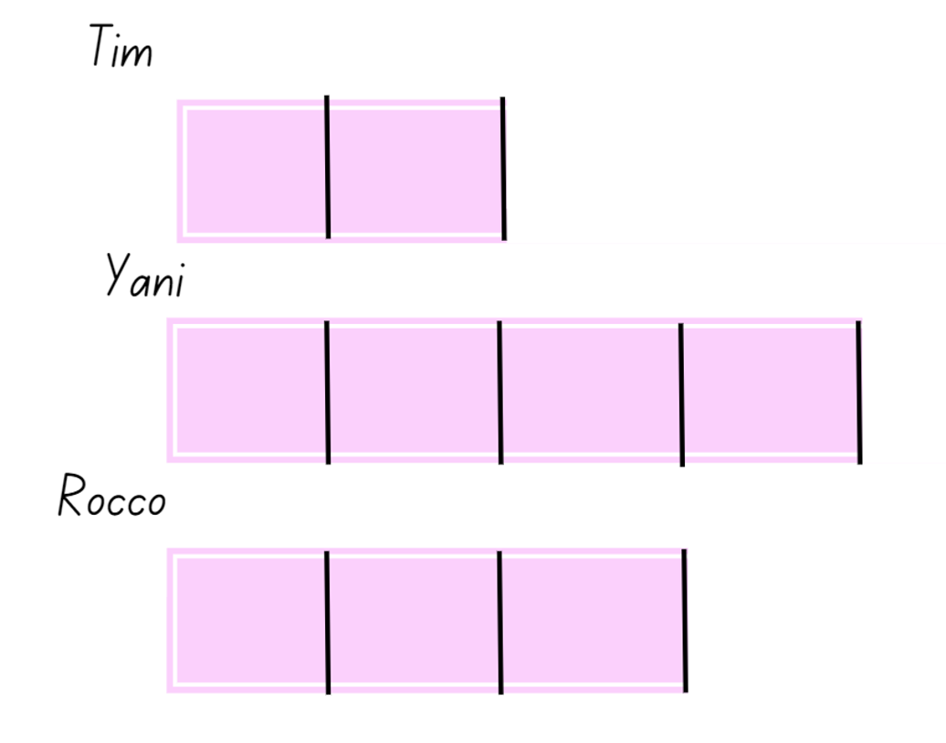
Activity 8 – modelling fractions with fraction strips (2) (2)
Notes:
Students turn and talk and discuss their responses in comparison to Resource 24 – answer strips.

Slide 61
Double Venn diagram
Object 1
Object 2
Features similar to both objects
Features of object 1
Features of object 2

Slide 62
Frayer
Definition
Facts/Characteristics
Word, term, concept
Examples
Non-examples

Slide 63
Spider map
Idea
Subject

Slide 64
Cline
Concept 1
Concept 2
Word
Word
Word
Word
Word
Word
Word
Word
Word
Word
Word

Slide 65

Compare and contrast

Slide 66
Multiple choice (5)
A
B
C
D

Slide 67
Multiple choice (6)
A
B
C
D

Slide 68
References
This presentation contains NSW Curriculum and syllabus content. The NSW Curriculum is developed by the NSW Education Standards Authority. This content is prepared by NESA for and on behalf of the Crown in the right of the State of New South Wales. The material is protected by Crown copyright.
Please refer to the NESA Copyright Disclaimer for more information https://educationstandards.nsw.edu.au/wps/portal/nesa/mini-footer/copyright.
NESA holds the only official and up-to-date versions of the NSW Curriculum and syllabus documents. Please visit the NSW Education Standards Authority (NESA) website https://educationstandards.nsw.edu.au/wps/portal/nesa/home and the NSW Curriculum website https://curriculum.nsw.edu.au.
Mathematics K–10 Syllabus © NSW Education Standards Authority (NESA) for and on behalf of the Crown in right of the State of New South Wales, 2022.​
National Numeracy Learning Progression © Australian Curriculum, Assessment and Reporting Authority (ACARA) 2010 to present, unless otherwise indicated. This material was downloaded from the Australian Curriculum website (National Numeracy Learning Progression) (accessed 22 July 2025) and was not modified.
Siemon D, Warren E, Beswick K, Faragher R, Miller J, Horne M, Jazby D, Breed M, Clark J and Brady K (2020) Teaching Mathematics: Foundations to Middle Years, 3rd edition, Oxford University Press Australia and New Zealand.
State of New South Wales (Department of Education) (n.d.) Coordinating groups: Snake eyes [PDF 8.0 MB], Developing efficient numeracy strategies (DENS): Stage 2, NSW Department of Education, accessed 26 June 2023.
State of New South Wales (Department of Education) (2023) ‘Colour in fractions’, Mathematics K-6 resources, NSW Department of Education website, accessed 17 June 2025.

Slide 69
Copyright
© State of New South Wales (Department of Education), 2025
The copyright material published in this resource is subject to the Copyright Act 1968 (Cth) and is owned by the NSW Department of Education or, where indicated, by a party other than the NSW Department of Education (third-party material).
Copyright material available in this resource and owned by the NSW Department of Education is licensed under a Creative Commons Attribution 4.0 International (CC BY 4.0) license.
This license allows you to share and adapt the material for any purpose, even commercially.
Attribution should be given to © State of New South Wales (Department of Education), 2025.
Material in this resource not available under a Creative Commons license:
the NSW Department of Education logo, other logos and trademark-protected material
Material owned by a third party that has been reproduced with permission. You will need to obtain permission from the third party to reuse its material.
Links to third-party material and websites
Please note that the provided (reading/viewing material/list/links/texts) are a suggestion only and implies no endorsement, by the New South Wales Department of Education, of any author, publisher, or book title. School principals and teachers are best placed to assess the suitability of resources that would complement the curriculum and reflect the needs and interests of their students.
If you use the links provided in this document to access a third party’s website, you acknowledge that the terms of use, including licence terms set out on the third-party’s website apply to the use which may be made of the materials on that third-party website or where permitted by the Copyright Act 1968 (Cth). The department accepts no responsibility for content on third-party websites.

