Slide 1
Instructions for use
This resource aligns to the learning in Stage 2 Year A Unit 18 and revisits content from earlier sample units.
Classroom teachers are encouraged to add and adapt to meet the needs of their students.
Save a copy of the file to make changes to the slide deck. Go to File > Download a Copy (this downloads a copy to the computer to edit in the PowerPoint app).
To convert the PowerPoint to Google Slides:
  Upload the file into Google Drive and open it.
  Go to File > Save as Google Slides.
  (Note – conversion may cause formatting changes in the slides.)

Slide 2

Review of Learning
Mathematics Stage 2 – Unit 18
Notes:
Reviews may include a combination of question types, requiring students to recall facts and key ideas, as well as apply their knowledge to solve problems and answer questions. To support active engagement, a mix of techniques should be employed.” (AERO, 2024).
This Review of Learning slide deck revisits key concepts from the following units:
Stage 2 Year A Unit 18
Stage 2 Year A Unit 17
Stage 2 Year A Unit 16
It also includes opportunities to review prior learning in non-number content, supporting consolidation across focus areas.
The review of learning resources include three key task types that support the development of mathematical proficiency through retrieval, spaced practice, and active participation. These practices complement the review phase (activating prior knowledge) embedded within the beginning of each lesson.
1.
Multiple-choice questions/True or false: Designed to promote active retrieval of key concepts and identify common misconceptions in number, supporting consolidation, understanding and fluency.
These questions:
support spaced and interleaved practice
help identify and address common misconceptions
support active recall and immediate feedback
support whole class participation
identify areas requiring reteach
2.
Short-response question sets: Carefully grouped questions that encourage spaced and interleaved practice across multiple focus areas, helping students revisit and apply knowledge from different points in time.
These questions:
have a combination of question types
address a range of focus areas
build automaticity and fluency
support active recall
allow for immediate feedback
identify content requiring reteach
3.
Developing number sense activities: A variety of practical, purposeful tasks that reinforce current learning and build on prior knowledge. These activities promote reasoning, problem-solving and conceptual understanding.
The review of learning resources are designed to work support teaching and learning in mathematics. For the most effective implementation, use the resources flexibly, adapting to meet student learning needs and individual classroom contexts.

Slide 3
Lessons
1
Review of learning 1
5
Review of learning 5
2
Review of learning 2
6
Review of learning 6
3
Review of learning 3
7
Review of learning 7
4
Review of learning 4
8
Review of learning 8
Notes:
Teacher notes:
Click lesson numbers to go to specific lessons
Interactive features can be viewed in slide show

Slide 4
Review of learning 1

Slide 5

Multiple choice (1)
If 36 + 28 = 64, then what is 64 – 28?
64
36
28
A | B | C | D
28 | 36 | 38 | 64
Notes:
This question connects to the content in the developing number sense activity (Activity 1)
Syllabus focus area:
Additive relations A

Slide 6

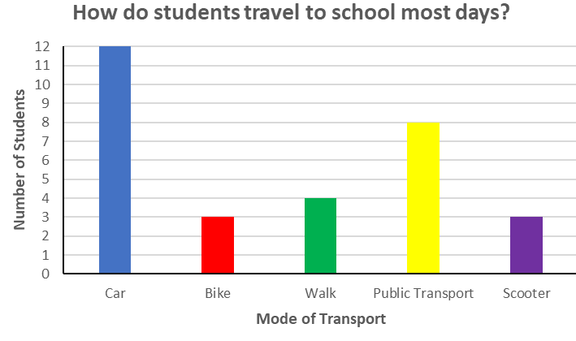
Short response (1)
Identify the features of the graph:
title
x-axis
y-axis
categories
data
intervals
Notes:
Short response questions provide brisk paced questions focussing on review of current and previous content to support spaced and interleaved practice.
Syllabus focus area:
Data A

Slide 7
Short response (2)
Create a number pattern using multiples of 3.
Describe the pattern using words, numbers and symbols.
Notes:
Short response questions provide brisk paced questions focussing on review of current and previous content to support spaced and interleaved practice.
Syllabus focus area:
Multiplicative Relations A

Slide 8
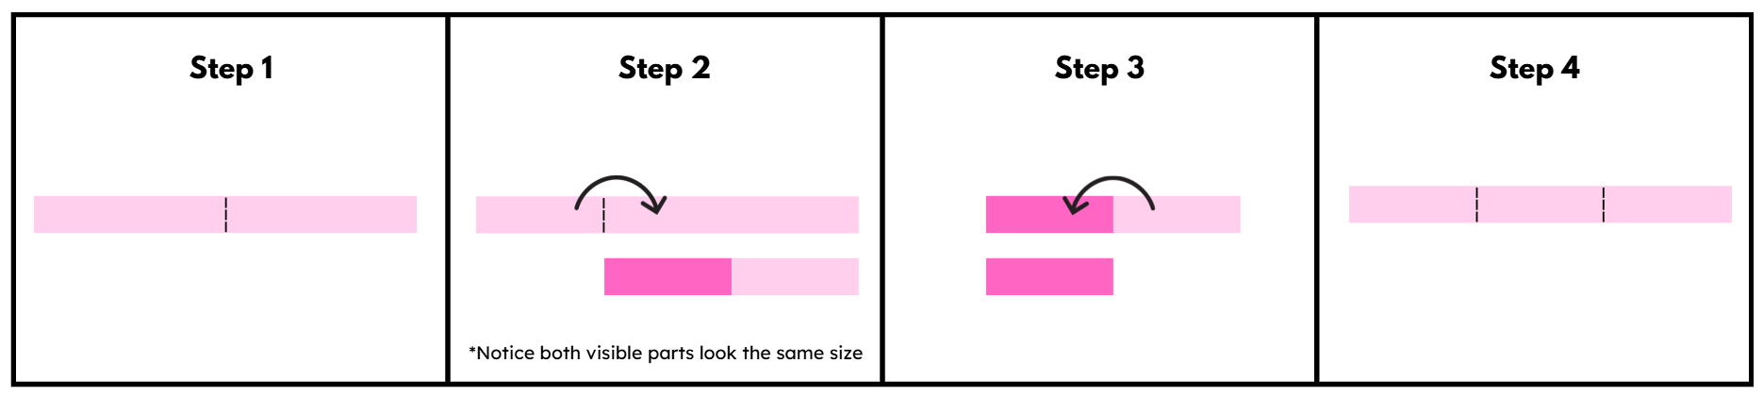
Short response (3)
Name the fraction made.
Communicate your reasoning.
Notes:
Short response questions provide brisk paced questions focussing on review of current and previous content to support spaced and interleaved practice.
Syllabus focus area:
Partitioned Fractions A

Slide 9
Short response (4)
Name the angle used to describe a quarter-turn.
Notes:
Short response questions provide brisk paced questions focussing on review of current and previous content to support spaced and interleaved practice.
Syllabus focus area:
Geometric measure A: Angles

Slide 10

Activity 1 – missing values (1)
There are 58 students in Year 3. 39 of them spend lunch time on the oval playing ball games. The remaining students play under the COLA.
How many students play under the COLA?
Think-pair-share the strategies that could be used to find the missing value.
Notes:
This is a developing number sense activity.
Number sense refers to a deep understanding of numbers, including their magnitude, relationships, and the effects of operations on them. It supports fluency and understanding, estimation, flexible thinking, and efficient problem-solving. Number sense activities 1–4 ‘activate’ prior number knowledge and support the learning of new content in the unit. Number sense activities 5–8 ‘loop’ back and provide opportunity for spaced practice with concepts and procedures covered in previous units.
Syllabus focus area:
Additive relations A
Missing value
This resource corresponds to Resource 28 – additive strategies, Resource 29 – word problem and Resource 30 – bar models in Stage 2 Year A Unit 18.
Notes: Students may wish to refer to Resource 28 – additive strategies.
Display Resource 29 – word problem.
Students turn and talk with a partner, discussing the strategies that could be used to find the missing value. Students may wish to refer to Resource 28 – additive strategies.
Explain that a bar model can be an effective representation to find missing values and to check solutions using inverse operations.
Definition – Inverse operation: the operation that reverses the effect of another operation. Addition and subtraction are inverse operations. When you add 3 to 7 you get 10. If you then subtract 3, you get back to 7.
Demonstrate drawing a bar model on the board to represent the solution to Resource 29 – word problem.
Identify the related addition and subtraction number sentences that the bar model represents. Model thinking aloud, ‘If I know 39 + 19 = 58, then I know 58 − 19 = 39.’
Display Resource 30 – bar models. Students solve the problems and record the related addition and subtraction number sentences.
Regroup and check for understanding by asking students to share responses.

Slide 11
Activity 1 – missing values (2) (2)
77
A.
56
?
83
B.
48
?
49
C.
12
?
Solve the problems and record the related addition and subtraction number sentences on a whiteboard.
Notes:
This is a developing number sense activity.
Number sense refers to a deep understanding of numbers, including their magnitude, relationships, and the effects of operations on them. It supports fluency and understanding, estimation, flexible thinking, and efficient problem-solving. Number sense activities 1–4 ‘activate’ prior number knowledge and support the learning of new content in the unit. Number sense activities 5–8 ‘loop’ back and provide opportunity for spaced practice with concepts and procedures covered in previous units.
Syllabus focus area:
Additive relations A
Missing value
This resource corresponds to Resource 28 – additive strategies, Resource 29 – word problem and Resource 30 – bar models in Stage 2 Year A Unit 18.
This task is continued from the previous slide.

Slide 12
Review of learning 2

Slide 13
True or false (1)
Nat said that all these number sentences are correct.
53 + 25 = 78
78 – 53 = 25
78 + 25 = 53
True | False
Notes:
The question on this slide connects to the content being explored in the developing number sense activity (Activity 2)
Syllabus focus area:
Additive relations A

Slide 14
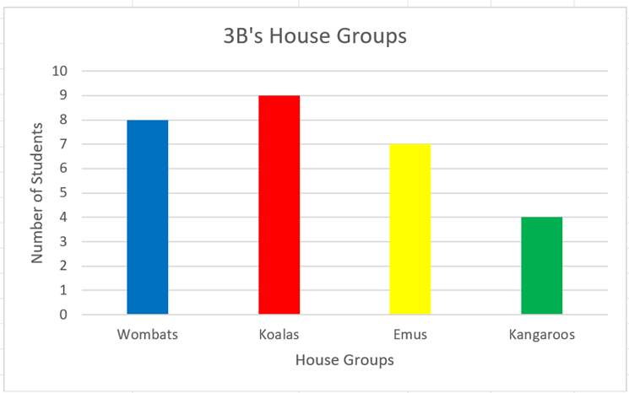
Short response (5)
Explain how using software helps to organise and display data.
Notes:
Short response questions provide brisk paced questions focussing on review of current and previous content to support spaced and interleaved practice.
Syllabus focus area:
Data A

Slide 15
Short response (6)
Record the fact families for the following:
2 x 4
2 x 5
2 x 6
2 x 7
Notes:
Short response questions provide brisk paced questions focussing on review of current and previous content to support spaced and interleaved practice.
Syllabus focus area:
Multiplicative Relations A

Slide 16
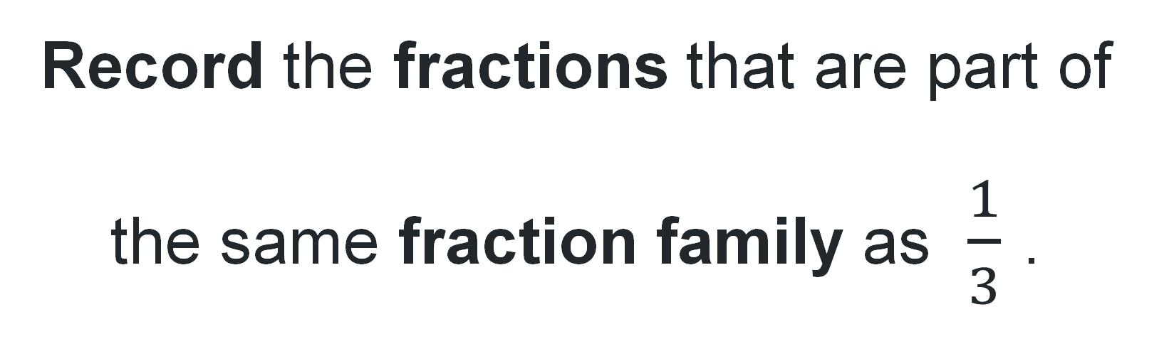
Short response (7)
Record the fractions that are part of the same fraction family as $\frac{1}{3}$ .
Notes:
Short response questions provide brisk paced questions focussing on review of current and previous content to support spaced and interleaved practice.
Syllabus focus area:
Partitioned Fractions A

Slide 17
Short response (8)
The pond was measured as 235 cm long.
Record its length in metres and centimetres?
Notes:
Short response questions provide brisk paced questions focussing on review of current and previous content to support spaced and interleaved practice.
Syllabus focus area:
Geometric measure A: Length

Slide 18
Activity 2 – number sentences
28
35
14
42
21
Use these numbers to record as many related number sentences as possible.
Notes:
This is a developing number sense activity.
Number sense refers to a deep understanding of numbers, including their magnitude, relationships, and the effects of operations on them. It supports fluency and understanding, estimation, flexible thinking, and efficient problem-solving. Number sense activities 1–4 ‘activate’ prior number knowledge and support the learning of new content in the unit. Number sense activities 5–8 ‘loop’ back and provide opportunity for spaced practice with concepts and procedures covered in previous units.
Syllabus focus area:
Additive relations A
Number sentences
Record the numbers 28, 35, 14, 42, 21 on the board.
Students use these numbers to identify as many related number sentences as possible.
Ask how the number sentence 28 + 14 = 42 could be used to identify other related number sentences. For example, ‘Because I know 28 + 14 = 42, then I know 42 − 14 = 28.’
Using only the numbers recorded on the board, students create as many number sentences as possible, recording their thinking on individual whiteboards.
Regroup and discuss:
Which of your number sentences show that addition and subtraction are inverse operations?
Which of your number sentences show the commutative property?

Slide 19
Review of learning 3

Slide 20
Multiple choice (2)
124 = __ + 96
Which bar model correctly represents the number sentence?
A | B | C | D
124
96
28
124
96
28
124
28
96
124
28
96
Communicate your reasoning.
Notes:
This question connects to the content in the developing number sense activity (Activity 3)
Syllabus focus area:
Additive relations A

Slide 21
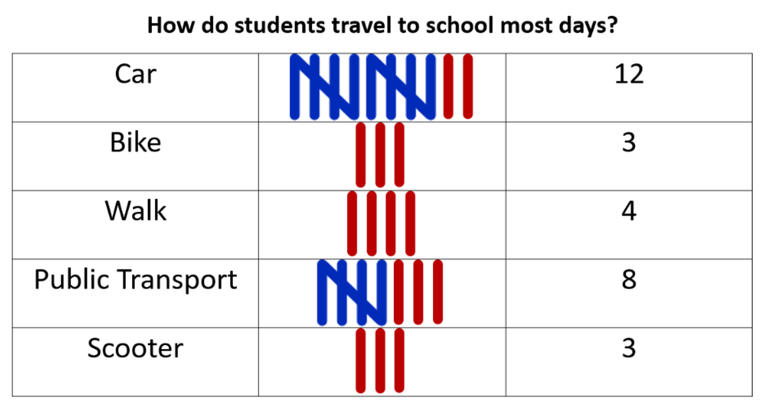
Short response (9)
Record labels for these parts of a graph using the data in the table:
title
x-axis
y-axis
categories
Notes:
Short response questions provide brisk paced questions focussing on review of current and previous content to support spaced and interleaved practice.
Syllabus focus area:
Data A

Slide 22
Short response (10)
Use the commutative property to create fact families for the following:
4 x 3
4 x 6
4 x 9
Notes:
Short response questions provide brisk paced questions focussing on review of current and previous content to support spaced and interleaved practice.
Syllabus focus area:
Multiplicative Relations A

Slide 23
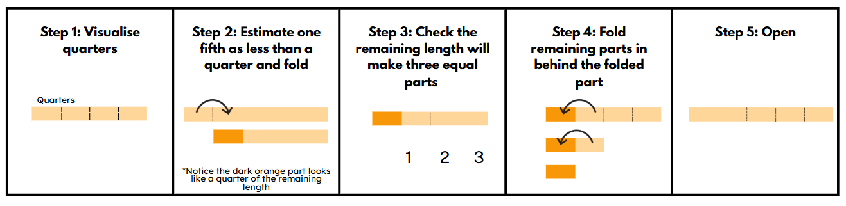
Short response (11)
Name the fraction made.
Communicate your reasoning
Notes:
Short response questions provide brisk paced questions focussing on review of current and previous content to support spaced and interleaved practice.
Syllabus focus area:
Partitioned fractions A

Slide 24
Short response (12)
Name and describe these shapes.
Explain how they are similar and how they are different.
Notes:
Short response questions provide brisk paced questions focussing on review of current and previous content to support spaced and interleaved practice.
Syllabus focus area:
Two-dimensional spatial structure A: 2D Shapes

Slide 25
Activity 3 – missing values (3)
_ + 26 = 58
19 + _ = 35
84 − _ = 33
194 = _ + 177
168 − _ = 45
Notes:
This is a developing number sense activity.
Number sense refers to a deep understanding of numbers, including their magnitude, relationships, and the effects of operations on them. It supports fluency and understanding, estimation, flexible thinking, and efficient problem-solving. Number sense activities 1–4 ‘activate’ prior number knowledge and support the learning of new content in the unit. Number sense activities 5–8 ‘loop’ back and provide opportunity for spaced practice with concepts and procedures covered in previous units.
Syllabus focus area:
Additive relations A
Missing values
This resource corresponds to Resource 28 – additive strategies in Stage 2 Year A Unit 18.
Record the following number sentences on the board and provide students with writing materials.
_ + 26 = 58
19 + _ = 35
84 − _ = 33
194 = _ + 177
168 − _ = 45.
Students select 2 of the number sentences to solve and calculate the missing value by using a number line or bar model. Encourage students to check their solution by using the inverse operation.
Students swap whiteboards with a partner to check solutions and provide peer feedback, including checking solutions using the inverse operation.
Ask students to share their recorded representations. Refer to Resource 28 – additive strategies to connect student recordings to strategies used. For example, for the number sentence 19 + _ = 35, a solution could use the strategies of inverse operation (knowing that 35 −19 = _ is the same as 19 + _ = 35) and constant difference (add one to both numbers = 36 − 20 = 16).
Reflect on which strategies and representations were most effective for number sentences with missing values.

Slide 26
Review of learning 4

Slide 27
True or false (2)
68
32
The missing number in this bar model is 28.
True | False
Notes:
The question on this slide connects to the content being explored in the developing number sense activity (Activity 4)
Syllabus focus area:
Additive relations A

Slide 28
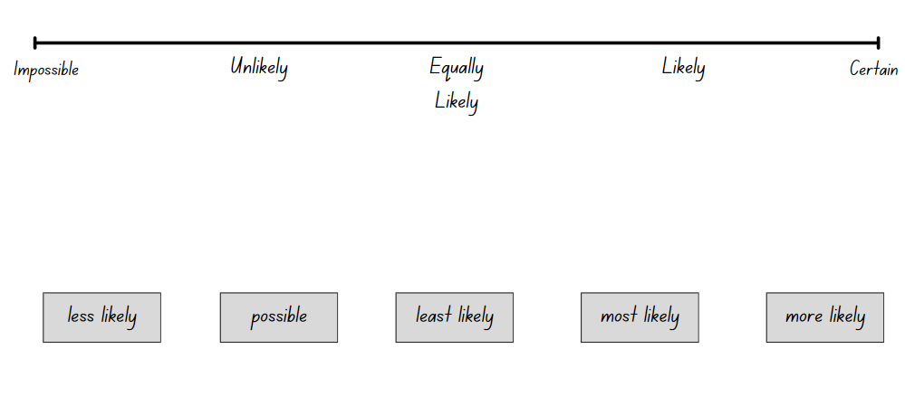
Short response (13)
Draw a line to where the chance words go on the chance scale.
Notes:
Short response questions provide brisk paced questions focussing on review of current and previous content to support spaced and interleaved practice.
Syllabus focus area:
Chance A

Slide 29
Short response (13)
Draw the following line.
Impossible
Certain
Write the following words in the correct position on the line.
Likely and Unlikely
Notes:
Short response questions provide brisk paced questions focussing on review of current and previous content to support spaced and interleaved practice.
Syllabus focus area:
Chance A

Slide 30
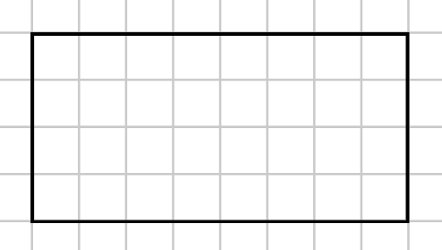
Short response (14)
This shape has been drawn on grid paper with 1 cm squares.
What is the area of this shape?
Explain how you know.
Notes:
Short response questions provide brisk paced questions focussing on review of current and previous content to support spaced and interleaved practice.
Syllabus focus area:
Two-dimensional spatial structure A: Area

Slide 31
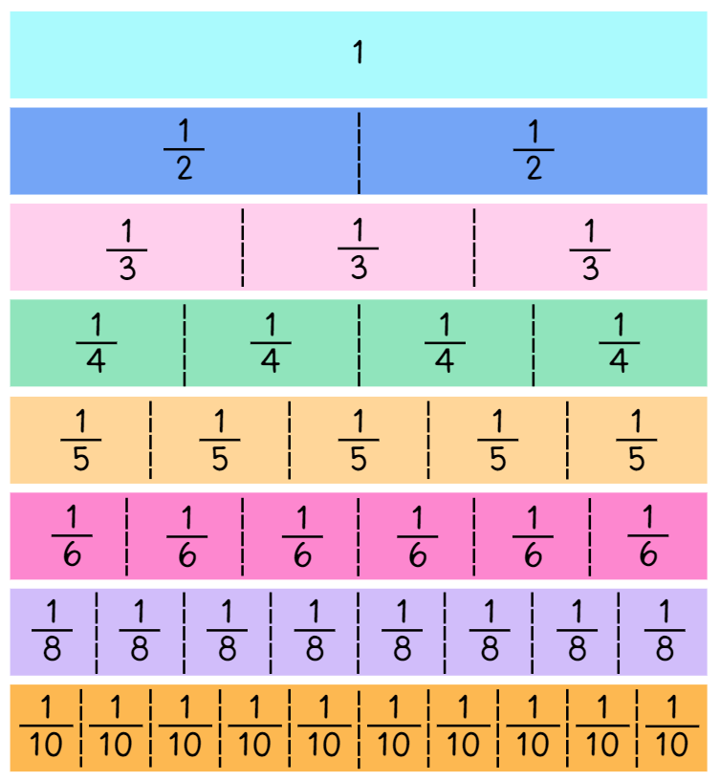
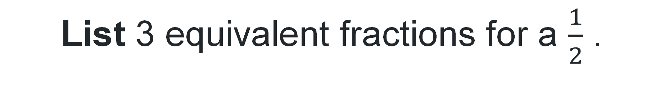
Short response (15)
List 3 equivalent fractions for a $\frac{1}{2}$ .
Notes:
Short response questions provide brisk paced questions focussing on review of current and previous content to support spaced and interleaved practice.
Syllabus focus area:
Partitioned Fractions B

Slide 32
Short response (16)
Describe 3 activities that take around 20 minutes.
For example, recess is about 20 minutes
Notes:
Short response questions provide brisk paced questions focussing on review of current and previous content to support spaced and interleaved practice.
Syllabus focus area:
Non-spatial measure A: Time

Slide 33
Activity 4 – part and whole
The whole is 82, one part is 56. What’s the missing part?
75 – 29 = ? Can you check it using addition?
If 38 + 19 = 57, how can we check it using subtraction?
Notes:
This is a developing number sense activity.
Number sense refers to a deep understanding of numbers, including their magnitude, relationships, and the effects of operations on them. It supports fluency and understanding, estimation, flexible thinking, and efficient problem-solving. Number sense activities 1–4 ‘activate’ prior number knowledge and support the learning of new content in the unit. Number sense activities 5–8 ‘loop’ back and provide opportunity for spaced practice with concepts and procedures covered in previous units.
Syllabus focus area:
Additive relations A
Part and whole
Ask: If 64 – 17 = 47, what is 64 – 47?
Seek input from students by asking them to explain their thinking.
Model how to check subtraction using the inverse operation (addition). For example, to check that 64 – 17 = 47, use addition: 47 + 17 = 64. This confirms the subtraction is correct.
Draw a bar model on the board that represents the number 64 as a whole, with two smaller bars showing the parts 17 and 47.
Explain that the picture shows a large number (the whole) split into 2 smaller numbers (the parts). If one part and the whole are known, the missing part can be found.
Ask students to work in pairs to answer the following questions:
The whole is 82, one part is 56. What’s the missing part?
75 – 29 = ? Can you check it using addition?
If 38 + 19 = 57, how can we check it using subtraction?
Regroup as a class and discuss the following prompts:
How did you find the missing number?
How can you check if you’re right?
What is the opposite of subtraction?

Slide 34
Review of learning 5

Slide 35

Multiple choice (3)
Which answer is correct?
x 100
A | B | C | D
8 | 80 | 800 | 8000
Communicate your reasoning.
Notes:
This question connects to the content in the developing number sense activity (Activity 5)
Syllabus focus area:
Representing numbers using place value B :Whole numbers

Slide 36
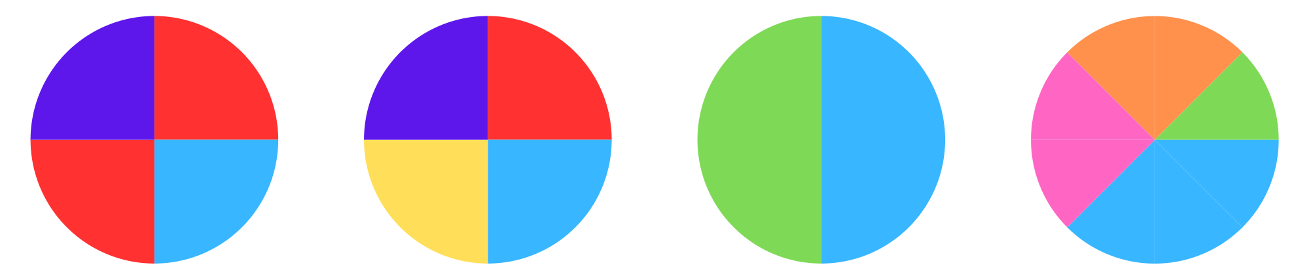
Short response (17)
Which 2 spinners show an equally likely chance of an event occurring?
Spinner 1 | Spinner 2 | Spinner 3 | Spinner 4
Communicate your reasoning.
Notes:
Short response questions provide brisk paced questions focussing on review of current and previous content to support spaced and interleaved practice.
Syllabus focus area:
Chance B

Slide 37

Short response (18)
Estimate which leaf would have the largest area.
Explain how you know.
Communicate how you could work it out.
Notes:
Short response questions provide brisk paced questions focussing on review of current and previous content to support spaced and interleaved practice.
Syllabus focus area:
Two-dimensional spatial structure A: Area

Slide 38
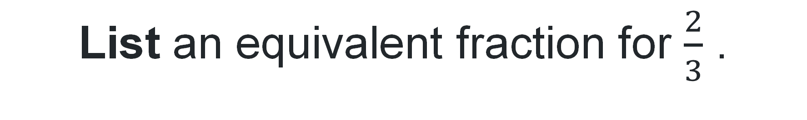
Short response (19)
List an equivalent fraction for $\frac{2}{3}$ .
Notes:
Short response questions provide brisk paced questions focussing on review of current and previous content to support spaced and interleaved practice.
Syllabus focus area:
Partitioned Fractions A

Slide 39
Short response (20)
List 5 items that each have a mass of about the same as one kilogram.
Notes:
Short response questions provide brisk paced questions focussing on review of current and previous content to support spaced and interleaved practice.
Syllabus focus area:
Non-spatial measure A: Mass

Slide 40
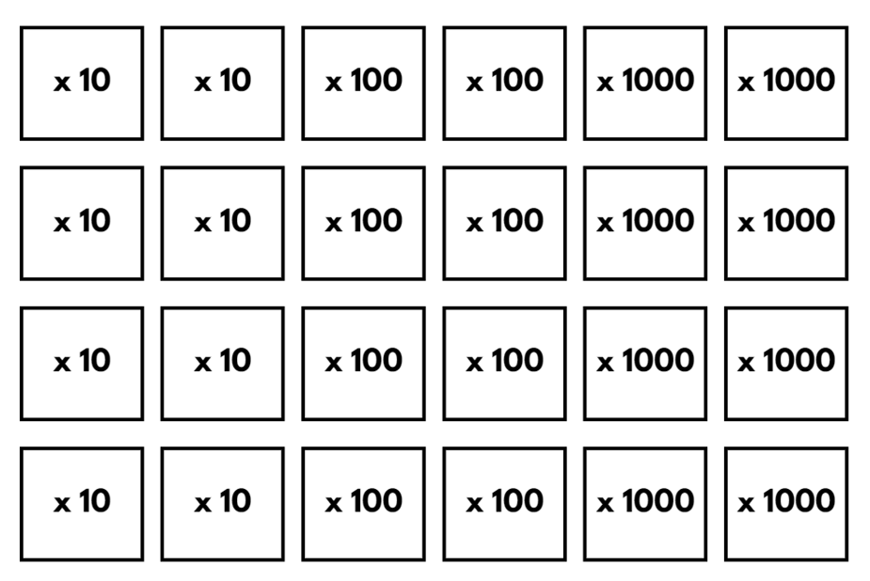
Activity 5 – largest number wins
Notes:
This is a developing number sense activity.
Number sense refers to a deep understanding of numbers, including their magnitude, relationships, and the effects of operations on them. It supports fluency and understanding, estimation, flexible thinking, and efficient problem-solving. Number sense activities 1–4 ‘activate’ prior number knowledge and support the learning of new content in the unit. Number sense activities 5–8 ‘loop’ back and provide opportunity for spaced practice with concepts and procedures covered in previous units.
Syllabus focus area:
Representing numbers using place value B: Whole numbers
Largest number wins
This resource corresponds to Resource 31 – Place value cards in Stage 2 Year A Unit 18.
Note: prepare Resource 31 – Place value cards prior to the lesson by printing and cutting one set per small group (3 to 4 students).
Explain the rules of the game:
The aim of the game is to make the largest number.
Randomly place cards from Resource 31 – Place value cards face down in the centre of the small group of players.
Players take turns to roll a 9-sided die.
After each roll, the player flips over a card and multiplies the number rolled by the value on the card. For example, if a 9 is rolled and the card flipped says ‘× 100’, it would become 900.
Repeat until each player has had a turn.
The player with the largest number receives a point if they can read the number correctly.
Shuffle cards after each round of play.
The player with the most points at the end of the game period, wins.
Provide small groups (3 to 4 students) with a pre-prepared set of Resource 31 – Place value cards and a 9-sided dice to play the game.
Regroup and share reflections on how making the number 10, 100 or 1000 times as large, changes the place value of the digits.

Slide 41
Review of learning 6

Slide 42
True or false (3)
64 multiplied by:
10 is 640
100 is 6 400
1 000 is 64 000
True | False
Communicate your reasoning.
Notes:
The question on this slide connects to the content being explored in the developing number sense activity (Activity 6)
Syllabus focus area:
Representing numbers using place value B :Whole numbers

Slide 43
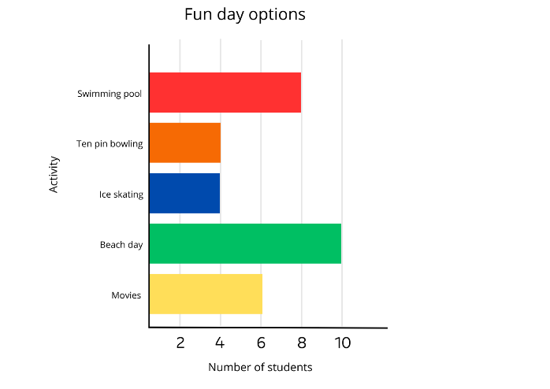
Short response (21)
List 3 things you know from the data in the column graph.
Notes:
Short response questions provide brisk paced questions focussing on review of current and previous content to support spaced and interleaved practice.
Syllabus focus area:
Data A

Slide 44
Short response (22)
Identify 3 differences between a pyramid and a cylinder.
Notes:
Short response questions provide brisk paced questions focussing on review of current and previous content to support spaced and interleaved practice.
Syllabus focus area:
Three-dimensional spatial structure A: 3D objects

Slide 45
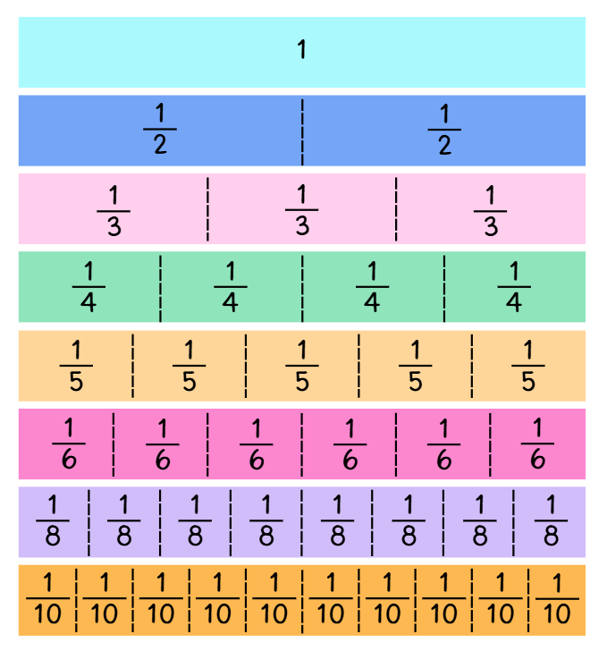
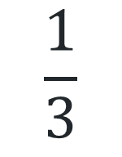
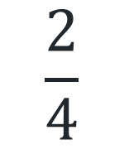
Short response (23)
Identify equivalent fractions for:
$$\frac{2}{4}$$
$$\frac{1}{3}$$
Notes:
Short response questions provide brisk paced questions focussing on review of current and previous content to support spaced and interleaved practice.
Syllabus focus area:
Partitioned Fractions B

Slide 46
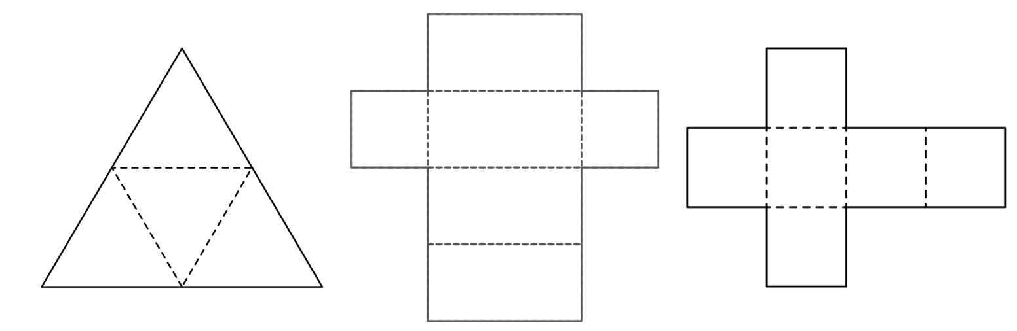
Short response (24)
Which of these nets would make a cube?
Explain your reasoning.
Notes:
Short response questions provide brisk paced questions focussing on review of current and previous content to support spaced and interleaved practice.
Syllabus focus area:
Three-dimensional spatial structure A: 3D Objects

Slide 47
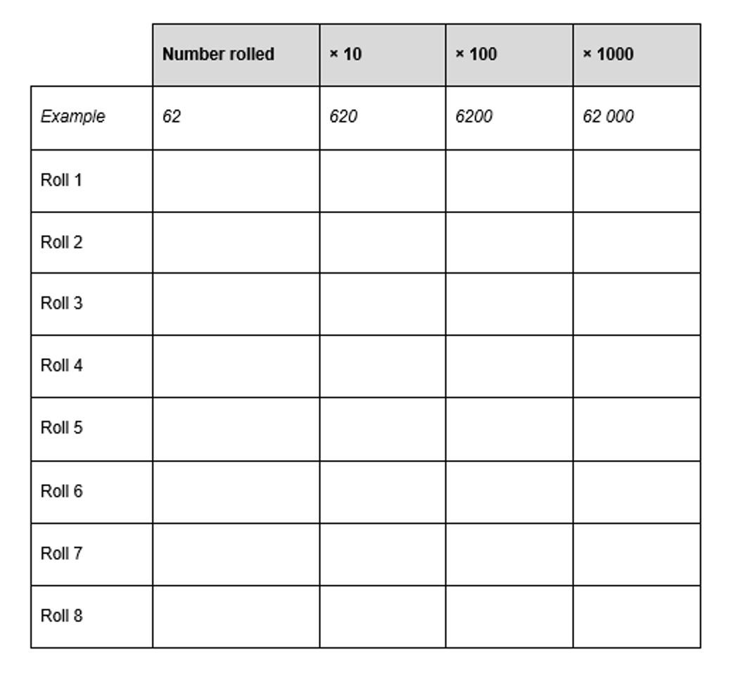
Activity 6 – ten times larger
Notes:
This is a developing number sense activity.
Number sense refers to a deep understanding of numbers, including their magnitude, relationships, and the effects of operations on them. It supports fluency and understanding, estimation, flexible thinking, and efficient problem-solving. Number sense activities 1–4 ‘activate’ prior number knowledge and support the learning of new content in the unit. Number sense activities 5–8 ‘loop’ back and provide opportunity for spaced practice with concepts and procedures covered in previous units.
Syllabus focus area:
Representing numbers using place value B: Whole numbers
10 times larger
This resource corresponds to Resource 32 – ten times larger in Stage 2 Year A Unit 18.
Provide pairs with Resource 32 – ten times larger and two 9-sided dice.
Pairs roll the dice and record the number rolled as a 2-digit number. For example, if a 6 and a 2 are rolled, the number 62 would be recorded.
Students record the numbers that are 10, 100 and 1000 times larger than the number rolled.
Repeat the process to complete the table on Resource 32 – ten times larger.
Note: some students may appreciate further investigation using 3-digit numbers.

Slide 48
Review of learning 7

Slide 49
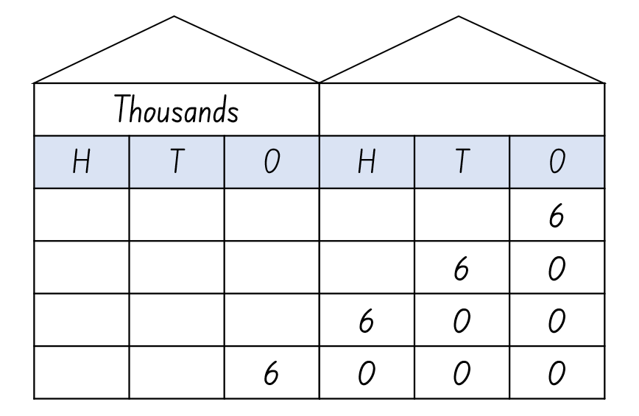
Multiple choice (4)
What is the value of the circled number?
A | B | C | D
6 ones | 6 tens | 6 hundreds | 6 thousands
Communicate your reasoning.
Notes:
This question connects to the content in the developing number sense activity (Activity 7)
Syllabus focus area:
Representing numbers using place value B :Whole numbers

Slide 50
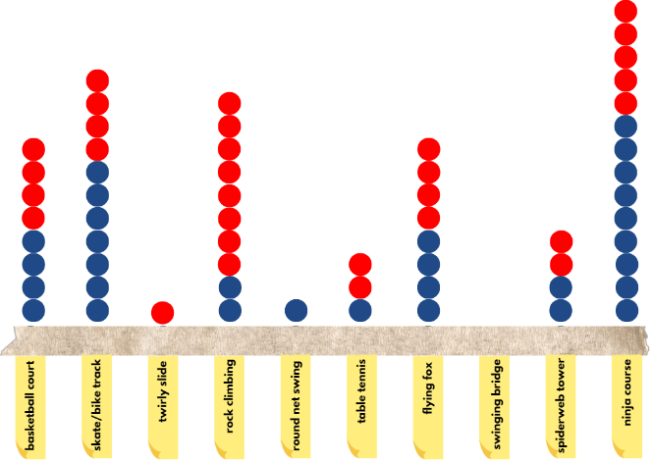
Short response (25)
Is the ninja course the most popular choice?
What was the second most popular choice?
What was a choice that wasn’t the most popular but wasn’t the least popular?
Notes:
Short response questions provide brisk paced questions focussing on review of current and previous content to support spaced and interleaved practice.
Syllabus focus area:
Data A

Slide 51

Short response (26)
This prism was made with cubic centimetre blocks.
How many layers does this prism have?
What is its volume?
How do you know?
Notes:
Short response questions provide brisk paced questions focussing on review of current and previous content to support spaced and interleaved practice.
Syllabus focus area:
Three-dimensional spatial structure A: Volume

Slide 52
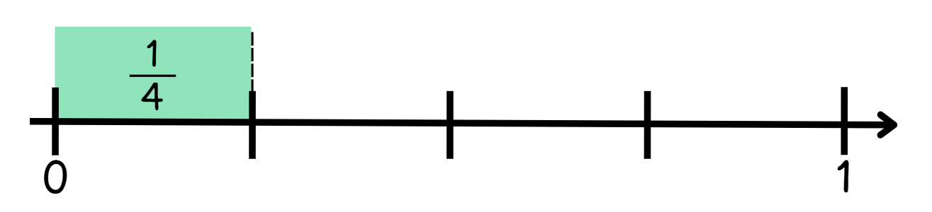
Short response (27)
?
Record the fraction needed to make the whole.
Communicate your reasoning.
Notes:
Short response questions provide brisk paced questions focussing on review of current and previous content to support spaced and interleaved practice.
Syllabus focus area:
Partitioned Fractions A

Slide 53
Short response (28)
If the pencil is 63 mm long, how long is it in centimetres and millimetres?
Notes:
Short response questions provide brisk paced questions focussing on review of current and previous content to support spaced and interleaved practice.
Syllabus focus area:
Geometric measure A: Length

Slide 54
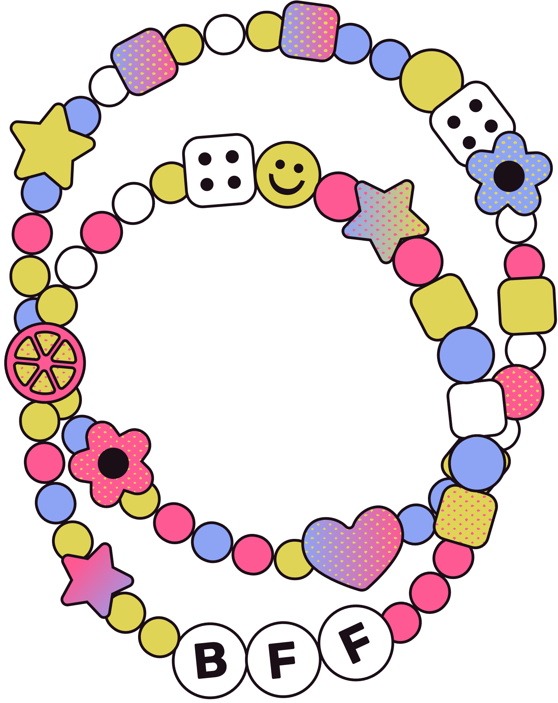


Activity 7 – truth detective(1)
.
A
B
C
Alex has $285 in their bank account.
Jesse has $2850 in his bank account.
Jesse has 100 times as much money as Alex.
Kel made 165 friendship bracelets.
Denise made 1650.
Denise made 10 times more bracelets than Kel.
Warrick collected 152 trading cards.
Paul collected 1520 trading cards.
Paul has 1000 times the number of cards that Warrick has.
Notes:
This is a developing number sense activity.
Number sense refers to a deep understanding of numbers, including their magnitude, relationships, and the effects of operations on them. It supports fluency and understanding, estimation, flexible thinking, and efficient problem-solving. Number sense activities 1–4 ‘activate’ prior number knowledge and support the learning of new content in the unit. Number sense activities 5–8 ‘loop’ back and provide opportunity for spaced practice with concepts and procedures covered in previous units.
Syllabus focus area:
Representing numbers using place value B: Whole numbers
Truth detective
This resource corresponds to Resource 33 – truth detective in Stage 2 Year A Unit 18.
Display Resource 33 – Truth detective. Explain that Detective Solve-it needs help identifying the true statement.
Students turn and talk with a partner to determine the true statement and justify their choice. Monitor and provide feedback on their understanding of how multiplying a number by 10, 100, or 1000 changes its place value.
Pairs create their own ‘truth detective’ scenarios involving numbers 10, 100 or 1000 times as large.

Slide 55
Review of learning 8

Slide 56
True or false (4)
When 96 is made 1000 times as large, it makes 9600.
True | False
Communicate your reasoning.
Notes:
The question on this slide connects to the content being explored in the developing number sense activity (Activity 8)
Syllabus focus area:
Representing numbers using place value B :Whole numbers

Slide 57
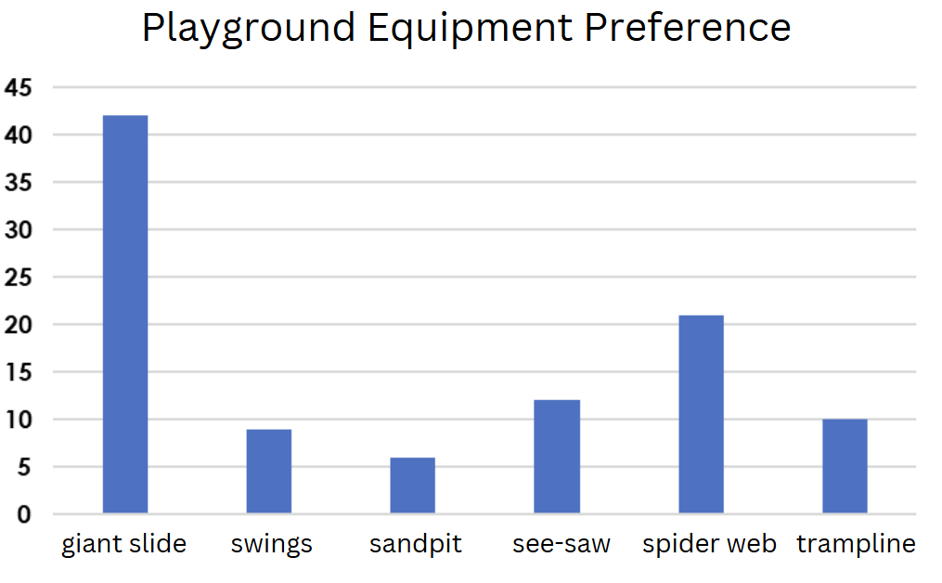
Short response (29)
How many students selected the giant slide?
How many more students selected the spider web compared to sandpit?
The least popular choice was the swings. True or false?
Communicate your reasoning.
Notes:
Short response questions provide brisk paced questions focussing on review of current and previous content to support spaced and interleaved practice.
Syllabus focus area:
Data A

Slide 58
Short response (30)
Which prism has the largest volume?
b.
a.
Communicate your reasoning.
Notes:
Short response questions provide brisk paced questions focussing on review of current and previous content to support spaced and interleaved practice.
Syllabus focus area:
Three-dimensional spatial structure A: Volume

Slide 59
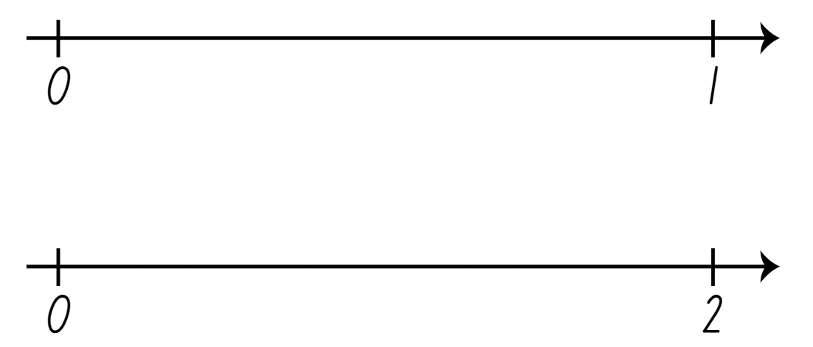

Short response (31)
Identify $\frac{1}{2}$ on both number lines
Communicate your reasoning.
Notes:
Short response questions provide brisk paced questions focussing on review of current and previous content to support spaced and interleaved practice.
Syllabus focus area:
Partitioned fractions B

Slide 60

Short response (32)
What time is shown on this clock?
How could it be read a different way?
Notes:
Short response questions provide brisk paced questions focussing on review of current and previous content to support spaced and interleaved practice.
Syllabus focus area:
Non-spatial measure A: Time

Slide 61
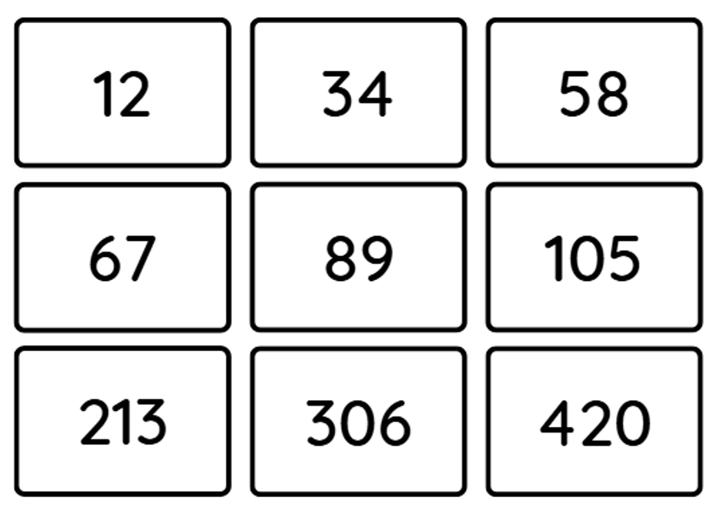
Activity 8 – slide it left(2)
Notes:
This is a developing number sense activity.
Number sense refers to a deep understanding of numbers, including their magnitude, relationships, and the effects of operations on them. It supports fluency and understanding, estimation, flexible thinking, and efficient problem-solving. Number sense activities 1–4 ‘activate’ prior number knowledge and support the learning of new content in the unit. Number sense activities 5–8 ‘loop’ back and provide opportunity for spaced practice with concepts and procedures covered in previous units.
Syllabus focus area:
Representing numbers using place value B: Whole numbers
10 times larger
This resource corresponds to Resource 31 – place value cards and Resource 34 – number cards in Stage 2 Year A Unit 18.
Note: prepare Resource 34 – Number cards prior to the lesson by printing and cutting one set per small group (3 to 4 students). Resource 31 – Place value cards can be utilised from DNS activity 5.
Explain the rules of the game:
Students work in pairs or small groups.
One player draws one number card and one multiplier card.
Example: Number card: 76, Place value card: ×100
The student multiplies the number (76 × 100 = 7 600).
They then describe how the digits have changed position using place value language. For example, the 7 shifted from tens place to thousands place, and the 6 moved from ones place to hundreds place.
The next player takes a turn.
Regroup as a class and check for understanding by asking:
What happened to the digits when you multiplied the number?
How does multiplying by 1000 make the number bigger compared to multiplying by 10?
Remind students that multiplying by 10, 100, or 1000 does not change the digits themselves, but moves them to a different place, which changes their value.

Slide 62
Double Venn diagram
Object 1
Object 2
Features similar to both objects
Features of object 1
Features of object 2

Slide 63
Frayer
Definition
Facts/Characteristics
Word, term, concept
Examples
Non-examples

Slide 64
Spider map
Idea
Subject

Slide 65
Cline
Concept 1
Concept 2
Word
Word
Word
Word
Word
Word
Word
Word
Word
Word
Word

Slide 66

Compare and contrast
Notes:
Use the arrows to navigate between related activities.
Hyperlink each arrow to compare between related slides.

Slide 67
Multiple choice (5)
A
B
C
D
Notes:
This question connects to the content in the developing number sense activity (Activity 1)
This question can:
support spaced and interleaved practice
help identify and address common misconceptions
support active recall and immediate feedback
support whole class participation
identify areas requiring reteach
Teachers are encouraged to adapt and contextualise for their contexts.

Slide 68
Multiple choice (6)
A
B
C
D
Notes:
This question connects to the content in the developing number sense activity (Activity 1)
Syllabus focus area:
Multiplicative relations A
This question can:
support spaced and interleaved practice
help identify and address common misconceptions
support active recall and immediate feedback
support whole class participation
identify areas requiring reteach
Teachers are encouraged to adapt and contextualise for their contexts.

Slide 69
References
This presentation contains NSW Curriculum and syllabus content. The NSW Curriculum is developed by the NSW Education Standards Authority. This content is prepared by NESA for and on behalf of the Crown in the right of the State of New South Wales. The material is protected by Crown copyright.
Please refer to the NESA Copyright Disclaimer for more information https://educationstandards.nsw.edu.au/wps/portal/nesa/mini-footer/copyright.
NESA holds the only official and up-to-date versions of the NSW Curriculum and syllabus documents. Please visit the NSW Education Standards Authority (NESA) website https://educationstandards.nsw.edu.au/wps/portal/nesa/home and the NSW Curriculum website https://curriculum.nsw.edu.au.
Mathematics K–10 Syllabus © NSW Education Standards Authority (NESA) for and on behalf of the Crown in right of the State of New South Wales, 2022.
National Numeracy Learning Progression © Australian Curriculum, Assessment and Reporting Authority (ACARA) 2010 to present, unless otherwise indicated. This material was downloaded from the Australian Curriculum website (National Numeracy Learning Progression) (accessed 20 May 2025) and was not modified.
Amplify Education (2024) Polypad, Polypad website, accessed 23 May 2025.
NESA (NSW Education Standards Authority) (2022a) ‘Glossary’, Mathematics K–10 Syllabus, NESA website, accessed 26 May 2025.
NESA (2022b) ‘Stage 2: Teaching advice for Chance B’, Mathematics K–10 Syllabus, NESA website, accessed 21 May 2025.
NESA (2022b) ‘Stage 2: Teaching advice for Data A’, Mathematics K–10 Syllabus, NESA website, accessed 21 May 2025.
Tuohilampi L (2022) Seriously Fun Maths: The complete guide to motivational mathematics, Amba Press, Melbourne.
wheelofnames.com (n.d.) Wheel of Names [website], accessed 26 May 2025.

Slide 70
Copyright
© State of New South Wales (Department of Education), 2025
The copyright material published in this resource is subject to the Copyright Act 1968 (Cth) and is owned by the NSW Department of Education or, where indicated, by a party other than the NSW Department of Education (third-party material).
Copyright material available in this resource and owned by the NSW Department of Education is licensed under a Creative Commons Attribution 4.0 International (CC BY 4.0) license.
This license allows you to share and adapt the material for any purpose, even commercially.
Attribution should be given to © State of New South Wales (Department of Education), 2025.
Material in this resource not available under a Creative Commons license:
the NSW Department of Education logo, other logos and trademark-protected material
Material owned by a third party that has been reproduced with permission. You will need to obtain permission from the third party to reuse its material.
Links to third-party material and websites
Please note that the provided (reading/viewing material/list/links/texts) are a suggestion only and implies no endorsement, by the New South Wales Department of Education, of any author, publisher, or book title. School principals and teachers are best placed to assess the suitability of resources that would complement the curriculum and reflect the needs and interests of their students.
If you use the links provided in this document to access a third party’s website, you acknowledge that the terms of use, including licence terms set out on the third-party’s website apply to the use which may be made of the materials on that third-party website or where permitted by the Copyright Act 1968 (Cth). The department accepts no responsibility for content on third-party websites.

