Slide 1
Instructions for use
This resource aligns to the learning in Stage 2 Year A Unit 16 and revisits content from earlier sample units.
Classroom teachers are encouraged to add, edit and adapt to meet the needs of their students.
Save a copy of the file to make changes to the slide deck. Go to File > Download a Copy (this downloads a copy to the computer to edit in the PowerPoint app).
To convert the PowerPoint to Google Slides:
  Upload the file into Google Drive and open it.
  Go to File > Save as Google Slides.
  (Note – conversion may cause formatting changes in the slides.)

Slide 2

Review of Learning
Mathematics Stage 2 – Unit 16
Notes:
Reviews may include a combination of question types, requiring students to recall facts and key ideas, as well as apply their knowledge to solve problems and answer questions. To support active engagement, a mix of techniques should be employed.” (AERO, 2024).
This Review of Learning slide deck revisits key concepts from the following units:
Stage 2 Year A Unit 16
Stage 2 Year A Unit 15
Stage 2 Year A Unit 14
It also includes opportunities to review prior learning in non-number content, supporting consolidation across focus areas.
The review of learning resources include three key task types that support the development of mathematical proficiency through retrieval, spaced practice, and active participation. These practices complement the review phase (activating prior knowledge) embedded within the beginning of each lesson.
1.
Multiple-choice questions/True or false: Designed to promote active retrieval of key concepts and identify common misconceptions in number, supporting consolidation, understanding and fluency.
These questions:
support spaced and interleaved practice
help identify and address common misconceptions
support active recall and immediate feedback
support whole class participation
identify areas requiring reteach
2.
Short-response question sets: Carefully grouped questions that encourage spaced and interleaved practice across multiple focus areas, helping students revisit and apply knowledge from different points in time.
These questions:
have a combination of question types
address a range of focus areas
build automaticity and fluency
support active recall
allow for immediate feedback
identify content requiring reteach
3.
Developing number sense activities: A variety of practical, purposeful tasks that reinforce current learning and build on prior knowledge. These activities promote reasoning, problem-solving and conceptual understanding.
The review of learning resources are designed to work support teaching and learning in mathematics. For the most effective implementation, use the resources flexibly, adapting to meet student learning needs and individual classroom contexts.

Slide 3
Lessons
1
Review of learning 1
5
Review of learning 5
2
Review of learning 2
6
Review of learning 6
3
Review of learning 3
7
Review of learning 7
4
Review of learning 4
8
Review of learning 8
Notes:
Teacher notes:
Click lesson numbers to go to specific lessons
Interactive features can be viewed in slide show

Slide 4
Review of learning 1

Slide 5

Multiple choice (1)
Which image shows a half?
A
B
C
D
Notes:
This question connects to the content in the developing number sense activity (Activity 1)
Syllabus focus area:
Partitioned fractions A

Slide 6

Short response (1)
How many to make a whole:
eighths
quarters
halves
Notes:
Short response questions provide brisk paced questions focussing on review of current and previous content to support spaced and interleaved practice.
Syllabus focus area:
Partitioned fractions A

Slide 7
Short response (2)
Write 3 equivalent number sentences for
45 - 17
Notes:
Short response questions provide brisk paced questions focussing on review of current and previous content to support spaced and interleaved practice.
Syllabus focus area:
Additive relations A

Slide 8
Short response (3)
Order the following lengths from shortest to longest:
1020 cm
1 m 25 cm
300 cm
2 m 85 cm
Notes:
Short response questions provide brisk paced questions focussing on review of current and previous content to support spaced and interleaved practice.
Syllabus focus area:
Geometric measure A: Length

Slide 9
Short response (4)
Estimate in minutes how long the following events take:
recess
brushing your teeth
travelling to school
eating breakfast
Notes:
Short response questions provide brisk paced questions focussing on review of current and previous content to support spaced and interleaved practice.
Syllabus focus area:
Non-spatial measure A: Time

Slide 10

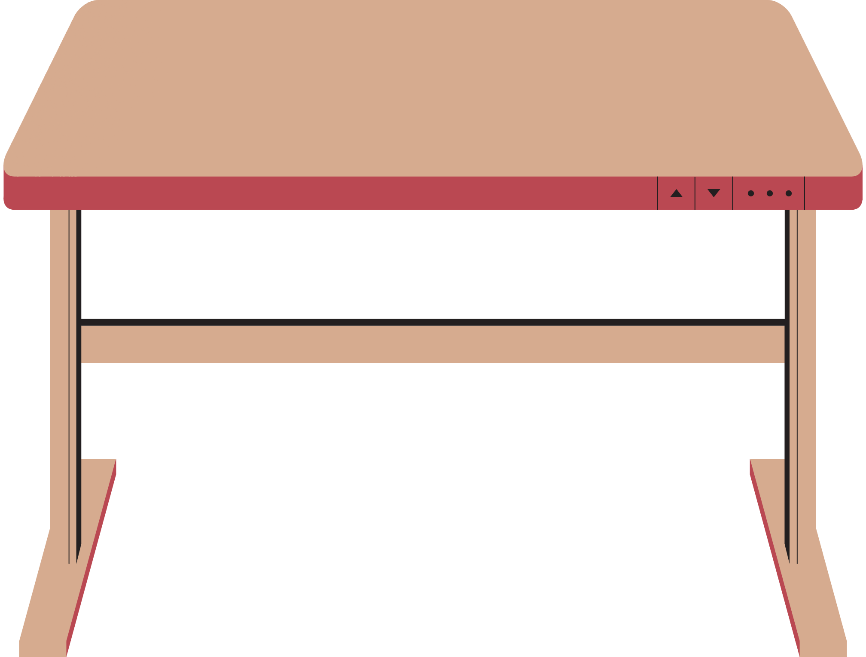
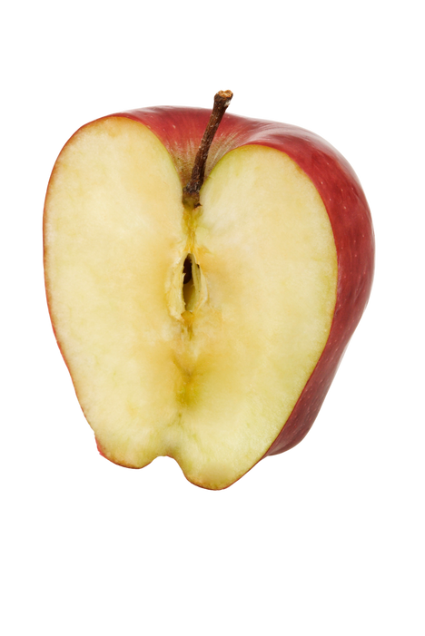
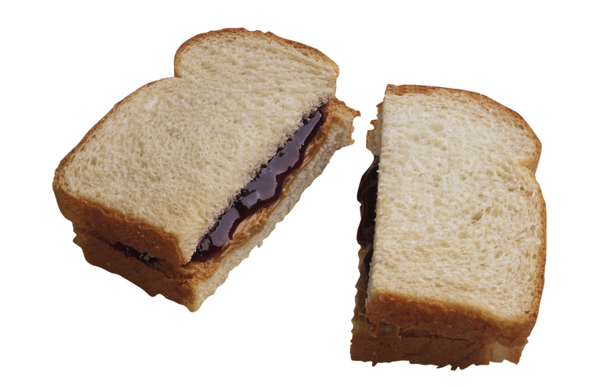

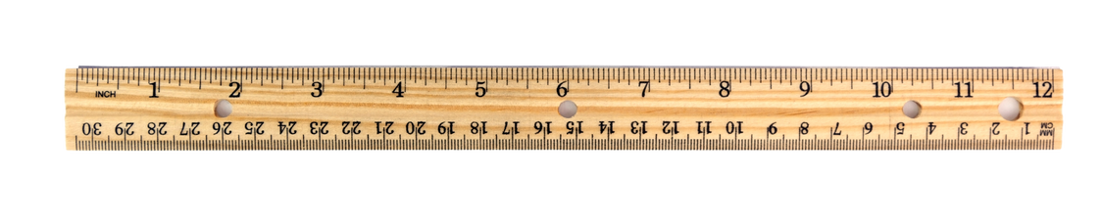
Activity 1 – Is it half?
The teacher asked the students to find something that shows half. Here's what they found.
Which items are correct? How do you know?
Notes:
This is a developing number sense activity.
Number sense refers to a deep understanding of numbers, including their magnitude, relationships, and the effects of operations on them. It supports fluency and understanding, estimation, flexible thinking, and efficient problem-solving. Number sense activities 1–4 ‘activate’ prior number knowledge and support the learning of new content in the unit. Number sense activities 5–8 ‘loop’ back and provide opportunity for spaced practice with concepts and procedures covered in previous units.
Syllabus focus area:
Partitioned fractions A
This resource corresponds to Resource 10 – Is it half? in Stage 2 Year A Unit 16.
Revise that the term 'half' can be used in everyday language as well as in the mathematics classroom.
Students Think-Pair-Share to provide examples of the term ‘half’ being used in both contexts. For example, the phrases ‘half a sandwich’ or ‘8-and-a-half years old’ use the term ‘half’ in everyday language. ‘Half a length of wood’, ‘half a cup of flour’ and ‘half a collection of counters’ are precise mathematical terms which describe 2 equal-sized parts.
Remind students that when the word ‘half’ is used in mathematics, it is a precise measurement which requires the creation of 2 equal-sized parts.
Display Resource 1 – Is it half?
In pairs, students determine which of the children have provided an example of half, justifying their choices.
Give each student a strip of paper and ask them to model half.
Discuss the conditions that need to be present for their folding to be considered half, such as 2 equal parts and accurate folding.

Slide 11
Review of learning 2

Slide 12
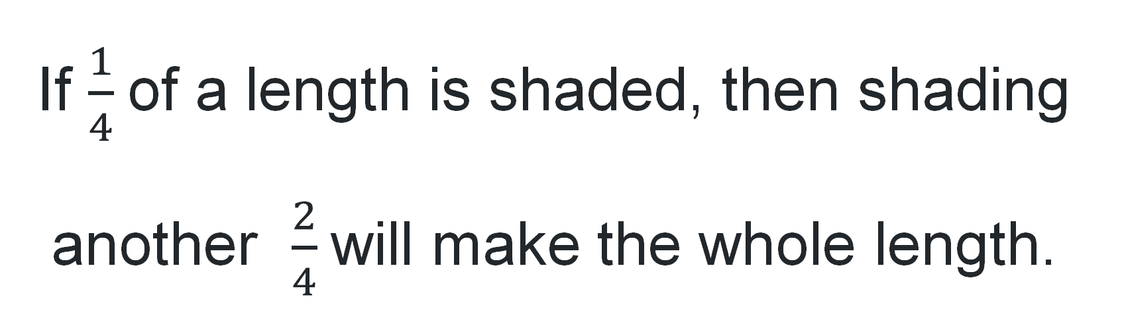
True or false (1)
If $\frac{1}{4}$of a length is shaded, then shading another $\frac{2}{4}$will make the whole length.
True | False
Notes:
The question on this slide connects to the content being explored in the developing number sense activity (Activity 2)
Syllabus focus area:
Partitioned fractions A

Slide 13
Short response (5)
What do you know about folding halves that can help you when folding quarters and eighths?
Notes:
Short response questions provide brisk paced questions focussing on review of current and previous content to support spaced and interleaved practice.
Syllabus focus area:
Partitioned fractions A

Slide 14
Short response (6)
Apply the compensation strategy to solve
76 – 48
Notes:
Short response questions provide brisk paced questions focussing on review of current and previous content to support spaced and interleaved practice.
Syllabus focus area:
Additive relations A

Slide 15
Short response (7)
Name 3 lengths that could be recorded using millimetres.
Notes:
Short response questions provide brisk paced questions focussing on review of current and previous content to support spaced and interleaved practice.
Syllabus focus area:
Geometric measure A: Length

Slide 16
Short response (8)
A quadrilateral has four sides, two pairs of parallel sides and all angles are equal.
What is the name of the quadrilateral and how do you know?
Notes:
Short response questions provide brisk paced questions focussing on review of current and previous content to support spaced and interleaved practice.
Syllabus focus area:
Two-dimensional spatial structure A: 2D shapes

Slide 17

Activity 2 – Is he correct?
Kai was given a strip of paper and told this was one-half of the whole length. He drew a diagram to show how big the whole would be.
This is the whole
Is Kai correct?
How do you know?
What has Kai done incorrectly?
If he is not correct, what would be the correct answer? How could you work it out?
Notes:
This is a developing number sense activity.
Number sense refers to a deep understanding of numbers, including their magnitude, relationships, and the effects of operations on them. It supports fluency and understanding, estimation, flexible thinking, and efficient problem-solving. Number sense activities 1–4 ‘activate’ prior number knowledge and support the learning of new content in the unit. Number sense activities 5–8 ‘loop’ back and provide opportunity for spaced practice with concepts and procedures covered in previous units.
Syllabus focus area:
Partitioned fractions A
This resource corresponds to Resource 11 – Is he correct? in Stage 2 Year A Unit 16.
Ask students to consider:
Is Kai correct? How do you know?
What has Kai done incorrectly?
If he is not correct, what would be the correct answer? How could you work it out?
Students turn and talk with a partner to compare their thoughts.
As a class, regroup and discuss.

Slide 18
Review of learning 3

Slide 19
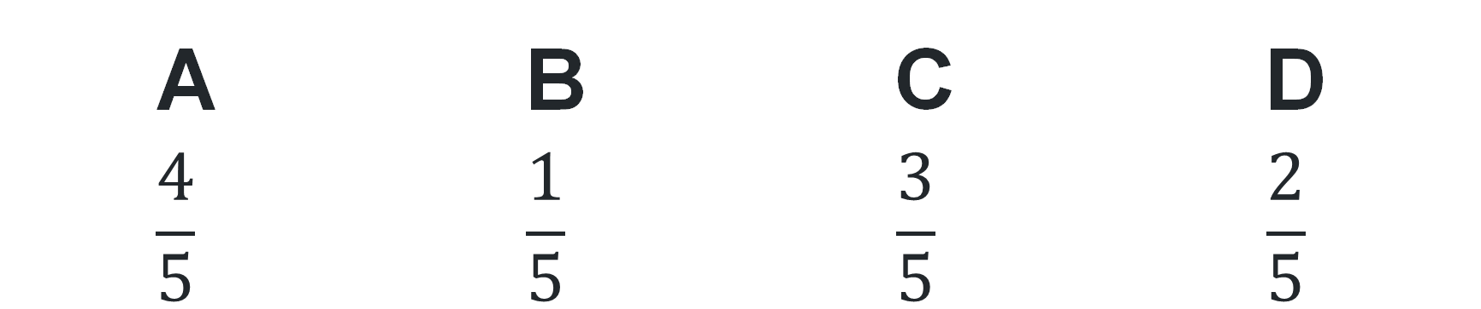
Multiple choice (2)
How many more fifths are needed to make the whole length?
1
5
1
5
A | B | C | D
$$\frac{4}{5}$$ | $$\frac{1}{5}$$ | $$\frac{3}{5}$$ | $$\frac{2}{5}$$
Notes:
This question connects to the content in the developing number sense activity (Activity 3)
Syllabus focus area:
Partitioned fractions A

Slide 20
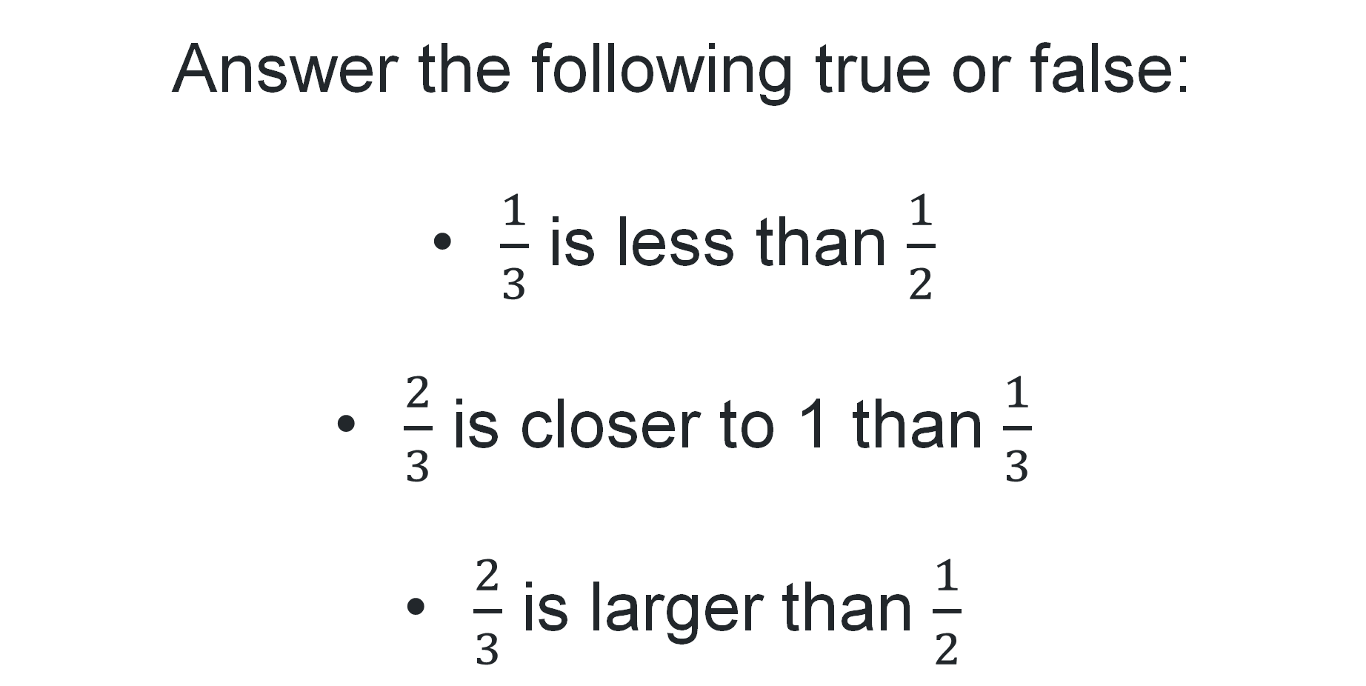
Short response (9)
Answer the following true or false:
      $\frac{1}{3}$ is less than $\frac{1}{2}$
      $\frac{2}{3}$ is closer to 1 than $\frac{1}{3}$
      $\frac{2}{3}$ is larger than $\frac{1}{2}$
Notes:
Short response questions provide brisk paced questions focussing on review of current and previous content to support spaced and interleaved practice.
Syllabus focus area:
Partitioned fractions A

Slide 21
Short response (10)
Using a number line solve
109 + 87
Notes:
Short response questions provide brisk paced questions focussing on review of current and previous content to support spaced and interleaved practice.
Syllabus focus area:
Additive relations A

Slide 22
Short response (11)
How many millimetres in a centimetre?
How many centimetres in a metre?
Notes:
Short response questions provide brisk paced questions focussing on review of current and previous content to support spaced and interleaved practice.
Syllabus focus area:
Geometric measure A: Length

Slide 23
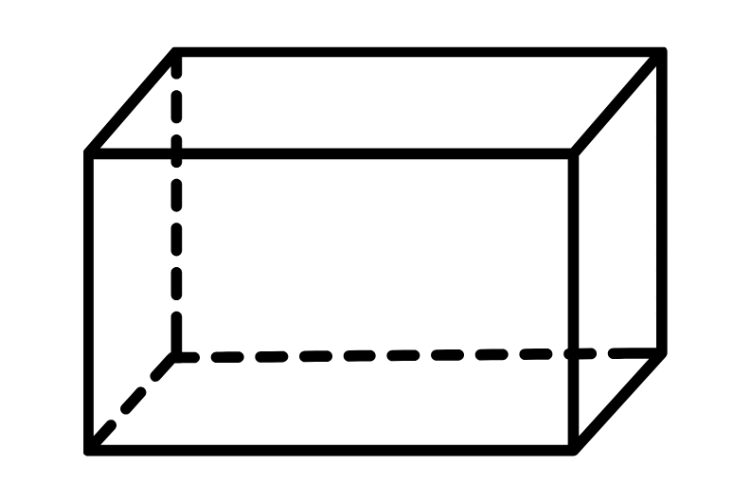
Short response (12)
Sketch the net of this prism.
Notes:
Short response questions provide brisk paced questions focussing on review of current and previous content to support spaced and interleaved practice.
Syllabus focus area:
Three-dimensional spatial structure A: 3DS objects

Slide 24
Activity 3 – fractured fraction wall
1
1
2
1
2
1
2
1
2
1
3
1
3
1
3
1
3
1
3
1
4
1
4
1
4
1
4
1
4
1
4
1
4
1
5
1
5
1
5
1
5
1
5
1
5
1
5
1
5
1
5
1
6
1
6
1
6
1
6
1
6
1
6
1
6
1
6
1
6
1
6
1
8
1
8
1
8
1
8
1
8
1
8
1
8
1
8
1
8
1
8
1
8
1
8
1
8
1
8
1
10
1
10
1
10
1
10
1
10
1
10
1
10
1
10
1
10
1
10
1
10
1
10
1
10
1
10
1
10
1
10
1
10
Notes:
This is a developing number sense activity.
Number sense refers to a deep understanding of numbers, including their magnitude, relationships, and the effects of operations on them. It supports fluency and understanding, estimation, flexible thinking, and efficient problem-solving. Number sense activities 1–4 ‘activate’ prior number knowledge and support the learning of new content in the unit. Number sense activities 5–8 ‘loop’ back and provide opportunity for spaced practice with concepts and procedures covered in previous units.
Syllabus focus area:
Partitioned fractions A
This resource corresponds to Resource 12 – fractured fraction wall in Stage 2 Year A Unit 16.
Read the scenario: The class had a fraction wall displayed in the classroom. One day, the wind blew some of the fractions off the wall. It is your job to fix the fraction wall, so each row represents one whole.
Students turn and talk about how to return the correct fractional parts on the fraction wall.
Provide students with a copy of either Resource 12 – fractured fraction wall 1 or Resource 13 – fractured fraction wall 2 to complete the fraction wall. Students can cut and paste to complete the fraction wall or draw and colour the fractional parts.
Students display their solutions and discuss with the class.
Note: The images on the right of the dotted line can be moved to recreate the fraction wall.

Slide 25
Review of learning 4

Slide 26
True or false (2)
Liam cuts a ribbon into 3 pieces. Each piece is the same length. Liam says he has divided the ribbon into thirds.
True | False
Notes:
The question on this slide connects to the content being explored in the developing number sense activity (Activity 4)
Syllabus focus area:
Partitioned fractions A

Slide 27
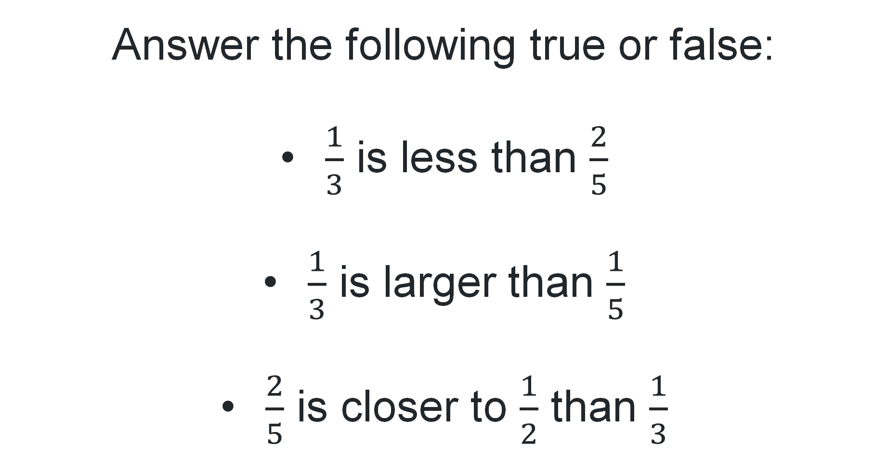
Short response (13))
Answer the following true or false:
$\frac{1}{3}$ is less than $\frac{2}{5}$
$\frac{1}{3}$ is larger than $\frac{1}{5}$
$\frac{2}{5}$ is closer to $\frac{1}{2}$ than $\frac{1}{3}$
Notes:
Short response questions provide brisk paced questions focussing on review of current and previous content to support spaced and interleaved practice.
Syllabus focus area:
Partitioned fractions A

Slide 28
Short response (14))
$5 is the same as ______ cents.
400 cents is the same as $_______.
$7.60 is the same as ______ cents.
300 cents is the same as $______.
Notes:
Short response questions provide brisk paced questions focussing on review of current and previous content to support spaced and interleaved practice.
Syllabus focus area:
Additive relations A

Slide 29
Short response (15)
Order the following lengths from longest to shortest:
295 cm
3 m 5 cm
375 cm
1 m 95 cm
Notes:
Short response questions provide brisk paced questions focussing on review of current and previous content to support spaced and interleaved practice.
Syllabus focus area:
Geometric measure A: Length

Slide 30
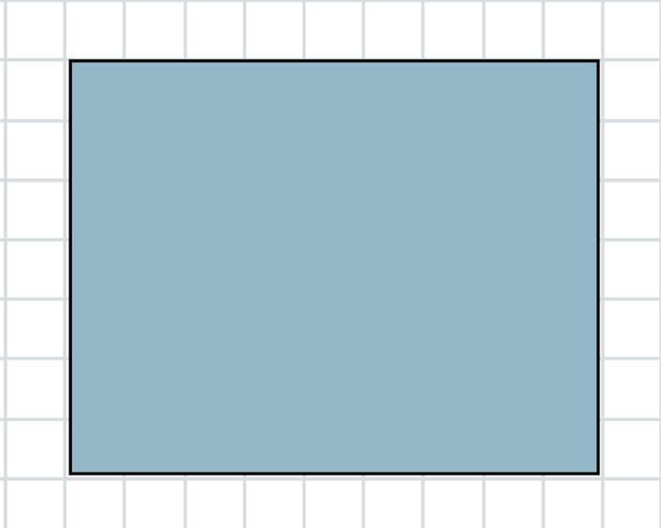
Short response (16)
Estimate and then record the area of the following rectangle.
Notes:
Short response questions provide brisk paced questions focussing on review of current and previous content to support spaced and interleaved practice.
Syllabus focus area:
Two-dimensional spatial structure A: Area

Slide 31
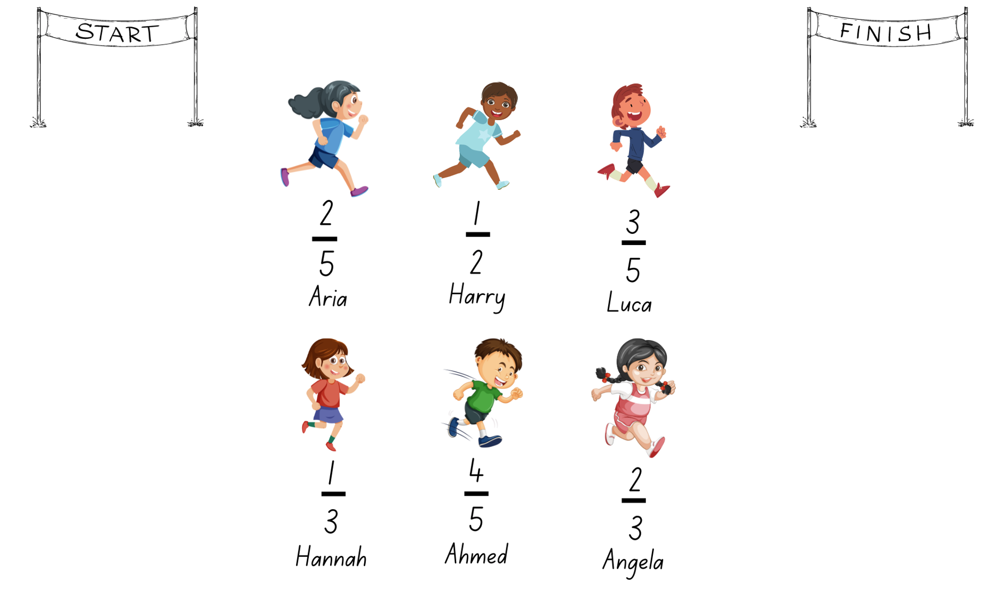
Activity 4 – Who is winning?
Notes:
This is a developing number sense activity.
Number sense refers to a deep understanding of numbers, including their magnitude, relationships, and the effects of operations on them. It supports fluency and understanding, estimation, flexible thinking, and efficient problem-solving. Number sense activities 1–4 ‘activate’ prior number knowledge and support the learning of new content in the unit. Number sense activities 5–8 ‘loop’ back and provide opportunity for spaced practice with concepts and procedures covered in previous units.
Syllabus focus area:
Partitioned fractions A
This activity is an adaptation of ‘Who is winning?’ from Primary and Middle Years Mathematics: Teaching Developmentally, 1st Australian edn by Van De Walle et al.
This resource corresponds to Resource 14 – Who is winning? in Stage 2 Year A Unit 16.
Explain that the 6 students are in a race. The fractions show the distance they have already run.
Provide pairs of students with a paper strip for each runner.
With their partner, students use a paper strip to mark and represent the fraction distance for each runner. Students then compare the fractional representations for each runner to determine who is winning the race.
Discuss students' strategies used to identify and represent the position of each fraction.

Slide 32
Review of learning 5

Slide 33
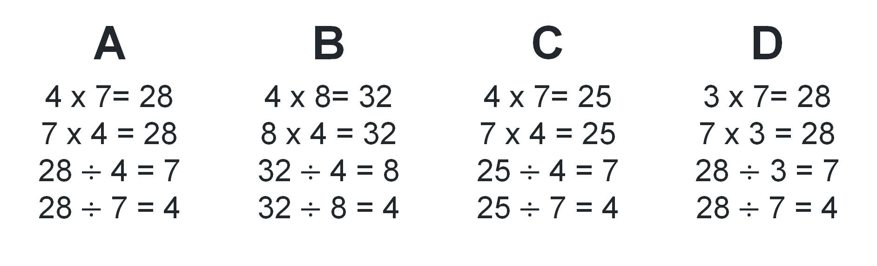
Multiple choice (3)
What are the related facts?
A | B | C | D
4 x 7= 28 7 x 4 = 28 28$÷$ 4 = 7 28$÷$ 7 = 4 | 4 x 8= 32 8 x 4 = 32 32$÷$ 4 = 8 32$÷$ 8 = 4 | 4 x 7= 25 7 x 4 = 25 25$÷$ 4 = 7 25$÷$ 7 = 4 | 3 x 7= 28 7 x 3 = 28 28 $÷$ 3 = 7 28$÷$ 7 = 4
Notes:
This question connects to the content in the developing number sense activity (Activity 5)
Syllabus focus area:
Multiplicative relations A

Slide 34
Short response (17)
Label the number line with the fractions.
1
6
1
6
1
6
1
6
1
6
1
6
0
1
Notes:
Short response questions provide brisk paced questions focussing on review of current and previous content to support spaced and interleaved practice.
Syllabus focus area:
Partitioned fractions A

Slide 35
Short response (18)
Heather went to the canteen and purchased a cup cake for $3 and 75 cents. How much change did she receive from $10?
Notes:
Short response questions provide brisk paced questions focussing on review of current and previous content to support spaced and interleaved practice.
Syllabus focus area:
Additive relations A

Slide 36
Short response (19)
Name items that have an estimated mass:
More than 1 kg | The same as 1 kg | Less than 1kg
Notes:
Short response questions provide brisk paced questions focussing on review of current and previous content to support spaced and interleaved practice.
Syllabus focus area:
Non-spatial measure A: Mass

Slide 37
Short response (20)
Write a sentence explaining what ‘possible’ and ‘likely’ mean in a chance experiment.
Notes:
Short response questions provide brisk paced questions focussing on review of current and previous content to support spaced and interleaved practice.
Syllabus focus area:
Chance A

Slide 38
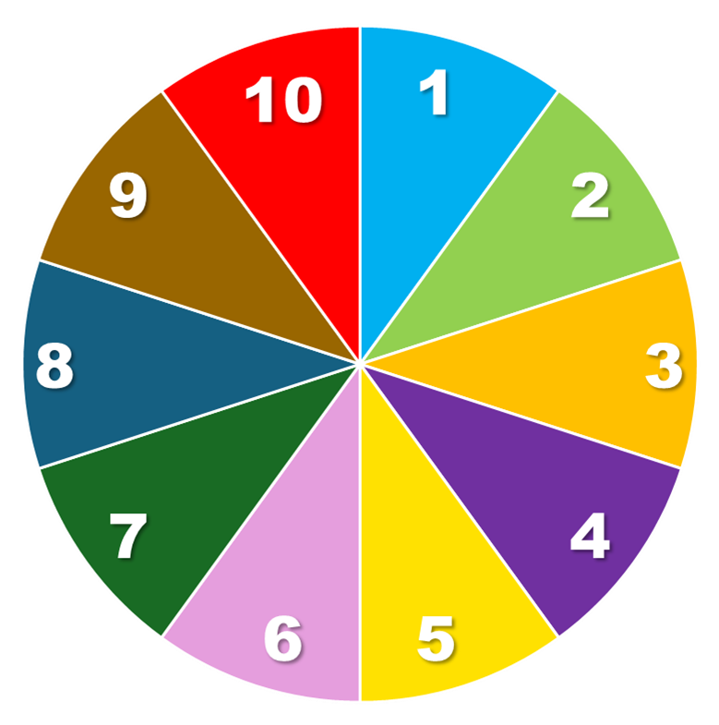
Activity 5 – using arrays
roll 2 dice or spin the spinner twice
use the 2 numbers to form an array
record the multiplication number sentence
record the division number sentences.
Counters
Spin!
Notes:
This is a developing number sense activity.
Number sense refers to a deep understanding of numbers, including their magnitude, relationships, and the effects of operations on them. It supports fluency and understanding, estimation, flexible thinking, and efficient problem-solving. Number sense activities 1–4 ‘activate’ prior number knowledge and support the learning of new content in the unit. Number sense activities 5–8 ‘loop’ back and provide opportunity for spaced practice with concepts and procedures covered in previous units.
Syllabus focus area:
Multiplicative relations A
This resource corresponds to Activity 6 – using arrays in Stage 2 Year A Unit 16.
Note: This page can be used to demonstrate how to spin 2 numbers, use them to form an array and then record them a variety of ways.
The spinner functions in the presentation mode in the desktop app. Click on the ‘Spin’ button to make the spinner spin. Click again on the ‘Spin’ button to make it stop. The spinner and the infinite pile of counters do not work in the same mode.
Highlight to students:
the link between multiplication and division
the commutative property of multiplication.
2. Once students are confident, provide them with two 10-sided dice, counters and their workbooks. Students record the array and their number sentences in their workbook.
3. Select students to share and explain their arrays and number sentences.

Slide 39
Review of learning 6

Slide 40
True or false (3)
A square number is the result of multiplying a number by itself.
True | False
Communicate your reasoning.
Notes:
The question on this slide connects to the content being explored in the developing number sense activity (Activity 6)
Syllabus focus area:
Multiplicative relations A

Slide 41
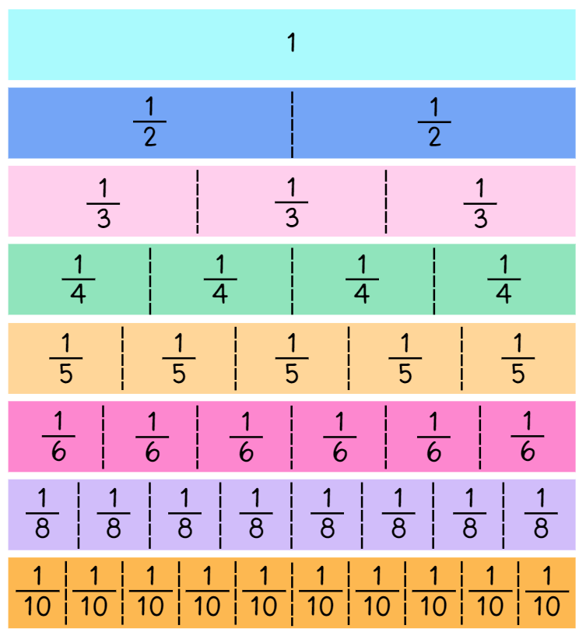
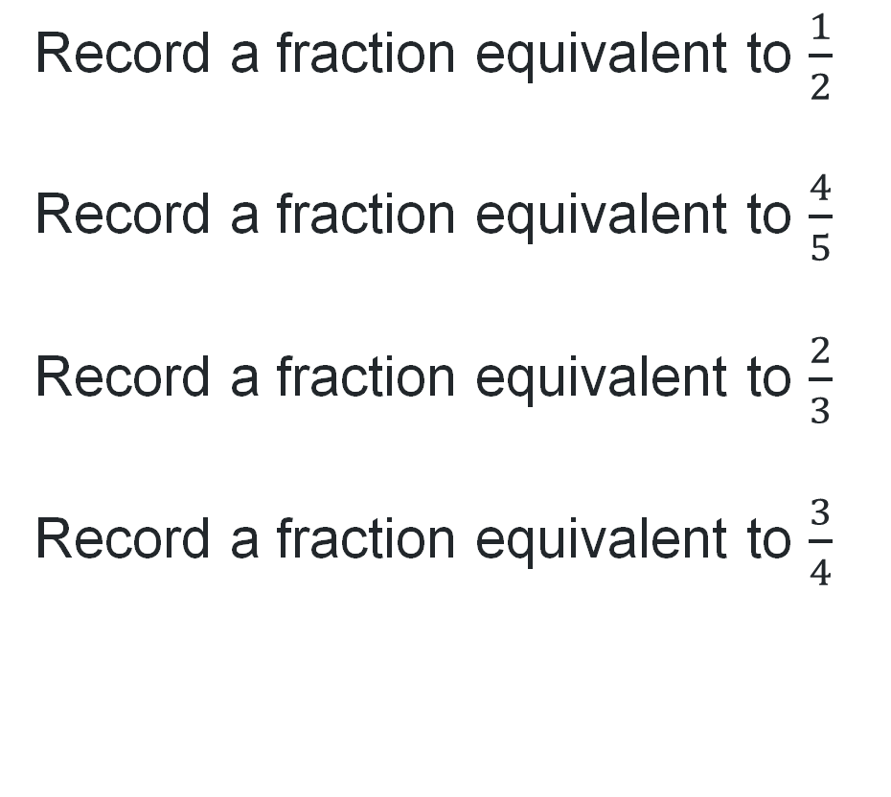
Short response (21)
Record a fraction equivalent to $\frac{1}{2}$
Record a fraction equivalent to $\frac{4}{5}$
Record a fraction equivalent to $\frac{2}{3}$
Record a fraction equivalent to $\frac{3}{4}$
Notes:
Short response questions provide brisk paced questions focussing on review of current and previous content to support spaced and interleaved practice.
Syllabus focus area:
Partitioned fractions B

Slide 42
Short response (22)
Canteen food​ | Price​ | Salads​ | Price​ | Hot food​ | Price​
Banana muffin ​ | $1.00​ | Greek salad​ | $6.50​ | Chicken burger​ | $5.50​
Energy choc balls​ | 50c​ | Garden salad​ | $6.00​ | Beef burger​ | $5.50​
Popcorn​ | 45c​ | Chicken salad​ | $8.00​ | Chicken wrap​ | $6.00​
Custard cup​ | 90c​ | Tuna salad​ | $8.00​ | Beef lasagna​ | $5.00​
Jelly cup​ | 70c​ | Egg salad​ | $7.00​ | Cheese pizza​ | $3.50​
Breadsticks​ | 25c​ | Fruit salad​ | $4.50​ | Sausage roll​ | $4.00​
Fruit​ | 60c​ | Frozen treats​ | Price​ | Sandwiches​ | Price​
Drinks​ | Price​ | Juice tubs​ | $1.50​ | Egg​ | $2.00​
Juice ​ | $2.50​ | Frozen fruit​ | $1.00​ | Ham​ | $3.00​
Flavoured milk​ | $2.00​ | Sweet stick​ | $1.00​ | Salad​ | $4.00​
Water – 600mL​ | $2.00​ | Frozen Yoghurt​ | $2.00​ | Cheese​ | $2.00​
Ryan went to the canteen and purchased the following for lunch:
custard cup
egg salad
frozen fruit
flavoured milk
How much did Ryan spend?
What was his change from $20?
Notes:
Short response questions provide brisk paced questions focussing on review of current and previous content to support spaced and interleaved practice.
Syllabus focus area:
Additive relations A

Slide 43
Short response (23)
Name 3 items that have a mass of about one kilogram.
Notes:
Short response questions provide brisk paced questions focussing on review of current and previous content to support spaced and interleaved practice.
Syllabus focus area:
Non-spatial measure A: Mass

Slide 44
Short response (24)
Name 3 familiar everyday containers that hold one litre.
Notes:
Short response questions provide brisk paced questions focussing on review of current and previous content to support spaced and interleaved practice.
Syllabus focus area:
Three-dimensional spatial structure A: Volume

Slide 45
Activity 6 – looking for squares
4 is a square number.
2 x 2 = 4.
Notes:
This is a developing number sense activity.
Number sense refers to a deep understanding of numbers, including their magnitude, relationships, and the effects of operations on them. It supports fluency and understanding, estimation, flexible thinking, and efficient problem-solving. Number sense activities 1–4 ‘activate’ prior number knowledge and support the learning of new content in the unit. Number sense activities 5–8 ‘loop’ back and provide opportunity for spaced practice with concepts and procedures covered in previous units.
Syllabus focus area:
Multiplicative relations A
This resource corresponds to Activity 6 – looking for squares in Stage 2 Year A Unit 16.
Display 4 circles in a square to represent the square number 4.
Display the following numbers: 16, 22, 25 and 9. Ask students to prove which number is not a square number.
Students record their responses on individual whiteboards. They including an array and a description linking multiplication and division fact families for each pair.
Ask:
Can you provide another example of a square number? Prove it.
What patterns do you notice with square numbers?

Slide 46
Review of learning 7

Slide 47
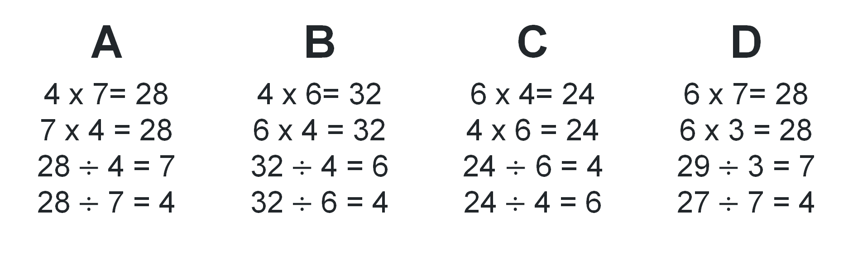
Multiple choice (4)(1)
24
6
4
What are the related facts?
A | B | C | D
4 x 7= 28 7 x 4 = 28 28$÷$ 4 = 7 28$÷$ 7 = 4 | 4 x 6= 32 6 x 4 = 32 32$÷$ 4 = 6 32$÷$ 6 = 4 | 6 x 4= 24 4 x 6 = 24 24 $÷$ 6 = 4 24$÷$ 4 = 6 | 6 x 7= 28 6 x 3 = 28 29$÷$ 3 = 7 27$÷$ 7 = 4
Notes:
This question connects to the content in the developing number sense activity (Activity 7)
Syllabus focus area:
Multiplicative relations A

Slide 48
Short response (25)
Continue the patterns
5, 10, 15 ___, ___, ___, ___, ___
16, 12, 8, ___, ___
12, 14, 16, ___, ___, ___, ___, ___
Notes:
Short response questions provide brisk paced questions focussing on review of current and previous content to support spaced and interleaved practice.
Syllabus focus area:
Multiplicative relations A

Slide 49
Short response (26)
Canteen food​ | Price​ | Salads​ | Price​ | Hot food​ | Price​
Banana muffin ​ | $1.00​ | Greek salad​ | $6.50​ | Chicken burger​ | $5.50​
Energy choc balls​ | 50c​ | Garden salad​ | $6.00​ | Beef burger​ | $5.50​
Popcorn​ | 45c​ | Chicken salad​ | $8.00​ | Chicken wrap​ | $6.00​
Custard cup​ | 90c​ | Tuna salad​ | $8.00​ | Beef lasagna​ | $5.00​
Jelly cup​ | 70c​ | Egg salad​ | $7.00​ | Cheese pizza​ | $3.50​
Breadsticks​ | 25c​ | Fruit salad​ | $4.50​ | Sausage roll​ | $4.00​
Fruit​ | 60c​ | Frozen treats​ | Price​ | Sandwiches​ | Price​
Drinks​ | Price​ | Juice tubs​ | $1.50​ | Egg​ | $2.00​
Juice ​ | $2.50​ | Frozen fruit​ | $1.00​ | Ham​ | $3.00​
Flavoured milk​ | $2.00​ | Sweet stick​ | $1.00​ | Salad​ | $4.00​
Water – 600mL​ | $2.00​ | Frozen Yoghurt​ | $2.00​ | Cheese​ | $2.00​
Koby has $12.50 to spend at the canteen.
Create a list of items he could buy that adds up as close as possible to $12.50.
Notes:
Short response questions provide brisk paced questions focussing on review of current and previous content to support spaced and interleaved practice.
Syllabus focus area:
Additive relations A

Slide 50
Short response (29)
Why do we need a formal unit smaller than the kilogram?
Name 3 items that can be measured in grams.
Notes:
Short response questions provide brisk paced questions focussing on review of current and previous content to support spaced and interleaved practice.
Syllabus focus area:
Non-spatial measure B: Mass

Slide 51
Short response (30)
Identify 3 angles found in the classroom.
For example, the angle between the arms of the clock.
Notes:
Short response questions provide brisk paced questions focussing on review of current and previous content to support spaced and interleaved practice.
Syllabus focus area:
Geometric measure A: Angles

Slide 52

















Activity 7 – solve the problem
Solve and record solutions to these problems on a whiteboard.
1
Samuel had 4 fish tanks. Each tank had 10 fish in it. He then bought one more tank. He shared all the fish equally between the 5 tanks. How many fish were then in each tank?
A shop sells cupcakes in trays and boxes.
Each tray holds 6 cupcakes.
Each box holds 8 cupcakes.
3
2
Nat had $24. She spent $4 each day. How many days did it take for Nat to spend all her money?
Julia buys a total of 50 cupcakes.
She buys 4 boxes and some trays.
How many trays does Julia buy?
Notes:
This is a developing number sense activity.
Number sense refers to a deep understanding of numbers, including their magnitude, relationships, and the effects of operations on them. It supports fluency and understanding, estimation, flexible thinking, and efficient problem-solving. Number sense activities 1–4 ‘activate’ prior number knowledge and support the learning of new content in the unit. Number sense activities 5–8 ‘loop’ back and provide opportunity for spaced practice with concepts and procedures covered in previous units.
Syllabus focus area:
Multiplicative relations A
This resource corresponds to Resource 15 – word problems in Stage 2 Year A Unit 16.
This activity is an adaptation of the National Assessment Program by ACARA.
Display and read Resource 8 – word problems.
In pairs, students solve and record their solutions on a whiteboard.
Ask:
How could you represent the problem using a number sentence?
Can you explain the steps you took to solve the problems?
How did your knowledge of fact families help you solve the problems?
Did you find any patterns while working on this activity?
Is there anything you would do differently next time?

Slide 53
Review of learning 8

Slide 54
True or false (4)
Fact families help us recall number facts quickly by showing the inverse relationship between multiplication and division, and how the commutative property works in multiplication.
20
5
4
True | False
Notes:
The question on this slide connects to the content being explored in the developing number sense activity (Activity 8)
Syllabus focus area:
Multiplicative relations A

Slide 55
Short response (31)
Record the complementary fractional part to recreate the whole.
3 quarters
one-half
5 eighths
0
1
4
2
4
3
4
1
0
12
1
0
18
28
38
48
58
68
78
1
2 quarters
3 tenths
7 eighths
0
1
4
2
4
3
4
1
0
1 10
2 10
3 10
4 10
5 10
6 10
7 10
8 10
9 10
1
0
18
28
38
48
58
68
78
1
Notes:
Short response questions provide brisk paced questions focussing on review of current and previous content to support spaced and interleaved practice.
Syllabus focus area:
Partitioned fractions A

Slide 56
Short response (32)
Canteen food​ | Price​ | Salads​ | Price​ | Hot food​ | Price​
Banana muffin ​ | $1.00​ | Greek salad​ | $6.50​ | Chicken burger​ | $5.50​
Energy choc balls​ | 50c​ | Garden salad​ | $6.00​ | Beef burger​ | $5.50​
Popcorn​ | 45c​ | Chicken salad​ | $8.00​ | Chicken wrap​ | $6.00​
Custard cup​ | 90c​ | Tuna salad​ | $8.00​ | Beef lasagna​ | $5.00​
Jelly cup​ | 70c​ | Egg salad​ | $7.00​ | Cheese pizza​ | $3.50​
Breadsticks​ | 25c​ | Fruit salad​ | $4.50​ | Sausage roll​ | $4.00​
Fruit​ | 60c​ | Frozen treats​ | Price​ | Sandwiches​ | Price​
Drinks​ | Price​ | Juice tubs​ | $1.50​ | Egg​ | $2.00​
Juice ​ | $2.50​ | Frozen fruit​ | $1.00​ | Ham​ | $3.00​
Flavoured milk​ | $2.00​ | Sweet stick​ | $1.00​ | Salad​ | $4.00​
Water – 600mL​ | $2.00​ | Frozen Yoghurt​ | $2.00​ | Cheese​ | $2.00​
You bought something from the canteen and received $2.50 in change.
What might you have bought if you started with $10? List the possibilities.
Notes:
Short response questions provide brisk paced questions focussing on review of current and previous content to support spaced and interleaved practice.
Syllabus focus area:
Additive relations A

Slide 57
Short response (33)
Sandra has a bag of rice that weighs 1.5 kilograms. Her friend says it weighs 1 kg and 500 g. Are they both correct? Explain your reasoning.
Notes:
Short response questions provide brisk paced questions focussing on review of current and previous content to support spaced and interleaved practice.
Syllabus focus area:
Non-spatial measure B: Mass

Slide 58
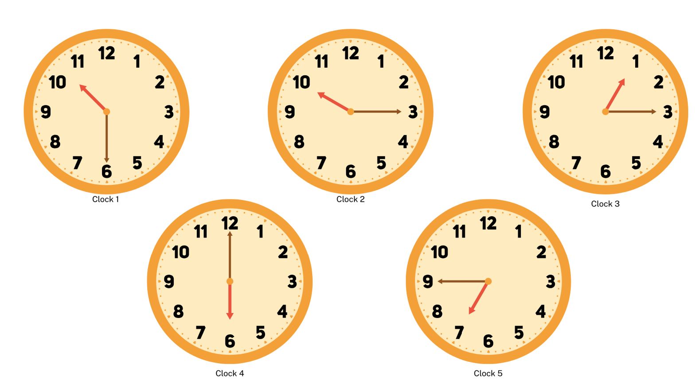
Short response (34)
Read the following times to the minute.
Shape B
Notes:
Short response questions provide brisk paced questions focussing on review of current and previous content to support spaced and interleaved practice.
Syllabus focus area:
Non-spatial measure A: Time

Slide 59
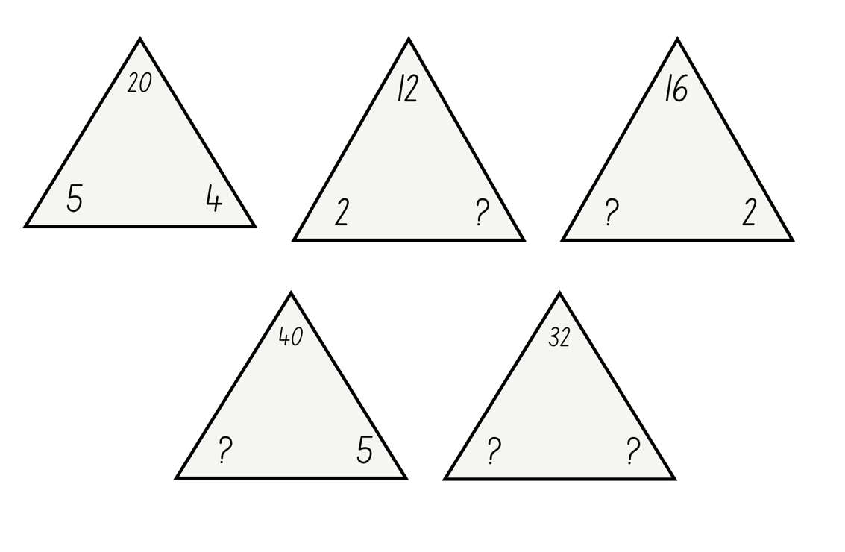
Activity 8 – fact families
Notes:
This is a developing number sense activity.
Number sense refers to a deep understanding of numbers, including their magnitude, relationships, and the effects of operations on them. It supports fluency and understanding, estimation, flexible thinking, and efficient problem-solving. Number sense activities 1–4 ‘activate’ prior number knowledge and support the learning of new content in the unit. Number sense activities 5–8 ‘loop’ back and provide opportunity for spaced practice with concepts and procedures covered in previous units.
Syllabus focus area:
Multiplicative relations A
This resource corresponds to Resource 16 – fact families in Stage 2 Year A Unit 16.
Revise fact family triangles.
Model using an array to prove the commutative property of multiplication.
Model how to write multiplication and division sentences.
Use arrays to prove the commutative property of multiplication.
Students create the fact families for the remaining triangles.
Share student responses and record student ideas.
Note: emphasise that the number at the top of the triangle is the product of the 2 factors at the bottom of the triangle. For division, ensure students understand that the product of the fact family must be at the start of the sentence. Division is not commutative, so 2 ÷ 4 = 8 is not correct.

Slide 60
Double Venn diagram
Object 1
Object 2
Features similar to both objects
Features of object 1
Features of object 2

Slide 61
Frayer
Definition
Facts/Characteristics
Word, term, concept
Examples
Non-examples

Slide 62
Spider map
Idea
Subject

Slide 63
Cline
Concept 1
Concept 2
Word
Word
Word
Word
Word
Word
Word
Word
Word
Word
Word

Slide 64

Compare and contrast
Notes:
Use the arrows to navigate between related activities.
Hyperlink each arrow to compare between related slides.

Slide 65
Multiple choice (1)
A
B
C
D
Notes:
This question connects to the content in the developing number sense activity (Activity 1)
This question can:
support spaced and interleaved practice
help identify and address common misconceptions
support active recall and immediate feedback
support whole class participation
identify areas requiring reteach
Teachers are encouraged to adapt and contextualise for their contexts.

Slide 66
Multiple choice (2)
A
B
C
D
Notes:
This question connects to the content in the developing number sense activity (Activity 1)
Syllabus focus area:
Multiplicative relations A
This question can:
support spaced and interleaved practice
help identify and address common misconceptions
support active recall and immediate feedback
support whole class participation
identify areas requiring reteach
Teachers are encouraged to adapt and contextualise for their contexts.

Slide 67
References
This presentation contains NSW Curriculum and syllabus content. The NSW Curriculum is developed by the NSW Education Standards Authority. This content is prepared by NESA for and on behalf of the Crown in the right of the State of New South Wales. The material is protected by Crown copyright.
Please refer to the NESA Copyright Disclaimer for more information https://educationstandards.nsw.edu.au/wps/portal/nesa/mini-footer/copyright.
NESA holds the only official and up-to-date versions of the NSW Curriculum and syllabus documents. Please visit the NSW Education Standards Authority (NESA) website https://educationstandards.nsw.edu.au/wps/portal/nesa/home and the NSW Curriculum website https://curriculum.nsw.edu.au.
Mathematics K–10 Syllabus © NSW Education Standards Authority (NESA) for and on behalf of the Crown in right of the State of New South Wales, 2022.
National Numeracy Learning Progression © Australian Curriculum, Assessment and Reporting Authority (ACARA) 2010 to present, unless otherwise indicated. This material was downloaded from the Australian Curriculum website (National Numeracy Learning Progression) (accessed 29 February 2024) and was not modified.
ACARA (2023a) NAPLAN 2014 Final test, Numeracy, Year 3 test papers and answers [PDF 4.48 MB], NAPLAN, accessed 29 February 2024.
ACARA (2023b) NAPLAN 2015 Final test, Numeracy, Year 3 test papers and answers [PDF 2.89 MB], NAPLAN, accessed 29 February 2024.
Amplify Education (n.d.) Virtual manipulatives, Amplify Polypad website, accessed 29 February 2024.
Clarke D and Roche A (2014) ‘Colour in fractions’ in Clarke D and Roche A (eds) Engaging Maths: 25 favourite lessons, 2nd edn, Mathematics Teaching and Learning Centre, Australia.

Slide 68
References
This presentation contains NSW Curriculum and syllabus content. The NSW Curriculum is developed by the NSW Education Standards Authority. This content is prepared by NESA for and on behalf of the Crown in the right of the State of New South Wales. The material is protected by Crown copyright.
Please refer to the NESA Copyright Disclaimer for more information https://educationstandards.nsw.edu.au/wps/portal/nesa/mini-footer/copyright.
NESA holds the only official and up-to-date versions of the NSW Curriculum and syllabus documents. Please visit the NSW Education Standards Authority (NESA) website https://educationstandards.nsw.edu.au/wps/portal/nesa/home and the NSW Curriculum website https://curriculum.nsw.edu.au.
Didax, Inc (2023) ‘Fraction number line’, Virtual Manipulatives, Didax website, accessed 29 February 2024.
ESA (Education Services Australia Ltd) and AAMT (The Australian Association of Mathematics Teachers) (n.d.) ‘Fraction wall game’, Fractions, Top Drawer Teachers: Resources for Teachers of Mathematics website, accessed 29 February 2024.
Siemon D, Warren E, Beswick K, Faragher R, Miller J, Horne M, Jazby D, Breed M, Clark J and Brady K (2022) Teaching Mathematics: Foundations to Middle Years, 3rd edn, Oxford University Press, Australia.
Valentine J (2024) ‘Fractions on a Number Line - Beyond One Whole’, Unit 9: Fractions, BetterLesson website, accessed 29 February 2024.

Slide 69
Copyright
© State of New South Wales (Department of Education), 2025
The copyright material published in this resource is subject to the Copyright Act 1968 (Cth) and is owned by the NSW Department of Education or, where indicated, by a party other than the NSW Department of Education (third-party material).
Copyright material available in this resource and owned by the NSW Department of Education is licensed under a Creative Commons Attribution 4.0 International (CC BY 4.0) license.
This license allows you to share and adapt the material for any purpose, even commercially.
Attribution should be given to © State of New South Wales (Department of Education), 2025.
Material in this resource not available under a Creative Commons license:
the NSW Department of Education logo, other logos and trademark-protected material
Material owned by a third party that has been reproduced with permission. You will need to obtain permission from the third party to reuse its material.
Links to third-party material and websites
Please note that the provided (reading/viewing material/list/links/texts) are a suggestion only and implies no endorsement, by the New South Wales Department of Education, of any author, publisher, or book title. School principals and teachers are best placed to assess the suitability of resources that would complement the curriculum and reflect the needs and interests of their students.
If you use the links provided in this document to access a third party’s website, you acknowledge that the terms of use, including licence terms set out on the third-party’s website apply to the use which may be made of the materials on that third-party website or where permitted by the Copyright Act 1968 (Cth). The department accepts no responsibility for content on third-party websites.

