Slide 1
Instructions for use
This resource aligns to the learning in Stage 2 Year A Unit 17 and revisits content from earlier sample units.
Classroom teachers are encouraged to add, edit and adapt to meet the needs of their students.
Save a copy of the file to make changes to the slide deck. Go to File > Download a Copy (this downloads a copy to the computer to edit in the PowerPoint app).
To convert the PowerPoint to Google Slides:
  Upload the file into Google Drive and open it.
  Go to File > Save as Google Slides.
  (Note – conversion may cause formatting changes in the slides.)

Slide 2

Review of Learning
Mathematics Stage 2 – Unit 17
Notes:
Reviews may include a combination of question types, requiring students to recall facts and key ideas, as well as apply their knowledge to solve problems and answer questions. To support active engagement, a mix of techniques should be employed.” (AERO, 2024).
This Review of Learning slide deck revisits key concepts from the following units:
Stage 2 Year A Unit 17
Stage 2 Year A Unit 16
Stage 2 Year A Unit 15
It also includes opportunities to review prior learning in non-number content, supporting consolidation across focus areas.
The review of learning resources include three key task types that support the development of mathematical proficiency through retrieval, spaced practice, and active participation. These practices complement the review phase (activating prior knowledge) embedded within the beginning of each lesson.
1.
Multiple-choice questions/True or false: Designed to promote active retrieval of key concepts and identify common misconceptions in number, supporting consolidation, understanding and fluency.
These questions:
support spaced and interleaved practice
help identify and address common misconceptions
support active recall and immediate feedback
support whole class participation
identify areas requiring reteach
2.
Short-response question sets: Carefully grouped questions that encourage spaced and interleaved practice across multiple focus areas, helping students revisit and apply knowledge from different points in time.
These questions:
have a combination of question types
address a range of focus areas
build automaticity and fluency
support active recall
allow for immediate feedback
identify content requiring reteach
3.
Developing number sense activities: A variety of practical, purposeful tasks that reinforce current learning and build on prior knowledge. These activities promote reasoning, problem-solving and conceptual understanding.
The review of learning resources are designed to work support teaching and learning in mathematics. For the most effective implementation, use the resources flexibly, adapting to meet student learning needs and individual classroom contexts.

Slide 3
Lessons
1
Review of learning 1
5
Review of learning 5
2
Review of learning 2
6
Review of learning 6
3
Review of learning 3
7
Review of learning 7
4
Review of learning 4
8
Review of learning 8
Notes:
Teacher notes:
Click lesson numbers to go to specific lessons
Interactive features can be viewed in slide show

Slide 4
Review of learning 1

Slide 5


Multiple choice (2)
Which multiplication matches the array?
A | B | C | D
3 x 4 | 3 x 3 | 4 x 4 | 4 x 3
Notes:
This question connects to the content in the developing number sense activity (Activity 1)
Syllabus focus area:
Multiplicative Relations A

Slide 6

Short response (5)
23 57 109 345
Are these numbers odd?
How do you know?
Notes:
Short response questions provide brisk paced questions focussing on review of current and previous content to support spaced and interleaved practice.
Syllabus focus area:
Multiplicative Relations A

Slide 7
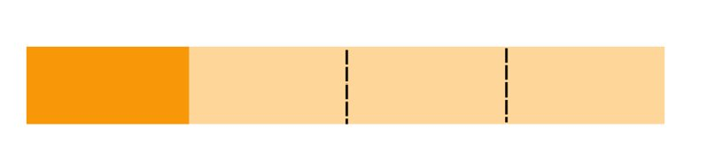
Short response (2)
What fraction is shaded?
How do you know?
Notes:
Short response questions provide brisk paced questions focussing on review of current and previous content to support spaced and interleaved practice.
Syllabus focus area:
Partitioned Fractions A

Slide 8
Short response (3)
What 2 numbers could go in the missing spaces to make the number sentence equal?
45 + 23 = ___ − ___
Notes:
Short response questions provide brisk paced questions focussing on review of current and previous content to support spaced and interleaved practice.
Syllabus focus area:
Additive relations A

Slide 9
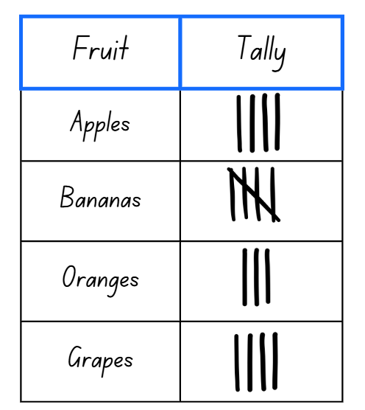
Short response (41)
Look at the tally chart:
How many students like grapes?
How many students like apples and bananas?
Which fruit do the least number of students like?
Notes:
Short response questions provide brisk paced questions focussing on review of current and previous content to support spaced and interleaved practice.
Syllabus focus area:
Data A

Slide 10

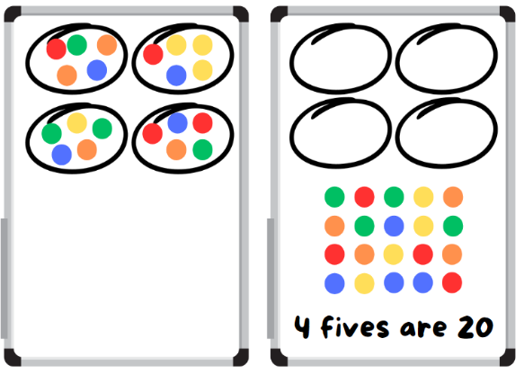
Activity 1 – groups to arrays
Notes:
This is a developing number sense activity.
Number sense refers to a deep understanding of numbers, including their magnitude, relationships, and the effects of operations on them. It supports fluency and understanding, estimation, flexible thinking, and efficient problem-solving. Number sense activities 1–4 ‘activate’ prior number knowledge and support the learning of new content in the unit. Number sense activities 5–8 ‘loop’ back and provide opportunity for spaced practice with concepts and procedures covered in previous units.
Syllabus focus area:
Multiplicative Relations A
Groups to arrays
This activity is an adaptation of Loops and Groups from Math Learning Center.
Explain that students will work with a partner to create and label arrays.
Provide pairs of students with a 6-sided die, counters and individual whiteboards.
Player 1 rolls the die and draws the resulting number of loops on their whiteboard. Player 1 rolls again and places that number of counters in each loop.
Note: when students are describing an array, encourage them to read an array like a book from left to right to determine how many in each row. For example, 5 rows (groups) of 3 becomes 5 threes with the ‘rows of’ or ‘groups of’ implied. This then leads to one three is 3, 2 threes are 6, 3 threes are nine, and so on.
Player 1 rearranges the counters into an array and labels the array, for example 4 fives are 20
Player 2 repeats the process.
At the end of the round, the player with the highest product wins and scores a point. The player who scores the most points by the end of the game is the winner.

Slide 11
Review of learning 2

Slide 12

True or false (1)
This array shows 4 rows of 5?
True | False
Notes:
The question on this slide connects to the content being explored in the developing number sense activity (Activity 2)
Syllabus focus area:
Multiplicative Relations A

Slide 13
Short response (1)
Farmer Cluck has 24 eggs.
Draw an array to represent the eggs.
Are there any other solutions?
Notes:
Short response questions provide brisk paced questions focussing on review of current and previous content to support spaced and interleaved practice.
Syllabus focus area:
Multiplicative Relations A

Slide 14
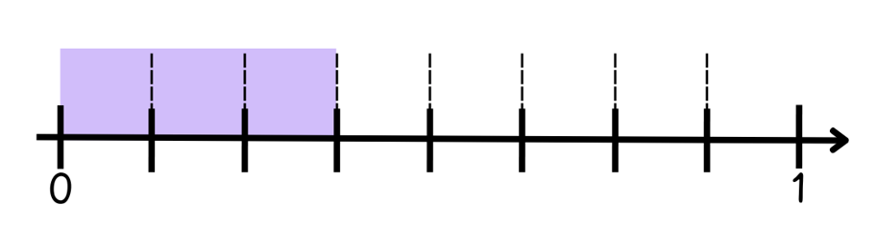
Short response (6)
Name the following fraction?
How many parts make 1 whole?
Notes:
Short response questions provide brisk paced questions focussing on review of current and previous content to support spaced and interleaved practice.
Syllabus focus area:
Partitioned Fractions A

Slide 15
Short response (7)
Use a partitioning strategy to solve
45 + 38
Notes:
Short response questions provide brisk paced questions focussing on review of current and previous content to support spaced and interleaved practice.
Syllabus focus area:
Additive relations A

Slide 16
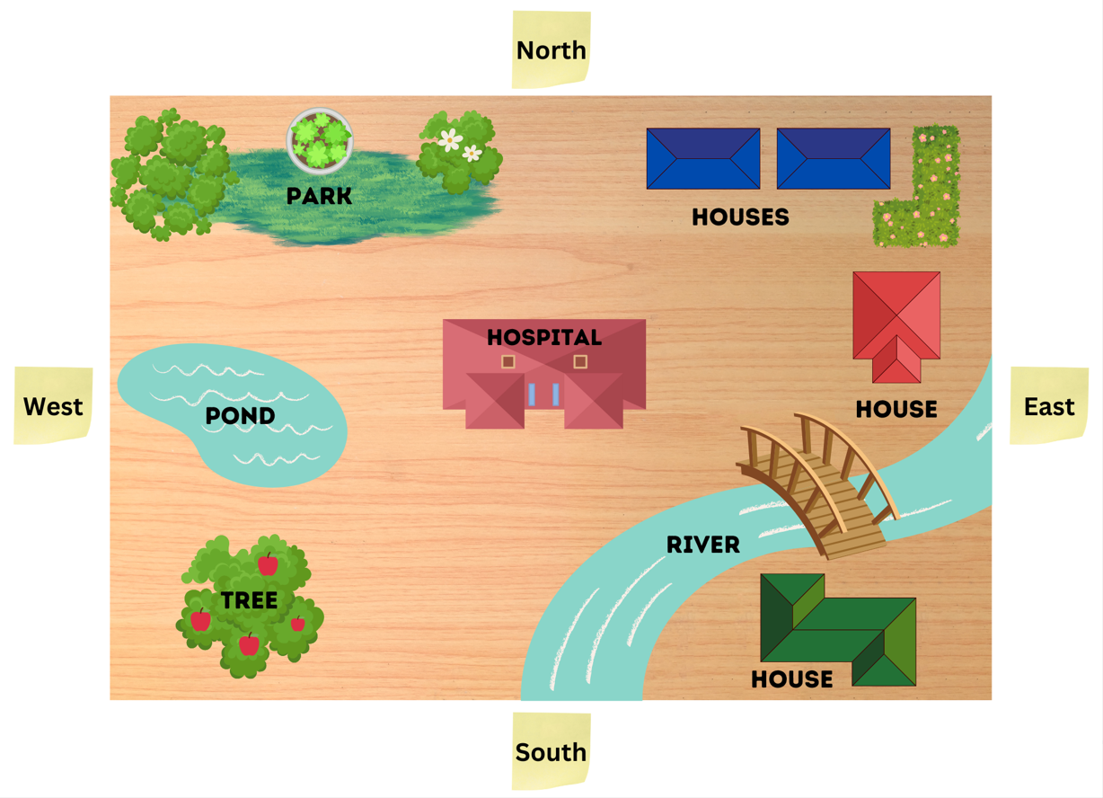
Short response 15 (8)
Start at the pond. Travel east until you reach the river then turn north and travel until you pass the hospital. If you make a quarter turn to the left and move west, where will you arrive?
Notes:
Short response questions provide brisk paced questions focussing on review of current and previous content to support spaced and interleaved practice.
Syllabus focus area:
Geometric measure A: Position

Slide 17
Activity 2 – groups to arrays 2
Notes:
This is a developing number sense activity.
Number sense refers to a deep understanding of numbers, including their magnitude, relationships, and the effects of operations on them. It supports fluency and understanding, estimation, flexible thinking, and efficient problem-solving. Number sense activities 1–4 ‘activate’ prior number knowledge and support the learning of new content in the unit. Number sense activities 5–8 ‘loop’ back and provide opportunity for spaced practice with concepts and procedures covered in previous units.
Syllabus focus area:
Multiplicative Relations A
Groups to arrays 2
This activity is an adaptation of Loops and Groups from Math Learning Center.
Explain that students will work with a partner to create and label arrays.
Provide pairs of students with a 6-sided die, counters and individual whiteboards.
Player 1 rolls the die and draws the resulting number of loops on their whiteboard. Player 1 rolls again and places that number of counters in each loop.
Note: when students are describing an array, encourage them to read an array like a book from left to right to determine how many in each row. For example, 5 rows (groups) of 3 becomes 5 threes with the ‘rows of’ or ‘groups of’ implied. This then leads to one three is 3, 2 threes are 6, 3 threes are nine, and so on.
Player 1 rearranges the counters into an array and labels the array, for example 4 fives are 20.
Player 2 repeats the process.
At the end of the round, the player with the highest product wins and scores a point. The player who scores the most points by the end of the game is the winner.

Slide 18
Review of learning 3

Slide 19
Multiple choice (5)
The first 5 multiples counting by fours are…
A | B | C | D
4, 8, 9,12,16 | 4, 8, 12, 16, 20 | 12, 16, 20, 24, 28 | 5, 10, 15, 20, 25
Notes:
This question connects to the content in the developing number sense activity (Activity 3)
Syllabus focus area:
Multiplicative Relations A

Slide 20
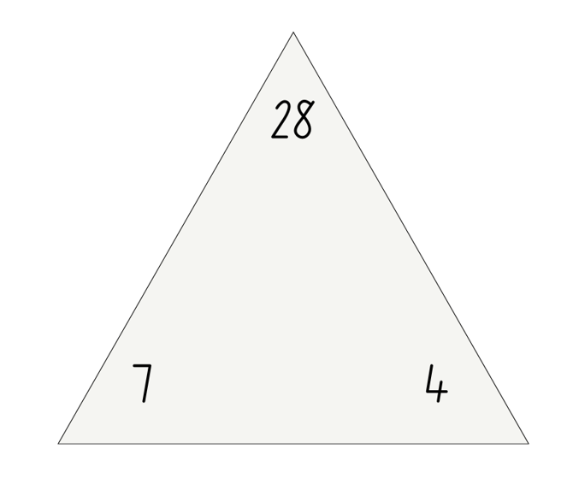
Short response (9)
Record the 4 number sentences for this fact family.
Notes:
Short response questions provide brisk paced questions focussing on review of current and previous content to support spaced and interleaved practice.
Syllabus focus area:
Multiplicative Relations A

Slide 21
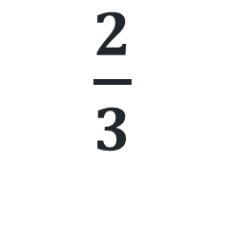
Short response (10)
Draw a fraction strip or diagram showing
$\frac{2}{3}$
Notes:
Short response questions provide brisk paced questions focussing on review of current and previous content to support spaced and interleaved practice.
Syllabus focus area:
Partitioned Fractions A

Slide 22
Short response(11)
Use the compensation strategy to solve
75 - 28
Notes:
Short response questions provide brisk paced questions focussing on review of current and previous content to support spaced and interleaved practice.
Syllabus focus area:
Additive relations A

Slide 23

Short response (12)
Name these two-dimensional shapes?
What features are the same?
How are they different?
Notes:
Short response questions provide brisk paced questions focussing on review of current and previous content to support spaced and interleaved practice.
Syllabus focus area:
Two-dimensional spatial structure A: 2D Shapes

Slide 24
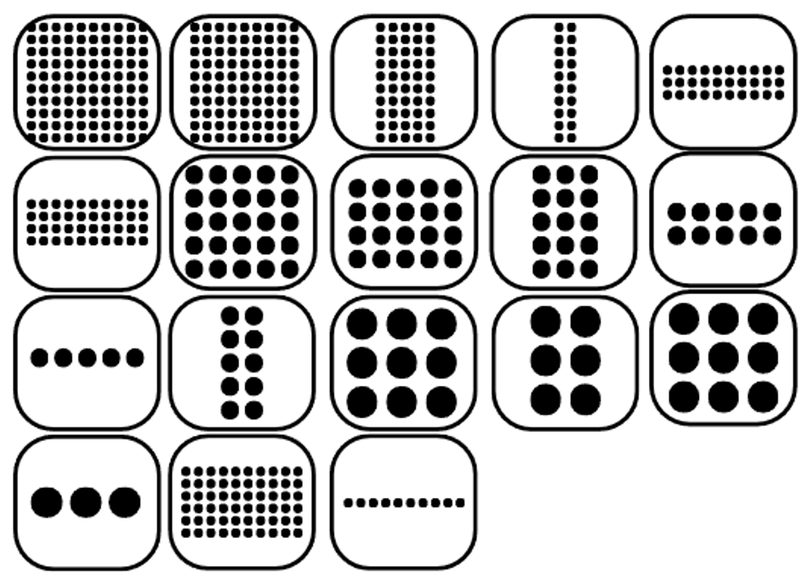
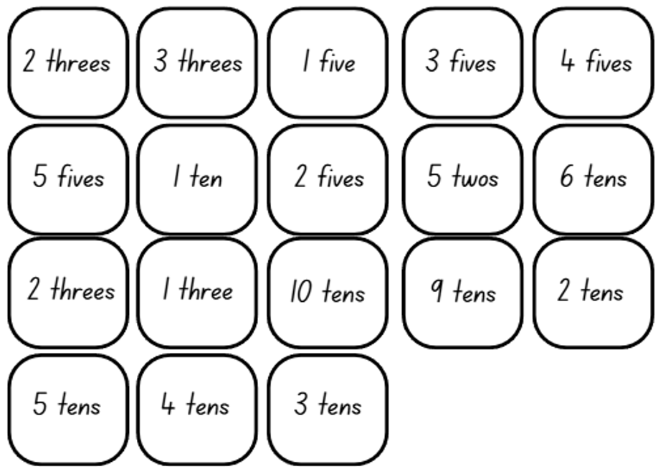
Activity 3 – array bingo
Notes:
This is a developing number sense activity.
Number sense refers to a deep understanding of numbers, including their magnitude, relationships, and the effects of operations on them. It supports fluency and understanding, estimation, flexible thinking, and efficient problem-solving. Number sense activities 1–4 ‘activate’ prior number knowledge and support the learning of new content in the unit. Number sense activities 5–8 ‘loop’ back and provide opportunity for spaced practice with concepts and procedures covered in previous units.
Syllabus focus area:
Multiplicative relations A
Array bingo
This resource corresponds to Resource 28 – array bingo cards and Resource 29 – array descriptor cards in Stage 2 Year A Unit 17.
This activity is an adaptation of Array bingo from Mathematics K–6 resources by State of New South Wales (Department of Education).
Provide pairs of students with Resource 28 – array bingo cards and Resource 29 – array descriptor cards (these resources correspond to Resource 28 – array bingo cards and Resource 29 – array descriptor cards in Stage 2, Year A Unit 17).
Each player creates a gameboard by selecting 6 dotted array cards, setting aside any remaining array cards.
Students place the descriptor cards in a pile facing down.
Players take turns to pick up a descriptor card and check if they have the matching array card. If they do, they can turn the array card face down. If both players have the matching array card, they can both turn their matching array card face down.
Students can use the commutative property to rotate and rename the arrays. For example, 3 twos can be rotated to show 2 threes.
If neither player has the matching array card, turn over the next descriptor card in the pile.
The winner is the first player to turn all their array cards face down and say ‘Bingo!’

Slide 25
Review of learning 4

Slide 26

True or false (2)
This array show 5 fives?
True | False
Notes:
The question on this slide connects to the content being explored in the developing number sense activity (Activity 4)
Syllabus focus area:
Multiplicative Relations A

Slide 27
Short response (13)
Liam used 1 cm × 1 cm squares to cover a rectangle. He made 4 rows with 6 squares in each row.
Draw and label your array.
Record the area in square centimetres.
Notes:
Short response questions provide brisk paced questions focussing on review of current and previous content to support spaced and interleaved practice.
Syllabus focus area:
Two-dimensional spatial structure A: Area

Slide 28
Short response (14))
A paper strip is divided into 5 equal parts.
If you shade 3 of these parts, what fraction of the strip is shaded? How do you know?
Notes:
Short response questions provide brisk paced questions focussing on review of current and previous content to support spaced and interleaved practice.
Syllabus focus area:
Partitioned Fractions A

Slide 29
Short response (15)
Record all the possible ways you could make $1.60.
How many ways did you find?
Notes:
Short response questions provide brisk paced questions focussing on review of current and previous content to support spaced and interleaved practice.
Syllabus focus area:
Additive relations A

Slide 30
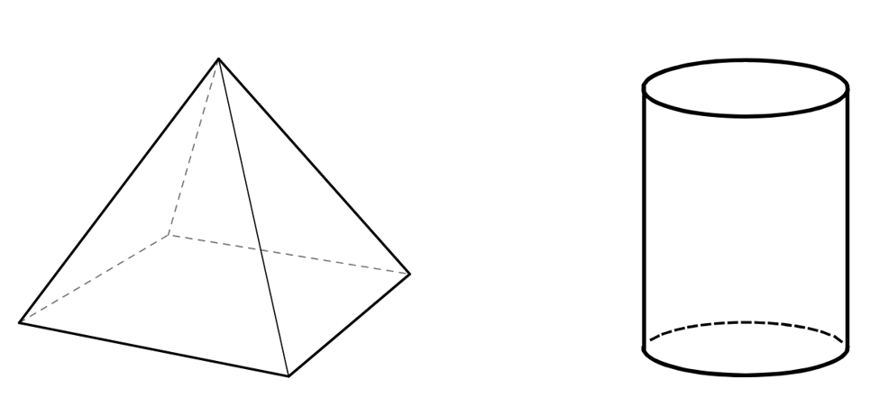
Short response (16)
Name the three-dimensional objects.
Notes:
Short response questions provide brisk paced questions focussing on review of current and previous content to support spaced and interleaved practice.
Syllabus focus area:
Three-dimensional spatial structure A: 3DS Objects

Slide 31



Activity 4 – What comes next?
Notes:
This is a developing number sense activity.
Number sense refers to a deep understanding of numbers, including their magnitude, relationships, and the effects of operations on them. It supports fluency and understanding, estimation, flexible thinking, and efficient problem-solving. Number sense activities 1–4 ‘activate’ prior number knowledge and support the learning of new content in the unit. Number sense activities 5–8 ‘loop’ back and provide opportunity for spaced practice with concepts and procedures covered in previous units.
Syllabus focus area:
Multiplicative Relations A
What comes next?
This resource corresponds to Resource 30 – What comes next? in Stage 2 Year A Unit 17
This activity is an adaptation of What comes next? Fruit Stand from Math Learning Center.
Display Resource 30 – What comes next? (this resource corresponds to Resource 30 – What comes next? in Stage 2, Year A Unit 17). Ask:
What do you notice? What do you wonder?
How would you describe this pattern?
What comes next? How do you know?
Will there be a picture with 40 apples? How do you know?
What might earlier pictures look like? How do you know?
Students show what the fruit pattern would look like if recording multiples of fives or tens, on an individual whiteboard.
Provide pairs of students with a 6-sided die, counters and individual whiteboards.
Students share their pattern with a partner and ask:
What comes next? How do you know?
How would you describe this pattern to someone?

Slide 32
Review of learning 5

Slide 33
Multiple choice (3)
6715 2908 4144 8156
Read the numbers. Which one correctly shows the numbers in ascending order?
A | B | C | D
6715 4144 2908 8156 | 2908 4144 6715 8156 | 2908 6715 4144 8156 | 8156 6715 4144 2908
Notes:
This question connects to the content in the developing number sense activity (Activity 5)
Syllabus focus area:
Representing numbers using place value B

Slide 34
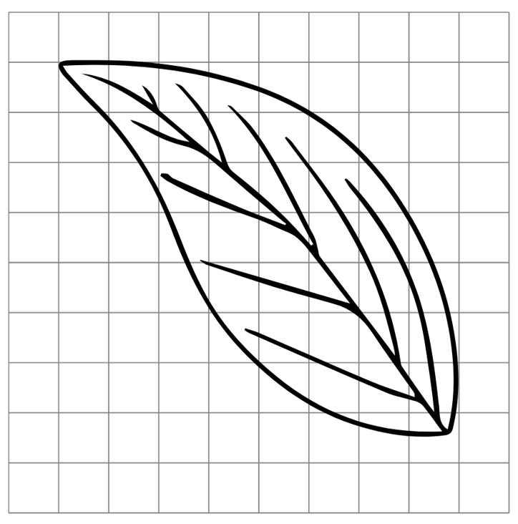
Short response (21)
Estimate the area of this leaf.
Notes:
Short response questions provide brisk paced questions focussing on review of current and previous content to support spaced and interleaved practice.
Syllabus focus area:
Two-dimensional spatial structure A: Area

Slide 35
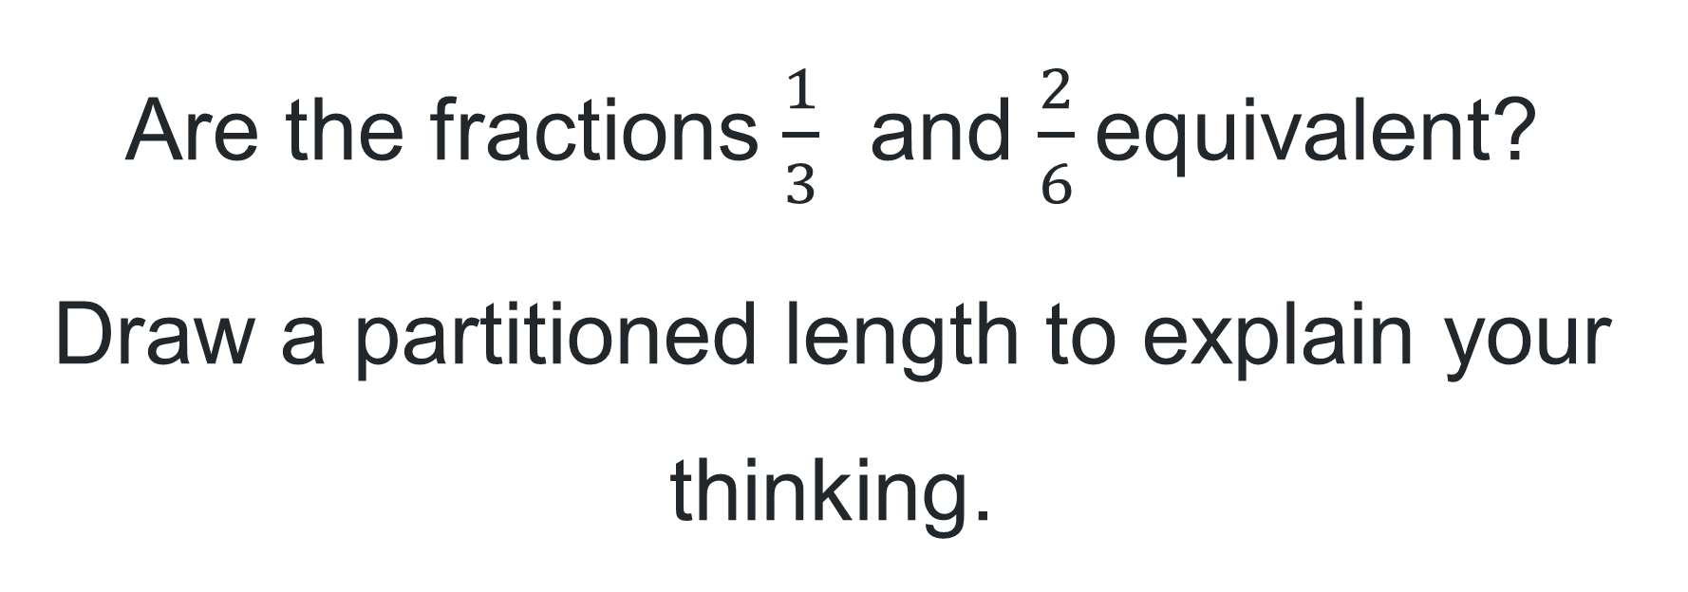
Short response (18)
Are the fractions $\frac{1}{3}$​ and $\frac{2}{6}$equivalent?
Draw a partitioned length to explain your thinking.
Notes:
Short response questions provide brisk paced questions focussing on review of current and previous content to support spaced and interleaved practice.
Syllabus focus area:
Partitioned Fractions A

Slide 36
Short response (19)
Lily buys an ice cream that costs $2.40 and pays with a $5 note.
How much change will she receive?
What combinations of coins could she be given?
Notes:
Short response questions provide brisk paced questions focussing on review of current and previous content to support spaced and interleaved practice.
Syllabus focus area:
Additive relations A

Slide 37
Short response (20)
The time is quarter past 2.
How many minutes is this past 2 o’clock?
Notes:
Short response questions provide brisk paced questions focussing on review of current and previous content to support spaced and interleaved practice.
Syllabus focus area:
Non-spatial measure A: Time

Slide 38
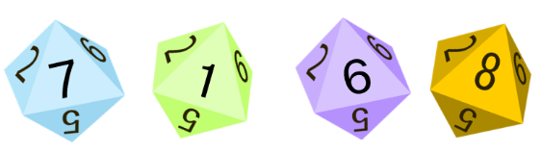
Activity 5 – ascending and descending order
Notes:
This is a developing number sense activity.
Number sense refers to a deep understanding of numbers, including their magnitude, relationships, and the effects of operations on them. It supports fluency and understanding, estimation, flexible thinking, and efficient problem-solving. Number sense activities 1–4 ‘activate’ prior number knowledge and support the learning of new content in the unit. Number sense activities 5–8 ‘loop’ back and provide opportunity for spaced practice with concepts and procedures covered in previous units.
Syllabus focus area:
Representing numbers using place value B
Ascending and descending order
Display a set of 4-digit numbers.
Model placing the set of 4-digit numbers into ascending and descending order.
Ask: How did you determine which number to place first/last when organising in ascending/descending order?
In small groups, students take turns to roll a 9-sided dice 4 times to create a 4-digit number. Students read the number aloud and record on a sticky note.
Roll the dice again and repeat the process. Arrange the 2 numbers made so far in ascending order.
Repeat 3 or 4 more times, arranging the numbers in ascending order.
Students read the list of numbers aloud starting from the smallest.
Repeat the process with new numbers, this time arranging in descending order.
As a class, discuss how to order one set of pre-prepared numbers that include internal zeros. For example, 2030, 2300, 2506 and 2650.

Slide 39
Review of learning 6

Slide 40
True or false (4)
The nearest thousand to 6789 is 7000.
True | False
Notes:
The question on this slide connects to the content being explored in the developing number sense activity (Activity 8)
Syllabus focus area:
Representing numbers using place value B

Slide 41
Short response (25)
Identify the differences between a cube and a pyramid.
Notes:
Short response questions provide brisk paced questions focussing on review of current and previous content to support spaced and interleaved practice.
Syllabus focus area:
Three-dimensional spatial structure A

Slide 42
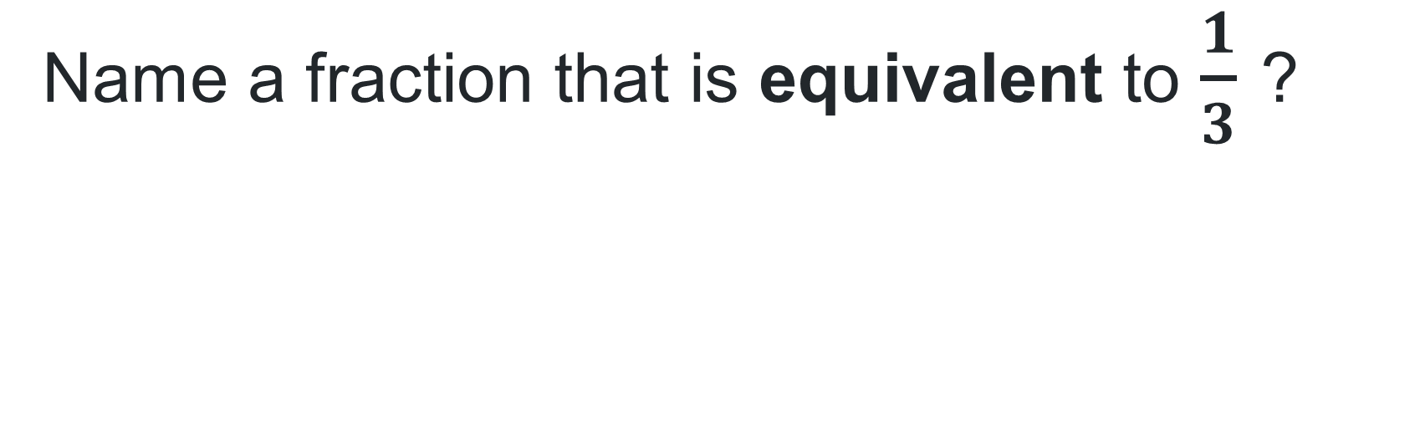
Short response (22)
Name a fraction that is equivalent to $\frac{1}{3}$ ?
Notes:
Short response questions provide brisk paced questions focussing on review of current and previous content to support spaced and interleaved practice.
Syllabus focus area:
Partitioned fractions B: Model equivalent fractions as lengths

Slide 43
Short response (23)
If a drink and a packet of chips cost $6.75 and you pay with a $20 note, how much change will you get back?
Notes:
Short response questions provide brisk paced questions focussing on review of current and previous content to support spaced and interleaved practice.
Syllabus focus area:
Additive relations A

Slide 44
Short response (24)
Record the order of these measurements from longest to shortest.
1m 75cm
250cm
2m 10cm
190cm
Notes:
Short response questions provide brisk paced questions focussing on review of current and previous content to support spaced and interleaved practice.
Syllabus focus area:
Geometric Measure A: Length

Slide 45
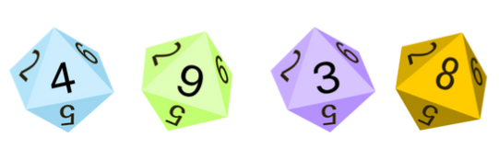
Activity 6 – What’s the nearest?
Notes:
This is a developing number sense activity.
Number sense refers to a deep understanding of numbers, including their magnitude, relationships, and the effects of operations on them. It supports fluency and understanding, estimation, flexible thinking, and efficient problem-solving. Number sense activities 1–4 ‘activate’ prior number knowledge and support the learning of new content in the unit. Number sense activities 5–8 ‘loop’ back and provide opportunity for spaced practice with concepts and procedures covered in previous units.
Syllabus focus area:
Representing numbers using place value B
What’s the nearest?
Display a set of 4-digit numbers.
Model identifying the nearest thousand in the displayed set of 4-digit numbers. Record the number rounded to the nearest thousand.
Ask:
What do I think about first to find the nearest thousand for each number?
How do I decide whether to round up or down to the nearest thousand?
In small groups, students roll four 9-sided dice to make a 4-digit number. Students read the number aloud and record it on a sticky note.
Students repeat the process multiple times.
Students order the collection of 4-digit numbers in ascending or descending order.
Students identify the nearest thousand for each recorded number. For example, 7984 is closest to 8000 and 6021 is closest to 6000. Students record the rounded number on the sticky note.
Display 9548 and discuss how the closest thousand is 10 000.

Slide 46
Review of learning 7

Slide 47
Multiple choice (4)(1)
What is the smallest number you can make with the digits 4, 5, 8, 0, 9?
A | B | C | D
98 054 | 45 908 | 98 540 | 90 584
Notes:
This question connects to the content in the developing number sense activity (Activity 7)
Syllabus focus area:
Representing numbers using place value B

Slide 48
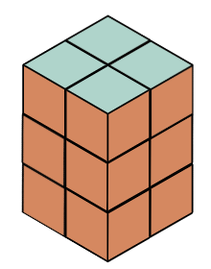
Short response (17)
What is the volume of this rectangular prism using cubic centimetres?
Notes:
Short response questions provide brisk paced questions focussing on review of current and previous content to support spaced and interleaved practice.
Syllabus focus area:
Three-dimensional spatial structure A

Slide 49
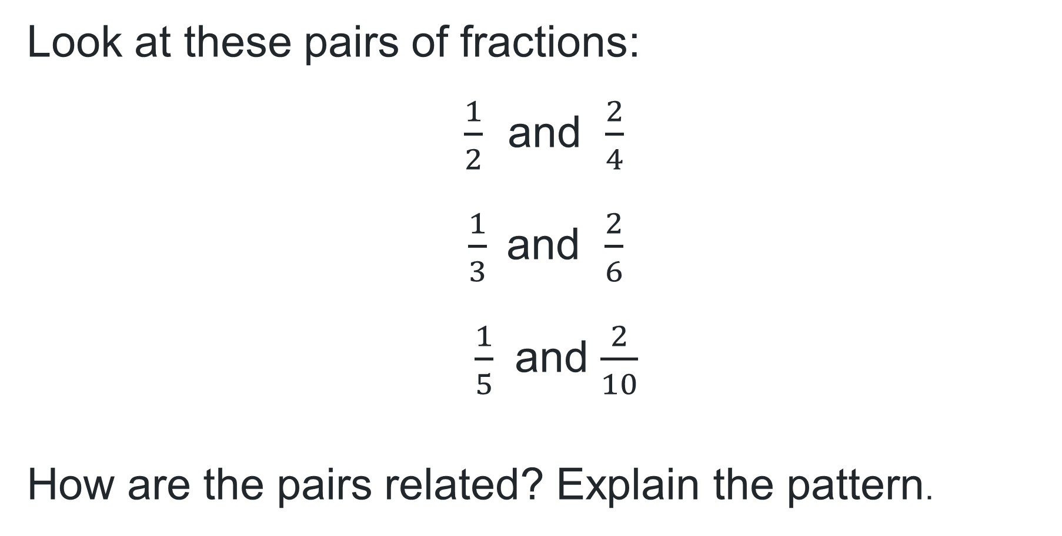
Short response (26)
Look at these pairs of fractions:
$\frac{1}{2}$ and $\frac{2}{4}$
$\frac{1}{3}$and $\frac{2}{6}$
$\frac{1}{5}$ and $\frac{2}{10}$
How are the pairs related? Explain the pattern.
Notes:
Short response questions provide brisk paced questions focussing on review of current and previous content to support spaced and interleaved practice.
Syllabus focus area:
Multiplicative relations A

Slide 50
Short response (29)
At the canteen you buy a juice for $2.50, a chicken burger for $6.00, and popcorn for $0.45. How much do you spend in total?
Notes:
Short response questions provide brisk paced questions focussing on review of current and previous content to support spaced and interleaved practice.
Syllabus focus area:
Additive relations A

Slide 51
Short response (30)
Sophie is planning a picnic and has 3 different types of sandwiches: ham, cheese, and vegemite. She also has apple juice and water.
Record all possible combinations of one sandwich and one drink that Sophie can choose for her picnic.
Notes:
Short response questions provide brisk paced questions focussing on review of current and previous content to support spaced and interleaved practice.
Syllabus focus area:
Chance A

Slide 52
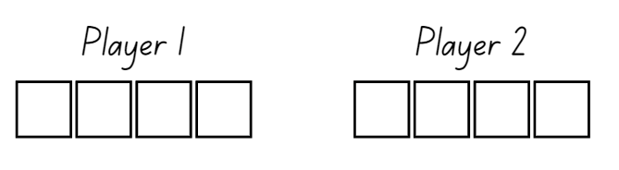
Activity 7 – largest 4-digit number
Notes:
This is a developing number sense activity.
Number sense refers to a deep understanding of numbers, including their magnitude, relationships, and the effects of operations on them. It supports fluency and understanding, estimation, flexible thinking, and efficient problem-solving. Number sense activities 1–4 ‘activate’ prior number knowledge and support the learning of new content in the unit. Number sense activities 5–8 ‘loop’ back and provide opportunity for spaced practice with concepts and procedures covered in previous units.
Syllabus focus area:
Representing numbers using place value B
Largest 4-digit number
This activity is an adaptation of Nice or nasty from NRICH by University of Cambridge.
The aim of the game is to create the largest 4-digit number.
In pairs, provide students with a 9-sided die and an individual whiteboard each.
Each student draws a set of 4 boxes,
Students take turns to roll the dice and decide which of the 4 boxes to write the digit in, trying to create the largest 4-digit number.
The player with the largest 4-digit number wins and scores a point. The first player to score 10 points wins the game.
Discuss:
What was your strategy for creating the largest 4-digit number?
How would your strategy change if you were making the smallest 4-digit number?

Slide 53
Review of learning 8

Slide 54
True or false (3)
The nearest thousand to the number 7897 is 8000.
True | False
Notes:
The question on this slide connects to the content being explored in the developing number sense activity (Activity 6)
Syllabus focus area:
Representing numbers using place value B

Slide 55
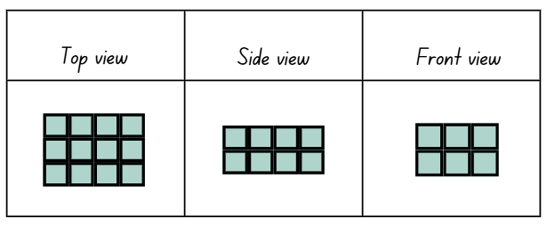
Short response (31)
Describe the volume of this prism in terms of layers.
Notes:
Short response questions provide brisk paced questions focussing on review of current and previous content to support spaced and interleaved practice.
Syllabus focus area:
Three-dimensional spatial structure A

Slide 56
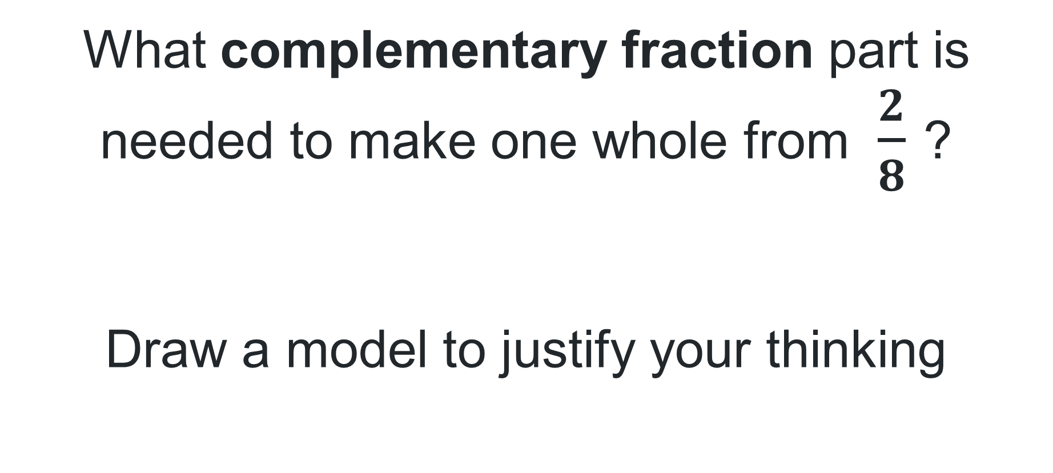
Short response (32)
What complementary fraction part is needed to make one whole from $\frac{2}{8}$ ?
Draw a model to justify your thinking
Notes:
Short response questions provide brisk paced questions focussing on review of current and previous content to support spaced and interleaved practice.
Syllabus focus area:
Partitioned fractions A

Slide 57
Short response (33)
Liam has $15. He wants to buy a toy that costs $8.50 and a book that costs $4.25.
How much money will Liam spend in total?
How much money will he have left after buying the toy and the book?
Notes:
Short response questions provide brisk paced questions focussing on review of current and previous content to support spaced and interleaved practice.
Syllabus focus area:
Additive relations A

Slide 58
Short response (34)
Record 3 polygons that have at least one pair of parallel sides.
Notes:
Short response questions provide brisk paced questions focussing on review of current and previous content to support spaced and interleaved practice.
Syllabus focus area:
Two-dimensional spatial structure A: 2D Shapes

Slide 59
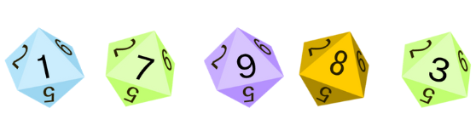
Activity 8 – What’s the nearest 2?
Notes:
This is a developing number sense activity.
Number sense refers to a deep understanding of numbers, including their magnitude, relationships, and the effects of operations on them. It supports fluency and understanding, estimation, flexible thinking, and efficient problem-solving. Number sense activities 1–4 ‘activate’ prior number knowledge and support the learning of new content in the unit. Number sense activities 5–8 ‘loop’ back and provide opportunity for spaced practice with concepts and procedures covered in previous units.
Syllabus focus area:
Representing numbers using place value B
What’s the nearest 2?
Revise Activity 6 – What’s the nearest?
In this version of the activity, students use 5-digit numbers and identify the nearest 10 thousand.
Display a 5-digit number and have students discuss the nearest 10 thousand.
In small groups, students write a collection of 5-digit numbers on sticky notes. Students order the collection of 5-digit numbers in ascending or descending order.
Students identify the nearest 10 thousand for each recorded number. For example, 17 984 is closest to 20 000 and 61 021 is closest to 60 000. Students record the rounded number on the sticky note.
Display 97 548 and discuss how the closest 10 thousand is 100 000

Slide 60
Double Venn diagram
Object 1
Object 2
Features similar to both objects
Features of object 1
Features of object 2

Slide 61
Frayer
Definition
Facts/Characteristics
Word, term, concept
Examples
Non-examples

Slide 62
Spider map
Idea
Subject

Slide 63
Cline
Concept 1
Concept 2
Word
Word
Word
Word
Word
Word
Word
Word
Word
Word
Word

Slide 64

Compare and contrast
Notes:
Use the arrows to navigate between related activities.
Hyperlink each arrow to compare between related slides.

Slide 65
Multiple choice (1)
A
B
C
D
Notes:
This question connects to the content in the developing number sense activity (Activity 1)
This question can:
support spaced and interleaved practice
help identify and address common misconceptions
support active recall and immediate feedback
support whole class participation
identify areas requiring reteach
Teachers are encouraged to adapt and contextualise for their contexts.

Slide 66
Multiple choice (2)
A
B
C
D
Notes:
This question connects to the content in the developing number sense activity (Activity 1)
Syllabus focus area:
Multiplicative relations A
This question can:
support spaced and interleaved practice
help identify and address common misconceptions
support active recall and immediate feedback
support whole class participation
identify areas requiring reteach
Teachers are encouraged to adapt and contextualise for their contexts.

Slide 67
References
This presentation contains NSW Curriculum and syllabus content. The NSW Curriculum is developed by the NSW Education Standards Authority. This content is prepared by NESA for and on behalf of the Crown in the right of the State of New South Wales. The material is protected by Crown copyright.
Please refer to the NESA Copyright Disclaimer for more information https://educationstandards.nsw.edu.au/wps/portal/nesa/mini-footer/copyright.
NESA holds the only official and up-to-date versions of the NSW Curriculum and syllabus documents. Please visit the NSW Education Standards Authority (NESA) website https://educationstandards.nsw.edu.au/wps/portal/nesa/home and the NSW Curriculum website https://curriculum.nsw.edu.au.
Mathematics K–10 Syllabus © Syllabus NSW Education Standards Authority (NESA) for and on behalf of the Crown in right of the State of New South Wales, 2022.
National Numeracy Learning Progression © Australian Curriculum, Assessment and Reporting Authority (ACARA) 2010 to present, unless otherwise indicated. This material was downloaded from the Australian Curriculum website (National Literacy Learning Progression) (accessed 10 May 2024) and was not modified.
Lilburn P and Sawczak I (2011) Teaching and Assessing Maths Through Open-ended Activities, 1st Australian edn, Pearson Education Australia, Melbourne.
The Math Learning Center (MLC) (n.d.) Work Place Instructions 2A Loops & Groups, MLC website, accessed 28 May 2024.
The Math Learning Center (MLC) (2024) What Comes Next? Fruit Stand, Math at Home website, accessed 28 May 2024.

Slide 68
References (1)
This presentation contains NSW Curriculum and syllabus content. The NSW Curriculum is developed by the NSW Education Standards Authority. This content is prepared by NESA for and on behalf of the Crown in the right of the State of New South Wales. The material is protected by Crown copyright.
Please refer to the NESA Copyright Disclaimer for more information https://educationstandards.nsw.edu.au/wps/portal/nesa/mini-footer/copyright.
NESA holds the only official and up-to-date versions of the NSW Curriculum and syllabus documents. Please visit the NSW Education Standards Authority (NESA) website https://educationstandards.nsw.edu.au/wps/portal/nesa/home and the NSW Curriculum website https://curriculum.nsw.edu.au.
NSW Department of Education (2023) ‘Array bingo’, Mathematics K–6 Resources, NSW Department of Education website, accessed 28 May 2024.
Toy Theater (2001–2024a) Colour Counters, Toy Theater website, accessed 28 May 2024.
Toy Theater (2001–2024b) Hundreds Chart, Toy Theater website, accessed 28 May 2024.
University of Cambridge (n.d.a) Dicey Perimeter, Dicey Area, NRICH website, accessed 28 May 2024.
——(n.d.b) Dozens, NRICH website, accessed 28 May 2024.
——(n.d.c) Nice or Nasty, NRICH website, accessed 28 May 2024.

Slide 69
Copyright
© State of New South Wales (Department of Education), 2025
The copyright material published in this resource is subject to the Copyright Act 1968 (Cth) and is owned by the NSW Department of Education or, where indicated, by a party other than the NSW Department of Education (third-party material).
Copyright material available in this resource and owned by the NSW Department of Education is licensed under a Creative Commons Attribution 4.0 International (CC BY 4.0) license.
This license allows you to share and adapt the material for any purpose, even commercially.
Attribution should be given to © State of New South Wales (Department of Education), 2025.
Material in this resource not available under a Creative Commons license:
the NSW Department of Education logo, other logos and trademark-protected material
Material owned by a third party that has been reproduced with permission. You will need to obtain permission from the third party to reuse its material.
Links to third-party material and websites
Please note that the provided (reading/viewing material/list/links/texts) are a suggestion only and implies no endorsement, by the New South Wales Department of Education, of any author, publisher, or book title. School principals and teachers are best placed to assess the suitability of resources that would complement the curriculum and reflect the needs and interests of their students.
If you use the links provided in this document to access a third party’s website, you acknowledge that the terms of use, including licence terms set out on the third-party’s website apply to the use which may be made of the materials on that third-party website or where permitted by the Copyright Act 1968 (Cth). The department accepts no responsibility for content on third-party websites.

