Slide 1
Instructions for use
This resource aligns to the learning in Stage 2 Year A Unit 19 and revisits content from earlier sample units.
Classroom teachers are encouraged to add, edit and adapt to meet the needs of their students.
Save a copy of the file to make changes to the slide deck. Go to File > Download a Copy (this downloads a copy to the computer to edit in the PowerPoint app).
To convert the PowerPoint to Google Slides:
  Upload the file into Google Drive and open it.
  Go to File > Save as Google Slides.
  (Note – conversion may cause formatting changes in the slides.)

Slide 2

Review of Learning
Mathematics Stage 2 – Unit 19
Notes:
Reviews may include a combination of question types, requiring students to recall facts and key ideas, as well as apply their knowledge to solve problems and answer questions. To support active engagement, a mix of techniques should be employed.” (AERO, 2024).
This Review of Learning slide deck revisits key concepts from the following units:
Stage 2 Year A Unit 19
Stage 2 Year A Unit 18
Stage 2 Year A Unit 17
It also includes opportunities to review prior learning in non-number content, supporting consolidation across focus areas.
The review of learning resources include three key task types that support the development of mathematical proficiency through retrieval, spaced practice, and active participation. These practices complement the review phase (activating prior knowledge) embedded within the beginning of each lesson.
1.
Multiple-choice questions/True or false: Designed to promote active retrieval of key concepts and identify common misconceptions in number, supporting consolidation, understanding and fluency.
These questions:
support spaced and interleaved practice
help identify and address common misconceptions
support active recall and immediate feedback
support whole class participation
identify areas requiring reteach
2.
Short-response question sets: Carefully grouped questions that encourage spaced and interleaved practice across multiple focus areas, helping students revisit and apply knowledge from different points in time.
These questions:
have a combination of question types
address a range of focus areas
build automaticity and fluency
support active recall
allow for immediate feedback
identify content requiring reteach
3.
Developing number sense activities: A variety of practical, purposeful tasks that reinforce current learning and build on prior knowledge. These activities promote reasoning, problem-solving and conceptual understanding.
The review of learning resources are designed to work support teaching and learning in mathematics. For the most effective implementation, use the resources flexibly, adapting to meet student learning needs and individual classroom contexts.

Slide 3
Lessons
1
Review of learning 1
5
Review of learning 5
2
Review of learning 2
6
Review of learning 6
3
Review of learning 3
7
Review of learning 7
4
Review of learning 4
8
Review of learning 8
Notes:
Teacher notes:
Click lesson numbers to go to specific lessons
Interactive features can be viewed in slide show

Slide 4
Review of learning 1

Slide 5

Multiple choice (1)
Which of the following shows the non-standard form for 6324?
A 6 thousands, 3 hundreds, 2 tens and 4 ones
B 6 thousands, 724 ones
C 63 hundreds and 24 ones
D 630 thousands and 24 ones
Notes:
This question connects to the content in the developing number sense activity (Activity 1)
Syllabus focus area:
Representing numbers using place value A

Slide 6


Short response (1)
What is the same and what is different about these shapes?
Notes:
Short response questions provide brisk paced questions focussing on review of current and previous content to support spaced and interleaved practice.
Syllabus focus area:
Two-dimensional spatial structure A

Slide 7
Short response (2)
Create a table to show 4D’s sporting house group data.
Bundjalung – 9 students
Gumbaynggirr – 8 students
Wiradjuri – 6 students
Muruwari – 7 students
Notes:
Short response questions provide brisk paced questions focussing on review of current and previous content to support spaced and interleaved practice.
Syllabus focus area:
Data A

Slide 8
Short response (3)
Which statement about patterns of multiples is in the wrong column and why?
Always | Sometimes | Never
When you add an even number and an odd number you get an even number. | Multiples of 5 end in a 5. | The sum of two odd numbers is always odd.
Notes:
Short response questions provide brisk paced questions focussing on review of current and previous content to support spaced and interleaved practice.
Syllabus focus area:
Multiplicative Relations A

Slide 9
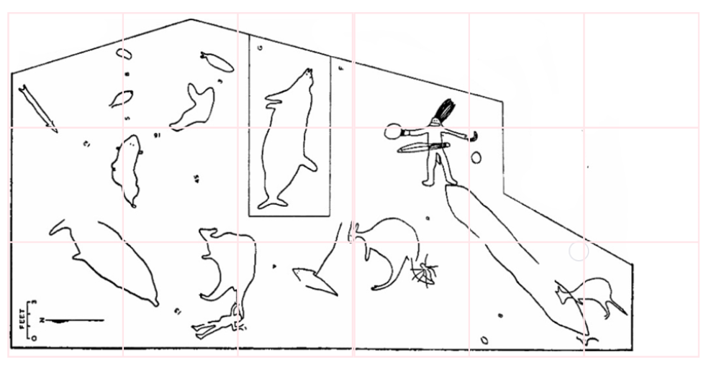
Short response (4)
Using the site map for Bulgandry Art Site Aboriginal Place, in Darkinjung Country, locate and record the engraving that is found on the grid position:
C2
F1
D2
A3
3
2
1
A B C D E F
https://hikingtheworld.blog/engravings/bulgandry-brisbane-water/
Notes:
Short response questions provide brisk paced questions focussing on review of current and previous content to support spaced and interleaved practice.
Syllabus focus area:
Geometric measure A: Position

Slide 10

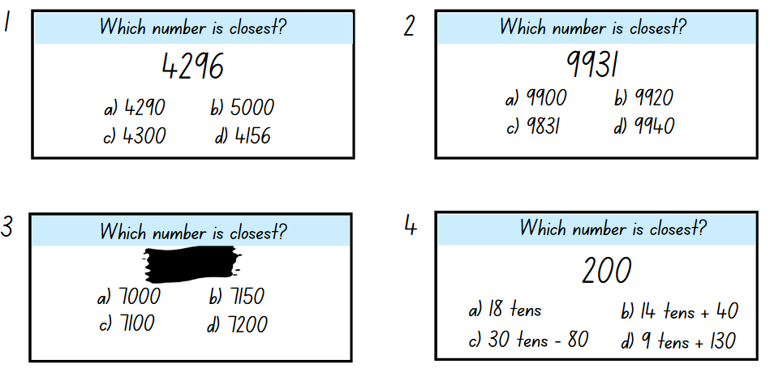
Activity 1 – ordering numbers
Notes:
This is a developing number sense activity.
Number sense refers to a deep understanding of numbers, including their magnitude, relationships, and the effects of operations on them. It supports fluency and understanding, estimation, flexible thinking, and efficient problem-solving. Number sense activities 1–4 ‘activate’ prior number knowledge and support the learning of new content in the unit. Number sense activities 5–8 ‘loop’ back and provide opportunity for spaced practice with concepts and procedures covered in previous units.
Syllabus focus area: Representing numbers using place value A
Ordering numbers
This activity is an adaptation of ‘As Close As It Gets’ from Maths is Figure-Out-Able! by Harris.
Display Resource 21 – ordering numbers (this resource corresponds to Resource 21 – ordering numbers in Stage 2, Year A Unit 19).
Identify that each card has a target number and read aloud card 1.
Draw a number line on the board and demonstrate positioning the target number on an empty number line, then each of the multiple-choice options to establish which is closest.
Use card 1 to demonstrate how to rename the target number using non-standard partitions such as 42 hundreds and 96 ones, or 429 tens and 6 ones.
Students use card 2 to Think-Pair-Share and read the numbers aloud. They position each of the numbers on a number line to establish which is closest.
All students show their responses on their individual whiteboards. Select students to justify their answer using place value language.
Explain that for card 3, the target number has been deleted.
Students record at least 2 target numbers that would make more than one of the responses correct. For example, 7050, 7125 or 7175.
Select students to communicate and reason about their responses.
Students use card 4 to record the target number in standard and non-standard place value form.
Students Think-Pair-Share to select and record the non-standard partition that is closest to the target number.
Check for understanding by observing student responses. Select students to justify their answer.

Slide 11
Review of learning 2

Slide 12
True or false (1)
2 thousands, 14 hundreds and 28 tens is equal to 3428.
True | False
How do you know?
Notes:
The question on this slide connects to the content being explored in the developing number sense activity (Activity 2)
Syllabus focus area:
Representing numbers using place value A

Slide 13
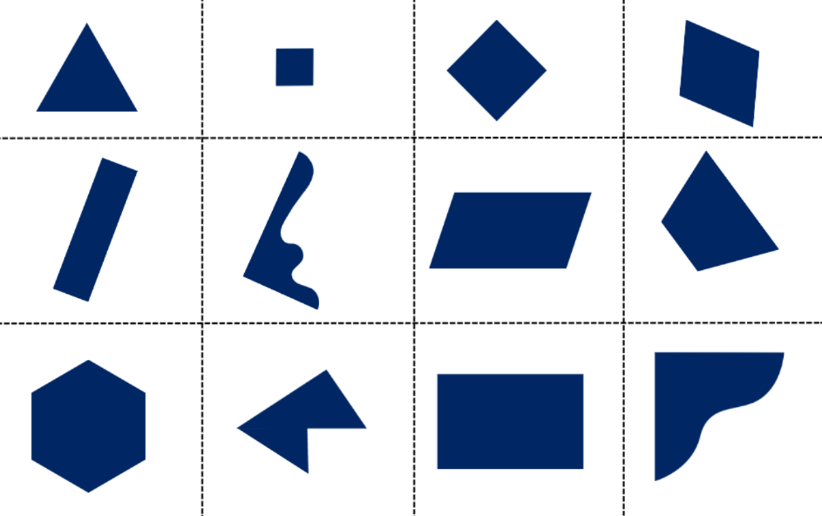
Short response (5)
How many of these 2D shapes are quadrilaterals?
Communicate your thinking.
Notes:
Short response questions provide brisk paced questions focussing on review of current and previous content to support spaced and interleaved practice.
Syllabus focus area:
Two-dimensional spatial structure A: 2D shapes

Slide 14
Short response (6)
Using the data for the number of Stage 2 students in house groups, name and label the axes of the column graph and give it an appropriate title.
Notes:
Short response questions provide brisk paced questions focussing on review of current and previous content to support spaced and interleaved practice.
Syllabus focus area:
Data A

Slide 15
Short response (7)
Record the first 10 multiples when counting by fours.
Notes:
Short response questions provide brisk paced questions focussing on review of current and previous content to support spaced and interleaved practice.
Syllabus focus area:
Multiplicative Relations A

Slide 16
Short response (8)
Order the following lengths from shortest to longest:
100 cm
5 metres
2 metres and 18 centimetres
1 metre and 4 centimetres
Notes:
Short response questions provide brisk paced questions focussing on review of current and previous content to support spaced and interleaved practice.
Syllabus focus area:
Geometric measure A: Length

Slide 17
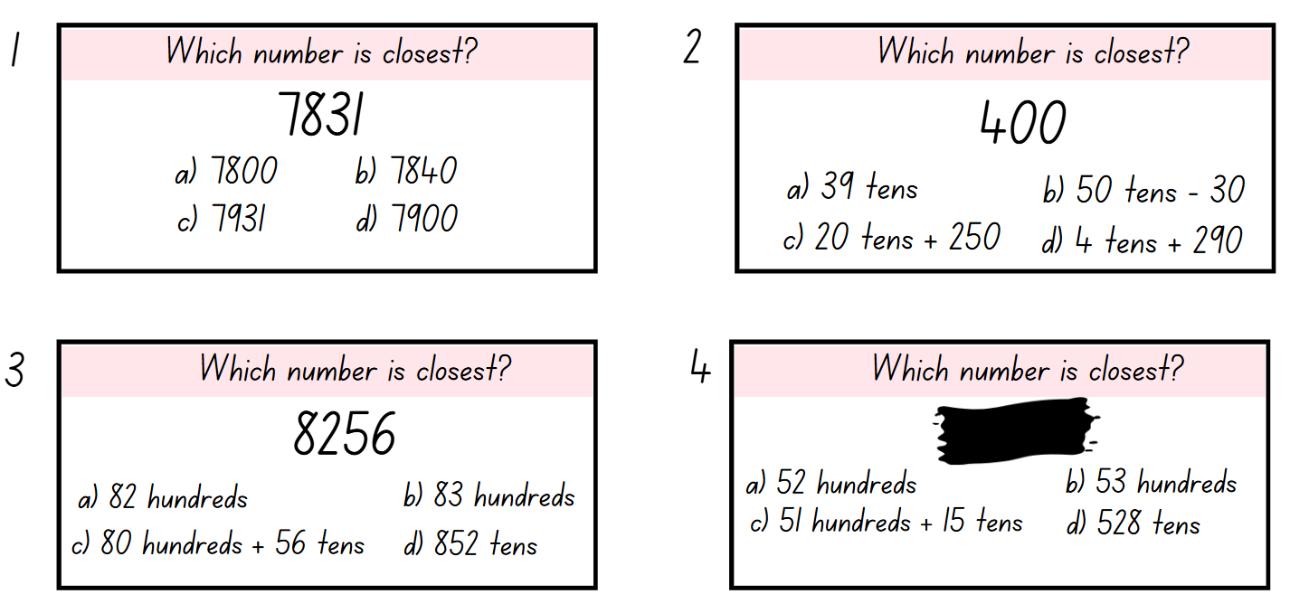
Activity 2 – place value
Notes:
This is a developing number sense activity.
Number sense refers to a deep understanding of numbers, including their magnitude, relationships, and the effects of operations on them. It supports fluency and understanding, estimation, flexible thinking, and efficient problem-solving. Number sense activities 1–4 ‘activate’ prior number knowledge and support the learning of new content in the unit. Number sense activities 5–8 ‘loop’ back and provide opportunity for spaced practice with concepts and procedures covered in previous units.
Syllabus focus area: Representing numbers using place value A
Place value
This activity is an adaptation of As Close As It Gets from Maths is Figure-Out-Able! by Harris.
Display Resource 22 – place value (this resource corresponds to Resource 22 – place value in Stage 2, Year A Unit 19).
Students use cards 1 and 2 to Think-Pair-Share and read the numbers aloud. They position each of the numbers on a number line to establish which is closest.
All students show their responses on individual whiteboards. Select students to justify their answer using place value language.
Students use card 3 to record the target number in standard and non-standard place value form.
Students Think-Pair-Share to select and record the non-standard partition that is closest to the target number.
Check for understanding by observing student responses. Select students to justify their answer.
Remind students that for card 4, the target number has been deleted.
Students record at least 2 target numbers that would make more than one of the responses correct. For example, 5205, 5281 or 5100.
Select students to communicate and reason about their responses.

Slide 18
Review of learning 3

Slide 19
Multiple choice (2)
9156 is closest to which number?
A 92 hundreds
B 93 hundreds
C 90 hundreds + 56 tens
D 951 tens
Notes:
This question connects to the content in the developing number sense activity (Activity 3)
Syllabus focus area:
Representing numbers using place value A

Slide 20

Short response (9)
Identify and describe the 2D shapes in the Australian, Aboriginal, Torres Strait Islands and NSW flags.
Notes:
Short response questions provide brisk paced questions focussing on review of current and previous content to support spaced and interleaved practice.
Syllabus focus area:
Two-dimensional spatial structure A: 2D shapes

Slide 21
Short response (14)
At the school picnic, Jake can choose one food and one drink. The drinks are water or orange juice. The lunch foods are sushi, a hot dog, a salad sandwich or chicken wrap. What are the possible combinations of food and drink Jake can choose?
Notes:
Short response questions provide brisk paced questions focussing on review of current and previous content to support spaced and interleaved practice.
Syllabus focus area:
Chance A

Slide 22

Short response (11)
Use your understanding of the commutative property to record 2 number sentences to represent this array.
Notes:
Short response questions provide brisk paced questions focussing on review of current and previous content to support spaced and interleaved practice.
Syllabus focus area:
Multiplicative Relations A

Slide 23
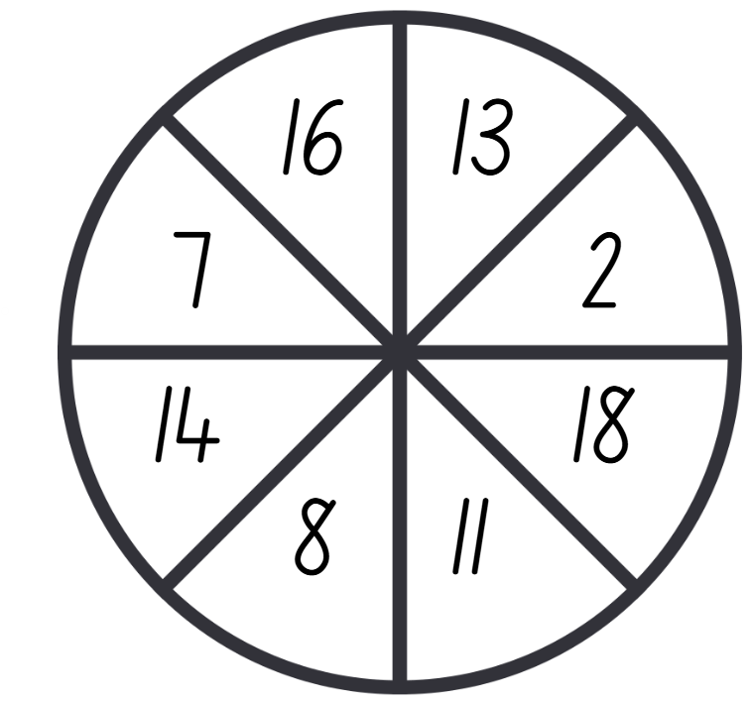
Short response (12)
What are the chances of the spinner landing on a number that includes a 1.
Notes:
Short response questions provide brisk paced questions focussing on review of current and previous content to support spaced and interleaved practice.
Syllabus focus area:
Chance A

Slide 24
Activity 3 – partitioning numbers
8637
Notes:
This is a developing number sense activity.
Number sense refers to a deep understanding of numbers, including their magnitude, relationships, and the effects of operations on them. It supports fluency and understanding, estimation, flexible thinking, and efficient problem-solving. Number sense activities 1–4 ‘activate’ prior number knowledge and support the learning of new content in the unit. Number sense activities 5–8 ‘loop’ back and provide opportunity for spaced practice with concepts and procedures covered in previous units.
Syllabus focus area: Representing numbers using place value A
Partitioning numbers
This activity is an adaptation of As Close As It Gets from Maths is Figure-Out-Able! by Harris.
Display and revise Resource 21 – ordering numbers and Resource 22 – place value (these resources correspond to Resource 21 – ordering numbers and Resource 22 – place value in Stage 2, Year A Unit 19).
Display a new 4-digit target number. Students record the number in standard place value form and one option for non-standard place value form on individual whiteboards, then compare with a partner.
In pairs, students write 4 multiple-choice questions for that target number using a mixture of 4-digit numbers in standard place value form and non-standard partitions.
Students present their 4 multiple-choice options for another pair to answer and explain. Pairs then swap roles, checking each other’s responses and reasoning.
Regroup and select students to share their 4 multiple-choice options to the class to respond to.
Repeat with a new 4-digit number.

Slide 25
Review of learning 4

Slide 26
True or false (2)
8734 is not equal to 7 thousands, 6 hundreds, 23 tens and 4 ones.
True | False
How do you know?
Notes:
The question on this slide connects to the content being explored in the developing number sense activity (Activity 4)
Syllabus focus area:
Representing numbers using place value A

Slide 27
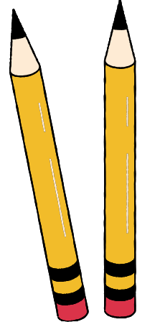
Short response (13)
Explain why the pencils do not represent an angle.
Draw the correct representation of an angle.
Notes:
Short response questions provide brisk paced questions focussing on review of current and previous content to support spaced and interleaved practice.
Syllabus focus area:
Geometric measure A: Angles

Slide 28
Short response (18)
The chance of landing on purple is:
impossible, unlikely, equally likely, likely, certain
Notes:
Short response questions provide brisk paced questions focussing on review of current and previous content to support spaced and interleaved practice.
Syllabus focus area:
Chance B

Slide 29
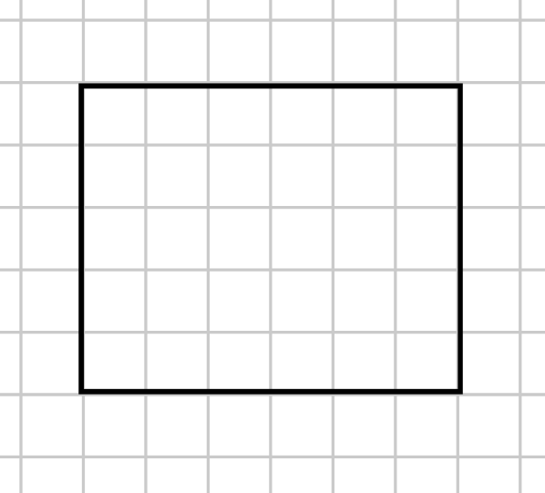

Short response (15)
Explain the error made when finding the area of this rectangle.
What strategies did you use to find the correct area?
6 sixes is
30 square centimetres
Notes:
Short response questions provide brisk paced questions focussing on review of current and previous content to support spaced and interleaved practice.
Syllabus focus area:
Two-dimensional spatial structure A: Area

Slide 30
Short response (16)
The mass of a pencil should be measured using kilograms.
Do you agree or disagree?
Explain your thinking.
Notes:
Short response questions provide brisk paced questions focussing on review of current and previous content to support spaced and interleaved practice.
Syllabus focus area:
Non-spatial measure A: Mass

Slide 31

Activity 4 – target number
Notes:
This is a developing number sense activity.
Number sense refers to a deep understanding of numbers, including their magnitude, relationships, and the effects of operations on them. It supports fluency and understanding, estimation, flexible thinking, and efficient problem-solving. Number sense activities 1–4 ‘activate’ prior number knowledge and support the learning of new content in the unit. Number sense activities 5–8 ‘loop’ back and provide opportunity for spaced practice with concepts and procedures covered in previous units.
Syllabus focus area: Representing numbers using place value A
Target number
Display and revise Resource 21 – ordering numbers or Resource 22 – place value (these resources correspond to Resource 21 – ordering numbers and Resource 22 – place value in Stage 2, Year A Unit 19).
Explain that students select their own target number.
Students write 4 multiple-choice options for that target number using a mixture of numbers in standard place value form and non-standard partitions on individual whiteboards.
Allow students to decide if they would prefer to complete the task independently or with a partner.
Students present their questions for peers to answer and explain. Students then swap roles, checking each other’s responses and reasoning.
Select students to share their questions for the class to respond to.
Note: consider challenging students to select target numbers up to 6 digits or decimals up to 2 decimal places, expressing numbers as both tenths and hundredths.

Slide 32
Review of learning 5

Slide 33
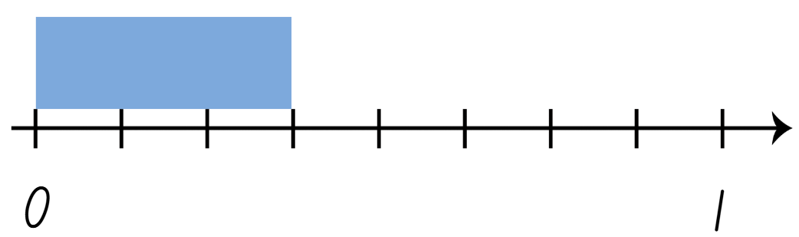
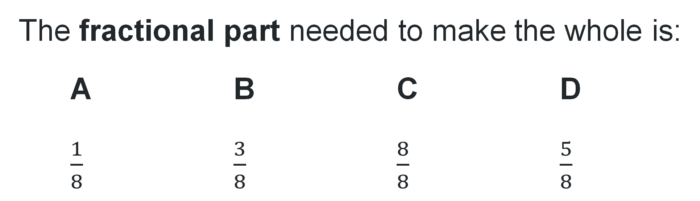
Multiple choice (3)
The fractional part needed to make the whole is:
A B C D
$\frac{1}{8}$ $\frac{3}{8}$ $\frac{8}{8}$ $\frac{5}{8}$
Notes:
This question connects to the content in the developing number sense activity (Activity 5)
Syllabus focus area:
Partitioned fractions A

Slide 34
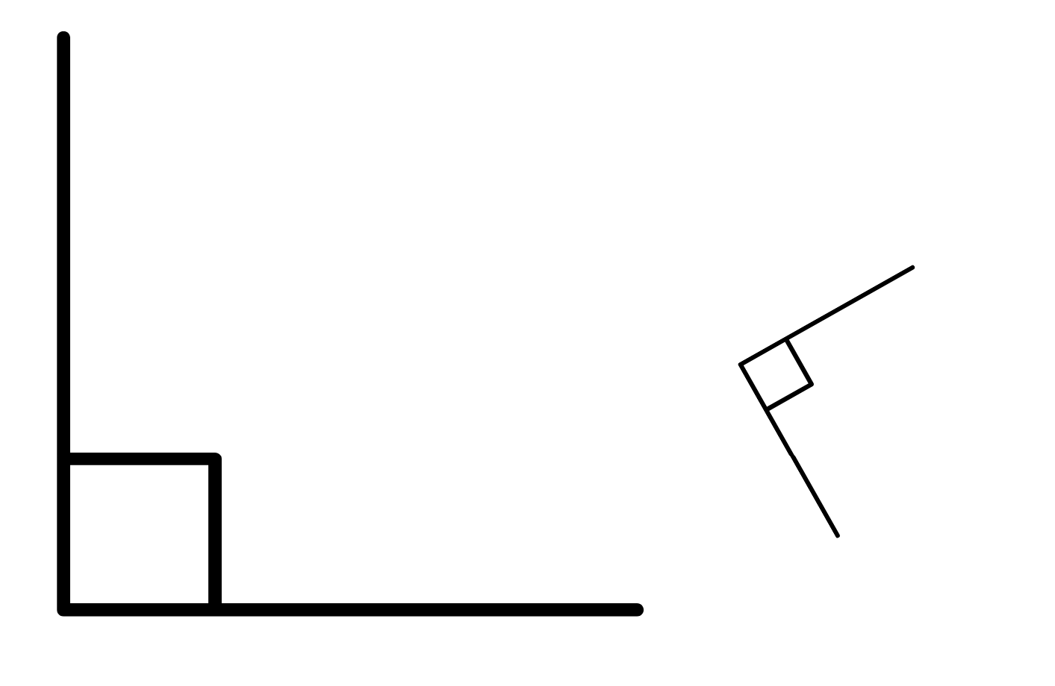
Short response (17)
Name the 2 angles. Are they the same size? Explain your thinking to a partner.
Notes:
Short response questions provide brisk paced questions focussing on review of current and previous content to support spaced and interleaved practice.
Syllabus focus area:
Geometric measure A: Angles

Slide 35
Short response (22)
Explain why the intervals in this graph are in multiples of ten.
Notes:
Short response questions provide brisk paced questions focussing on review of current and previous content to support spaced and interleaved practice.
Syllabus focus area:
Data A

Slide 36
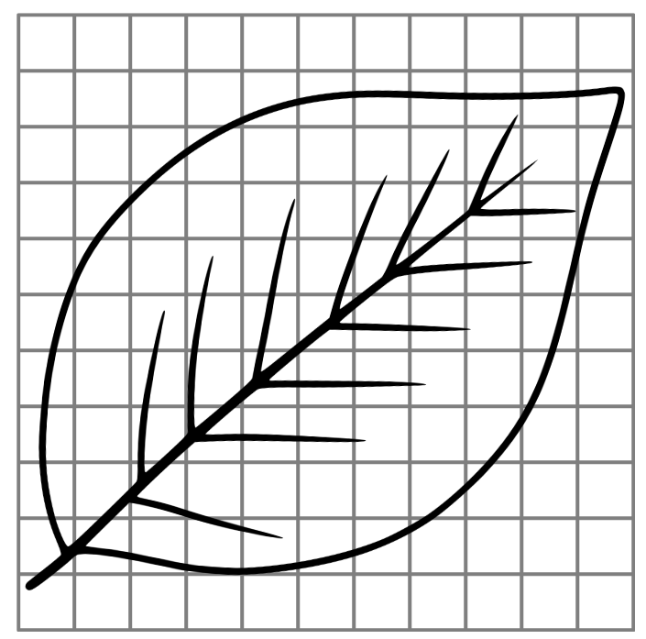
Short response (19)
What strategies could you use to estimate the area of this leaf in square centimetres?
Notes:
Short response questions provide brisk paced questions focussing on review of current and previous content to support spaced and interleaved practice.
Syllabus focus area:
Two-dimensional spatial structure A: Area

Slide 37

Short response (20)
Ben is baking a cake. He needs to measure 250 ml of milk for the recipe but only has a teacup. Will this be an accurate measurement?
Explain your thinking.
Notes:
Short response questions provide brisk paced questions focussing on review of current and previous content to support spaced and interleaved practice.
Syllabus focus area:
Three-dimensional spatial structure B: Volume

Slide 38

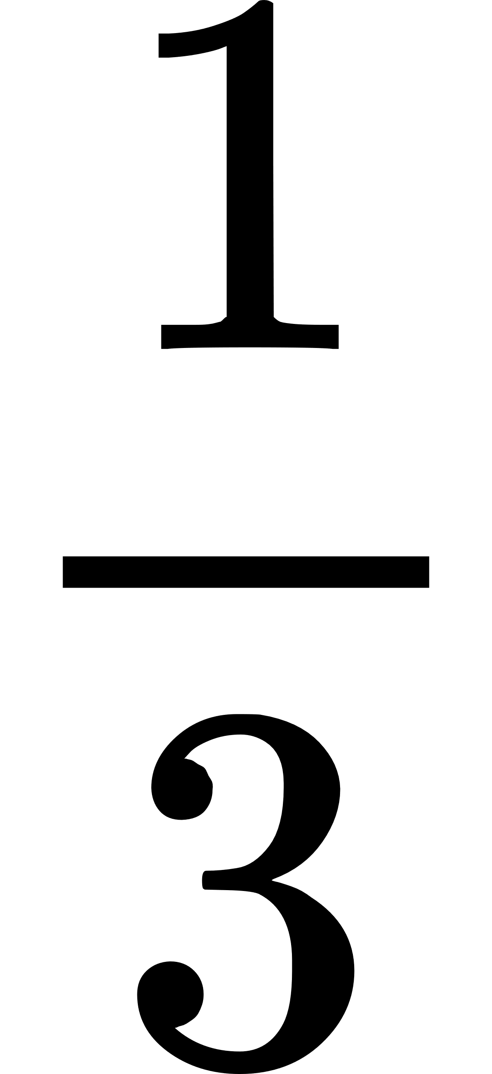
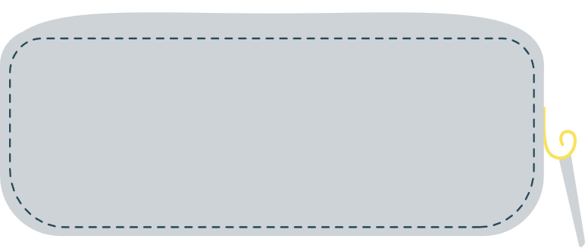




Activity 5 – completing a whole
Notes:
This is a developing number sense activity.
Number sense refers to a deep understanding of numbers, including their magnitude, relationships, and the effects of operations on them. It supports fluency and understanding, estimation, flexible thinking, and efficient problem-solving. Number sense activities 1–4 ‘activate’ prior number knowledge and support the learning of new content in the unit. Number sense activities 5–8 ‘loop’ back and provide opportunity for spaced practice with concepts and procedures covered in previous units.
Syllabus focus area: Partitioned fractions A
Completing a whole
Display Resource 23 – whole pencils (this resource corresponds to Resource 23 – whole pencils in Stage 2, Year A Unit 19). Explain that for each pencil, the unit fractional part is visible.
Provide each student with one copy of the pencils and case from Resource 23 – whole pencils.
To check for understanding, students draw the hidden fractional part of each pencil and identify:
a complete whole for each pencil
the longest and shortest pencils
the missing fractional part for each pencil.
4. Select students to communicate their reasoning and their answers.

Slide 39
Review of learning 6

Slide 40
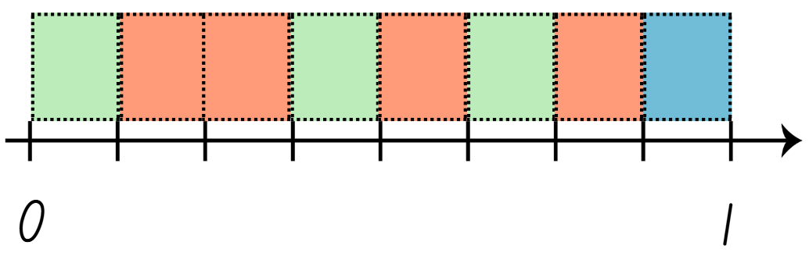
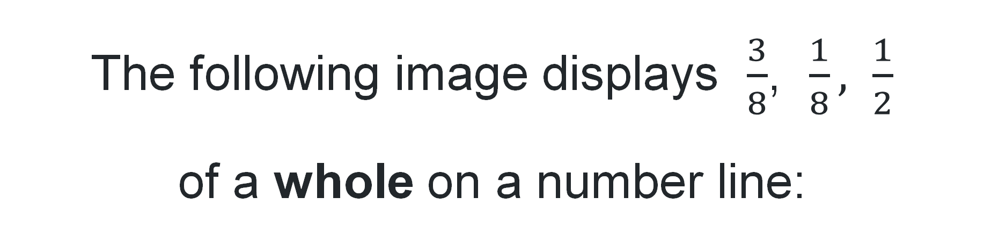
True or false (3)
The following image displays $\frac{3}{8}$, $\frac{1}{8}, \frac{1}{2}$
of a whole on a number line:
True | False
Notes:
The question on this slide connects to the content being explored in the developing number sense activity (Activity 6)
Syllabus focus area:
Partitioned fractions A

Slide 41
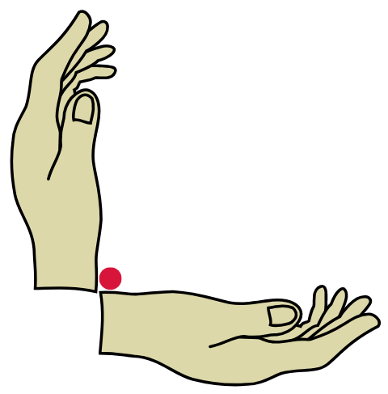
Short response (21)
Identify an object in the room with an angle that is about the same as a right angle.
Notes:
Short response questions provide brisk paced questions focussing on review of current and previous content to support spaced and interleaved practice.
Syllabus focus area:
Geometric measure B: Angles

Slide 42
Short response (22)
The council is building a sensory garden, which means they need to take out part of the playground. They surveyed visitors about their favourite playground equipment to help them decide.
According to the data, which equipment should be removed?
Explain your thinking.
Notes:
Short response questions provide brisk paced questions focussing on review of current and previous content to support spaced and interleaved practice.
Syllabus focus area:
Data A

Slide 43
Short response (23)
Lachlan constructed a 3D object with 5 faces (including 2 triangles), 6 vertices and 9 edges. Draw the 3D object Lachlan made.
Notes:
Short response questions provide brisk paced questions focussing on review of current and previous content to support spaced and interleaved practice.
Syllabus focus area:
Three-dimensional spatial structure A: 3D objects

Slide 44
Short response (24)
Do these rectangles have the same area? Communicate your thinking.
6 cm
3 cm
2 cm
4 cm
Notes:
Short response questions provide brisk paced questions focussing on review of current and previous content to support spaced and interleaved practice.
Syllabus focus area:
Two-dimensional spatial structure A: Area

Slide 45
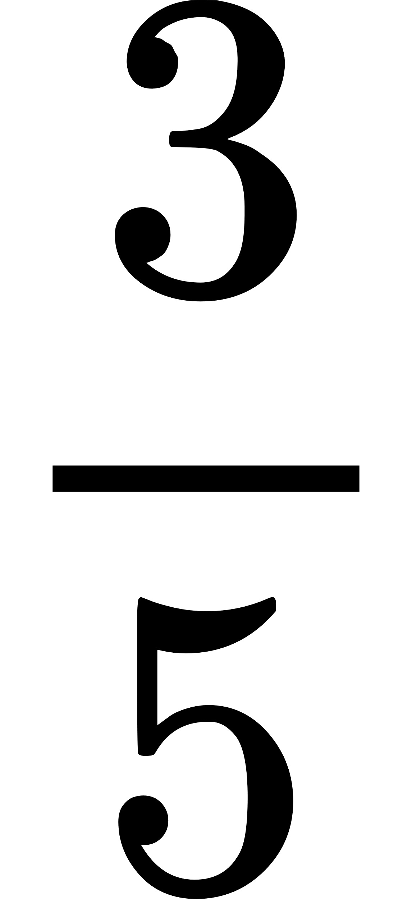
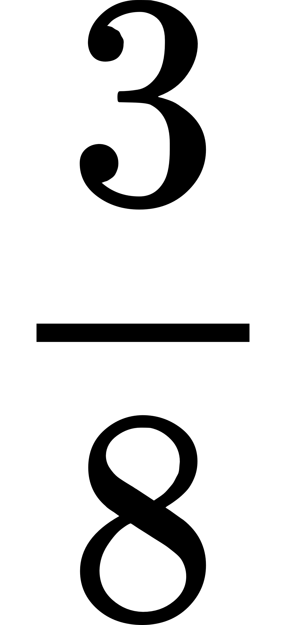
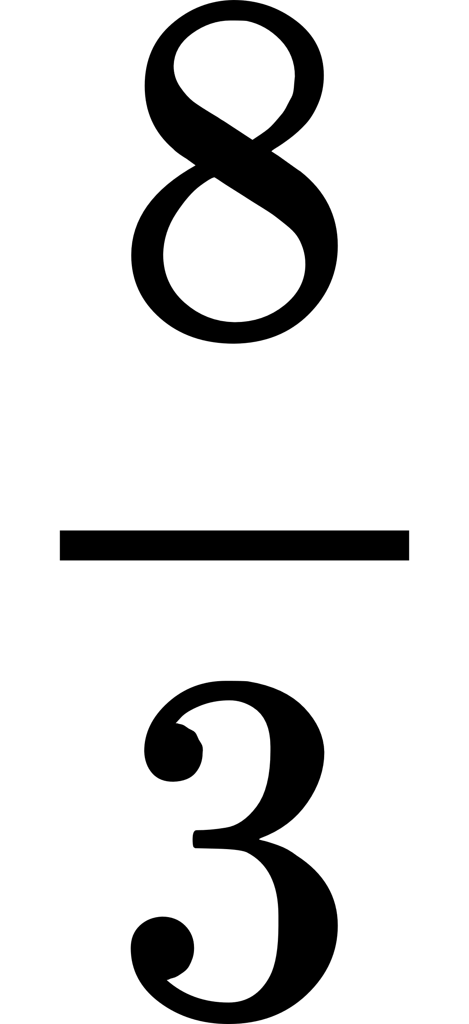
Activity 6 – fractions of a whole
What fraction of the strip is blue?
A.
3
B.
C.
D.
Notes:
This is a developing number sense activity.
Number sense refers to a deep understanding of numbers, including their magnitude, relationships, and the effects of operations on them. It supports fluency and understanding, estimation, flexible thinking, and efficient problem-solving. Number sense activities 1–4 ‘activate’ prior number knowledge and support the learning of new content in the unit. Number sense activities 5–8 ‘loop’ back and provide opportunity for spaced practice with concepts and procedures covered in previous units.
Syllabus focus area: Partitioned fractions A
Fractions of a whole
Note: this activity explores a common misconception about fractions referred to as the double count. When working with fractions, students using the double-count strategy can lose sight of the whole and incorrectly interpret a part-whole situation as a ratio. For more information, see Misunderstandings on the Top Drawer Teachers website by Australian Association of Mathematics Teachers (AAMT).
Display and read Resource 24 – fractions of a whole (this resource corresponds to Resource 24 – fractions of a whole in Stage 2, Year A Unit 19).
Identify that the correct answer is C. Select students to communicate and reason why C is correct.
Explain that in an assessment, many students incorrectly chose B as the answer. Students Think-Pair-Share to respond to:
What misunderstanding do you think students who chose B had?
What would you say to those students to help them?
4. Repeat the questions for responses A and D.
5. Provide student with writing materials. Ask students to draw at least 2 other fraction strips for $\frac{3}{8}$ that are different to that presented in Resource 24 – fractions of a whole.

Slide 46
Review of learning 7

Slide 47
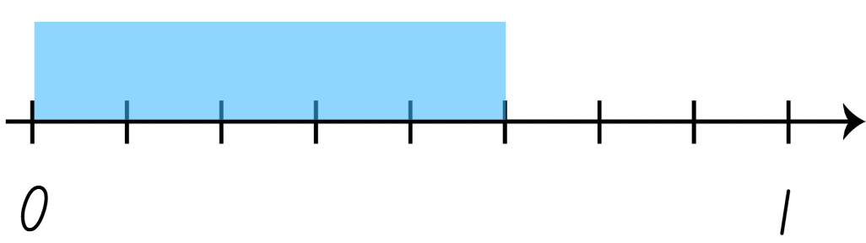
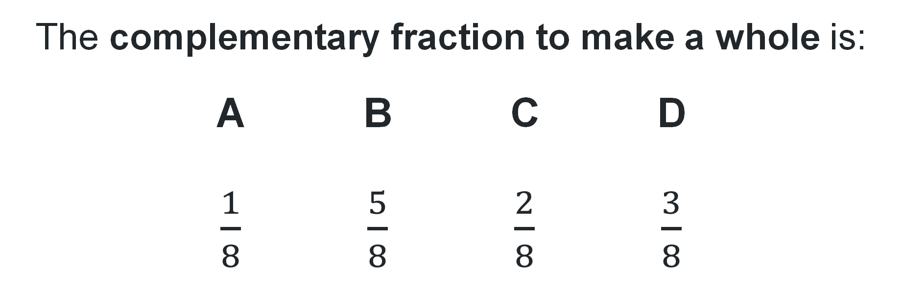
Multiple choice (4)(1)
The complementary fraction to make a whole is:
A B C D
$\frac{1}{8}$ $\frac{5}{8}$ $\frac{2}{8}$ $\frac{3}{8}$
Notes:
This question connects to the content in the developing number sense activity (Activity 7)
Syllabus focus area:
Partitioned fractions A

Slide 48
Short response (25)
Draw angles that are:
    less than a right angle
equal to a right angle
about the same as a right angle
greater than a right angle
Notes:
Short response questions provide brisk paced questions focussing on review of current and previous content to support spaced and interleaved practice.
Syllabus focus area:
Geometric measure B: Angles

Slide 49
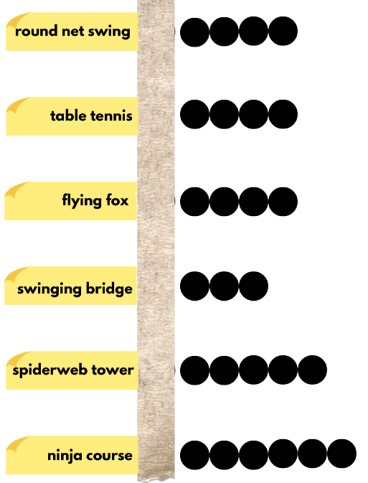
Short response (26)
The council has space to add a new piece of equipment in the playground. After surveying 3S, the results were close.
According to the data, what piece of equipment should the council add?
Explain your thinking.
Notes:
Short response questions provide brisk paced questions focussing on review of current and previous content to support spaced and interleaved practice.
Syllabus focus area:
Data A

Slide 50
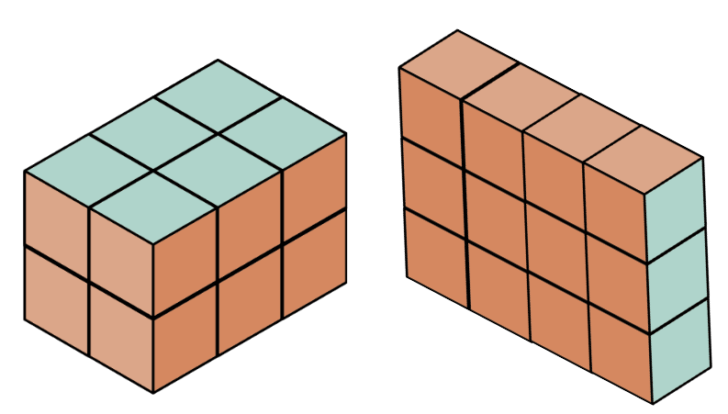
Short response (27)
Tom believes these 3D objects have the same volume in cubic centimetres. Do you agree or disagree with Tom? Explain your thinking.
Notes:
Short response questions provide brisk paced questions focussing on review of current and previous content to support spaced and interleaved practice.
Syllabus focus area:
Three-dimensional spatial structure A: Volume

Slide 51

Short response (28)
Record the time that is a quarter-hour after the time on the analog clock.
Notes:
Short response questions provide brisk paced questions focussing on review of current and previous content to support spaced and interleaved practice.
Syllabus focus area:
Non-spatial measure A: Time

Slide 52
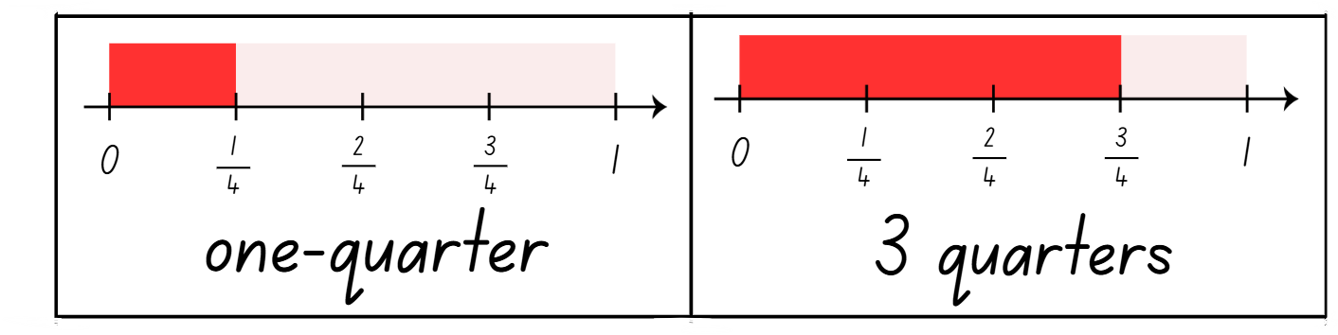
Activity 7 – fractions and wholes
Notes:
This is a developing number sense activity.
Number sense refers to a deep understanding of numbers, including their magnitude, relationships, and the effects of operations on them. It supports fluency and understanding, estimation, flexible thinking, and efficient problem-solving. Number sense activities 1–4 ‘activate’ prior number knowledge and support the learning of new content in the unit. Number sense activities 5–8 ‘loop’ back and provide opportunity for spaced practice with concepts and procedures covered in previous units.
Syllabus focus area: Partitioned fractions A
Fraction complements
Display Resource 25 – fractions memory (this resource corresponds to Resource 25 – fractions memory in Stage 2, Year A Unit 19).
Revise fraction complements to recreate the whole from a fractional part.
Explain the game instructions:
Shuffle the cards and lay out all the cards face down in an array formation.
Players take turns flipping over 2 cards at a time, aiming to find pairs of fractions to make a whole.
Keep the cards and take another turn if the fractions create one whole.
Flip the cards back over and the next player has a turn if the fractions do not create a whole.
The game continues until all pairs of fractions have been matched.

Slide 53
Review of learning 8

Slide 54
True or false (4)
A complementary fractional part is always more than one whole.
True | False
Notes:
The question on this slide connects to the content being explored in the developing number sense activity (Activity 8)
Syllabus focus area:
Partitioned fractions A

Slide 55

Short response (29)
The numbers on an analog clock can represent 2 different values. What value can the following numbers represent?
2 7 4 11
Notes:
Short response questions provide brisk paced questions focussing on review of current and previous content to support spaced and interleaved practice.
Syllabus focus area:
Non-spatial measure A: Time

Slide 56
Short response (30)
The two graphs display the same data. Evaluate the effectiveness of how the data is displayed.
Communicate your thinking.
Notes:
Short response questions provide brisk paced questions focussing on review of current and previous content to support spaced and interleaved practice.
Syllabus focus area:
Data B

Slide 57
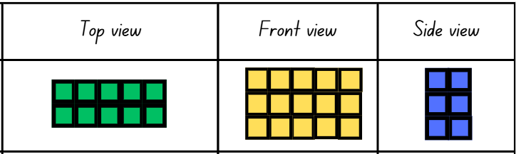
Short response (31)
Record the volume of this 3D object in numerals and words.
Notes:
Short response questions provide brisk paced questions focussing on review of current and previous content to support spaced and interleaved practice.
Syllabus focus area:
Three-dimensional spatial structure A: Volume

Slide 58

Short response (32)
Explain why the image below is symmetrical.
Notes:
Short response questions provide brisk paced questions focussing on review of current and previous content to support spaced and interleaved practice.
Syllabus focus area:
Two-dimensional spatial structure A: 2D shape

Slide 59
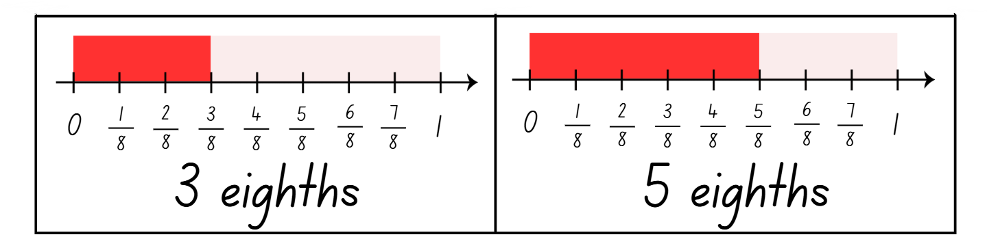
Activity 8 – fractions and wholes
Notes:
This is a developing number sense activity.
Number sense refers to a deep understanding of numbers, including their magnitude, relationships, and the effects of operations on them. It supports fluency and understanding, estimation, flexible thinking, and efficient problem-solving. Number sense activities 1–4 ‘activate’ prior number knowledge and support the learning of new content in the unit. Number sense activities 5–8 ‘loop’ back and provide opportunity for spaced practice with concepts and procedures covered in previous units.
Syllabus focus area: Partitioned fractions A
Fractions and wholes
Display Resource 25 – fractions memory (this resource corresponds to Resource 25 – fractions memory in Stage 2, Year A Unit 19).
Review the game instructions:
Shuffle the cards and lay out all the cards face down in an array formation.
Players take turns flipping over 2 cards at a time, aiming to find pairs of fractions to make a whole.
Keep the cards and take another turn if the fractions create one whole.
Flip the cards back over and the next player has a turn if the fractions do not create a whole.
The game continues until all pairs of fractions have been matched.
3. To vary the activity, each player turns one card over at the same time and either:
the player whose card requires the largest fraction to create the whole, keeps their card
the player whose card requires the smallest fraction to create the whole, keeps their card
the player whose fraction card is closest in size to one-half keeps their card.

Slide 60
Double Venn diagram
Object 1
Object 2
Features similar to both objects
Features of object 1
Features of object 2

Slide 61
Frayer
Definition
Facts/Characteristics
Word, term, concept
Examples
Non-examples

Slide 62
Spider map
Idea
Subject

Slide 63
Cline
Concept 1
Concept 2
Word
Word
Word
Word
Word
Word
Word
Word
Word
Word
Word

Slide 64

Compare and contrast
Notes:
Use the arrows to navigate between related activities.
Hyperlink each arrow to compare between related slides.

Slide 65
Multiple choice (1a)
A
B
C
D
Notes:
This question connects to the content in the developing number sense activity (Activity 1)
This question can:
support spaced and interleaved practice
help identify and address common misconceptions
support active recall and immediate feedback
support whole class participation
identify areas requiring reteach
Teachers are encouraged to adapt and contextualise for their contexts.

Slide 66
Multiple choice (1b)
A
B
C
D
Notes:
This question connects to the content in the developing number sense activity (Activity 1)
Syllabus focus area:
Multiplicative relations A
This question can:
support spaced and interleaved practice
help identify and address common misconceptions
support active recall and immediate feedback
support whole class participation
identify areas requiring reteach
Teachers are encouraged to adapt and contextualise for their contexts.

Slide 67
References (1)
This presentation contains NSW Curriculum and syllabus content. The NSW Curriculum is developed by the NSW Education Standards Authority. This content is prepared by NESA for and on behalf of the Crown in the right of the State of New South Wales. The material is protected by Crown copyright.
Please refer to the NESA Copyright Disclaimer for more information https://educationstandards.nsw.edu.au/wps/portal/nesa/mini-footer/copyright.
NESA holds the only official and up-to-date versions of the NSW Curriculum and syllabus documents. Please visit the NSW Education Standards Authority (NESA) website https://educationstandards.nsw.edu.au/wps/portal/nesa/home and the NSW Curriculum website https://curriculum.nsw.edu.au.
Mathematics K–10 Syllabus © Syllabus NSW Education Standards Authority (NESA) for and on behalf of the Crown in right of the State of New South Wales, 2022.
National Numeracy Learning Progression © Australian Curriculum, Assessment and Reporting Authority (ACARA) 2010 to present, unless otherwise indicated. This material was downloaded from the Australian Curriculum website (National Literacy Learning Progression) (accessed 8 April 2024 and was not modified.
Amplify (n.d.) Polypad [website], accessed 3 June 2025.
AAMT (Australian Association of Mathematics Teachers) (n.d.) ‘Misunderstandings’, Fractions, Top Drawer Teachers website, accessed 15 May 2024.
Harris P (2024) As Close As It Gets, Math is Figure-Out-Able! website, accessed 4 July 2024.
Harris P (2024) Math is Figure-Out-Able! [website], accessed 4 July 2024.
International Olympic Committee (2017) The Sports Pictograms of the Olympic Summer Games from Tokyo 1964 to Rio 2016 [PDF 4.98 MB], The Olympic Studies Centre, International Olympic Committee, accessed 23 May 2024.

Slide 68
References (2)
This presentation contains NSW Curriculum and syllabus content. The NSW Curriculum is developed by the NSW Education Standards Authority. This content is prepared by NESA for and on behalf of the Crown in the right of the State of New South Wales. The material is protected by Crown copyright.
Please refer to the NESA Copyright Disclaimer for more information https://educationstandards.nsw.edu.au/wps/portal/nesa/mini-footer/copyright.
NESA holds the only official and up-to-date versions of the NSW Curriculum and syllabus documents. Please visit the NSW Education Standards Authority (NESA) website https://educationstandards.nsw.edu.au/wps/portal/nesa/home and the NSW Curriculum website https://curriculum.nsw.edu.au.
NCTM (National Council of Teachers of Mathematics) (n.d.) National Council of Teachers of Mathematics [website], accessed 4 July 2024.
NCTM (2008) Polygon Capture: A Geometry Game [PDF 57 KB], NCTM, accessed 9 May 2024.
NESA (NSW Education Standards Authority) (2022a) ‘Stage 2 – Teaching advice for Two-dimensional spatial structure A: Language’, Mathematics K–10 Syllabus: Content, NESA website, accessed 8 August 2024.
NESA (2022b) ‘Stage 2 – Teaching advice for Geometric measure A: Misconceptions with angles’, Mathematics K–10 Syllabus: Content, NESA website, accessed 8 August 2024.
Robichaux RR and Rodrigue PR (2010) ‘Polygon properties: What is possible?’, Teaching Children Mathematics, 16(9):524–531, doi:10.5951/TCM.16.9.0514, accessed 19 June 2024.

Slide 69
References (3)
This presentation contains NSW Curriculum and syllabus content. The NSW Curriculum is developed by the NSW Education Standards Authority. This content is prepared by NESA for and on behalf of the Crown in the right of the State of New South Wales. The material is protected by Crown copyright.
Please refer to the NESA Copyright Disclaimer for more information https://educationstandards.nsw.edu.au/wps/portal/nesa/mini-footer/copyright.
NESA holds the only official and up-to-date versions of the NSW Curriculum and syllabus documents. Please visit the NSW Education Standards Authority (NESA) website https://educationstandards.nsw.edu.au/wps/portal/nesa/home and the NSW Curriculum website https://curriculum.nsw.edu.au.
State of New South Wales (Department of Education) (2024) ‘Analysing fractions’, Mathematics 3–6, My Professional Learning website, accessed 15 May 2024.
State of New South Wales (Department of Education) (2024) ‘The role of place value’, Mathematics 3-6, My Professional Learning website, accessed 15 May 2024.
Thinkport Maryland Public Television and Great Blue Hill (WGBH) Educational Foundation (n.d.) 'Angles in Soccer | Thinkport' [video], PBS LearningMedia, PBS LearningMedia website, accessed 27 May 2024.
Toy Theater (2024) ‘Interactive clock | Telling Time’, Time Manipulatives, Toy Theater website, accessed 19 May 2024.
University of Cambridge (n.d.a) Clocks, NRICH website, accessed 3 June 2025.
University of Cambridge (n.d.b) Two clocks, NRICH website, accessed 3 June 2025.

Slide 70
Copyright
© State of New South Wales (Department of Education), 2025
The copyright material published in this resource is subject to the Copyright Act 1968 (Cth) and is owned by the NSW Department of Education or, where indicated, by a party other than the NSW Department of Education (third-party material).
Copyright material available in this resource and owned by the NSW Department of Education is licensed under a Creative Commons Attribution 4.0 International (CC BY 4.0) license.
This license allows you to share and adapt the material for any purpose, even commercially.
Attribution should be given to © State of New South Wales (Department of Education), 2025.
Material in this resource not available under a Creative Commons license:
the NSW Department of Education logo, other logos and trademark-protected material
Material owned by a third party that has been reproduced with permission. You will need to obtain permission from the third party to reuse its material.
Links to third-party material and websites
Please note that the provided (reading/viewing material/list/links/texts) are a suggestion only and implies no endorsement, by the New South Wales Department of Education, of any author, publisher, or book title. School principals and teachers are best placed to assess the suitability of resources that would complement the curriculum and reflect the needs and interests of their students.
If you use the links provided in this document to access a third party’s website, you acknowledge that the terms of use, including licence terms set out on the third-party’s website apply to the use which may be made of the materials on that third-party website or where permitted by the Copyright Act 1968 (Cth). The department accepts no responsibility for content on third-party websites.

