Slide 1
Instructions for use
This resource aligns to the learning in Stage 2 Year A Unit 20 and revisits content from earlier sample units.
Classroom teachers are encouraged to add, edit and adapt to meet the needs of their students.
Save a copy of the file to make changes to the slide deck. Go to File > Download a Copy (this downloads a copy to the computer to edit in the PowerPoint app).
To convert the PowerPoint to Google Slides:
  Upload the file into Google Drive and open it.
  Go to File > Save as Google Slides.
  (Note – conversion may cause formatting changes in the slides.)

Slide 2

Review of Learning
Mathematics Stage 2 – Unit 20
Notes:
Reviews may include a combination of question types, requiring students to recall facts and key ideas, as well as apply their knowledge to solve problems and answer questions. To support active engagement, a mix of techniques should be employed.” (AERO, 2024).
This Review of Learning slide deck revisits key concepts from the following units:
Stage 2 Year A Unit 20
Stage 2 Year A Unit 19
Stage 2 Year A Unit 18
It also includes opportunities to review prior learning in non-number content, supporting consolidation across focus areas.
The review of learning resources include three key task types that support the development of mathematical proficiency through retrieval, spaced practice, and active participation. These practices complement the review phase (activating prior knowledge) embedded within the beginning of each lesson.
1.
Multiple-choice questions/True or false: Designed to promote active retrieval of key concepts and identify common misconceptions in number, supporting consolidation, understanding and fluency.
These questions:
support spaced and interleaved practice
help identify and address common misconceptions
support active recall and immediate feedback
support whole class participation
identify areas requiring reteach
2.
Short-response question sets: Carefully grouped questions that encourage spaced and interleaved practice across multiple focus areas, helping students revisit and apply knowledge from different points in time.
These questions:
have a combination of question types
address a range of focus areas
build automaticity and fluency
support active recall
allow for immediate feedback
identify content requiring reteach
3.
Developing number sense activities: A variety of practical, purposeful tasks that reinforce current learning and build on prior knowledge. These activities promote reasoning, problem-solving and conceptual understanding.
The review of learning resources are designed to work support teaching and learning in mathematics. For the most effective implementation, use the resources flexibly, adapting to meet student learning needs and individual classroom contexts.

Slide 3
Lessons
1
Review of learning 1
5
Review of learning 5
2
Review of learning 2
6
Review of learning 6
3
Review of learning 3
7
Review of learning 7
4
Review of learning 4
8
Review of learning 8
Notes:
Teacher notes:
Click lesson numbers to go to specific lessons
Interactive features can be viewed in slide show

Slide 4
Review of learning 1

Slide 5

Multiple choice (1)
36 + 27 =
A | B | C | D
53 | 63 | 73 | 83
Notes:
This question connects to the content in the developing number sense activity (Activity 1)
Syllabus focus area:
Additive relations A

Slide 6

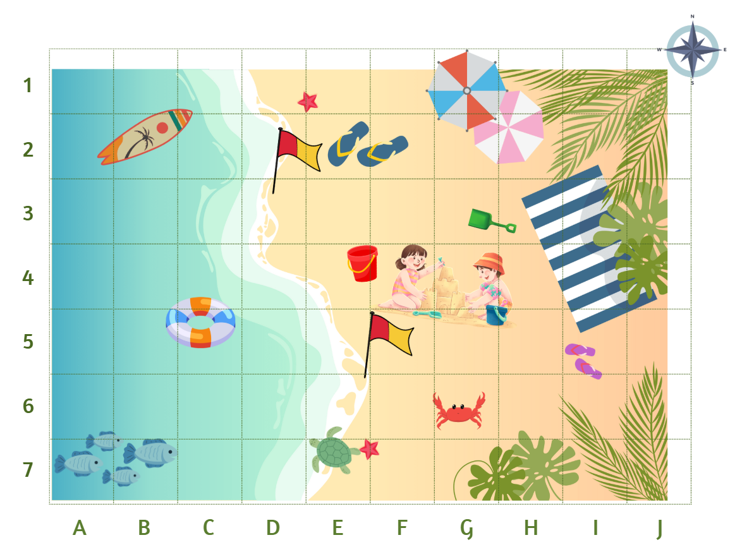
Short response (1)
On the grid map, what is located at:
G4
C5
E7
Notes:
Short response questions provide brisk paced questions focussing on review of current and previous content to support spaced and interleaved practice.
Syllabus focus area:
Geometric measure A: Position

Slide 7

Short response (2)
Describe the features of these two-dimensional shapes.
Notes:
Short response questions provide brisk paced questions focussing on review of current and previous content to support spaced and interleaved practice.
Syllabus focus area:
Two-dimensional spatial structure A

Slide 8
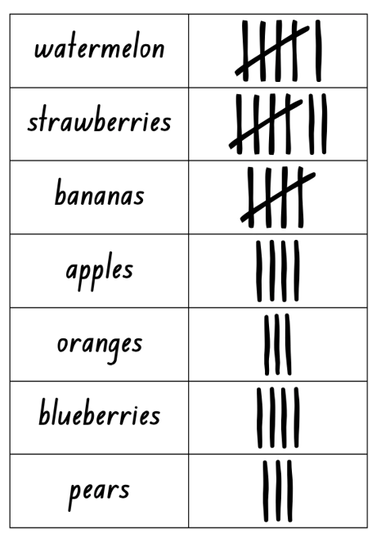
Short response (3)
If you created a column graph to show the number of students who liked each fruit, what would you label the title and the y-axis?
Notes:
Short response questions provide brisk paced questions focussing on review of current and previous content to support spaced and interleaved practice.
Syllabus focus area:
Data A

Slide 9
Short response (4)
Draw analog clocks with the following times:
ten minutes past 3
ten minutes to 8
Notes:
Short response questions provide brisk paced questions focussing on review of current and previous content to support spaced and interleaved practice.
Syllabus focus area:
Non-spatial measure A: Time

Slide 10

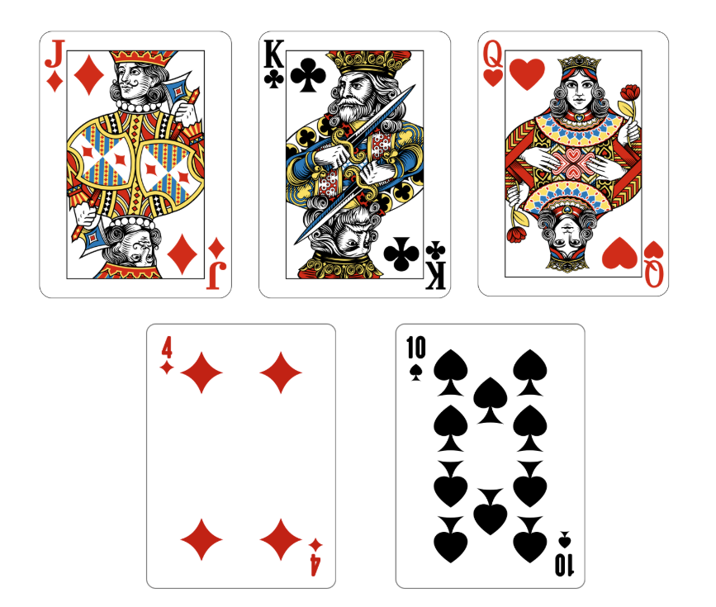
Activity 1 – apply known mental strategies to add
Notes:
This is a developing number sense activity.
Number sense refers to a deep understanding of numbers, including their magnitude, relationships, and the effects of operations on them. It supports fluency and understanding, estimation, flexible thinking, and efficient problem-solving. Number sense activities 1–4 ‘activate’ prior number knowledge and support the learning of new content in the unit. Number sense activities 5–8 ‘loop’ back and provide opportunity for spaced practice with concepts and procedures covered in previous units.
Syllabus focus area:
Additive relations A
Apply known mental strategies to add
This activity is an adaptation of ‘Unpacking game mechanics: Five types of whole-class mathematical games: King’s Tax’ from Australian Primary Mathematics Classroom by Russo and Russo.
Note: the game is to be played as a whole class. You may choose to use a deck of cards or an online card generator.
Provide students with individual whiteboards and ask them to stand up to start the game.
Explain that they are going to play “King’s Tax”. To play, one card is drawn from the pack. This is the amount of money that has been earned. For example, if a 5 is turned over, the class has earned $5.
After each turn, students choose whether they will ‘bank’ their money (by sitting down and recording their amount on their individual whiteboard) or whether to play on. The players who stay in, continue to add to their money.
The following rules apply:
If a Jack is turned over, the players receive $15.
If a Queen is turned over, the amount is doubled for that round (For example, if 6 is turned over, the players receive $12).
If a King is turned over, he collects his taxes. Anyone who is still standing loses their money for that round.
A round ends after the King collects his taxes or if nobody is left standing.
After 4 rounds, students add up the amount they have banked. The winner is the student with the most money in their bank.
Ask students:
What strategy did you use to add your money?
Did you use the same strategy each time? Why or why not?
Was one strategy more efficient than another one you tried?

Slide 11
Review of learning 2

Slide 12
True or false (1)
Liam has 36 marbles and finds another 27 more marbles in his toy box. To find the total, Liam added 4 to get to 40. Then, he added 23 more marbles to get 63. Liam correctly used the bridging the decades strategy to find a total of 63 marbles.
True | False
Notes:
The question on this slide connects to the content being explored in the developing number sense activity (Activity 2).
Syllabus focus area:
Additive relations A

Slide 13
Short response (5)
Identify the grid location for:
- crab
- surfboard
- red bucket
Notes:
Short response questions provide brisk paced questions focussing on review of current and previous content to support spaced and interleaved practice.
Syllabus focus area:
Geometric measure A

Slide 14
Short response (6)
Shape A has 4 sides, 2 pairs are parallel, and all angles are right angles.
Shape B has 4 sides, 2 pairs are parallel, but it does not have any right angles.
Name the 2 shapes and identify how are they different.
Notes:
Short response questions provide brisk paced questions focussing on review of current and previous content to support spaced and interleaved practice.
Syllabus focus area:
Two-dimensional spatial structure A

Slide 15
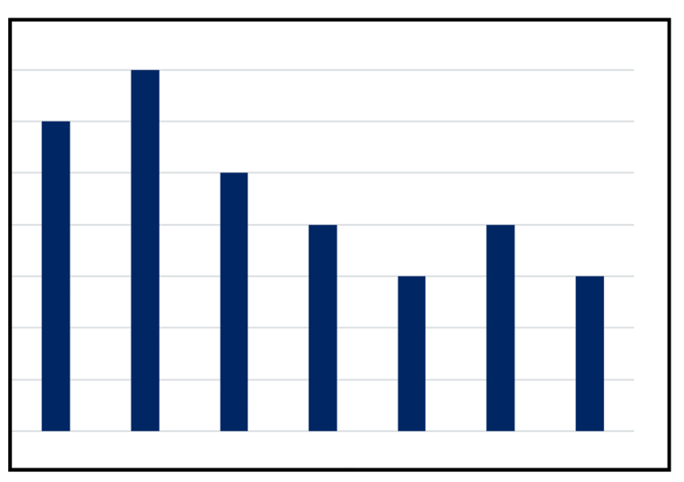
Short response (7)
What features are missing from this graph?
Notes:
Short response questions provide brisk paced questions focussing on review of current and previous content to support spaced and interleaved practice.
Syllabus focus area:
Data A

Slide 16

Short response (8)
Which quadrilateral does not have a line of symmetry?
Explain why it does not have a line of symmetry.
Notes:
Short response questions provide brisk paced questions focussing on review of current and previous content to support spaced and interleaved practice.
Syllabus focus area:
Two-dimensional spatial structure A: 2D Shape

Slide 17
Activity 2 – apply known mental strategies to add and subtract
Notes:
This is a developing number sense activity.
Number sense refers to a deep understanding of numbers, including their magnitude, relationships, and the effects of operations on them. It supports fluency and understanding, estimation, flexible thinking, and efficient problem-solving. Number sense activities 1–4 ‘activate’ prior number knowledge and support the learning of new content in the unit. Number sense activities 5–8 ‘loop’ back and provide opportunity for spaced practice with concepts and procedures covered in previous units.
Syllabus focus area:
Additive relations A
Apply known mental strategies to add and subtract
This activity is an adaptation of ‘Unpacking game mechanics: Five types of whole-class mathematical games: King’s Tax’ from Australian Primary Mathematics Classroom by Russo and Russo.
Note: the game is to be played as a whole class. You may choose to use a deck of cards or an online card generator.
Revise the rules to “King’s Tax” from Activity 1.
Explain that they are going to play the game again today but with a new rule:
If an Ace is turned over, it represents an unexpected expense. Anyone still standing must subtract $10 from their total. If their total is less than $10, it becomes zero for that round and they must sit down.
Play the game using the new rule.
After playing, ask students:
What strategy did you use to add your money?
Did you use the same strategy each time? Why or why not?
Was one strategy more efficient than another one you tried?

Slide 18
Review of learning 3

Slide 19
Multiple choice (2)
Use a number line to show
67 + 86 =
Select the correct answer.
A | B | C | D
153 | 160 | 157 | 178
Notes:
This question connects to the content in the developing number sense activity (Activity 3)
Syllabus focus area:
Additive relations A

Slide 20
Short response (9)
Record the different combinations of coins that can be used to make a total of $2.60
Notes:
Short response questions provide brisk paced questions focussing on review of current and previous content to support spaced and interleaved practice.
Syllabus focus area:
Additive relations A

Slide 21
Short response (10)
Identify which two-dimensional shape doesn’t belong.
parallelogram kite rhombus trapezium
Explain your reasoning, describing the features of each shape.
Notes:
Short response questions provide brisk paced questions focussing on review of current and previous content to support spaced and interleaved practice.
Syllabus focus area:
Two-dimensional spatial structure A

Slide 22
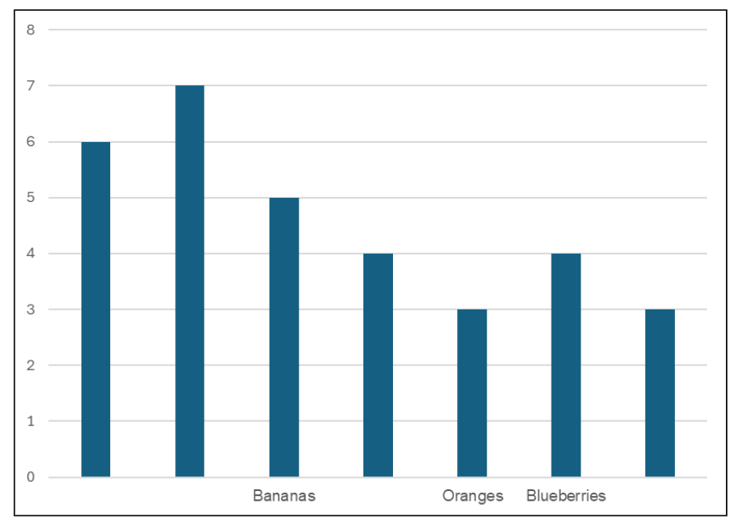
Short response (11)
What information is missing from the graph?
Notes:
Short response questions provide brisk paced questions focussing on review of current and previous content to support spaced and interleaved practice.
Syllabus focus area:
Data A

Slide 23
Short response (12)
Record how a rectangular prism is different from a pyramid?
Notes:
Short response questions provide brisk paced questions focussing on review of current and previous content to support spaced and interleaved practice.
Syllabus focus area:
Three-dimensional spatial structure A: 3DS Objects

Slide 24
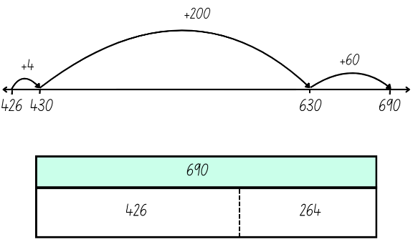
Activity 3 – apply known mental strategies to add and represent the solutions using a model
Notes:
This is a developing number sense activity.
Number sense refers to a deep understanding of numbers, including their magnitude, relationships, and the effects of operations on them. It supports fluency and understanding, estimation, flexible thinking, and efficient problem-solving. Number sense activities 1–4 ‘activate’ prior number knowledge and support the learning of new content in the unit. Number sense activities 5–8 ‘loop’ back and provide opportunity for spaced practice with concepts and procedures covered in previous units.
Syllabus focus area:
Additive relations A
Apply know mental strategies to add and represent the solutions using a model
Revise mental strategies to add 2 numbers together, including bridging the decades.
Provide each student with an individual whiteboard and ask them to draw an empty number line and a bar model
Working in pairs, students roll 3 dice.
Students use the numbers rolled to form two 3-digit numbers, for example, 264 and 426.
The aim is to use mental strategies to calculate the sum of the 2 numbers. Students then represent their solution using a bar model or number line.
Ask the following questions:
Which strategy did you use? Explain why.
Can you explain your representation to a partner?
Students roll the dice again and repeat the activity.

Slide 25
Review of learning 4

Slide 26
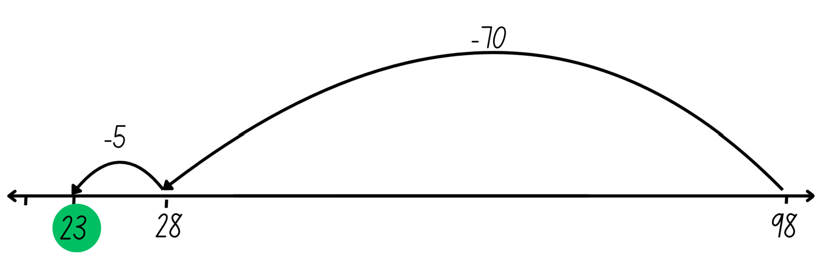
True or false (2)
Sam used a number line to solve 98 – 75.
His solution is correct.
True | False
Notes:
The question on this slide connects to the content being explored in the developing number sense activity (Activity 4)
Syllabus focus area:
Additive relations A

Slide 27
Short response (13)
Record the number 79:
10 times larger
100 times larger
1000 times larger
Notes:
Short response questions provide brisk paced questions focussing on review of current and previous content to support spaced and interleaved practice.
Syllabus focus area:
Representing numbers using place value A

Slide 28
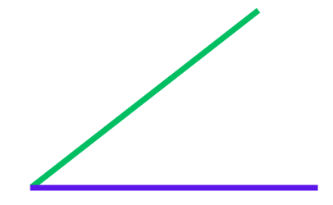
Short response (14)
What happens to the angle when you move the arms further apart?
Notes:
Short response questions provide brisk paced questions focussing on review of current and previous content to support spaced and interleaved practice.
Syllabus focus area:
Geometric measure A

Slide 29
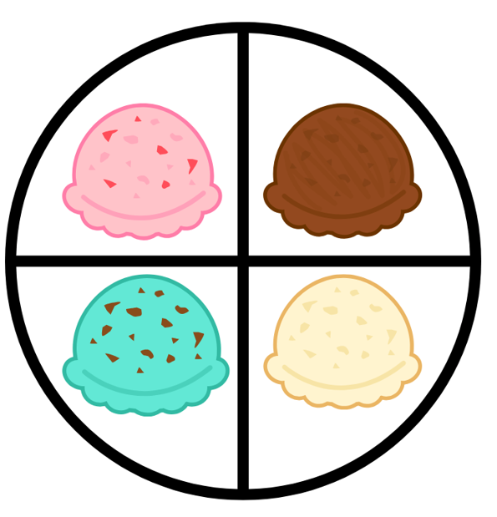

Short response (15)
At the canteen, there is a spinner for ice cream flavours and another for toppings.
How many different outcomes are possible when one flavour and one topping are selected?
Notes:
Short response questions provide brisk paced questions focussing on review of current and previous content to support spaced and interleaved practice.
Syllabus focus area:
Chance A

Slide 30
Short response (16)
How many square metres would you need to cover a rectangle that is 2 metres wide and 5 metres long?
Notes:
Short response questions provide brisk paced questions focussing on review of current and previous content to support spaced and interleaved practice.
Syllabus focus area:
Two-dimensional spatial structure A: Area

Slide 31
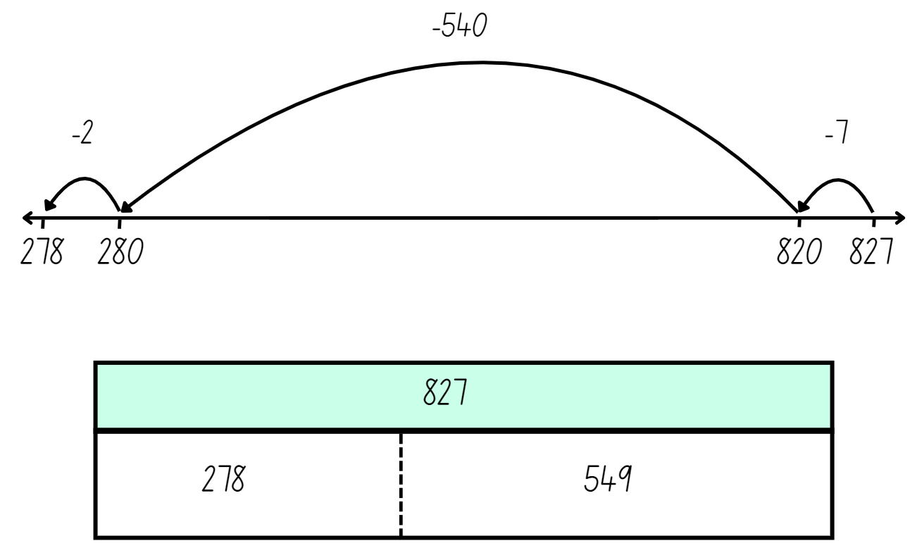
Activity 4 – apply known mental strategies to subtract and represent the solutions using a model
Notes:
This is a developing number sense activity.
Number sense refers to a deep understanding of numbers, including their magnitude, relationships, and the effects of operations on them. It supports fluency and understanding, estimation, flexible thinking, and efficient problem-solving. Number sense activities 1–4 ‘activate’ prior number knowledge and support the learning of new content in the unit. Number sense activities 5–8 ‘loop’ back and provide opportunity for spaced practice with concepts and procedures covered in previous units.
Syllabus focus area:
Additive relations A
Apply known mental strategies to subtract and represent the solutions using a model
Provide each student with an individual whiteboard and ask them to draw an empty number line and a bar model.
Working in pairs, students roll 3 dice.
Students use the numbers rolled to form two 3-digit numbers, for example, 827 and 278.
The aim is to use mental strategies to calculate the difference between the 2 numbers. Students then represent their solution using a bar model or number line.
Ask the following questions:
Which strategy did you use? Explain why.
Can you explain your representation to a partner?
Students roll the dice again and repeat the activity.

Slide 32
Review of learning 5

Slide 33
Multiple choice (3)
Which number is made up of 5 thousands, 3 hundreds, 2 tens and 4 ones?
A | B | C | D
5304 | 5032 | 5234 | 5324
Notes:
This question connects to the content in the developing number sense activity (Activity 5)
Syllabus focus area:
Representing numbers using place value A

Slide 34
Short response (17)
Solve the following:
248 + 36 = ?
172 − 59 = ?
Explain your strategy to a partner.
Notes:
Short response questions provide brisk paced questions focussing on review of current and previous content to support spaced and interleaved practice.
Syllabus focus area:
Additive relations A

Slide 35
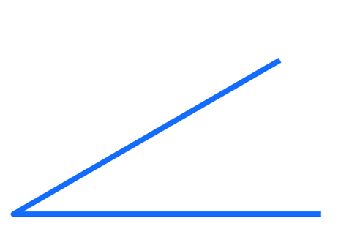
Short response (18)
Compare the two angles. Does the length of the arms change the size of the angle?
Notes:
Short response questions provide brisk paced questions focussing on review of current and previous content to support spaced and interleaved practice.
Syllabus focus area:
Geometric measure A

Slide 36
Short response (19)
Archer spins two spinners to create an ice cream.
Is it likely, unlikely, or certain that Archer will get chocolate as his ice cream flavour?
Is it possible that Archer will get vanilla and sprinkles?
Explain your thinking.
Notes:
Short response questions provide brisk paced questions focussing on review of current and previous content to support spaced and interleaved practice.
Syllabus focus area:
Chance B

Slide 37
Short response (20)
You are going to roll a standard 6-sided dice 60 times.
How many times do you predict it will land on the number 3?
Communicate your reasoning.
Notes:
Short response questions provide brisk paced questions focussing on review of current and previous content to support spaced and interleaved practice.
Syllabus focus area:
Chance A

Slide 38
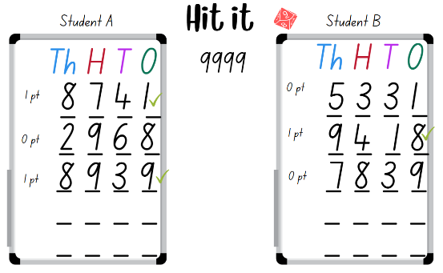
Activity 5 – represent numbers up to thousands using numerals
Notes:
This is a developing number sense activity.
Number sense refers to a deep understanding of numbers, including their magnitude, relationships, and the effects of operations on them. It supports fluency and understanding, estimation, flexible thinking, and efficient problem-solving. Number sense activities 1–4 ‘activate’ prior number knowledge and support the learning of new content in the unit. Number sense activities 5–8 ‘loop’ back and provide opportunity for spaced practice with concepts and procedures covered in previous units.
Syllabus focus area:
Representing numbers using place value A
Represent numbers up to thousands using numerals
This activity is an adaptation of Hit it (3-digit numbers) from Thinking mathematically resources by the State of New South Wales (Department of Education).
Provide pairs with markers, an individual whiteboard and a 9-sided die.
Students draw a gameboard on their whiteboard with 4 place value labels and 4 lines to represent the 4 digits.
Students take turns to roll the die. After each roll, write the number on one of the lines. Once the 4 blank lines are full, players read their number and identify which number is the closest to 9999. This player wins a point.
The player with the most points after 5 rounds is declared the winner.

Slide 39
Review of learning 6

Slide 40
True or false (3)
Five thousand and sixty-two is the same as 5062.
True | False
Communicate your reasoning.
Notes:
The question on this slide connects to the content being explored in the developing number sense activity (Activity 6)
Syllabus focus area:
Representing numbers using place value A

Slide 41
Short response (21)
Solve:
67 + 29 + 13 = ?
How could you rearrange the numbers to make it easier to solve?
Notes:
Short response questions provide brisk paced questions focussing on review of current and previous content to support spaced and interleaved practice.
Syllabus focus area:
Additive relations A

Slide 42
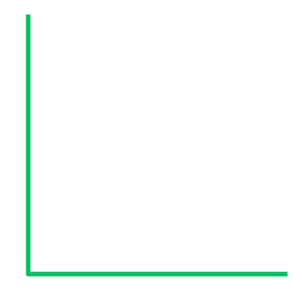
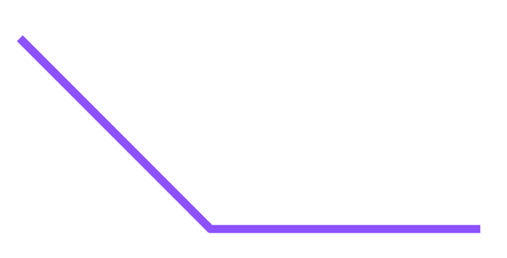
Short response (22)
Match the angle to the description:
greater than a right angle
a right angle
less than a right angle
A B C
Notes:
Short response questions provide brisk paced questions focussing on review of current and previous content to support spaced and interleaved practice.
Syllabus focus area:
Geometric measure B

Slide 43
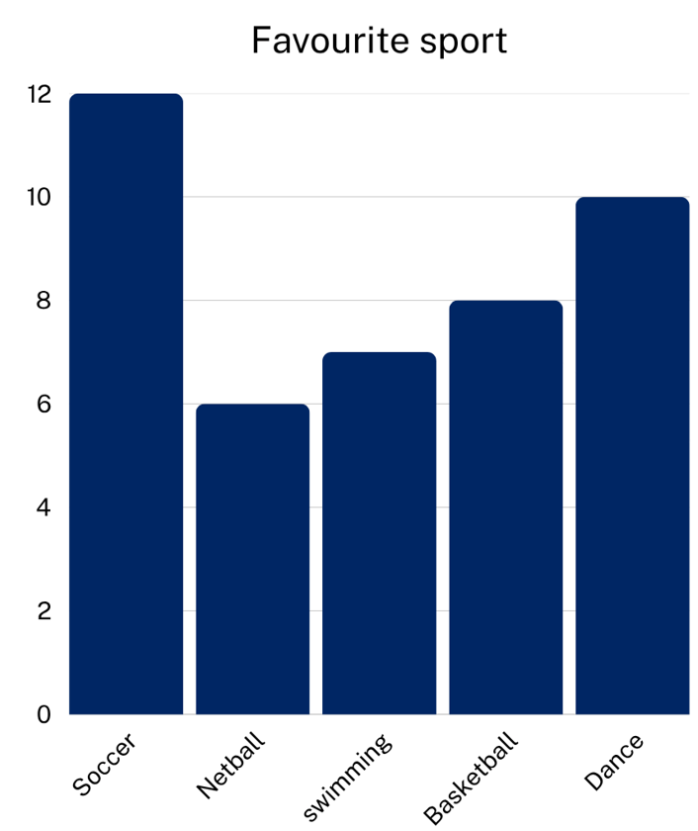
Short response (23)
Using the data in the column graph:
Which sport was the most popular?
How many students chose basketball and netball altogether?
How many more students chose soccer than swimming?
Notes:
Short response questions provide brisk paced questions focussing on review of current and previous content to support spaced and interleaved practice.
Syllabus focus area:
Data A

Slide 44
Short response (24)
Identify everyday items that would hold
less than 1 litre
about 1 litre
more than 1 litre
Notes:
Short response questions provide brisk paced questions focussing on review of current and previous content to support spaced and interleaved practice.
Syllabus focus area:
Three-dimensional spatial structure A: Volume

Slide 45
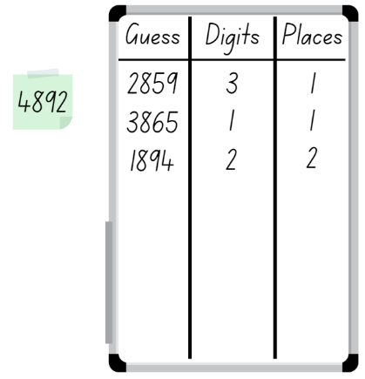
Activity 6 – represent, read and order numbers up to thousands
Notes:
This is a developing number sense activity.
Number sense refers to a deep understanding of numbers, including their magnitude, relationships, and the effects of operations on them. It supports fluency and understanding, estimation, flexible thinking, and efficient problem-solving. Number sense activities 1–4 ‘activate’ prior number knowledge and support the learning of new content in the unit. Number sense activities 5–8 ‘loop’ back and provide opportunity for spaced practice with concepts and procedures covered in previous units.
Syllabus focus area:
Representing numbers using place value A
Represent, read and order numbers up to thousands
This activity is an adaptation of Mastermind from Thinking mathematically resources by the State of New South Wales (Department of Education).
In pairs, each student records a 4-digit number, with no repeated digits, on a sticky note. Students draw up their gameboard on individual whiteboards.
Students take turns to guess their partner’s 4-digit number. Partners record the guess, the number of digits that are correct and the number of digits that are in the right place, see Figure 17. Students then use this information to refine their guesses.
The first student to correctly guess their partner’s number is the winner.
Note: this activity can be adapted by using 2-, 3- or 5-digit numbers.

Slide 46
Review of learning 7

Slide 47
Multiple choice (4)
Which group of numbers is ordered in ascending order?
A
4321 3214 1432 2143
1432 2143 3214 4321
B
C
3214 2143 1432 4321
D
2143 1432 4321 3214
Notes:
This question connects to the content in the developing number sense activity (Activity 7)
Syllabus focus area:
Representing numbers using place value A

Slide 48
Short response (25)
Solve the problems:
245 + 35 = ?
150 - 142 = ?
What strategies did you use?
Notes:
Short response questions provide brisk paced questions focussing on review of current and previous content to support spaced and interleaved practice.
Syllabus focus area:
Additive relations A

Slide 49
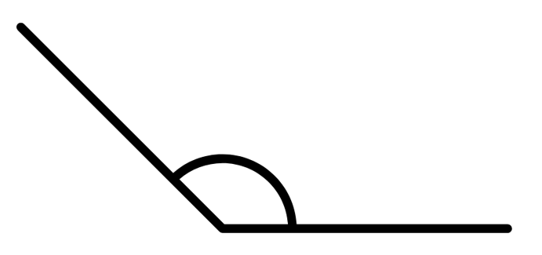
Short response (26)
Is this angle less than, equal to, about the same as or greater than a right angle?
Communicate your reasoning.
Notes:
Short response questions provide brisk paced questions focussing on review of current and previous content to support spaced and interleaved practice.
Syllabus focus area:
Geometric measure B

Slide 50
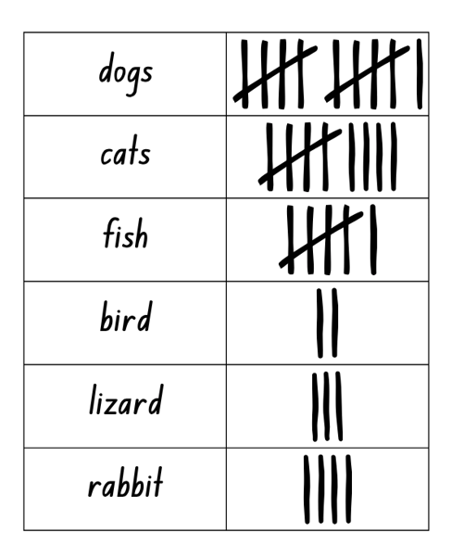
Short response (29)
What does the tally table tell you about the most popular pet?
Communicate your reasoning.
Notes:
Short response questions provide brisk paced questions focussing on review of current and previous content to support spaced and interleaved practice.
Syllabus focus area:
Data A

Slide 51
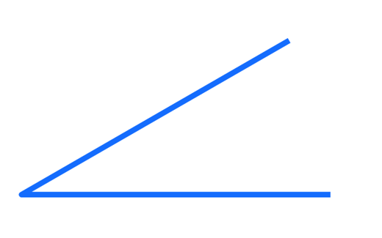
Short response (30)
Label the parts of the angle.
Notes:
Short response questions provide brisk paced questions focussing on review of current and previous content to support spaced and interleaved practice.
Syllabus focus area:
Geometric measure A: Angles

Slide 52
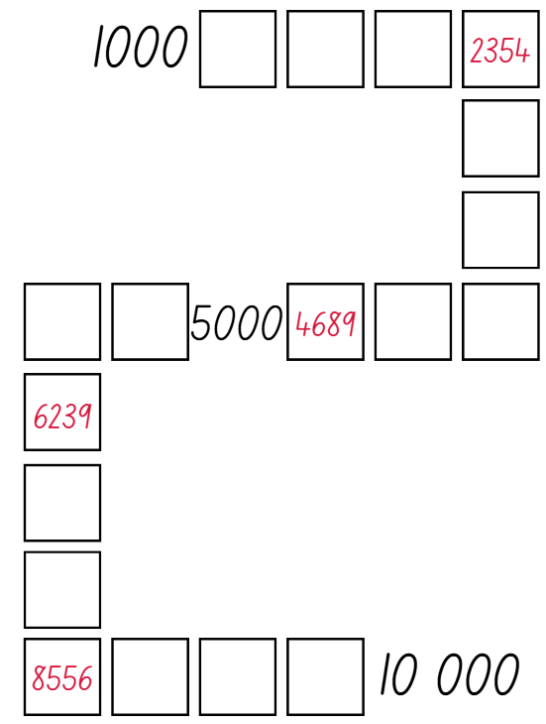
Activity 7 – read and order 4-digit numbers 1
Notes:
This is a developing number sense activity.
Number sense refers to a deep understanding of numbers, including their magnitude, relationships, and the effects of operations on them. It supports fluency and understanding, estimation, flexible thinking, and efficient problem-solving. Number sense activities 1–4 ‘activate’ prior number knowledge and support the learning of new content in the unit. Number sense activities 5–8 ‘loop’ back and provide opportunity for spaced practice with concepts and procedures covered in previous units.
Syllabus focus area:
Representing numbers using place value A
Read and order 4-digit numbers 1
This activity is an adaptation of the Place value game from Thinking mathematically resources by the State of New South Wales (Department of Education).
Explain that the students will be playing the “Place value game”. The aim of the game is to order 4-digit numbers in ascending order on a gameboard.
Provide pairs with four 9-sided dice and Resource 27 – place value game, for each player.
Students roll the dice and create a 4-digit number. For example, 6, 2, 8, 3 could be recorded as 6238, 3682, 2863, 3826, 3628 and so on. Players record their chosen number in the most appropriate position between 1000 and 10 000.
If numbers cannot be placed, students miss their turn. Play continues until all boxes are filled.
Note: the game can also be played as a whole class. It is recommended to use dice that have a zero. It is important that students understand the role of zero in changing the value of the 4-digit numbers created.
Using a reusable sleeve for the gameboard and non-permanent markers will allow students to play multiple games.

Slide 53
Review of learning 8

Slide 54
True or false (4)
These 4-digit numbers are written in descending order.
5432 4987 4675 3210.
True | False
Notes:
The question on this slide connects to the content being explored in the developing number sense activity (Activity 8)
Syllabus focus area:
Representing numbers using place value A

Slide 55

Short response (31)
Record all the related multiplication and division facts for this array.
Notes:
Short response questions provide brisk paced questions focussing on review of current and previous content to support spaced and interleaved practice.
Syllabus focus area:
Multiplicative relations A

Slide 56

Short response (32)
What time is the analog clock showing?
What time will it be in 2 hours?
Notes:
Short response questions provide brisk paced questions focussing on review of current and previous content to support spaced and interleaved practice.
Syllabus focus area:
Non-spatial measure A

Slide 57
Short response (33)
A column graph shows the number of books read by students in each class. The vertical axis goes up in multiples of 5, and each block on the graph represents 5 books.
Why might the graph use a scale of 1 block = 5 books instead of 1 block = 1 book?
Notes:
Short response questions provide brisk paced questions focussing on review of current and previous content to support spaced and interleaved practice.
Syllabus focus area:
Data B

Slide 58
Short response (34)
The time is 4:19 pm.
Describe this time to the nearest 5-minute interval.
Notes:
Short response questions provide brisk paced questions focussing on review of current and previous content to support spaced and interleaved practice.
Syllabus focus area:
Non-spatial measure A: Time

Slide 59
Activity 8 – read and order 4-digit numbers 2
Notes:
This is a developing number sense activity.
Number sense refers to a deep understanding of numbers, including their magnitude, relationships, and the effects of operations on them. It supports fluency and understanding, estimation, flexible thinking, and efficient problem-solving. Number sense activities 1–4 ‘activate’ prior number knowledge and support the learning of new content in the unit. Number sense activities 5–8 ‘loop’ back and provide opportunity for spaced practice with concepts and procedures covered in previous units.
Syllabus focus area:
Representing numbers using place value A
Read and order 4-digit numbers 2
This activity is an adaptation of the Place value game from Thinking mathematically resources by the State of New South Wales (Department of Education).
Revise the rules to the “Place value game” from Activity 7.
Explain that the students are going to play a variation of the game called “Place value game - closest fit challenge”. This version follows the rules from the previous activity but adds the following:
If a player creates a number that does not fit into the sequence, they may still place it above/below/beside the box where it is closest in value.
The player must justify their choice by comparing the number to those already placed in the sequence. For example, “4823 is closer to 4689 than to 5000, so I can place it here”.
If a player cannot justify a logical placement such as if the number is too far out of range or the space has already been filled, they miss their turn as in the original game.
Each box can only have up to two numbers above, below or beside it. If both positions are already taken, the player must choose another box or miss their turn.

Slide 60
Double Venn diagram
Object 1
Object 2
Features similar to both objects
Features of object 1
Features of object 2

Slide 61
Frayer
Definition
Facts/Characteristics
Word, term, concept
Examples
Non-examples

Slide 62
Spider map
Idea
Subject

Slide 63
Cline
Concept 1
Concept 2
Word
Word
Word
Word
Word
Word
Word
Word
Word
Word
Word

Slide 64

Compare and contrast
Notes:
Use the arrows to navigate between related activities.
Hyperlink each arrow to compare between related slides.

Slide 65
Multiple choice (1a)
A
B
C
D
Notes:
This question connects to the content in the developing number sense activity (Activity 1)
This question can:
support spaced and interleaved practice
help identify and address common misconceptions
support active recall and immediate feedback
support whole class participation
identify areas requiring reteach
Teachers are encouraged to adapt and contextualise for their contexts.

Slide 66
Multiple choice (1b)
A
B
C
D
Notes:
This question connects to the content in the developing number sense activity (Activity 1)
Syllabus focus area:
Multiplicative relations A
This question can:
support spaced and interleaved practice
help identify and address common misconceptions
support active recall and immediate feedback
support whole class participation
identify areas requiring reteach
Teachers are encouraged to adapt and contextualise for their contexts.

Slide 67
References
This presentation contains NSW Curriculum and syllabus content. The NSW Curriculum is developed by the NSW Education Standards Authority. This content is prepared by NESA for and on behalf of the Crown in the right of the State of New South Wales. The material is protected by Crown copyright.
Please refer to the NESA Copyright Disclaimer for more information https://educationstandards.nsw.edu.au/wps/portal/nesa/mini-footer/copyright.
NESA holds the only official and up-to-date versions of the NSW Curriculum and syllabus documents. Please visit the NSW Education Standards Authority (NESA) website https://educationstandards.nsw.edu.au/wps/portal/nesa/home and the NSW Curriculum website https://curriculum.nsw.edu.au.
Mathematics K–10 Syllabus © NSW Education Standards Authority (NESA) for and on behalf of the Crown in right of the State of New South Wales, 2022.
National Numeracy Learning Progression © Australian Curriculum, Assessment and Reporting Authority (ACARA) 2010 to present, unless otherwise indicated. This material was downloaded from the Australian Curriculum website (National Literacy Learning Progression) (accessed 8 April 2024 and was not modified.
Barton C (2019) Volume of a cuboid 1, Maths Venns Website, accessed 8 April 2024.
Finkel D (2019) Fill the Stairs, Math for Love website, accessed 8 April 2024.
NESA (NSW Education Standards Authority) (2024) ‘Teaching advice for Three-dimensional spatial structure A’, Stage 3, NESA website, accessed 30 May 2024.
State of New South Wales (Department of Education) (2023) ‘Factors fun’, Mathematics K–6 resources, NSW Department of Education website, accessed 3 April 2024.

Slide 68
References
This presentation contains NSW Curriculum and syllabus content. The NSW Curriculum is developed by the NSW Education Standards Authority. This content is prepared by NESA for and on behalf of the Crown in the right of the State of New South Wales. The material is protected by Crown copyright.
Please refer to the NESA Copyright Disclaimer for more information https://educationstandards.nsw.edu.au/wps/portal/nesa/mini-footer/copyright.
NESA holds the only official and up-to-date versions of the NSW Curriculum and syllabus documents. Please visit the NSW Education Standards Authority (NESA) website https://educationstandards.nsw.edu.au/wps/portal/nesa/home and the NSW Curriculum website https://curriculum.nsw.edu.au.
State of New South Wales (Department of Education) (2024b) ‘Hit it (3-digit numbers)’, Thinking mathematically resources, NSW Department of Education website, accessed 13 August 2024.
Toy Theater (2001–2024) ‘Playing Cards’, Probability Manipulatives, Toy Theater website, accessed 26th June 2024.
University of Cambridge (n.d.b) Treasure Hunt, NRICH website, accessed 13 June 2024.
Wang E and Russo J (2022) ‘Our epic Monopoly game: Exploring non-standard partitioning using money’, Prime Number, 37(4):21–23, accessed 13 June 2024.
White Rose Education (2022) ‘Use arrays’, Number: Multiplication and division, White Rose Education.

Slide 69
References 1
This presentation contains NSW Curriculum and syllabus content. The NSW Curriculum is developed by the NSW Education Standards Authority. This content is prepared by NESA for and on behalf of the Crown in the right of the State of New South Wales. The material is protected by Crown copyright.
Please refer to the NESA Copyright Disclaimer for more information https://educationstandards.nsw.edu.au/wps/portal/nesa/mini-footer/copyright.
NESA holds the only official and up-to-date versions of the NSW Curriculum and syllabus documents. Please visit the NSW Education Standards Authority (NESA) website https://educationstandards.nsw.edu.au/wps/portal/nesa/home and the NSW Curriculum website https://curriculum.nsw.edu.au.
Sullivan P (2018) Challenging Mathematical Tasks, Oxford University Press Australia and New Zealand.
University of Cambridge (n.d.a) Area and Perimeter, NRICH website, accessed 4 April 2024.
Sullivan P (2018) Challenging Mathematical Tasks, Oxford University Press Australia and New Zealand.
University of Cambridge (n.d.a) Area and Perimeter, NRICH website, accessed 4 April 2024.
——(n.d.b) Factor-multiple Chains, NRICH website, accessed 4 April 2024.
——(n.d.c) Rod Area, NRICH website, accessed 4 April 2024.
——(n.d.d) Route Product, NRICH website, accessed 4 April 2024.

Slide 70
Copyright
© State of New South Wales (Department of Education), 2025
The copyright material published in this resource is subject to the Copyright Act 1968 (Cth) and is owned by the NSW Department of Education or, where indicated, by a party other than the NSW Department of Education (third-party material).
Copyright material available in this resource and owned by the NSW Department of Education is licensed under a Creative Commons Attribution 4.0 International (CC BY 4.0) license.
This license allows you to share and adapt the material for any purpose, even commercially.
Attribution should be given to © State of New South Wales (Department of Education), 2025.
Material in this resource not available under a Creative Commons license:
the NSW Department of Education logo, other logos and trademark-protected material
Material owned by a third party that has been reproduced with permission. You will need to obtain permission from the third party to reuse its material.
Links to third-party material and websites
Please note that the provided (reading/viewing material/list/links/texts) are a suggestion only and implies no endorsement, by the New South Wales Department of Education, of any author, publisher, or book title. School principals and teachers are best placed to assess the suitability of resources that would complement the curriculum and reflect the needs and interests of their students.
If you use the links provided in this document to access a third party’s website, you acknowledge that the terms of use, including licence terms set out on the third-party’s website apply to the use which may be made of the materials on that third-party website or where permitted by the Copyright Act 1968 (Cth). The department accepts no responsibility for content on third-party websites.

