Slide 1
Instructions for use
This resource is not a teaching and learning program. It should be used in conjunction with Stage 3 Year B Unit 24.
Classroom teachers are encouraged to add and adapt slides as required to meet the needs of their students.
Save a copy of the file to make changes to the slide deck. Go to File > Download a Copy (this downloads a copy to the computer to edit in the PowerPoint app).
To convert the PowerPoint to Google Slides:
  Upload the file into Google Drive and open it.
  Go to File > Save as Google Slides.
  (Note – conversion may cause formatting changes in the slides.)

Slide 2

Review of Learning
Mathematics Stage 3 – Unit 24
Notes:
Reviews may include a combination of question types, requiring students to recall facts and key ideas, as well as apply their knowledge to solve problems and answer questions. To support active engagement, a mix of techniques should be employed.” (AERO, 2024).
This Review of Learning slide deck revisits key concepts from the following units:
Stage 3 Year X Unit 22
Stage 3 Year X Unit 23
Stage 3 Year X Unit 24
It also includes opportunities to review prior learning in non-number content, supporting consolidation across focus areas.
The review of learning resources include three key task types that support the development of mathematical proficiency through retrieval, spaced practice, and active participation. These practices complement the review phase (activating prior knowledge) embedded within the beginning of each lesson.
1.
Multiple-choice questions/True or false: Designed to promote active retrieval of key concepts and identify common misconceptions in number, supporting consolidation, understanding and fluency.
These questions:
support spaced and interleaved practice
help identify and address common misconceptions
support active recall and immediate feedback
support whole class participation
identify areas requiring reteach
2.
Short-response question sets: Carefully grouped questions that encourage spaced and interleaved practice across multiple focus areas, helping students revisit and apply knowledge from different points in time.
These questions:
have a combination of question types
address a range of focus areas
build automaticity and fluency
support active recall
allow for immediate feedback
identify content requiring reteach
3.
Developing number sense activities: A variety of practical, purposeful tasks that reinforce current learning and build on prior knowledge. These activities promote reasoning, problem-solving and conceptual understanding.
The review of learning resources are designed to work support teaching and learning in mathematics. For the most effective implementation, use the resources flexibly, adapting to meet student learning needs and individual classroom contexts.

Slide 3
Lessons
1
Review of learning 1
5
Review of learning 5
2
Review of learning 2
6
Review of learning 6
3
Review of learning 3
7
Review of learning 7
4
Review of learning 4
8
Review of learning 8
Notes:
Teacher notes:
Click lesson numbers to go to specific lessons
Interactive features can be viewed in slide show

Slide 4
Review of learning 1

Slide 5

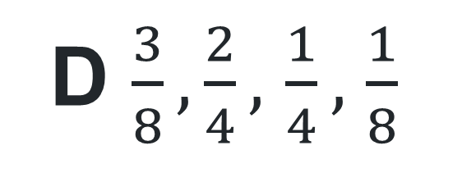
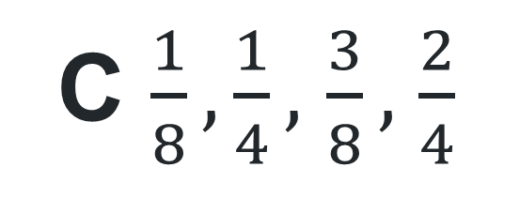
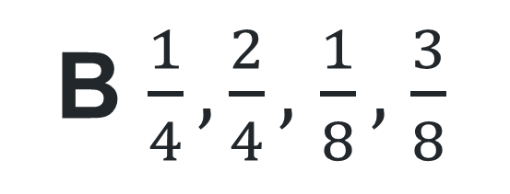
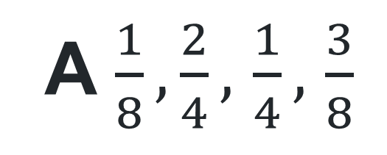
Multiple choice (1)
Which of the following lists these fractions in ascending order?
A $\frac{1}{8}, \frac{2}{4},$ $\frac{1}{4},$ $\frac{3}{8}$
C $\frac{1}{8}, \frac{1}{4},$ $\frac{3}{8},$ $\frac{2}{4}$
B $\frac{1}{4}, \frac{2}{4},$ $\frac{1}{8},$ $\frac{3}{8}$
D $\frac{3}{8}, \frac{2}{4},$ $\frac{1}{4},$ $\frac{1}{8}$
Notes:
This question connects to the content in the developing number sense activity (Activity 1)
Syllabus focus area:
Representing quantity fractions B

Slide 6

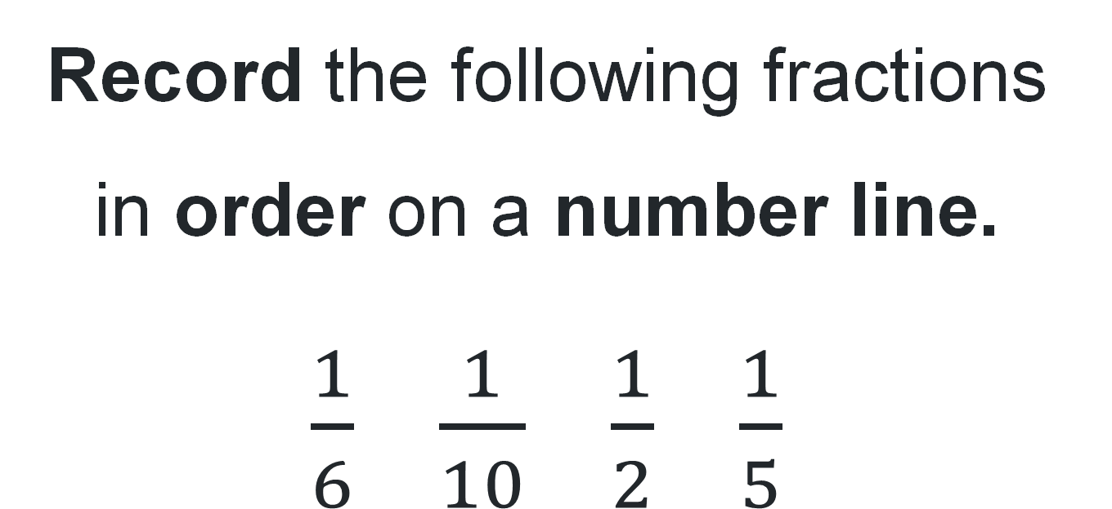
Short response (1)
Record the following fractions in order on a number line.
$\frac{1}{6}$ $\frac{1}{10}$ $\frac{1}{2}$ $\frac{1}{5}$
Notes:
Short response questions provide brisk paced questions focussing on review of current and previous content to support spaced and interleaved practice.
Syllabus focus area:
Representing quantity fractions A

Slide 7
Short response (2)
Record the following lengths using decimal notation:
2 metres and 70 centimetres
5 kilometres and 200 centimetres
2 kilometres and 400 centimetres
Notes:
Short response questions provide brisk paced questions focussing on review of current and previous content to support spaced and interleaved practice.
Syllabus focus area:
Geometric measure B: Length

Slide 8
Short response (3)
A library had 8230 books. They removed 2485 damaged books and then added 1350 new books.
What is the total number of books in the library now?
Communicate your strategy.
Notes:
Short response questions provide brisk paced questions focussing on review of current and previous content to support spaced and interleaved practice.
Syllabus focus area:
Additive relations B

Slide 9
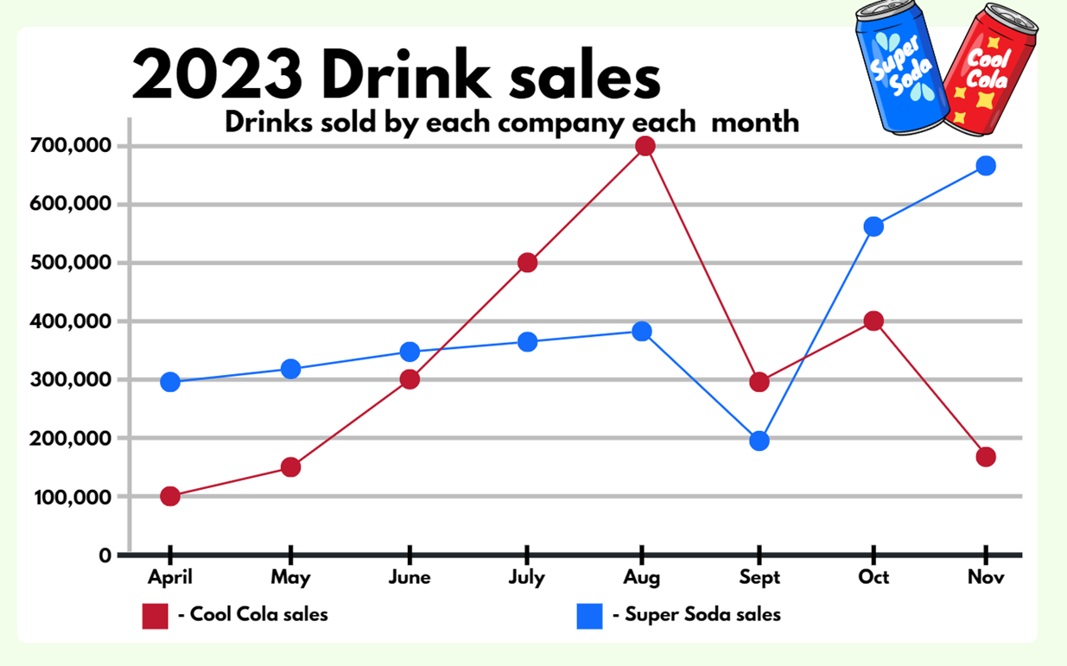
Short response (4)
Identify the month with the smallest difference in sales between Cool Cola and Super Soda.
Record the number of sales for each drink for that month.
Notes:
Short response questions provide brisk paced questions focussing on review of current and previous content to support spaced and interleaved practice.
Syllabus focus area:
Data A

Slide 10

Activity 1 – compare and represent fractions (1)
Jas has 60 marbles and shares them with:
1 friend | 4 friends
5 friends | 10 friends
Record the fraction and the quantity each friend would receive.
Notes:
This is a developing number sense activity.
Number sense refers to a deep understanding of numbers, including their magnitude, relationships, and the effects of operations on them. It supports fluency and understanding, estimation, flexible thinking, and efficient problem-solving. Number sense activities 1–4 ‘activate’ prior number knowledge and support the learning of new content in the unit. Number sense activities 5–8 ‘loop’ back and provide opportunity for spaced practice with concepts and procedures covered in previous units.
Syllabus focus area:
Representing quantity fractions B
Activity title 1 – compare and represent fractions
Explain that Jas has 60 marbles. She decides to keep half and give half to a friend. Ask students to record the fraction and the quantity Jas and her friend would each get on individual whiteboards.
Repeat the process to share the marbles between increasing numbers of friends:
4 friends: one quarter = 15
5 friends: one fifth = 12
10 friends: one tenth= 6.
Ask:
Are there any numbers of friends that Jas won’t be able to share her marbles equally with? (Yes. Numbers such as 7, 8, and 9 friends.)
How do you know? (60 is not a multiple of numbers such as 7, 8 or 9 and therefore cannot be shared equally.)
As a class, place each fraction on a number line (next slide) and discuss how the quantity each friend gets is smaller each time the denominator increases. Some students may like the challenge of checking to see whether this works for other fractions, such as eighths and twentieths. Support students to revise that this is how the size of fractions is different to whole numbers.

Slide 11
Activity 1 – compare and represent fractions (2)
Notes:
Activity title 1 – compare and represent fractions (continued)

Slide 12
Review of learning 2

Slide 13
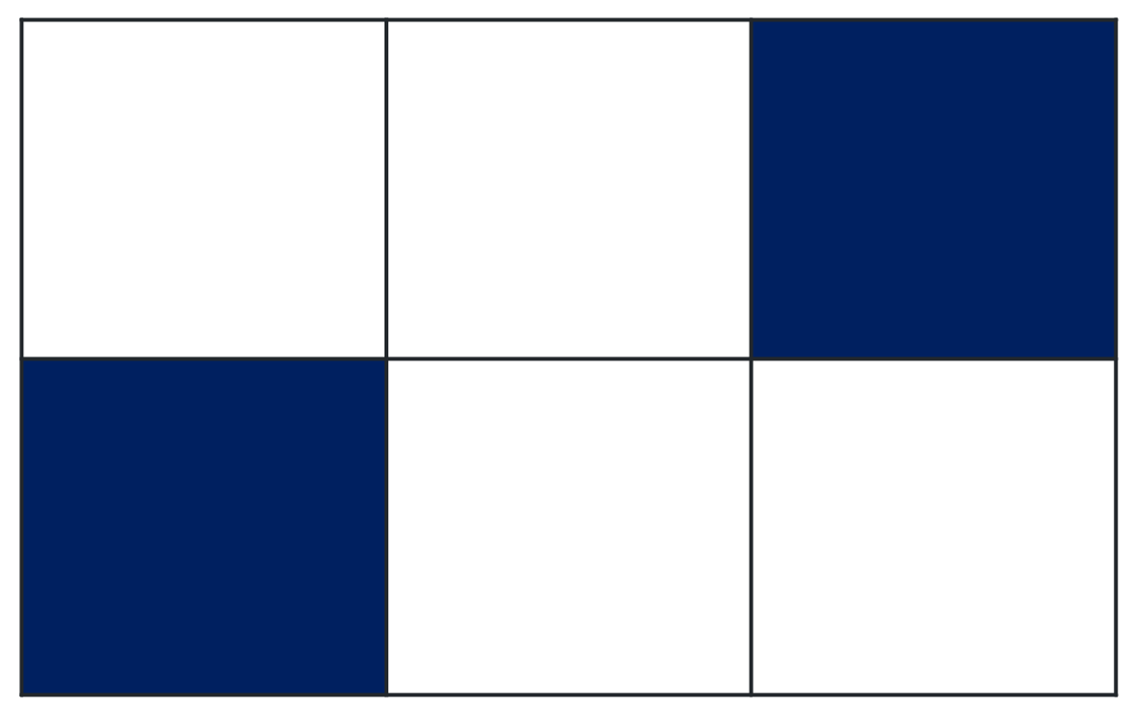
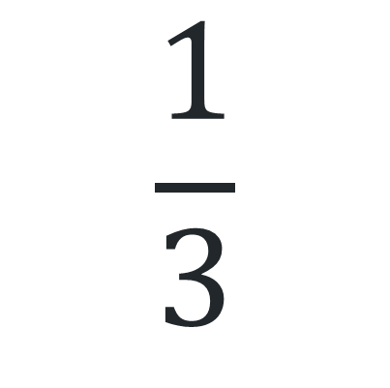
True or false (1)
Each of these represent one-third.
$$\frac{1}{3}$$
True | False
Notes:
The question on this slide connects to the content being explored in the developing number sense activity (Activity 2)
Syllabus focus area:
Representing quantity fractions B

Slide 14
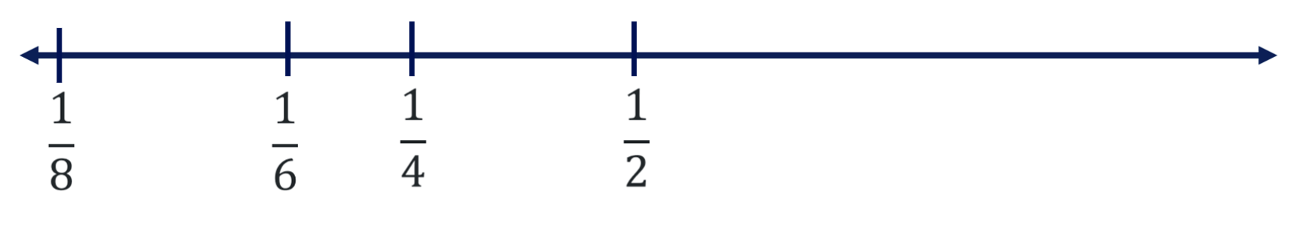
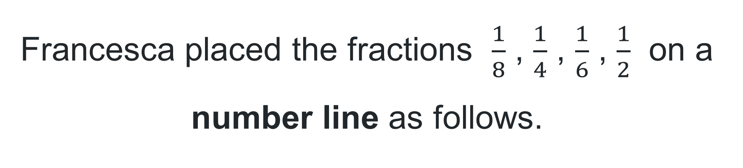
Short response (5)
Francesca placed the fractions $\frac{1}{8}$ , $\frac{1}{4}$ , $\frac{1}{6}$ , $\frac{1}{2}$ on a number line as follows.
Do you agree with her placements? Why / why not?
Notes:
Short response questions provide brisk paced questions focussing on review of current and previous content to support spaced and interleaved practice.
Syllabus focus area:
Representing quantity fractions A

Slide 15
Short response (6)
Lilly walks 3200 metres to the park.
Convert the length to show how many kilometres she walked?
Notes:
Short response questions provide brisk paced questions focussing on review of current and previous content to support spaced and interleaved practice.
Syllabus focus area:
Geometric measure B: Length

Slide 16
Short response (7)
Oscar added 3785 + 4629 and got 8314.
Use place value to check if her answer is correct.
Communicate your reasoning.
Notes:
Short response questions provide brisk paced questions focussing on review of current and previous content to support spaced and interleaved practice.
Syllabus focus area:
Additive relations A

Slide 17
Short response (8)
Record events that can be described as:
likely
unlikely
equally likely
certain
impossible
Notes:
Short response questions provide brisk paced questions focussing on review of current and previous content to support spaced and interleaved practice.
Syllabus focus area:
Chance A

Slide 18
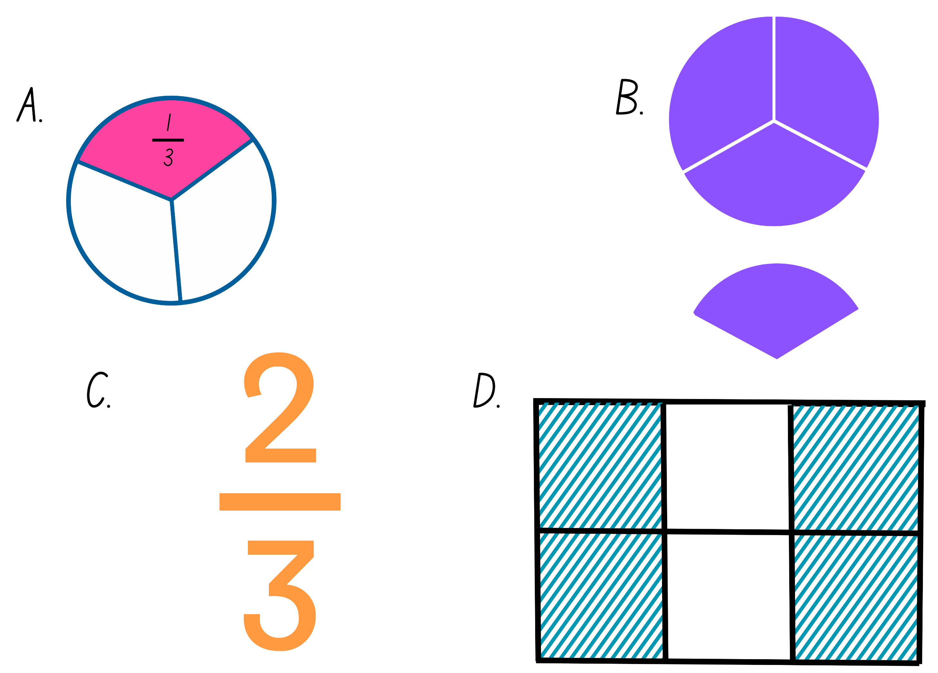
Activity 2 – ordering fractions
Notes:
This is a developing number sense activity.
Number sense refers to a deep understanding of numbers, including their magnitude, relationships, and the effects of operations on them. It supports fluency and understanding, estimation, flexible thinking, and efficient problem-solving. Number sense activities 1–4 ‘activate’ prior number knowledge and support the learning of new content in the unit. Number sense activities 5–8 ‘loop’ back and provide opportunity for spaced practice with concepts and procedures covered in previous units.
Syllabus focus area:
Representing quantity fractions B
Activity 2 – ordering fractions
This resource corresponds to Resource 17 – Which fraction doesn’t belong? in Stage 3 Year B Unit 24.
Students discuss how they are all related to thirds.
Students then discuss how each could be the odd one out. Ideas include:
A is different because it is the only one that shows one-third.
B is different because it is the only diagram that shows more than one.
C is different because it is the only one shown with fractional notation, without a diagram.
D is different because it shows sixths, which must be simplified to find thirds.
In pairs, students draw a number line on an individual whiteboard and use it to order and place the 4 fractions represented.

Slide 19
Review of learning 3

Slide 20
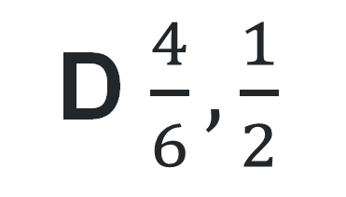
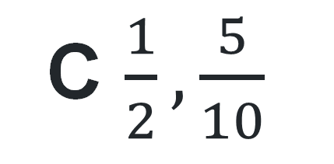
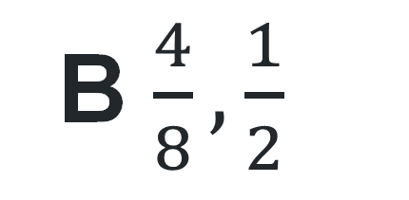
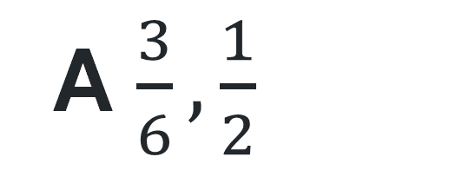
Multiple choice (2)
Which of the following pairs are not equivalent fractions?
A $\frac{3}{6},\frac{1}{2}$
B $\frac{4}{8},\frac{1}{2}$
C $\frac{1}{2},\frac{5}{10}$
D $\frac{4}{6},\frac{1}{2}$
Notes:
This question connects to the content in the developing number sense activity (Activity 3)
Syllabus focus area:
Representing quantity fractions B

Slide 21
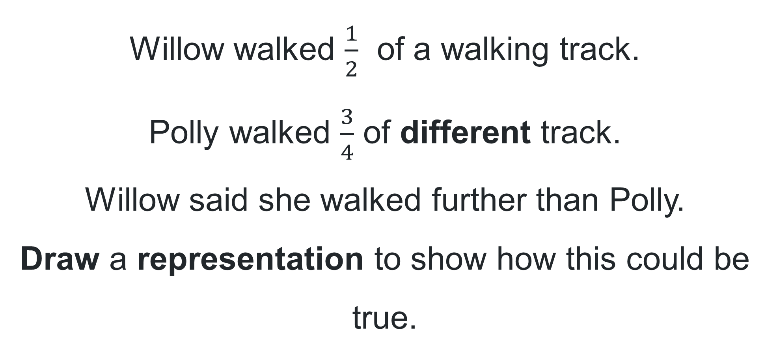
Short response (9)
Willow walked $\frac{1}{2}$ of a walking track.
Polly walked $\frac{3}{4}$ of different track.
Willow said she walked further than Polly.
Draw a representation to show how this could be true.
Notes:
Short response questions provide brisk paced questions focussing on review of current and previous content to support spaced and interleaved practice.
Syllabus focus area:
Representing quantity fractions A

Slide 22
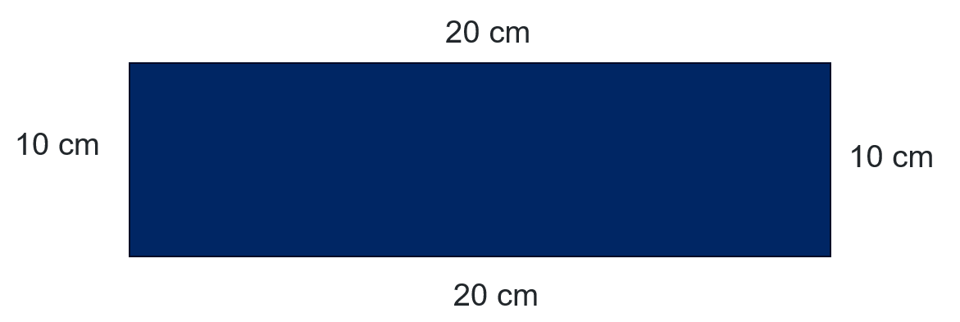
Short response (10)
Calculate the perimeter of this shape.
Notes:
Short response questions provide brisk paced questions focussing on review of current and previous content to support spaced and interleaved practice.
Syllabus focus area:
Geometric measure A: Length

Slide 23
Short response (11)
Sophie is counting the number of pencils in 3 Year 6 classrooms.
Class 6Y | 2562
Class 6B | 78
Class 6G | 349
Record how many pencils there are in total.
Notes:
Short response questions provide brisk paced questions focussing on review of current and previous content to support spaced and interleaved practice.
Syllabus focus area:
Additive relations A

Slide 24
Short response (12)
Arlo wanted to track the growth of a new plant in his garden over time.
Identify the type of data display that would be most suitable to represent this information.
Notes:
Short response questions provide brisk paced questions focussing on review of current and previous content to support spaced and interleaved practice.
Syllabus focus area:
Data A

Slide 25
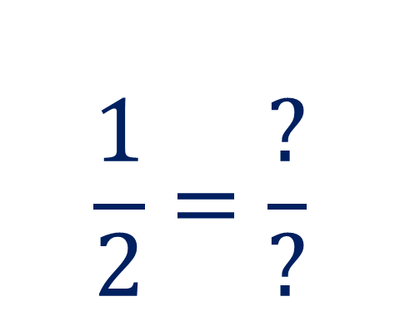
Activity 3 – equivalent fractions
How many ways can you show half, using a different denominator each time?
Record the fractions that represent half on your whiteboard.
$$\frac{1}{2}=\frac{?}{?}$$
Notes:
This is a developing number sense activity.
Number sense refers to a deep understanding of numbers, including their magnitude, relationships, and the effects of operations on them. It supports fluency and understanding, estimation, flexible thinking, and efficient problem-solving. Number sense activities 1–4 ‘activate’ prior number knowledge and support the learning of new content in the unit. Number sense activities 5–8 ‘loop’ back and provide opportunity for spaced practice with concepts and procedures covered in previous units.
Syllabus focus area:
Representing quantity fractions B
Activity title
Ask students how many ways they can show a half, using a different denominator each time. For example, two quarters, three sixths, fifty hundredths, sixteen thirty-seconds, two hundred four-hundredths, and so on. Students continue the process in pairs, recording on individual whiteboards.
Ask students to share all the different ways they made halves. As a class, discuss what is always the same about the relationship between the numerator and the denominator. For example, the numerator is always half the size of the denominator.
Call out fractions such as three sixths, six tenths, and forty fiftieths. Students state whether each fraction is exactly one half, close to one half, or not close to one half.

Slide 26
Review of learning 4

Slide 27
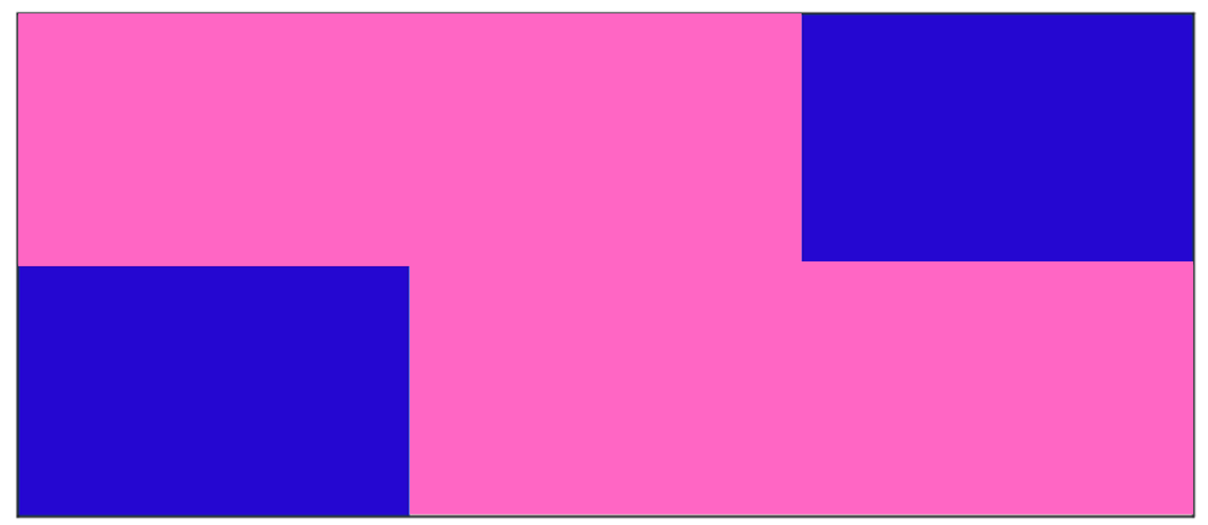
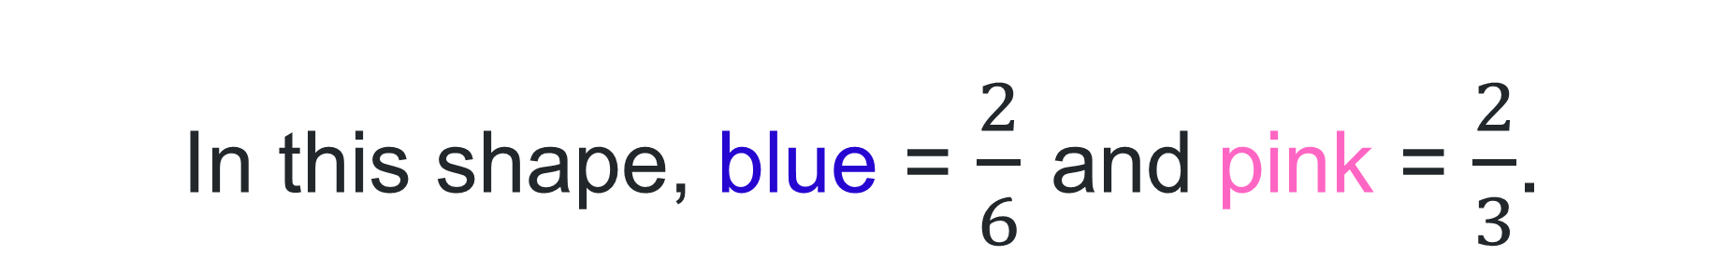
True or false (2)
In this shape, blue = $\frac{2}{6}$ and pink = $\frac{2}{3}$.
True | False
Notes:
The question on this slide connects to the content being explored in the developing number sense activity (Activity 4)
Syllabus focus area:
Representing quantity fractions B

Slide 28
Short response (13)
Record the fraction of the hexagon for each of the 3 parts.
Notes:
Short response questions provide brisk paced questions focussing on review of current and previous content to support spaced and interleaved practice.
Syllabus focus area:
Representing quantity fractions B

Slide 29
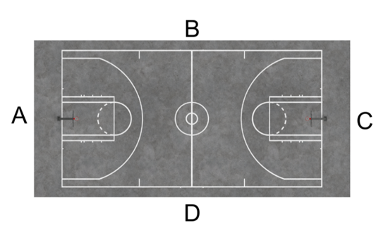
Short response (14)
Which side lengths are needed to determine the perimeter of the basketball court?
Communicate your reasoning.
Notes:
Short response questions provide brisk paced questions focussing on review of current and previous content to support spaced and interleaved practice.
Syllabus focus area:
Geometric measure A: Length

Slide 30
Short response (15)
A gardener planted 1500 flowers. 420 were damaged in a storm and removed and 350 new flowers were planted. The flowers were then evenly arranged into 14 beds.
How many flowers are there in total now?
How many flowers are in each flower bed?
Notes:
Short response questions provide brisk paced questions focussing on review of current and previous content to support spaced and interleaved practice.
Syllabus focus area:
Additive relations B

Slide 31
Short response (16)
A die is rolled once.
Represent the probability of rolling a 4 as a fraction.
Notes:
Short response questions provide brisk paced questions focussing on review of current and previous content to support spaced and interleaved practice.
Syllabus focus area:
Chance A

Slide 32
Activity 4 – area model and fractions
Notes:
This is a developing number sense activity.
Number sense refers to a deep understanding of numbers, including their magnitude, relationships, and the effects of operations on them. It supports fluency and understanding, estimation, flexible thinking, and efficient problem-solving. Number sense activities 1–4 ‘activate’ prior number knowledge and support the learning of new content in the unit. Number sense activities 5–8 ‘loop’ back and provide opportunity for spaced practice with concepts and procedures covered in previous units.
Syllabus focus area:
Representing quantity fractions B
Activity 4 – area model and fractions
Explain that to create equivalent fractions for half in quarters, eighths, sixths and tenths we redivide the whole.
Demonstrate subdividing the area of a rectangle by both length and width to represent the multiplicative relationship between common and equivalent fractions. For example, fold a paper rectangle to show half. Fold it again to show quarters.
Ask: how many quarters are there in a half?
Provide student with 3 rectangle pieces of paper of equal size. In pairs, students subdivide the rectangle to create equivalent representations for half in quarters, eighths, sixths and tenths.
Students identify any other equivalent fractions and record these.
As a class order the common fractions on a number line.

Slide 33
Review of learning 5

Slide 34
Multiple choice (3)
Sadie said ‘4009 – 2997 is the same as 4012 – 3000, which equals 1012’. Which strategy did Sadie use?
A Constant difference
B Levelling
C Addition for subtraction
D Bridging
Notes:
This question connects to the content in the developing number sense activity (Activity 5)
Syllabus focus area:
Additive relations A

Slide 35
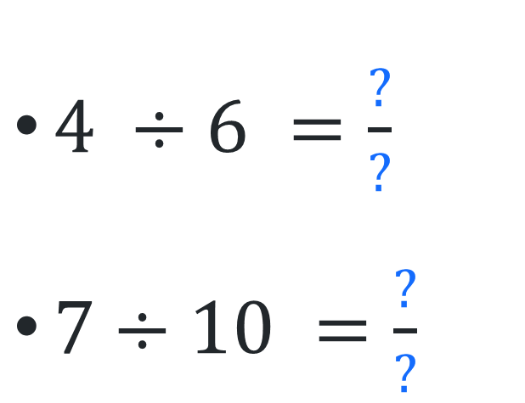
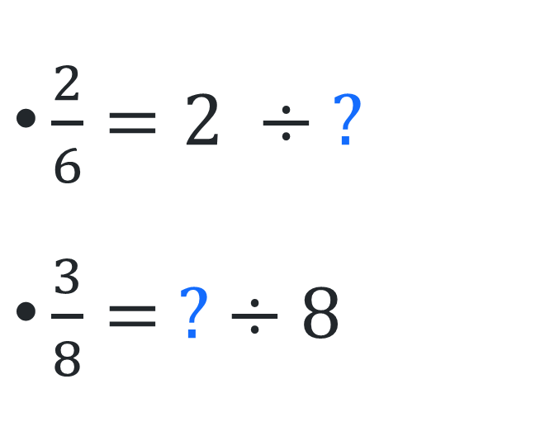
Short response (17)
Complete the number sentences.
$\frac{2}{6}=2 ÷ ?$
$\frac{3}{8}= ? ÷8$
$4 ÷6 =\frac{?}{?}$
$7÷10 =\frac{?}{?}$
Notes:
Short response questions provide brisk paced questions focussing on review of current and previous content to support spaced and interleaved practice.
Syllabus focus area:
Representing quantity fractions B

Slide 36
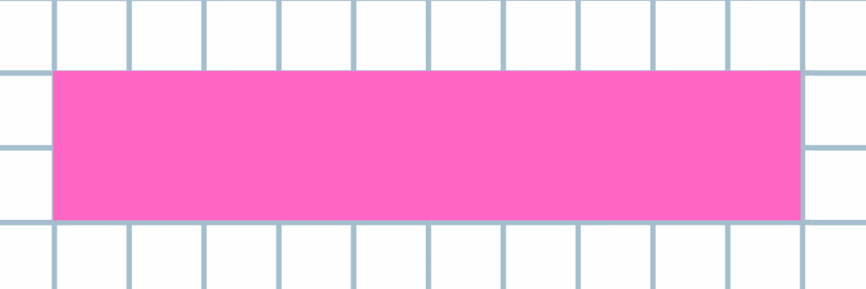
Short response (18)
This rectangle has a perimeter of 24 cm and side dimensions of 2 cm and 10 cm.
Record the dimensions of a different rectangle that has the same perimeter.
Notes:
Short response questions provide brisk paced questions focussing on review of current and previous content to support spaced and interleaved practice.
Syllabus focus area:
Geometric measure B: Length

Slide 37
Short response (19)
Record the place value of each digit in the decimal:
5.67
Notes:
Short response questions provide brisk paced questions focussing on review of current and previous content to support spaced and interleaved practice.
Syllabus focus area:
Represents numbers A: Decimals and percentages

Slide 38
Short response (20)
Identify the appropriate unit and device to measure the weight of a full suitcase.
Notes:
Short response questions provide brisk paced questions focussing on review of current and previous content to support spaced and interleaved practice.
Syllabus focus area:
Non-spatial measure A: Mass

Slide 39
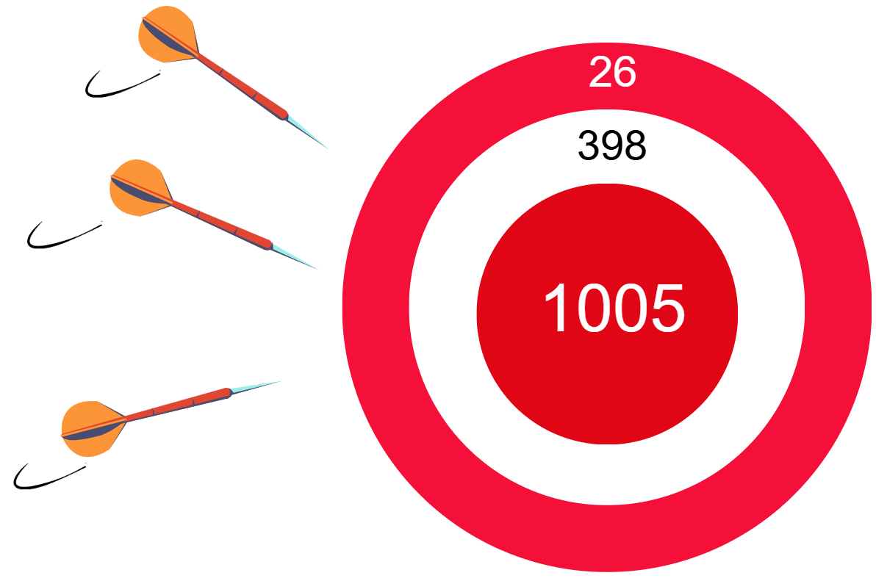
Activity 5 – addition strategies
Notes:
This is a developing number sense activity.
Number sense refers to a deep understanding of numbers, including their magnitude, relationships, and the effects of operations on them. It supports fluency and understanding, estimation, flexible thinking, and efficient problem-solving. Number sense activities 1–4 ‘activate’ prior number knowledge and support the learning of new content in the unit. Number sense activities 5–8 ‘loop’ back and provide opportunity for spaced practice with concepts and procedures covered in previous units.
Syllabus focus area:
Additive relations A
Activity 5 – addition strategies
Note: This activity is an adaptation of ‘Bull’s Eye’ from Creative problem solving in school mathematics: A handbook for teachers, parents and students by Lenchner.
Explain that 3 darts have been thrown at this target and at least one of the darts has hit the bullseye.
Ask what point totals are possible. Students work in small groups to discuss strategies to find possible totals.
Select a range of student responses and strategies to share with the class. Ask:
How many possibilities are there? How do you know you have found all of them? (There are 6 possibilities.)
What addition strategies did you use to determine the total?
Which numbers were easiest to add together? Why?

Slide 40
Review of learning 6

Slide 41
True or false (3)
Using an algorithm would be an efficient strategy to solve 7 896 – 7 816.
True | False
Notes:
The question on this slide connects to the content being explored in the developing number sense activity (Activity 6)
Syllabus focus area:
Additive relations A

Slide 42

Short response (21)
Record the fraction of the rectangle for each of the 3 colours.
Notes:
Short response questions provide brisk paced questions focussing on review of current and previous content to support spaced and interleaved practice.
Syllabus focus area:
Representing quantity fractions B

Slide 43
Short response (22)
A plane took off at 13:20 and landed at 17:30.
Calculate the duration of the flight.
Communicate your reasoning.
Notes:
Short response questions provide brisk paced questions focussing on review of current and previous content to support spaced and interleaved practice.
Syllabus focus area:
Non-spatial measure B: Time

Slide 44
Short response (23)
Maria ran 4.98km today and 5.23km yesterday. Calculate the total distance she ran.
Communicate your strategy.
Notes:
Short response questions provide brisk paced questions focussing on review of current and previous content to support spaced and interleaved practice.
Syllabus focus area:
Additive relations B

Slide 45
Short response (24)
Complete each sentence:
2.08 kg is the same as ___ kilograms and ___ grams.
12.80 kg is the same as ___ kilograms and ___ grams.
6.45 kg is the same as ___ kilograms and ___ grams.
Notes:
Short response questions provide brisk paced questions focussing on review of current and previous content to support spaced and interleaved practice.
Syllabus focus area:
Non-spatial measure A: Mass

Slide 46
Activity 6 – subtraction strategies
6005 − 2997 =
Notes:
This is a developing number sense activity.
Number sense refers to a deep understanding of numbers, including their magnitude, relationships, and the effects of operations on them. It supports fluency and understanding, estimation, flexible thinking, and efficient problem-solving. Number sense activities 1–4 ‘activate’ prior number knowledge and support the learning of new content in the unit. Number sense activities 5–8 ‘loop’ back and provide opportunity for spaced practice with concepts and procedures covered in previous units.
Syllabus focus area:
Additive relations A
Activity 6 – subtraction strategies
Note: This activity is an adaption of Dicey Operations in Line from NRICH by University of Cambridge.
Ask students to record how they would solve this on individual whiteboards.
Ask:
What strategy did you use to solve this problem?
How could addition help solve this problem? (Add 3 to 2997 to make 3000. The difference is easier to work out as 3005, so the difference is 3008).
Are there any other strategies that can be used to solve this problem?
Which strategy is the most efficient strategy?
Explain that students are to play a game subtracting 2 numbers. The winner is the student that gets closest to zero whether the answer is a positive or negative integer.
Provide pairs of students with four 9-sided dice. Students roll the dice twice to make two 4-digit numbers and record these in a number sentence. For example: 4632 – 3875 = 757.
Students can manipulate the 4-digit numbers from any of the numbers rolled. For example, if 6, 4, 2 and 3 are rolled, students can choose to record 6432, 2346 or 4632 and so on.
As students are playing, move around the room and engage students in discussion about the strategies they use. Students play multiple rounds.

Slide 47
Review of learning 7

Slide 48
Multiple choice (4)
Jeremiah needs to solve 4000 + 1273 + 65.
Which strategy would be the most efficient?
A Constant difference
B Levelling
C Addition for subtraction
D Using place value to partition
Notes:
This question connects to the content in the developing number sense activity (Activity 5)
Syllabus focus area:
Additive relations A

Slide 49
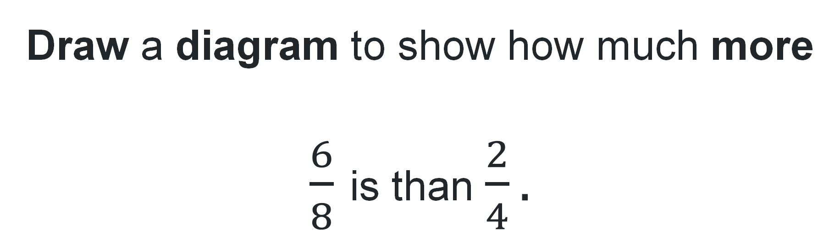
Short response (25)
Draw a diagram to show how much more
$\frac{6}{8}$ is than $\frac{2}{4}.$
Notes:
Short response questions provide brisk paced questions focussing on review of current and previous content to support spaced and interleaved practice.
Syllabus focus area:
Representing quantity fractions B

Slide 50
Short response (26)
Penny woke up at 08:10 and fell asleep that night at 19:40.
How long was she awake for?
Communicate your reasoning.
Notes:
Short response questions provide brisk paced questions focussing on review of current and previous content to support spaced and interleaved practice.
Syllabus focus area:
Non-spatial measure B: Time

Slide 51
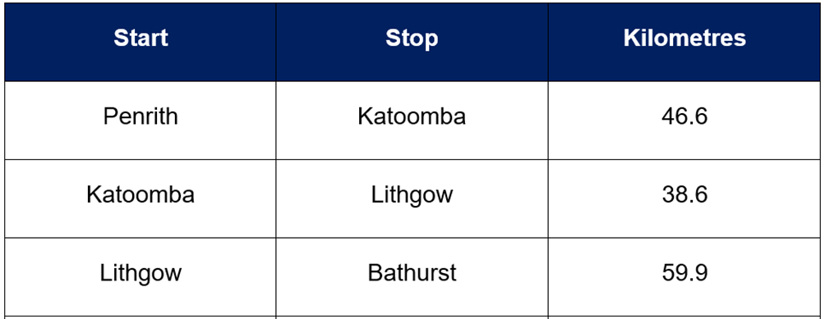
Short response (27)
Levi went on a road trip from Penrith to Bathurst. Calculate the total distance he travelled.
Notes:
Short response questions provide brisk paced questions focussing on review of current and previous content to support spaced and interleaved practice.
Syllabus focus area:
Additive relations B

Slide 52
Short response (28)
Explain why 24-hour time is used and provide an example to justify your answer.
Notes:
Short response questions provide brisk paced questions focussing on review of current and previous content to support spaced and interleaved practice.
Syllabus focus area:
Non-spatial measure A: Time

Slide 53
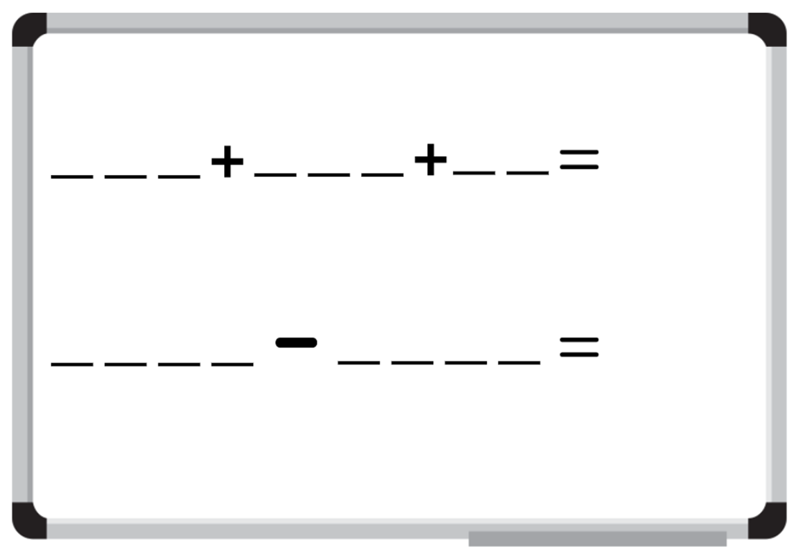
Activity 7 – addition and subtraction strategies
Notes:
This is a developing number sense activity.
Number sense refers to a deep understanding of numbers, including their magnitude, relationships, and the effects of operations on them. It supports fluency and understanding, estimation, flexible thinking, and efficient problem-solving. Number sense activities 1–4 ‘activate’ prior number knowledge and support the learning of new content in the unit. Number sense activities 5–8 ‘loop’ back and provide opportunity for spaced practice with concepts and procedures covered in previous units.
Syllabus focus area:
Additive relations A
Activity 7 – addition and subtraction strategies
Note: This activity is an adaption of Dicey Operations in Line from NRICH by University of Cambridge.
Ask students to draw up a game board on their individual whiteboards.
Explain that students are to play a dice game where each round involves two parts: firstly, adding 3 numbers together and recording the total and secondly, subtracting one 4-digit number from another and recording the total.
For each total recorded that is closest to 1000, the player scores a point. The winner is the student who has the most points at the end of the game.
Provide pairs of students with four 9-sided dice. Firstly, students take turns to roll the set of 4 dice twice. They use the digits rolled to make two 3-digit numbers and one 2-digit number for the addition number sentence. Explain that students can choose to fill any of the missing numbers on their addition number sentence gameboard to record the numbers they have rolled. For example, in round one, Player 1 creates the addition number sentence: 412 + 693 + 26 = 1131 and Player 2: 589 + 386 + 17 = 992.
Whichever student has a total closest to 1000 scores a point. For example, in round one Player 2 would score a point because 992 is closer to 1000 than Player 1’s total of 1131.
Next, students take turns rolling the set of 4 dice twice to make two 4-digit numbers and record these in a subtraction number sentence. Explain again that students can choose to fill any of the missing numbers on their subtraction number sentence gameboard to record the numbers they have rolled. For example: Player 1 creates the subtraction number sentence: 5234 – 4123 = 1111 and Player 2: 4628 – 3127 = 1501.
Whichever student has a total closest to 1000, scores a point. For example, Player 1 would score a point in this round because 1111 is closer to 1000 than Player 2’s total of 1501.
As students are playing, move around the room and engage students in discussion about the strategies they use. Students may play multiple rounds, recording a tally of their points to find the overall winner at the end of the game.

Slide 54
Review of learning 8

Slide 55
True or false (4)
Using a calculator is the most efficient way to solve
2 000 + 400 + 400 + 6 + 1.
True | False
Notes:
The question on this slide connects to the content being explored in the developing number sense activity (Activity 8)
Syllabus focus area:
Additive relations A

Slide 56
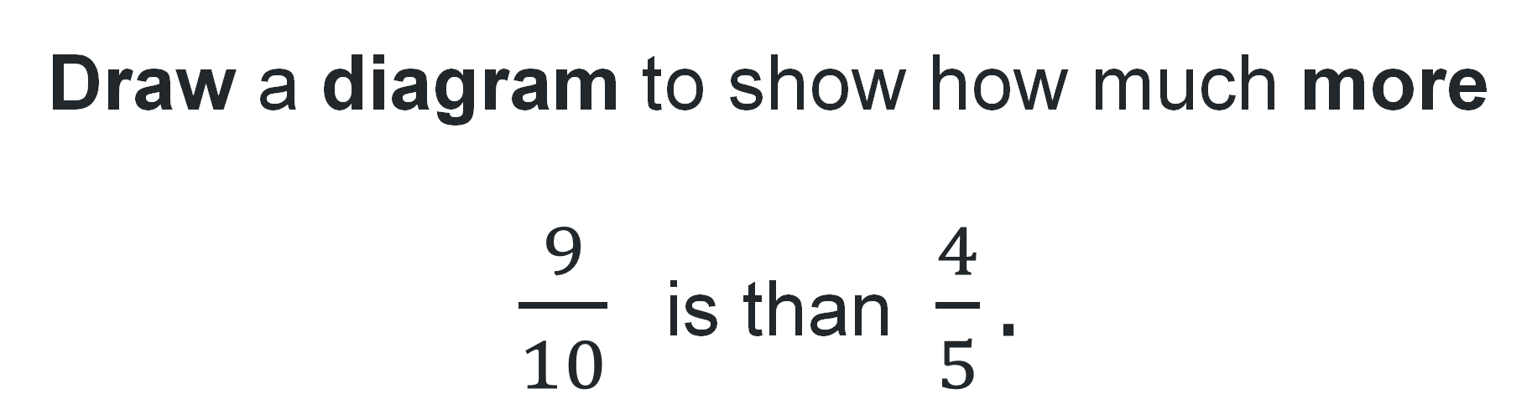
Short response (29)
Draw a diagram to show how much more $\frac{9}{10}$ is than $\frac{4}{5}.$
Notes:
Short response questions provide brisk paced questions focussing on review of current and previous content to support spaced and interleaved practice.
Syllabus focus area:
Representing quantity fractions B

Slide 57
Short response (30)
Complete the following sentences:
13.5 cm = ____ cm and ____ mm
12.6 km = ____ km and ____ m
7.5 m = ____ m and ____ cm
Notes:
Short response questions provide brisk paced questions focussing on review of current and previous content to support spaced and interleaved practice.
Syllabus focus area:
Geometric measure B: Length

Slide 58

Short response (31)
Estella is travelling by plane and can only take 7 kg in carry-on luggage.
Calculate the total weight of Estella’s bag to determine if she is under the 7 kg weight limit.
Electronic devices = 1.15 kg
Snacks and water bottle = 1.7 kg
Clothes = 2.8 kg
Shoes 1.95 kg
Notes:
Short response questions provide brisk paced questions focussing on review of current and previous content to support spaced and interleaved practice.
Syllabus focus area:
Additive relations B

Slide 59
Short response (32)
Sarah is struggling to read the 24-hour train schedule and asks her friend to help convert the departure time of 18:45 into 12-hour format.
Record the time her friend should tell her?
Notes:
Short response questions provide brisk paced questions focussing on review of current and previous content to support spaced and interleaved practice.
Syllabus focus area:
Non-spatial measure A: Time

Slide 60
Activity 8 – efficient calculator use
Our school opened in _______.
Create a range of equations with the year as the answer.
Notes:
This is a developing number sense activity.
Number sense refers to a deep understanding of numbers, including their magnitude, relationships, and the effects of operations on them. It supports fluency and understanding, estimation, flexible thinking, and efficient problem-solving. Number sense activities 1–4 ‘activate’ prior number knowledge and support the learning of new content in the unit. Number sense activities 5–8 ‘loop’ back and provide opportunity for spaced practice with concepts and procedures covered in previous units.
Syllabus focus area:
Additive relations A
Activity 8 – efficient calculator use
Note: This activity is an adaptation of It Was 2010! from NRICH by University of Cambridge.
Tell students which year their school opened in. Ask students to create a range of equations with the year as the answer. For example, a school that opened in 2010 could produce the equations:
2000 + 10
201 × 10
1000 + 500 + 500 + 5 + 5
(19 × 19) + (25 × 25) + (32 × 32)
3000 − 1000 + 10.
Explain that students can use calculators where they think this might be quicker than mentally working out.
In pairs or small groups, students explore ways to make their school year in a variety of equations.
Students share solutions and discuss which were more efficient to work out mentally and where it was quicker with a calculator.

Slide 61
Double Venn diagram
Object 1
Object 2
Features similar to both objects
Features of object 1
Features of object 2

Slide 62
Frayer
Definition
Facts/Characteristics
Word, term, concept
Examples
Non-examples

Slide 63
Spider map
Idea
Subject

Slide 64
Cline
Concept 1
Concept 2
Word
Word
Word
Word
Word
Word
Word
Word
Word
Word
Word

Slide 65

Compare and contrast

Slide 66
Multiple choice (5)
A
B
C
D

Slide 67
Multiple choice (6)
A
B
C
D

Slide 68
References (1)
This presentation contains NSW Curriculum and syllabus content. The NSW Curriculum is developed by the NSW Education Standards Authority. This content is prepared by NESA for and on behalf of the Crown in the right of the State of New South Wales. The material is protected by Crown copyright.
Please refer to the NESA Copyright Disclaimer for more information https://educationstandards.nsw.edu.au/wps/portal/nesa/mini-footer/copyright.
NESA holds the only official and up-to-date versions of the NSW Curriculum and syllabus documents. Please visit the NSW Education Standards Authority (NESA) website https://educationstandards.nsw.edu.au/wps/portal/nesa/home and the NSW Curriculum website https://curriculum.nsw.edu.au.
Mathematics K–10 Syllabus © NSW Education Standards Authority (NESA) for and on behalf of the Crown in right of the State of New South Wales, 2022.
National Numeracy Learning Progression © Australian Curriculum, Assessment and Reporting Authority (ACARA) 2010 to present, unless otherwise indicated. This material was downloaded from the Australian Curriculum website (National Numeracy Learning Progression) (accessed 30 September 2025) and was not modified.
Amplify Education (2024) Amplify Polypad – Fraction Bars, Amplify Polypad website, accessed 21 February 2024.
Boaler J, Munson J and Williams C (2017) Mindset Mathematics: Visualizing and Investigating Big Ideas, Grade 4, Jossey-Bass, New Jersey.
Gojak LM and Miles RH (2018) Your Mathematics Standards Companion, Grades 3–5, Corwin Mathematics and National Council of Teachers of Mathematics, United States of America.
Kaplinsky O (2024) Adding fractions to make a whole number, Open Middle website, accessed 30 January 2024.

Slide 69
References (2)
This presentation contains NSW Curriculum and syllabus content. The NSW Curriculum is developed by the NSW Education Standards Authority. This content is prepared by NESA for and on behalf of the Crown in the right of the State of New South Wales. The material is protected by Crown copyright.
Please refer to the NESA Copyright Disclaimer for more information https://educationstandards.nsw.edu.au/wps/portal/nesa/mini-footer/copyright.
NESA holds the only official and up-to-date versions of the NSW Curriculum and syllabus documents. Please visit the NSW Education Standards Authority (NESA) website https://educationstandards.nsw.edu.au/wps/portal/nesa/home and the NSW Curriculum website https://curriculum.nsw.edu.au.
Kaplinsky R (2024) Subtracting Fractions, Open Middle website, accessed 30 January 2024.
Kersaint G (2021) 100 questions that promote mathematical discourse, Curriculum Associates, LLC website, accessed 30 January 2024.
Lenchner G (2022) Creative Problem Solving in School Mathematics: A handbook for teachers, parents and students, Australasian Problem Solving Mathematical Olympiads (APSMO), NSW, Australia.
Sullivan P (2021) Building Engagement for Middle Years Mathematics: Learning sequences for mixed-ability classrooms, Oxford University Press Australia and New Zealand.
University of Cambridge (n.d.) Dicey Operations in Line, NRICH website, accessed 30 January 2024.
University of Cambridge (n.d.) Fractional Wall, NRICH website, accessed 30 January 2024.
University of Cambridge (n.d.) Fractions in a Box, NRICH website, accessed 30 January 2024.

Slide 70
Copyright
© State of New South Wales (Department of Education), 2025
The copyright material published in this resource is subject to the Copyright Act 1968 (Cth) and is owned by the NSW Department of Education or, where indicated, by a party other than the NSW Department of Education (third-party material).
Copyright material available in this resource and owned by the NSW Department of Education is licensed under a Creative Commons Attribution 4.0 International (CC BY 4.0) license.
This license allows you to share and adapt the material for any purpose, even commercially.
Attribution should be given to © State of New South Wales (Department of Education), 2025.
Material in this resource not available under a Creative Commons license:
the NSW Department of Education logo, other logos and trademark-protected material
Material owned by a third party that has been reproduced with permission. You will need to obtain permission from the third party to reuse its material.
Links to third-party material and websites
Please note that the provided (reading/viewing material/list/links/texts) are a suggestion only and implies no endorsement, by the New South Wales Department of Education, of any author, publisher, or book title. School principals and teachers are best placed to assess the suitability of resources that would complement the curriculum and reflect the needs and interests of their students.
If you use the links provided in this document to access a third party’s website, you acknowledge that the terms of use, including licence terms set out on the third-party’s website apply to the use which may be made of the materials on that third-party website or where permitted by the Copyright Act 1968 (Cth). The department accepts no responsibility for content on third-party websites.

