Slide 1
Instructions for use
This resource is not a teaching and learning program. It should be used in conjunction with Stage 3 Year B Unit 25.
Classroom teachers are encouraged to add and adapt slides as required to meet the needs of their students.
Save a copy of the file to make changes to the slide deck. Go to File > Download a Copy (this downloads a copy to the computer to edit in the PowerPoint app).
To convert the PowerPoint to Google Slides:
  Upload the file into Google Drive and open it.
  Go to File > Save as Google Slides.
  (Note – conversion may cause formatting changes in the slides.)

Slide 2

Review of Learning
Mathematics Stage 3 – Unit 25
Notes:
Reviews may include a combination of question types, requiring students to recall facts and key ideas, as well as apply their knowledge to solve problems and answer questions. To support active engagement, a mix of techniques should be employed.” (AERO, 2024).
This Review of Learning slide deck revisits key concepts from the following units:
Stage 3 Year B Unit 25
Stage 3 Year B Unit 24
Stage 3 Year B Unit 23
It also includes opportunities to review prior learning in non-number content, supporting consolidation across focus areas.
The review of learning resources include three key task types that support the development of mathematical proficiency through retrieval, spaced practice, and active participation. These practices complement the review phase (activating prior knowledge) embedded within the beginning of each lesson.
1.
Multiple-choice questions/True or false: Designed to promote active retrieval of key concepts and identify common misconceptions in number, supporting consolidation, understanding and fluency.
These questions:
support spaced and interleaved practice
help identify and address common misconceptions
support active recall and immediate feedback
support whole class participation
identify areas requiring reteach
2.
Short-response question sets: Carefully grouped questions that encourage spaced and interleaved practice across multiple focus areas, helping students revisit and apply knowledge from different points in time.
These questions:
have a combination of question types
address a range of focus areas
build automaticity and fluency
support active recall
allow for immediate feedback
identify content requiring reteach
3.
Developing number sense activities: A variety of practical, purposeful tasks that reinforce current learning and build on prior knowledge. These activities promote reasoning, problem-solving and conceptual understanding.
The review of learning resources are designed to work support teaching and learning in mathematics. For the most effective implementation, use the resources flexibly, adapting to meet student learning needs and individual classroom contexts.

Slide 3
Lessons
1
Review of learning 1
5
Review of learning 5
2
Review of learning 2
6
Review of learning 6
3
Review of learning 3
7
Review of learning 7
4
Review of learning 4
8
Review of learning 8
Notes:
Teacher notes:
Click lesson numbers to go to specific lessons
Interactive features can be viewed in slide show

Slide 4
Review of learning 1

Slide 5


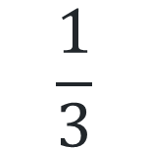
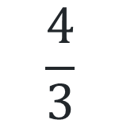
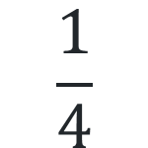
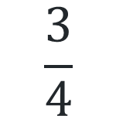
Multiple choice (1)
How would you record 3 divided by 4 as a fraction?
A
B
C
D
$$\frac{3}{4}$$
$$\frac{1}{4}$$
$$\frac{4}{3}$$
$$\frac{1}{3}$$
Notes:
This question connects to the content in the developing number sense activity (Activity 1)
Syllabus focus area:
Representing quantity fractions B

Slide 6

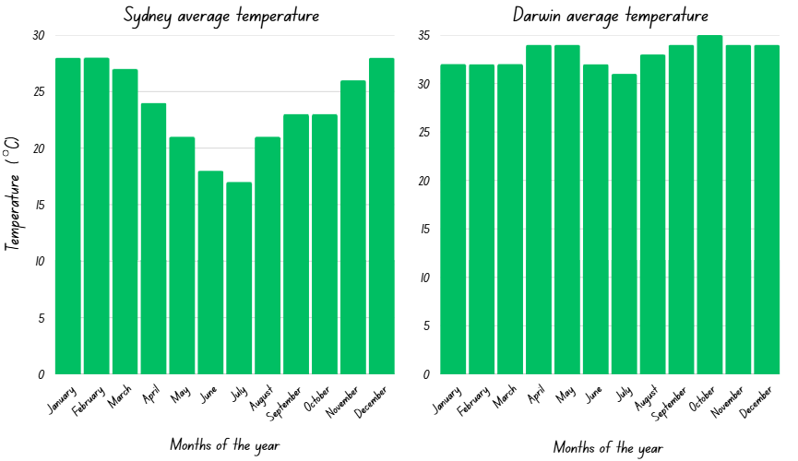
Short response (1)
Describe how the distribution of data is different in these graphs.
Notes:
Short response questions provide brisk paced questions focussing on review of current and previous content to support spaced and interleaved practice.
Syllabus focus area:
Data B

Slide 7
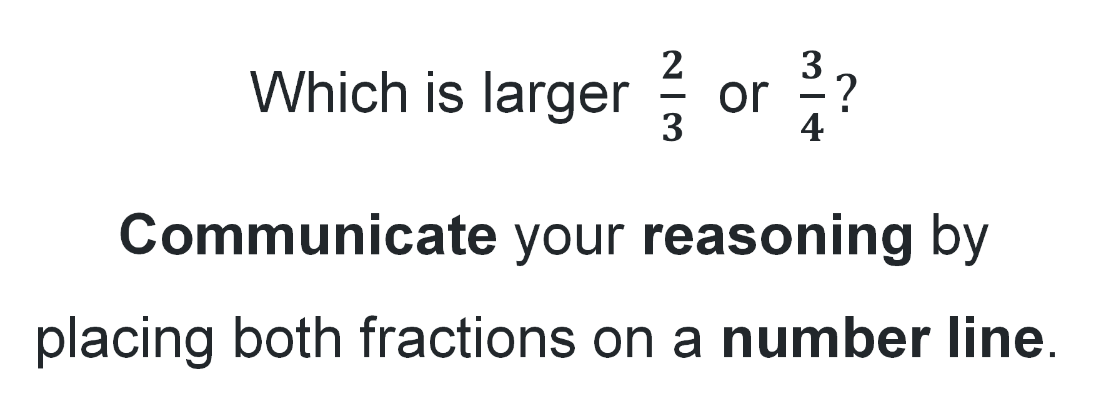
Short response (2)
Which is larger $\frac{2}{3}$ or $\frac{3}{4}?$
Communicate your reasoning by placing both fractions on a number line.
Notes:
Short response questions provide brisk paced questions focussing on review of current and previous content to support spaced and interleaved practice.
Syllabus focus area:
Representing quantity fractions A

Slide 8
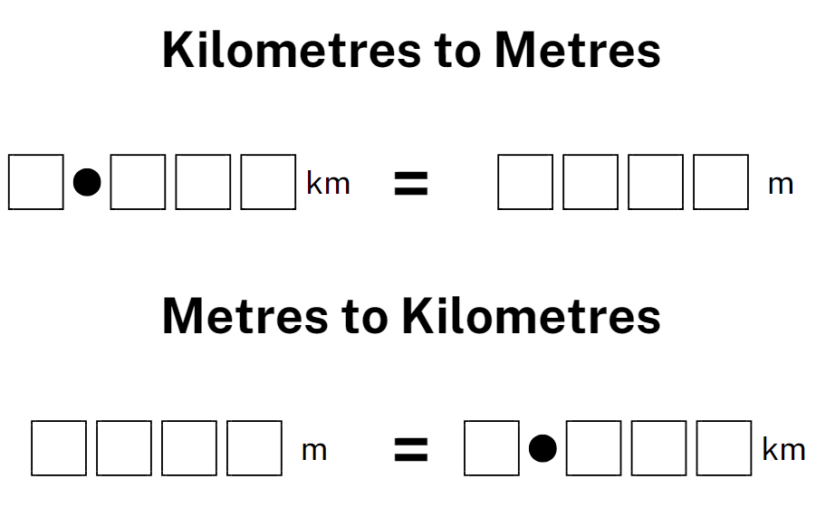
Short response (3)
Alan ran 2.396km on Monday. How many metres did he run?
Alan ran 3187m on Friday. How many kilometres did he run?
Notes:
Short response questions provide brisk paced questions focussing on review of current and previous content to support spaced and interleaved practice.
Syllabus focus area:
Geometric Measure B

Slide 9
Short response (4)
Draw 3 types of triangles:
an equilateral
an isosceles
a scalene
Describe the properties that identify and classify each triangle.
Notes:
Short response questions provide brisk paced questions focussing on review of current and previous content to support spaced and interleaved practice.
Syllabus focus area:
Two-dimensional spatial structure A

Slide 10

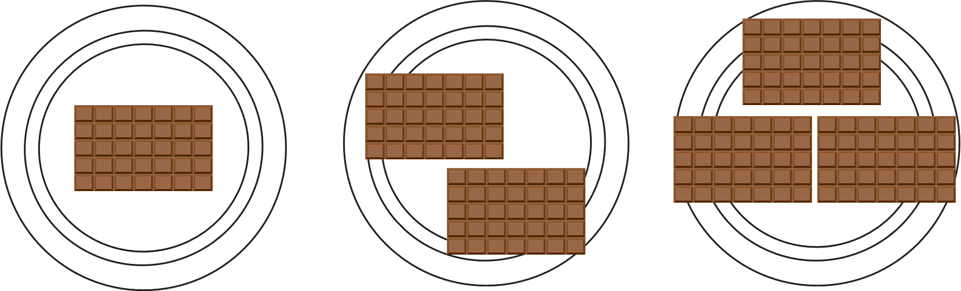
Activity 1 – division: fractions as sharing 1
Which plate will you sit behind?
Justify your choice.
Notes:
This is a developing number sense activity.
Number sense refers to a deep understanding of numbers, including their magnitude, relationships, and the effects of operations on them. It supports fluency and understanding, estimation, flexible thinking, and efficient problem-solving. Number sense activities 1–4 ‘activate’ prior number knowledge and support the learning of new content in the unit. Number sense activities 5–8 ‘loop’ back and provide opportunity for spaced practice with concepts and procedures covered in previous units.
Syllabus focus area:
Representing quantity fractions B
Division: fractions as sharing 1
This activity is an adaptation of Lamingtons from reSolve by Australian Government Department of Education.
Select 10 students. Position them so they cannot see the plates until they are called for their turn.
Ask the first student to sit behind a plate. Ask them to justify their choice.
Repeat for the other 9 students, reminding them that they will need to share the chocolate with whoever is behind their plate.
Ask how much chocolate the students behind each plate will receive. Students think-pair-share and justify their thinking.
Discuss similarities and differences between different strategies used.
Demonstrate solving the problem by dividing each chocolate bar into the same number of parts as students. Record how much chocolate students in each group would receive, for example 3 fifths.
Explain that this strategy demonstrates that fractions represent division because 3 shared between 5 is equal to 3 fifths, so 3 ÷ 5 = 3 fifths.
Ask students to demonstrate if the same applies to the other 2 groups.

Slide 11
Review of learning 2

Slide 12
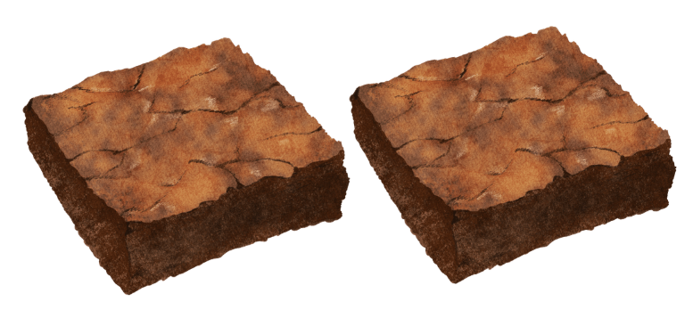
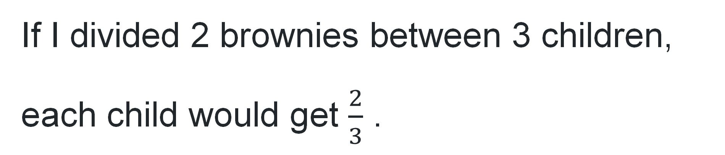
True or false (1)
If I divided 2 brownies between 3 children, each child would get $\frac{2}{3}$ .
True | False
Notes:
The question on this slide connects to the content being explored in the developing number sense activity (Activity 2)
Syllabus focus area:
Representing quantity fractions B

Slide 13
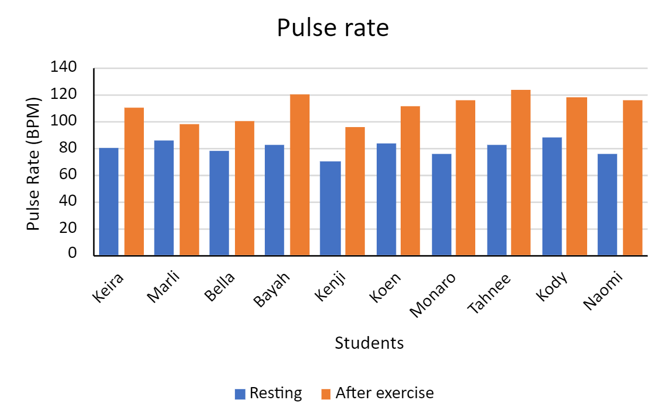
Short response (5)
What is the range of pulse rates after exercise?
Notes:
Short response questions provide brisk paced questions focussing on review of current and previous content to support spaced and interleaved practice.
Syllabus focus area:
Data B

Slide 14
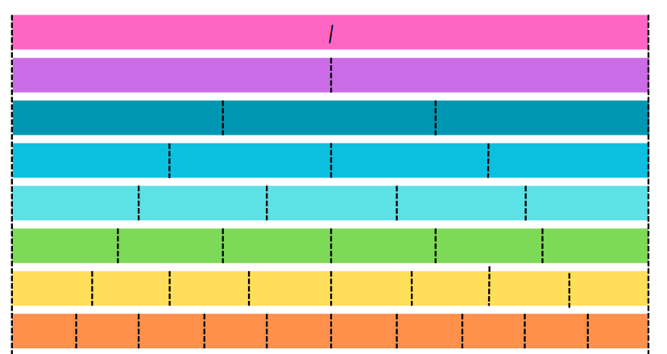
Short response (6)
Record the equivalent fractions for half in quarters, eighths, sixths and tenths.
Notes:
Short response questions provide brisk paced questions focussing on review of current and previous content to support spaced and interleaved practice.
Syllabus focus area:
Representing quantity fractions B

Slide 15
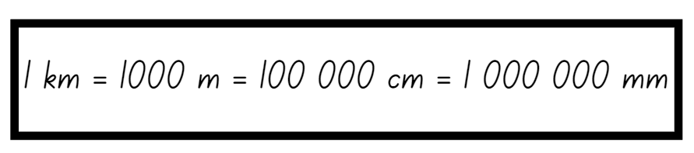
Short response (7)
Emma jogged 3.9 kilometres around the park, then walked
1890 metres to the nearby café and later cycled 410 000 centimetres to her friend’s house.
Which distance was the longest?
Explain your thinking.
Notes:
Short response questions provide brisk paced questions focussing on review of current and previous content to support spaced and interleaved practice.
Syllabus focus area:
Geometric Measure B

Slide 16
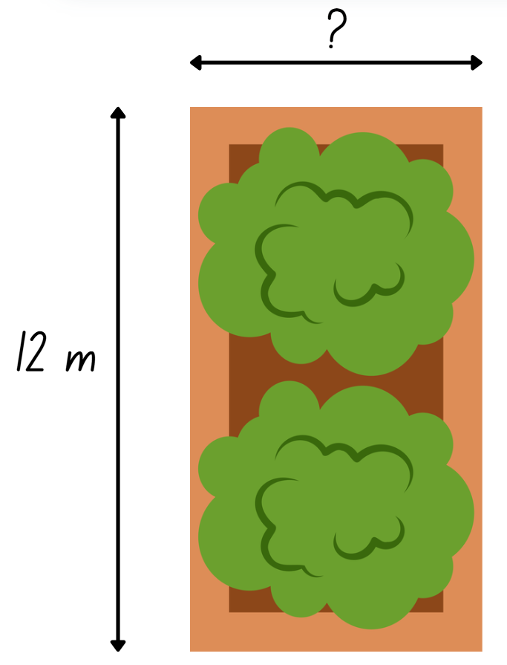
Short response (8)
The area of this garden bed is 72 m².
What is the missing length of the garden bed?
Communicate your reasoning.
Notes:
Short response questions provide brisk paced questions focussing on review of current and previous content to support spaced and interleaved practice.
Syllabus focus area:
Two-dimensional spatial structure A

Slide 17
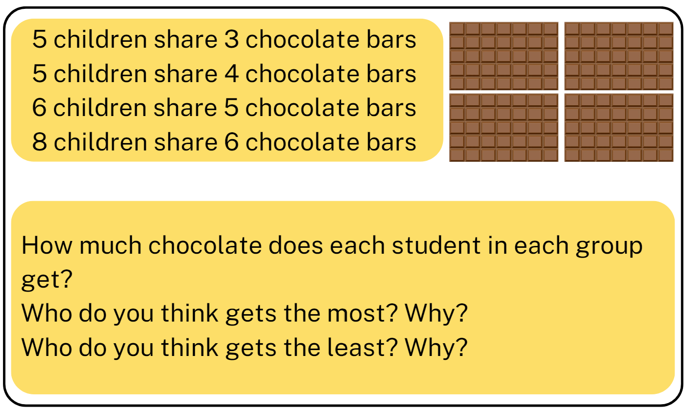
Activity 2 – division: fractions as sharing 2
Notes:
This is a developing number sense activity.
Number sense refers to a deep understanding of numbers, including their magnitude, relationships, and the effects of operations on them. It supports fluency and understanding, estimation, flexible thinking, and efficient problem-solving. Number sense activities 1–4 ‘activate’ prior number knowledge and support the learning of new content in the unit. Number sense activities 5–8 ‘loop’ back and provide opportunity for spaced practice with concepts and procedures covered in previous units.
Syllabus focus area:
Representing quantity fractions B
Division: fractions as sharing 2
This activity is an adaptation of Lamingtons from reSolve by Australian Government Department of Education.
This resource corresponds to Resource 31 – sharing chocolate in Stage 3 Year B Unit 25.
Explain that another class completed the chocolate bar sharing activity from Lesson 1. However, in this class, all 24 students participated. The first plate had 3 chocolates, the second had 4, the third had 5 and a fourth had 6. The 24 students came into their classroom one at a time and chose where to sit.
Ask students to work in pairs and use the fractions as division strategy shown in Lesson 1 to solve the questions. Encourage students to draw their solutions.
Select pairs to share their thinking.
Discuss student responses, asking question such as:
What was challenging about this task? Why?
Did all pairs have the same answers? Why or why not?

Slide 18
Review of learning 3

Slide 19
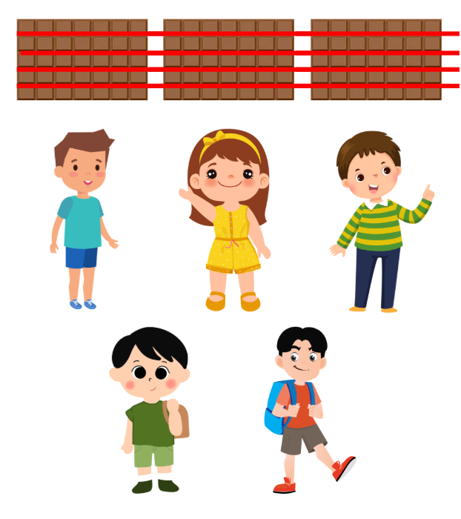
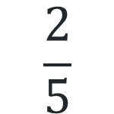
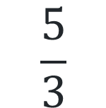
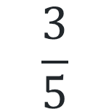
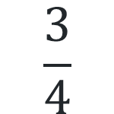
Multiple choice (2)
What fraction of chocolate would each child receive?
A
B
C
D
$$\frac{3}{4}$$
$$\frac{3}{5}$$
$$\frac{5}{3}$$
$$\frac{2}{5}$$
Notes:
This question connects to the content in the developing number sense activity (Activity 3)
Syllabus focus area:
Representing quantity fractions B

Slide 20
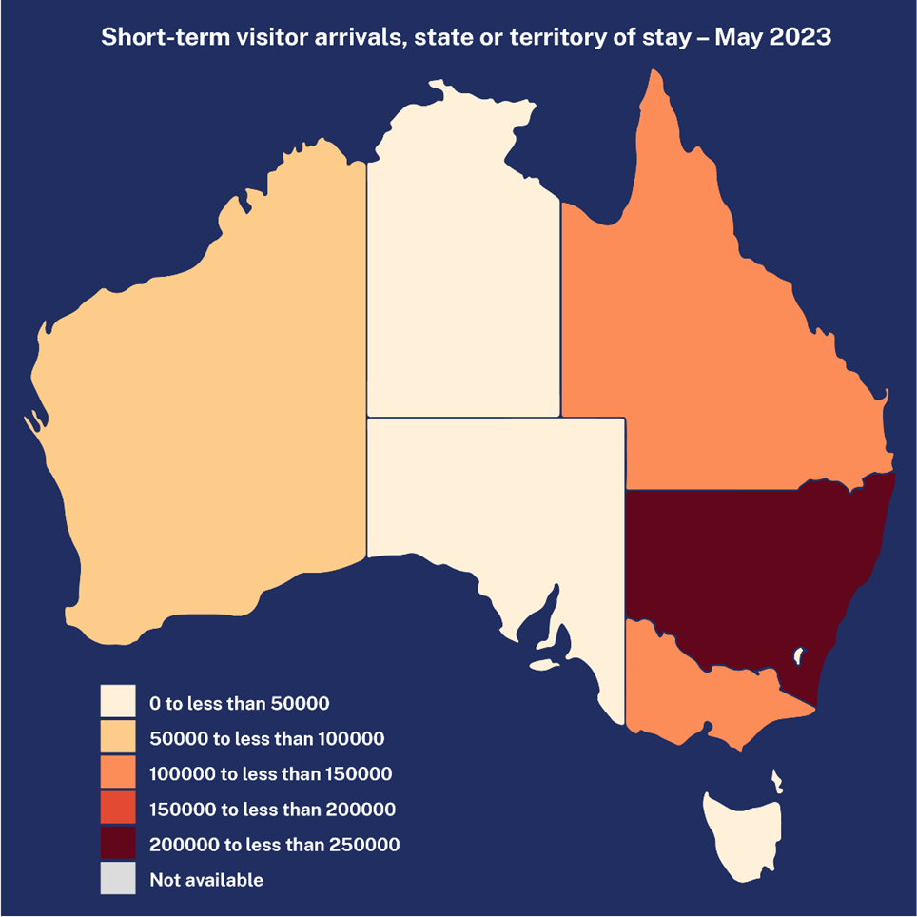
Short response (9)
Which state has the highest number of short-term visitors?
Which has the lowest number of short-term visitors?
Where might you see this type of data representation? ​
Notes:
Short response questions provide brisk paced questions focussing on review of current and previous content to support spaced and interleaved practice.
Syllabus focus area:
Data B

Slide 21
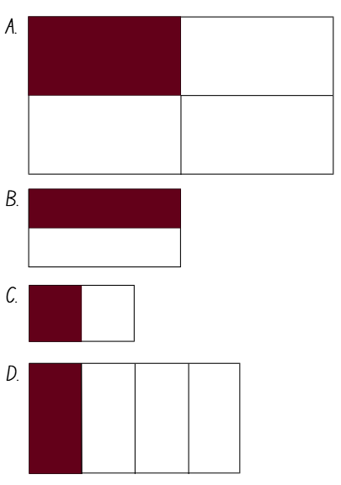
Short response (10)
Why do you need a common whole when comparing fractions?
Communicate your reasoning.
Notes:
Short response questions provide brisk paced questions focussing on review of current and previous content to support spaced and interleaved practice.
Syllabus focus area:
Representing quantity fractions A

Slide 22
Short response (11)
Cristian is looking for a walk that is about 4 kilometres.
Which walk is closest to that distance?
Length of walks | centimetres (cm) | metres (m) | kilometres (km)
Goanna Gap Walk | 870 000 cm |  | 8.7 km
Eagle Lookout Trail |  | 4278 m
Ironbark Ridge Walk | 395 000 cm
Communicate your thinking.
Notes:
Short response questions provide brisk paced questions focussing on review of current and previous content to support spaced and interleaved practice.
Syllabus focus area:
Geometric Measure B

Slide 23
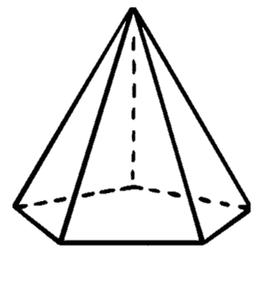
Short response (12)
Name this 3D object.
Describe 3 properties of the object
Notes:
Short response questions provide brisk paced questions focussing on review of current and previous content to support spaced and interleaved practice.
Syllabus focus area:
Three-dimensional spatial structure A

Slide 24
Activity 3 – fair shares with fractions 1
Consider how much each student would receive if the chocolate bars were shared equally across the groups.
Notes:
This is a developing number sense activity.
Number sense refers to a deep understanding of numbers, including their magnitude, relationships, and the effects of operations on them. It supports fluency and understanding, estimation, flexible thinking, and efficient problem-solving. Number sense activities 1–4 ‘activate’ prior number knowledge and support the learning of new content in the unit. Number sense activities 5–8 ‘loop’ back and provide opportunity for spaced practice with concepts and procedures covered in previous units.
Syllabus focus area:
Representing quantity fractions B
Fair shares with fractions 1
This activity is an adaptation of Lamingtons from reSolve by Australian Government Department of Education.
This resource corresponds to Resource 31 – sharing chocolate in Stage 3 Year B Unit .
Use Resource 31 – sharing chocolate to review the previous activity, reminding students that in the scenario students in the:
first group received 3 fifths.
second group received 4 fifths.
third group received 5 sixths.
fourth group received 6 eighths.
2. Ask students to consider how much each student would receive if the chocolate bars were shared equally across the groups.
Ask
How many students are there? 24.
How many chocolate bars are there? 18.
Is the strategy used in the previous lessons the best strategy? Why or why not? It is not the best strategy because it is impractical to cut chocolate bars into 24 pieces.
How are some suggested strategies similar and how are they different?
3. Demonstrate dividing 12 chocolate bars in half, giving 24 halves and therefore, each student one half. Divide the remaining 6 chocolate bars into quarters, giving 24 quarters and therefore, each student a further one quarter. Each student now receives one half plus one quarter.
Ask students:
Can you think of another way to write one half, one quarter and 3 quarters? How do you know?
Which group gets more using this method? The first group.
Which group gets less using this method? The second and third groups.
Which group gets the same using this method? The fourth group.

Slide 25
Review of learning 4

Slide 26
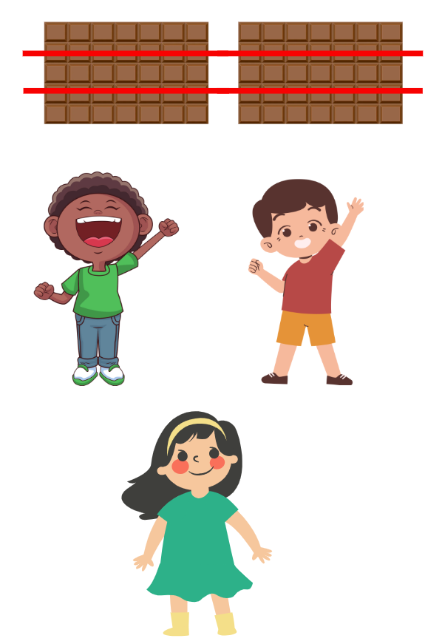
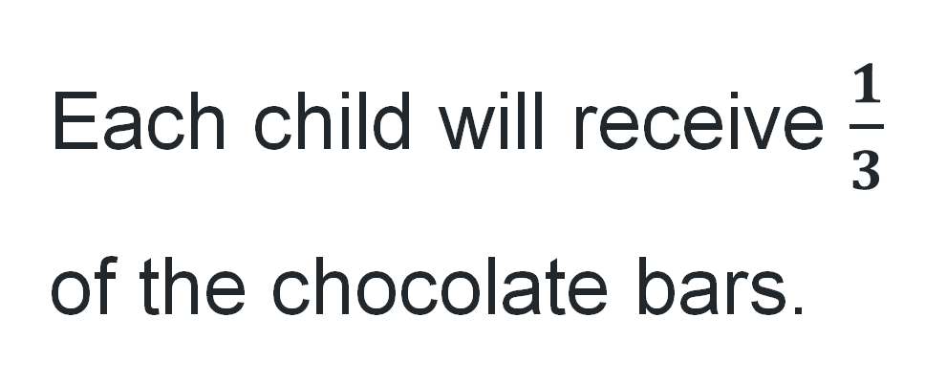
True or false (2)
Each child will receive $\frac{1}{3}$ of the chocolate bars.
True | False
Notes:
The question on this slide connects to the content being explored in the developing number sense activity (Activity 4)
Syllabus focus area:
Representing quantity fractions B

Slide 27
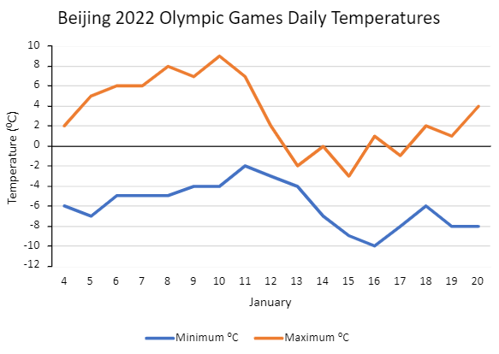
Short response (13)
What was the highest maximum temperature recorded?
What was the lowest minimum temperature recorded?
Notes:
Short response questions provide brisk paced questions focussing on review of current and previous content to support spaced and interleaved practice.
Syllabus focus area:
Data B

Slide 28

Short response (14)
What fraction of the whole shape is:
green?
blue?
pink?
orange and pink combined?
Notes:
Short response questions provide brisk paced questions focussing on review of current and previous content to support spaced and interleaved practice.
Syllabus focus area:
Representing quantity fractions B

Slide 29
Short response (15)
Bec measured the perimeter of a
basketball court as 87.78 m.
Sally measured the perimeter of a futsal field as 1760 cm.
Which has the largest perimeter?
Communicate your reasoning.
Notes:
Short response questions provide brisk paced questions focussing on review of current and previous content to support spaced and interleaved practice.
Syllabus focus area:
Geometric Measure B

Slide 30
Short response (16)
Convert the following times into 12-hour time:
09:45
13:15
19:20
Notes:
Short response questions provide brisk paced questions focussing on review of current and previous content to support spaced and interleaved practice.
Syllabus focus area:
Non spatial measure A

Slide 31
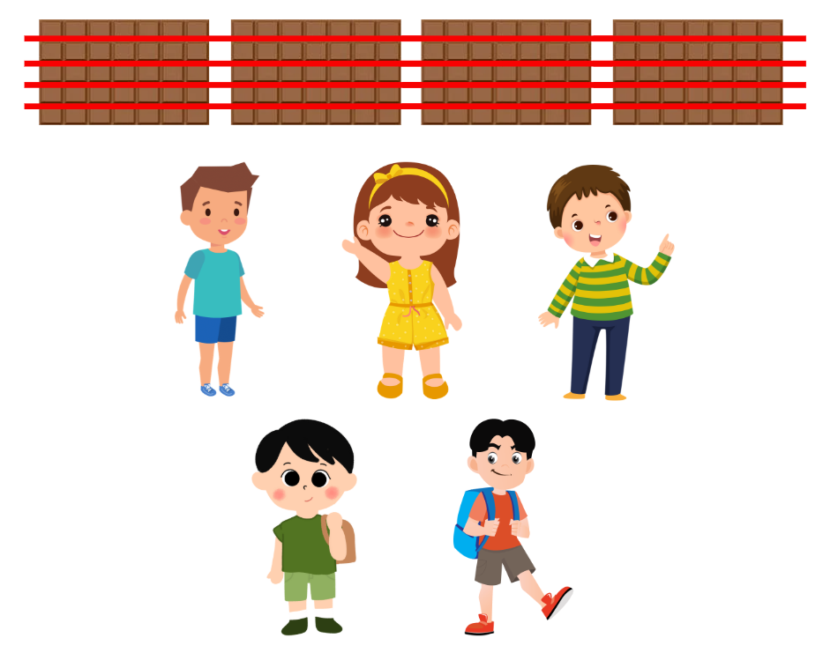
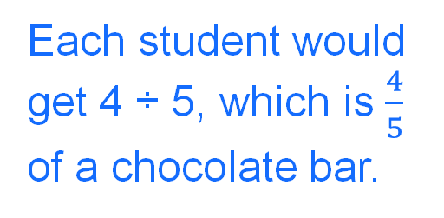
Activity 4 – fair shares with fractions 2
Create your own chocolate-sharing scenario. Include:
The total number of chocolate bars.
The total number of people.
A diagram or model to represent the sharing.
A fraction representing how much each person receives.
A reflection prompt: Is this a fair share? How do you know?
Example
Each student would get 4 ÷ 5, which is $\frac{4}{5}$ of a chocolate bar.
Notes:
This is a developing number sense activity.
Number sense refers to a deep understanding of numbers, including their magnitude, relationships, and the effects of operations on them. It supports fluency and understanding, estimation, flexible thinking, and efficient problem-solving. Number sense activities 1–4 ‘activate’ prior number knowledge and support the learning of new content in the unit. Number sense activities 5–8 ‘loop’ back and provide opportunity for spaced practice with concepts and procedures covered in previous units.
Syllabus focus area:
Representing quantity fractions B
Fair shares with fractions 2
This activity is an adaptation of Lamingtons from reSolve by Australian Government Department of Education.
Explain to students that they will be designing their own problem. Their task is to create their own chocolate-sharing scenario and work out how much each person would get.
Model the process. For example, there are 4 chocolate bars and 5 students. Each student would get 4 ÷ 5, which is four fifths of a chocolate bar. Show how this could be represented with a labelled diagram or drawing.
Ask student to use whiteboards to record their problem, including:
The total number of chocolate bars.
The total number of people.
A diagram or model to represent the sharing.
A fraction representing how much each person receives.
A reflection prompt: Is this a fair share? How do you know?
Students work in pairs to:
create and solve their own chocolate-sharing problem
represent their thinking using diagrams and fractions
justify their reasoning.

Slide 32
Review of learning 5

Slide 33

Multiple choice (3)
How do you write $\frac{1}{2}$ as a percentage?
A
B
C
D
12%
20%
75%
50%
Notes:
This question connects to the content in the developing number sense activity (Activity 5)
Syllabus focus area:
Represents numbers B

Slide 34
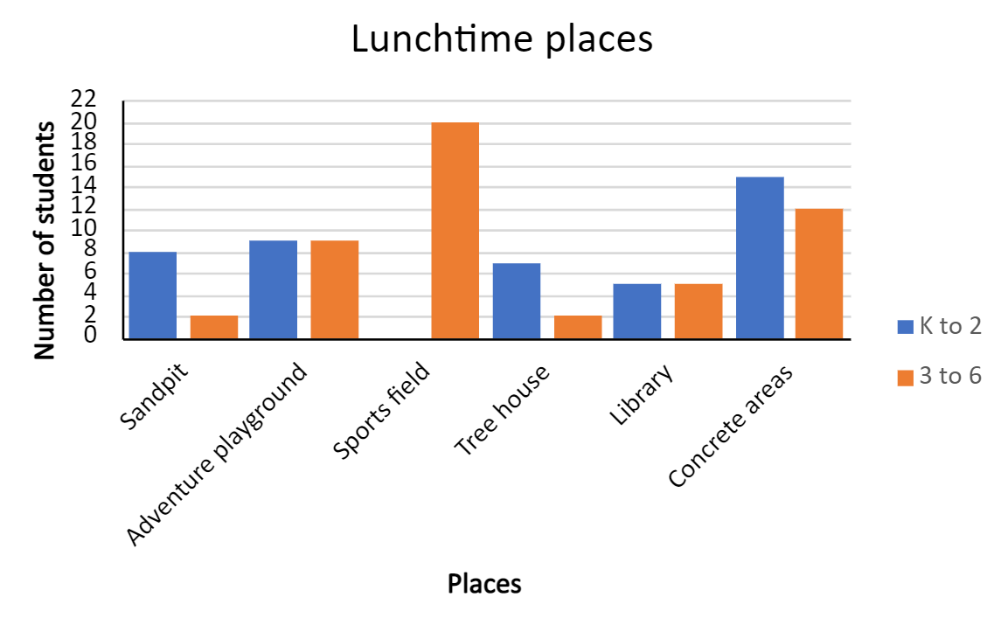
Short response (17)
What was the range of student responses for K-2?
What was the mode of student responses for 3-6?
Notes:
Short response questions provide brisk paced questions focussing on review of current and previous content to support spaced and interleaved practice.
Syllabus focus area:
Data B

Slide 35

Short response (18)
How many equal parts is the whole shape divided into?
How do you record one of these parts as a fraction?
Notes:
Short response questions provide brisk paced questions focussing on review of current and previous content to support spaced and interleaved practice.
Syllabus focus area:
Representing quantity fractions B

Slide 36
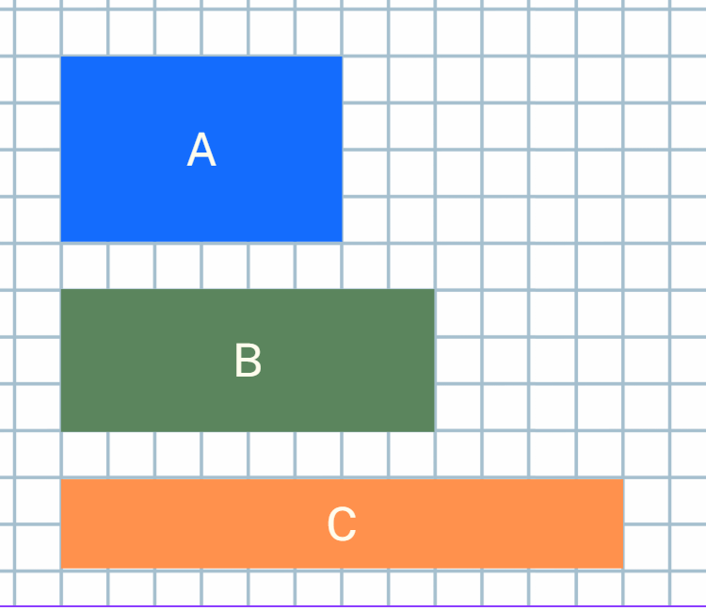
Short response (19)
Shape B:
Area = 24 cm²
Perimeter =
Shape C:
Area = 24 cm²
Perimeter =
Shape A:
Area = 24 cm²
Perimeter =
Do rectangles with the same area always have the same perimeter?
Communicate your thinking.
Notes:
Short response questions provide brisk paced questions focussing on review of current and previous content to support spaced and interleaved practice.
Syllabus focus area:
Geometric Measure B

Slide 37
Short response (20)
Which is heavier:
2000 g or 1.2 kg?
0.234 t or 35.9 kg?
Notes:
Short response questions provide brisk paced questions focussing on review of current and previous content to support spaced and interleaved practice.
Syllabus focus area:
Non spatial measure A

Slide 38



Activity 5 – fractions and percentages
What fractions can you see?
What is the same about all 3 stacks and what is different?
What percentage of each colour is in each stack?
What percentage can you see? How could this be written?
38
Notes:
Note: This slide is designed to be used in presentation mode to reveal stacks one at a time.
This is a developing number sense activity.
Number sense refers to a deep understanding of numbers, including their magnitude, relationships, and the effects of operations on them. It supports fluency and understanding, estimation, flexible thinking, and efficient problem-solving. Number sense activities 1–4 ‘activate’ prior number knowledge and support the learning of new content in the unit. Number sense activities 5–8 ‘loop’ back and provide opportunity for spaced practice with concepts and procedures covered in previous units.
Syllabus focus area:
Represents numbers B
Fractions and percentages
This activity is an adaptation of Simple fractions as percentages from NZ Maths by New Zealand Ministry of Education.
This resource corresponds to Figures 5 & 6 in Stage 3 Year B Unit 25.
Show students a stack of 2 interlocking cubes of different colours
Ask students what fractions can be seen (one half).
Ask students what percentage can be seen and how it could be written. (50%.)
Show students 2 other stacks of interlocking cubes that also represent 50% of each colour.
Ask students:
What is the same about all 3 stacks and what is different?
What percentage of each colour is in each stack? 50%.
How can it be 50% when there are different numbers in each stack? Remind students that 50% is equal to one half?
How many of each colour would there be if there were 100 cubes in total?
How could you show 25% of 100 interlocking cubes? Explain your thinking.
How could you show 10% of 100 cubes? Explain your thinking.
Distribute interlocking cubes and in small groups make stacks to show:
50%
25%
75%
10%
100%.
Select groups to share their stacks and ask:
How do you know that the percentage is correct?
Can you think of a fraction that is the same as the percentage?

Slide 39
Review of learning 6

Slide 40
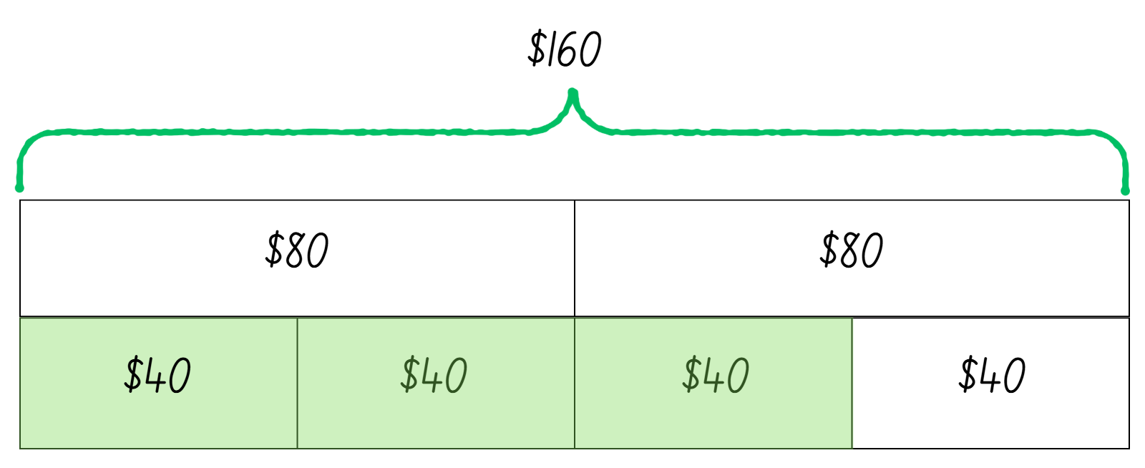
True or false (3)
75% of $160 is $40.
True | False
Notes:
The question on this slide connects to the content being explored in the developing number sense activity (Activity 6)
Syllabus focus area:
Represents numbers B

Slide 41
Short response (21)
Round these numbers to the nearest hundred thousand:
3 276 489
5 842 173
7 159 622
9 903 457
Notes:
Short response questions provide brisk paced questions focussing on review of current and previous content to support spaced and interleaved practice.
Syllabus focus area:
Represents numbers A

Slide 42
Short response (22)
My vegetable garden has produced 25 carrots.
If I sold one-fifth of them, how many did I sell?
Use a bar model to record the solution.
Notes:
Short response questions provide brisk paced questions focussing on review of current and previous content to support spaced and interleaved practice.
Syllabus focus area:
Representing quantity fractions B

Slide 43
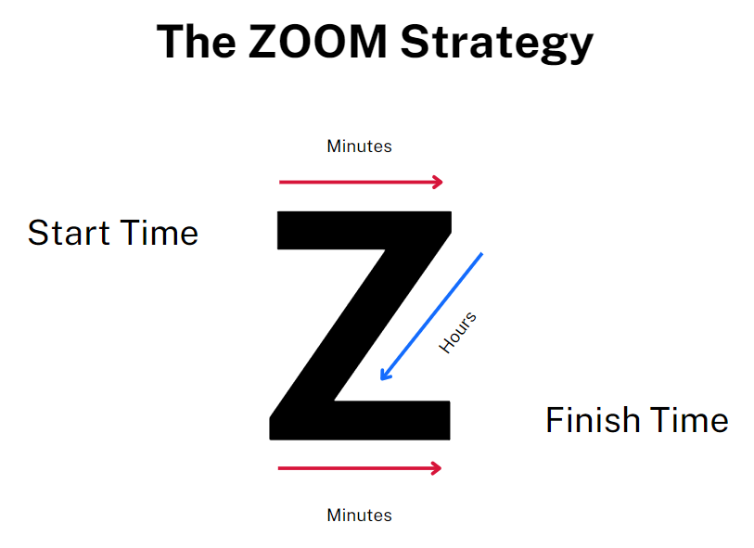
Short response (23)
Mel left home at 6.20 am and returned at 4:35 pm.
How much time has elapsed since she left home?
Notes:
Short response questions provide brisk paced questions focussing on review of current and previous content to support spaced and interleaved practice.
Syllabus focus area:
Non-Spatial Measure B

Slide 44
Short response (24)
Name and classify this 2D shape.
How many lines of symmetry does this shape have?
Communicate your thinking.
Notes:
Short response questions provide brisk paced questions focussing on review of current and previous content to support spaced and interleaved practice.
Syllabus focus area:
Two-dimensional spatial structure A

Slide 45
Activity 6 – percentages for comparisons
Remy scored 15 out of 20 on a mathematics test and 20 out of 25 on an English test. Remy said that she was better at English because she got more questions right than she did on the mathematics test. Her friend Ben said that Remy was equally good at mathematics and at English because she got 5 questions wrong in each test.
Who is correct? Use a double number line to check your answer.
Notes:
This is a developing number sense activity.
Number sense refers to a deep understanding of numbers, including their magnitude, relationships, and the effects of operations on them. It supports fluency and understanding, estimation, flexible thinking, and efficient problem-solving. Number sense activities 1–4 ‘activate’ prior number knowledge and support the learning of new content in the unit. Number sense activities 5–8 ‘loop’ back and provide opportunity for spaced practice with concepts and procedures covered in previous units.
Syllabus focus area:
Represents numbers B
Percentages for comparisons
This activity is an adaptation of ‘Best At?’ from A Practical Guide to Transforming Primary Mathematics: Activities and tasks that really work by Askew.
This resource corresponds Figure 6 – example double number line in Stage 3 Year B Unit 25.
Select students to share and explain their thinking.
Explain that students can check their answer by using a double number line.
Demonstrate drawing a double number line to represent the mathematics test. Explain that it has a scale of 0–20 on the top and from 0% to 100% on the bottom. Ask students to assist by adding the benchmark percentages on the bottom, such as 50%, 25%, 75% and 10%, then adding the corresponding score on the top, such as 10, 5, 15 and 2.
Identify and record Remy’s mathematics score and corresponding percentage on the number line.
In pairs, students use the same method to draw a double number line to represent the English test and identify and record Remy’s score. Explain that students will need to mark 10%, then the other percentage multiples of 10 can be added.
Select students to share their thinking and explain which test result is higher.

Slide 46
Review of learning 7

Slide 47

Multiple choice (4)
How do you write $\frac{4}{5}$ as a percentage?
A
B
C
D
40%
80%
50%
45%
Notes:
This question connects to the content in the developing number sense activity (Activity 7)
Syllabus focus area:
Represents numbers B

Slide 48
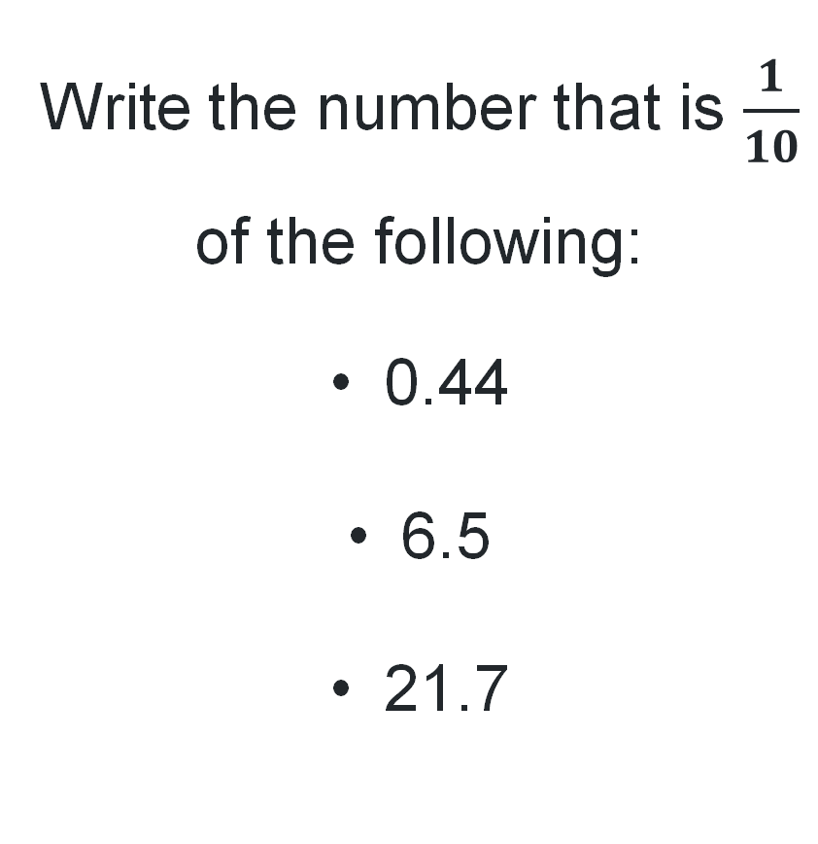
Short response (25)
Write the number that is $\frac{1}{10}$ of the following:
0.44
6.5
21.7
Write the number that is 10 times:
0.8
1.3
3.62
Notes:
Short response questions provide brisk paced questions focussing on review of current and previous content to support spaced and interleaved practice.
Syllabus focus area:
Represents numbers A

Slide 49
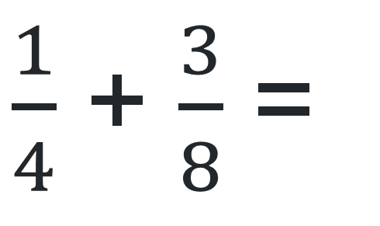
Short response (26)
Use a fraction strip to record the solution to:
$\frac{1}{4}$ + $\frac{3}{8}$ =
Notes:
Short response questions provide brisk paced questions focussing on review of current and previous content to support spaced and interleaved practice.
Syllabus focus area:
Representing quantity fractions B

Slide 50
Short response (27)
What time does PD/H/PE start on a Wednesday?
Which subject finishes at 14:00 on a Tuesday?
12-hour | 24-hour | Monday | Tuesday | Wednesday | Thursday | Friday
8:30 am | 08:30
9:00 am | 09:00 | English | English | English | PD/H/PE | Sport
9:30 am | 09:30 | English | English | English | PD/H/PE | Sport
10:00 am | 10:00 | English | English | English | English | English
10:30 am | 10:30 | English | English | English | English | English
11:00 am | 11:00 | Recess | Recess | Recess | Recess | Recess
11:30 am | 11:30 | Maths | Maths | Maths | Maths | Maths
12:00 pm | 12:00 | Maths | Maths | Maths | Maths | Maths
12:30 pm | 12:30 | Maths | Maths | Maths | Maths | Maths
1:00 pm | 13:00 | Lunch | Lunch | Lunch | Lunch | Lunch
1:30 pm | 13:30 | HSIE | HSIE | Creative arts | Creative arts | Science
2:00 pm | 14:00 | HSIE | Library | PD/H/PE | Creative arts | Science
2:30 pm | 14:30 | HSIE | Assembly | PD/H/PE | Creative arts | Science
3:00 pm | 15:00
Notes:
Short response questions provide brisk paced questions focussing on review of current and previous content to support spaced and interleaved practice.
Syllabus focus area:
Non-Spatial Measure A

Slide 51
Short response (28)
Elyssa’s tap leaks 200 mL per hour.
How many millilitres have leaked after 8 hours?
How many litres have leaked after 8 hours?
Notes:
Short response questions provide brisk paced questions focussing on review of current and previous content to support spaced and interleaved practice.
Syllabus focus area:
Three-dimensional spatial structure A

Slide 52
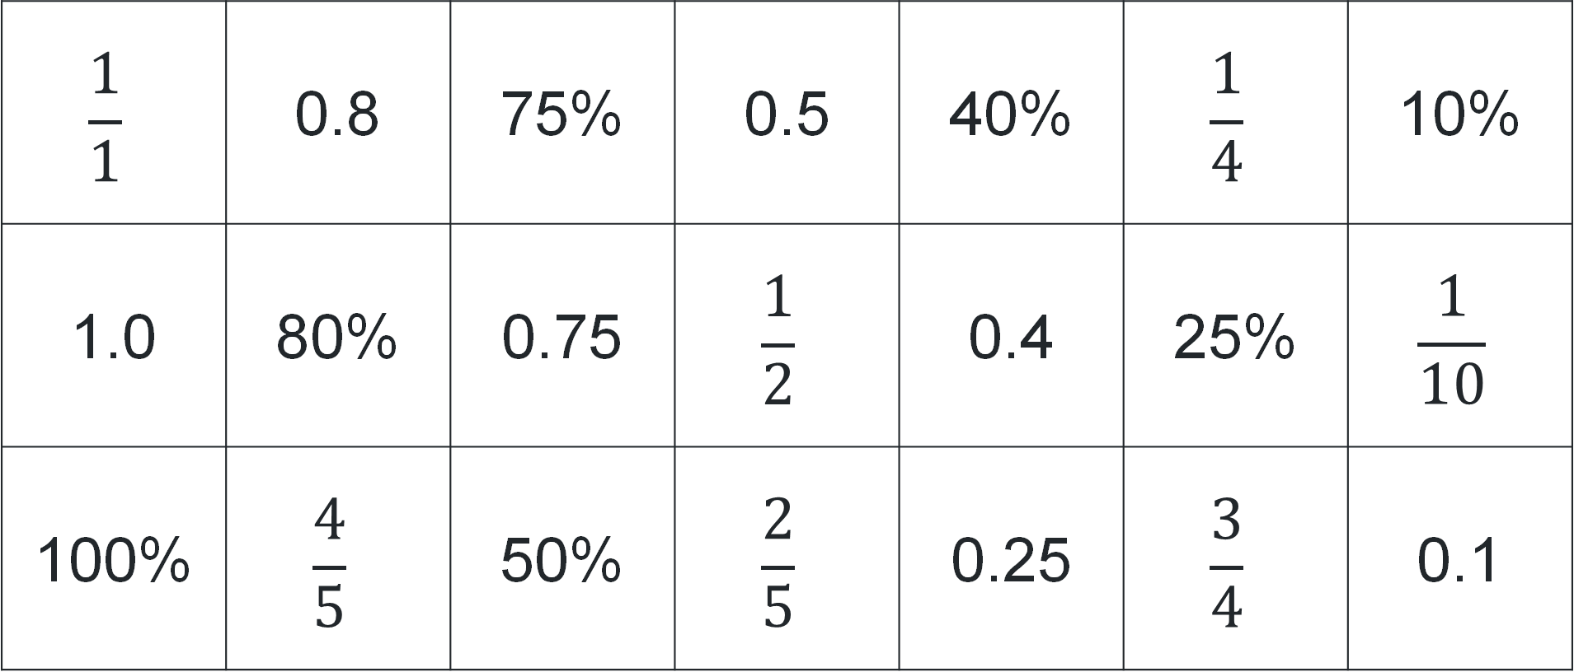
Activity 7 – equivalent percentages, fractions and decimals 1
$$\frac{1}{1}$$ | 0.8 | 75% | 0.5 | 40% | $$\frac{1}{4}$$ | 10%
1.0 | 80% | 0.75 | $$\frac{1}{2}$$ | 0.4 | 25% | $$\frac{1}{10}$$
100% | $$\frac{4}{5}$$ | 50% | $$\frac{2}{5}$$ | 0.25 | $$\frac{3}{4}$$ | 0.1
Notes:
This is a developing number sense activity.
Number sense refers to a deep understanding of numbers, including their magnitude, relationships, and the effects of operations on them. It supports fluency and understanding, estimation, flexible thinking, and efficient problem-solving. Number sense activities 1–4 ‘activate’ prior number knowledge and support the learning of new content in the unit. Number sense activities 5–8 ‘loop’ back and provide opportunity for spaced practice with concepts and procedures covered in previous units.
Syllabus focus area:
Represents numbers B
Activity title
This resource corresponds to Resource 32 – percentage match in Stage 3 Year B Unit 25.
Distribute the matching cards from Resource 32– percentage match to small groups of students.
Explain that students are playing a memory-style game to find and collect matching trios.
The rules are:
Shuffle all cards and place them face down in a grid.
Players take turns flipping over 3 cards to try to find a matching trio.
If a player finds a correct trio, they keep the cards and have another turn.
If the cards do not match, they are flipped back over in the same positions, and the next player takes a turn.
The game continues until all cards have been matched.
The player with the most trios at the end is the winner.
Reflect on the activity, asking questions such as:
Which matches were the hardest to find? Why?
Which matches were the easiest to find? Why?
Were there any you weren’t sure about? How did you work them out?
What strategies helped you remember where certain cards were?
How could this game help you in recognising equivalent fractions, decimals and percentages?

Slide 53
Review of learning 8

Slide 54
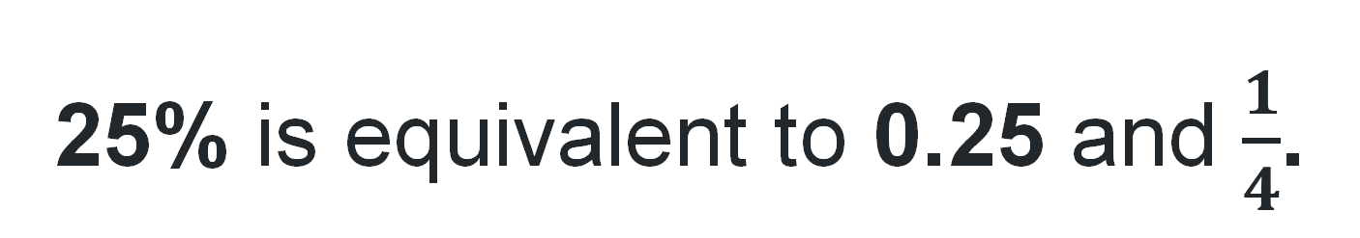
True or false (4)
25% is equivalent to 0.25 and $\frac{1}{4}$.
True | False
Notes:
The question on this slide connects to the content being explored in the developing number sense activity (Activity 8)
Syllabus focus area:
Represents numbers B

Slide 55
Short response (29)
Draw a number line and mark the following decimals:
1.609
1.80
1.021
Notes:
Short response questions provide brisk paced questions focussing on review of current and previous content to support spaced and interleaved practice.
Syllabus focus area:
Represents numbers A

Slide 56
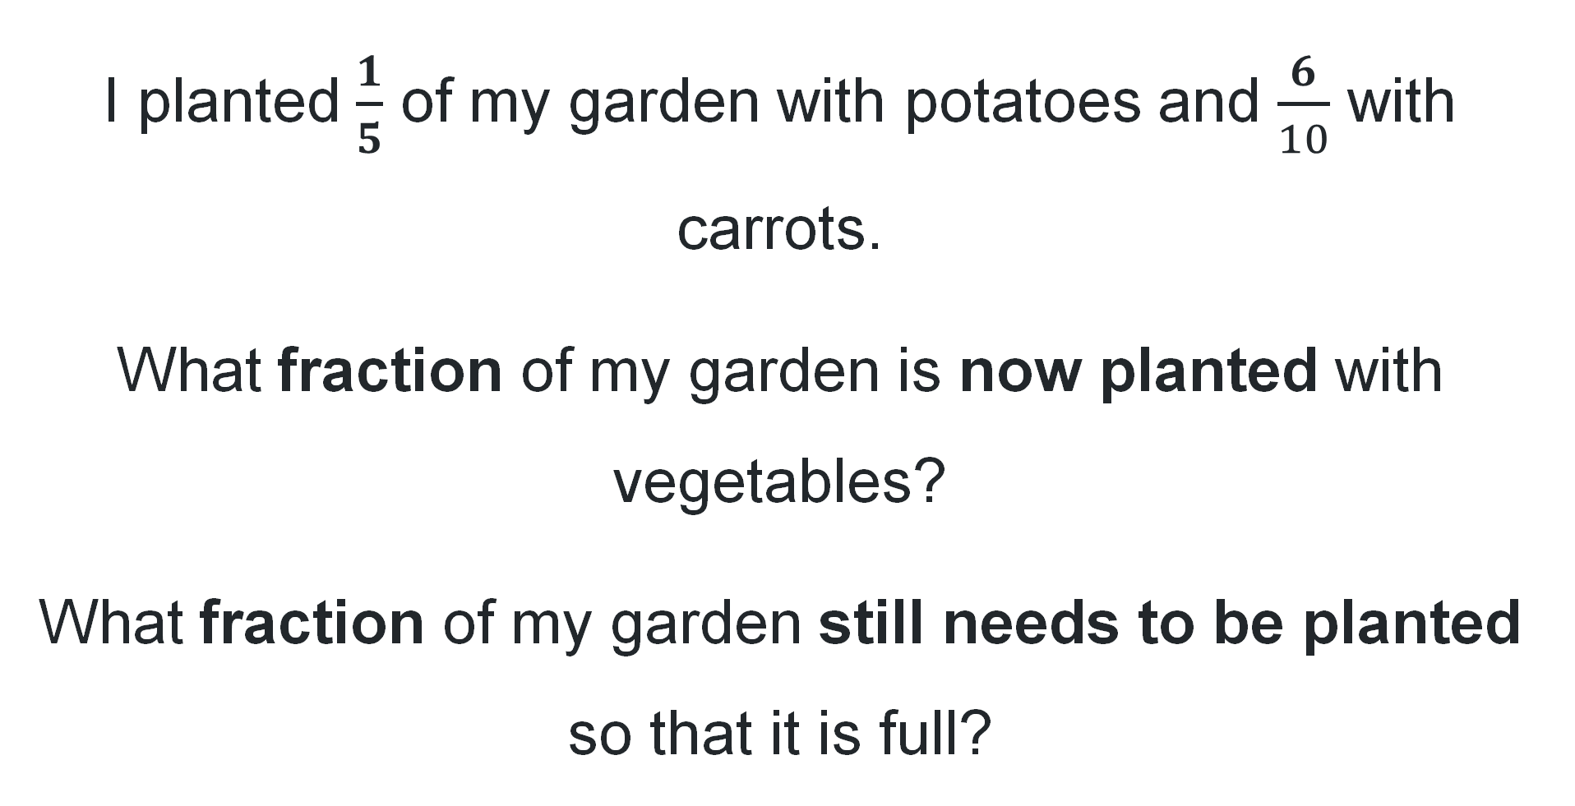
Short response (30)
I planted $\frac{1}{5}$ of my garden with potatoes and $\frac{6}{10}$ with carrots.
What fraction of my garden is now planted with vegetables?
What fraction of my garden still needs to be planted so that it is full?
Notes:
Short response questions provide brisk paced questions focussing on review of current and previous content to support spaced and interleaved practice.
Syllabus focus area:
Representing quantity fractions B

Slide 57
Short response (31)
Convert the following times into 24-hour time.
5:45 am
8:15 pm
1:40 pm
11:30 am
Notes:
Short response questions provide brisk paced questions focussing on review of current and previous content to support spaced and interleaved practice.
Syllabus focus area:
Non-Spatial Measure A

Slide 58
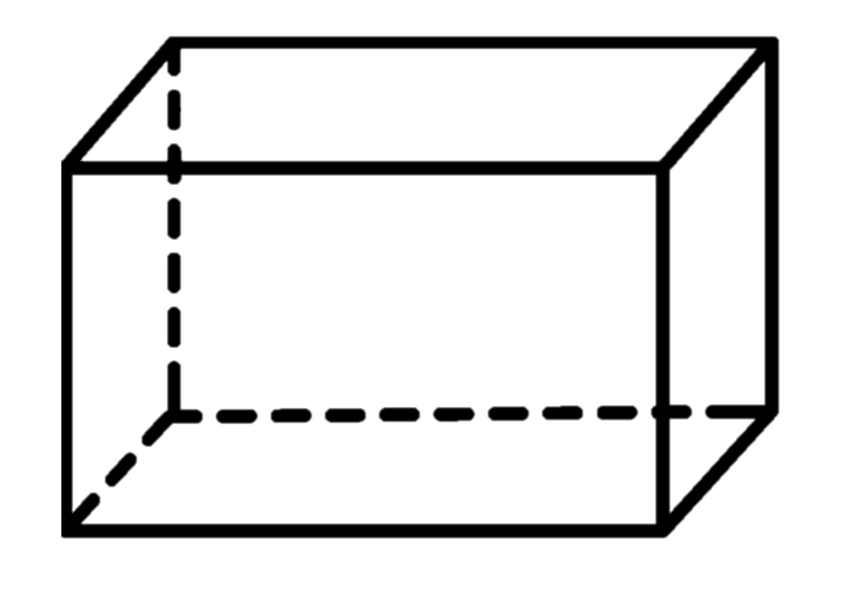
Short response (32)
Name the 3D object.
Describe 3 properties of this object.
Notes:
Short response questions provide brisk paced questions focussing on review of current and previous content to support spaced and interleaved practice.
Syllabus focus area:
Three-dimensional spatial structure A

Slide 59
Activity 8 – equivalent percentages, fractions and decimals 2
Example dominoes in a doughnut
1
10
1
100%
4
80%
10%
0.8
25%
Notes:
This is a developing number sense activity.
Number sense refers to a deep understanding of numbers, including their magnitude, relationships, and the effects of operations on them. It supports fluency and understanding, estimation, flexible thinking, and efficient problem-solving. Number sense activities 1–4 ‘activate’ prior number knowledge and support the learning of new content in the unit. Number sense activities 5–8 ‘loop’ back and provide opportunity for spaced practice with concepts and procedures covered in previous units.
Syllabus focus area:
Represents numbers B
Activity title
This activity is an adaptation of Doughnut Percents from NRICH by University of Cambridge.
This resource corresponds to Resource 33 – doughnut percents in Stage 3 Year B Unit 25.
Distribute the 8 domino cards from Resource 33 – doughnut percents to pairs of students so that each student has 4 dominoes.
Explain that each student must end up with a set of 4 dominoes arranged to form a ‘doughnut’, where touching ends have equal value
Explain that the rules are designed to encourage teamwork. The rules are:
Each player starts with 4 dominoes in front of them.
The dominoes in front of each person should be visible to both players.
Players pass dominoes to their partner to help each other complete their doughnut.
Team members can only give dominoes; they cannot take dominoes from someone else.
Each team member must always have at least 2 dominoes in front of them.
No one can talk or give non-verbal signals to other members of the team.
Reflect on the activity, asking questions such as:
Which domino ends were the hardest to match? Why?
Were there any that you didn’t know? Were you still able to match them? What strategy did you use?
Which domino ends were the easiest to match? Why?
Would you change anything about this activity? Why or why not?

Slide 60
Double Venn diagram
Object 1
Object 2
Features similar to both objects
Features of object 1
Features of object 2

Slide 61
Frayer
Definition
Facts/Characteristics
Word, term, concept
Examples
Non-examples

Slide 62
Spider map
Idea
Subject

Slide 63
Cline
Concept 1
Concept 2
Word
Word
Word
Word
Word
Word
Word
Word
Word
Word
Word

Slide 64

Compare and contrast

Slide 65
Multiple choice (5)
A
B
C
D

Slide 66
Multiple choice (6)
A
B
C
D

Slide 67
References
This presentation contains NSW Curriculum and syllabus content. The NSW Curriculum is developed by the NSW Education Standards Authority. This content is prepared by NESA for and on behalf of the Crown in the right of the State of New South Wales. The material is protected by Crown copyright.
Please refer to the NESA Copyright Disclaimer for more information https://educationstandards.nsw.edu.au/wps/portal/nesa/mini-footer/copyright.
NESA holds the only official and up-to-date versions of the NSW Curriculum and syllabus documents. Please visit the NSW Education Standards Authority (NESA) website https://educationstandards.nsw.edu.au/wps/portal/nesa/home and the NSW Curriculum website https://curriculum.nsw.edu.au.
Mathematics K–10 Syllabus © NSW Education Standards Authority (NESA) for and on behalf of the Crown in right of the State of New South Wales, 2022.
National Numeracy Learning Progression © Australian Curriculum, Assessment and Reporting Authority (ACARA) 2010 to present, unless otherwise indicated. This material was downloaded from the Australian Curriculum website (National Numeracy Learning Progression) (accessed 25 July 2025) and was not modified.
NSW Education Standards Authority (NESA) (2022a) ‘Teaching advice for Data A’, Stage 3, NSW Curriculum website, accessed 15 October 2025.
——(2022b) ‘Teaching advice for Data B’, Stage 3, NSW Curriculum website, accessed 15 October 2025.

Slide 68
References 2
This presentation contains NSW Curriculum and syllabus content. The NSW Curriculum is developed by the NSW Education Standards Authority. This content is prepared by NESA for and on behalf of the Crown in the right of the State of New South Wales. The material is protected by Crown copyright.
Please refer to the NESA Copyright Disclaimer for more information https://educationstandards.nsw.edu.au/wps/portal/nesa/mini-footer/copyright.
NESA holds the only official and up-to-date versions of the NSW Curriculum and syllabus documents. Please visit the NSW Education Standards Authority (NESA) website https://educationstandards.nsw.edu.au/wps/portal/nesa/home and the NSW Curriculum website https://curriculum.nsw.edu.au.
Askew M (2016) A Practical Guide to Transforming Primary Mathematics: Activities and tasks that really work, 1st edn, Routledge, UK.
ABS (Australian Bureau of Statistics) (2023) Overseas Arrivals and Departures, Australia [dataset], ABS website, accessed 3 July 2023.
Australian Academy of Science (2020) ‘Lamingtons’, Classic sequences for AC V8.4, reSolve website, accessed 27 June 2023.
New Zealand Ministry of Education (n.d.) ‘Simple fractions as percentages’, Mathematics and Statistics Resources, Tāhūrangi - New Zealand Curriculum website, accessed 28 June 2023.
University of Cambridge (n.d.) Doughnut percents, NRICH website, accessed 28 June 2023.

Slide 69
Copyright
© State of New South Wales (Department of Education), 2025
The copyright material published in this resource is subject to the Copyright Act 1968 (Cth) and is owned by the NSW Department of Education or, where indicated, by a party other than the NSW Department of Education (third-party material).
Copyright material available in this resource and owned by the NSW Department of Education is licensed under a Creative Commons Attribution 4.0 International (CC BY 4.0) license.
This license allows you to share and adapt the material for any purpose, even commercially.
Attribution should be given to © State of New South Wales (Department of Education), 2025.
Material in this resource not available under a Creative Commons license:
the NSW Department of Education logo, other logos and trademark-protected material
Material owned by a third party that has been reproduced with permission. You will need to obtain permission from the third party to reuse its material.
Links to third-party material and websites
Please note that the provided (reading/viewing material/list/links/texts) are a suggestion only and implies no endorsement, by the New South Wales Department of Education, of any author, publisher, or book title. School principals and teachers are best placed to assess the suitability of resources that would complement the curriculum and reflect the needs and interests of their students.
If you use the links provided in this document to access a third party’s website, you acknowledge that the terms of use, including licence terms set out on the third-party’s website apply to the use which may be made of the materials on that third-party website or where permitted by the Copyright Act 1968 (Cth). The department accepts no responsibility for content on third-party websites.

