Slide 1
Instructions for use
This resource is not a teaching and learning program. It should be used in conjunction with Stage 3 Year B Unit 26.
Classroom teachers are encouraged to add and adapt slides as required to meet the needs of their students.
Save a copy of the file to make changes to the slide deck. Go to File > Download a Copy (this downloads a copy to the computer to edit in the PowerPoint app).
To convert the PowerPoint to Google Slides:
  Upload the file into Google Drive and open it.
  Go to File > Save as Google Slides.
  (Note – conversion may cause formatting changes in the slides.)

Slide 2

Review of Learning
Mathematics Stage 3 – Unit 26
Notes:
Reviews may include a combination of question types, requiring students to recall facts and key ideas, as well as apply their knowledge to solve problems and answer questions. To support active engagement, a mix of techniques should be employed.” (AERO, 2024).
This Review of Learning slide deck revisits key concepts from the following units:
Stage 3 Year B Unit 26
Stage 3 Year B Unit 25
Stage 3 Year B Unit 24
It also includes opportunities to review prior learning in non-number content, supporting consolidation across focus areas.
The review of learning resources include three key task types that support the development of mathematical proficiency through retrieval, spaced practice, and active participation. These practices complement the review phase (activating prior knowledge) embedded within the beginning of each lesson.
1.
Multiple-choice questions/True or false: Designed to promote active retrieval of key concepts and identify common misconceptions in number, supporting consolidation, understanding and fluency.
These questions:
support spaced and interleaved practice
help identify and address common misconceptions
support active recall and immediate feedback
support whole class participation
identify areas requiring reteach
2.
Short-response question sets: Carefully grouped questions that encourage spaced and interleaved practice across multiple focus areas, helping students revisit and apply knowledge from different points in time.
These questions:
have a combination of question types
address a range of focus areas
build automaticity and fluency
support active recall
allow for immediate feedback
identify content requiring reteach
3.
Developing number sense activities: A variety of practical, purposeful tasks that reinforce current learning and build on prior knowledge. These activities promote reasoning, problem-solving and conceptual understanding.
The review of learning resources are designed to work support teaching and learning in mathematics. For the most effective implementation, use the resources flexibly, adapting to meet student learning needs and individual classroom contexts.

Slide 3
Lessons
1
Review of learning 1
5
Review of learning 5
2
Review of learning 2
6
Review of learning 6
3
Review of learning 3
7
Review of learning 7
4
Review of learning 4
8
Review of learning 8
Notes:
Teacher notes:
Click lesson numbers to go to specific lessons
Interactive features can be viewed in slide show

Slide 4
Review of learning 1

Slide 5

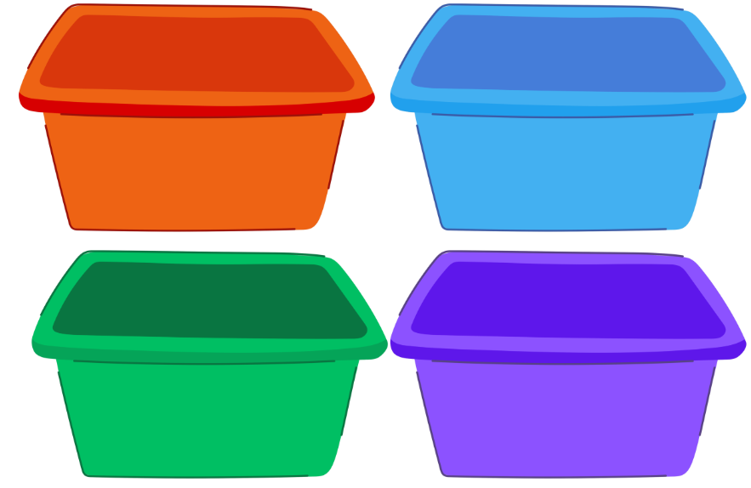
Multiple choice (1)
I am sorting 75 toy cars into 4 coloured boxes. The purple box has twice as many as the blue box. Which of the following could be correct? You may select more than one answer.
A
orange 22, blue 10, green 23, purple 20
B
orange 20, blue 15, green 12, purple 28
C
orange 25, blue 13, green 15, purple 22
D
orange 19, blue 15, green 11, purple 30
Notes:
This question connects to the content in the developing number sense activity (Activity 1)
Syllabus focus area:
Additive relations B

Slide 6

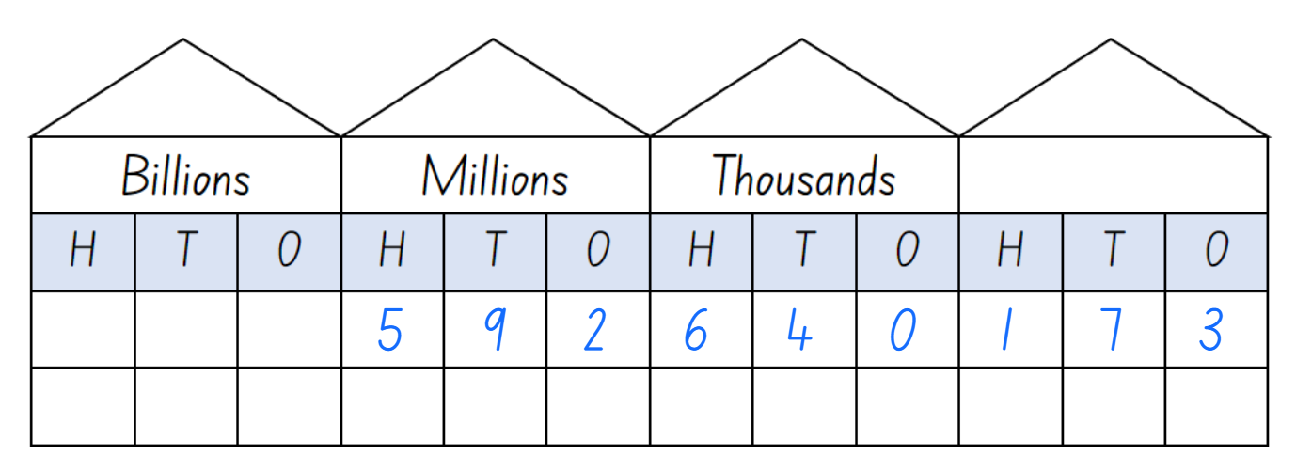
Short response (1)
In non-standard partitioning, record how many:
tens
hundred thousands
millions
Notes:
Short response questions provide brisk paced questions focussing on review of current and previous content to support spaced and interleaved practice.
Syllabus focus area:
Represents numbers A

Slide 7
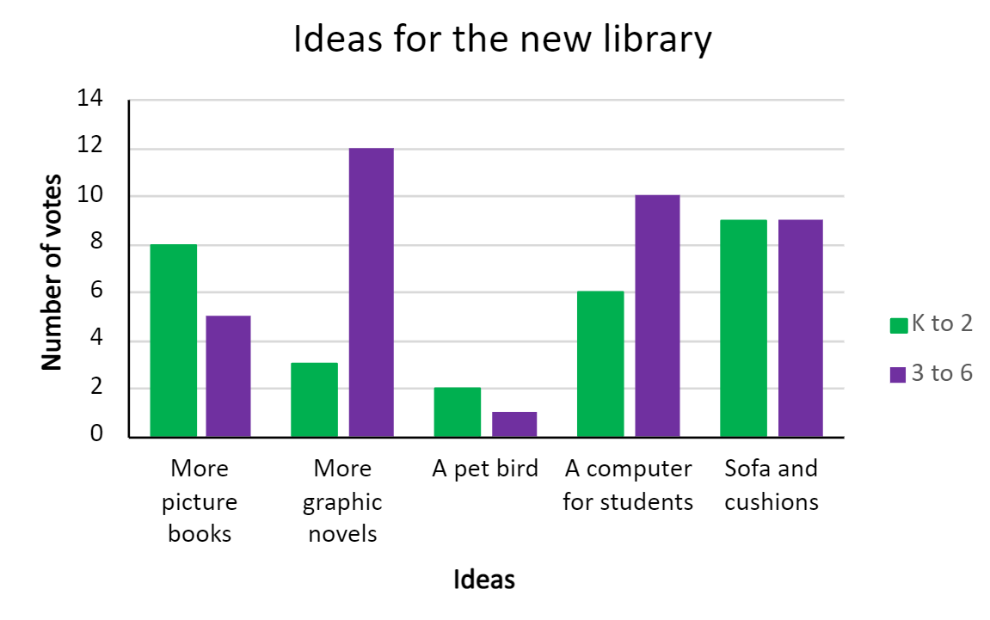
Short response (2)
What is the mode for K-2 ?
What is the mode for 3-6 students?
Notes:
Short response questions provide brisk paced questions focussing on review of current and previous content to support spaced and interleaved practice.
Syllabus focus area:
Data B

Slide 8
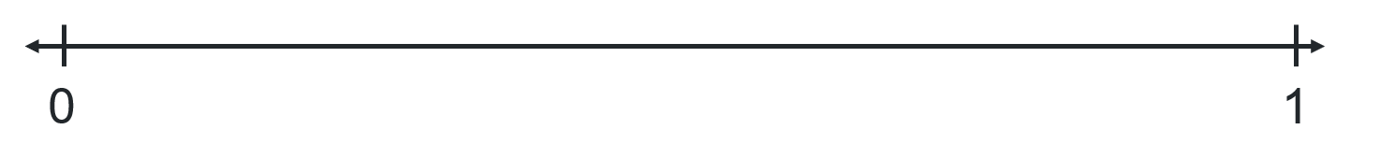
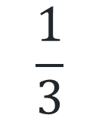
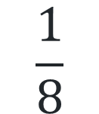
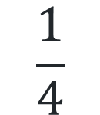
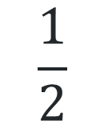
Short response (3)
Draw an empty number line starting at 0 and ending at 1.
Mark the following unit fractions on the number line:
$$\frac{1}{2}$$
$$\frac{1}{4}$$
$$\frac{1}{8}$$
$$\frac{1}{3}$$
Notes:
Short response questions provide brisk paced questions focussing on review of current and previous content to support spaced and interleaved practice.
Syllabus focus area:
Representing quantity fractions A

Slide 9
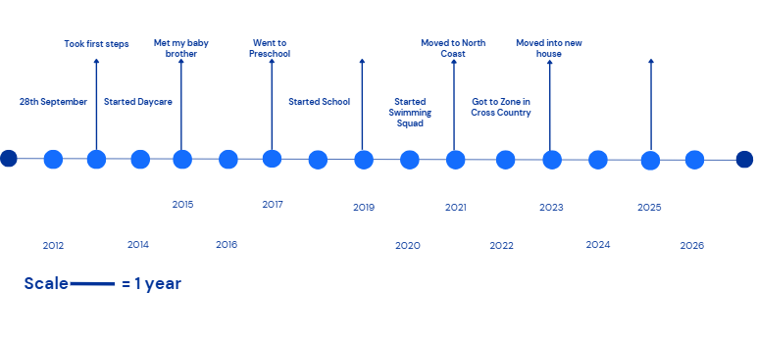
Short response (4)
Using the scale, record the years for the following events:
Moved into a new house.
Met my baby brother.
Got to Zone in Cross Country.
Notes:
Short response questions provide brisk paced questions focussing on review of current and previous content to support spaced and interleaved practice.
Syllabus focus area:
Data B

Slide 10

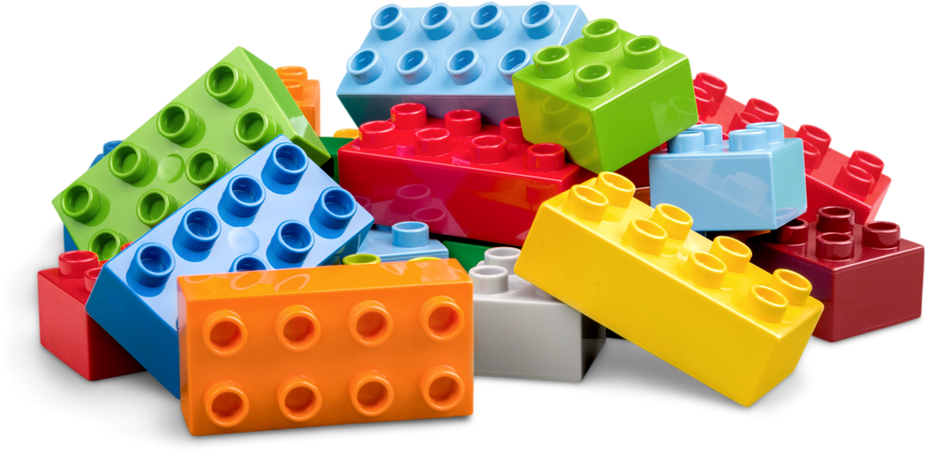
Activity 1 – four piles
Place 100 objects into 4 piles so that:
The first pile has 15 more than the third pile.
The third pile has 5 more than pile 2.
Pile 4 has twice as many as pile 2.
Notes:
This is a developing number sense activity.
Number sense refers to a deep understanding of numbers, including their magnitude, relationships, and the effects of operations on them. It supports fluency and understanding, estimation, flexible thinking, and efficient problem-solving. Number sense activities 1–4 ‘activate’ prior number knowledge and support the learning of new content in the unit. Number sense activities 5–8 ‘loop’ back and provide opportunity for spaced practice with concepts and procedures covered in previous units.
Syllabus focus area:
Additive relations B
Four piles
This activity is an adaptation of ‘Task 3 – Four Piles Problem’ from 3-6 – Remote Maths – Edition 9 by Mathematical Association of Victoria.
This resource corresponds to Resource 30 – four piles in Stage 3 Year B Unit 26.
Students work independently or in pairs, using one set of 100 objects.
Students distribute the 100 objects by following the instructions on Resource 27 – four piles, recording their working on a whiteboard.
When they have solved the problem, students share their ideas with another student or group, justifying their reasoning.
Ask students to make their own problem for a partner to solve.

Slide 11
Review of learning 2

Slide 12
True or false (1)
836 + 1984 + 92
This number sentence accurately represents the following word problem:
Brian is getting a new kitchen in his home. So far, he has paid $1984 for the builder, $836 on a new oven and $92 on a kettle.
True | False
Notes:
The question on this slide connects to the content being explored in the developing number sense activity (Activity 2)
Syllabus focus area:
Additive relations B

Slide 13
Short response (5)
Round this number to the nearest million:
274 896 173
Notes:
Short response questions provide brisk paced questions focussing on review of current and previous content to support spaced and interleaved practice.
Syllabus focus area:
Represents numbers A

Slide 14
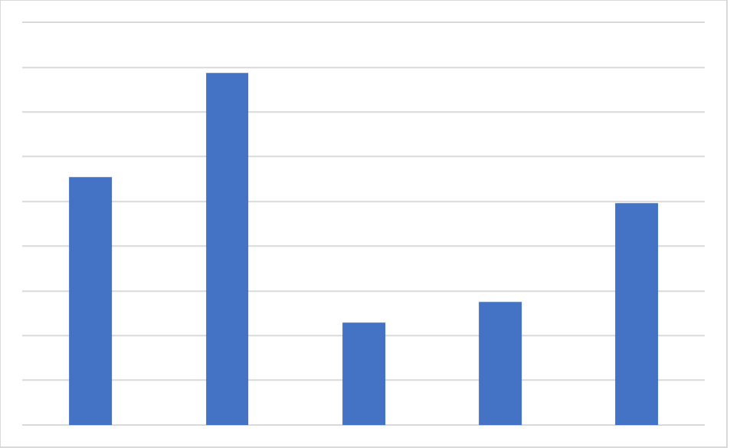
Short response (6)
What information could be added to interpret this column graph?
Notes:
Short response questions provide brisk paced questions focussing on review of current and previous content to support spaced and interleaved practice.
Syllabus focus area:
Data B

Slide 15
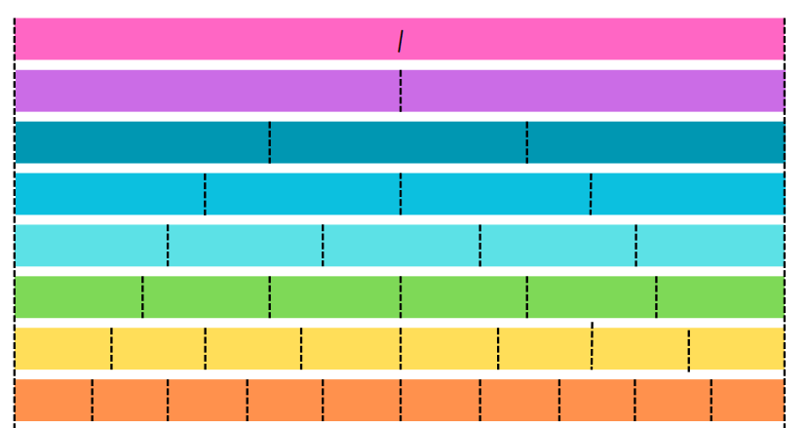
Short response (7)
Record the equivalent fractions for half in:
quarters, eighths, sixths and tenths.
Notes:
Short response questions provide brisk paced questions focussing on review of current and previous content to support spaced and interleaved practice.
Syllabus focus area:
Representing quantity fractions B

Slide 16

Short response (8)
How could you prove this is an equilateral triangle?
Communicate your thinking.
Notes:
Short response questions provide brisk paced questions focussing on review of current and previous content to support spaced and interleaved practice.
Syllabus focus area:
Two-dimensional spatial structure A

Slide 17
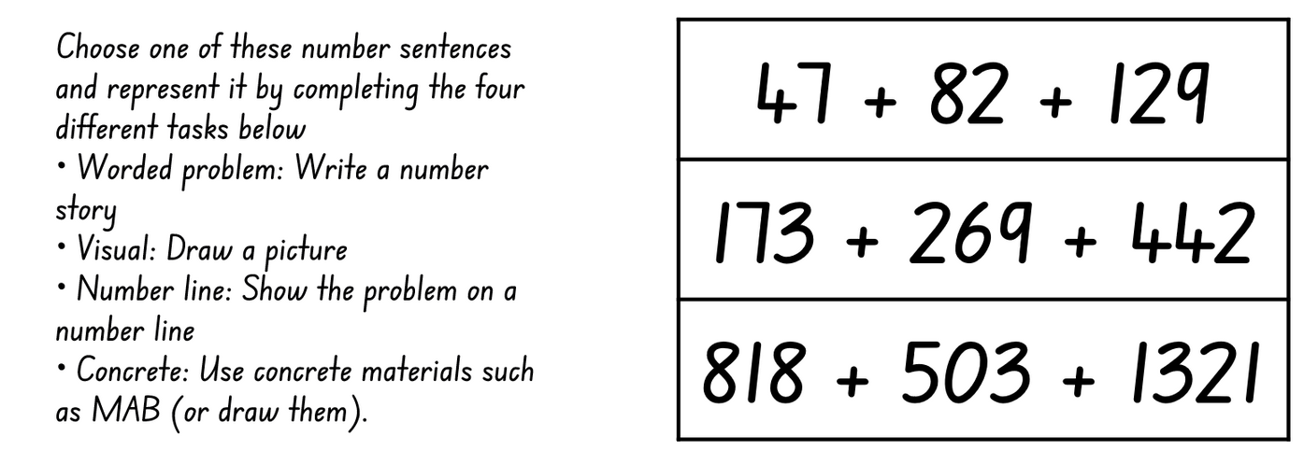

Activity 2 – representing addition
Notes:
This is a developing number sense activity.
Number sense refers to a deep understanding of numbers, including their magnitude, relationships, and the effects of operations on them. It supports fluency and understanding, estimation, flexible thinking, and efficient problem-solving. Number sense activities 1–4 ‘activate’ prior number knowledge and support the learning of new content in the unit. Number sense activities 5–8 ‘loop’ back and provide opportunity for spaced practice with concepts and procedures covered in previous units.
Syllabus focus area:
Additive relations B
Show us how
This activity is an adaptation of ‘Task 3 – Addition’ from 3-6 – Remote Maths – Edition 2 by Mathematical Association of Victoria.
This resource corresponds to Resource 31 – representing addition in Stage 3 Year B Unit 26.
As a class, discuss the various ways addition problems can be represented and solved.
Explain that students must choose one of the equations from the table and then use it to complete each of the 4 tasks.
When they have completed the tasks, students choose another student who completed the same equation to compare representations and solutions.

Slide 18
Review of learning 3

Slide 19
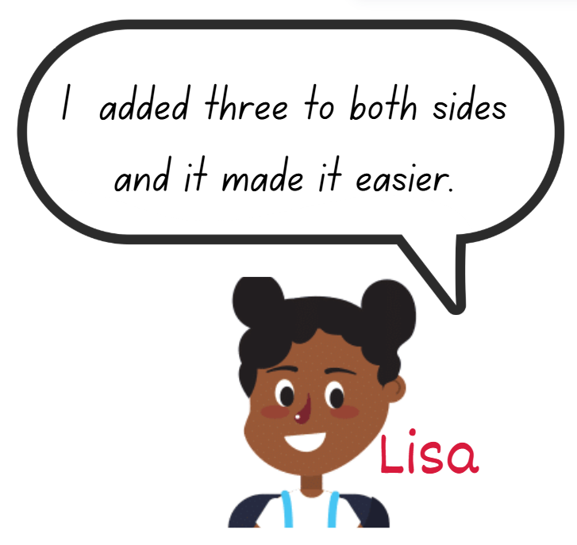
Multiple choice (2)
If Lisa was using an efficient strategy, which equation might she have been solving? You may choose more than one answer.
A
5000 – 367 =
B
5004 – 291 =
C
4997 – 497 =
D
2291 – 1116 =
Communicate your reasoning.
Notes:
This question connects to the content in the developing number sense activity (Activity 3)
Syllabus focus area:
Additive relations B
This activity is an adaptation of ‘Which one doesn’t belong?’ from Thinking mathematically resources by State of New South Wales (Department of Education).

Slide 20
Short response (9)
4.293
What is the value of the digit in the tenths place?
What is the value of the digit in the hundredths place?
What is the value of the digit in the thousandths place?
How many thousandths are represented in the number?
Notes:
Short response questions provide brisk paced questions focussing on review of current and previous content to support spaced and interleaved practice.
Syllabus focus area:
Represents numbers A

Slide 21
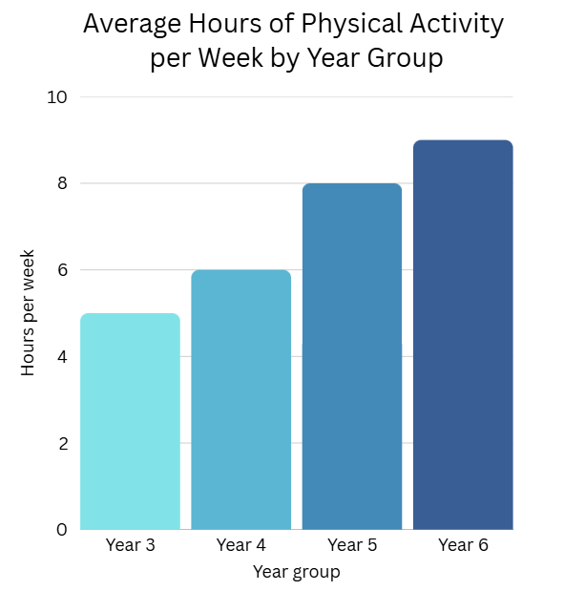
Short response (10)
Write a question that can be answered
using this data.
Notes:
Short response questions provide brisk paced questions focussing on review of current and previous content to support spaced and interleaved practice.
Syllabus focus area:
Data B

Slide 22
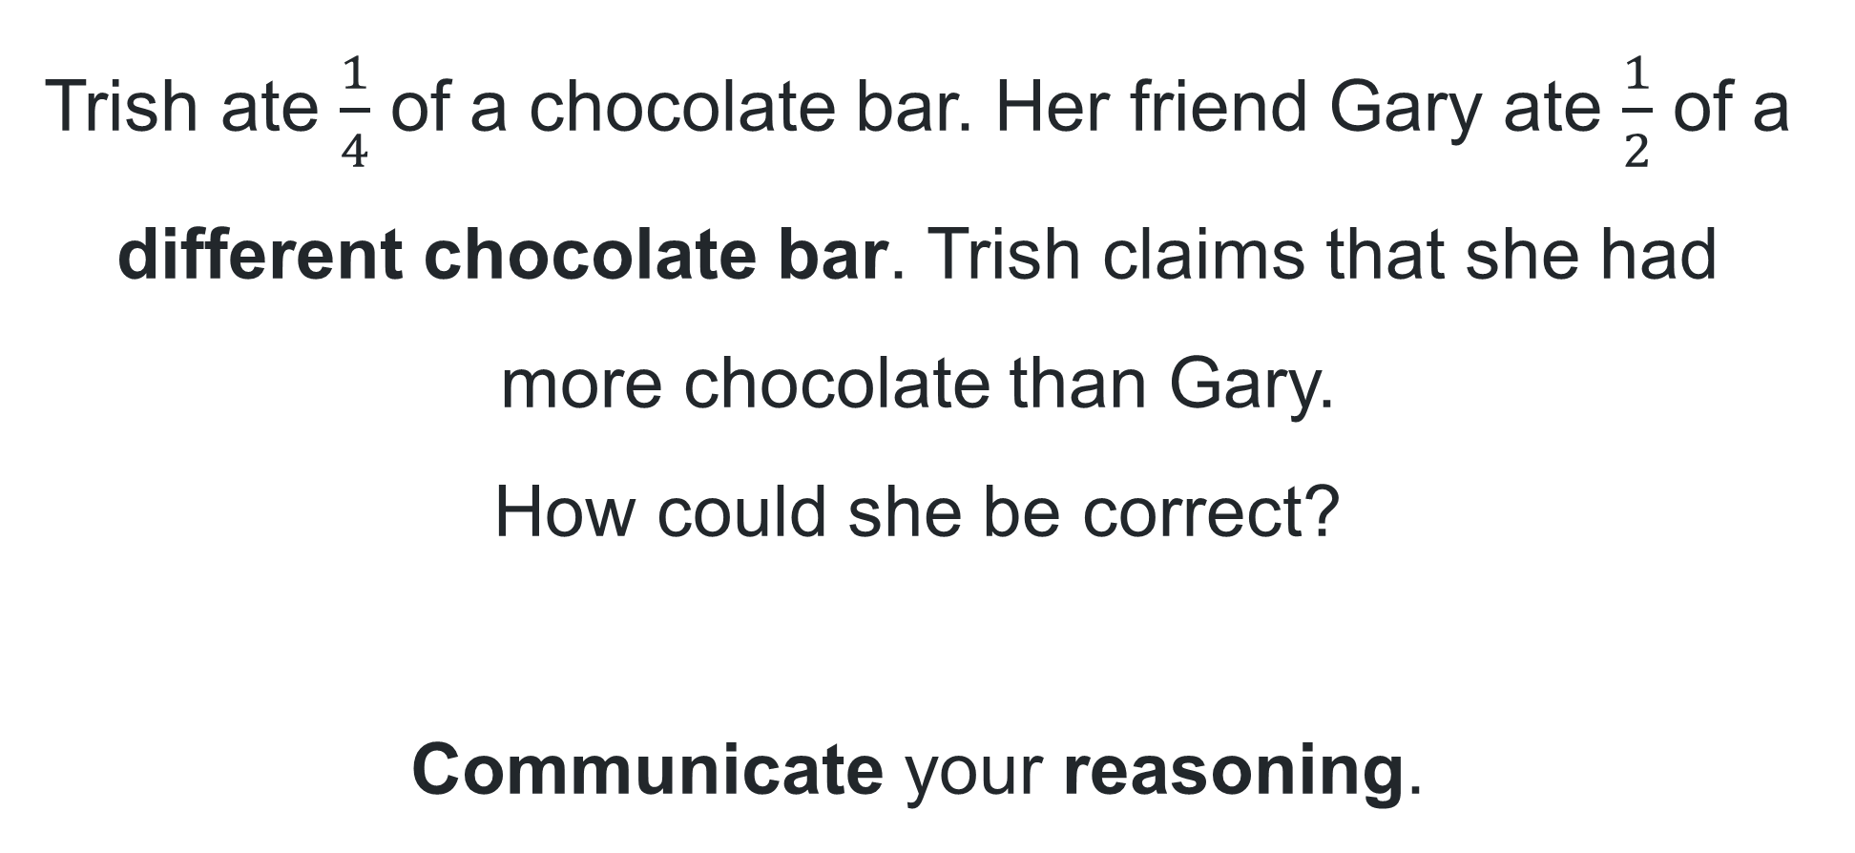
Short response (11)
Trish ate $\frac{1}{4}$ of a chocolate bar. Her friend Gary ate $\frac{1}{2}$ of a different chocolate bar. Trish claims that she had more chocolate than Gary.
How could she be correct?
Communicate your reasoning.
Notes:
Short response questions provide brisk paced questions focussing on review of current and previous content to support spaced and interleaved practice.
Syllabus focus area:
Representing quantity fractions A

Slide 23
Short response (12)
Is this an example of biased data collection?
A sports store wanted to find out which sport is most popular in the community. They handed out surveys only at the local football club asking, “What is your favourite sport?”
Communicate your thinking.
Notes:
Short response questions provide brisk paced questions focussing on review of current and previous content to support spaced and interleaved practice.
Syllabus focus area:
Data B

Slide 24
Activity 3 – Which number doesn’t belong?
Communicate your reasoning.
9 | 16
25 | 43
Notes:
This is a developing number sense activity.
Number sense refers to a deep understanding of numbers, including their magnitude, relationships, and the effects of operations on them. It supports fluency and understanding, estimation, flexible thinking, and efficient problem-solving. Number sense activities 1–4 ‘activate’ prior number knowledge and support the learning of new content in the unit. Number sense activities 5–8 ‘loop’ back and provide opportunity for spaced practice with concepts and procedures covered in previous units.
Syllabus focus area:
Additive relations B
Which doesn’t belong?
This activity is an adaptation of Which one number doesn’t belong? from Mathematics K-6 Resources by State of New South Wales (Department of Education).
In pairs, students must decide which number doesn’t belong using addition or subtraction thinking and why. For example, the number 9 is the only number whose digits don’t add up to 7.
Students record their ideas on a whiteboard.
Challenge students who finish quickly to make a case for why each of the numbers does not belong.
When all pairs have a solution, students report back to the class, explaining which number they decided didn’t belong and why. Discuss.

Slide 25
Review of learning 4

Slide 26
True or false (2)
These number combinations are all equal to 100:
77 + 23
75 + 25
84 + 16
81 + 19
True | False
Notes:
The question on this slide connects to the content being explored in the developing number sense activity (Activity 4)
Syllabus focus area:
Additive relations B

Slide 27
Short response (13)
Draw an empty number line starting at 0 and ending at 1.
Mark the following decimals on the number line:
0.275
0.704
0.586
0.931
Notes:
Short response questions provide brisk paced questions focussing on review of current and previous content to support spaced and interleaved practice.
Syllabus focus area:
Represents numbers A

Slide 28
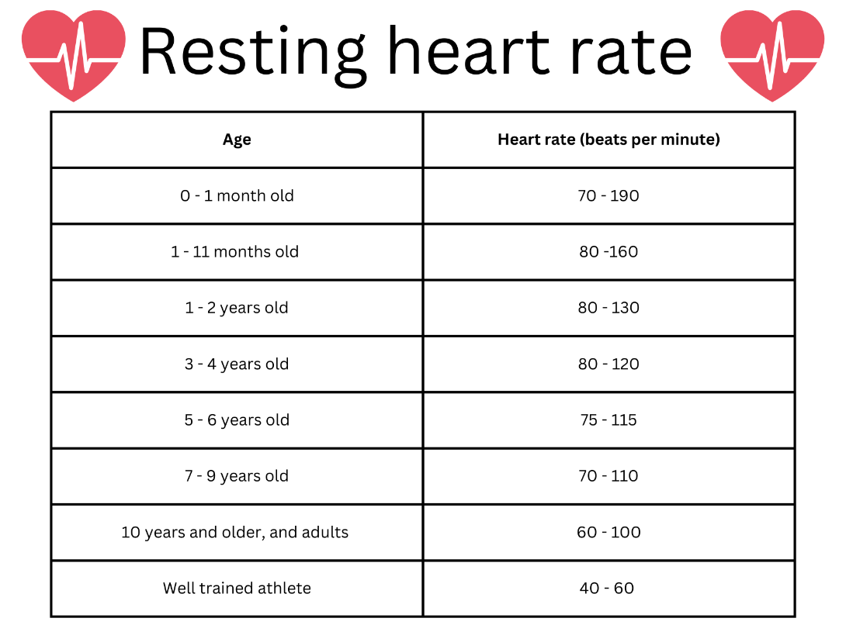
Short response (14)
What is the range of resting heart rates?
Notes:
Short response questions provide brisk paced questions focussing on review of current and previous content to support spaced and interleaved practice.
Syllabus focus area:
Data B

Slide 29
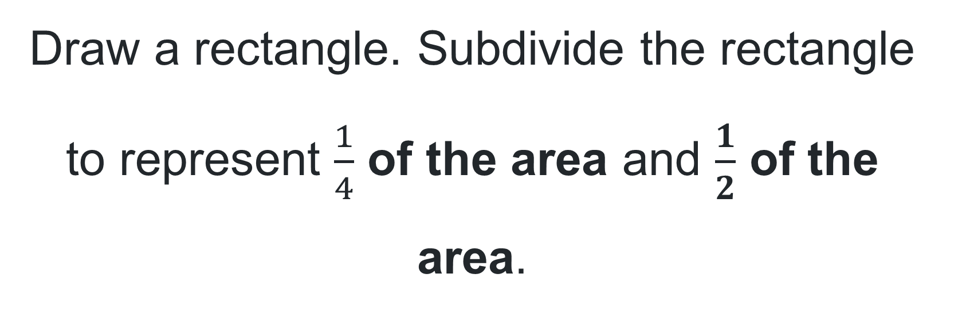
Short response (15)
Draw a rectangle. Subdivide the rectangle to represent $\frac{1}{4}$ of the area and $\frac{1}{2}$ of the area.
Notes:
Short response questions provide brisk paced questions focussing on review of current and previous content to support spaced and interleaved practice.
Syllabus focus area:
Representing quantity fractions B

Slide 30
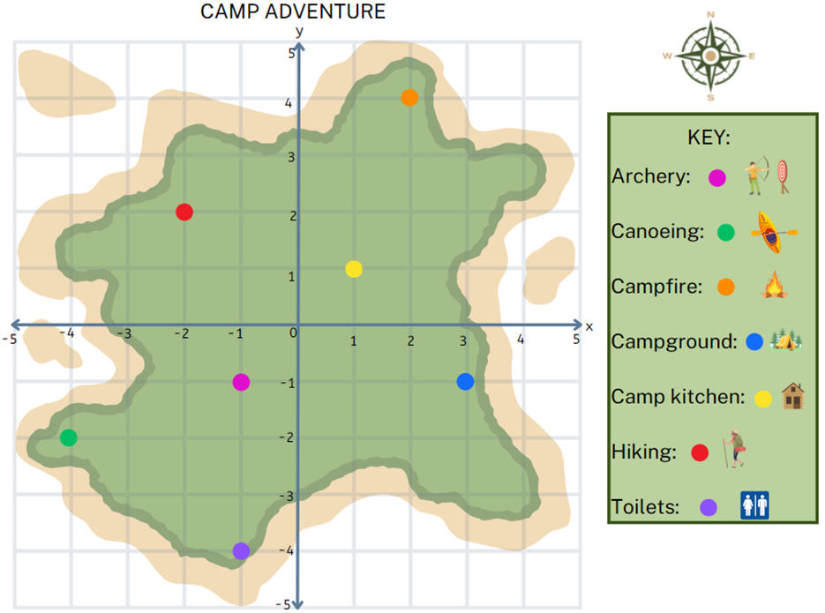
Short response (16)
Record the coordinates for the following:
Canoeing
Archery
Campground
Hiking
Notes:
Short response questions provide brisk paced questions focussing on review of current and previous content to support spaced and interleaved practice.
Syllabus focus area:
Geometric measure A

Slide 31
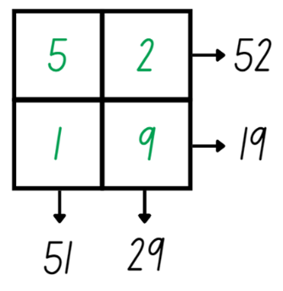
Activity 4 – efficient addition strategies
Notes:
This is a developing number sense activity.
Number sense refers to a deep understanding of numbers, including their magnitude, relationships, and the effects of operations on them. It supports fluency and understanding, estimation, flexible thinking, and efficient problem-solving. Number sense activities 1–4 ‘activate’ prior number knowledge and support the learning of new content in the unit. Number sense activities 5–8 ‘loop’ back and provide opportunity for spaced practice with concepts and procedures covered in previous units.
Syllabus focus area:
Additive relations B
20 dice
This activity is an adaptation of ‘Reach 100’ from NRICH by University of Cambridge.
Choose 4 different digits from 1–9 and record one in each box
Demonstrate how reading the grid vertically and horizontally gives four 2-digit numbers: 52, 19, 51 and 29.
Ask students to turn and talk and discuss what strategies they could use to find the sum of the 4 digits.
Students share and communicate their strategies with the class. For example, one student levels the numbers to make the algorithm 50 + 50 + 3 + 40 + 8. The sum of the numbers is 151.
Explain that the challenge is to find 4 different digits within the grid that create four 2-digit numbers that add up to exactly 150.
Provide small groups with whiteboards to draw their grid and compare the strategies shared to solve the problem.
Select groups to share the strategies they used to solve the problem.
Seek student input to compare and evaluate different strategies selected.

Slide 32
Review of learning 5

Slide 33
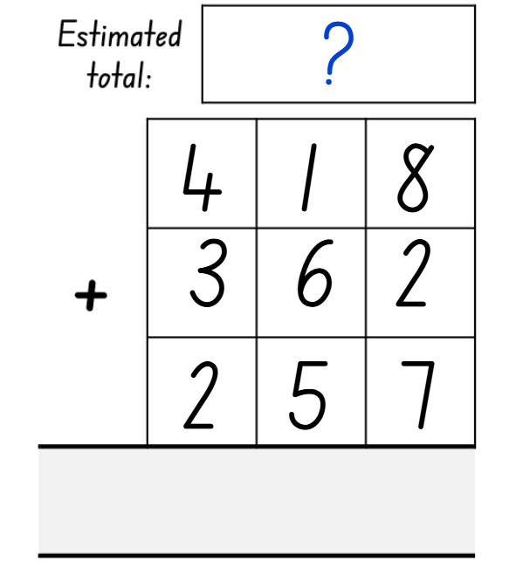
Multiple choice (4)
What would be the closest estimated total?
A
B
C
D
900
1000
1750
2000
Notes:
This question connects to the content in the developing number sense activity (Activity 7)
Syllabus focus area:
Additive relations A

Slide 34
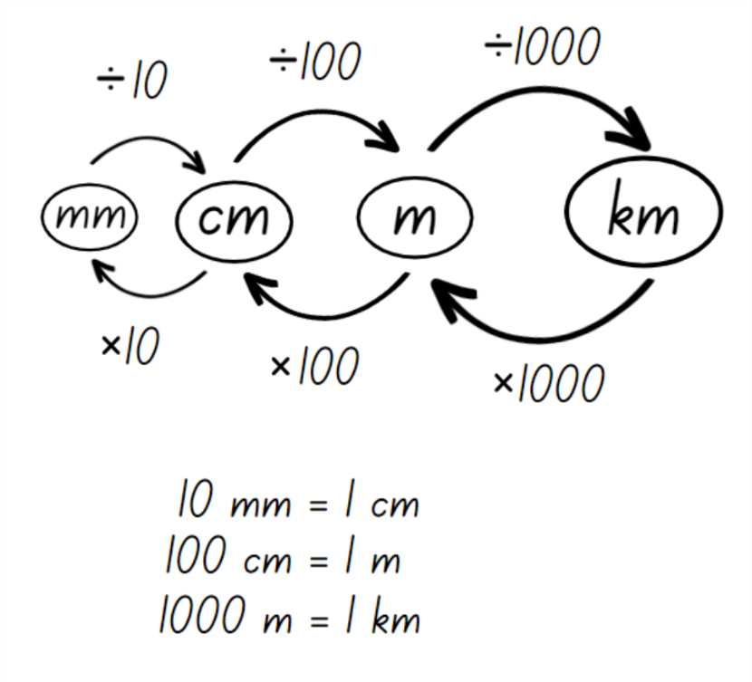
Short response (17)
Convert the following measurements:
3846 cm = ______ mm
9.243 km = ______ m
857 m = ______ km
Notes:
Short response questions provide brisk paced questions focussing on review of current and previous content to support spaced and interleaved practice.
Syllabus focus area:
Geometric measure B

Slide 35
Short response (18)
Arrange the following numbers in ascending order:
1 632 000
2 805 500
1 670 900
2 970 800
Notes:
Short response questions provide brisk paced questions focussing on review of current and previous content to support spaced and interleaved practice.
Syllabus focus area:
Represents numbers A

Slide 36
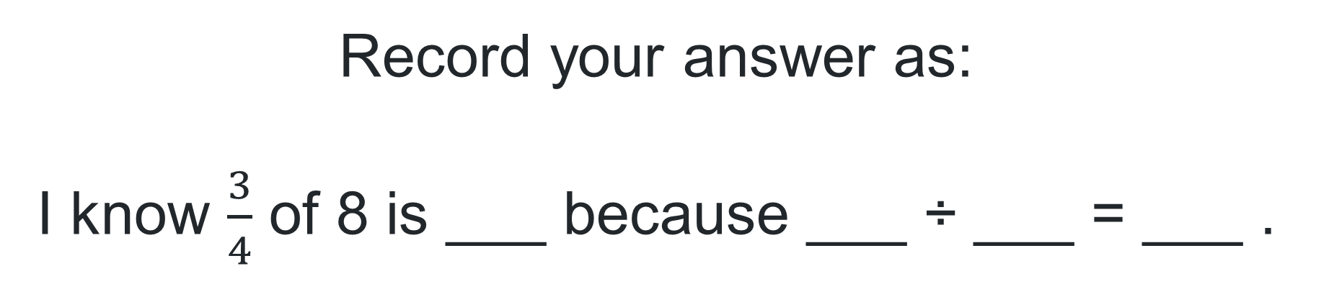
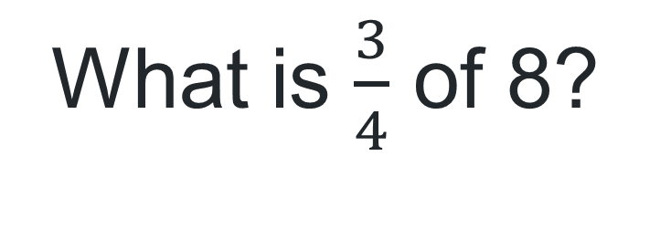
Short response (19)
What is $\frac{3}{4}$ of 8?
Record your answer as:
I know $\frac{3}{4}$ of 8 is ___ because ___ ÷ ___ = ___ .
Notes:
Short response questions provide brisk paced questions focussing on review of current and previous content to support spaced and interleaved practice.
Syllabus focus area:
Representing quantity fractions B

Slide 37
Short response (20)
Record the following equivalent measurements:
1000 m = ____ km
_____ m = 3 km
8500 m = ____ km
_____ m = 7.5 km
Notes:
Short response questions provide brisk paced questions focussing on review of current and previous content to support spaced and interleaved practice.
Syllabus focus area:
Geometric measure A

Slide 38
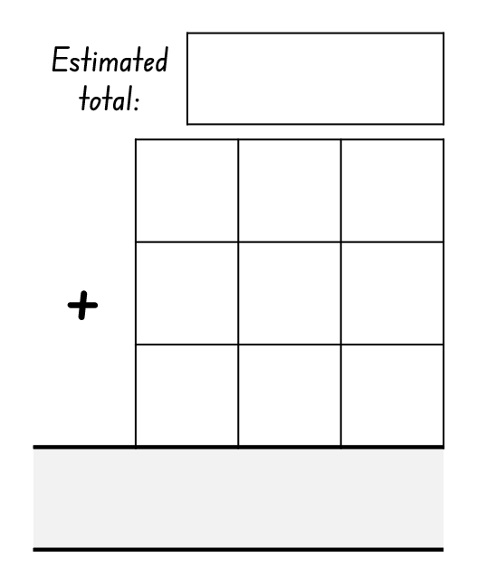
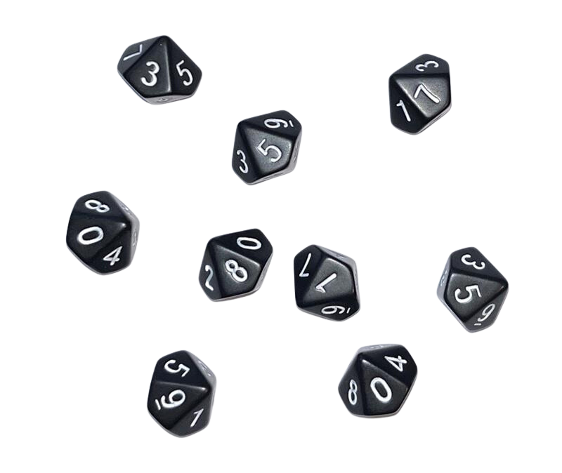
Activity 5 – estimating totals
Notes:
This is a developing number sense activity.
Number sense refers to a deep understanding of numbers, including their magnitude, relationships, and the effects of operations on them. It supports fluency and understanding, estimation, flexible thinking, and efficient problem-solving. Number sense activities 1–4 ‘activate’ prior number knowledge and support the learning of new content in the unit. Number sense activities 5–8 ‘loop’ back and provide opportunity for spaced practice with concepts and procedures covered in previous units.
Syllabus focus area:
Additive relations A
Dicey operations
This resource corresponds to Figure 10 in Stage 3 Year B Unit 26.
Working in pairs, students draw a 3 by 3 grid on their whiteboard.
Students take it in turns to roll a 9-sided dice and place their number in one of the squares of their grid.
When all squares are full, students estimate what they think their total will be and record this number on their whiteboard.
Using their knowledge of place value, students add their numbers to come up with a total.
The student in each pair who got closest to their estimated total gets a point.

Slide 39
Review of learning 6

Slide 40
True or false (3)
45 921 + 836 = 46 807
True | False
Communicate your thinking.
Notes:
The question on this slide connects to the content being explored in the developing number sense activity (Activity 6)
Syllabus focus area:
Additive relations A

Slide 41
Short response (21)
Record the following mass using decimal notation:
8 kilograms and 250 grams
7200 grams
6 kilograms and 775 grams
Notes:
Short response questions provide brisk paced questions focussing on review of current and previous content to support spaced and interleaved practice.
Syllabus focus area:
Non-spatial measure A

Slide 42
Short response (22)
Approximate the following decimals to one decimal place:
1.82
1.27
1.53
1.94
1.38
1.66
Notes:
Short response questions provide brisk paced questions focussing on review of current and previous content to support spaced and interleaved practice.
Syllabus focus area:
Represents numbers A

Slide 43
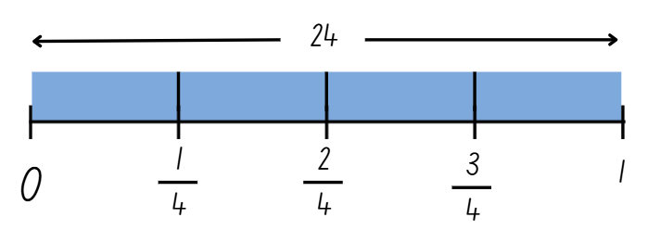
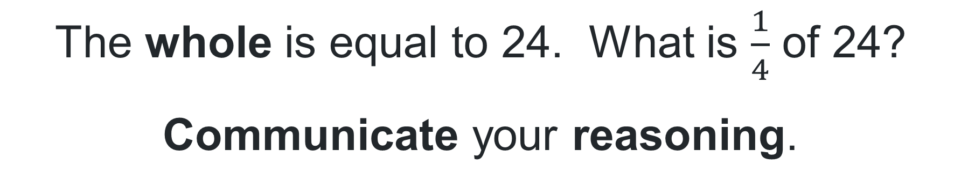
Short response (23)
The whole is equal to 24. What is $\frac{1}{4}$ of 24?
Communicate your reasoning.
Notes:
Short response questions provide brisk paced questions focussing on review of current and previous content to support spaced and interleaved practice.
Syllabus focus area:
Representing quantity fractions B

Slide 44
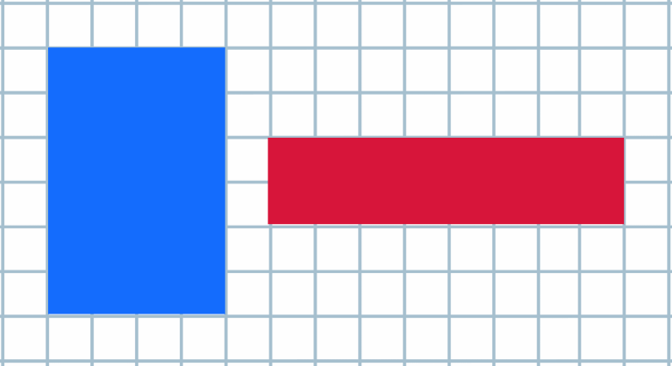
Short response (24)
Communicate your reasoning about whether the following statement is true or not:
These rectangles have different dimensions, so they can not have the same perimeter.
Notes:
Short response questions provide brisk paced questions focussing on review of current and previous content to support spaced and interleaved practice.
Syllabus focus area:
Geometric measure B

Slide 45
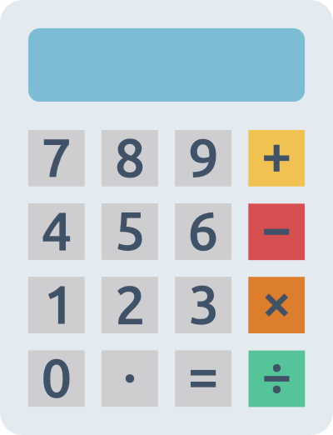
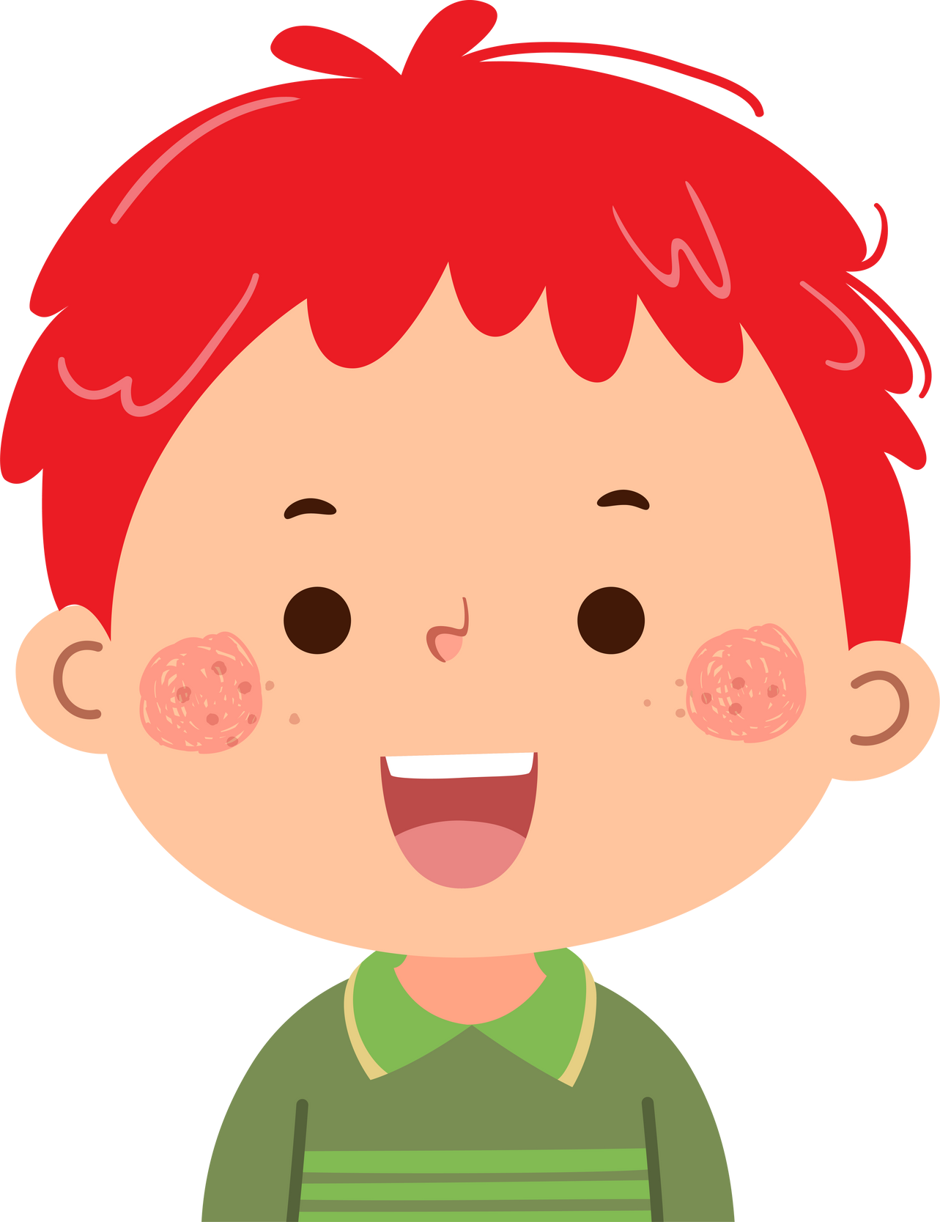
Activity 6 – reasonableness of solutions 1
John added 34 567 and 478 on his calculator. The answer he got was ...
34 089
Am I correct? How do you know?
Notes:
This is a developing number sense activity.
Number sense refers to a deep understanding of numbers, including their magnitude, relationships, and the effects of operations on them. It supports fluency and understanding, estimation, flexible thinking, and efficient problem-solving. Number sense activities 1–4 ‘activate’ prior number knowledge and support the learning of new content in the unit. Number sense activities 5–8 ‘loop’ back and provide opportunity for spaced practice with concepts and procedures covered in previous units.
Syllabus focus area:
Additive relations A
Prove it
This resource corresponds to Resource 32 – prove it in Stage 3 Year B Unit 26.
Read the scenario to the students.
Students estimate the answer themselves and then explain their thinking to a partner. They must be able to provide evidence to support their answers. For example, John’s answer could not be correct because it is an addition problem however the answer is less than the number he started with. Students then work on whiteboards to check if John’s answer is correct.
Discuss student answers as a class.
Ask students:
How did you determine if the answer was correct?
Was there a way to determine if the answer was correct without working out the correct answer? How?

Slide 46
Review of learning 7

Slide 47

Multiple choice (3)
What do you consider the closest estimate to the number of books displayed?
A
100
B
150
C
200
D
250
Communicate your reasoning.
Notes:
This question connects to the content in the developing number sense activity (Activity 5)
Syllabus focus area:
Additive relations A

Slide 48
Short response (25)
A water bottle holds 1.375 litres of water. After Sam drinks some water, there is 0.842 litres left. How much water did Sam drink?
Notes:
Short response questions provide brisk paced questions focussing on review of current and previous content to support spaced and interleaved practice.
Syllabus focus area:
Additive relations B

Slide 49
Short response (26)
Draw an empty number line starting at 0 and ending at 1.
Mark the following benchmark numbers on the number line: 0.25, 0.5 and 0.75.
Communicate your reasoning.
Notes:
Short response questions provide brisk paced questions focussing on review of current and previous content to support spaced and interleaved practice.
Syllabus focus area:
Represents numbers A

Slide 50
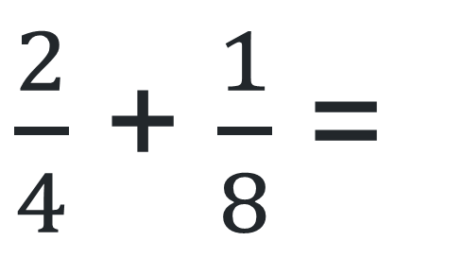
Short response (27)
Use a number line to record the solution.
$\frac{2}{4}$ + $\frac{1}{8}$ =
Notes:
Short response questions provide brisk paced questions focussing on review of current and previous content to support spaced and interleaved practice.
Syllabus focus area:
Representing quantity fractions B

Slide 51

Short response (28)
Calculate the perimeter of this rectangle drawn onto 1 cm × 1 cm grid paper. Communicate your reasoning.
Notes:
Short response questions provide brisk paced questions focussing on review of current and previous content to support spaced and interleaved practice.
Syllabus focus area:
Geometric measure A

Slide 52
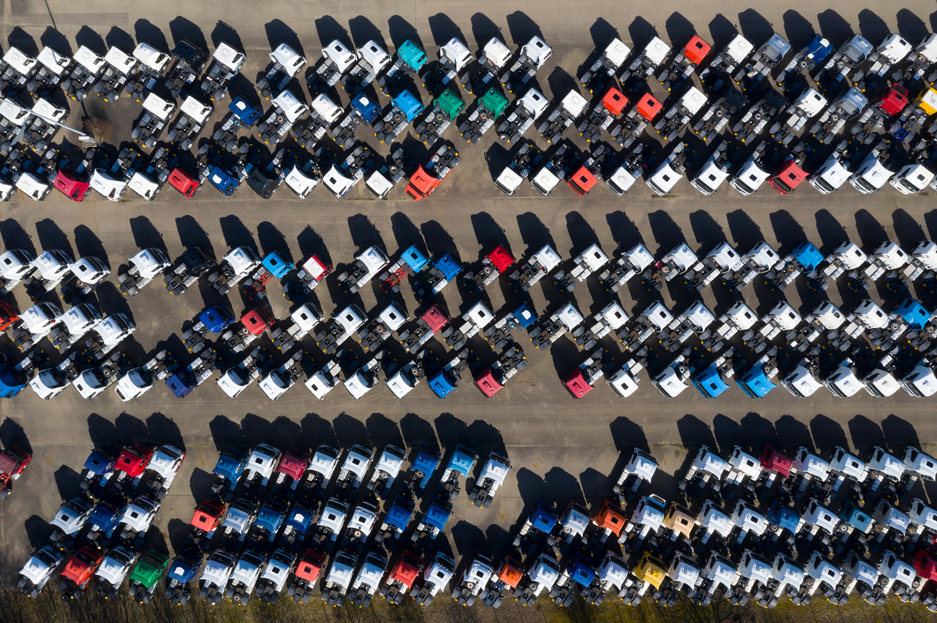
Activity 7 – efficient addition strategies
How many trucks can be seen in this collection?
Notes:
This is a developing number sense activity.
Number sense refers to a deep understanding of numbers, including their magnitude, relationships, and the effects of operations on them. It supports fluency and understanding, estimation, flexible thinking, and efficient problem-solving. Number sense activities 1–4 ‘activate’ prior number knowledge and support the learning of new content in the unit. Number sense activities 5–8 ‘loop’ back and provide opportunity for spaced practice with concepts and procedures covered in previous units.
Syllabus focus area:
Additive relations A
How many trucks?
This resource corresponds to Resource 33 – estimation in Stage 3 Year B Unit 26.
Provide each student with a copy of the Resource 33 – estimation
Ask students to estimate how many trucks can be seen in the collection.
Students work independently or in pairs to organise the collection to support efficient counting.
Choose students to share how they organised their collection and what the total is.
Ask students:
How close was your estimation to the actual total number of trucks in the collection?
Did your estimation help or hinder your ability to determine how many trucks were in the collection?
What strategy did you use to determine how many trucks were in this collection?
Was your strategy efficient? Why or why not?
Were there any other strategies to determine the size of the truck collection that you think would have been more efficient?

Slide 53
Review of learning 8

Slide 54
True or false (4)
This is a reasonable estimate:
4500 – 650 = 3200
True | False
Communicate your reasoning.
Notes:
The question on this slide connects to the content being explored in the developing number sense activity (Activity 8)
Syllabus focus area:
Additive relations A

Slide 55
Short response (29)
A giant dominoes set is on sale for 20% off the original price of $75. A foam javelin set is on sale for $12 off the original price of $68. Which item has the biggest discount?
Communicate your reasoning.
Notes:
Short response questions provide brisk paced questions focussing on review of current and previous content to support spaced and interleaved practice.
Syllabus focus area:
Represents numbers B

Slide 56
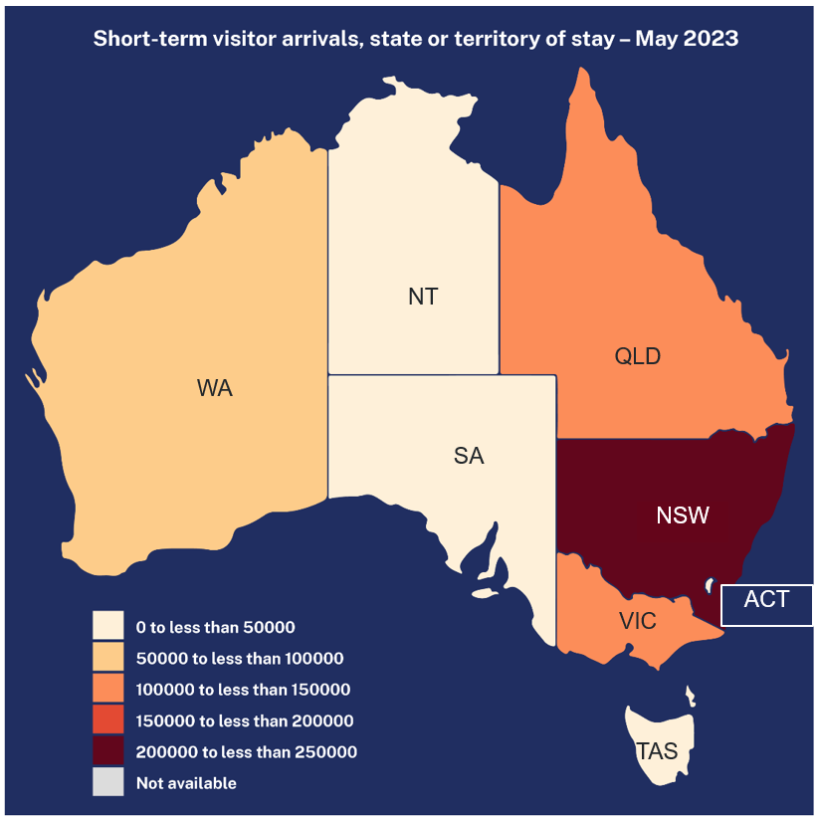
Short response (30)
Which states and/or territories have between 100 000 and 150 000 short-term visitor arrivals?
Source: Adapted from Australian Bureau of Statistics (2023).
Notes:
Short response questions provide brisk paced questions focussing on review of current and previous content to support spaced and interleaved practice.
Syllabus focus area:
Data B

Slide 57
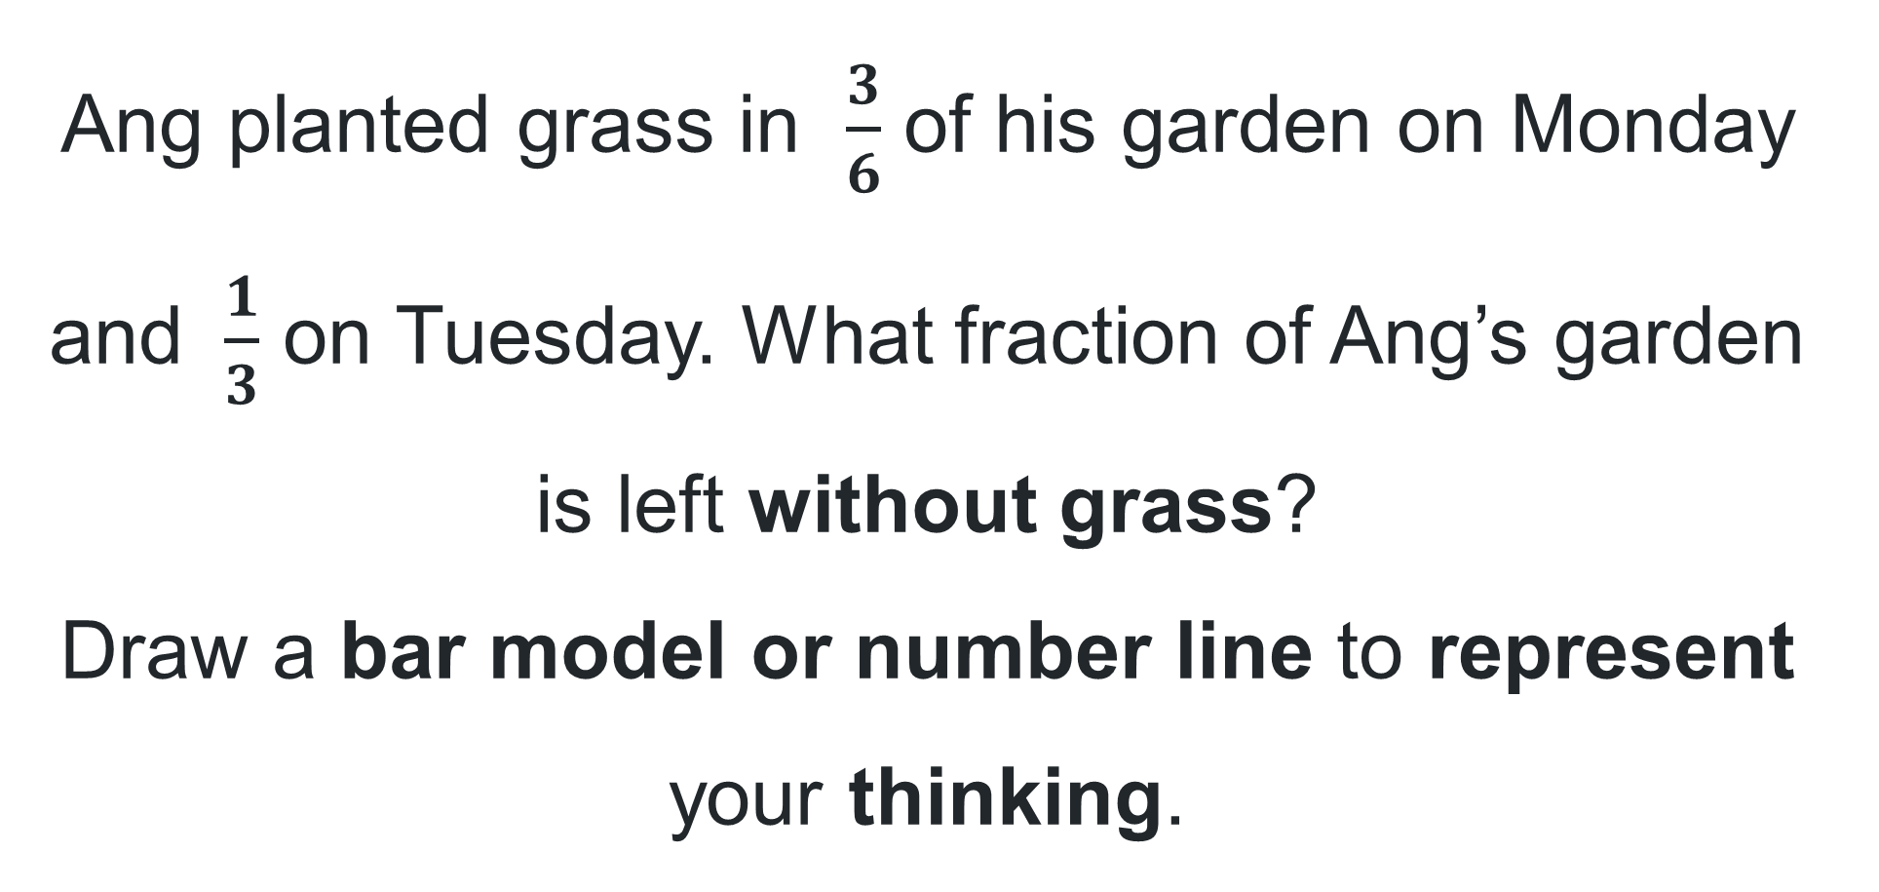
Short response (31)
Ang planted grass in $\frac{3}{6}$ of his garden on Monday and $\frac{1}{3}$ on Tuesday. What fraction of Ang’s garden is left without grass?
Draw a bar model or number line to represent your thinking.
Notes:
Short response questions provide brisk paced questions focussing on review of current and previous content to support spaced and interleaved practice.
Syllabus focus area:
Representing quantity fractions B

Slide 58
Short response (32)
Use the partial timetable to answer:
On Monday, Simone was 20 minutes late to HSIE after lunch. How much time did she spend in the lesson?
On Thursday, Sam went to Creative arts 45 minutes after lunch ended. What time did Sam arrive? Record your answer in 24-hour time.
12-hour | 24-hour | Monday | Tuesday | Wednesday | Thursday | Friday
12:30 pm | 12:30 | Maths | Maths | Maths | Maths | Maths
1:00 pm | 13:00 | Lunch | Lunch | Lunch | Lunch | Lunch
1:30 pm | 13:30 | HSIE | HSIE | Creative arts | Creative arts | Science
2:00 pm | 14:00 | HSIE | Library | PDHPE | Creative arts | Science
2:30 pm | 14:30 | HSIE | Assembly | PDHPE | Creative arts | Science
3:00 pm | 15:00 | End of school | End of school | End of school | End of school | End of school
Notes:
Short response questions provide brisk paced questions focussing on review of current and previous content to support spaced and interleaved practice.
Syllabus focus area:
Non-spatial measure A

Slide 59
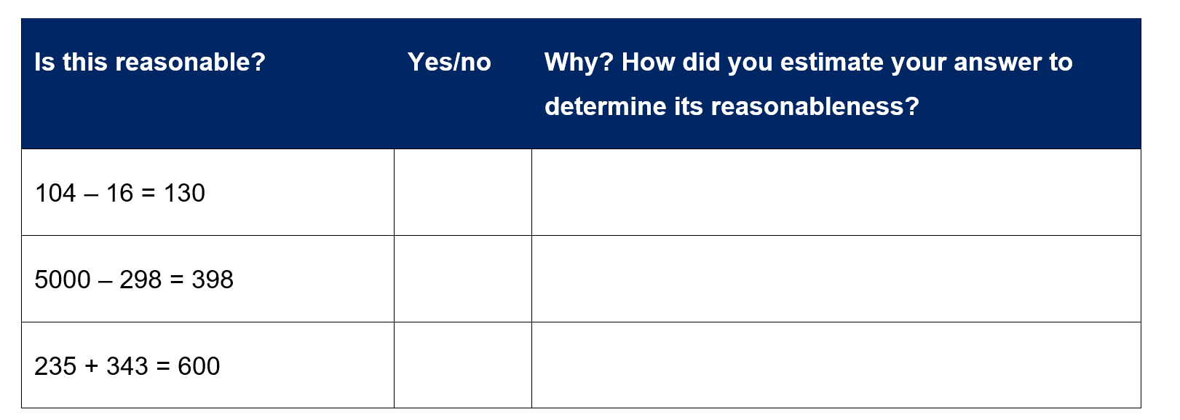
Activity 8 – reasonableness of solutions 2
Notes:
This is a developing number sense activity.
Number sense refers to a deep understanding of numbers, including their magnitude, relationships, and the effects of operations on them. It supports fluency and understanding, estimation, flexible thinking, and efficient problem-solving. Number sense activities 1–4 ‘activate’ prior number knowledge and support the learning of new content in the unit. Number sense activities 5–8 ‘loop’ back and provide opportunity for spaced practice with concepts and procedures covered in previous units.
Syllabus focus area:
Additive relations A
Is this reasonable?
This resource corresponds to Resource 34 – Is this reasonable? in Stage 3 Year B Unit 26.
Provide each student with a copy of Resource 34 – Is this reasonable?
Students to work in pairs to collaboratively complete Resource 32 – Is this reasonable?
Students discuss whether the answers to the questions are reasonable and give reasons for their answer.
Regroup to discuss class answers and reasons for their choices.

Slide 60
Double Venn diagram
Object 1
Object 2
Features similar to both objects
Features of object 1
Features of object 2

Slide 61
Frayer
Definition
Facts/Characteristics
Word, term, concept
Examples
Non-examples

Slide 62
Spider map
Idea
Subject

Slide 63
Cline
Concept 1
Concept 2
Word
Word
Word
Word
Word
Word
Word
Word
Word
Word
Word

Slide 64

Compare and contrast

Slide 65
Multiple choice (5)
A
B
C
D

Slide 66
Multiple choice
A
B
C
D
Notes:
This question connects to the content in the developing number sense activity (Activity 3)
Syllabus focus area:
[Focus area A/B]

Slide 67
References (1)
This presentation contains NSW Curriculum and syllabus content. The NSW Curriculum is developed by the NSW Education Standards Authority. This content is prepared by NESA for and on behalf of the Crown in the right of the State of New South Wales. The material is protected by Crown copyright.
Please refer to the NESA Copyright Disclaimer for more information https://educationstandards.nsw.edu.au/wps/portal/nesa/mini-footer/copyright.
NESA holds the only official and up-to-date versions of the NSW Curriculum and syllabus documents. Please visit the NSW Education Standards Authority (NESA) website https://educationstandards.nsw.edu.au/wps/portal/nesa/home and the NSW Curriculum website https://curriculum.nsw.edu.au.
Mathematics K–10 Syllabus © NSW Education Standards Authority (NESA) for and on behalf of the Crown in right of the State of New South Wales, 2022.
National Numeracy Learning Progression © Australian Curriculum, Assessment and Reporting Authority (ACARA) 2010 to present, unless otherwise indicated. This material was downloaded from the Australian Curriculum website (National Numeracy Learning Progression) (accessed 4 April 2024) and was not modified.
Chin A (2015) Make 100, 1000, 10, 1: Adding and subtracting using place value [PDF 1.12 MB], Anita Chin Mathematics Consultancy, accessed 28 June 2023.
Frykholm, J. (2010) ‘Greater Than? Less than? The Same?’, Learning to Think Mathematically with the Number Line: A Resource for Teachers, A Tool for Young Children [PDF 1.1 MB], The Math Learning Center, accessed 25 September 2025.
University of Cambridge (n.d.) Reach 100, NRICH website, accessed 28 November 2024.
Mathematical Association of Victoria (2020) ‘Task 4 – Double Hat Trick’, 3-6 Remote Maths – Edition 8 [PDF 542 KB], Mathematical Association of Victoria, accessed 25 September 2025.

Slide 68
References (2)
This presentation contains NSW Curriculum and syllabus content. The NSW Curriculum is developed by the NSW Education Standards Authority. This content is prepared by NESA for and on behalf of the Crown in the right of the State of New South Wales. The material is protected by Crown copyright.
Please refer to the NESA Copyright Disclaimer for more information https://educationstandards.nsw.edu.au/wps/portal/nesa/mini-footer/copyright.
NESA holds the only official and up-to-date versions of the NSW Curriculum and syllabus documents. Please visit the NSW Education Standards Authority (NESA) website https://educationstandards.nsw.edu.au/wps/portal/nesa/home and the NSW Curriculum website https://curriculum.nsw.edu.au.
State of New South Wales (Department of Education) (2023) ‘Decimats (understanding fractions), Thinking mathematically resources, NSW Department of Education website, accessed 18 May 2023.
State of New South Wales (Department of Education) (n.d.) Identifies, represents and compares decimals (DOCX), NSW Department of Education, accessed 25 September 2025.
NESA (NSW Education Standards Authority) (2022b) ‘Teaching advice for Represents numbers A’, Stage 3, accessed 25 September 2025.
NESA (NSW Education Standards Authority) (2022c) ‘Teaching advice for Represents numbers B’, Stage 3, accessed 25 September 2025.
NESA (NSW Education Standards Authority) (2022d) ‘Teaching advice for Representing numbers using place value B’, Stage 3, accessed 25 September 2025.
NESA (NSW Education Standards Authority) (2022e) ‘Teaching advice for Stage 2 Representing numbers using place value B’, Stage 2, accessed 25 September 2025.
NESA (NSW Education Standards Authority) (2022f) ‘Teaching advice for Additive relations B’, Stage 2, accessed 25 September 2025.

Slide 69
Copyright
© State of New South Wales (Department of Education), 2025
The copyright material published in this resource is subject to the Copyright Act 1968 (Cth) and is owned by the NSW Department of Education or, where indicated, by a party other than the NSW Department of Education (third-party material).
Copyright material available in this resource and owned by the NSW Department of Education is licensed under a Creative Commons Attribution 4.0 International (CC BY 4.0) license.
This license allows you to share and adapt the material for any purpose, even commercially.
Attribution should be given to © State of New South Wales (Department of Education), 2025.
Material in this resource not available under a Creative Commons license:
the NSW Department of Education logo, other logos and trademark-protected material
Material owned by a third party that has been reproduced with permission. You will need to obtain permission from the third party to reuse its material.
Links to third-party material and websites
Please note that the provided (reading/viewing material/list/links/texts) are a suggestion only and implies no endorsement, by the New South Wales Department of Education, of any author, publisher, or book title. School principals and teachers are best placed to assess the suitability of resources that would complement the curriculum and reflect the needs and interests of their students.
If you use the links provided in this document to access a third party’s website, you acknowledge that the terms of use, including licence terms set out on the third-party’s website apply to the use which may be made of the materials on that third-party website or where permitted by the Copyright Act 1968 (Cth). The department accepts no responsibility for content on third-party websites.

