Slide 1
Instructions for use
This resource is not a teaching and learning program. It should be used in conjunction with Stage 2 Year B Unit 29.
Classroom teachers are encouraged to add and adapt slides as required to meet the needs of their students.
Save a copy of the file to make changes to the slide deck. Go to File > Download a Copy (this downloads a copy to the computer to edit in the PowerPoint app).
To convert the PowerPoint to Google Slides:
  Upload the file into Google Drive and open it.
  Go to File > Save as Google Slides.
  (Note – conversion may cause formatting changes in the slides.)

Slide 2

Review of Learning
Mathematics Stage 2 – Unit 29
Notes:
Reviews may include a combination of question types, requiring students to recall facts and key ideas, as well as apply their knowledge to solve problems and answer questions. To support active engagement, a mix of techniques should be employed.” (AERO, 2024).
This Review of Learning slide deck revisits key concepts from the following units:
Stage 2 Year B Unit 29
Stage 2 Year B Unit 28
Stage 2 Year B Unit 27
It also includes opportunities to review prior learning in non-number content, supporting consolidation across focus areas.
The review of learning resources include three key task types that support the development of mathematical proficiency through retrieval, spaced practice, and active participation. These practices complement the review phase (activating prior knowledge) embedded within the beginning of each lesson.
1.
Multiple-choice questions/True or false: Designed to promote active retrieval of key concepts and identify common misconceptions in number, supporting consolidation, understanding and fluency.
These questions:
support spaced and interleaved practice
help identify and address common misconceptions
support active recall and immediate feedback
support whole class participation
identify areas requiring reteach
2.
Short-response question sets: Carefully grouped questions that encourage spaced and interleaved practice across multiple focus areas, helping students revisit and apply knowledge from different points in time.
These questions:
have a combination of question types
address a range of focus areas
build automaticity and fluency
support active recall
allow for immediate feedback
identify content requiring reteach
3.
Developing number sense activities: A variety of practical, purposeful tasks that reinforce current learning and build on prior knowledge. These activities promote reasoning, problem-solving and conceptual understanding.
The review of learning resources are designed to work support teaching and learning in mathematics. For the most effective implementation, use the resources flexibly, adapting to meet student learning needs and individual classroom contexts.

Slide 3
Lessons
1
Review of learning 1
5
Review of learning 5
2
Review of learning 2
6
Review of learning 6
3
Review of learning 3
7
Review of learning 7
4
Review of learning 4
8
Review of learning 8
Notes:
Teacher notes:
Click lesson titles to go to specific lessons
Interactive features can be viewed in slide show

Slide 4
Review of learning 1

Slide 5

Multiple choice (1)
4321 rounded to the nearest multiple of 1000 is:
A
B
C
D
4000
4300​
5000​
4330​
Notes:
This question connects to the content in the developing number sense activity (Activity 1)
Syllabus focus area:
Representing numbers using place value B

Slide 6

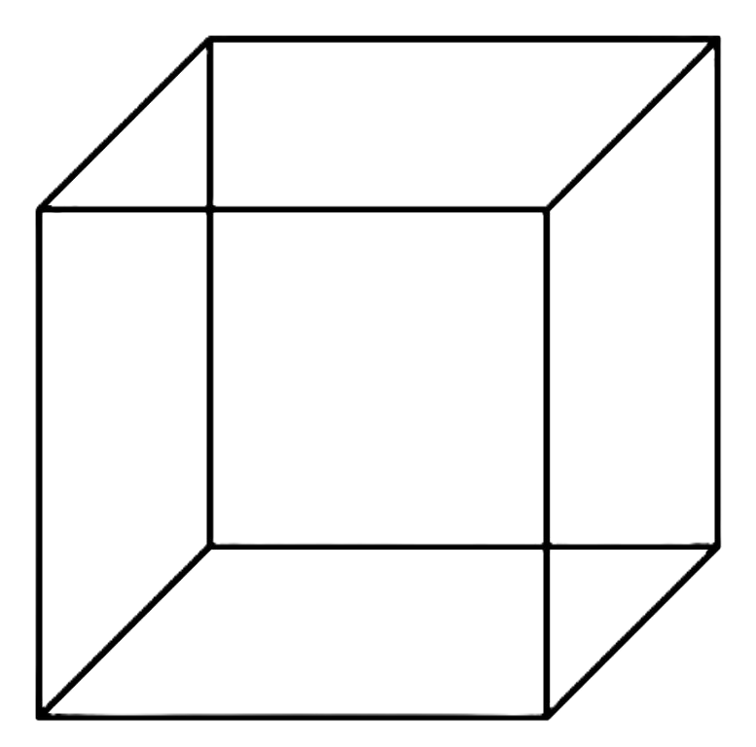
Short response (1)
This is a cube. How many faces, edges and vertices does it have?
Notes:
Short response questions provide brisk paced questions focussing on review of current and previous content to support spaced and interleaved practice.
Syllabus focus area:
Three-dimensional spatial structure B

Slide 7
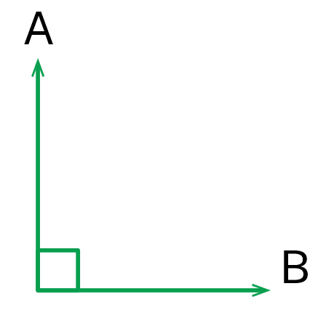
Short response (2)
A quarter turn from A to B forms a right angle.
How many right angles would be needed to perform 2 quarter turns?
Notes:
Short response questions provide brisk paced questions focussing on review of current and previous content to support spaced and interleaved practice.
Syllabus focus area:
Geometric Measure A

Slide 8
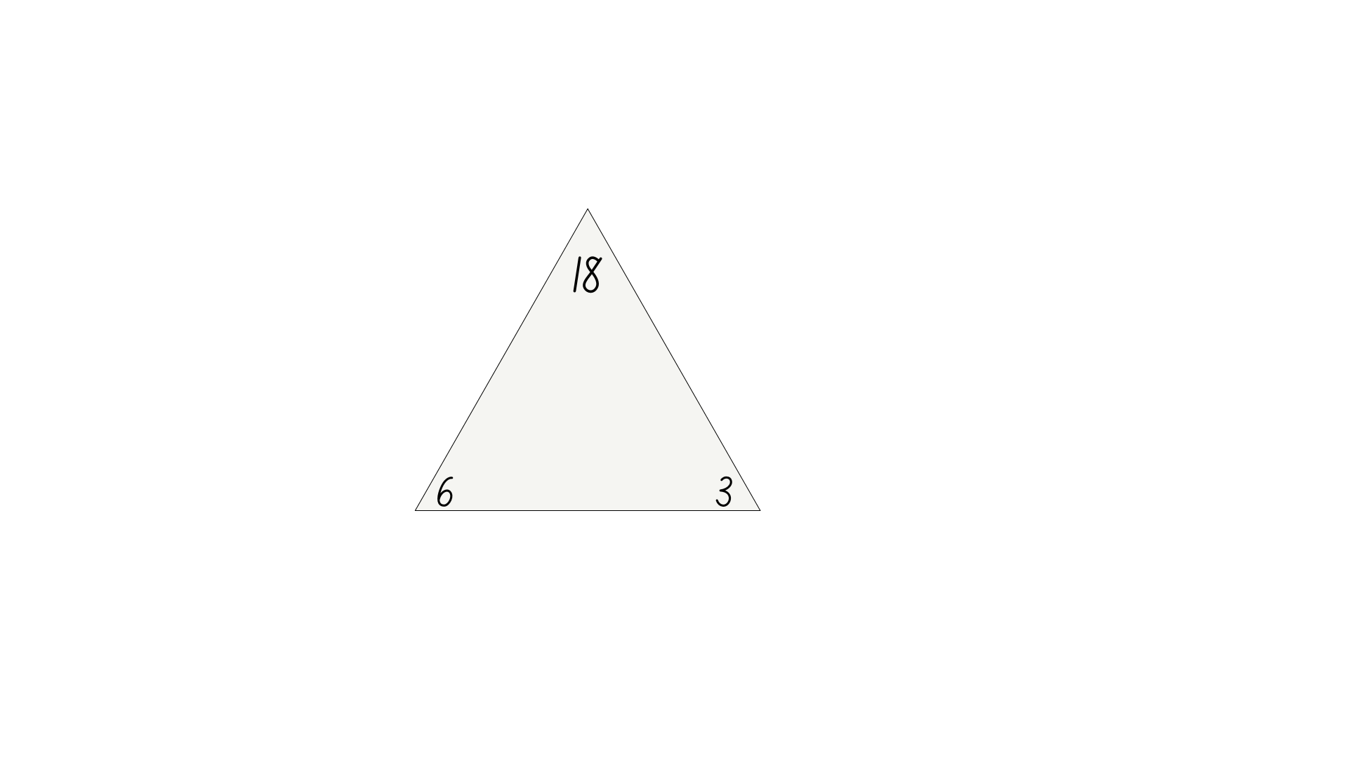
Short response (3)
Use the fact family triangle to create 2 multiplication and 2 division number sentences.
Notes:
Short response questions provide brisk paced questions focussing on review of current and previous content to support spaced and interleaved practice.
Syllabus focus area:
Multiplicative relations B

Slide 9
Short response (4)
Use minutes to describe the duration of these events.
recess
soccer game
Notes:
Short response questions provide brisk paced questions focussing on review of current and previous content to support spaced and interleaved practice.
Syllabus focus area:
Non-spatial measure A

Slide 10



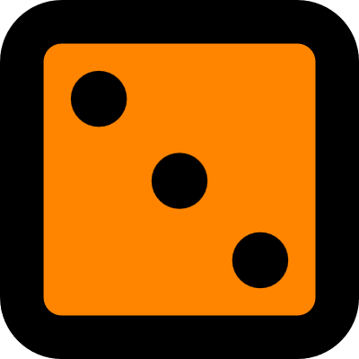

Activity 1– round the four dice
1243 | 1324 | 1342
2341 | 2413 | 2431
3142 | 3214 | 3241
4231 | 4312 | 4321
Choose and record 4 numbers.
Round each number to the nearest multiple of 1000.
Notes:
This is a developing number sense activity.
Number sense refers to a deep understanding of numbers, including their magnitude, relationships, and the effects of operations on them. It supports fluency and understanding, estimation, flexible thinking, and efficient problem-solving. Number sense activities 1–4 ‘activate’ prior number knowledge and support the learning of new content in the unit. Number sense activities 5–8 ‘loop’ back and provide opportunity for spaced practice with concepts and procedures covered in previous units.
Syllabus focus area:
Representing numbers using place value B
Activity 1– dice combinations
This resource corresponds to Resource 14 – dice combinations in Stage 2 Year B Unit 29.
This activity is an adaptation of ‘Round the Four Dice’ from NRICH by the University of Cambridge (Faculty of Mathematics).
Students choose 4 numbers from the dice combinations and round them to the nearest 1000.
Ask:
How did you work out whether to round up or round down to the nearest multiple of 1000?
Did you round up to the nearest thousand or round down to the nearest thousand more often? Why?
Did any of the four 4-digit numbers you chose round to the same multiple of 1000?

Slide 11
Review of learning 2

Slide 12
True or false (1)
Emily rolled five 0-9 dice.
Her digits were: 7, 3, 1, 4, 9.
The smallest number she could make by arranging the digits is 14 379.
True | False
Notes:
The question on this slide connects to the content being explored in the developing number sense activity (Activity 2)
Syllabus focus area:
Representing numbers using place value B

Slide 13
Short response (5)
I have a three-dimensional object with the following features:
Faces: 5 Edges: 8 Vertices: 5
Use the information to draw a simple sketch of this object.
Notes:
Short response questions provide brisk paced questions focussing on review of current and previous content to support spaced and interleaved practice.
Syllabus focus area:
Three-dimensional spatial structure B

Slide 14
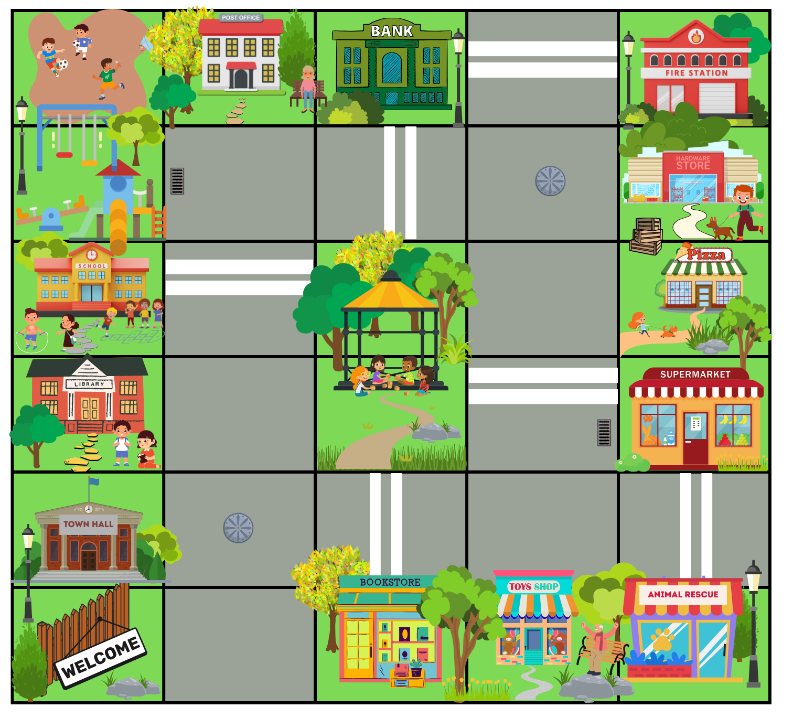
Short response (6)
Start at the bookstore facing the welcome sign.
Move forward 1 square.
Make a right-angled turn to face the post office.
Move forward 4 squares.
Make a quarter turn to the right and move forward 1 square.
Which building is on the left?
Notes:
Short response questions provide brisk paced questions focussing on review of current and previous content to support spaced and interleaved practice.
Syllabus focus area:
Geometric Measure A

Slide 15
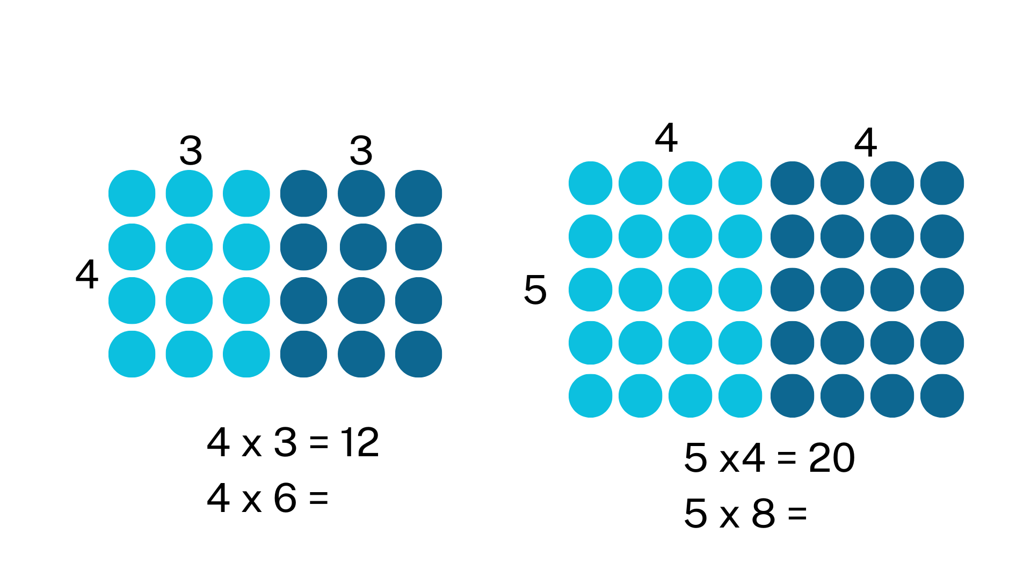
Short response (7)
Notes:
Short response questions provide brisk paced questions focussing on review of current and previous content to support spaced and interleaved practice.
Syllabus focus area:
Multiplicative relations B

Slide 16
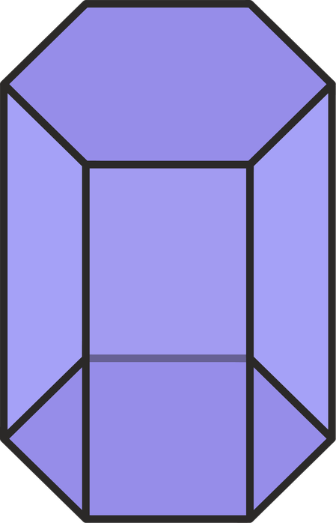
Short response (8)
Sketch the top and side view.
Notes:
Short response questions provide brisk paced questions focussing on review of current and previous content to support spaced and interleaved practice.
Syllabus focus area:
Three-dimensional spatial structure B: 3D objects

Slide 17
Activity 2 – to the nearest thousand
Record these target numbers:​
20 000​
40 000​
60 000​
80 000​
Roll five 0-9 dice to make a 5-digit number as close as possible​ to each target number.
Notes:
This is a developing number sense activity.
Number sense refers to a deep understanding of numbers, including their magnitude, relationships, and the effects of operations on them. It supports fluency and understanding, estimation, flexible thinking, and efficient problem-solving. Number sense activities 1–4 ‘activate’ prior number knowledge and support the learning of new content in the unit. Number sense activities 5–8 ‘loop’ back and provide opportunity for spaced practice with concepts and procedures covered in previous units.
Syllabus focus area:
Representing numbers using place value B
Activity 2 – to the nearest thousand
Students write the target numbers 20 000, 40 000, 60 000 and 80 000 on individual whiteboards.
Students roll five 0–9 dice and arrange them to make a 5-digit number as close as possible to one of the target numbers. Students say their chosen number aloud and record it next to the desired target number in any order. Repeat the process 7 times.
Ask:
Who got nearest to a target number? How do you know?
Is there a 5-digit number you noticed that if the arrangement of numbers was changed, it would create a number closer to one of the target numbers? Explain your reasoning.
Can you select one of your rolled numbers and rearrange it to be the smallest number possible?

Slide 18
Review of learning 3

Slide 19
Multiple choice (2)
Which is the closest thousand to 7492?
A
7490
B
7000
C
8000
D
7500
Notes:
This question connects to the content in the developing number sense activity (Activity 3)
Syllabus focus area:
Representing numbers using place value A

Slide 20
Short response (9)
Sketch a rectangular prism showing depth. Think about the 2D shapes that can be seen.
Notes:
Short response questions provide brisk paced questions focussing on review of current and previous content to support spaced and interleaved practice.
Syllabus focus area:
Three-dimensional spatial structure B

Slide 21
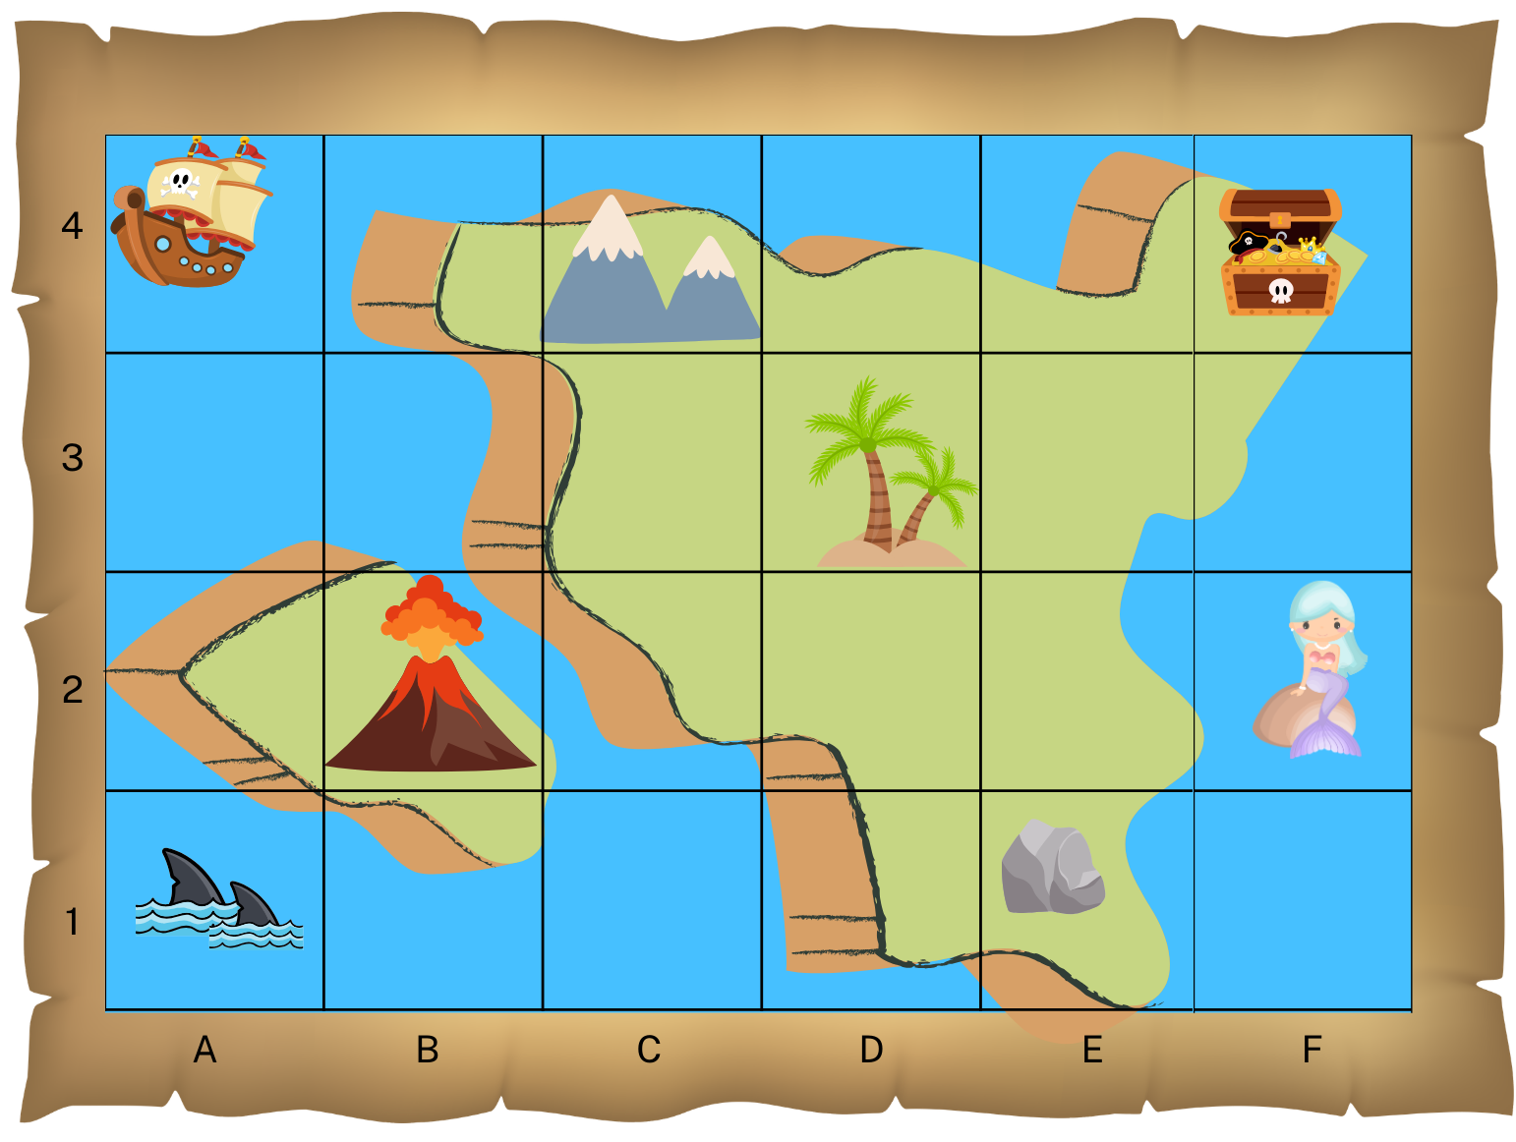



Short response (10)
Record the grid references for the:
mountains
mermaid
treasure chest
Notes:
Short response questions provide brisk paced questions focussing on review of current and previous content to support spaced and interleaved practice.
Syllabus focus area:
Geometric measure A

Slide 22
Short response (11)
Use this fact 3 x 7 = 21 to solve:​
​6 x 7​
9 x 7​
12 x 7​
Notes:
Short response questions provide brisk paced questions focussing on review of current and previous content to support spaced and interleaved practice.
Syllabus focus area:
Multiplicative relations B

Slide 23
Short response (12)
Record the capacity in L and mL.
3250 mL = ___ L ___ mL
Notes:
Short response questions provide brisk paced questions focussing on review of current and previous content to support spaced and interleaved practice.
Syllabus focus area:
Three-dimensional spatial structure B: Volume

Slide 24
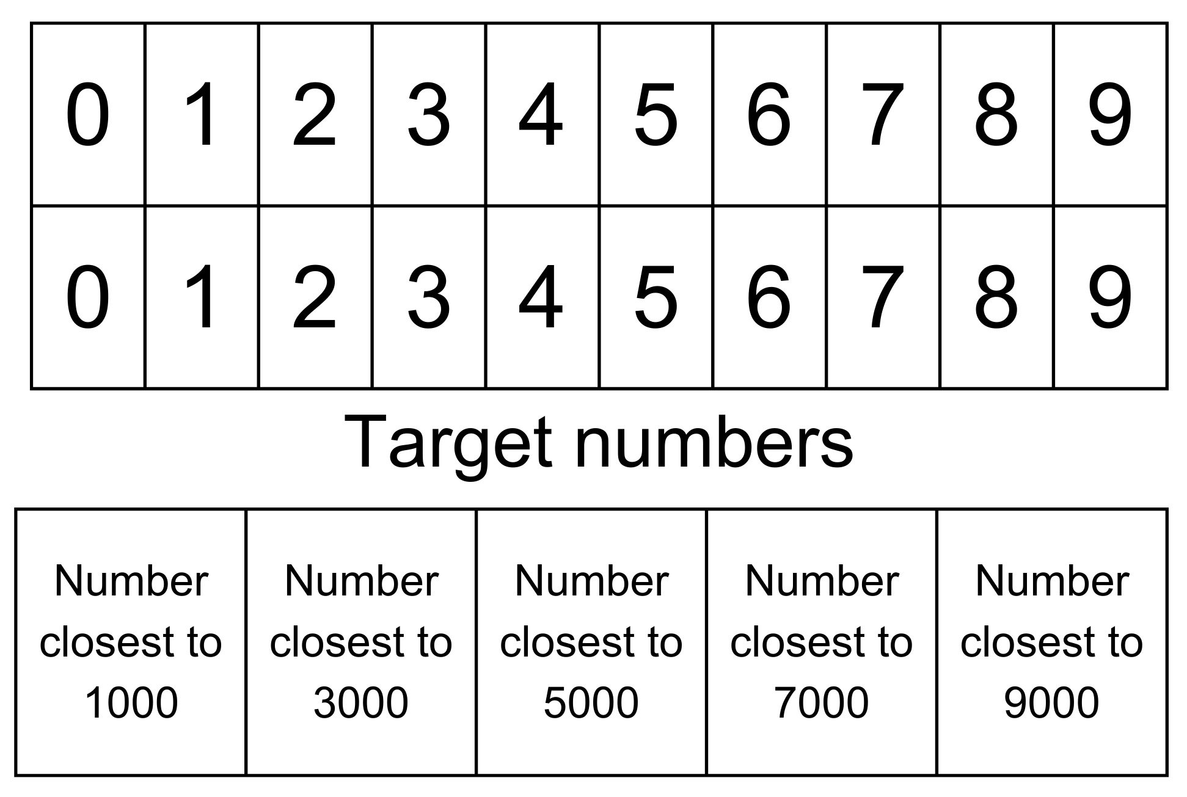
Activity 3 – 4-digit targets
Notes:
This is a developing number sense activity.
Number sense refers to a deep understanding of numbers, including their magnitude, relationships, and the effects of operations on them. It supports fluency and understanding, estimation, flexible thinking, and efficient problem-solving. Number sense activities 1–4 ‘activate’ prior number knowledge and support the learning of new content in the unit. Number sense activities 5–8 ‘loop’ back and provide opportunity for spaced practice with concepts and procedures covered in previous units.
Syllabus focus area:
Representing numbers using place value B
Activity 3 – 20 numbers
This resource corresponds to Resource 15 – 20 numbers in Stage 2 Year B Unit 29.
This activity is an adaptation of ‘Four-digit Targets’ from NRICH by the University of Cambridge (Faculty of Mathematics).
Tell students they need to arrange the digits to make five 4-digit numbers as close to the target numbers as possible. Explain to students that they can use each digit only once.
Encourage small groups of students to work strategically and systematically to get numbers nearest to the target numbers. Remind students they can adjust their answers as they progress with the problem.
Ask:
Who recorded the 4-digit number nearest to each target number? How do you know?
Does your 4-digit number round up or down to the target number?
What were the challenges in this task?

Slide 25
Review of learning 4

Slide 26
True or false (2)
2780 is 780 more than 2000 and 220 less than 3000.
True | False
Notes:
The question on this slide connects to the content being explored in the developing number sense activity (Activity 4)
Syllabus focus area:
Representing number using place value B

Slide 27
Short response (13)
Sketch a triangular prism.
Notes:
Short response questions provide brisk paced questions focussing on review of current and previous content to support spaced and interleaved practice.
Syllabus focus area:
Three-dimensional spatial structure B

Slide 28
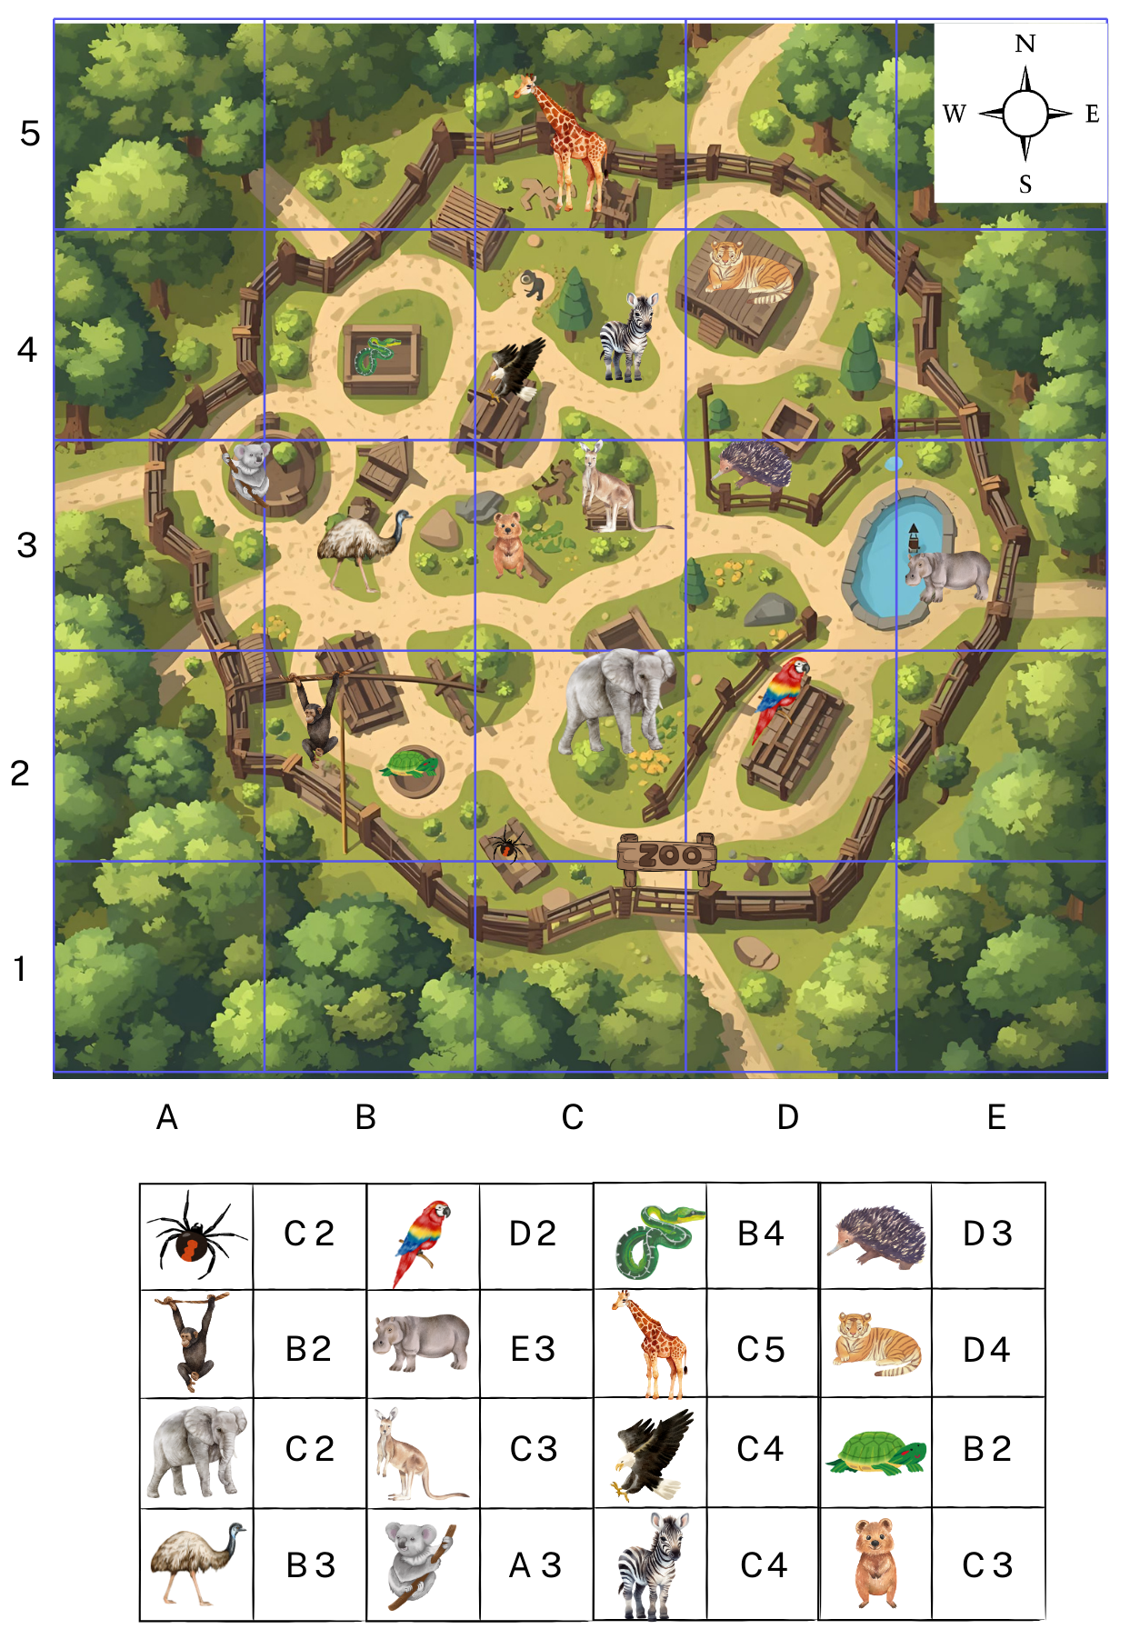
Short response (14)
Follow these directions:
Starting at D2 move north 1 square.
Turn west and head to C3.
Turn north.
Head 2 squares up to C5.
What animal are you viewing?
What direction do you need to head to see the zebra?
Notes:
Short response questions provide brisk paced questions focussing on review of current and previous content to support spaced and interleaved practice.
Syllabus focus area:
Geometric measure B

Slide 29

Short response (15)
Partially covered array
How many rows are there in this array?
How many dots are in each row?
What is the total number of dots in the array?
Notes:
Short response questions provide brisk paced questions focussing on review of current and previous content to support spaced and interleaved practice.
Syllabus focus area:
Multiplicative relations A

Slide 30
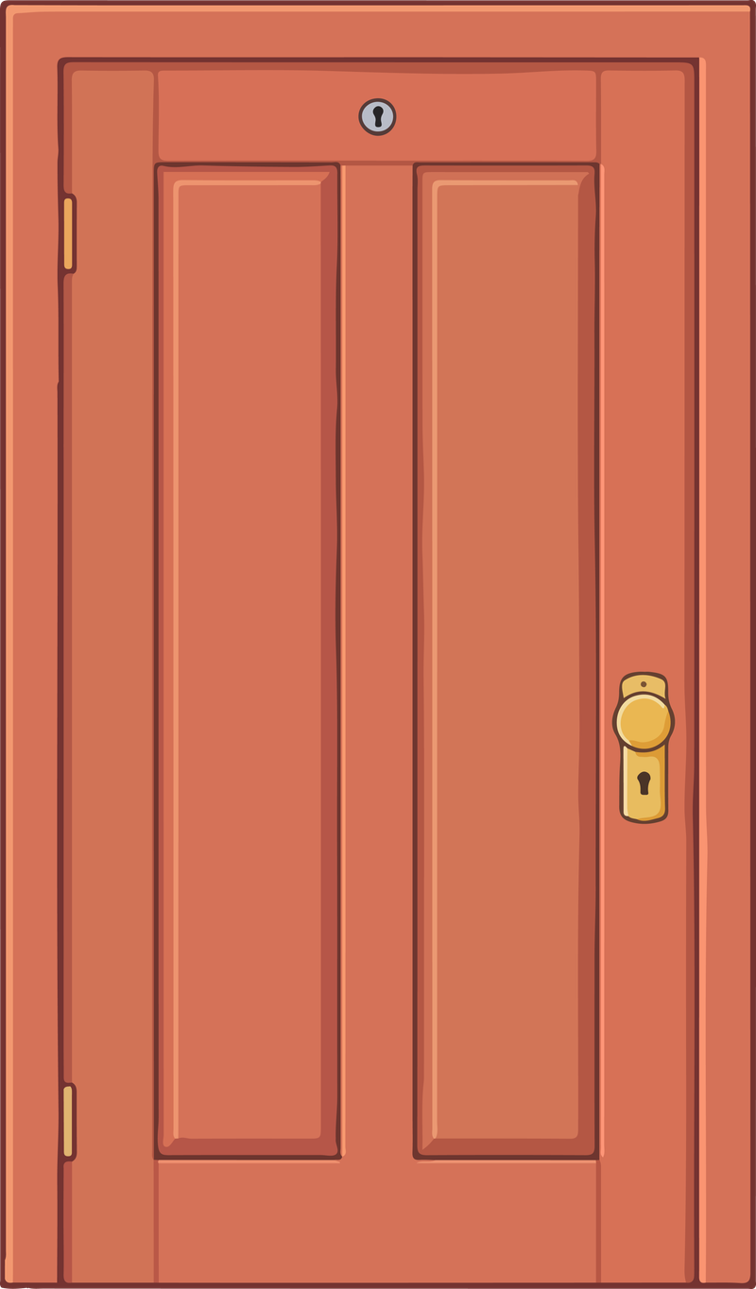
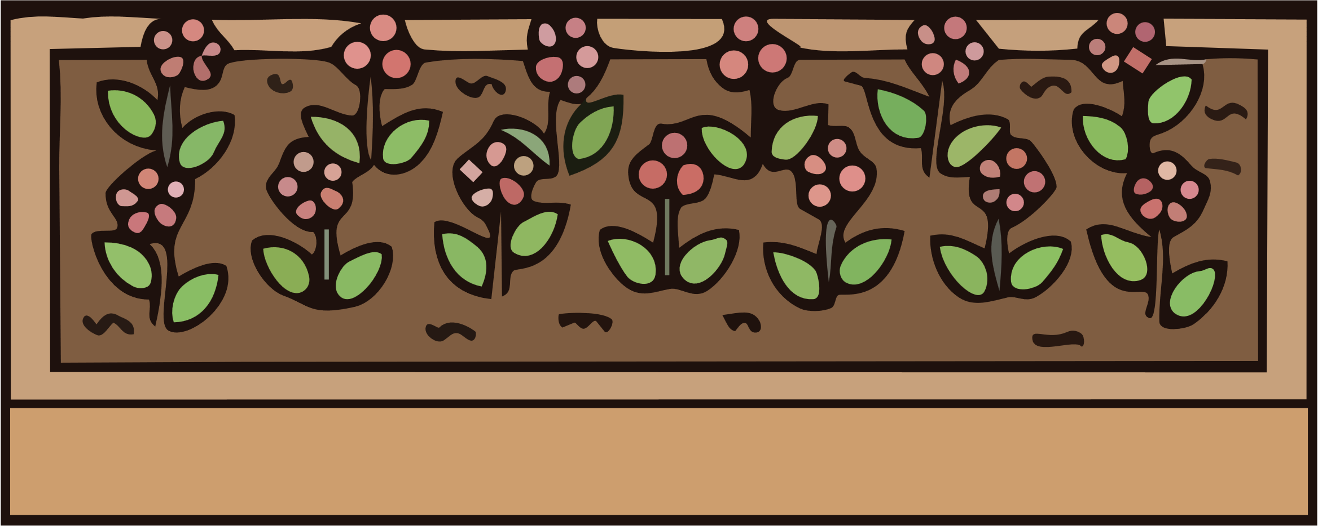
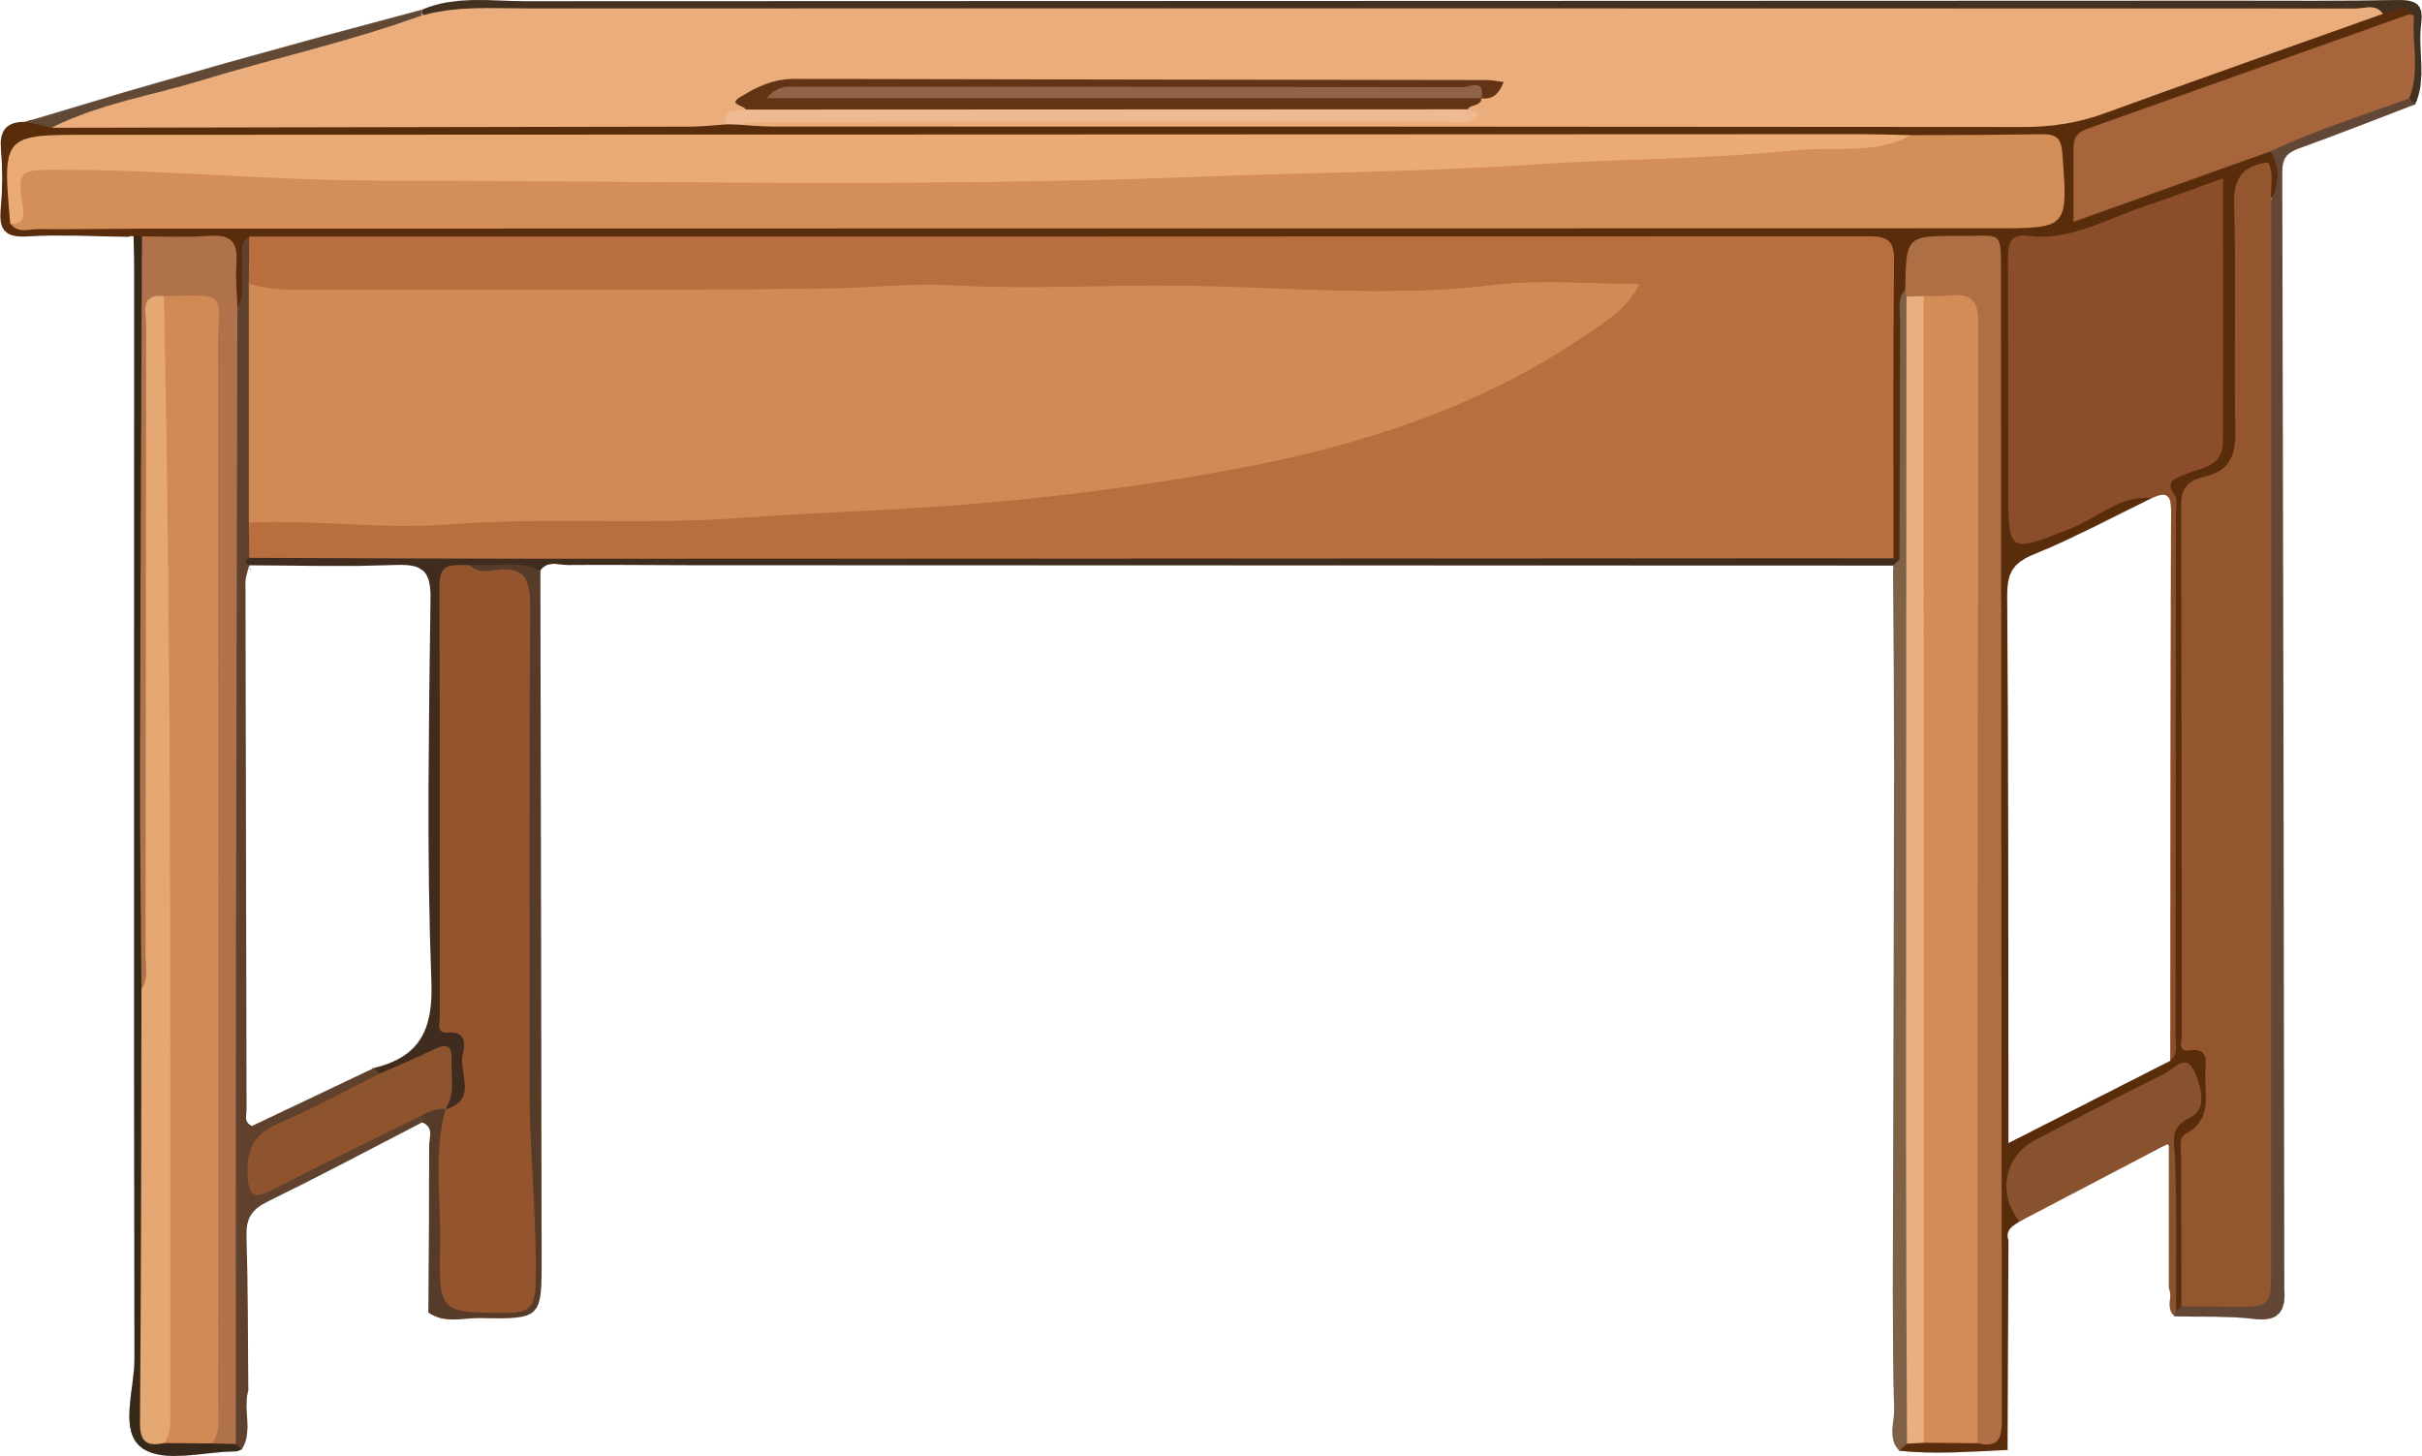
Short response (16)
Compare and order the lengths in metres and centimetres.
2 m 75 cm
82 cm
130 cm
Communicate your thinking.
Notes:
Short response questions provide brisk paced questions focussing on review of current and previous content to support spaced and interleaved practice.
Syllabus focus area:
Geometric measure A: Length

Slide 31
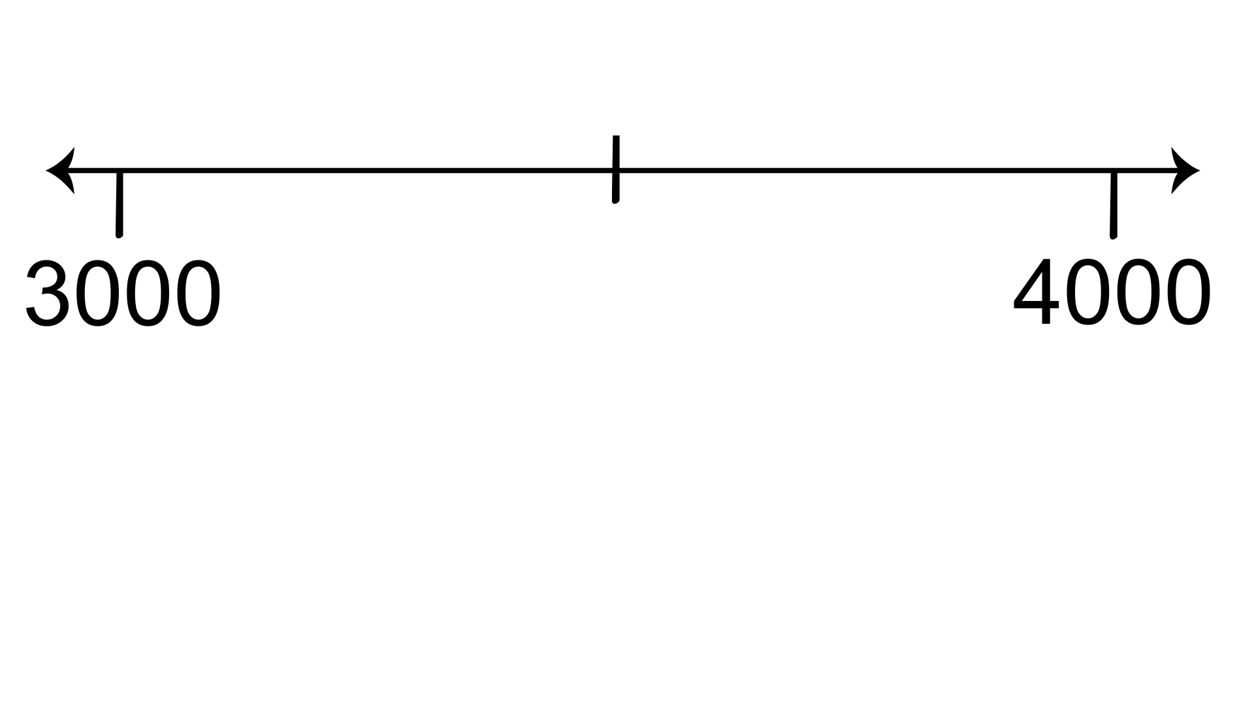
Activity 4 – quick fire - call it out!
3520
?
?
Which two thousands is this number between?
Which thousand is it closest to?
How do you know?
Notes:
This is a developing number sense activity.
Number sense refers to a deep understanding of numbers, including their magnitude, relationships, and the effects of operations on them. It supports fluency and understanding, estimation, flexible thinking, and efficient problem-solving. Number sense activities 1–4 ‘activate’ prior number knowledge and support the learning of new content in the unit. Number sense activities 5–8 ‘loop’ back and provide opportunity for spaced practice with concepts and procedures covered in previous units.
Syllabus focus area:
Representing numbers using place value B
Activity 4 – Quick fire- call it out
Ask:
What two thousands is this number between?
Which thousand is it closest to?
How do you know?
Repeat the process with students working in pairs.
Provide students with example of 4-digit numbers.
Ask them to draw a number line from the lower to the higher thousand ( for example 2 000 – 3 000), estimate where their number lies and then discuss and compare answers with each other.

Slide 32
Review of learning 5

Slide 33
Multiple choice (3)
These are the first 3 terms in a sequence.
1423, 1323, 1223
What is the sixth term in this sequence?
A
B
C
D
1123
923
823
1523
Notes:
This question connects to the content in the developing number sense activity (Activity 5)
Syllabus focus area:
Representing numbers using place value A

Slide 34
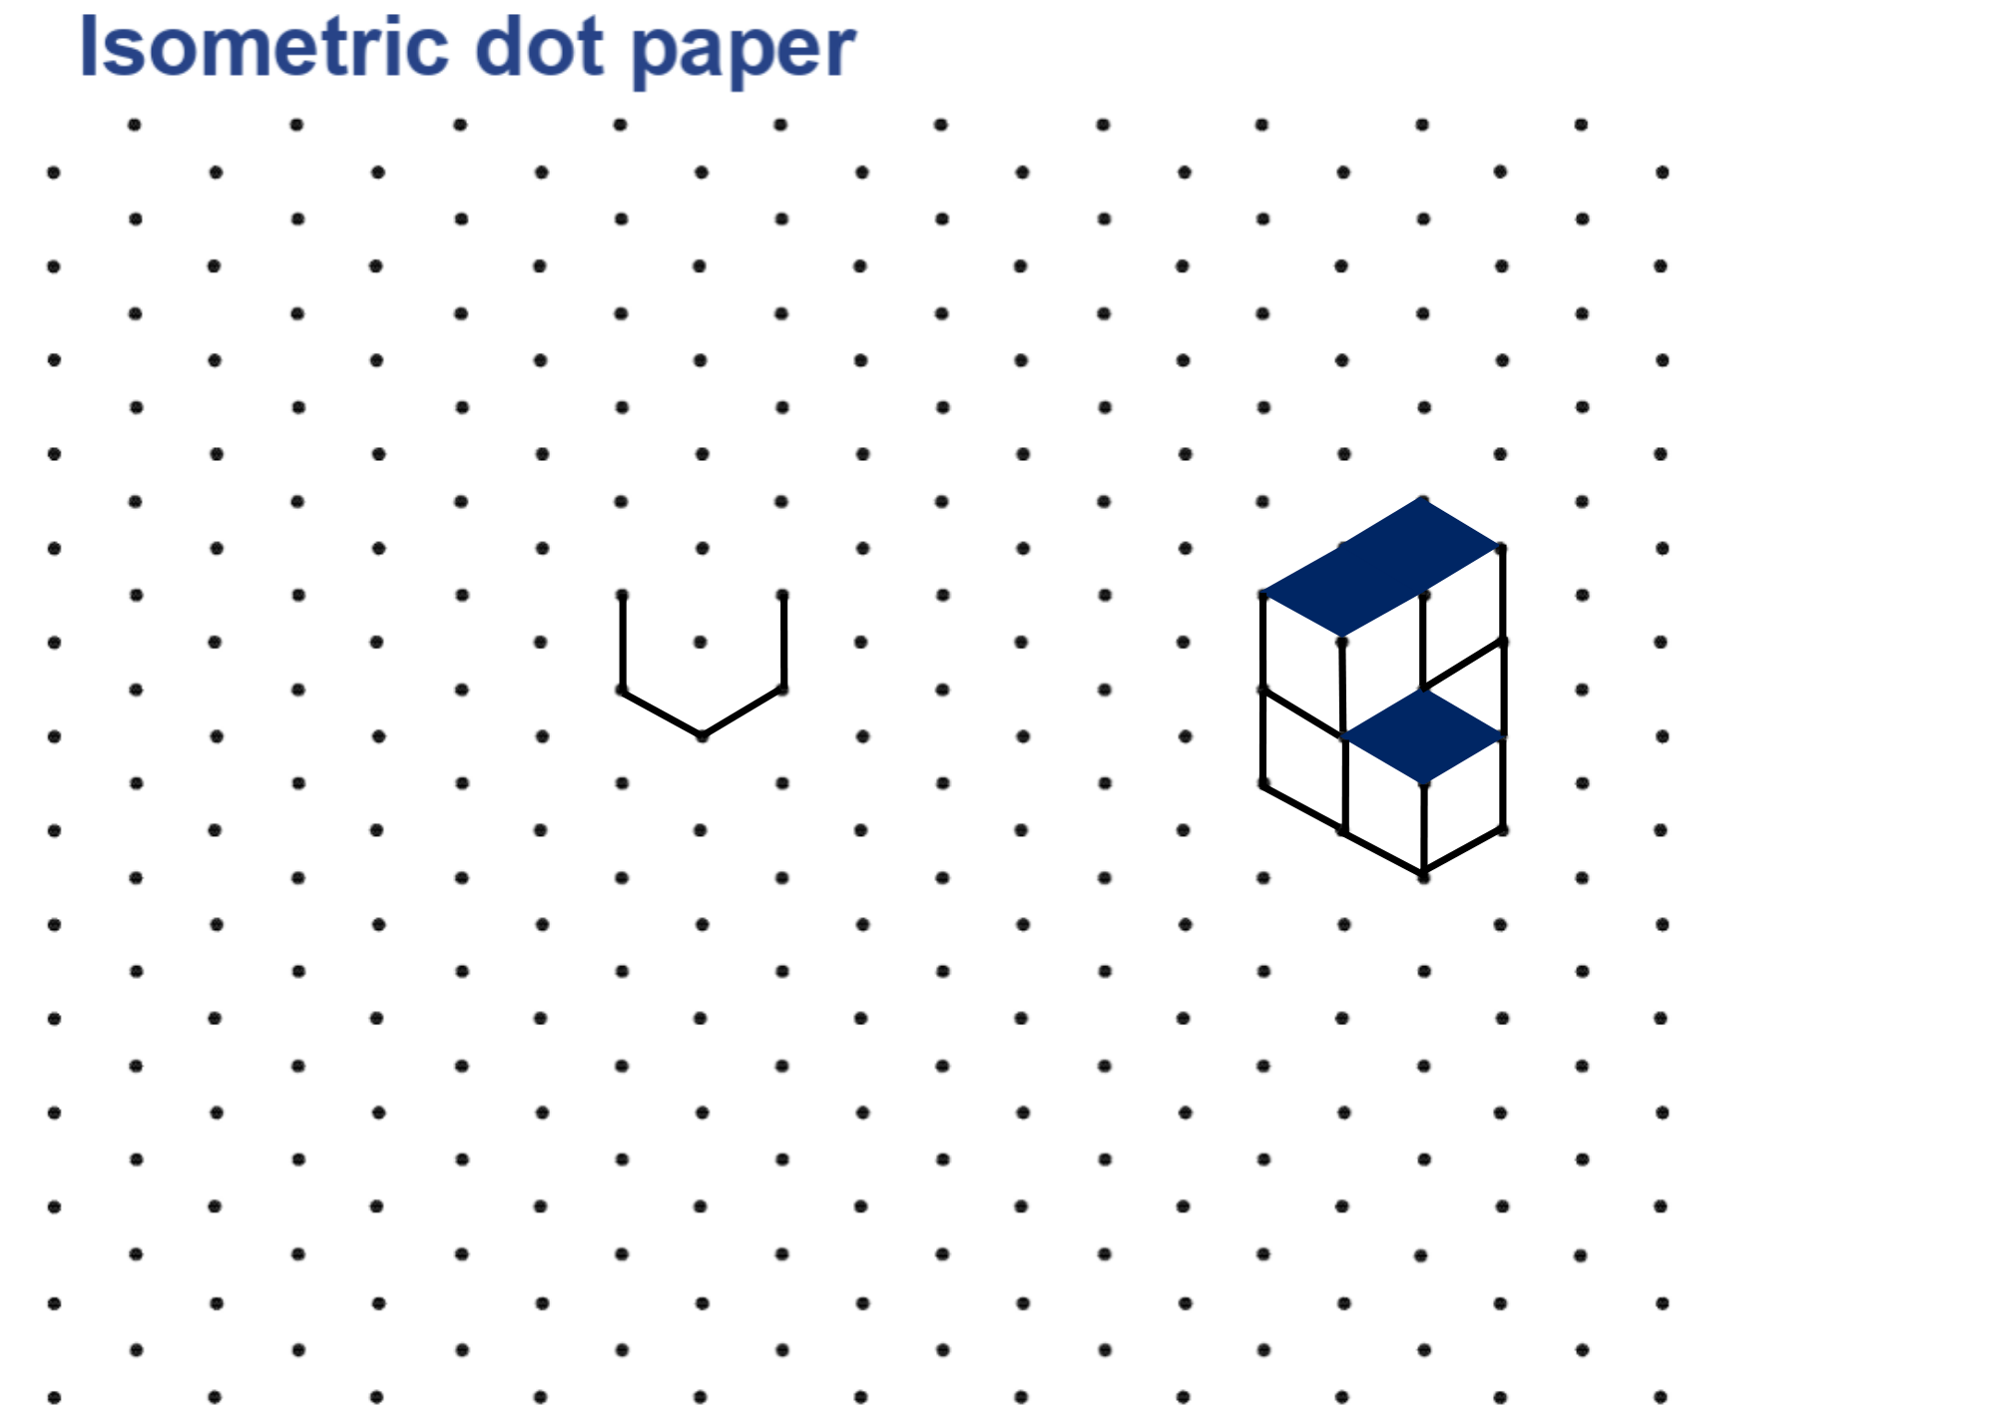
Short response (17)
How many cubes make up this object?
How many hidden faces are there?
Notes:
Short response questions provide brisk paced questions focussing on review of current and previous content to support spaced and interleaved practice.
Syllabus focus area:
Three-dimensional spatial structure B

Slide 35
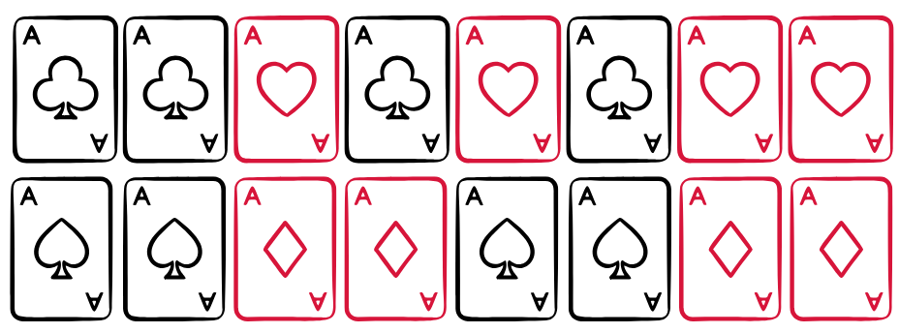
Short response (18)
In this set of 16 cards, I am more likely to draw a red card than a black card.
Do you agree with this statement?
Communicate your reasoning.
Notes:
Short response questions provide brisk paced questions focussing on review of current and previous content to support spaced and interleaved practice.
Syllabus focus area:
Chance B

Slide 36
Short response (19)
Use 5 x 9 = 45 to complete the following number sentences:​
​45 ÷ 9 = ​◻
​45 ÷◻ = 9​
​Show these numbers in a fact family triangle.
Notes:
Short response questions provide brisk paced questions focussing on review of current and previous content to support spaced and interleaved practice.
Syllabus focus area:
Multiplicative relations A

Slide 37
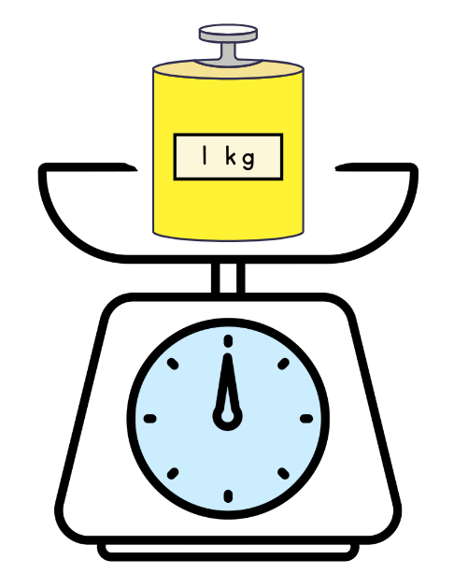
Short response (20)
Record 3 familiar objects that each have a mass of about one kilogram (kg).
Communicate your reasoning.
Notes:
Short response questions provide brisk paced questions focussing on review of current and previous content to support spaced and interleaved practice.
Syllabus focus area:
Non-spatial measure A: Mass

Slide 38
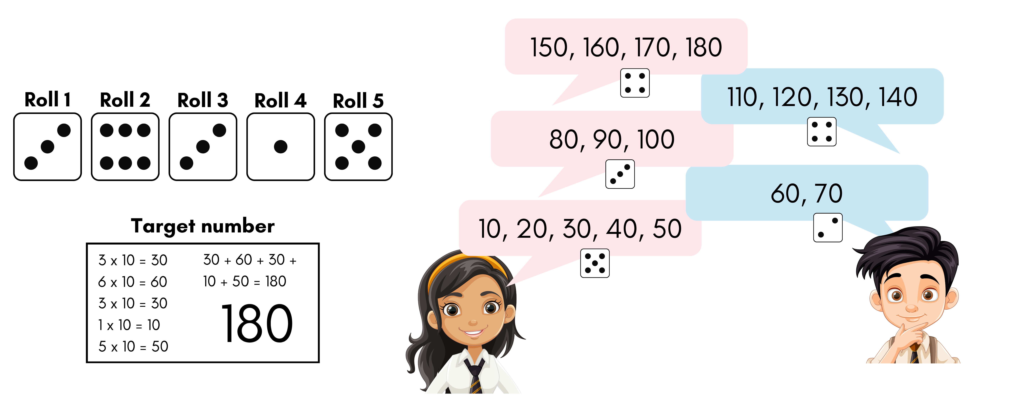
Activity 5 – counting by tens
Notes:
This is a developing number sense activity.
Number sense refers to a deep understanding of numbers, including their magnitude, relationships, and the effects of operations on them. It supports fluency and understanding, estimation, flexible thinking, and efficient problem-solving. Number sense activities 1–4 ‘activate’ prior number knowledge and support the learning of new content in the unit. Number sense activities 5–8 ‘loop’ back and provide opportunity for spaced practice with concepts and procedures covered in previous units.
Syllabus focus area:
Multiplicative relations B
Activity 5 – counting by 10s
This activity is an adaptation of ‘Counting game (by multiples of 10)’ from K–6 Mathematics resources by the State of New South Wales (Department of Education).
Aim of the game
Use multiples of 10 to reach a target number
In pairs, students roll a 6-sided die 5 times. Each time, the number rolled is multiplied by 10. The totals are then added together to determine a target number.
Ask students how they know that the target number is a multiple of 10.
Explain that the object of the game is to be the person who gets to the target number first.
Starting at zero, players take turns to roll the die and count on in tens. For example, player A rolls a 5 and counts by 10 five times; 10, 20, 30, 40, 50. Player B rolls a 2 and counts 60, 70. This continues until an exact throw is rolled to land on the target number.
Pairs record their dice throw and counting on each turn.

Slide 39
Review of learning 6

Slide 40
True or false (3)
3 groups of 5 tens = 5 groups of 3 tens
True | False
Notes:
The question on this slide connects to the content being explored in the developing number sense activity (Activity 6)
Syllabus focus area:
Multiplicative relations B

Slide 41
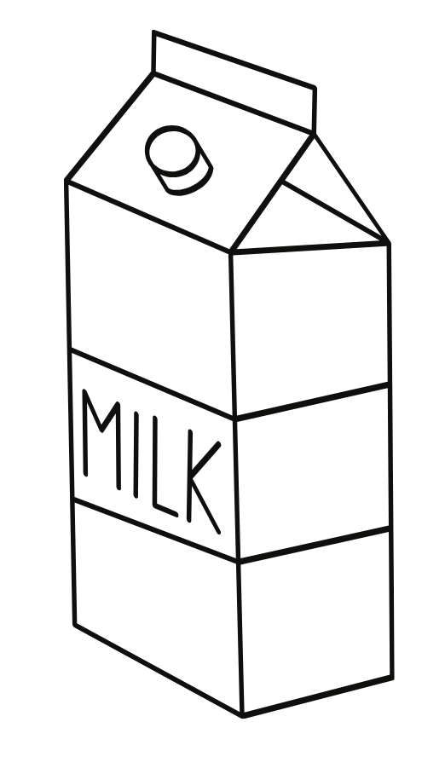
Short response (21)
Record the capacity of a 1-litre milk container using the abbreviation for litres.
Notes:
Short response questions provide brisk paced questions focussing on review of current and previous content to support spaced and interleaved practice.
Syllabus focus area:
Three-dimensional spatial structure A

Slide 42
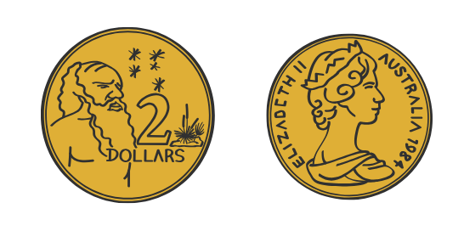
Short response (22)
Taran tossed a coin 20 times and recorded her findings. She had tossed 15 heads and 5 tails.
What is the chance that the next toss will be tails?
Communicate your reasoning.
Notes:
Short response questions provide brisk paced questions focussing on review of current and previous content to support spaced and interleaved practice.
Syllabus focus area:
Chance B

Slide 43

Short response (23)
Fact families:
8 x 6 = 48
6 x 8 = 48
48 ÷ 8 = 6
48 ÷ 6 = 8
Create your own fact families for these numbers:
24
55
72
Notes:
Short response questions provide brisk paced questions focussing on review of current and previous content to support spaced and interleaved practice.
Syllabus focus area:
Multiplicative relations B

Slide 44
Short response (24)
Record the chance terms to complete each sentence:
likely
equally likely
unlikely
It is ______ it will snow in Sydney during Summer.
It is _______ will see your classmates at school.
It is ________ that when you flip a coin, it will land on
heads or tails.
Notes:
Short response questions provide brisk paced questions focussing on review of current and previous content to support spaced and interleaved practice.
Syllabus focus area:
Chance B

Slide 45
Activity 6 – multiples madness
0 | 10 | 40 | 80 | 60
30 | 70 | 20 | 50 | 30
50 | 20 | 0 | 40 | 60
90 | 10 | 70 | 80 | 50
40 | 60 | 30 | 90 | 20
Notes:
This is a developing number sense activity.
Number sense refers to a deep understanding of numbers, including their magnitude, relationships, and the effects of operations on them. It supports fluency and understanding, estimation, flexible thinking, and efficient problem-solving. Number sense activities 1–4 ‘activate’ prior number knowledge and support the learning of new content in the unit. Number sense activities 5–8 ‘loop’ back and provide opportunity for spaced practice with concepts and procedures covered in previous units.
Syllabus focus area:
Multiplicative relations B
Activity 6 – multiples madness
This resource corresponds to Resource 16 – multiples madness gameboard in Stage 2 Year B Unit 29.
This activity is an adaptation of ‘Multiples madness (fives)’ at Mathematics K–6 resources by the State of New South Wales (Department of Education).
Aim of the game
Multiply numbers by 10 to get 3 counters in a row on a gameboard.
Rules:
in pairs, take turns to roll a dice and multiply the number by 10
place one of your 3 counters over the number on your gameboard
if the number is not available, miss a turn
continue until you have 3 counters in a row in any orientation.
Support students to reflect on the activity by asking:
Did you prefer going first or second? Why?
What strategy did you use? How successful was it and why?
How might the game change if you multiplied by 20?
Would it be easier if you had more counters? Why?

Slide 46
Review of learning 7

Slide 47
Multiple choice (4)
What is the second smallest number formed by rearranging the digits within 54 321?
A
54 312
B
12 345
C
12 354
D
54 123
Notes:
This question connects to the content in the developing number sense activity (Activity 3)
Syllabus focus area:
Representing numbers using place value B

Slide 48
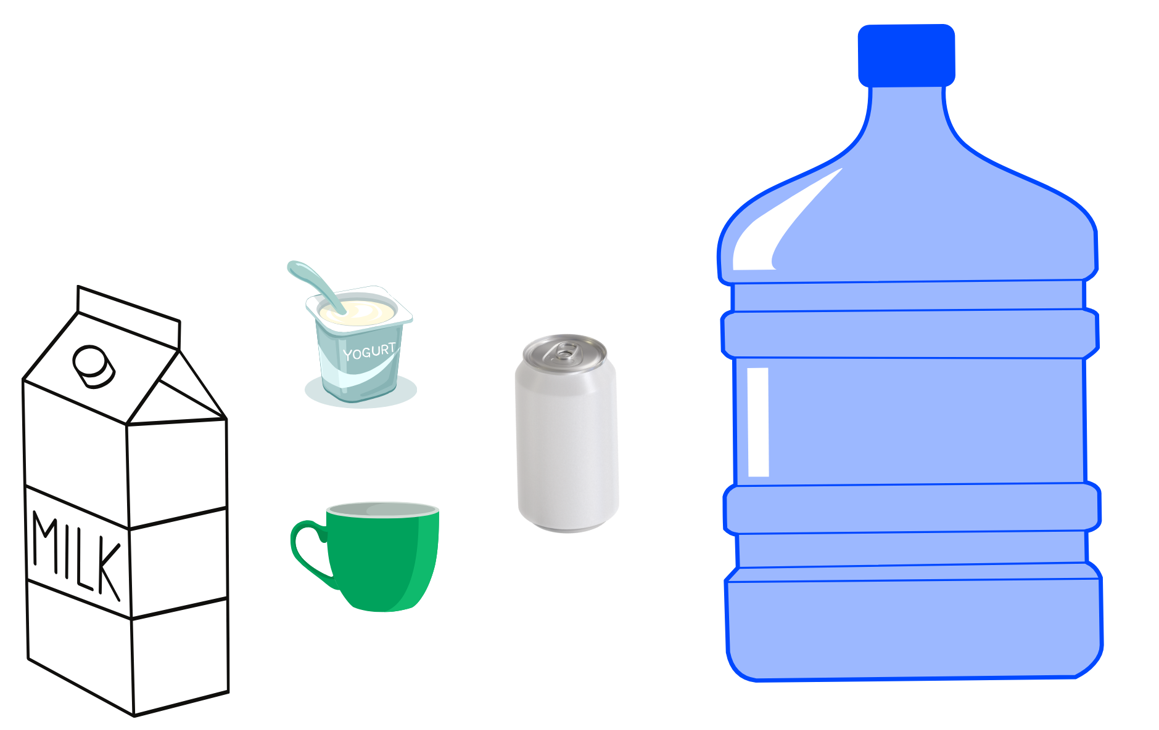
Short response (25)
The milk carton has a capacity of 1L. Use this information to estimate the capacities of the other objects.
Notes:
Short response questions provide brisk paced questions focussing on review of current and previous content to support spaced and interleaved practice.
Syllabus focus area:
Three-dimensional spatial structure B

Slide 49
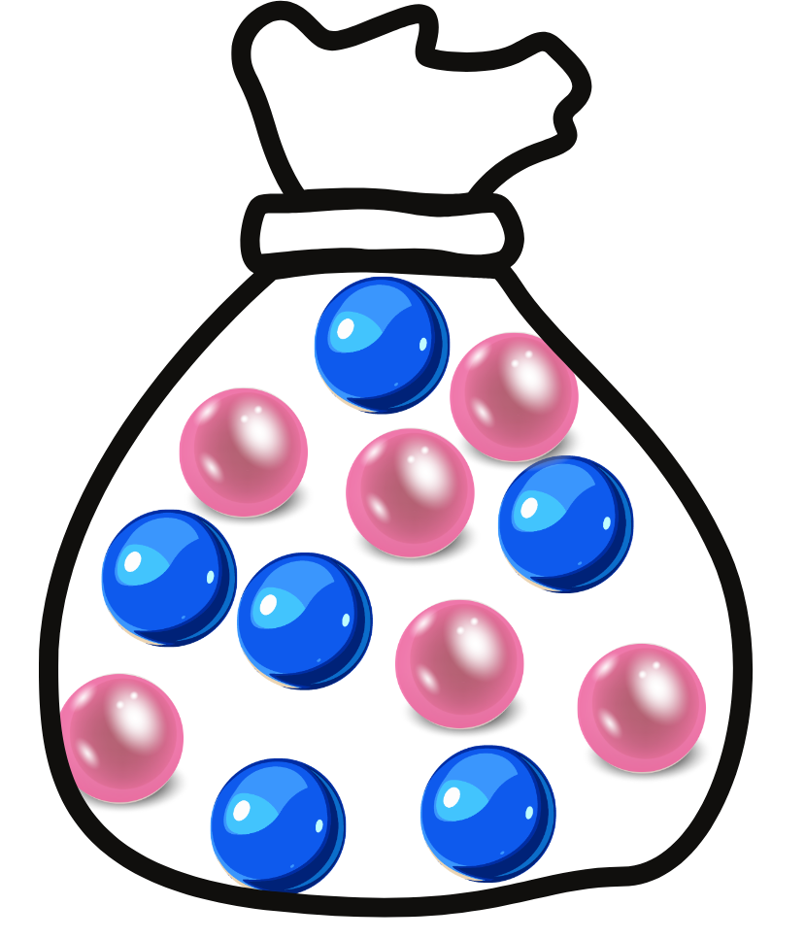
Short response (26)
I have a bag of pink and blue marbles.
List all the possible outcomes for randomly picking any 3 marbles.
Notes:
Short response questions provide brisk paced questions focussing on review of current and previous content to support spaced and interleaved practice.
Syllabus focus area:
Chance A

Slide 50
Short response (27)
Sophie solved 60 x 4 using the following strategy:
6 x 10 x 4
= 6 x 4 x 10
= 24 x 10
= 240
Do you think this is an efficient strategy?
Communicate your reasoning.
Solve 70 x 5 using the same strategy.
Notes:
Short response questions provide brisk paced questions focussing on review of current and previous content to support spaced and interleaved practice.
Syllabus focus area:
Multiplicative relations B

Slide 51
Short response (28)
What is similar and different about these two-dimensional shapes?
Notes:
Short response questions provide brisk paced questions focussing on review of current and previous content to support spaced and interleaved practice.
Syllabus focus area:
Two-dimensional spatial structure A

Slide 52
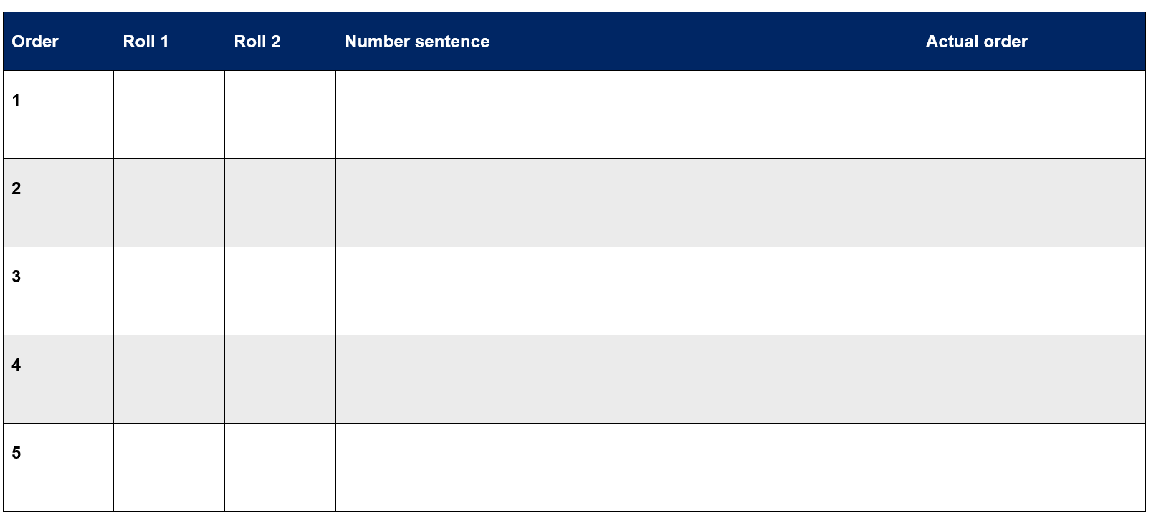
Activity 7 – multiplying by multiples
Notes:
This is a developing number sense activity.
Number sense refers to a deep understanding of numbers, including their magnitude, relationships, and the effects of operations on them. It supports fluency and understanding, estimation, flexible thinking, and efficient problem-solving. Number sense activities 1–4 ‘activate’ prior number knowledge and support the learning of new content in the unit. Number sense activities 5–8 ‘loop’ back and provide opportunity for spaced practice with concepts and procedures covered in previous units.
Syllabus focus area:
Representing numbers using place value B
Activity 7
This resource corresponds to Resource 17 – multiplying multiples in Stage 2 Year B Unit 29.
Provide pairs of students with a 10-sided die and 2 copies of Resource 17 – multiplying multiples
Aim of the game
Place the product of dice rolls in ascending order.
Rules:
in pairs, take turns to roll a dice twice
the first number is the multiplier and the second becomes a multiple of 10
multiply these 2 numbers
decide where to place your number on the multiplying multiples gameboard. The aim is to have the final products in ascending order after 5 turns.
At the end of the game, score a point for each correct placement.
When students have played the game, encourage reflection by asking:
How did you decide where to place each answer?
Did you change your strategy after the first round? Why or why not?
What modifications could you suggest for the game?

Slide 53
Review of learning 8

Slide 54
True or false (4)
Pick 4 consecutive digits (1-9). Form the largest and smallest possible numbers. The difference between those numbers is 3087.
True | False
Notes:
The question on this slide connects to the content being explored in the developing number sense activity (Activity 8)
Syllabus focus area:
Representing numbers using place value B

Slide 55
Short response (29)
Sort these containers in order from smallest estimated capacity to largest estimated capacity.
Notes:
Short response questions provide brisk paced questions focussing on review of current and previous content to support spaced and interleaved practice.
Syllabus focus area:
Three-dimensional spatial structure B

Slide 56
Short response (30)
Remove 1 blue marble from this bag. Has this action changed the chance of picking a pink marble next?
Communicate your reasoning.
Notes:
Short response questions provide brisk paced questions focussing on review of current and previous content to support spaced and interleaved practice.
Syllabus focus area:
Chance B

Slide 57
Short response (31)
Kieran solved 25 x 8 using 2 strategies.
Which strategy do you prefer? Why?
Strategy 1:​
25 x 8 = 25 x 4 x 2​
= 100 x 2 ​
= 200​
Strategy 2:​
25 x 8 = 25 x 4 x 2​
= 25 x 2 x 4​
= 50 x 4 ​
= 200
Notes:
Short response questions provide brisk paced questions focussing on review of current and previous content to support spaced and interleaved practice.
Syllabus focus area:
Multiplicative relations B

Slide 58
Short response (32)
A line of symmetry is a line that divides a shape into 2 halves.
How many lines of symmetry does each shape have?
Notes:
Short response questions provide brisk paced questions focussing on review of current and previous content to support spaced and interleaved practice.
Syllabus focus area:
Two-dimensional spatial structure A

Slide 59
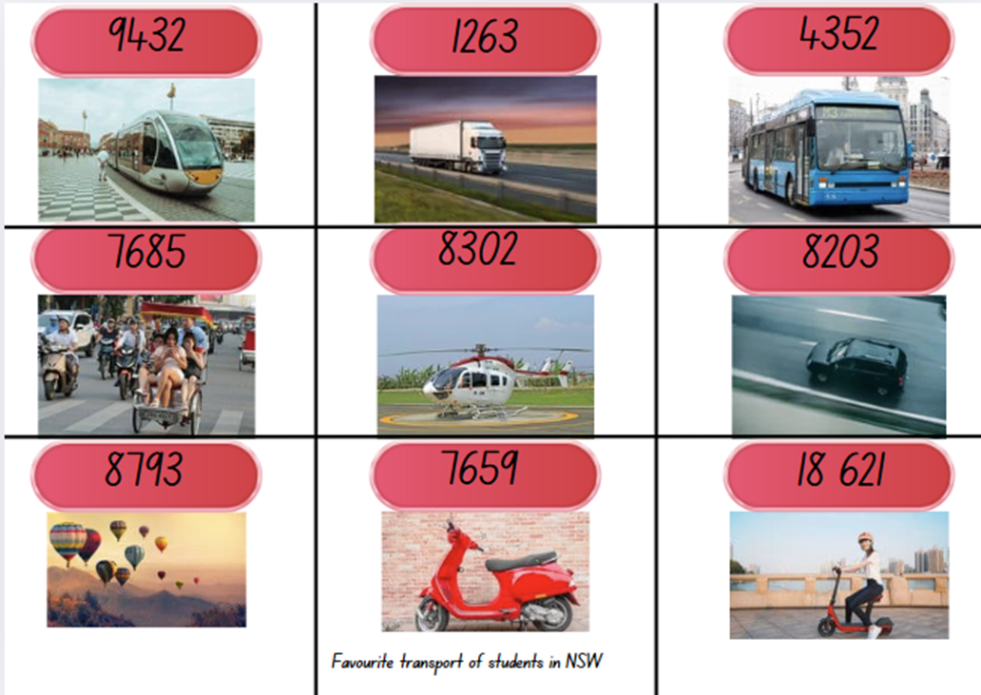
Activity 8 – number arranging
  read each number aloud together.
  arrange the numbers in ascending order (smallest to largest).
  rearrange them in descending order (largest to smallest).
  How did you decide which came first? What did you look at?”
Notes:
This is a developing number sense activity.
Number sense refers to a deep understanding of numbers, including their magnitude, relationships, and the effects of operations on them. It supports fluency and understanding, estimation, flexible thinking, and efficient problem-solving. Number sense activities 1–4 ‘activate’ prior number knowledge and support the learning of new content in the unit. Number sense activities 5–8 ‘loop’ back and provide opportunity for spaced practice with concepts and procedures covered in previous units.
Syllabus focus area:
Representing number using place value B
Activity 8
This resource corresponds to Resource 18 – favourite transport in Stage 2 Year B Unit 29.
Cut Resource 18 – favourite transport into individual cards
Show a few cards and read the numbers aloud with the class.
Ask students to identify the place value of digits (e.g., “What does the 4 represent in 4,875?”).
Divide students into small groups and give each group a set of cards.
Instruct groups to:
read each number aloud together.
arrange the numbers in ascending order (smallest to largest).
rearrange them in descending order (largest to smallest).
Regroup class and invite groups to read their sequences aloud and ask: “How did you decide which came first? What did you look at?”
Discuss strategies (compare thousands first, then hundreds, etc.).

Slide 60
References
This presentation contains NSW Curriculum and syllabus content. The NSW Curriculum is developed by the NSW Education Standards Authority. This content is prepared by NESA for and on behalf of the Crown in the right of the State of New South Wales. The material is protected by Crown copyright.
Please refer to the NESA Copyright Disclaimer for more information https://educationstandards.nsw.edu.au/wps/portal/nesa/mini-footer/copyright.
NESA holds the only official and up-to-date versions of the NSW Curriculum and syllabus documents. Please visit the NSW Education Standards Authority (NESA) website https://educationstandards.nsw.edu.au/wps/portal/nesa/home and the NSW Curriculum website https://curriculum.nsw.edu.au.
Mathematics K-10 Syllabus © Syllabus NSW Education Standards Authority (NESA) for and on behalf of the Crown in right of the State of New South Wales, 2022.
National Numeracy Learning Progression © Australian Curriculum, Assessment and Reporting Authority (ACARA) 2010 to present, unless otherwise indicated. This material was downloaded from the Australian Curriculum website (National Literacy Learning Progression) (accessed 8 April 2024 and was not modified.
State of New South Wales (Department of Education) (2023) ‘ Counting game (by multiples of 10) ‘K–6 Mathematics Resources, NSW Department of Education website, accessed 10 March 2026.
State of New South Wales (Department of Education) (2023) ‘Multiples madness (fives)’, K–6 Mathematics Resources, NSW Department of Education website, accessed 10 March 2026.
Sullivan P and Lilburn P (2017) Open-ended Maths Activities: Using ‘Good’ Questions to Enhance Learning in Mathematics, Revised edn, Oxford University Press ANZ, Great Britain.

Slide 61
References (2)
This presentation contains NSW Curriculum and syllabus content. The NSW Curriculum is developed by the NSW Education Standards Authority. This content is prepared by NESA for and on behalf of the Crown in the right of the State of New South Wales. The material is protected by Crown copyright.
Please refer to the NESA Copyright Disclaimer for more information https://educationstandards.nsw.edu.au/wps/portal/nesa/mini-footer/copyright.
NESA holds the only official and up-to-date versions of the NSW Curriculum and syllabus documents. Please visit the NSW Education Standards Authority (NESA) website https://educationstandards.nsw.edu.au/wps/portal/nesa/home and the NSW Curriculum website https://curriculum.nsw.edu.au.
University of Cambridge (n.d.) Four-digit Targets, NRICH website, accessed 10 March 2026.
University of Cambridge (n.d.) Round the Four Dice, NRICH website, accessed 10 March 2026.
[

Slide 62
Copyright
© State of New South Wales (Department of Education), 2025
The copyright material published in this resource is subject to the Copyright Act 1968 (Cth) and is owned by the NSW Department of Education or, where indicated, by a party other than the NSW Department of Education (third-party material).
Copyright material available in this resource and owned by the NSW Department of Education is licensed under a Creative Commons Attribution 4.0 International (CC BY 4.0) license.
This license allows you to share and adapt the material for any purpose, even commercially.
Attribution should be given to © State of New South Wales (Department of Education), 2025.
Material in this resource not available under a Creative Commons license:
the NSW Department of Education logo, other logos and trademark-protected material
Material owned by a third party that has been reproduced with permission. You will need to obtain permission from the third party to reuse its material.
Links to third-party material and websites
Please note that the provided (reading/viewing material/list/links/texts) are a suggestion only and implies no endorsement, by the New South Wales Department of Education, of any author, publisher, or book title. School principals and teachers are best placed to assess the suitability of resources that would complement the curriculum and reflect the needs and interests of their students.
If you use the links provided in this document to access a third party’s website, you acknowledge that the terms of use, including licence terms set out on the third-party’s website apply to the use which may be made of the materials on that third-party website or where permitted by the Copyright Act 1968 (Cth). The department accepts no responsibility for content on third-party websites.

