Slide 1
Instructions for use
This resource aligns to the learning in Stage 2 Year B Unit 30 and revisits content from earlier sample units.
Classroom teachers are encouraged to add and adapt slides as required to meet the needs of their students.
Save a copy of the file to make changes to the slide deck. Go to File > Download a Copy (this downloads a copy to the computer to edit in the PowerPoint app).
To convert the PowerPoint to Google Slides:
  Upload the file into Google Drive and open it.
  Go to File > Save as Google Slides.
  (Note – conversion may cause formatting changes in the slides.)

Slide 2

Review of Learning
Mathematics Stage 2 – Unit 30
Notes:
Reviews may include a combination of question types, requiring students to recall facts and key ideas, as well as apply their knowledge to solve problems and answer questions. To support active engagement, a mix of techniques should be employed.” (AERO, 2024).
This Review of Learning slide deck revisits key concepts from the following units:
Stage 2 Year B Unit 30
Stage 2 Year B Unit 29
Stage 2 Year B Unit 28
It also includes opportunities to review prior learning in non-number content, supporting consolidation across focus areas.
The review of learning resources include three key task types that support the development of mathematical proficiency through retrieval, spaced practice, and active participation. These practices complement the review phase (activating prior knowledge) embedded within the beginning of each lesson.
1.
Multiple-choice questions/True or false: Designed to promote active retrieval of key concepts and identify common misconceptions in number, supporting consolidation, understanding and fluency.
These questions:
support spaced and interleaved practice
help identify and address common misconceptions
support active recall and immediate feedback
support whole class participation
identify areas requiring reteach
2.
Short-response question sets: Carefully grouped questions that encourage spaced and interleaved practice across multiple focus areas, helping students revisit and apply knowledge from different points in time.
These questions:
have a combination of question types
address a range of focus areas
build automaticity and fluency
support active recall
allow for immediate feedback
identify content requiring reteach
3.
Developing number sense activities: A variety of practical, purposeful tasks that reinforce current learning and build on prior knowledge. These activities promote reasoning, problem-solving and conceptual understanding.
The review of learning resources are designed to work support teaching and learning in mathematics. For the most effective implementation, use the resources flexibly, adapting to meet student learning needs and individual classroom contexts.

Slide 3
Lessons
1
Review of learning 1
5
Review of learning 5
2
Review of learning 2
6
Review of learning 6
3
Review of learning 3
7
Review of learning 7
4
Review of learning 4
8
Review of learning 8
Notes:
Teacher notes:
Click lesson titles to go to specific lessons
Interactive features can be viewed in slide show

Slide 4
Review of learning 1

Slide 5

Multiple choice (1)
Andrea builds an array with 4 rows of 5 counters. Which set of number sentences correctly shows the related multiplication and division facts?
A
B
C
D
4 × 5 = 20
5 × 4 = 20
20 ÷ 4 = 5
20 ÷ 5 = 4
4 × 5 = 9
5 × 4 = 9
20 ÷ 4 = 5
20 ÷ 5 = 4
4 × 5 = 20
5 × 4 = 20
20 ÷ 4 = 4
20 ÷ 5 = 5
4 × 5 = 20
5 × 2 = 20
4 ÷ 20 = 5
5 ÷ 20 = 4
Notes:
This question connects to the content in the developing number sense activity (Activity 1)
Syllabus focus area:
Multiplicative relations A

Slide 6

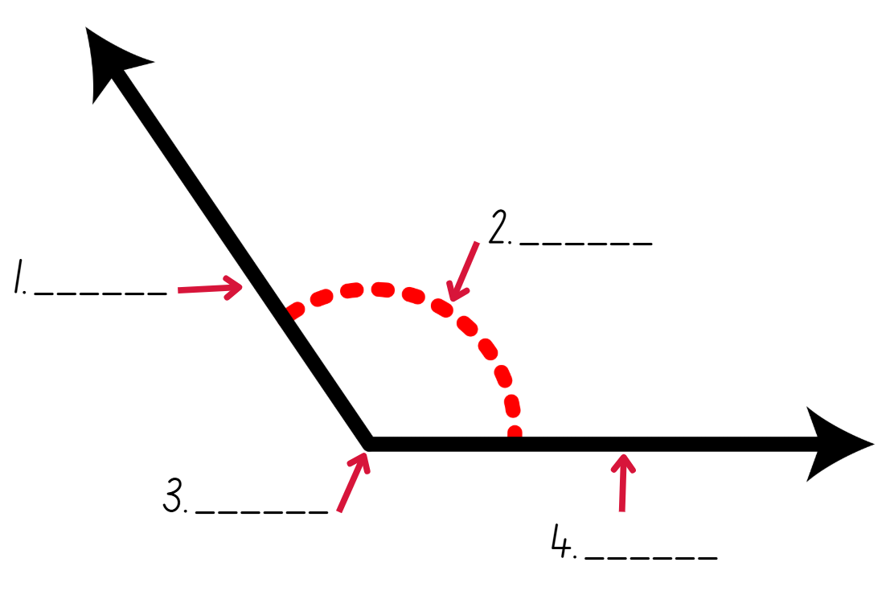
Short response (1)
Draw and label the angle using the terms:
arm
angle
vertex
Notes:
Short response questions provide brisk paced questions focussing on review of current and previous content to support spaced and interleaved practice.
Syllabus focus area:
Geometric measure A

Slide 7
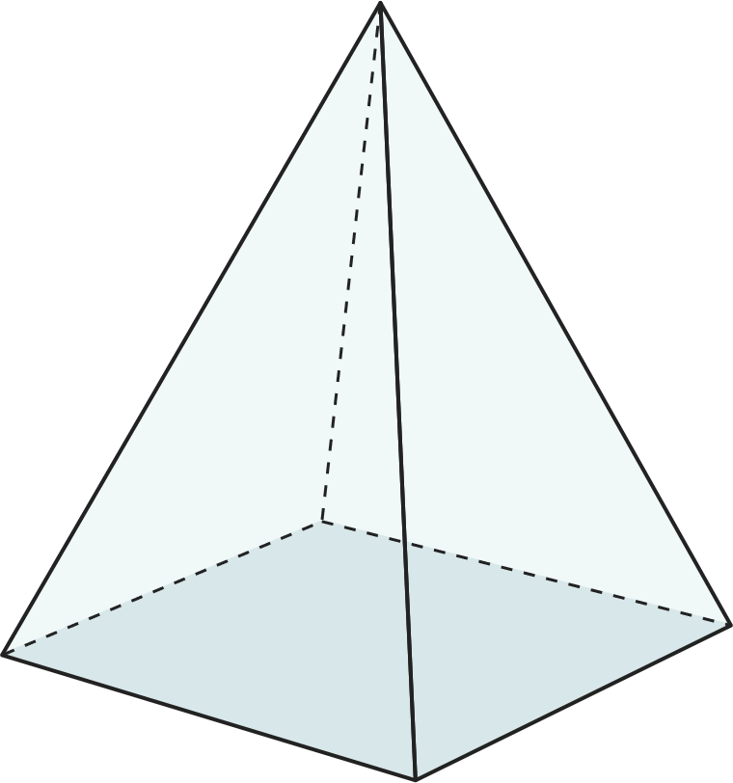
Short response (2)
Name the following three-dimensional object. Identify the number of faces, vertices and edges.
Notes:
Short response questions provide brisk paced questions focussing on review of current and previous content to support spaced and interleaved practice.
Syllabus focus area:
Three-dimensional spatial structure A

Slide 8
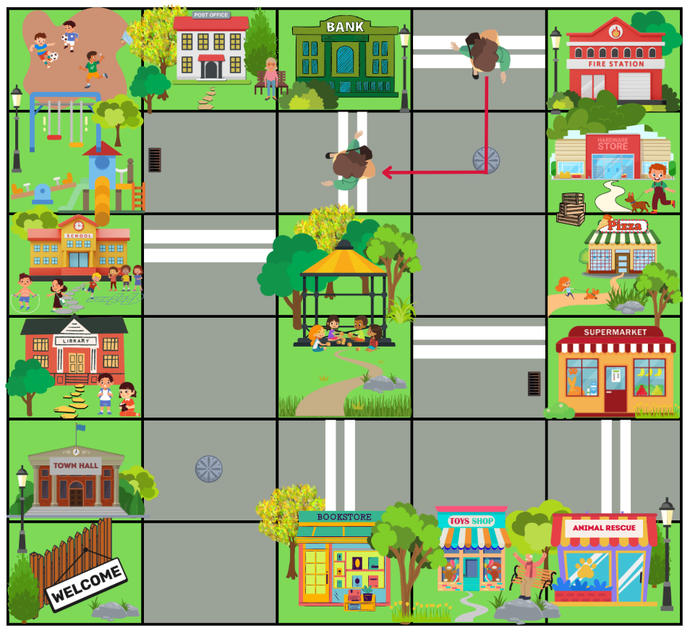
Short response (3)
Tessa started at the fire station and made a quarter-turn down the road to go to the bank.
Describe Tessa’s quarter-turn as type of angle.
Notes:
Short response questions provide brisk paced questions focussing on review of current and previous content to support spaced and interleaved practice.
Syllabus focus area:
Geometric measure A

Slide 9
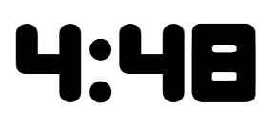

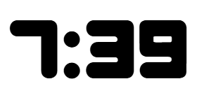
Short response (4)
How many minutes remaining until the next hour on the digital times?
a)
b)
c)
Notes:
Short response questions provide brisk paced questions focussing on review of current and previous content to support spaced and interleaved practice.
Syllabus focus area:
Non-spatial measure B

Slide 10

Activity 1 – using arrays
Notes:
This is a developing number sense activity. The slide is interactive when displayed in the presentation mode in the desktop app.
Number sense refers to a deep understanding of numbers, including their magnitude, relationships, and the effects of operations on them. It supports fluency and understanding, estimation, flexible thinking, and efficient problem-solving. Number sense activities 1–4 ‘activate’ prior number knowledge and support the learning of new content in the unit. Number sense activities 5–8 ‘loop’ back and provide opportunity for spaced practice with concepts and procedures covered in previous units.
Syllabus focus area:
Multiplicative relations A
Using arrays
1. Demonstrate to students how to link multiplication and division using arrays. Roll two 10-sided dice and use the numbers rolled to form an array using the interactive counters on the slide.
2. From the array, record multiplication and division number sentences (see Figure 21 – array number sentences in Stage 2 Year B Unit 30).
3. Highlight to students:
the link between multiplication and division
the commutative property of multiplication.
4. Once students are confident, provide them with two 10-sided dice, counters and their workbooks. Students record their number sentences in their workbook.
5. Select students to share and explain their arrays and number sentences.

Slide 11
Review of learning 2

Slide 12
True or false (1)
The following fact family is accurately recorded:
8 × 2 = 16
2 × 8 = 16
16 ÷ 2 = 8
2 ÷ 16 = 8
True | False
Notes:
The question on this slide connects to the content being explored in the developing number sense activity (Activity 2)
Syllabus focus area:
Multiplicative relations A

Slide 13
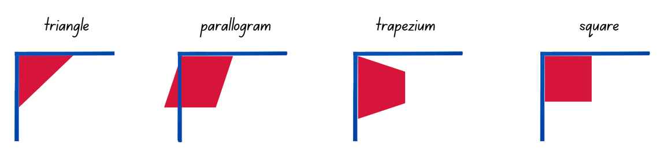
Short response (5)
Identify which of the following shapes contain a right angle using an angle tester:
Notes:
Short response questions provide brisk paced questions focussing on review of current and previous content to support spaced and interleaved practice.
Syllabus focus area:
Geometric measure B

Slide 14
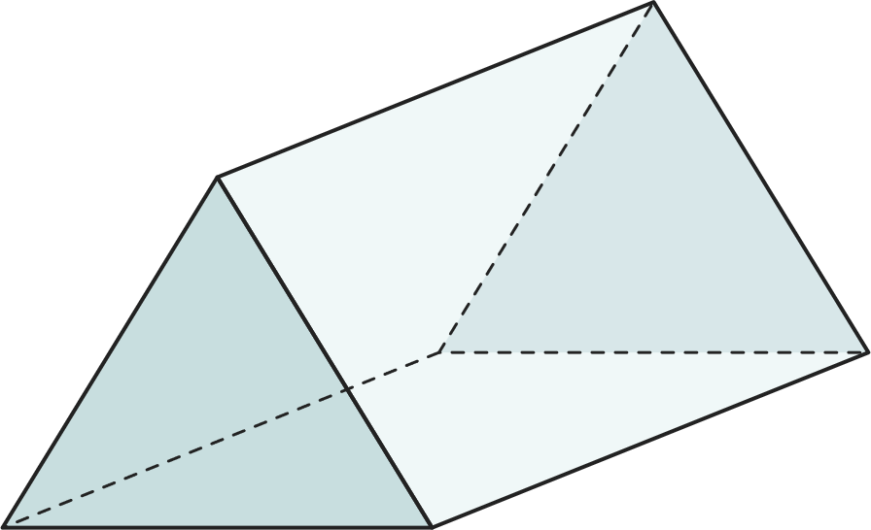
Short response (6)
Name the following three-dimensional object. Identify the number of faces, vertices and edges.
Notes:
Short response questions provide brisk paced questions focussing on review of current and previous content to support spaced and interleaved practice.
Syllabus focus area:
Three-dimensional spatial structure A

Slide 15
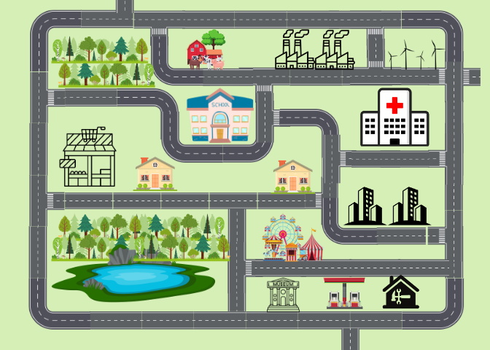
Short response (7)
Use landmarks and directional language to describe a route from the school to the supermarket.
supermarket
Notes:
Short response questions provide brisk paced questions focussing on review of current and previous content to support spaced and interleaved practice.
Syllabus focus area:
Geometric measure A

Slide 16
Short response (8)
Record the following lengths using a combination of metres and centimetres.
For example, 1.25 m = 1 m and 25 cm
7.59 m
9.14 m
10.72 m
15.5 m
12.1 m
22.09 m
Notes:
Short response questions provide brisk paced questions focussing on review of current and previous content to support spaced and interleaved practice.
Syllabus focus area:
Geometric measure A

Slide 17
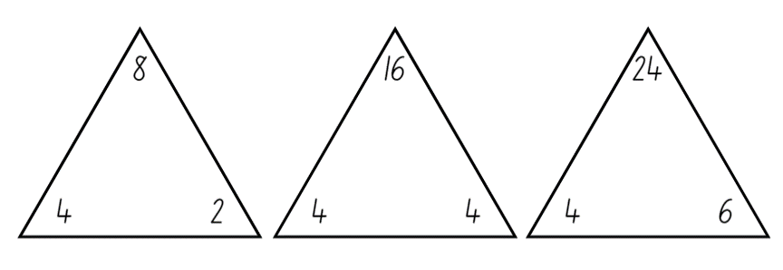
Activity 2 – fact families
Notes:
This is a developing number sense activity.
Number sense refers to a deep understanding of numbers, including their magnitude, relationships, and the effects of operations on them. It supports fluency and understanding, estimation, flexible thinking, and efficient problem-solving. Number sense activities 1–4 ‘activate’ prior number knowledge and support the learning of new content in the unit. Number sense activities 5–8 ‘loop’ back and provide opportunity for spaced practice with concepts and procedures covered in previous units.
Syllabus focus area:
Multiplicative relations A
Fact families
This resource corresponds to Resource 13 – making fact families in Stage 2 Year B Unit 30.
1. Explain that 8 is a multiple of 2 and 4 (record the skip counting pattern by 2 and then by 4 to confirm that 8 is in both patterns). Explain that 2 and 4 are called factors of 8.
2. Select one fact family from Resource 13 – making fact families to:
model how to write multiplication and division sentences using fact families
use arrays to prove the commutative property of multiplication.
Note: highlight to students that the number at the top of the triangle is the product of the 2 factors at the bottom of the triangle. For division, ensure students understand that the product of the fact family must be at the start of the sentence. Division is not commutative, so 2 ÷ 4 = 8 is not correct.
3. Provide students with Resource 13 – making fact families. Students identify the fact families for the remaining triangles and record the number sentences.
Note: students may need concrete materials, such as counters, to manipulate while completing the activity. This activity can be differentiated by having students find other factors of the top number and writing out the fact families.
4. Select students to share and explain their work and record each student’s responses for the class to see.

Slide 18
Review of learning 3

Slide 19
Multiple choice (2)
Which number sentences have been accurately recorded to represent fact families for multiples of 2 and 4 and 5 and 10? There may be more than one correct answer.
A
B
C
D
2 × 9 = 18
9 × 2 = 18
18 ÷ 2 = 9
18 ÷ 9 = 2
4 × 6 = 24
6 × 4 = 24
24 ÷ 4 = 6
24 ÷ 6 = 4
2 × 10 = 22
10 × 2 = 22
20 ÷ 2 = 10
20 ÷ 10 = 2
5 × 8 = 40
8 × 5 = 40
40 ÷ 5 = 8
40 ÷ 8 = 5
Notes:
This question connects to the content in the developing number sense activity (Activity 3)
Syllabus focus area:
Multiplicative relations A

Slide 20
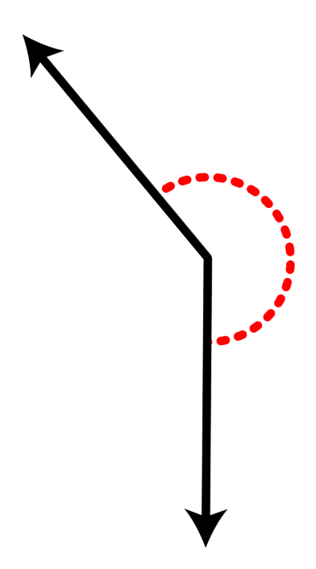
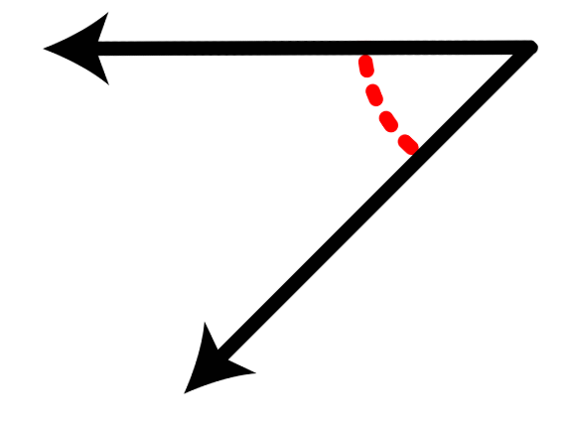
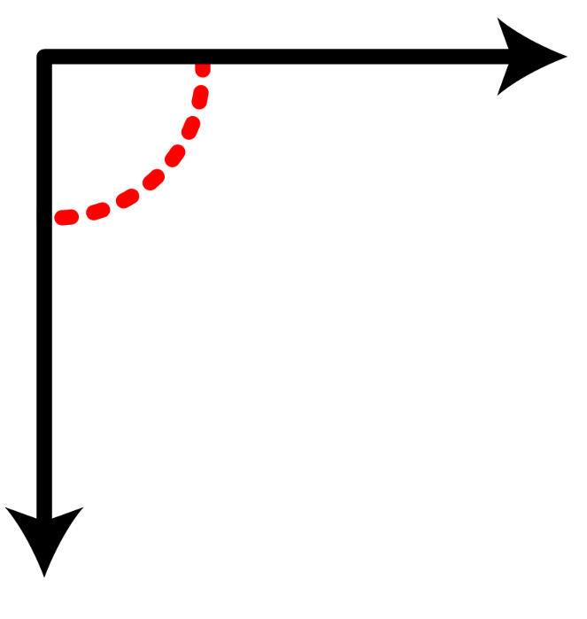
Short response (9)
Match each angle to its description:
A.
less than a right angle
about the same as a right angle
greater than a right angle.
B.
C.
Notes:
Short response questions provide brisk paced questions focussing on review of current and previous content to support spaced and interleaved practice.
Syllabus focus area:
Geometric measure B

Slide 21
Short response (10)
Sketch a pyramid showing depth. Think about the 2D shapes that can be seen.
Notes:
Short response questions provide brisk paced questions focussing on review of current and previous content to support spaced and interleaved practice.
Syllabus focus area:
Three-dimensional spatial structure A

Slide 22
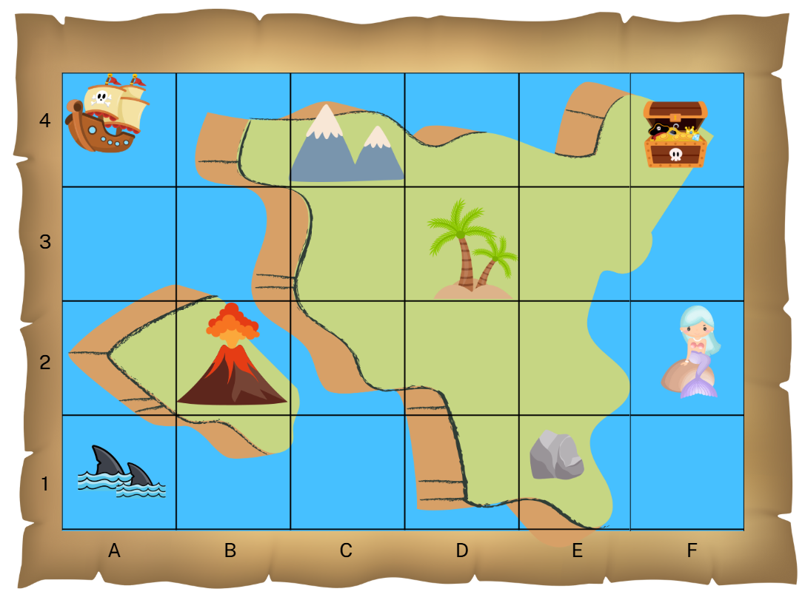




Short response (11)
Use the grid map to locate the position of the:
ship
mermaid
treasure chest
sharks.
Notes:
Short response questions provide brisk paced questions focussing on review of current and previous content to support spaced and interleaved practice.
Syllabus focus area:
Geometric measure A

Slide 23
Short response (12)
Place the following lengths in order from shortest to longest:
129 cm
1.36 m
130 cm
1.4 m
Notes:
Short response questions provide brisk paced questions focussing on review of current and previous content to support spaced and interleaved practice.
Syllabus focus area:
Geometric measure A

Slide 24
Activity 3 – recalling fact families
4 × 5 = 20
5 × 4 = 20
20 ÷ 4 = 5
20 ÷ 5 = 4
Notes:
This is a developing number sense activity.
Number sense refers to a deep understanding of numbers, including their magnitude, relationships, and the effects of operations on them. It supports fluency and understanding, estimation, flexible thinking, and efficient problem-solving. Number sense activities 1–4 ‘activate’ prior number knowledge and support the learning of new content in the unit. Number sense activities 5–8 ‘loop’ back and provide opportunity for spaced practice with concepts and procedures covered in previous units.
Syllabus focus area:
Multiplicative relations A
Recalling fact families
1. Provide each student with whiteboards or workbooks.
2. Explain that students will be engaging in speed rounds to recall the 4 related number sentences that represent fact families for multiples of 2 and 4 and 5 and 10.
3. Model how to play with an example. For example, 4 × 5.
4. Provide students with a range of examples, for example, 10 × 6, 5 × 3, 2 × 9, to record number sentences that represent fact families for multiples of 2 and 4 and 5 and 10.
5. Once students have written the 4 number sentences for each round, encourage them to turn their boards to the front so their recordings can be checked for accuracy.

Slide 25
Review of learning 4

Slide 26
True or false (2)
Ralph says the following is a correct fact family:
4 × 5 = 20
2 × 10 = 20
20 ÷ 4 = 5
20 ÷ 10 = 2
True | False
Notes:
The question on this slide connects to the content being explored in the developing number sense activity (Activity 4)
Syllabus focus area:
Multiplicative relations A

Slide 27
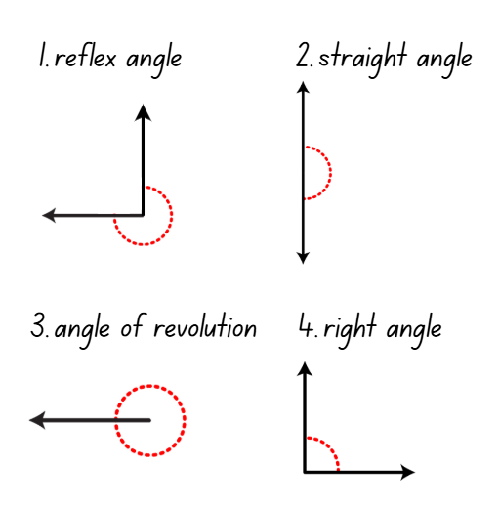
Short response (13)
Match the angles to the number of quarter-turns:
a. 1 quarter-turn
b. 2 quarter-turns
c. 3 quarter-turns
d. 4 quarter turns
Notes:
Short response questions provide brisk paced questions focussing on review of current and previous content to support spaced and interleaved practice.
Syllabus focus area:
Geometric measure B

Slide 28
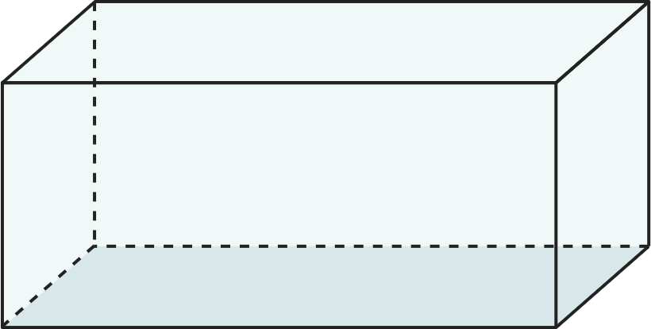
Short response (14)
Sketch a prism showing depth. Think about the 2D shapes that can be seen.
Notes:
Short response questions provide brisk paced questions focussing on review of current and previous content to support spaced and interleaved practice.
Syllabus focus area:
Three-dimensional spatial structure A

Slide 29
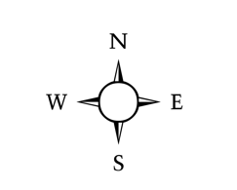
Short response (15)
Complete the number of quarter turns:
To face east, I make _____ quarter-turn right from north.
To face south, I make _____ quarter-turns left from east.
To face north, I make _____ quarter-turns left from south.
Notes:
Short response questions provide brisk paced questions focussing on review of current and previous content to support spaced and interleaved practice.
Syllabus focus area:
Geometric measure B

Slide 30
Short response (16)
Estimate and then calculate the perimeter of the quadrilateral:
29 cm
8 cm
8 cm
29 cm
Notes:
Short response questions provide brisk paced questions focussing on review of current and previous content to support spaced and interleaved practice.
Syllabus focus area:
Geometric measure B

Slide 31
Activity 4 – solving problems with fact families
A shirt maker received a delivery of buttons.
There are 6 packets of buttons.
In each packet there are 10 buttons.
How many buttons are there all together?
If the shirt maker is using the new buttons to sew onto 10 shirts, how many buttons will be used on each shirt?
Notes:
This is a developing number sense activity.
Number sense refers to a deep understanding of numbers, including their magnitude, relationships, and the effects of operations on them. It supports fluency and understanding, estimation, flexible thinking, and efficient problem-solving. Number sense activities 1–4 ‘activate’ prior number knowledge and support the learning of new content in the unit. Number sense activities 5–8 ‘loop’ back and provide opportunity for spaced practice with concepts and procedures covered in previous units.
Syllabus focus area:
Multiplicative relations A
Solving problems with fact families
This resource corresponds to Resource 14 – lots of buttons in Stage 2 Year B Unit 30.
1. Explain that students will work in pairs to solve the problem. Ask:
What is the problem asking you to find out?
How many different parts are there to the problem? Can you use the same strategy to solve each part?
Which strategy do you think will work best to find a solution for this problem? Why?
How can you record the solution?
2. After students have had the opportunity to work on the solution, ask:
How do you know the strategy you are using is working?
How can you check that the answer is correct?
Which fact family helped you with this problem?
3. In pairs, students choose a fact family and create a word problem to match.

Slide 32
Review of learning 5

Slide 33
Multiple choice (3)
Which of the following lists the decimals in ascending order?
A
0.56, 0.65, 0.6, 0.61
B
0.56, 0.6, 0.61, 0.65
C
0.61, 0.6, 0.56, 0.65
D
0.65, 0.61, 0.6, 0.56
Notes:
This question connects to the content in the developing number sense activity (Activity 5)
Syllabus focus area:
Representing number using place value B

Slide 34
Short response (17)
Name the angle in comparison to quarter-turns:
One quarter-turn is a _______ angle.
Less than one quarter-turn is an _____ angle
More than one quarter-turn and less than 2 quarter-turns is an _____ angle.
Equal to 2 quarter-turns is an ______ angle.
More than 2 quarter-turns and less than 4 quarter-turns is a _______ angle
Equal to 4 quarter-turns is an ______________
Acute | Angle of revolution | Straight | Obtuse | Reflex | Right
Notes:
Short response questions provide brisk paced questions focussing on review of current and previous content to support spaced and interleaved practice.
Syllabus focus area:
Geometric measure B

Slide 35
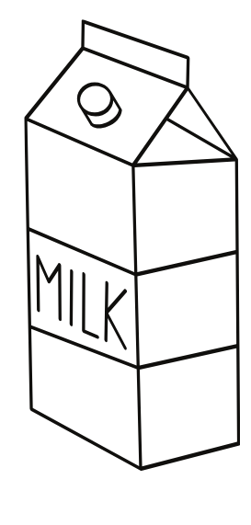
Short response (18)
Record the capacity of a 2-litre milk container using the abbreviation for litres.
Notes:
Short response questions provide brisk paced questions focussing on review of current and previous content to support spaced and interleaved practice.
Syllabus focus area:
Three-dimensional spatial structure A

Slide 36
Short response (19)
A bag contains 2 red grapes and 6 green grapes. Describe the likelihood of picking a red grape and the likelihood of picking a green grape using the words equally likely, likely or unlikely.
Notes:
Short response questions provide brisk paced questions focussing on review of current and previous content to support spaced and interleaved practice.
Syllabus focus area:
Chance B

Slide 37
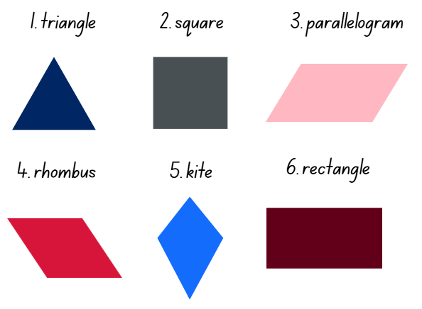
Short response (20)
Sort the following polygons into 2 groups:
Group 1: polygons that have parallel sides
Group 2: polygons that do not have parallel sides
Notes:
Short response questions provide brisk paced questions focussing on review of current and previous content to support spaced and interleaved practice.
Syllabus focus area:
Two-dimensional spatial structure A

Slide 38
Activity 5 – ordering decimals
.
.
.
.
.
Notes:
This is a developing number sense activity.
Number sense refers to a deep understanding of numbers, including their magnitude, relationships, and the effects of operations on them. It supports fluency and understanding, estimation, flexible thinking, and efficient problem-solving. Number sense activities 1–4 ‘activate’ prior number knowledge and support the learning of new content in the unit. Number sense activities 5–8 ‘loop’ back and provide opportunity for spaced practice with concepts and procedures covered in previous units.
Syllabus focus area:
Representing number using place value B
Ordering decimals
1. Provide pairs of students with playing cards with the face cards removed. Students divide the cards between them (aces are ones).
2. Each students’ cards remain face down in a pile in front on them.
3. On whiteboards, students draw a box large enough to fit a playing card, a dot and then 2 more boxes.
4. Each student turns over 3 cards, placing them into the boxes on their whiteboard (see Figure 23 – example student whiteboard in Stage 2 Year B Unit 30).
5. Students then record their decimal on a sticky note.
6. Pairs of students compare their decimals and place the sticky notes in ascending order.
7. Repeat the process, adding the new sticky notes to the order (see Figure 24 – ascending order in Stage 2 Year B Unit 30).

Slide 39
Review of learning 6

Slide 40
True or false (3)
The following decimals are correctly arranged in ascending order:
0.3, 0.4, 0.35, 0.36
True | False
Communicate your reasoning.
Notes:
The question on this slide connects to the content being explored in the developing number sense activity (Activity 6)
Syllabus focus area:
Representing number using place value B

Slide 41
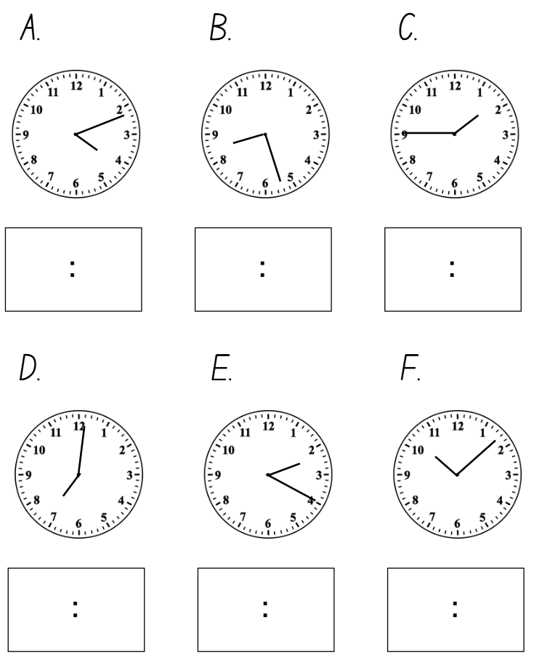
Short response (21)
Record the digital times for the times displayed on the analog clocks to the minute.
Notes:
Short response questions provide brisk paced questions focussing on review of current and previous content to support spaced and interleaved practice.
Syllabus focus area:
Non-spatial measure B

Slide 42
Short response (22)
1000 mL is equal to _______ litre.
Notes:
Short response questions provide brisk paced questions focussing on review of current and previous content to support spaced and interleaved practice.
Syllabus focus area:
Three-dimensional spatial structure A

Slide 43
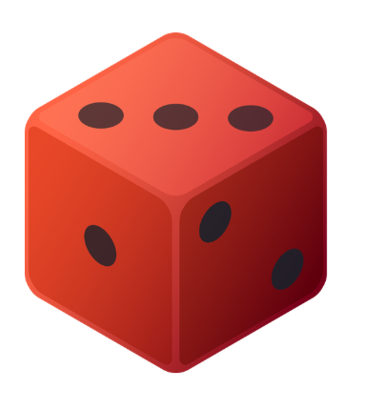
Short response (23)
Ryan is rolling a 6-sided dice twice.
Does the outcome of the first roll affect the chance of rolling a 3 on the second roll?
Communicate your reasoning.
Notes:
Short response questions provide brisk paced questions focussing on review of current and previous content to support spaced and interleaved practice.
Syllabus focus area:
Chance B

Slide 44
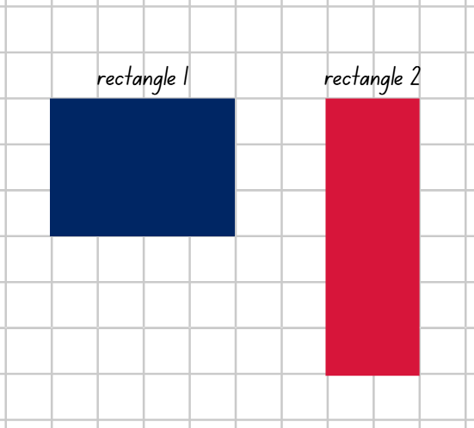
Short response (24)
Do the 2 rectangles have the same area?
Communicate your thinking.
Notes:
Short response questions provide brisk paced questions focussing on review of current and previous content to support spaced and interleaved practice.
Syllabus focus area:
Two-dimensional spatial structure B

Slide 45
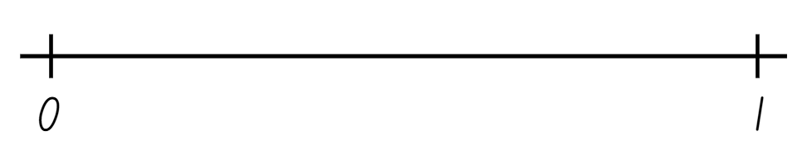
Activity 6 – comparing and ordering decimals
Notes:
This is a developing number sense activity.
Number sense refers to a deep understanding of numbers, including their magnitude, relationships, and the effects of operations on them. It supports fluency and understanding, estimation, flexible thinking, and efficient problem-solving. Number sense activities 1–4 ‘activate’ prior number knowledge and support the learning of new content in the unit. Number sense activities 5–8 ‘loop’ back and provide opportunity for spaced practice with concepts and procedures covered in previous units.
Syllabus focus area:
Representing number using place value B
Comparing and ordering decimals
1. Provide pairs with two 10-sided dice and a whiteboard. Students draw a number line from zero to one.
2. Students take turns to roll the dice and arrange them to make the largest number between zero and one with 2 decimal places, such as 0.86. Students record their decimal on the number line (see Figure 25 – number line example in Stage 2 Year B Unit 30).
3. Students repeat this process to create another decimal number each and place it on the number line.
4. Students read the decimals in order from zero to one, using their place value knowledge to justify how they know the order is correct.
Note: the focus for this activity can be easily changed, for example, students could be aiming for closest to zero, closet to 0.5 or the smallest decimal.

Slide 46
Review of learning 7

Slide 47
Multiple choice (4)
Which clue would help you identify the decimal 0.43?
A
It is less than 0.5 and the hundredths digit is 3.
B
It is greater than 0.5 and the tenths digit is 3.
C
It is equal to $\frac{1}{3}$.
D
It is greater than 0.4 and the hundredths digit is 4.
Notes:
This question connects to the content in the developing number sense activity (Activity 7)
Syllabus focus area:
Representing number using place value B

Slide 48
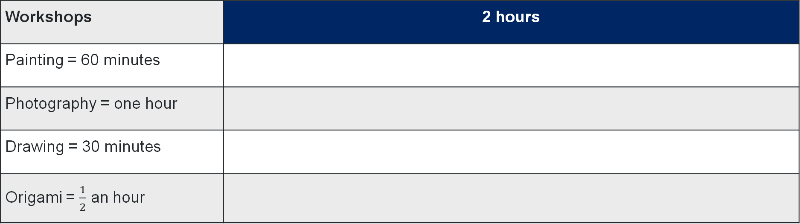
Short response (25)
How many of each workshop could be held in 2 hours?
Workshops | 2 hours
Painting = 60 minutes
Photography = one hour
Drawing = 30 minutes
Origami = $\frac{1}{2}$ an hour
Notes:
Short response questions provide brisk paced questions focussing on review of current and previous content to support spaced and interleaved practice.
Syllabus focus area:
Non-spatial measure A

Slide 49

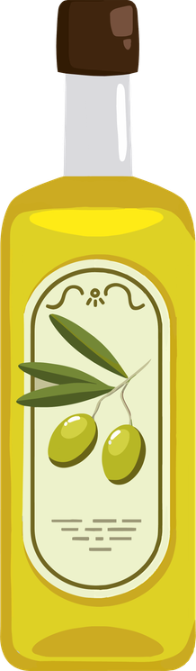



Short response (26)
Record the capacities of the containers from smallest to largest capacity. Use millilitres (mL) when recording.
1500 mL
1000 mL
250 mL
750 mL
500 mL
Notes:
Short response questions provide brisk paced questions focussing on review of current and previous content to support spaced and interleaved practice.
Syllabus focus area:
Three-dimensional spatial structure A

Slide 50
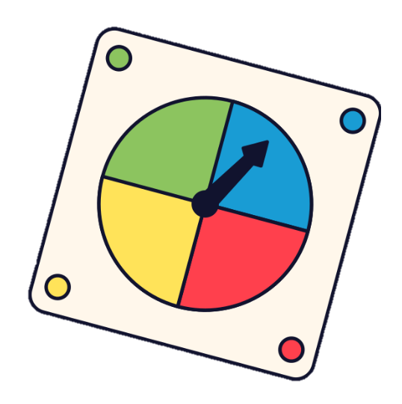
Short response (27)
Emily spins the spinner.
List all the possible outcomes of one spin.
What does the term outcome mean in chance experiments?
Notes:
Short response questions provide brisk paced questions focussing on review of current and previous content to support spaced and interleaved practice.
Syllabus focus area:
Chance A

Slide 51
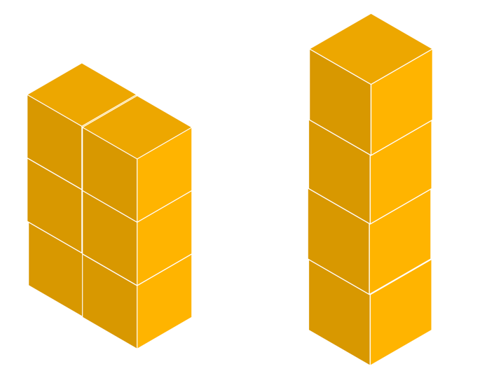
Short response (28)
Record and compare the volume of these 2 objects made from
cubic-centimetre blocks.
Notes:
Short response questions provide brisk paced questions focussing on review of current and previous content to support spaced and interleaved practice.
Syllabus focus area:
Two-dimensional spatial structure A

Slide 52
Activity 7 – comparing decimals
Secret decimal clues:
It is between 0 and 1.
It is greater than 0.4 but less than 0.6.
The hundredths digit is 8.
Notes:
This is a developing number sense activity.
Number sense refers to a deep understanding of numbers, including their magnitude, relationships, and the effects of operations on them. It supports fluency and understanding, estimation, flexible thinking, and efficient problem-solving. Number sense activities 1–4 ‘activate’ prior number knowledge and support the learning of new content in the unit. Number sense activities 5–8 ‘loop’ back and provide opportunity for spaced practice with concepts and procedures covered in previous units.
Syllabus focus area:
Representing number using place value B
Comparing decimals
1. Explain to students that they will play a quick game called ‘Decimal Dash’. A secret decimal will be described using clues. Students must use their place value knowledge to work out the number and record their answer on their whiteboards.
2. State: the secret decimal is between 0 and 1. Some clues to help you are:
it is greater than 0.4 but less than 0.6
the hundredths digit is 8.
3. Students record their answers. For example, 0.48 or 0.58.
4. Repeat the process for several rounds using different clues.
Note: to extend the activity, include clues that connect fractions and decimals. For example, the secret decimal is equal to three-quarters (0.75).
5. After several rounds, discuss:
What clues did you find most helpful and why?
How did your understanding of place value help you order and compare decimals?

Slide 53
Review of learning 8

Slide 54
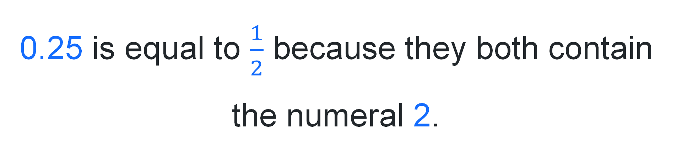
True or false (4)
0.25 is equal to $\frac{1}{2}$ because they both contain the numeral 2.
True | False
Communicate your reasoning.
Notes:
The question on this slide connects to the content being explored in the developing number sense activity (Activity 8)
Syllabus focus area:
Representing number using place value B

Slide 55
Short response (29)
Record the following as digital times:
20 minutes and 39 seconds
35 minutes and 10 seconds
42 seconds
Notes:
Short response questions provide brisk paced questions focussing on review of current and previous content to support spaced and interleaved practice.
Syllabus focus area:
Non-spatial measure B

Slide 56
Short response (30)
The capacities of 5 containers are:
430 mL, 870 mL, 250 mL, 610 mL, 990 mL
Order the containers from smallest to largest capacity.
Notes:
Short response questions provide brisk paced questions focussing on review of current and previous content to support spaced and interleaved practice.
Syllabus focus area:
Three-dimensional spatial structure A

Slide 57

Short response (31)
A bag contains 5 red, 4 purple, and 3 orange marbles. You draw one marble at a time and do not put it back.
Which colour is most likely to be drawn first? Why?
If you draw a red marble first, how does that affect the likelihood of drawing another red marble next?
Which colour is now least likely to be drawn?
Notes:
Short response questions provide brisk paced questions focussing on review of current and previous content to support spaced and interleaved practice.
Syllabus focus area:
Chance B

Slide 58
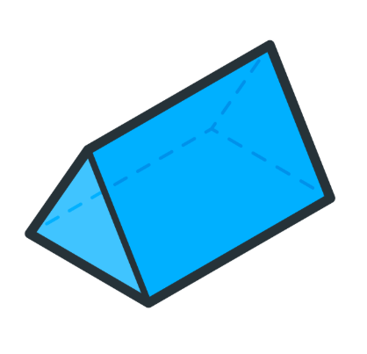
Short response (32)
Sketch the top, front and side views of the three-dimensional object displayed.
Notes:
Short response questions provide brisk paced questions focussing on review of current and previous content to support spaced and interleaved practice.
Syllabus focus area:
Three-dimensional spatial structure B

Slide 59
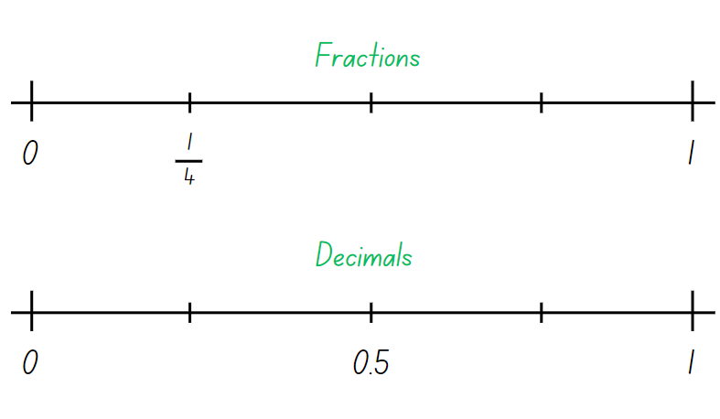
Activity 8 – fractions and decimals connections
Notes:
This is a developing number sense activity.
Number sense refers to a deep understanding of numbers, including their magnitude, relationships, and the effects of operations on them. It supports fluency and understanding, estimation, flexible thinking, and efficient problem-solving. Number sense activities 1–4 ‘activate’ prior number knowledge and support the learning of new content in the unit. Number sense activities 5–8 ‘loop’ back and provide opportunity for spaced practice with concepts and procedures covered in previous units.
Syllabus focus area:
Representing number using place value B
Fractions and decimals connections
This resource corresponds to Resource 15 – fractions and decimals in Stage 2 Year B Unit 30.
1. Students label the correct fractions and matching decimal benchmarks. For example, 0.5 is the same as half.
2. Students then add any other matching fractions and decimals to the number lines that they know. For example, one-fifth is the same as 0.2.
3. Select students to share and explain the fractions and decimals they selected.

Slide 60
Double Venn diagram
Object 1
Object 2
Features similar to both objects
Features of object 1
Features of object 2

Slide 61
Frayer
Definition
Facts/Characteristics
Word, term, concept
Examples
Non-examples

Slide 62
Spider map
Idea
Subject

Slide 63
Cline
Concept 1
Concept 2
Word
Word
Word
Word
Word
Word
Word
Word
Word
Word
Word

Slide 64

Compare and contrast

Slide 65
Multiple choice (5)
A
B
C
D

Slide 66
Multiple choice
A
B
C
D
Notes:
This question connects to the content in the developing number sense activity (Activity 3)
Syllabus focus area:
[Focus area A/B]

Slide 67
References (1)
This presentation contains NSW Curriculum and syllabus content. The NSW Curriculum is developed by the NSW Education Standards Authority. This content is prepared by NESA for and on behalf of the Crown in the right of the State of New South Wales. The material is protected by Crown copyright.
Please refer to the NESA Copyright Disclaimer for more information https://educationstandards.nsw.edu.au/wps/portal/nesa/mini-footer/copyright.
NESA holds the only official and up-to-date versions of the NSW Curriculum and syllabus documents. Please visit the NSW Education Standards Authority (NESA) website https://educationstandards.nsw.edu.au/wps/portal/nesa/home and the NSW Curriculum website https://curriculum.nsw.edu.au.
Mathematics K–10 Syllabus © NSW Education Standards Authority (NESA) for and on behalf of the Crown in right of the State of New South Wales, 2022.
National Numeracy Learning Progression © Australian Curriculum, Assessment and Reporting Authority (ACARA) 2010 to present, unless otherwise indicated. This material was downloaded from the Australian Curriculum website (National Numeracy Learning Progression) (accessed 11 November 2025 and was not modified.
ABC (Australian Broadcasting Corporation) (2022) Time Tools: 12-hour to the minute, ABC Education website, accessed 11 November 2025.
Amplify Education, Inc (2024) Polypad, Amplify website, accessed 11 November 2025.
Didax, Inc (n.d) Geoboard, Didax website, accessed 11 March 2026.
New South Wales Department of Education (n.d.) ‘Representative school sport results and records’, Representative sport, NSW Department of Education website, accessed 11 November 2025.
Sullivan P (2018) Challenging Mathematical tasks: Unlocking the Potential of all Students, Oxford University Press, Australia.

Slide 68
References (2)
This presentation contains NSW Curriculum and syllabus content. The NSW Curriculum is developed by the NSW Education Standards Authority. This content is prepared by NESA for and on behalf of the Crown in the right of the State of New South Wales. The material is protected by Crown copyright.
Please refer to the NESA Copyright Disclaimer for more information https://educationstandards.nsw.edu.au/wps/portal/nesa/mini-footer/copyright.
NESA holds the only official and up-to-date versions of the NSW Curriculum and syllabus documents. Please visit the NSW Education Standards Authority (NESA) website https://educationstandards.nsw.edu.au/wps/portal/nesa/home and the NSW Curriculum website https://curriculum.nsw.edu.au.
Siemon D, Warren E, Beswick K, Faragher R, Miller J, Horne M, Jazby D, Breed M, Clark J and Brady K (2021) Teaching Mathematics: Foundations to Middle Years, 3rd edn, Oxford University Press Australia and New Zealand.
Toy Theater (n.d.) ‘Active analog clock: Time’, Time Manipulatives, Toy Theater website, accessed 11 November 2025.
Toy Theater (n.d.) ‘Interactive Clock | Telling Time’, Time Manipulatives, Toy Theater website, accessed 11 November 2025.
Toy Theater (n.d.) ‘Stop Watch’, Time Manipulatives, Toy Theater website, accessed 11 November 2025.
University of Cambridge (n.d.) Clocks, NRICH website, accessed 11 November 2025.
Van de Walle J, Karp K, Bay-Williams JM, Brass A, Bentley B, Ferguson S, Goff W, Livy S, Marshman M, Martin D, Pearn C, Prodromou T, Symons D and Wilkie K (2019) Primary and Middle Years Mathematics: Teaching Developmentally, 1st Australian edn, Pearson Education Australia, Melbourne.

Slide 69
Copyright
© State of New South Wales (Department of Education), 2025
The copyright material published in this resource is subject to the Copyright Act 1968 (Cth) and is owned by the NSW Department of Education or, where indicated, by a party other than the NSW Department of Education (third-party material).
Copyright material available in this resource and owned by the NSW Department of Education is licensed under a Creative Commons Attribution 4.0 International (CC BY 4.0) license.
This license allows you to share and adapt the material for any purpose, even commercially.
Attribution should be given to © State of New South Wales (Department of Education), 2025.
Material in this resource not available under a Creative Commons license:
the NSW Department of Education logo, other logos and trademark-protected material
Material owned by a third party that has been reproduced with permission. You will need to obtain permission from the third party to reuse its material.
Links to third-party material and websites
Please note that the provided (reading/viewing material/list/links/texts) are a suggestion only and implies no endorsement, by the New South Wales Department of Education, of any author, publisher, or book title. School principals and teachers are best placed to assess the suitability of resources that would complement the curriculum and reflect the needs and interests of their students.
If you use the links provided in this document to access a third party’s website, you acknowledge that the terms of use, including licence terms set out on the third-party’s website apply to the use which may be made of the materials on that third-party website or where permitted by the Copyright Act 1968 (Cth). The department accepts no responsibility for content on third-party websites.

