Slide 1
Instructions for use
This resource aligns to the learning in Stage 2 Year B Unit 31 and revisits content from earlier sample units.
Classroom teachers are encouraged to add and adapt slides as required to meet the needs of their students.
Save a copy of the file to make changes to the slide deck. Go to File > Download a Copy (this downloads a copy to the computer to edit in the PowerPoint app).
To convert the PowerPoint to Google Slides:
  Upload the file into Google Drive and open it.
  Go to File > Save as Google Slides.
  (Note – conversion may cause formatting changes in the slides.)

Slide 2

Review of Learning
Mathematics Stage 2 – Unit 31
Notes:
Reviews may include a combination of question types, requiring students to recall facts and key ideas, as well as apply their knowledge to solve problems and answer questions. To support active engagement, a mix of techniques should be employed.” (AERO, 2024).
This Review of Learning slide deck revisits key concepts from the following units:
Stage 2 Year B Unit 31
Stage 2 Year B Unit 30
Stage 2 Year B Unit 29
It also includes opportunities to review prior learning in non-number content, supporting consolidation across focus areas.
The review of learning resources include three key task types that support the development of mathematical proficiency through retrieval, spaced practice, and active participation. These practices complement the review phase (activating prior knowledge) embedded within the beginning of each lesson.
1.
Multiple-choice questions/True or false: Designed to promote active retrieval of key concepts and identify common misconceptions in number, supporting consolidation, understanding and fluency.
These questions:
support spaced and interleaved practice
help identify and address common misconceptions
support active recall and immediate feedback
support whole class participation
identify areas requiring reteach
2.
Short-response question sets: Carefully grouped questions that encourage spaced and interleaved practice across multiple focus areas, helping students revisit and apply knowledge from different points in time.
These questions:
have a combination of question types
address a range of focus areas
build automaticity and fluency
support active recall
allow for immediate feedback
identify content requiring reteach
3.
Developing number sense activities: A variety of practical, purposeful tasks that reinforce current learning and build on prior knowledge. These activities promote reasoning, problem-solving and conceptual understanding.
The review of learning resources are designed to work support teaching and learning in mathematics. For the most effective implementation, use the resources flexibly, adapting to meet student learning needs and individual classroom contexts.

Slide 3
Lessons
1
Review of learning 1
5
Review of learning 5
2
Review of learning 2
6
Review of learning 6
3
Review of learning 3
7
Review of learning 7
4
Review of learning 4
8
Review of learning 8
Notes:
Teacher notes:
Click lesson titles to go to specific lessons
Interactive features can be viewed in slide show

Slide 4
Review of learning 1

Slide 5

Multiple choice (1)
Which number is not a multiple of 6?
Communicate your reasoning.
A
B
C
D
12
16
18
30
Notes:
This question connects to the content in the developing number sense activity (Activity 1)
Syllabus focus area:
Multiplicative relations B

Slide 6

Short response (1)
Record 7354 using standard
place value form.
7354 = + + +
Notes:
Short response questions provide brisk paced questions focussing on review of current and previous content to support spaced and interleaved practice.
Syllabus focus area:
Representing numbers using place value A

Slide 7
Short response (2)
What everyday objects in our classroom can be used as an informal way to compare various angles to a right angle?
Notes:
Short response questions provide brisk paced questions focussing on review of current and previous content to support spaced and interleaved practice.
Syllabus focus area:
Geometric measure B: Angles

Slide 8
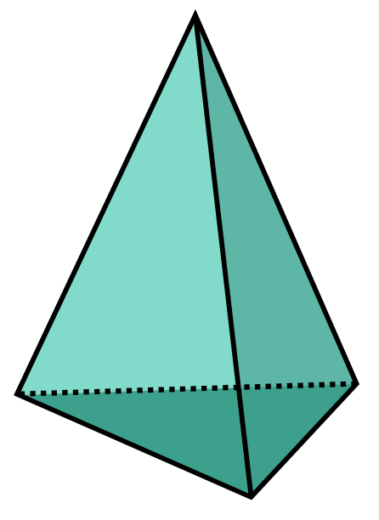
Short response (3)
How many faces, edges and vertices does a triangular pyramid have?
​
Notes:
Short response questions provide brisk paced questions focussing on review of current and previous content to support spaced and interleaved practice.
Syllabus focus area:
Three-dimensional spatial structure B: 3D objects

Slide 9
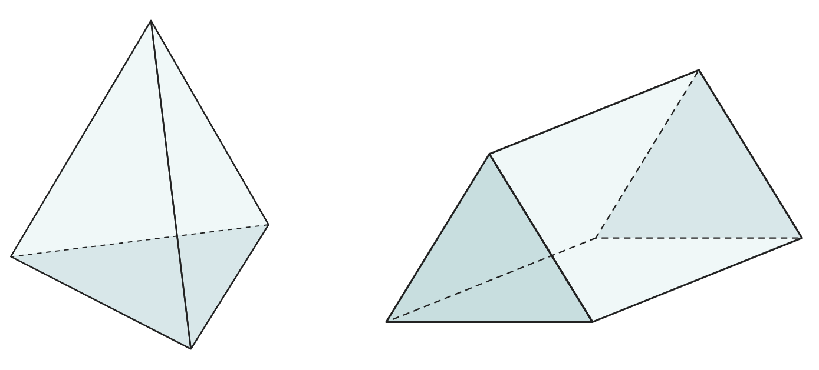
Short response (4)
What are the differences between these 3D objects?
Notes:
Short response questions provide brisk paced questions focussing on review of current and previous content to support spaced and interleaved practice.
Syllabus focus area:
Three-dimensional spatial structure A: 3D objects

Slide 10
Activity 1 – number patterns with related multiples of 2 and 3
1 | 2 | 3 | 4 | 5 | 6
7 | 8 | 9 | 10 | 11 | 12
13 | 14 | 15 | 16 | 17 | 18
19 | 20 | 21 | 22 | 23 | 24
25 | 26 | 27 | 28 | 29 | 30
Notes:
This is a developing number sense activity.
Number sense refers to a deep understanding of numbers, including their magnitude, relationships, and the effects of operations on them. It supports fluency and understanding, estimation, flexible thinking, and efficient problem-solving. Number sense activities 1–4 ‘activate’ prior number knowledge and support the learning of new content in the unit. Number sense activities 5–8 ‘loop’ back and provide opportunity for spaced practice with concepts and procedures covered in previous units.
Syllabus focus area:
Multiplicative relations B
Number patterns with related multiples of 2 and 3
This resource corresponds to Resource 28 – numbers to 30 in Stage 2 Year B Unit 31.
Provide students with a copy of Resource 28 – numbers to 30 and a highlighter or coloured pencils.
Prompt students to generate the multiples of 2 by adding two each time and highlighting the on the number chart.
Repeat with multiples of 4 using a different coloured highlighter or pencil.
Students draw a circle around numbers where both colours are used, to show the related multiples of 2 and 4.
Ask students to record two multiplication facts showing related multiples. For example, 4 x 3 = 12 and 6 x 2 = 12.

Slide 11
Review of learning 2

Slide 12
True or false (1)
If I start at 6 and count forward in threes, my sequence would be:
6, 9, 12, 15, 18
True | False
Notes:
The question on this slide connects to the content being explored in the developing number sense activity (Activity 2)
Syllabus focus area:
Multiplicative relations B

Slide 13
Short response (5)
What is the largest and smallest
number you can make be rearranging all
these digits:
3, 5, 2, 8, 1
Communicate your reasoning.
Notes:
Short response questions provide brisk paced questions focussing on review of current and previous content to support spaced and interleaved practice.
Syllabus focus area:
Representing numbers using place value B

Slide 14
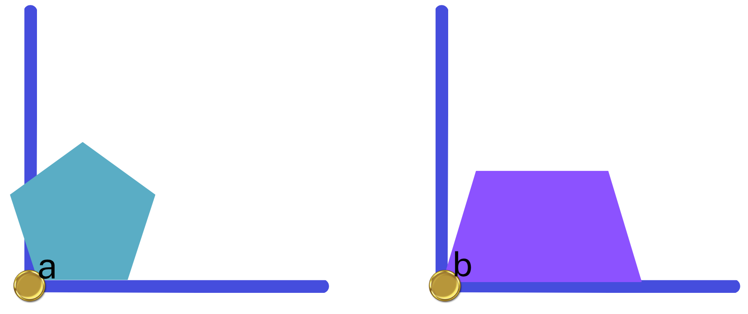
Short response (6)
Using the angle testers, are angle a and b smaller, larger or the same as a right angle?
What are the names of these 2 angles?
Notes:
Short response questions provide brisk paced questions focussing on review of current and previous content to support spaced and interleaved practice.
Syllabus focus area:
Geometric measure B: Angles

Slide 15
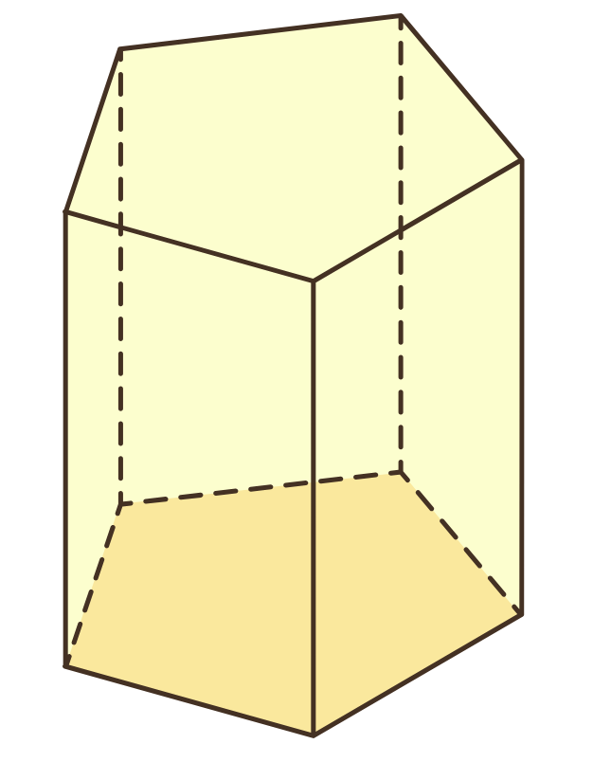
Short response (7)
How many faces, edges and vertices does a pentagonal prism have?​
Notes:
Short response questions provide brisk paced questions focussing on review of current and previous content to support spaced and interleaved practice.
Syllabus focus area:
Three-dimensional spatial structure B: 3D objects

Slide 16
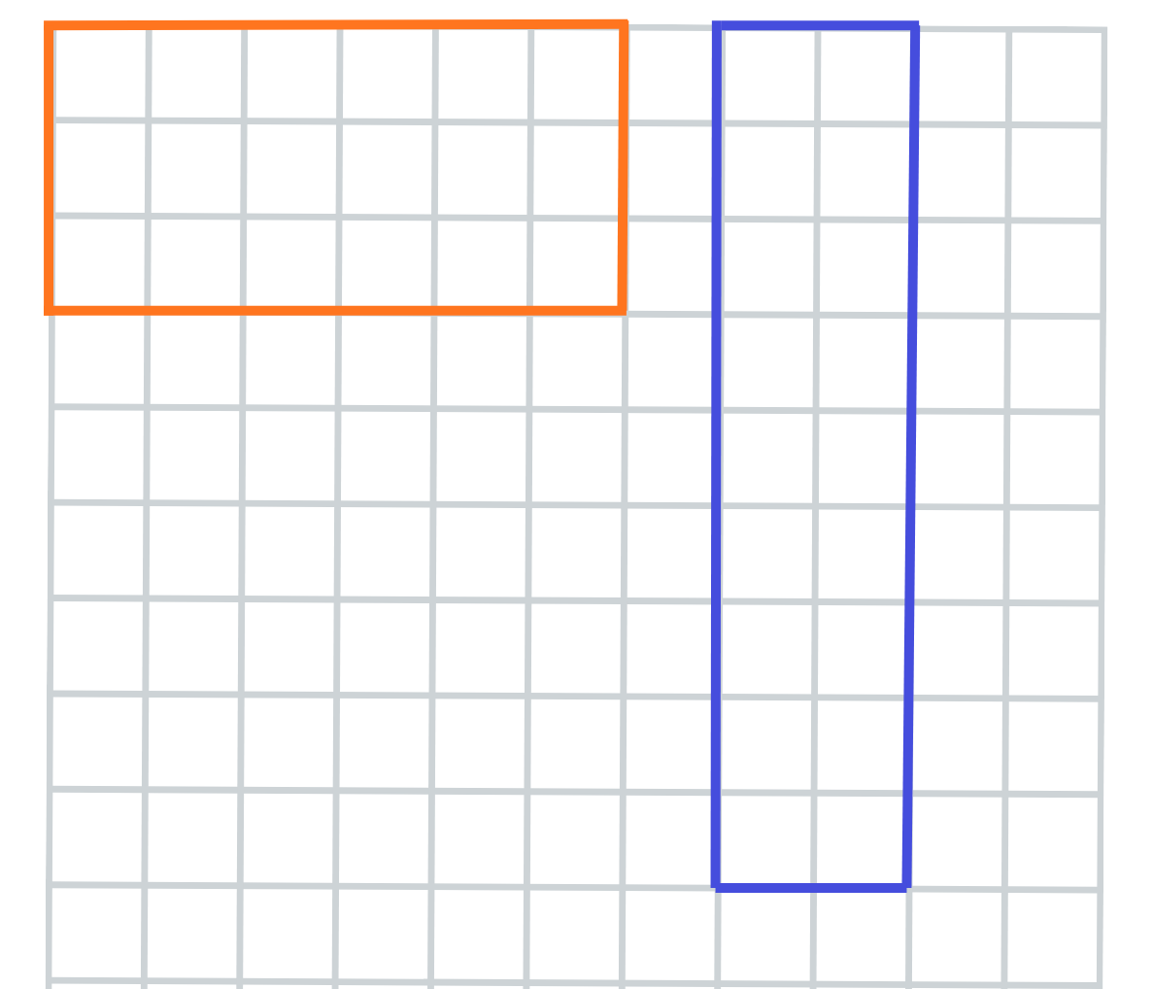
Short response (8)
What is the same and what
is different between these
2 shapes?
Notes:
Short response questions provide brisk paced questions focussing on review of current and previous content to support spaced and interleaved practice.
Syllabus focus area:
Two-dimensional spatial structure B: Area

Slide 17

Activity 2 – finding multiples of 4
8
Start at 8. Count up in fours. Record your sequence.
Notes:
This is a developing number sense activity.
Number sense refers to a deep understanding of numbers, including their magnitude, relationships, and the effects of operations on them. It supports fluency and understanding, estimation, flexible thinking, and efficient problem-solving. Number sense activities 1–4 ‘activate’ prior number knowledge and support the learning of new content in the unit. Number sense activities 5–8 ‘loop’ back and provide opportunity for spaced practice with concepts and procedures covered in previous units.
Syllabus focus area:
Multiplicative relations B
Finding multiples of 4
Display a number that is a multiple of 4.
Say a rule for the number sequence. For example, start at 8 and go up by fours.
Students record this starting number in their workbooks and continue the number sequence until told to stop.
Seek input from students to record the number sequence on the board.
Ask:
What is the first term in this number sequence?
Can you describe any patterns in the sequence?
What will be the tenth term and the twentieth term in this number sequence?
What multiple is used in this number sequence?

Slide 18
Review of learning 3

Slide 19
Multiple choice (2)
Which number is a multiple of both 5 and 7.
A
B
C
D
10
14
35
21
Notes:
This question connects to the content in the developing number sense activity (Activity 3)
Syllabus focus area:
Multiplicative relations B

Slide 20
Short response (9)
Record the number that has been partitioned in non-standard form:
60 hundreds + 93 tens + 5 ones
Notes:
Short response questions provide brisk paced questions focussing on review of current and previous content to support spaced and interleaved practice.
Syllabus focus area:
Representing numbers using place value B

Slide 21
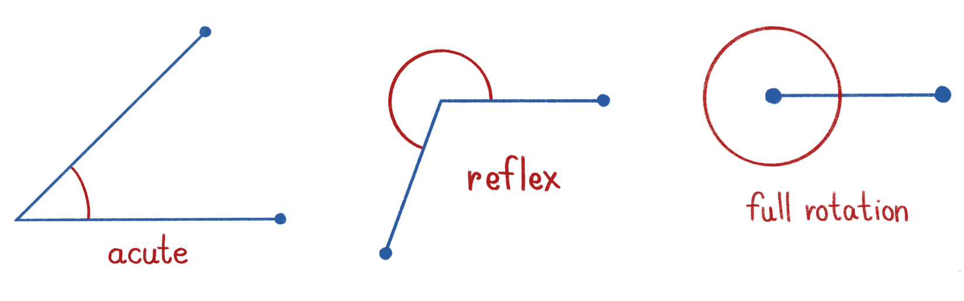
Short response (10)
A quarter turn forms a right angle.
Describe these 3 angles in comparison to a quarter turn:
Notes:
Short response questions provide brisk paced questions focussing on review of current and previous content to support spaced and interleaved practice.
Syllabus focus area:
Geometric measure B: Angles

Slide 22
Short response (11)
Sketch a square-based pyramid.
Notes:
Short response questions provide brisk paced questions focussing on review of current and previous content to support spaced and interleaved practice.
Syllabus focus area:
Three-dimensional spatial structure B: 3D objects

Slide 23
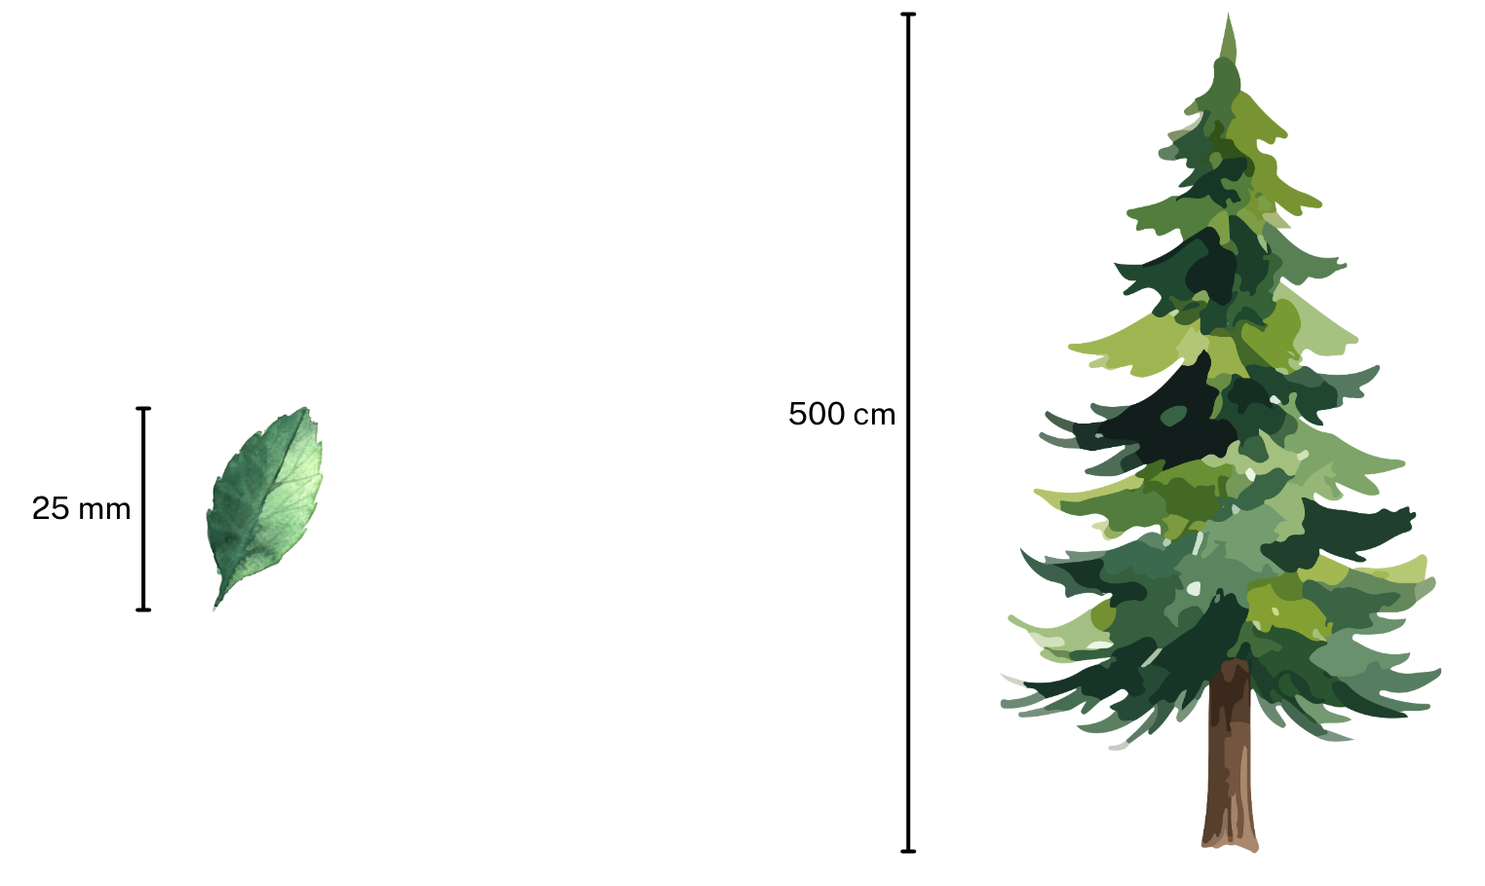
Short response (12)
Record the length of the leaf in centimetres.
Record the height of the tree in metres.
Notes:
Short response questions provide brisk paced questions focussing on review of current and previous content to support spaced and interleaved practice.
Syllabus focus area:
Geometric measure B: Length

Slide 24
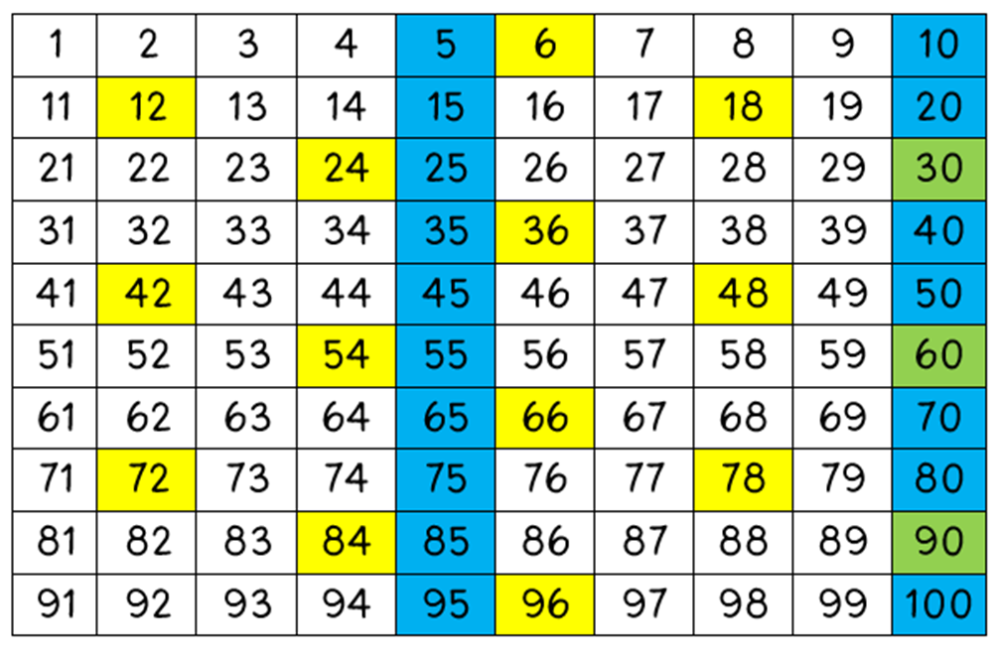
Activity 3 – investigating related multiples in a 100 grid
Notes:
This is a developing number sense activity.
Number sense refers to a deep understanding of numbers, including their magnitude, relationships, and the effects of operations on them. It supports fluency and understanding, estimation, flexible thinking, and efficient problem-solving. Number sense activities 1–4 ‘activate’ prior number knowledge and support the learning of new content in the unit. Number sense activities 5–8 ‘loop’ back and provide opportunity for spaced practice with concepts and procedures covered in previous units.
Syllabus focus area:
Multiplicative relations B
Investigating related multiples in a 100 grid
This resource corresponds to Resource 28 – number chart in Stage 2 Year B Unit 31.
Explain that this is a 100 grid with some numbers shaded in yellow, blue and green.
Ask the students the following:
- What do all the colours shaded in yellow have in common?
- What do you notice about all the numbers shaded in blue?
- Can you think of a reason why there are some numbers shaded in green?
4. Students turn and talk to discuss the questions and share their answers with the class. For example, yellow numbers are multiples of 6, blue numbers are multiples of 5 and green numbers are multiples of both 6 and 5.

Slide 25
Review of learning 4

Slide 26
True or false (2)
If I double each term in my sequence: 3, 6, 9 I get multiples of 6.
True | False
Notes:
The question on this slide connects to the content being explored in the developing number sense activity (Activity 4)
Syllabus focus area:
Multiplicative relations B

Slide 27
Short response (13)
Is 0.7 smaller, larger or equal to 0.70?
Communicate your reasoning.
Notes:
Short response questions provide brisk paced questions focussing on review of current and previous content to support spaced and interleaved practice.
Syllabus focus area:
Representing numbers using place value B

Slide 28
Short response (14)
Name the angle that is the same as:
1 quarter turn
2 quarter turns
3 quarter turns
4 quarter turns
Notes:
Short response questions provide brisk paced questions focussing on review of current and previous content to support spaced and interleaved practice.
Syllabus focus area:
Geometric measure B: Angles

Slide 29
Short response (15)
Sketch a square-based prism.
Notes:
Short response questions provide brisk paced questions focussing on review of current and previous content to support spaced and interleaved practice.
Syllabus focus area:
Three-dimensional spatial structure B: 3D objects

Slide 30
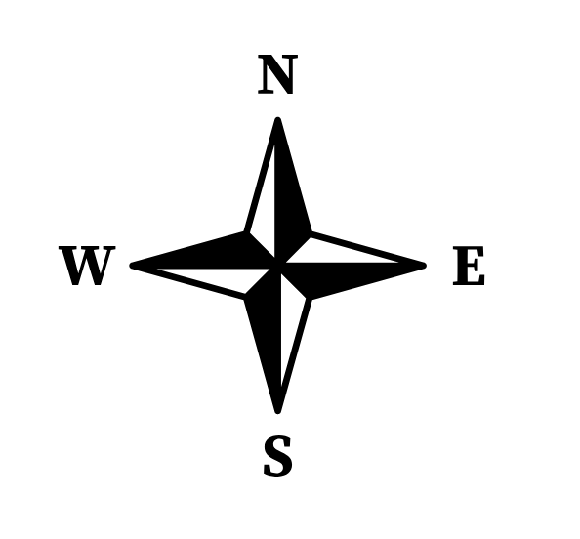
Short response (16)
I am facing north, to face east I would make a quarter turn.
Facing the compass point south, where would I be facing after a half turn?
Explain what happens when you do a full turn from any compass point?
Notes:
Short response questions provide brisk paced questions focussing on review of current and previous content to support spaced and interleaved practice.
Syllabus focus area:
Geometric measure B: Position

Slide 31
Activity 4 – applying doubles to connect multiples of 3 to 6 and 4 to 8
Multiples of 3:
3, 6, 9, 12, 15
Notes:
This is a developing number sense activity.
Number sense refers to a deep understanding of numbers, including their magnitude, relationships, and the effects of operations on them. It supports fluency and understanding, estimation, flexible thinking, and efficient problem-solving. Number sense activities 1–4 ‘activate’ prior number knowledge and support the learning of new content in the unit. Number sense activities 5–8 ‘loop’ back and provide opportunity for spaced practice with concepts and procedures covered in previous units.
Syllabus focus area:
Multiplicative relations B
Applying doubles to connect multiples of 3 to 6 and 4 to 8
Ask students to double each number to make a multiple of 6 using a choral response. Write student responses next to each number (6, 12, 18, 24, 30).
Repeat by writing multiples of 4 on the board: 4, 8, 12, 16, 20
Ask students to double each number to make a multiple of 8 using a choral response. Write student responses next to each number (8, 16, 24, 32, 40).
Students turn and talk to discuss what pattern they notice (doubling multiples of 3 gives multiples of 6 and doubling multiples of 4 gives multiples of 8).

Slide 32
Review of learning 5

Slide 33
Multiple choice (3)
The sixth multiple of 4 is 24.
What is the twelfth multiple of 4?
A
B
C
D
30
48
28
16
Notes:
This question connects to the content in the developing number sense activity (Activity 5)
Syllabus focus area:
Multiplicative relations B

Slide 34
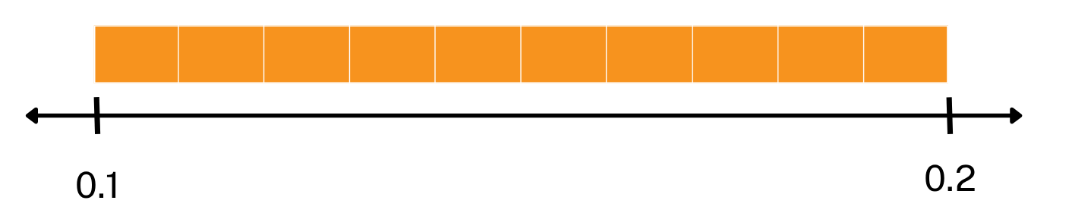
Short response (17)
List in order the decimals between 0.1 and 0.2.
Communicate your reasoning.
Notes:
Short response questions provide brisk paced questions focussing on review of current and previous content to support spaced and interleaved practice.
Syllabus focus area:
Representing numbers using place value B

Slide 35
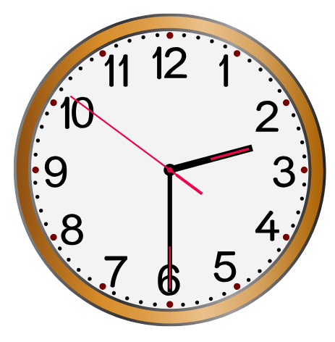
Short response (18)
Record this in digital time.
How many seconds are there in a minute?
Notes:
Short response questions provide brisk paced questions focussing on review of current and previous content to support spaced and interleaved practice.
Syllabus focus area:
Non-spatial measure B

Slide 36
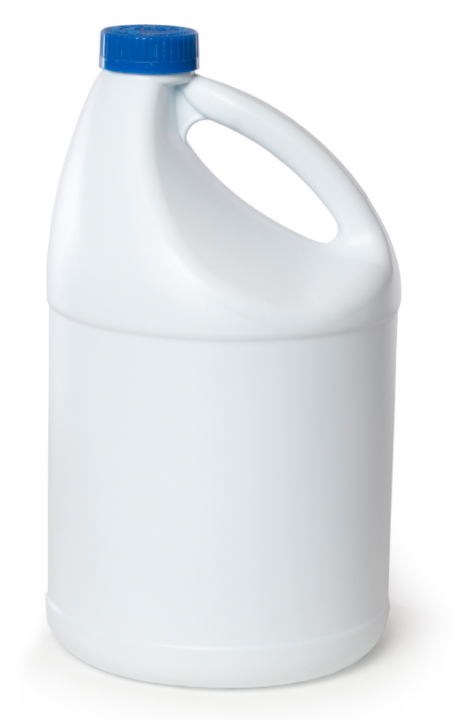
Short response (19)
Record the capacity of a 2-litre milk container using the abbreviation for litres.
Notes:
Short response questions provide brisk paced questions focussing on review of current and previous content to support spaced and interleaved practice.
Syllabus focus area:
Three-dimensional spatial structure A: Volume

Slide 37
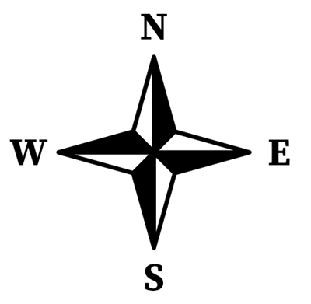
Short response (20)
To face east, I would make a quarter turn from north. This turn forms a right angle.
Record other examples of right angles between compass points.
Communicate your reasoning.
Notes:
Short response questions provide brisk paced questions focussing on review of current and previous content to support spaced and interleaved practice.
Syllabus focus area:
Geometric measure A: Position

Slide 38
Activity 5 – using multiplication and division to solve problems
Volleyball is played in teams of 6.
There were enough players to make 3 teams.
How many players are there altogether?
Notes:
This is a developing number sense activity.
Number sense refers to a deep understanding of numbers, including their magnitude, relationships, and the effects of operations on them. It supports fluency and understanding, estimation, flexible thinking, and efficient problem-solving. Number sense activities 1–4 ‘activate’ prior number knowledge and support the learning of new content in the unit. Number sense activities 5–8 ‘loop’ back and provide opportunity for spaced practice with concepts and procedures covered in previous units.
Syllabus focus area:
Multiplicative relations B
Using multiplication and division to solve problems
Explain that they will be using multiplication and division to solve some problems.
(Note: this activity is an adaptation of Solving Multiplication and Division Word Problems from SAS by Commonwealth of Pennsylvania.)
2. Read the following problem to the students: Volleyball is played in teams of 6. There were enough players to make 3 teams. How many players
are there altogether?
3. Students turn and talk how they would solve this problem and share this with the class. Ask:
How many teams are there?
How many players does each team have?

Slide 39
Review of learning 6

Slide 40
True or false (3)
There are 20 students playing sport in groups of 4. Two more groups join in.
The total number of students is now 28.
True | False
Notes:
The question on this slide connects to the content being explored in the developing number sense activity (Activity 6)
Syllabus focus area:
Multiplicative relations B

Slide 41
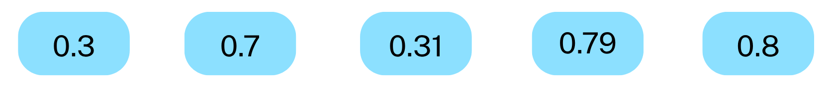
Short response (21)
Arrange the following decimals in ascending order:
Notes:
Short response questions provide brisk paced questions focussing on review of current and previous content to support spaced and interleaved practice.
Syllabus focus area:
Representing numbers using place value B

Slide 42
Short response (22)
My journey to work usually takes one and a half hours.
How many half-hours is that in total?
If I took an extra half an hour to get there, how long is my total journey now?
Notes:
Short response questions provide brisk paced questions focussing on review of current and previous content to support spaced and interleaved practice.
Syllabus focus area:
Non-spatial measure A: Time

Slide 43
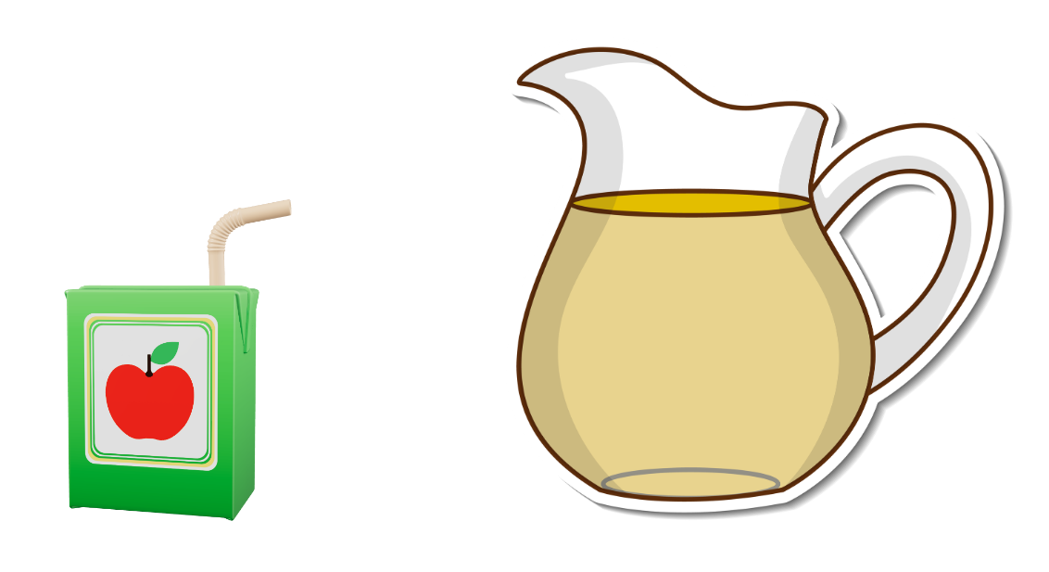
Short response (23)
The juice popper has a capacity of 250mL.
How many poppers will be needed to fill a 1L jug?
Communicate your reasoning.
Notes:
Short response questions provide brisk paced questions focussing on review of current and previous content to support spaced and interleaved practice.
Syllabus focus area:
Three-dimensional spatial structure B: Volume

Slide 44
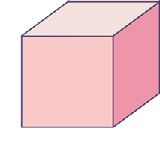
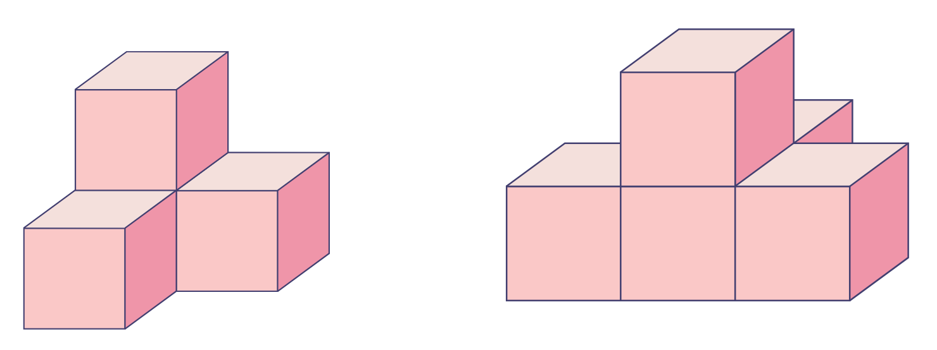
Short response (24)
1 cube has a volume of 1 cubic centimetre.
What is the volume of each multi-cube object below?
A
B
Notes:
Short response questions provide brisk paced questions focussing on review of current and previous content to support spaced and interleaved practice.
Syllabus focus area:
Three-dimensional spatial structure A: Volume

Slide 45
Activity 6 – using multiplication and division to solve problems 2
Volleyball is played in teams of 6. There were enough players to make 3 teams.
How many players are there altogether?
Notes:
This is a developing number sense activity.
Number sense refers to a deep understanding of numbers, including their magnitude, relationships, and the effects of operations on them. It supports fluency and understanding, estimation, flexible thinking, and efficient problem-solving. Number sense activities 1–4 ‘activate’ prior number knowledge and support the learning of new content in the unit. Number sense activities 5–8 ‘loop’ back and provide opportunity for spaced practice with concepts and procedures covered in previous units.
Syllabus focus area:
Multiplicative relations B
Using multiplication and division to solve problems 2
This activity is an adaptation of Solving Multiplication and Division Word Problems from SAS by Commonwealth of Pennsylvania.
Explain that you are going to change the problem: If there are 3 teams, 18 people are playing and there are an equal number of people in each team, how many people are in each team?
Students turn and talk to discuss how to solve the problem.
Note: linking multiplication and division is an important understanding for students by the end of Stage 2. They should come to realise that
division 'undoes' multiplication and multiplication 'undoes' division. Students use multiplication facts to divide, for example 35 ÷ 7 = is the same
as _ × 7 = 35. They should be encouraged to check the answer to a division question by multiplying their answer by the divisor.
4. Discuss what students noticed when solving the problem. For example, the inverse relationship between 18 ÷ 3 = 6 and 3 x 6 = 18 by asking:
- How did you know what operation to use?
- How do you know when you should multiply or divide a problem?

Slide 46
Review of learning 7

Slide 47
Multiple choice (4)
The eighth multiple of 6 is 48. This can be represented as:
A
8 sixes
B
8 + 6
C
48 - 6
D
8 x 6
Notes:
This question connects to the content in the developing number sense activity (Activity 7)
Syllabus focus area:
Multiplicative relations B

Slide 48
Short response (25)
Use the commutative property to solve:
16 x 5 = (2 x 8) x 5
Notes:
Short response questions provide brisk paced questions focussing on review of current and previous content to support spaced and interleaved practice.
Syllabus focus area:
Multiplicative relations B

Slide 49
Short response (26)
My kitchen timer is set for 1 minute.
Record this in seconds.
Notes:
Short response questions provide brisk paced questions focussing on review of current and previous content to support spaced and interleaved practice.
Syllabus focus area:
Non-spatial measure B: Time

Slide 50
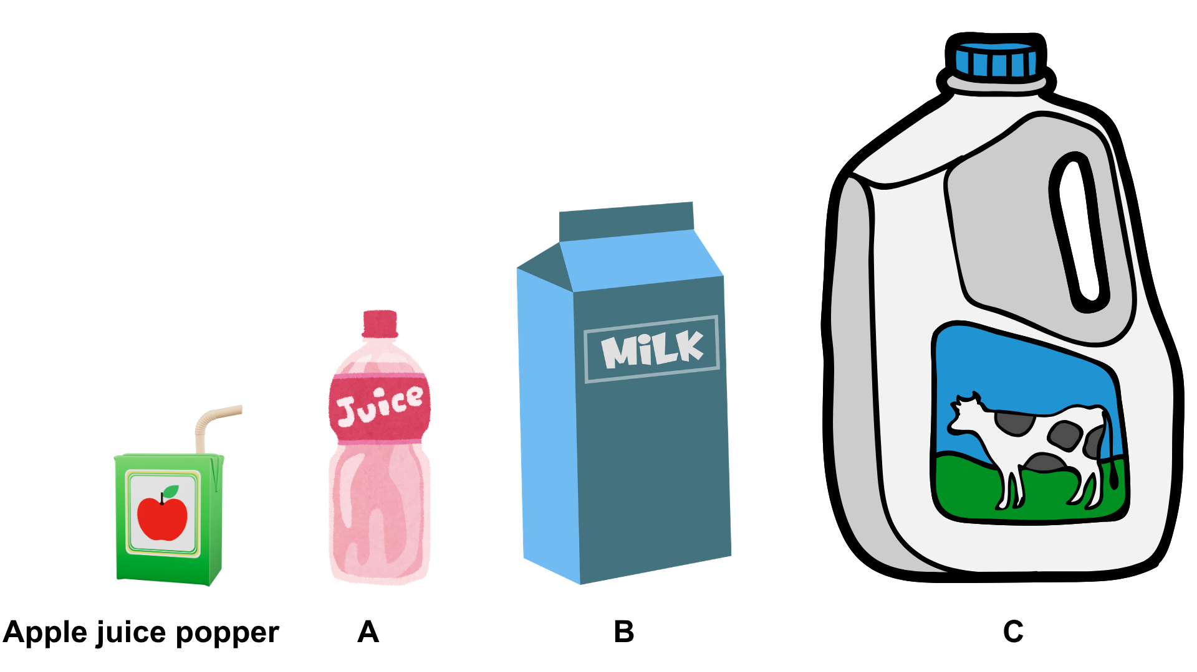
Short response (27)
The apple juice popper has a capacity of 250 mL. Use this information to estimate the capacities of the other objects.
apple juice popper
A
B
C
Notes:
Short response questions provide brisk paced questions focussing on review of current and previous content to support spaced and interleaved practice.
Syllabus focus area:
Three-dimensional spatial structure B: Volume

Slide 51
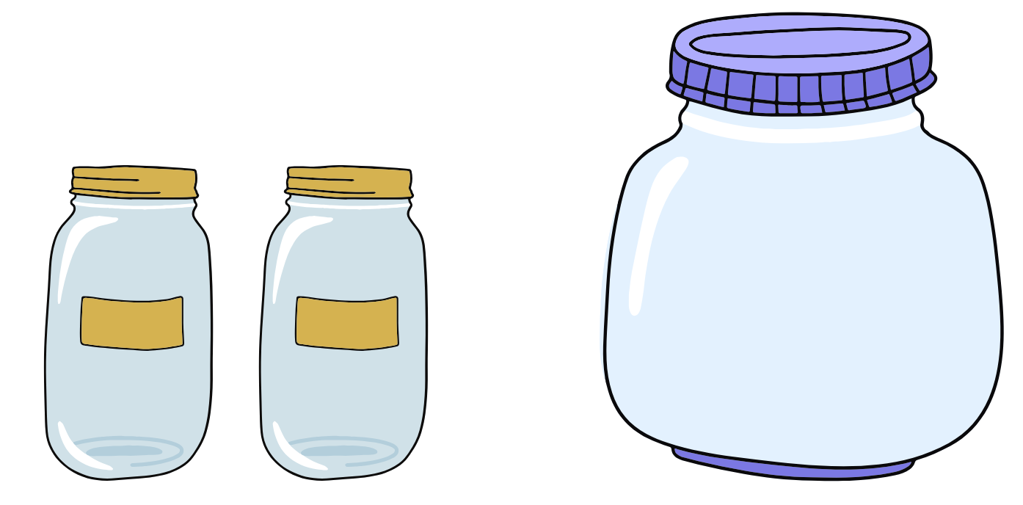
Short response (28)
Each of these smaller jars holds 1 litre (1 L) of water.
2 smaller jars of water will fill exactly half of the larger jar.
What is the capacity of the larger jar (L)?
Notes:
Short response questions provide brisk paced questions focussing on review of current and previous content to support spaced and interleaved practice.
Syllabus focus area:
Three-dimensional spatial structure A: Volume

Slide 52
Activity 7 – using number sentences to solve multiplicative word problems
28 = x 7
Notes:
This is a developing number sense activity.
Number sense refers to a deep understanding of numbers, including their magnitude, relationships, and the effects of operations on them. It supports fluency and understanding, estimation, flexible thinking, and efficient problem-solving. Number sense activities 1–4 ‘activate’ prior number knowledge and support the learning of new content in the unit. Number sense activities 5–8 ‘loop’ back and provide opportunity for spaced practice with concepts and procedures covered in previous units.
Syllabus focus area:
Multiplicative relations B
Using number sentences to solve multiplicative word problems
Students turn and talk to find the missing numbers.
Seek input from students to write the missing number. (4).
Display the following problem: I buy 7 chocolates and the total cost is $28. What is the cost of each chocolate?
Prompt students to write a number sentence on a whiteboard to represent the problem. This can be represented as 7 x 4 = 28 or 28 ÷ 7 = 4.
Students turn and talk to discuss how they solved the problem.

Slide 53
Review of learning 8

Slide 54
True or false (4)
If 7 x 5 = 35, then 35 ÷ 7 = 5
True | False
Notes:
The question on this slide connects to the content being explored in the developing number sense activity (Activity 8)
Syllabus focus area:
Multiplicative relations B

Slide 55
Short response (29)
Use flexible partitioning to solve this problem in 2 different ways:
7 x 9
Notes:
Short response questions provide brisk paced questions focussing on review of current and previous content to support spaced and interleaved practice.
Syllabus focus area:
Multiplicative relations B

Slide 56

Short response (30)
Kirsty must be at school by nine o’clock in the morning.
Record this using digital time.
Notes:
Short response questions provide brisk paced questions focussing on review of current and previous content to support spaced and interleaved practice.
Syllabus focus area:
Non-spatial measure B: Time

Slide 57
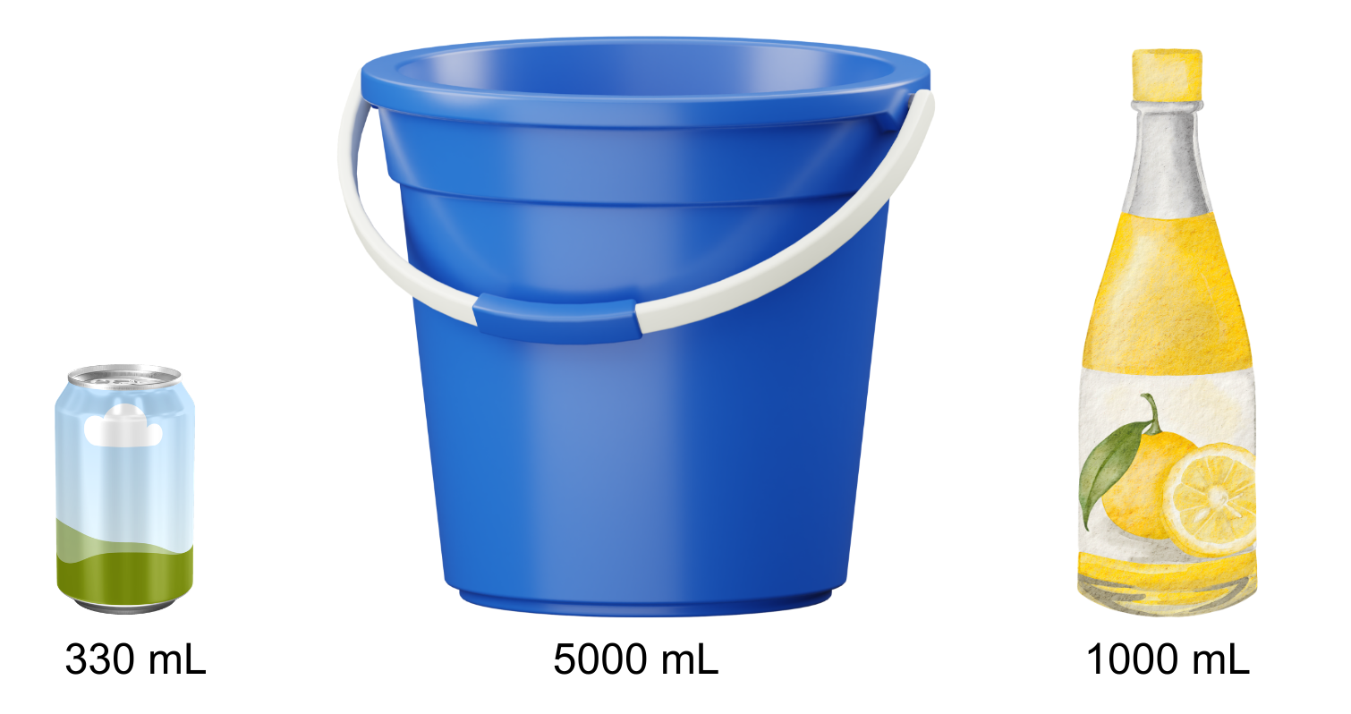
Short response (31)
Order the containers shown from
smallest to largest capacity.
Notes:
Short response questions provide brisk paced questions focussing on review of current and previous content to support spaced and interleaved practice.
Syllabus focus area:
Three-dimensional spatial structure B: Volume

Slide 58
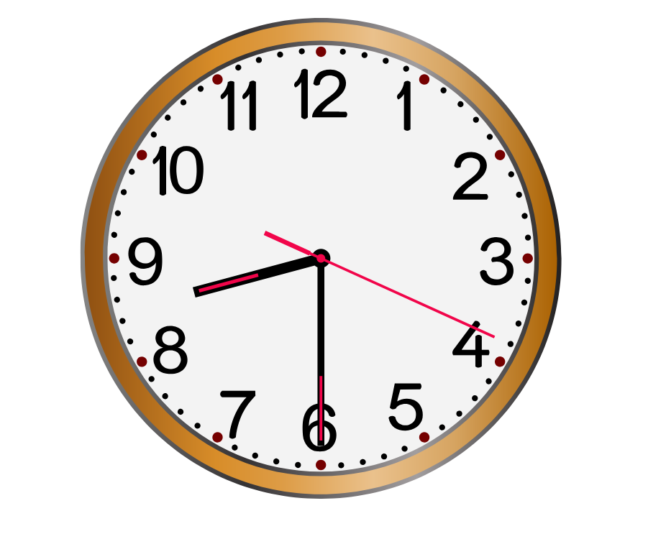
Short response (32)
I go to bed at this time each night:
Record this in digital time.
It took me 60 seconds to fall asleep.
How many minutes is this?
Notes:
Short response questions provide brisk paced questions focussing on review of current and previous content to support spaced and interleaved practice.
Syllabus focus area:
Non-spatial measure B: Time

Slide 59
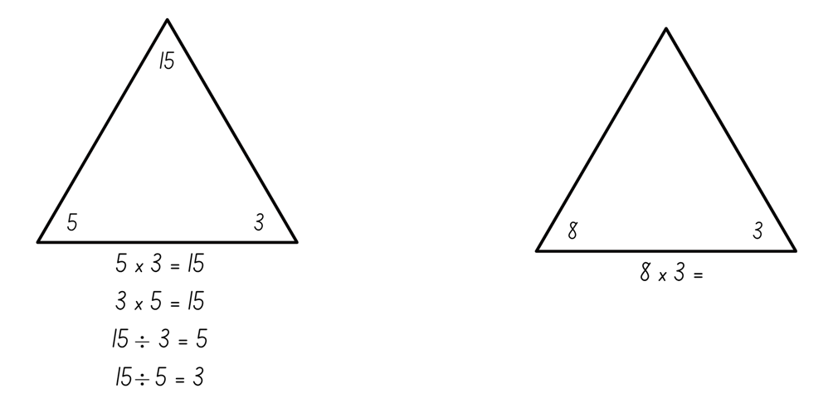
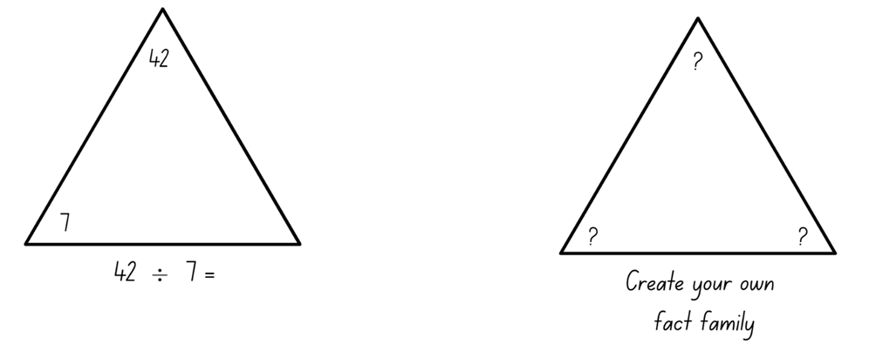
Activity 8 – fact families
Notes:
This is a developing number sense activity.
Number sense refers to a deep understanding of numbers, including their magnitude, relationships, and the effects of operations on them. It supports fluency and understanding, estimation, flexible thinking, and efficient problem-solving. Number sense activities 1–4 ‘activate’ prior number knowledge and support the learning of new content in the unit. Number sense activities 5–8 ‘loop’ back and provide opportunity for spaced practice with concepts and procedures covered in previous units.
Syllabus focus area:
Multiplicative relations B
Fact families
This resource corresponds to Resource 29 – fact families in Stage 2 Year B Unit 31.
Remind students that fact family triangles show groups of related multiplication and division facts. The numbers that sit on the corners of the triangle can be used to create 4 different number sentences, 2 multiplication sentences and 2 division sentences.
Refer to the first fact family triangle to solve as a class and represent all related facts (see Figure 19).
Ask students to complete the fact families for the second and third triangles, before students then create their own fact family.

Slide 60
Double Venn diagram
Object 1
Object 2
Features similar to both objects
Features of object 1
Features of object 2

Slide 61
Frayer
Definition
Facts/Characteristics
Word, term, concept
Examples
Non-examples

Slide 62
Spider map
Idea
Subject

Slide 63
Cline
Concept 1
Concept 2
Word
Word
Word
Word
Word
Word
Word
Word
Word
Word
Word

Slide 64
Compare and contrast
Notes:
Use the arrows to navigate between related activities.
Hyperlink each arrow to compare between related slides.

Slide 65
Multiple choice (5)
A
B
C
D
Notes:
This question connects to the content in the developing number sense activity (Activity 1)
This question can:
support spaced and interleaved practice
help identify and address common misconceptions
support active recall and immediate feedback
support whole class participation
identify areas requiring reteach
Teachers are encouraged to adapt and contextualise for their contexts.

Slide 66
Multiple choice (6)
A
B
C
D
Notes:
This question connects to the content in the developing number sense activity (Activity 1)
Syllabus focus area:
Multiplicative relations A
This question can:
support spaced and interleaved practice
help identify and address common misconceptions
support active recall and immediate feedback
support whole class participation
identify areas requiring reteach
Teachers are encouraged to adapt and contextualise for their contexts.

Slide 67
References (1)
This presentation contains NSW Curriculum and syllabus content. The NSW Curriculum is developed by the NSW Education Standards Authority. This content is prepared by NESA for and on behalf of the Crown in the right of the State of New South Wales. The material is protected by Crown copyright.
Please refer to the NESA Copyright Disclaimer for more information https://educationstandards.nsw.edu.au/wps/portal/nesa/mini-footer/copyright.
NESA holds the only official and up-to-date versions of the NSW Curriculum and syllabus documents. Please visit the NSW Education Standards Authority (NESA) website https://educationstandards.nsw.edu.au/wps/portal/nesa/home and the NSW Curriculum website https://curriculum.nsw.edu.au.
Mathematics K-10 Syllabus © Syllabus NSW Education Standards Authority (NESA) for and on behalf of the Crown in right of the State of New South Wales, 2022.
National Numeracy Learning Progression © Australian Curriculum, Assessment and Reporting Authority (ACARA) 2010 to present, unless otherwise indicated. This material was downloaded from the Australian Curriculum website (National Literacy Learning Progression) (accessed 24 April 2026) and was not modified.
Clarke D and Roche A (2014) Engaging Maths: 25 favourite lessons, 2nd edn, Mathematics Teaching and Learning Centre, Australian Catholic University and Catholic Education office.
Commonwealth of Pennsylvania (2013) Solving Multiplication and Division Word Problems, Pennsylvania Department of Education: SAS (Standards Aligned System) website, accessed 15 December 2025.
Daily Maths Review (2026) Hundreds chart. Daily Maths Review website, accessed 13 March, 2026.

Slide 68
References (2)
This presentation contains NSW Curriculum and syllabus content. The NSW Curriculum is developed by the NSW Education Standards Authority. This content is prepared by NESA for and on behalf of the Crown in the right of the State of New South Wales. The material is protected by Crown copyright.
Please refer to the NESA Copyright Disclaimer for more information https://educationstandards.nsw.edu.au/wps/portal/nesa/mini-footer/copyright.
NESA holds the only official and up-to-date versions of the NSW Curriculum and syllabus documents. Please visit the NSW Education Standards Authority (NESA) website https://educationstandards.nsw.edu.au/wps/portal/nesa/home and the NSW Curriculum website https://curriculum.nsw.edu.au.
Lowry C (2020) Number Patterns, AMSI (Australian Mathematical Sciences Institute), accessed 4 December 2025.
State of New South Wales (Department of Education) (2023) ‘Multiplication toss’, Mathematics K–6 resources, NSW Department of Education website, accessed 12 December 2025.
Sullivan P (2018) Challenging Mathematical Tasks: Unlocking the Potential of all Students, Oxford University Press, Australia.
University of Cambridge (n.d.) Multiples Grid, NRICH website, accessed 12 December 2025.
Van de Walle J, Karp K, Bay-Williams JM, Brass A, Bentley B, Ferguson S, Goff W, Livy S, Marshman M, Martin D, Pearn C, Prodromou T, Symons D and Wilkie K (2019) Primary and Middle Years Mathematics: Teaching Developmentally, 1st Australian edn, Pearson Education Australia, Melbourne.

Slide 69
Copyright
© State of New South Wales (Department of Education), 2025
The copyright material published in this resource is subject to the Copyright Act 1968 (Cth) and is owned by the NSW Department of Education or, where indicated, by a party other than the NSW Department of Education (third-party material).
Copyright material available in this resource and owned by the NSW Department of Education is licensed under a Creative Commons Attribution 4.0 International (CC BY 4.0) license.
This license allows you to share and adapt the material for any purpose, even commercially.
Attribution should be given to © State of New South Wales (Department of Education), 2025.
Material in this resource not available under a Creative Commons license:
the NSW Department of Education logo, other logos and trademark-protected material
Material owned by a third party that has been reproduced with permission. You will need to obtain permission from the third party to reuse its material.
Links to third-party material and websites
Please note that the provided (reading/viewing material/list/links/texts) are a suggestion only and implies no endorsement, by the New South Wales Department of Education, of any author, publisher, or book title. School principals and teachers are best placed to assess the suitability of resources that would complement the curriculum and reflect the needs and interests of their students.
If you use the links provided in this document to access a third party’s website, you acknowledge that the terms of use, including licence terms set out on the third-party’s website apply to the use which may be made of the materials on that third-party website or where permitted by the Copyright Act 1968 (Cth). The department accepts no responsibility for content on third-party websites.

