Slide 1
Instructions for use
This resource is not a teaching and learning program. It should be used in conjunction with Stage 2 Year A Unit 1.
Classroom teachers are encouraged to add and adapt slides as required to meet the needs of their students.
Save a copy of the file to make changes to the slide deck. Go to File > Download a Copy (this downloads a copy to the computer to edit in the PowerPoint app).
To convert the PowerPoint to Google Slides:
  Upload the file into Google Drive and open it.
  Go to File > Save as Google Slides.
  (Note – conversion may cause formatting changes in the slides.)

Slide 2

Review of Learning
Mathematics Stage 2 – Unit 1
Notes:
Reviews may include a combination of question types, requiring students to recall facts and key ideas, as well as apply their knowledge to solve problems and answer questions. To support active engagement, a mix of techniques should be employed.” (AERO, 2024).
This Review of Learning slide deck revisits key concepts from the following:
Stage 2 Year A Unit 1
Stage 1 Combining and separating quantities syllabus content
Stage 1 Forming groups syllabus content
It also includes opportunities to review prior learning in non-number content, supporting consolidation across focus areas.
The review of learning resources include three key task types that support the development of mathematical proficiency through retrieval, spaced practice, and active participation. These practices complement the review phase (activating prior knowledge) embedded within the beginning of each lesson.
1.
Multiple-choice questions/True or false: Designed to promote active retrieval of key concepts and identify common misconceptions in number, supporting consolidation, understanding and fluency.
These questions:
support spaced and interleaved practice
help identify and address common misconceptions
support active recall and immediate feedback
support whole class participation
identify areas requiring reteach
2.
Short-response question sets: Carefully grouped questions that encourage spaced and interleaved practice across multiple focus areas, helping students revisit and apply knowledge from different points in time.
These questions:
have a combination of question types
address a range of focus areas
build automaticity and fluency
support active recall
allow for immediate feedback
identify content requiring reteach
3.
Developing number sense activities: A variety of practical, purposeful tasks that reinforce current learning and build on prior knowledge. These activities promote reasoning, problem-solving and conceptual understanding.
The review of learning resources are designed to work support teaching and learning in mathematics. For the most effective implementation, use the resources flexibly, adapting to meet student learning needs and individual classroom contexts.

Slide 3
Lessons
1
Review of Learning 1
5
Review of Learning 5
2
Review of Learning 2
6
Review of Learning 6
3
Review of Learning 3
7
Review of Learning 7
4
Review of Learning 4
8
Review of Learning 8
Notes:
Teacher notes:
Click lesson numbers to go to specific lessons
Interactive features can be viewed in slide show

Slide 4
Review of learning 1

Slide 5

Multiple choice (1)
A collection of craft sticks is used to make the number 26. How can 26 be partitioned and renamed?
A
13 ones + 13 ones
B
2 tens and 6 ones
C
1 ten + 1 ten + 6 ones
D
All the above
Notes:
This question connects to the content in the developing number sense activity (Activity 1)
Syllabus focus area:
Representing whole numbers B (Note: Stage 1 content reviewed)

Slide 6

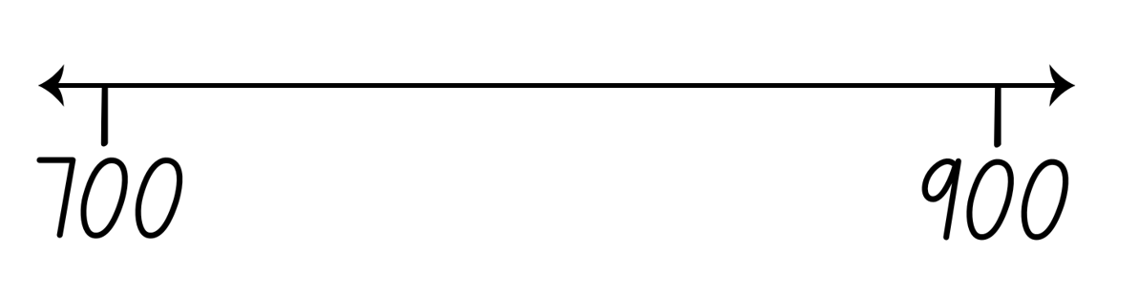
Short response (1)
The numbers 745, 860, and 805 are positioned on a number line.
Which number is closest to 900?
Which number is closest to 700?
Which number is closest to 800?
Notes:
Short response questions provide brisk paced questions focussing on review of current and previous content to support spaced and interleaved practice.
Syllabus focus area:
Representing whole numbers B (Note: Stage 1 content reviewed)

Slide 7
Short response (2)
Record 10 combinations of 2 numbers that add to 16.
Notes:
Short response questions provide brisk paced questions focussing on review of current and previous content to support spaced and interleaved practice.
Syllabus focus area:
Combining and separating quantities B (Note: Stage 1 content reviewed)

Slide 8
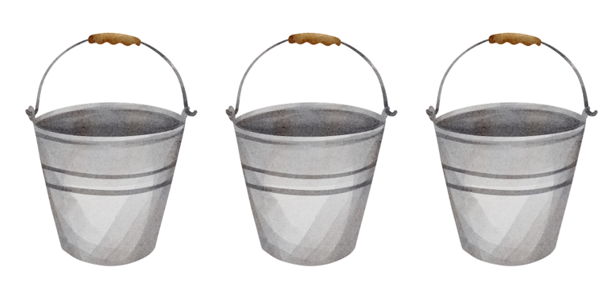
Short response (3)
Each bucket has 4 balls.
Record the repeated addition number sentence and answer.
Notes:
Short response questions provide brisk paced questions focussing on review of current and previous content to support spaced and interleaved practice.
Syllabus focus area:
Forming groups B (Note: Stage 1 content reviewed)

Slide 9
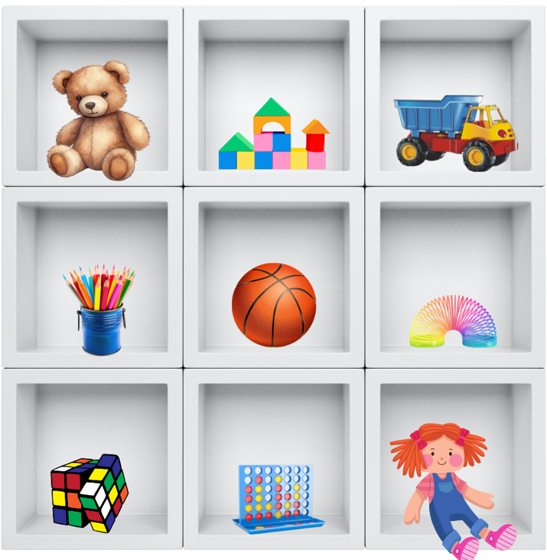
Short response (4)
Record the object that is on the:
left of the basketball
right of the rubrics cube
below the teddy bear
above the slinky
Notes:
Short response questions provide brisk paced questions focussing on review of current and previous content to support spaced and interleaved practice.
Syllabus focus area:
Geometric measure B (Note: Stage 1 content reviewed)

Slide 10

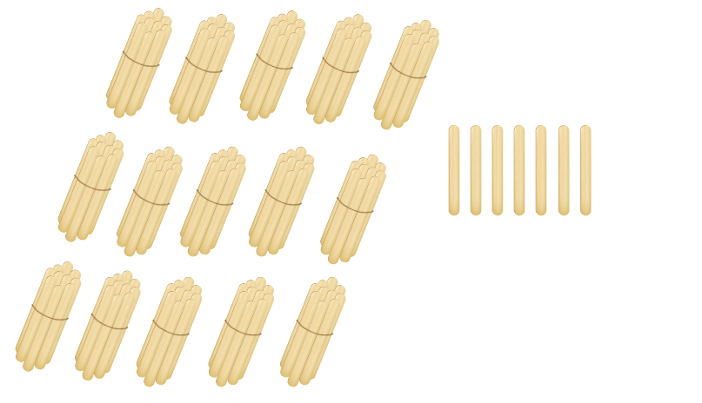
Activity 1 – place value through partitioning
Notes:
This is a developing number sense activity.
Number sense refers to a deep understanding of numbers, including their magnitude, relationships, and the effects of operations on them. It supports fluency and understanding, estimation, flexible thinking, and efficient problem-solving. Number sense activities 1–4 ‘activate’ prior number knowledge and support the learning of new content in the unit. Number sense activities 5–8 ‘loop’ back and provide opportunity for spaced practice with concepts and procedures covered in previous units.
Syllabus focus area:
Representing whole numbers B (Note: Stage 1 content reviewed)
Place value through partitioning
Students sit in a circle.
Display 15 groups of 10 and 7 ones using craft sticks or other materials. Explain you have 157 craft sticks.
Students turn and talk to share ideas on how they can prove there are 157 sticks.
Note: bundles of 10 can be made with craft sticks, interlocking cubes, straws, or something similar that can be separated. Before the lesson, watch Number busting – number talk (renaming 26) (2:00).
Model how to use the collection to partition 157 in different ways by partitioning and physically moving the craft sticks.
Ask pairs to Think-Pair-Share and draw on mental computation to identify ways to partition 157.
Invite students to share their ideas. Encourage students to undo the craft sticks bundles to check and prove this.
Record a variety of representations on the board:
147 = 100 + 40 + 7
147 = 1 hundred, 4 tens, 7 ones
147 = 14 tens, 7 ones

Slide 11
Review of learning 2

Slide 12
True or false (1)
253 can be partitioned as 25 tens and 3 ones, or as 25 tens and 3 ones.
True | False
Notes:
The question on this slide connects to the content being explored in the developing number sense activity (Activity 2)
Syllabus focus area:
Representing whole numbers B (Note: Stage 1 content reviewed)

Slide 13
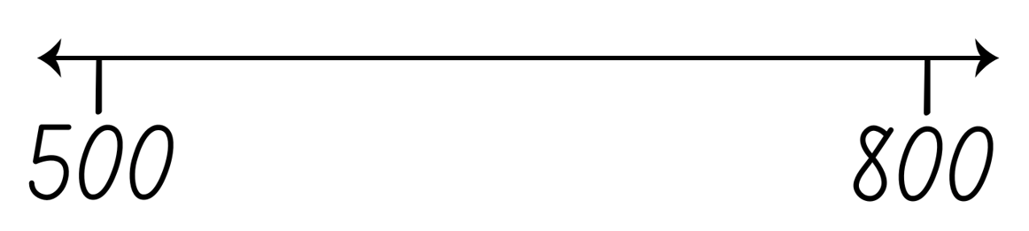
Short response (5)
Write the numbers 648, 725, 589, and 703 in order from smallest to largest on a number line.
Notes:
Short response questions provide brisk paced questions focussing on review of current and previous content to support spaced and interleaved practice.
Syllabus focus area:
Representing numbers using place value A

Slide 14
Short response (6)
The difference between 14 and 19 is the same as the difference between 25 and 30.
Draw 2 number lines to show the constant difference.
Notes:
Short response questions provide brisk paced questions focussing on review of current and previous content to support spaced and interleaved practice.
Syllabus focus area:
Combining and separating quantities B (Note: Stage 1 content reviewed)

Slide 15
Short response (7)
Sam has 6 plates. There are 3 cookies on each plate.
Write a repeated addition number sentence to find the total number of cookies.
Notes:
Short response questions provide brisk paced questions focussing on review of current and previous content to support spaced and interleaved practice.
Syllabus focus area:
Forming groups B (Note: Stage 1 content reviewed)

Slide 16
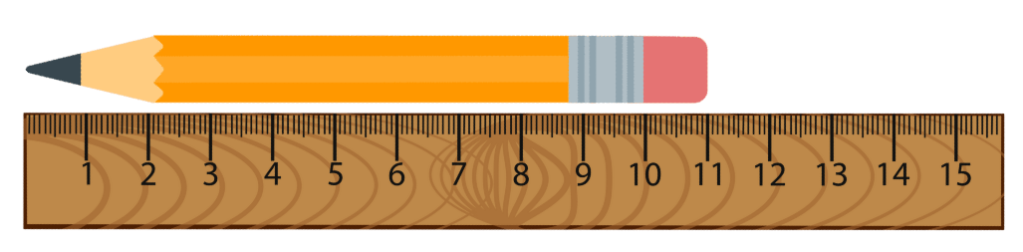
Short response (8)
What is the length of the pencil? Record your answer using the abbreviation for centimetres.
Notes:
Short response questions provide brisk paced questions focussing on review of current and previous content to support spaced and interleaved practice.
Syllabus focus area:
Geometric measure B (Note: Stage 1 content reviewed)

Slide 17
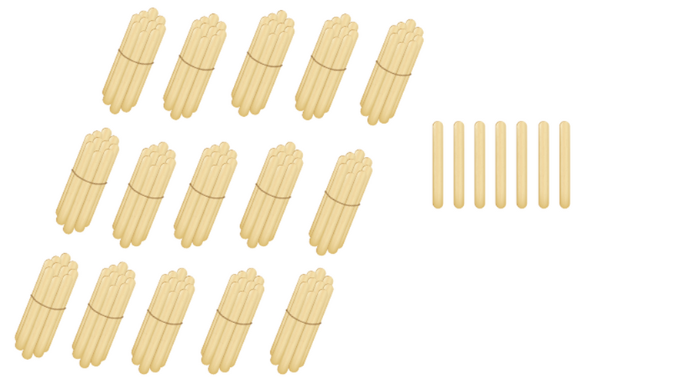
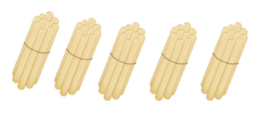
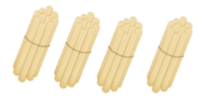
Activity 2 – partitioning with tens and ones
Notes:
This is a developing number sense activity.
Number sense refers to a deep understanding of numbers, including their magnitude, relationships, and the effects of operations on them. It supports fluency and understanding, estimation, flexible thinking, and efficient problem-solving. Number sense activities 1–4 ‘activate’ prior number knowledge and support the learning of new content in the unit. Number sense activities 5–8 ‘loop’ back and provide opportunity for spaced practice with concepts and procedures covered in previous units.
Syllabus focus area:
Representing whole numbers B (Note: Stage 1 content reviewed)
Partitioning with tens and ones
Provide opportunities for students to identify and explain strategies to partition 3-digit numbers. Students use whiteboards to record the strategy used. Seek input from students to share and justify their reasoning.
Students sit in a circle.
Display 24 groups of 10 and 3 ones using craft sticks or other materials. Explain you have 243 craft sticks.
Students turn and talk to share ideas on how they can prove there are 243 sticks.
Note: Use bundles of 10 made with craft sticks, interlocking cubes, straws, or similar materials that can be unbundled and regrouped. Prior to the lesson, consider watching “Number busting – number talk (renaming 26)” (2:00).
Model how to partition 243 in different ways by physically rearranging the craft sticks (e.g. breaking up tens to form ones). For example: 24 tens and 3 ones; or 20 tens and 43 ones.
Ask pairs to Think-Pair-Share using mental strategies to generate different ways to partition the number 243.
Seek input from students to share their thinking. Encourage them to break and regroup bundles to check their reasoning and prove different partitions.
Record a variety of representations on the board. Demonstrate less obvious decompositions, such as:
243 = 200 + 40 + 3
243 = 2 hundreds, 3 tens, 13 ones
243 = 1 hundred, 14 tens, 3 ones

Slide 18
Review of learning 3

Slide 19
Multiple choice (2)
In the number 472, what is the quantity value of the digit 7?
A | B | C | D
7 | 70 | 700 | 7000
Notes:
This question connects to the content in the developing number sense activity (Activity 3)
Syllabus focus area:
Representing whole numbers B (Note: Stage 1 content reviewed)

Slide 20
Short response (9)
Write the numbers 3428, 2915, 4072, and 3056 in ascending order.
Communicate your reasoning.
Notes:
Short response questions provide brisk paced questions focussing on review of current and previous content to support spaced and interleaved practice.
Syllabus focus area:
Representing numbers using place value A

Slide 21
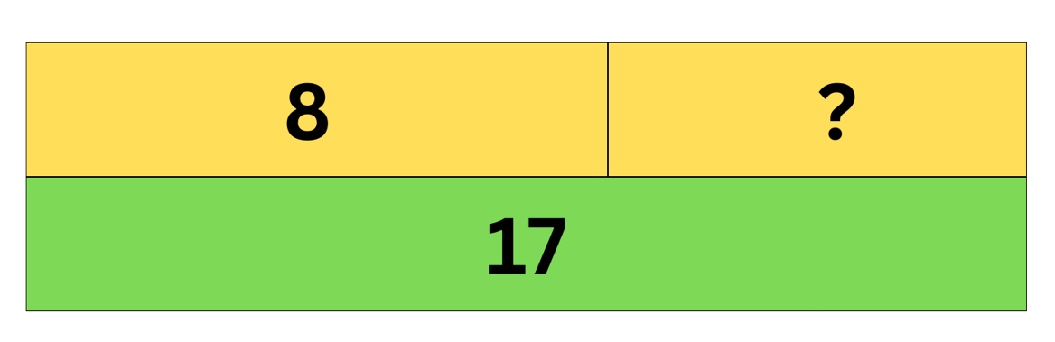
Short response (10)
Write an addition number sentence and a subtraction number sentence to show how addition and subtraction are inverse operations.
Notes:
Short response questions provide brisk paced questions focussing on review of current and previous content to support spaced and interleaved practice.
Syllabus focus area:
Combining and separating quantities B (Note: Stage 1 content reviewed)

Slide 22
Short response (11)
A gardener plants 5 rows of flowers with 8 flowers in each row.
Draw an array to represent this arrangement.
If the gardener decides to plant the same number of flowers in 8 rows, how many flowers will be in each row? Draw the new array.
Notes:
Short response questions provide brisk paced questions focussing on review of current and previous content to support spaced and interleaved practice.
Syllabus focus area:
Forming groups B (Note: Stage 1 content reviewed)

Slide 23

Short response (12)
Draw 2 different shapes you could make using the triangles. Explain how the triangles were combined to form each new shape.
Notes:
Short response questions provide brisk paced questions focussing on review of current and previous content to support spaced and interleaved practice.
Syllabus focus area:
Two-dimensional spatial structure B (Note: Stage 1 content reviewed)

Slide 24


Activity 3 – investigating place value
Guess
Digits
Places
859
2
1
892
865
1
1
894
2
2
Notes:
This is a developing number sense activity.
Number sense refers to a deep understanding of numbers, including their magnitude, relationships, and the effects of operations on them. It supports fluency and understanding, estimation, flexible thinking, and efficient problem-solving. Number sense activities 1–4 ‘activate’ prior number knowledge and support the learning of new content in the unit. Number sense activities 5–8 ‘loop’ back and provide opportunity for spaced practice with concepts and procedures covered in previous units.
Syllabus focus area:
Representing whole numbers B (Note: Stage 1 content reviewed)
Investigating place value
This resource corresponds to Figure 5 – Mastermind example in Stage 2 Year A Unit 1.
Students draw up their gameboard on a whiteboard.
In pairs, each student records a 3-digit number, with no repeated digits, on a sticky note.
Students take turns to guess their partner’s 3-digit number. Partners record the guess, the number of digits that are correct and the number of digits that are in the right place Students then use this information to refine their guesses.
The first student to correctly guess their partner’s number is the winner.
Ask students to discuss the strategies they used to determine the correct answer.
Note: this activity can be adapted by using 2-, 4- or 5-digit numbers.

Slide 25
Review of learning 4

Slide 26
True or false (2)
386 can be renamed as
300 + 80 + 6
or as
38 tens and 6 ones.
True | False
Notes:
The question on this slide connects to the content being explored in the developing number sense activity (Activity 4)
Syllabus focus area:
Representing whole numbers B (Note: Stage 1 content reviewed)

Slide 27
Short response (13)
Write the number that comes before and after the number 4072.
Communicate your reasoning.
Notes:
Short response questions provide brisk paced questions focussing on review of current and previous content to support spaced and interleaved practice.
Syllabus focus area:
Representing numbers using place value A

Slide 28
Short response (14)
14 − 8 = 6
What is the related addition fact?
What is the other related subtraction fact?
Notes:
Short response questions provide brisk paced questions focussing on review of current and previous content to support spaced and interleaved practice.
Syllabus focus area:
Combining and separating quantities B (Note: Stage 1 content reviewed)

Slide 29

Short response (15)
Explain how the arrays show the commutative property of multiplication.
Notes:
Short response questions provide brisk paced questions focussing on review of current and previous content to support spaced and interleaved practice.
Syllabus focus area:
Forming groups B (Note: Stage 1 content reviewed)

Slide 30
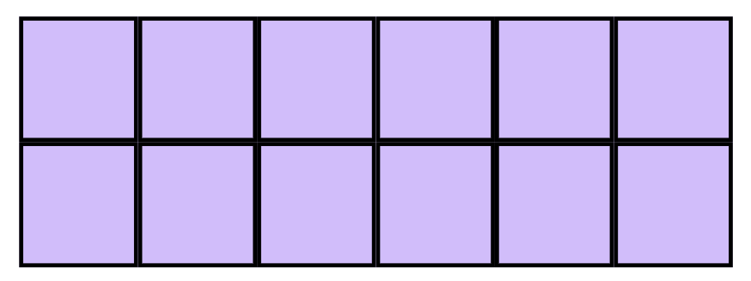
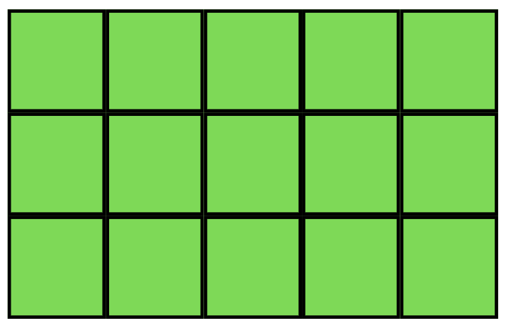
Short response (16)
Explain how you can use the grid structure of rows and columns to help to find the areas? Which rectangle has the larger area?
Notes:
Short response questions provide brisk paced questions focussing on review of current and previous content to support spaced and interleaved practice.
Syllabus focus area:
Two-dimensional spatial structure B (Note: Stage 1 content reviewed)

Slide 31

Activity 4 – ordering numbers using place value
741
7 hundreds, 4 tens and 1 ones = 741
174
1 hundreds, 7 tens and 4 ones = 174
Notes:
This is a developing number sense activity.
Number sense refers to a deep understanding of numbers, including their magnitude, relationships, and the effects of operations on them. It supports fluency and understanding, estimation, flexible thinking, and efficient problem-solving. Number sense activities 1–4 ‘activate’ prior number knowledge and support the learning of new content in the unit. Number sense activities 5–8 ‘loop’ back and provide opportunity for spaced practice with concepts and procedures covered in previous units.
Syllabus focus area:
Representing whole numbers B (Note: Stage 1 content reviewed)
Ordering numbers using place value
This resource corresponds to Figure 6 – ladder example in Stage 2 Year A Unit 1.
Explain the aim of the game is to position 3-digit numbers in sequence on the ladder rungs.
Draw a ladder with 5 rungs on the board. Roll three 9-sided dice and form a 3-digit number. State the value of each digit, for example, 7 hundreds, 4 tens and one ones = 741; or one hundred, 7 tens and 4 ones = 174. Record the chosen 3-digit number on one of the ladder rungs.
Select a student to roll the 3 dice again and form another 3-digit number to place on a rung of the ladder. Ask the student to explain and justify why they selected the 3-digit number, which rung they nominated to place it on, and to state the value of the digits before recording it on the ladder (see Figure 6).
Continue the game until a player is unable to place their number on the ladder, at which point the game is over. Discuss if there were any other possible combinations that could have helped a player win.
Note: the game can be played as whole class or in pairs.

Slide 32
Review of learning 5

Slide 33
Multiple choice (3)
Which of the following shows a pattern counting forwards by 5s starting at 12?
A
12, 16, 20, 24, 28
B
12, 17, 22, 27, 32
C
12, 18, 24, 30, 36
D
12, 20, 25, 30, 35
Notes:
This question connects to the content in the developing number sense activity (Activity 5)
Syllabus focus area:
Forming groups A (Note: Stage 1 content reviewed)

Slide 34
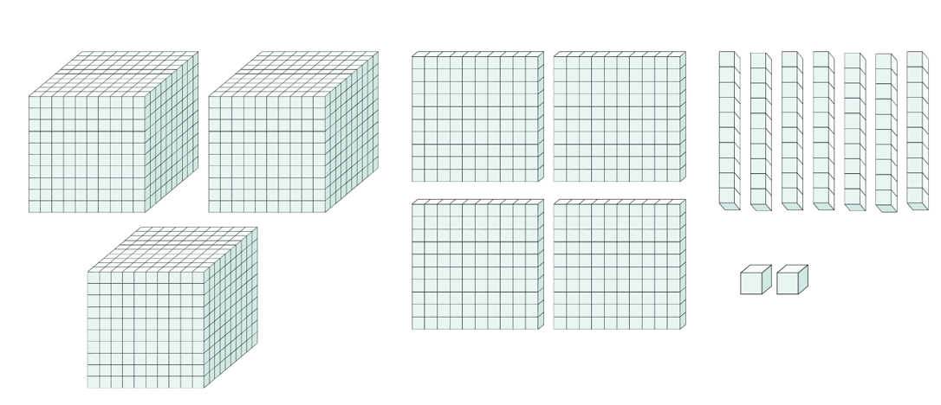
Short response (17)
What number is represented by the MAB materials?
What is the place value of each digit?
Notes:
Short response questions provide brisk paced questions focussing on review of current and previous content to support spaced and interleaved practice.
Syllabus focus area:
Representing numbers using place value A

Slide 35
Short response (18)
Record using a number line how Liam can build to a multiple of ten to solve 56 + 28?
Notes:
Short response questions provide brisk paced questions focussing on review of current and previous content to support spaced and interleaved practice.
Syllabus focus area:
Combining and separating B (Note: Stage 1 content reviewed)

Slide 36
Short response (19)
There are 24 apples. If you put them into baskets with 6 apples in each basket, record how many baskets you will need.
Communicate your reasoning.
Notes:
Short response questions provide brisk paced questions focussing on review of current and previous content to support spaced and interleaved practice.
Syllabus focus area:
Forming groups B (Note: Stage 1 content reviewed)

Slide 37
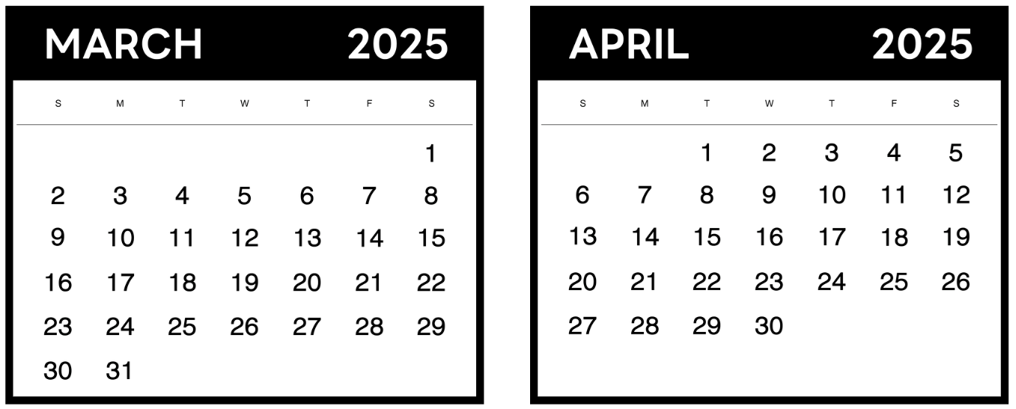
Short response (20)
Today is March 10. Your school holiday begins on April 20. How many days until the holidays?
Notes:
Short response questions provide brisk paced questions focussing on review of current and previous content to support spaced and interleaved practice.
Syllabus focus area:
Non-spatial measure B (Note: Stage 1 content reviewed)

Slide 38
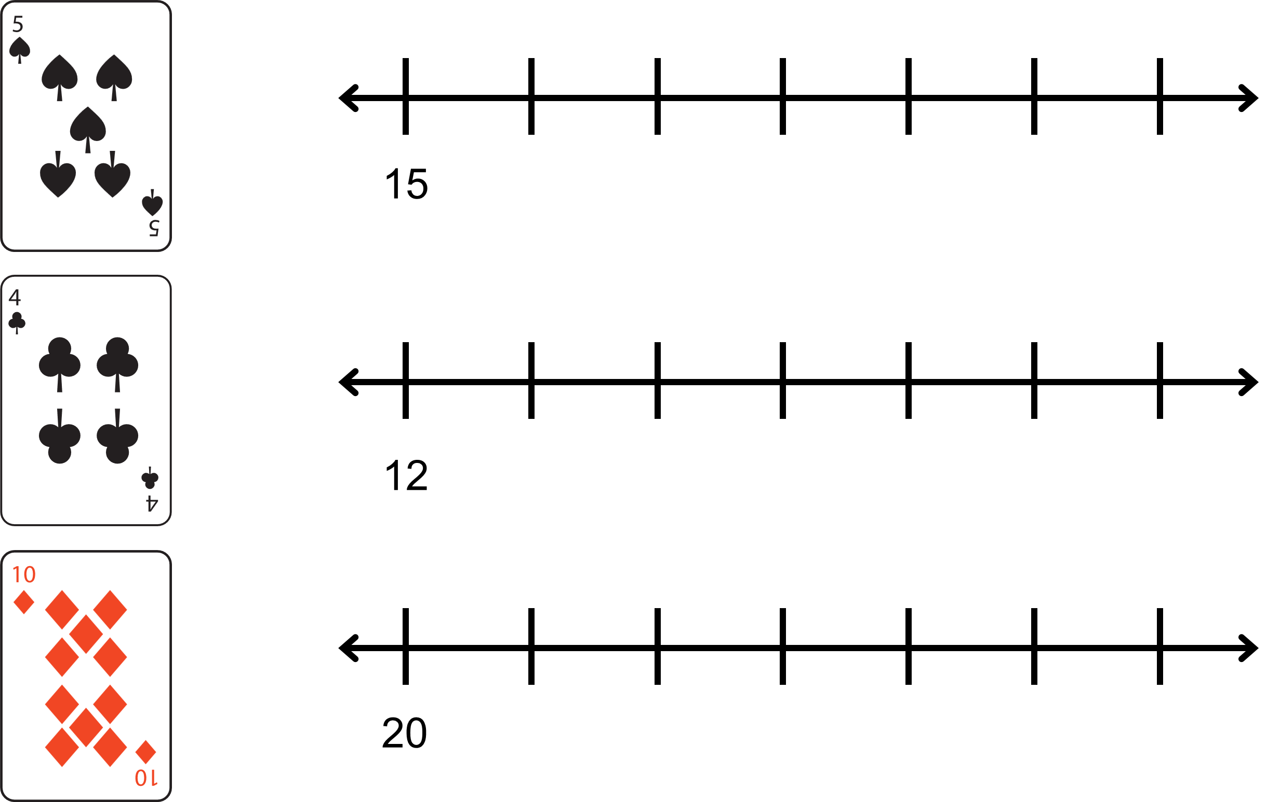
Activity 5 – skip counting
Notes:
This is a developing number sense activity.
Number sense refers to a deep understanding of numbers, including their magnitude, relationships, and the effects of operations on them. It supports fluency and understanding, estimation, flexible thinking, and efficient problem-solving. Number sense activities 1–4 ‘activate’ prior number knowledge and support the learning of new content in the unit. Number sense activities 5–8 ‘loop’ back and provide opportunity for spaced practice with concepts and procedures covered in previous units.
Syllabus focus area:
Forming groups A (Note: Stage 1 content reviewed)
Skip counting
This resource corresponds to Figure 7 – example of student recording in Stage 2 Year A Unit 1.
Have a collection of 2, 4, 5 and 10 number cards and draw a blank number line.
Turn over a number card to identify the focus multiple, for example, if a 5 is turned over students are identifying multiples of 5. Write a multiple of 5 at the start of the number line and students use their whiteboard to draw a number line and record the next 6 multiples (see Figure 7).
Figure 7 - example of student recordings
Choose students to demonstrate and explain their number line after each card has been turned.
Note: not all number lines need to start from zero.

Slide 39
Review of learning 6

Slide 40
True or false (3)
When skip counting backwards by 5s starting at 30, the next four numbers are 25, 15, 10, and 5
True | False
Notes:
The question on this slide connects to the content being explored in the developing number sense activity (Activity 6)
Syllabus focus area:
Forming groups A (Note: Stage 1 content reviewed)

Slide 41
Short response (21)
Record 5186 using standard place value form.
Notes:
Short response questions provide brisk paced questions focussing on review of current and previous content to support spaced and interleaved practice.
Syllabus focus area:
Representing numbers using place value A

Slide 42
Short response (22)
Solve 86 – 47 using a number line.
Communicate your reasoning.
Notes:
Short response questions provide brisk paced questions focussing on review of current and previous content to support spaced and interleaved practice.
Syllabus focus area:
Combining and separating B (Note: Stage 1 content reviewed)

Slide 43
Short response (23)
There are 18 cupcakes shared equally onto 3 plates. How many cupcakes are on each plate? Record your answer using drawings, words and numerals.
Notes:
Short response questions provide brisk paced questions focussing on review of current and previous content to support spaced and interleaved practice.
Syllabus focus area:
Forming groups B (Note: Stage 1 content reviewed)

Slide 44

Short response (24)
What time is shown on the clock?
Communicate your reasoning.
Notes:
Short response questions provide brisk paced questions focussing on review of current and previous content to support spaced and interleaved practice.
Syllabus focus area:
Non-spatial measure B: Time (Note: Stage 1 content reviewed)

Slide 45
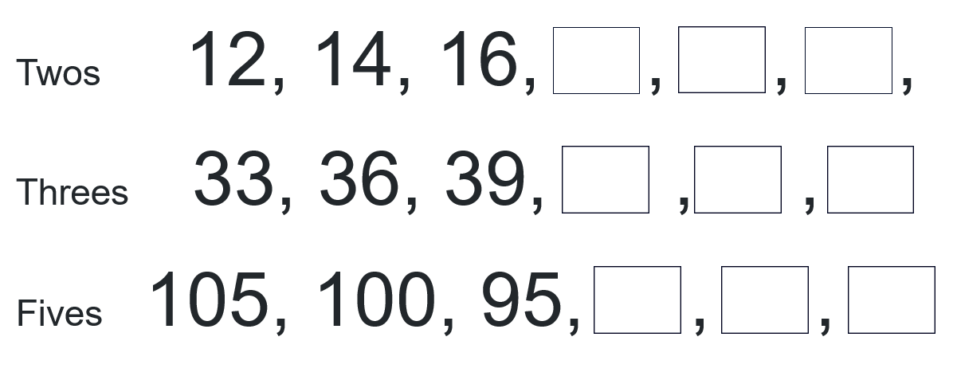
Activity 6 – number patterns
Notes:
This is a developing number sense activity.
Number sense refers to a deep understanding of numbers, including their magnitude, relationships, and the effects of operations on them. It supports fluency and understanding, estimation, flexible thinking, and efficient problem-solving. Number sense activities 1–4 ‘activate’ prior number knowledge and support the learning of new content in the unit. Number sense activities 5–8 ‘loop’ back and provide opportunity for spaced practice with concepts and procedures covered in previous units.
Syllabus focus area:
Forming groups A (Note: Stage 1 content reviewed)
Number patterns
This resource corresponds to Figure 8 – number patterns in Stage 2 Year A Unit 1.
Demonstrate how to create an increasing or decreasing number pattern and show the increasing or decreasing pattern (see Figure 8). Select a student to identify the next 3 numbers in the pattern and record them.
Figure 8 - number patterns
Challenge students to create 3 different forwards or backwards number patterns that increase or decrease by twos, threes and fives. Students use their whiteboard to record their patterns.
Choose different students to share and justify their number patterns.
Note: number patterns can be adapted to increase or decrease by any number under 12.

Slide 46
Review of learning 7

Slide 47
Multiple choice (4)
What number comes next in this pattern?
12, 17, 22, 27, ___
A | B | C | D
31 | 32 | 33 | 34
Notes:
This question connects to the content in the developing number sense activity (Activity 7)
Syllabus focus area:
Forming groups A (Note: Stage 1 content reviewed)

Slide 48
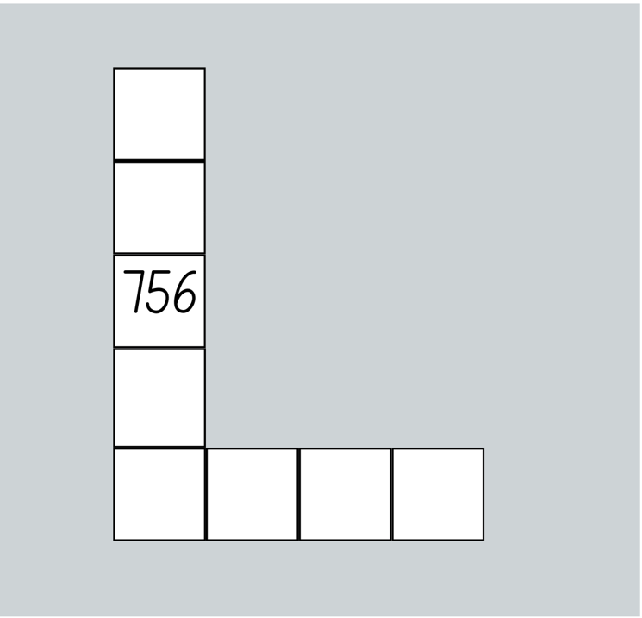
Short response (25)
Record the missing numbers for the number chart pattern.
Notes:
Short response questions provide brisk paced questions focussing on review of current and previous content to support spaced and interleaved practice.
Syllabus focus area:
Multiplicative relations A

Slide 49
Short response (26)
Use quantity values to separate the tens and ones to solve 79 + 33.
Communicate your reasoning.
Notes:
Short response questions provide brisk paced questions focussing on review of current and previous content to support spaced and interleaved practice.
Syllabus focus area:
Combining and separating B (Note: Stage 1 content reviewed)

Slide 50
Short response (27)
There are 23 oranges. If 5 oranges are put in each basket, how many baskets are needed?
Notes:
Short response questions provide brisk paced questions focussing on review of current and previous content to support spaced and interleaved practice.
Syllabus focus area:
Forming groups B (Note: Stage 1 content reviewed)

Slide 51
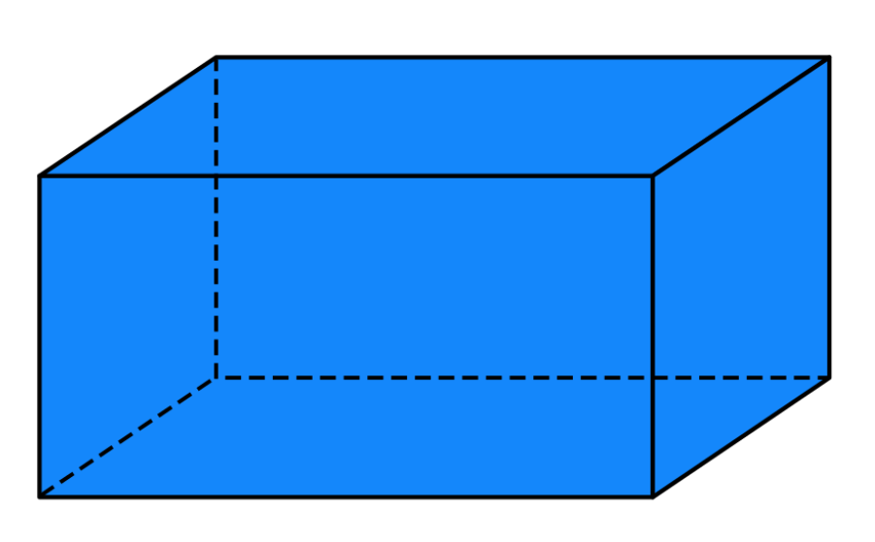
Short response (28)
Describe the prism by recording:
        How many faces?
        How many edges?
        How many vertices?
Notes:
Short response questions provide brisk paced questions focussing on review of current and previous content to support spaced and interleaved practice.
Syllabus focus area:
Three-dimensional spatial structure B (Note: Stage 1 content reviewed)

Slide 52
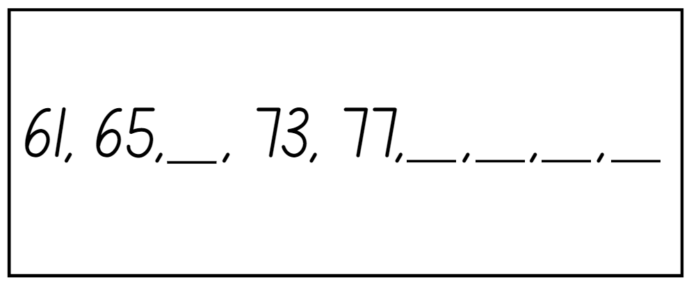
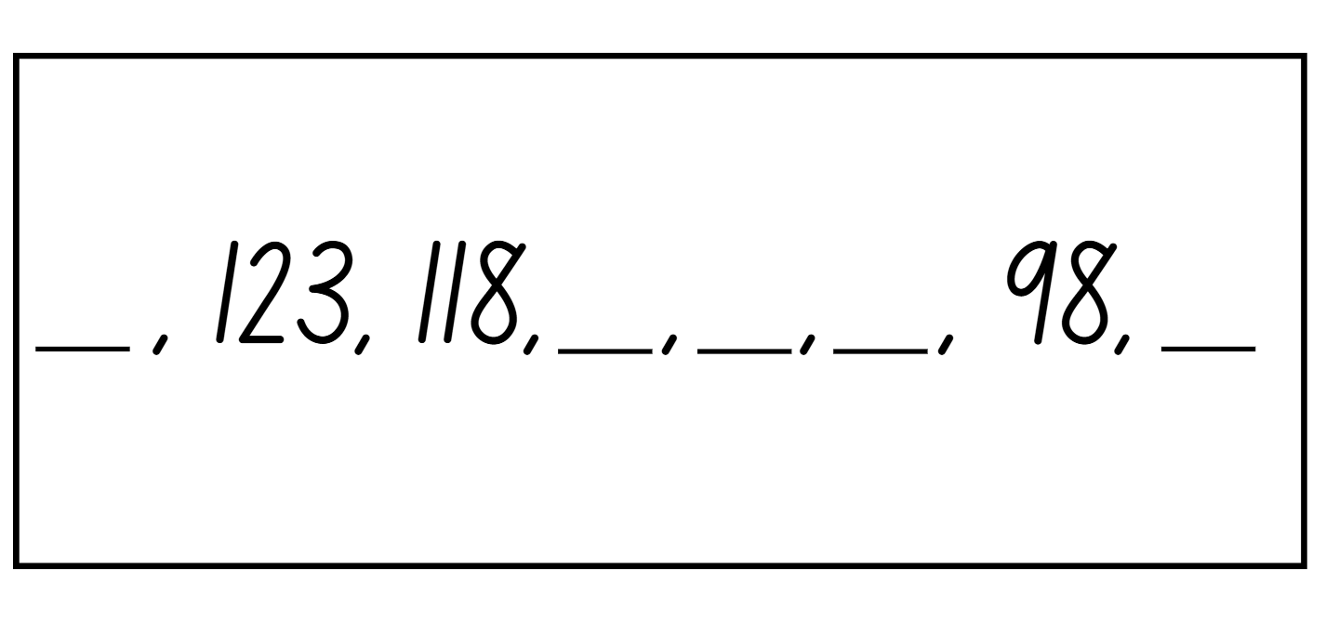
Activity 7 – missing number patterns
Notes:
This is a developing number sense activity.
Number sense refers to a deep understanding of numbers, including their magnitude, relationships, and the effects of operations on them. It supports fluency and understanding, estimation, flexible thinking, and efficient problem-solving. Number sense activities 1–4 ‘activate’ prior number knowledge and support the learning of new content in the unit. Number sense activities 5–8 ‘loop’ back and provide opportunity for spaced practice with concepts and procedures covered in previous units.
Syllabus focus area:
Forming groups A (Note: Stage 1 content reviewed)
Missing number patterns.
This resource corresponds to Resource 19 – number patterns 1 and Resource 20 – number patterns 2 in Stage 2 Year A Unit 1.
Display Resource 19 – number patterns 1 and ask students to determine the missing numbers in the pattern. Students use their whiteboard to record the number pattern showing the rule and the missing numbers
Choose students to demonstrate their working, explaining how they determined the missing number. Select a student to identify the next 3 numbers in the pattern and record.
Display Resource 20 – number patterns 2 in Stage 2 Year A Unit 1 and follow the above steps.

Slide 53
Review of learning 8

Slide 54
True or false (4)
In the number pattern
9, 14, 19, 24, ___, 34
the missing number is 29.
True | False
Notes:
The question on this slide connects to the content being explored in the developing number sense activity (Activity 8)
Syllabus focus area:
Forming groups A (Note: Stage 1 content reviewed)

Slide 55

Short response (29)
Rearrange the balls into an array. Describe the array using the language of multiples.
For example, my array is __ rows of __ Which is a total of ___. So, ____ is a multiple of ___ and ____.
Notes:
Short response questions provide brisk paced questions focussing on review of current and previous content to support spaced and interleaved practice.
Syllabus focus area:
Multiplicative relations A

Slide 56
Short response (30)
Use the inverse strategy to solve
$150- $62 =
Record your solution on a number line.
Notes:
Short response questions provide brisk paced questions focussing on review of current and previous content to support spaced and interleaved practice.
Syllabus focus area:
Combining and separating B (Note: Stage 1 content reviewed)

Slide 57
Short response (31)
A farmer has 18 eggs. He wants to pack them into boxes with 4 eggs in each box. How many full boxes can he make, and how many eggs will be left over?
Notes:
Short response questions provide brisk paced questions focussing on review of current and previous content to support spaced and interleaved practice.
Syllabus focus area:
Forming groups B (Note: Stage 1 content reviewed)

Slide 58

Short response (32)
An arrow is turned a quarter turn clockwise each time. After 4 turns, the shape is back in its starting position.
Draw the repeating pattern formed by the quarter turns.
Notes:
Short response questions provide brisk paced questions focussing on review of current and previous content to support spaced and interleaved practice.
Syllabus focus area:
Two-dimensional spatial structure B (Note: Stage 1 content reviewed)

Slide 59
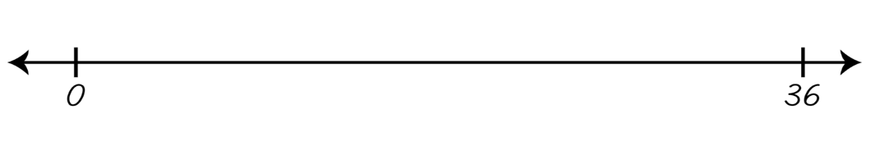
Activity 8 – multiples and number sequence
Notes:
This is a developing number sense activity.
Number sense refers to a deep understanding of numbers, including their magnitude, relationships, and the effects of operations on them. It supports fluency and understanding, estimation, flexible thinking, and efficient problem-solving. Number sense activities 1–4 ‘activate’ prior number knowledge and support the learning of new content in the unit. Number sense activities 5–8 ‘loop’ back and provide opportunity for spaced practice with concepts and procedures covered in previous units.
Syllabus focus area:
Forming groups A (Note: Stage 1 content reviewed)
Multiples and number sequence
This resource corresponds to Resource 21 – number line skip counting in Stage 2 Year A Unit 1.
Explain that students will investigate how many different ways they can skip count to 36.
Provide pairs of students with Resource 21 - number line skip counting in Stage 2 Year A Unit 1.
Prompt students to use of various intervals (e.g. by 2s, 3s, 4s, 6s, 9s).
Students use the number line to trial different sequences and record all the possible ways to share with the class.
Students to label each sequence clearly and highlight the rule for each pattern.
Regroup and discuss:
Was there any skip counting sequence that did not reach 36? Why?
Describe a skip counting sequence that created an interesting pattern.
What was the easiest or most efficient skip counting sequence? Why?
Which patterns connect to multiplication facts you already know?

Slide 60
Double Venn diagram
Object 1
Object 2
Features similar to both objects
Features of object 1
Features of object 2

Slide 61
Frayer
Definition
Facts/Characteristics
Word, term, concept
Examples
Non-examples

Slide 62
Spider map
Idea
Subject

Slide 63
Cline
Concept 1
Concept 2
Word
Word
Word
Word
Word
Word
Word
Word
Word
Word
Word

Slide 64

Compare and contrast
Notes:
Use the arrows to navigate between related activities.
Hyperlink each arrow to compare between related slides.

Slide 65
Multiple choice
A
B
C
D
Notes:
This question connects to the content in the developing number sense activity (Activity 1)
This question can:
support spaced and interleaved practice
help identify and address common misconceptions
support active recall and immediate feedback
support whole class participation
identify areas requiring reteach
Teachers are encouraged to adapt and contextualise for their contexts.

Slide 66
Multiple choice
A
B
C
D
Notes:
This question connects to the content in the developing number sense activity (Activity 1)
Syllabus focus area:
Multiplicative relations A
This question can:
support spaced and interleaved practice
help identify and address common misconceptions
support active recall and immediate feedback
support whole class participation
identify areas requiring reteach
Teachers are encouraged to adapt and contextualise for their contexts.

Slide 67
References (1)
This presentation contains NSW Curriculum and syllabus content. The NSW Curriculum is developed by the NSW Education Standards Authority. This content is prepared by NESA for and on behalf of the Crown in the right of the State of New South Wales. The material is protected by Crown copyright.
Please refer to the NESA Copyright Disclaimer for more information https://educationstandards.nsw.edu.au/wps/portal/nesa/mini-footer/copyright.
NESA holds the only official and up-to-date versions of the NSW Curriculum and syllabus documents. Please visit the NSW Education Standards Authority (NESA) website https://educationstandards.nsw.edu.au/wps/portal/nesa/home and the NSW Curriculum website https://curriculum.nsw.edu.au.
[Mathematics K–10 Syllabus © NSW Education Standards Authority (NESA) for and on behalf of the Crown in right of the State of New South Wales, 2022.
National Numeracy Learning Progression © Australian Curriculum, Assessment and Reporting Authority (ACARA) 2010 to present, unless otherwise indicated. This material was downloaded from the Australian Curriculum website (National Literacy Learning Progression) (accessed 24 August 2023) and was not modified.
Boaler J, Munson J, and Williams C (2021) Mindset Mathematics: Visualising and Investigating Big Ideas, Grade 1, Jossey-Bass Inc., US.
New Zealand Ministry of Education (n.d) Memory Doubles, NZ Maths website, accessed 19 May 2023.
Siemon D, Warren E, Beswick K, Faragher R, Miller J, Horne M, Jazby D, Breed M, Clark J and Brady K (2021) Teaching Mathematics: Foundations to Middle Years, 3rd edn, Oxford University Press ANZ, Australia.
Stanford University (n.d.) ‘Pig’, Tasks, youcubed website, accessed 19 May 2023.
State of New South Wales (Department of Education) (2023) ‘Mastermind’, Mathematics K-6 resources, NSW Department of Education website, accessed 19 May 2023.

Slide 68
References (2)
This presentation contains NSW Curriculum and syllabus content. The NSW Curriculum is developed by the NSW Education Standards Authority. This content is prepared by NESA for and on behalf of the Crown in the right of the State of New South Wales. The material is protected by Crown copyright.
Please refer to the NESA Copyright Disclaimer for more information https://educationstandards.nsw.edu.au/wps/portal/nesa/mini-footer/copyright.
NESA holds the only official and up-to-date versions of the NSW Curriculum and syllabus documents. Please visit the NSW Education Standards Authority (NESA) website https://educationstandards.nsw.edu.au/wps/portal/nesa/home and the NSW Curriculum website https://curriculum.nsw.edu.au.
State of New South Wales (Department of Education) (2023) ‘Number busting – number talk (renaming 26)’, Mathematics K-6 resources, NSW Department of Education website, accessed 19 May 2023.
State of New South Wales (Department of Education) (n.d) Number line jumps, Developing Efficient Numeracy Strategies website, accessed 19 May 2023.
State of Victoria (Department of Education and Training) (2018) Place alue and modelling numbers, FUSE website, accessed 19 May 2023.
Sullivan P (2018) Challenging Mathematical Tasks: Unlocking the potential of all students, Oxford University Press ANZ, Great Britain.
Toy Theater (2001–2023) Hundreds chart, Toy Theater website, accessed 19 May 2023.
Van de Walle J, Karp K, Bay-Williams JM, Brass A, Bentley B, Ferguson S, Goff W, Livy S, Marshman M, Martin D, Pearn C, Prodromou T, Symons D and Wilkie K (2019) Primary and Middle Years Mathematics: Teaching Developmentally, 1st edn, Pearson Education Australia, Melbourne.

Slide 69
Copyright
© State of New South Wales (Department of Education), 2025
The copyright material published in this resource is subject to the Copyright Act 1968 (Cth) and is owned by the NSW Department of Education or, where indicated, by a party other than the NSW Department of Education (third-party material).
Copyright material available in this resource and owned by the NSW Department of Education is licensed under a Creative Commons Attribution 4.0 International (CC BY 4.0) license.
This license allows you to share and adapt the material for any purpose, even commercially.
Attribution should be given to © State of New South Wales (Department of Education), 2025.
Material in this resource not available under a Creative Commons license:
the NSW Department of Education logo, other logos and trademark-protected material
Material owned by a third party that has been reproduced with permission. You will need to obtain permission from the third party to reuse its material.
Links to third-party material and websites
Please note that the provided (reading/viewing material/list/links/texts) are a suggestion only and implies no endorsement, by the New South Wales Department of Education, of any author, publisher, or book title. School principals and teachers are best placed to assess the suitability of resources that would complement the curriculum and reflect the needs and interests of their students.
If you use the links provided in this document to access a third party’s website, you acknowledge that the terms of use, including licence terms set out on the third-party’s website apply to the use which may be made of the materials on that third-party website or where permitted by the Copyright Act 1968 (Cth). The department accepts no responsibility for content on third-party websites.

