Slide 1
Instructions for use
This resource is not a teaching and learning program. It should be used in conjunction with Stage 2 Year A Unit 2.
Classroom teachers are encouraged to add and adapt slides as required to meet the needs of their students.
Save a copy of the file to make changes to the slide deck. Go to File > Download a Copy (this downloads a copy to the computer to edit in the PowerPoint app).
To convert the PowerPoint to Google Slides:
  Upload the file into Google Drive and open it.
  Go to File > Save as Google Slides.
  (Note – conversion may cause formatting changes in the slides.)

Slide 2

Review of Learning
Mathematics Stage 2 – Unit 2
Notes:
Reviews may include a combination of question types, requiring students to recall facts and key ideas, as well as apply their knowledge to solve problems and answer questions. To support active engagement, a mix of techniques should be employed.” (AERO, 2024).
This Review of Learning slide deck revisits key concepts from the following units:
Stage 1 Year B Unit 40
Stage 2 Year A Unit 1
Stage 2 Year A Unit 2
It also includes opportunities to review prior learning in non-number content, supporting consolidation across focus areas.
The review of learning resources include three key task types that support the development of mathematical proficiency through retrieval, spaced practice, and active participation. These practices complement the review phase (activating prior knowledge) embedded within the beginning of each lesson.
1.
Multiple-choice questions/True or false: Designed to promote active retrieval of key concepts and identify common misconceptions in number, supporting consolidation, understanding and fluency.
These questions:
support spaced and interleaved practice
help identify and address common misconceptions
support active recall and immediate feedback
support whole class participation
identify areas requiring reteach
2.
Short-response question sets: Carefully grouped questions that encourage spaced and interleaved practice across multiple focus areas, helping students revisit and apply knowledge from different points in time.
These questions:
have a combination of question types
address a range of focus areas
build automaticity and fluency
support active recall
allow for immediate feedback
identify content requiring reteach
3.
Developing number sense activities: A variety of practical, purposeful tasks that reinforce current learning and build on prior knowledge. These activities promote reasoning, problem-solving and conceptual understanding.
The review of learning resources are designed to work support teaching and learning in mathematics. For the most effective implementation, use the resources flexibly, adapting to meet student learning needs and individual classroom contexts.

Slide 3
Lessons
1
Review of learning 1
5
Review of learning 5
2
Review of learning 2
6
Review of learning 6
3
Review of learning 3
7
Review of learning 7
4
Review of learning 4
8
Review of learning 8
Notes:
Teacher notes:
Click lesson numbers to go to specific lessons
Interactive features can be viewed in slide show

Slide 4
Review of learning 1

Slide 5

Multiple choice (1)
Ariah has $20 to spend at the shop. She spends $8. How much change will she get?
A
B
C
D
$28 $5 $12 $2
Notes:
This question connects to the content in the developing number sense activity (Activity 1)
Syllabus focus area:
Additive relations A

Slide 6

Short response (1)
Build to a multiple of 10 to solve this number sentence.
38 + 25
Communicate your thinking.
Notes:
Short response questions provide brisk paced questions focussing on review of current and previous content to support spaced and interleaved practice.
Syllabus focus area:
Combining and separating quantities B (Note: Stage 1 content reviewed)

Slide 7
Short response (2)
Record the following number in standard form: 500 + 80 + 7
H | T | O
Notes:
Short response questions provide brisk paced questions focussing on review of current and previous content to support spaced and interleaved practice.
Syllabus focus area:
Representing whole number

Slide 8
Short response (3)
How many centimetres are in 1 metre?
Name something that is about a metre long.
Notes:
Short response questions provide brisk paced questions focussing on review of current and previous content to support spaced and interleaved practice.
Syllabus focus area:
Geometric measure B: Length (Note: Stage 1 content reviewed)

Slide 9
Short response (4)
You are a bird high in the sky looking down.
Draw a simple map of your playground from your perspective.
Notes:
Short response questions provide brisk paced questions focussing on review of current and previous content to support spaced and interleaved practice.
Syllabus focus area:
Geometric measure B: Position (Note: Stage 1 content reviewed)

Slide 10

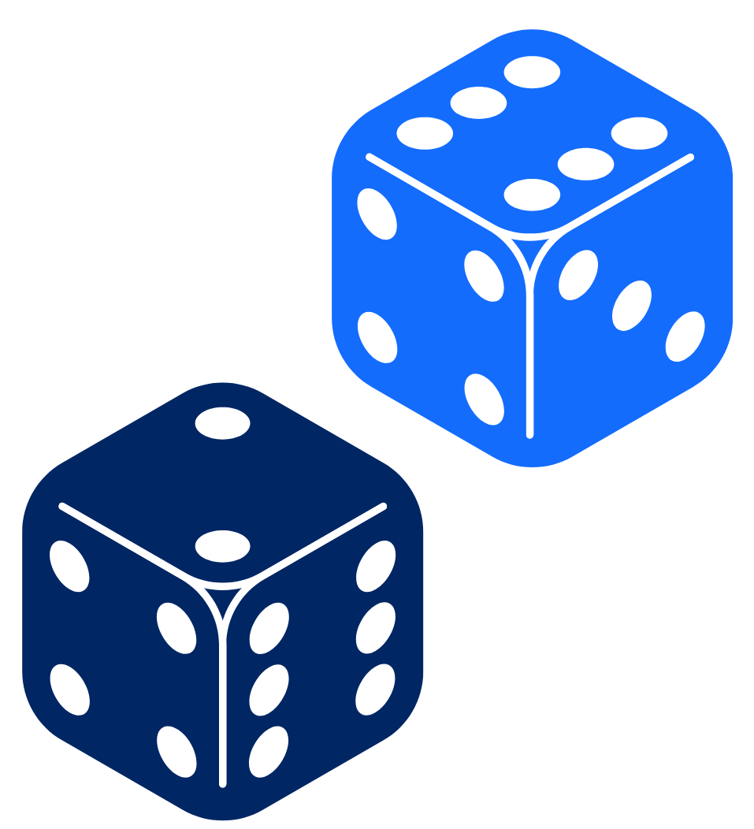
Activity 1 – decade dash
26
26 + = 30
What number do you need to add to reach the next multiple of 10?
62
62 + = 70
Notes:
This is a developing number sense activity.
Number sense refers to a deep understanding of numbers, including their magnitude, relationships, and the effects of operations on them. It supports fluency and understanding, estimation, flexible thinking, and efficient problem-solving. Number sense activities 1–4 ‘activate’ prior number knowledge and support the learning of new content in the unit. Number sense activities 5–8 ‘loop’ back and provide opportunity for spaced practice with concepts and procedures covered in previous units.
Syllabus focus area:
Additive relations A
Decade dash
Provide pairs of students with 2 dice and individual whiteboards.
The activity can be repeated several times to make multiple 2-digit numbers.
Note: the activity can be adapted by using 3 dice and creating 3-digit numbers.

Slide 11
Review of learning 2

Slide 12
True or false (1)
27 – 15 = 12
so
15 + 12 = 27
True | False
Notes:
The question on this slide connects to the content being explored in the developing number sense activity (Activity 2)
Syllabus focus area:
Additive relations A

Slide 13
Short response (5)
27 + 13 = 30 + 10
Complete this number sentence
14 + 22 = 16 + ___
Notes:
Short response questions provide brisk paced questions focussing on review of current and previous content to support spaced and interleaved practice.
Syllabus focus area:
Additive relations A

Slide 14
Short response (6)
Record the following numbers:
one hundred and one
one hundred and eleven
one hundred and twenty-one
Notes:
Short response questions provide brisk paced questions focussing on review of current and previous content to support spaced and interleaved practice.
Syllabus focus area:
Representing numbers using place value A: Whole numbers

Slide 15
Short response (7)
A rope measures three metres.
Record this measurement using the
correct abbreviation.
Notes:
Short response questions provide brisk paced questions focussing on review of current and previous content to support spaced and interleaved practice.
Syllabus focus area:
Geometric measure B: Length (Note: Stage 1 content reviewed)

Slide 16


Short response (8)
Write the time shown in words.
Notes:
Short response questions provide brisk paced questions focussing on review of current and previous content to support spaced and interleaved practice.
Syllabus focus area:
Non-spatial measure B: Time (Note: Stage 1 content reviewed)

Slide 17
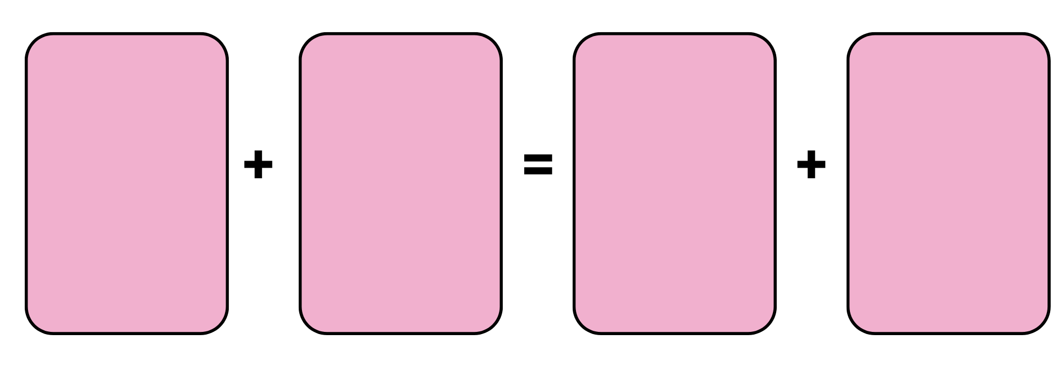
Activity 2 – the same as
+
=
+
Notes:
This is a developing number sense activity.
Number sense refers to a deep understanding of numbers, including their magnitude, relationships, and the effects of operations on them. It supports fluency and understanding, estimation, flexible thinking, and efficient problem-solving. Number sense activities 1–4 ‘activate’ prior number knowledge and support the learning of new content in the unit. Number sense activities 5–8 ‘loop’ back and provide opportunity for spaced practice with concepts and procedures covered in previous units.
Syllabus focus area:
Additive relations A
The same as
This resource corresponds to Resource 17 – number sentence board in Stage 2 Year A Unit 2
In pairs, provide students with a deck of cards (Jack = 11, Queen = 12, King = 13 and Joker = 14).
Player 1 picks up a card from the centre pile and decides which of the 4 slots to place the card. For example, Player 1 picks up a 12 and places it in one of the slots and reads out the number sentence stating whether it is true or not. For example, ‘ten plus eight is not the same as twelve plus two’.
Player 2 picks up a card and places it in one of the slots. For example, player 2 picks up a 7 and reads out the number sentence stating if it is true or not.
Play continues until a player selects a card that makes a true statement. For example, Player 1 picks up a 9 and places it in a slot and reads ‘ten plus nine is the same as twelve plus seven.’
Player 1 records the number sentences on their whiteboard and that is the end of a round. The cards on the game board are placed at the bottom of the pile, 4 new cards are dealt and play starts again. The game ends once a player has 5 accurate number sentences.

Slide 18
Review of learning 3

Slide 19
Multiple choice (2)
18 + 4 = 20 + __
A
B
C
D
4 24 42 2
Notes:
This question connects to the content in the developing number sense activity (Activity 3)
Syllabus focus area:
Additive relations A

Slide 20
Short response (9)
16 + 24 = 40
24 + 16 = 40
40 – 24 = 16
40 – 16 = __
Notes:
Short response questions provide brisk paced questions focussing on review of current and previous content to support spaced and interleaved practice.
Syllabus focus area:
Additive relations A

Slide 21
Short response (10)
Order these numbers
from smallest to largest.
1023
1332
1203
Notes:
Short response questions provide brisk paced questions focussing on review of current and previous content to support spaced and interleaved practice.
Syllabus focus area:
Representing numbers using place value A

Slide 22
Short response (11)
A pencil measures eight centimetres.
Record this measurement using the
correct abbreviation.
Notes:
Short response questions provide brisk paced questions focussing on review of current and previous content to support spaced and interleaved practice.
Syllabus focus area:
Geometric measure B: Length (Note: Stage 1 content reviewed)

Slide 23
Short response (12)
Draw a rectangle.
Now, draw straight lines to split it
into 3 triangles.
Notes:
Short response questions provide brisk paced questions focussing on review of current and previous content to support spaced and interleaved practice.
Syllabus focus area:
Two-dimensional spatial structure B: 2D shapes (Note: Stage 1 content reviewed)

Slide 24
Activity 3 – True or false?
5 + 8 = 13
13 = 5 + 8
13 = 13
5 + 8 = 5 + 8
5 + 8 = 8 + 5
5 + 8 = 6 + 7
Notes:
This is a developing number sense activity.
Number sense refers to a deep understanding of numbers, including their magnitude, relationships, and the effects of operations on them. It supports fluency and understanding, estimation, flexible thinking, and efficient problem-solving. Number sense activities 1–4 ‘activate’ prior number knowledge and support the learning of new content in the unit. Number sense activities 5–8 ‘loop’ back and provide opportunity for spaced practice with concepts and procedures covered in previous units.
Syllabus focus area:
Additive relations A
True or false?
This activity is an adaptation of True or False? from NRICH by University of Cambridge (Faculty of Mathematics).
This resource corresponds to Resource 18 True or false? in Stage 2 Year A Unit 2
Students need to decide whether each of the number sentences are true or false. Students turn and talk to share their ideas and record their answers on a white board.
Regroup as a class and ask:
Which are true? Which are false? How do you know?
What strategies did you use to find the answer without doing any calculating?
Note: the activity can be adapted by using 3-digit number sentences.

Slide 25
Review of learning 4

Slide 26
True or false (2)
To correctly solve 38 + 7 = 45 I can add 2 to 38, then add 5 to get 45.
True | False
Notes:
The question on this slide connects to the content being explored in the developing number sense activity (Activity 4)
Syllabus focus area:
Additive relations A

Slide 27
Short response (13)
Use the compensation strategy to add these numbers
23 + 29 =
Communicate your thinking.
Notes:
Short response questions provide brisk paced questions focussing on review of current and previous content to support spaced and interleaved practice.
Syllabus focus area:
Additive relations A

Slide 28
Short response (14)
Order these numbers
from largest to smallest:
1089
1200
1099
Notes:
Short response questions provide brisk paced questions focussing on review of current and previous content to support spaced and interleaved practice.
Syllabus focus area:
Representing numbers using place value A: Whole numbers

Slide 29
Short response (15)
Write the most appropriate formal unit, metres or centimetres, to measure the length of each object:
a train
a fork
a pen
an eraser
Notes:
Short response questions provide brisk paced questions focussing on review of current and previous content to support spaced and interleaved practice.
Syllabus focus area:
Geometric measure B: Length (Note: Stage 1 content reviewed)

Slide 30
Short response (16)
What is something you could use to measure the area of your desk?
Notes:
Short response questions provide brisk paced questions focussing on review of current and previous content to support spaced and interleaved practice.
Syllabus focus area:
Two-dimensional spatial structures A: Area (Note: Stage 1 content reviewed)

Slide 31
Activity 4 – near ten number match
In pairs:
Roll two dice.
Use the digits to make a 2-digit number (e.g. roll 3 and 7 → choose 37 or 73).
Adjust your number to the nearest 10, then compensate to keep the total the same.
🧠 Example: 37 + 6 = 40 + 3 → so 37 + 6 = 43
Talk with your partner:
What number did you make?
Why did you adjust it?
What did you add or subtract to make it easier?
Notes:
This is a developing number sense activity.
Number sense refers to a deep understanding of numbers, including their magnitude, relationships, and the effects of operations on them. It supports fluency and understanding, estimation, flexible thinking, and efficient problem-solving. Number sense activities 1–4 ‘activate’ prior number knowledge and support the learning of new content in the unit. Number sense activities 5–8 ‘loop’ back and provide opportunity for spaced practice with concepts and procedures covered in previous units.
Syllabus focus area:
Additive relations A
Near ten number match
Place students in pairs and provide each pair with two dice.
Each student rolls both dice and uses the digits to form a 2-digit number by deciding which digit goes in the tens place and which in the ones place.
For example: roll a 3 and 7 → form 37 or 73.
Students then write a number sentence where they adjust their number to the nearest multiple of 10 and compensate to maintain equality.
E.g. 37 + 6 = 40 + 3 → so 37 + 6 = 43
Both students solve the problem and then turn and talk to compare thinking.
Prompts to support discussion:
What number did you make? Why?
Why did you choose to adjust that number?
What did you add or subtract to make it easier?
How do you know your equation is still equal?

Slide 32
Review of learning 5

Slide 33
Multiple choice (3)
If 52 + 23 = 75, which of these
are true? You may choose more than one.
A
75 – 52 = 23
B
75 – 23 = 52
C
52 – 75 = 23
23 + 75 = 52
D
Notes:
This question connects to the content in the developing number sense activity (Activity 5)
Syllabus focus area:
Additive relations A

Slide 34
Short response (17)
Draw a number line to show a way to complete this number sentence
147 + 152 =
Notes:
Short response questions provide brisk paced questions focussing on review of current and previous content to support spaced and interleaved practice.
Syllabus focus area:
Additive relations A

Slide 35
Short response (18)
Record the numbers before and after
___, 1111, ___
___, 1009, ___
___, 1001, ____
Notes:
Short response questions provide brisk paced questions focussing on review of current and previous content to support spaced and interleaved practice.
Syllabus focus area:
Representing numbers using place value A

Slide 36
Short response (20)
Estimate the length of your teacher’s desk Record using in metres and centimetres.
Communicate your thinking.
Now check by having someone measure it.
Reflect on your estimation.
Notes:
Short response questions provide brisk paced questions focussing on review of current and previous content to support spaced and interleaved practice.
Syllabus focus area:
Geometric measure B: Length

Slide 37
Short response (18)
September
Monday | Tuesday | Wednesday | Thursday | Friday | Saturday | Sunday
 |  | 1 | 2 | 3 | 4 | 5
6 | 7 | 8 | 9 | 10 | 11 | 12
13 | 14 | 15 | 16 | 17 | 18 | 19
20 | 21 | 22 | 23 | 24 | 25 | 26
27 | 28 | 29 | 30
It is Friday 10 September. How many days until it will be October?
Notes:
Short response questions provide brisk paced questions focussing on review of current and previous content to support spaced and interleaved practice.
Syllabus focus area:
Non-spatial measure B: Time:

Slide 38
Activity 5 – strike it out
0
1
2
3
4
5
6
7
8
9
10
11
12
13
14
15
16
17
18
19
20
Player 1
choose 2 numbers and cross them out
circle the sum or difference
record a number sentence
Player 2
start with the circled number and cross out a second number
circle the sum or difference
record a number sentence
Notes:
This is a developing number sense activity.
Number sense refers to a deep understanding of numbers, including their magnitude, relationships, and the effects of operations on them. It supports fluency and understanding, estimation, flexible thinking, and efficient problem-solving. Number sense activities 1–4 ‘activate’ prior number knowledge and support the learning of new content in the unit. Number sense activities 5–8 ‘loop’ back and provide opportunity for spaced practice with concepts and procedures covered in previous units.
Syllabus focus area:
Additive relations A
Strike it out
1. In pairs, provide students with paper and writing materials. Students create a number line from 0–20.
2. Play continues until one player is no longer able to make a valid move. The player who stops their opponent from being able to take a turn is the winner.
3. Play the game again, with the second player starting first.
4. As a class, discuss and reflect on the activity by asking questions such as:
How did you know when the game was over?
Share the strategy that you used to try to win the game. Was it successful? Why?
What addition and subtraction strategies did you find useful?
When adding, did it matter which way you added the numbers? Why not? (Commutative property).
Can you think of any ways to make the game easier or harder?

Slide 39
Review of learning 6

Slide 40
True or false (3)
To solve 52 + 23, using partitioning to add the tens then the ones is an efficient strategy.
True | False
40
Notes:
The question on this slide connects to the content being explored in the developing number sense activity (Activity 6)
Syllabus focus area:
Additive relations A

Slide 41
Short response (21)
There are 71 students and 55 chairs. How many students must sit
on the floor?
Communicate your strategy.
Notes:
Short response questions provide brisk paced questions focussing on review of current and previous content to support spaced and interleaved practice.
Syllabus focus area:
Additive relations A

Slide 42
Short response (22)
Partition 1221
into thousands, hundreds,
tens and ones.
Notes:
Short response questions provide brisk paced questions focussing on review of current and previous content to support spaced and interleaved practice.
Syllabus focus area:
Representing numbers using place value A

Slide 43

Short response (23)
This paper strip has been divided into equal parts.
What fraction is the arrow pointing to?
Notes:
Short response questions provide brisk paced questions focussing on review of current and previous content to support spaced and interleaved practice.
Syllabus focus area:
Geometric measure B: Length (Note: Stage 1 content reviewed)

Slide 44
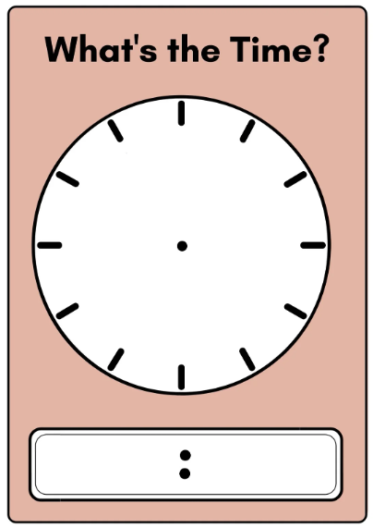
Short response (24)
3 15
11 45
Record the times in writing, as quarter past or quarter to.
Notes:
Short response questions provide brisk paced questions focussing on review of current and previous content to support spaced and interleaved practice.
Syllabus focus area:
Non-spatial measure: Time (Note: Stage 1 content reviewed)

Slide 45
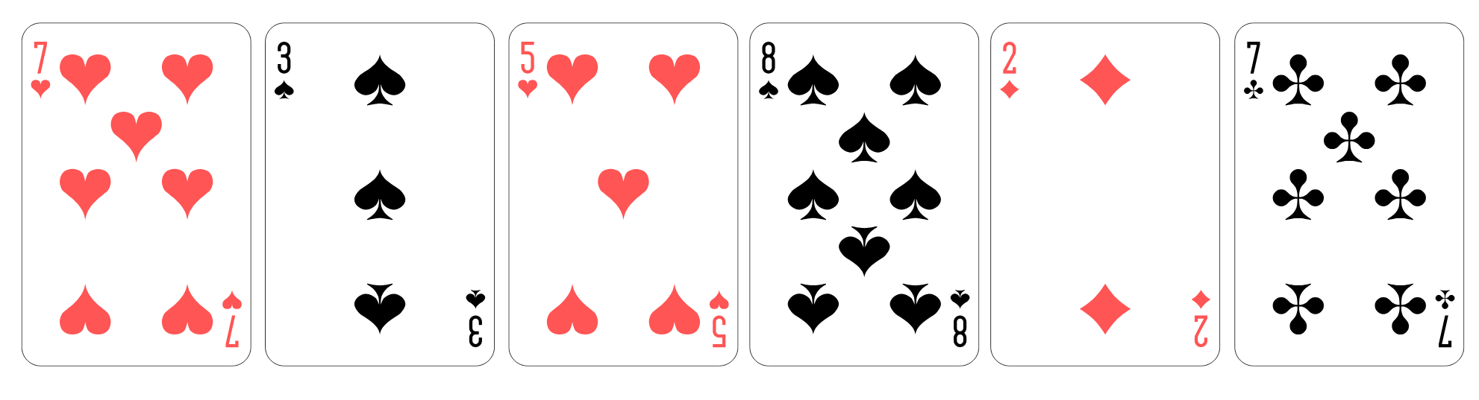
Activity 6 – closest to 100
Pairs vs Pairs:
Shuffle a pack of cards from A-10.
Place 6 cards face up.
Take turns making a one- or 2-digit number.
🧠 Example: 87 + 7 = 94
Consider:
How can I use addition or subtraction to keep my total as low as possible?
Notes:
This is a developing number sense activity.
Number sense refers to a deep understanding of numbers, including their magnitude, relationships, and the effects of operations on them. It supports fluency and understanding, estimation, flexible thinking, and efficient problem-solving. Number sense activities 1–4 ‘activate’ prior number knowledge and support the learning of new content in the unit. Number sense activities 5–8 ‘loop’ back and provide opportunity for spaced practice with concepts and procedures covered in previous units.
Syllabus focus area:
Additive relations A
Closest to 100.
In pairs, provide students with a whiteboard and a pack of cards from A–10. Player 1 shuffles the cards and puts them in a central pile. Player 2 takes 6 cards and places them face up for everyone to see.
Students record their number sentence and score on their whiteboard. The pair with the lowest score at the end wins.

Slide 46
Review of learning 7

Slide 47
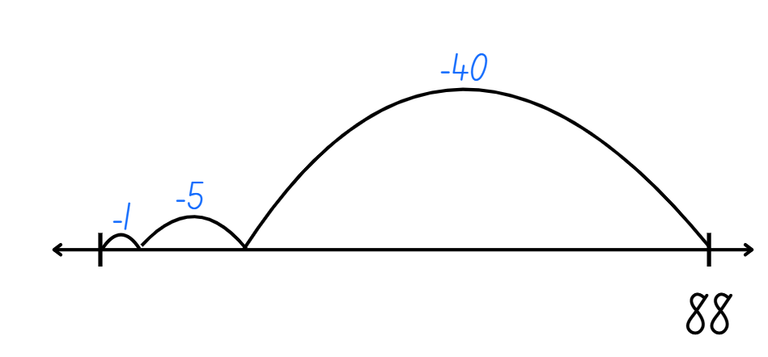
Multiple choice (4)
88 – 46 =
A
B
C
D
44 26 32 42
Notes:
This question connects to the content in the developing number sense activity (Activity 7)
Syllabus focus area:
Additive relations A

Slide 48
Short response (25)
Albie has 245 marbles.
He gives 78 to Blair.
How many marbles does Albie have left?
Communicate your strategy.
Notes:
Short response questions provide brisk paced questions focussing on review of current and previous content to support spaced and interleaved practice.
Syllabus focus area:
Additive relations A

Slide 49
Short response (26)
Complete the patterns:
16, 18, 20, __, 24, __.
15, 20, 25, ___, 35, ___, ___.
Notes:
Short response questions provide brisk paced questions focussing on review of current and previous content to support spaced and interleaved practice.
Syllabus focus area:
Multiplicative relations A

Slide 50
Short response (27)
Tom folded a strip of paper in half,
then in half again and in half again.
When Tom opened his paper,
how many equal parts did he have?
Notes:
Short response questions provide brisk paced questions focussing on review of current and previous content to support spaced and interleaved practice.
Syllabus focus area:
Geometric measure B: Length (Note: Stage 1 content reviewed)

Slide 51

Short response (28)
Record the name and the number of faces
this 3D object has.
Notes:
Short response questions provide brisk paced questions focussing on review of current and previous content to support spaced and interleaved practice.
Syllabus focus area:
Three-dimensional spatial structure B: 3D objects (Note: Stage 1 content reviewed)

Slide 52
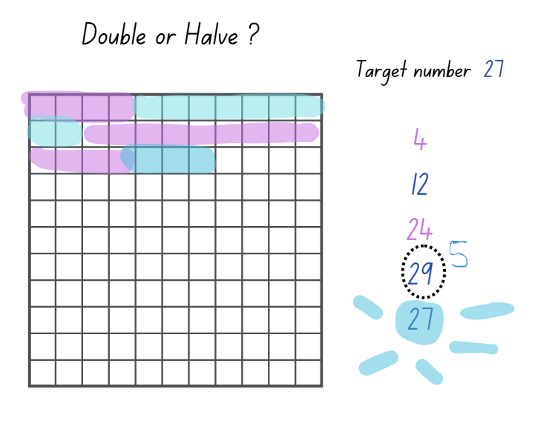
Activity 7– double or halve
In pairs:
Choose a target number.
Players take turns to roll the dice and choose to double or halve the number.
Players shade the number of squares rolled.
Players record a running total on the side of the grid.
Notes:
This is a developing number sense activity.
Number sense refers to a deep understanding of numbers, including their magnitude, relationships, and the effects of operations on them. It supports fluency and understanding, estimation, flexible thinking, and efficient problem-solving. Number sense activities 1–4 ‘activate’ prior number knowledge and support the learning of new content in the unit. Number sense activities 5–8 ‘loop’ back and provide opportunity for spaced practice with concepts and procedures covered in previous units.
Syllabus focus area:
Additive relations A
Double or halve
This resource corresponds to Resource 19 – grid in Stage 2 Year A Unit 2.
Provide pairs with Resource 19 – grid, 2 different coloured pencils and a 6-sided die.
Students choose a target number between 10 and 30, write it on the side of their grid and on the correct grid square.
The first player rolls the die and chooses to either double or halve the number. The player records their choice on the grid by shading the correct number of squares. Players record a running total on the side of their grid.
Players take turns to roll the die and record their chosen number. If a player cannot go, they miss a turn. The winner is the player who reaches the target number exactly.
While students are playing, ask:
If you play the game again are there any moves you would change?
Is there a number you should have halved instead of doubled? Why?
If you play the game again and the rules changed so you can double, halve or keep your roll, do you think this might make it easier to reach the target number?

Slide 53
Review of learning 8

Slide 54
True or false (4)
To solve 62 – 5, you can think 62 – 2 = 60, then subtract 3 more to make 57.
True | False
Communicate your thinking.
Notes:
The question on this slide connects to the content being explored in the developing number sense activity (Activity 8)
Syllabus focus area:
Additive relations A

Slide 55
Short response (29)
Elsa had 186 stickers. Anna gave her 129 more. How many stickers does Elsa have altogether?
Communicate your strategy.
Notes:
Short response questions provide brisk paced questions focussing on review of current and previous content to support spaced and interleaved practice.
Syllabus focus area:
Additive relations A

Slide 56
Short response (30)
Draw an array structure to show 4 multiples of 5.
Notes:
Short response questions provide brisk paced questions focussing on review of current and previous content to support spaced and interleaved practice.
Syllabus focus area:
Multiplicative relations A

Slide 57
Short response
How many times do you need to fold a strip of paper in half to get 8 equal parts?
Notes:
Short response questions provide brisk paced questions focussing on review of current and previous content to support spaced and interleaved practice.
Syllabus focus area:
Geometric measure B: Length (Note: Stage 1 content reviewed)

Slide 58
Short response (32)
Describe a pentagon.
Notes:
Short response questions provide brisk paced questions focussing on review of current and previous content to support spaced and interleaved practice.
Syllabus focus area:
Two-dimensional spatial structure A: 2D shapes (Note: Stage 1 content reviewed)

Slide 59
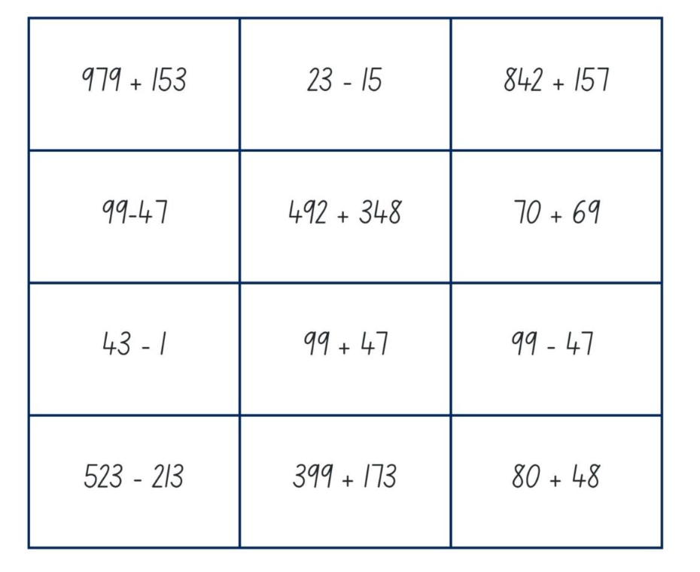
Activity 8 – strategy snap
Problem | Strategy used | Answer | Why I Chose This Strategy / How It Helped
57 + 28 | Partitioning (50 + 20 + 7 + 8) | 85 | It helped me break the numbers into tens and ones to add easily.
Notes:
This is a developing number sense activity.
Number sense refers to a deep understanding of numbers, including their magnitude, relationships, and the effects of operations on them. It supports fluency and understanding, estimation, flexible thinking, and efficient problem-solving. Number sense activities 1–4 ‘activate’ prior number knowledge and support the learning of new content in the unit. Number sense activities 5–8 ‘loop’ back and provide opportunity for spaced practice with concepts and procedures covered in previous units.
Syllabus focus area:
Additive relations A
Strategy snap
This resource corresponds to Resource 20 – problem cards in Stage 2, Year A Unit 2.
Organise students into pairs and provide each pair with a set of problem cards (Resource 20).
Shuffle the cards and place them face down in a pile.
One student flips over the top card and reads the problem aloud.
Both students solve the same problem, but each must choose a different strategy (e.g. partitioning, compensation, constant difference).
Students record their thinking on the Strategy Snap Sheet, including:
The problem
The strategy used
The answer
A sentence explaining why they chose that strategy or how it helped
After several rounds:
Students review all strategies they’ve used.
Each student selects their top two strategies and justifies when and why those strategies are most useful.
Prompts to support discussion:
Which strategy felt easiest for this problem? Why?
Did both strategies give the same answer?
How do you know your strategy was efficient?
In what type of problem would this strategy be best used again?

Slide 60
Double Venn diagram
Object 1
Object 2
Features similar to both objects
Features of object 1
Features of object 2

Slide 61
Frayer
Definition
Facts/Characteristics
Word, term, concept
Examples
Non-examples

Slide 62
Spider map
Idea
Subject

Slide 63
Cline
Concept 1
Concept 2
Word
Word
Word
Word
Word
Word
Word
Word
Word
Word
Word

Slide 64
Compare and contrast

Slide 65
Multiple choice (5)
A
B
C
D

Slide 66
Multiple choice (6)
A
B
C
D

Slide 67
References
This presentation contains NSW Curriculum and syllabus content. The NSW Curriculum is developed by the NSW Education Standards Authority. This content is prepared by NESA for and on behalf of the Crown in the right of the State of New South Wales. The material is protected by Crown copyright.
Please refer to the NESA Copyright Disclaimer for more information https://educationstandards.nsw.edu.au/wps/portal/nesa/mini-footer/copyright.
NESA holds the only official and up-to-date versions of the NSW Curriculum and syllabus documents. Please visit the NSW Education Standards Authority (NESA) website https://educationstandards.nsw.edu.au/wps/portal/nesa/home and the NSW Curriculum website https://curriculum.nsw.edu.au.
[Subject] [Year–Year] © Syllabus NSW Education Standards Authority (NESA) for and on behalf of the Crown in right of the State of New South Wales, [Year of publication].
[Insert references consulted to produce the presentation being developed.]
[Include any other full attributions here.]

Slide 68
Copyright
© State of New South Wales (Department of Education), 2025
The copyright material published in this resource is subject to the Copyright Act 1968 (Cth) and is owned by the NSW Department of Education or, where indicated, by a party other than the NSW Department of Education (third-party material).
Copyright material available in this resource and owned by the NSW Department of Education is licensed under a Creative Commons Attribution 4.0 International (CC BY 4.0) license.
This license allows you to share and adapt the material for any purpose, even commercially.
Attribution should be given to © State of New South Wales (Department of Education), 2025.
Material in this resource not available under a Creative Commons license:
the NSW Department of Education logo, other logos and trademark-protected material
Material owned by a third party that has been reproduced with permission. You will need to obtain permission from the third party to reuse its material.
Links to third-party material and websites
Please note that the provided (reading/viewing material/list/links/texts) are a suggestion only and implies no endorsement, by the New South Wales Department of Education, of any author, publisher, or book title. School principals and teachers are best placed to assess the suitability of resources that would complement the curriculum and reflect the needs and interests of their students.
If you use the links provided in this document to access a third party’s website, you acknowledge that the terms of use, including licence terms set out on the third-party’s website apply to the use which may be made of the materials on that third-party website or where permitted by the Copyright Act 1968 (Cth). The department accepts no responsibility for content on third-party websites.

