Slide 1
Instructions for use
This resource is not a teaching and learning program. It should be used in conjunction with Stage 2 Year A Unit 3.
Classroom teachers are encouraged to add and adapt slides as required to meet the needs of their students.
Save a copy of the file to make changes to the slide deck. Go to File > Download a Copy (this downloads a copy to the computer to edit in the PowerPoint app).
To convert the PowerPoint to Google Slides:
  Upload the file into Google Drive and open it.
  Go to File > Save as Google Slides.
  (Note – conversion may cause formatting changes in the slides.)

Slide 2

Review of Learning
Mathematics Stage 2 – Unit 3
Notes:
Reviews may include a combination of question types, requiring students to recall facts and key ideas, as well as apply their knowledge to solve problems and answer questions. To support active engagement, a mix of techniques should be employed.” (AERO, 2024).
This Review of Learning slide deck revisits key concepts from the following units:
Stage 2 Year A Unit 3
Stage 2 Year A Unit 2
Stage 2 Year A Unit 1
It also includes opportunities to review prior learning in non-number content, supporting consolidation across focus areas.
The review of learning resources include three key task types that support the development of mathematical proficiency through retrieval, spaced practice, and active participation. These practices complement the review phase (activating prior knowledge) embedded within the beginning of each lesson.
1.
Multiple-choice questions/True or false: Designed to promote active retrieval of key concepts and identify common misconceptions in number, supporting consolidation, understanding and fluency.
These questions:
support spaced and interleaved practice
help identify and address common misconceptions
support active recall and immediate feedback
support whole class participation
identify areas requiring reteach
2.
Short-response question sets: Carefully grouped questions that encourage spaced and interleaved practice across multiple focus areas, helping students revisit and apply knowledge from different points in time.
These questions:
have a combination of question types
address a range of focus areas
build automaticity and fluency
support active recall
allow for immediate feedback
identify content requiring reteach
3.
Developing number sense activities: A variety of practical, purposeful tasks that reinforce current learning and build on prior knowledge. These activities promote reasoning, problem-solving and conceptual understanding.
The review of learning resources are designed to work support teaching and learning in mathematics. For the most effective implementation, use the resources flexibly, adapting to meet student learning needs and individual classroom contexts.

Slide 3
Lessons
1
Review of learning 1
5
Review of learning 5
2
Review of learning 2
6
Review of learning 6
3
Review of learning 3
7
Review of learning 7
4
Review of learning 4
8
Review of learning 8
Notes:
Teacher notes:
Click lesson numbers to go to specific lessons
Interactive features can be viewed in slide show

Slide 4
Review of learning 1

Slide 5

Multiple choice (1)
How is the number 2046 read correctly?
A
Two thousand four hundred and sixty
B
Two hundred and forty-six
C
Two thousand and forty-six
D
Two thousand and sixty-four
Notes:
This question connects to the content in the developing number sense activity (Activity 1)
Syllabus focus area:
Representing numbers using place value A

Slide 6

Short response (1)
Record something you would measure in:
centimetres
metres
Notes:
Short response questions provide brisk paced questions focussing on review of current and previous content to support spaced and interleaved practice.
Syllabus focus area:
Geometric measure: (Note: Stage 1 content reviewed)

Slide 7
Short response (2)
Find the missing numbers.
13 + 8 = 12 +
25 − 14 = 15 −
5 + 6 = 10 +
Notes:
Short response questions provide brisk paced questions focussing on review of current and previous content to support spaced and interleaved practice.
Syllabus focus area:
Additive relations A

Slide 8
Short response (3)
Rename
4 groups of 100, 3 groups of 10
and 6 ones.
Notes:
Short response questions provide brisk paced questions focussing on review of current and previous content to support spaced and interleaved practice.
Syllabus focus area:
Representing whole numbers B

Slide 9
Short response (4)
Sketch a simple map to go from your classroom to the office.
Notes:
Short response questions provide brisk paced questions focussing on review of current and previous content to support spaced and interleaved practice.
Syllabus focus area:
Geometric measure B: Position (Note: Stage 1 content reviewed)

Slide 10

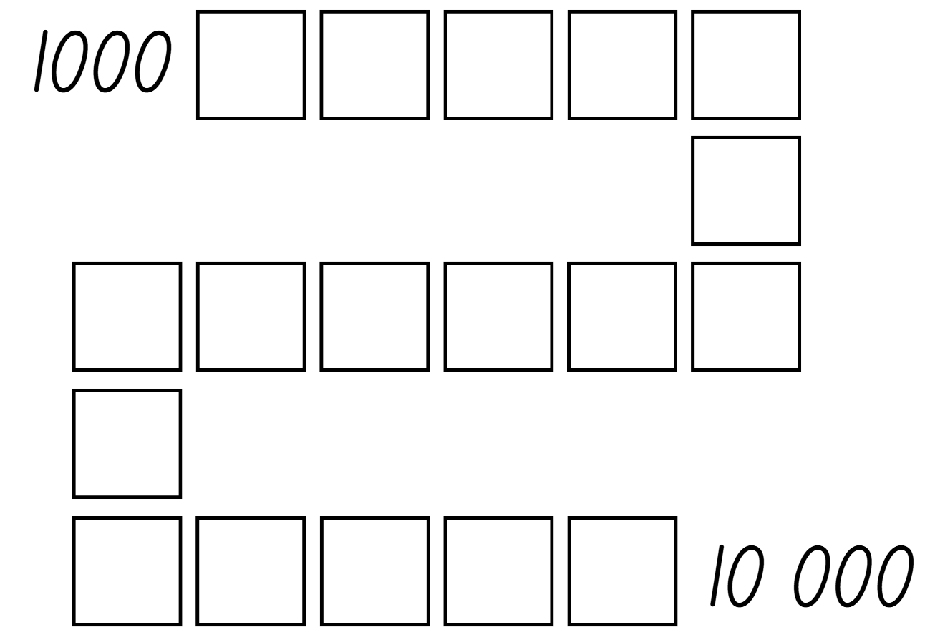
Activity 1 – 4-digit place value
Notes:
This is a developing number sense activity.
Number sense refers to a deep understanding of numbers, including their magnitude, relationships, and the effects of operations on them. It supports fluency and understanding, estimation, flexible thinking, and efficient problem-solving. Number sense activities 1–4 ‘activate’ prior number knowledge and support the learning of new content in the unit. Number sense activities 5–8 ‘loop’ back and provide opportunity for spaced practice with concepts and procedures covered in previous units.
Syllabus focus area:
Representing numbers using place value A
4-digit place value
This resource corresponds to Resource 22 – Place value game in Stage 2 Year A Unit 3.
Explain that the aim of the game is to order 4-digit numbers in ascending order on a gameboard.
Provide pairs with four 9-sided dice and Resource 22 – Place value game or each player.
Students roll the dice and create a 4-digit number. For example, 6, 2, 8, 3 could be recorded as 6238, 3682, 2863, 3826, 3628 and so on. Players record their chosen number in the most appropriate position between 1000 and 10 000.
If numbers cannot be placed, students miss their turn. Play continues until all boxes are filled.
Note: the game can also be played as a whole class. It is recommended to use dice that have a zero. It is important that students understand the role of zero in changing the value of the 4-digit numbers created. Using a reusable sleeve for the gameboard and non-permanent markers will allow students to play multiple games.

Slide 11
Review of learning 2

Slide 12
True or false (1)
These numbers are in ascending order.
1013
1021
1012
True | False
Notes:
The question on this slide connects to the content being explored in the developing number sense activity (Activity 2)
Syllabus focus area:
Representing numbers using place value A

Slide 13
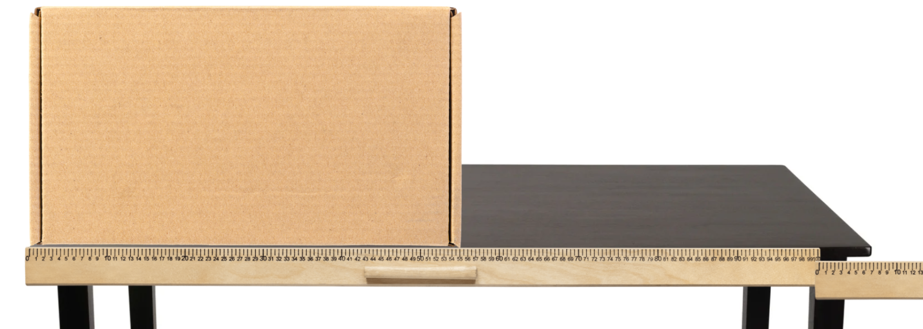
Short response (5)
Record the lengths of the box and the table using the abbreviations m and cm.
Notes:
Short response questions provide brisk paced questions focussing on review of current and previous content to support spaced and interleaved practice.
Syllabus focus area:
Geometric measure A: Length

Slide 14
Short response (6)
Complete the number sentences.
18 = 10 +
25 + 5 = + 15
Notes:
Short response questions provide brisk paced questions focussing on review of current and previous content to support spaced and interleaved practice.
Syllabus focus area:
Additive relations A

Slide 15
Short response (7)
Record the numbers that are before and after.
___, 109, ___
___, 119, ___
Notes:
Short response questions provide brisk paced questions focussing on review of current and previous content to support spaced and interleaved practice.
Syllabus focus area:
Representing numbers using place value A

Slide 16
Short response (8)
Which is longer,
168 cm or 1 metre and 40 cm?
Communicate your reasoning.
Notes:
Short response questions provide brisk paced questions focussing on review of current and previous content to support spaced and interleaved practice.
Syllabus focus area:
Geometric measure B (Note: Stage 1 content reviewed)

Slide 17






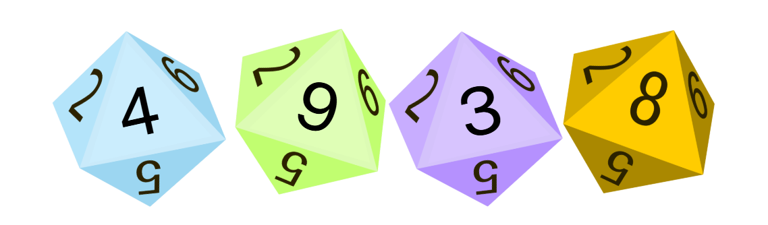
Activity 2 – ordering 4-digit numbers 1
take turns rolling four 10-sided dice to create a 4-digit number
write your number on a sticky note
read your numbers aloud and arrange yourselves from smallest to largest
combine with another group and reorder yourselves to keep everyone in ascending order
repeat until the entire class is arranged from smallest to largest.
Notes:
This is a developing number sense activity.
Number sense refers to a deep understanding of numbers, including their magnitude, relationships, and the effects of operations on them. It supports fluency and understanding, estimation, flexible thinking, and efficient problem-solving. Number sense activities 1–4 ‘activate’ prior number knowledge and support the learning of new content in the unit. Number sense activities 5–8 ‘loop’ back and provide opportunity for spaced practice with concepts and procedures covered in previous units.
Syllabus focus area:
Representing numbers using place value A
Ordering 4-digit numbers 1
Students work in groups of 4–6.
Provide each group with four 10-sided dice.
Students take turns rolling the dice to create a 4-digit number. Students record the number on a sticky note and, one by one, read their number aloud and then place themselves in order from smallest to largest.
When each group has all their members in order, have 2 groups combine. Group members need to adjust their order to ensure they are still in order from smallest to largest.
Continue to combine groups and adjust placements until the whole class is in order.
Note: this activity can be adapted to use only two or three 10-sided dice.

Slide 18
Review of learning 3

Slide 19
Multiple choice (2)
Which number is missing in this counting sequence? 1009, 1010, ____, 1012, 1013
A
111
B
1011
C
10011
D
1101
Notes:
This question connects to the content in the developing number sense activity (Activity 3)
Syllabus focus area:
Representing numbers using place value A

Slide 20
Short response (9)
Record 3 items that would be
about 30 cm long.
Notes:
Short response questions provide brisk paced questions focussing on review of current and previous content to support spaced and interleaved practice.
Syllabus focus area:
Geometric measure A: Length

Slide 21

Short response (10)
Find the missing number in the bar model.
Record 3 different number sentences.
Notes:
Short response questions provide brisk paced questions focussing on review of current and previous content to support spaced and interleaved practice.
Syllabus focus area:
Additive relations A

Slide 22
Short response (11)
547
How many hundreds are in this number?
What does the digit in the tens place represent?
What is the value of the digit in the ones place?
Notes:
Short response questions provide brisk paced questions focussing on review of current and previous content to support spaced and interleaved practice.
Syllabus focus area:
Representing numbers using place value A

Slide 23
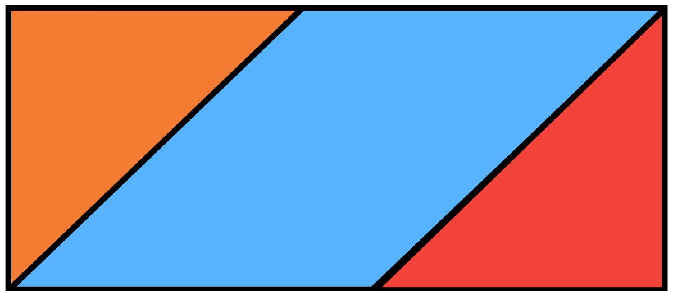
Short response (12)
Tayla combined 3 shapes to make a rectangle. Which shapes did Tayla use?
Notes:
Short response questions provide brisk paced questions focussing on review of current and previous content to support spaced and interleaved practice.
Syllabus focus area:
Two-dimensional spatial structure B: 2D shapes (Note: Stage 1 content reviewed)

Slide 24
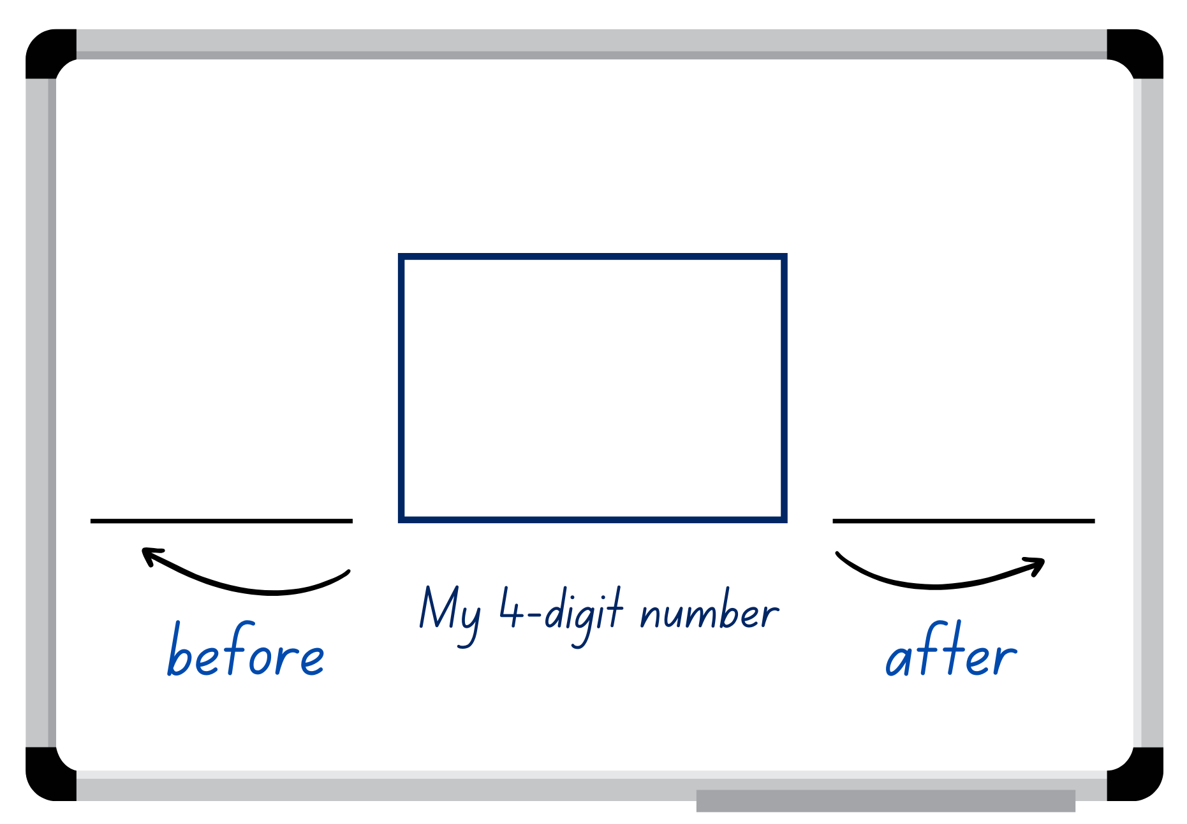
Activity 3 – number before and after
Notes:
This is a developing number sense activity.
Number sense refers to a deep understanding of numbers, including their magnitude, relationships, and the effects of operations on them. It supports fluency and understanding, estimation, flexible thinking, and efficient problem-solving. Number sense activities 1–4 ‘activate’ prior number knowledge and support the learning of new content in the unit. Number sense activities 5–8 ‘loop’ back and provide opportunity for spaced practice with concepts and procedures covered in previous units.
Syllabus focus area:
Representing numbers using place value A
Number before and after
Provide students with a 10-sided die. Students roll the die 4 times to create a 4-digit number and record their number in the middle of their individual whiteboard. Note: using a 10-sided dice with 0–9 will allow students to use and understand the role of the internal zero.
Students identify and record the number before and the number after their 4-digit number.
Select students to share their working and justify how they know the number is more or less than their number.
Students repeat the above steps with other 4-digit numbers.

Slide 25
Review of learning 4

Slide 26
True or false (2)
24 hundreds is the same as
2000 and 4 hundreds.
True | False
Notes:
The question on this slide connects to the content being explored in the developing number sense activity (Activity 4)
Syllabus focus area:
Representing numbers using place value A

Slide 27
Short response (13)
How many millimetres are there in:
1 cm
2 cm
5 cm
10 cm
Notes:
Short response questions provide brisk paced questions focussing on review of current and previous content to support spaced and interleaved practice.
Syllabus focus area:
Geometric measure A: Length

Slide 28
Short response (14)
Draw a number line to find the difference between 25 and 108.
Record your answer.
Notes:
Short response questions provide brisk paced questions focussing on review of current and previous content to support spaced and interleaved practice.
Syllabus focus area:
Additive relations A

Slide 29
Short response (15)
Record the numbers in order
from smallest to largest.
97, 103, 1009, 745
Notes:
Short response questions provide brisk paced questions focussing on review of current and previous content to support spaced and interleaved practice.
Syllabus focus area:
Representing numbers using place value A

Slide 30
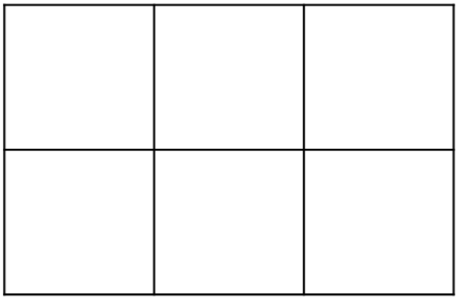
Short response (16)
Complete this sentence:
I can use a grid of rows and columns to find the area because…
Notes:
Short response questions provide brisk paced questions focussing on review of current and previous content to support spaced and interleaved practice.
Syllabus focus area:
Two-dimensional special structure B: Area (Note: Stage 1 content reviewed)

Slide 31
Activity 4 – ordering 4-digit numbers 2
Start
Finish
Can you decide where to place your number on the gameboard so that the sequence of numbers remains in order?
Notes:
This is a developing number sense activity.
Number sense refers to a deep understanding of numbers, including their magnitude, relationships, and the effects of operations on them. It supports fluency and understanding, estimation, flexible thinking, and efficient problem-solving. Number sense activities 1–4 ‘activate’ prior number knowledge and support the learning of new content in the unit. Number sense activities 5–8 ‘loop’ back and provide opportunity for spaced practice with concepts and procedures covered in previous units.
Syllabus focus area:
Representing numbers using place value A
Ordering 4-digit numbers 2
This activity is an adaptation of ‘From here to there’ from Dice Dazzlers by Swan.
Group students into pairs and provide each pair with an individual whiteboard and four 10-sided dice. Note: different dice can be used for this activity. If so, guide the students to understand the starting and finishing numbers. For example, if students use four 6-sided dice, the maximum finishing number will be 6666 and the starting number has to be above 1111.
One student draws a gameboard on their whiteboard with at least 12 squares. Together they set the starting and finishing numbers and write them on the gameboard.
The first player rolls the dice to form a number. The player must decide where to place the number on the gameboard so that the sequence of numbers remains in order. The next player rolls the dice and places their number on the same gameboard. If a number cannot be placed, the player misses their turn.
The winner is the person who completes the sequence of numbers from the starting to the finishing number. Note: the game can also be played as a whole class. It is recommended to use dice that have a zero. It is important that students understand the role of zero in changing the value of the 4-digit numbers created. Using a reusable sleeve for the gameboard and non-permanent markers will allow students to play multiple games.

Slide 32
Review of learning 5

Slide 33
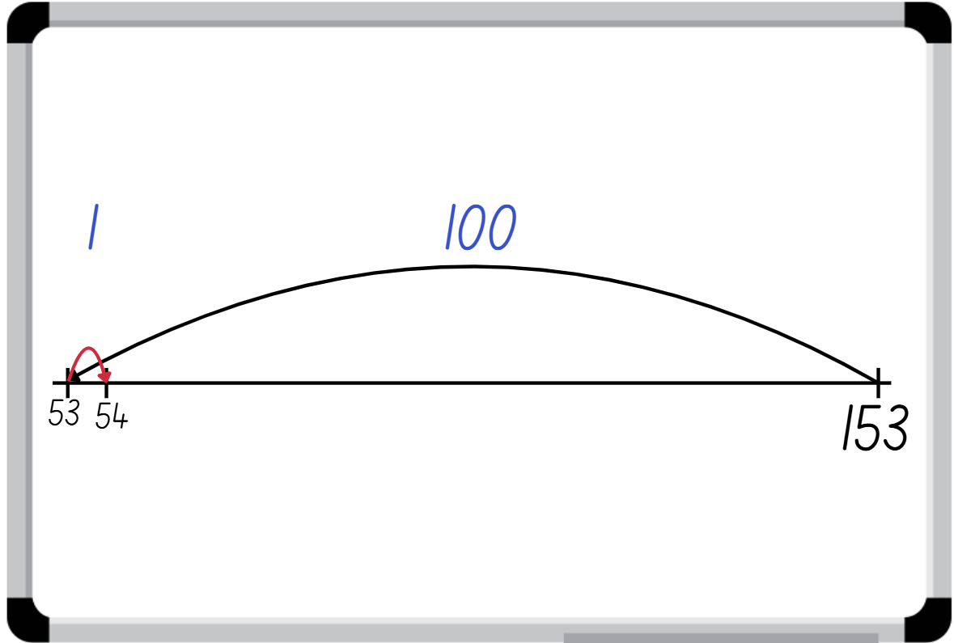
Multiple choice (3)
Which calculation does this number line represent?
A
153 + 99
B
153 – 99
C
99+ 54
D
53 + 100
Notes:
This question connects to the content in the developing number sense activity (Activity 5)
Syllabus focus area:
Additive relations A

Slide 34
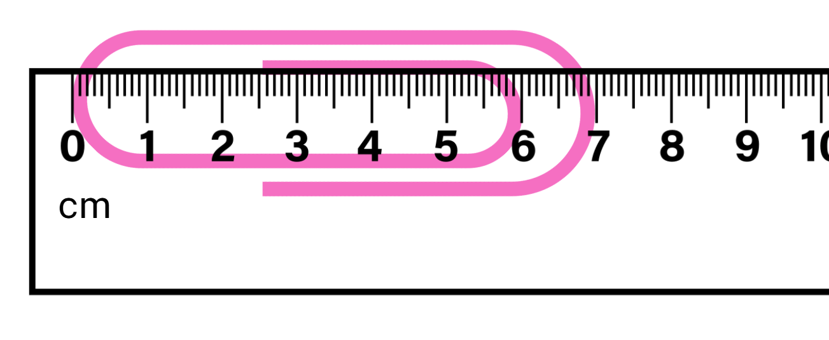
Short response (17)
How long is this paperclip?
Record using mm.
Notes:
Short response questions provide brisk paced questions focussing on review of current and previous content to support spaced and interleaved practice.
Syllabus focus area:
Geometric measure A: Length

Slide 35
Short response (18)
Use the compensation strategy to complete:
90 – 28 =
Explain your reasoning.
Notes:
Short response questions provide brisk paced questions focussing on review of current and previous content to support spaced and interleaved practice.
Syllabus focus area:
Additive relations A

Slide 36
Short response (19)
Record the following numbers in numerals:
one hundred and three
one thousand and forty-seven
two hundred and sixty
Notes:
Short response questions provide brisk paced questions focussing on review of current and previous content to support spaced and interleaved practice.
Syllabus focus area:
Representing numbers using place value A

Slide 37
Short response (20)
It is Saturday 4 September. How many weeks until Saturday 25 September?
September
Monday | Tuesday | Wednesday | Thursday | Friday | Saturday | Sunday
 |  | 1 | 2 | 3 | 4 | 5
6 | 7 | 8 | 9 | 10 | 11 | 12
13 | 14 | 15 | 16 | 17 | 18 | 19
20 | 21 | 22 | 23 | 24 | 25 | 26
27 | 28 | 29 | 30
Notes:
Short response questions provide brisk paced questions focussing on review of current and previous content to support spaced and interleaved practice.
Syllabus focus area:
Non-spatial measure B: Time (Note: Stage 1 content reviewed)

Slide 38
Activity 5 – number line addition and subtraction (1)
84 - 68 =
Notes:
This is a developing number sense activity.
Number sense refers to a deep understanding of numbers, including their magnitude, relationships, and the effects of operations on them. It supports fluency and understanding, estimation, flexible thinking, and efficient problem-solving. Number sense activities 1–4 ‘activate’ prior number knowledge and support the learning of new content in the unit. Number sense activities 5–8 ‘loop’ back and provide opportunity for spaced practice with concepts and procedures covered in previous units.
Syllabus focus area:
Additive relations A
Number line addition and subtraction
Ask students how they could solve the problem using the number line and have students record their thinking on an individual whiteboard.
Select students to share and justify their ideas, checking solutions on the number line.
Display 38 + 43 = _ (NEXT SLIDE) and have students record and solve the problem on their whiteboard using a number line. Students share and demonstrate their working.
Repeat multiple times with other 2- and 3-digit addition and subtraction problems.
Note: this activity can be adapted to 1- or 3-digit numbers.

Slide 39
Activity 5 – number line addition and subtraction (2)
38 + 43 =
Notes:
This is a developing number sense activity.
Number sense refers to a deep understanding of numbers, including their magnitude, relationships, and the effects of operations on them. It supports fluency and understanding, estimation, flexible thinking, and efficient problem-solving. Number sense activities 1–4 ‘activate’ prior number knowledge and support the learning of new content in the unit. Number sense activities 5–8 ‘loop’ back and provide opportunity for spaced practice with concepts and procedures covered in previous units.
Syllabus focus area:
Additive relations A
Activity title
Have students record and solve the problem on their whiteboard using a number line. Students share and demonstrate their working.
Repeat multiple times with other 2- and 3-digit addition and subtraction problems.
Note: this activity can be adapted to 1- or 3-digit numbers.

Slide 40
Review of learning 6

Slide 41
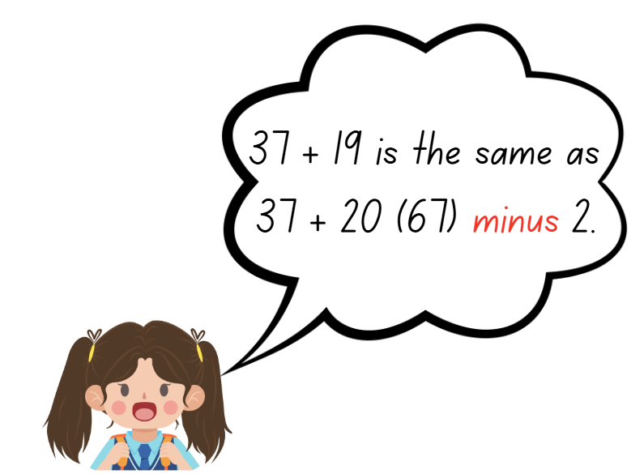
True or false (3)
Maddie has used the
compensation strategy correctly.
True | False
Notes:
The question on this slide connects to the content being explored in the developing number sense activity (Activity 6)
Syllabus focus area:
Additive relations A

Slide 42
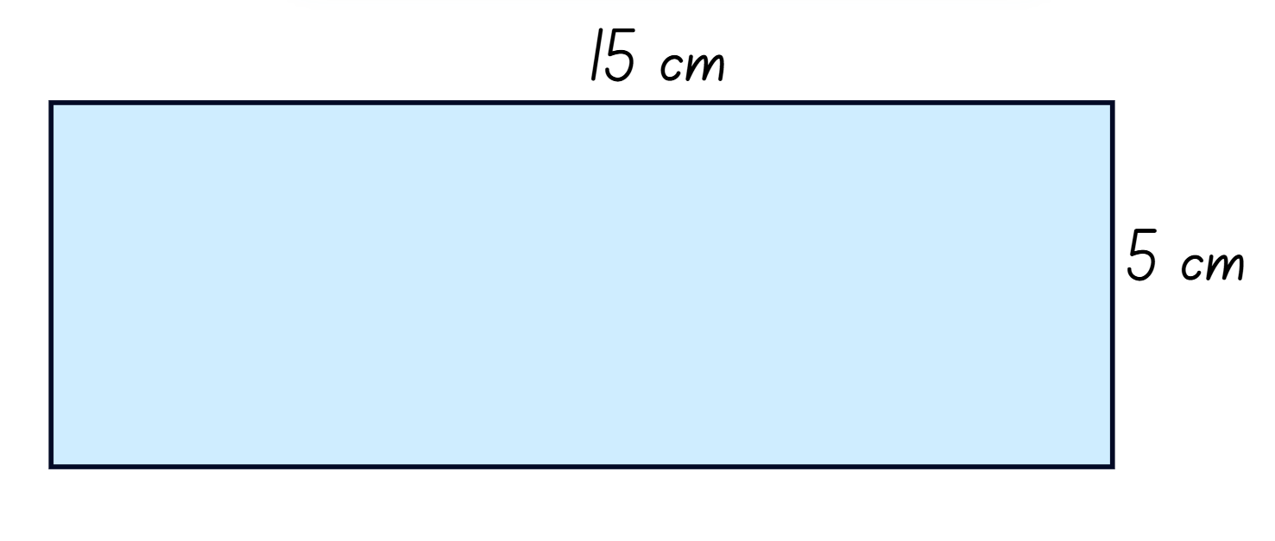
Short response (21)
What is the perimeter in cm and mm?
Notes:
Short response questions provide brisk paced questions focussing on review of current and previous content to support spaced and interleaved practice.
Syllabus focus area:
Geometric measure B: Length

Slide 43
Short response (22)
Use the levelling strategy to complete:
27 + 28 =
36 + 44 =
Explain your reasoning.
Notes:
Short response questions provide brisk paced questions focussing on review of current and previous content to support spaced and interleaved practice.
Syllabus focus area:
Additive relations A

Slide 44
Short response (23)
What does the 2 represent
in this number?
4123
Notes:
Short response questions provide brisk paced questions focussing on review of current and previous content to support spaced and interleaved practice.
Syllabus focus area:
Representing numbers using place value A

Slide 45
Short response (24)
Record different ways to show
a quarter past 3.
Notes:
Short response questions provide brisk paced questions focussing on review of current and previous content to support spaced and interleaved practice.
Syllabus focus area:
Non-spatial measure B: Time (Note: Stage 1 content reviewed)

Slide 46
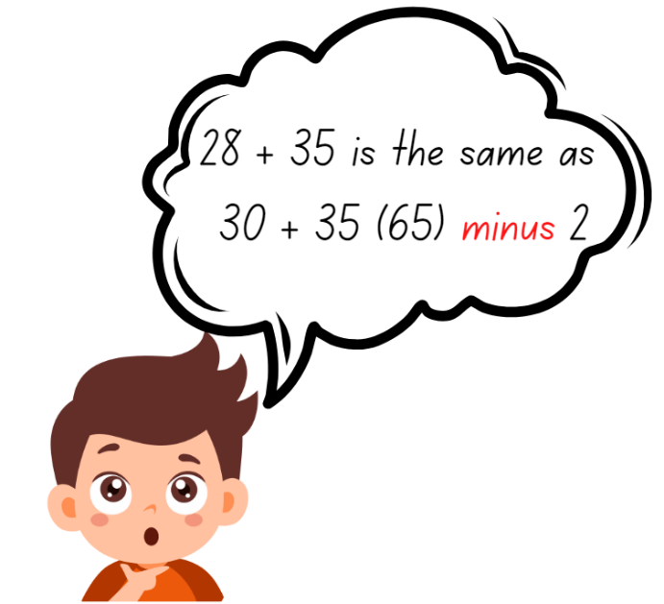

Activity 6 – compensation strategy
Tens
Ones
What do I need to think about before placing a number in a column to get as close to 100 as possible?
Notes:
This is a developing number sense activity.
Number sense refers to a deep understanding of numbers, including their magnitude, relationships, and the effects of operations on them. It supports fluency and understanding, estimation, flexible thinking, and efficient problem-solving. Number sense activities 1–4 ‘activate’ prior number knowledge and support the learning of new content in the unit. Number sense activities 5–8 ‘loop’ back and provide opportunity for spaced practice with concepts and procedures covered in previous units.
Syllabus focus area:
Additive relations
Compensation strategy
Demonstrate how to use the compensation strategy by rolling a 9-sided die 4 times to make two 2-digit numbers.
After each throw of the die, decide whether the number is placed in the ones or tens column.
Explain that the goal is to get as close to 100 as possible. Ask what students need to think about before putting a number in a certain column. For example, putting the 9 in the tens place brings the total too close to 100; you will bust over 100 if you don’t roll a one.
Model solving the addition number sentence using the compensation strategy. For example, 28 + 35 is the same as 30 + 35 = 65, subtract 2 to obtain 63.
Once students are confident, provide them with a 9-sided die and an individual whiteboard.
Students repeat the activity multiple times with both 2-digit addition and subtraction problems.
Note: this activity can be adapted to allow students to add a 2-digit and 1-digit numbers.

Slide 47
Review of learning 7

Slide 48
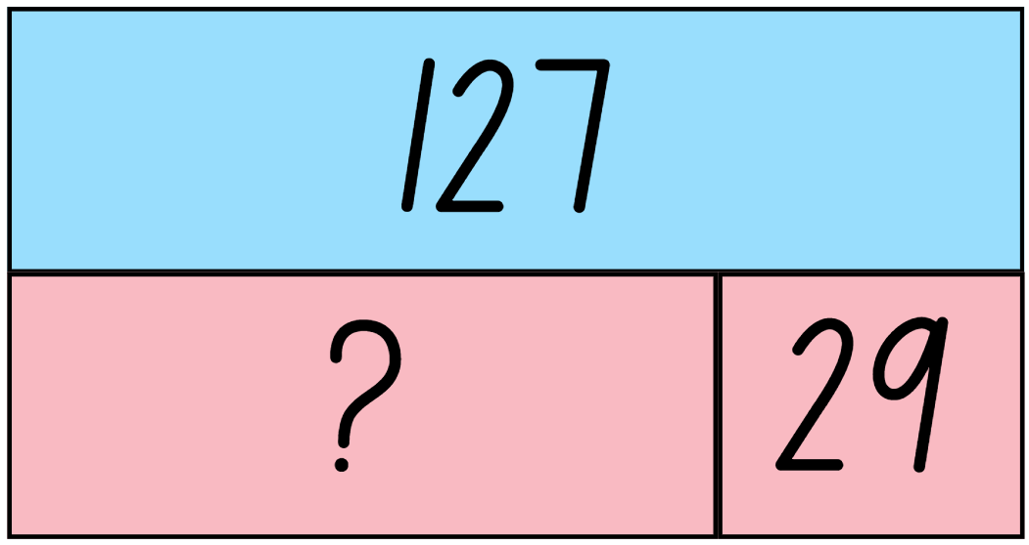
Multiple choice (4)
127 - 29 =
A
B
C
D
99
98
97
96
Notes:
This question connects to the content in the developing number sense activity (Activity 7)
Syllabus focus area:
Additive relations A

Slide 49
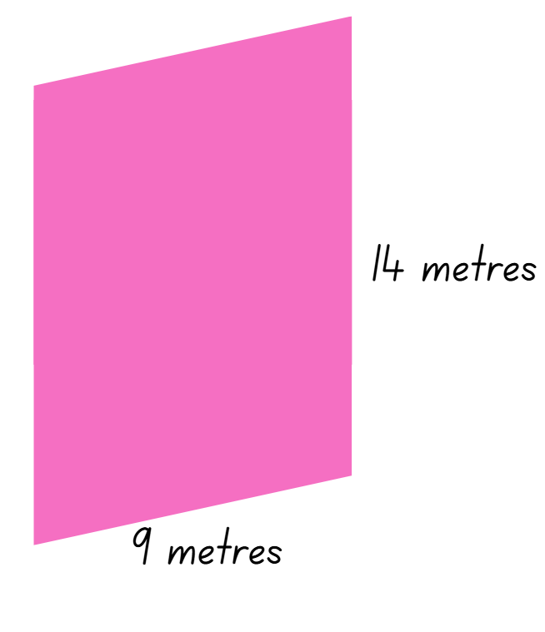
Short response (25)
Calculate and record the perimeter of this shape.
Notes:
Short response questions provide brisk paced questions focussing on review of current and previous content to support spaced and interleaved practice.
Syllabus focus area:
Geometric measure B: Length

Slide 50
Short response (26)
Blair has 74 marbles, and she gives 36 to Phil. How many does Blair have left?
Draw a tape diagram to record your answer.
Notes:
Short response questions provide brisk paced questions focussing on review of current and previous content to support spaced and interleaved practice.
Syllabus focus area:
Additive relations A

Slide 51
Short response (27)
What number patterns do you see in this calendar?
September
Monday | Tuesday | Wednesday | Thursday | Friday | Saturday | Sunday
 |  | 1 | 2 | 3 | 4 | 5
6 | 7 | 8 | 9 | 10 | 11 | 12
13 | 14 | 15 | 16 | 17 | 18 | 19
20 | 21 | 22 | 23 | 24 | 25 | 26
27 | 28 | 29 | 30
Notes:
Short response questions provide brisk paced questions focussing on review of current and previous content to support spaced and interleaved practice.
Syllabus focus area:
Multiplicative relations A

Slide 52

Short response (28)
Describe this triangular prism using the terms face, edge and vertex.
Notes:
Short response questions provide brisk paced questions focussing on review of current and previous content to support spaced and interleaved practice.
Syllabus focus area:
Three-dimensional spatial structure B: 3D objects (Note: Stage 1 content reviewed)

Slide 53
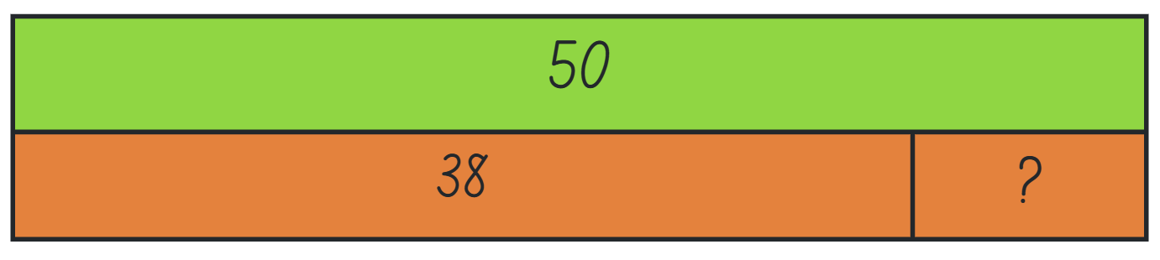
Activity 7 – using the bar model
Use the bar model to work out
50 – 38 =
Notes:
This is a developing number sense activity.
Number sense refers to a deep understanding of numbers, including their magnitude, relationships, and the effects of operations on them. It supports fluency and understanding, estimation, flexible thinking, and efficient problem-solving. Number sense activities 1–4 ‘activate’ prior number knowledge and support the learning of new content in the unit. Number sense activities 5–8 ‘loop’ back and provide opportunity for spaced practice with concepts and procedures covered in previous units.
Syllabus focus area:
Additive relations A
Using the bar model
This resource corresponds to Resource 23 in Stage 2 Unit 3
Model the equation represented by the bar model.
Demonstrate how to use the inverse operation 50 − 38 = _ to solve the equation.
Explain that the connection between addition and subtraction means subtraction can be used to solve the problem.
Students record their solution on an individual whiteboard, sharing and justifying their working. Record the answer 50 − 38 = 12.
Ask: Could you write this subtraction equation in a different way? How many ways can you write it?
Display the following equations: 37 + _ = 57, 58 = 70 − _, 72 = _ + 15, 94 − _ = 23
Students select 2 of the equations, create a bar model to represent the equations and calculate the missing value.
Seek student input to share and justify their answers.

Slide 54
Review of learning 8

Slide 55
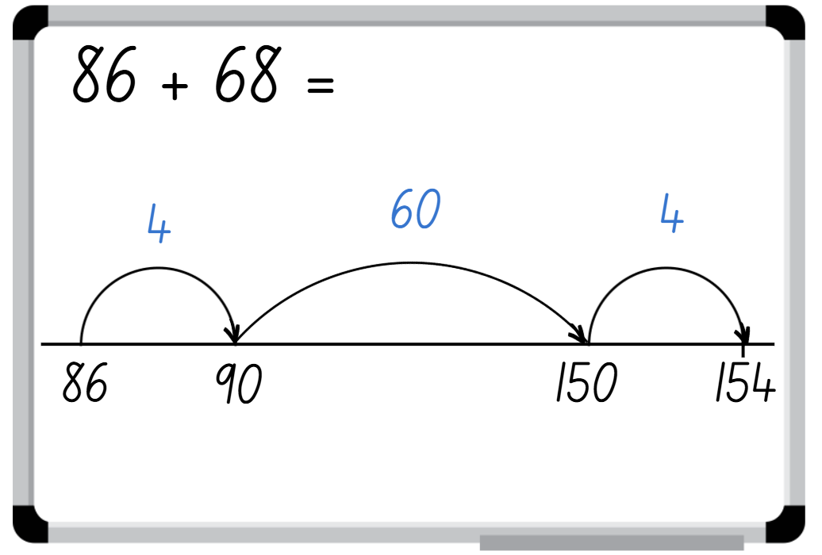
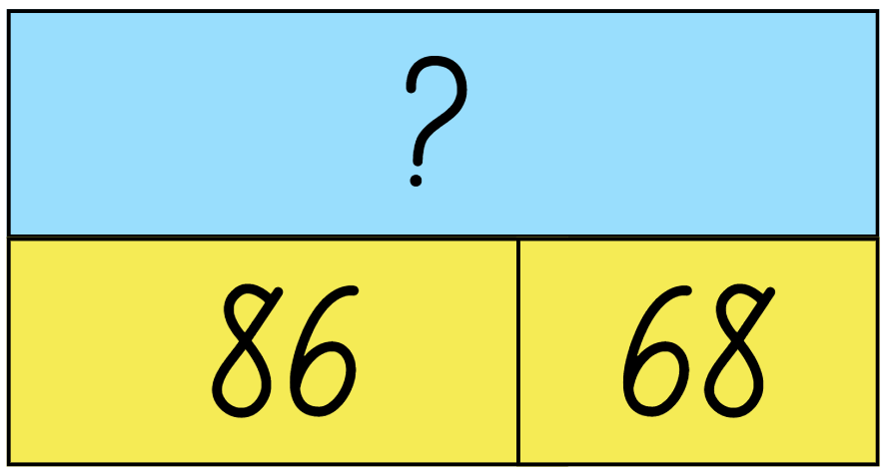
True or false (4)
This bar model and number line show the same calculation.
True | False
Notes:
The question on this slide connects to the content being explored in the developing number sense activity (Activity 8)
Syllabus focus area:
Additive relations A

Slide 56
Short response (29)
Record how many minutes in:
quarter of an hour
half an hour
one hour
Notes:
Short response questions provide brisk paced questions focussing on review of current and previous content to support spaced and interleaved practice.
Syllabus focus area:
Non-spatial measure A: Time

Slide 57
Short response (30)
Use the most efficient strategy to solve
127 – 58 =
Explain your reasoning.
Notes:
Short response questions provide brisk paced questions focussing on review of current and previous content to support spaced and interleaved practice.
Syllabus focus area:
Additive relations A

Slide 58
Short response (31)
Draw arrays to show
5 fours.
Notes:
Short response questions provide brisk paced questions focussing on review of current and previous content to support spaced and interleaved practice.
Syllabus focus area:
Multiplicative relations A

Slide 59
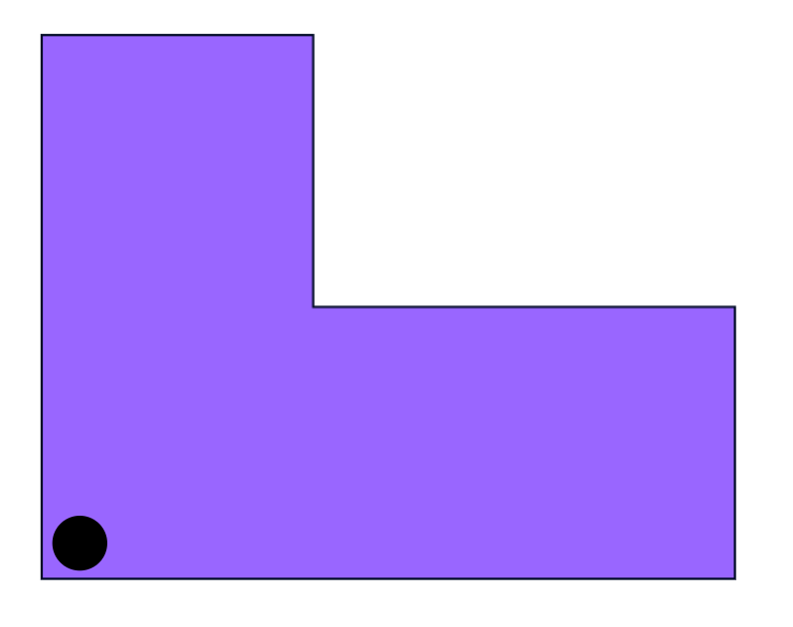
Short response (32)
Draw this shape if it was turned anti-clockwise a quarter of a turn.
Notes:
Short response questions provide brisk paced questions focussing on review of current and previous content to support spaced and interleaved practice.
Syllabus focus area:
Two-dimensional spatial structure B: 2D shapes (Note: Stage 1 content reviewed)

Slide 60
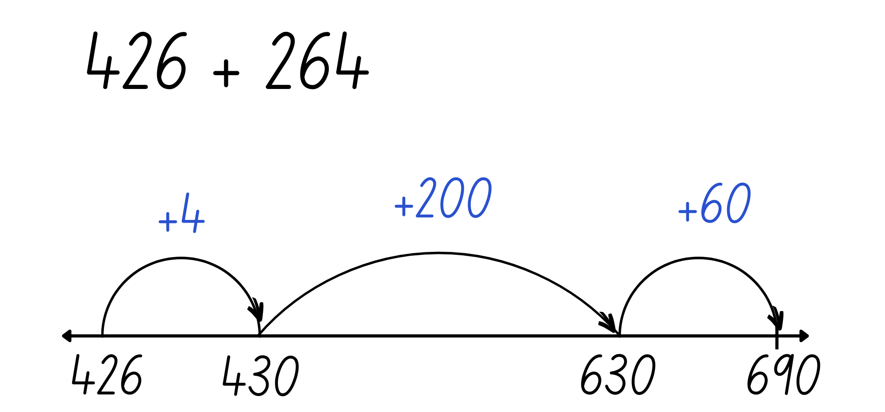
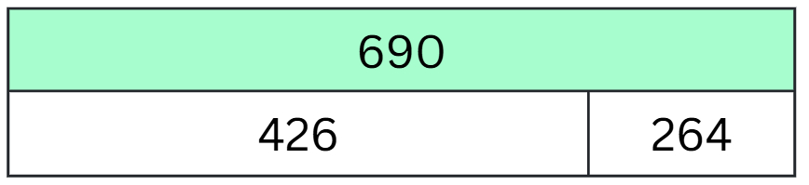
Activity 8 – bar model addition
Can you use mental strategies to calculate the sum of your 2 numbers and represent the solution using a bar model or number line?
Notes:
This is a developing number sense activity.
Number sense refers to a deep understanding of numbers, including their magnitude, relationships, and the effects of operations on them. It supports fluency and understanding, estimation, flexible thinking, and efficient problem-solving. Number sense activities 1–4 ‘activate’ prior number knowledge and support the learning of new content in the unit. Number sense activities 5–8 ‘loop’ back and provide opportunity for spaced practice with concepts and procedures covered in previous units.
Syllabus focus area:
Additive relations A
Bar model addition
Revise mental strategies to add 2 numbers together, including bridging the decades.
Provide each student with an individual whiteboard and ask them to draw an empty number line and a bar model.
Working in pairs, students roll 3 dice.
Students use the numbers rolled to form two 3-digit numbers, for example, 264 and 426.
The aim is to use mental strategies to calculate the sum of the 2 numbers. Students then represent their solution using a bar model or number line.
Ask the following questions:
Which strategy did you use? Explain why.
Can you explain your representation to a partner?
Students roll the dice again and repeat the activity

Slide 61
Double Venn diagram
Object 1
Object 2
Features similar to both objects
Features of object 1
Features of object 2

Slide 62
Frayer
Definition
Facts/Characteristics
Word, term, concept
Examples
Non-examples

Slide 63
Spider map
Idea
Subject

Slide 64
Cline
Concept 1
Concept 2
Word
Word
Word
Word
Word
Word
Word
Word
Word
Word
Word

Slide 65

Compare and contrast

Slide 66
Multiple choice (5)
A
B
C
D

Slide 67
Multiple choice (6)
A
B
C
D

Slide 68
References
This presentation contains NSW Curriculum and syllabus content. The NSW Curriculum is developed by the NSW Education Standards Authority. This content is prepared by NESA for and on behalf of the Crown in the right of the State of New South Wales. The material is protected by Crown copyright.
Please refer to the NESA Copyright Disclaimer for more information https://educationstandards.nsw.edu.au/wps/portal/nesa/mini-footer/copyright.
NESA holds the only official and up-to-date versions of the NSW Curriculum and syllabus documents. Please visit the NSW Education Standards Authority (NESA) website https://educationstandards.nsw.edu.au/wps/portal/nesa/home and the NSW Curriculum website https://curriculum.nsw.edu.au.
Mathematics K–10 Syllabus © NSW Education Standards Authority (NESA) for and on behalf of the Crown in right of the State of New South Wales, 2022.
National Numeracy Learning Progression © Australian Curriculum, Assessment and Reporting Authority (ACARA) 2010 to present, unless otherwise indicated. This material was downloaded from the Australian Curriculum website (National Numeracy Learning Progression) (accessed 22 July 2025) and was not modified.
State of New South Wales (Department of Education) (2024) ‘Place value game’, Thinking mathematically resources, NSW Department of Education website, accessed 9 September 2025.

Slide 69
Copyright
© State of New South Wales (Department of Education), 2025
The copyright material published in this resource is subject to the Copyright Act 1968 (Cth) and is owned by the NSW Department of Education or, where indicated, by a party other than the NSW Department of Education (third-party material).
Copyright material available in this resource and owned by the NSW Department of Education is licensed under a Creative Commons Attribution 4.0 International (CC BY 4.0) license.
This license allows you to share and adapt the material for any purpose, even commercially.
Attribution should be given to © State of New South Wales (Department of Education), 2025.
Material in this resource not available under a Creative Commons license:
the NSW Department of Education logo, other logos and trademark-protected material
Material owned by a third party that has been reproduced with permission. You will need to obtain permission from the third party to reuse its material.
Links to third-party material and websites
Please note that the provided (reading/viewing material/list/links/texts) are a suggestion only and implies no endorsement, by the New South Wales Department of Education, of any author, publisher, or book title. School principals and teachers are best placed to assess the suitability of resources that would complement the curriculum and reflect the needs and interests of their students.
If you use the links provided in this document to access a third party’s website, you acknowledge that the terms of use, including licence terms set out on the third-party’s website apply to the use which may be made of the materials on that third-party website or where permitted by the Copyright Act 1968 (Cth). The department accepts no responsibility for content on third-party websites.

