Slide 1
Instructions for use
This resource is not a teaching and learning program. It should be used in conjunction with Stage 2 Year A Unit 4.
Classroom teachers are encouraged to add and adapt slides as required to meet the needs of their students.
Save a copy of the file to make changes to the slide deck. Go to File > Download a Copy (this downloads a copy to the computer to edit in the PowerPoint app).
To convert the PowerPoint to Google Slides:
  Upload the file into Google Drive and open it.
  Go to File > Save as Google Slides.
  (Note – conversion may cause formatting changes in the slides.)

Slide 2

Review of Learning
Mathematics Stage 2 – Unit 4
Notes:
Reviews may include a combination of question types, requiring students to recall facts and key ideas, as well as apply their knowledge to solve problems and answer questions. To support active engagement, a mix of techniques should be employed.” (AERO, 2024).
This Review of Learning slide deck revisits key concepts from the following units:
Stage 2 Year A Unit 4
Stage 2 Year A Unit 3
Stage 2 Year A Unit 2
It also includes opportunities to review prior learning in non-number content, supporting consolidation across focus areas.
The review of learning resources include three key task types that support the development of mathematical proficiency through retrieval, spaced practice, and active participation. These practices complement the review phase (activating prior knowledge) embedded within the beginning of each lesson.
1.
Multiple-choice questions/True or false: Designed to promote active retrieval of key concepts and identify common misconceptions in number, supporting consolidation, understanding and fluency.
These questions:
support spaced and interleaved practice
help identify and address common misconceptions
support active recall and immediate feedback
support whole class participation
identify areas requiring reteach
2.
Short-response question sets: Carefully grouped questions that encourage spaced and interleaved practice across multiple focus areas, helping students revisit and apply knowledge from different points in time.
These questions:
have a combination of question types
address a range of focus areas
build automaticity and fluency
support active recall
allow for immediate feedback
identify content requiring reteach
3.
Developing number sense activities: A variety of practical, purposeful tasks that reinforce current learning and build on prior knowledge. These activities promote reasoning, problem-solving and conceptual understanding.
The review of learning resources are designed to work support teaching and learning in mathematics. For the most effective implementation, use the resources flexibly, adapting to meet student learning needs and individual classroom contexts.

Slide 3
Lessons
1
Review of learning 1
5
Review of learning 5
2
Review of learning 2
6
Review of learning 6
3
Review of learning 3
7
Review of learning 7
4
Review of learning 4
8
Review of learning 8
Notes:
Teacher notes:
Click lesson numbers to go to specific lessons
Interactive features can be viewed in slide show

Slide 4
Review of learning 1

Slide 5


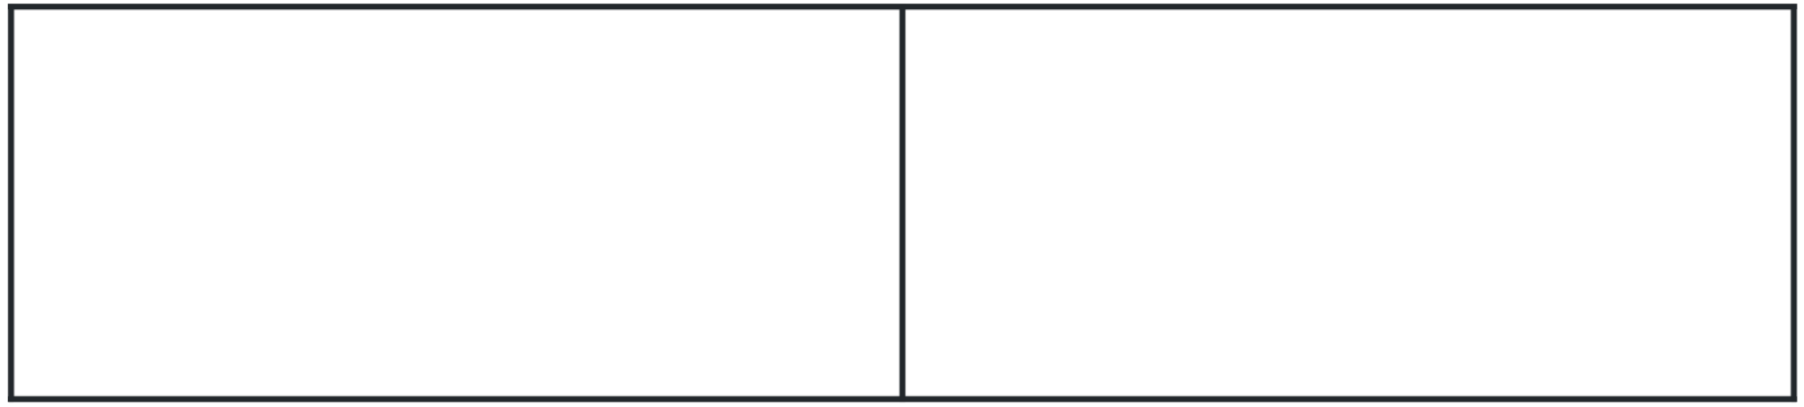
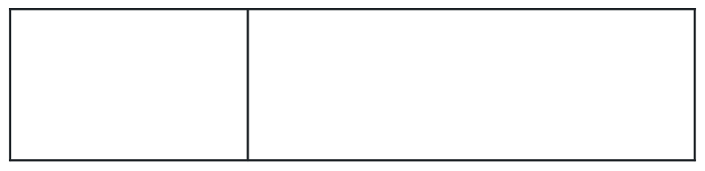
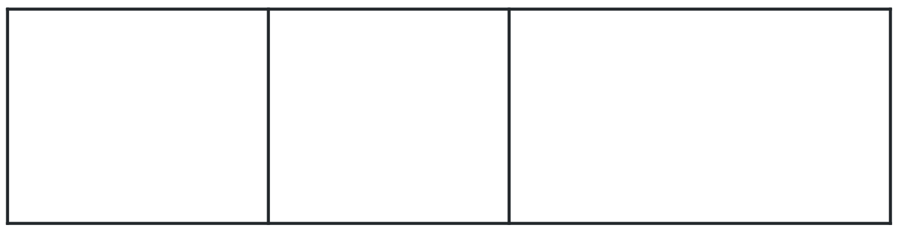
Multiple choice (1)
Which fraction strip has been correctly divided into halves?
A
B
C
D
Notes:
This question connects to the content in the developing number sense activity (Activity 1)
Syllabus focus area:
Partitioned fractions A

Slide 6

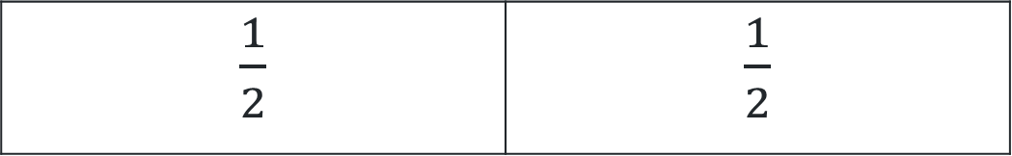
Short response (1)
This fraction strip has been partitioned into halves.
$\frac{1}{2}$ | $\frac{1}{2}$
Draw and label a fraction strip that has been partitioned into quarters.
Notes:
Short response questions provide brisk paced questions focussing on review of current and previous content to support spaced and interleaved practice.
Syllabus focus area:
Partitioned fractions A

Slide 7
Short response (2)
Estimate your height using metres and centimetres.
Communicate your reasoning.
Notes:
Short response questions provide brisk paced questions focussing on review of current and previous content to support spaced and interleaved practice.
Syllabus focus area:
Geometric measure A: Length

Slide 8
Short response (3)
Both these number sentences have an equal difference of 8.
17 – 9 = 8 and 24 – 16 = 8
Record the equal difference of
18 – 11 and 14 – 7
Notes:
Short response questions provide brisk paced questions focussing on review of current and previous content to support spaced and interleaved practice.
Syllabus focus area:
Additive relations A

Slide 9
Short response (4)
Name 3 different objects that would be measured using millimetres.
Notes:
Short response questions provide brisk paced questions focussing on review of current and previous content to support spaced and interleaved practice.
Syllabus focus area:
Geometric measure A: Length

Slide 10


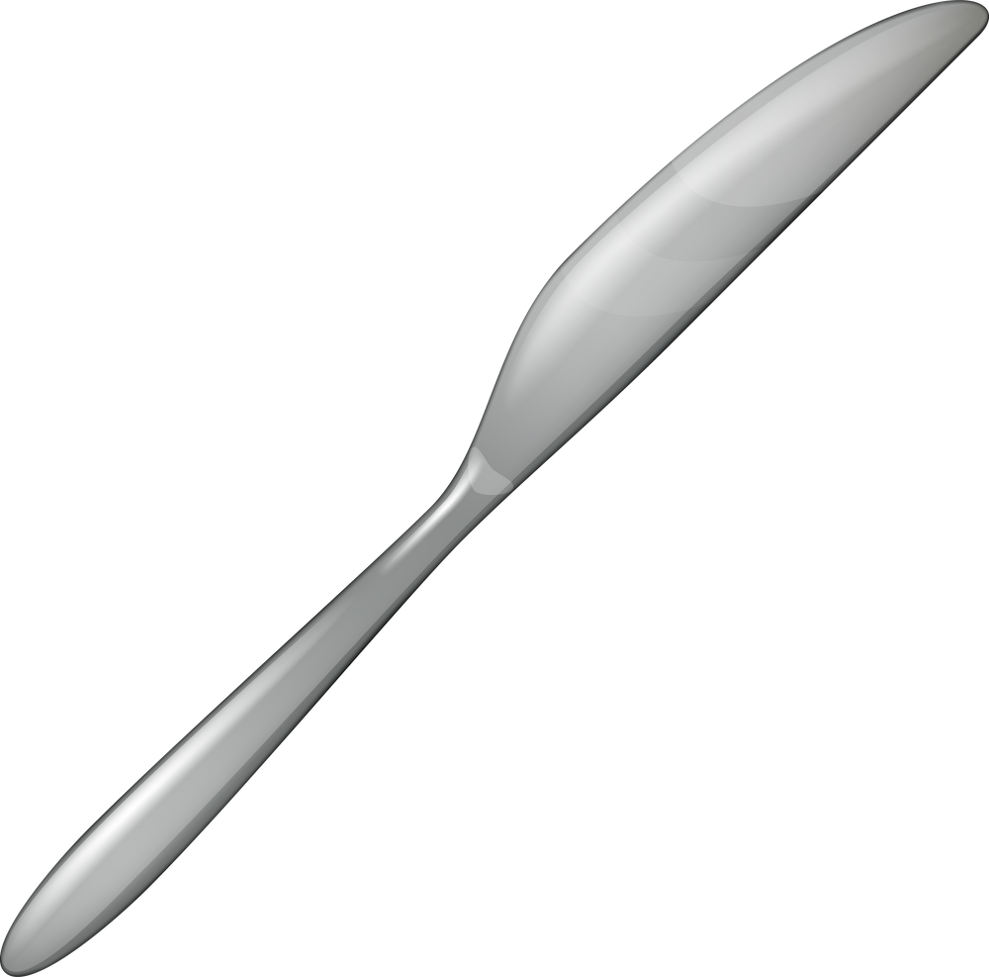
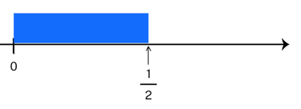
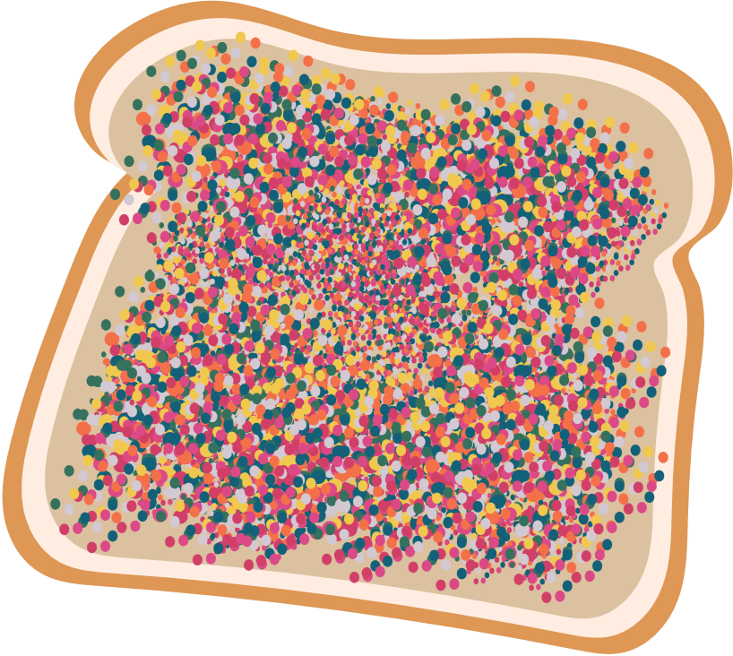






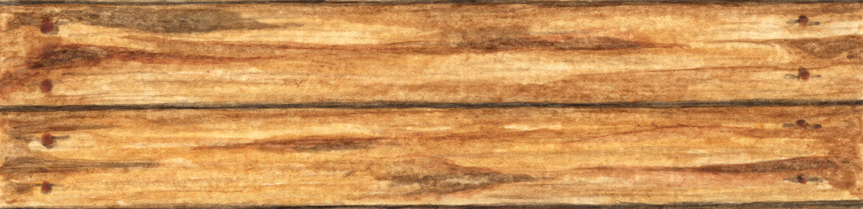
Activity 1 – What is half?
Which images represent half as 2 equal pieces?
The smaller half
The bigger half
I am 9 and a half years old
1
2
Notes:
This is a developing number sense activity.
Number sense refers to a deep understanding of numbers, including their magnitude, relationships, and the effects of operations on them. It supports fluency and understanding, estimation, flexible thinking, and efficient problem-solving. Number sense activities 1–4 ‘activate’ prior number knowledge and support the learning of new content in the unit. Number sense activities 5–8 ‘loop’ back and provide opportunity for spaced practice with concepts and procedures covered in previous units.
Syllabus focus area:
Partitioned Fractions A
Activity 1 – What is half?
This resource corresponds to Resource 16 – Is it half? in Stage 2 Year A Unit 4
Note: fractional language can be confusing. Students often use the fractional term ‘half’ as an everyday adjective to describe part of an object, rather than as a mathematical term related to equal partitioning of a known whole. Research suggests that tasks such as cutting toast or an apple to represent fractions can be misleading for students as the parts are NOT ‘exactly equal’. This is why it is not unusual to hear young children referring to the ‘bigger half’ (Gould 2013).
Ask students to consider each example.
Determine which images represent half as exactly 2 parts that are equal and those that don’t.
Students draw, model or represent half in a diagram.
Discuss which representations accurately show half as a mathematical term.

Slide 11
Review of learning 2

Slide 12
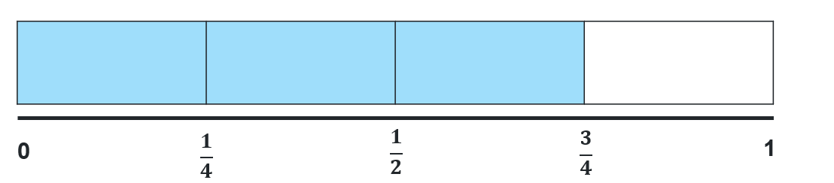
True or false (1)
The fractional part needed to complete this one whole is one third.
True | False
Notes:
The question on this slide connects to the content being explored in the developing number sense activity (Activity 2)
Syllabus focus area:
Partitioned fractions A

Slide 13
Short response (5)
Tyra had a strip of blue paper she wanted to fold into eighths.
Describe the instructions you could give Tyra to make sure she created 8 equal parts.
Notes:
Short response questions provide brisk paced questions focussing on review of current and previous content to support spaced and interleaved practice.
Syllabus focus area:
Partitioned fractions A

Slide 14
Short response (6)
Record 3 different benchmarks for measuring length.
Notes:
Short response questions provide brisk paced questions focussing on review of current and previous content to support spaced and interleaved practice.
Syllabus focus area:
Geometric measure A: Length

Slide 15
Short response (7)
Represent the following number sentence using a bar model and calculate the missing value.
72 = ? + 13
Notes:
Short response questions provide brisk paced questions focussing on review of current and previous content to support spaced and interleaved practice.
Syllabus focus area:
Additive relations A

Slide 16
Short response (8)
Describe the features that are similar and different between these 2 shapes.
square
rectangle
Notes:
Short response questions provide brisk paced questions focussing on review of current and previous content to support spaced and interleaved practice.
Syllabus focus area:
Two-dimensional spatial structure A: 2D shapes

Slide 17
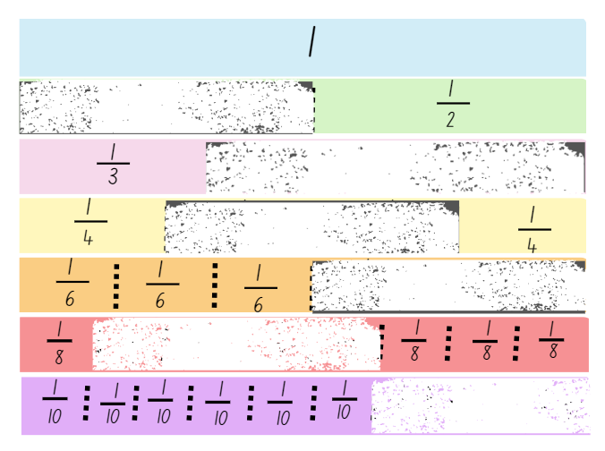
Activity 2 – wholes on a fraction wall
How could you help Maya understand what is missing from the broken fraction wall.
How does the fraction symbol help you determine how many parts are needed to make the whole?
Notes:
This is a developing number sense activity.
Number sense refers to a deep understanding of numbers, including their magnitude, relationships, and the effects of operations on them. It supports fluency and understanding, estimation, flexible thinking, and efficient problem-solving. Number sense activities 1–4 ‘activate’ prior number knowledge and support the learning of new content in the unit. Number sense activities 5–8 ‘loop’ back and provide opportunity for spaced practice with concepts and procedures covered in previous units.
Syllabus focus area:
Partitioned fractions A
Activity 2 – wholes on a fraction wall
This resource corresponds to Resource 17 – broken fraction wall in Stage 2 Year A Unit 4
Explain that Maya’s little brother scribbled on her fraction wall. She has forgotten how many fractional parts are missing from each length.
Students turn and talk and discuss how they could support Maya to understand what is missing.
Students share their strategies with the class.
Ask students, ‘How does the fraction symbol help you determine how many parts are needed to make the whole?’

Slide 18
Review of learning 3

Slide 19
Multiple choice (2)
The colours in the fraction strip represent…
A
$\frac{2}{4} blue,\frac{3}{8}$ pink and $\frac{1}{2}$ grey
B
$\frac{1}{4} blue,\frac{1}{3}$ pink and $\frac{1}{3}$ grey
C
$\frac{2}{8} blue,\frac{3}{8}$ pink and $\frac{1}{2}$ grey
D
$\frac{1}{4} blue,\frac{3}{8}$ pink and $\frac{3}{8}$ grey
Notes:
This question connects to the content in the developing number sense activity (Activity 3)
Syllabus focus area:
Partitioned fractions A

Slide 20
Short response (9)
Draw a rectangle and divide it into thirds.
How do you know each part is one third of the whole?
Communicate your reasoning.
Notes:
Short response questions provide brisk paced questions focussing on review of current and previous content to support spaced and interleaved practice.
Syllabus focus area:
Partitioned fractions A

Slide 21
Short response (10)
Complete the sentences.
There are ___ mm in 1 cm.
There are ___ mm in 3 cm.
There are ___ mm in ___ cm.
Notes:
Short response questions provide brisk paced questions focussing on review of current and previous content to support spaced and interleaved practice.
Syllabus focus area:
Geometric measure A: Length

Slide 22
Short response (11)
Use partitioning to solve
13 + 46
Record your thinking.
Notes:
Short response questions provide brisk paced questions focussing on review of current and previous content to support spaced and interleaved practice.
Syllabus focus area:
Additive relations A

Slide 23
Short response (12)
Record a shape that has:
two pairs of parallel sides
opposite sides that are equal
all corners the same.
Notes:
Short response questions provide brisk paced questions focussing on review of current and previous content to support spaced and interleaved practice.
Syllabus focus area:
Two-dimensional spatial structure A: 2D shapes

Slide 24
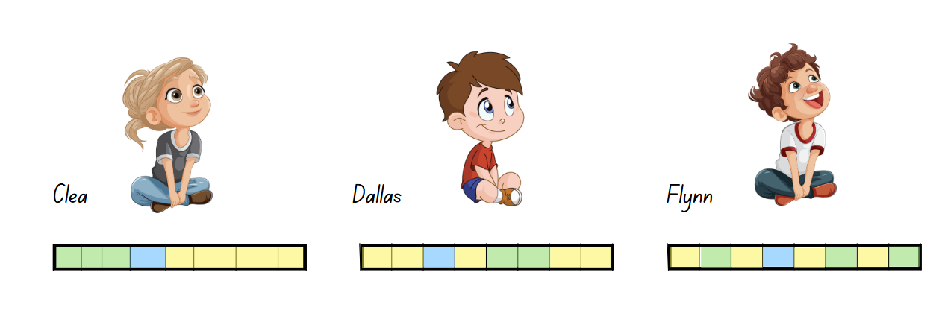
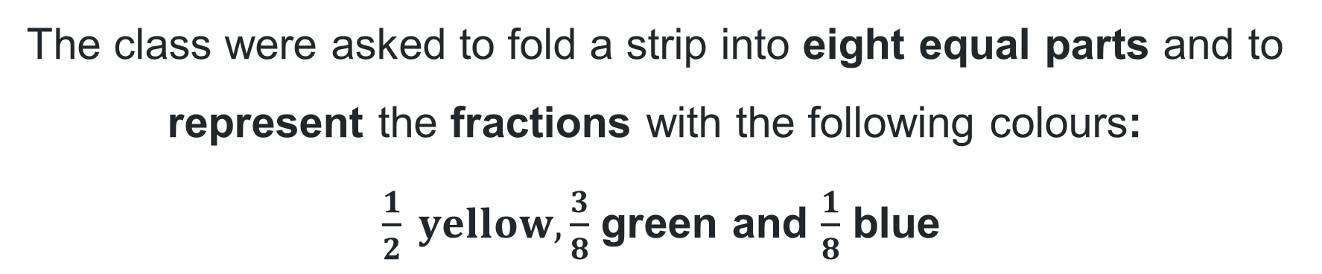
Activity 3 – Who is correct?
The class were asked to fold a strip into eight equal parts and to represent the fractions with the following colours:
$\frac{1}{2} yellow,\frac{3}{8}$ green and $\frac{1}{8}$ blue
Who is correct?
Notes:
This is a developing number sense activity.
Number sense refers to a deep understanding of numbers, including their magnitude, relationships, and the effects of operations on them. It supports fluency and understanding, estimation, flexible thinking, and efficient problem-solving. Number sense activities 1–4 ‘activate’ prior number knowledge and support the learning of new content in the unit. Number sense activities 5–8 ‘loop’ back and provide opportunity for spaced practice with concepts and procedures covered in previous units.
Syllabus focus area:
Partitioned fractions A
Activity 3 – Who is correct?
This resource corresponds to Resource 18 – Who is correct? in Stage 2 Year A Unit 4
Prompt students to turn and talk to decide who represented the fractions correctly.
Select students to share their decision and mathematical thinking with the class.
Ask:
Where did Clea go wrong? (the eight parts are not equal)
What mistake did Dallas make? (how many and how much)
Why is Flynn’s representation correct?

Slide 25
Review of learning 4

Slide 26
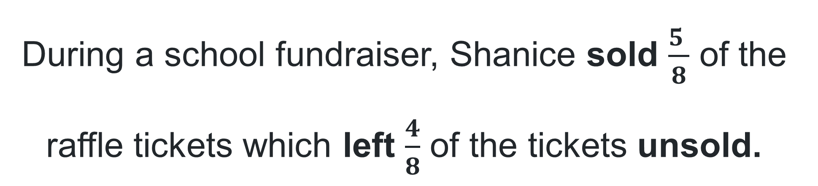
True or false (2)
During a school fundraiser, Shanice sold $\frac{5 }{8}$ of the raffle tickets which left $\frac{4}{8}$ of the tickets unsold.
True | False
Notes:
The question on this slide connects to the content being explored in the developing number sense activity (Activity 4)
Syllabus focus area:
Partitioned fractions A

Slide 27

Short response (13)
Record the fraction that has been shaded blue?
Communicate your reasoning.
Notes:
Short response questions provide brisk paced questions focussing on review of current and previous content to support spaced and interleaved practice.
Syllabus focus area:
Partitioned fractions A

Slide 28
Short response (14)
Complete the sentence.
53 mm is the same as __ cm and __ mm.
Communicate your reasoning.
Notes:
Short response questions provide brisk paced questions focussing on review of current and previous content to support spaced and interleaved practice.
Syllabus focus area:
Geometric measure A: Length

Slide 29
Short response (15)
To solve 19 + 34, Kenny changed the number sentence to 20 + 33 to find the answer of 53.
Record the name of the strategy he used and why it was an efficient strategy.
Notes:
Short response questions provide brisk paced questions focussing on review of current and previous content to support spaced and interleaved practice.
Syllabus focus area:
Additive relations A

Slide 30
Short response (16)
Bobbi started getting ready for school at 8 am and it took her 30 minutes. Record the time she finished.
Notes:
Short response questions provide brisk paced questions focussing on review of current and previous content to support spaced and interleaved practice.
Syllabus focus area:
Non-spatial measure A: Time

Slide 31
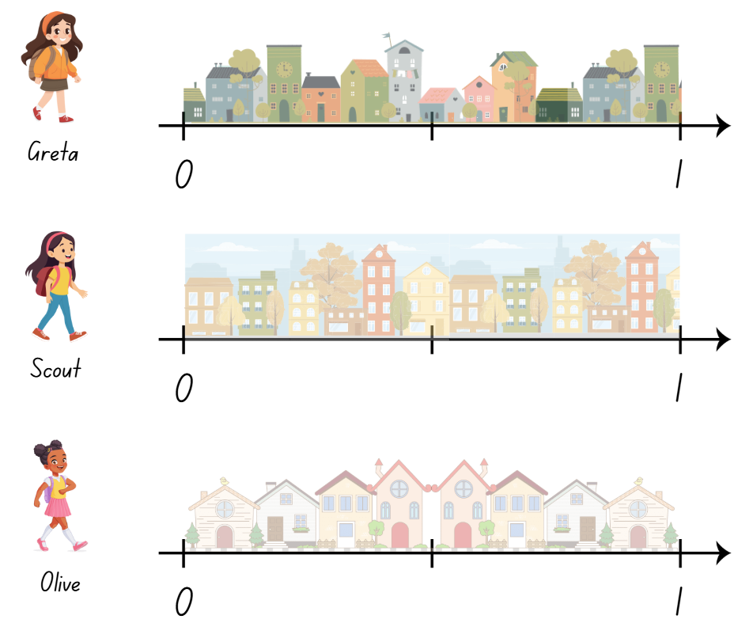
Activity 4 – fractions on a number line
Notes:
This is a developing number sense activity.
Number sense refers to a deep understanding of numbers, including their magnitude, relationships, and the effects of operations on them. It supports fluency and understanding, estimation, flexible thinking, and efficient problem-solving. Number sense activities 1–4 ‘activate’ prior number knowledge and support the learning of new content in the unit. Number sense activities 5–8 ‘loop’ back and provide opportunity for spaced practice with concepts and procedures covered in previous units.
Syllabus focus area:
Partitioned fractions A
Activity 4 – fractions on a number line
This resource corresponds to Resource 19 – pamphlet delivery in Stage 2 Year A Unit 4
Provide students with Resource 19 – pamphlet delivery.
Read the scenario: Greta, Scout and Olive were asked to deliver pamphlets to houses on their street. The girls had to stop due to a thunderstorm, so they did not cover the distance of the whole street.
Greta delivered to half of her street
Scout delivered to quarter of her street
Olive delivered to 3 eighths of her street.
Instruct students to mark the distance covered in fractions on the number lines.
Ask:
Who covered more distance on their street? How do you know?
What fraction of the street does each girl still need to cover, to ensure they have delivered their pamphlets to the whole street?

Slide 32
Review of learning 5

Slide 33
Multiple choice (3)
This array shows…
A
B
C
D
2 groups of 4
2 twos are 4
4 groups of 2
4 twos are 4
Notes:
This question connects to the content in the developing number sense activity (Activity 5)
Syllabus focus area:
Multiplicative relations A

Slide 34
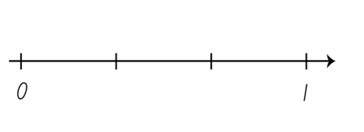
Short response (17)
Record the fractions missing from the marked points on this number line.
Notes:
Short response questions provide brisk paced questions focussing on review of current and previous content to support spaced and interleaved practice.
Syllabus focus area:
Partitioned fractions A

Slide 35
Short response (18)
The term perimeter means…
Notes:
Short response questions provide brisk paced questions focussing on review of current and previous content to support spaced and interleaved practice.
Syllabus focus area:
Geometric measure B: Length

Slide 36
Short response (19)
Use the levelling strategy to solve
22 + 36
Notes:
Short response questions provide brisk paced questions focussing on review of current and previous content to support spaced and interleaved practice.
Syllabus focus area:
Additive relations A

Slide 37
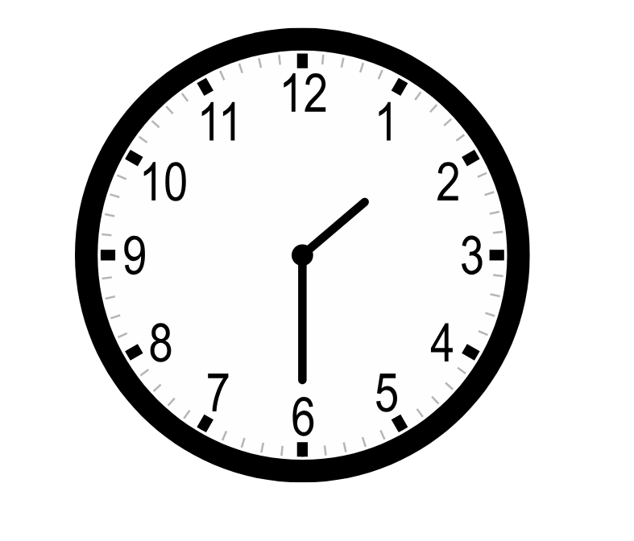
Short response (20)
Read and record the time shown on the clock.
Notes:
Short response questions provide brisk paced questions focussing on review of current and previous content to support spaced and interleaved practice.
Syllabus focus area:
Non-spatial measure A: Time

Slide 38
Activity 5 – arrays for multiples of 2 and 4
A
B
Notes:
This is a developing number sense activity.
Number sense refers to a deep understanding of numbers, including their magnitude, relationships, and the effects of operations on them. It supports fluency and understanding, estimation, flexible thinking, and efficient problem-solving. Number sense activities 1–4 ‘activate’ prior number knowledge and support the learning of new content in the unit. Number sense activities 5–8 ‘loop’ back and provide opportunity for spaced practice with concepts and procedures covered in previous units.
Syllabus focus area:
Multiplicative relations A
Activity 5 – arrays for multiples of 2 and 4
Provide students with a collection of counters. Prompt them to place 2 counters down.
Instruct them to double the number of counters to create a 2 × 2 array.
Ask: How many counters do you have?
Prompt students to finish the sentence: Double 2 is…
Repeat steps 2 - 4 by doubling again to create a 2 × 4 array and 2 × 8 array.
Instruct students to rearrange their array so that it has 4 rows of 4.
Prompt students to finish the sentence: Double 4 is… and double 8 is…
Model how doubling and doubling again can help to find an answer to a multiplication problem when multiplying by 4. For example, double 4 is 8, doubled again is 16. 4 rows of 4 is 16.
Repeat all the steps starting with 3 counters.

Slide 39
Review of learning 6

Slide 40
True or false (3)
Double 5 is 10 so
half of 10 must be 5.
True | False
Notes:
The question on this slide connects to the content being explored in the developing number sense activity (Activity 6)
Syllabus focus area:
Multiplicative relations A

Slide 41
Short response (21)
Explain why one-quarter of a ruler would be larger than one-quarter of a pencil.
Notes:
Short response questions provide brisk paced questions focussing on review of current and previous content to support spaced and interleaved practice.
Syllabus focus area:
Partitioned fractions B

Slide 42
Short response (22)
Calculate the perimeter of this quadrilateral.
15 cm
5 cm
5 cm
15 cm
Notes:
Short response questions provide brisk paced questions focussing on review of current and previous content to support spaced and interleaved practice.
Syllabus focus area:
Geometric measure B: Length

Slide 43
Short response (23)
Select 1 strategy from the list to solve the problem.
32 children are playing and 24 more join.
How many children are now playing?
Strategy list
Levelling
Bridging
Compensation
Notes:
Short response questions provide brisk paced questions focussing on review of current and previous content to support spaced and interleaved practice.
Syllabus focus area:
Additive relations A

Slide 44
Short response (24)
Identify and record an object you could measure the length of using the personal benchmark of a step.
Notes:
Short response questions provide brisk paced questions focussing on review of current and previous content to support spaced and interleaved practice.
Syllabus focus area:
Geometric measure A: Length

Slide 45
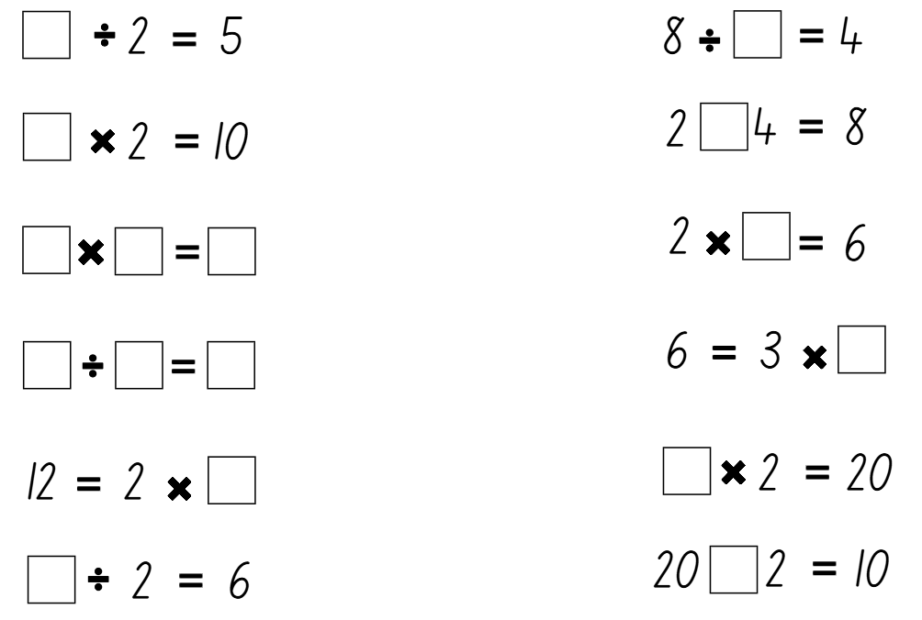
Activity 6 – doubling and halving
Notes:
This is a developing number sense activity.
Number sense refers to a deep understanding of numbers, including their magnitude, relationships, and the effects of operations on them. It supports fluency and understanding, estimation, flexible thinking, and efficient problem-solving. Number sense activities 1–4 ‘activate’ prior number knowledge and support the learning of new content in the unit. Number sense activities 5–8 ‘loop’ back and provide opportunity for spaced practice with concepts and procedures covered in previous units.
Syllabus focus area:
Multiplicative relations A
Activity 6 – doubling and halving
This resource corresponds to Resource 20 – doubling and halving in Stage 2 Year A Unit 4
Explain that students are going to solve doubling and halving problems with a missing part. The missing part could be a number or a symbol.
Explain that when we multiply by 2, we double the number. When we divide by 2, we halve the number.
Model the first equation . Highlight that the missing number has been divided by 2 and the answer is 5.
Ask: What number, when halved, equals 5?
Model the second equation, highlighting that the missing number has been multiplied by 2 and the answer is 10.
Ask: What number, when doubled, equals 10?
Discuss the inverse relationship between the two examples.
Provide students with Resource 20 – doubling and halving. Students solve problems in pairs, determining the missing number and recording in the number sentence in their workbooks.

Slide 46
Review of learning 7

Slide 47
Multiple choice (4)
Remi recorded 6 multiplied by 5. Which number sentence shows this correctly?
A
6 + 5 = 11
B
6 x 5 = 30
C
5 x 6 = 25
D
5 x 5 = 25
Notes:
This question connects to the content in the developing number sense activity (Activity 7)
Syllabus focus area:
Multiplicative relations A

Slide 48
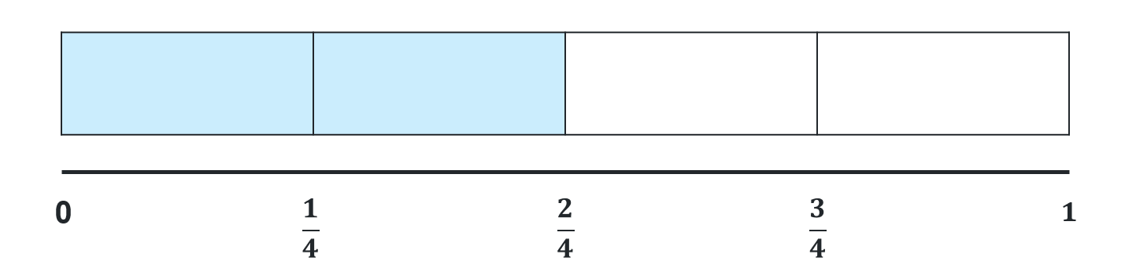
Short response (25)
Identify the fraction needed to complete the whole.
Notes:
Short response questions provide brisk paced questions focussing on review of current and previous content to support spaced and interleaved practice.
Syllabus focus area:
Partitioned fractions A

Slide 49
Short response (26)
Record 3 events that would each have a duration of approximately 20 minutes.
Notes:
Short response questions provide brisk paced questions focussing on review of current and previous content to support spaced and interleaved practice.
Syllabus focus area:
Non-spatial measure A: Time

Slide 50
Short response (27)
Explain what is meant by an
‘efficient strategy’.
Notes:
Short response questions provide brisk paced questions focussing on review of current and previous content to support spaced and interleaved practice.
Syllabus focus area:
Additive relations A

Slide 51
Short response (28)
Estimate the perimeter of your maths workbook.
Explain how you determined your estimation.
Notes:
Short response questions provide brisk paced questions focussing on review of current and previous content to support spaced and interleaved practice.
Syllabus focus area:
Geometric measure B: Length

Slide 52
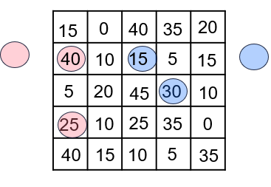
Activity 7 – multiples madness (1)
Player 1 |  | Player 2
Rolled | Number sentence | Rolled | Number sentence
8 | 8x5= 40 | 6 | 6x5= 30
5 | 5x5= 25 | 3 | 3x5= 15
Notes:
This is a developing number sense activity.
Number sense refers to a deep understanding of numbers, including their magnitude, relationships, and the effects of operations on them. It supports fluency and understanding, estimation, flexible thinking, and efficient problem-solving. Number sense activities 1–4 ‘activate’ prior number knowledge and support the learning of new content in the unit. Number sense activities 5–8 ‘loop’ back and provide opportunity for spaced practice with concepts and procedures covered in previous units.
Syllabus focus area:
Multiplicative relations A
Activity 7 – multiples madness
This activity is an adaptation of Multiples madness from Thinking mathematically by NSW Department of Education. Gameboards for two, fives and tens are available from the Thinking mathematically website.
This resource corresponds to Resource 21 – multiples madness in Stage 2 Year A Unit 4.
Provide students with a 9-sided dice, 3 counters in two colours and Resource 21 – multiples madness
Select 2, 5 or 10 to be the multiple and instruct students to fill in the gameboard with numbers accordingly. For example, if number 5 is chosen, the gameboard would be filled with 0, 5, 10, 15, 20, 25, 30, 35, 40 and 45.
Players take turns to roll the dice.
They multiply the number rolled by the chosen multiple and record their number sentence on Resource 21 – multiples madness. For example, if 6 is rolled, the player would record 6 × 5 = 30.
They then place one of their counters on the number on the gameboard, claiming that place.
If the number is taken, players miss a turn.
Since players only have 3 counters, they will need to choose which counter to move once all 3 have been placed on the gameboard.
A player wins by getting three counters in a row (in any orientation).

Slide 53
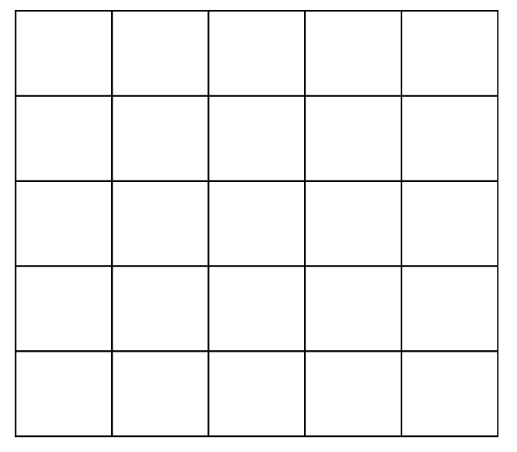
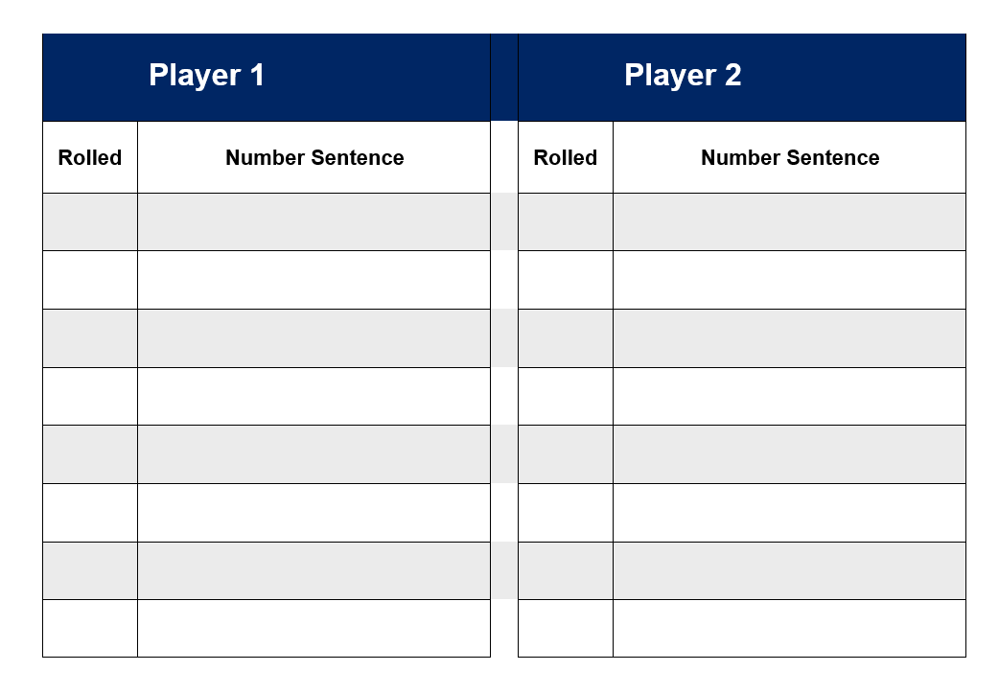
Activity 7 – multiples madness (2)
Notes:
Activity 7 – multiples madness continued
This resource corresponds to Resource 21 – multiples madness in Stage 2 Year A Unit 4.

Slide 54
Review of learning 8

Slide 55
True or false (4)
2 x 4 = 8 and 8 ÷ 4 = 2
True | False
Notes:
The question on this slide connects to the content being explored in the developing number sense activity (Activity 8)
Syllabus focus area:
Multiplicative relations A

Slide 56
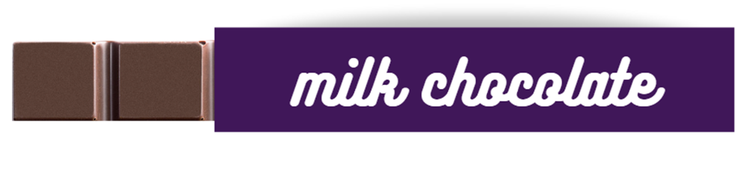
Short response (29)
2-eighths of the chocolate bar are showing.
Record the fraction of the chocolate bar that is hidden under the wrapper?
Notes:
Short response questions provide brisk paced questions focussing on review of current and previous content to support spaced and interleaved practice.
Syllabus focus area:
Partitioned fractions A

Slide 57
Short response (30)
Record how many minutes are in a quarter hour.
Communicate your reasoning.
Notes:
Short response questions provide brisk paced questions focussing on review of current and previous content to support spaced and interleaved practice.
Syllabus focus area:
Non-spatial measure A: Time

Slide 58
Short response (31)
Choose the most efficient strategy to solve the following problem.
Emma picked 34 flowers in the morning and 28 flowers in the afternoon. How many flowers did she pick in total?
Notes:
Short response questions provide brisk paced questions focussing on review of current and previous content to support spaced and interleaved practice.
Syllabus focus area:
Additive relations A

Slide 59
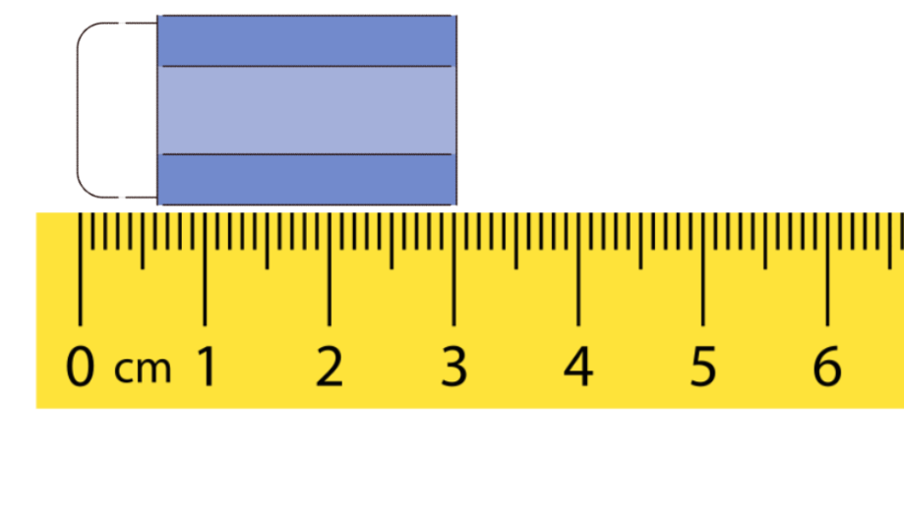
Short response (32)
Record the length of the eraser in millimetres.
Notes:
Short response questions provide brisk paced questions focussing on review of current and previous content to support spaced and interleaved practice.
Syllabus focus area:
Geometric measure A: Length

Slide 60
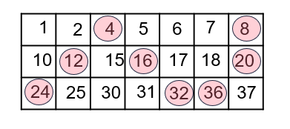

Activity 8 – multiples of 2, 4 ,5 and 10 (1)
4
Notes:
This is a developing number sense activity.
Number sense refers to a deep understanding of numbers, including their magnitude, relationships, and the effects of operations on them. It supports fluency and understanding, estimation, flexible thinking, and efficient problem-solving. Number sense activities 1–4 ‘activate’ prior number knowledge and support the learning of new content in the unit. Number sense activities 5–8 ‘loop’ back and provide opportunity for spaced practice with concepts and procedures covered in previous units.
Syllabus focus area:
Multiplicative relations A
Activity 8 – multiples of 2, 4 ,5 and 10
This activity is an adaptation of Common Multiples from NZ Maths by New Zealand Ministry of Education.
This resource corresponds to Resource 22 – ‘Multiples’ gameboard and Resource 22 – ‘multiples’ rule cards in Stage 2 Year A Unit 4
Provide students with Resource 22 – ‘Multiples’ gameboard and Resource 22 – ‘multiples’ rule cards.
Shuffle and place the cards face down in a pile.
Players take turns to pick a card and cover a multiple of that number on the gameboard using counters. For example, if rule card 4 is drawn, the multiples 4, 8, 12, 16, 20, 24, 28 or 32 can be covered.
Play continues until one player covers three number in a row (vertically, horizontally or diagonally).
After a round of play, ask:
Which numbers are more likely to be covered? Why?
Which numbers would never be covered? Why?
Play another round, encouraging students to be strategic with their number choices.
Note: Some students may enjoy the challenge of working with other multiples, such as 3, 7 and 9, or making their own gameboards to play with.

Slide 61
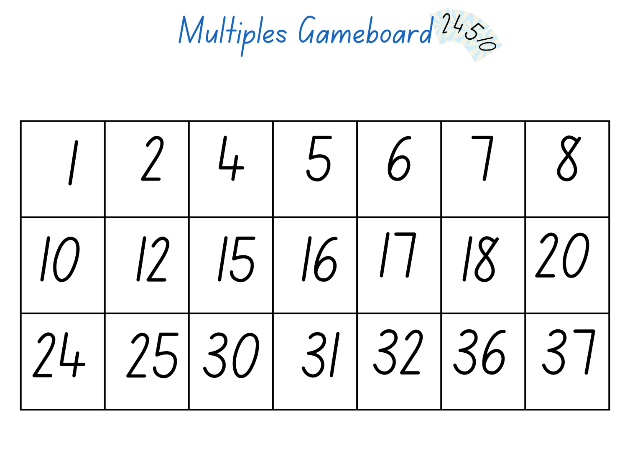
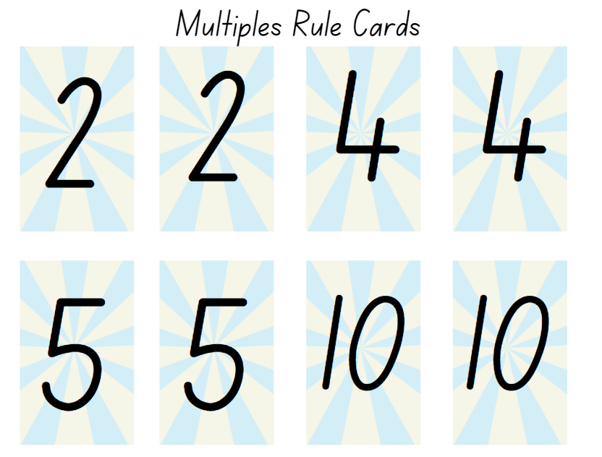
Activity 8 – multiples of 2, 4 ,5 and 10 (2)
Notes:
Activity 8 – multiples of 2, 4 ,5 and 10 continued
This resource corresponds to Resource 21 – ‘multiples’ gameboard and Resource 22 – ‘multiples’ rule cards in Stage 2 Year A Unit 4.

Slide 62
Double Venn diagram
Object 1
Object 2
Features similar to both objects
Features of object 1
Features of object 2

Slide 63
Frayer
Definition
Facts/Characteristics
Word, term, concept
Examples
Non-examples

Slide 64
Spider map
Idea
Subject

Slide 65
Cline
Concept 1
Concept 2
Word
Word
Word
Word
Word
Word
Word
Word
Word
Word
Word

Slide 66

Compare and contrast

Slide 67
Multiple choice (5)
A
B
C
D

Slide 68
Multiple choice (6)
A
B
C
D

Slide 69
References (1)
This presentation contains NSW Curriculum and syllabus content. The NSW Curriculum is developed by the NSW Education Standards Authority. This content is prepared by NESA for and on behalf of the Crown in the right of the State of New South Wales. The material is protected by Crown copyright.
Please refer to the NESA Copyright Disclaimer for more information https://educationstandards.nsw.edu.au/wps/portal/nesa/mini-footer/copyright.
NESA holds the only official and up-to-date versions of the NSW Curriculum and syllabus documents. Please visit the NSW Education Standards Authority (NESA) website https://educationstandards.nsw.edu.au/wps/portal/nesa/home and the NSW Curriculum website https://curriculum.nsw.edu.au.
Mathematics K-10 Syllabus © Syllabus NSW Education Standards Authority (NESA) for and on behalf of the Crown in right of the State of New South Wales, 2022.
National Numeracy Learning Progression © Australian Curriculum, Assessment and Reporting Authority (ACARA) 2010 to present, unless otherwise indicated. This material was downloaded from the Australian Curriculum website (National Numeracy Learning Progression) (accessed 17 January 2024) and was not modified.
Gould P (2013) ‘Australia's next top fraction model’, Australian Primary Mathematics Classroom, 18(3):5–12.
Math Open Reference (2011) Complement, Math Open Reference website, accessed 2 February 2024.
Maths Learning Centre (2025) Number lines, Math apps website, accessed 4 July 2025
New Zealand Ministry of Education (n.d.) ‘Common multiples’, Resources, NZ Maths website, accessed 17 January 2024.
New Zealand Ministry of Education (n.d.) ‘Little Bites at Big Multiplications and Divisions’, Resources, NZ Maths website, accessed 17 January 2024.

Slide 70
References (2)
This presentation contains NSW Curriculum and syllabus content. The NSW Curriculum is developed by the NSW Education Standards Authority. This content is prepared by NESA for and on behalf of the Crown in the right of the State of New South Wales. The material is protected by Crown copyright.
Please refer to the NESA Copyright Disclaimer for more information https://educationstandards.nsw.edu.au/wps/portal/nesa/mini-footer/copyright.
NESA holds the only official and up-to-date versions of the NSW Curriculum and syllabus documents. Please visit the NSW Education Standards Authority (NESA) website https://educationstandards.nsw.edu.au/wps/portal/nesa/home and the NSW Curriculum website https://curriculum.nsw.edu.au.
Siemon D, Warren E, Beswick K, Faragher R, Miller J, Horne M, Jazby D, Breed M, Clark J and Brady K (2020) Teaching Mathematics: Foundations to Middle Years, 3rd edition, Oxford University Press Australia and New Zealand.
Sullivan P and Lilburn P (2017) Open-Ended Maths Activities: Using Good Questions to Enhance Learning Mathematics, 2nd edn, Oxford University Press Australia and New Zealand, Great Britain.
University of Cambridge (n.d.) Cuisenaire Environment, NRICH website, accessed 17 January 2024.
Van de Walle J, Karp K, Bay-Williams JM, Brass A, Bentley B, Ferguson S, Goff W, Livy S, Marshman M, Martin D, Pearn C, Prodromou T, Symons D and Wilkie K (2019) Primary and Middle Years Mathematics: Teaching Developmentally, 1st Australian edn, Pearson Education Australia, Melbourne.

Slide 71
Copyright
© State of New South Wales (Department of Education), 2025
The copyright material published in this resource is subject to the Copyright Act 1968 (Cth) and is owned by the NSW Department of Education or, where indicated, by a party other than the NSW Department of Education (third-party material).
Copyright material available in this resource and owned by the NSW Department of Education is licensed under a Creative Commons Attribution 4.0 International (CC BY 4.0) license.
This license allows you to share and adapt the material for any purpose, even commercially.
Attribution should be given to © State of New South Wales (Department of Education), 2025.
Material in this resource not available under a Creative Commons license:
the NSW Department of Education logo, other logos and trademark-protected material
Material owned by a third party that has been reproduced with permission. You will need to obtain permission from the third party to reuse its material.
Links to third-party material and websites
Please note that the provided (reading/viewing material/list/links/texts) are a suggestion only and implies no endorsement, by the New South Wales Department of Education, of any author, publisher, or book title. School principals and teachers are best placed to assess the suitability of resources that would complement the curriculum and reflect the needs and interests of their students.
If you use the links provided in this document to access a third party’s website, you acknowledge that the terms of use, including licence terms set out on the third-party’s website apply to the use which may be made of the materials on that third-party website or where permitted by the Copyright Act 1968 (Cth). The department accepts no responsibility for content on third-party websites.

