Slide 1
Instructions for use
This resource is not a teaching and learning program. It should be used in conjunction with Stage 2 Year A Unit 5.
Classroom teachers are encouraged to add and adapt slides as required to meet the needs of their students.
Save a copy of the file to make changes to the slide deck. Go to File > Download a Copy (this downloads a copy to the computer to edit in the PowerPoint app).
To convert the PowerPoint to Google Slides:
  Upload the file into Google Drive and open it.
  Go to File > Save as Google Slides.
  (Note – conversion may cause formatting changes in the slides.)

Slide 2

Review of Learning
Mathematics Stage 2 – Unit 5
Notes:
Reviews may include a combination of question types, requiring students to recall facts and key ideas, as well as apply their knowledge to solve problems and answer questions. To support active engagement, a mix of techniques should be employed.” (AERO, 2024).
This Review of Learning slide deck revisits key concepts from the following units:
Stage 2 Year A Unit 3
Stage 2 Year A Unit 4
Stage 2 Year A Unit 5
It also includes opportunities to review prior learning in non-number content, supporting consolidation across focus areas.
The review of learning resources include three key task types that support the development of mathematical proficiency through retrieval, spaced practice, and active participation. These practices complement the review phase (activating prior knowledge) embedded within the beginning of each lesson.
1.
Multiple-choice questions/True or false: Designed to promote active retrieval of key concepts and identify common misconceptions in number, supporting consolidation, understanding and fluency.
These questions:
support spaced and interleaved practice
help identify and address common misconceptions
support active recall and immediate feedback
support whole class participation
identify areas requiring reteach
2.
Short-response question sets: Carefully grouped questions that encourage spaced and interleaved practice across multiple focus areas, helping students revisit and apply knowledge from different points in time.
These questions:
have a combination of question types
address a range of focus areas
build automaticity and fluency
support active recall
allow for immediate feedback
identify content requiring reteach
3.
Developing number sense activities: A variety of practical, purposeful tasks that reinforce current learning and build on prior knowledge. These activities promote reasoning, problem-solving and conceptual understanding.
The review of learning resources are designed to work support teaching and learning in mathematics. For the most effective implementation, use the resources flexibly, adapting to meet student learning needs and individual classroom contexts.

Slide 3
Lessons
1
Review of learning 1
5
Review of learning 5
2
Review of learning 2
6
Review of learning 6
3
Review of learning 3
7
Review of learning 7
4
Review of learning 4
8
Review of learning 8
Notes:
Teacher notes:
Click lesson numbers to go to specific lessons
Interactive features can be viewed in slide show

Slide 4
Review of learning 1

Slide 5

Multiple choice (1)
4 thousands, 8 hundreds, 4 tens and 6 ones is recorded as…
A
4648
B
4846
C
6484
D
4864
Notes:
This question connects to the content in the developing number sense activity (Activity 1)
Syllabus focus area:
Representing numbers using place value A: Whole numbers

Slide 6

Short response (1)
The data question “What is your favourite food?” could include response categories such as chocolate, fruit, pizza, and cake.
Record 2 more categories for this question.
Communicate your reasoning.
Notes:
Short response questions provide brisk paced questions focussing on review of current and previous content to support spaced and interleaved practice.
Syllabus focus area:
Data A

Slide 7
Short response (2)
Draw a rectangular fraction strip partitioned into fifths.
Notes:
Short response questions provide brisk paced questions focussing on review of current and previous content to support spaced and interleaved practice.
Syllabus focus area:
Partitioned fractions A

Slide 8
Short response (3)
Order the following lengths from shortest to longest
6 m and 35 cm
5 m and 95 cm
6 m and 53 cm
Communicate your reasoning.
Notes:
Short response questions provide brisk paced questions focussing on review of current and previous content to support spaced and interleaved practice.
Syllabus focus area:
Geometric measure A: Length

Slide 9
Short response (4)
Draw this triangle.
Next draw the same triangle in
2 different orientations.
Notes:
Short response questions provide brisk paced questions focussing on review of current and previous content to support spaced and interleaved practice.
Syllabus focus area:
Two-dimensional spatial structure B: 2D shapes (Note: Stage 1 content reviewed)

Slide 10

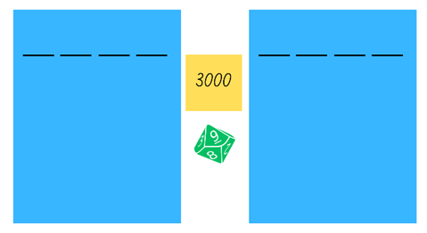
Activity 1 – read and record 4-digit numbers
Notes:
This is a developing number sense activity.
Number sense refers to a deep understanding of numbers, including their magnitude, relationships, and the effects of operations on them. It supports fluency and understanding, estimation, flexible thinking, and efficient problem-solving. Number sense activities 1–4 ‘activate’ prior number knowledge and support the learning of new content in the unit. Number sense activities 5–8 ‘loop’ back and provide opportunity for spaced practice with concepts and procedures covered in previous units.
Syllabus focus area:
Representing numbers using place value A
Activity 1 – read and record 4-digit numbers
This activity is an adaptation of Hit it (3-digit numbers) from K-6 Mathematics resources by State of New South Wales (Department of Education).
In pairs, students choose a multiple of a thousand between 1000 and 9000 as their target number.
Each student draws their own gameboard with space for a 4-digit number
Students take turns to roll the 0-9 dice and record the digit in the thousands, hundreds, tens or ones position. The aim is to get the closest number to the target number.
Once both players’ digits are full, each student reads their number and determines how far away they are from the target number. They can be over or under the target number.
The player who is closest to the target number wins a point.
Students can choose to keep or change their target number between each round.
The student with the most points after 3 rounds is declared the winner.
As students play, ask questions such as:
What number did you roll?
What would be the best position for that number?
What might happen if you placed it in a different position?
What number would you like to roll next?
How could you make the game easier or harder?

Slide 11
Review of learning 2

Slide 12
True or false (1)
6000 + 200 + 40 + 6 is the same as
6 thousands, 2 hundreds, 4 tens and 6 ones which is also the same as 6246.
True | False
Notes:
The question on this slide connects to the content being explored in the developing number sense activity (Activity 2)
Syllabus focus area:
Representing numbers using place value A: Whole numbers

Slide 13
Short response (5)
Create a list of categories for a matter of interest about favourite school subjects.
Communicate your reasoning.
Notes:
Short response questions provide brisk paced questions focussing on review of current and previous content to support spaced and interleaved practice.
Syllabus focus area:
Data A

Slide 14
Short response (6)
Draw the following fraction strip and partition into thirds.
Shade one-third of the fraction strip.
Notes:
Short response questions provide brisk paced questions focussing on review of current and previous content to support spaced and interleaved practice.
Syllabus focus area:
Partitioned fractions A

Slide 15
Short response (7)
Estimate the length of the classroom using a step as the benchmark.
Communicate your reasoning.
Notes:
Short response questions provide brisk paced questions focussing on review of current and previous content to support spaced and interleaved practice.
Syllabus focus area:
Geometric measure A: Length

Slide 16
Short response (8)
Draw a basic map of the classroom.
Notes:
Short response questions provide brisk paced questions focussing on review of current and previous content to support spaced and interleaved practice.
Syllabus focus area:
Geometric measure length B: Position (Note: Stage 1 content reviewed)

Slide 17
Activity 2 – identifying 4-digit numbers
Ask only questions that require a ‘yes’ or ‘no’ answer to guess the mystery number.
Record the guessed number using standard place value form.
Example ‘yes’ or ‘no’ questions
  Is the number an even number?
  Is the number a 4-digit number?
  Is the number larger than 500?
  Does the number have less than 7 hundreds?
Notes:
This is a developing number sense activity.
Number sense refers to a deep understanding of numbers, including their magnitude, relationships, and the effects of operations on them. It supports fluency and understanding, estimation, flexible thinking, and efficient problem-solving. Number sense activities 1–4 ‘activate’ prior number knowledge and support the learning of new content in the unit. Number sense activities 5–8 ‘loop’ back and provide opportunity for spaced practice with concepts and procedures covered in previous units.
Syllabus focus area:
Representing numbers using place value A
Activity 2 – identifying 4-digit numbers
Explain that the students will try to identify a mystery 3- or 4-digit number by asking questions that require a ‘yes’ or ‘no’ answer.
Ask students to provide examples of suitable questions, such as:
Is the number an even number?
Is the number a 4-digit number?
Is the number larger than 500?
Does the number have less than 7 hundreds?
Select a 3- or 4-digit number and select students to ask questions.
Assist students to keep track of possible answers and eliminated numbers by asking questions as students play, such as:
Could the answer be 458? Why or why not?
Could the answer have a 4 in the ones place? Why or why not?
Could the answer have more than 25 tens? Why or why not?
When the mystery number has been guessed, students record the number using standard place value form. For example, 523 = 500 + 20 + 3 or 5 hundreds, 2 tens and 3 ones.
Discuss, asking questions such as:
Which questions were the most useful? Why?
Can you think of any additional questions that would have been useful to ask?
How could you make the game easier or harder?
Repeat twice in pairs, allowing students to alternate between creating and guessing a mystery number.

Slide 18
Review of learning 3

Slide 19
Multiple choice (2)
Using non-standard partitioning, how many hundreds are in 2560?
A
B
C
D
5
56
25
6
Notes:
This question connects to the content in the developing number sense activity (Activity 3)
Syllabus focus area:
Representing numbers using place value A: Whole number

Slide 20
Short response (9)
Record a question for a matter of interest about pets where the information can be recorded in categories.
Notes:
Short response questions provide brisk paced questions focussing on review of current and previous content to support spaced and interleaved practice.
Syllabus focus area:
Data A

Slide 21

Short response (10)
Record the fraction shaded.
Notes:
Short response questions provide brisk paced questions focussing on review of current and previous content to support spaced and interleaved practice.
Syllabus focus area:
Partitioned fractions A

Slide 22
Short response (11)
Complete the sentences.
10 mm is the same as __ cm.
2 cm is the same as __ mm.
30 mm is the same as __ cm.
Communicate your reasoning.
Notes:
Short response questions provide brisk paced questions focussing on review of current and previous content to support spaced and interleaved practice.
Syllabus focus area:
Geometric measure A: Length

Slide 23
Short response (12)
Draw the arrow that should replace the question mark to complete the pattern.
?
Communicate your reasoning.
Notes:
Short response questions provide brisk paced questions focussing on review of current and previous content to support spaced and interleaved practice.
Syllabus focus area:
Two-dimensional spatial structure B: 2D shapes (Note: Stage 1 content reviewed)

Slide 24
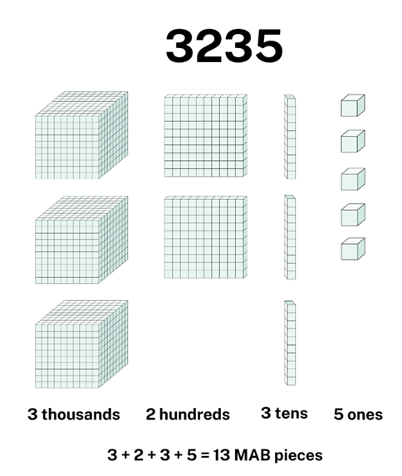
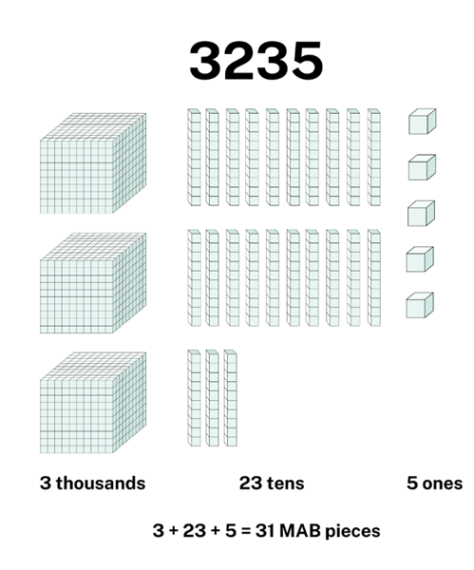
Activity 3 – partitioning numbers up to 4 digits (1)
Notes:
Note: this slide has been designed to use in presentation mode.
This is a developing number sense activity.
Number sense refers to a deep understanding of numbers, including their magnitude, relationships, and the effects of operations on them. It supports fluency and understanding, estimation, flexible thinking, and efficient problem-solving. Number sense activities 1–4 ‘activate’ prior number knowledge and support the learning of new content in the unit. Number sense activities 5–8 ‘loop’ back and provide opportunity for spaced practice with concepts and procedures covered in previous units.
Syllabus focus area:
Representing numbers using place value A
Activity 3 – partitioning numbers up to 4 digits
Using MAB materials, model making a 3- or 4-digit number using standard partitioning.
Ask students if this is the only way to represent the number.
If the answer is yes, provide an example using non-standard partitioning and record how many MAB pieces were used.
After providing an example or if the answer is no, ask students how many ways the number can be made.
Discuss how to identify if all the possibilities have been found.
Demonstrate how to use a table to record different models (next slide)
Provide groups of students with MAB materials to explore predictions.
Select groups to share their thinking and discuss using questions such as:
How many possibilities did you find?
How many more possibilities might there be? How do you know?
What was the least number of MAB pieces used and how was the number partitioned?
What was the greatest number of MAB pieces used and how was the number partitioned?

Slide 25
Activity 3 – partitioning numbers up to 4 digits (2)
Number | Partitioning | Number of MAB pieces
3235 | 3 thousands 2 hundreds 3 tens 5 ones | 13
3235 | 3 thousands 0 hundreds 23 tens 5 ones | 31
3235 | 2 thousands 12 hundreds 3 tens 5 ones | 22
3235 | 3 thousands 2 hundreds 1 ten 25 ones | 31
Notes:
Demonstrate how to use a table to record different models
Provide groups of students with MAB materials to explore predictions.
Select groups to share their thinking and discuss using questions such as:
How many possibilities did you find?
How many more possibilities might there be? How do you know?
What was the least number of MAB pieces used and how was the number partitioned?
What was the greatest number of MAB pieces used and how was the number partitioned?

Slide 26
Review of learning 4

Slide 27
True or false (2)
5097 can be written in standard place value form as 5000 + 900 + 7.
True | False
Notes:
The question on this slide connects to the content being explored in the developing number sense activity (Activity 4)
Syllabus focus area:
Representing numbers using place value A: Whole number

Slide 28
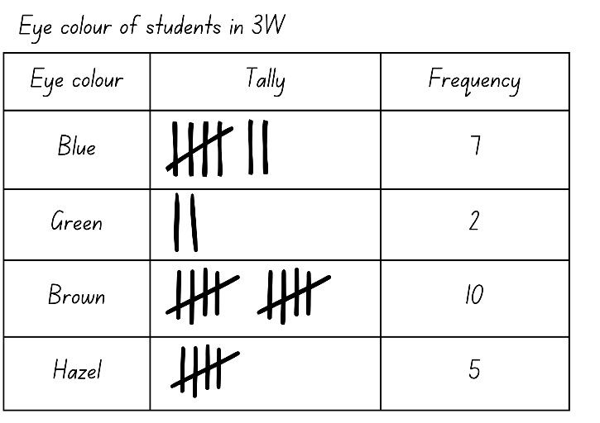
Short response (13)
Use the tally table to answer:
Which eye colour was least frequent?
Which eye colour has a frequency of less than 10 but more than 5?
How many more students in 3W have brown eyes than green eyes?
Notes:
Short response questions provide brisk paced questions focussing on review of current and previous content to support spaced and interleaved practice.
Syllabus focus area:
Data A

Slide 29
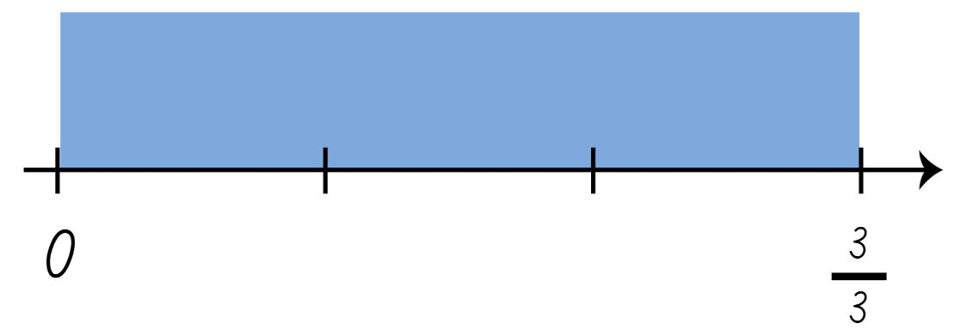
Short response (14)
Record the fractions missing from the number line.
Notes:
Short response questions provide brisk paced questions focussing on review of current and previous content to support spaced and interleaved practice.
Syllabus focus area:
Partitioned fractions A

Slide 30
Short response (15)
Record the following lengths using the abbreviations for millimetres and centimetres.
35 centimetres
78 millimetres
3 centimetres and 46 millimetres
Notes:
Short response questions provide brisk paced questions focussing on review of current and previous content to support spaced and interleaved practice.
Syllabus focus area:
Geometric measure A: Length

Slide 31
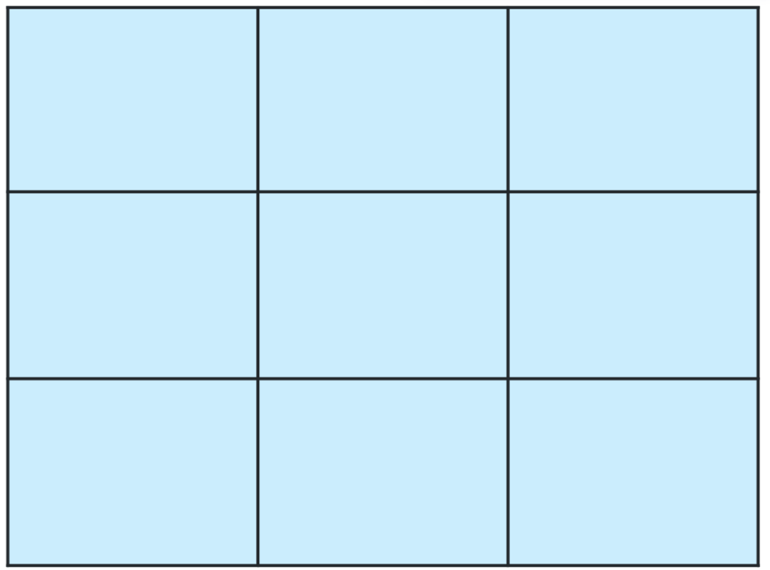
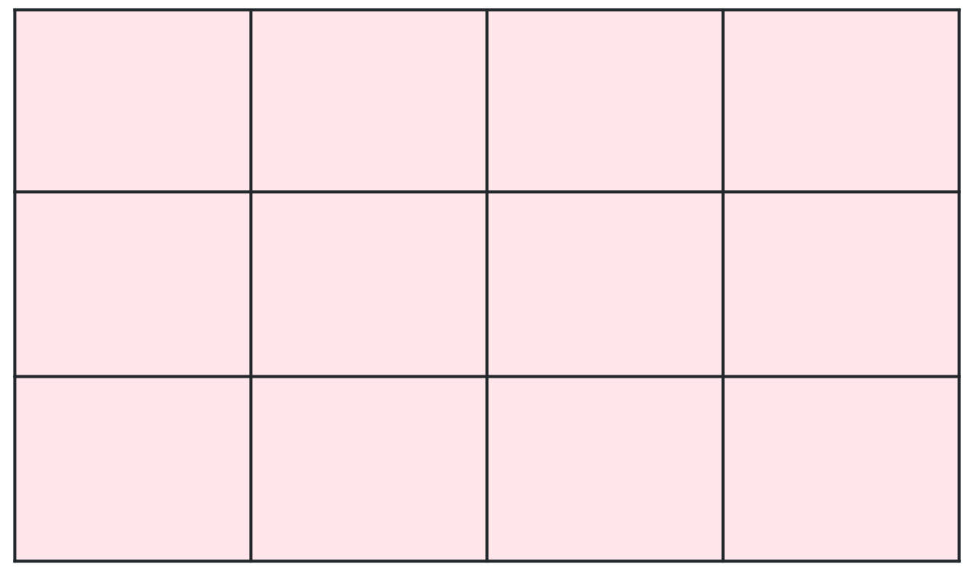
Short response (16)
These rectangles are made using the same unit.
What is the area of each rectangle?
Which one has the largest area.
Notes:
Short response questions provide brisk paced questions focussing on review of current and previous content to support spaced and interleaved practice.
Syllabus focus area:
Two-dimensional spatial structure B: Area (Note: Stage 1 content reviewed)

Slide 32

Activity 4 – ordering 4-digit numbers
Notes:
This is a developing number sense activity.
Number sense refers to a deep understanding of numbers, including their magnitude, relationships, and the effects of operations on them. It supports fluency and understanding, estimation, flexible thinking, and efficient problem-solving. Number sense activities 1–4 ‘activate’ prior number knowledge and support the learning of new content in the unit. Number sense activities 5–8 ‘loop’ back and provide opportunity for spaced practice with concepts and procedures covered in previous units.
Syllabus focus area:
Representing numbers using place value A
Activity 4 – ordering 4-digit numbers
Divide the class into pairs. Provide each student with 4 strips of paper.
Instruct students to write 4 four-digit numbers, one on each strip of paper, including numbers that contain an internal zero. For example, 4039.
In pairs, students read and identify the place value of each digit.
After identifying the place value of each digit, students write each number in expanded form. For example, 4039 would be 4000 + 0 + 30 + 9.
Ask: Can you order your 4-digit numbers from smallest to largest. Prompt students to pay close attention to the place value of digits, including the internal zeros.
Students explain their reasoning to their partner when ordering the numbers from smallest to largest.

Slide 33
Review of learning 5

Slide 34
Multiple choice (3)
What would the next two numbers be in this number sequence?
35, 40, 45, ___, ___
A
B
C
D
55, 65
46, 47
47, 49
50, 55
Notes:
This question connects to the content in the developing number sense activity (Activity 5)
Syllabus focus area:
Multiplicative relations A

Slide 35
Short response (17)
What is one way to organise data collected about students’ favourite ice cream flavours?
Notes:
Short response questions provide brisk paced questions focussing on review of current and previous content to support spaced and interleaved practice.
Syllabus focus area:
Data A

Slide 36
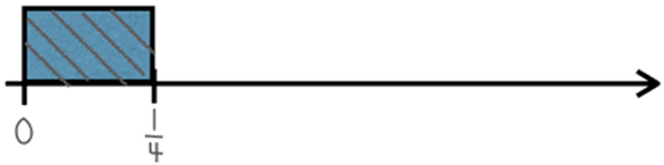
Short response (18)
Sienna has one-quarter of a fraction strip.
How many more quarters does she need to create the whole fraction strip?
Notes:
Short response questions provide brisk paced questions focussing on review of current and previous content to support spaced and interleaved practice.
Syllabus focus area:
Partitioned fractions A

Slide 37
Short response (19)
The term ‘perimeter’ is used to describe…
Notes:
Short response questions provide brisk paced questions focussing on review of current and previous content to support spaced and interleaved practice.
Syllabus focus area:
Geometric measure B: Length

Slide 38

Short response (20)
Describe the cube using the terms:
face
edge
vertex
Notes:
Short response questions provide brisk paced questions focussing on review of current and previous content to support spaced and interleaved practice.
Syllabus focus area:
Three-dimensional spatial structure B: 3D objects (Note: Stage 1 content reviewed)

Slide 39
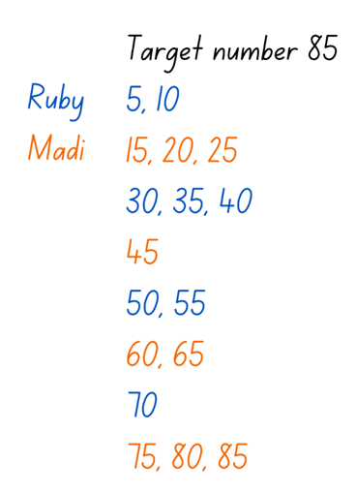

Activity 5 – number patterns and multiples
Example recording of target number 85
Notes:
This is a developing number sense activity.
Number sense refers to a deep understanding of numbers, including their magnitude, relationships, and the effects of operations on them. It supports fluency and understanding, estimation, flexible thinking, and efficient problem-solving. Number sense activities 1–4 ‘activate’ prior number knowledge and support the learning of new content in the unit. Number sense activities 5–8 ‘loop’ back and provide opportunity for spaced practice with concepts and procedures covered in previous units.
Syllabus focus area:
Multiplicative relations A
Activity 5 – number patterns and multiples
This activity is an adaptation of Counting game (by multiples of 5) from Mathematics K-6 resources by State of New South Wales (Department of Education).
In pairs, students choose a target number that is a multiple of 5.
Ask students how they know that the target number is a multiple of 5. For example, any number that ends in 0 or 5 is a multiple of 5.
Explain that the object of the game is to be the person who says the target number.
Players take turns to count on by saying the next one, 2 or 3 number words in the fives sequence.
Pairs record the target number and the number words each turn.
The player who says the target number receives a point.
Students choose a new target number and play the game again.
The game may be varied by starting at the target number and counting backwards to zero.
Reflect on the activity, asking questions such as:
Did you prefer going first or second? Why?
What strategy did you use? How successful was it and why?
Looking back on the games that you played, can you see any ways that one player could change their moves to win?
How could you make the game easier or harder?

Slide 40
Review of learning 6

Slide 41
True or false (3)
The numbers 3, 58 and 845 are all odd.
True | False
Notes:
The question on this slide connects to the content being explored in the developing number sense activity (Activity 6)
Syllabus focus area:
Multiplicative relations A

Slide 42
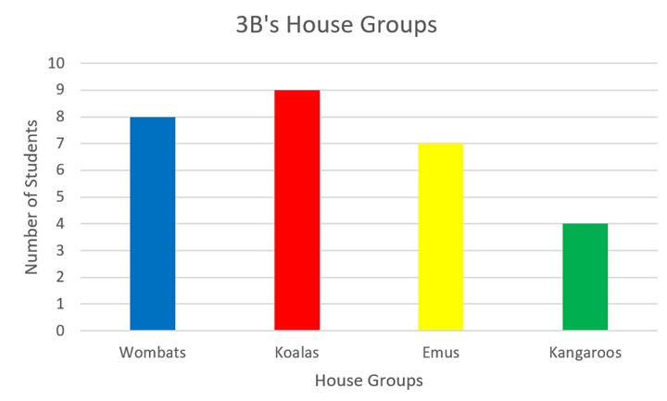
Short response (21)
Record one piece of information presented in this column graph.
Notes:
Short response questions provide brisk paced questions focussing on review of current and previous content to support spaced and interleaved practice.
Syllabus focus area:
Data A

Slide 43
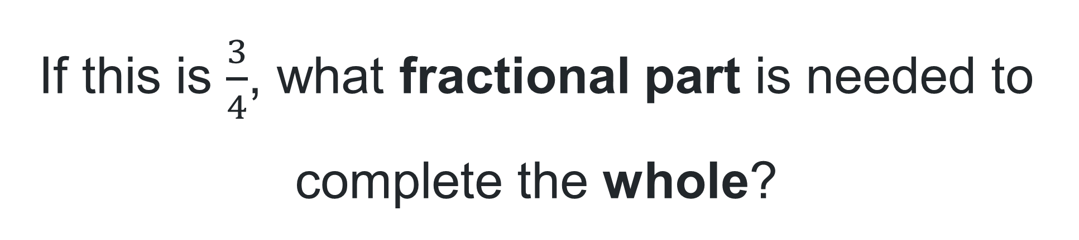
Short response (22)
If this is $\frac{3}{4}$, what fractional part is needed to complete the whole?
Notes:
Short response questions provide brisk paced questions focussing on review of current and previous content to support spaced and interleaved practice.
Syllabus focus area:
Partitioned fractions A

Slide 44
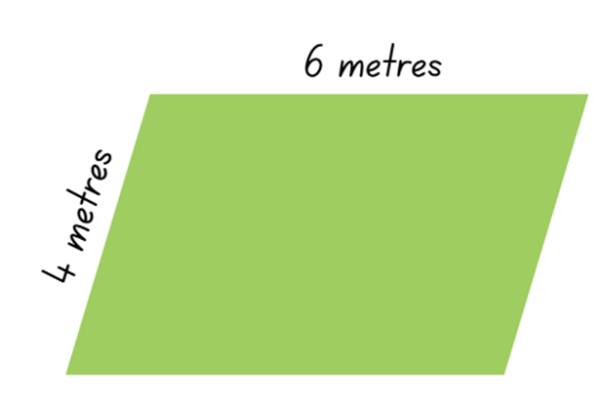
Short response (23)
Calculate and record the perimeter of this shape.
Notes:
Short response questions provide brisk paced questions focussing on review of current and previous content to support spaced and interleaved practice.
Syllabus focus area:
Geometric measure B: Length

Slide 45
Short response (24)
The term ‘mass’ means…
Notes:
Short response questions provide brisk paced questions focussing on review of current and previous content to support spaced and interleaved practice.
Syllabus focus area:
Non-spatial measure B: Mass (Note: Stage 1 content reviewed)

Slide 46
Activity 6 – largest even and odd numbers
87
324
5
7
92
634
589
Notes:
This is a developing number sense activity.
Number sense refers to a deep understanding of numbers, including their magnitude, relationships, and the effects of operations on them. It supports fluency and understanding, estimation, flexible thinking, and efficient problem-solving. Number sense activities 1–4 ‘activate’ prior number knowledge and support the learning of new content in the unit. Number sense activities 5–8 ‘loop’ back and provide opportunity for spaced practice with concepts and procedures covered in previous units.
Syllabus focus area:
Multiplicative relations A
Activity 6 – largest even and odd numbers
This activity is an adaptation of Largest Even from NRICH by University of Cambridge (Faculty of Mathematics).
Ask students to identify if these numbers are odd or even.
Ask students to explain how they know if a number is odd or even. For example:
a number is even if it ends in zero, 2, 4, 6, or 8
even numbers can be divided by 2 without leaving a remainder
a number is odd if it ends in one, 3, 5, 7, or 9
odd numbers cannot be divided evenly by 2.
Demonstrate the link between even numbers and the multiplication facts for 2. Then demonstrate the significance of the final digit of a whole number.
Note: one result that follows from our place value system is that any whole number can be written as a multiple of 10 plus a single digit. For example, 153 is 150 plus 3. Since a multiple of 10 is always even because every group of 10 is 2 rows of 5, then whether a number is odd or even can be determined by its final digit.
Provide students with a random digit between one and 9. Alternatively, roll a 9-sided dice or use a spinner.
Ask students to record the largest possible 3-digit even number using the digit provided and 2 digits of their choice.
Select students to share and justify their thinking. Ask question such as:
What is your number?
Where did you place the random digit? Why?
Is your number an even number?
How do you know?
How could you prove that it is an even number?
Can you prove that this is the largest possible 3-digit even number possible?
Select another random digit and repeat.
Students to compare their answers and describe any commonalities.
Repeat a third time, this time using the random digit and 3 digits of their choice to make the largest 4-digit even number.
Compare responses with the first 2 and ask what is the same and what is different.
Repeat, making the largest possible 4-digit odd number.
Select students to share their thinking and ask:
What is your number?
Where did you place the random digit? Why?
Is your number an odd number?
How do you know?
Can you prove that this is the largest possible 4-digit odd number possible?

Slide 47
Review of learning 7

Slide 48
Multiple choice (4)
Identify the missing number in the following number pattern.
16, 20, 24, 28, __, 36
A
B
C
D
34
30
32
29
Notes:
This question connects to the content in the developing number sense activity (Activity 7)
Syllabus focus area:
Multiplicative relations A

Slide 49
Short response (25)
How many more students in 3B are in the Koalas house than the Emus house?
Which house has the lowest number of students from 3B?
Do you think the data for the houses would be the same in other classes? Why/ why not?
Notes:
Short response questions provide brisk paced questions focussing on review of current and previous content to support spaced and interleaved practice.
Syllabus focus area:
Data A

Slide 50
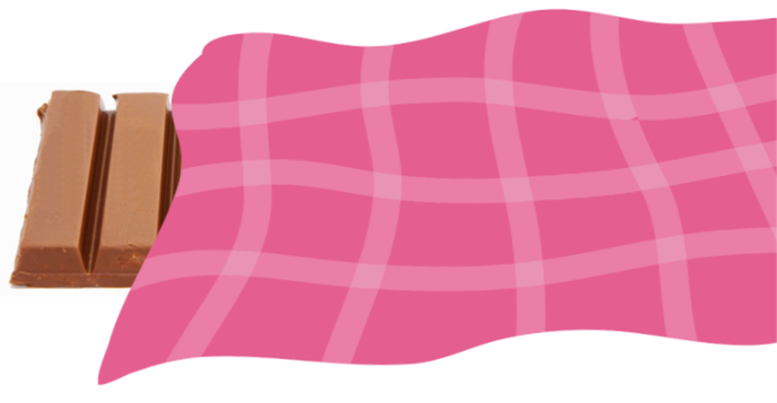
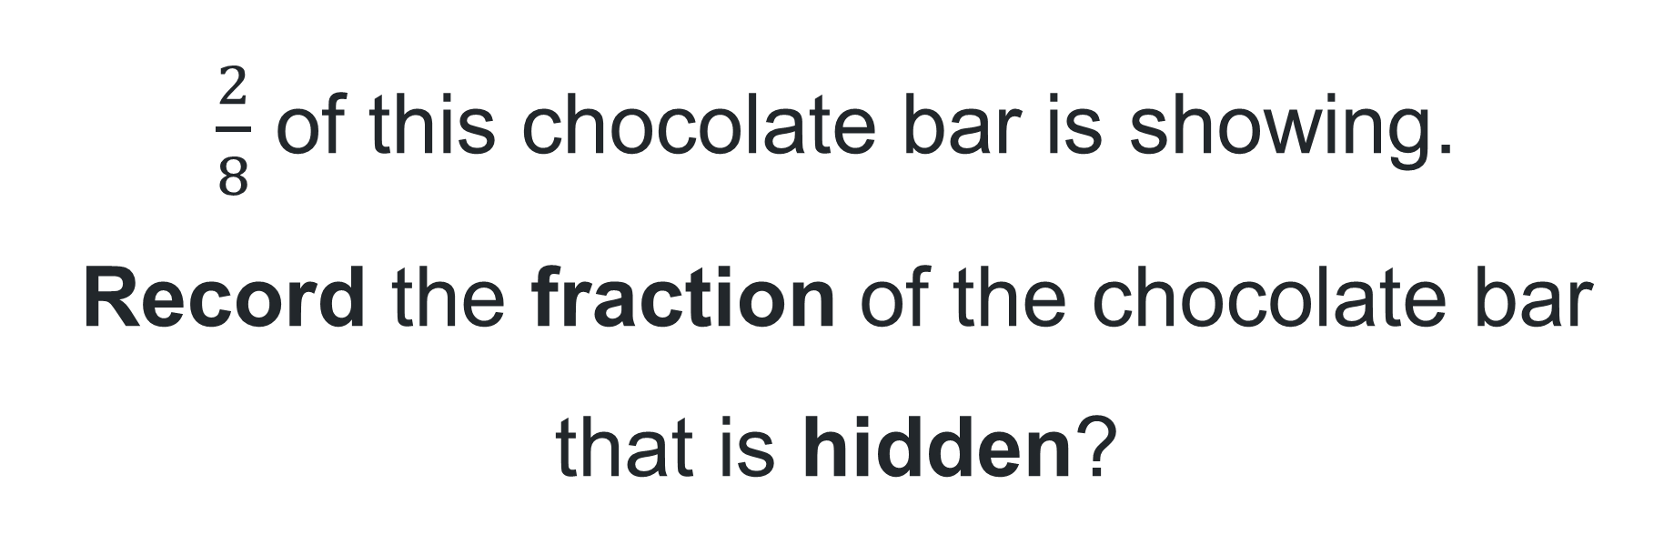
Short response (26)
$\frac{2}{8}$ of this chocolate bar is showing.
Record the fraction of the chocolate bar that is hidden?
Notes:
Short response questions provide brisk paced questions focussing on review of current and previous content to support spaced and interleaved practice.
Syllabus focus area:
Partitioned fractions A

Slide 51
Short response (27)
Record events that have a duration of approximately:
1 minute
5 minutes
20 minutes
Communicate your reasoning.
Notes:
Short response questions provide brisk paced questions focussing on review of current and previous content to support spaced and interleaved practice.
Syllabus focus area:
Non-spatial measure A: Time

Slide 52
Short response (28)
Record an event that is likely to happen today.
Record an event that is unlikely to happen today.
Communicate your reasoning.
Notes:
Short response questions provide brisk paced questions focussing on review of current and previous content to support spaced and interleaved practice.
Syllabus focus area:
Chance B (Note: Stage 1 content reviewed)

Slide 53
Activity 7 – number patterns
66, 63, 60, 57, 54
75, 80, 85, 90, 95
110, 108, 106, 104, 102
Create and record your own number patterns that increase or decrease by any number under 12.
Give your pattern to a partner and ask them to describe the pattern and record the next 3 numbers.
Notes:
This is a developing number sense activity.
Number sense refers to a deep understanding of numbers, including their magnitude, relationships, and the effects of operations on them. It supports fluency and understanding, estimation, flexible thinking, and efficient problem-solving. Number sense activities 1–4 ‘activate’ prior number knowledge and support the learning of new content in the unit. Number sense activities 5–8 ‘loop’ back and provide opportunity for spaced practice with concepts and procedures covered in previous units.
Syllabus focus area:
Multiplicative relations A
Activity 7 – number patterns
For each number pattern, ask students:
Can you describe the pattern?
How do you know it is a pattern?
What would the next 3 numbers be?
What would the previous 3 numbers be?
Students create and record their own number patterns that increase or decrease by any number under 12.
Students give their patterns to a partner and ask them to describe the pattern and record the next 3 numbers.

Slide 54
Review of learning 8

Slide 55
True or false (4)
The following number pattern is decreasing by a constant amount.
85, 80, 75, 70, 65
True | False
Notes:
The question on this slide connects to the content being explored in the developing number sense activity (Activity 8)
Syllabus focus area:
Multiplicative relations A

Slide 56
Short response (29)
The school canteen is collecting data from students by asking them about their favourite lunch choices.
Explain how this data could be used to help make decisions.
Notes:
Short response questions provide brisk paced questions focussing on review of current and previous content to support spaced and interleaved practice.
Syllabus focus area:
Data A

Slide 57



Short response (30)
Record the fraction shown.
$$0$$
$$1$$
$$2$$
Notes:
Short response questions provide brisk paced questions focussing on review of current and previous content to support spaced and interleaved practice.
Syllabus focus area:
Partitioned fractions B

Slide 58
Short response (31)
Complete the sentences:
A quarter-hour is the same as ___ minutes.
A half-hour is the same as ___ minutes.
An hour is the same as ___ minutes.
Notes:
Short response questions provide brisk paced questions focussing on review of current and previous content to support spaced and interleaved practice.
Syllabus focus area:
Non-spatial measure A: Time

Slide 59
Short response (32)
Draw a clock face showing
a quarter past 6.
Notes:
Short response questions provide brisk paced questions focussing on review of current and previous content to support spaced and interleaved practice.
Syllabus focus area:
Non-spatial measure B: Time (Note: Stage 1 content reviewed)

Slide 60
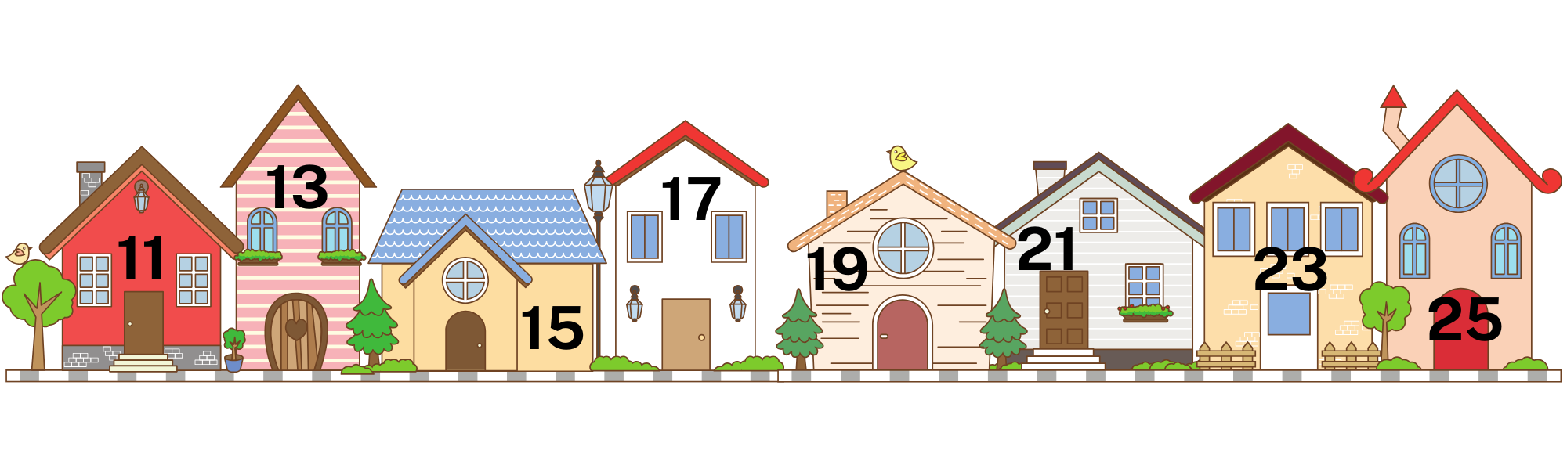
Activity 8 – patterns that increase and decrease
Notes:
This is a developing number sense activity.
Number sense refers to a deep understanding of numbers, including their magnitude, relationships, and the effects of operations on them. It supports fluency and understanding, estimation, flexible thinking, and efficient problem-solving. Number sense activities 1–4 ‘activate’ prior number knowledge and support the learning of new content in the unit. Number sense activities 5–8 ‘loop’ back and provide opportunity for spaced practice with concepts and procedures covered in previous units.
Syllabus focus area:
Multiplicative relations A
Activity 8 – patterns that increase and decrease
This activity is an adaptation of Street Sequences from NRICH by University of Cambridge (Faculty of Mathematics).
This corresponds to Resource 15 – houses from Stage 2 Year A Unit 5.
Discuss with students the number patterns that they see on the houses in their streets.
Ask:
Can you think about the houses in your street?
How are the houses numbered?
Using individual whiteboards, ask students to record the numbers they see.
Ask:
What patterns do you notice?
Are they increasing or decreasing?
Are these numbers odd or even? How do you know?
Pose the scenario: imagine you are walking down this street. What are some other patterns that you could use to number the houses?
Students create and continue a variety of number patterns that increase or decrease by a constant amount.

Slide 61
Double Venn diagram
Object 1
Object 2
Features similar to both objects
Features of object 1
Features of object 2

Slide 62
Frayer
Definition
Facts/Characteristics
Word, term, concept
Examples
Non-examples

Slide 63
Spider map
Idea
Subject

Slide 64
Cline
Concept 1
Concept 2
Word
Word
Word
Word
Word
Word
Word
Word
Word
Word
Word

Slide 65

Compare and contrast

Slide 66
Multiple choice (5)
A
B
C
D

Slide 67
Multiple choice (6)
A
B
C
D

Slide 68
References (1)
This presentation contains NSW Curriculum and syllabus content. The NSW Curriculum is developed by the NSW Education Standards Authority. This content is prepared by NESA for and on behalf of the Crown in the right of the State of New South Wales. The material is protected by Crown copyright.
Please refer to the NESA Copyright Disclaimer for more information https://educationstandards.nsw.edu.au/wps/portal/nesa/mini-footer/copyright.
NESA holds the only official and up-to-date versions of the NSW Curriculum and syllabus documents. Please visit the NSW Education Standards Authority (NESA) website https://educationstandards.nsw.edu.au/wps/portal/nesa/home and the NSW Curriculum website https://curriculum.nsw.edu.au.
Mathematics K–10 Syllabus © NSW Education Standards Authority (NESA) for and on behalf of the Crown in right of the State of New South Wales, 2022.
National Numeracy Learning Progression © Australian Curriculum, Assessment and Reporting Authority (ACARA) 2010 to present, unless otherwise indicated. This material was downloaded from the Australian Curriculum website (National Numeracy Learning Progression) (accessed 10 August 2025) and was not modified.
Australian Institute of Family Studies (2021) ‘Too much time on screens? Screen time effects and guidelines for children and young people’, Australian Institute of Family Studies, accessed 10 August 2025.
International Union for Conservation of Nature and Natural Resources (2023) The IUCN Red List of Threatened Species, IUCN Red List website, accessed 10 August 2025.
McCarthy N (2020) ‘Brazil Sees Worst Deforestation In A Decade’, Brazil, Statista website, accessed 10 August 2025.
New Zealand Ministry of Education (n.d.) ‘True or false’, NZ Maths website, accessed 10 August 2025.

Slide 69
References (2)
This presentation contains NSW Curriculum and syllabus content. The NSW Curriculum is developed by the NSW Education Standards Authority. This content is prepared by NESA for and on behalf of the Crown in the right of the State of New South Wales. The material is protected by Crown copyright.
Please refer to the NESA Copyright Disclaimer for more information https://educationstandards.nsw.edu.au/wps/portal/nesa/mini-footer/copyright.
NESA holds the only official and up-to-date versions of the NSW Curriculum and syllabus documents. Please visit the NSW Education Standards Authority (NESA) website https://educationstandards.nsw.edu.au/wps/portal/nesa/home and the NSW Curriculum website https://curriculum.nsw.edu.au.
Santos-Longhorn A (November 27 2018) ‘How Many Steps Do People Take Per Day on Average?’, Healthline website, accessed 10 August 2025.
State of New South Wales (Department of Education) (2023) ‘Counting game (by multiples of 5)’, Mathematics K-6 resources, NSW Department of Education website, accessed 10 August 2025.
State of New South Wales (Department of Education) (2023) ‘Data toss – Stage 2 and 3’, Mathematics K-6 resources, NSW Department of Education website, accessed 10 August 2025.
State of New South Wales (Department of Education) (2023) ‘Hit it (3-digit numbers)’, Mathematics K-6 resources, NSW Department of Education website, accessed 10 August 2025.
University of Cambridge (n.d.) Largest even, NRICH website, accessed 10 August 2025.
——(n.d.) Street sequences, NRICH website, accessed 10 August 2025.

Slide 70
Copyright
© State of New South Wales (Department of Education), 2025
The copyright material published in this resource is subject to the Copyright Act 1968 (Cth) and is owned by the NSW Department of Education or, where indicated, by a party other than the NSW Department of Education (third-party material).
Copyright material available in this resource and owned by the NSW Department of Education is licensed under a Creative Commons Attribution 4.0 International (CC BY 4.0) license.
This license allows you to share and adapt the material for any purpose, even commercially.
Attribution should be given to © State of New South Wales (Department of Education), 2025.
Material in this resource not available under a Creative Commons license:
the NSW Department of Education logo, other logos and trademark-protected material
Material owned by a third party that has been reproduced with permission. You will need to obtain permission from the third party to reuse its material.
Links to third-party material and websites
Please note that the provided (reading/viewing material/list/links/texts) are a suggestion only and implies no endorsement, by the New South Wales Department of Education, of any author, publisher, or book title. School principals and teachers are best placed to assess the suitability of resources that would complement the curriculum and reflect the needs and interests of their students.
If you use the links provided in this document to access a third party’s website, you acknowledge that the terms of use, including licence terms set out on the third-party’s website apply to the use which may be made of the materials on that third-party website or where permitted by the Copyright Act 1968 (Cth). The department accepts no responsibility for content on third-party websites.

