Slide 1
Instructions for use
This resource is not a teaching and learning program. It should be used in conjunction with Stage 2 Year A Unit 10.
Classroom teachers are encouraged to add and adapt slides as required to meet the needs of their students.
Save a copy of the file to make changes to the slide deck. Go to File > Download a Copy (this downloads a copy to the computer to edit in the PowerPoint app).
To convert the PowerPoint to Google Slides:
  Upload the file into Google Drive and open it.
  Go to File > Save as Google Slides.
  (Note – conversion may cause formatting changes in the slides.)

Slide 2

Review of Learning
Mathematics Stage 2 – Unit 10
Notes:
Reviews may include a combination of question types, requiring students to recall facts and key ideas, as well as apply their knowledge to solve problems and answer questions. To support active engagement, a mix of techniques should be employed.” (AERO, 2024).
This Review of Learning slide deck revisits key concepts from the following units:
Stage 2 Year A Unit 10
Stage 2 Year A Unit 9
Stage 2 Year A Unit 8
It also includes opportunities to review prior learning in non-number content, supporting consolidation across focus areas.
The review of learning resources include three key task types that support the development of mathematical proficiency through retrieval, spaced practice, and active participation. These practices complement the review phase (activating prior knowledge) embedded within the beginning of each lesson.
1.
Multiple-choice questions/True or false: Designed to promote active retrieval of key concepts and identify common misconceptions in number, supporting consolidation, understanding and fluency.
These questions:
support spaced and interleaved practice
help identify and address common misconceptions
support active recall and immediate feedback
support whole class participation
identify areas requiring reteach
2.
Short-response question sets: Carefully grouped questions that encourage spaced and interleaved practice across multiple focus areas, helping students revisit and apply knowledge from different points in time.
These questions:
have a combination of question types
address a range of focus areas
build automaticity and fluency
support active recall
allow for immediate feedback
identify content requiring reteach
3.
Developing number sense activities: A variety of practical, purposeful tasks that reinforce current learning and build on prior knowledge. These activities promote reasoning, problem-solving and conceptual understanding.
The review of learning resources are designed to work support teaching and learning in mathematics. For the most effective implementation, use the resources flexibly, adapting to meet student learning needs and individual classroom contexts.

Slide 3
Lessons
1
Review of learning 1
5
Review of learning 5
2
Review of learning 2
6
Review of learning 6
3
Review of learning 3
7
Review of learning 7
4
Review of learning 4
8
Review of learning 8
Notes:
Teacher notes:
Click lesson numbers to go to specific lessons
Interactive features can be viewed in slide show

Slide 4
Review of learning 1

Slide 5

Multiple choice (1)
98 - 68 =
A
100 - 66
B
97 - 65
C
101 - 69
D
102 - 62
Notes:
This question connects to the content in the developing number sense activity (Activity 3)
Syllabus focus area:
Additive relations A

Slide 6


Short response (1)
Record the direction of the turn of this two-dimensional object.
Notes:
Short response questions provide brisk paced questions focussing on review of current and previous content to support spaced and interleaved practice.
Syllabus focus area: Two-dimensional spatial structure B

Slide 7
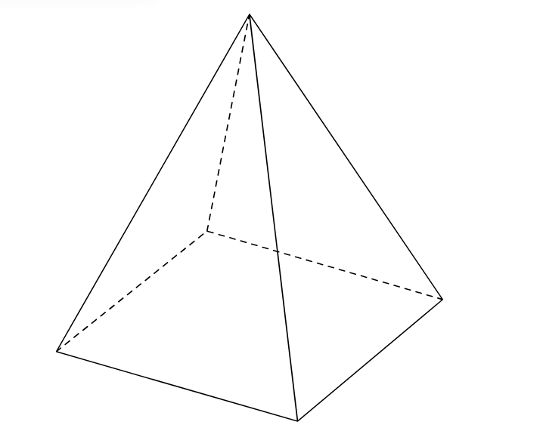
Short response (2)
Record the number of:
faces
vertices
edges
Notes:
Short response questions provide brisk paced questions focussing on review of current and previous content to support spaced and interleaved practice.
Syllabus focus area:
Three- dimensional spatial structure B

Slide 8
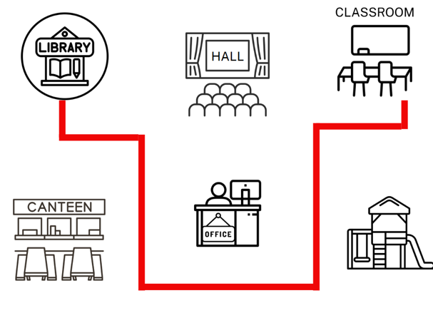
Short response (3)
Use landmarks and directional language to describe the route from the library to the classroom .
Notes:
Short response questions provide brisk paced questions focussing on review of current and previous content to support spaced and interleaved practice.
Syllabus focus area:
Geometric measure A

Slide 9
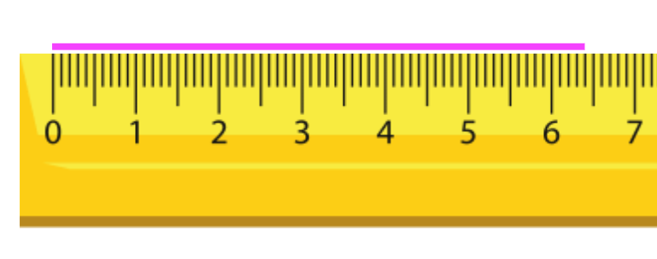
Short response (4)
Record the length of the pink line using the abbreviation for millimetres.
Notes:
Short response questions provide brisk paced questions focussing on review of current and previous content to support spaced and interleaved practice.
Syllabus focus area:
Geometric measure B

Slide 10
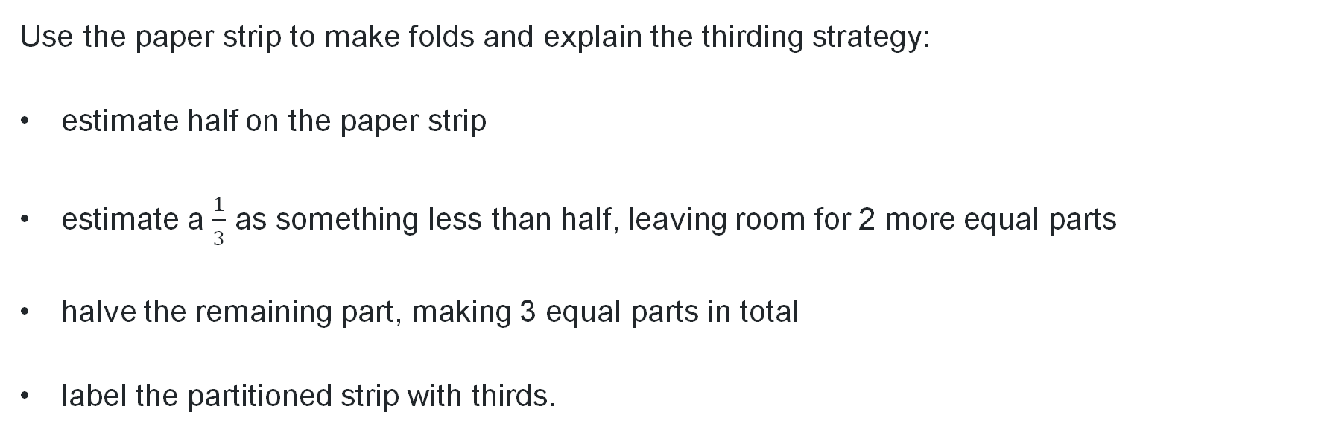
Activity 1– the ‘thirding’ strategy
This paper has been folded in half. There are 2 equal parts and 2 halves make a whole.
Use the paper strip to make folds and explain the thirding strategy:
estimate half on the paper strip
estimate a $\frac{1}{3}$ as something less than half, leaving room for 2 more equal parts
halve the remaining part, making 3 equal parts in total
label the partitioned strip with thirds.
Notes:
This is a developing number sense activity.
Number sense refers to a deep understanding of numbers, including their magnitude, relationships, and the effects of operations on them. It supports fluency and understanding, estimation, flexible thinking, and efficient problem-solving. Number sense activities 1–4 ‘activate’ prior number knowledge and support the learning of new content in the unit. Number sense activities 5–8 ‘loop’ back and provide opportunity for spaced practice with concepts and procedures covered in previous units.
Syllabus focus area:
Partitioned fractions A
The ‘thirding’ strategy
This activity is an adaptation of ‘Thirding strategy’ from Teaching Mathematics: Foundations to Middle Years by Siemon et al.
Provide students with a paper strip and writing materials. Ask students to fold the paper in half.
Revise: what a half is and that 2 halves make a whole.
As a class, discuss strategies to make thirds and where one third would be placed on the paper strip. Ask: Do you think one third is more or less than one half? How do you know?’
Use the paper strip to make folds and explain the thirding strategy to students:
Estimate half on the paper strip.
Estimate one third as something less than half, leaving room for 2 more equal parts.
Halve the remaining part, making 3 equal parts in total.
As a class label the partitioned strip with thirds.

Slide 11
Review of learning 2

Slide 12
True or false (1)
The equal sign (=)
means ‘the same as’.
True | False
Notes:
The question on this slide connects to the content being explored in the developing number sense activity (Activity 2)
Syllabus focus area:
Additive relations A

Slide 13
Short response (5)
Draw an angle.
Label the arms and the vertex of the angle.
Notes:
Short response questions provide brisk paced questions focussing on review of current and previous content to support spaced and interleaved practice.
Syllabus focus area:
Geometric measure A

Slide 14
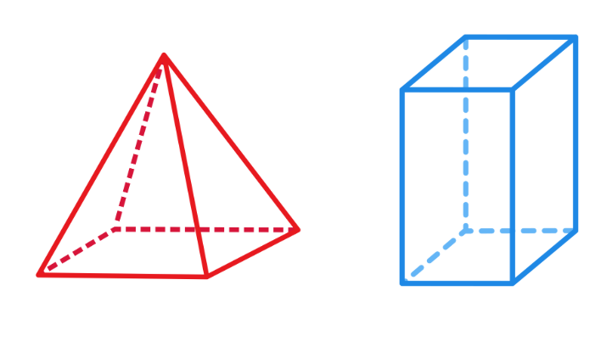
Short response (6)
Record the differences between this pyramid and this prism.
Notes:
Short response questions provide brisk paced questions focussing on review of current and previous content to support spaced and interleaved practice.
Syllabus focus area:
Three- dimensional spatial structure A

Slide 15
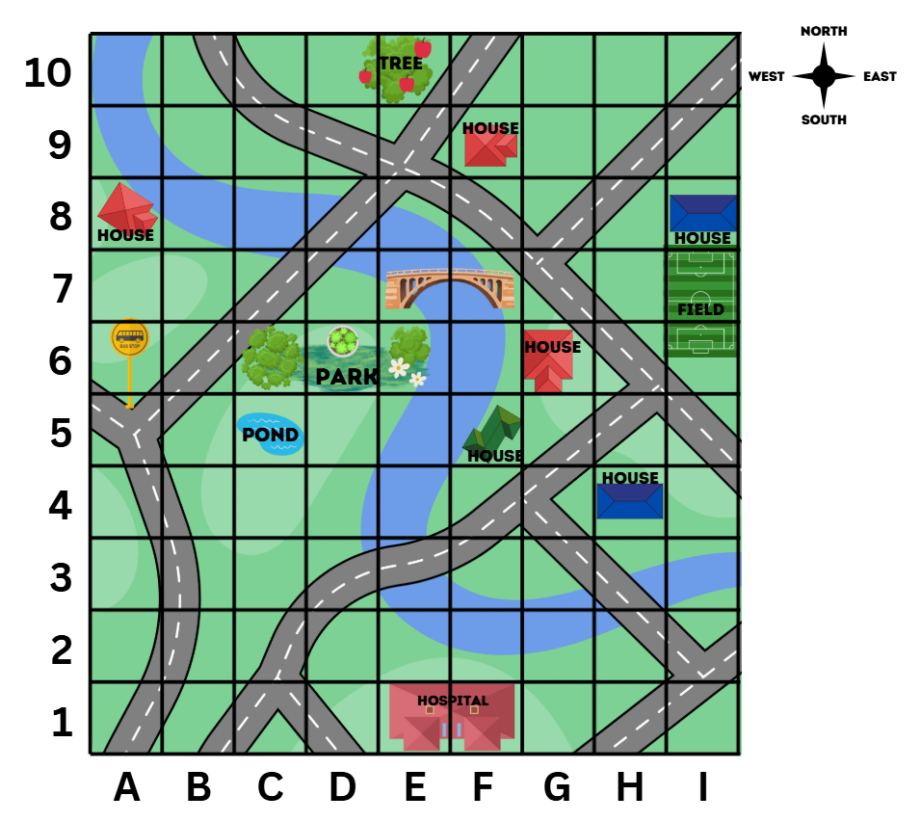



Short response (7)
Record the positions of the:
pond
blue house
tree
Notes:
Short response questions provide brisk paced questions focussing on review of current and previous content to support spaced and interleaved practice.
Syllabus focus area:
Geometric measure A

Slide 16
Short response (8)
Estimate the length of your classroom using metres and centimetres.
Communicate your reasoning.
Notes:
Short response questions provide brisk paced questions focussing on review of current and previous content to support spaced and interleaved practice.
Syllabus focus area:
Geometric measure B

Slide 17
Activity 2 – the ‘fifthing strategy’ (1)
Review thirds by fold the paper strip to show thirds, using the halfway point as a reference.
How could you show fifths on their paper strip.
Would a fifth be larger or smaller than a third? How do you know?
Would a fifth be larger or smaller than a quarter? How do you know?
How can you use quarters on your fraction strip to find fifths?
Notes:
This is a developing number sense activity.
Number sense refers to a deep understanding of numbers, including their magnitude, relationships, and the effects of operations on them. It supports fluency and understanding, estimation, flexible thinking, and efficient problem-solving. Number sense activities 1–4 ‘activate’ prior number knowledge and support the learning of new content in the unit. Number sense activities 5–8 ‘loop’ back and provide opportunity for spaced practice with concepts and procedures covered in previous units.
Syllabus focus area:
Partitioned fractions A
The ‘fifthing’ strategy
This activity is an adaptation of the ‘Fifthing strategy’ from Teaching Mathematics: Foundations to Middle Years by Siemon et al.
Provide students with a paper strip and writing materials. Revise the strategies for identifying thirds in Lesson 1.
Students fold the paper strip to show thirds, using the halfway point as a reference.
Ask students to consider how they could show fifths on their paper strip. Ask:
Would a fifth be larger or smaller than a third? How do you know?
Would a fifth be larger or smaller than a quarter? How do you know?
How can you use quarters on your fraction strip to find fifths?
Move to the next slide.
Explain the ‘fifthing strategy’ to students:
Estimate half, then estimate one-quarter.
Estimate one-fifth as something slightly less than one-quarter.
As 4 more equal parts are needed, halve and halve again the remaining part.
Fold to create 5 equal parts in total.
After folding and checking for 5 equal fifths, students draw a bar diagram that represents their folded fraction strip. They label the parts of the bar diagram to show each fifth.

Slide 18
Activity 2 (– the ‘fifthing strategy’ (2)
Explain the fifthing strategy:
estimate half, then estimate one-quarter
estimate one-fifth as something slightly less than one-quarter
as 4 more equal parts are needed, halve and halve again the remaining part
fold to create 5 equal parts in total.
Notes:
This is a developing number sense activity.
Number sense refers to a deep understanding of numbers, including their magnitude, relationships, and the effects of operations on them. It supports fluency and understanding, estimation, flexible thinking, and efficient problem-solving. Number sense activities 1–4 ‘activate’ prior number knowledge and support the learning of new content in the unit. Number sense activities 5–8 ‘loop’ back and provide opportunity for spaced practice with concepts and procedures covered in previous units.
Syllabus focus area:
Partitioned fractions A
The ‘fifthing’ strategy
Explain the ‘fifthing strategy’ to students:
Estimate half, then estimate one-quarter.
Estimate one-fifth as something slightly less than one-quarter.
As 4 more equal parts are needed, halve and halve again the remaining part.
Fold to create 5 equal parts in total.
After folding and checking for 5 equal fifths, students draw a bar diagram that represents their folded fraction strip. They label the parts of the bar diagram to show each fifth.

Slide 19
Review of learning 3

Slide 20
Multiple choice (2)
287 - 176 =
A
290 - 173
B
280 - 179
C
300 - 190
D
288 - 170
Notes:
This question connects to the content in the developing number sense activity (Activity 3)
Syllabus focus area:
Additive relations A

Slide 21
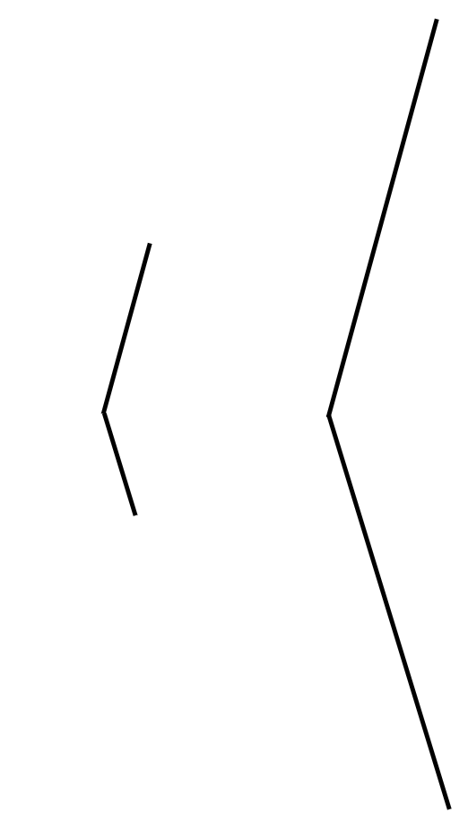
Short response (9)
How are these angles the same?
How are they different?
Notes:
Short response questions provide brisk paced questions focussing on review of current and previous content to support spaced and interleaved practice.
Syllabus focus area:
Geometric measure A

Slide 22
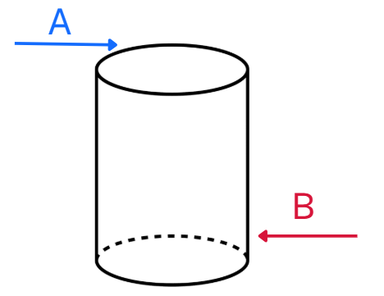
Short response (10)
Match the features to the labels.
flat surface
curved surface
Notes:
Short response questions provide brisk paced questions focussing on review of current and previous content to support spaced and interleaved practice.
Syllabus focus area:
Three-dimensional spatial structure B

Slide 23


Short response (11)
Use the grid map and compass directions to record a route from the pond to the tree.
Notes:
Short response questions provide brisk paced questions focussing on review of current and previous content to support spaced and interleaved practice.
Syllabus focus area:
Geometric measure B

Slide 24
Short response (12)
How many millimetres are there in one centimetre?
Notes:
Short response questions provide brisk paced questions focussing on review of current and previous content to support spaced and interleaved practice.
Syllabus focus area:
Geometric measure B

Slide 25
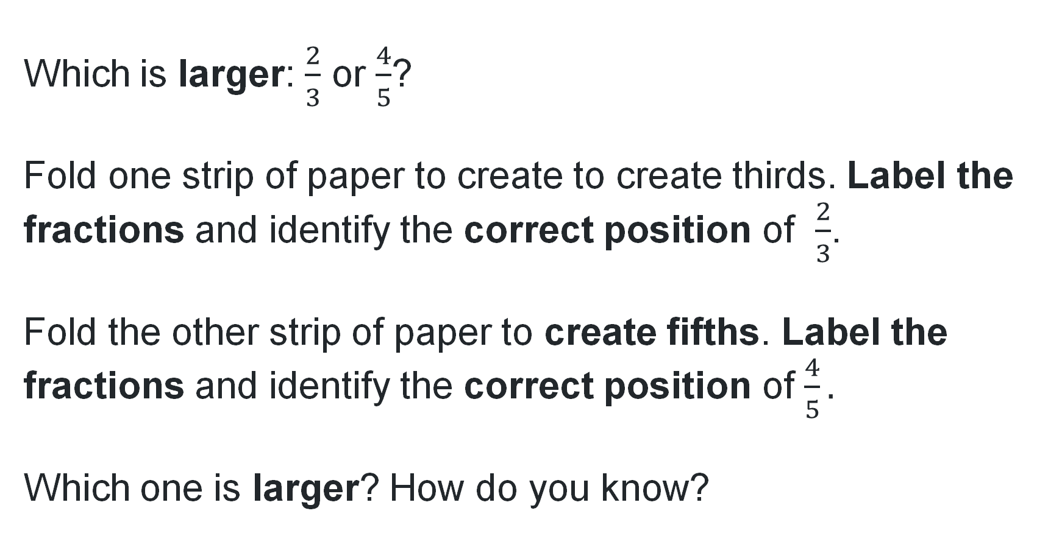
Activity 3 – labelling thirds and fifths
Which is larger: $\frac{2}{3}$ or $\frac{4}{5}$?
Fold one strip of paper to create to create thirds. Label the fractions and identify the correct position of $\frac{2}{3}$.
Fold the other strip of paper to create fifths. Label the fractions and identify the correct position of $\frac{4}{5}.$
Which one is larger? How do you know?
Notes:
This is a developing number sense activity.
Number sense refers to a deep understanding of numbers, including their magnitude, relationships, and the effects of operations on them. It supports fluency and understanding, estimation, flexible thinking, and efficient problem-solving. Number sense activities 1–4 ‘activate’ prior number knowledge and support the learning of new content in the unit. Number sense activities 5–8 ‘loop’ back and provide opportunity for spaced practice with concepts and procedures covered in previous units.
Syllabus focus area:
Partitioned fractions A
Labelling thirds and fifths
Provide students with two strips of paper of equal length.
Pose the question: Which is larger: two thirds or four fifths?
Students fold one strip of paper to create to create thirds. They label the fractions and identify the correct position of two thirds.
Students fold the other strip of paper to create to create fifths. They label the fractions and identify the correct position of four fifths.
Ask: Which one is larger? How do you know?

Slide 26
Review of learning 4

Slide 27
True or false (2)
908 + 667 = 990 + 602
True | False
Communicate your reasoning.
Notes:
The question on this slide connects to the content being explored in the developing number sense activity (Activity 4)
Syllabus focus area:
Additive relations A

Slide 28
Short response (13)
Is a right angle a quarter-turn?
Communicate your reasoning.
Notes:
Short response questions provide brisk paced questions focussing on review of current and previous content to support spaced and interleaved practice.
Syllabus focus area:
Geometric measure A

Slide 29

Short response (14)
How are these shapes the same?
How are they different?
Notes:
Short response questions provide brisk paced questions focussing on review of current and previous content to support spaced and interleaved practice.
Syllabus focus area:
Two-dimensional spatial structure A

Slide 30


Short response (15)
Use the grid map and compass directions to record a route from the green house to the hospital.
Notes:
Short response questions provide brisk paced questions focussing on review of current and previous content to support spaced and interleaved practice.
Syllabus focus area:
Geometric measure B

Slide 31
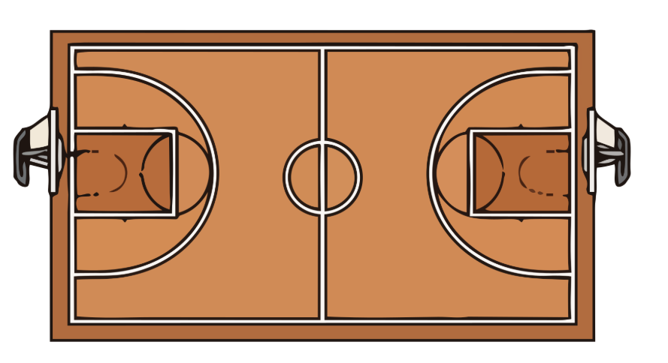
Short response (16)
What word is used to describe the distance around a boundary?
Notes:
Short response questions provide brisk paced questions focussing on review of current and previous content to support spaced and interleaved practice.
Syllabus focus area:
Geometric measure B

Slide 32

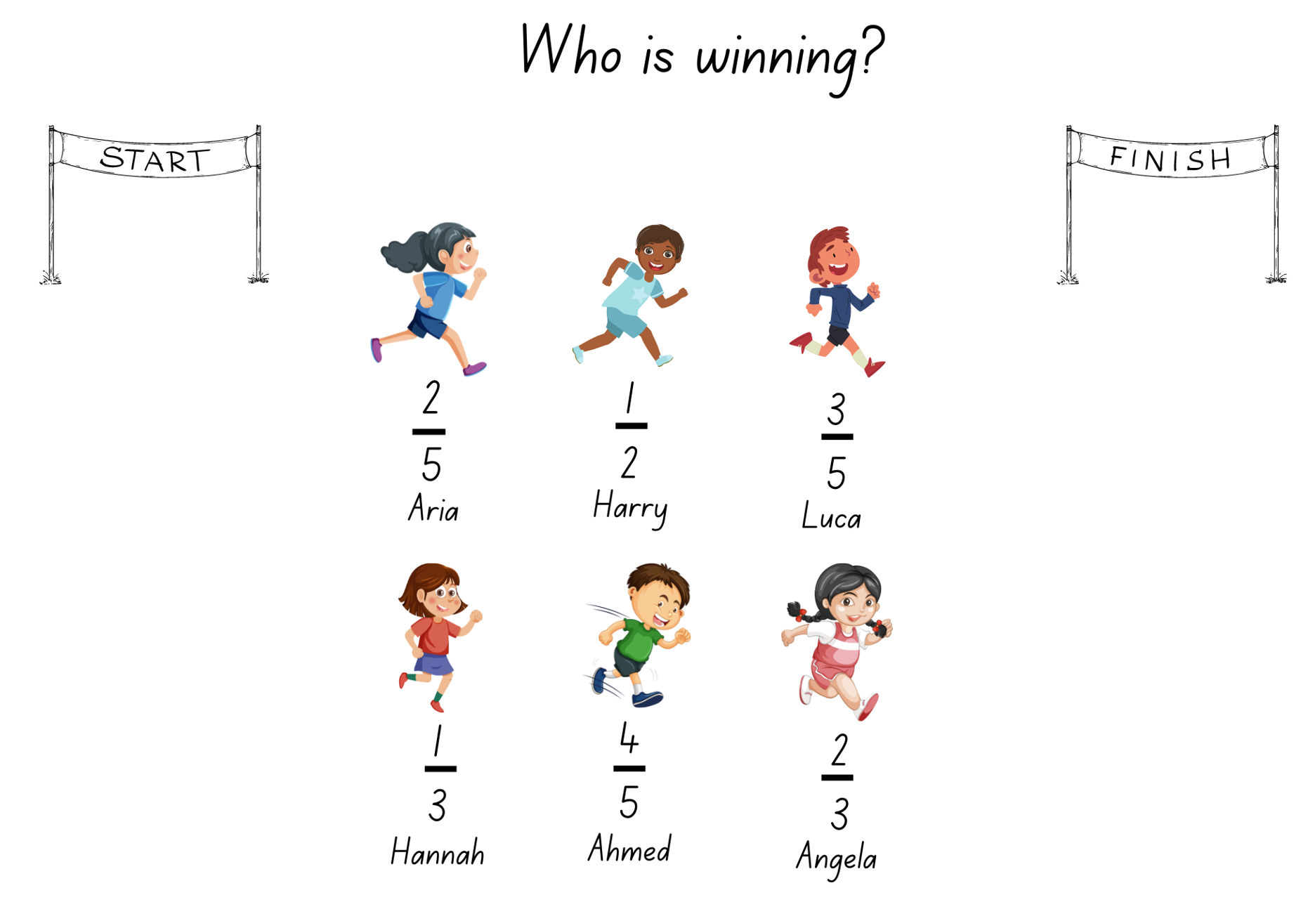
Activity 4 – ordering thirds and fifths
There are 6 students in the race. use a paper strip to mark and represent the fraction distance for each runner. compare the fractional representations for each runner to determine who is winning the race.
Notes:
This is a developing number sense activity.
Number sense refers to a deep understanding of numbers, including their magnitude, relationships, and the effects of operations on them. It supports fluency and understanding, estimation, flexible thinking, and efficient problem-solving. Number sense activities 1–4 ‘activate’ prior number knowledge and support the learning of new content in the unit. Number sense activities 5–8 ‘loop’ back and provide opportunity for spaced practice with concepts and procedures covered in previous units.
Syllabus focus area:
Partitioned fractions A
Activity title
This resource corresponds to Resource15 – Who is winning? in Stage A Year A Unit 10.
This activity is an adaptation of ‘Who is winning?’ from Primary and Middle Years Mathematics: Teaching Developmentally, 1st Australian edn by Van De Walle et al.
Provide pairs of students with multiple paper strips of the same length and writing materials. Revise how to identify thirds and fifths of a length from Activity 1 and 2.
Explain that the 6 students are in a race. The fractions show the distance they have already run.
Provide pairs of students with a paper strip for each runner.
With their partner, students use a paper strip to mark and represent the fraction distance for each runner. Students then compare the fractional representations for each runner to determine who is winning the race.
Discuss students' strategies used to identify and represent the position of each fraction.

Slide 33
Review of learning 5

Slide 34
Multiple choice (3)
32 - 13 =
A
31 - 10
B
30 - 11
C
30 - 16
D
35 - 10
Notes:
This question connects to the content in the developing number sense activity (Activity 3)
Syllabus focus area:
Additive relations A

Slide 35
Short response (17)
Which of these activities have a duration of longer than 1 minute?
You may select more than one answer.
writing your name once
eating your lunch
reading a book
Notes:
Short response questions provide brisk paced questions focussing on review of current and previous content to support spaced and interleaved practice.
Syllabus focus area:
Non-spatial measure A

Slide 36

Short response (18)
Do you think this milk container holds
a litre?
Communicate your reasoning.
Notes:
Short response questions provide brisk paced questions focussing on review of current and previous content to support spaced and interleaved practice.
Syllabus focus area
Three-dimensional spatial structure A

Slide 37
Short response (19)
Record if these chance events are
equally likely, likely or unlikely to occur.
You will eat lunch today
You roll a 1 on a standard dice
You choose a black card from a deck of cards.
Notes:
Short response questions provide brisk paced questions focussing on review of current and previous content to support spaced and interleaved practice.
Syllabus focus area:
Chance B

Slide 38

Short response (20)
Describe this two-dimensional shape.
Notes:
Short response questions provide brisk paced questions focussing on review of current and previous content to support spaced and interleaved practice.
Syllabus focus area:
Two- dimensional structure

Slide 39
Activity 5 – balancing number sentences
Roll the dice 2 times to form two 2-digit numbers, for example, 26 and 32 and record a number sentence.
26 + 32 =
In pairs, calculate two other 2-digit numbers that could be written on the other side of the equal sign that would balance the number sentence. For example, 26 + 32 = 43 + 15.
Notes:
This is a developing number sense activity.
Number sense refers to a deep understanding of numbers, including their magnitude, relationships, and the effects of operations on them. It supports fluency and understanding, estimation, flexible thinking, and efficient problem-solving. Number sense activities 1–4 ‘activate’ prior number knowledge and support the learning of new content in the unit. Number sense activities 5–8 ‘loop’ back and provide opportunity for spaced practice with concepts and procedures covered in previous units.
Syllabus focus area:
Additive relations A
Balancing number sentences
Provide pairs with two 6-sided dice and an individual whiteboard.
Students roll the dice to form a 2-digit number, for example, 26. Students roll again to form another 2-digit number, for example, 32.
Students record the number sentence 26 + 32 =.
In pairs, students then calculate two other 2-digit numbers that could be written on the other side of the equal sign that would balance the number sentence. For example, 26 + 32 = 43 + 15.
Students roll the 2 dice several times and repeat the process, recording a variety of balanced number sentences.
Ask the class:
What strategies were most useful when selecting the two additional numbers?
How did you check that each side was the same as the other?
How could you convince someone that your number sentence shows equality?
Note: the activity can be adapted by using 3 dice to create 3-digit numbers.

Slide 40
Review of learning 6

Slide 41
True or false (3)
82 - 13 = 85 - 10
True | False
Communicate your reasoning.
Notes:
The question on this slide connects to the content being explored in the developing number sense activity (Activity 6)
Syllabus focus area:
Additive relations A

Slide 42
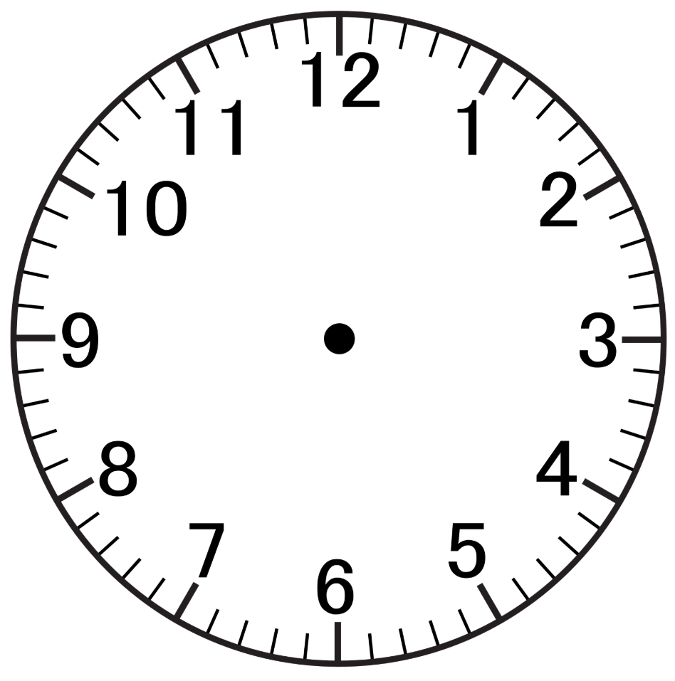
Short response (21)
What does the 3 represent on the analog clock when:
the hour hand points to it?
the minute hand points to it?
Notes:
Short response questions provide brisk paced questions focussing on review of current and previous content to support spaced and interleaved practice.
Syllabus focus area:
Non- spatial measure A

Slide 43
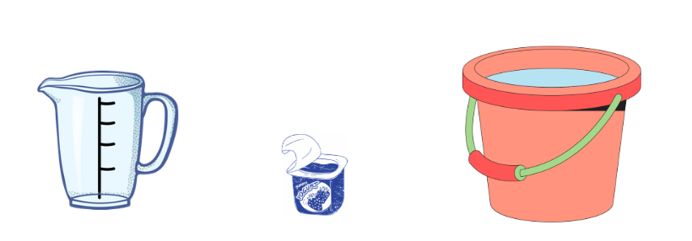
Short response (22)
Are these containers more, less or about one litre?
A B C
Notes:
Short response questions provide brisk paced questions focussing on review of current and previous content to support spaced and interleaved practice.
Syllabus focus area:
Three-dimensional spatial structure A

Slide 44
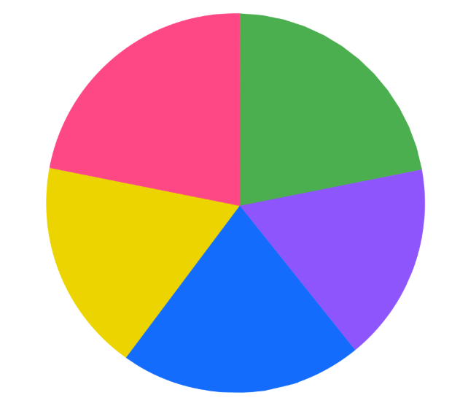
Short response (23)
What are the possible outcomes of spinning this spinner?
Notes:
Short response questions provide brisk paced questions focussing on review of current and previous content to support spaced and interleaved practice.
Syllabus focus area:
Chance A

Slide 45
Short response (24)
Describe and compare these two-dimensional shapes.
Notes:
Short response questions provide brisk paced questions focussing on review of current and previous content to support spaced and interleaved practice.
Syllabus focus area:
Two- dimensional structure

Slide 46
Activity 6 – the same as
Deal 4 cards face up and place the remainder of the cards in a centre pile
Player 1 picks a card from the centre pile and decides which of the 4 slots to place the card. Places it in one of the slots, then reads out the number sentence stating whether it is true or not
Player 2 then picks a card and places it in one of the slots
Play continues until a player selects a card that makes a true statement. Players record the number sentences on a whiteboard
The cards on the game board are placed at the bottom of the pile, 4 new cards are dealt and play starts again
Notes:
This is a developing number sense activity.
Number sense refers to a deep understanding of numbers, including their magnitude, relationships, and the effects of operations on them. It supports fluency and understanding, estimation, flexible thinking, and efficient problem-solving. Number sense activities 1–4 ‘activate’ prior number knowledge and support the learning of new content in the unit. Number sense activities 5–8 ‘loop’ back and provide opportunity for spaced practice with concepts and procedures covered in previous units.
Syllabus focus area:
Additive relations A
The same as
This resource corresponds to Resource 16 – number sentence board in Stage 2 Year A Unit 10.
This activity is an adaptation of Let’s Play: Number Sentences by Russo.
Note: prior to the lesson, remove all the picture cards. It is optional to use the picture cards if appropriate to increase the level of challenge.
Demonstrate how to play the game by playing against a student or the whole class.
Deal 4 cards face up on Resource 16 – number sentence board and place the remainder of the cards in a centre pile (see Figure 4)
Player 1 picks a card from the centre pile and decides which of the 4 slots to place the card. For example, Player 1 picks a 7 and places it in one of the slots, then reads out the number sentence stating whether it is true or not. For example, 10 plus 4 is not the same as 7 plus 6 (see Figure 5).
Player 2 then picks a card and places it in one of the slots. For example, player 2 picks a 7 and reads out the number sentence stating if it is true or not (see Figure 6).
Play continues until a player selects a card that makes a true statement. For example, Player 1 picks a 3, places it in a slot and reads 10 plus 3 is the same as 7 plus 6 (see Figure 7).
Players record the number sentences on their whiteboard and that is the end of a round. The cards on the game board are placed at the bottom of the pile, 4 new cards are dealt and play starts again.

Slide 47
Review of learning 7

Slide 48
Multiple choice (4)
78 + 90 =
A
105 + 60
B
99 + 67
C
80 + 81
D
110 + 55
Notes:
This question connects to the content in the developing number sense activity (Activity 3)
Syllabus focus area:
Additive relations A

Slide 49
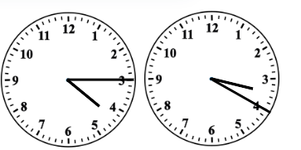
Short response (25)
What time is shown on each of these analog clocks?
clock A
clock B
Notes:
Short response questions provide brisk paced questions focussing on review of current and previous content to support spaced and interleaved practice.
Syllabus focus area:
Non-spatial measure A

Slide 50

Short response (26)
Three water bottles each hold 2 litres.
Record how many of litres there are in total using the abbreviation for litres.
Notes:
Short response questions provide brisk paced questions focussing on review of current and previous content to support spaced and interleaved practice.
Syllabus focus area:
Three-dimensional spatial structure A

Slide 51
Short response (27)
What is the term used to describe any possible result of a chance experiment?
Notes:
Short response questions provide brisk paced questions focussing on review of current and previous content to support spaced and interleaved practice.
Syllabus focus area:
Chance A

Slide 52
Short response (28)
How many minutes are in an hour?
How many minutes are in half an hour?
Notes:
Short response questions provide brisk paced questions focussing on review of current and previous content to support spaced and interleaved practice.
Syllabus focus area:
Non – spatial measure A

Slide 53
Activity 7 – true or false number sentences
Is this true or false?
27 + 13 = 11 + 29
What about these?
21 + 12 = 34 | 36 = 19 + 17 | 26 + 13 = 13 + 26 | 42 + 19 = 26 + 17
169 + 672 = 2041 | 182 = 182 | 19 + 15 = 20 + 16 | 87 - 62 = 92 - 75
346 + 289 = 349 + 286 | 831 - 344 = 941 - 234 | 727 + 581 - 581 = 727 | 861 - 344 + 344 = 861
Notes:
This is a developing number sense activity.
Number sense refers to a deep understanding of numbers, including their magnitude, relationships, and the effects of operations on them. It supports fluency and understanding, estimation, flexible thinking, and efficient problem-solving. Number sense activities 1–4 ‘activate’ prior number knowledge and support the learning of new content in the unit. Number sense activities 5–8 ‘loop’ back and provide opportunity for spaced practice with concepts and procedures covered in previous units.
Syllabus focus area:
Additive relations A
True or false number sentences
This resource corresponds to Resource 17 – number sentences in Stage 2 Year A Unit 10.
This activity is an adaptation of True or false from NRICH by University of Cambridge.
Display the number sentence 27 + 13 = 11 + 29. Ask students to turn and talk about if the number sentence is true or false.
Select students to explain how they know that the number sentence is true or false.
Emphasise to students that the equals sign means ‘the same as’ or ‘balance’ and not just the ‘total’ or the ‘answer’.
Ask students the following questions for each number sentence in the first row.
Is the number sentence true or false?
How do you know you are correct?
Could you decide without doing any calculating?
What strategy did you use?

Slide 54
Review of learning 8

Slide 55
True or false (4)
899 + 676 = 1099 + 500
True | False
Communicate your reasoning.
Notes:
The question on this slide connects to the content being explored in the developing number sense activity (Activity 8)
Syllabus focus area:
Additive relations A

Slide 56
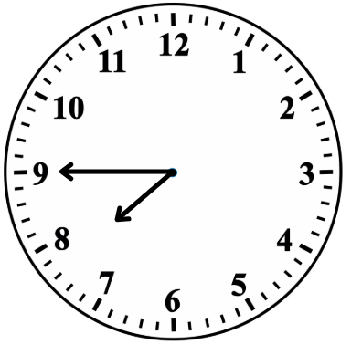
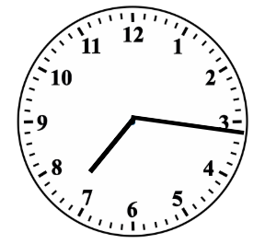
Short response (29)
Read the time on these analog clocks using the terms ‘past’ or ‘to’.
clock A
clock B
Notes:
Short response questions provide brisk paced questions focussing on review of current and previous content to support spaced and interleaved practice.
Syllabus focus area:
Non-spatial measure A

Slide 57
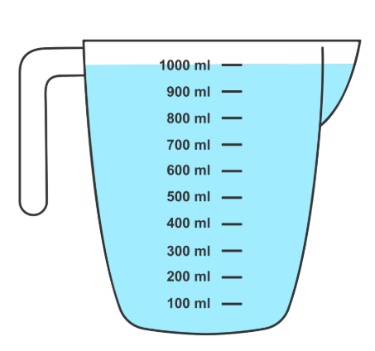
Short response (30)
Record the volume of water in litres.
Communicate your reasoning.
Notes:
Short response questions provide brisk paced questions focussing on review of current and previous content to support spaced and interleaved practice.
Syllabus focus area:
Three- dimensional spatial structure B

Slide 58
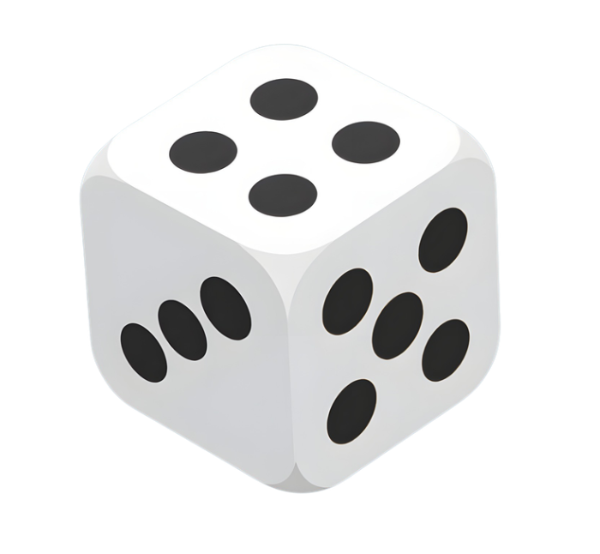
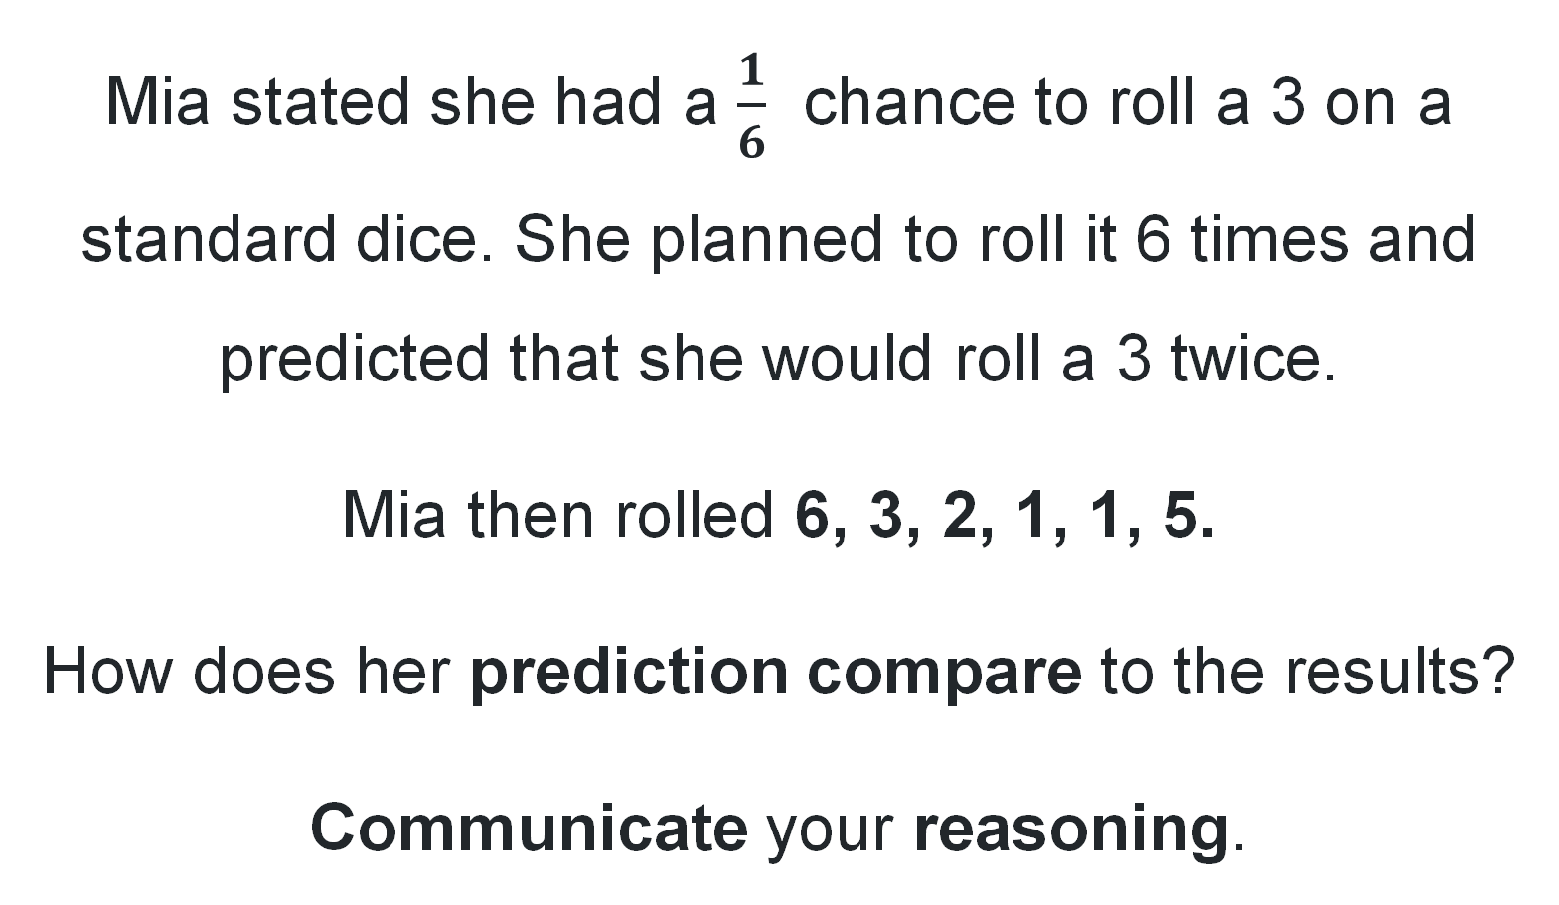
Short response (31)
Mia stated she had a $\frac{1}{6}$ chance to roll a 3 on a standard dice. She planned to roll it 6 times and predicted that she would roll a 3 twice.
Mia then rolled 6, 3, 2, 1, 1, 5.
How does her prediction compare to the results?
Communicate your reasoning.
Notes:
Short response questions provide brisk paced questions focussing on review of current and previous content to support spaced and interleaved practice.
Syllabus focus area:
Chance B

Slide 59
Short response (32)
Create a question to gather data about the most common forms of transport your classmates use to get to school.
Notes:
Short response questions provide brisk paced questions focussing on review of current and previous content to support spaced and interleaved practice.
Syllabus focus area:
Data A

Slide 60
Activity 8 – true or false number sentences 2
21 + 12 = 34 | 36 = 19 + 17 | 26 + 13 = 13 + 26 | 42 + 19 = 26 + 17
169 + 672 = 2041 | 182 = 182 | 19 + 15 = 20 + 16 | 87 - 62 = 92 - 75
346 + 289 = 349 + 286 | 831 - 344 = 941 - 234 | 727 + 581 - 581 = 727 | 861 - 344 + 344 = 861
Notes:
This is a developing number sense activity.
Number sense refers to a deep understanding of numbers, including their magnitude, relationships, and the effects of operations on them. It supports fluency and understanding, estimation, flexible thinking, and efficient problem-solving. Number sense activities 1–4 ‘activate’ prior number knowledge and support the learning of new content in the unit. Number sense activities 5–8 ‘loop’ back and provide opportunity for spaced practice with concepts and procedures covered in previous units.
Syllabus focus area:
Additive relations A
True or false number sentences
This resource corresponds to Resource 17 – number sentences in Stage 2 Year A Unit 10.
This activity is an adaptation of True or false from NRICH by University of Cambridge.
Revisit that the equals sign means ‘the same as’ or ‘balance’ and not just the ‘total’ or the ‘answer’.
Display Resource 17 – number sentences and ask students the following questions for each number sentence in the second and third rows:
Is the number sentence true or false?
How do you know you are correct?
Could you decide without doing any calculating?
What strategy did you use?

Slide 61
Double Venn diagram
Object 1
Object 2
Features similar to both objects
Features of object 1
Features of object 2

Slide 62
Frayer
Definition
Facts/Characteristics
Word, term, concept
Examples
Non-examples

Slide 63
Spider map
Idea
Subject

Slide 64
Cline
Concept 1
Concept 2
Word
Word
Word
Word
Word
Word
Word
Word
Word
Word
Word

Slide 65

Compare and contrast

Slide 66
Multiple choice (5)
A
B
C
D

Slide 67
Multiple choice
A
B
C
D
Notes:
This question connects to the content in the developing number sense activity (Activity 3)
Syllabus focus area:
[Focus area A/B]

Slide 68
References (1)
This presentation contains NSW Curriculum and syllabus content. The NSW Curriculum is developed by the NSW Education Standards Authority. This content is prepared by NESA for and on behalf of the Crown in the right of the State of New South Wales. The material is protected by Crown copyright.
Please refer to the NESA Copyright Disclaimer for more information https://educationstandards.nsw.edu.au/wps/portal/nesa/mini-footer/copyright.
NESA holds the only official and up-to-date versions of the NSW Curriculum and syllabus documents. Please visit the NSW Education Standards Authority (NESA) website https://educationstandards.nsw.edu.au/wps/portal/nesa/home and the NSW Curriculum website https://curriculum.nsw.edu.au.
Mathematics K–10 Syllabus © NSW Education Standards Authority (NESA) for and on behalf of the Crown in right of the State of New South Wales, 2022.
National Numeracy Learning Progression © Australian Curriculum, Assessment and Reporting Authority (ACARA) 2010 to present, unless otherwise indicated. This material was downloaded from the Australian Curriculum website (National Numeracy Learning Progression) (accessed 4 November 2025) and was not modified.
Australians Together (2023) Teacher guide Y5 maths: Comparing 12- and 24-hour time systems and Indigenous concepts of time [PDF 2.32 MB], Australians Together, accessed 19 July 2023.
Merrill J (2022) Time to Win, The Mathematical Isles of What If...? website, accessed 19 July 2023.
New Zealand Ministry of Education (2026) ‘Just a minute’, Measurement, Tāhūrangi - New Zealand Curriculum website, accessed 19 July 2023.
NZ Maths (n.d.) Clock wise (time), Meaningful Maths website, accessed 19 July 2023.
NZ Maths (n.d.) Hinea's watch's hands, Meaningful Maths website, accessed 19 July 2023.

Slide 69
References (2)
This presentation contains NSW Curriculum and syllabus content. The NSW Curriculum is developed by the NSW Education Standards Authority. This content is prepared by NESA for and on behalf of the Crown in the right of the State of New South Wales. The material is protected by Crown copyright.
Please refer to the NESA Copyright Disclaimer for more information https://educationstandards.nsw.edu.au/wps/portal/nesa/mini-footer/copyright.
NESA holds the only official and up-to-date versions of the NSW Curriculum and syllabus documents. Please visit the NSW Education Standards Authority (NESA) website https://educationstandards.nsw.edu.au/wps/portal/nesa/home and the NSW Curriculum website https://curriculum.nsw.edu.au.
Queensland University of Technology (2014) Yumi Deadly Maths: Measurement Prep to Year 9, prepared by the Yumi Deadly Centre, Queensland, accessed 4 November 2025.
Russo J (2021) ‘Let's Play: Number Sentences’, Prime Number, 36(2):4–5, accessed 4 November 2025.
Siemon D, Warren E, Beswick K, Faragher R, Miller J, Horne M, Jazby D, Breed M, Clark J and Brady K (2021) Teaching Mathematics: Foundations to Middle Years, 3rd edn, Oxford University Press Australia and New Zealand.
State of NSW, Department of Education and Training, Professional Support and Curriculum Directorate (2003) Teaching about angles: Stage 2 [PDF 3.36 MB], Department of Education and Training website, accessed 4 November 2025.
Sullivan P (2018) Challenging Mathematical tasks: Unlocking the Potential of all Students, Oxford University Press, Australia.

Slide 70
References (3)
This presentation contains NSW Curriculum and syllabus content. The NSW Curriculum is developed by the NSW Education Standards Authority. This content is prepared by NESA for and on behalf of the Crown in the right of the State of New South Wales. The material is protected by Crown copyright.
Please refer to the NESA Copyright Disclaimer for more information https://educationstandards.nsw.edu.au/wps/portal/nesa/mini-footer/copyright.
NESA holds the only official and up-to-date versions of the NSW Curriculum and syllabus documents. Please visit the NSW Education Standards Authority (NESA) website https://educationstandards.nsw.edu.au/wps/portal/nesa/home and the NSW Curriculum website https://curriculum.nsw.edu.au.
Toy Theater (2024) ‘Interactive clock | Telling Time’, Time Manipulatives, Toy Theater website, accessed 3 June 2025.
——(2024) ‘Interactive classroom timer | Telling Time’, Time Manipulatives, Toy Theater website, accessed 3 June 2025.
University of Cambridge (n.d.) Clocks, NRICH website, accessed 4 November 2025.
——(n.d.) Stop the Clock, NRICH website, accessed 4 November 2025.
——(n.d.) True or False?, NRICH website, accessed 4 November 2025.
——(n.d.) What Is the Time?, NRICH website, accessed 4 November 2025.
——(n.d.) Wonky Watches, NRICH website, accessed 4 November 2025.
Van de Walle J, Karp K, Bay-Williams JM, Brass A, Bentley B, Ferguson S, Goff W, Livy S, Marshman M, Martin D, Pearn C, Prodromou T, Symons D and Wilkie K (2019) Primary and Middle Years Mathematics: Teaching Developmentally, 1st Australian edn, Pearson Education Australia, Melbourne.

Slide 71
Copyright
© State of New South Wales (Department of Education), 2025
The copyright material published in this resource is subject to the Copyright Act 1968 (Cth) and is owned by the NSW Department of Education or, where indicated, by a party other than the NSW Department of Education (third-party material).
Copyright material available in this resource and owned by the NSW Department of Education is licensed under a Creative Commons Attribution 4.0 International (CC BY 4.0) license.
This license allows you to share and adapt the material for any purpose, even commercially.
Attribution should be given to © State of New South Wales (Department of Education), 2025.
Material in this resource not available under a Creative Commons license:
the NSW Department of Education logo, other logos and trademark-protected material
Material owned by a third party that has been reproduced with permission. You will need to obtain permission from the third party to reuse its material.
Links to third-party material and websites
Please note that the provided (reading/viewing material/list/links/texts) are a suggestion only and implies no endorsement, by the New South Wales Department of Education, of any author, publisher, or book title. School principals and teachers are best placed to assess the suitability of resources that would complement the curriculum and reflect the needs and interests of their students.
If you use the links provided in this document to access a third party’s website, you acknowledge that the terms of use, including licence terms set out on the third-party’s website apply to the use which may be made of the materials on that third-party website or where permitted by the Copyright Act 1968 (Cth). The department accepts no responsibility for content on third-party websites.

