Slide 1
Instructions for use
This resource is not a teaching and learning program. It should be used in conjunction with Stage 2 Year A Unit 6.
Classroom teachers are encouraged to add and adapt slides as required to meet the needs of their students.
Save a copy of the file to make changes to the slide deck. Go to File > Download a Copy (this downloads a copy to the computer to edit in the PowerPoint app).
To convert the PowerPoint to Google Slides:
  Upload the file into Google Drive and open it.
  Go to File > Save as Google Slides.
  (Note – conversion may cause formatting changes in the slides.)

Slide 2

Review of Learning
Mathematics Stage 2 – Unit 6
Notes:
Reviews may include a combination of question types, requiring students to recall facts and key ideas, as well as apply their knowledge to solve problems and answer questions. To support active engagement, a mix of techniques should be employed.” (AERO, 2024).
This Review of Learning slide deck revisits key concepts from the following units:
Stage 2 Year A Unit 6
Stage 2 Year A Unit 5
Stage 2 Year A Unit 4
Stage 1 (non-number content)
It also includes opportunities to review prior learning in non-number content, supporting consolidation across focus areas.
The review of learning resources include three key task types that support the development of mathematical proficiency through retrieval, spaced practice, and active participation. These practices complement the review phase (activating prior knowledge) embedded within the beginning of each lesson.
1.
Multiple-choice questions/True or false: Designed to promote active retrieval of key concepts and identify common misconceptions in number, supporting consolidation, understanding and fluency.
These questions:
support spaced and interleaved practice
help identify and address common misconceptions
support active recall and immediate feedback
support whole class participation
identify areas requiring reteach
2.
Short-response question sets: Carefully grouped questions that encourage spaced and interleaved practice across multiple focus areas, helping students revisit and apply knowledge from different points in time.
These questions:
have a combination of question types
address a range of focus areas
build automaticity and fluency
support active recall
allow for immediate feedback
identify content requiring reteach
3.
Developing number sense activities: A variety of practical, purposeful tasks that reinforce current learning and build on prior knowledge. These activities promote reasoning, problem-solving and conceptual understanding.
The review of learning resources are designed to work support teaching and learning in mathematics. For the most effective implementation, use the resources flexibly, adapting to meet student learning needs and individual classroom contexts.

Slide 3
Lessons
1
Review of learning 1
5
Review of learning 5
2
Review of learning 2
6
Review of learning 6
3
Review of learning 3
7
Review of learning 7
4
Review of learning 4
8
Review of learning 8
Notes:
Teacher notes:
Click lesson numbers to go to specific lessons
Interactive features can be viewed in slide show

Slide 4
Review of learning 1

Slide 5

Multiple choice (1)
Which number sentence is equivalent to
4 + 3 + 2 + 6
A
5 + 4 + 2 + 6
B
4 + 3 + 2 + 1 + 5
C
4 + 3 + 2 + 2 + 2
D
2 + 2 + 3 + 2 + 3
Notes:
This question connects to the content in the developing number sense activity (Activity 1)
Syllabus focus area:
Additive relations A

Slide 6

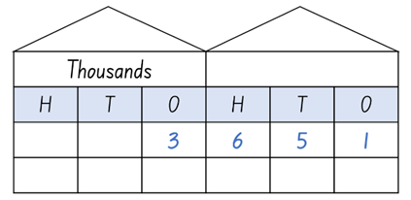
Short response (1)
Record this number in words.
Notes:
Short response questions provide brisk paced questions focussing on review of current and previous content to support spaced and interleaved practice.
Syllabus focus area:
Representing numbers using place value A

Slide 7
Short response (2)
Create a list of possible categories for this question:
What is the most common eye colour in our class?
Notes:
Short response questions provide brisk paced questions focussing on review of current and previous content to support spaced and interleaved practice.
Syllabus focus area:
Data A

Slide 8
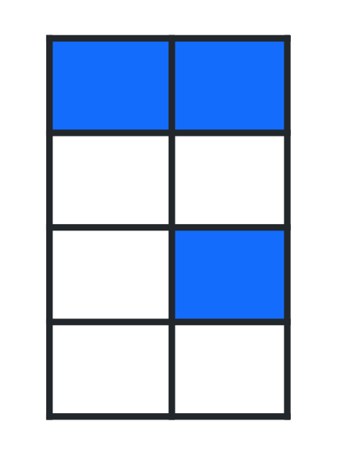
Short response (3)
What fraction of the shape is blue?
What fraction of the shape is white?
Notes:
Short response questions provide brisk paced questions focussing on review of current and previous content to support spaced and interleaved practice.
Syllabus focus area:
Partitioned fractions A

Slide 9
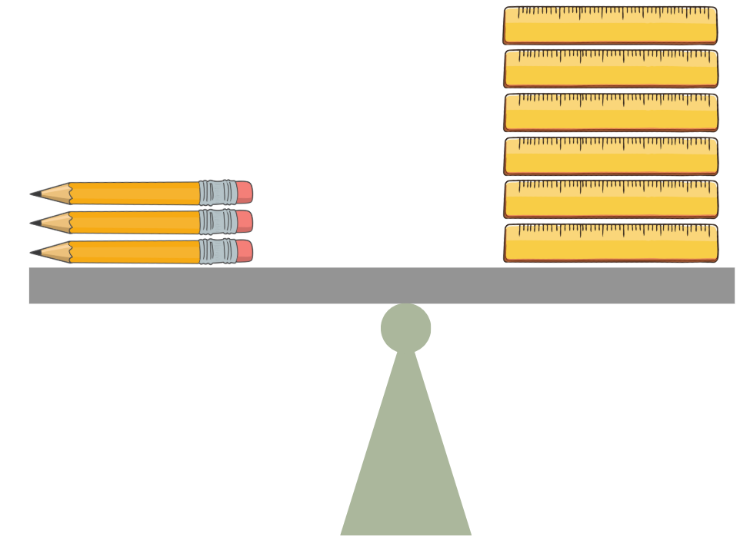
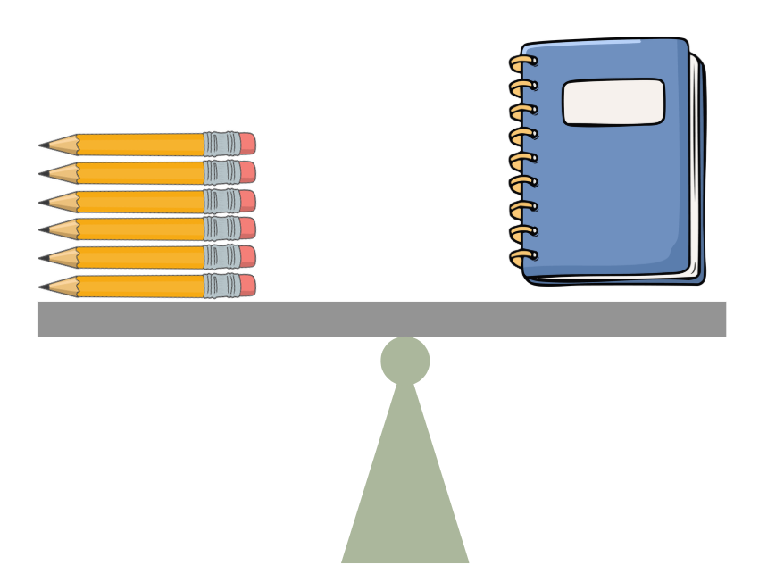
Short response (4)
This equal arm balance shows that 3 pencils has the same mass as 6 rulers.
If the mass of the book is 6 pencils, what is the mass of the book in rulers?
Notes:
Short response questions provide brisk paced questions focussing on review of current and previous content to support spaced and interleaved practice.
Syllabus focus area:
Non-spatial measure B (Note: Stage 1 content reviewed)

Slide 10


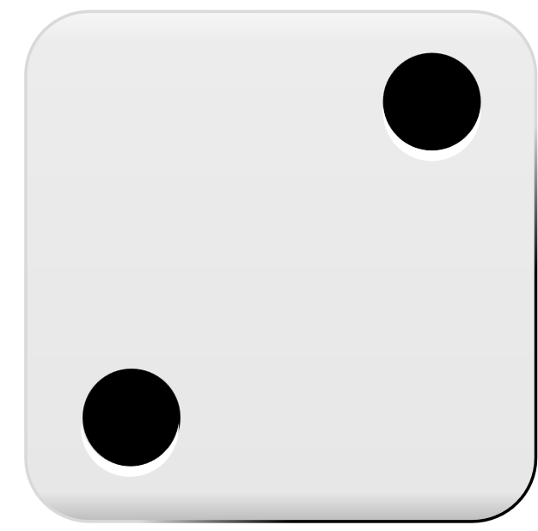
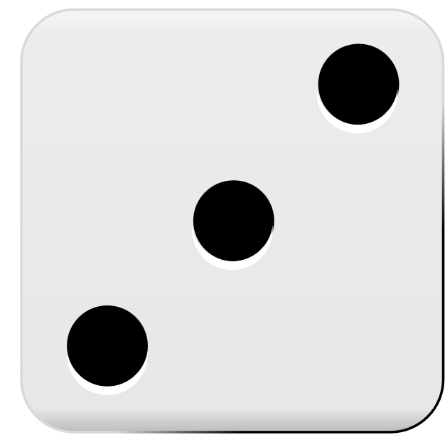
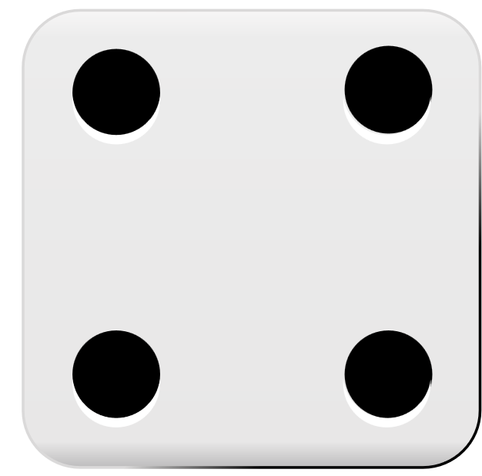
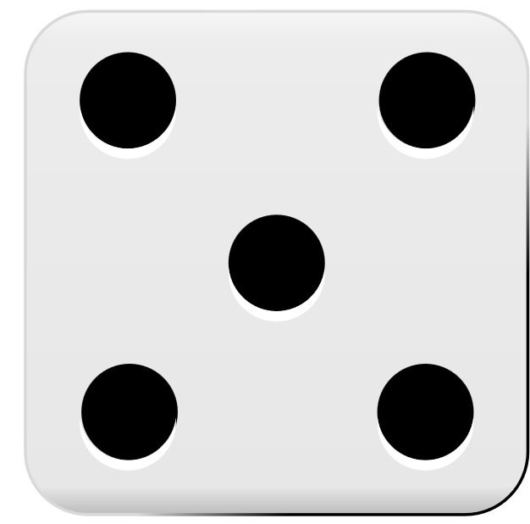
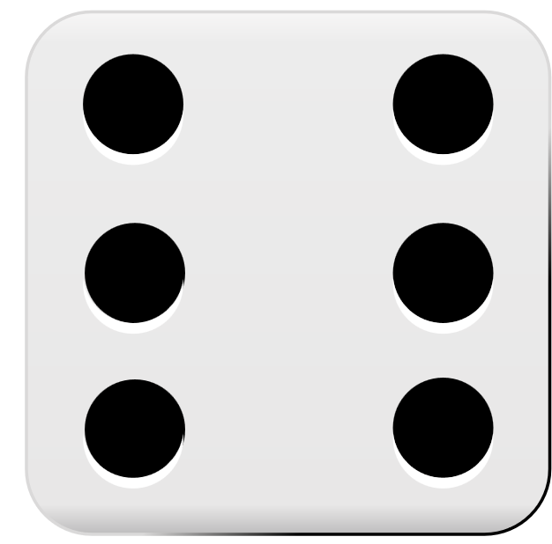
Activity 1 – equals sign means 'the same as'
6 + 5 + 4 = 4 + 3 + 1 + 2 + 2 + 2 + 1
Notes:
This is a developing number sense activity.
Number sense refers to a deep understanding of numbers, including their magnitude, relationships, and the effects of operations on them. It supports fluency and understanding, estimation, flexible thinking, and efficient problem-solving. Number sense activities 1–4 ‘activate’ prior number knowledge and support the learning of new content in the unit. Number sense activities 5–8 ‘loop’ back and provide opportunity for spaced practice with concepts and procedures covered in previous units.
Syllabus focus area:
Additive relations A
Equals sign means 'the same as'
This activity is an adaptation of Balancing Act – A dice game [PDF 250 KB] from Primary Learning.
Students play in pairs. Each pair are given a 6-sided die, an individual whiteboard and whiteboard marker.
Student A rolls the die 10 times and tries to use as many of the numbers as they can to make a number sentence that balances. For example, if they roll a 1, 1, 2, 2, 2, 3, 4, 4, 5, 6 they could make the number sentence 6 + 5 + 4 = 4 + 3 + 1 + 2 + 2 + 2 + 1 (both sides equal 15).
Students write their equation on the whiteboard for their partner to check and must include at least one plus sign on either side of their equation.

Slide 11
Review of learning 2

Slide 12
True or false (1)
15 + 7 = 22 + 7
True | False
Notes:
The question on this slide connects to the content being explored in the developing number sense activity (Activity 2)
Syllabus focus area:
Additive relations A

Slide 13
Short response (5)
Complete this sequence:
1230,1330,1430,____,____,____,1830,____
Communicate your reasoning.
Notes:
Short response questions provide brisk paced questions focussing on review of current and previous content to support spaced and interleaved practice.
Syllabus focus area:
Representing number using place value A

Slide 14
Short response (6)
Would a tally table be an efficient way to collect data on eye colour in your class?
When is a tally chart not an efficient method?
Communicate your reasoning.
Notes:
Short response questions provide brisk paced questions focussing on review of current and previous content to support spaced and interleaved practice.
Syllabus focus area:
Data A

Slide 15
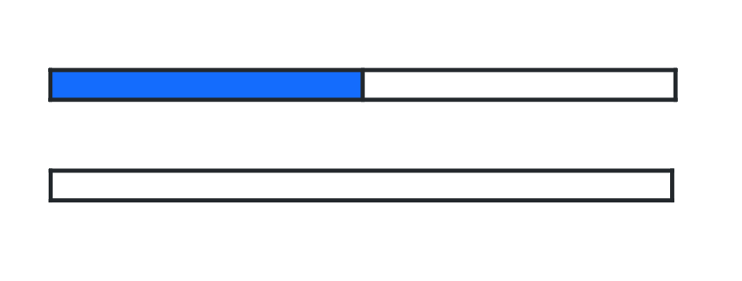
Short response (7)
Draw a fraction strip.
Use your knowledge of what half looks like to divide your strip into thirds.
Notes:
Short response questions provide brisk paced questions focussing on review of current and previous content to support spaced and interleaved practice.
Syllabus focus area:
Partitioned fractions A

Slide 16
Short response (8)
Order these units of time from shortest to longest:
one minute
one hour
one second
Notes:
Short response questions provide brisk paced questions focussing on review of current and previous content to support spaced and interleaved practice.
Syllabus focus area:
Non-spatial measure B (Note: Stage 1 content reviewed)

Slide 17
Activity 2 – equivalent number sentences (1)
27 + 13 = 11 + 29
Notes:
This is a developing number sense activity.
Number sense refers to a deep understanding of numbers, including their magnitude, relationships, and the effects of operations on them. It supports fluency and understanding, estimation, flexible thinking, and efficient problem-solving. Number sense activities 1–4 ‘activate’ prior number knowledge and support the learning of new content in the unit. Number sense activities 5–8 ‘loop’ back and provide opportunity for spaced practice with concepts and procedures covered in previous units.
Syllabus focus area:
Additive relations A
Equivalent number sentences
This resource corresponds to Resource 17 – true or false? in Stage 2 Unit 6.
This activity is an adaptation of True or false? from NRICH by the University of Cambridge.
Ask students if the number sentence is true or false. Students turn and talk to a partner to justify their answer.
Ask students how they know whether a particular number sentence is true or false.
Emphasise to students that ‘=’ means ‘has the same value as’ and not just the ‘total’ or the ‘answer’.
NEXT SLIDE:
Resource 17– True or false? and ask students:
Which statements are true?
Which are false?
How do you know?
Can you decide without doing any calculating?
Go through each number sentence one by one as a class.

Slide 18
Activity 2 – equivalent number sentences (2)
19 + 15 = 34 | 34 = 19 + 15
19 + 15 = 15 + 19 | 19 + 15 = 21 + 13
19 + 15 = 34 + 0 | 19 + 15 = 22 + 18
34 = 16 + 17 | 19 + 15 = 20 + 16
19 + 15 = 0 + 34 | 19 + 15 = 34 + 15
34 = 34 | 15 + 19 = 20 + 14
Notes:
This is a developing number sense activity.
Number sense refers to a deep understanding of numbers, including their magnitude, relationships, and the effects of operations on them. It supports fluency and understanding, estimation, flexible thinking, and efficient problem-solving. Number sense activities 1–4 ‘activate’ prior number knowledge and support the learning of new content in the unit. Number sense activities 5–8 ‘loop’ back and provide opportunity for spaced practice with concepts and procedures covered in previous units.
Syllabus focus area:
Additive relations A
Equivalent number sentences continued
This resource corresponds to Resource 17 – true or false? in Stage 2 Unit 6.
This activity is an adaptation of True or false? from NRICH by the University of Cambridge.
Ask students:
Which statements are true?
Which are false?
How do you know?
Can you decide without doing any calculating?
Go through each number sentence one by one as a class.

Slide 19
Review of learning 3

Slide 20
Multiple choice (2)
Which of the following are equivalent to
12 + 13?
You may select more than one answer.
A
B
C
D
13 + 12​
13 - 12
30 - 5​
13 + 14
Notes:
This question connects to the content in the developing number sense activity (Activity 3)
Syllabus focus area:
Additive relations A

Slide 21
Short response (9)
One thousand is the same as:
_______ hundreds
_______ tens
_______ ones.
Notes:
Short response questions provide brisk paced questions focussing on review of current and previous content to support spaced and interleaved practice.
Syllabus focus area:
Representing number using place value A

Slide 22
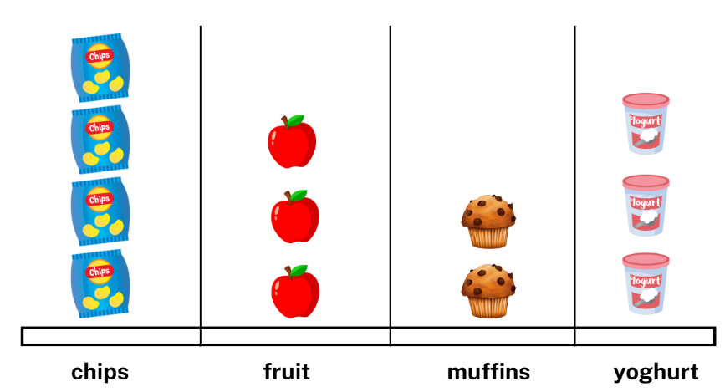
Short response (10)
What is missing that would help us understand the data?
Notes:
Short response questions provide brisk paced questions focussing on review of current and previous content to support spaced and interleaved practice.
Syllabus focus area:
Data A

Slide 23

Short response (11)
How many quarters of the strip are shown by the blue parts?
What fraction of the strip is shown by the
orange part?
Notes:
Short response questions provide brisk paced questions focussing on review of current and previous content to support spaced and interleaved practice.
Syllabus focus area:
Partitioned fractions A

Slide 24

Short response (12)
Record the time shown on this clock.
Notes:
Short response questions provide brisk paced questions focussing on review of current and previous content to support spaced and interleaved practice.
Syllabus focus area:
Non-spatial measure B (Note: Stage 1 content reviewed)

Slide 25
Activity 3 – recognising equal value
1 + 2 | 6 - 2 | 5 + 1 + 1 | 5 - 2 | 7 - 1
10 - 5 | 10 - 3 | 8 - 3 | 1 + 1 + 1 | 9 + 0
8 - 1 | 6 - 1 | 6 - 3 | 9 - 2 | 8 + 3
7 - 4 | 7 - 2 | 4 + 4 | 4 - 2 | 11 - 3
9 - 4 | 10 - 2 | 1 + 1 | 3 + 2 | 3 + 7 + 2
9 - 1 | 10 - 8 | 4 + 1 | 5 + 2 + 1 | 5 + 7 - 0
5 - 3 | 3 + 2 + 1 | 5 + 2 + 2 | 2 + 0 | 6 + 2
3 + 1 + 2 | 5 + 1 + 3 | 2 + 1 + 1 | 10 - 4 | 1 + 1 + 1
2 + 7 | 3 + 1 | 9 - 3 | 10 - 1 | 6 - 3
2 + 2 + 0 | 8 - 2 | 1 + 8 | 5 - 1 | 10 - 2
Notes:
This is a developing number sense activity.
Number sense refers to a deep understanding of numbers, including their magnitude, relationships, and the effects of operations on them. It supports fluency and understanding, estimation, flexible thinking, and efficient problem-solving. Number sense activities 1–4 ‘activate’ prior number knowledge and support the learning of new content in the unit. Number sense activities 5–8 ‘loop’ back and provide opportunity for spaced practice with concepts and procedures covered in previous units.
Syllabus focus area:
Additive relations A
Recognising equal value
This resource corresponds to Resource of Resource 18 – snap cards in Stage 2 Unit 6.
This activity is an adaptation of Same Name snap from NZ Maths by New Zealand Ministry of Education.
The game can be played in pairs or in small groups. Provide a set of Resource 18 – snap cards to each group.
Students shuffle all the cards and hand them out so that each player has the same number of cards.
Each player takes it in turns to place their cards one on top of another in a pile in the middle. If 2 cards have number sentences of equal value, the first student to recognise this can call out ‘same value’. For example, if 2 + 3 is placed on top of 1 + 4, a student must say ‘Same value! 5!’
The student then collects the pile of cards from the middle and the game starts again.
The player with the greatest number of cards at the end of the game wins.

Slide 26
Review of learning 4

Slide 27
True or false (2)
25 – 14 = 28 – 17
True | False
Notes:
The question on this slide connects to the content being explored in the developing number sense activity (Activity 4)
Syllabus focus area:
Additive relations A

Slide 28
Short response (13)
Arrange the following digits to form a 4 different 3-digit numbers:
3, 8, 6
Then, sort these 3-digit numbers into ascending order.
Notes:
Short response questions provide brisk paced questions focussing on review of current and previous content to support spaced and interleaved practice.
Syllabus focus area:
Representing number using place value B

Slide 29
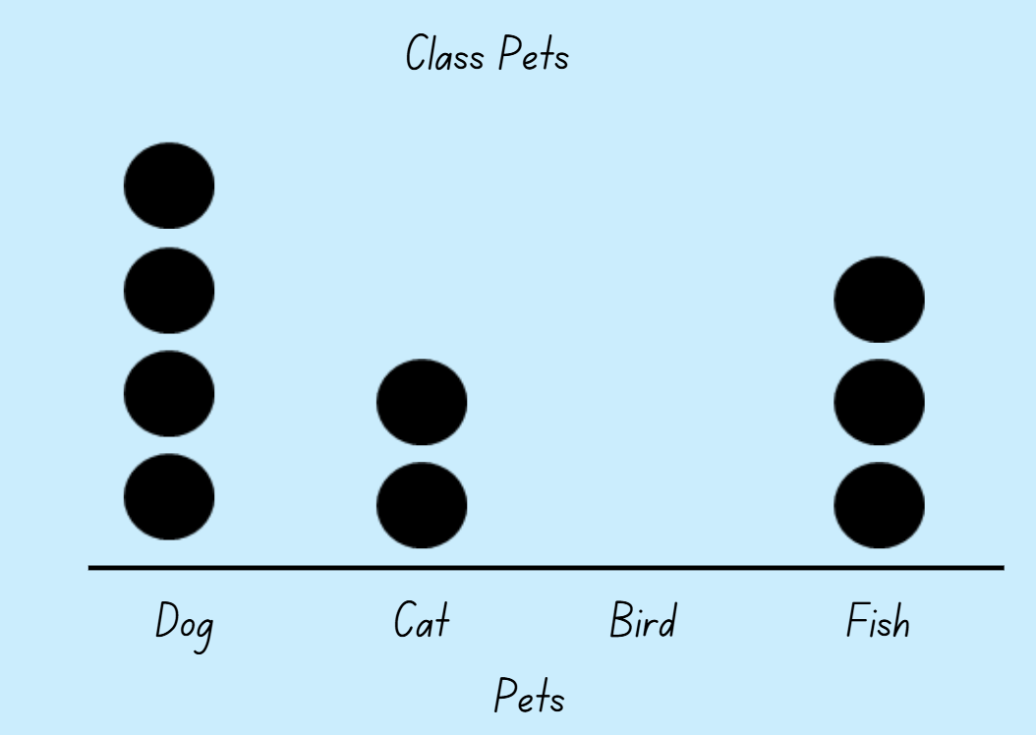
Short response (14)
What data has been collected?
How is it represented?
Notes:
Short response questions provide brisk paced questions focussing on review of current and previous content to support spaced and interleaved practice.
Syllabus focus area:
Data A

Slide 30
Short response (15)
Record the fraction shown in grey that completes one whole.
Notes:
Short response questions provide brisk paced questions focussing on review of current and previous content to support spaced and interleaved practice.
Syllabus focus area:
Partitioned fractions A

Slide 31

Short response (16)
Describe the three-dimensional object using the words face, edge and vertex.
Notes:
Short response questions provide brisk paced questions focussing on review of current and previous content to support spaced and interleaved practice.
Syllabus focus area:
Three-dimensional spatial structure B (Note: Stage 1 content reviewed)

Slide 32
Activity 4 – non-stop equivalence
20 – 14 = 6
Notes:
This is a developing number sense activity.
Number sense refers to a deep understanding of numbers, including their magnitude, relationships, and the effects of operations on them. It supports fluency and understanding, estimation, flexible thinking, and efficient problem-solving. Number sense activities 1–4 ‘activate’ prior number knowledge and support the learning of new content in the unit. Number sense activities 5–8 ‘loop’ back and provide opportunity for spaced practice with concepts and procedures covered in previous units.
Syllabus focus area:
Additive relations A
Non-stop equivalence
Display subtraction number fact on the whiteboard. For example, 20 – 14 = 6.
Think-aloud – “The equals sign means the same as. You need to build a chain of subtraction number sentences that are all the same value.”
In pairs, Student A adds the first subtraction number sentence with the same difference. For example, 20 – 14 = 25 – 19.
Student B adds a different subtraction number sentence with the same difference.
Students continue to take turns to add a subtraction number sentence with the same difference.
After a few minutes, pairs swap individual whiteboards with another pair to check each other’s subtraction chains.

Slide 33
Review of learning 5

Slide 34
Multiple choice (3)
17 – 9 + 13 is the same as:
A
21
B
8
C
22
D
39
Notes:
This question connects to the content in the developing number sense activity (Activity 3)
Syllabus focus area:
Additive relations A

Slide 35
Short response (17)
Partition the following number in
non-standard form.
3725
Notes:
Short response questions provide brisk paced questions focussing on review of current and previous content to support spaced and interleaved practice.
Syllabus focus area:
Representing number using place value A

Slide 36
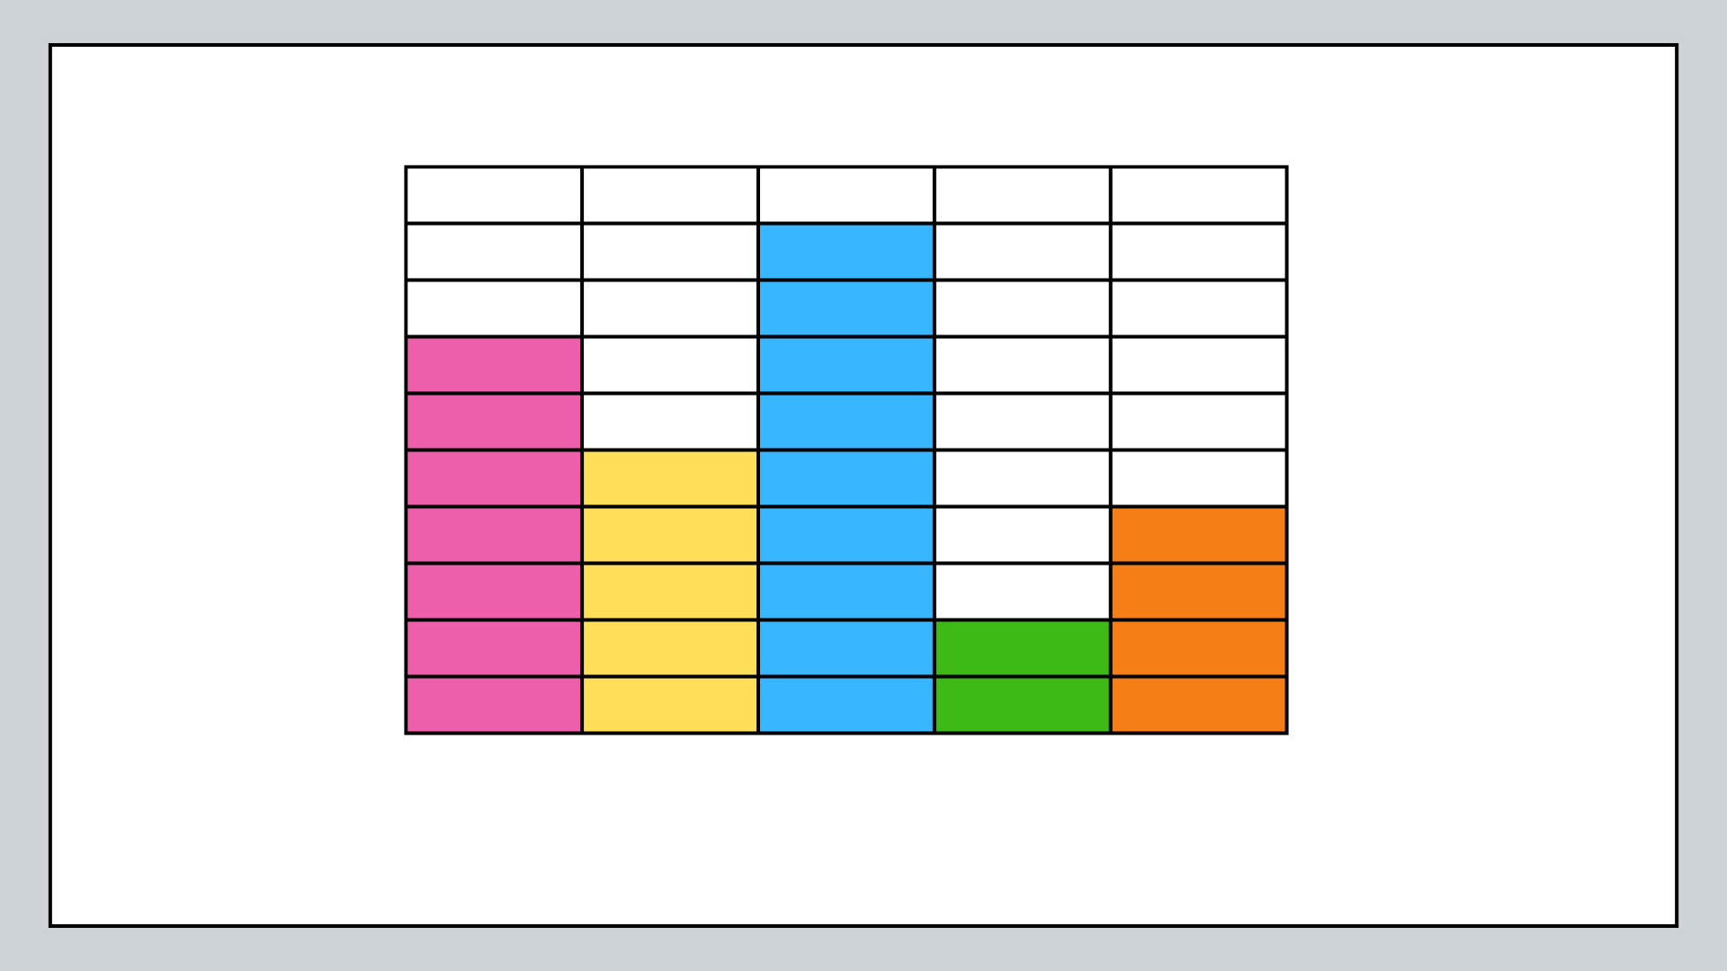
Short response (18)
What data could be represented by this graph?
Record possible labels for the 2 axes.
Notes:
Short response questions provide brisk paced questions focussing on review of current and previous content to support spaced and interleaved practice.
Syllabus focus area:
Data A

Slide 37
Short response (19)
What is the missing fraction quantity that completes one whole?
?
Notes:
Short response questions provide brisk paced questions focussing on review of current and previous content to support spaced and interleaved practice.
Syllabus focus area:
Partitioned fractions A

Slide 38
Short response (20)
Describe a path from where you are sitting to the classroom door.
Notes:
Short response questions provide brisk paced questions focussing on review of current and previous content to support spaced and interleaved practice.
Syllabus focus area:
Geometric measure B (Note: Stage 1 content reviewed)

Slide 39
Activity 5 – use addition and subtraction 1
35
Notes:
This is a developing number sense activity.
Number sense refers to a deep understanding of numbers, including their magnitude, relationships, and the effects of operations on them. It supports fluency and understanding, estimation, flexible thinking, and efficient problem-solving. Number sense activities 1–4 ‘activate’ prior number knowledge and support the learning of new content in the unit. Number sense activities 5–8 ‘loop’ back and provide opportunity for spaced practice with concepts and procedures covered in previous units.
Syllabus focus area:
Additive relations A
Use addition and subtraction 1
This activity is an adaptation of Target Number from Math for Love by Finkel.
Write a 2-digit ‘target’ number on the board. For example, 35.
Using individual whiteboards, students write down as many different number sentences that have the target number as the answer. They must use addition and subtraction in their number sentence. For example, 32 + 7 − 4 = 35.
Students turn and talk to a partner to share one of their number sentences and describe the strategies they used to create it.

Slide 40
Review of learning 6

Slide 41
True or false (3)
24 + 37 = 61 and 61 – 37 = 24
are related number facts.
True | False
Notes:
The question on this slide connects to the content being explored in the developing number sense activity (Activity 6)
Syllabus focus area:
Additive relations A

Slide 42
Short response (21)
1326
How many hundreds are in the hundreds place?
Notes:
Short response questions provide brisk paced questions focussing on review of current and previous content to support spaced and interleaved practice.
Syllabus focus area:
Representing number using place value B

Slide 43
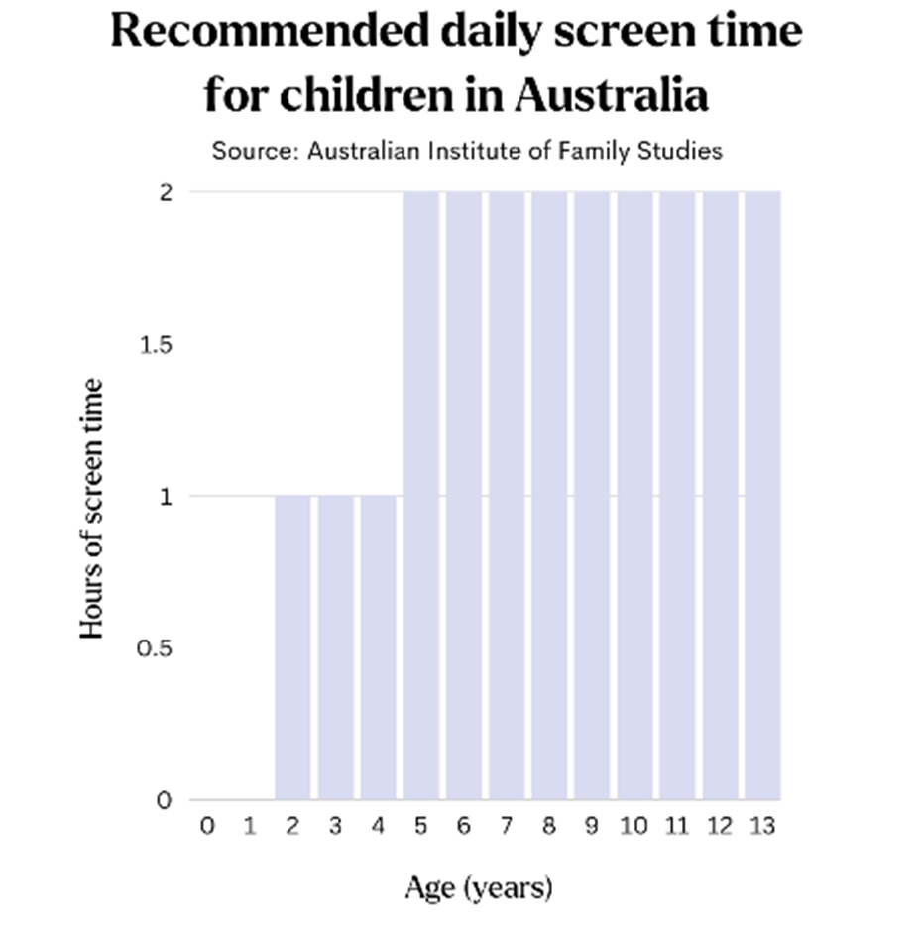
Short response (22)
What is the recommended daily screen time for a
9 year old?
Notes:
Short response questions provide brisk paced questions focussing on review of current and previous content to support spaced and interleaved practice.
Syllabus focus area:
Data A

Slide 44
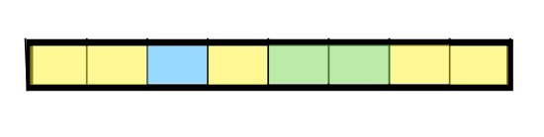
Short response (23)
What fraction is represented by:
blue
yellow
green
Notes:
Short response questions provide brisk paced questions focussing on review of current and previous content to support spaced and interleaved practice.
Syllabus focus area:
Partitioned fractions A

Slide 45
Short response (24)
Make a list of objects in your classroom that are shorter than one metre.
Notes:
Short response questions provide brisk paced questions focussing on review of current and previous content to support spaced and interleaved practice.
Syllabus focus area:
Geometric measure B (Note: Stage 1 content reviewed)

Slide 46
Activity 6 – related addition and subtraction facts
22 + 13 = 35
Notes:
This is a developing number sense activity.
Number sense refers to a deep understanding of numbers, including their magnitude, relationships, and the effects of operations on them. It supports fluency and understanding, estimation, flexible thinking, and efficient problem-solving. Number sense activities 1–4 ‘activate’ prior number knowledge and support the learning of new content in the unit. Number sense activities 5–8 ‘loop’ back and provide opportunity for spaced practice with concepts and procedures covered in previous units.
Syllabus focus area:
Additive relations A
Related addition and subtraction facts
Students determine related addition and subtraction facts from a given number sentence.
Ask students to list on their individual whiteboard all the addition and subtraction facts they know by looking at this number sentence. For example, they should list 13 + 22 = 35, 35 – 13 = 22 and 35 – 22 = 13.
Students display and compare individual whiteboards.
Repeat for different number sentences, alternating between starting with addition and subtraction number sentences.

Slide 47
Review of learning 7

Slide 48
Multiple choice (4)
50 – 7– 3 –10 =
12 + 18 + 10
A
7 + 13 + 10
B
10 + 3 + 7 + 50
C
12 + 8 + 10
D
Notes:
This question connects to the content in the developing number sense activity (Activity 7)
Syllabus focus area:
Additive relations A

Slide 49

Short response (25)
Interactive 120 number chart
Use the bridging the decade strategy to solve:
43 + 58
49
Notes:
Short response questions provide brisk paced questions focussing on review of current and previous content to support spaced and interleaved practice.
Syllabus focus area:
Additive relations A

Slide 50
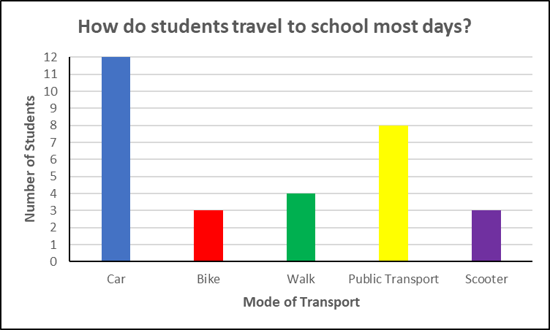
Short response (26)
What is the most common way to travel to school?
How many more students travel by car than by walking?
How many students were surveyed?
Notes:
Short response questions provide brisk paced questions focussing on review of current and previous content to support spaced and interleaved practice.
Syllabus focus area:
Data A

Slide 51
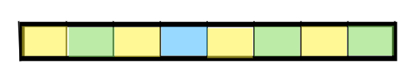
Short response (27)
Sarah said 4-eighths are yellow and Bella said one-half is yellow.
Who is correct?
Communicate your reasoning.
Notes:
Short response questions provide brisk paced questions focussing on review of current and previous content to support spaced and interleaved practice.
Syllabus focus area:
Partitioned fractions B

Slide 52
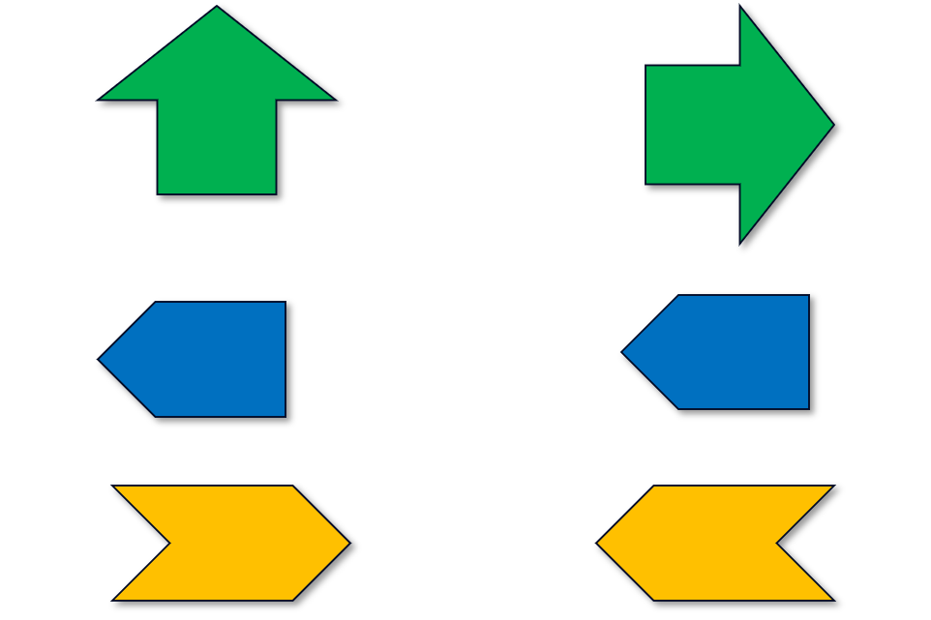
Short response (28)
Describe the turn each shape has made.
Use words such as quarter, half, and full turn.
1.
2.
3.
Notes:
Short response questions provide brisk paced questions focussing on review of current and previous content to support spaced and interleaved practice.
Syllabus focus area:
Two-dimensional spatial structure B (Note: Stage 1 content reviewed)

Slide 53
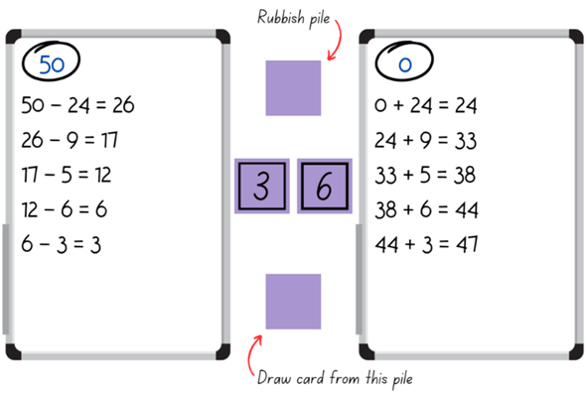
Activity 7 – one adds, one subtracts
Notes:
This is a developing number sense activity.
Number sense refers to a deep understanding of numbers, including their magnitude, relationships, and the effects of operations on them. It supports fluency and understanding, estimation, flexible thinking, and efficient problem-solving. Number sense activities 1–4 ‘activate’ prior number knowledge and support the learning of new content in the unit. Number sense activities 5–8 ‘loop’ back and provide opportunity for spaced practice with concepts and procedures covered in previous units.
Syllabus focus area:
Additive relations A
One adds, one subtracts
This resource corresponds to Resource 17 – playing cards and Figure15 in Stage 2 Unit 6.
Give pairs of students a set of cards from Resource 17 – playing cards. They will also need a whiteboard each to record their number sentences.
One student starts with the number 50 at the top of their whiteboard. Their aim is to subtract numbers until they reach zero. The other student starts with zero at the top of their whiteboard. Their aim is to add numbers until they reach 50.
Students place the cards in a pile between them, face down.
The first student turns over 3 cards. They must select 2 cards for both players to use. These cards can be used individually or combined to make a 2-digit number. If a 2-digit number is made, both students must use the exact same number. The card that is not selected is discarded to a rubbish pile.
Both students record their number sentence on their individual whiteboard.
Ask students the following:
What do you think will happen if 2-digit numbers continue to be added or subtracted to each list?
How many turns do you think will be needed to reach your target number?
The second student repeats this process by turning over 3 cards from the top of the pile and choosing which 2 to keep and use.
The game continues, with the players taking turns to select the cards and recording their individual number sentences until a player hits their target number (see Figure 15).
If time permits, students swap roles and play again. Prior to playing, have students predict whether they'll finish at the same time.
Note: the power in this activity comes from the students noticing what is happening as they progress through the game. As each player is using the same numbers, students should both reach their target number at the same time. A class discussion of how and why this happens is an important teaching opportunity.

Slide 54
Review of learning 8

Slide 55
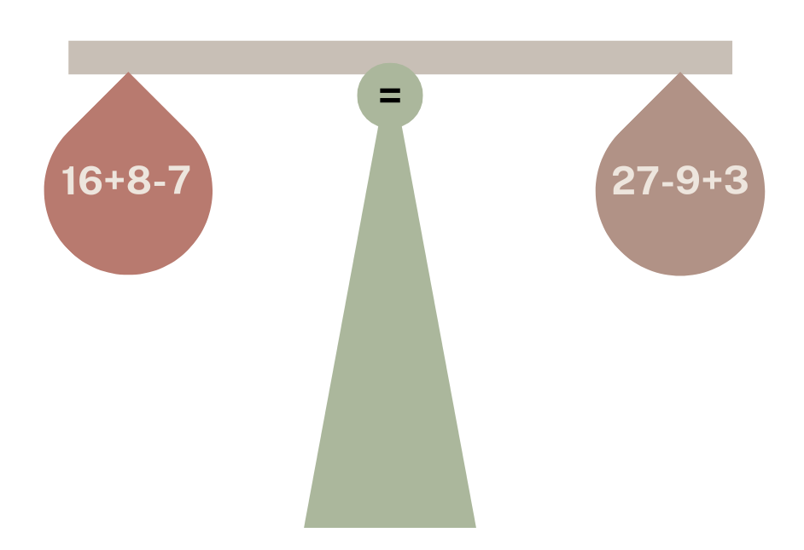
True or false (4)
True | False
Notes:
The question on this slide connects to the content being explored in the developing number sense activity (Activity 8)
Syllabus focus area:
Additive relations A

Slide 56
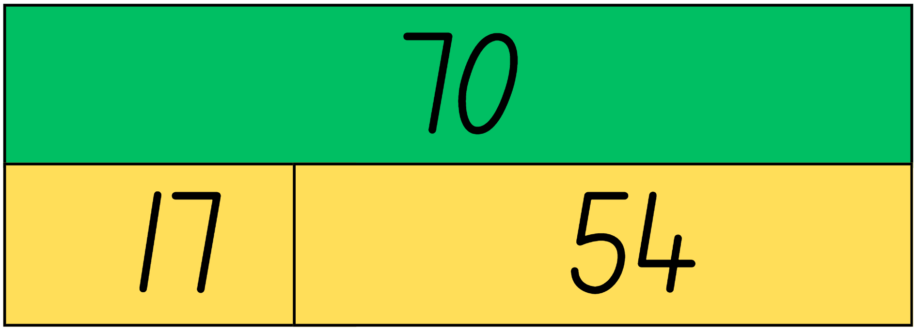
Short response (29)
Use this bar model to complete the number sentences
70 – 17 =
70 – 54 =
70 = ___ + ___
Notes:
Short response questions provide brisk paced questions focussing on review of current and previous content to support spaced and interleaved practice.
Syllabus focus area:
Additive relations A

Slide 57
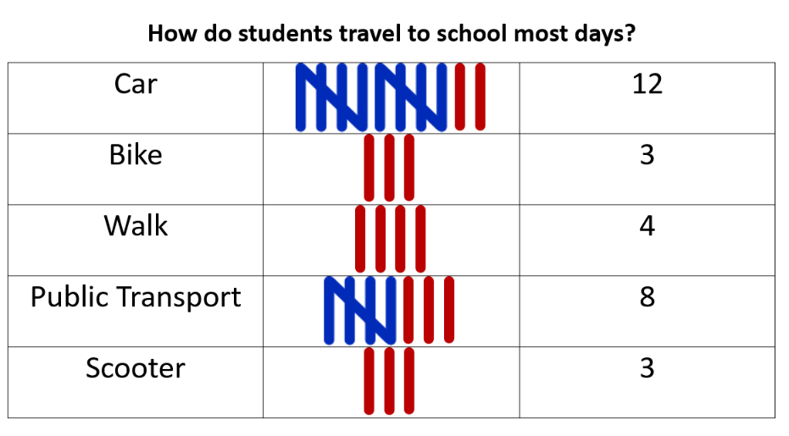
Short response (30)
Compare the column graph and tally table.
Which do you find easier to understand?
Communicate your reasoning.
Notes:
Short response questions provide brisk paced questions focussing on review of current and previous content to support spaced and interleaved practice.
Syllabus focus area:
Data A

Slide 58
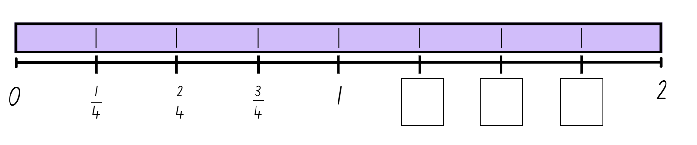
Short response (31)
Record the missing fractions.
Notes:
Short response questions provide brisk paced questions focussing on review of current and previous content to support spaced and interleaved practice.
Syllabus focus area:
Partitioned fractions B

Slide 59
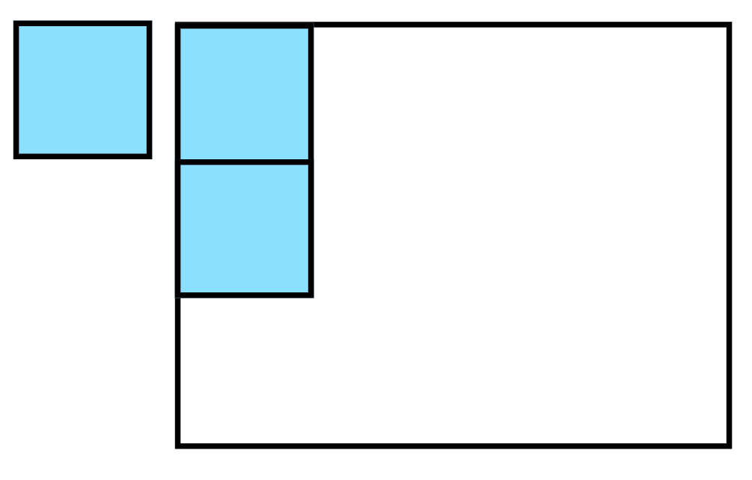
Short response (32)
Use the blue square to calculate the area of the larger white rectangle.
Notes:
Short response questions provide brisk paced questions focussing on review of current and previous content to support spaced and interleaved practice.
Syllabus focus area:
Two-dimensional spatial structure B (Note: Stage 1 content reviewed)

Slide 60
Activity 8 – use addition and subtraction 2
Target Number: 35
32 + 7 − 4 = 35
30 + 20 – 15 = 35
60− 30 + 5 = 35
27 + 22 – 2 = 35
Notes:
This is a developing number sense activity.
Number sense refers to a deep understanding of numbers, including their magnitude, relationships, and the effects of operations on them. It supports fluency and understanding, estimation, flexible thinking, and efficient problem-solving. Number sense activities 1–4 ‘activate’ prior number knowledge and support the learning of new content in the unit. Number sense activities 5–8 ‘loop’ back and provide opportunity for spaced practice with concepts and procedures covered in previous units.
Syllabus focus area:
Additive relations A
Use addition and subtraction 2
This activity is an adaptation of Target Number from Math for Love by Finkel.
Write a 2-digit ‘target’ number on the board.
Using individual whiteboards, students write down as many different number sentences that have the target number as the answer. They must use addition and subtraction in their number sentence. For example, 32 + 7 − 4 = 35.
Students turn and talk to a partner to share one of their number sentences and describe the strategies they used to create it.

Slide 61
Double Venn diagram
Object 1
Object 2
Features similar to both objects
Features of object 1
Features of object 2

Slide 62
Frayer
Definition
Facts/Characteristics
Word, term, concept
Examples
Non-examples

Slide 63
Spider map
Idea
Subject

Slide 64
Cline
Concept 1
Concept 2
Word
Word
Word
Word
Word
Word
Word
Word
Word
Word
Word

Slide 65

Compare and contrast

Slide 66
Multiple choice (5)
A
B
C
D

Slide 67
Multiple choice
A
B
C
D
Notes:
This question connects to the content in the developing number sense activity (Activity 3)
Syllabus focus area:
[Focus area A/B]

Slide 68
References
This presentation contains NSW Curriculum and syllabus content. The NSW Curriculum is developed by the NSW Education Standards Authority. This content is prepared by NESA for and on behalf of the Crown in the right of the State of New South Wales. The material is protected by Crown copyright.
Please refer to the NESA Copyright Disclaimer for more information https://educationstandards.nsw.edu.au/wps/portal/nesa/mini-footer/copyright.
NESA holds the only official and up-to-date versions of the NSW Curriculum and syllabus documents. Please visit the NSW Education Standards Authority (NESA) website https://educationstandards.nsw.edu.au/wps/portal/nesa/home and the NSW Curriculum website https://curriculum.nsw.edu.au.
Finkel D (2015) ‘Target Number’, Free Lessons, Math for Love website, accessed 12 August 2024.​
Murphy SJ (n.d.) Earth Day Hooray! (Adriani R illus), MathStart website, accessed 12 August 2024.​
Primary Learning (2018) Balancing Act – A dice game [PDF 250 KB], Primary Learning, accessed 12 August 2024.​
State of New South Wales (Department of Education) (n.d.) Chicken Scramble School Sport Unit, NSW Department of Education, accessed 12 August 2024​
University of Cambridge (Faculty of Mathematics) (1997–2023) True or False?, NRICH website, accessed 12 August 2024.​
New Zealand Ministry of Education (2025) ‘Equality and equations’, Algebra, Tāhūrangi - New Zealand Curriculum website, accessed 13 September 2025.
Australian Institute of Family Studies (2021) Too much time on screens? Screen time effects and guidelines for children and young people, Australian Institute of Family Studies website, accessed 10 August 2025.

Slide 69
Copyright
© State of New South Wales (Department of Education), 2025
The copyright material published in this resource is subject to the Copyright Act 1968 (Cth) and is owned by the NSW Department of Education or, where indicated, by a party other than the NSW Department of Education (third-party material).
Copyright material available in this resource and owned by the NSW Department of Education is licensed under a Creative Commons Attribution 4.0 International (CC BY 4.0) license.
This license allows you to share and adapt the material for any purpose, even commercially.
Attribution should be given to © State of New South Wales (Department of Education), 2025.
Material in this resource not available under a Creative Commons license:
the NSW Department of Education logo, other logos and trademark-protected material
Material owned by a third party that has been reproduced with permission. You will need to obtain permission from the third party to reuse its material.
Links to third-party material and websites
Please note that the provided (reading/viewing material/list/links/texts) are a suggestion only and implies no endorsement, by the New South Wales Department of Education, of any author, publisher, or book title. School principals and teachers are best placed to assess the suitability of resources that would complement the curriculum and reflect the needs and interests of their students.
If you use the links provided in this document to access a third party’s website, you acknowledge that the terms of use, including licence terms set out on the third-party’s website apply to the use which may be made of the materials on that third-party website or where permitted by the Copyright Act 1968 (Cth). The department accepts no responsibility for content on third-party websites.

