Slide 1
Instructions for use
This resource is not a teaching and learning program. It should be used in conjunction with Stage 2 Year A Unit 7.
Classroom teachers are encouraged to add and adapt slides as required to meet the needs of their students.
Save a copy of the file to make changes to the slide deck. Go to File > Download a Copy (this downloads a copy to the computer to edit in the PowerPoint app).
To convert the PowerPoint to Google Slides:
  Upload the file into Google Drive and open it.
  Go to File > Save as Google Slides.
  (Note – conversion may cause formatting changes in the slides.)

Slide 2

Review of Learning
Mathematics Stage 2 – Unit 7
Notes:
Reviews may include a combination of question types, requiring students to recall facts and key ideas, as well as apply their knowledge to solve problems and answer questions. To support active engagement, a mix of techniques should be employed.” (AERO, 2024).
This Review of Learning slide deck revisits key concepts from the following units:
Stage 2 Year A Unit 5
Stage 2 Year A Unit 6
Stage 3 Year A Unit 7
It also includes opportunities to review prior learning in non-number content, supporting consolidation across focus areas.
The review of learning resources include three key task types that support the development of mathematical proficiency through retrieval, spaced practice, and active participation. These practices complement the review phase (activating prior knowledge) embedded within the beginning of each lesson.
1.
Multiple-choice questions/True or false: Designed to promote active retrieval of key concepts and identify common misconceptions in number, supporting consolidation, understanding and fluency.
These questions:
support spaced and interleaved practice
help identify and address common misconceptions
support active recall and immediate feedback
support whole class participation
identify areas requiring reteach
2.
Short-response question sets: Carefully grouped questions that encourage spaced and interleaved practice across multiple focus areas, helping students revisit and apply knowledge from different points in time.
These questions:
have a combination of question types
address a range of focus areas
build automaticity and fluency
support active recall
allow for immediate feedback
identify content requiring reteach
3.
Developing number sense activities: A variety of practical, purposeful tasks that reinforce current learning and build on prior knowledge. These activities promote reasoning, problem-solving and conceptual understanding.
The review of learning resources are designed to work support teaching and learning in mathematics. For the most effective implementation, use the resources flexibly, adapting to meet student learning needs and individual classroom contexts.

Slide 3
Lessons
1
Review of learning 1
5
Review of learning 5
2
Review of learning 2
6
Review of learning 6
3
Review of learning 3
7
Review of learning 7
4
Review of learning 4
8
Review of learning 8
Notes:
Teacher notes:
Click lesson numbers to go to specific lessons
Interactive features can be viewed in slide show

Slide 4
Review of learning 1

Slide 5

Multiple choice (1)
You may select one or more options.
5768 is the same as:
A
576 hundreds and 8 ones
B
5 thousands, 7 hundreds, 6 tens and 8 ones
C
57 tens and 68 ones
D
57 hundreds, 6 tens and 8 ones.
Notes:
This question connects to the content in the developing number sense activity (Activity 1)
Syllabus focus area:
Representing numbers using place value A

Slide 6

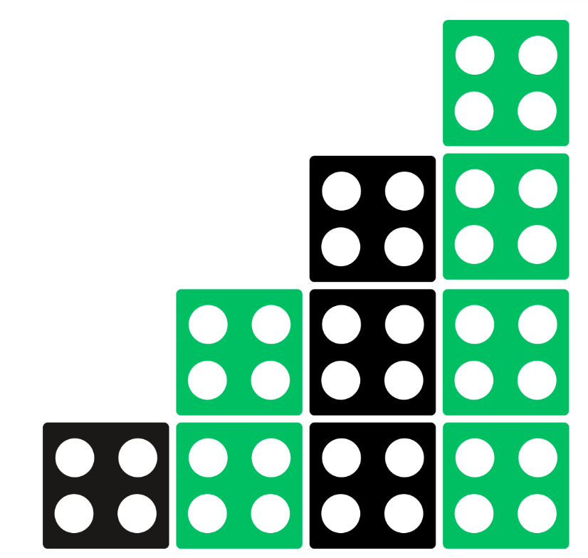
Short response (1)
Using words such as each, multiple, pattern, group, increase, decrease, record the rules for this pattern.
Notes:
Short response questions provide brisk paced questions focussing on review of current and previous content to support spaced and interleaved practice.
Syllabus focus area:
Multiplicative Relations A

Slide 7
Short response (2)
Fill in the missing numbers:
1490, _____, 1510, 1520, _____
_____, 2437, 2537, _____, 2737
3499, 3399, _____, ______
Notes:
Short response questions provide brisk paced questions focussing on review of current and previous content to support spaced and interleaved practice.
Syllabus focus area:
Representing numbers using place value A

Slide 8
Short response (3)
Write a possible list of categories for the question:
What is your hair colour?
Notes:
Short response questions provide brisk paced questions focussing on review of current and previous content to support spaced and interleaved practice.
Syllabus focus area:
Data A

Slide 9
Short response (4)
How many millimetres are in one centimetre?
What is the abbreviation for millimetres?
Notes:
Short response questions provide brisk paced questions focussing on review of current and previous content to support spaced and interleaved practice.
Syllabus focus area:
Geometric measure A

Slide 10

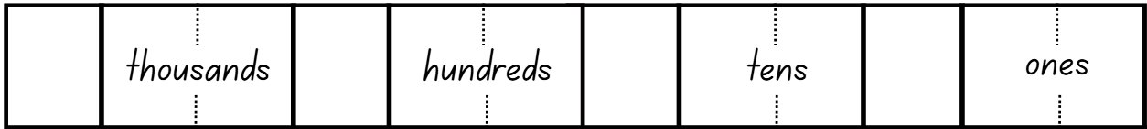
Activity 1 – partitioning and regrouping
Notes:
This is a developing number sense activity.
Number sense refers to a deep understanding of numbers, including their magnitude, relationships, and the effects of operations on them. It supports fluency and understanding, estimation, flexible thinking, and efficient problem-solving. Number sense activities 1–4 ‘activate’ prior number knowledge and support the learning of new content in the unit. Number sense activities 5–8 ‘loop’ back and provide opportunity for spaced practice with concepts and procedures covered in previous units.
Syllabus focus area:
Representing numbers using place value A
Partitioning and regrouping
This resource corresponds to Resource 19 – number expander in Stage 2 Year A Unit 7.
Provide students with Resource 19 - number expander. (see Figure 9)
Model how to fold the number expander (see Figure 10)
Explain how the number expander assists in understanding place value and renaming numbers into non-standard forms.
Model how to use the number expander by rolling a die four times, each time stating the positional value and recording on paper or individual whiteboard. For example, ‘I rolled an 8. I will make this 8 tens, which means eighty’.
Ask students to explain where to place other numbers rolled. For example, ‘I will write the 6 in the hundreds place, which means six hundred’.
After modelling all the positional parts of the number, say and write the number formed.
Fold the number expander to show other ways to partition the number. (see Figure 11)
Check for understanding by asking students to hold up their number expanders. Provide feedback and correction as required.

Slide 11
Review of learning 2

Slide 12
True or false (1)
Using non-standard partitioning, there are no hundreds in the number 4099.
True | False
Notes:
The question on this slide connects to the content being explored in the developing number sense activity (Activity 2)
Syllabus focus area:
Representing numbers using place value A

Slide 13
Short response (5)
Record the number pattern that starts at 36 and decreases by 4.
Notes:
Short response questions provide brisk paced questions focussing on review of current and previous content to support spaced and interleaved practice.
Syllabus focus area:
Multiplicative Relations A

Slide 14
Short response (6)
Regroup these numbers using standard place value:
1322
7809
Notes:
Short response questions provide brisk paced questions focussing on review of current and previous content to support spaced and interleaved practice.
Syllabus focus area:
Representing Numbers using place value A

Slide 15
Short response (7)
Some categorical responses are:
Read in the library, go to the canteen, play on the oval.
What question might have been asked?
Notes:
Short response questions provide brisk paced questions focussing on review of current and previous content to support spaced and interleaved practice.
Syllabus focus area:
Data A

Slide 16

Short response (8)
Estimate and determine the perimeter of this quadrilateral.
8 metres
Notes:
Short response questions provide brisk paced questions focussing on review of current and previous content to support spaced and interleaved practice.
Syllabus focus area:
Geometric Measure B

Slide 17
Activity 2 – role of zero
3809
Notes:
This is a developing number sense activity.
Number sense refers to a deep understanding of numbers, including their magnitude, relationships, and the effects of operations on them. It supports fluency and understanding, estimation, flexible thinking, and efficient problem-solving. Number sense activities 1–4 ‘activate’ prior number knowledge and support the learning of new content in the unit. Number sense activities 5–8 ‘loop’ back and provide opportunity for spaced practice with concepts and procedures covered in previous units.
Syllabus focus area:
Representing numbers using place value A
Role of zero
This resource corresponds to Resource 19 – number expander in Stage 2 Year A Unit 7.
Provide students with Resource 19 – number expander and ask them to write the numbers based on their positional value.
Display the number 3809 on the number expander. Ask:
What do you notice about the zero?
What do you wonder about the zero?
Explain to students that the zero means there are no tens in this number.
Using interactive or concrete MAB materials, ask students to work in small groups to model 3809.

Slide 18
Review of learning 3

Slide 19
Multiple choice (2)
The number that is 10 more than 4890 is:
A
4900
B
4880
C
4800
D
4990
Communicate your reasoning.
Notes:
This question connects to the content in the developing number sense activity (Activity 3)
Syllabus focus area:
Representing numbers using place value A

Slide 20
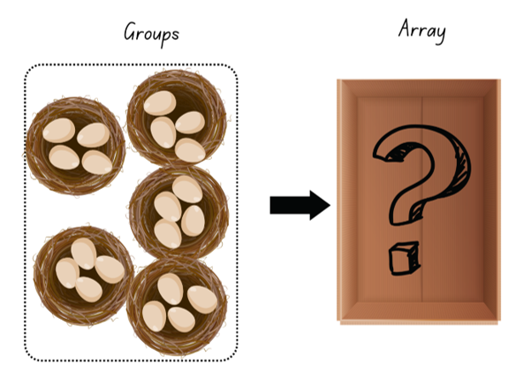
Short response (5)
Create an array for these eggs and describe it.
Notes:
Short response questions provide brisk paced questions focussing on review of current and previous content to support spaced and interleaved practice.
Syllabus focus area:
Multiplicative Relations A

Slide 21
Short response (10)
Reorder the digits in each number to create the largest number possible
7831
7281
9001
Communicate your reasoning.
Notes:
Short response questions provide brisk paced questions focussing on review of current and previous content to support spaced and interleaved practice.
Syllabus focus area:
Representing numbers using place value B

Slide 22
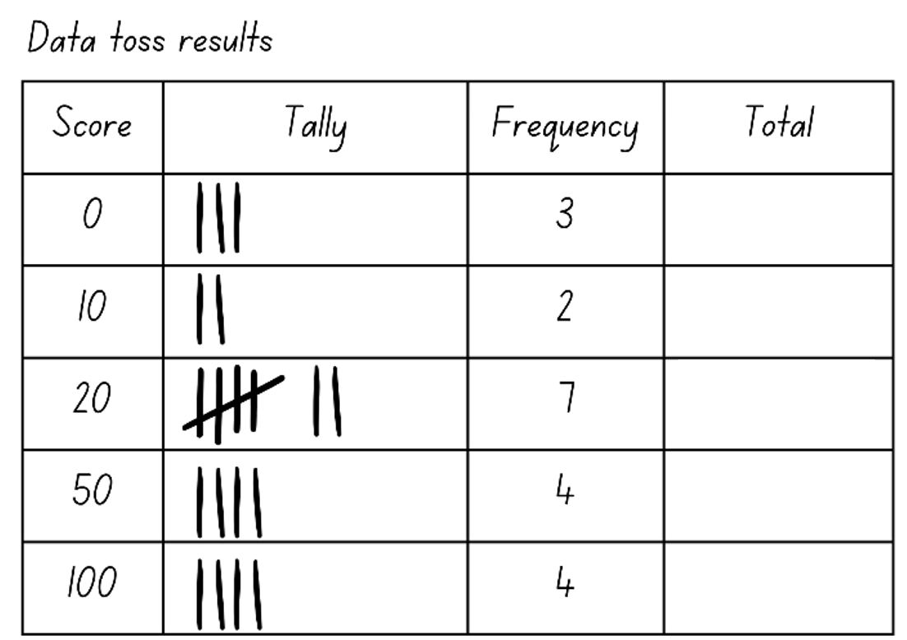
Short response (11)
Complete the total column.
Notes:
Short response questions provide brisk paced questions focussing on review of current and previous content to support spaced and interleaved practice.
Syllabus focus area:
Data A

Slide 23

Short response (12)
Gabby said a rhombus has two pairs of parallel sides, all sides are not equal, but the opposite angles are equal.
Is she right?
Communicate your thinking.
Notes:
Short response questions provide brisk paced questions focussing on review of current and previous content to support spaced and interleaved practice.
Syllabus focus area:
Two-dimensional spatial structure A

Slide 24
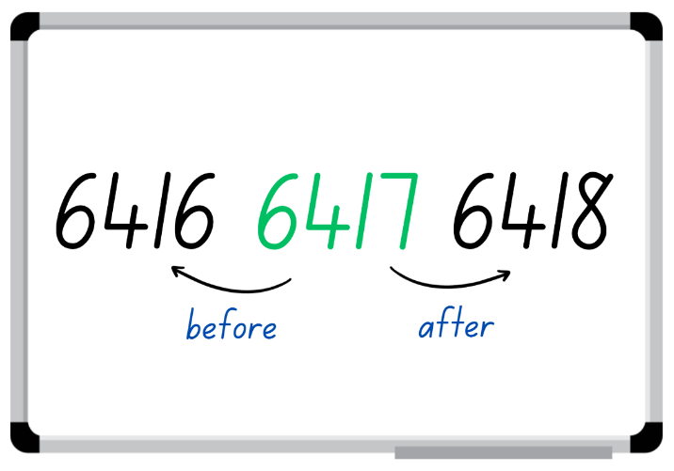
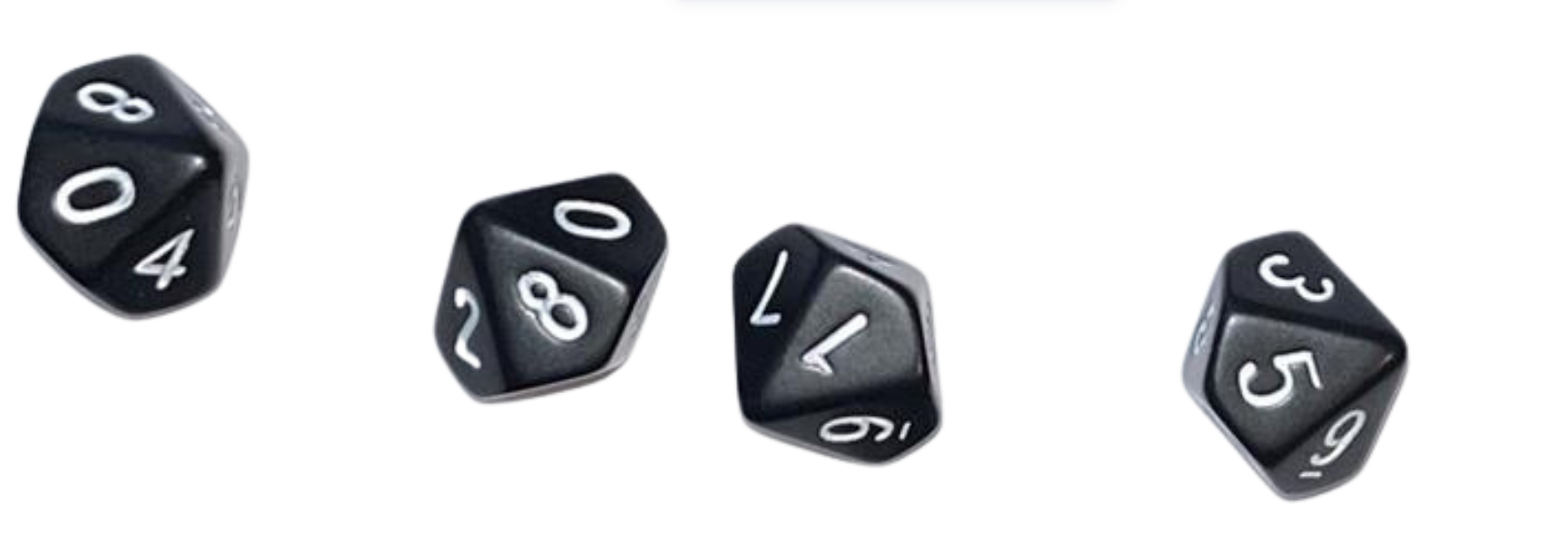
Activity 3 – before and after
D10 Dice Roller - Roll a Virtual D10 Die
Notes:
This is a developing number sense activity.
Number sense refers to a deep understanding of numbers, including their magnitude, relationships, and the effects of operations on them. It supports fluency and understanding, estimation, flexible thinking, and efficient problem-solving. Number sense activities 1–4 ‘activate’ prior number knowledge and support the learning of new content in the unit. Number sense activities 5–8 ‘loop’ back and provide opportunity for spaced practice with concepts and procedures covered in previous units.
Syllabus focus area:
Representing numbers using place value A
Before and After
Provide students with a 10-sided die or use the link onscreen to use virtual die.
Students roll the die 4 times to make a 4-digit number and record it in the middle of their individual whiteboard.
Students identify and record the number before and the number after their 4-digit number (see Figure 12).
Modify the activity by asking students to record the number 10, 100 or 1000 before and after their number.
Select students to justify how they know a number is one, 10, 100, or 1000 before or after their number.
Students repeat the steps with other 4-digit numbers.
Check for understanding by providing exit ticket questions:
What number comes after 6257?
What number comes before 6257?
What number is 10 after 6257?
What number is 10 before 6257?
What number is 100 after 6257?
What number is 100 before 6257?

Slide 25
Review of learning 4

Slide 26
True or false (2)
6589 is 100 less than 6489.
True | False
Communicate your reasoning.
Notes:
The question on this slide connects to the content being explored in the developing number sense activity (Activity 4)
Syllabus focus area:
Representing numbers using place value A

Slide 27
Short response (13)
Record multiples of 2 and 4.
What do you notice about the multiples of 4 compared to the multiples of 2?
Notes:
Short response questions provide brisk paced questions focussing on review of current and previous content to support spaced and interleaved practice.
Syllabus focus area:
Multiplicative Relations A

Slide 28
Short response (14)
Partition these numbers using non- standard forms:
2009
6789
Notes:
Short response questions provide brisk paced questions focussing on review of current and previous content to support spaced and interleaved practice.
Syllabus focus area:
Representing numbers using place value A

Slide 29
Short response (15)
List the attributes of a dot plot.
Notes:
Short response questions provide brisk paced questions focussing on review of current and previous content to support spaced and interleaved practice.
Syllabus focus area:
Data A

Slide 30
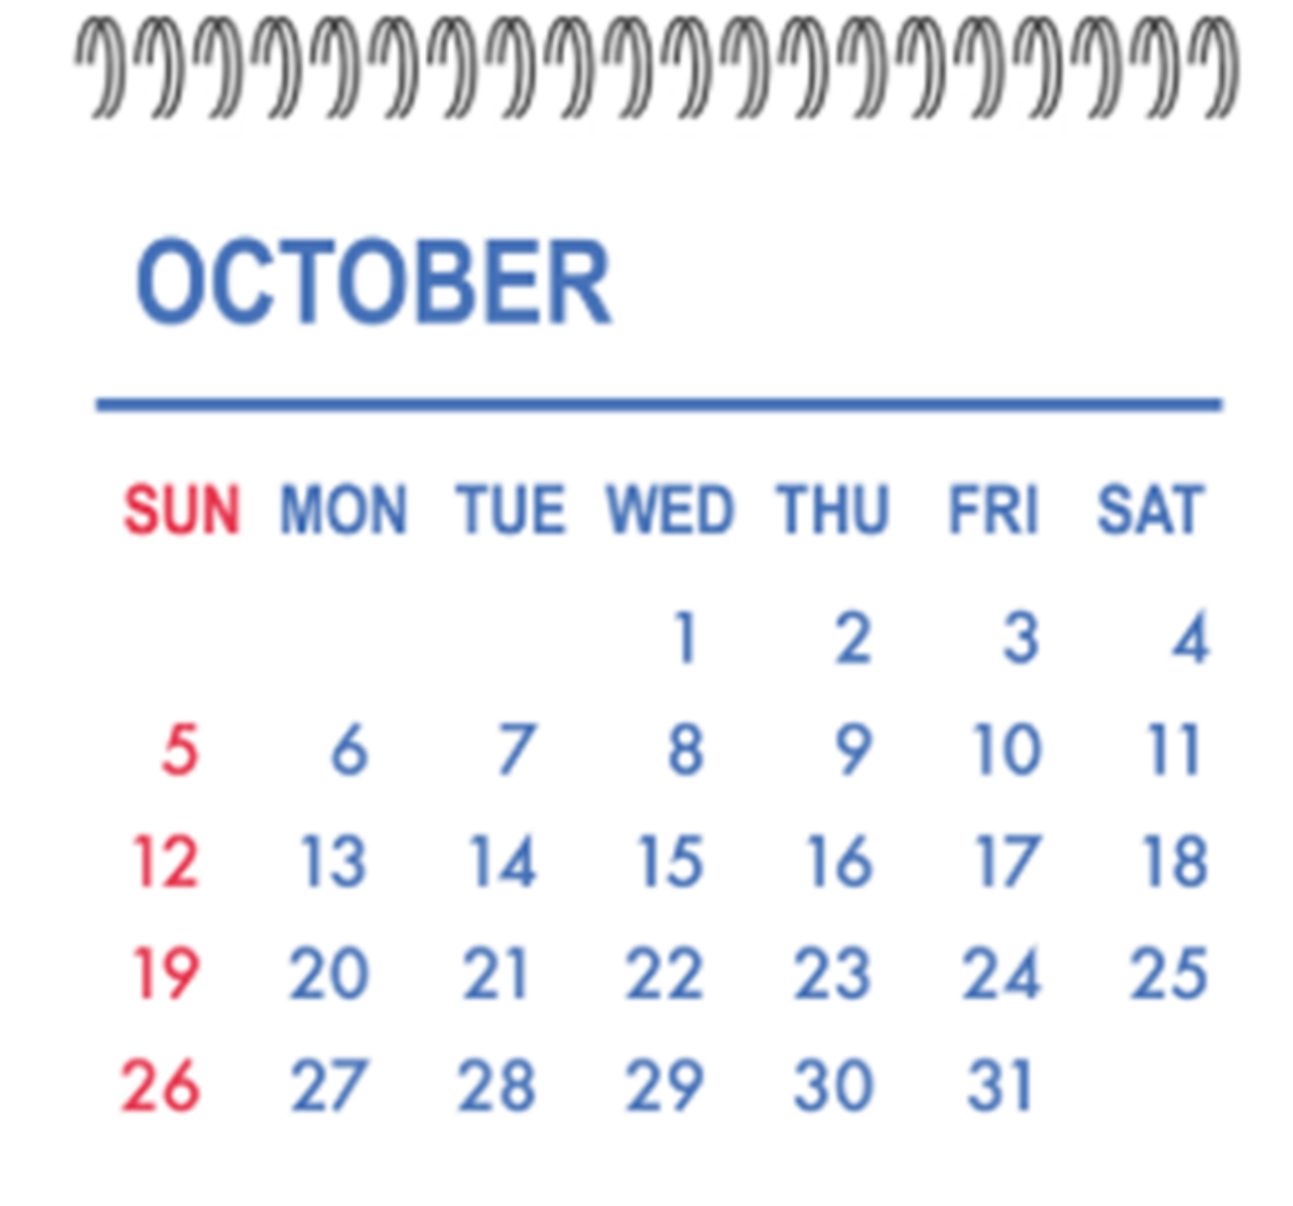
Short response (16)
Today is the first day of October.
Jessica’s birthday is on the Monday 20 October. How many days until Jessica’s birthday?
Notes:
Short response questions provide brisk paced questions focussing on review of current and previous content to support spaced and interleaved practice.
Syllabus focus area:
Non-spatial measure B: Time (Note: Stage 1 content reviewed)

Slide 31
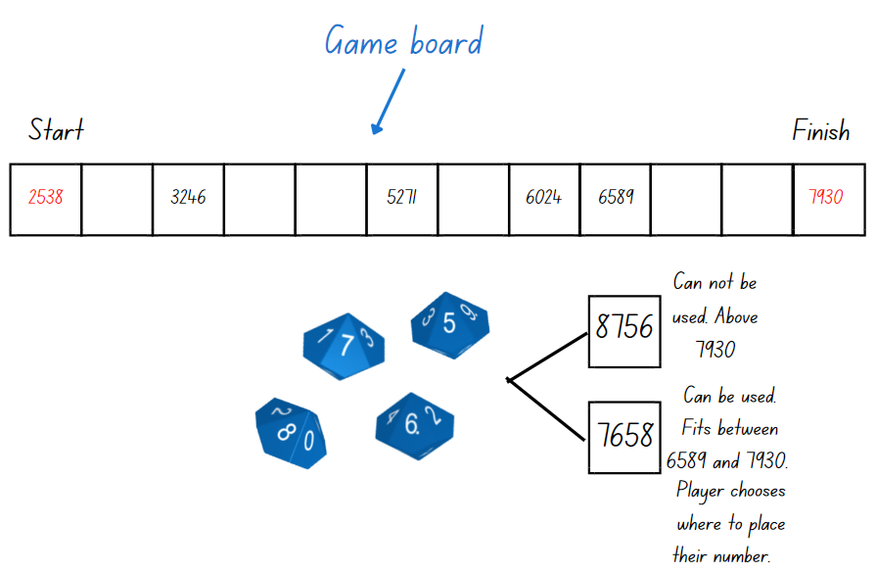
Activity 4 – representing 4-digit numbers
Notes:
This is a developing number sense activity.
Number sense refers to a deep understanding of numbers, including their magnitude, relationships, and the effects of operations on them. It supports fluency and understanding, estimation, flexible thinking, and efficient problem-solving. Number sense activities 1–4 ‘activate’ prior number knowledge and support the learning of new content in the unit. Number sense activities 5–8 ‘loop’ back and provide opportunity for spaced practice with concepts and procedures covered in previous units.
Syllabus focus area:
Representing numbers using place value A
Representing 4-digit numbers
This resource corresponds to Figure 13 in Stage 2 Year A Unit 7.
Provide pairs of students with writing materials and four 10-sided dice.
One student draws a gameboard with at least 12 squares.
Students set the starting and finishing numbers and write them on the gameboard.
The first player rolls the dice to form a number. The player must decide where to place the number on the gameboard so that the sequence of numbers remains in order.
Model to students an example of how to play. (See Figure 13)
The winner is the person who completes the sequence of numbers.

Slide 32
Review of learning 5

Slide 33
Multiple choice (3)
Complete the pattern: 27, 23,19, __
A
12
B
15
C
13
D
23
Communicate your reasoning.
Notes:
This question connects to the content in the developing number sense activity (Activity 3)
Syllabus focus area:
Multiplicative relations A

Slide 34
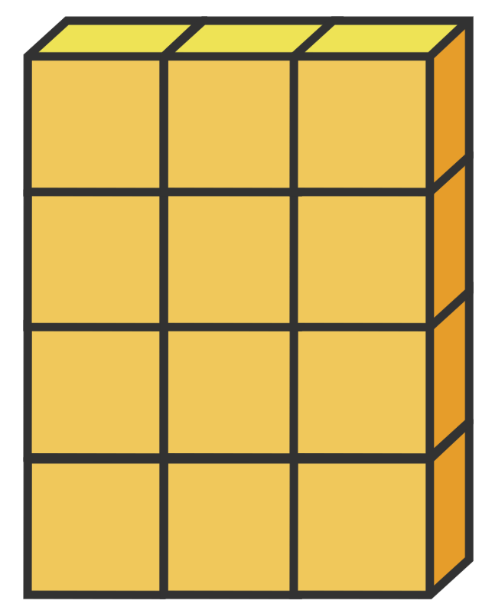
Short response (17)
Halve the number of blocks and create a matching division equation.
Notes:
Short response questions provide brisk paced questions focussing on review of current and previous content to support spaced and interleaved practice.
Syllabus focus area:
Multiplicative Relations A

Slide 35
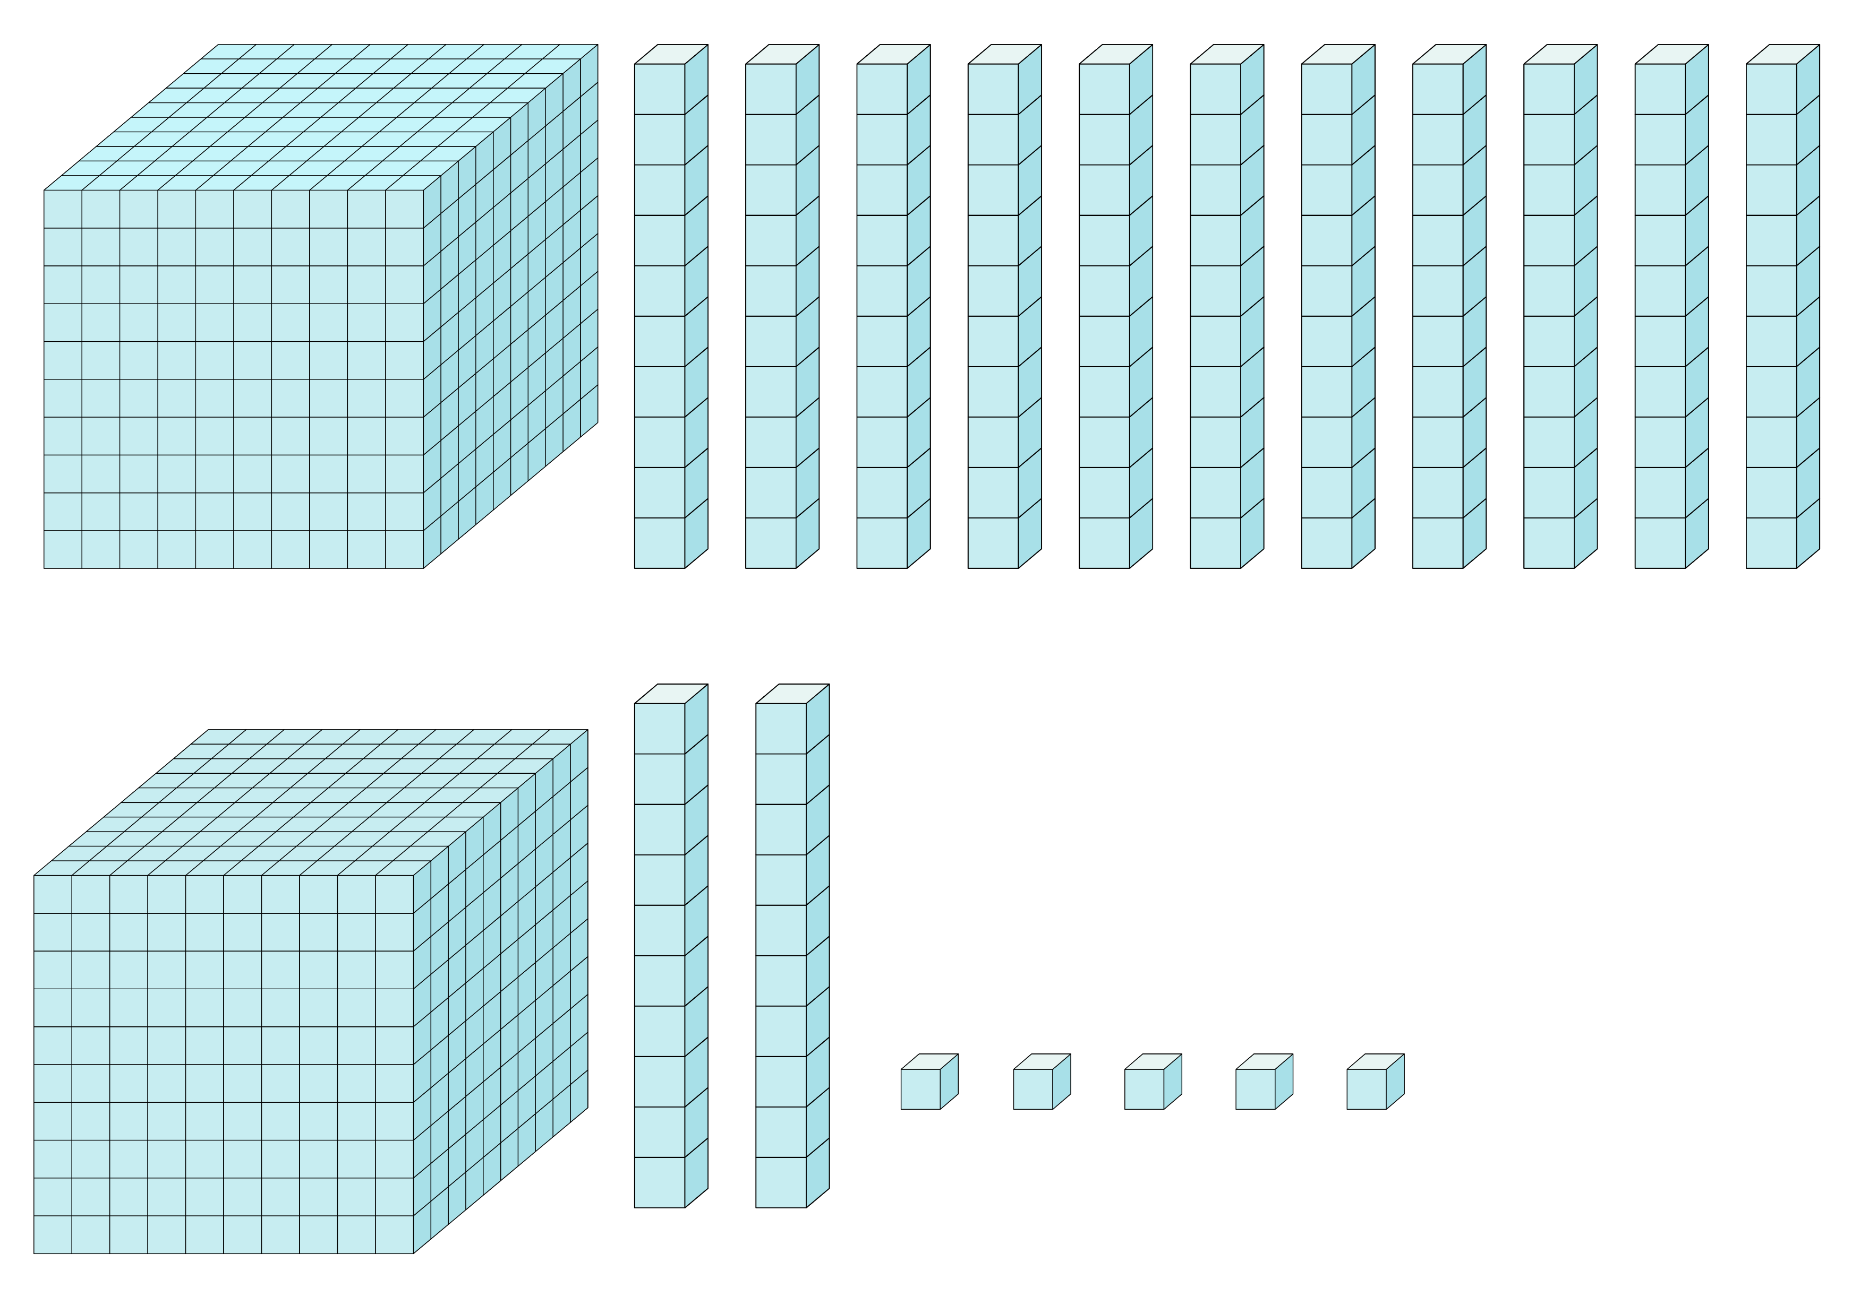
Short response (18)
Identify the number of thousands, hundreds, tens and ones in this representation.
Notes:
Short response questions provide brisk paced questions focussing on review of current and previous content to support spaced and interleaved practice.
Syllabus focus area:
Representing numbers using place value B

Slide 36
Short response (19)
List the attributes of a column graph.
Notes:
Short response questions provide brisk paced questions focussing on review of current and previous content to support spaced and interleaved practice.
Syllabus focus area:
Data A

Slide 37
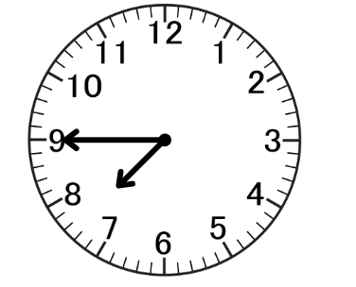
Short response (20)
Jamie said it was quarter past 7.
Is he correct?
Explain your thinking.
Notes:
Short response questions provide brisk paced questions focussing on review of current and previous content to support spaced and interleaved practice.
Syllabus focus area:
Non-spatial measure B: Time (Note: Stage 1 content reviewed)

Slide 38
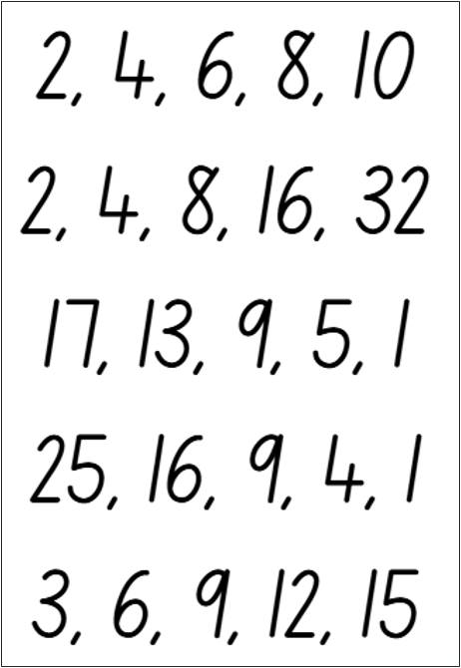
Activity 5 – patterns of multiples
Notes:
This is a developing number sense activity.
Number sense refers to a deep understanding of numbers, including their magnitude, relationships, and the effects of operations on them. It supports fluency and understanding, estimation, flexible thinking, and efficient problem-solving. Number sense activities 1–4 ‘activate’ prior number knowledge and support the learning of new content in the unit. Number sense activities 5–8 ‘loop’ back and provide opportunity for spaced practice with concepts and procedures covered in previous units.
Syllabus focus area:
Multiplicative relations A
Patterns of multiples
This resource corresponds to Resource 20 – number patterns in Stage 2 Year A Unit 7.
Ask:
What do you notice?
What do you wonder?
What is the same and what is different?
Record students’ ideas and vocabulary, such as: even, odd, ascending, descending, larger, smaller, difference, multiple, pattern, rule, core, number, picture, repeated addition, repeated subtraction and square numbers.
Display the definition of a pattern.
Pattern: a pattern in mathematics is made up of several elements that repeat or follow a rule.
Explain that patterns and rules are the foundation for being able to think multiplicatively, which means being able to see the multiplicative relations when working with numbers.
Discuss which patterns are not multiplicative because the numbers are changing by adding or subtracting, not by multiplying. Explain that a multiplicative pattern would involve multiplying by the same number each time.
Check for understanding by asking students to provide the next multiple and justify why they chose that number in the sequence 4, 8, 12, 16, ____

Slide 39
Review of learning 6

Slide 40
True or false (3)
The number pattern decreases by 4:
78, 74, 70, 66
True | False
Notes:
The question on this slide connects to the content being explored in the developing number sense activity (Activity 6)
Syllabus focus area:
Multiplicative relations A

Slide 41
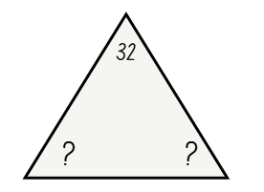
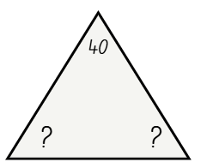
Short response (21)
Record the multiplication fact family for the numbers 32 and 40.
Notes:
Short response questions provide brisk paced questions focussing on review of current and previous content to support spaced and interleaved practice.
Syllabus focus area:
Multiplicative Relations A

Slide 42
Short response (22)
Use the bridging strategy to solve
47 + 35
Record your thinking on an empty number line.
Notes:
Short response questions provide brisk paced questions focussing on review of current and previous content to support spaced and interleaved practice.
Syllabus focus area:
Additive Relations A

Slide 43
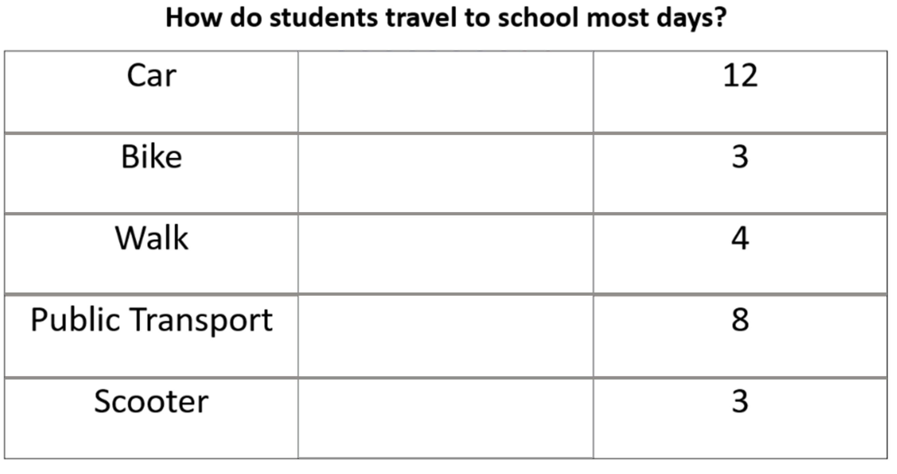
Short response (23)
Record the missing tally marks.
Notes:
Short response questions provide brisk paced questions focussing on review of current and previous content to support spaced and interleaved practice.
Syllabus focus area:
Data A

Slide 44

Short response (24)
How many faces, edges and vertices does this three-dimensional object have?
Notes:
Short response questions provide brisk paced questions focussing on review of current and previous content to support spaced and interleaved practice.
Syllabus focus area:
Three-dimensional spatial structure B: 3D objects (Note: Stage 1 content reviewed)

Slide 45
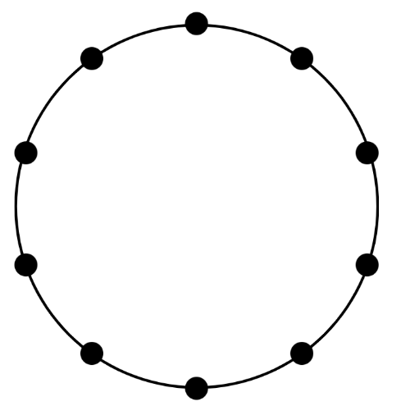
Activity 6 – comparing number patterns
Notes:
This is a developing number sense activity.
Number sense refers to a deep understanding of numbers, including their magnitude, relationships, and the effects of operations on them. It supports fluency and understanding, estimation, flexible thinking, and efficient problem-solving. Number sense activities 1–4 ‘activate’ prior number knowledge and support the learning of new content in the unit. Number sense activities 5–8 ‘loop’ back and provide opportunity for spaced practice with concepts and procedures covered in previous units.
Syllabus focus area:
Multiplicative relations A
Comparing number patterns
This resource corresponds to Resource 21 – number circles in Stage 2 Year A Unit 7
Display 10 steps of a twos pattern, starting from zero. For example, 0, 2, 4, 6, 8, 10 and so on.
In pairs, students draw the same twos pattern starting from zero in a number circle. Students verbalise the counting pattern when moving clockwise around the circle.
Display 5 steps of a twos pattern, starting from one. For example, 1, 3, 5, 7, 9, 11 and so on.
Ask students what is the same and what is different. Record student responses.
Provide students with another copy of Resource 21 – number circles.
Students select pairs of patterns to investigate starting from zero and from one. Number patterns can be altered to meet the learning needs of students. Investigations could include a:
twos pattern and fours pattern
threes pattern and sixes pattern
fours pattern and eights pattern
fives pattern and tens pattern
Ask students to explain what they noticed about the patterns they recorded in the number circle.
Conclude with a circle game where students take turns to recite multiple number patterns both forwards and backwards. Provide feedback and correction as required.

Slide 46
Review of learning 7

Slide 47
Multiple choice (4)
76, 68,__, 52, __, 36.
The number pattern:
A
increases by 8 each time
B
decreases by 8 each time
C
increases by 9 each time
D
decreases by 7 each time
Notes:
This question connects to the content in the developing number sense activity (Activity 3)
Syllabus focus area:
Multiplicative relations A

Slide 48
Short response (25)
Draw an array of 6 rows of 6.
Next, record the 4 related multiplication and division facts for the array.
Notes:
Short response questions provide brisk paced questions focussing on review of current and previous content to support spaced and interleaved practice.
Syllabus focus area:
Multiplicative Relations A

Slide 49
Short response (26)
Use the constant difference strategy to solve:
62 - 18
Notes:
Short response questions provide brisk paced questions focussing on review of current and previous content to support spaced and interleaved practice.
Syllabus focus area:
Additive relations A

Slide 50
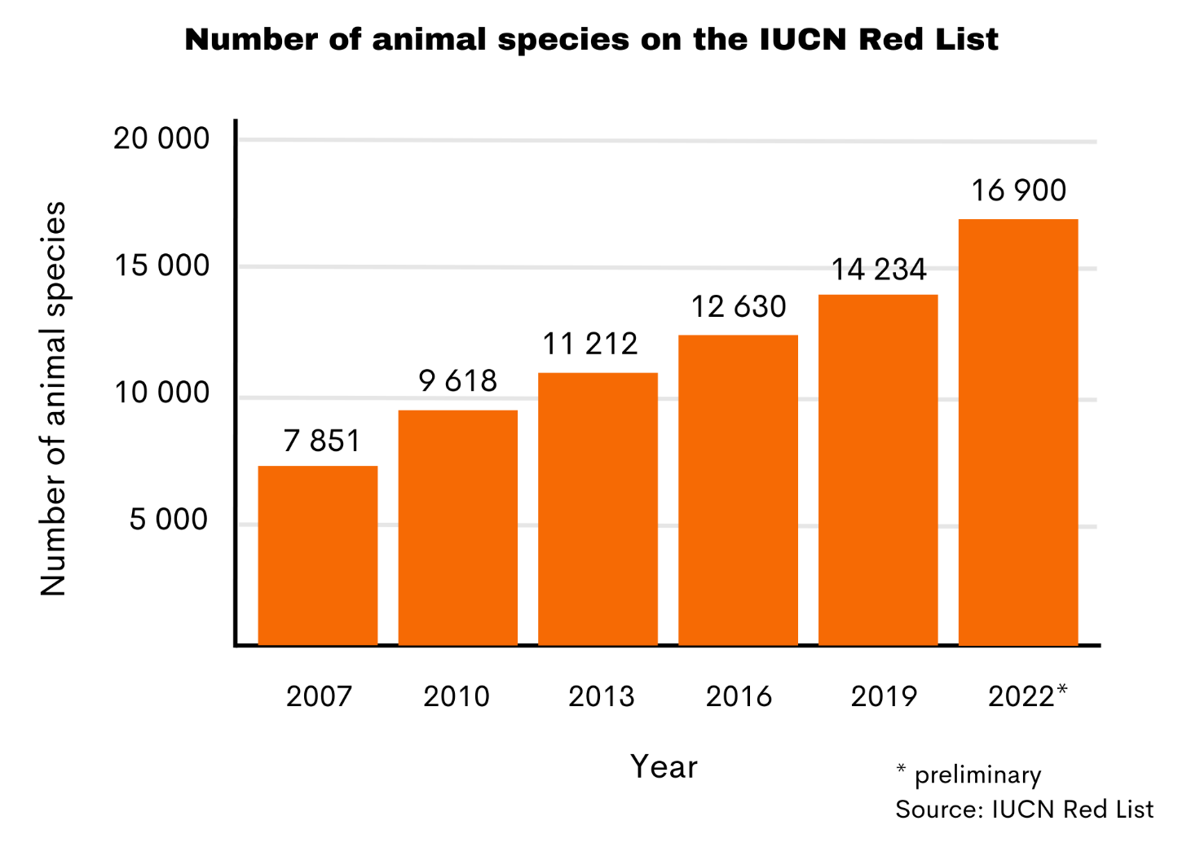
Short response (27)
What is the difference between animal species on the IUCN red list from 2007 to 2010?
Which year saw the largest increase of animals on the list?
Notes:
Short response questions provide brisk paced questions focussing on review of current and previous content to support spaced and interleaved practice.
Syllabus focus area:
Data A

Slide 51
Short response (28)
What shape am I?
Draw and label the shapes to match the clues.
1. I have eight straight sides and eight angles. You might see me on a STOP sign!
2. I have straight sides. I have fewer sides than a square. I have three corners.
3. I am a two-dimensional shape with six sides and six angles.
Notes:
Short response questions provide brisk paced questions focussing on review of current and previous content to support spaced and interleaved practice.
Syllabus focus area:
Two-dimensional spatial structure A: 2D shapes (Note: Stage 1 content reviewed)

Slide 52
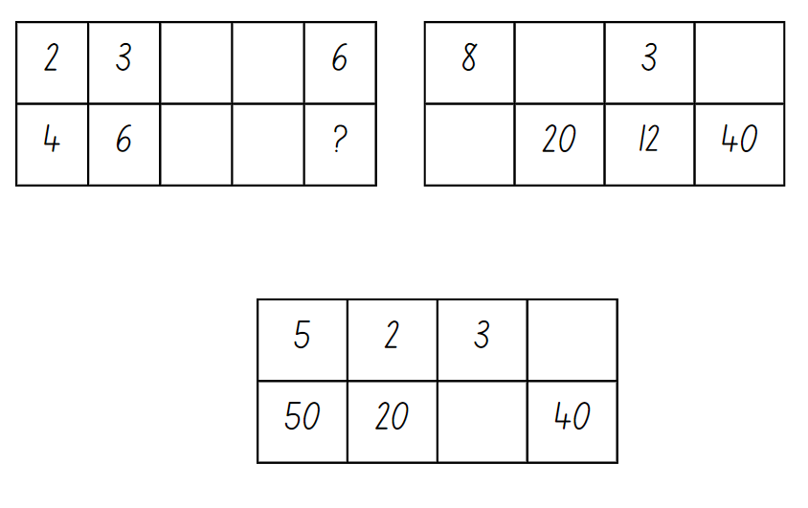
Activity 7 – multiplicative relationships (1)
Notes:
This is a developing number sense activity.
Number sense refers to a deep understanding of numbers, including their magnitude, relationships, and the effects of operations on them. It supports fluency and understanding, estimation, flexible thinking, and efficient problem-solving. Number sense activities 1–4 ‘activate’ prior number knowledge and support the learning of new content in the unit. Number sense activities 5–8 ‘loop’ back and provide opportunity for spaced practice with concepts and procedures covered in previous units.
Syllabus focus area:
Multiplicative relations A
Multiplicative Relationships
This resource corresponds to Resource 22 – multiplicative tables 1 in Stage 2 Year A Unit 7.
This activity has been adapted from Enrich-e-matics – Book 3, 3rd edition by Joshua.
Examine each table one at a time. Ask students to identify the multiplicative relationship between the number pairs. Invite students to nominate other pairs that belong in each table.
Activity continues on next slide.
Students turn and talk to nominate missing numbers and a rule that applies to this table.
Discuss that possible answers for whole numbers include multiplying by 1, 2, 4, 5, 10, 20.
Ask students why 3, 6, 7, 8 and 9 are not possible multipliers for whole numbers. Select students to share and justify why one of these numbers is not possible. (Not every whole number has 3, 6, 7, 8, or 9 as a factor. For a number to have one of these as a factor, it must be divisible by that number.)
This activity can be extended with students making their own tables.
Provide feedback and correction as required based on responses.

Slide 53
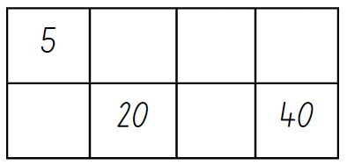
Activity 7 – multiplicative relationships (2) (2)
Notes:
This is a developing number sense activity.
Number sense refers to a deep understanding of numbers, including their magnitude, relationships, and the effects of operations on them. It supports fluency and understanding, estimation, flexible thinking, and efficient problem-solving. Number sense activities 1–4 ‘activate’ prior number knowledge and support the learning of new content in the unit. Number sense activities 5–8 ‘loop’ back and provide opportunity for spaced practice with concepts and procedures covered in previous units.
Syllabus focus area:
Multiplicative relations A
Multiplicative Relationships
This resource corresponds to Resource 23 – multiplicative tables 2 in Stage 2 Year A Unit 7.
Students turn and talk to nominate missing numbers and a rule that applies to this table.
Discuss that possible answers for whole numbers include multiplying by 1, 2, 4, 5, 10, 20.
Ask students why 3, 6, 7, 8 and 9 are not possible multipliers for whole numbers. Select students to share and justify why one of these numbers is not possible. (Not every whole number has 3, 6, 7, 8, or 9 as a factor. For a number to have one of these as a factor, it must be divisible by that number.)
This activity can be extended with students making their own tables.
Provide feedback and correction as required based on responses.

Slide 54
Review of learning 8

Slide 55
True or false (4)
36, 42, 48 and 52 are all multiples of 6.
True | False
Communicate your reasoning.
Notes:
The question on this slide connects to the content being explored in the developing number sense activity (Activity 8)
Syllabus focus area:
Multiplicative relations A

Slide 56
Short response (29)
8 x __ = 64
64 ÷ 8 = __
Communicate your reasoning.
Notes:
Short response questions provide brisk paced questions focussing on review of current and previous content to support spaced and interleaved practice.
Syllabus focus area:
Multiplicative Relations A

Slide 57
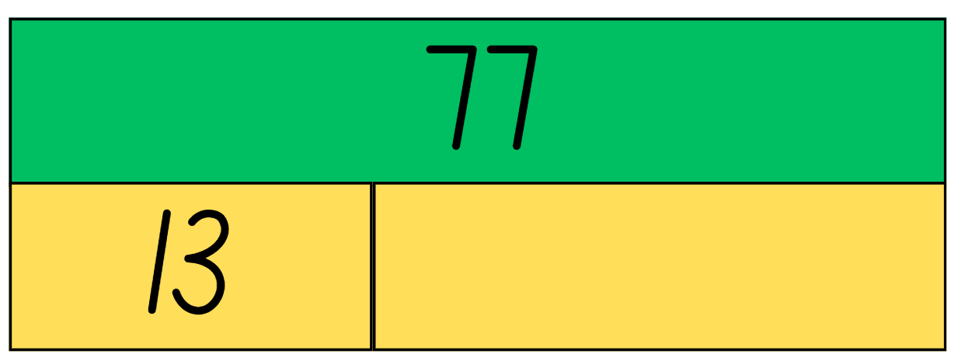
Short response (30)
Record number sentences for this bar model showing how addition and subtraction are inverse operations.
Notes:
Short response questions provide brisk paced questions focussing on review of current and previous content to support spaced and interleaved practice.
Syllabus focus area:
Additive Relations A

Slide 58
Short response (31)
A group of students were asked,
‘How many pets do you have at home?’.
The responses were:
0,0,0,1,1,3,3,3,5,5,4,4,5,6,6.
What effective ways could this data be displayed?
Communicate your reasoning.
Notes:
Short response questions provide brisk paced questions focussing on review of current and previous content to support spaced and interleaved practice.
Syllabus focus area:
Data A

Slide 59
Short response (32)
Record if these events are likely or unlikely to occur:
The school bell will ring at the end of the day.
I will go to the library today.
I will brush my teeth tonight.
Notes:
Short response questions provide brisk paced questions focussing on review of current and previous content to support spaced and interleaved practice.
Syllabus focus area:
Chance B (Note: Stage 1 content reviewed)

Slide 60
Activity 8 – counting in multiples
4, 8, 12, 16, 20
Notes:
This is a developing number sense activity.
Number sense refers to a deep understanding of numbers, including their magnitude, relationships, and the effects of operations on them. It supports fluency and understanding, estimation, flexible thinking, and efficient problem-solving. Number sense activities 1–4 ‘activate’ prior number knowledge and support the learning of new content in the unit. Number sense activities 5–8 ‘loop’ back and provide opportunity for spaced practice with concepts and procedures covered in previous units.
Syllabus focus area:
Multiplicative relations A
Counting in multiples
Review Lesson 1, as required to activate prior knowledge.
Explain that silent counting helps us to recognise patterns and how multiples build.
Explain that to count in multiples of four, they will say the first three numbers quietly in their heads (one, two, three) and then say the fourth number out loud. This fourth number is a multiple of four.
Repeat, and have the students record the sequence for multiples of four on an individual whiteboard (4, 8, 12, 16, 20 … 48).
Explain that this sequence increases by the amount of four each time.
Repeat steps 3 and 4, and have the students say and record the sequence for multiples of 4 from 48.
Explain that this sequence decreases by the amount of four each time.
Check for understanding as students silent count and during their recording of multiples.
Provide feedback and correction as required. (see Figure 14)

Slide 61
Double Venn diagram
Object 1
Object 2
Features similar to both objects
Features of object 1
Features of object 2

Slide 62
Frayer
Definition
Facts/Characteristics
Word, term, concept
Examples
Non-examples

Slide 63
Spider map
Idea
Subject

Slide 64
Cline
Concept 1
Concept 2
Word
Word
Word
Word
Word
Word
Word
Word
Word
Word
Word

Slide 65

Compare and contrast

Slide 66
Multiple choice (5)
A
B
C
D

Slide 67
Multiple choice
A
B
C
D
Notes:
This question connects to the content in the developing number sense activity (Activity 3)
Syllabus focus area:
[Focus area A/B]

Slide 68
References
This presentation contains NSW Curriculum and syllabus content. The NSW Curriculum is developed by the NSW Education Standards Authority. This content is prepared by NESA for and on behalf of the Crown in the right of the State of New South Wales. The material is protected by Crown copyright.
Please refer to the NESA Copyright Disclaimer for more information https://educationstandards.nsw.edu.au/wps/portal/nesa/mini-footer/copyright.
NESA holds the only official and up-to-date versions of the NSW Curriculum and syllabus documents. Please visit the NSW Education Standards Authority (NESA) website https://educationstandards.nsw.edu.au/wps/portal/nesa/home and the NSW Curriculum website https://curriculum.nsw.edu.au.
Mathematics K–10 Syllabus © NSW Education Standards Authority (NESA) for and on behalf of the Crown in right of the State of New South Wales, 2022.
National Numeracy Learning Progression © Australian Curriculum, Assessment and Reporting Authority (ACARA) 2010 to present, unless otherwise indicated. This material was downloaded from the Australian Curriculum website (National Numeracy Learning Progression) (accessed 12 August 2025) and was not modified.
AAMT (The Australian Association of Mathematics Teachers) (2021) Growing Mathematically, AAMT website, accessed 7 June 2023.
Joshua A (2006) Enrich-e-matics – Book 3, 3rd edition, Pearson Education Australia, Melbourne.
Malola M, Stephens M, Symons D (2021) ‘Key Teaching Stages for Developing Multiplicative Thinking in Students’, Australian Mathematical Education Journal, 3(1):9–15 ISSN: ISSN-2652-0176.
Russo T & Russo J (2022) ‘Short Activity: Exploring arrays’, Australian Primary Mathematics Classroom, 27(2):16–17, ISSN: ISSN-1326-0286.
.

Slide 69
References
This presentation contains NSW Curriculum andsyllabus content. The NSW Curriculum is developed by the NSW Education Standards Authority. This content is prepared by NESA for and on behalf of the Crown in the right of the State of New South Wales. The material is protected by Crown copyright.
Please refer to the NESA Copyright Disclaimer for more information https://educationstandards.nsw.edu.au/wps/portal/nesa/mini-footer/copyright.
NESA holds the only official and up-to-date versions of the NSW Curriculum and syllabus documents. Please visit the NSW Education Standards Authority (NESA) website https://educationstandards.nsw.edu.au/wps/portal/nesa/home and the NSW Curriculum website https://curriculum.nsw.edu.au.
.Siemon D, Warren E, Beswick K, Faragher R, Miller J, Horne Marj, Jazby D, Breed M, Clark J, Brady K (2022) Teaching Mathematics: Foundation to middle years, 3rd edn, Oxford University Press, Australia.
Swan P (2003) Dice Dazzlers, A-Z Type, Australia.
University of Cambridge (Faculty of Mathematics) (1997–2023) Round and round the circle, NRICH website, accessed 7 June 2023.
Van de Walle J, Karp K, Bay-Williams JM, Brass A, Bentley B, Ferguson S, Goff W, Livy S, Marshman M, Martin D, Pearn C, Prodromou T, Symons D and Wilkie K (2019) Primary and Middle Years Mathematics: Teaching Developmentally, 1st Australian edn, Pearson Education Australia, Melbourne.
Further reading
Mathematical Association of NSW Inc (2021) Teaching through problem solving Primary and Middle Years, Pamphlet No. 95.
Way J (2014) Using Questioning to Stimulate Mathematical Thinking, NRICH website, accessed 21 June 2023

Slide 70
Copyright
© State of New South Wales (Department of Education), 2025
The copyright material published in this resource is subject to the Copyright Act 1968 (Cth) and is owned by the NSW Department of Education or, where indicated, by a party other than the NSW Department of Education (third-party material).
Copyright material available in this resource and owned by the NSW Department of Education is licensed under a Creative Commons Attribution 4.0 International (CC BY 4.0) license.
This license allows you to share and adapt the material for any purpose, even commercially.
Attribution should be given to © State of New South Wales (Department of Education), 2025.
Material in this resource not available under a Creative Commons license:
the NSW Department of Education logo, other logos and trademark-protected material
Material owned by a third party that has been reproduced with permission. You will need to obtain permission from the third party to reuse its material.
Links to third-party material and websites
Please note that the provided (reading/viewing material/list/links/texts) are a suggestion only and implies no endorsement, by the New South Wales Department of Education, of any author, publisher, or book title. School principals and teachers are best placed to assess the suitability of resources that would complement the curriculum and reflect the needs and interests of their students.
If you use the links provided in this document to access a third party’s website, you acknowledge that the terms of use, including licence terms set out on the third-party’s website apply to the use which may be made of the materials on that third-party website or where permitted by the Copyright Act 1968 (Cth). The department accepts no responsibility for content on third-party websites.

