Slide 1
Instructions for use
This resource is not a teaching and learning program. It should be used in conjunction with Stage 2 Year A Unit 9.
Classroom teachers are encouraged to add and adapt slides as required to meet the needs of their students.
Save a copy of the file to make changes to the slide deck. Go to File > Download a Copy (this downloads a copy to the computer to edit in the PowerPoint app).
To convert the PowerPoint to Google Slides:
  Upload the file into Google Drive and open it.
  Go to File > Save as Google Slides.
  (Note – conversion may cause formatting changes in the slides.)

Slide 2

Review of Learning
Mathematics Stage 2 – Unit 9
Notes:
Reviews may include a combination of question types, requiring students to recall facts and key ideas, as well as apply their knowledge to solve problems and answer questions. To support active engagement, a mix of techniques should be employed.” (AERO, 2024).
This Review of Learning slide deck revisits key concepts from the following units:
Stage 2 Year A Unit 9
Stage 2 Year A Unit 8
Stage 2 Year A Unit 7
It also includes opportunities to review prior learning in non-number content, supporting consolidation across focus areas.
The review of learning resources include three key task types that support the development of mathematical proficiency through retrieval, spaced practice, and active participation. These practices complement the review phase (activating prior knowledge) embedded within the beginning of each lesson.
1.
Multiple-choice questions/True or false: Designed to promote active retrieval of key concepts and identify common misconceptions in number, supporting consolidation, understanding and fluency.
These questions:
support spaced and interleaved practice
help identify and address common misconceptions
support active recall and immediate feedback
support whole class participation
identify areas requiring reteach
2.
Short-response question sets: Carefully grouped questions that encourage spaced and interleaved practice across multiple focus areas, helping students revisit and apply knowledge from different points in time.
These questions:
have a combination of question types
address a range of focus areas
build automaticity and fluency
support active recall
allow for immediate feedback
identify content requiring reteach
3.
Developing number sense activities: A variety of practical, purposeful tasks that reinforce current learning and build on prior knowledge. These activities promote reasoning, problem-solving and conceptual understanding.
The review of learning resources are designed to work support teaching and learning in mathematics. For the most effective implementation, use the resources flexibly, adapting to meet student learning needs and individual classroom contexts.

Slide 3
Lessons
1
Review of learning 1
5
Review of learning 5
2
Review of learning 2
6
Review of learning 6
3
Review of learning 3
7
Review of learning 7
4
Review of learning 4
8
Review of learning 8
Notes:
Teacher notes:
Click lesson titles to go to specific lessons
Interactive features can be viewed in slide show

Slide 4
Review of learning 1

Slide 5

Multiple choice (1)
Which numbers are arranged in ascending order?
A
4092, 4911, 4367, 3489
B
3489, 4092, 4367, 4911
C
3489, 4367, 4092, 4911
D
4911, 4367, 4092, 3489
Notes:
This question connects to the content in the developing number sense activity (Activity 3)
Syllabus focus area:
Representing numbers using place value B: Whole numbers

Slide 6

Short response (2)
Describe a rhombus using the terms:
side
vertex
parallel
Notes:
Short response questions provide brisk paced questions focussing on review of current and previous content to support spaced and interleaved practice.
Syllabus focus area:
Two-dimensional spatial structure A: 2D shapes

Slide 7
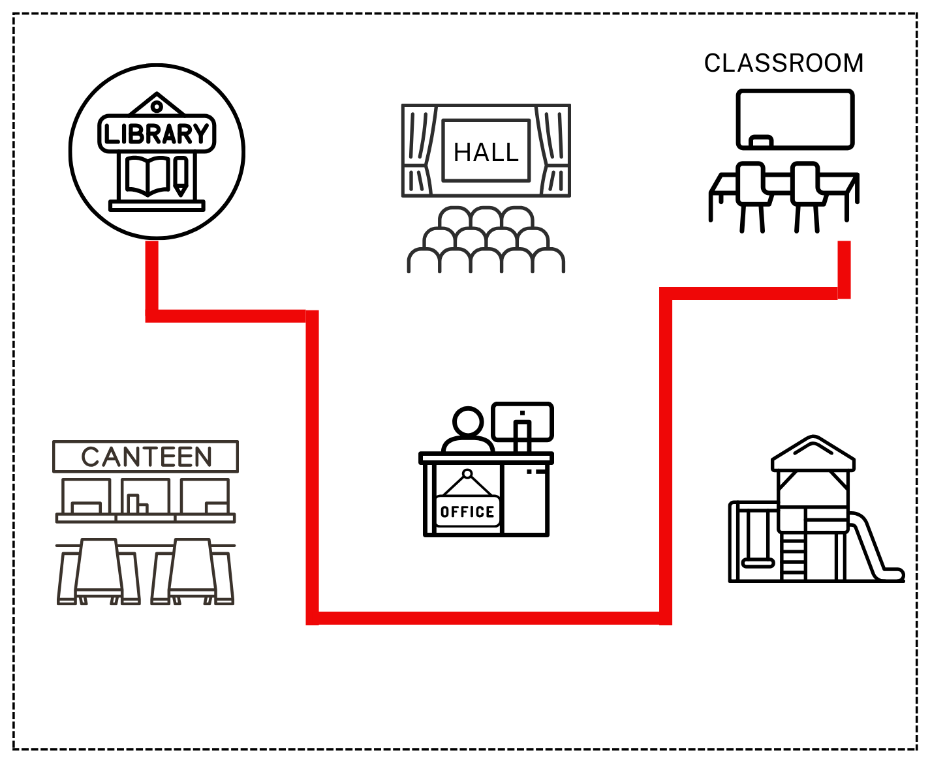
Short response (3)
Describe the route taken using landmarks and directional language.
START
FINISH
Notes:
Short response questions provide brisk paced questions focussing on review of current and previous content to support spaced and interleaved practice.
Syllabus focus area:
Geometric measure A: Position

Slide 8
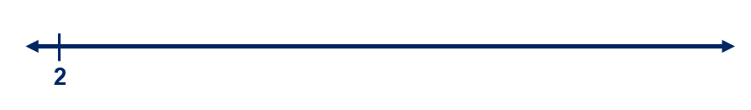
Short response (4)
Draw a number line starting at 2.
Record the next five numbers in the pattern, increasing by 4.
Record the pattern on your number line.
Notes:
Short response questions provide brisk paced questions focussing on review of current and previous content to support spaced and interleaved practice.
Syllabus focus area:
Multiplicative relations A

Slide 9
Short response (5)
Are all shapes with 4 sides rectangles?
Communicate your thinking.
Notes:
Short response questions provide brisk paced questions focussing on review of current and previous content to support spaced and interleaved practice.
Syllabus focus area:
Two-dimensional spatial structure A

Slide 10

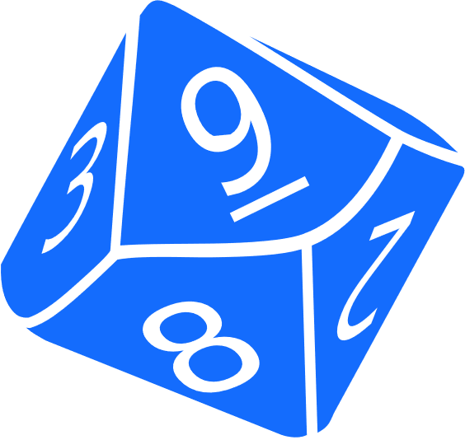
Activity 1 – ascending and descending order
Create and arrange 4-digit numbers in ascending and descending order.
Notes:
This is a developing number sense activity.
Number sense refers to a deep understanding of numbers, including their magnitude, relationships, and the effects of operations on them. It supports fluency and understanding, estimation, flexible thinking, and efficient problem-solving. Number sense activities 1–4 ‘activate’ prior number knowledge and support the learning of new content in the unit. Number sense activities 5–8 ‘loop’ back and provide opportunity for spaced practice with concepts and procedures covered in previous units.
Syllabus focus area:
Representing numbers using place value B: Whole numbers
Ascending and descending order
Explain that the aim of the game is to create, order and arrange 4-digit numbers in ascending and descending order.
Organise students into small groups. Provide students with a 9-sided dice and sticky notes.
Students take turns to roll a 9-sided dice 4 times to create a 4-digit number. Students read the number aloud and record the number on a sticky note.
After each roll, students arrange the numbers in ascending order.
Repeat 3 or 4 more times, arranging the numbers in ascending order.
Students read the list of numbers aloud starting from the smallest.
Repeat the process with new numbers, this time using descending order to arrange the numbers.
As a class, discuss how to order one set of pre-prepared numbers that include internal zeros.

Slide 11
Review of learning 2

Slide 12
True or false (1)
The nearest thousand to 4763 is 5000.
True | False
Communicate your reasoning.
Notes:
The question on this slide connects to the content being explored in the developing number sense activity (Activity 2)
Syllabus focus area:
Representing numbers using place value B: Whole numbers

Slide 13
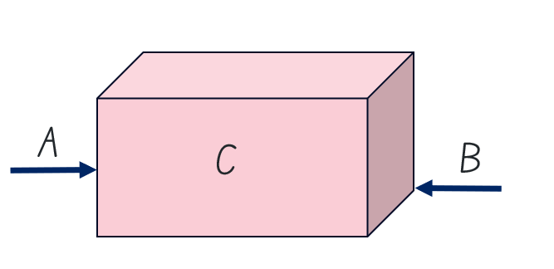
Short response (6)
Match the features of the prism labelled A, B and C with the terms:
vertex
edge
face
Notes:
Short response questions provide brisk paced questions focussing on review of current and previous content to support spaced and interleaved practice.
Syllabus focus area:
Three-dimensional spatial structure B: 3D objects

Slide 14
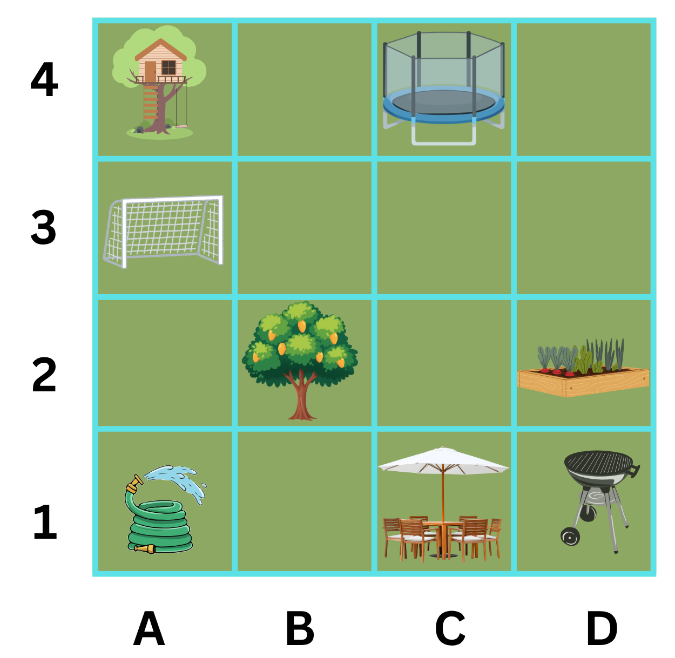

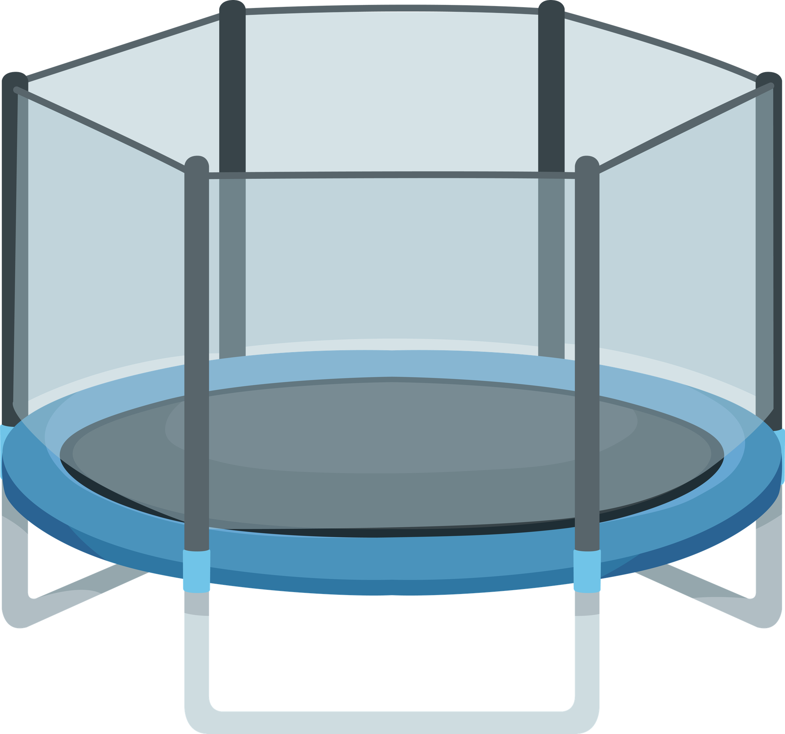
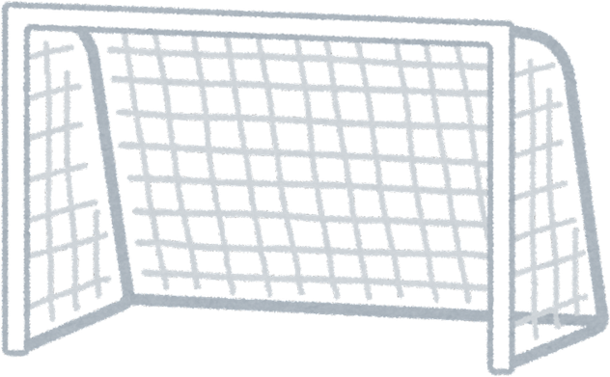
Short response (7)
Record the locations of the:
hose
trampoline
soccer goal
Notes:
Short response questions provide brisk paced questions focussing on review of current and previous content to support spaced and interleaved practice.
Syllabus focus area:
Geometric measure A: Position

Slide 15
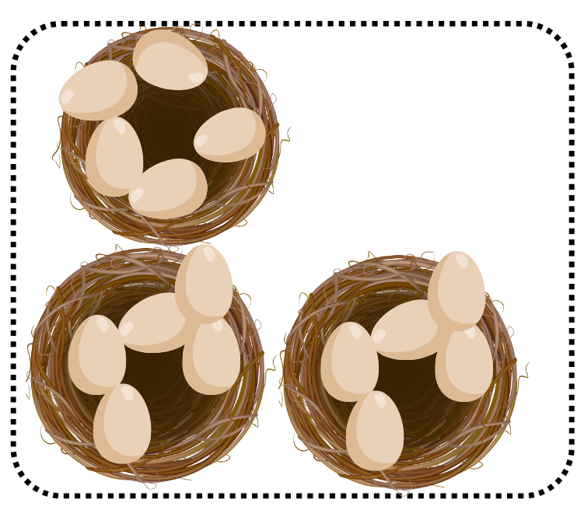
Short response (8)
Record the number of groups and the number in each group.
Notes:
Short response questions provide brisk paced questions focussing on review of current and previous content to support spaced and interleaved practice.
Syllabus focus area:
Multiplicative relations A

Slide 16
Short response (9)
How many minutes are in one hour?
How many minutes are in half an hour?
Communicate your reasoning.
Notes:
Short response questions provide brisk paced questions focussing on review of current and previous content to support spaced and interleaved practice.
Syllabus focus area:
Non-spatial measure A: Time

Slide 17
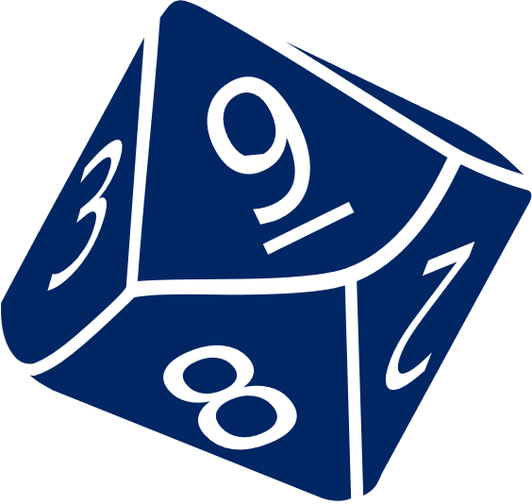
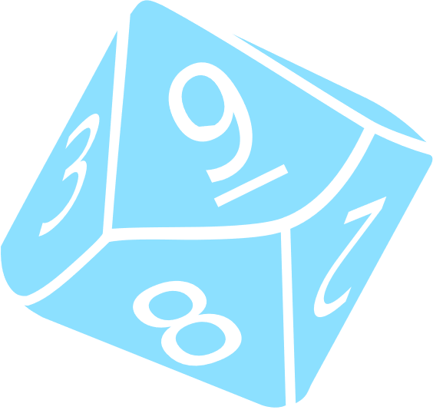
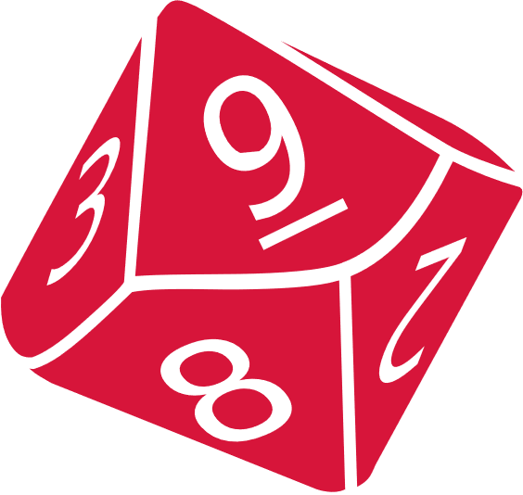
Activity 2 – identifying the nearest thousand
Create a 4-digit number.
Can you determine the nearest thousand?
8524 is closest to 9000
Notes:
This is a developing number sense activity.
Number sense refers to a deep understanding of numbers, including their magnitude, relationships, and the effects of operations on them. It supports fluency and understanding, estimation, flexible thinking, and efficient problem-solving. Number sense activities 1–4 ‘activate’ prior number knowledge and support the learning of new content in the unit. Number sense activities 5–8 ‘loop’ back and provide opportunity for spaced practice with concepts and procedures covered in previous units.
Syllabus focus area:
Representing numbers using place value B: Whole numbers
Identifying the nearest thousand
In small groups, students roll four 9-sided dice to make a 4-digit number.
Students take turns reading the number aloud and recording it on a sticky note. Students circle the hundreds digit.
Students determine and record the nearest thousand based on the hundreds digit. For example, 8524 is closest to 9000 and 8203 is closest to 8000.
Students repeat the process 5 times.
Students order the collection of 4-digit numbers in ascending or descending order.
Repeat the process.
At the end of this activity, display the number 9537 and discuss how the closest thousand is 10 000.

Slide 18
Review of learning 3

Slide 19
Multiple choice (2)
What is the largest number that can be formed by rearranging the digits in 4213?
A
B
C
D
4231
4312
4321
4132
Notes:
This question connects to the content in the developing number sense activity (Activity 3)
Syllabus focus area:
Representing numbers using place value B: Whole numbers

Slide 20
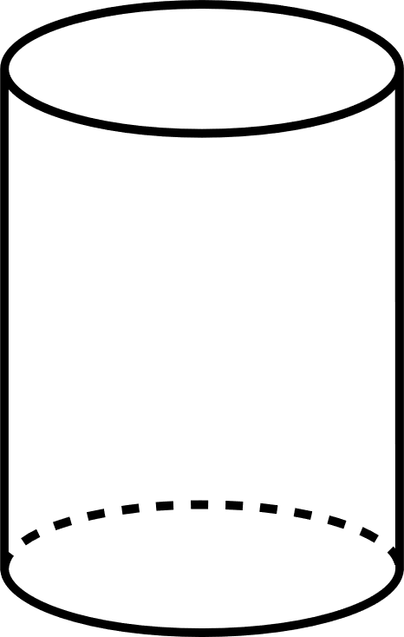
Short response (10)
Describe the features of the cylinder using the terms:
flat surface
curved surface
Notes:
Short response questions provide brisk paced questions focussing on review of current and previous content to support spaced and interleaved practice.
Syllabus focus area:
Three-dimensional spatial structure A: 3D objects

Slide 21
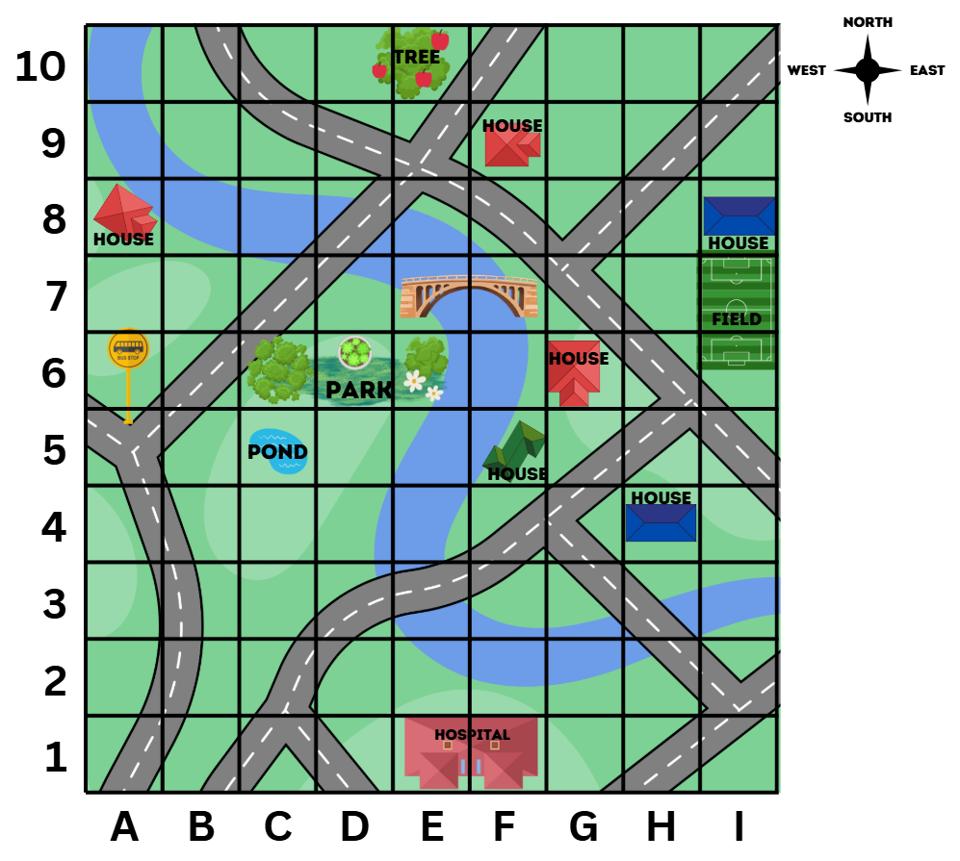
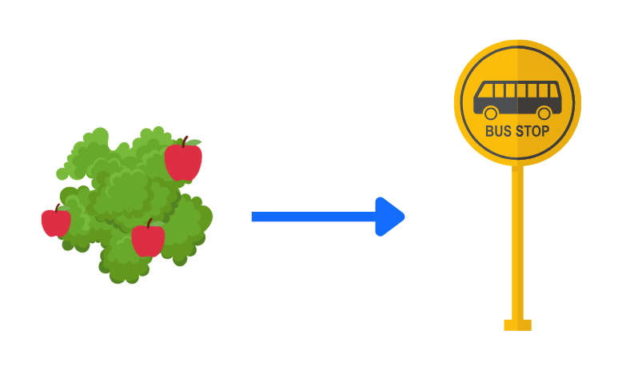
Short response (11)
Using grid references and compass directions, describe the route from the apple tree to the bus stop.
Notes:
Short response questions provide brisk paced questions focussing on review of current and previous content to support spaced and interleaved practice.
Syllabus focus area:
Geometric measure B: Position

Slide 22
Short response (12)
Choose a multiple of 4 and record as
an array
a multiplication number sentence
Notes:
Short response questions provide brisk paced questions focussing on review of current and previous content to support spaced and interleaved practice.
Syllabus focus area:
Multiplicative relations A

Slide 23
Short response (13)
If it’s a quarter to five, how many minutes are there until 5 o’clock?
Notes:
Short response questions provide brisk paced questions focussing on review of current and previous content to support spaced and interleaved practice.
Syllabus focus area:
Non-spatial measure A: Time

Slide 24
Activity 3 – rearranging digits to change the size of a number
Create and record a 4-digit number.
8
2
1
1
Swap the positions of 2 of the digits.
1
2
1
8
Describe how the new number is larger or smaller.
Notes:
This is a developing number sense activity.
Number sense refers to a deep understanding of numbers, including their magnitude, relationships, and the effects of operations on them. It supports fluency and understanding, estimation, flexible thinking, and efficient problem-solving. Number sense activities 1–4 ‘activate’ prior number knowledge and support the learning of new content in the unit. Number sense activities 5–8 ‘loop’ back and provide opportunity for spaced practice with concepts and procedures covered in previous units.
Syllabus focus area:
Representing numbers using place value B: Whole numbers
Rearranging digits to change the size of a number
Explain how rearranging digits in a number changes the size of a number.
Model the process of creating a 4-digit number and rearranging the digits to change the size of the number. For example:
- Roll four 9-sided dice to make and record a 4-digit number.
- Read the number aloud.
- Swap the positions of 2 of the digits and record the new number.
- Describe how the new number is larger or smaller than the original number.
In small groups, students repeat the process multiple times. Students order the 4-digit numbers in ascending or descending order.
Some students may enjoy the challenge of working out the difference between 2 numbers and explaining the strategy used.

Slide 25
Review of learning 4

Slide 26
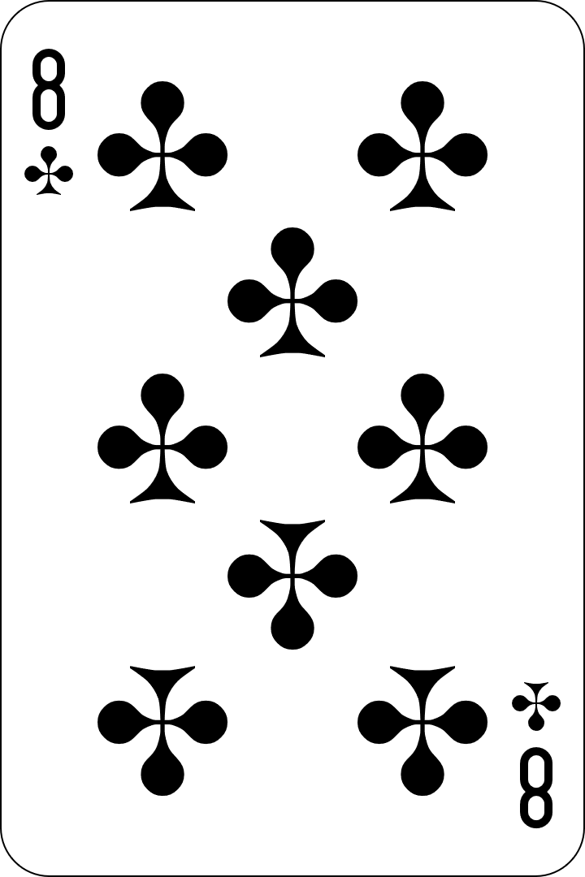
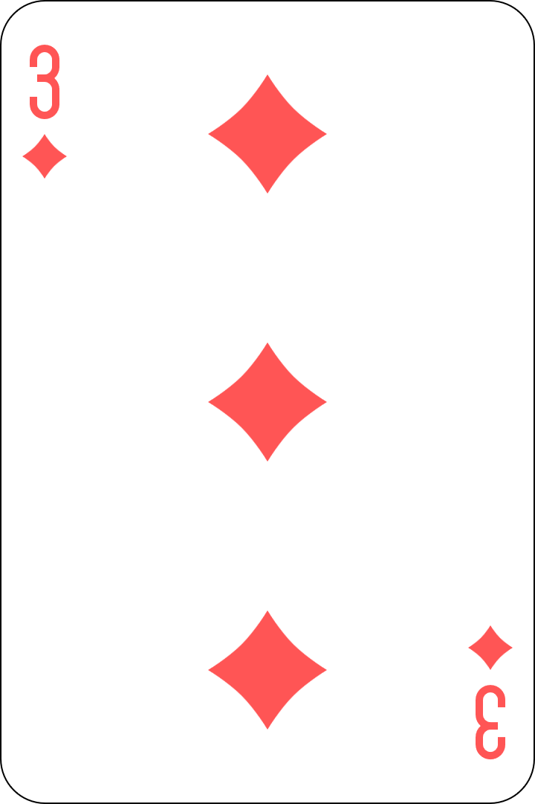
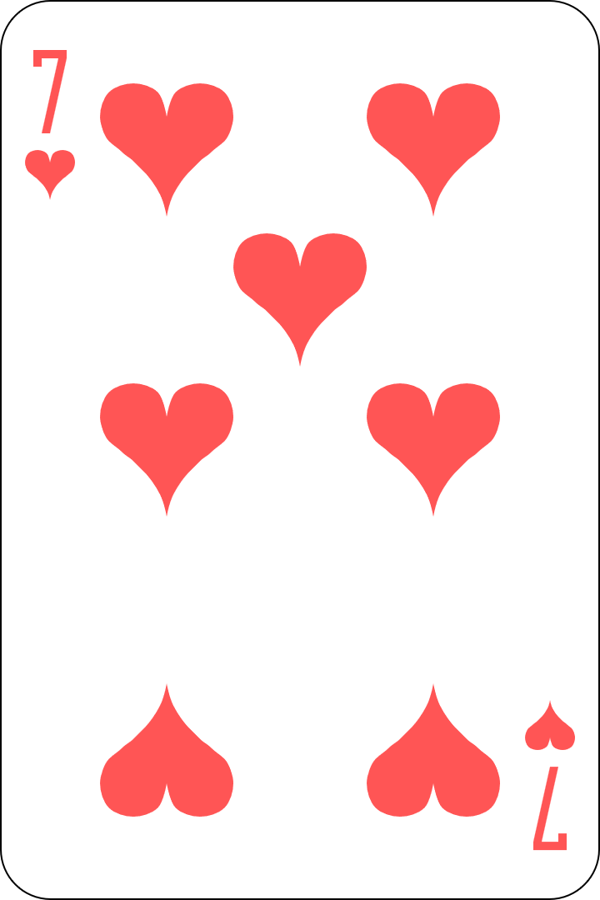
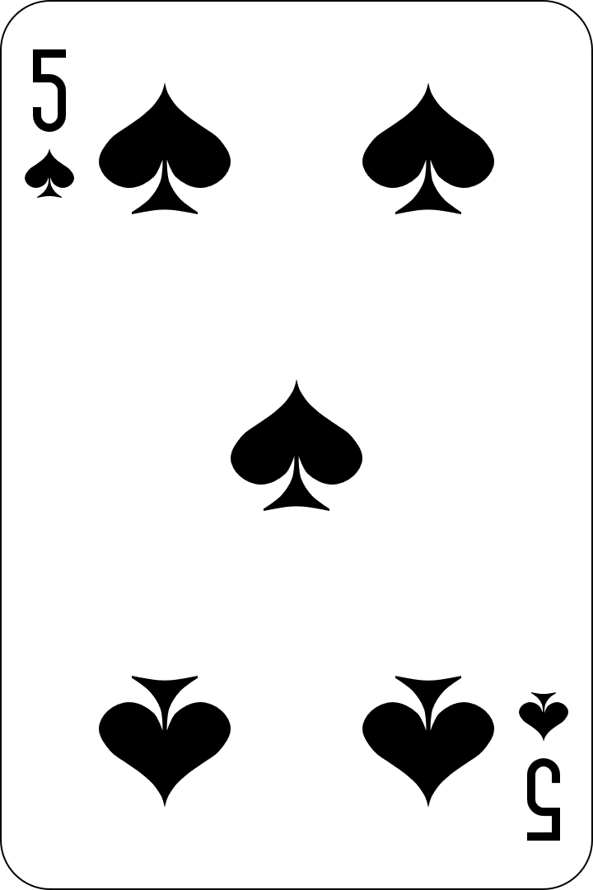
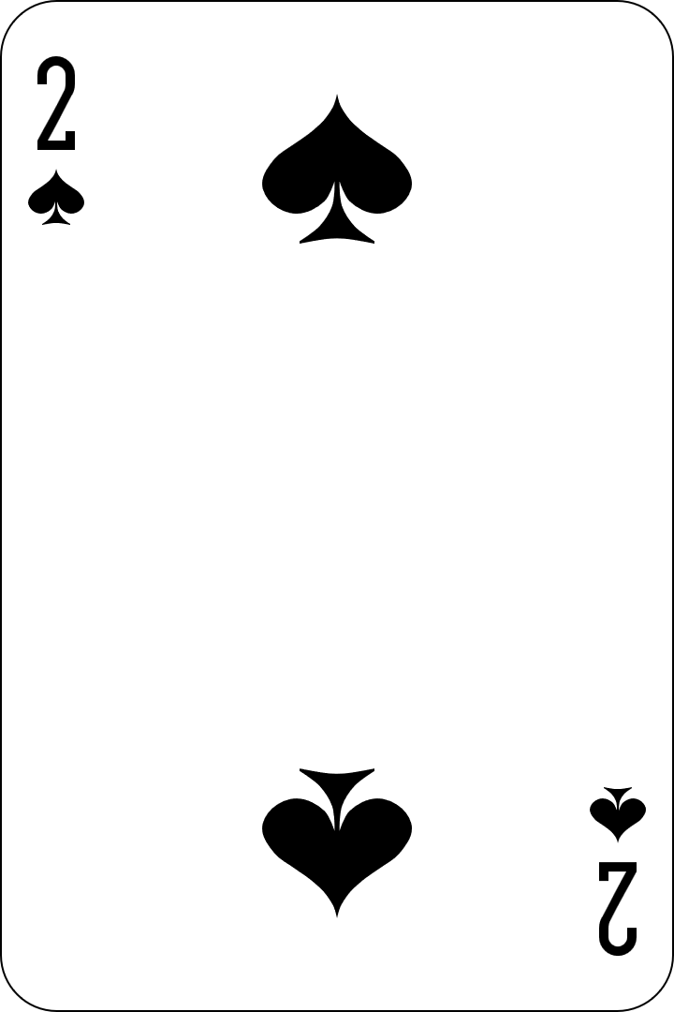
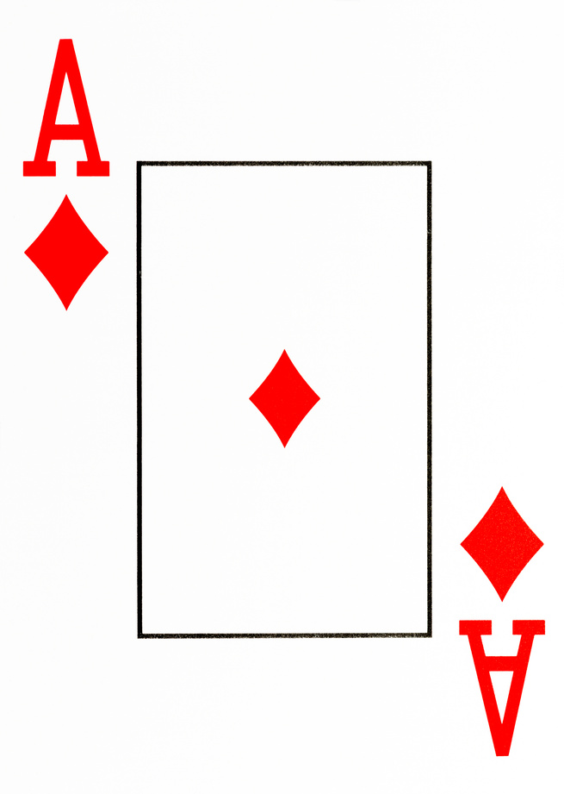
True or false (2)
857 321 is the largest number that can be made by rearranging these digits.
True | False
Communicate your reasoning.
Notes:
The question on this slide connects to the content being explored in the developing number sense activity (Activity 4)
Syllabus focus area:
Representing numbers using place value B: Whole numbers

Slide 27
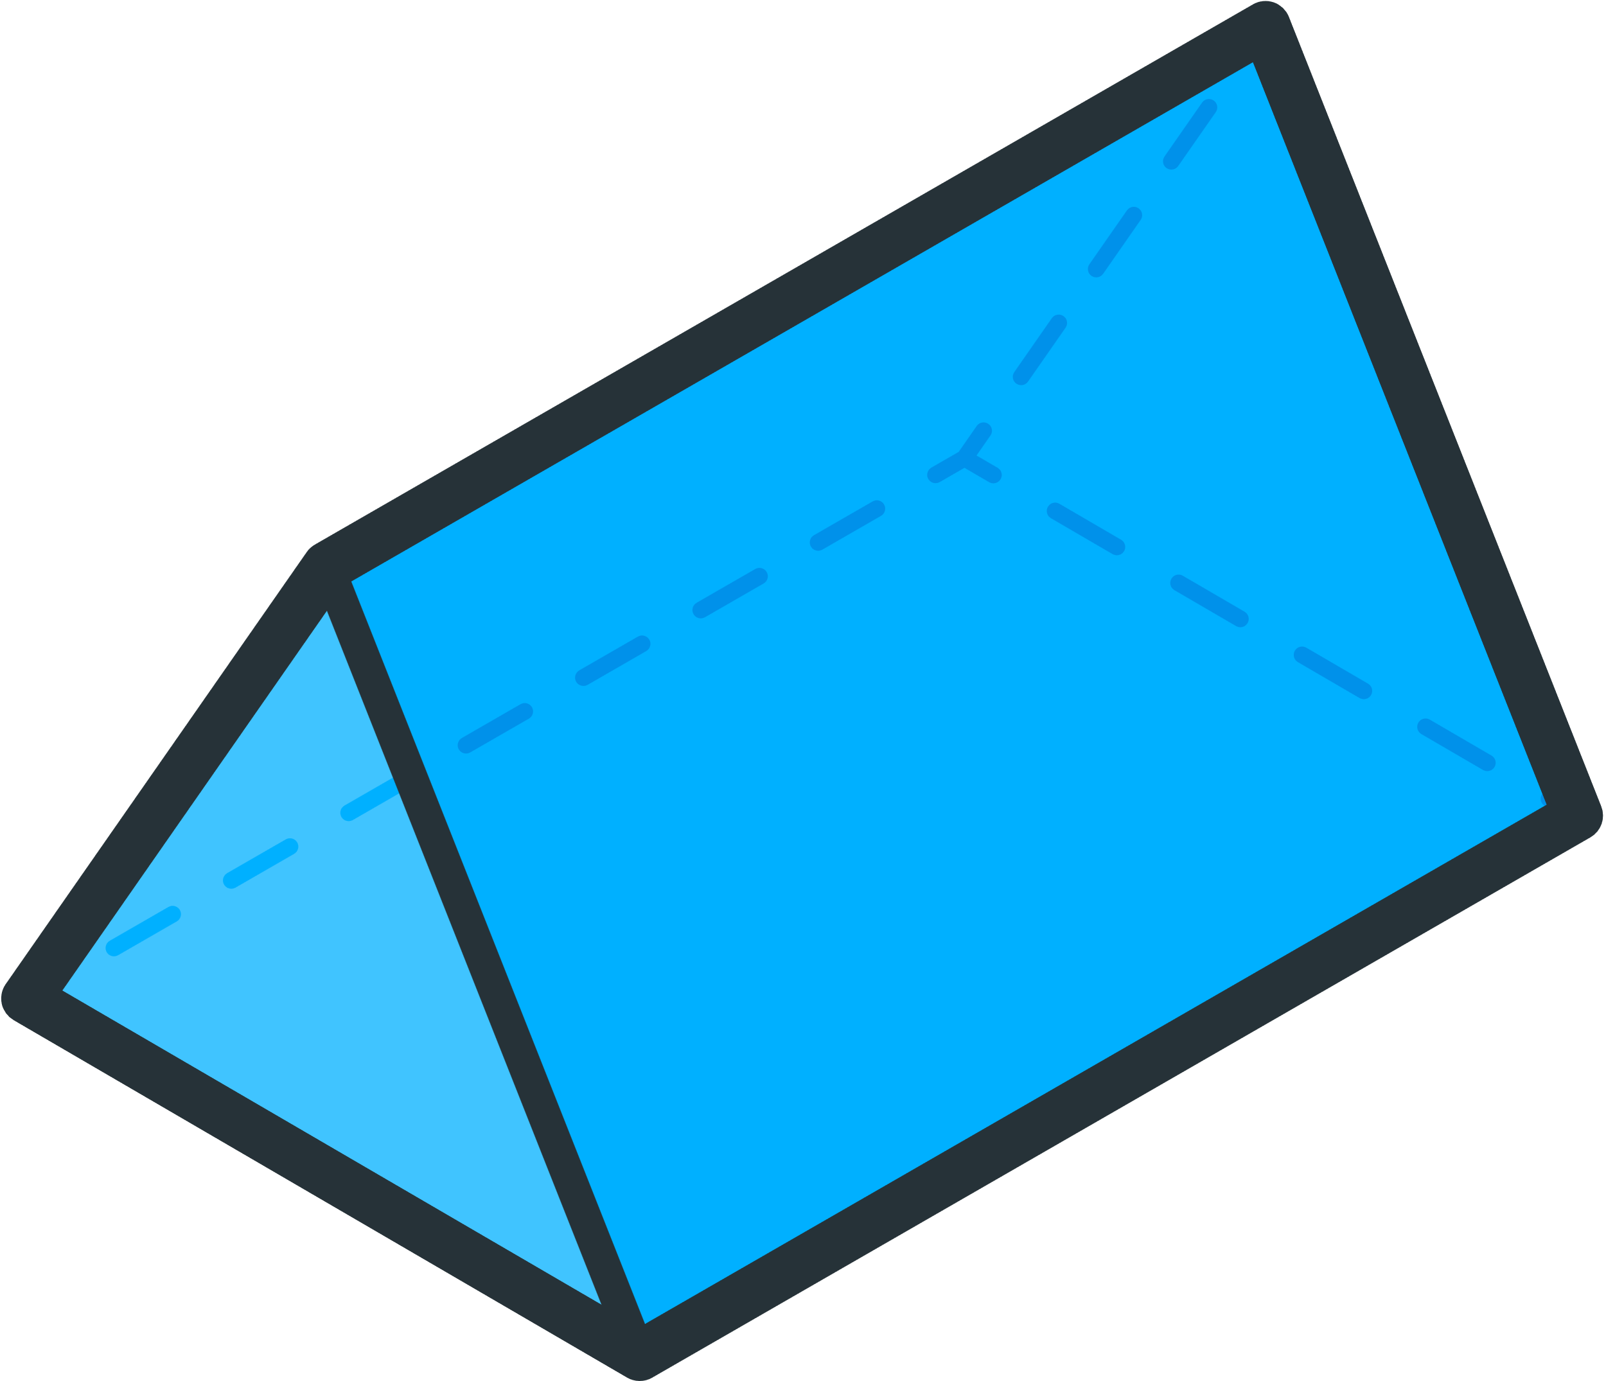
Short response (14)
Which 2D shapes can you see on this 3D object?
Notes:
Short response questions provide brisk paced questions focussing on review of current and previous content to support spaced and interleaved practice.
Syllabus focus area:
Three-dimensional spatial structure B: 3D objects

Slide 28
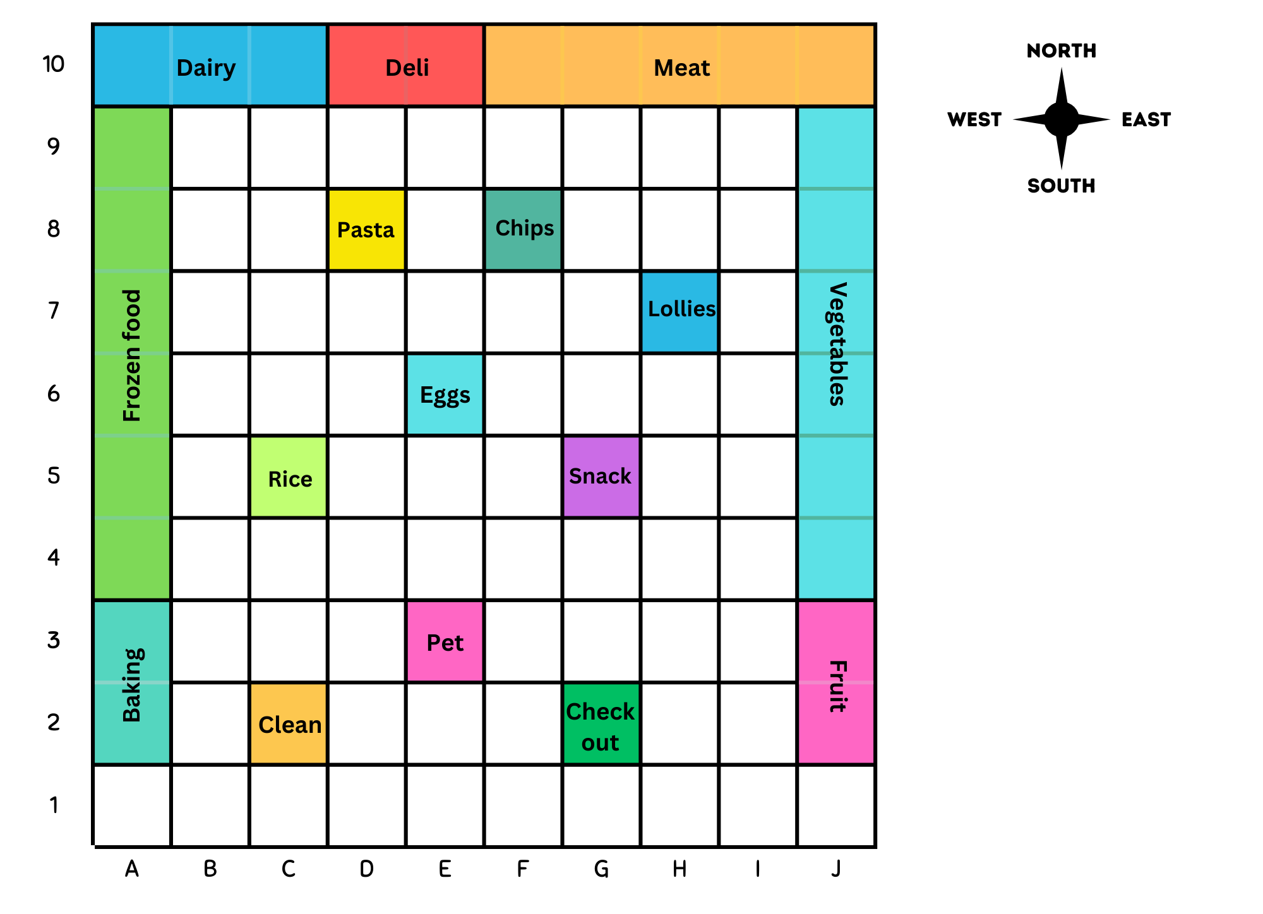
Short response (15)
Record the path from the Pasta to the Check out.
Use:
grid references
compass directions
directional language.
Notes:
Short response questions provide brisk paced questions focussing on review of current and previous content to support spaced and interleaved practice.
Syllabus focus area:
Geometric measure B: Position

Slide 29
Short response (16)
Halve the array.
Record a number sentence using a division sign (÷).
Notes:
Short response questions provide brisk paced questions focussing on review of current and previous content to support spaced and interleaved practice.
Syllabus focus area:
Multiplicative relations A

Slide 30
Short response (17)
Create a list of categories to collect data for this question:
What is the favourite game played at lunchtime?
Notes:
Short response questions provide brisk paced questions focussing on review of current and previous content to support spaced and interleaved practice.
Syllabus focus area:
Data A

Slide 31
Activity 4 – rearranging and rounding numbers
Arrange 6 cards to make the largest and the smallest 6-digit number.
Notes:
This is a developing number sense activity.
Number sense refers to a deep understanding of numbers, including their magnitude, relationships, and the effects of operations on them. It supports fluency and understanding, estimation, flexible thinking, and efficient problem-solving. Number sense activities 1–4 ‘activate’ prior number knowledge and support the learning of new content in the unit. Number sense activities 5–8 ‘loop’ back and provide opportunity for spaced practice with concepts and procedures covered in previous units.
Syllabus focus area:
Representing numbers using place value B: Whole numbers
Rearranging and rounding numbers
Group students into pairs and provide each pair with a set of six playing cards. For example, the cards 3, 5, 7, 8, 1 and 2.
Students arrange the digits to make:
- The largest possible 6-digit number
- The smallest possible 6-digit number.
Ask:
- How did rearranging the digits change the size of the number?
- How did you know which number to place in the hundred thousands place to make the largest number?
Regroup as a class and ask:
- Can you round your numbers to the nearest thousand?
- Can you round your numbers to the nearest 10 thousand?
- Can you round your numbers to the nearest 100 thousand?
Students write the rounded numbers on their individual whiteboard and hold it up.
Provide immediate feedback, highlighting reasoning about which place value digit determines the rounding.
Note: the game can be scaffolded by using 4 and 5-digit numbers.

Slide 32
Review of learning 5

Slide 33
Multiple choice (3)
Find 3974 recorded in standard place value form.
A
2000 + 1900 + 74
B
3 thousands, 974 ones
C
3000 + 970 + 4
D
3 thousands, 9 hundreds, 7 tens and 4 ones
Notes:
This question connects to the content in the developing number sense activity (Activity 3)
Syllabus focus area:
Representing numbers using place value A: Whole numbers

Slide 34
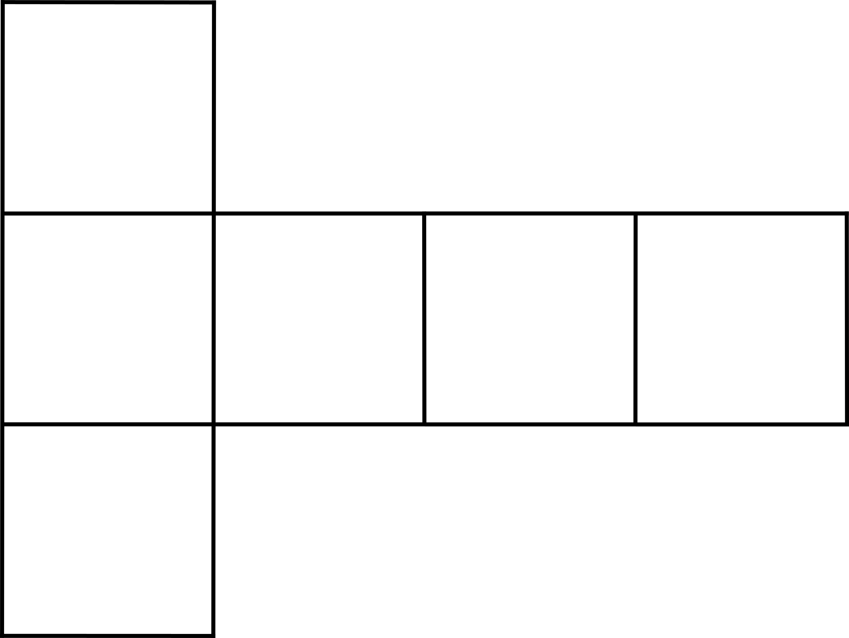
Short response (18)
Is this a net of a cube?
Communicate your reasoning.
Notes:
Short response questions provide brisk paced questions focussing on review of current and previous content to support spaced and interleaved practice.
Syllabus focus area:
Two-dimensional spatial structure A: 2D shapes

Slide 35




Short response (19)
Match the chance term with the everyday event.
equally likely
likely
unlikely
You attending school on Monday.
It snowing at school today.
A coin flip landing on heads or tails
Notes:
Short response questions provide brisk paced questions focussing on review of current and previous content to support spaced and interleaved practice.
Syllabus focus area:
Chance B

Slide 36
Short response (20)
2 x 6 = 6 x 2
Draw the arrays.
Notes:
Short response questions provide brisk paced questions focussing on review of current and previous content to support spaced and interleaved practice.
Syllabus focus area:
Multiplicative relations A

Slide 37
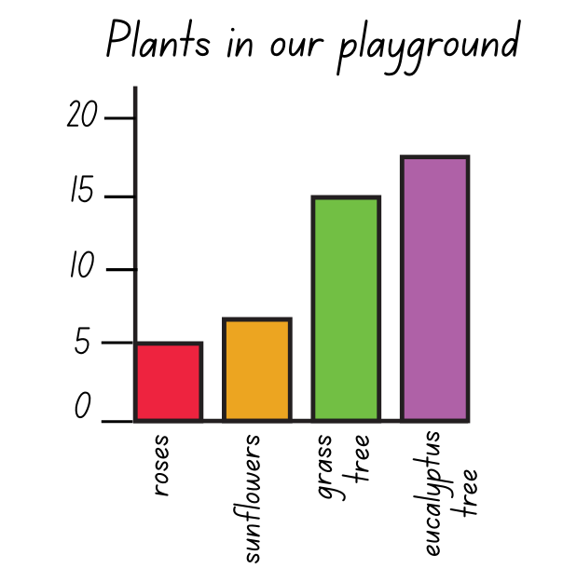
Short response (21)
Record the total amount of plants found in the playground.
Notes:
Short response questions provide brisk paced questions focussing on review of current and previous content to support spaced and interleaved practice.
Syllabus focus area:
Data A

Slide 38

Activity 5 – recording 4-digit numbers using place value
Ask yes or no questions to guess the mystery number.
Record the number using standard place value form.
523 = 500 + 20 + 3
or
5 hundreds, 2 tens and 3 ones
Notes:
This is a developing number sense activity.
Number sense refers to a deep understanding of numbers, including their magnitude, relationships, and the effects of operations on them. It supports fluency and understanding, estimation, flexible thinking, and efficient problem-solving. Number sense activities 1–4 ‘activate’ prior number knowledge and support the learning of new content in the unit. Number sense activities 5–8 ‘loop’ back and provide opportunity for spaced practice with concepts and procedures covered in previous units.
Syllabus focus area:
Representing numbers using place value A: Whole numbers
Recording 4-digit numbers using place value
Explain to students that they will play the game ‘What’s my number?’. The aim of the game is to correctly guess the number by asking a series of ‘yes’ or ‘no’ questions to help determine the number.
Seek input from students to record questions that will give them useful information, for example:
- Is the number an even number?
- Is the number a 4-digit number?
- Is the number larger than 500?
- Does the number have less than 7 hundreds?
Tell students that you are thinking of a 3- or 4-digit number.
Students ask a series of questions that require a ‘yes’ or ‘no’ answer to try and determine the number.
Prompt students to think about possible and eliminated numbers after each question has been answered.
Support students to think about the most effective questions to ask next, by using the information they already know.
When the mystery number has been guessed, students record the number using standard place value form. For example, 523 = 500 + 20 + 3 or 5 hundreds, 2 tens and 3 ones.
Ask:
- Which questions provided the most useful information about the mystery number?
- Were there any other questions that would help find the mystery number in a more efficient way?
Note: students will play this game in small groups in Activity 6.

Slide 39
Review of learning 6

Slide 40
True or false (3)
2324 =
2 thousands, 3 hundreds and 24 ones or 2000 + 300 + 24
True | False
Communicate your reasoning.
Notes:
The question on this slide connects to the content being explored in the developing number sense activity (Activity 6)
Syllabus focus area:
Representing numbers using place value A: Whole numbers

Slide 41
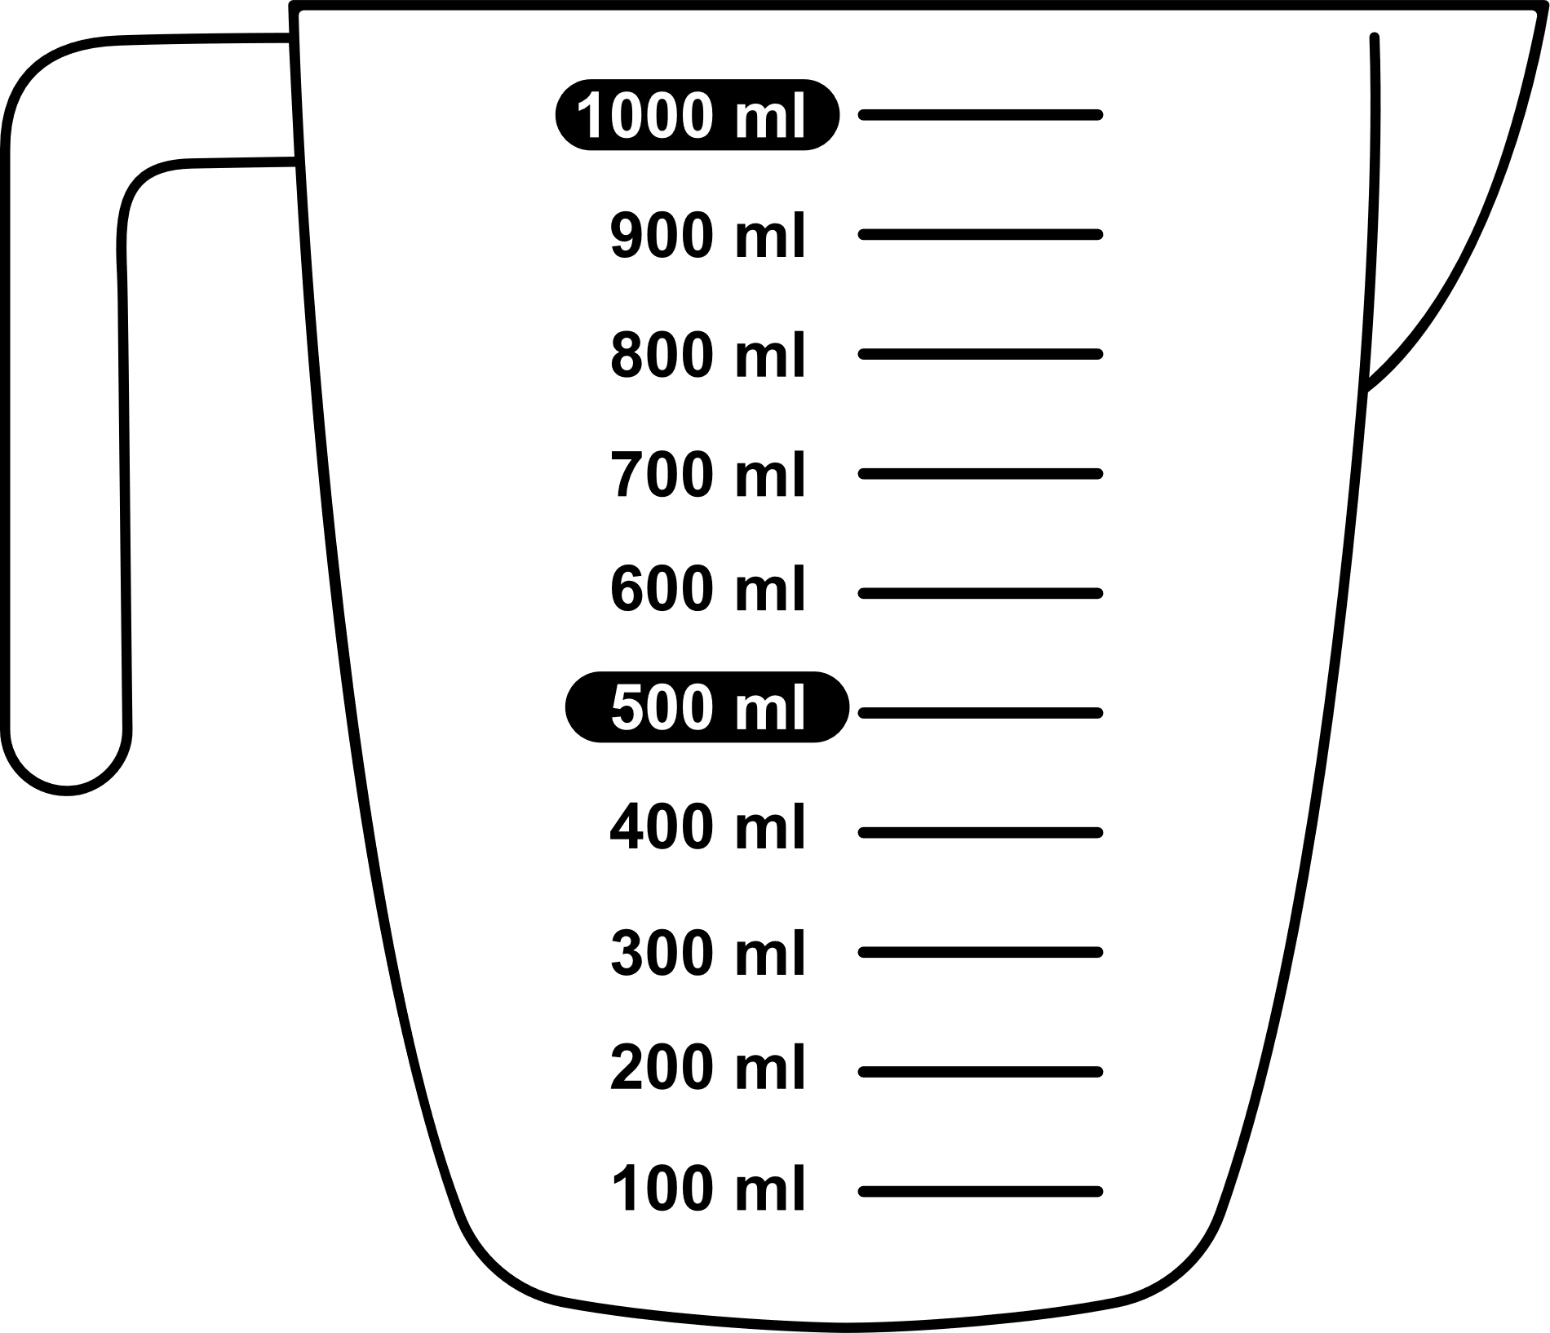
Short response (22)
Identify 3 everyday containers that hold about one litre.
1 Litre
1L
Notes:
Short response questions provide brisk paced questions focussing on review of current and previous content to support spaced and interleaved practice.
Syllabus focus area:
Three-dimensional spatial structure A: Volume

Slide 42
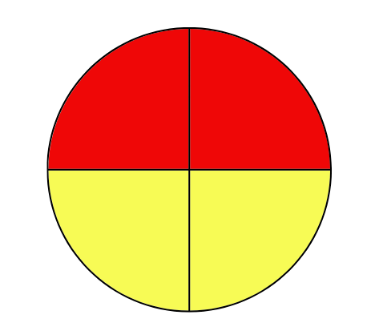
Short response (24)
Record the outcomes when spinning this spinner.
Communicate your reasoning.
Notes:
Short response questions provide brisk paced questions focussing on review of current and previous content to support spaced and interleaved practice.
Syllabus focus area:
Chance A

Slide 43
Short response (25)
Record the 4 related facts for the array using the symbols x and ÷ .
Notes:
Short response questions provide brisk paced questions focussing on review of current and previous content to support spaced and interleaved practice.
Syllabus focus area:
Multiplicative relations A

Slide 44
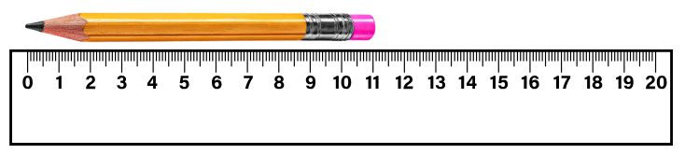
Short response (26)
Measure the length of the pencil in millimetres.
Communicate your reasoning.
Notes:
Short response questions provide brisk paced questions focussing on review of current and previous content to support spaced and interleaved practice.
Syllabus focus area:
Geometric measure A: Length

Slide 45
Activity 6 – partitioning numbers in non-standard forms
State the place value of each digit.
3517
Can you partition this number:
without using tens
without using hundreds?
Notes:
This is a developing number sense activity.
Number sense refers to a deep understanding of numbers, including their magnitude, relationships, and the effects of operations on them. It supports fluency and understanding, estimation, flexible thinking, and efficient problem-solving. Number sense activities 1–4 ‘activate’ prior number knowledge and support the learning of new content in the unit. Number sense activities 5–8 ‘loop’ back and provide opportunity for spaced practice with concepts and procedures covered in previous units.
Syllabus focus area:
Representing numbers using place value A: Whole numbers
Partitioning numbers in non-standard forms
Note: this lesson is a continuation of the ‘Developing number sense’ from Activity 5.
In small groups, students play ‘What’s my number?’ from Activity 5, taking turns to create and guess a mystery number.
Move between groups, supporting effective questioning and recording.
Display a 4-digit number. Seek input from students to state the place value of each digit. For example, 3517 can be described as 3000 + 500 + 10 + 7.
Ask: How could you partition 3517:
- without using tens? (3 thousands, 5 hundreds and 17 ones or 3000 + 500 +17)
- without using hundreds? (3 thousands, 51 tens and 7 ones or 3000 + 510 + 7)
In pairs, students record their partitioned numbers on individual whiteboards. Select a few students to share their partitioned numbers, explaining their partitions.
Provide feedback and corrections as necessary.
Remind students that this is called non-standard place value form. At this point, some students may need to use 2- or 3-digit numbers to revise this concept before working with 4-digit numbers.
Note: use MAB materials to demonstrate how 1 ten equals 10 ones and 5 hundreds equals 50 tens if necessary.

Slide 46
Review of learning 7

Slide 47
Multiple choice (4)
Which of these show 6724 partitioned in non-standard forms? You may select more than one answer
A
6000 + 700 + 20 + 4
B
6 thousands, 7 hundreds, 2 tens and 4 ones
C
67 hundreds and 24 ones
D
600 + 70 + 20 + 4
Notes:
This question connects to the content in the developing number sense activity (Activity 3)
Syllabus focus area:
Representing numbers using place value A: Whole numbers

Slide 48



Short response (27)
Record which container holds more, less and about the same as one litre.
Communicate your reasoning.
Notes:
Short response questions provide brisk paced questions focussing on review of current and previous content to support spaced and interleaved practice.
Syllabus focus area:
Three-dimensional spatial structure A: Volume

Slide 49
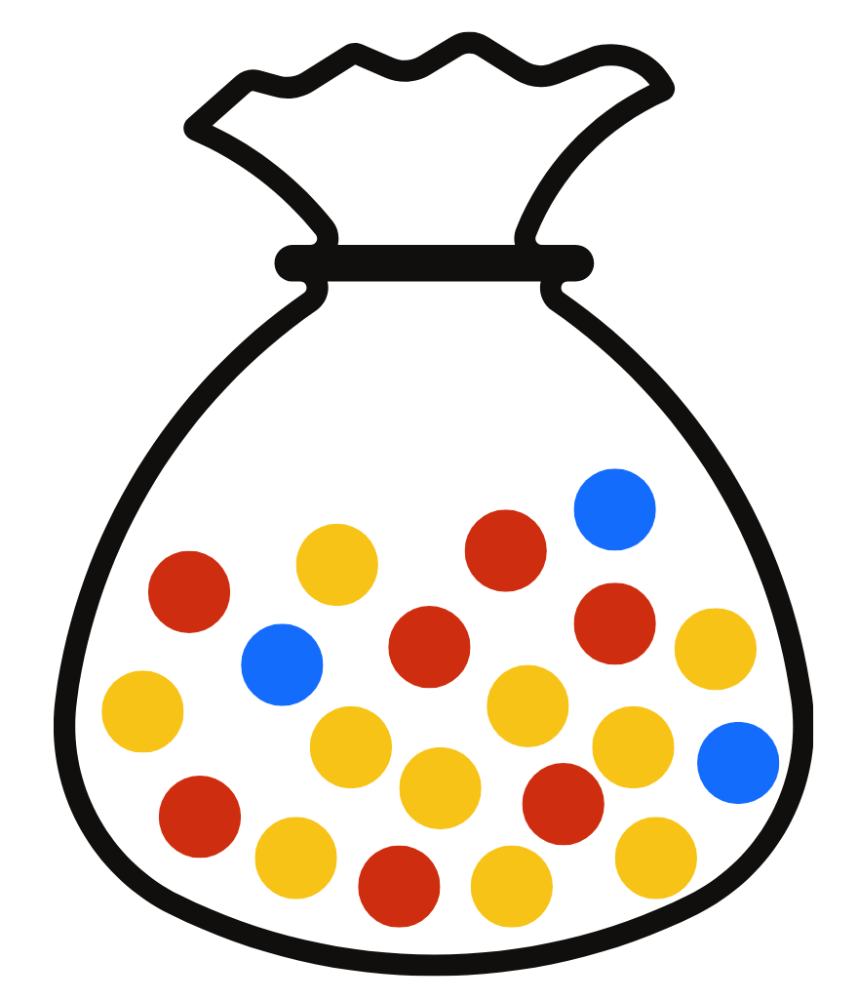
Short response (28)
If I draw out 1 marble:
Which colour do you predict is most likely to be drawn?
Which colour do you predict is least likely to be drawn?
Communicate your reasoning.
Notes:
Short response questions provide brisk paced questions focussing on review of current and previous content to support spaced and interleaved practice.
Syllabus focus area:
Chance A

Slide 50
Short response (29)
Place the numbers 8, 2 and 16 into a fact family triangle.
Record the related facts using the x , ÷ and = symbols.
Notes:
Short response questions provide brisk paced questions focussing on review of current and previous content to support spaced and interleaved practice.
Syllabus focus area:
Multiplicative relations A

Slide 51
Short response (30)
Record the lengths in metres and centimetres.
154 cm
672 cm
205 cm
Notes:
Short response questions provide brisk paced questions focussing on review of current and previous content to support spaced and interleaved practice.
Syllabus focus area:
Geometric measure A: Length

Slide 52
Activity 7 – partitioning 4-digit numbers
Describe the 4-digit number using standard and non-standard partitioning.
4627
Notes:
This is a developing number sense activity.
Number sense refers to a deep understanding of numbers, including their magnitude, relationships, and the effects of operations on them. It supports fluency and understanding, estimation, flexible thinking, and efficient problem-solving. Number sense activities 1–4 ‘activate’ prior number knowledge and support the learning of new content in the unit. Number sense activities 5–8 ‘loop’ back and provide opportunity for spaced practice with concepts and procedures covered in previous units.
Syllabus focus area:
Representing numbers using place value A: Whole numbers
Partitioning 4-digit numbers
Ask: Can you describe this number using standard partitioning? For example, this is 4000 + 600 + 20 + 7 or 4 thousands, 6 hundreds, 2 tens and 7 ones.
Students record the number using standard partitioning on individual whiteboards.
Guide students to partition the 4-digit number without using the place value of tens. For example, the number could now be described as 4000 + 600 + 27 or 4 thousands, 6 hundreds and 27 ones. Record these partitions on the board.
Students turn and talk to work out how they could describe 4627 without using thousands. Select a few students to share their partitions and mathematical reasoning. Record these on the board.
In small groups, students choose a 4-digit number and explore describing it in as many ways as possible, using standard and non-standard partitioning.
Monitor and provide feedback and corrections as necessary, moving between groups, supporting understanding of place value.
Note: students may need additional scaffolding to model a number using MAB materials to support thinking. Others may need to work with non-standard place value forms for 2- and 3-digit numbers first.
This task can be extended to allow students to work out all possible standard and non-standard partitioning using tens and ones, hundreds and tens and so on. For example, 4 thousands, 5 hundreds, 12 tens and 7 ones and then 4 thousands, 4 hundreds, 22 tens and 7 ones and so on.

Slide 53
Review of learning 8

Slide 54
True or false (4)
9826 =
98 hundreds and 26 ones or 9800 + 26
True | False
Communicate your reasoning.
Notes:
The question on this slide connects to the content being explored in the developing number sense activity (Activity 8)
Syllabus focus area:
Representing numbers using place value A: Whole numbers

Slide 55
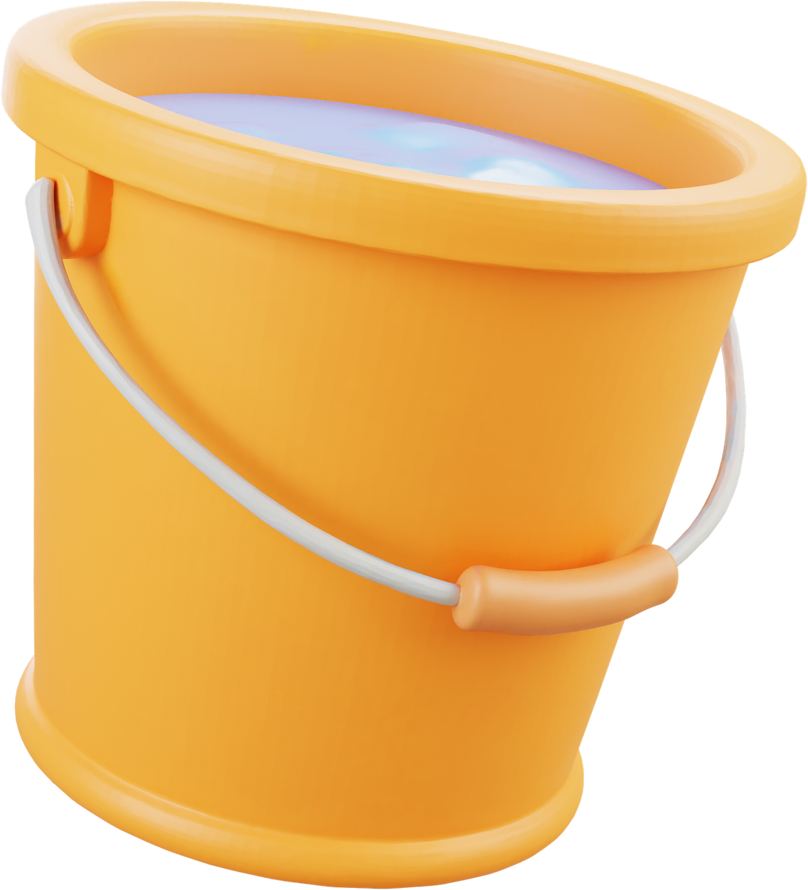
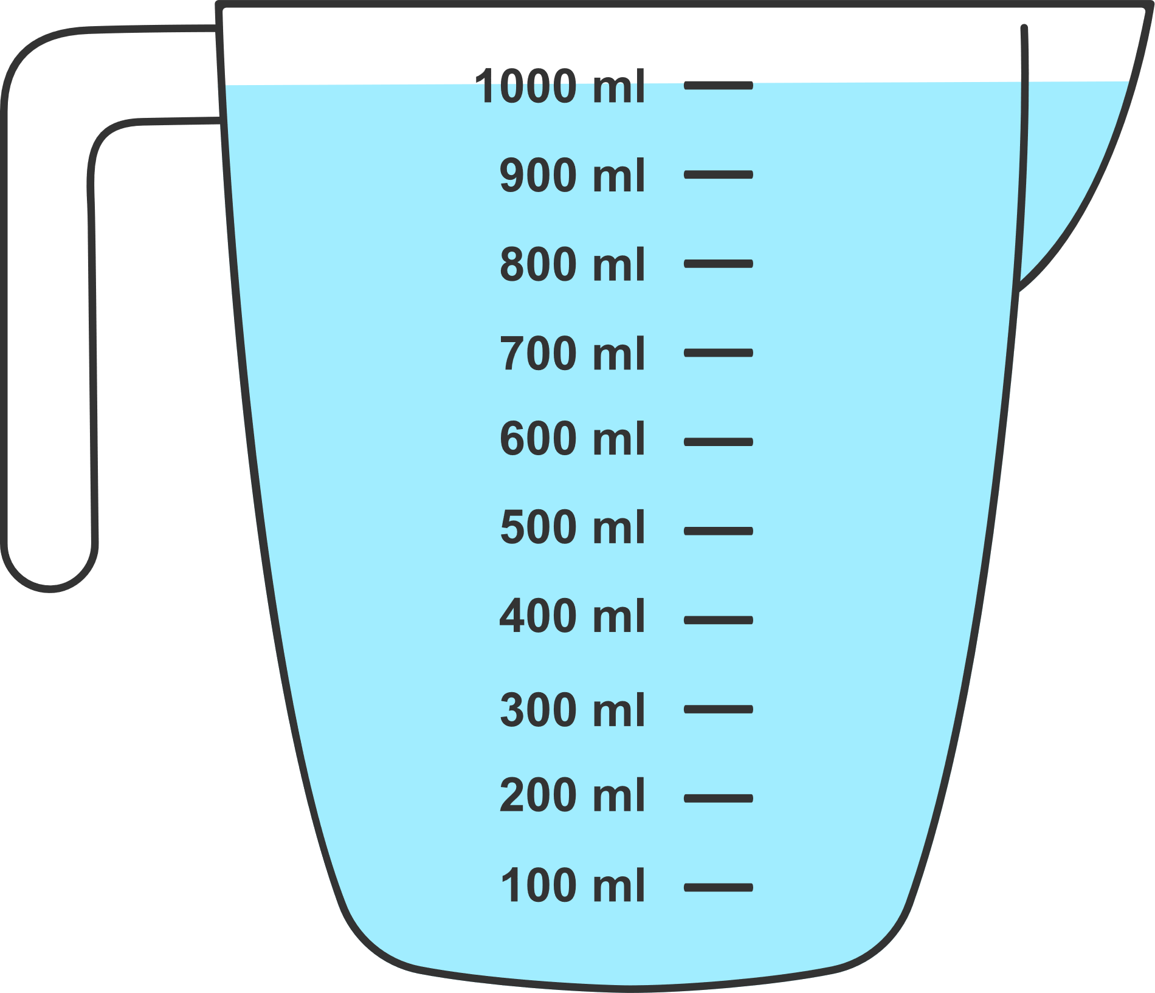
Short response (31)
Harry filled a measuring jug 6 times to fill the bucket.
Record the capacity of the bucket in litres.
Notes:
Short response questions provide brisk paced questions focussing on review of current and previous content to support spaced and interleaved practice.
Syllabus focus area:
Three-dimensional spatial structure A: Volume

Slide 56



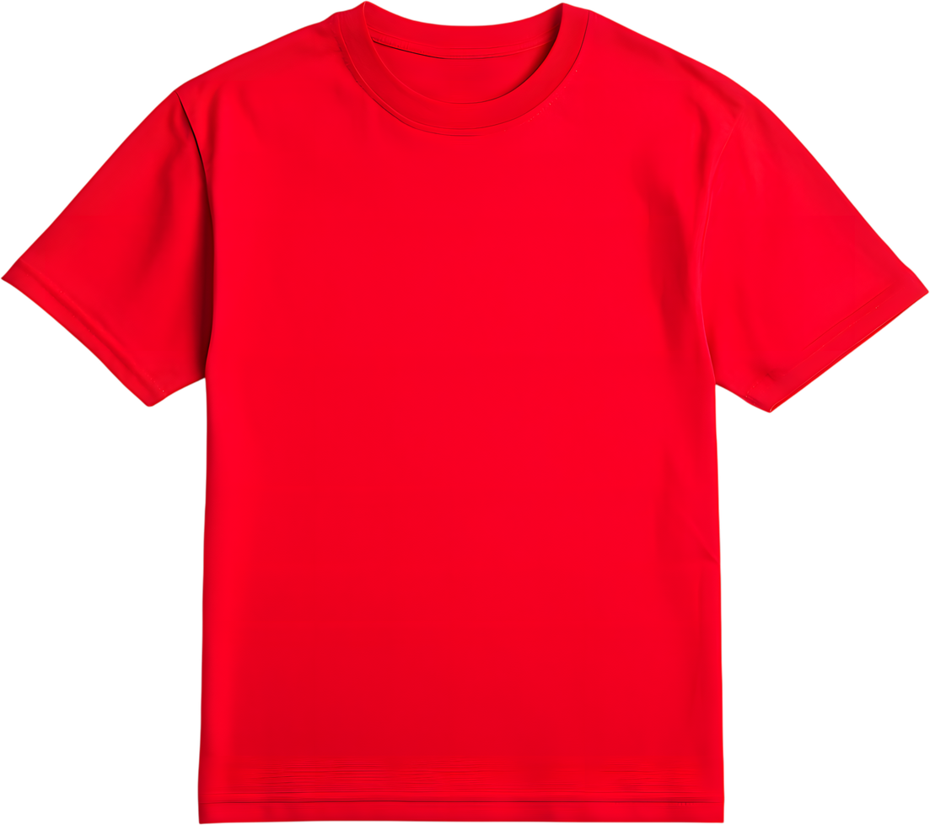
Short response (32)
Record the clothing combinations that can be made with the blue shorts.
blue shorts
yellow T-shirt
orange T-shirt
red T-shirt
Notes:
Short response questions provide brisk paced questions focussing on review of current and previous content to support spaced and interleaved practice.
Syllabus focus area:
Chance B

Slide 57
Short response (33)
Explain the strategy used to represent the word problem.
Lucy created 3 paintings. Her friend Thomas created 4 times as many paintings.
Notes:
Short response questions provide brisk paced questions focussing on review of current and previous content to support spaced and interleaved practice.
Syllabus focus area:
Multiplicative relations B

Slide 58
Short response (34)
Explain the term ‘perimeter’.
Notes:
Short response questions provide brisk paced questions focussing on review of current and previous content to support spaced and interleaved practice.
Syllabus focus area:
Geometric measure B: Length

Slide 59
Activity 8 – representing and partitioning 4-digit numbers
Two truths and one lie.
Which two of these statements are true
and which one is false?
32 can be represented with five MABs, for example, 3 tens, 2 ones
68 can be represented with 41 MABs
45 can be represented with 28 MABs.
Notes:
This is a developing number sense activity.
Number sense refers to a deep understanding of numbers, including their magnitude, relationships, and the effects of operations on them. It supports fluency and understanding, estimation, flexible thinking, and efficient problem-solving. Number sense activities 1–4 ‘activate’ prior number knowledge and support the learning of new content in the unit. Number sense activities 5–8 ‘loop’ back and provide opportunity for spaced practice with concepts and procedures covered in previous units.
Syllabus focus area:
Representing numbers using place value A: Whole numbers
Representing and partitioning 4-digit numbers
Revise reading, ordering, and partitioning numbers up to 4 digits in different forms to develop flexible understanding of place value.
Explain the game ‘Two truths and one lie’. Students will be presented with 3 statements about numbers - two statements are true and one is false.
Present three statements that use a range of MAB. For example:
- 32 can be represented with five MABs, for example, 3 tens, 2 ones.
- 68 can be represented with 41 MABs
- 45 can be represented with 28 MABs.
Ask: Which two of these statements are true and which one is false?
In pairs, students use drawings and MAB materials to represent their thinking. Prompt students to partition the numbers into tens and ones, using both standard and non-standard forms.
Support students in regrouping tens into ones to increase the total number of blocks to reach the desired number of blocks.
Ask:
- Did you need to partition the numbers in non-standard ways?
- Which statements were true and which statements were false? Why? Explain your reasoning.

Slide 60
References (1)
This presentation contains NSW Curriculum and syllabus content. The NSW Curriculum is developed by the NSW Education Standards Authority. This content is prepared by NESA for and on behalf of the Crown in the right of the State of New South Wales. The material is protected by Crown copyright.
Please refer to the NESA Copyright Disclaimer for more information https://educationstandards.nsw.edu.au/wps/portal/nesa/mini-footer/copyright.
NESA holds the only official and up-to-date versions of the NSW Curriculum and syllabus documents. Please visit the NSW Education Standards Authority (NESA) website https://educationstandards.nsw.edu.au/wps/portal/nesa/home and the NSW Curriculum website https://curriculum.nsw.edu.au.
Mathematics K–10 Syllabus © NSW Education Standards Authority (NESA) for and on behalf of the Crown in right of the State of New South Wales, 2022.
National Numeracy Learning Progression © Australian Curriculum, Assessment and Reporting Authority (ACARA) 2010 to present, unless otherwise indicated. This material was downloaded from the Australian Curriculum website (National Numeracy Learning Progression) (accessed 24 February 2026) and was not modified.
Meaningful Maths (n.d.) Banana Cake, Meaningful Maths website, accessed 19 February 2026.
State of New South Wales (Department of Education) (2023) Identifies, represents and compares decimals, Universal Resource Hub website, accessed 27 November 2023.

Slide 61
References (2)
This presentation contains NSW Curriculum and syllabus content. The NSW Curriculum is developed by the NSW Education Standards Authority. This content is prepared by NESA for and on behalf of the Crown in the right of the State of New South Wales. The material is protected by Crown copyright.
Please refer to the NESA Copyright Disclaimer for more information https://educationstandards.nsw.edu.au/wps/portal/nesa/mini-footer/copyright.
NESA holds the only official and up-to-date versions of the NSW Curriculum and syllabus documents. Please visit the NSW Education Standards Authority (NESA) website https://educationstandards.nsw.edu.au/wps/portal/nesa/home and the NSW Curriculum website https://curriculum.nsw.edu.au.
State of New South Wales (Department of Education) (n.d.) N, S, E, W S2, Thinking while Moving website, accessed 25 March 2026.
University of Cambridge (Faculty of Mathematics) (n.d.) The Hair Colour Game, NRICH website, accessed 2 March 2026.

Slide 62
Copyright
© State of New South Wales (Department of Education), 2025
The copyright material published in this resource is subject to the Copyright Act 1968 (Cth) and is owned by the NSW Department of Education or, where indicated, by a party other than the NSW Department of Education (third-party material).
Copyright material available in this resource and owned by the NSW Department of Education is licensed under a Creative Commons Attribution 4.0 International (CC BY 4.0) license.
This license allows you to share and adapt the material for any purpose, even commercially.
Attribution should be given to © State of New South Wales (Department of Education), 2025.
Material in this resource not available under a Creative Commons license:
the NSW Department of Education logo, other logos and trademark-protected material
Material owned by a third party that has been reproduced with permission. You will need to obtain permission from the third party to reuse its material.
Links to third-party material and websites
Please note that the provided (reading/viewing material/list/links/texts) are a suggestion only and implies no endorsement, by the New South Wales Department of Education, of any author, publisher, or book title. School principals and teachers are best placed to assess the suitability of resources that would complement the curriculum and reflect the needs and interests of their students.
If you use the links provided in this document to access a third party’s website, you acknowledge that the terms of use, including licence terms set out on the third-party’s website apply to the use which may be made of the materials on that third-party website or where permitted by the Copyright Act 1968 (Cth). The department accepts no responsibility for content on third-party websites.

