Slide 1
Instructions for use
This resource is not a teaching and learning program. It should be used in conjunction with Stage 3 Year B Unit 27.
Classroom teachers are encouraged to add and adapt slides as required to meet the needs of their students.
Save a copy of the file to make changes to the slide deck. Go to File > Download a Copy (this downloads a copy to the computer to edit in the PowerPoint app).
To convert the PowerPoint to Google Slides:
  Upload the file into Google Drive and open it.
  Go to File > Save as Google Slides.
  (Note – conversion may cause formatting changes in the slides.)

Slide 2

Review of Learning
Mathematics Stage 3 – Unit 27
Notes:
Reviews may include a combination of question types, requiring students to recall facts and key ideas, as well as apply their knowledge to solve problems and answer questions. To support active engagement, a mix of techniques should be employed.” (AERO, 2024).
This Review of Learning slide deck revisits key concepts from the following units:
Stage 3 Year B Unit 27
Stage 3 Year B Unit 26
Stage 3 Year B Unit 25
It also includes opportunities to review prior learning in non-number content, supporting consolidation across focus areas.
The review of learning resources include three key task types that support the development of mathematical proficiency through retrieval, spaced practice, and active participation. These practices complement the review phase (activating prior knowledge) embedded within the beginning of each lesson.
1.
Multiple-choice questions/True or false: Designed to promote active retrieval of key concepts and identify common misconceptions in number, supporting consolidation, understanding and fluency.
These questions:
support spaced and interleaved practice
help identify and address common misconceptions
support active recall and immediate feedback
support whole class participation
identify areas requiring reteach
2.
Short-response question sets: Carefully grouped questions that encourage spaced and interleaved practice across multiple focus areas, helping students revisit and apply knowledge from different points in time.
These questions:
have a combination of question types
address a range of focus areas
build automaticity and fluency
support active recall
allow for immediate feedback
identify content requiring reteach
3.
Developing number sense activities: A variety of practical, purposeful tasks that reinforce current learning and build on prior knowledge. These activities promote reasoning, problem-solving and conceptual understanding.
The review of learning resources are designed to work support teaching and learning in mathematics. For the most effective implementation, use the resources flexibly, adapting to meet student learning needs and individual classroom contexts.

Slide 3
Lessons
1
Review of learning 1
5
Review of learning 5
2
Review of learning 2
6
Review of learning 6
3
Review of learning 3
7
Review of learning 7
4
Review of learning 4
8
Review of learning 8
Notes:
Teacher notes:
Click lesson numbers to go to specific lessons
Interactive features can be viewed in slide show

Slide 4
Review of learning 1

Slide 5

Multiple choice (1)
The number 73 is. . .
A
prime
B
composite
C
both prime and composite
D
Neither prime nor composite.
Notes:
This question connects to the content in the developing number sense activity (Activity 1)
Syllabus focus area:
Multiplicative relations A

Slide 6

Short response (1)
Write the related multiplication and division number sentences for:
56, 8 and 7
Notes:
Short response questions provide brisk paced questions focussing on review of current and previous content to support spaced and interleaved practice.
Syllabus focus area:
Multiplicative relations A (Stage 2 content reviewed)

Slide 7
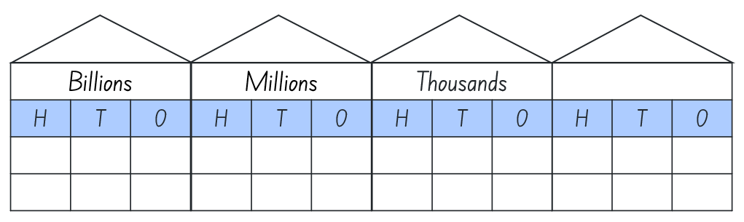
Short response (2)
Write the number 3 458 217 in words.
Notes:
Short response questions provide brisk paced questions focussing on review of current and previous content to support spaced and interleaved practice.
Syllabus focus area:
Represents numbers A

Slide 8
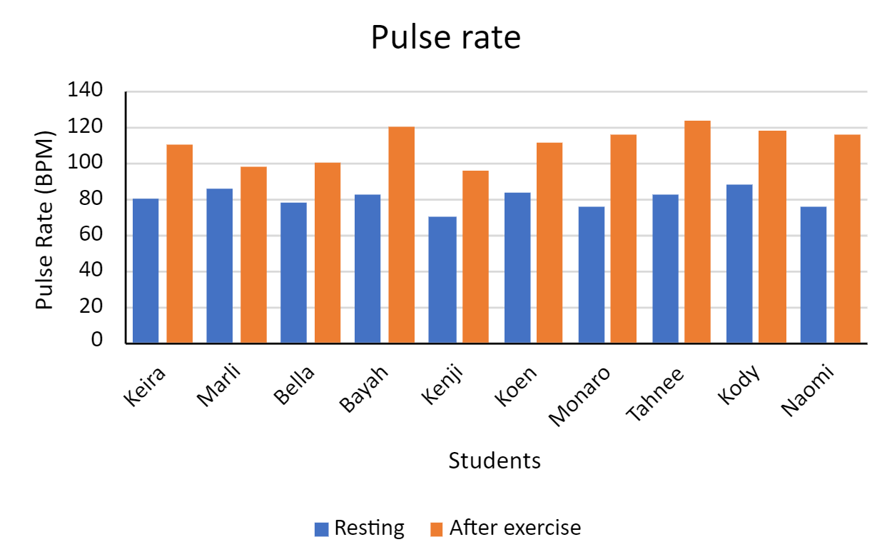
Short response (3)
Who recorded the lowest resting pulse rate?
Who recorded the highest pulse rate after exercise?
Notes:
Short response questions provide brisk paced questions focussing on review of current and previous content to support spaced and interleaved practice.
Syllabus focus area:
Data B

Slide 9
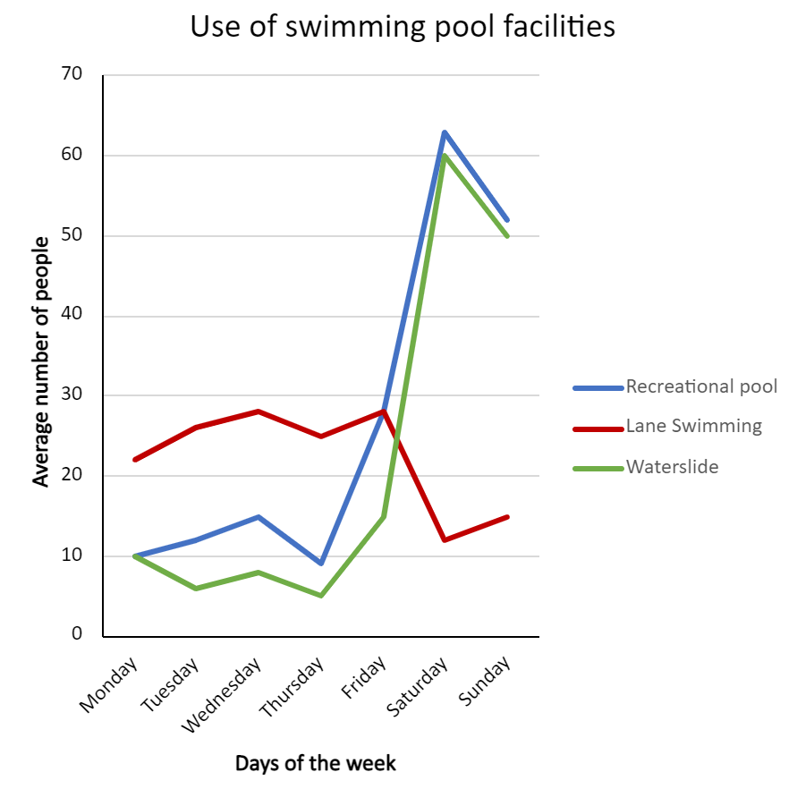
Short response (4)
Describe how the range is different for each facility at the swimming pool.
Notes:
Short response questions provide brisk paced questions focussing on review of current and previous content to support spaced and interleaved practice.
Syllabus focus area:
Data B

Slide 10

Activity 1 – prime, composite, neither (1)
12 | 13
Notes:
This is a developing number sense activity.
Number sense refers to a deep understanding of numbers, including their magnitude, relationships, and the effects of operations on them. It supports fluency and understanding, estimation, flexible thinking, and efficient problem-solving. Number sense activities 1–4 ‘activate’ prior number knowledge and support the learning of new content in the unit. Number sense activities 5–8 ‘loop’ back and provide opportunity for spaced practice with concepts and procedures covered in previous units.
Syllabus focus area:
Multiplicative relations A
Prime, composite, neither
Factor: a number which divides another number without a remainder. For example, 1, 2, 3 and 6 are factors of 6, but 4 and 5 are not.
Composite number: a non-zero natural number that has a factor other than one and itself. For example, all even numbers besides 2 are composite numbers. Some odd numbers are composite (for example, 21) but not all are composite (for example, 11).
Prime number: a prime number is a positive integer which has exactly 2 distinct factors, itself and one. Modelled as an array it has only one row.
Revise the definition of prime number, composite number and factor.
Prompt students to record the factors of 12 and 13 on their whiteboards. Ask:
What are the factors of 12?
What are the factors of 13?
Is 12 a composite or prime number? How do you know?
Is 13 a composite or prime number? How do you know?
CONTINUED ON NEXT SLIDE

Slide 11
Activity 1 – prime, composite, neither (2)
41 | 44 | 48 | 49
Notes:
This is a developing number sense activity.
Number sense refers to a deep understanding of numbers, including their magnitude, relationships, and the effects of operations on them. It supports fluency and understanding, estimation, flexible thinking, and efficient problem-solving. Number sense activities 1–4 ‘activate’ prior number knowledge and support the learning of new content in the unit. Number sense activities 5–8 ‘loop’ back and provide opportunity for spaced practice with concepts and procedures covered in previous units.
Syllabus focus area:
Multiplicative relations A
Prime, composite, neither
Factor: a number which divides another number without a remainder. For example, 1, 2, 3 and 6 are factors of 6, but 4 and 5 are not.
Composite number: a non-zero natural number that has a factor other than one and itself. For example, all even numbers besides 2 are composite numbers. Some odd numbers are composite (for example, 21) but not all are composite (for example, 11).
Prime number: a prime number is a positive integer which has exactly 2 distinct factors, itself and one. Modelled as an array it has only one row.
Prompt students to record the factors of 41, 44, 48 and 49 on their whiteboards and identify whether each number is prime or composite.
CONTINUED ON NEXT SLIDE

Slide 12
Activity 1 – prime, composite, neither (3)
1
Notes:
This is a developing number sense activity.
Number sense refers to a deep understanding of numbers, including their magnitude, relationships, and the effects of operations on them. It supports fluency and understanding, estimation, flexible thinking, and efficient problem-solving. Number sense activities 1–4 ‘activate’ prior number knowledge and support the learning of new content in the unit. Number sense activities 5–8 ‘loop’ back and provide opportunity for spaced practice with concepts and procedures covered in previous units.
Syllabus focus area:
Multiplicative relations A
Prime, composite, neither
Factor: a number which divides another number without a remainder. For example, 1, 2, 3 and 6 are factors of 6, but 4 and 5 are not.
Composite number: a non-zero natural number that has a factor other than one and itself. For example, all even numbers besides 2 are composite numbers. Some odd numbers are composite (for example, 21) but not all are composite (for example, 11).
Prime number: a prime number is a positive integer which has exactly 2 distinct factors, itself and one. Modelled as an array it has only one row.
Ask students whether one is a prime or composite number.
Revise that one is neither prime nor composite because it only has one factor which is itself.

Slide 13
Review of learning 2

Slide 14
True or false (1)
‘Product’ means the result of multiplying 2 or more numbers.
True | False
Notes:
The question on this slide connects to the content being explored in the developing number sense activity (Activity 2)
Syllabus focus area:
Multiplicative relations A

Slide 15
Short response (5)
Use a multiplication algorithm to solve:
The cricket club buys boxes of cricket balls. Each box holds 22 balls. The cricket club bought 35 boxes. How many cricket balls did they get in total?
Notes:
Short response questions provide brisk paced questions focussing on review of current and previous content to support spaced and interleaved practice.
Syllabus focus area:
Multiplicative relations A

Slide 16
Short response (6)
Partition the following number in 2 different ways using non-standard partitioning.
541 267 895
Notes:
Short response questions provide brisk paced questions focussing on review of current and previous content to support spaced and interleaved practice.
Syllabus focus area:
Represents numbers A

Slide 17
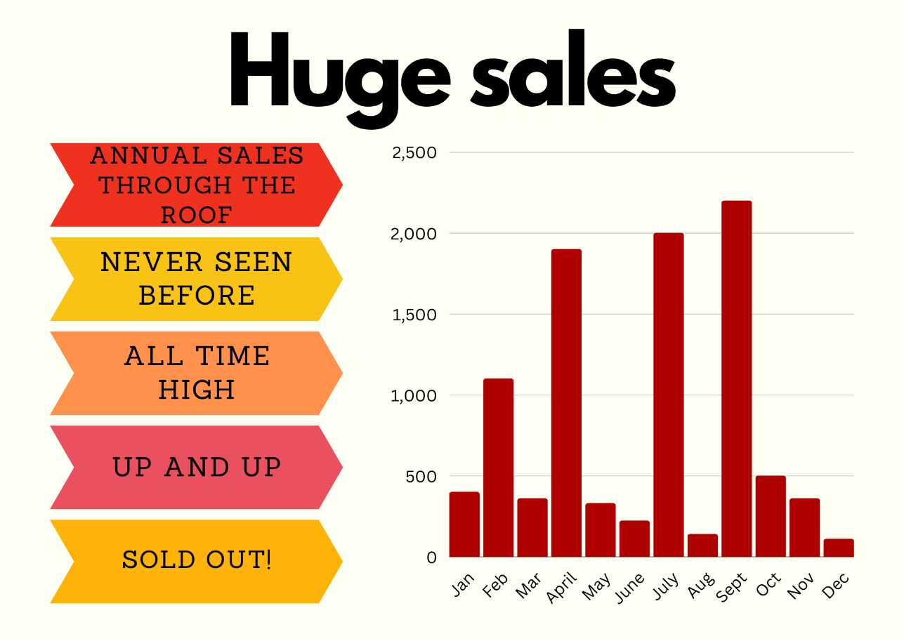
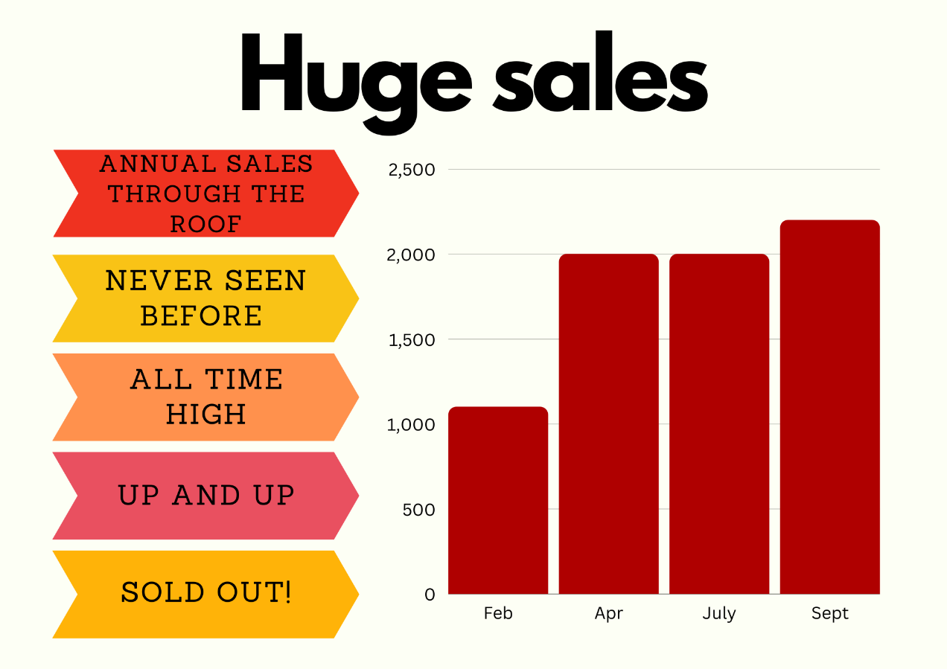
Short response (7)
Which of these data representations is the most misleading?
Communicate your reasoning.
Notes:
Short response questions provide brisk paced questions focussing on review of current and previous content to support spaced and interleaved practice.
Syllabus focus area:
Data B

Slide 18



Short response (8)
Classify the triangles.
Notes:
Short response questions provide brisk paced questions focussing on review of current and previous content to support spaced and interleaved practice.
Syllabus focus area:
Two-dimensional spatial structure A: 2D shapes

Slide 19
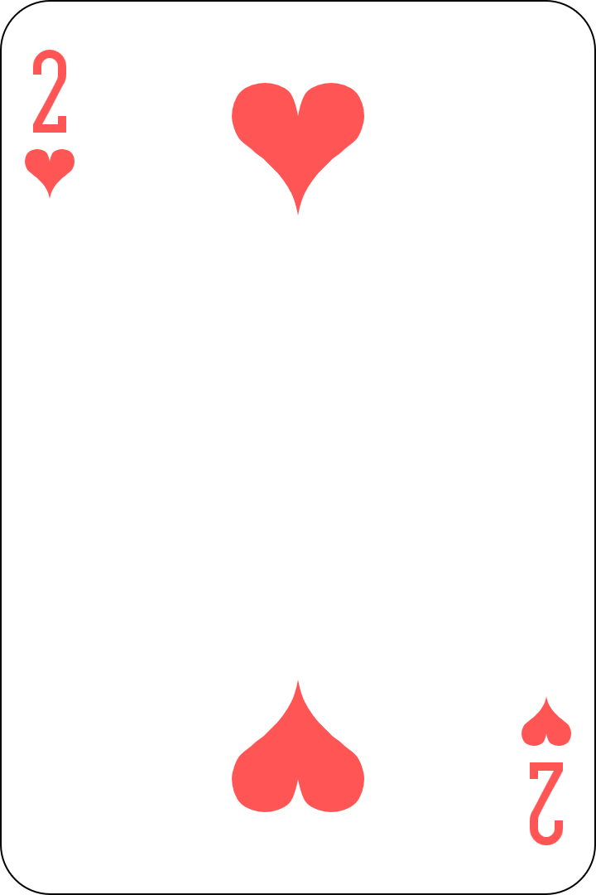
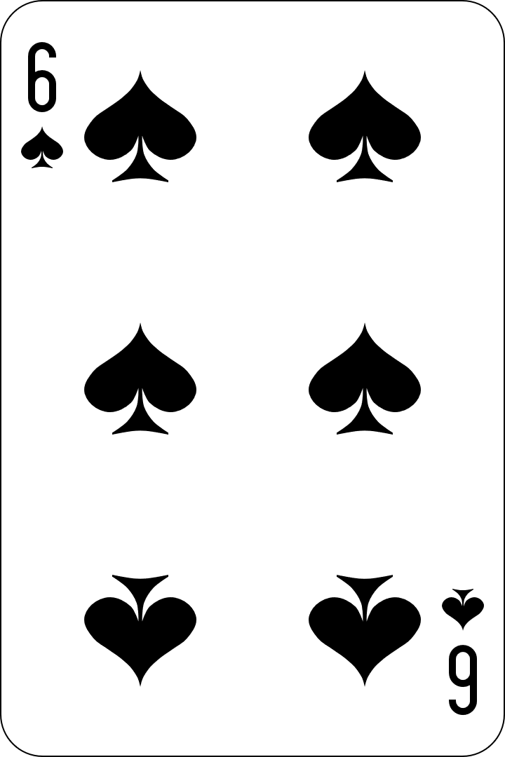

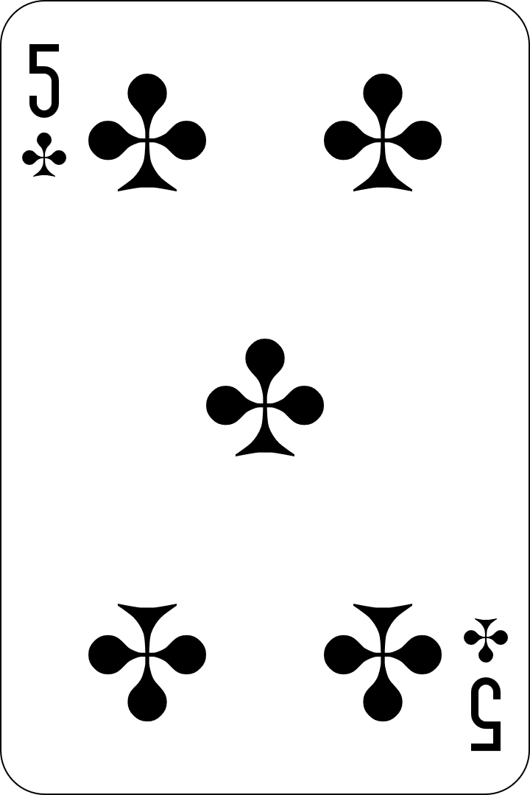
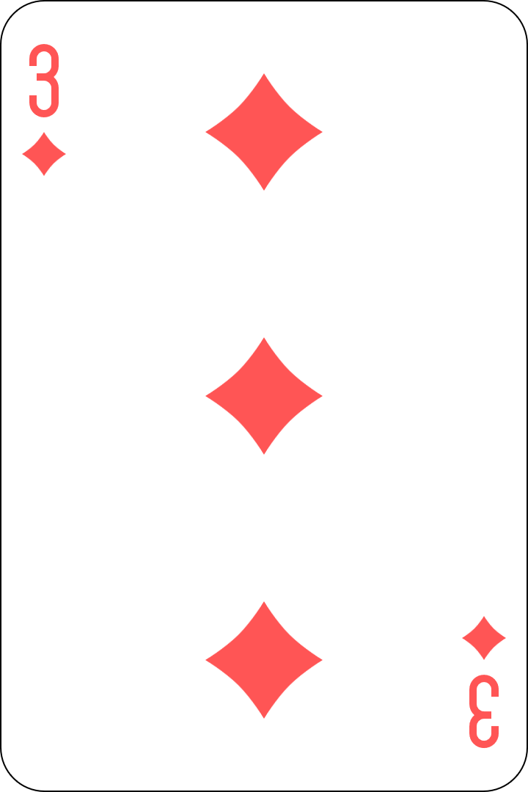
Activity 2 – product 100 target
53 x 2 = 106
Notes:
This is a developing number sense activity.
Number sense refers to a deep understanding of numbers, including their magnitude, relationships, and the effects of operations on them. It supports fluency and understanding, estimation, flexible thinking, and efficient problem-solving. Number sense activities 1–4 ‘activate’ prior number knowledge and support the learning of new content in the unit. Number sense activities 5–8 ‘loop’ back and provide opportunity for spaced practice with concepts and procedures covered in previous units.
Syllabus focus area:
Multiplicative relations A
Product 100 target
Product: a number which is the result of multiplying 2 or more numbers.
Revise the definition of product.
In pairs, provide students with playing cards (ace–9).
One student deals out 4 cards to each player.
Using their 4 cards, students form any one-digit or 2-digit number.
Players find the product of 2 or more numbers to get as close to 100 as possible. Each card can only be used once and not all cards need to be used. Students record their multiplication number sentence on their whiteboard. For example, if 2, 6, 5 and 3 are dealt, a student may choose to record 53 × 2 = 106.
Students score one point for being the player closest to 100.
The game continues until a player reaches 10 points.

Slide 20
Review of learning 3

Slide 21
Multiple choice (2)
Which of these numbers have the factors 6 and 7?
A
B
C
D
24
42
36
40
Notes:
This question connects to the content in the developing number sense activity (Activity 3)
Syllabus focus area:
Multiplicative relations A

Slide 22
Short response (9)
A farmer has collected 97 eggs.
Each carton holds 12 eggs.
8 cartons are filled.
How many eggs are left?
Notes:
Short response questions provide brisk paced questions focussing on review of current and previous content to support spaced and interleaved practice.
Syllabus focus area:
Multiplicative relations A

Slide 23
Short response (10)
What is the value of the digit in the:
Tenths place? Hundredths place? Thousandths place?
4.581
1 2 3 4 5 6 7 8 9 10
How many thousandths are represented in the number?
Notes:
Short response questions provide brisk paced questions focussing on review of current and previous content to support spaced and interleaved practice.
Syllabus focus area:
Represent numbers A

Slide 24
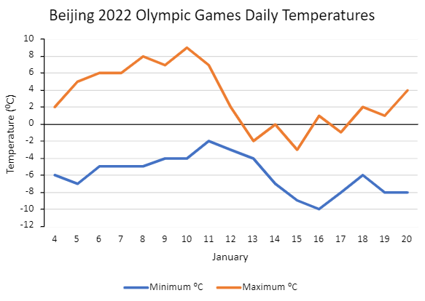
Short response (11)
Which days had maximum temperatures below 0°C?
What is the difference in temperature between the warmest day and the coldest day?
Source: Adapted from World Weather Online (2023).
Notes:
Short response questions provide brisk paced questions focussing on review of current and previous content to support spaced and interleaved practice.
Syllabus focus area:
Data B

Slide 25
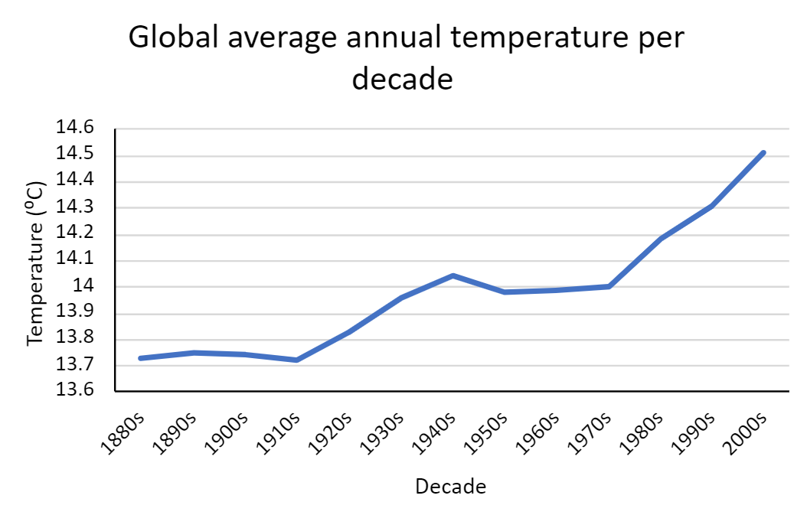
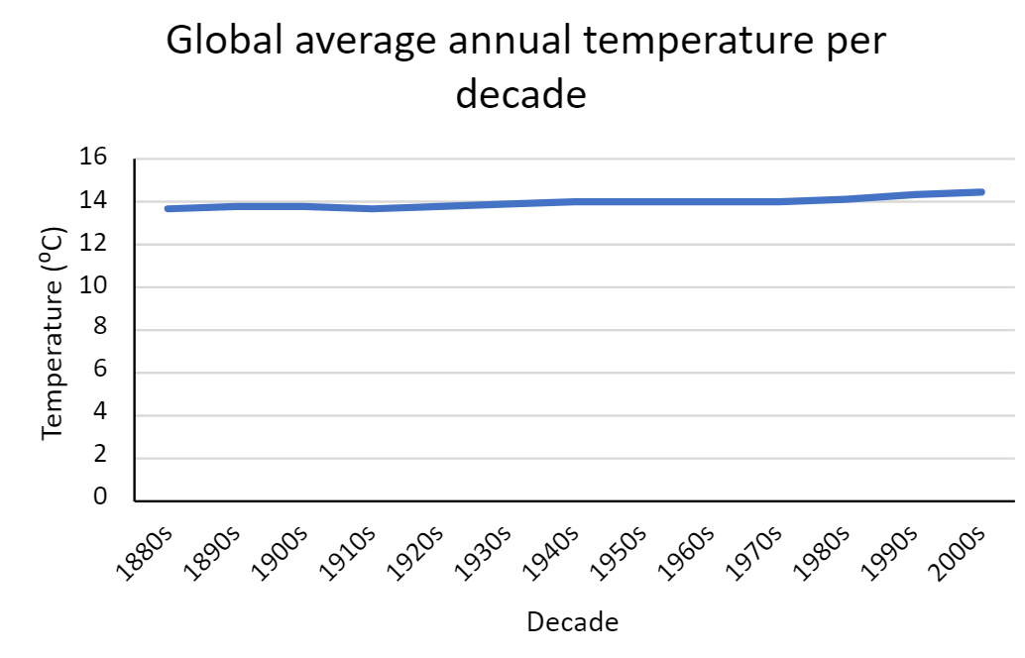
Short response (12)
Which of these data representations is the most misleading?
Communicate your reasoning.
Notes:
Short response questions provide brisk paced questions focussing on review of current and previous content to support spaced and interleaved practice.
Syllabus focus area:
Data B

Slide 26


Activity 3 – product game
Factors
1
2
3
4
5
6
7
8
9
1 | 2 | 3 | 4 | 5 | 6
7 | 8 | 9 | 10 | 12 | 14
15 | 16 | 18 | 20 | 21 | 24
25 | 27 | 28 | 30 | 32 | 35
36 | 40 | 42 | 45 | 48 | 49
54 | 56 | 63 | 64 | 72 | 81
Notes:
This is a developing number sense activity.
Number sense refers to a deep understanding of numbers, including their magnitude, relationships, and the effects of operations on them. It supports fluency and understanding, estimation, flexible thinking, and efficient problem-solving. Number sense activities 1–4 ‘activate’ prior number knowledge and support the learning of new content in the unit. Number sense activities 5–8 ‘loop’ back and provide opportunity for spaced practice with concepts and procedures covered in previous units.
Syllabus focus area:
Multiplicative relations B
Product game
This resource corresponds to Resource 18 – product gameboard in Stage 3 Year B Unit 27.
This activity is an adaptation of ‘Product Game’ by National Council of Teachers of Mathematics.
Provide pairs of students with Resource 18 – product gameboard, 2 paper clips and coloured counters.
Explain the rules of the product game:
Player A puts a paper clip on a number in the factor list.
Player B puts the other paper clip on any number in the factor list. They then cover the product of the 2 factors on the grid using a coloured counter.
Players can put the paper clips on the same number in the factor list.
Player A moves either one of the paper clips to another number in the factor list. Then they cover the new product using a different coloured counter.
Each player, in turn, moves a paper clip and covers a product.
If a product is already covered, the player does not get a mark for that turn.
The winner is the first player to cover 4 squares in a row vertically, horizontally or diagonally.

Slide 27
Review of learning 4

Slide 28
True or false (2)
24 counters could be arranged into an 8 by 3 array.
True | False
Communicate your reasoning.
Notes:
The question on this slide connects to the content being explored in the developing number sense activity (Activity 4)
Syllabus focus area:
Multiplicative relations A

Slide 29
Short response (13)
Solve this number sentence.
12 × __ = 96 ÷ 8
Communicate your reasoning.
Notes:
Short response questions provide brisk paced questions focussing on review of current and previous content to support spaced and interleaved practice.
Syllabus focus area:
Multiplicative relations B

Slide 30
Short response (14)
Place the decimal numbers in ascending order.
0.490
0.55
0.901
Communicate your reasoning.
Notes:
Short response questions provide brisk paced questions focussing on review of current and previous content to support spaced and interleaved practice.
Syllabus focus area:
Represent numbers A

Slide 31
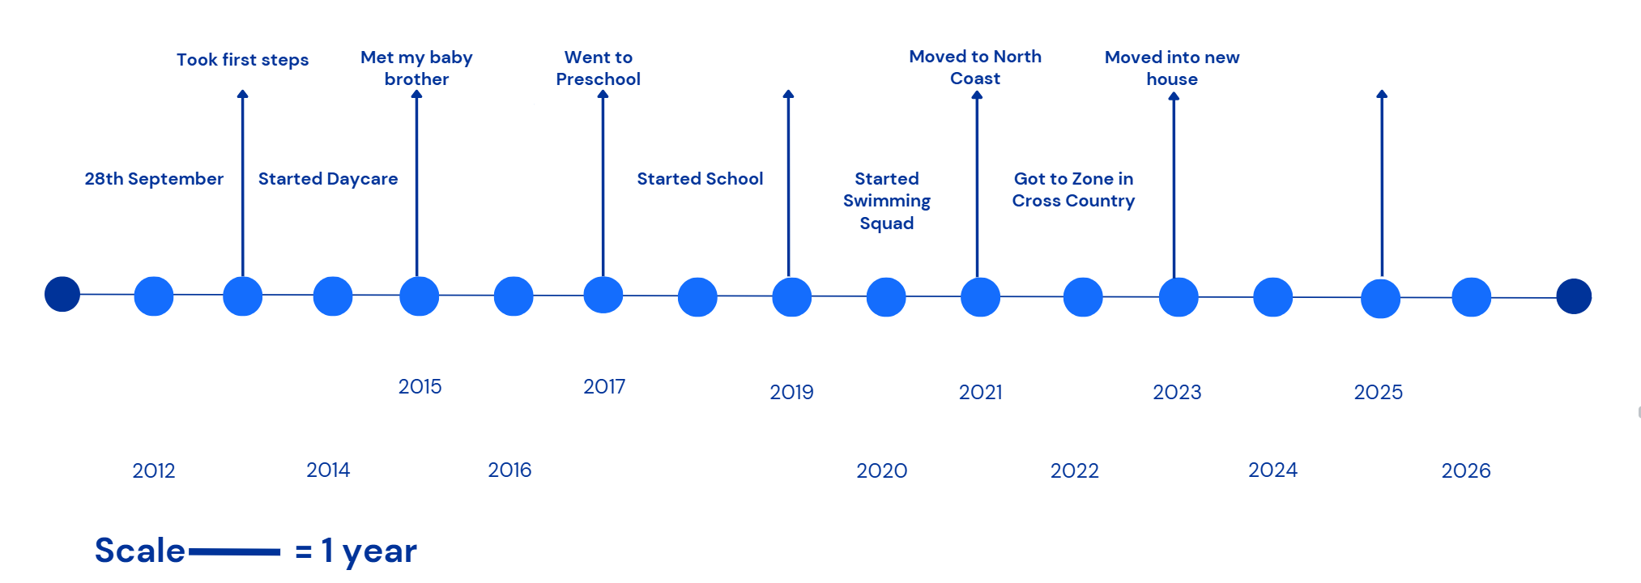
Short response (15)
How many years between the child’s first steps and going to zone in cross country?
Communicate your reasoning.
Notes:
Short response questions provide brisk paced questions focussing on review of current and previous content to support spaced and interleaved practice.
Syllabus focus area:
Data B

Slide 32
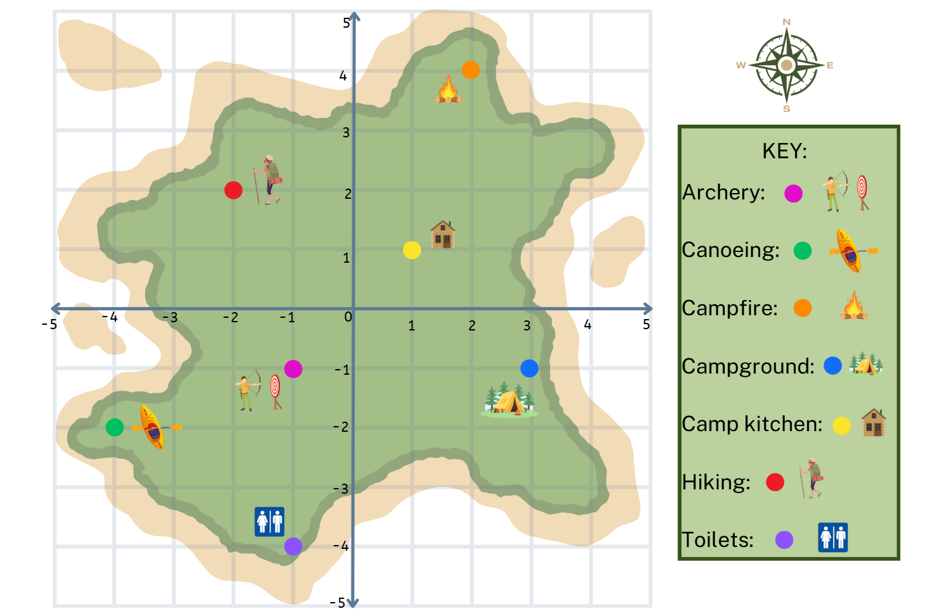
Short response (16)
Record the position of the:
Canoeing
Campfire
Notes:
Short response questions provide brisk paced questions focussing on review of current and previous content to support spaced and interleaved practice.
Syllabus focus area:
Geometric measure A: Position

Slide 33
Activity 4 – rearrange arrays
I have 48 counters arranged in an array. How might they be arranged?
I have 96 counters arranged in an array. How might they be arranged?
Notes:
This is a developing number sense activity.
Number sense refers to a deep understanding of numbers, including their magnitude, relationships, and the effects of operations on them. It supports fluency and understanding, estimation, flexible thinking, and efficient problem-solving. Number sense activities 1–4 ‘activate’ prior number knowledge and support the learning of new content in the unit. Number sense activities 5–8 ‘loop’ back and provide opportunity for spaced practice with concepts and procedures covered in previous units.
Syllabus focus area:
Multiplicative relations A
Rearrange arrays
Pose the following question: I have 48 counters arranged in an array. How might they be arranged?
Students turn and talk and record their ideas on a whiteboard. For example, 48 as 2 by 24, 4 by 12, 6 by 8.
Ask:
How many possibilities are there?
How did multiplication help you with this problem?
Pose the following question: I have 96 counters arranged in an array. How might they be arranged?
Ask students to record their ideas as number sentences where 96 is the product and identify the factors of 96.
Ask:
How many possibilities are there?
How did the factors of 48 help you work out the factors of 96?

Slide 34
Review of learning 5

Slide 35
Multiple choice (3)
4.6 plus 6 tenths equals
A
B
C
D
5.2
10.6
4.12
5.4
Notes:
This question connects to the content in the developing number sense activity (Activity 5)
Syllabus focus area:
Additive relations B

Slide 36
Short response (17)
How can we express 4 cakes shared between 3 people?
Record your answer using fractions, words and division symbols.
Notes:
Short response questions provide brisk paced questions focussing on review of current and previous content to support spaced and interleaved practice.
Syllabus focus area:
Multiplicative relations B

Slide 37
Short response (18)
3.14 m is equivalent to
________ centimetres or
_________ millimetres.
Communicate your reasoning.
Notes:
Short response questions provide brisk paced questions focussing on review of current and previous content to support spaced and interleaved practice.
Syllabus focus area:
Geometric measure B

Slide 38
Short response (19)
Arrange the following numbers in ascending order:
3 452 478
8 601 329
3 452 577
Communicate your reasoning.
Notes:
Short response questions provide brisk paced questions focussing on review of current and previous content to support spaced and interleaved practice.
Syllabus focus area:
Represents numbers A: Whole numbers

Slide 39
Short response (20)
Use the abbreviations for kilometres and metres to record the following distances:
1200 metres
3650 metres
12 550 metres
Notes:
Short response questions provide brisk paced questions focussing on review of current and previous content to support spaced and interleaved practice.
Syllabus focus area:
Geometric measure A: Length

Slide 40
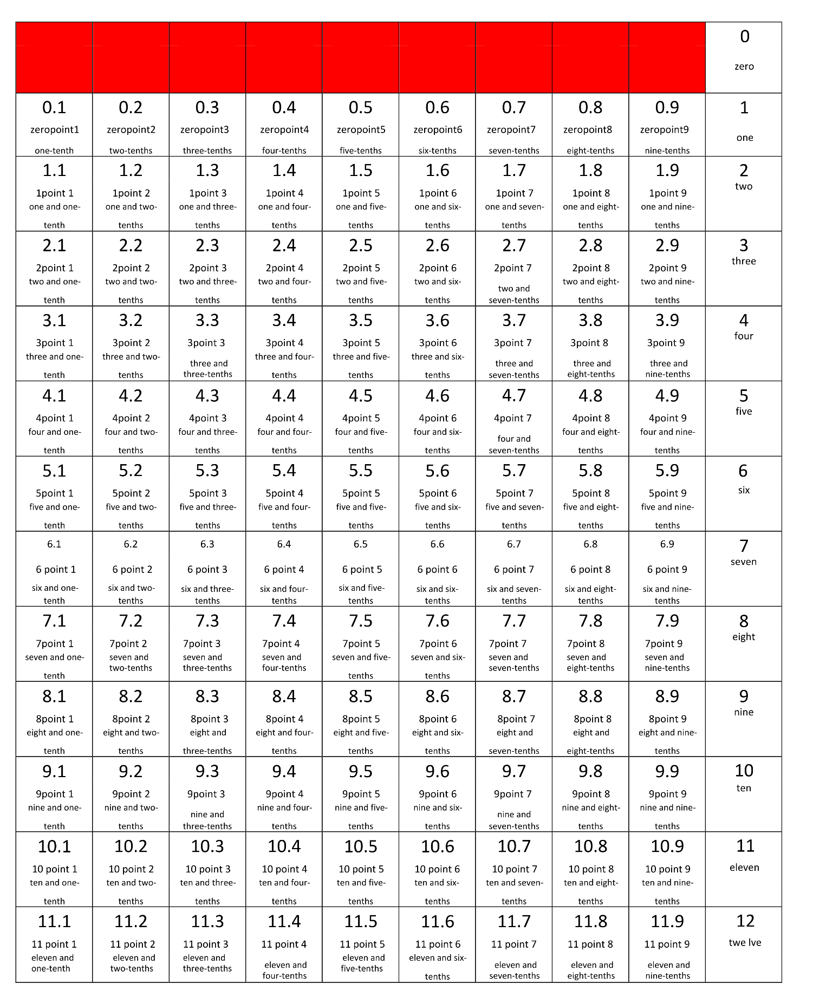
Activity 5 – decimal addition
Notes:
This is a developing number sense activity.
Number sense refers to a deep understanding of numbers, including their magnitude, relationships, and the effects of operations on them. It supports fluency and understanding, estimation, flexible thinking, and efficient problem-solving. Number sense activities 1–4 ‘activate’ prior number knowledge and support the learning of new content in the unit. Number sense activities 5–8 ‘loop’ back and provide opportunity for spaced practice with concepts and procedures covered in previous units.
Syllabus focus area:
Additive relations B
Decimal addition
This resource corresponds to Resource 19 – labelled 12 charts and Resource 20 – fraction spinner in Stage 3 Year B Unit 27.
This activity is an adaptation of ‘Task 4 – I’ll race you to zero: decimal place value’ from Flexible additive strategies – Decimals by State of New South Wales (Department of Education). Resources used for this daily number sense will be reused for variations of the same game in Activity 6 and Activity 7.
Provide pairs of students with:
a copy of Resource 19 – labelled 12 charts
a copy of Resource 20 – fraction spinner
2 counters
a 6-sided dice.
Students place their counters at zero. Spin to decide who goes first.
Students take turns to spin and roll and then decide which to use, adding the amount to their current position. For example, if a student spun six-tenths and rolled a 4, they can choose to add six-tenths or to add 4.
Students explain where they need to move their counter to their partner, justifying their thinking. If their partner agrees, they move the counter to the corresponding position.
Students take turns until someone has been able to land exactly on 12.
Students miss a turn if they cannot move.
Variations include:
Students make a number roll by cutting their 12 chart into strips and joining them into one number strip – students can roll it up when out of use.
Students make their own chart where the target number is 1.2 and numbers increase by hundredths, such as 0, 0.01, 0.02 and so on. Use Resource 20 – fraction spinner for tenths and the 1–6 dice for hundredths.

Slide 41
Review of learning 6

Slide 42
True or false (3)
11.5 take away 9 tenths equals 10.4
True | False
Communicate your reasoning.
Notes:
The question on this slide connects to the content being explored in the developing number sense activity (Activity 6)
Syllabus focus area:
Additive relations B

Slide 43
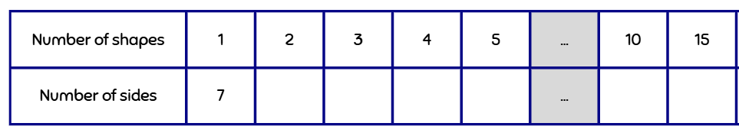
Short response (21)
Complete the table using the pattern.
Notes:
Short response questions provide brisk paced questions focussing on review of current and previous content to support spaced and interleaved practice.
Syllabus focus area:
Multiplicative relations B

Slide 44
Short response (22)
Write the measurements of mass in decimals.
5 kilograms and 258 grams
2650 grams
Notes:
Short response questions provide brisk paced questions focussing on review of current and previous content to support spaced and interleaved practice.
Syllabus focus area:
Non-spatial measure A
Mass: Connect decimal representations to the metric system
• Recognise the equivalence of whole-number and decimal representations of measurements of mass

Slide 45
Short response (23)
Record in ascending order:
7.294
7.924
7.429
Communicate your reasoning.
Notes:
Short response questions provide brisk paced questions focussing on review of current and previous content to support spaced and interleaved practice.
Syllabus focus area:
Represents numbers A: Decimals and percentages

Slide 46
Short response (24)
Find the total length of 3 items measuring 5 millimetres, 45 centimetres and 6.2 metres.
Notes:
Short response questions provide brisk paced questions focussing on review of current and previous content to support spaced and interleaved practice.
Syllabus focus area:
Geometric measure B: Length

Slide 47
Activity 6 – decimal subtraction
Notes:
This is a developing number sense activity.
Number sense refers to a deep understanding of numbers, including their magnitude, relationships, and the effects of operations on them. It supports fluency and understanding, estimation, flexible thinking, and efficient problem-solving. Number sense activities 1–4 ‘activate’ prior number knowledge and support the learning of new content in the unit. Number sense activities 5–8 ‘loop’ back and provide opportunity for spaced practice with concepts and procedures covered in previous units.
Syllabus focus area:
Additive relations B
Decimal subtraction
This resource corresponds to Resource 19 – labelled 12 charts and Resource 20 – fraction spinner in Stage 3 Year B Unit 27.
This activity is an adaptation of ‘Task 4 – I’ll race you to zero: decimal place value’ from Flexible additive strategies – Decimals by State of New South Wales (Department of Education) using resources in Lesson 5.
Provide pairs of students with their resources from Activity 5.
Students place their counters at 12. Spin to decide who goes first.
Students take turns to spin and roll and then to decide which to use, subtracting the amount to their current position. For example, if a student spun six-tenths and rolled a 4, they can choose to subtract six-tenths or to subtract 4.
Students explain where they need to move their counter to their partner, justifying their thinking. If their partner agrees, they move the counter to the corresponding position.
Students take turns until someone has been able to land exactly on zero.
Students miss a turn if they cannot move.
Variations include:
Students make a number roll by cutting their 12 chart into strips and joining them into one number strip.
Students make their own chart, where the starting number is 1.2. Numbers decrease by hundredths, such as 1.2, 1.19, 1.18 and so on. Use Resource 20 – fraction spinner for tenths and the 1–6 dice for hundredths.

Slide 48
Review of learning 7

Slide 49
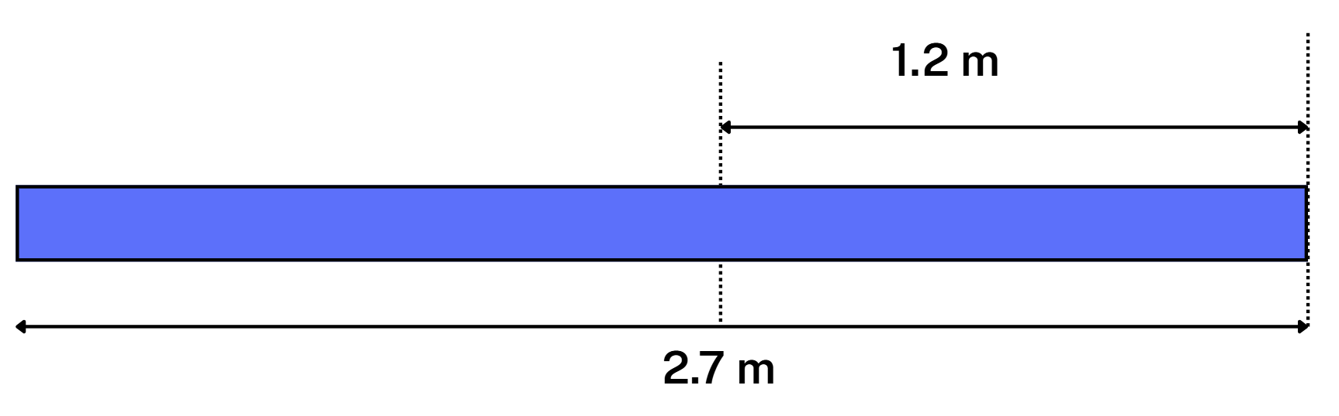
Multiple choice (4)
This metal bar is 2.7 m long. If one section is 1.2 m, how long is the other part of the bar?
A
B
C
D
3.9 m
1.9 m
1.5 m
2.5 m
Notes:
This question connects to the content in the developing number sense activity (Activity 7)
Syllabus focus area:
Additive relations B

Slide 50
Short response (25)
Solve the following problem:
If 8 concert tickets cost $1 936, what is the cost of one ticket?
Communicate your reasoning.
Notes:
Short response questions provide brisk paced questions focussing on review of current and previous content to support spaced and interleaved practice.
Syllabus focus area:
Multiplicative relations A

Slide 51
Short response (26)
Solve the problem using 2 different strategies.
A cyclist completes part 1 of a race in 732.589 seconds and part 2 in 730.124 seconds.
What is the total time taken to complete both parts?
Communicate your reasoning.
Notes:
Short response questions provide brisk paced questions focussing on review of current and previous content to support spaced and interleaved practice.
Syllabus focus area:
Additive relations B

Slide 52
Short response (27)
Record in descending order:
6.971
6.9
6.719
0.697
Communicate your reasoning.
Notes:
Short response questions provide brisk paced questions focussing on review of current and previous content to support spaced and interleaved practice.
Syllabus focus area:
Represents numbers A: Decimals and percentages

Slide 53
Short response (28)
If each side of this rhombus is 12 cm, what is its perimeter?
Communicate your reasoning.
Notes:
Short response questions provide brisk paced questions focussing on review of current and previous content to support spaced and interleaved practice.
Syllabus focus area:
Geometric measure A: Length

Slide 54
Activity 7 – decimal operations
Notes:
This is a developing number sense activity.
Number sense refers to a deep understanding of numbers, including their magnitude, relationships, and the effects of operations on them. It supports fluency and understanding, estimation, flexible thinking, and efficient problem-solving. Number sense activities 1–4 ‘activate’ prior number knowledge and support the learning of new content in the unit. Number sense activities 5–8 ‘loop’ back and provide opportunity for spaced practice with concepts and procedures covered in previous units.
Syllabus focus area:
Additive relations B
Activity title
This resource corresponds to Resource 19 – labelled 12 charts and Resource 20 – fraction spinner in Stage 3 Year B Unit 27.
This activity is an adaptation of ‘Task 4 – I’ll race you to zero: decimal place value’ from Flexible additive strategies – Decimals by State of New South Wales (Department of Education) using resources in Lesson 5.
Provide pairs of students with their resources from Activity 5.
The aim of this variation is to stay as close to 6 as possible by selecting amounts to add or subtract.
Students place their counters at 6. Spin to decide who goes first.
Students take turns to spin and roll and to decide which to use, subtracting or adding the amount to their current position. For example, if a student spun six-tenths and rolled a 4, they can choose to add or subtract six-tenths or to add or subtract 4.
Students explain where they need to move their counter to their partner, justifying their thinking. If their partner agrees, they move the counter to the corresponding position.
The winner is the student closest to 6 after 10 rolls each. Students may have a score that is higher or lower than 6.

Slide 55
Review of learning 8

Slide 56
True or false (4)
7.8 plus 8 tenths equals 8.6
True | False
Communicate your reasoning.
Notes:
The question on this slide connects to the content being explored in the developing number sense activity (Activity 8)
Syllabus focus area:
Additive relations B

Slide 57
Short response (29)
Solve the following problem:
A recipe uses 5 eggs for 12 muffins.
How many eggs are needed to make 36 muffins?
Notes:
Short response questions provide brisk paced questions focussing on review of current and previous content to support spaced and interleaved practice.
Syllabus focus area:
Multiplicative relations B

Slide 58
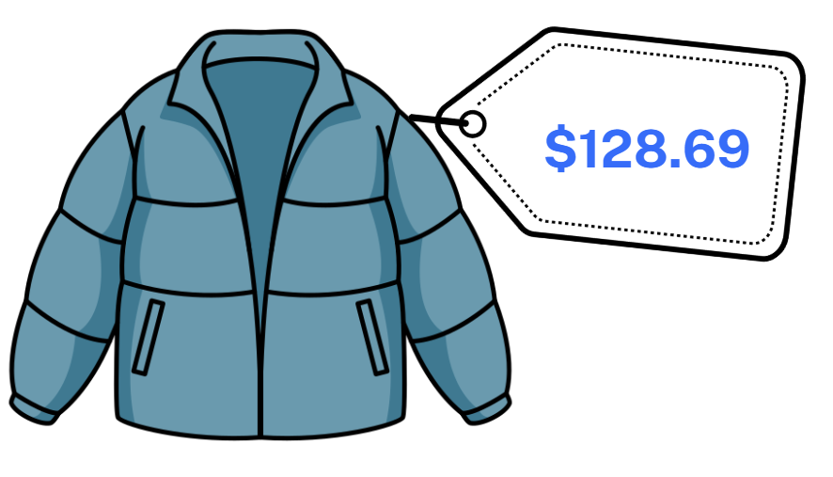
Short response (30)
Estimate a discount of :
10%
25%
50%
Communicate your reasoning.
Notes:
Short response questions provide brisk paced questions focussing on review of current and previous content to support spaced and interleaved practice.
Syllabus focus area:
Represents numbers B
Decimals and percentages: Determine percentage discounts of 10%, 25% and 50%
• Use mental strategies to estimate discounts of 10%, 25% and 50%

Slide 59
Short response (31)
In what way does this data representation mislead the audience?
Communicate your reasoning.
Notes:
Short response questions provide brisk paced questions focussing on review of current and previous content to support spaced and interleaved practice.
Syllabus focus area:
Data B

Slide 60
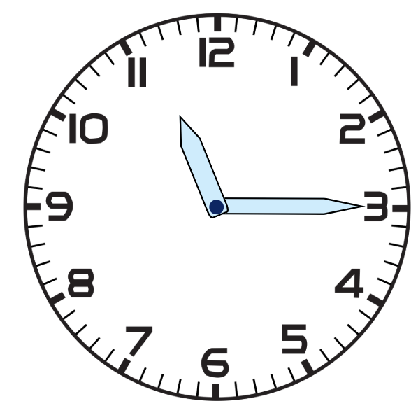
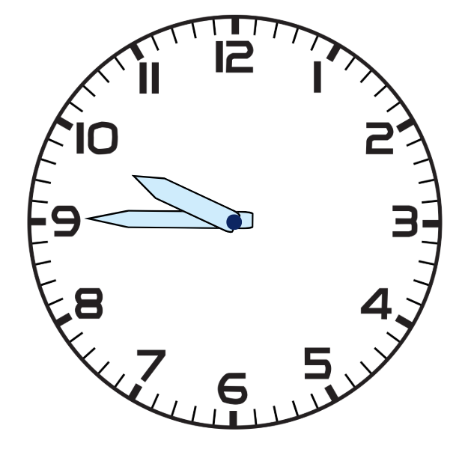

Short response (32)
Record these times using 12-hour and 24-hour time.
Notes:
Short response questions provide brisk paced questions focussing on review of current and previous content to support spaced and interleaved practice.
Syllabus focus area:
Non-spatial measure A: Time

Slide 61
Activity 8 – decimal operations 2
Notes:
This is a developing number sense activity.
Number sense refers to a deep understanding of numbers, including their magnitude, relationships, and the effects of operations on them. It supports fluency and understanding, estimation, flexible thinking, and efficient problem-solving. Number sense activities 1–4 ‘activate’ prior number knowledge and support the learning of new content in the unit. Number sense activities 5–8 ‘loop’ back and provide opportunity for spaced practice with concepts and procedures covered in previous units.
Syllabus focus area:
Additive relations B
Activity title
This resource corresponds to Resource 19 – labelled 12 charts and Resource 20 – fraction spinner in Stage 3 Year B Unit 27.
This activity is an adaptation of ‘Task 4 – I’ll race you to zero: decimal place value’ from Flexible additive strategies – Decimals by State of New South Wales (Department of Education) using resources in Lesson 5.
Provide pairs of students with their resources from Lesson 5.
The aim of this variation is to stay as close to 11 as possible by selecting amounts to add or subtract.
Students place their counters at 11. Spin to decide who goes first.
Students take turns to spin and roll and to decide which to use, subtracting or adding the amount to their current position. For example, if a student spun six-tenths and rolled a 4, they can choose to add or subtract six-tenths or to add or subtract 4.
Students explain where they need to move their counter to their partner, justifying their thinking. If their partner agrees, they move the counter to the corresponding position.
The winner is the student closest to 11 after 10 rolls each. Students may have a score that is higher or lower than 11.

Slide 62
Double Venn diagram
Object 1
Object 2
Features similar to both objects
Features of object 1
Features of object 2

Slide 63
Frayer
Definition
Facts/Characteristics
Word, term, concept
Examples
Non-examples

Slide 64
Spider map
Idea
Subject

Slide 65
Cline
Concept 1
Concept 2
Word
Word
Word
Word
Word
Word
Word
Word
Word
Word
Word

Slide 66

Compare and contrast

Slide 67
Multiple choice (5)
A
B
C
D

Slide 68
Multiple choice
A
B
C
D
Notes:
This question connects to the content in the developing number sense activity (Activity 3)
Syllabus focus area:
[Focus area A/B]

Slide 69
References
This presentation contains NSW Curriculum and syllabus content. The NSW Curriculum is developed by the NSW Education Standards Authority. This content is prepared by NESA for and on behalf of the Crown in the right of the State of New South Wales. The material is protected by Crown copyright.
Please refer to the NESA Copyright Disclaimer for more information https://educationstandards.nsw.edu.au/wps/portal/nesa/mini-footer/copyright.
NESA holds the only official and up-to-date versions of the NSW Curriculum and syllabus documents. Please visit the NSW Education Standards Authority (NESA) website https://educationstandards.nsw.edu.au/wps/portal/nesa/home and the NSW Curriculum website https://curriculum.nsw.edu.au.
Mathematics K–10 Syllabus © NSW Education Standards Authority (NESA) for and on behalf of the Crown in right of the State of New South Wales, 2022.
National Numeracy Learning Progression © Australian Curriculum, Assessment and Reporting Authority (ACARA) 2010 to present, unless otherwise indicated. This material was downloaded from the Australian Curriculum website (National Numeracy Learning Progression) (accessed 20 September 2023) and was not modified.
NCTM (National Council of Teachers of Mathematics) (n.d.) Product Game, NCTM website, accessed 18 February 2026.
State of New South Wales (Department of Education) (2023) ‘Flexible additive strategies – Decimals – Task 4 – I’ll race you to zero: decimal place value ’, Numeracy, NSW Department of Education website, accessed on 11 July 2023.
Osborn L (2023) ‘History of Changes in the Earth's Temperature’, Environmental Science Articles, Current Results website, accessed 3 July 2023.

Slide 70
Copyright
© State of New South Wales (Department of Education), 2025
The copyright material published in this resource is subject to the Copyright Act 1968 (Cth) and is owned by the NSW Department of Education or, where indicated, by a party other than the NSW Department of Education (third-party material).
Copyright material available in this resource and owned by the NSW Department of Education is licensed under a Creative Commons Attribution 4.0 International (CC BY 4.0) license.
This license allows you to share and adapt the material for any purpose, even commercially.
Attribution should be given to © State of New South Wales (Department of Education), 2025.
Material in this resource not available under a Creative Commons license:
the NSW Department of Education logo, other logos and trademark-protected material
Material owned by a third party that has been reproduced with permission. You will need to obtain permission from the third party to reuse its material.
Links to third-party material and websites
Please note that the provided (reading/viewing material/list/links/texts) are a suggestion only and implies no endorsement, by the New South Wales Department of Education, of any author, publisher, or book title. School principals and teachers are best placed to assess the suitability of resources that would complement the curriculum and reflect the needs and interests of their students.
If you use the links provided in this document to access a third party’s website, you acknowledge that the terms of use, including licence terms set out on the third-party’s website apply to the use which may be made of the materials on that third-party website or where permitted by the Copyright Act 1968 (Cth). The department accepts no responsibility for content on third-party websites.

