Slide 1
Instructions for use
This resource is not a teaching and learning program. It should be used in conjunction with Stage 3 Year B Unit 28.
Classroom teachers are encouraged to add and adapt slides as required to meet the needs of their students.
Save a copy of the file to make changes to the slide deck. Go to File > Download a Copy (this downloads a copy to the computer to edit in the PowerPoint app).
To convert the PowerPoint to Google Slides:
  Upload the file into Google Drive and open it.
  Go to File > Save as Google Slides.
  (Note – conversion may cause formatting changes in the slides.)

Slide 2

Review of Learning
Mathematics Stage 3 – Unit 28
Notes:
Reviews may include a combination of question types, requiring students to recall facts and key ideas, as well as apply their knowledge to solve problems and answer questions. To support active engagement, a mix of techniques should be employed.” (AERO, 2024).
This Review of Learning slide deck revisits key concepts from the following units:
Stage 3 Year B Unit 28
Stage 3 Year B Unit 27
Stage 3 Year B Unit 26
It also includes opportunities to review prior learning in non-number content, supporting consolidation across focus areas.
The review of learning resources include three key task types that support the development of mathematical proficiency through retrieval, spaced practice, and active participation. These practices complement the review phase (activating prior knowledge) embedded within the beginning of each lesson.
1.
Multiple-choice questions/True or false: Designed to promote active retrieval of key concepts and identify common misconceptions in number, supporting consolidation, understanding and fluency.
These questions:
support spaced and interleaved practice
help identify and address common misconceptions
support active recall and immediate feedback
support whole class participation
identify areas requiring reteach
2.
Short-response question sets: Carefully grouped questions that encourage spaced and interleaved practice across multiple focus areas, helping students revisit and apply knowledge from different points in time.
These questions:
have a combination of question types
address a range of focus areas
build automaticity and fluency
support active recall
allow for immediate feedback
identify content requiring reteach
3.
Developing number sense activities: A variety of practical, purposeful tasks that reinforce current learning and build on prior knowledge. These activities promote reasoning, problem-solving and conceptual understanding.
The review of learning resources are designed to work support teaching and learning in mathematics. For the most effective implementation, use the resources flexibly, adapting to meet student learning needs and individual classroom contexts.

Slide 3
Lessons
1
Review of learning 1
5
Review of learning 5
2
Review of learning 2
6
Review of learning 6
3
Review of learning 3
7
Review of learning 7
4
Review of learning 4
8
Review of learning 8
Notes:
Teacher notes:
Click lesson numbers to go to specific lessons
Interactive features can be viewed in slide show

Slide 4
Review of learning 1

Slide 5

Multiple choice (1)
What number is marked as missing on the number line?
-45
?
-15
0
15
45
A
B
C
D
-25
25
-30
30
Notes:
This question connects to the content in the developing number sense activity (Activity 1)
Syllabus focus area:
Represents numbers B

Slide 6

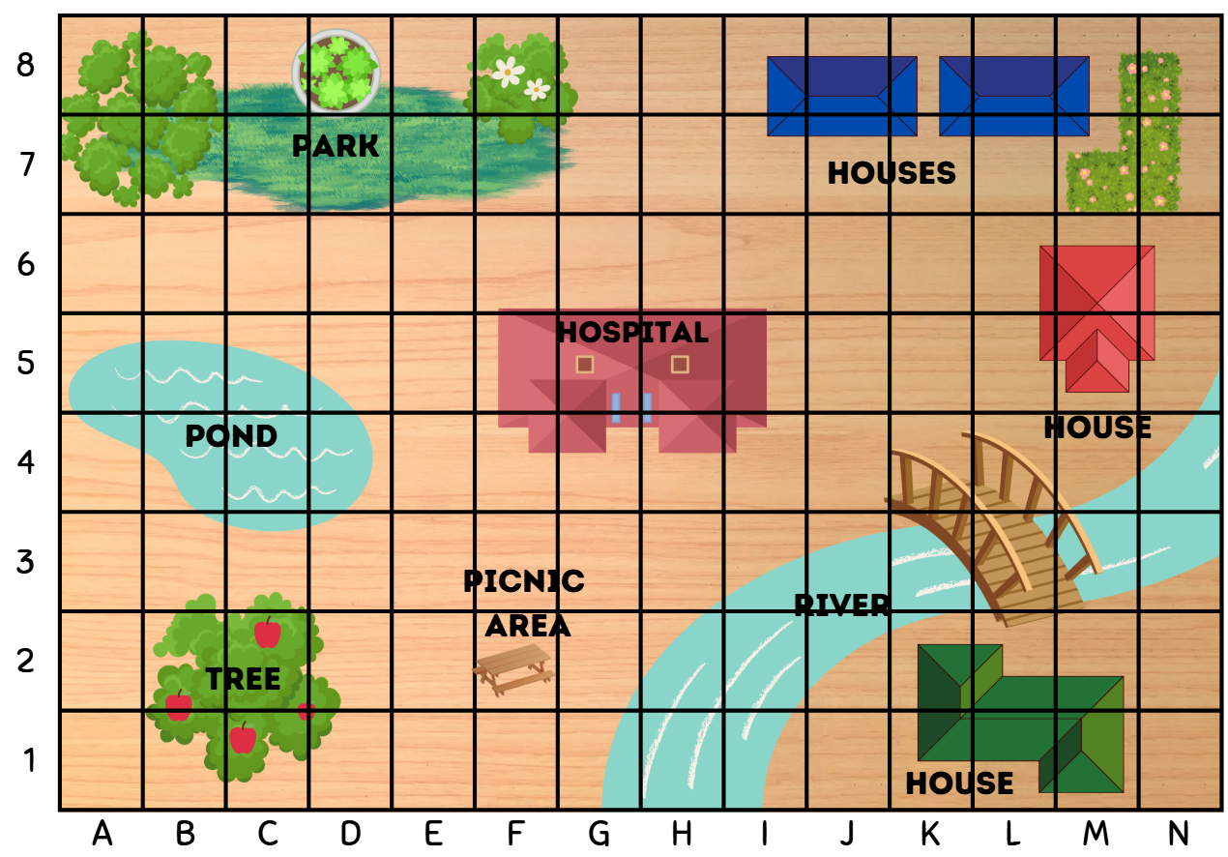
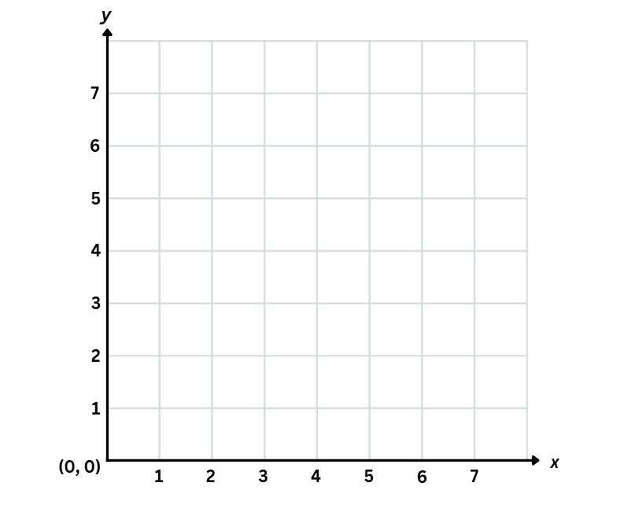
Short response (1)
Complete the sentences.
The _________ reference is used to give the area of a location.
The _________ is used to identify a specific point.
grid-map
number plane
Notes:
Short response questions provide brisk paced questions focussing on review of current and previous content to support spaced and interleaved practice.
Syllabus focus area:
Geometric Measure a

Slide 7
Short response (2)
At a music festival, 48 rows of seats are set up, and 37 seats are placed in each row.
How many seats are there in total?
Communicate your strategy.
Notes:
Short response questions provide brisk paced questions focussing on review of current and previous content to support spaced and interleaved practice.
Syllabus focus area:
Multiplicative relations A

Slide 8
Short response (3)
Round the following numbers to the nearest million:
452 732 672
279 108 344
390 487 192
Notes:
Short response questions provide brisk paced questions focussing on review of current and previous content to support spaced and interleaved practice.
Syllabus focus area:
Represents numbers A

Slide 9
Short response (4)
Record the properties missing from the table:
Shape | Properties of sides | Properties of angles | Regular or irregular?
Equilateral triangle |  | 3 equal acute angles | Regular
Isosceles triangle |  | 2 equal acute angles opposite the equal side lengths | Irregular
Scalene triangle | All 3 sides are different in length |  | Irregular
Square | 4 equal sides 2 pairs of parallel lines
Notes:
Short response questions provide brisk paced questions focussing on review of current and previous content to support spaced and interleaved practice.
Syllabus focus area:
Two-dimensional spatial structure A

Slide 10

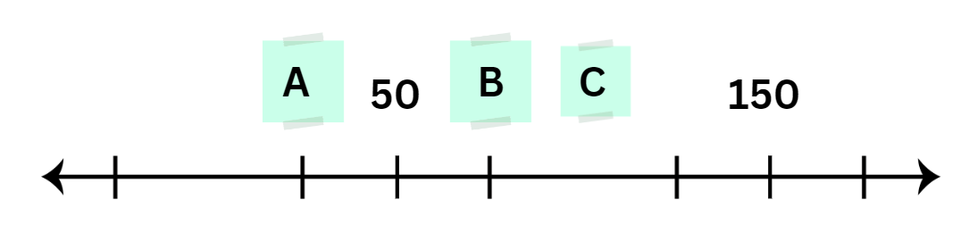
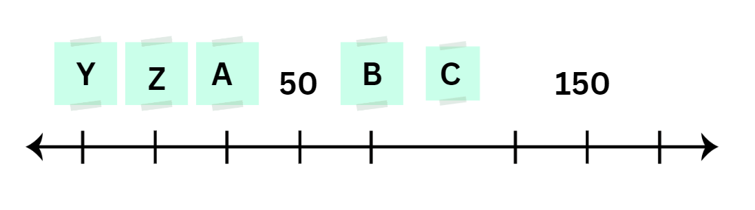
Activity 1 – number line search
Line ABC
Line YZ
Notes:
This is a developing number sense activity.
Number sense refers to a deep understanding of numbers, including their magnitude, relationships, and the effects of operations on them. It supports fluency and understanding, estimation, flexible thinking, and efficient problem-solving. Number sense activities 1–4 ‘activate’ prior number knowledge and support the learning of new content in the unit. Number sense activities 5–8 ‘loop’ back and provide opportunity for spaced practice with concepts and procedures covered in previous units.
Syllabus focus area:
Represents numbers B
Number line search
This resource corresponds to Resource 34 – number lines in Stage 3 Year B Unit 28.
This activity is an adaptation of Finding numbers on a number line from Mathematics K–6 resources by State of New South Wales (Department of Education).
1. Direct student attention to Line ABC. Ask:
What do you notice about the number line?
What numbers could be placed on the number line at point A, B and C?
How can you prove it?
2. Provide students with individual whiteboards to record their answers.
3. Direct student attention to Line YZ. Ask:
What numbers can be placed on the number line at point Y and Z?
Can you find zero?
4. Students record their responses on individual whiteboards. Ask:
Where would you place -10 and -15 on the number line?
What is half between Y and Z? Why?
Can you give an example of when we use negative numbers in real life and what the negative numbers represent? For example, temperature -5 degrees Celsius is 5 degrees below freezing point.

Slide 11
Review of learning 2

Slide 12
True or false (1)
The term integers describes negative whole numbers only.
True | False
Communicate your reasoning.
Notes:
The question on this slide connects to the content being explored in the developing number sense activity (Activity 2)
Syllabus focus area:
Represents numbers B

Slide 13
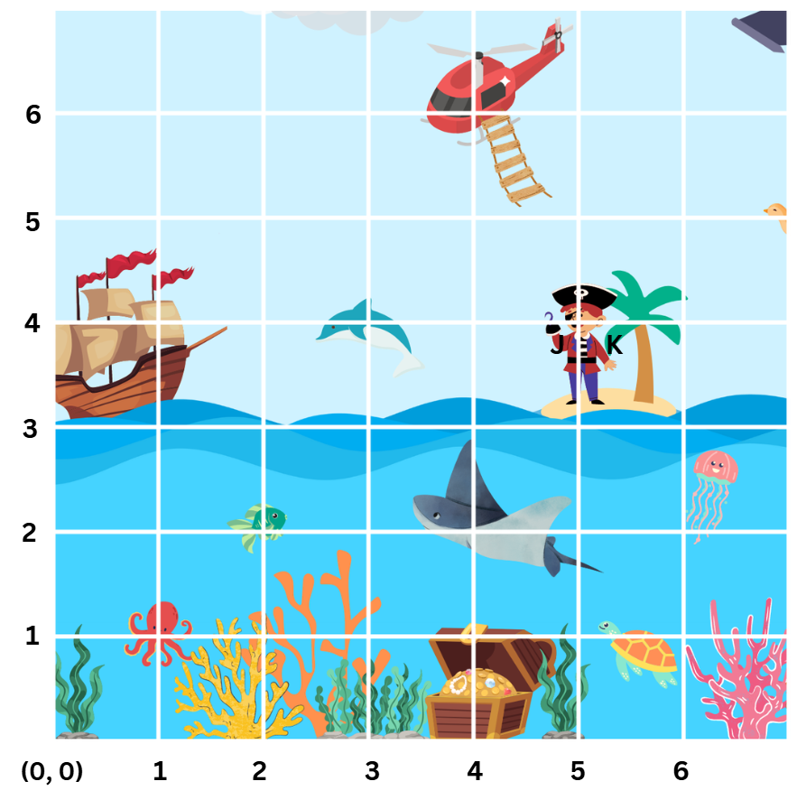
Short response (5)
Record the coordinates for the following:
dolphin
octopus
fish
Notes:
Short response questions provide brisk paced questions focussing on review of current and previous content to support spaced and interleaved practice.
Syllabus focus area:
Geometric measure A

Slide 14
Short response (6)
A cinema printed 742 tickets for a special event. The tickets are packed equally into 6 envelopes for different school groups.
How many tickets will go into each envelope?
Will there be any tickets left over? If so, how many?
Communicate your strategy.
Notes:
Short response questions provide brisk paced questions focussing on review of current and previous content to support spaced and interleaved practice.
Syllabus focus area:
Multiplicative relations A

Slide 15
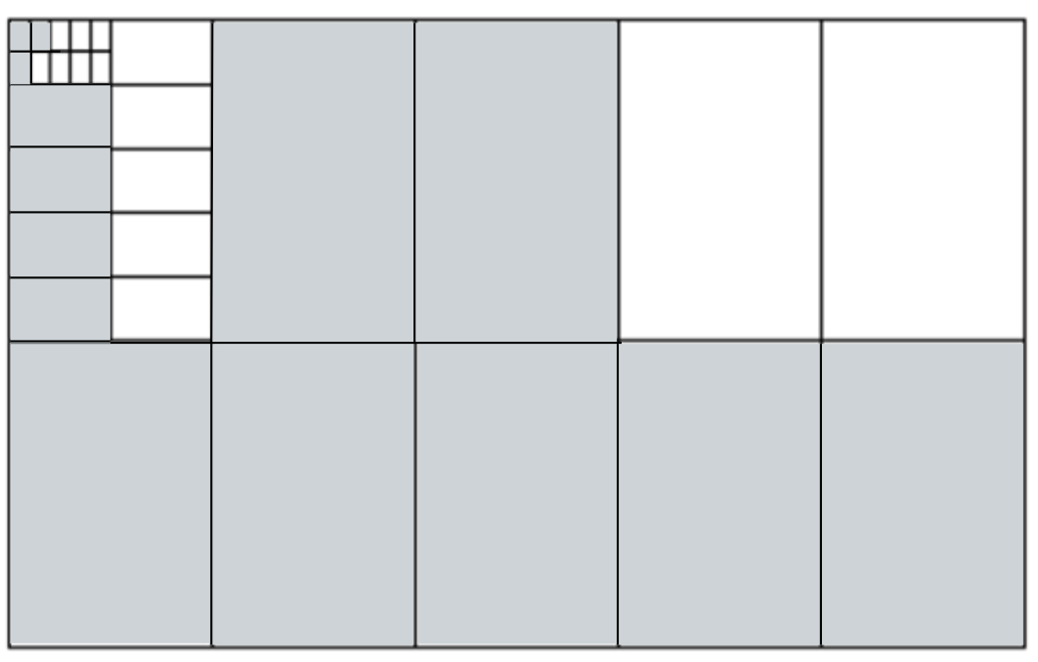
Short response (7)
1. Which decimal is represented on the decimat?
2. How many thousandths are represented in the number?
Notes:
Short response questions provide brisk paced questions focussing on review of current and previous content to support spaced and interleaved practice.
Syllabus focus area:
Represents numbers A

Slide 16

Short response (8)
Calculate the area of the rectangle displayed on square centimetre grid paper.
Notes:
Short response questions provide brisk paced questions focussing on review of current and previous content to support spaced and interleaved practice.
Syllabus focus area:
Two-dimensional spatial structure A

Slide 17
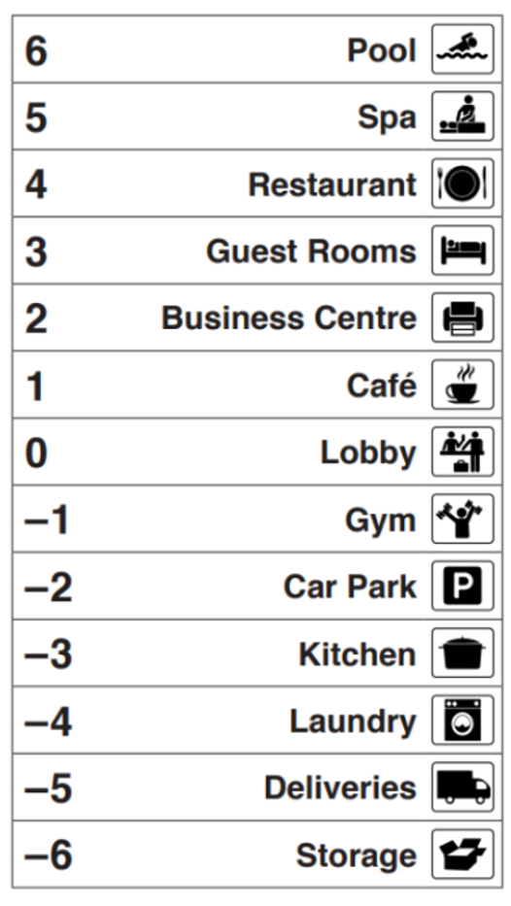
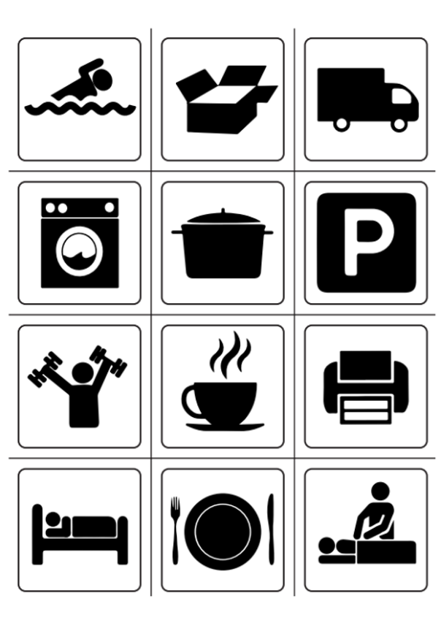
Activity 2 – elevator number line
Notes:
This is a developing number sense activity.
Number sense refers to a deep understanding of numbers, including their magnitude, relationships, and the effects of operations on them. It supports fluency and understanding, estimation, flexible thinking, and efficient problem-solving. Number sense activities 1–4 ‘activate’ prior number knowledge and support the learning of new content in the unit. Number sense activities 5–8 ‘loop’ back and provide opportunity for spaced practice with concepts and procedures covered in previous units.
Syllabus focus area:
Represents numbers B
Elevator number line
This resource corresponds to Resource 35 – elevator floor cards and Resource 36 – hotel floors in Stage 3 Year B Unit 28.
The activity is an adaptation of Directed Number from reSolve by Australian Government Department of Education.
1. Introduce the context of the elevator challenge: students are employees at a hotel. The manager has given them each 4 errands to run on 4 different floors of the hotel. They need to share the elevator to get up and down to complete each task. The person who finishes all their jobs first will be ‘Employee of the Month’.
2. Explain that students will locate negative whole numbers on a number line to complete the activity. The floors of the building are a vertical number line. Model the steps:
Provide pairs of students with 12 cards from Resource 34 – elevator floor cards. Students take 4 cards each; these are the 4 errands. Place the remaining cards to the side.
Provide each pair a dice, Resource 35 – hotel floors and one counter. Place the counter at floor zero, the lobby.
Students roll the dice and the player with the highest number goes first.
Player 1 rolls the dice and moves the elevator (counter) the number of floors according to the number shown on the dice, either up or down as they choose. Whoever holds the card matching the floor the elevator lands on can discard it; the errand is complete.
Player 2 rolls the dice and moves the elevator (counter) from the level where it is, up or down in either direction. Once again, when the elevator stops, the owner of the card for that level can discard it.
Students continue rolling the dice, taking turns to move the elevator up or down.
Students are not to go above floor 6, below -6 or ‘bounce’ the elevator off the top or bottom. This means if a student is on floor 5 and rolls a 3, they must go down. Each journey can be in one direction only. Players must move the total on the dice.
The winner is the first player to complete all their jobs. They can then be awarded the ‘Employee of the Month’.

Slide 18
Review of learning 3

Slide 19
Multiple choice (2)
Sandy is keeping track of the hotel elevator from the lobby (floor 0). The elevator goes up 3 floors, then down 8 floors.
What floor is the elevator on now?
A
B
C
D
-3
-5
-8
0
Notes:
This question connects to the content in the developing number sense activity (Activity 3)
Syllabus focus area:
Represents numbers B

Slide 20
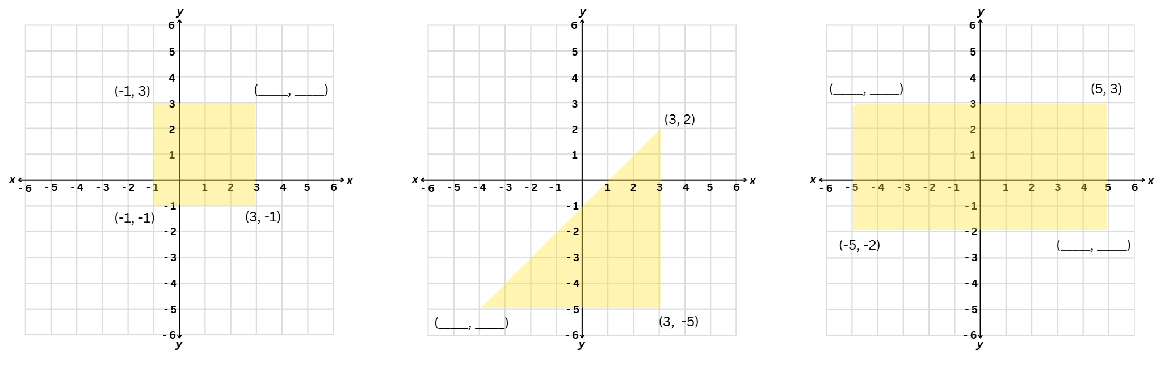
Short response (9)
Record the coordinates of the missing points on the number planes:
A
B
C
Notes:
Short response questions provide brisk paced questions focussing on review of current and previous content to support spaced and interleaved practice.
Syllabus focus area:
Geometric measure B

Slide 21
Short response (10)
7 × 6 = 84 ÷ ☐
What is the missing number?
Write another equivalent number sentence using multiplication and division.
Notes:
Short response questions provide brisk paced questions focussing on review of current and previous content to support spaced and interleaved practice.
Syllabus focus area:
Multiplicative relations B

Slide 22
Short response (11)
Explain why this is ordered from smallest to largest?
0.305, 0.42, 0.5, 0.799
Communicate your reasoning.
Notes:
Short response questions provide brisk paced questions focussing on review of current and previous content to support spaced and interleaved practice.
Syllabus focus area:
Represents numbers A

Slide 23
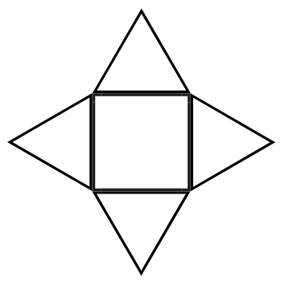
Short response (12)
How do you know this is a net for a square pyramid?
Communicate your reasoning.
Notes:
Short response questions provide brisk paced questions focussing on review of current and previous content to support spaced and interleaved practice.
Syllabus focus area:
Three-dimensional spatial structure A

Slide 24
Activity 3 – negative number subtraction 1
1. 25 + 7 = target number 60
2. 32 - 5 = target number -3
3. 40 - 6 = target number -14
4. 16 - 8 = target number -16
0
Notes:
This is a developing number sense activity.
Number sense refers to a deep understanding of numbers, including their magnitude, relationships, and the effects of operations on them. It supports fluency and understanding, estimation, flexible thinking, and efficient problem-solving. Number sense activities 1–4 ‘activate’ prior number knowledge and support the learning of new content in the unit. Number sense activities 5–8 ‘loop’ back and provide opportunity for spaced practice with concepts and procedures covered in previous units.
Syllabus focus area:
Represents numbers B
Negative number subtraction 1
The activity is an adaptation from Engaging Maths: 25 Favourite Lessons by Clark and Roche.
1. Explain that this activity shows that negative whole numbers can be the result of subtraction.
2. Students place a calculator on a flat surface in front of them. Explain that they will:
be given 2 numbers to type and a target number
put their finger on the equals key, close their eyes and push equals (each time they push the equals key, the second number is added to the new total)
keep track of the number sequence in their head
open their eyes when they are confident that the calculator is showing the target number.
3. Model this by guiding students to type 25 + 7, close their eyes and push the equals sign enough times to reach the target number of 60 (7 is added each time they push the equals key).
4. When they think they have reached the targeted number of 60, they are to stop and check their answer. Students share their results.
5. Draw a number line marked with zero at the centre. Explain that this also occurs with subtraction. If they continue subtracting below zero, they move into negative numbers.
6. Repeat the task for the following equations and represent them on the number line:
32 - 5 = target number -3
40 - 6 = target number -14
16 - 8 = target number -16
7. Regroup and facilitate a class discussion about negative whole numbers resulting from subtraction:
How did you feel about completing mental calculations with your eyes closed?
What strategies did you use to keep track of the number sequence in your head?
How did you know when to stop for negative number calculations?
Did you need to adjust your mental strategies when dealing with negative numbers?

Slide 25
Review of learning 4

Slide 26
True or false (2)
Reading a thermometer is an example of interpreting integers in an everyday context.
True | False
Communicate your reasoning.
Notes:
The question on this slide connects to the content being explored in the developing number sense activity (Activity 4)
Syllabus focus area:
Represents numbers B

Slide 27
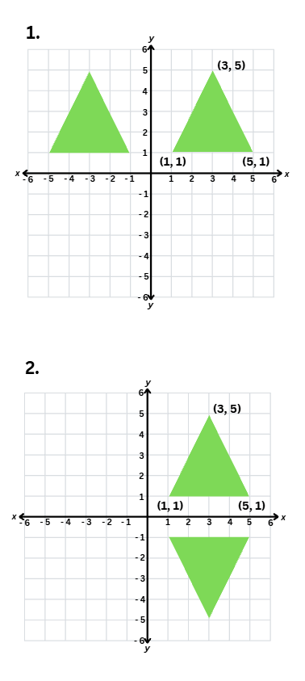
Short response (13)
One of these triangles has been translated.
Record its coordinates.
Notes:
Short response questions provide brisk paced questions focussing on review of current and previous content to support spaced and interleaved practice.
Syllabus focus area:
Geometric measure B

Slide 28
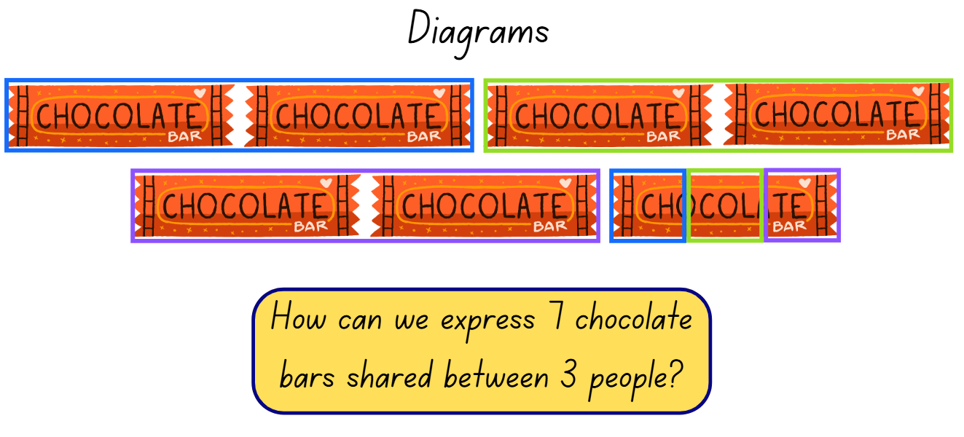
Short response (14)
Record the solution using a fraction, decimal and words.
Notes:
Short response questions provide brisk paced questions focussing on review of current and previous content to support spaced and interleaved practice.
Syllabus focus area:
Multiplicative relations B

Slide 29
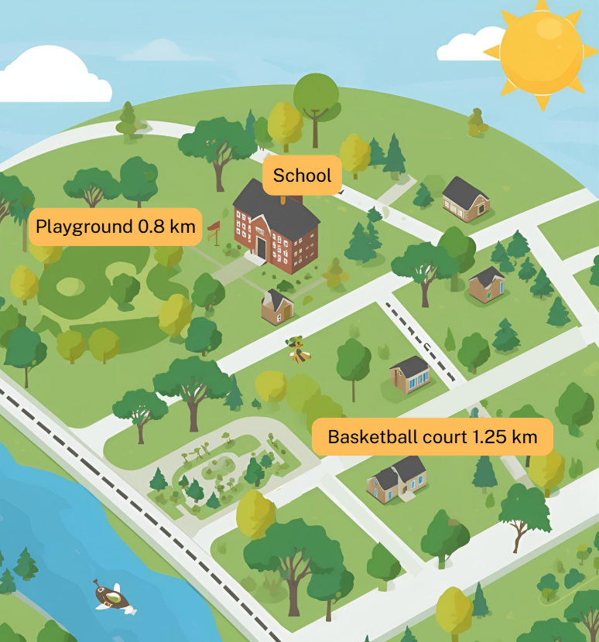
Short response (15)
The basketball court is 1.25 km from the school. How could this distance be recorded in metres?
The playground is 0.8 km from the school. If you walked to the playground and back, how far would you walk in kilometres?
Notes:
Short response questions provide brisk paced questions focussing on review of current and previous content to support spaced and interleaved practice.
Syllabus focus area:
Geometric measure B

Slide 30
Short response (16)
This timetable shows bus departure times:
Bus | Departure Time
1 | 18:45 hours
2 | 07:15 hours
3 | 23:30 hours
4 | 13:15 hours
Convert the 24-hour times to 12-hour time
Order the buses from earliest departure time to latest departure time.
Notes:
Short response questions provide brisk paced questions focussing on review of current and previous content to support spaced and interleaved practice.
Syllabus focus area:
Non-spatial measure A

Slide 31
Activity 4 – negative number subtraction 2
48 - 12 = target number -12
55 - 11 = target number -22
60 - 15 = target number -30
0
Notes:
This is a developing number sense activity.
Number sense refers to a deep understanding of numbers, including their magnitude, relationships, and the effects of operations on them. It supports fluency and understanding, estimation, flexible thinking, and efficient problem-solving. Number sense activities 1–4 ‘activate’ prior number knowledge and support the learning of new content in the unit. Number sense activities 5–8 ‘loop’ back and provide opportunity for spaced practice with concepts and procedures covered in previous units.
Syllabus focus area:
Represents numbers B
Negative number subtraction 2
The activity is an adaptation from Engaging Maths: 25 Favourite Lessons by Clark and Roche. It builds on the learning from Activity 3 – negative number subtraction.
1. Revise the learning from Activity 3 – negative number subtraction, that negative whole numbers can be the result of subtraction.
2. In pairs, students draw a number line marked with zero at the centre.
3. Students repeat the task for the following equations and represent them on the number line:
48 - 12 = target number -12
55 - 11 = target number -22
60 - 15 = target number -30
4. Regroup and facilitate a class discussion about negative whole numbers resulting from subtraction:
How did you feel about completing mental calculations with 2-digit subtractions?
What strategies did you use to keep track of the number sequence in your head?
How did you know where to mark each subtraction on the number line?

Slide 32
Review of learning 5

Slide 33
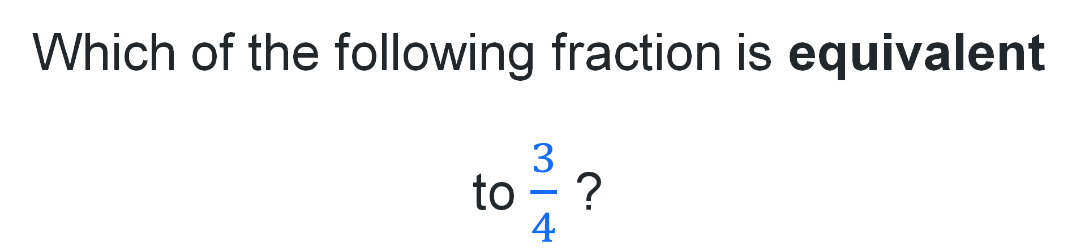




Multiple choice (3)
Which of the following fraction is equivalent to $\frac{3}{4}$ ?
A
B
C
D
$$\frac{4}{6}$$
$$\frac{2}{3}$$
$$\frac{6}{8}$$
$$\frac{5}{8}$$
Notes:
This question connects to the content in the developing number sense activity (Activity 5)
Syllabus focus area:
Representing quantity fractions B

Slide 34
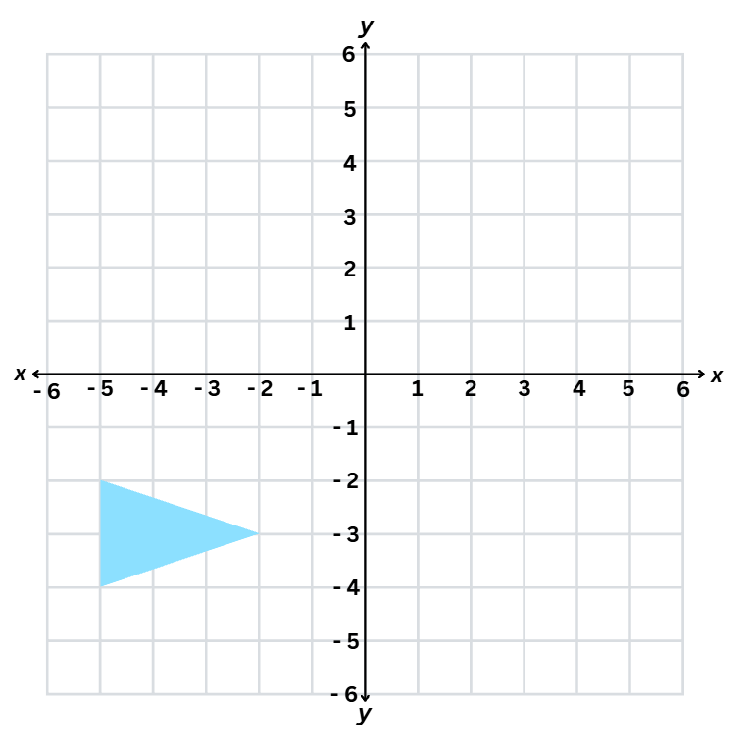
Short response (17)
Record the coordinates for the shape if it were reflected across the:
x-axis
y-axis.
Notes:
Short response questions provide brisk paced questions focussing on review of current and previous content to support spaced and interleaved practice.
Syllabus focus area:
Geometric measure B

Slide 35
Short response (18)
A pattern is made using pentagons.
Each term in the pattern adds one new pentagon.
The pentagons are not joined together.
Record the numbers that complete the table of values by following the pattern rule.
Number of shapes | 1 | 2 | 3 | 4 | 5 |  | 10 | 15 | 20 | 50 | 100
Number of sides | 5 | 10 | 15 | 20 | 25
Notes:
Short response questions provide brisk paced questions focussing on review of current and previous content to support spaced and interleaved practice.
Syllabus focus area:
Multiplicative relations B

Slide 36
Short response (19)
A toy weighs 0.425 kg.
Record this mass in grams.
Communicate your reasoning.
Notes:
Short response questions provide brisk paced questions focussing on review of current and previous content to support spaced and interleaved practice.
Syllabus focus area:
Non-spatial measure A

Slide 37
Short response (20)
A shop sells different fruits. The masses of the fruits are recorded in kilograms using decimal notation.
Fruit | Mass (kg)
Apples | 1.75
Bananas | 2.08
Cherries | 0.875
Mangoes | 3.25
What is the total mass of apples and mangoes?
Notes:
Short response questions provide brisk paced questions focussing on review of current and previous content to support spaced and interleaved practice.
Syllabus focus area:
Non-spatial measure A

Slide 38
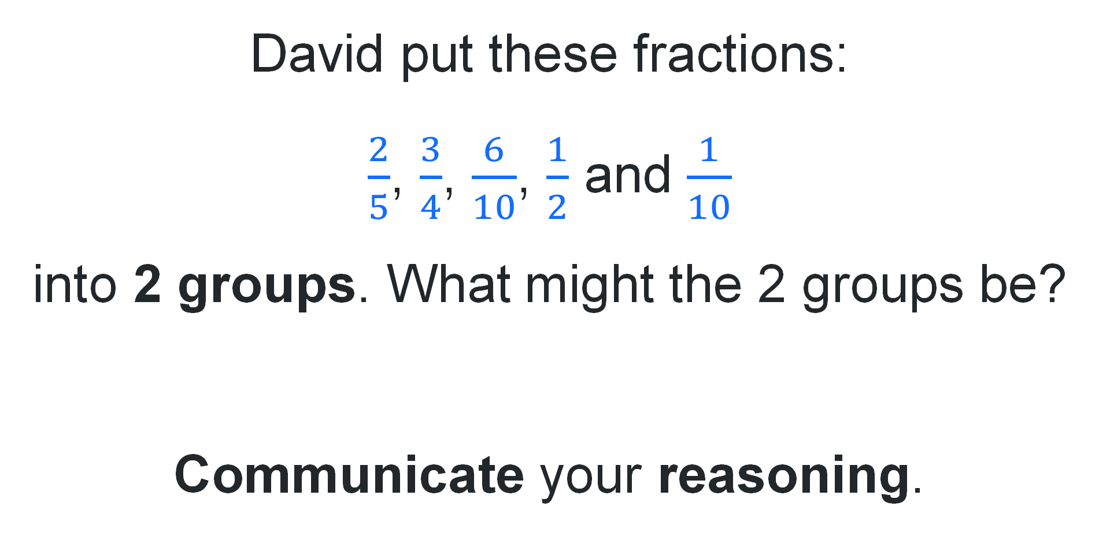
Activity 5 – equivalent fractions 1
David put these fractions:
$\frac{2}{5}$, $\frac{3}{4}$, $\frac{6}{10}$, $\frac{1}{2}$ and $\frac{1}{10}$
into 2 groups. What might the 2 groups be?
Communicate your reasoning.
Notes:
This is a developing number sense activity.
Number sense refers to a deep understanding of numbers, including their magnitude, relationships, and the effects of operations on them. It supports fluency and understanding, estimation, flexible thinking, and efficient problem-solving. Number sense activities 1–4 ‘activate’ prior number knowledge and support the learning of new content in the unit. Number sense activities 5–8 ‘loop’ back and provide opportunity for spaced practice with concepts and procedures covered in previous units.
Syllabus focus area:
Representing quantity fractions B
Equivalent fractions 1
This activity has been adapted from Open-Ended Maths Activities by Sullivan and Lilburn.
1. Revise the meaning of equivalent and explain that equivalent fractions can be recorded using diagrams, words and fraction notation.
Equivalent: two things are equivalent if they have the same value.
2. Display the following problem: A friend of mine put these fractions into 2 groups: 2/5, ¾ , 6/10, ½ and 1/10. What might the 2 groups be?
3. Students give reasons for their groups. Use the prompts to support their explanation:
What common characteristics or properties do you notice among these fractions?
Can you simplify any of the fractions to make them easier to compare?
Can you arrange the fractions in ascending or descending order to see if that helps in grouping?
Do any of the fractions have the same numerator or denominator? Does that matter for grouping?
What do you notice about the denominators of these fractions? Are there any common factors?

Slide 39
Review of learning 6

Slide 40
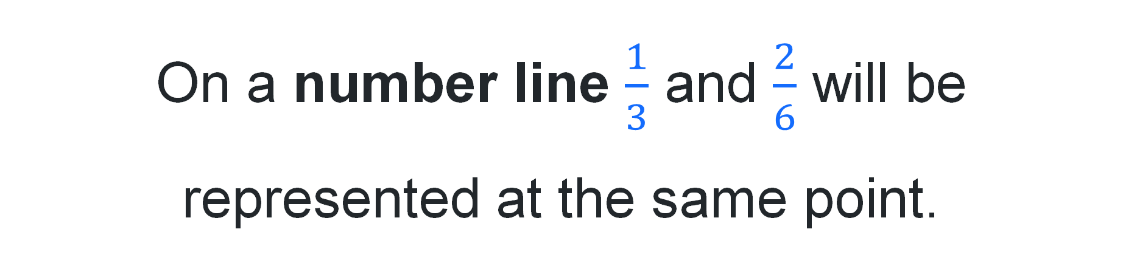
True or false (3)
On a number line $\frac{1}{3}$ and $\frac{2}{6}$ will be represented at the same point.
True | False
Communicate your reasoning.
Notes:
The question on this slide connects to the content being explored in the developing number sense activity (Activity 6)
Syllabus focus area:
Representing quantity fractions B

Slide 41
Short response (21)
A bag contains 8 counters: 3 red, 3 blue and 2 pink. One counter is chosen at random.
Which outcomes are equally likely?
Represent the probability of choosing a red counter as a fraction.
Communicate your reasoning.
Notes:
Short response questions provide brisk paced questions focussing on review of current and previous content to support spaced and interleaved practice.
Syllabus focus area:
Chance A

Slide 42
Short response (22)
Jimmy had 8 times as many balloons as Mindy. Jimmy had 48 balloons. How many balloons does Mindy have?
Use a model to show the multiplicative relationship.
Notes:
Short response questions provide brisk paced questions focussing on review of current and previous content to support spaced and interleaved practice.
Syllabus focus area:
Multiplicative relations A

Slide 43
Short response (23)
A go-kart completes a lap in 1.287 minutes. Another go-kart completes the same lap in
1.325 minutes.
How many thousandths of a minute difference was there between the 2 go-karts?
Notes:
Short response questions provide brisk paced questions focussing on review of current and previous content to support spaced and interleaved practice.
Syllabus focus area:
Additive relations B

Slide 44
Short response (24)
Record the properties missing from the table:
Shape | Properties of sides | Properties of angles | Regular or irregular?
Rectangle | 2 pairs of equal sides 2 pairs of parallel lines | 4 right angles | Irregular
Rhombus | 4 equal sides 2 pairs of parallel lines |  | Irregular
Parallelogram | Opposite sides are equal 2 pairs of parallel lines | Opposite angles are equal
Kite |  | One pair of opposite angles are equal | Irregular
Trapezium | Opposite sides are parallel | Opposite angles are equal | Irregular
Notes:
Short response questions provide brisk paced questions focussing on review of current and previous content to support spaced and interleaved practice.
Syllabus focus area:
Two-dimensional spatial structure A

Slide 45
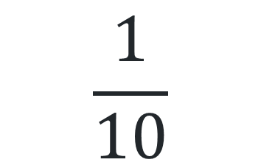
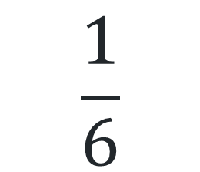
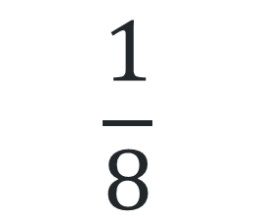
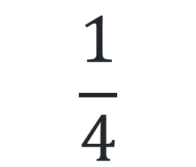
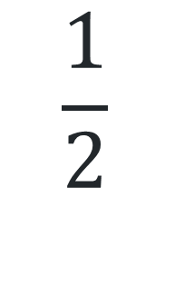
Activity 6 – equivalent fractions 2
$$\frac{1}{2}$$
$$\frac{1}{4}$$
$$\frac{1}{8}$$
$$\frac{1}{6}$$
$$\frac{1}{10}$$
0
1
Notes:
This is a developing number sense activity.
Number sense refers to a deep understanding of numbers, including their magnitude, relationships, and the effects of operations on them. It supports fluency and understanding, estimation, flexible thinking, and efficient problem-solving. Number sense activities 1–4 ‘activate’ prior number knowledge and support the learning of new content in the unit. Number sense activities 5–8 ‘loop’ back and provide opportunity for spaced practice with concepts and procedures covered in previous units.
Syllabus focus area:
Representing quantity fractions B
Equivalent fractions 2
This activity is an adaptation from Fractions: pikelets and lamingtons by State of New South Wales (Department of Education) and Professional Support and Curriculum Directorate.
Write the following fractions on the board: ½, ¼ , 1/8, 1/6 and 1/10.
Explain that for quantity fractions (that is, fractions as numbers) the ‘whole’ is always the number one.
Ask the students to draw 5 number lines from 0–1, all of equal length.
Students partition each number line to represent each of the unit fractions and label the fraction.
Once students have finished, ask:
How did you determine the position of one-eighth (or one-quarter or one-half)?
Can you give an example of 2 fractions that are equivalent?
Can you use your number lines to prove that ½ and 2/4 are equivalent fractions?
Is two-eighths the same as one quarter?
Can you have an equivalent fraction for 1/3 ? Why or why not?
How would you explain the concept of equivalent fractions to someone who has never learned about them before?

Slide 46
Review of learning 7

Slide 47
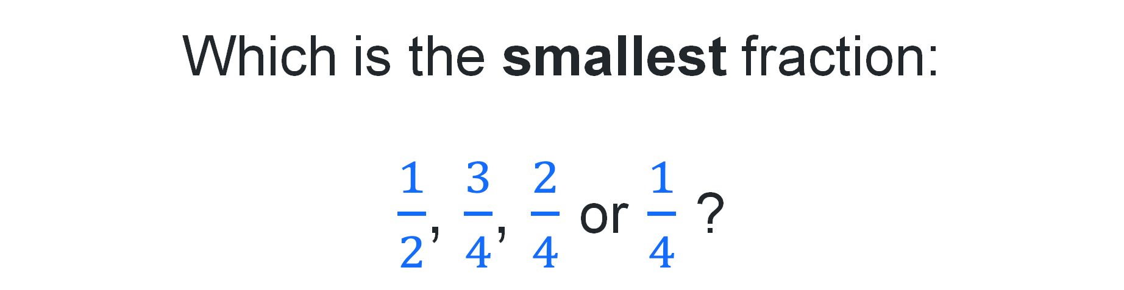




Multiple choice (4)
Which is the smallest fraction:
$\frac{1}{2}$, $\frac{3}{4}$, $\frac{2}{4}$ or $\frac{1}{4}$ ?
A
B
C
D
$$\frac{3}{4}$$
$$\frac{1}{2}$$
$$\frac{2}{4}$$
$$\frac{1}{4}$$
Notes:
This question connects to the content in the developing number sense activity (Activity 7)
Syllabus focus area:
Representing quantity fractions B

Slide 48
Short response (25)
Mia is designing a game using a bag with 5 counters: 2 red, 1 blue, and 2 pink. A player draws one counter at random.
Record all possible outcomes and assign a fraction to show the probability of drawing each colour.
Which outcomes are not equally likely?
How could Mia change the game so that all outcomes are equally likely?
Notes:
Short response questions provide brisk paced questions focussing on review of current and previous content to support spaced and interleaved practice.
Syllabus focus area:
Chance B

Slide 49
Short response (26)
A baker bakes 24 loaves of bread every 3 hours.
How many loaves will the baker bake in 12 hours?
How many hours will it take to bake 96 loaves at the same rate?
Notes:
Short response questions provide brisk paced questions focussing on review of current and previous content to support spaced and interleaved practice.
Syllabus focus area:
Multiplicative relations B

Slide 50
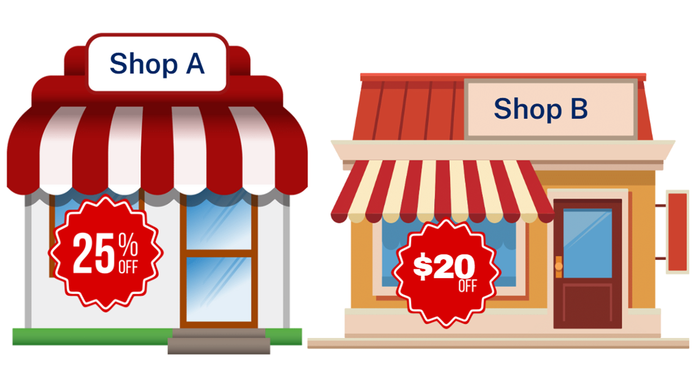
Short response (27)
A pickleball set costs $75.
Shop A offers 25% off.
Shop B offers $20 off.
Which shop offers the best price?
Communicate your reasoning.
Notes:
Short response questions provide brisk paced questions focussing on review of current and previous content to support spaced and interleaved practice.
Syllabus focus area:
Represents numbers B

Slide 51
Short response (28)
Water bottles for a school sports day are filled with the following amounts of water. The capacities are recorded in litres.
Bottle | Volume (L)
A | 0.325
B | 0.75
C | 1.275
Order the capacities from smallest to largest?
Which bottle holds more than 1000 mL?
Notes:
Short response questions provide brisk paced questions focussing on review of current and previous content to support spaced and interleaved practice.
Syllabus focus area:
Three-dimensional spatial structure A

Slide 52
Activity 7 – equivalent fractions 3
Step 1: Choose a fraction with a denominator of 2, 3, 4, 5, 6, 8, or 10.
Step 2: Represent your fraction on a number line.
Step 3: Record 3 other fractions equivalent to your fraction.
Step 4: Represent your fraction as part of a whole length.
Step 5: Give a real-life example where your fraction might be useful.
Step 6: Represent your fraction in a different form, for example, tape diagram, circle or collection.
Notes:
This is a developing number sense activity.
Number sense refers to a deep understanding of numbers, including their magnitude, relationships, and the effects of operations on them. It supports fluency and understanding, estimation, flexible thinking, and efficient problem-solving. Number sense activities 1–4 ‘activate’ prior number knowledge and support the learning of new content in the unit. Number sense activities 5–8 ‘loop’ back and provide opportunity for spaced practice with concepts and procedures covered in previous units.
Syllabus focus area:
Representing quantity fractions B
Equivalent fractions 3
This activity is an adaptation from Mathematics Assessment for Learning Rich Tasks and Work Samples by Downton et al.
1. Provide students an individual whiteboard and writing materials.
2. Students choose a fraction with a denominator of 2, 3, 4, 5, 6, 8, or 10.
3. Students complete the following task:
Represent your fraction on a number line.
Record 3 other fractions equivalent to your fraction.
Represent your fraction as part of a whole length.
Give a real-life example where your fraction might be useful.
Represent your fraction in a different form, for example, tape diagram, circle or collection.
4. As a class, create a fraction gallery. Students display their work and review each other's examples.

Slide 53
Review of learning 8

Slide 54

True or false (4)
The fraction $\frac{2}{10}$ is equivalent to $\frac{1}{5}.$
True | False
Communicate your reasoning.
Notes:
The question on this slide connects to the content being explored in the developing number sense activity (Activity 8)
Syllabus focus area:
Representing quantity fractions B

Slide 55
Short response (29)
Saxon is designing a mystery bag with 10 counters: some are green and some are blue. He wants it to be twice as likely to pick a green counter than a blue counter.
How many green and blue counters should Saxon put in the bag to make this happen?
Represent the probability of picking each colour as a fraction.
Notes:
Short response questions provide brisk paced questions focussing on review of current and previous content to support spaced and interleaved practice.
Syllabus focus area:
Chance B

Slide 56
Short response (30)
Use the digits 3, 1, 4, 5, the operations +, -, × and ÷ and brackets ( ), to create equations with answers from 1 to 10.
For example, (3 + 1) × 1 = 4.
Notes:
Short response questions provide brisk paced questions focussing on review of current and previous content to support spaced and interleaved practice.
Syllabus focus area:
Multiplicative relations B

Slide 57
Short response (31)
A bank account had $15.
A withdrawal of $35 was made. What is the account balance?
Communicate your reasoning.
Notes:
Short response questions provide brisk paced questions focussing on review of current and previous content to support spaced and interleaved practice.
Syllabus focus area:
Represents numbers B

Slide 58
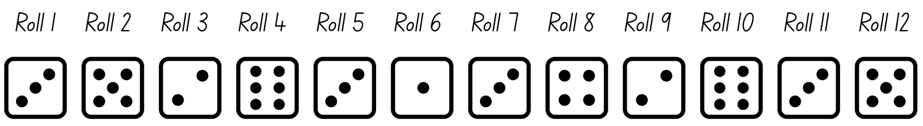
Short response (32)
Amie rolled a dice 12 times.
Use the term ‘probability’ to describe the likelihood of rolling a 3.
Notes:
Short response questions provide brisk paced questions focussing on review of current and previous content to support spaced and interleaved practice.
Syllabus focus area:
Chance A

Slide 59
Activity 8 – equivalent fractions 4
Step 1. Choose a fraction with a denominator of 2, 3, 4, 5, 6, 8, or 10 for a partner to use.
Step 2. Using the fraction from a partner:
represent the fraction on a number line
record 3 other equivalent fractions
represent the fraction as part of a whole length
give a real-life example where this fraction might be useful
represent the fraction in a different form, for example, tape diagram, circle or collection.
Step 3. In small groups, arrange whiteboards in ascending order of the size of the fractions.
Notes:
This is a developing number sense activity.
Number sense refers to a deep understanding of numbers, including their magnitude, relationships, and the effects of operations on them. It supports fluency and understanding, estimation, flexible thinking, and efficient problem-solving. Number sense activities 1–4 ‘activate’ prior number knowledge and support the learning of new content in the unit. Number sense activities 5–8 ‘loop’ back and provide opportunity for spaced practice with concepts and procedures covered in previous units.
Syllabus focus area:
Representing quantity fractions B
Equivalent fractions 4
This activity is an adaptation from Mathematics Assessment for Learning Rich Tasks and Work Samples by Downton et al. It builds on the learning from Activity 7 – equivalent fractions 3.
1. Provide students an individual whiteboard and writing materials.
2. Students choose a fraction with a denominator of 2, 3, 4, 5, 6, 8, or 10 for a partner to use.
3. Using the fraction from their partner, students complete the following task:
Represent the fraction on a number line.
Record 3 other equivalent fractions.
Represent the fraction as part of a whole length.
Give a real-life example where this fraction might be useful.
Represent the fraction in a different form, for example, tape diagram, circle or collection.
4. After representing their fraction, form small groups.
5. Students arrange their whiteboards in ascending order of the size of the fractions. They use the different representations on each whiteboard to confirm that the order is correct.
6. As a class, complete a gallery walk. Students review each other's examples to ensure they are correctly arranged in ascending order.

Slide 60
Double Venn diagram
Object 1
Object 2
Features similar to both objects
Features of object 1
Features of object 2

Slide 61
Frayer
Definition
Facts/Characteristics
Word, term, concept
Examples
Non-examples

Slide 62
Spider map
Idea
Subject

Slide 63
Cline
Concept 1
Concept 2
Word
Word
Word
Word
Word
Word
Word
Word
Word
Word
Word

Slide 64

Compare and contrast

Slide 65
Multiple choice (5)
A
B
C
D

Slide 66
Multiple choice
A
B
C
D
Notes:
This question connects to the content in the developing number sense activity (Activity 3)
Syllabus focus area:
[Focus area A/B]

Slide 67
References (1)
This presentation contains NSW Curriculum and syllabus content. The NSW Curriculum is developed by the NSW Education Standards Authority. This content is prepared by NESA for and on behalf of the Crown in the right of the State of New South Wales. The material is protected by Crown copyright.
Please refer to the NESA Copyright Disclaimer for more information https://educationstandards.nsw.edu.au/wps/portal/nesa/mini-footer/copyright.
NESA holds the only official and up-to-date versions of the NSW Curriculum and syllabus documents. Please visit the NSW Education Standards Authority (NESA) website https://educationstandards.nsw.edu.au/wps/portal/nesa/home and the NSW Curriculum website https://curriculum.nsw.edu.au.
Mathematics K–10 Syllabus © NSW Education Standards Authority (NESA) for and on behalf of the Crown in right of the State of New South Wales, 2022.
National Numeracy Learning Progression © Australian Curriculum, Assessment and Reporting Authority (ACARA) 2010 to present, unless otherwise indicated. This material was downloaded from the Australian Curriculum website (National Numeracy Learning Progression) (accessed 26/09/23) and was not modified.
Australian Government Department of Education (2020) Directed Number, reSolve website, accessed 26 September 2023.
Clark D and Roche A (2014) Engaging Maths: 25 Favourite Lessons, Classic Press, Australia.
Downton A, Knight R, Clarke D and Lewis G (2015) Mathematics Assessment for Learning Rich Tasks and Work Samples, ACU National, Australia.
Hunt, K (n.d.) Guess My Line, Illustrative Mathematics website, accessed 20 January 2026.

Slide 68
References (2)
This presentation contains NSW Curriculum and syllabus content. The NSW Curriculum is developed by the NSW Education Standards Authority. This content is prepared by NESA for and on behalf of the Crown in the right of the State of New South Wales. The material is protected by Crown copyright.
Please refer to the NESA Copyright Disclaimer for more information https://educationstandards.nsw.edu.au/wps/portal/nesa/mini-footer/copyright.
NESA holds the only official and up-to-date versions of the NSW Curriculum and syllabus documents. Please visit the NSW Education Standards Authority (NESA) website https://educationstandards.nsw.edu.au/wps/portal/nesa/home and the NSW Curriculum website https://curriculum.nsw.edu.au.
State of New South Wales (Department of Education) and Professional Support and Curriculum Directorate (2003) Fractions: pikelets and lamingtons [PDF 4.08 MB], NSW Department of Education and Training, accessed 26 September 2023.
State of New South Wales (Department of Education) (2023) ‘Creating shapes using geoboards’ Universal Resources Hub, NSW Department of Education website, accessed 9 October 2025.
State of New South Wales (Department of Education) (2023) ‘Finding numbers on a number line’ Mathematics K–6 resources, NSW Department of Education website, accessed 12 October 2023.
Steenstra C and Kennedy C (2026) Coordinate Plane – Points and Shapes, GeoGebra website, accessed 1 February 2026.
Sullivan P and Lilburn P (2017) Open-Ended Maths Activities, Oxford University Press, Australia and New Zealand.

Slide 69
Copyright
© State of New South Wales (Department of Education), 2025
The copyright material published in this resource is subject to the Copyright Act 1968 (Cth) and is owned by the NSW Department of Education or, where indicated, by a party other than the NSW Department of Education (third-party material).
Copyright material available in this resource and owned by the NSW Department of Education is licensed under a Creative Commons Attribution 4.0 International (CC BY 4.0) license.
This license allows you to share and adapt the material for any purpose, even commercially.
Attribution should be given to © State of New South Wales (Department of Education), 2025.
Material in this resource not available under a Creative Commons license:
the NSW Department of Education logo, other logos and trademark-protected material
Material owned by a third party that has been reproduced with permission. You will need to obtain permission from the third party to reuse its material.
Links to third-party material and websites
Please note that the provided (reading/viewing material/list/links/texts) are a suggestion only and implies no endorsement, by the New South Wales Department of Education, of any author, publisher, or book title. School principals and teachers are best placed to assess the suitability of resources that would complement the curriculum and reflect the needs and interests of their students.
If you use the links provided in this document to access a third party’s website, you acknowledge that the terms of use, including licence terms set out on the third-party’s website apply to the use which may be made of the materials on that third-party website or where permitted by the Copyright Act 1968 (Cth). The department accepts no responsibility for content on third-party websites.

