Slide 1
Instructions for use
This resource is not a teaching and learning program. It should be used in conjunction with Stage 3 Year B Unit 29.
Classroom teachers are encouraged to add and adapt slides as required to meet the needs of their students.
Save a copy of the file to make changes to the slide deck. Go to File > Download a Copy (this downloads a copy to the computer to edit in the PowerPoint app).
To convert the PowerPoint to Google Slides:
  Upload the file into Google Drive and open it.
  Go to File > Save as Google Slides.
  (Note – conversion may cause formatting changes in the slides.)

Slide 2

Review of Learning
Mathematics Stage 3 – Unit 29
Notes:
Reviews may include a combination of question types, requiring students to recall facts and key ideas, as well as apply their knowledge to solve problems and answer questions. To support active engagement, a mix of techniques should be employed.” (AERO, 2024).
This Review of Learning slide deck revisits key concepts from the following units:
Stage 3 Year B Unit 29
Stage 3 Year B Unit 28
Stage 3 Year B Unit 27
It also includes opportunities to review prior learning in non-number content, supporting consolidation across focus areas.
The review of learning resources include three key task types that support the development of mathematical proficiency through retrieval, spaced practice, and active participation. These practices complement the review phase (activating prior knowledge) embedded within the beginning of each lesson.
1.
Multiple-choice questions/True or false: Designed to promote active retrieval of key concepts and identify common misconceptions in number, supporting consolidation, understanding and fluency.
These questions:
support spaced and interleaved practice
help identify and address common misconceptions
support active recall and immediate feedback
support whole class participation
identify areas requiring reteach
2.
Short-response question sets: Carefully grouped questions that encourage spaced and interleaved practice across multiple focus areas, helping students revisit and apply knowledge from different points in time.
These questions:
have a combination of question types
address a range of focus areas
build automaticity and fluency
support active recall
allow for immediate feedback
identify content requiring reteach
3.
Developing number sense activities: A variety of practical, purposeful tasks that reinforce current learning and build on prior knowledge. These activities promote reasoning, problem-solving and conceptual understanding.
The review of learning resources are designed to work support teaching and learning in mathematics. For the most effective implementation, use the resources flexibly, adapting to meet student learning needs and individual classroom contexts.

Slide 3
Lessons
1
Review of learning 1
5
Review of learning 5
2
Review of learning 2
6
Review of learning 6
3
Review of learning 3
7
Review of learning 7
4
Review of learning 4
8
Review of learning 8
Notes:
Teacher notes:
Click lesson titles to go to specific lessons
Interactive features can be viewed in slide show

Slide 4
Review of learning 1

Slide 5

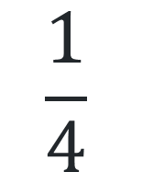
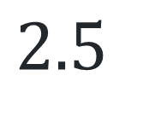
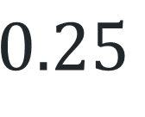
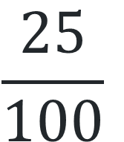
Multiple choice (1)
Which of the following are equivalent to 25%?
You may select more than one answer.
A
B
C
D
$$\frac{25}{100}$$
$$\frac{1}{4}$$
$$0.25$$
$$2.5$$
Communicate your reasoning.
Notes:
This question connects to the content in the developing number sense activity (Activity 1)
Syllabus focus area:
Represent numbers B

Slide 6

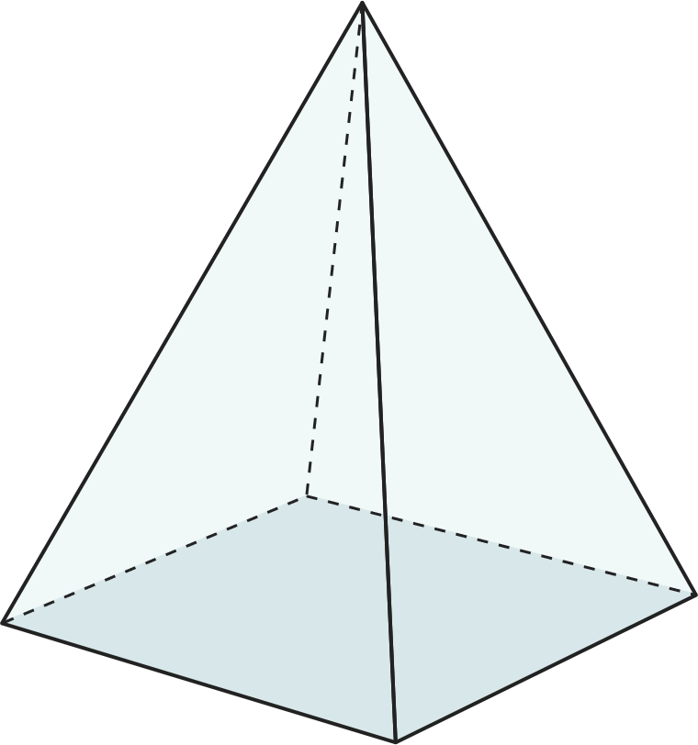
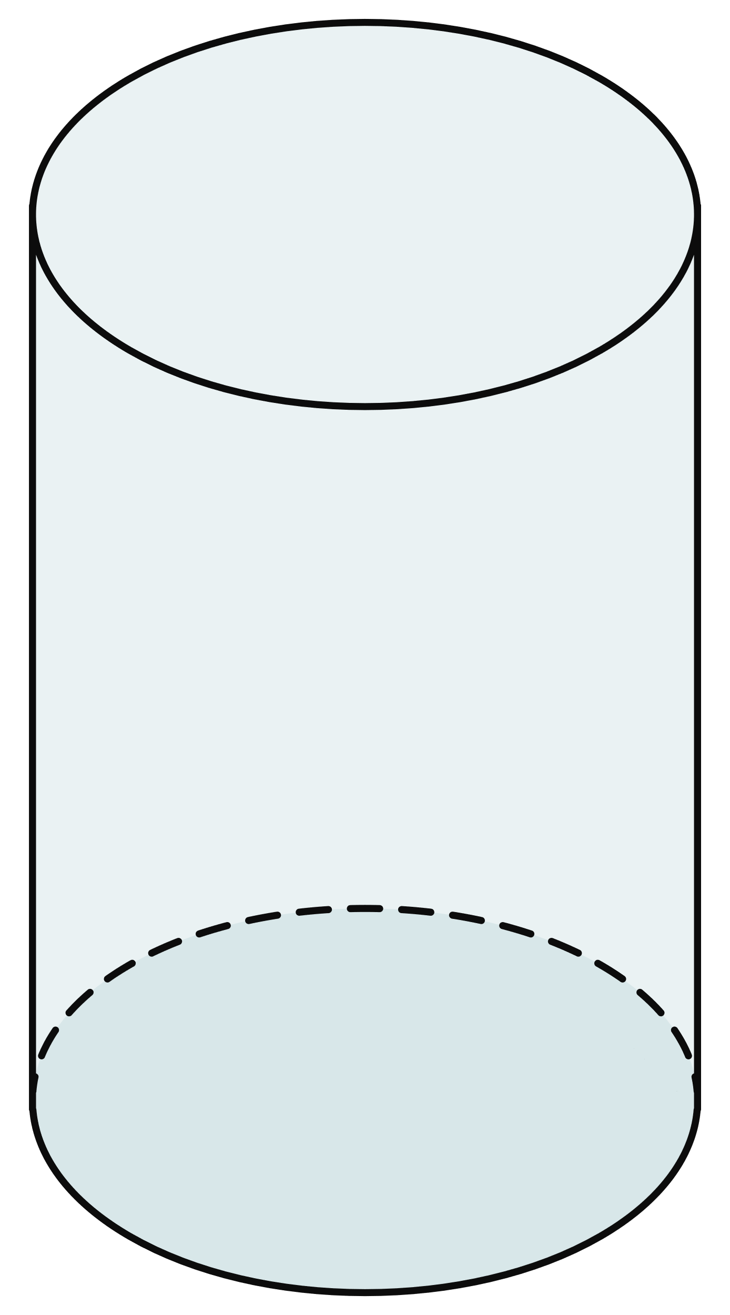
Short response (1)
Record the 5 missing features labelled on the following three-dimensional shapes:
1. ____
surface
3. ____
4. ____
2. ____
surface
5. ____
Notes:
Short response questions provide brisk paced questions focussing on review of current and previous content to support spaced and interleaved practice.
Syllabus focus area:
Three-dimensional spatial structure B (Stage 2 content reviewed)

Slide 7
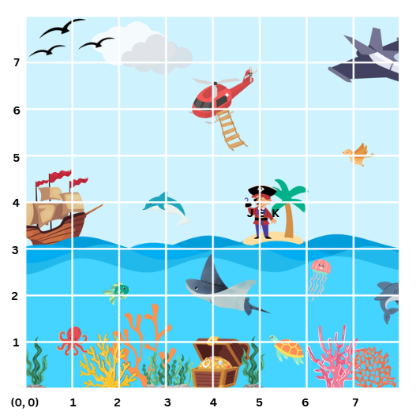
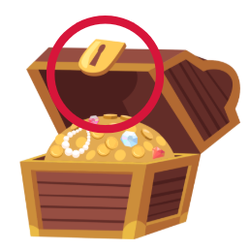


Short response (2)
Record the coordinates for the following:
treasure chest’s latch
green fish
pirate’s face
Notes:
Short response questions provide brisk paced questions focussing on review of current and previous content to support spaced and interleaved practice.
Syllabus focus area:
Geometric measure A

Slide 8
Short response (3)
Use an algorithm to solve:
48 x 36
Notes:
Short response questions provide brisk paced questions focussing on review of current and previous content to support spaced and interleaved practice.
Syllabus focus area:
Multiplicative relations A

Slide 9
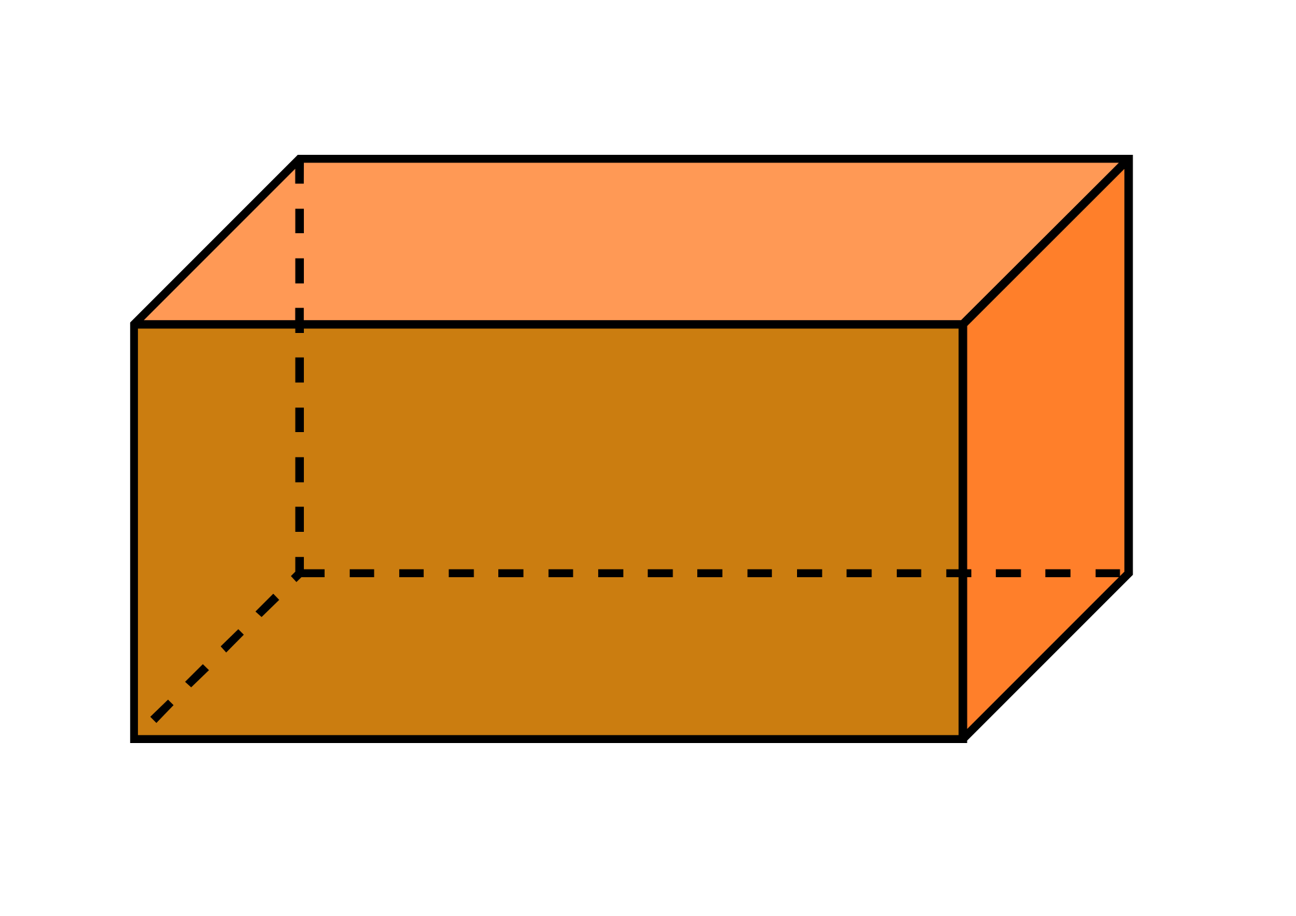
Short response (4)
Name the dimensions of the prism by completing the labelled terms.
h _______
w _______
l _______
Notes:
Short response questions provide brisk paced questions focussing on review of current and previous content to support spaced and interleaved practice.
Syllabus focus area:
Three-dimensional spatial structure B

Slide 10

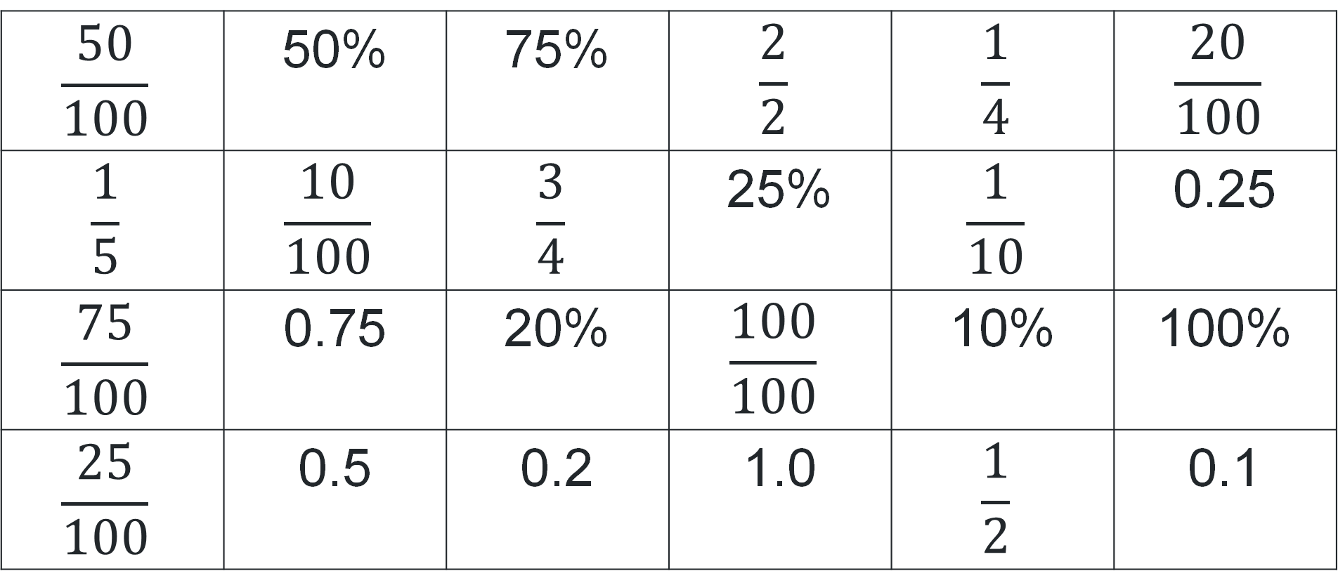
Activity 1 – sorting equivalent percentages, decimals and fractions
$$\frac{50}{100}$$ | 50% | 75% | $$\frac{2}{2}$$ | $$\frac{1}{4}$$ | $$\frac{20}{100}$$
$$\frac{1}{5}$$ | $$\frac{10}{100}$$ | $$\frac{3}{4}$$ | 25% | $$\frac{1}{10}$$ | 0.25
$$\frac{75}{100}$$ | 0.75 | 20% | $$\frac{100}{100}$$ | 10% | 100%
$$\frac{25}{100}$$ | 0.5 | 0.2 | 1.0 | $$\frac{1}{2}$$ | 0.1
Notes:
This is a developing number sense activity.
Number sense refers to a deep understanding of numbers, including their magnitude, relationships, and the effects of operations on them. It supports fluency and understanding, estimation, flexible thinking, and efficient problem-solving. Number sense activities 1–4 ‘activate’ prior number knowledge and support the learning of new content in the unit. Number sense activities 5–8 ‘loop’ back and provide opportunity for spaced practice with concepts and procedures covered in previous units.
Syllabus focus area:
Represents numbers B
Sorting equivalent percentages, decimals and fractions
This resource corresponds to Resource 16 – equivalency cards in Stage 3 Year B Unit 29.
1. Revise common equivalent percentages, decimals and fractions. For example, 50% = 0.5 = fifty hundredths = one half.
2. Prompt students to rearrange the cards to represent equivalence. For example, 75% is equivalent to 0.75.
3. Once students have sorted their cards, ask students to conduct a gallery walk.
4. Regroup students and ask:
Are there any cards that were sorted differently to your groups? Why do you think that is?
Are there any cards you need to rearrange after conducting the gallery walk?
Were there any groups of equivalency cards that were harder to sort? Why?
5. Ask students to read aloud a set of equivalency cards they sorted. For example, 10% is equal to 0.1 is equal to ten hundredths is equal to one tenth.

Slide 11
Review of learning 2

Slide 12

True or false (1)
$\frac{1}{4}$is equivalent to 25%.
True | False
Communicate your reasoning.
Notes:
The question on this slide connects to the content being explored in the developing number sense activity (Activity 2)
Syllabus focus area:
Represents numbers B

Slide 13
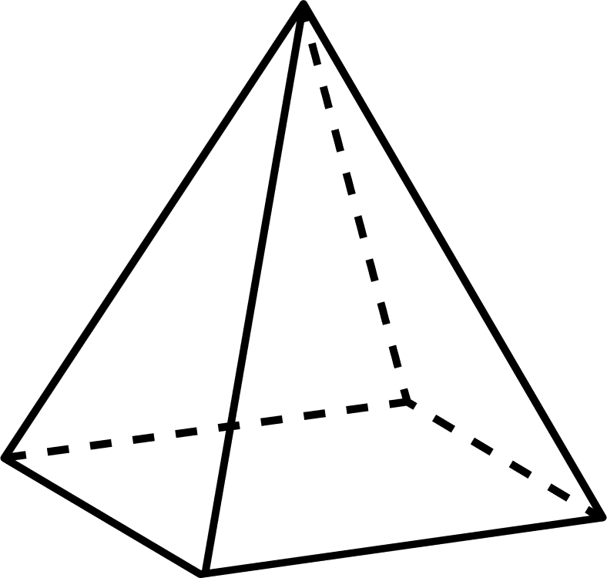
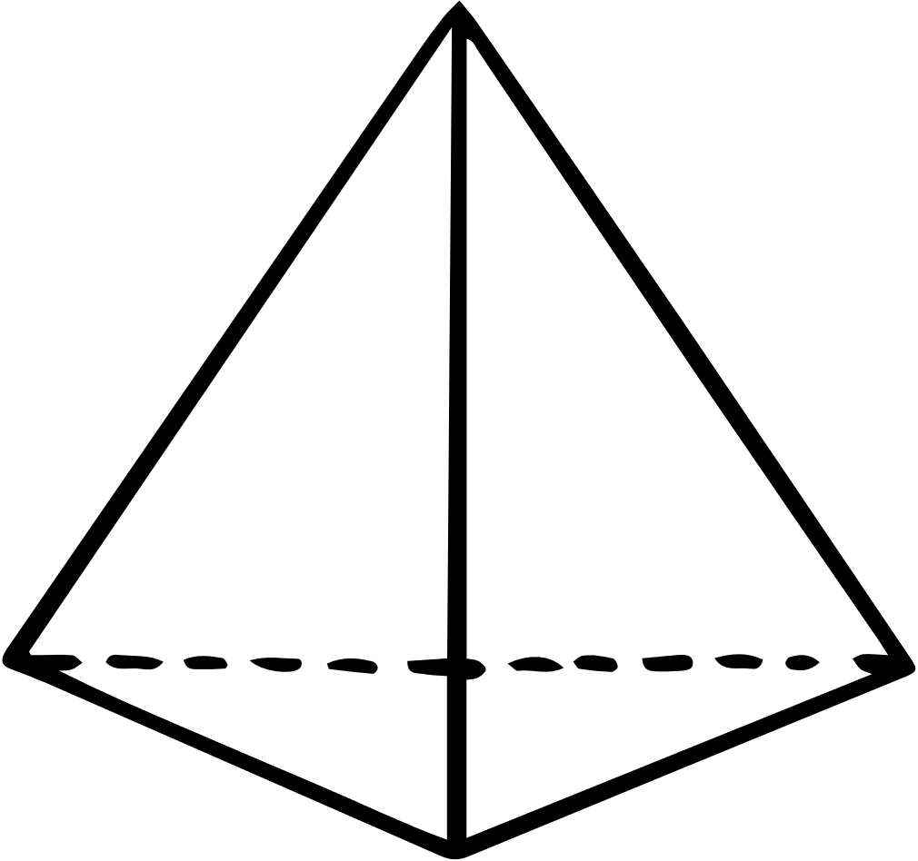

Short response (5)
Name these three-dimensional objects according to their base:
1.
2.
3.
Notes:
Short response questions provide brisk paced questions focussing on review of current and previous content to support spaced and interleaved practice.
Syllabus focus area:
Three-dimensional spatial structure A

Slide 14
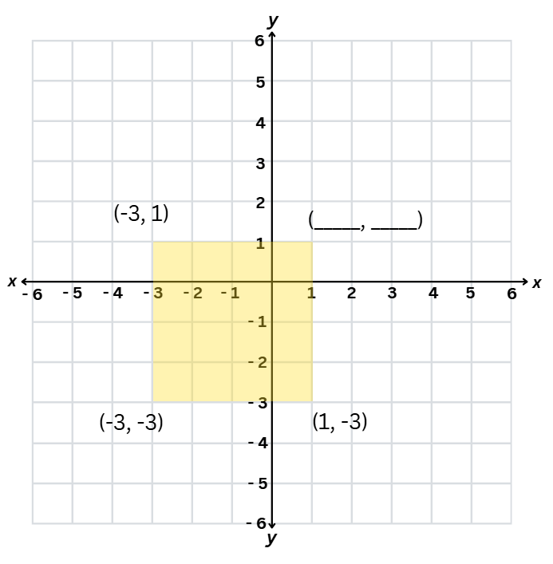
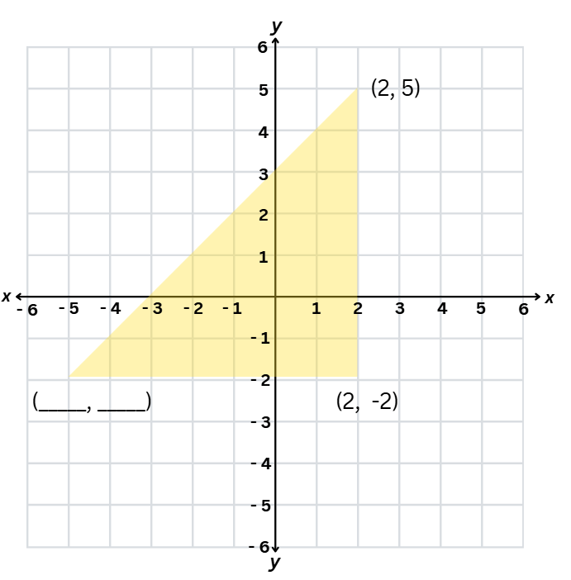
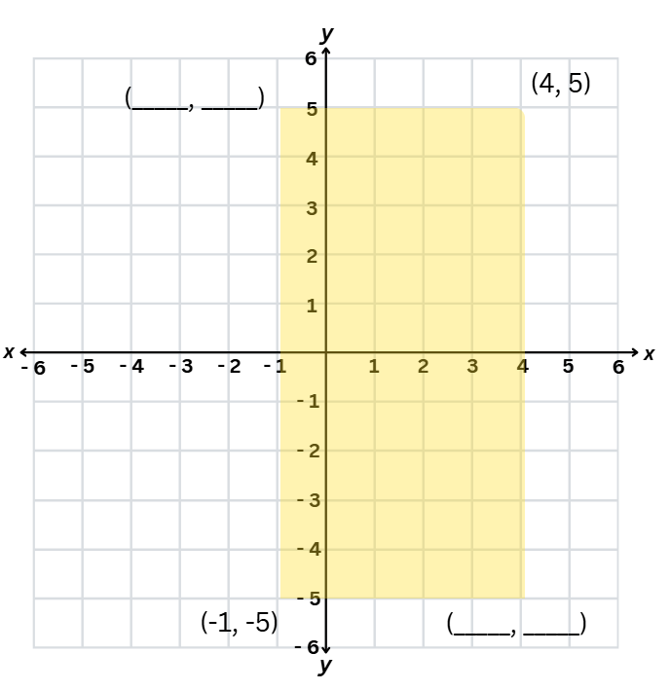
Short response (6)
Record the coordinates of the missing points on the number planes:
A
B
C
Notes:
Short response questions provide brisk paced questions focussing on review of current and previous content to support spaced and interleaved practice.
Syllabus focus area:
Geometric measure B

Slide 15
Short response (7)
A toy factory produces 624 toy cars. The cars are packed into boxes that each hold 7 cars.
How many full boxes can the factory fill?
How many cars will be left over?
Notes:
Short response questions provide brisk paced questions focussing on review of current and previous content to support spaced and interleaved practice.
Syllabus focus area:
Multiplicative relations A

Slide 16
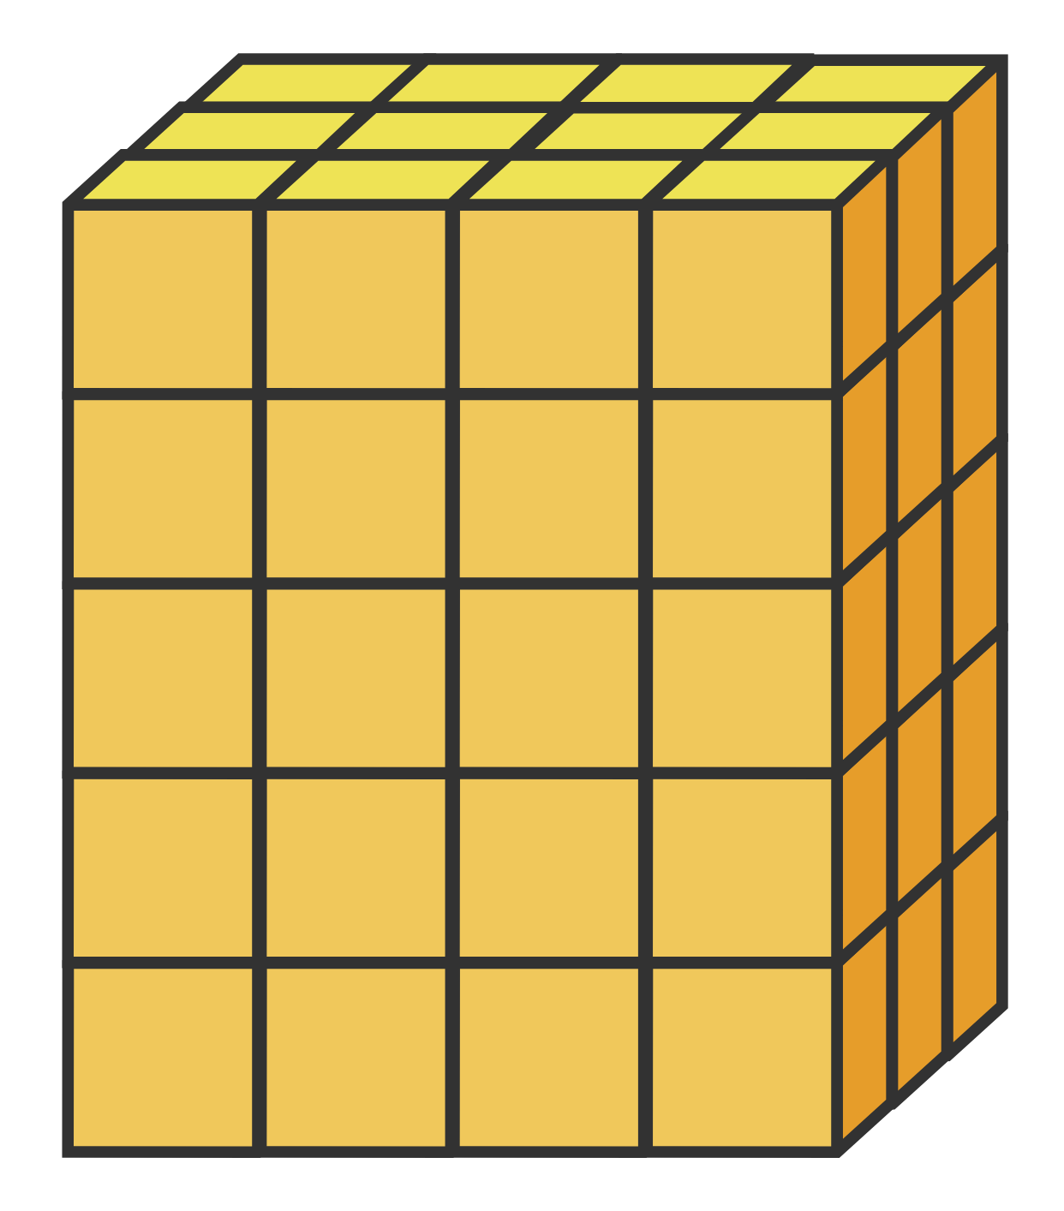
Short response (8)
Record the words that complete this statement:
This prism has ____ layers of ____ cubic-centimetre blocks.
Each layer is ____ rows of ____ blocks.
Notes:
Short response questions provide brisk paced questions focussing on review of current and previous content to support spaced and interleaved practice.
Syllabus focus area:
Three-dimensional spatial structure B

Slide 17
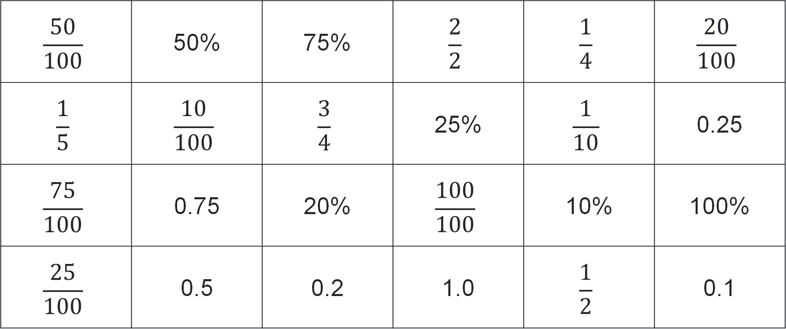
Activity 2 – matching equivalent percentages, decimals and fractions
$$\frac{50}{100}$$ | 50% | 75% | $$\frac{2}{2}$$ | $$\frac{1}{4}$$ | $$\frac{20}{100}$$
$$\frac{1}{5}$$ | $$\frac{10}{100}$$ | $$\frac{3}{4}$$ | 25% | $$\frac{1}{10}$$ | 0.25
$$\frac{75}{100}$$ | 0.75 | 20% | $$\frac{100}{100}$$ | 10% | 100%
$$\frac{25}{100}$$ | 0.5 | 0.2 | 1.0 | $$\frac{1}{2}$$ | 0.1
Notes:
This is a developing number sense activity.
Number sense refers to a deep understanding of numbers, including their magnitude, relationships, and the effects of operations on them. It supports fluency and understanding, estimation, flexible thinking, and efficient problem-solving. Number sense activities 1–4 ‘activate’ prior number knowledge and support the learning of new content in the unit. Number sense activities 5–8 ‘loop’ back and provide opportunity for spaced practice with concepts and procedures covered in previous units.
Syllabus focus area:
Represents numbers B
Matching equivalent percentages, decimals and fractions
This resource corresponds to Resource 16 – equivalency cards in Stage 3 Year B Unit 29.
1. Revise common equivalent percentages, decimals and fractions. For example, 50% = 0.5 = fifty hundredths = one half.
2. Explain to students they will be matching percentages, decimals and fractions by playing a matching game. All cards are placed upside down in a pile. In pairs, students take turns to flip over 2 cards at a time, trying to find a pair of equivalent cards. For example, two halves is equivalent to 100% or one fifth is equivalent to 0.2. If a pair of cards match, the student keeps the cards. If a match isn’t made, the cards are turned face down again.
3. Students repeat the process until all cards have been matched.

Slide 18
Review of learning 3

Slide 19
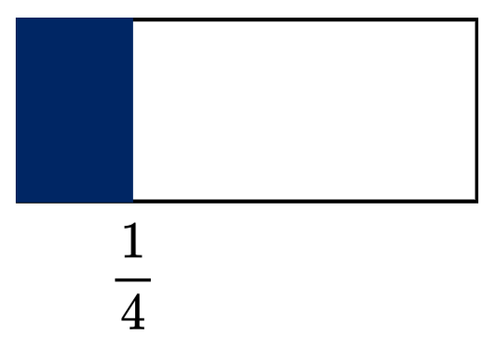
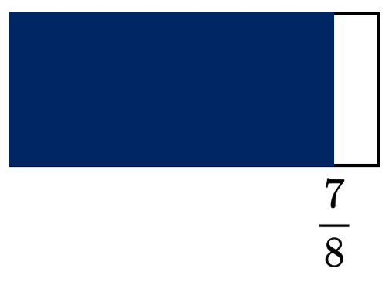
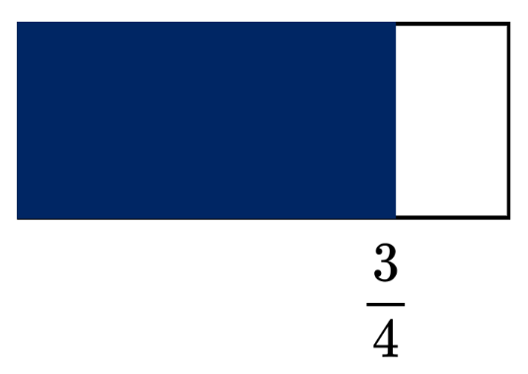
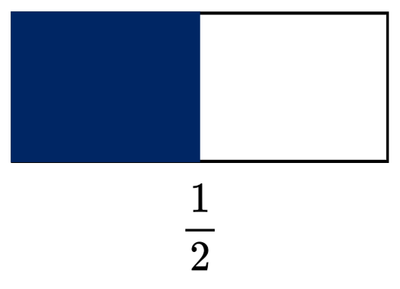
Multiple choice (2)
Which bar has 0.75 of the whole
accurately shaded blue?
A
B
C
D
Communicate your reasoning.
Notes:
This question connects to the content in the developing number sense activity (Activity 3)
Syllabus focus area:
Represents numbers B

Slide 20
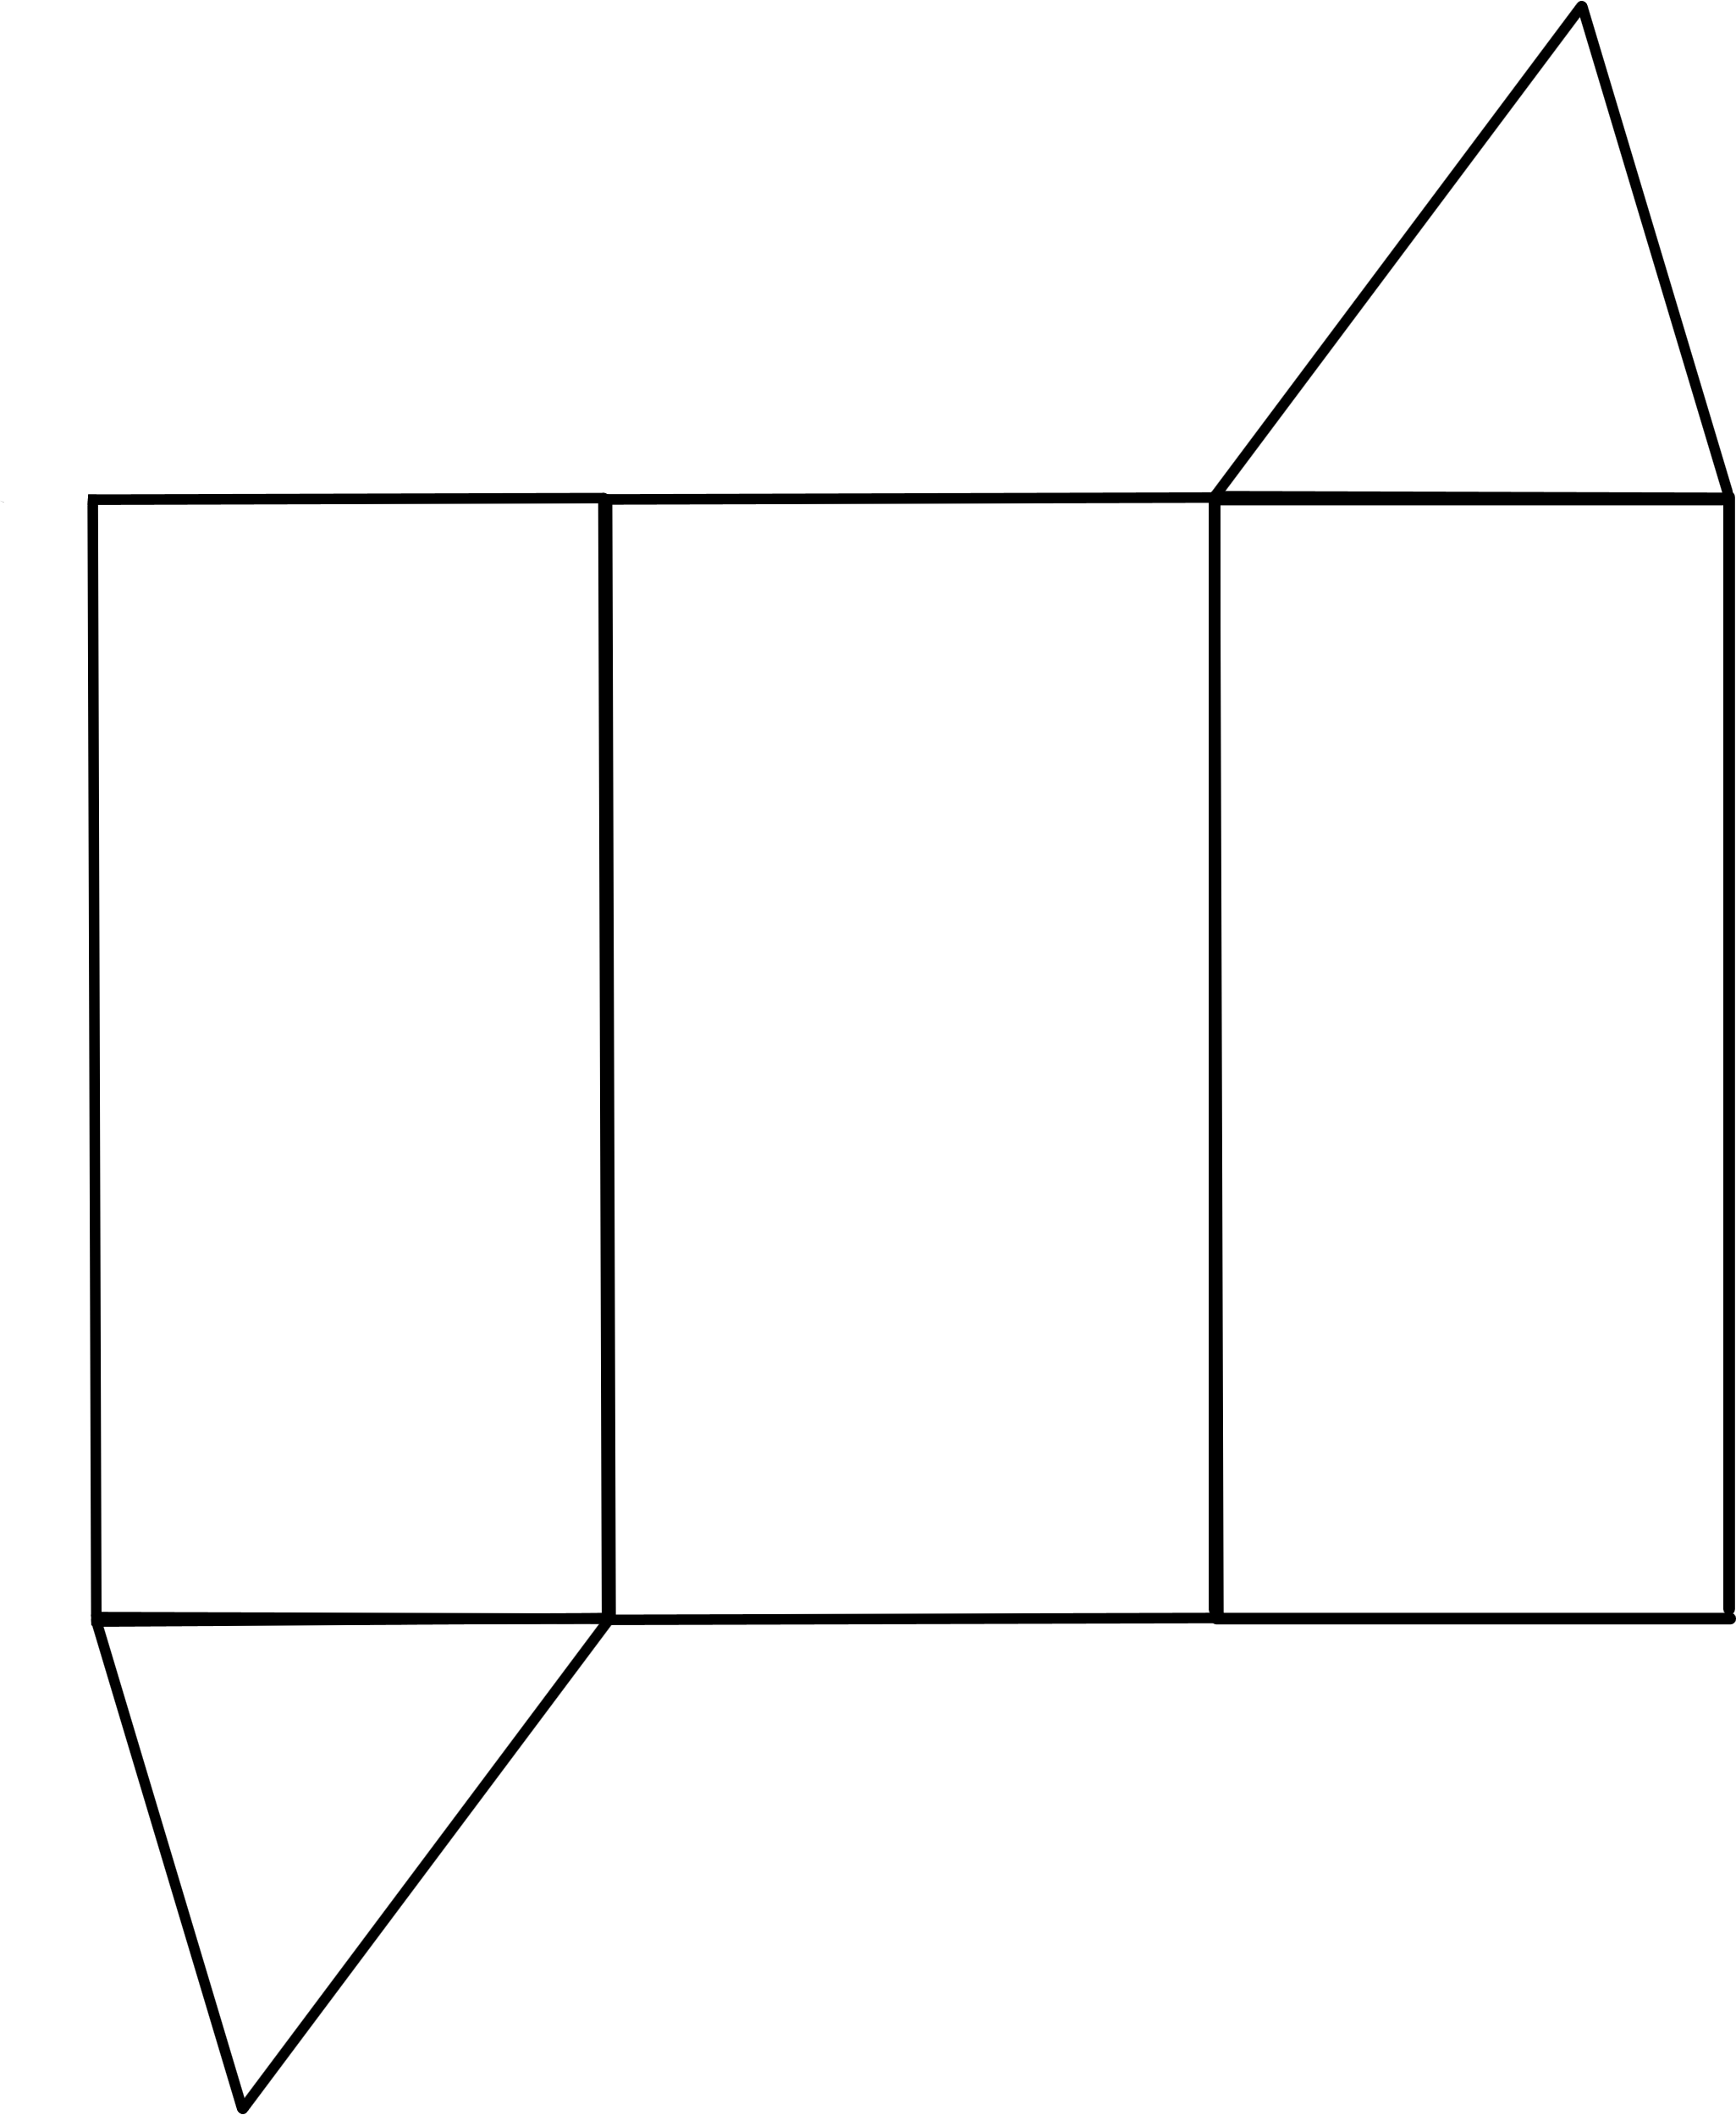
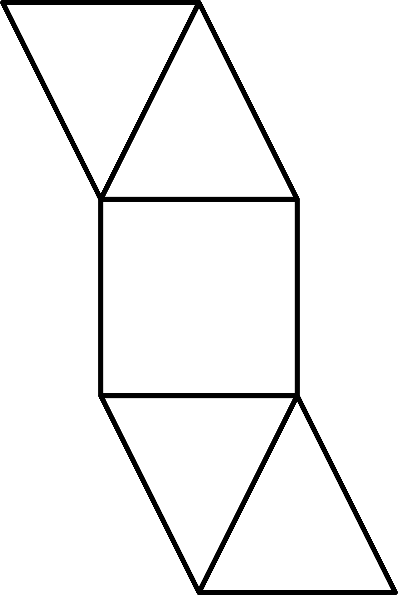
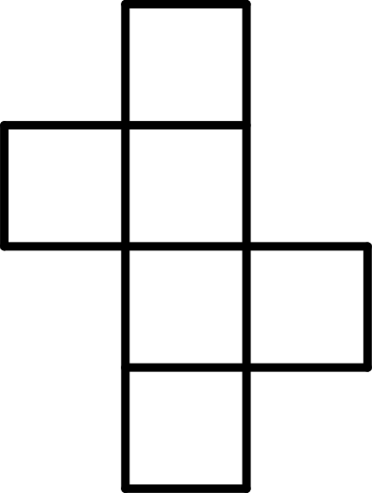
Short response (9)
Name these three-dimensional objects from their nets:
1.
2.
3.
Notes:
Short response questions provide brisk paced questions focussing on review of current and previous content to support spaced and interleaved practice.
Syllabus focus area:
Three-dimensional spatial structure A

Slide 21
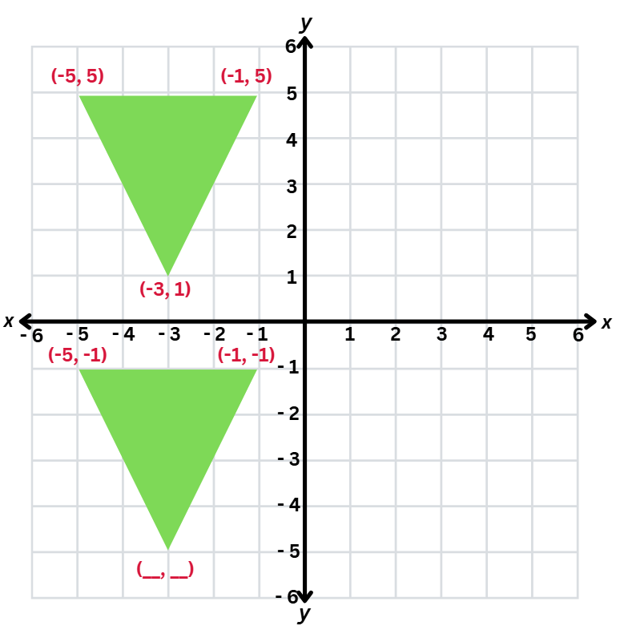
Short response (10)
Record the missing coordinate of the translated triangle.
Describe the change to the coordinate when the triangle was translated over the x-axis.
Notes:
Short response questions provide brisk paced questions focussing on review of current and previous content to support spaced and interleaved practice.
Syllabus focus area:
Geometric measure B

Slide 22
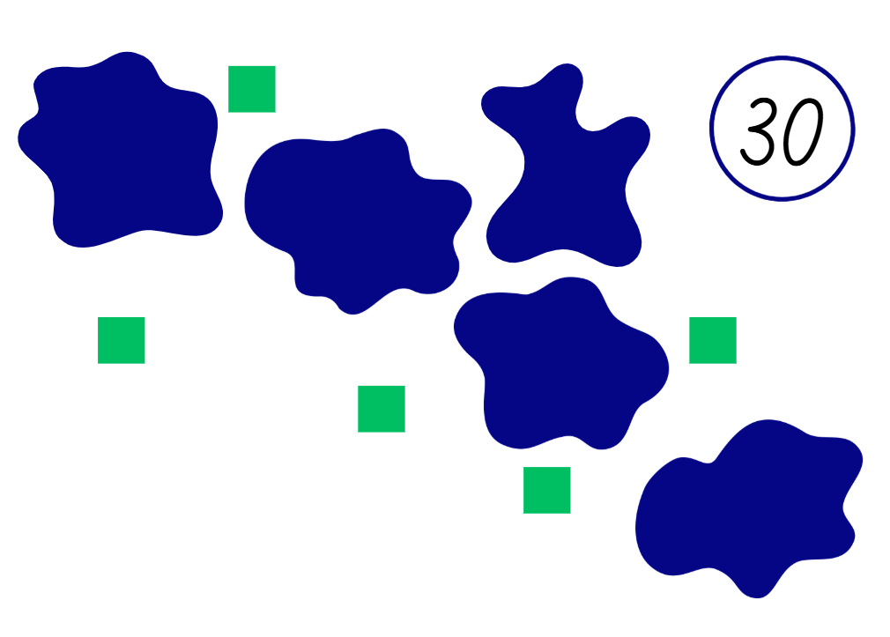
Short response (11)
There are 30 cubes.
Some cubes can be seen.
Some cubes are under the splats.
There are 5 splats.
Each splat has the same number of cubes hidden underneath.
How many cubes are under each splat?
Write a number sentence to show your reasoning.
Adapted from Wyborney (2017).
Notes:
This activity is an adaptation of ‘Splat!’ from Steve Wyborney's Blog: I'm on a Learning Mission by Wyborney.
Short response questions provide brisk paced questions focussing on review of current and previous content to support spaced and interleaved practice.
Syllabus focus area:
Multiplicative relations B

Slide 23
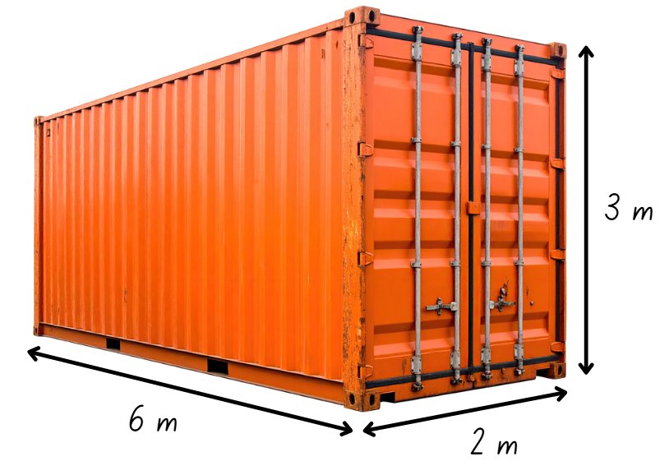
Short response (12)
Calculate the volume of the shipping container in cubic metres.
Notes:
Short response questions provide brisk paced questions focussing on review of current and previous content to support spaced and interleaved practice.
Syllabus focus area:
Three-dimensional spatial structure B

Slide 24
Activity 3 – connecting percentages to the fraction ‘tenth’
100%
Notes:
This is a developing number sense activity.
Number sense refers to a deep understanding of numbers, including their magnitude, relationships, and the effects of operations on them. It supports fluency and understanding, estimation, flexible thinking, and efficient problem-solving. Number sense activities 1–4 ‘activate’ prior number knowledge and support the learning of new content in the unit. Number sense activities 5–8 ‘loop’ back and provide opportunity for spaced practice with concepts and procedures covered in previous units.
Syllabus focus area:
Represents numbers B
Connecting percentages to the fraction ‘tenth’
1. Draw a rectangle on the board to represent a bar of chocolate. Explain to students the whole chocolate bar is 100%. Write the percentage ‘100%’ on the board.
2. Remind students the symbol (%) represents the term ‘percent’ and a percentage is a fraction whose denominator is 100. For example, 20% is equivalent to twenty hundredths (20 out of 100).
3. Provide students with individual whiteboards to draw their bar of chocolate.
4. Ask students to draw lines and shade the bar of chocolate to show 25%.
5. Facilitate a discussion by asking:
How did you determine you have shaded 25%?
If each square of chocolate is 25%, how many squares are in the chocolate bar?
If we eat 25%, how much of the chocolate bar is left? How do we know?
What fraction is equivalent to 25%?

Slide 25
Review of learning 4

Slide 26
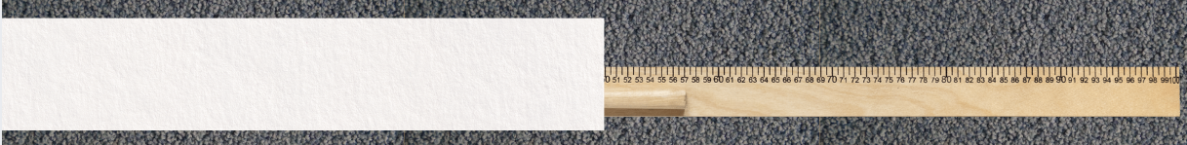
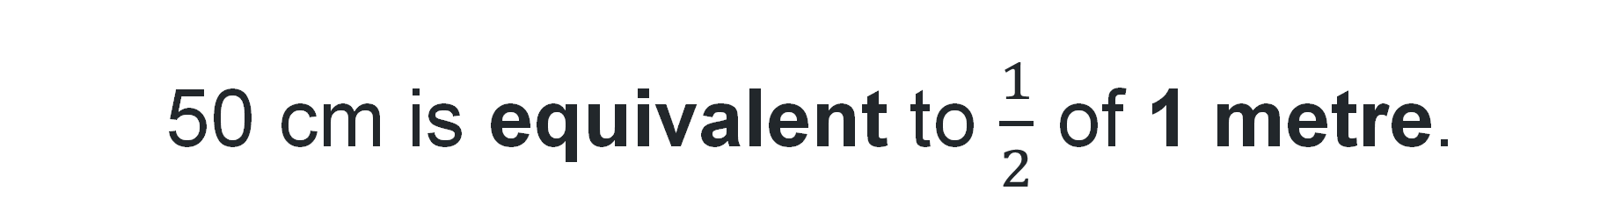
True or false (2)
50 cm is equivalent to $\frac{1}{2}$ of 1 metre.
True | False
Communicate your reasoning.
Notes:
The question on this slide connects to the content being explored in the developing number sense activity (Activity 4)
Syllabus focus area:
Represent numbers B

Slide 27
Short response (13)
Sketch the top, front and side views of a rectangular prism.
Notes:
Short response questions provide brisk paced questions focussing on review of current and previous content to support spaced and interleaved practice.
Syllabus focus area:
Three-dimensional spatial structure A

Slide 28
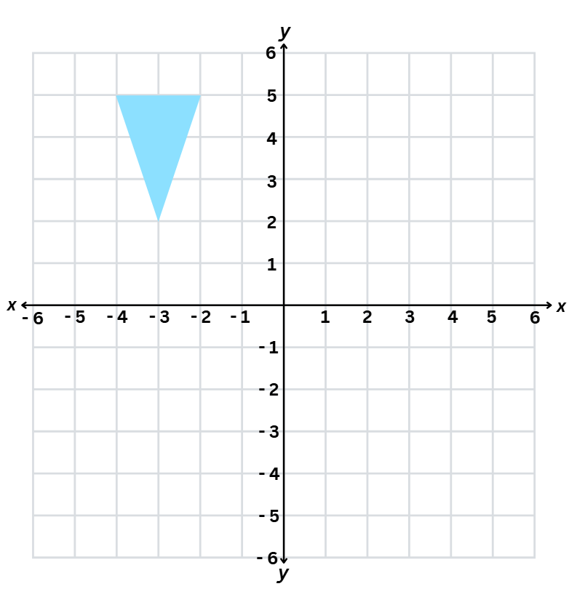
Short response (14)
Record the coordinates for the shape if it were reflected across the:
x-axis
y-axis.
Notes:
Short response questions provide brisk paced questions focussing on review of current and previous content to support spaced and interleaved practice.
Syllabus focus area:
Geometric measure B

Slide 29
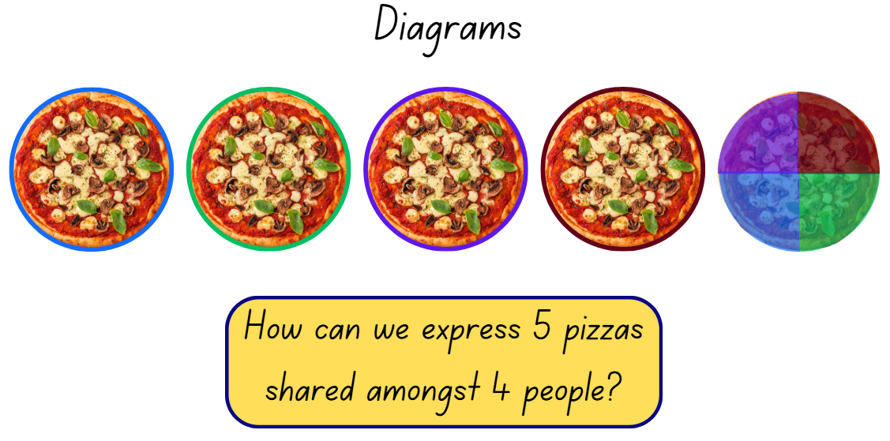
Short response (15)
Record the solution using a fraction, decimal or and words.
Notes:
Short response questions provide brisk paced questions focussing on review of current and previous content to support spaced and interleaved practice.
Syllabus focus area:
Multiplicative relations B

Slide 30
Short response (16)
Write each mass using kilograms (kg) and
grams (g):
3.45 kg
2.08 kg
12.40 kg
Notes:
Short response questions provide brisk paced questions focussing on review of current and previous content to support spaced and interleaved practice.
Syllabus focus area:
Non-spatial measure A

Slide 31
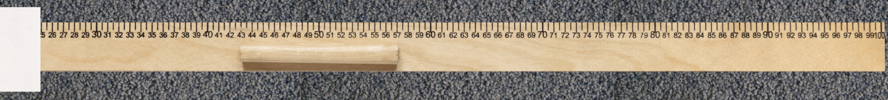
Activity 4 – representing lengths as fractions and decimals
Notes:
This is a developing number sense activity.
Number sense refers to a deep understanding of numbers, including their magnitude, relationships, and the effects of operations on them. It supports fluency and understanding, estimation, flexible thinking, and efficient problem-solving. Number sense activities 1–4 ‘activate’ prior number knowledge and support the learning of new content in the unit. Number sense activities 5–8 ‘loop’ back and provide opportunity for spaced practice with concepts and procedures covered in previous units.
Syllabus focus area:
Represent numbers B
Representing lengths as fractions and decimals
This resource corresponds to Figure 21 – covered metre ruler in Stage 3 Year B Unit 29.
1. Explain to students that we can describe lengths as percentages, decimals and fractions of a whole length. For example, 25 cm can be represented as 0.25 m, twenty-five hundredths , 25% of 100 cm and $\frac{1}{4}$ of one metre.
2. Show students a one metre ruler. Remind students that percent means ‘out of 100’. Explain that the full length of the ruler would equal 100%.
3. Cover part of the metre ruler with a piece of paper (see Figure 21 – covered metre ruler in Stage 3 Year B Unit 29).
4. Ask:
What percentage of the ruler has been covered? (Answer: 25%.)
What percentage of the ruler is not covered? (Answer: 75%.)
What could you say about the covered and uncovered parts of the ruler? (Answer: together they are equal to 100%.)
5. Provide small groups of students a metre ruler, sticky notes and an individual whiteboard. Ask students to mark on the one metre ruler: 10%, 20%, 25%, 50%, 75% and 100% of 100 cm.
6. Students record the marked percentages as measurements, fractions and decimals (see Figure 22 – student recording example in Stage 3 Year B Unit 29).

Slide 32
Review of learning 5

Slide 33
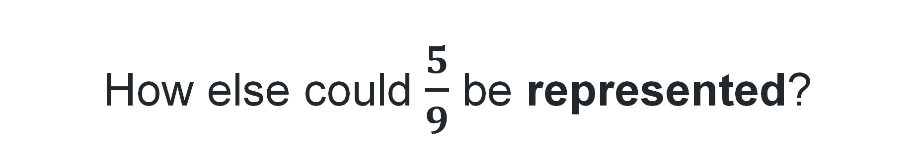
Multiple choice (3)
How else could $\frac{5}{9}$ be represented?
A
B
C
D
5 groups of 9
5 shared between 9
5 rows of 9
5 divided by 9
Notes:
This question connects to the content in the developing number sense activity (Activity 5)
Syllabus focus area:
Representing quantity fractions B

Slide 34
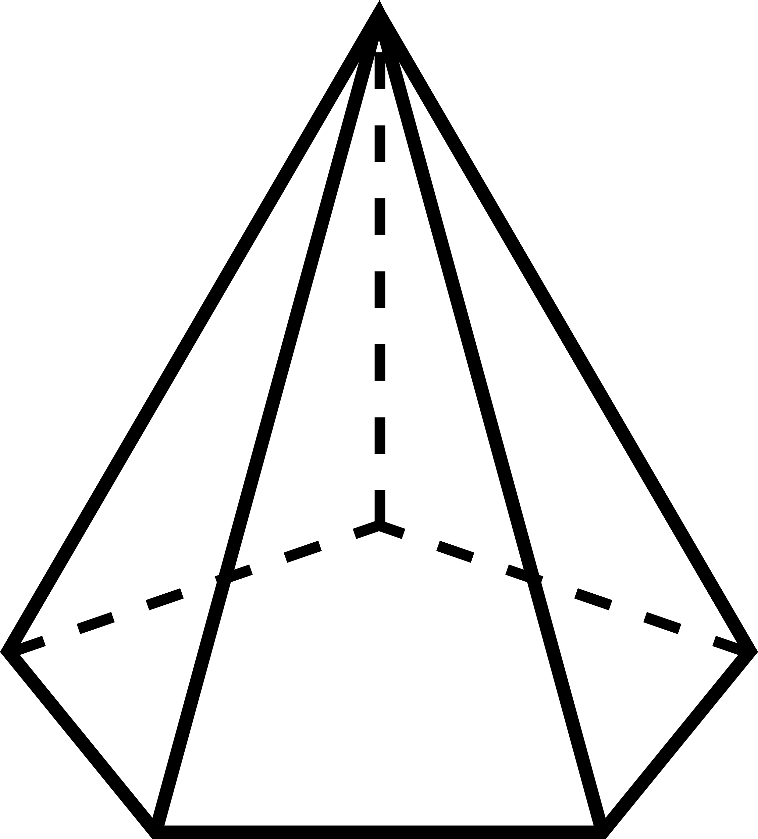
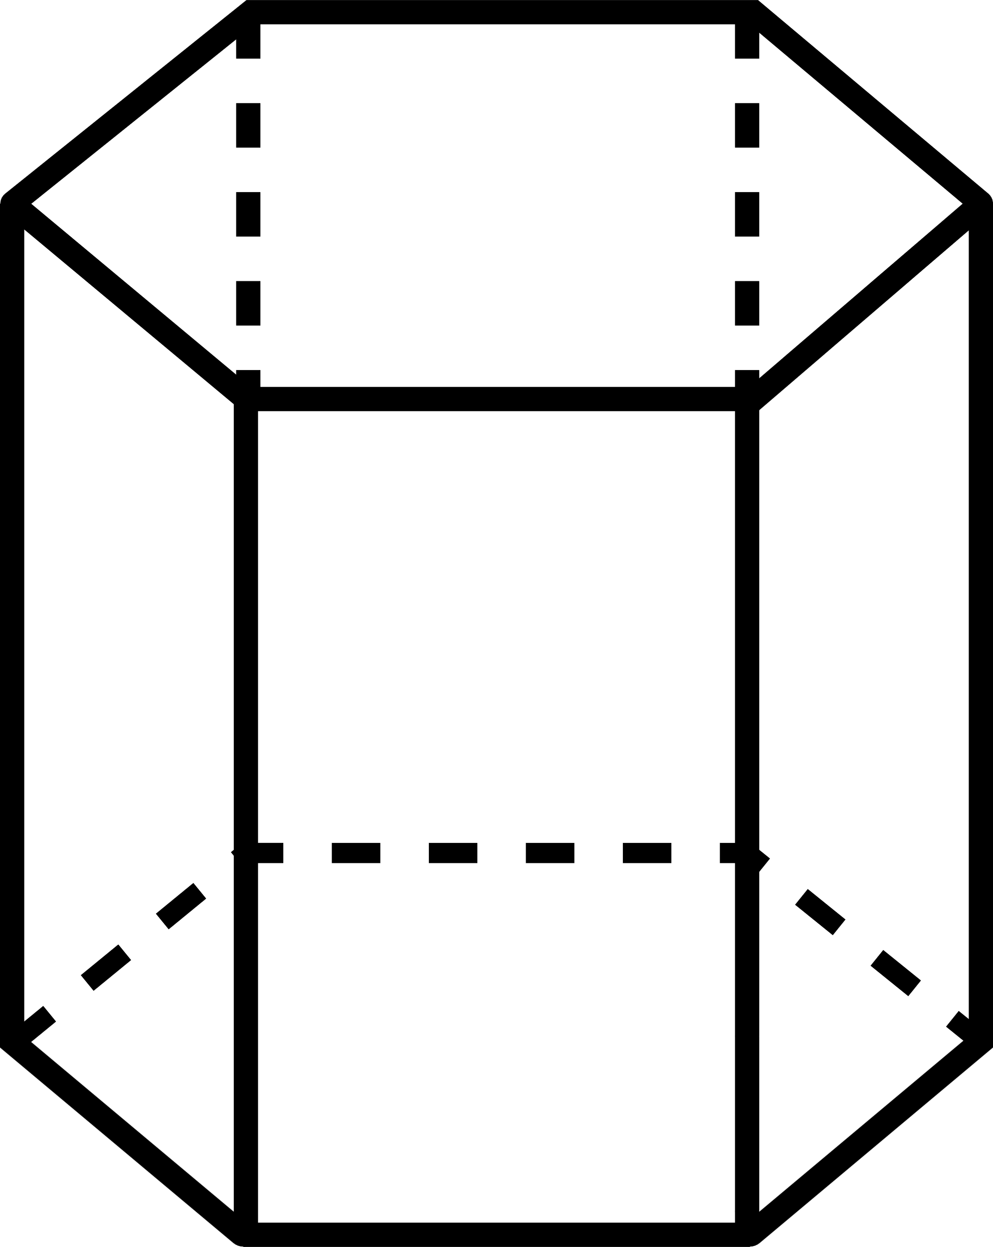
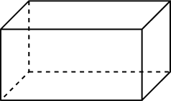
Short response (17)
Name these three-dimensional objects according to their base:
1.
2.
3.
Notes:
Short response questions provide brisk paced questions focussing on review of current and previous content to support spaced and interleaved practice.
Syllabus focus area:
Three-dimensional spatial structure A

Slide 35
Short response (18)
A spinner is divided into 10 equal sections: 4 green, 4 blue and 2 orange. The spinner is spun once.
Which outcomes are equally likely?
Would it be correct to say landing on orange is equally likely as landing on blue?
Communicate your reasoning.
Notes:
Short response questions provide brisk paced questions focussing on review of current and previous content to support spaced and interleaved practice.
Syllabus focus area:
Chance A

Slide 36
Short response (19)
A pattern is made using a triangle. Each term in the pattern adds one new triangle. The triangles are not joined together.
Record the numbers that complete the table of values by following the pattern rule.
Number of shapes | 1 | 2 | 3 | 4 | 5
Number of sides | 3 | 6 | 9
Notes:
Short response questions provide brisk paced questions focussing on review of current and previous content to support spaced and interleaved practice.
Syllabus focus area:
Multiplicative relations B

Slide 37
Short response (20)
A concert starts at 7:40 pm and finishes at 9:15 pm.
Calculate the duration of the concert.
Notes:
Short response questions provide brisk paced questions focussing on review of current and previous content to support spaced and interleaved practice.
Syllabus focus area:
Non-spatial measure B

Slide 38
Activity 5 – representing fractions as division (1)
3 divided by 4 | 1 divided by 10 | 2 shared between 5 | 2 shared between 3
4 divided by 9 | 9 divided by 10 | 1 shared between 4 | 5 shared between 7
6 shared between 7 | 7 divided by 9 | 1 shared between 6 | 3 divided by 8
4 divided by 6 | 5 divided by 8 | 1 shared between 2 | 3 shared between 5
Notes:
This is a developing number sense activity.
Number sense refers to a deep understanding of numbers, including their magnitude, relationships, and the effects of operations on them. It supports fluency and understanding, estimation, flexible thinking, and efficient problem-solving. Number sense activities 1–4 ‘activate’ prior number knowledge and support the learning of new content in the unit. Number sense activities 5–8 ‘loop’ back and provide opportunity for spaced practice with concepts and procedures covered in previous units.
Syllabus focus area:
Representing quantity fractions B
Representing fractions as division
This resource corresponds to Resource 16 – fractions as division set 1 in Stage 3 Year B Unit 29.
1. Revise that fractions represent a division. For example, 4 shared between 9 is equal to four ninths, so 4 divided by 9 = four ninths.
2. Explain to students that they will be playing a game of snap with a partner, where they pair the fraction with its matching representation (next slide).
For example, five eighths matches with 5 divided by 8 and one sixth matches with one shared between 6.
3. Explain that each student turns their pile of cards face down in front of them. Students turn the top card from their pile over at the same time. If the 2 cards turned over match, the player who says ‘Snap!’ first and reads aloud the matching set of cards, keeps them. If the cards don’t match, they are returned to the bottom of the pile.
4. Once students have turned over all cards in the set, they shuffle the cards and play again. Play continues for a set time and the player who gets the most matches by the end of the game wins.

Slide 39
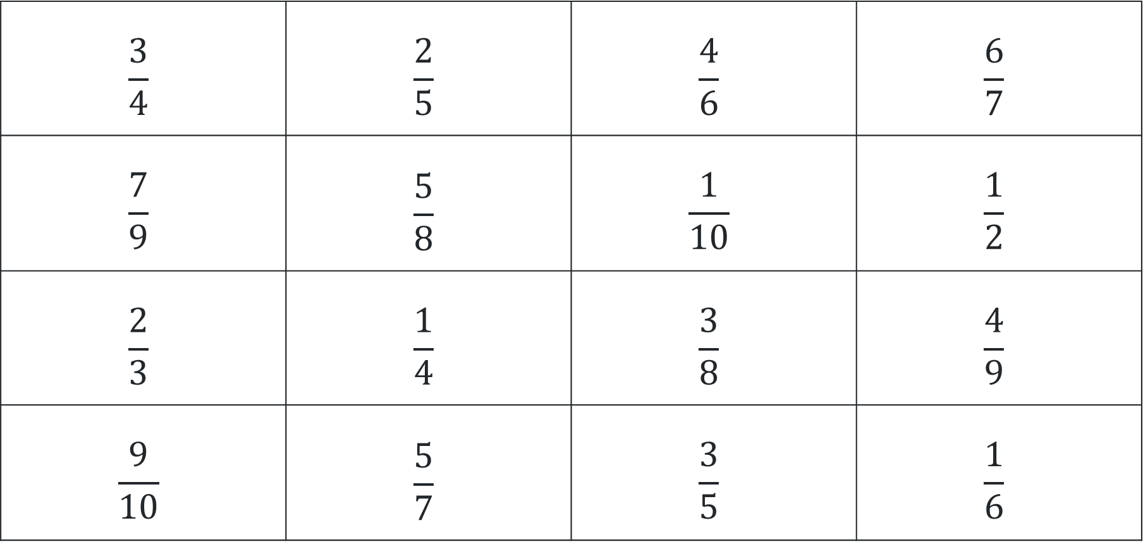
Activity 5 – representing fractions as division (2)
$$\frac{3}{4}$$ | $$\frac{2}{5}$$ | $$\frac{4}{6}$$ | $$\frac{6}{7}$$
$$\frac{7}{9}$$ | $$\frac{5}{8}$$ | $$\frac{1}{10}$$ | $$\frac{1}{2}$$
$$\frac{2}{3}$$ | $$\frac{1}{4}$$ | $$\frac{3}{8}$$ | $$\frac{4}{9}$$
$$\frac{9}{10}$$ | $$\frac{5}{7}$$ | $$\frac{3}{5}$$ | $$\frac{1}{6}$$
Notes:
This is a developing number sense activity.
Number sense refers to a deep understanding of numbers, including their magnitude, relationships, and the effects of operations on them. It supports fluency and understanding, estimation, flexible thinking, and efficient problem-solving. Number sense activities 1–4 ‘activate’ prior number knowledge and support the learning of new content in the unit. Number sense activities 5–8 ‘loop’ back and provide opportunity for spaced practice with concepts and procedures covered in previous units.
Syllabus focus area:
Representing quantity fractions B
Representing fractions as division
This resource corresponds to Resource 17 – fractions as division set 2 in Stage 3 Year B Unit 29.
(Previous slide)
1. Revise that fractions represent a division. For example, 4 shared between 9 is equal to four ninths, so 4 divided by 9 = four ninths.
2. Explain to students that they will be playing a game of snap with a partner, where they pair the fraction with its matching representation.
(This slide)
For example, five eighths matches with 5 divided by 8 and one sixth matches with one shared between 6.
3. Explain that each student turns their pile of cards face down in front of them. Students turn the top card from their pile over at the same time. If the 2 cards turned over match, the player who says ‘Snap!’ first and reads aloud the matching set of cards, keeps them. If the cards don’t match, they are returned to the bottom of the pile.
4. Once students have turned over all cards in the set, they shuffle the cards and play again. Play continues for a set time and the player who gets the most matches by the end of the game wins.

Slide 40
Review of learning 6

Slide 41

True or false (3)
8 ÷ 4 can be written as $\frac{8}{4}$.
True | False
Communicate your reasoning.
Notes:
The question on this slide connects to the content being explored in the developing number sense activity (Activity 6)
Syllabus focus area:
Representing quantity fractions B

Slide 42
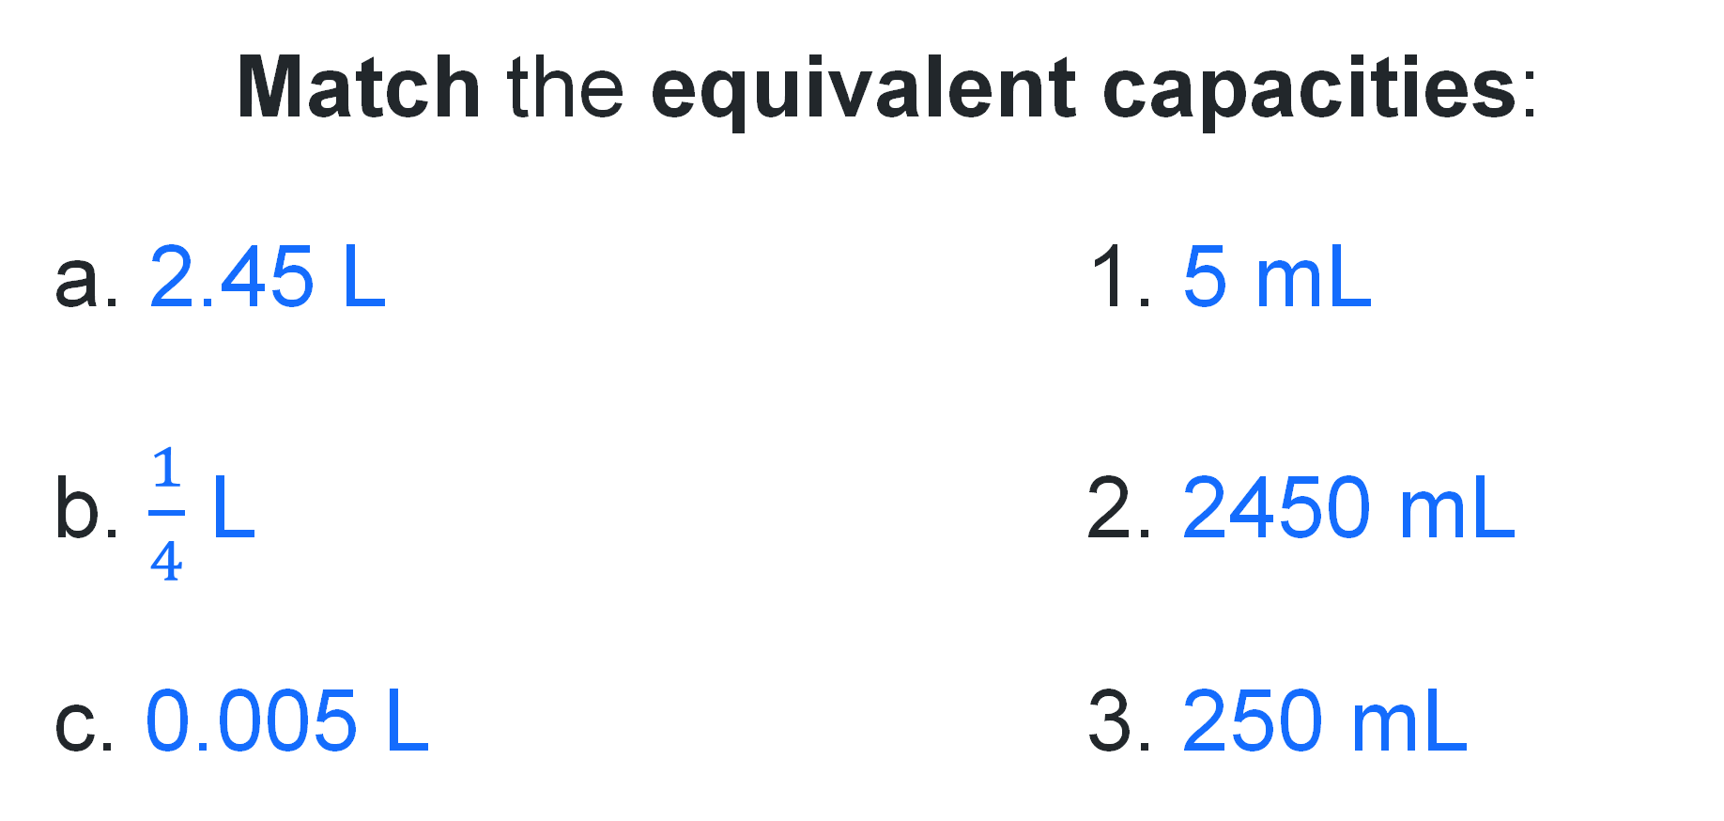
Short response (21)
Match the equivalent capacities:
a. 2.45 L 1. 5 mL
b. $\frac{1}{4}$ L 2. 2450 mL
c. 0.005 L 3. 250 mL
Notes:
Short response questions provide brisk paced questions focussing on review of current and previous content to support spaced and interleaved practice.
Syllabus focus area:
Three-dimensional spatial structure A

Slide 43
Short response (22)
A special six-sided dice has faces coloured as follows:
2 faces are red, 3 faces are blue and 1 face is green.
A player rolls the die once.
Show the probability of landing on each colour as a fraction.
How could the dice be changed so that all outcomes are equally likely?
Notes:
Short response questions provide brisk paced questions focussing on review of current and previous content to support spaced and interleaved practice.
Syllabus focus area:
Chance B

Slide 44
Short response (23)
Andy has 42 marbles. He has 7 times as many marbles as Ryan.
How many marbles does Ryan have?
Communicate your strategy.
Notes:
Short response questions provide brisk paced questions focussing on review of current and previous content to support spaced and interleaved practice.
Syllabus focus area:
Multiplicative relations A

Slide 45
Short response (24)
A road trip begins at 8:35 am and ends at 1:20 pm.
How long is the trip?
Round the duration to the nearest hour.
Notes:
Short response questions provide brisk paced questions focussing on review of current and previous content to support spaced and interleaved practice.
Syllabus focus area:
Non-spatial measure B

Slide 46
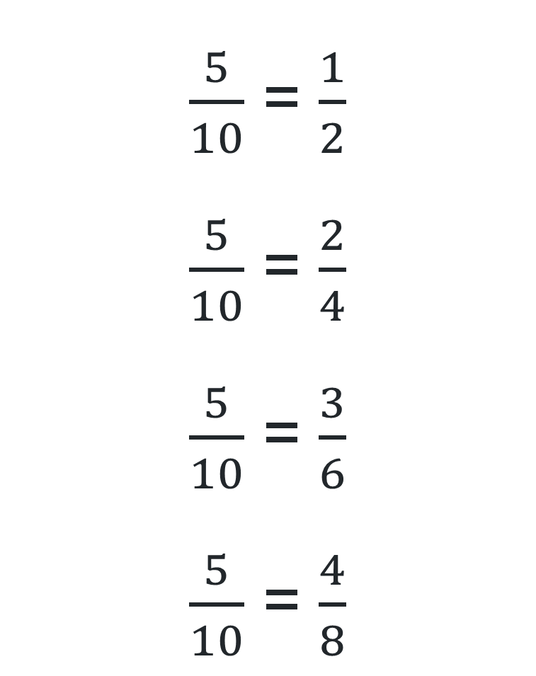
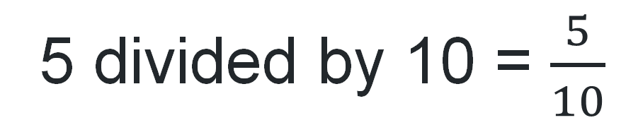
Activity 6 – representing equivalent fractions as division
$\frac{5}{10}$ = $\frac{1}{2}$
$\frac{5}{10}$ = $\frac{2}{4}$
$\frac{5}{10}$ = $\frac{3}{6}$
$\frac{5}{10}$ = $\frac{4}{8}$
5 divided by 10 = $\frac{5}{10}$
Notes:
This is a developing number sense activity.
Number sense refers to a deep understanding of numbers, including their magnitude, relationships, and the effects of operations on them. It supports fluency and understanding, estimation, flexible thinking, and efficient problem-solving. Number sense activities 1–4 ‘activate’ prior number knowledge and support the learning of new content in the unit. Number sense activities 5–8 ‘loop’ back and provide opportunity for spaced practice with concepts and procedures covered in previous units.
Syllabus focus area:
Representing quantity fractions B
Representing equivalent fractions as division
1. Revise that fractions represent division. For example, 5 divided by 10 = five tenths. Remind students that the fraction five tenths can also be represented in different ways and still be equivalent. For example, five tenths is equal to one half, two quarters, three sixths and four eighths. (all represent the same value of 0.5).
2. Explain to students that they will be making and recording fractions and equivalent fractions. For example, six eighths = three quarters. 6 ÷ 8 = six eighths and 3 ÷ 4 = three quarters.
3. Provide students with two 10-sided dice and an individual whiteboard. Students roll the dice, make a fraction and record the fractions and division number sentences. The larger number rolled will be the denominator and the smaller number rolled will be the numerator. For example, ‘I rolled a 4 and a 10, so 4 is the numerator and 10 is the denominator. The fraction is four tenths.’ (see Figure 23)
Note: tell students that some fractions, for example one seventh, will have less possible equivalent fractions without going beyond a denominator of 10. Students can either record the fraction and roll the dice again or try to think of an equivalent fraction that would have a denominator that is greater than 10.
4. Students turn and talk to share the recordings they made. Ask:
Which fraction did you roll that had the least number of equivalent fractions?
Which fraction did you roll that had the greatest number of equivalent fractions?
Did you roll a fraction with the same numerator and denominator? What did you notice?

Slide 47
Review of learning 7

Slide 48
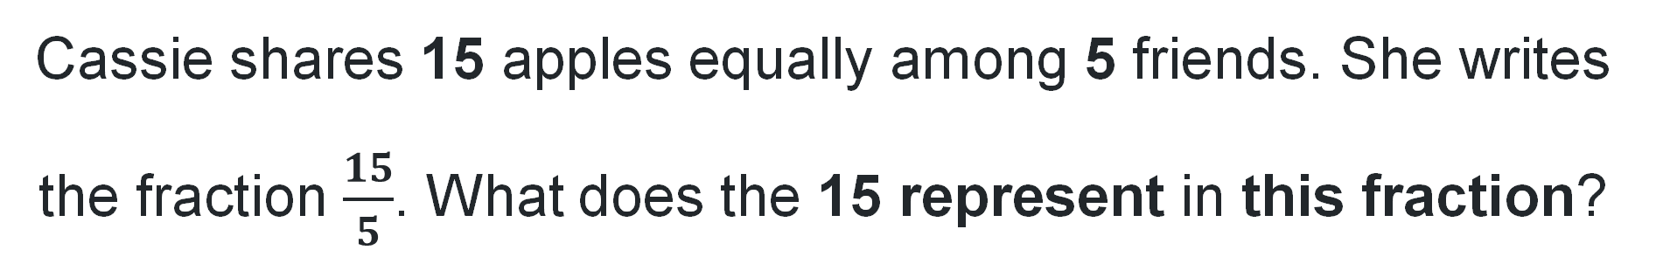
Multiple choice (4)
Cassie shares 15 apples equally among 5 friends. She writes the fraction $\frac{15}{5}$​. What does the 15 represent in this fraction?
A
The number of groups.
B
The total amount being shared.
C
The amount each person gets.
D
The number of people sharing.
Notes:
This question connects to the content in the developing number sense activity (Activity 7)
Syllabus focus area:
Representing quantity fractions B

Slide 49
Short response (25)
A water bottle holds 3.745 L of water.
Record this measurement in millilitres.
Notes:
Short response questions provide brisk paced questions focussing on review of current and previous content to support spaced and interleaved practice.
Syllabus focus area:
Three-dimensional spatial structure A

Slide 50
Short response (26)
A mystery bag is being filled with 12 counters: some are blue and some are orange. Lisa wants it to be 3 times as likely to pick a blue counter than an orange counter.
How many blue and orange counters should be put in the bag to make this happen?
Represent the probability of picking each colour as a fraction.
If 2 red counters were added to the bag, record the new probabilities.
Notes:
Short response questions provide brisk paced questions focussing on review of current and previous content to support spaced and interleaved practice.
Syllabus focus area:
Chance B

Slide 51
Short response (27)
A bus travels at an average speed of
90 km an hour.
How long will it take the bus to travel
360 km?
Notes:
Short response questions provide brisk paced questions focussing on review of current and previous content to support spaced and interleaved practice.
Syllabus focus area:
Multiplicative relations B

Slide 52
Short response (28)
You have three pieces of ribbon with the following lengths:
8 mm
25 cm
1.3 m
1. Convert all the lengths to metres.
2. Find the total length of the ribbons in metres.
3. Explain why it is important to have the same units before adding lengths.
Notes:
Short response questions provide brisk paced questions focussing on review of current and previous content to support spaced and interleaved practice.
Syllabus focus area:
Geometric measure B

Slide 53
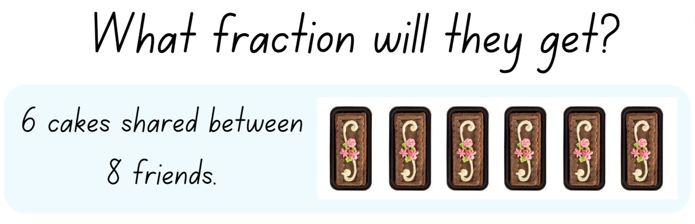
Activity 7 – solving problems using fractions as division (1)
Notes:
This is a developing number sense activity.
Number sense refers to a deep understanding of numbers, including their magnitude, relationships, and the effects of operations on them. It supports fluency and understanding, estimation, flexible thinking, and efficient problem-solving. Number sense activities 1–4 ‘activate’ prior number knowledge and support the learning of new content in the unit. Number sense activities 5–8 ‘loop’ back and provide opportunity for spaced practice with concepts and procedures covered in previous units.
Syllabus focus area:
Representing quantity fractions B
Solving problems using fractions as division
This resource corresponds to Resource 18 – fair shares in Stage 3 Year B Unit 29.
1. Ask students:
How could 6 cakes be shared equally between 8 friends?
Is there more than one way the cakes could be shared equally?
How could our knowledge of equivalent fractions help us find more than one possibility?
2. Provide students time to solve the problem on individual whiteboards, encouraging them to find more than one answer. Ask students to turn and talk and share their thinking.
3. Possible student responses could be:
Divide each of the cakes into eighths and give each friend 6 of the eighths. Each friend gets six-eighths.
Students realise that one-quarter is equivalent to two-eighths. Divide each of the cakes into quarters and give each friend 3 of the quarters. Each friend gets three-quarters.
4. (next slide) Display the remaining problems on Resource 18 – fair shares and ask students to record their answers on an individual whiteboard, including equivalent fractions where appropriate.

Slide 54
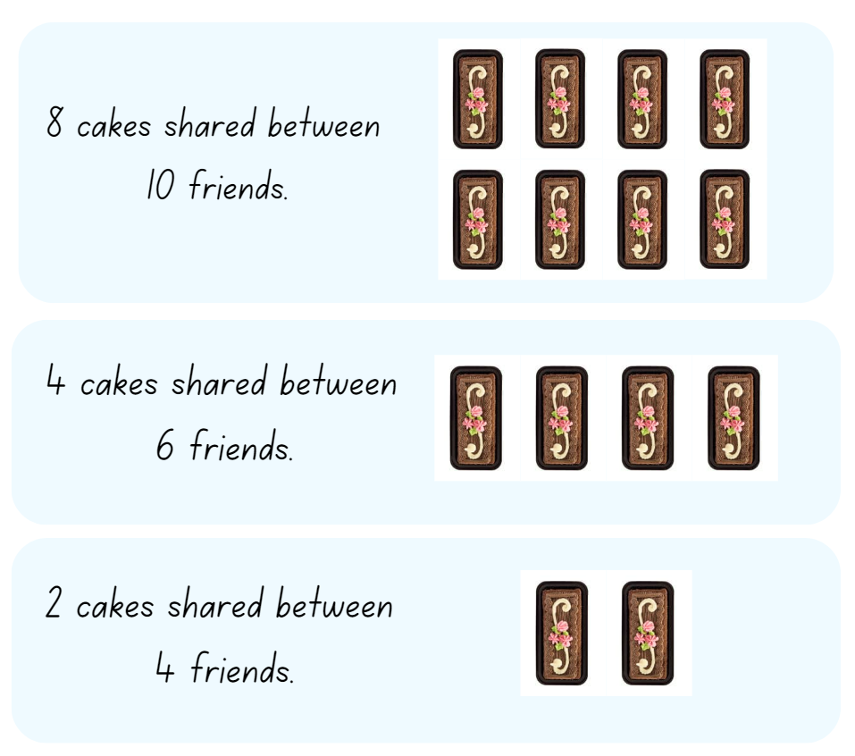
Activity 7 – solving problems using fractions as division (2)
Notes:
This is a developing number sense activity.
Number sense refers to a deep understanding of numbers, including their magnitude, relationships, and the effects of operations on them. It supports fluency and understanding, estimation, flexible thinking, and efficient problem-solving. Number sense activities 1–4 ‘activate’ prior number knowledge and support the learning of new content in the unit. Number sense activities 5–8 ‘loop’ back and provide opportunity for spaced practice with concepts and procedures covered in previous units.
Syllabus focus area:
Representing quantity fractions B
Solving problems using fractions as division
This resource corresponds to Resource 18 – fair shares in Stage 3 Year B Unit 29.
1. Ask students:
How could 6 cakes be shared equally between 8 friends?
Is there more than one way the cakes could be shared equally?
How could our knowledge of equivalent fractions help us find more than one possibility?
2. Provide students time to solve the problem on individual whiteboards, encouraging them to find more than one answer. Ask students to turn and talk and share their thinking.
3. Possible student responses could be:
Divide each of the cakes into eighths and give each friend 6 of the eighths. Each friend gets six-eighths.
Students realise that one-quarter is equivalent to two-eighths. Divide each of the cakes into quarters and give each friend 3 of the quarters. Each friend gets three-quarters.
4. Display the remaining problems on Resource 18 – fair shares and ask students to record their answers on an individual whiteboard, including equivalent fractions where appropriate.

Slide 55
Review of learning 8

Slide 56
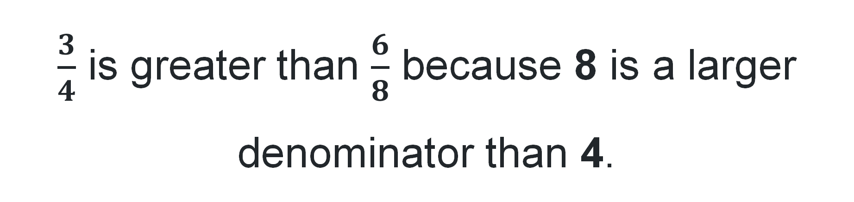
True or false (4)
$\frac{3}{4}$​ is greater than $\frac{6}{8}$ because 8 is a larger denominator than 4.
True | False
Use a diagram or number line to communicate your reasoning.
Notes:
The question on this slide connects to the content being explored in the developing number sense activity (Activity 8)
Syllabus focus area:
Representing quantity fractions B

Slide 57
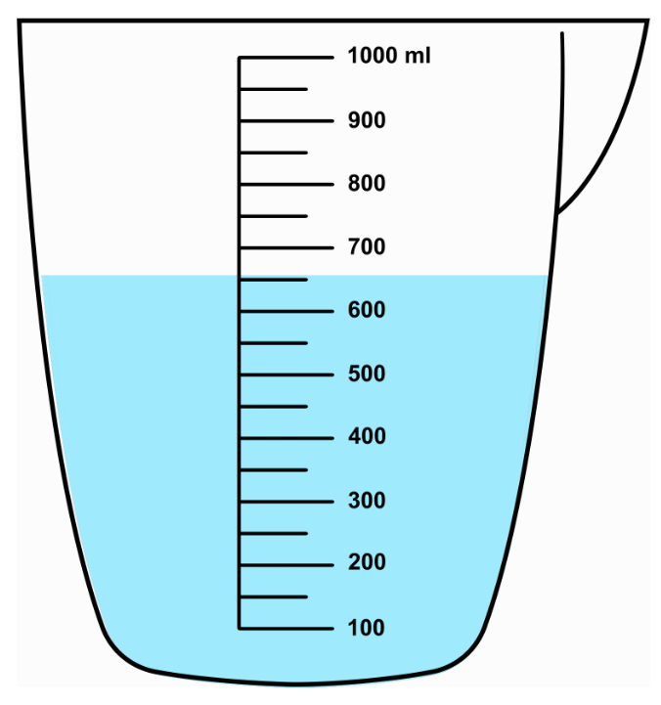
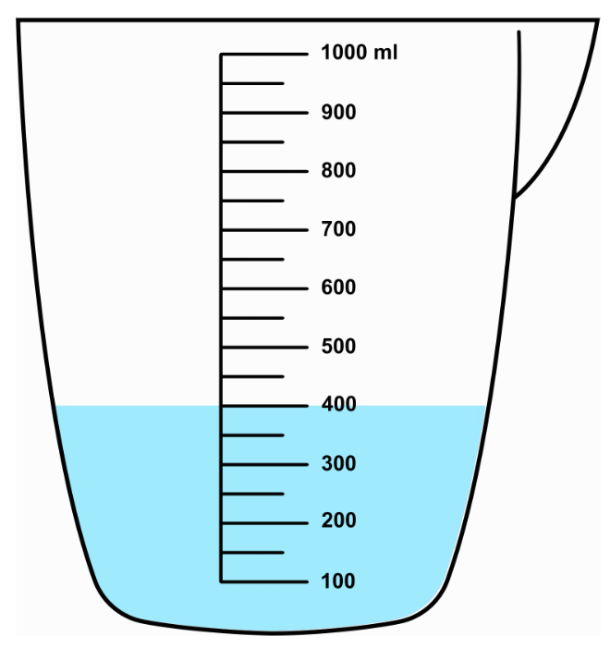
Short response (29)
Record the measurements displayed in litres (L), to 3 decimal places.
Re
A.
B.
Notes:
Short response questions provide brisk paced questions focussing on review of current and previous content to support spaced and interleaved practice.
Syllabus focus area:
Three-dimensional spatial structure A

Slide 58
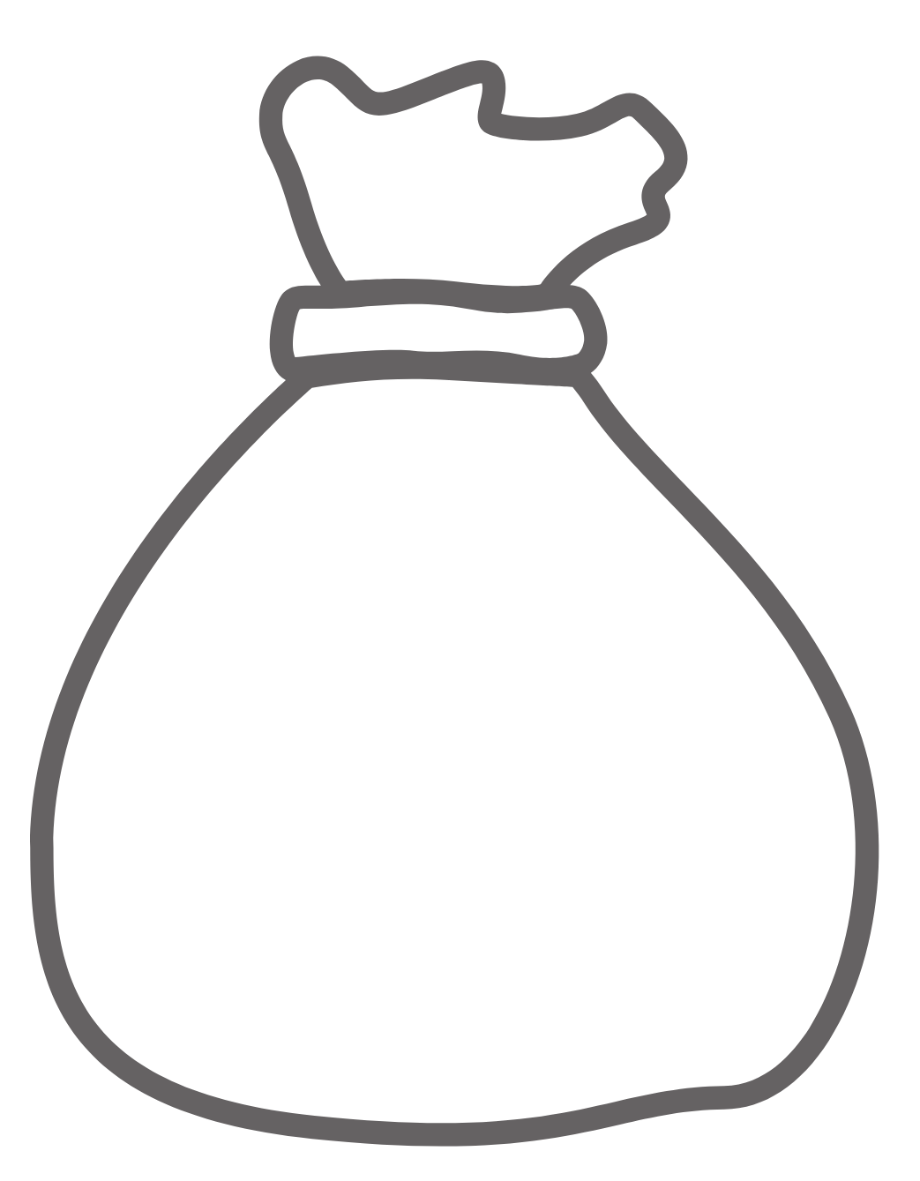
Short response (30)
Sarah has a mystery bag containing a large number of coloured counters. 1 counter was drawn out then returned to the collection before the next counter was drawn. Here are the results:
?
From these results:
What do you think are the contents of the mystery bag?
Communicate your reasoning.
Notes:
Short response questions provide brisk paced questions focussing on review of current and previous content to support spaced and interleaved practice.
Syllabus focus area:
Chance B

Slide 59
Short response (31)
Use the digits 0, 6, 3, 2, the operations +, -, × and ÷ and brackets ( ), to create equations with answers from 1 to 10.
For example, (6 - 2) × 2 = 8.
Notes:
Short response questions provide brisk paced questions focussing on review of current and previous content to support spaced and interleaved practice.
Syllabus focus area:
Multiplicative relations B

Slide 60
Short response (32)
Calculate the perimeter for each of these
two-dimensional shapes:
A rectangle with a length of 8 cm and a width of 5 cm.
A square 7 cm side lengths.
A triangle with sides measuring 6 cm, 8 cm, and 10 cm.
Notes:
Short response questions provide brisk paced questions focussing on review of current and previous content to support spaced and interleaved practice.
Syllabus focus area:
Geometric measure A

Slide 61

Activity 8 – ordering equivalent fractions on number lines
0
1
Notes:
This is a developing number sense activity.
Number sense refers to a deep understanding of numbers, including their magnitude, relationships, and the effects of operations on them. It supports fluency and understanding, estimation, flexible thinking, and efficient problem-solving. Number sense activities 1–4 ‘activate’ prior number knowledge and support the learning of new content in the unit. Number sense activities 5–8 ‘loop’ back and provide opportunity for spaced practice with concepts and procedures covered in previous units.
Syllabus focus area:
Representing quantity fractions B
Ordering equivalent fractions on number lines
1. Provide students with a strip of paper. Explain this represents a zero to one number line.
2. Guide students to fold their strip of paper into eighths by repeated halving (three folds).
3. Explain to students they will record as many different ways the folded lines could be represented with fractions (see Figure 24 – number line paper strip in Stage 3 Year B Unit 29).
4. Ask students to share their models and record other fractions that other students represented. For example, one student may have recorded the half-way fold as a one half, whereas another recorded its equivalence, being two-quarters (two quarters).

Slide 62
Double Venn diagram
Object 1
Object 2
Features similar to both objects
Features of object 1
Features of object 2

Slide 63
Frayer
Definition
Facts/Characteristics
Word, term, concept
Examples
Non-examples

Slide 64
Spider map
Idea
Subject

Slide 65
Cline
Concept 1
Concept 2
Word
Word
Word
Word
Word
Word
Word
Word
Word
Word
Word

Slide 66

Compare and contrast

Slide 67
Multiple choice (5)
A
B
C
D

Slide 68
Multiple choice
A
B
C
D
Notes:
This question connects to the content in the developing number sense activity (Activity 3)
Syllabus focus area:
[Focus area A/B]

Slide 69
References (1)
This presentation contains NSW Curriculum and syllabus content. The NSW Curriculum is developed by the NSW Education Standards Authority. This content is prepared by NESA for and on behalf of the Crown in the right of the State of New South Wales. The material is protected by Crown copyright.
Please refer to the NESA Copyright Disclaimer for more information https://educationstandards.nsw.edu.au/wps/portal/nesa/mini-footer/copyright.
NESA holds the only official and up-to-date versions of the NSW Curriculum and syllabus documents. Please visit the NSW Education Standards Authority (NESA) website https://educationstandards.nsw.edu.au/wps/portal/nesa/home and the NSW Curriculum website https://curriculum.nsw.edu.au.
Mathematics K–10 Syllabus © NSW Education Standards Authority (NESA) for and on behalf of the Crown in right of the State of New South Wales, 2022.
National Numeracy Learning Progression © Australian Curriculum, Assessment and Reporting Authority (ACARA) 2010 to present, unless otherwise indicated. This material was downloaded from the Australian Curriculum website (National Numeracy Learning Progression) (accessed 17 October 2025 and was not modified.
Aesop (1919) ‘The Crow and the Pitcher’, The Aesop for Children: with Pictures by Milo Winter (Winter M illus), Rand, McNally and Co, adapted by the Library of Congress, accessed 25 October 2025.
Allen P (2020) Mr Archimedes’ Bath, Harper Collins Children's Books, Australia.
Amplify Education, Inc (2023) Polypad, Mathigon website, accessed 21 October 2025.

Slide 70
References (2)
This presentation contains NSW Curriculum and syllabus content. The NSW Curriculum is developed by the NSW Education Standards Authority. This content is prepared by NESA for and on behalf of the Crown in the right of the State of New South Wales. The material is protected by Crown copyright.
Please refer to the NESA Copyright Disclaimer for more information https://educationstandards.nsw.edu.au/wps/portal/nesa/mini-footer/copyright.
NESA holds the only official and up-to-date versions of the NSW Curriculum and syllabus documents. Please visit the NSW Education Standards Authority (NESA) website https://educationstandards.nsw.edu.au/wps/portal/nesa/home and the NSW Curriculum website https://curriculum.nsw.edu.au.
State of New South Wales (Department of Education) (2023) ‘Designing food packaging’, Measurement and geometric reasoning, Universal Resources Hub website, accessed 22 October 2025.
State of Victoria (Department of Education and Training) (2020) ‘Metre Ruler’, Fractions and decimals, Maths Curriculum Companion website, accessed 23 October 2025.
Sullivan P (2017) Challenging Mathematical Tasks: Unlocking the Potential of all Students, Oxford University Press, Victoria.
University of Cambridge (n.d.) Cut Nets, NRICH website, accessed 23 October 2025.
University of Cambridge (n.d.) Guess What?, NRICH website, accessed 23 October 2025.

Slide 71
Copyright
© State of New South Wales (Department of Education), 2025
The copyright material published in this resource is subject to the Copyright Act 1968 (Cth) and is owned by the NSW Department of Education or, where indicated, by a party other than the NSW Department of Education (third-party material).
Copyright material available in this resource and owned by the NSW Department of Education is licensed under a Creative Commons Attribution 4.0 International (CC BY 4.0) license.
This license allows you to share and adapt the material for any purpose, even commercially.
Attribution should be given to © State of New South Wales (Department of Education), 2025.
Material in this resource not available under a Creative Commons license:
the NSW Department of Education logo, other logos and trademark-protected material
Material owned by a third party that has been reproduced with permission. You will need to obtain permission from the third party to reuse its material.
Links to third-party material and websites
Please note that the provided (reading/viewing material/list/links/texts) are a suggestion only and implies no endorsement, by the New South Wales Department of Education, of any author, publisher, or book title. School principals and teachers are best placed to assess the suitability of resources that would complement the curriculum and reflect the needs and interests of their students.
If you use the links provided in this document to access a third party’s website, you acknowledge that the terms of use, including licence terms set out on the third-party’s website apply to the use which may be made of the materials on that third-party website or where permitted by the Copyright Act 1968 (Cth). The department accepts no responsibility for content on third-party websites.

