Slide 1
Instructions for use
This resource is not a teaching and learning program. It should be used in conjunction with Stage 3 Year B Unit 30.
Classroom teachers are encouraged to add and adapt slides as required to meet the needs of their students.
Save a copy of the file to make changes to the slide deck. Go to File > Download a Copy (this downloads a copy to the computer to edit in the PowerPoint app).
To convert the PowerPoint to Google Slides:
  Upload the file into Google Drive and open it.
  Go to File > Save as Google Slides.
  (Note – conversion may cause formatting changes in the slides.)

Slide 2

Review of Learning
Mathematics Stage 3 – Unit 30
Notes:
Reviews may include a combination of question types, requiring students to recall facts and key ideas, as well as apply their knowledge to solve problems and answer questions. To support active engagement, a mix of techniques should be employed.” (AERO, 2024).
This Review of Learning slide deck revisits key concepts from the following units:
Stage 3 Year B Unit 30
Stage 3 Year B Unit 29
Stage 3 Year B Unit 28
It also includes opportunities to review prior learning in non-number content, supporting consolidation across focus areas.
The review of learning resources include three key task types that support the development of mathematical proficiency through retrieval, spaced practice, and active participation. These practices complement the review phase (activating prior knowledge) embedded within the beginning of each lesson.
1.
Multiple-choice questions/True or false: Designed to promote active retrieval of key concepts and identify common misconceptions in number, supporting consolidation, understanding and fluency.
These questions:
support spaced and interleaved practice
help identify and address common misconceptions
support active recall and immediate feedback
support whole class participation
identify areas requiring reteach
2.
Short-response question sets: Carefully grouped questions that encourage spaced and interleaved practice across multiple focus areas, helping students revisit and apply knowledge from different points in time.
These questions:
have a combination of question types
address a range of focus areas
build automaticity and fluency
support active recall
allow for immediate feedback
identify content requiring reteach
3.
Developing number sense activities: A variety of practical, purposeful tasks that reinforce current learning and build on prior knowledge. These activities promote reasoning, problem-solving and conceptual understanding.
The review of learning resources are designed to work support teaching and learning in mathematics. For the most effective implementation, use the resources flexibly, adapting to meet student learning needs and individual classroom contexts.

Slide 3
Lessons
1
Review of learning 1
5
Review of learning 5
2
Review of learning 2
6
Review of learning 6
3
Review of learning 3
7
Review of learning 7
4
Review of learning 4
8
Review of learning 8
Notes:
Teacher notes:
Click lesson numbers to go to specific lessons
Interactive features can be viewed in slide show

Slide 4
Review of learning 1

Slide 5

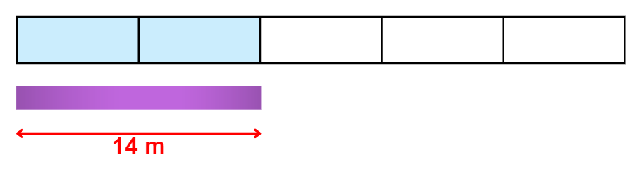
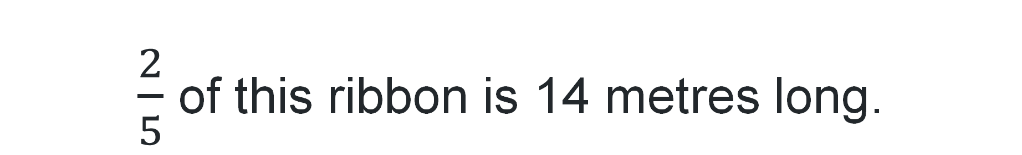
Multiple choice (1)
$\frac{2}{5}$ of this ribbon is 14 metres long.
How long is the ribbon?
A
B
C
D
14 m
35 m
70 m
7 m
Notes:
This question connects to the content in the developing number sense activity (Activity 1)
Syllabus focus area:
Representing quantity fractions B

Slide 6

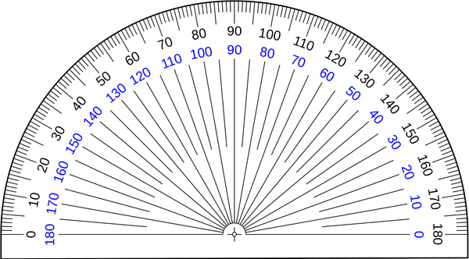
Short response (1)
Explain why a protractor has 2 scales.
Notes:
Short response questions provide brisk paced questions focussing on review of current and previous content to support spaced and interleaved practice.
Syllabus focus area:
Geometric measure A

Slide 7
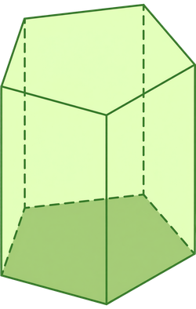
Short response (2)
Name the type of prism.
Notes:
Short response questions provide brisk paced questions focussing on review of current and previous content to support spaced and interleaved practice.
Syllabus focus area:
Three-dimensional spatial structure A

Slide 8
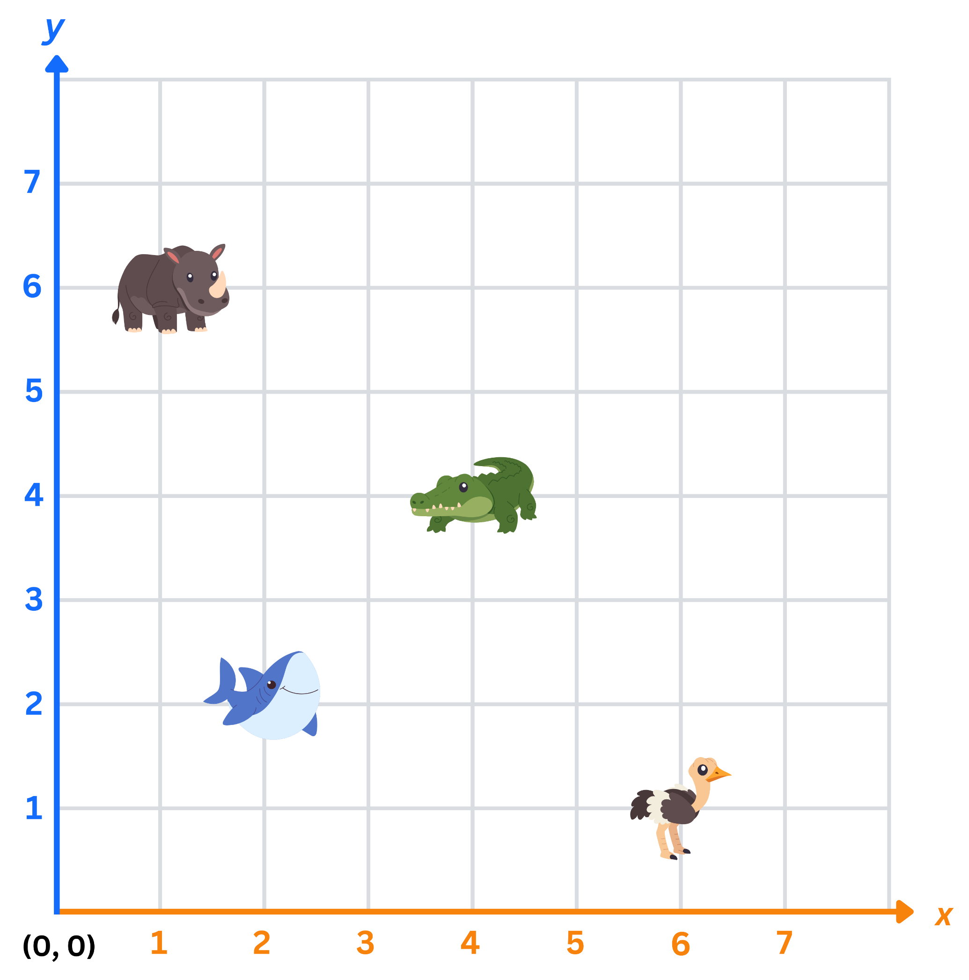
Short response (3)
Record the coordinates of each animal on the first quadrant of the Cartesian plane.
rhinoceros
crocodile
shark
ostrich
Notes:
Short response questions provide brisk paced questions focussing on review of current and previous content to support spaced and interleaved practice.
Syllabus focus area:
Geometric measure A

Slide 9
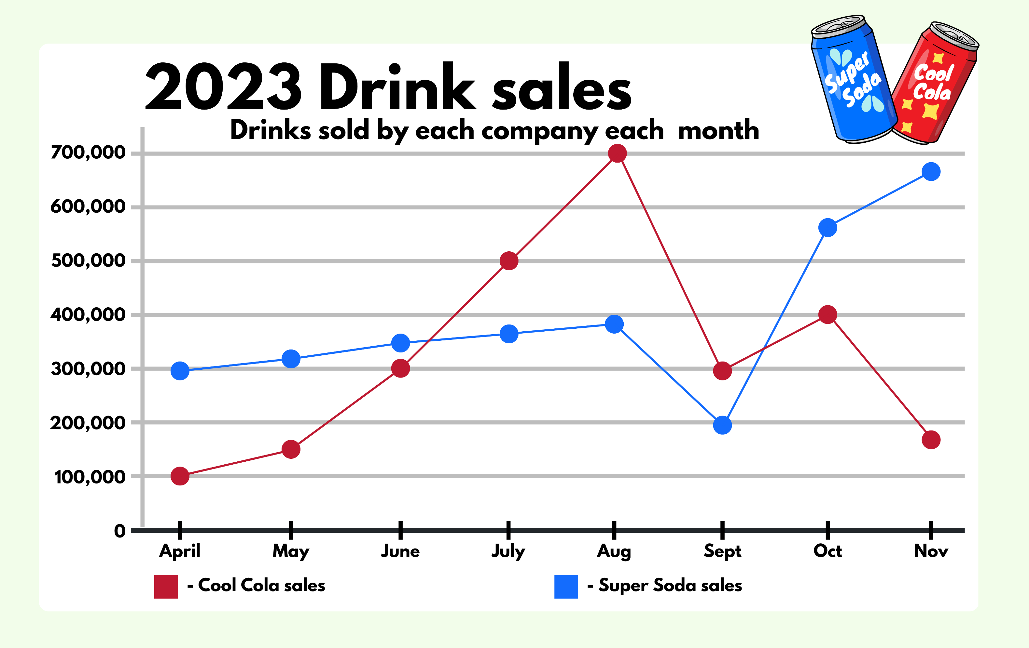
Short response (4)
“Cool Cola is more popular than Super Soda.”
Do you agree or disagree?
Communicate your reasoning.
Notes:
Short response questions provide brisk paced questions focussing on review of current and previous content to support spaced and interleaved practice.
Syllabus focus area:
Data B

Slide 10

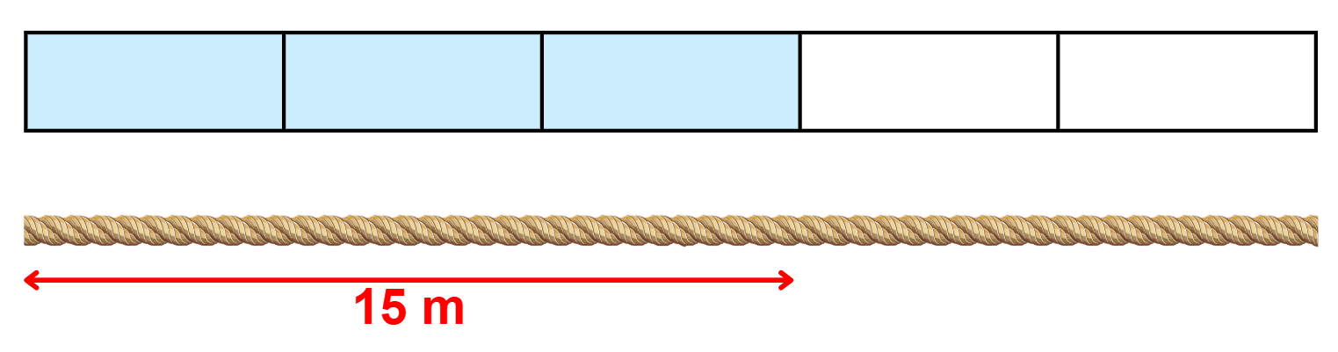
Activity 1 – build to the whole 1
Notes:
This is a developing number sense activity.
Number sense refers to a deep understanding of numbers, including their magnitude, relationships, and the effects of operations on them. It supports fluency and understanding, estimation, flexible thinking, and efficient problem-solving. Number sense activities 1–4 ‘activate’ prior number knowledge and support the learning of new content in the unit. Number sense activities 5–8 ‘loop’ back and provide opportunity for spaced practice with concepts and procedures covered in previous units.
Syllabus focus area:
Representing quantity fractions B
Build to the whole 1
Explain to students that if a fraction of a total is known, it can be used to find the total amount.
Ask students how they could find the total length of a rope if they were given three-fifths.
Draw a line on the board and tell students that three-fifths of this rope is 15 metres long.
Allow time for students to think and turn and talk to discuss how they could find the total length.
Select students to share and explain their strategy. Record student responses.
The table below outlines stimulus prompts to generate conversation about the topic, along with anticipated responses from students.
Prompt
How can you find the total length of the rope?
Anticipated student responses
We would find how long one-fifth of the rope is first, then build it up to have all 5 of those amounts for the total length.
One-fifth is 5 metres long, so the total length of the rope is 25 metres.
We know that 3 fives is 15, so one-fifth must be 5 metres long. We would then multiply 5 metres by the 5 fifths, making a total of 25 metres.
Ask:
Does it matter what fraction of the length of rope you are given?
Does the size of the fraction change your strategy? Why or why not?

Slide 11
Review of learning 2

Slide 12
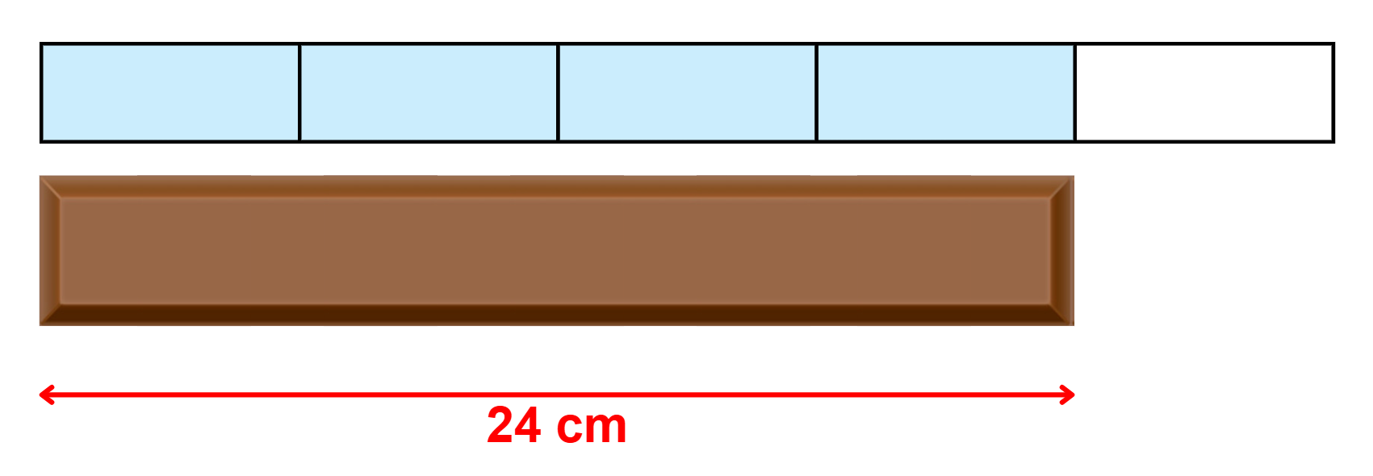
True or false (1)
The whole chocolate bar is 30 cm.
True | False
Notes:
The question on this slide connects to the content being explored in the developing number sense activity (Activity 2)
Syllabus focus area:
Representing quantity fractions B

Slide 13
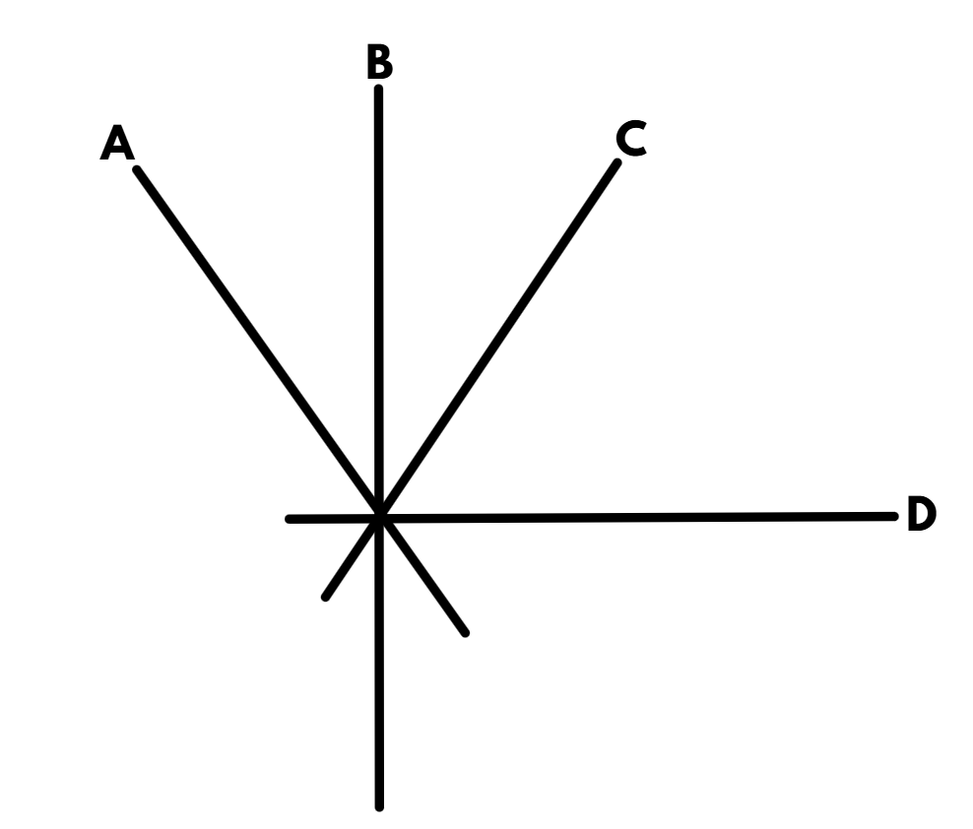
Short response (5)
Which 2 lines are perpendicular?
Notes:
Short response questions provide brisk paced questions focussing on review of current and previous content to support spaced and interleaved practice.
Syllabus focus area:
Geometric measure B

Slide 14
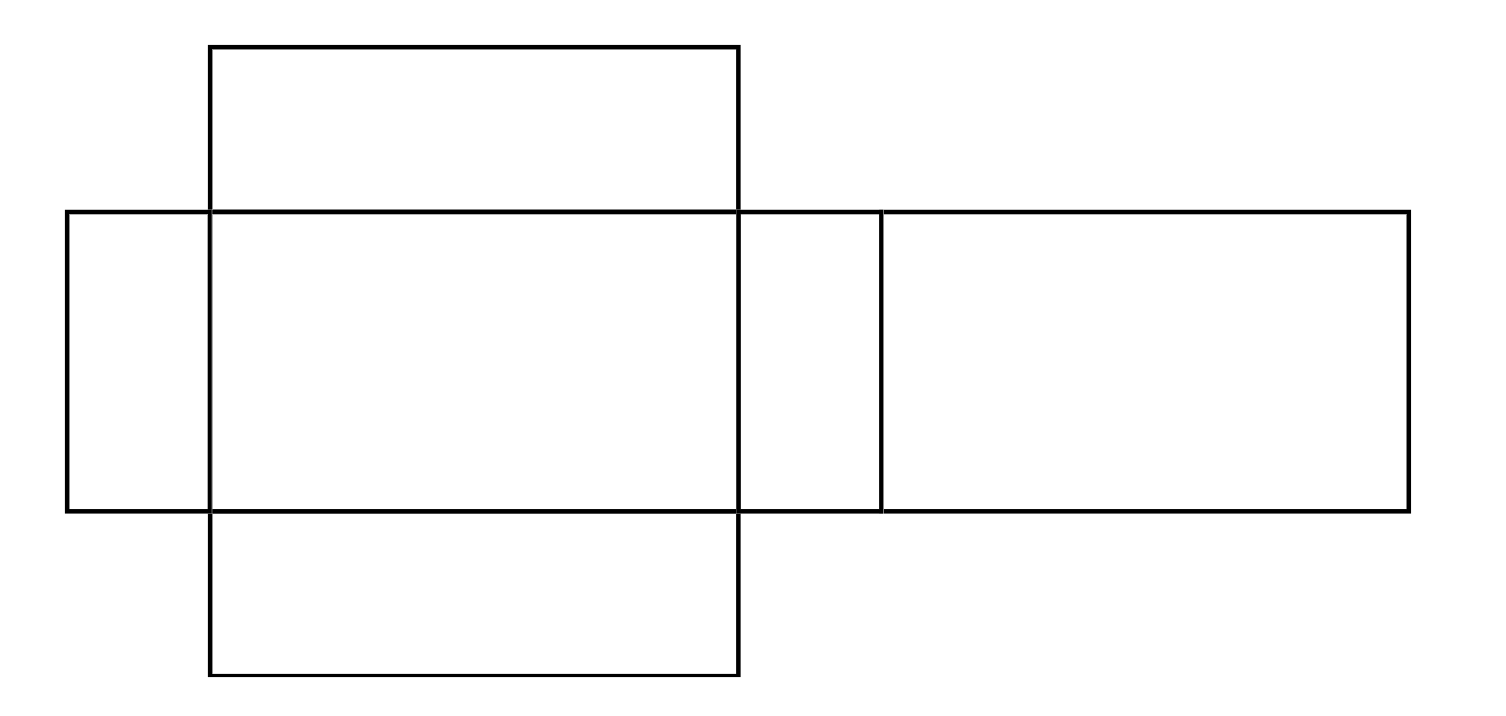
Short response (6)
Name the shape this net would create.
Notes:
Short response questions provide brisk paced questions focussing on review of current and previous content to support spaced and interleaved practice.
Syllabus focus area:
Three-dimensional spatial structure A

Slide 15
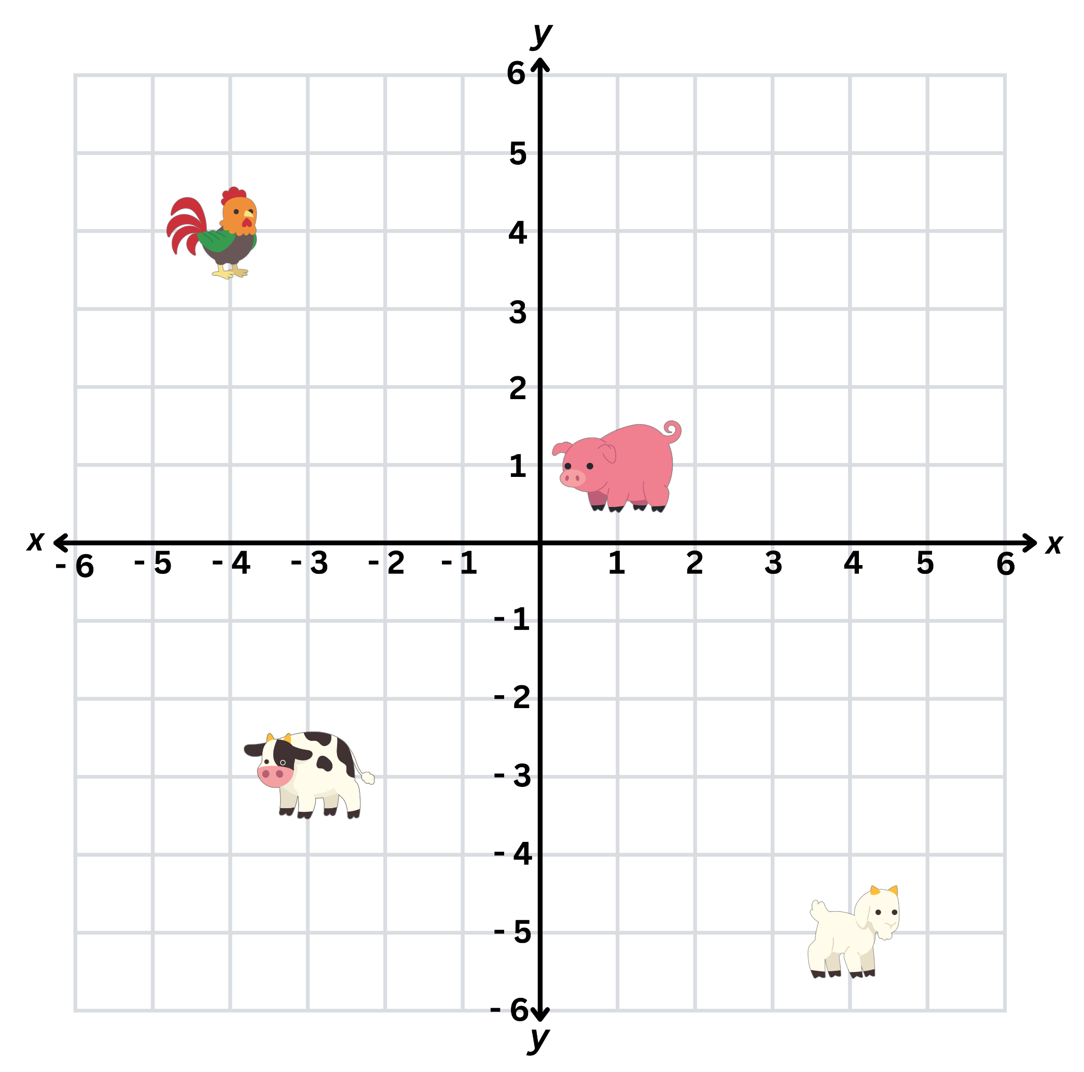
Short response (7)
Record the coordinates of each animal on the Cartesian plane.
rooster
pig
cow
goat
Notes:
Short response questions provide brisk paced questions focussing on review of current and previous content to support spaced and interleaved practice.
Syllabus focus area:
Geometric measure B

Slide 16
Short response (8)
Convert between kilograms and tonnes:
2.75 t
0.25 t
5250 kg
Notes:
Short response questions provide brisk paced questions focussing on review of current and previous content to support spaced and interleaved practice.
Syllabus focus area:
Non-spatial measure B

Slide 17
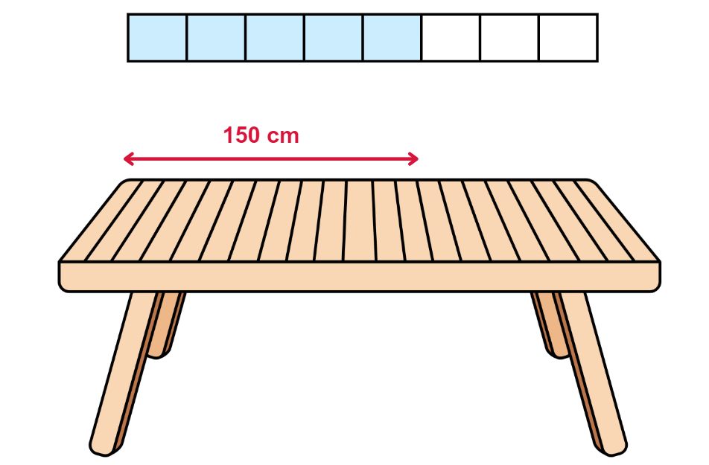
Activity 2 – build the whole 2
Notes:
This is a developing number sense activity.
Number sense refers to a deep understanding of numbers, including their magnitude, relationships, and the effects of operations on them. It supports fluency and understanding, estimation, flexible thinking, and efficient problem-solving. Number sense activities 1–4 ‘activate’ prior number knowledge and support the learning of new content in the unit. Number sense activities 5–8 ‘loop’ back and provide opportunity for spaced practice with concepts and procedures covered in previous units.
Syllabus focus area:
Representing quantity fractions B
Build the whole 2
Remind students that, if a fraction of a total is known, it can be used to find the total amount.
Explain that you have seen a new outdoor table setting that you want to get but you are not sure if it will fit in your outdoor area. You know that five-eighths of the table is 150 cm. Ask how long the whole table is.
Ask students how they could find the total length of a table if they know five-eighths of the length.
Allow time for students to think and then turn and talk to discuss how they could find the total length.
Select students to share and explain their strategy. Record and test student responses.
Tell students that there is another table setting you like, but five-eighths of the table is 160 cm. Ask what the total length of this table would be.
Select students to share their findings and explain their strategy. Record and test student responses.
The table below outlines stimulus prompts to generate conversation about the topic, along with anticipated responses from students.
Prompt
How can you find the total length of the table if five-eighths of the table is 160 cm?
Anticipated student responses
We would find out how long one-eighth of the table is first, then build it up to have all 8 of those amounts for the total length.
160 cm divided by 5 equals 32 cm.
One-eighth is 32 cm long, so the total length of the table is 256 cm long.
256 cm is the same as 2 metres and 56 centimetres, or 2.56 m.

Slide 18
Review of learning 3

Slide 19
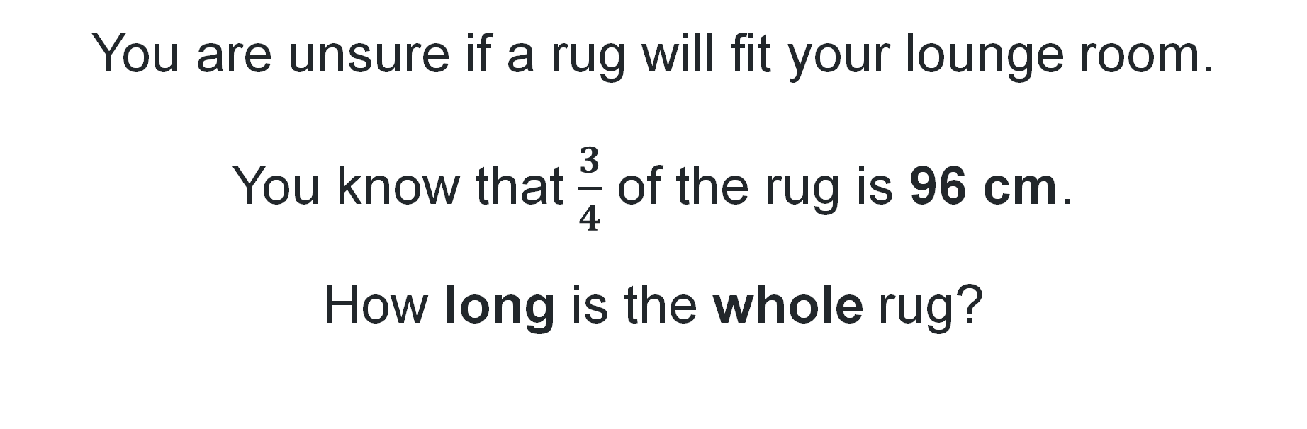
Multiple choice (2)
You are unsure if a rug will fit your lounge room.
You know that $\frac{3}{4}$ of the rug is 96 cm.
How long is the whole rug?
A
B
C
D
128 cm
384 cm
72 cm
32 cm
Notes:
This question connects to the content in the developing number sense activity (Activity 3)
Syllabus focus area:
Representing quantity fractions B

Slide 20
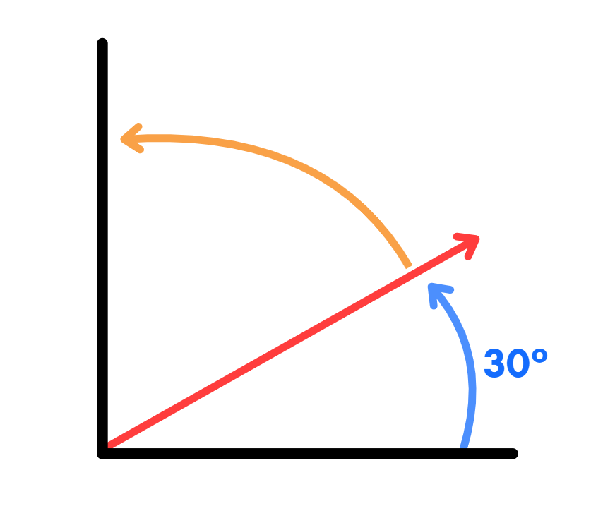
Short response (9)
Record the size of the orange angle.
Communicate your reasoning.
Notes:
Short response questions provide brisk paced questions focussing on review of current and previous content to support spaced and interleaved practice.
Syllabus focus area:
Geometric measure B

Slide 21

Short response (10)
Draw the top, front and side view of this 3D object.
Top
Front
Side
Notes:
Short response questions provide brisk paced questions focussing on review of current and previous content to support spaced and interleaved practice.
Syllabus focus area:
Three-dimensional spatial structure A

Slide 22
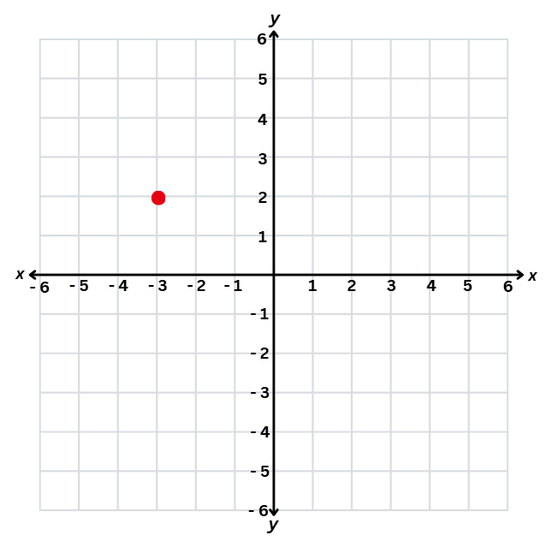
Short response (11)
Describe the changes to coordinates when a point is reflected across an axis.
Notes:
Short response questions provide brisk paced questions focussing on review of current and previous content to support spaced and interleaved practice.
Syllabus focus area:
Geometric measure B

Slide 23
Short response (12)
Describe the arrangement of cubic-centimetre blocks in terms of layers.
Notes:
Short response questions provide brisk paced questions focussing on review of current and previous content to support spaced and interleaved practice.
Syllabus focus area:
Three-dimensional spatial structure B

Slide 24
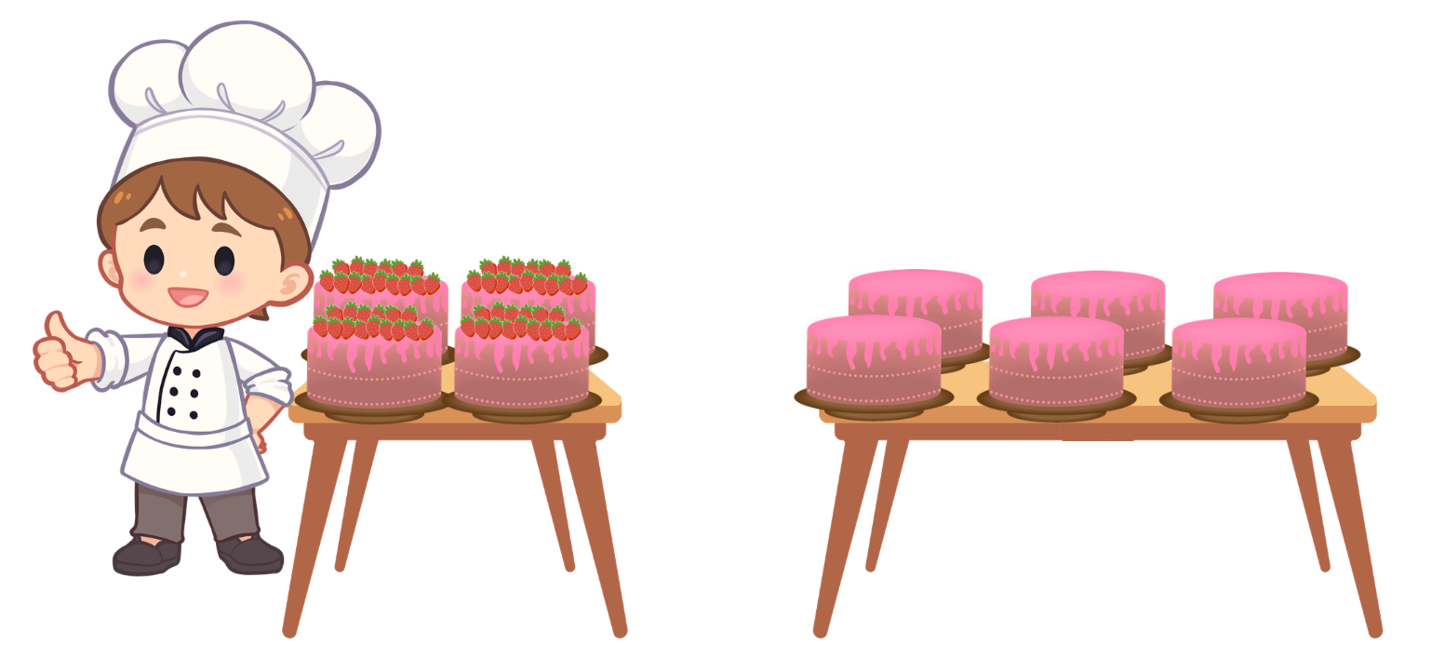
Activity 3 – given fraction parts
Notes:
This is a developing number sense activity.
Number sense refers to a deep understanding of numbers, including their magnitude, relationships, and the effects of operations on them. It supports fluency and understanding, estimation, flexible thinking, and efficient problem-solving. Number sense activities 1–4 ‘activate’ prior number knowledge and support the learning of new content in the unit. Number sense activities 5–8 ‘loop’ back and provide opportunity for spaced practice with concepts and procedures covered in previous units.
Syllabus focus area:
Representing quantity fractions B
Given fraction parts
Remind students that, if a fraction of a total is known, it can be used to find the total amount.
Explain that a pastry chef is decorating 10 cakes with strawberries. So far, he has decorated 4 cakes and has already used 60 strawberries. Each cake needs the same number of decorations. The pastry chef wants to know the number of strawberries he will need for all 10 cakes.
Ask students, how they could find the total number of objects if they were given four-tenths of a collection.
Allow time for students to think and turn and talk to discuss how they could find the total number.
Select students to share and explain their strategy. Record and test student responses.

Slide 25
Review of learning 4

Slide 26
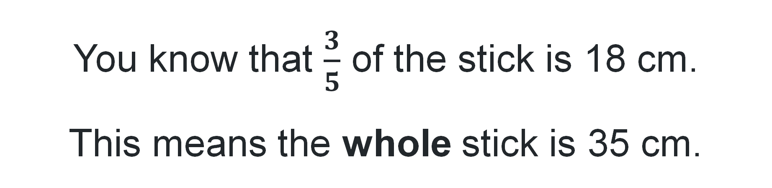
True or false (2)
You know that $\frac{3}{5}$ of the stick is 18 cm.
This means the whole stick is 35 cm.
True | False
Notes:
The question on this slide connects to the content being explored in the developing number sense activity (Activity 4)
Syllabus focus area:
Representing quantity fractions B

Slide 27
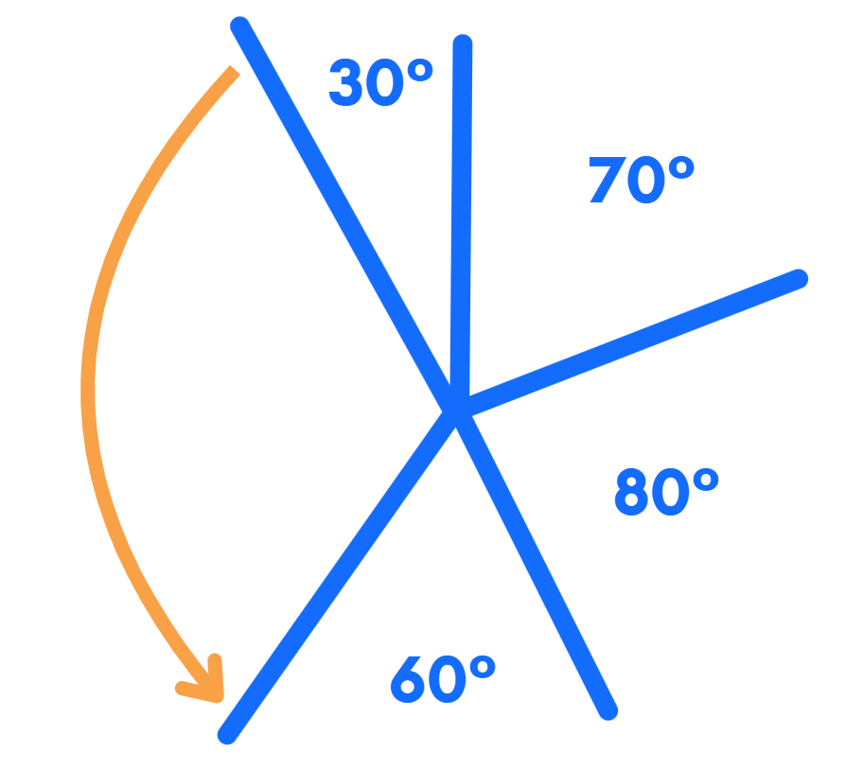
Short response (13)
Record the size of the orange angle.
Communicate your reasoning.
Notes:
Short response questions provide brisk paced questions focussing on review of current and previous content to support spaced and interleaved practice.
Syllabus focus area:
Geometric measure B

Slide 28
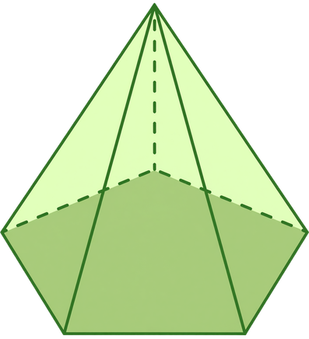
Short response (14)
Name the type of pyramid.
Notes:
Short response questions provide brisk paced questions focussing on review of current and previous content to support spaced and interleaved practice.
Syllabus focus area:
Three-dimensional spatial structure A

Slide 29
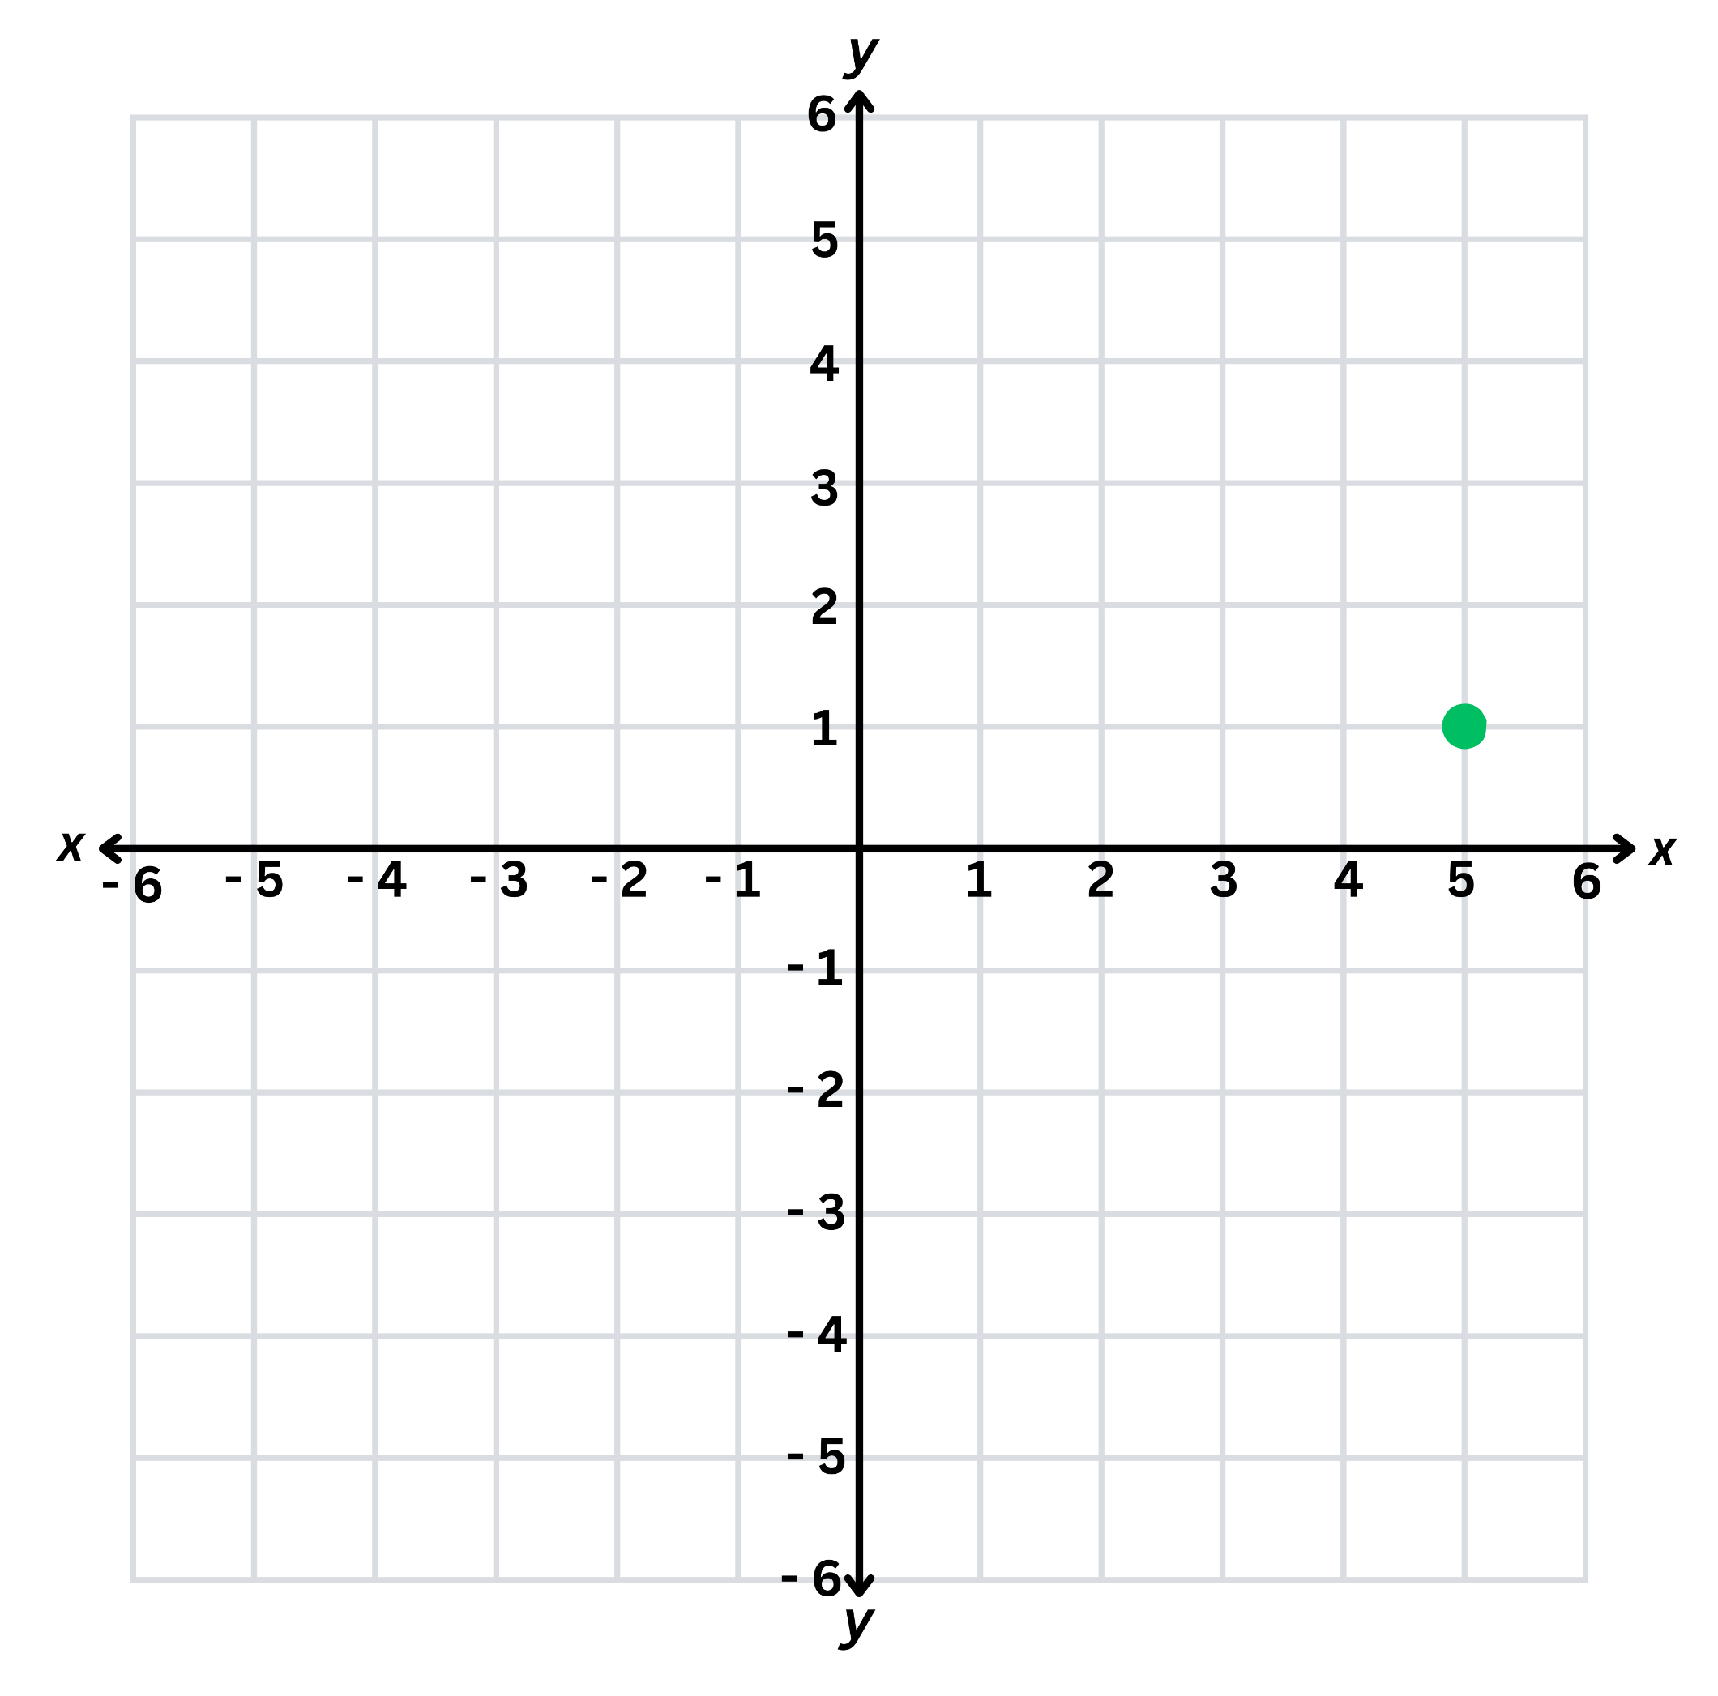
Short response (15)
Describe the changes to coordinates when this point is translated across an axis.
Notes:
Short response questions provide brisk paced questions focussing on review of current and previous content to support spaced and interleaved practice.
Syllabus focus area:
Geometric measure B

Slide 30
Short response (16)
A rectangular prism is built using 1 cm cubes. One layer has 12 cubes.
The prism has 5 layers.
What is the volume of the prism?
Notes:
Short response questions provide brisk paced questions focussing on review of current and previous content to support spaced and interleaved practice.
Syllabus focus area:
Three-dimensional spatial structure B

Slide 31

Activity 4 – fraction word problem
Notes:
This is a developing number sense activity.
Number sense refers to a deep understanding of numbers, including their magnitude, relationships, and the effects of operations on them. It supports fluency and understanding, estimation, flexible thinking, and efficient problem-solving. Number sense activities 1–4 ‘activate’ prior number knowledge and support the learning of new content in the unit. Number sense activities 5–8 ‘loop’ back and provide opportunity for spaced practice with concepts and procedures covered in previous units.
Syllabus focus area:
Representing quantity fractions B
Fraction word problem
Revise the idea that if a fraction of a total is known, it can be used to find the total amount.
Pose the question: Jessica ordered 72 balloons for her birthday party. Three-eighths were delivered.
How many balloons were delivered?
How many balloons still needed to be delivered?
Students solve the problem in their workbooks.
Select students to share and explain their strategy.

Slide 32
Review of learning 5

Slide 33
Multiple choice (3)
Which strategy is most efficient to calculate:
398 + 276
A
Add 398 + 200, then +70, then +6
B
Round 398 to 400, add 276, then subtract 2
C
Use repeated addition of 10
D
Write the numbers in words and estimate
Notes:
This question connects to the content in the developing number sense activity (Activity 3)
Syllabus focus area:
Additive relations B

Slide 34
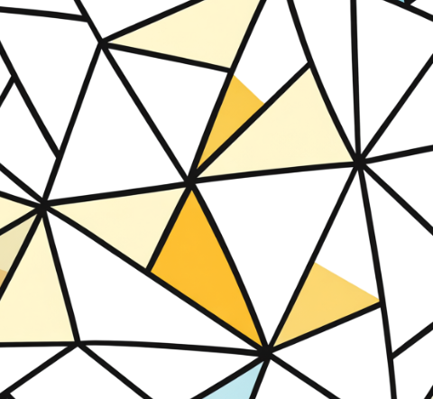
Short response (17)
What is the total of the angles at a point in this diagram?
Communicate your reasoning.
Notes:
Short response questions provide brisk paced questions focussing on review of current and previous content to support spaced and interleaved practice.
Syllabus focus area:
Geometric measure B

Slide 35
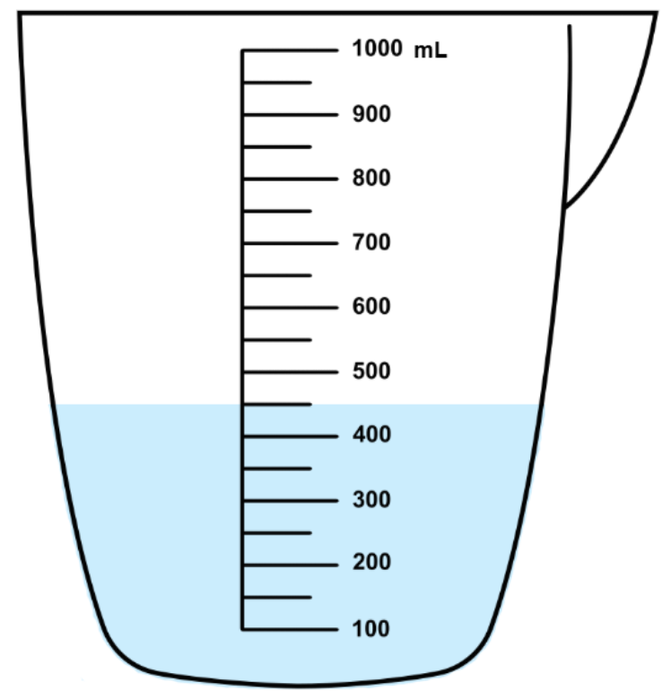
Short response (18)
Record this measurement using millilitres (mL) and litres (L).
Notes:
Short response questions provide brisk paced questions focussing on review of current and previous content to support spaced and interleaved practice.
Syllabus focus area:
Three-dimensional spatial structure A

Slide 36

Short response (19)
In a chance experiment, which number is most likely to be rolled?
Communicate your reasoning.
Notes:
Short response questions provide brisk paced questions focussing on review of current and previous content to support spaced and interleaved practice.
Syllabus focus area:
Chance A

Slide 37

Short response (20)
Draw this shape including the dot after it has been:
translated
reflected
rotated.
Notes:
Short response questions provide brisk paced questions focussing on review of current and previous content to support spaced and interleaved practice.
Syllabus focus area:
Two-dimensional spatial structure B

Slide 38
Activity 5 – strategies for solving addition problems
52 + 79 + 135
162 + 258 + 575
807 + 648 + 1649
Choose one of these number sentences and represent it by completing the four tasks below:
  Estimate a reasonable answer without calculating the exact amount.
  Write a number story using the amounts.
  Solve the problem using your preferred solution method.
  Use a number line to check the accuracy of your solution.
Notes:
This is a developing number sense activity.
Number sense refers to a deep understanding of numbers, including their magnitude, relationships, and the effects of operations on them. It supports fluency and understanding, estimation, flexible thinking, and efficient problem-solving. Number sense activities 1–4 ‘activate’ prior number knowledge and support the learning of new content in the unit. Number sense activities 5–8 ‘loop’ back and provide opportunity for spaced practice with concepts and procedures covered in previous units.
Syllabus focus area:
Additive relations B
Strategies for solving addition problems
This resource corresponds to Resource 20 – addition problems in Stage 3 Year B Unit 30.
This activity is an adaptation of 3–6: Remote Maths – Edition 2 [PDF 417 KB] from MAV Learning Activities by The Mathematical Association of Victoria (2020).
Discuss the various ways addition problems can be represented and solved.
Display Resource 20 – addition problems and explain that students will choose one of the equations from the table and then use it to complete each of the 4 tasks.
Students choose another student who completed the same equation to compare representations and solutions.

Slide 39
Review of learning 6

Slide 40
True or false (3)
A school collected 485 cans on Monday and 376 cans on Tuesday. They donated 214 cans to a food bank.
To find how many cans are left, you calculate 485 + 376 − 214.
True | False
Notes:
The question on this slide connects to the content being explored in the developing number sense activity (Activity 6)
Syllabus focus area:
Additive relations B

Slide 41
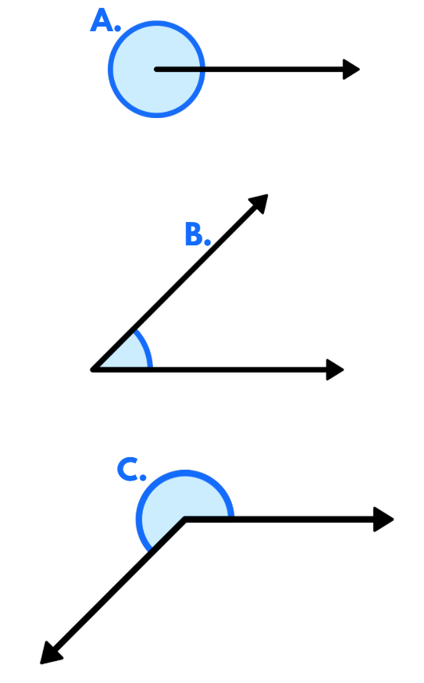
Short response (21)
Name each type of angle and give a possible range of degrees for each.
Notes:
Short response questions provide brisk paced questions focussing on review of current and previous content to support spaced and interleaved practice.
Syllabus focus area:
Geometric measure A

Slide 42
Short response (22)
Record these capacities in another way. How can these capacities be recorded… what is another way you can record these capacities.
1.5 L
0.75 L
1250 mL
Notes:
Short response questions provide brisk paced questions focussing on review of current and previous content to support spaced and interleaved practice.
Syllabus focus area:
Three-dimensional spatial structure A

Slide 43




Short response (23)
Eight balls are placed in a bag. One ball is selected from the bag.
Record the probability of each outcome using a fraction.
Notes:
Short response questions provide brisk paced questions focussing on review of current and previous content to support spaced and interleaved practice.
Syllabus focus area:
Chance B

Slide 44
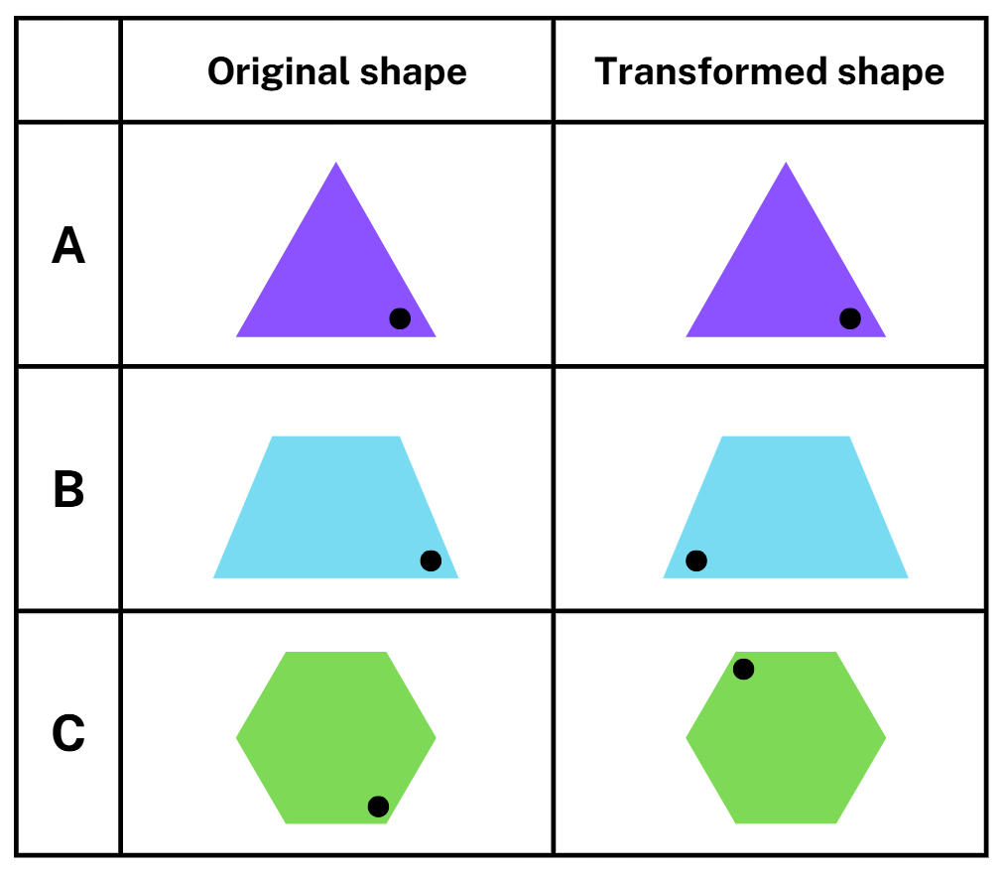
Short response (24)
Match each transformation to the correct term.
translate
reflect
rotate
Notes:
Short response questions provide brisk paced questions focussing on review of current and previous content to support spaced and interleaved practice.
Syllabus focus area:
Two-dimensional spatial structure B

Slide 45
Activity 6 – addition and subtraction problems that require more than one operation
Word problems | Working out
Year 6 donated 123 cans of food to the food drive. Year 5 donated 53 more cans of food than Year 6. Year 4 donated 23 less cans than year 6. How many cans did they donate altogether?
Rod wanted to be a photographer. He took 237 photos of nature and 369 of buildings. He added 419 to his portfolio. How many did he not add to his portfolio?
Carolyn has 216 points in darts. On her next throw she scores 180. How many more points does she need to reach 500 points?
Notes:
This is a developing number sense activity.
Number sense refers to a deep understanding of numbers, including their magnitude, relationships, and the effects of operations on them. It supports fluency and understanding, estimation, flexible thinking, and efficient problem-solving. Number sense activities 1–4 ‘activate’ prior number knowledge and support the learning of new content in the unit. Number sense activities 5–8 ‘loop’ back and provide opportunity for spaced practice with concepts and procedures covered in previous units.
Syllabus focus area:
Additive relations B
Addition and subtraction problems that require more than one operation
This resource corresponds to Resource 21 – word problems in Stage 3 Year B Unit 30.
Provide students with Resource 21 – word problems and their workbook.
Students solve the problems on Resource 21 – word problems using an efficient strategy.
Select students to share and explain their strategy and answers.
Discuss strategies chosen as a class.

Slide 46
Review of learning 7

Slide 47
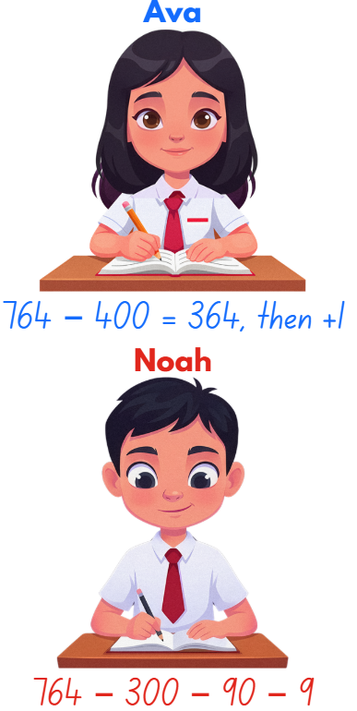
Multiple choice (4)
To solve 764 – 399, two students used different strategies. Which statement is correct?
A
Ava's strategy is more efficient
B
Noah's strategy is more efficient
C
Both strategies are equally efficient
D
Neither strategy will work
Notes:
This question connects to the content in the developing number sense activity (Activity 3)
Syllabus focus area:
[Focus area A/B]

Slide 48
Short response (25)
The train left the station at 6:45 am and arrived at the next station at 7:30 am.
Use a bridging strategy mentally to calculate the elapsed time.
Record your calculation on an empty number line.
Notes:
Short response questions provide brisk paced questions focussing on review of current and previous content to support spaced and interleaved practice.
Syllabus focus area:
Non-spatial measure B

Slide 49

Short response (26)
Record 2125 millilitres using litres.
Notes:
Short response questions provide brisk paced questions focussing on review of current and previous content to support spaced and interleaved practice.
Syllabus focus area:
Three-dimensional spatial structure A

Slide 50
Short response (27)
Taj is designing a game using a bag with 8 counters:
2 red, 1 blue, 3 orange and 2 purple. A player draws one counter at random.
Record all possible outcomes and assign a fraction to show the probability of drawing each colour.
Which outcomes are not equally likely? Communicate your reasoning.
Notes:
Short response questions provide brisk paced questions focussing on review of current and previous content to support spaced and interleaved practice.
Syllabus focus area:
Chance B

Slide 51
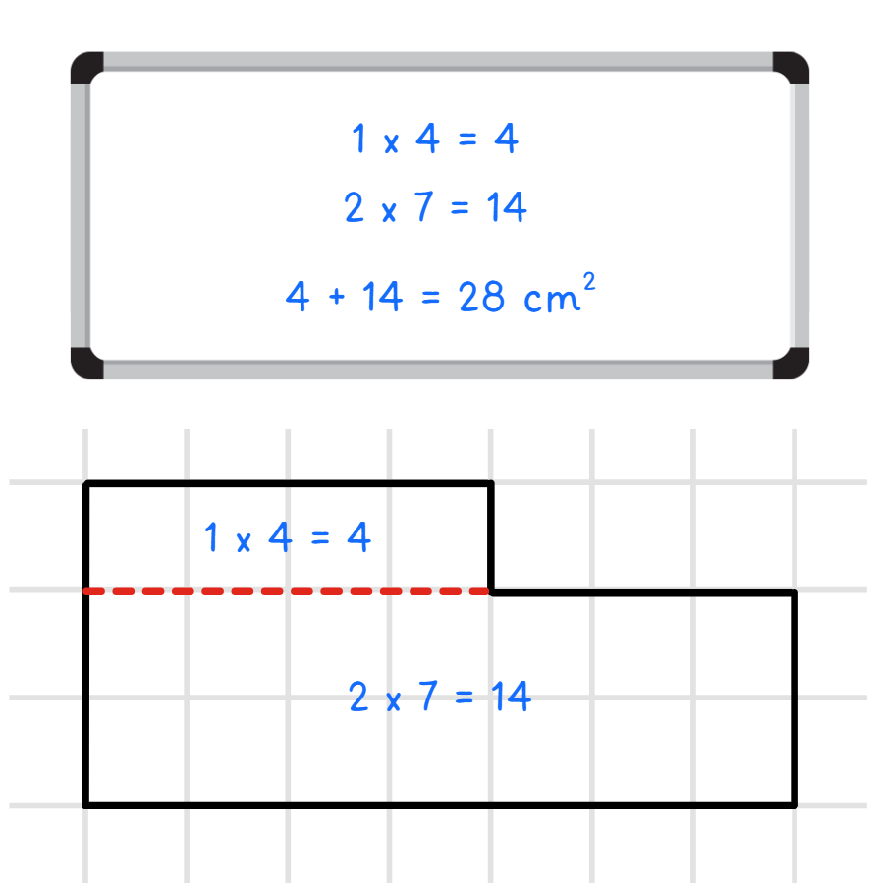
Short response (28)
Record a different way to calculate the area of this composite L-shape figure.
Notes:
Short response questions provide brisk paced questions focussing on review of current and previous content to support spaced and interleaved practice.
Syllabus focus area:
Two-dimensional spatial structure B

Slide 52
Activity 7 – compare, evaluate and communicate addition and subtraction strategies
3 | 27
123 | 31
Notes:
This is a developing number sense activity.
Number sense refers to a deep understanding of numbers, including their magnitude, relationships, and the effects of operations on them. It supports fluency and understanding, estimation, flexible thinking, and efficient problem-solving. Number sense activities 1–4 ‘activate’ prior number knowledge and support the learning of new content in the unit. Number sense activities 5–8 ‘loop’ back and provide opportunity for spaced practice with concepts and procedures covered in previous units.
Syllabus focus area:
Additive relations B
Compare, evaluate and communicate addition and subtraction strategies
Draw a 4-box grid on the board and write the numbers 3, 27, 123 and 31 in one box each.
In pairs, students must decide which number doesn’t belong using addition or subtraction and explain their mathematical thinking. For example, the number 31 is the only number that is not divisible by 3.
Students record their ideas on a whiteboard.
Challenge students who finish quickly to make a case for why each of the numbers does not belong.
When all pairs have a solution, students report back to the class, explaining which number they decided didn’t belong and why.

Slide 53
Review of learning 8

Slide 54
True or false (4)
A theatre sold 468 tickets on Friday and 395 tickets on Saturday. The theatre holds 1000 people.
To find how many seats are left, you calculate 468 + 395 − 1000.
True | False
Notes:
The question on this slide connects to the content being explored in the developing number sense activity (Activity 8)
Syllabus focus area:
Additive relations B

Slide 55
Short response (29)
The movie started at 18:20 and finished at 20:45.
Use a bridging strategy mentally to calculate the elapsed time.
Record your calculation on an empty number line.
Notes:
Short response questions provide brisk paced questions focussing on review of current and previous content to support spaced and interleaved practice.
Syllabus focus area:
Non-spatial measure B

Slide 56
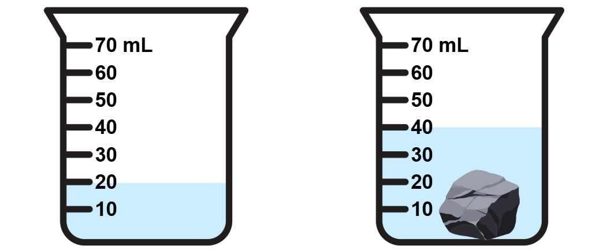
Short response (30)
Record what happened to the water level when the rock was added to the container.
Notes:
Short response questions provide brisk paced questions focussing on review of current and previous content to support spaced and interleaved practice.
Syllabus focus area:
Three-dimensional spatial structure A

Slide 57
Short response (31)
A jar contains red and blue lollies.
You take a sample of 10 lollies, record the colour, and return them each time.
Your sample results were:
Red, Blue, Red, Red, Blue, Red, Red, Blue, Red, Red
Which colour lolly is likely to make up most of the jar? Communicate your reasoning.
Notes:
Short response questions provide brisk paced questions focussing on review of current and previous content to support spaced and interleaved practice.
Syllabus focus area:
Chance B

Slide 58
Short response (32)
A.
Identify which shape is:
a regular polygon
an irregular polygon
not a polygon.
B.
C.
Notes:
Short response questions provide brisk paced questions focussing on review of current and previous content to support spaced and interleaved practice.
Syllabus focus area:
Two-dimensional spatial structure A

Slide 59
Activity 8 – multi-step problems
A library had 2,475 books at the start of the year. In March, they bought 385 new books, and in June, they received a donation of 642 more books. During Term 4, 1,128 books were borrowed, but 1,056 were returned by the end of the term.
How many books are in the library now?
Notes:
This is a developing number sense activity.
Number sense refers to a deep understanding of numbers, including their magnitude, relationships, and the effects of operations on them. It supports fluency and understanding, estimation, flexible thinking, and efficient problem-solving. Number sense activities 1–4 ‘activate’ prior number knowledge and support the learning of new content in the unit. Number sense activities 5–8 ‘loop’ back and provide opportunity for spaced practice with concepts and procedures covered in previous units.
Syllabus focus area:
Additive relations B
Multi-step problems
Display the question: A library had 2,475 books at the start of the year. In March, they bought 385 new books, and in June, they received a donation of 642 more books. During Term 4, 1,128 books were borrowed, but 1,056 were returned by the end of the term. How many books are in the library now?
On whiteboards, students solve the problem using an efficient strategy.
Ask:
What steps and operations had to be taken to solve the problem?
What strategies were used to solve the problem?
Were these the most efficient? Why or why not?

Slide 60
Double Venn diagram
Object 1
Object 2
Features similar to both objects
Features of object 1
Features of object 2

Slide 61
Frayer
Definition
Facts/Characteristics
Word, term, concept
Examples
Non-examples

Slide 62
Spider map
Idea
Subject

Slide 63
Cline
Concept 1
Concept 2
Word
Word
Word
Word
Word
Word
Word
Word
Word
Word
Word

Slide 64

Compare and contrast

Slide 65
Multiple choice (5)
A
B
C
D

Slide 66
Multiple choice
A
B
C
D
Notes:
This question connects to the content in the developing number sense activity (Activity 3)
Syllabus focus area:
[Focus area A/B]

Slide 67
References (1)
This presentation contains NSW Curriculum and syllabus content. The NSW Curriculum is developed by the NSW Education Standards Authority. This content is prepared by NESA for and on behalf of the Crown in the right of the State of New South Wales. The material is protected by Crown copyright.
Please refer to the NESA Copyright Disclaimer for more information https://educationstandards.nsw.edu.au/wps/portal/nesa/mini-footer/copyright.
NESA holds the only official and up-to-date versions of the NSW Curriculum and syllabus documents. Please visit the NSW Education Standards Authority (NESA) website https://educationstandards.nsw.edu.au/wps/portal/nesa/home and the NSW Curriculum website https://curriculum.nsw.edu.au.
Mathematics K–10 Syllabus © Syllabus NSW Education Standards Authority (NESA) for and on behalf of the Crown in right of the State of New South Wales, 2022.
National Numeracy Learning Progression © Australian Curriculum, Assessment and Reporting Authority (ACARA) 2010 to present, unless otherwise indicated. This material was downloaded from the Australian Curriculum website (National Numeracy Learning Progression) (accessed 04 November 2026) and was not modified.
Australian Government Department of Education 2023 (2020) 'Lesson 1: How Many Right Angles', Teaching resources, reSolve website, accessed 04 March 2026.
State of New South Wales (Department of Education) (2023) ‘Let’s get magical (3-digit addition and subtraction)’, Mathematics K–6 resources, NSW Department of Education website, accessed 04 March 2026.
State of Victoria (Department of Education and Training) (n.d) ‘Measure, calculate and compare elapsed time’, Arc website, accessed 04 March 2026.
The Mathematical Association of Victoria (2020) 3–6: Remote Maths – Edition 2 [PDF 417 KB], MAV Learning Activities website, accessed 04 March 2026.
University of Cambridge (n.d.) Buses, NRICH website, accessed 04 March 2026.

Slide 68
References (2)
This presentation contains NSW Curriculum and syllabus content. The NSW Curriculum is developed by the NSW Education Standards Authority. This content is prepared by NESA for and on behalf of the Crown in the right of the State of New South Wales. The material is protected by Crown copyright.
Please refer to the NESA Copyright Disclaimer for more information https://educationstandards.nsw.edu.au/wps/portal/nesa/mini-footer/copyright.
NESA holds the only official and up-to-date versions of the NSW Curriculum and syllabus documents. Please visit the NSW Education Standards Authority (NESA) website https://educationstandards.nsw.edu.au/wps/portal/nesa/home and the NSW Curriculum website https://curriculum.nsw.edu.au.
Further reading
Siemon D, Warren E, Beswick K, Faragher R, Miller J, Horne Marj, Jazby D, Breed M, Clark J, Brady K (2022) Teaching Mathematics: Foundation to Middle Years, 3rd edn Oxford University Press, Australia.
Van de Walle J, Karp K, Bay-Williams JM, Brass A, Bentley B, Ferguson S, Goff W, Livy S, Marshman M, Martin D, Pearn C, Prodromou T, Symons D and Wilkie K (2019) Primary and Middle Years Mathematics: Teaching Developmentally, 1st Australian edn, Pearson Education Australia, Melbourne.
Note: the State of Victoria Department of Education and Training website FUSE will redirect to their new platform, ARC Learning, from Term 1 2024. Information about the transition can be found here.

Slide 69
Copyright
© State of New South Wales (Department of Education), 2025
The copyright material published in this resource is subject to the Copyright Act 1968 (Cth) and is owned by the NSW Department of Education or, where indicated, by a party other than the NSW Department of Education (third-party material).
Copyright material available in this resource and owned by the NSW Department of Education is licensed under a Creative Commons Attribution 4.0 International (CC BY 4.0) license.
This license allows you to share and adapt the material for any purpose, even commercially.
Attribution should be given to © State of New South Wales (Department of Education), 2025.
Material in this resource not available under a Creative Commons license:
the NSW Department of Education logo, other logos and trademark-protected material
Material owned by a third party that has been reproduced with permission. You will need to obtain permission from the third party to reuse its material.
Links to third-party material and websites
Please note that the provided (reading/viewing material/list/links/texts) are a suggestion only and implies no endorsement, by the New South Wales Department of Education, of any author, publisher, or book title. School principals and teachers are best placed to assess the suitability of resources that would complement the curriculum and reflect the needs and interests of their students.
If you use the links provided in this document to access a third party’s website, you acknowledge that the terms of use, including licence terms set out on the third-party’s website apply to the use which may be made of the materials on that third-party website or where permitted by the Copyright Act 1968 (Cth). The department accepts no responsibility for content on third-party websites.

