Slide 1
Instructions for use
This resource aligns to the learning in Stage 2 Year B Unit 37 and revisits content from earlier sample units.
Classroom teachers are encouraged to add, edit and adapt to meet the needs of their students.
Save a copy of the file to make changes to the slide deck. Go to File > Download a Copy (this downloads a copy to the computer to edit in the PowerPoint app).
To convert the PowerPoint to Google Slides:
  Upload the file into Google Drive and open it.
  Go to File > Save as Google Slides.
  (Note – conversion may cause formatting changes in the slides.)

Slide 2
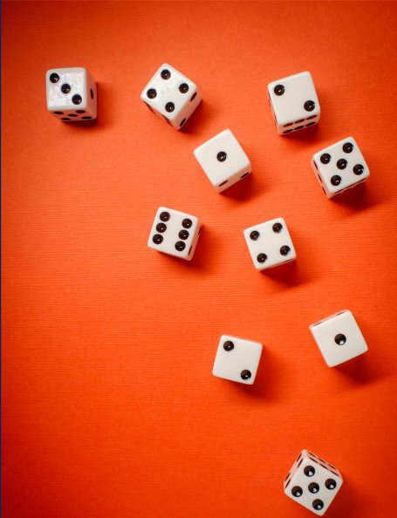
Review of Learning
Mathematics Stage 2 – Unit 37
Notes:
Reviews may include a combination of question types, requiring students to recall facts and key ideas, as well as apply their knowledge to solve problems and answer questions. To support active engagement, a mix of techniques should be employed.” (AERO, 2024).
This Review of Learning slide deck revisits key concepts from the following units:
Stage 2 Year B Unit 37
Stage 2 Year B Unit 36
Stage 2 Year B Unit 35
It also includes opportunities to review prior learning in non-number content, supporting consolidation across focus areas.
The review of learning resources include three key task types that support the development of mathematical proficiency through retrieval, spaced practice, and active participation. These practices complement the review phase (activating prior knowledge) embedded within the beginning of each lesson.
1.
Multiple-choice questions/True or false: Designed to promote active retrieval of key concepts and identify common misconceptions in number, supporting consolidation, understanding and fluency.
These questions:
support spaced and interleaved practice
help identify and address common misconceptions
support active recall and immediate feedback
support whole class participation
identify areas requiring reteach
2.
Short-response question sets: Carefully grouped questions that encourage spaced and interleaved practice across multiple focus areas, helping students revisit and apply knowledge from different points in time.
These questions:
have a combination of question types
address a range of focus areas
build automaticity and fluency
support active recall
allow for immediate feedback
identify content requiring reteach
3.
Developing number sense activities: A variety of practical, purposeful tasks that reinforce current learning and build on prior knowledge. These activities promote reasoning, problem-solving and conceptual understanding.
The review of learning resources are designed to work support teaching and learning in mathematics. For the most effective implementation, use the resources flexibly, adapting to meet student learning needs and individual classroom contexts.

Slide 3
Lessons
1
Review of learning 1
5
Review of learning 5
2
Review of learning 2
6
Review of learning 6
3
Review of learning 3
7
Review of learning 7
4
Review of learning 4
8
Review of learning 8
Notes:
Teacher notes:
Click lesson numbers to go to specific lessons
Interactive features can be viewed in slide show

Slide 4
Review of learning 1

Slide 5

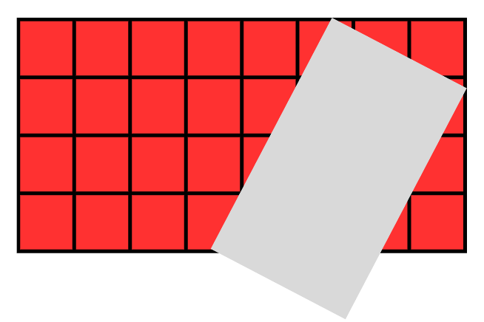
Multiple choice (1)
Part of this grid has been covered.
What is the total of the grid?
A | B | C | D
28 | 32 | 24 | 40
Notes:
This question connects to the content in the developing number sense activity (Activity 1)
Syllabus focus area:
Multiplicative relations B

Slide 6

Short response (1)
If 3 threes are 9,
what is 3 sixes?
Communicate your reasoning.
Notes:
Short response questions provide brisk paced questions focussing on review of current and previous content to support spaced and interleaved practice.
Syllabus focus area:
Multiplicative relations B

Slide 7
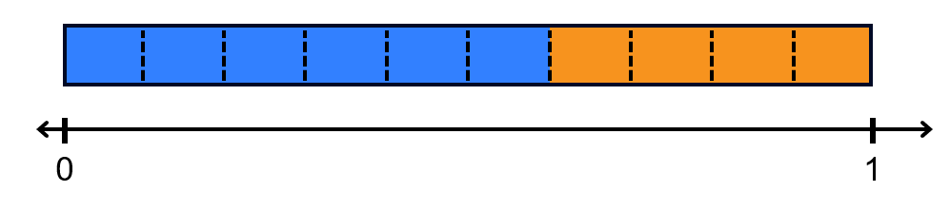
Short response (2)
How many tenths are shaded blue?
Record this as a decimal.
Notes:
Short response questions provide brisk paced questions focussing on review of current and previous content to support spaced and interleaved practice.
Syllabus focus area:
Representing numbers using place value B

Slide 8
Short response (3)
Use bridging the decades to mentally solve 137 + 28
Explain your thinking.
Notes:
Short response questions provide brisk paced questions focussing on review of current and previous content to support spaced and interleaved practice.
Syllabus focus area:
Additive relations A

Slide 9
Short response (4)
Class 4W wanted to know what is their class’s favourite lunch. They created this question:
What lunch are you having today?
The first student they asked said ‘I have a vegemite sandwich. Yuck!’
How could they refine their question to better find out the class’s favourite lunch?
Notes:
Short response questions provide brisk paced questions focussing on review of current and previous content to support spaced and interleaved practice.
Syllabus focus area:
Data B

Slide 10


Activity 1 – How many tiles?
How many tiles would
there be if this was
a complete grid?
Notes:
This is a developing number sense activity.
Number sense refers to a deep understanding of numbers, including their magnitude, relationships, and the effects of operations on them. It supports fluency and understanding, estimation, flexible thinking, and efficient problem-solving. Number sense activities 1–4 ‘activate’ prior number knowledge and support the learning of new content in the unit. Number sense activities 5–8 ‘loop’ back and provide opportunity for spaced practice with concepts and procedures covered in previous units.
Syllabus focus area:
Multiplicative relations B
This resource corresponds to Resource 22 – How many tiles? in Stage 2 Year B Unit 37
This activity is an adaptation of Partial Arrays from AAMT by The Australian Association of Mathematics Teachers (AAMT) Inc.
Ask the following questions:
How many tiles can you see?
How many tiles would there be if this was a complete grid? How do you know?
What multiplication and division facts are represented by this grid?
What would it look like if the complete grid was doubled?
How many tiles would there be then?
With a partner, students create their own partial arrays or grids on an individual whiteboard. Students ask their partner to determine how many tiles they would need if it was complete.

Slide 11
Review of learning 2

Slide 12
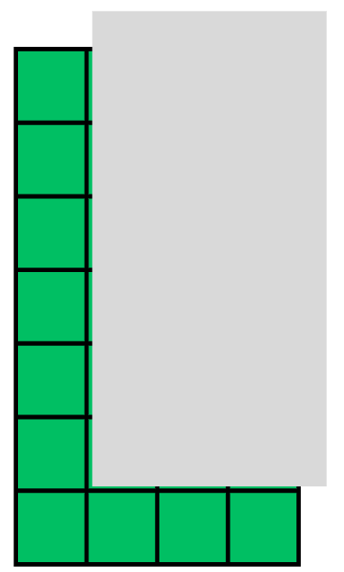
True or false (1)
In this partially covered grid, 18 squares are covered.
True | False
Notes:
The question on this slide connects to the content being explored in the developing number sense activity (Activity 2)
Syllabus focus area:
Multiplicative relations B

Slide 13
Short response (5)
Each lunch order costs $9.
How can we work out the total
cost for 4 students?
Notes:
Short response questions provide brisk paced questions focussing on review of current and previous content to support spaced and interleaved practice.
Syllabus focus area:
Multiplicative relations B

Slide 14
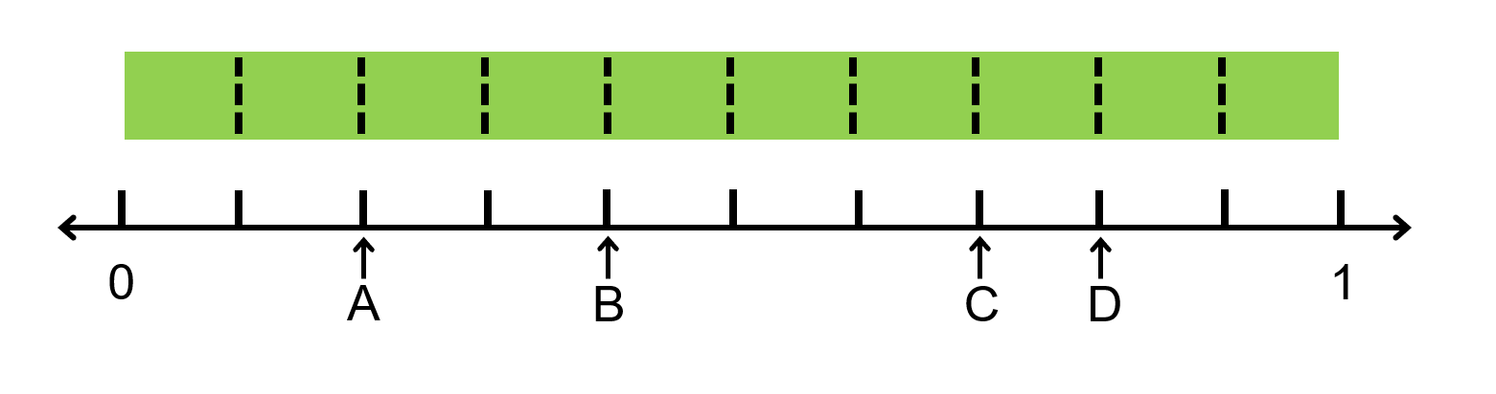
Short response (6)
Record the decimals marked A, B, C and D.
Notes:
Short response questions provide brisk paced questions focussing on review of current and previous content to support spaced and interleaved practice.
Syllabus focus area:
Representing numbers using place value B

Slide 15
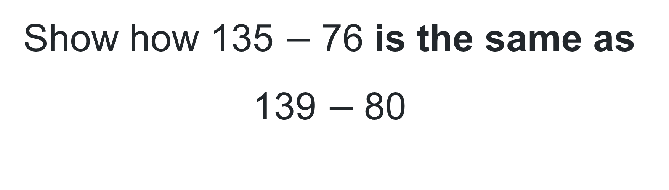
Short response (7)
Show how 135 $−$ 76 is the same as 139 $−$ 80
Notes:
Short response questions provide brisk paced questions focussing on review of current and previous content to support spaced and interleaved practice.
Syllabus focus area:
Additive relations A

Slide 16
Short response (8)
Ranya was facing west.
She made a quarter turn clockwise. Which direction is she facing now?
Notes:
Short response questions provide brisk paced questions focussing on review of current and previous content to support spaced and interleaved practice.
Syllabus focus area:
Geometric measure B: Position

Slide 17
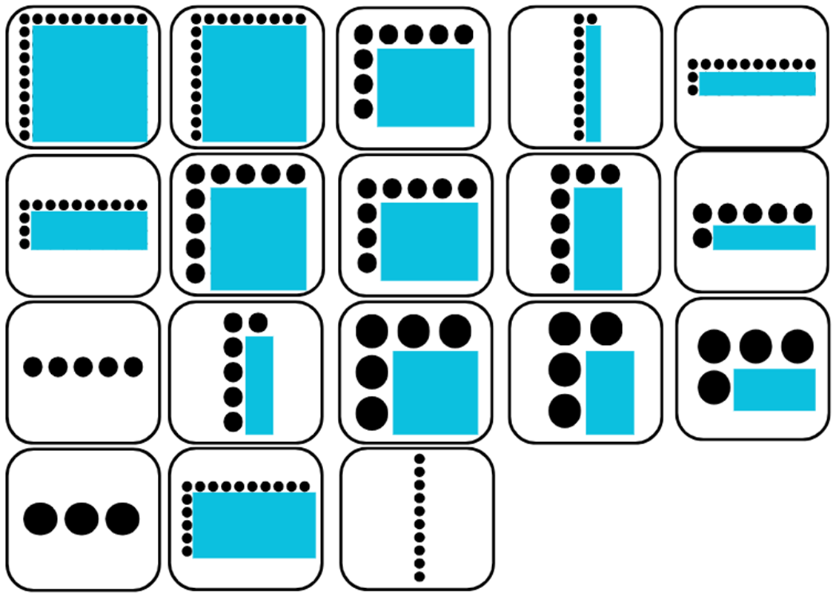
Activity 2 – partial array bingo
Aim of the game
To identify the products that are represented in partial arrays.
Rules:
each player selects 6 partial array cards and places them face up in a row
place the product cards in a pile facing down
take it in turns to pick up a product card and check if you have a matching partial array card
if your product card matches a partial array card, turn the array card face down.
the winner is the first player to turn down all partial array cards
Notes:
This is a developing number sense activity.
Number sense refers to a deep understanding of numbers, including their magnitude, relationships, and the effects of operations on them. It supports fluency and understanding, estimation, flexible thinking, and efficient problem-solving. Number sense activities 1–4 ‘activate’ prior number knowledge and support the learning of new content in the unit. Number sense activities 5–8 ‘loop’ back and provide opportunity for spaced practice with concepts and procedures covered in previous units.
Syllabus focus area:
Multiplicative relations B
This resource corresponds to Resource 22 – How many tiles? in Stage 2 Year B Unit 37
Prior to the lesson print and cut Resource 23 – partial array cards and Resource 24 – partial array products ensuring there is one set between each pair of students.
Give pairs of students Resource 23 – partial array cards and Resource 24 – partial array products.
Each player selects 6 partial array cards and places them face up in a row. Students set aside the remaining array cards.
Students place the product cards in a pile facing down.
Players take turns to pick up a product card and check if they have the matching partial array card. If they do, the student turns the array card face down. If both players have the matching array card, they both turn their matching array card face down.
If neither player has the matching array card, that turn is missed and the product card is set aside. The next player turns over a product card from the pile.
The winner is the first player to turn down all their partial array cards and say bingo.

Slide 18
Review of learning 3

Slide 19
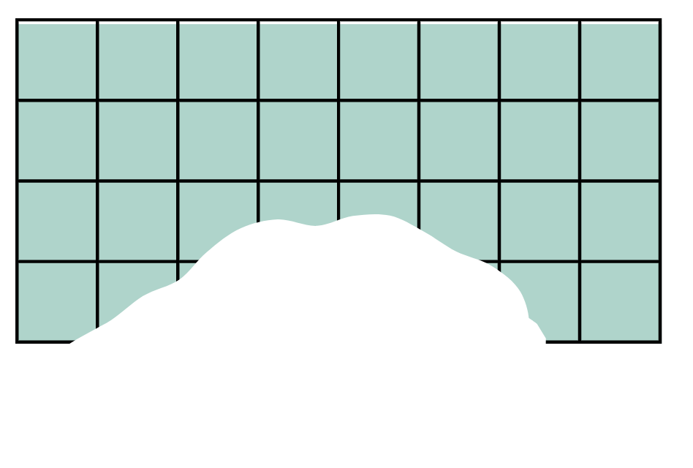
Multiple choice (1)
This grid has been torn. How many squares make up the complete grid?
A | B | C | D
28 | 32 | 24 | 40
Notes:
This question connects to the content in the developing number sense activity (Activity 3)
Syllabus focus area:
Multiplicative relations B

Slide 20
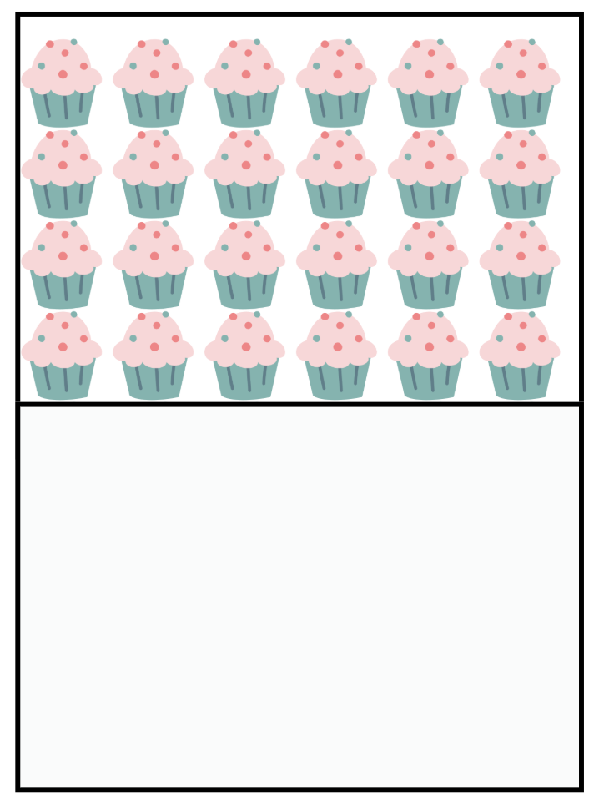
Short response (9)
If there are 36 cupcakes on the tray, how many rows are being covered?
Notes:
Short response questions provide brisk paced questions focussing on review of current and previous content to support spaced and interleaved practice.
Syllabus focus area:
Multiplicative relations A

Slide 21
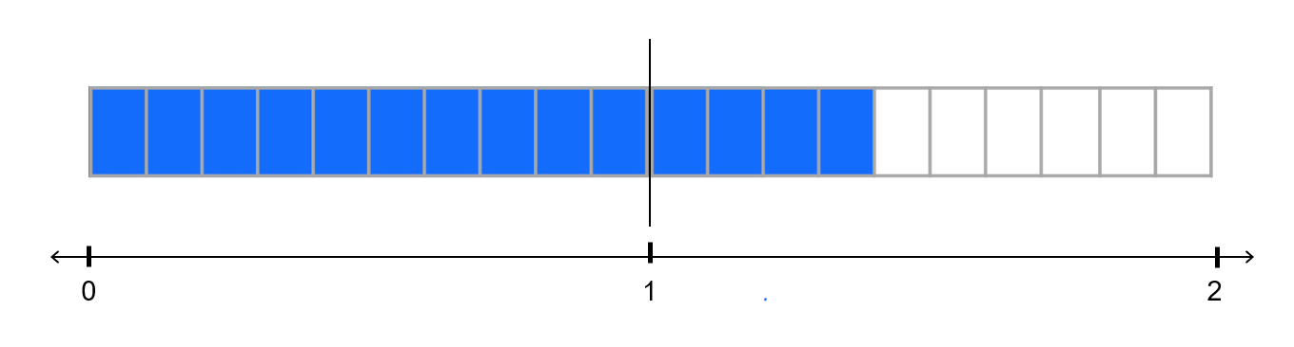
Short response (10)
How many tenths are shaded?
How can we rename this as a decimal?
Notes:
Short response questions provide brisk paced questions focussing on review of current and previous content to support spaced and interleaved practice.
Syllabus focus area:
Representing numbers using place value B

Slide 22
Short response (11)
Show the answer to this using a bar model:
A bus can hold 92 passengers.
67 people are already on the bus.
How many more people can get on?
Notes:
Short response questions provide brisk paced questions focussing on review of current and previous content to support spaced and interleaved practice.
Syllabus focus area:
Additive relations A

Slide 23
Short response (12)
Draw a trapezium.
Draw lines to split your trapezium into smaller shapes you know
What shapes did you make?
Notes:
Short response questions provide brisk paced questions focussing on review of current and previous content to support spaced and interleaved practice.
Syllabus focus area:
Two-dimensional spatial structure B: 2D shapes

Slide 24
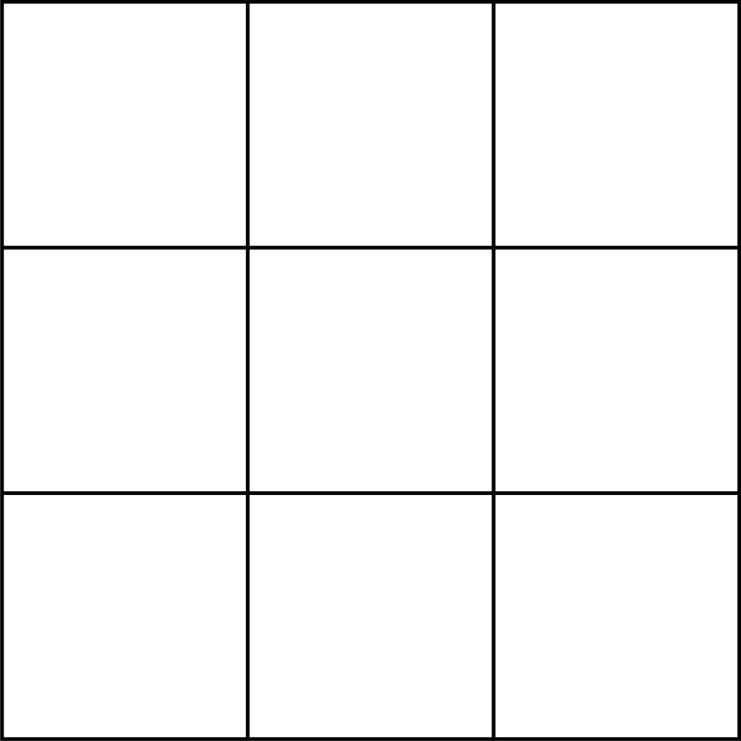
Activity 3 – covered grid
Notes:
This is a developing number sense activity.
Number sense refers to a deep understanding of numbers, including their magnitude, relationships, and the effects of operations on them. It supports fluency and understanding, estimation, flexible thinking, and efficient problem-solving. Number sense activities 1–4 ‘activate’ prior number knowledge and support the learning of new content in the unit. Number sense activities 5–8 ‘loop’ back and provide opportunity for spaced practice with concepts and procedures covered in previous units.
Syllabus focus area:
Multiplicative relations B
This resource corresponds to Resource 25 – covered grid in Stage 2 Year B Unit 37.
Ask:
What do you notice?
What are you visualising?
How can the lines help you solve this problem?
How can multiplication facts be used to help determine the total number of covered squares?

Slide 25
Review of learning 4

Slide 26
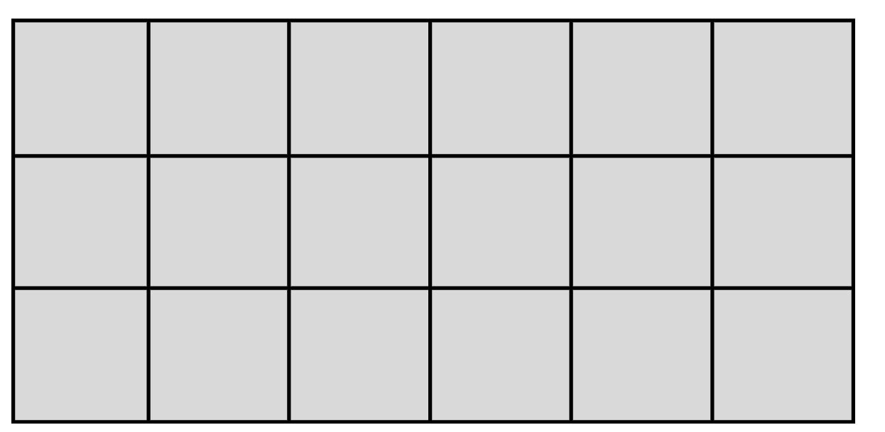
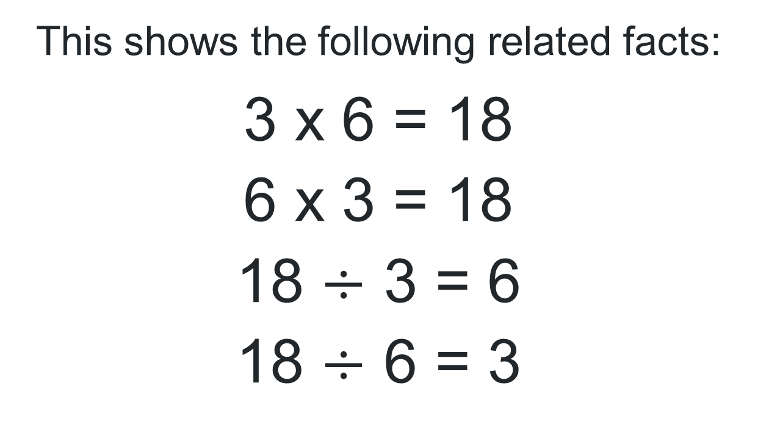
True or false (2)
This shows the following related facts:
3 x 6 = 18
6 x 3 = 18
18 $÷$ 3 = 6
18 $÷$ 6 = 3
True | False
Notes:
The question on this slide connects to the content being explored in the developing number sense activity (Activity 4)
Syllabus focus area:
Multiplicative relations B

Slide 27
Short response (13)
Riley says, ‘A rectangle that is 10 cm long and 2 cm wide has the same area as one that is 5 cm long and 4 cm wide.”
Is Riley correct? Explain how you know.
Notes:
Short response questions provide brisk paced questions focussing on review of current and previous content to support spaced and interleaved practice.
Syllabus focus area:
Two-dimensional spatial structure B

Slide 28
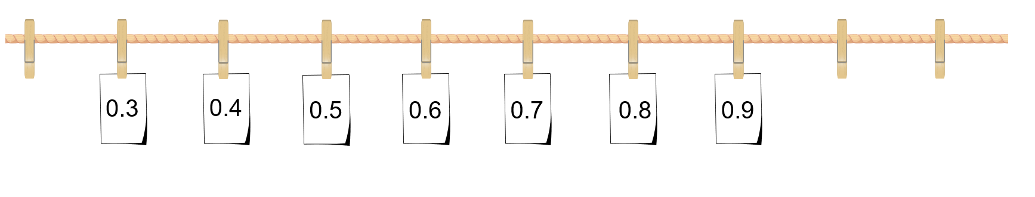
Short response (14)
Write the 3 missing numbers from this number line.
Notes:
Short response questions provide brisk paced questions focussing on review of current and previous content to support spaced and interleaved practice.
Syllabus focus area:
Representing numbers using place value B: Decimals

Slide 29
Short response (15)
Solve 148 + 273
Show the method you used.
Did you need to regroup?
Why or why not?
Notes:
Short response questions provide brisk paced questions focussing on review of current and previous content to support spaced and interleaved practice.
Syllabus focus area:
Additive relations B

Slide 30
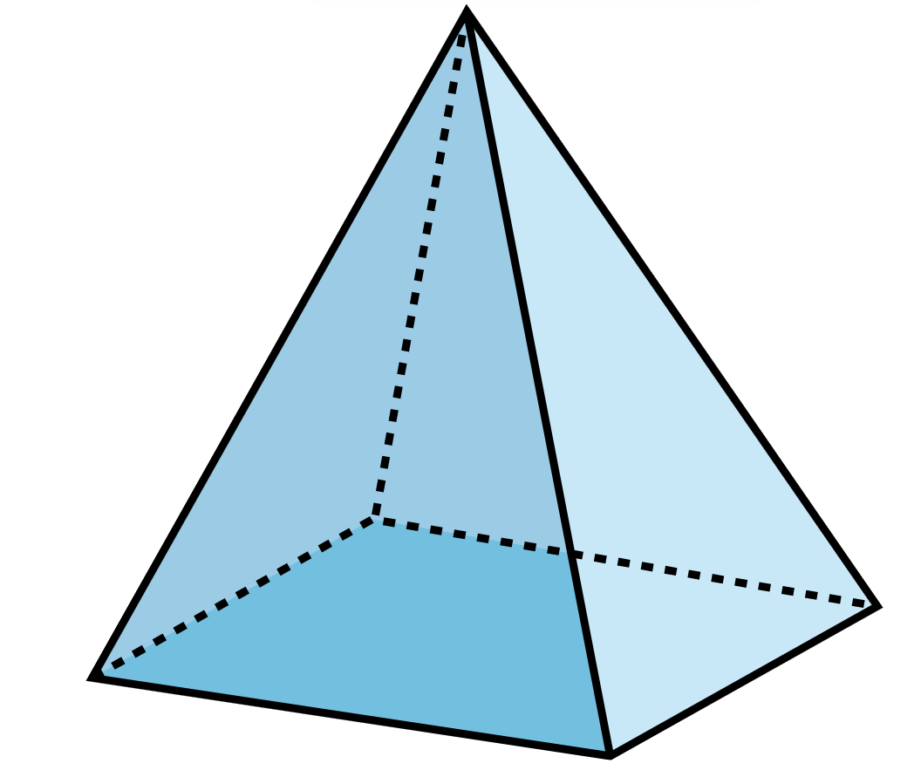
Short response (16)
Describe this pyramid features.
Notes:
Short response questions provide brisk paced questions focussing on review of current and previous content to support spaced and interleaved practice.
Syllabus focus area:
Three-dimensional spatial structure A: 3D objects

Slide 31
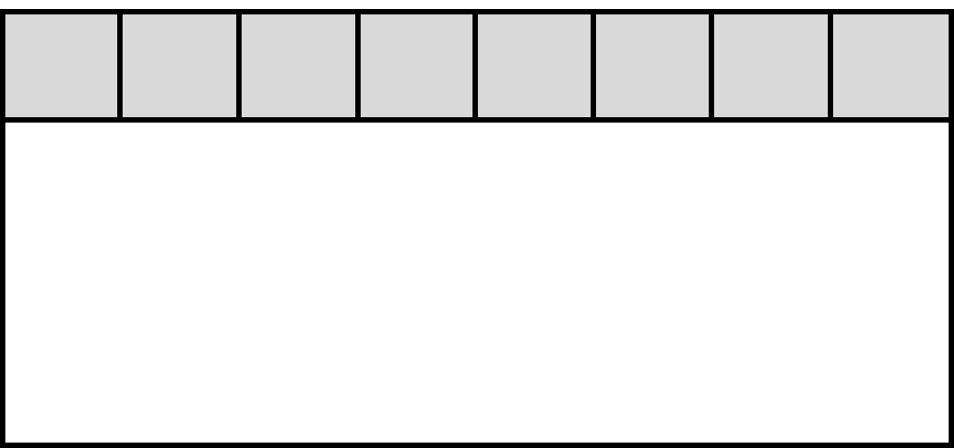
Activity 4 – partial grid
32 ÷ ? = 8
31
Notes:
This is a developing number sense activity.
Number sense refers to a deep understanding of numbers, including their magnitude, relationships, and the effects of operations on them. It supports fluency and understanding, estimation, flexible thinking, and efficient problem-solving. Number sense activities 1–4 ‘activate’ prior number knowledge and support the learning of new content in the unit. Number sense activities 5–8 ‘loop’ back and provide opportunity for spaced practice with concepts and procedures covered in previous units.
Syllabus focus area:
Multiplicative relations B
This resource corresponds to Resource 26 – covered grid in Stage 2 Year B Unit 37.
Ask students the following questions:
What do you notice?
How can the squares help you solve this problem?
What are you visualising?
How can multiplication be used to help solve division?
What advice would you give to a friend if they didn’t know how to solve this problem?
Students create their own partial grid, write a division number sentence with a missing value and ask a partner to solve it.

Slide 32
Review of learning 5

Slide 33
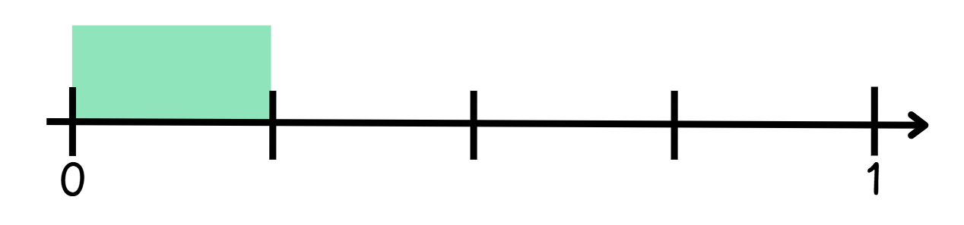
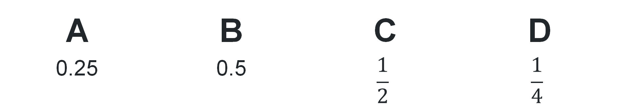
Multiple choice (3)
Which 2 answers are correct here?
This model is showing …
A | B | C | D
0.25 | 0.5 | $$\frac{1}{2}$$ | $$\frac{1}{4}$$
Notes:
This question connects to the content in the developing number sense activity (Activity 5)
Syllabus focus area:
Representing numbers using place value B: Decimals

Slide 34
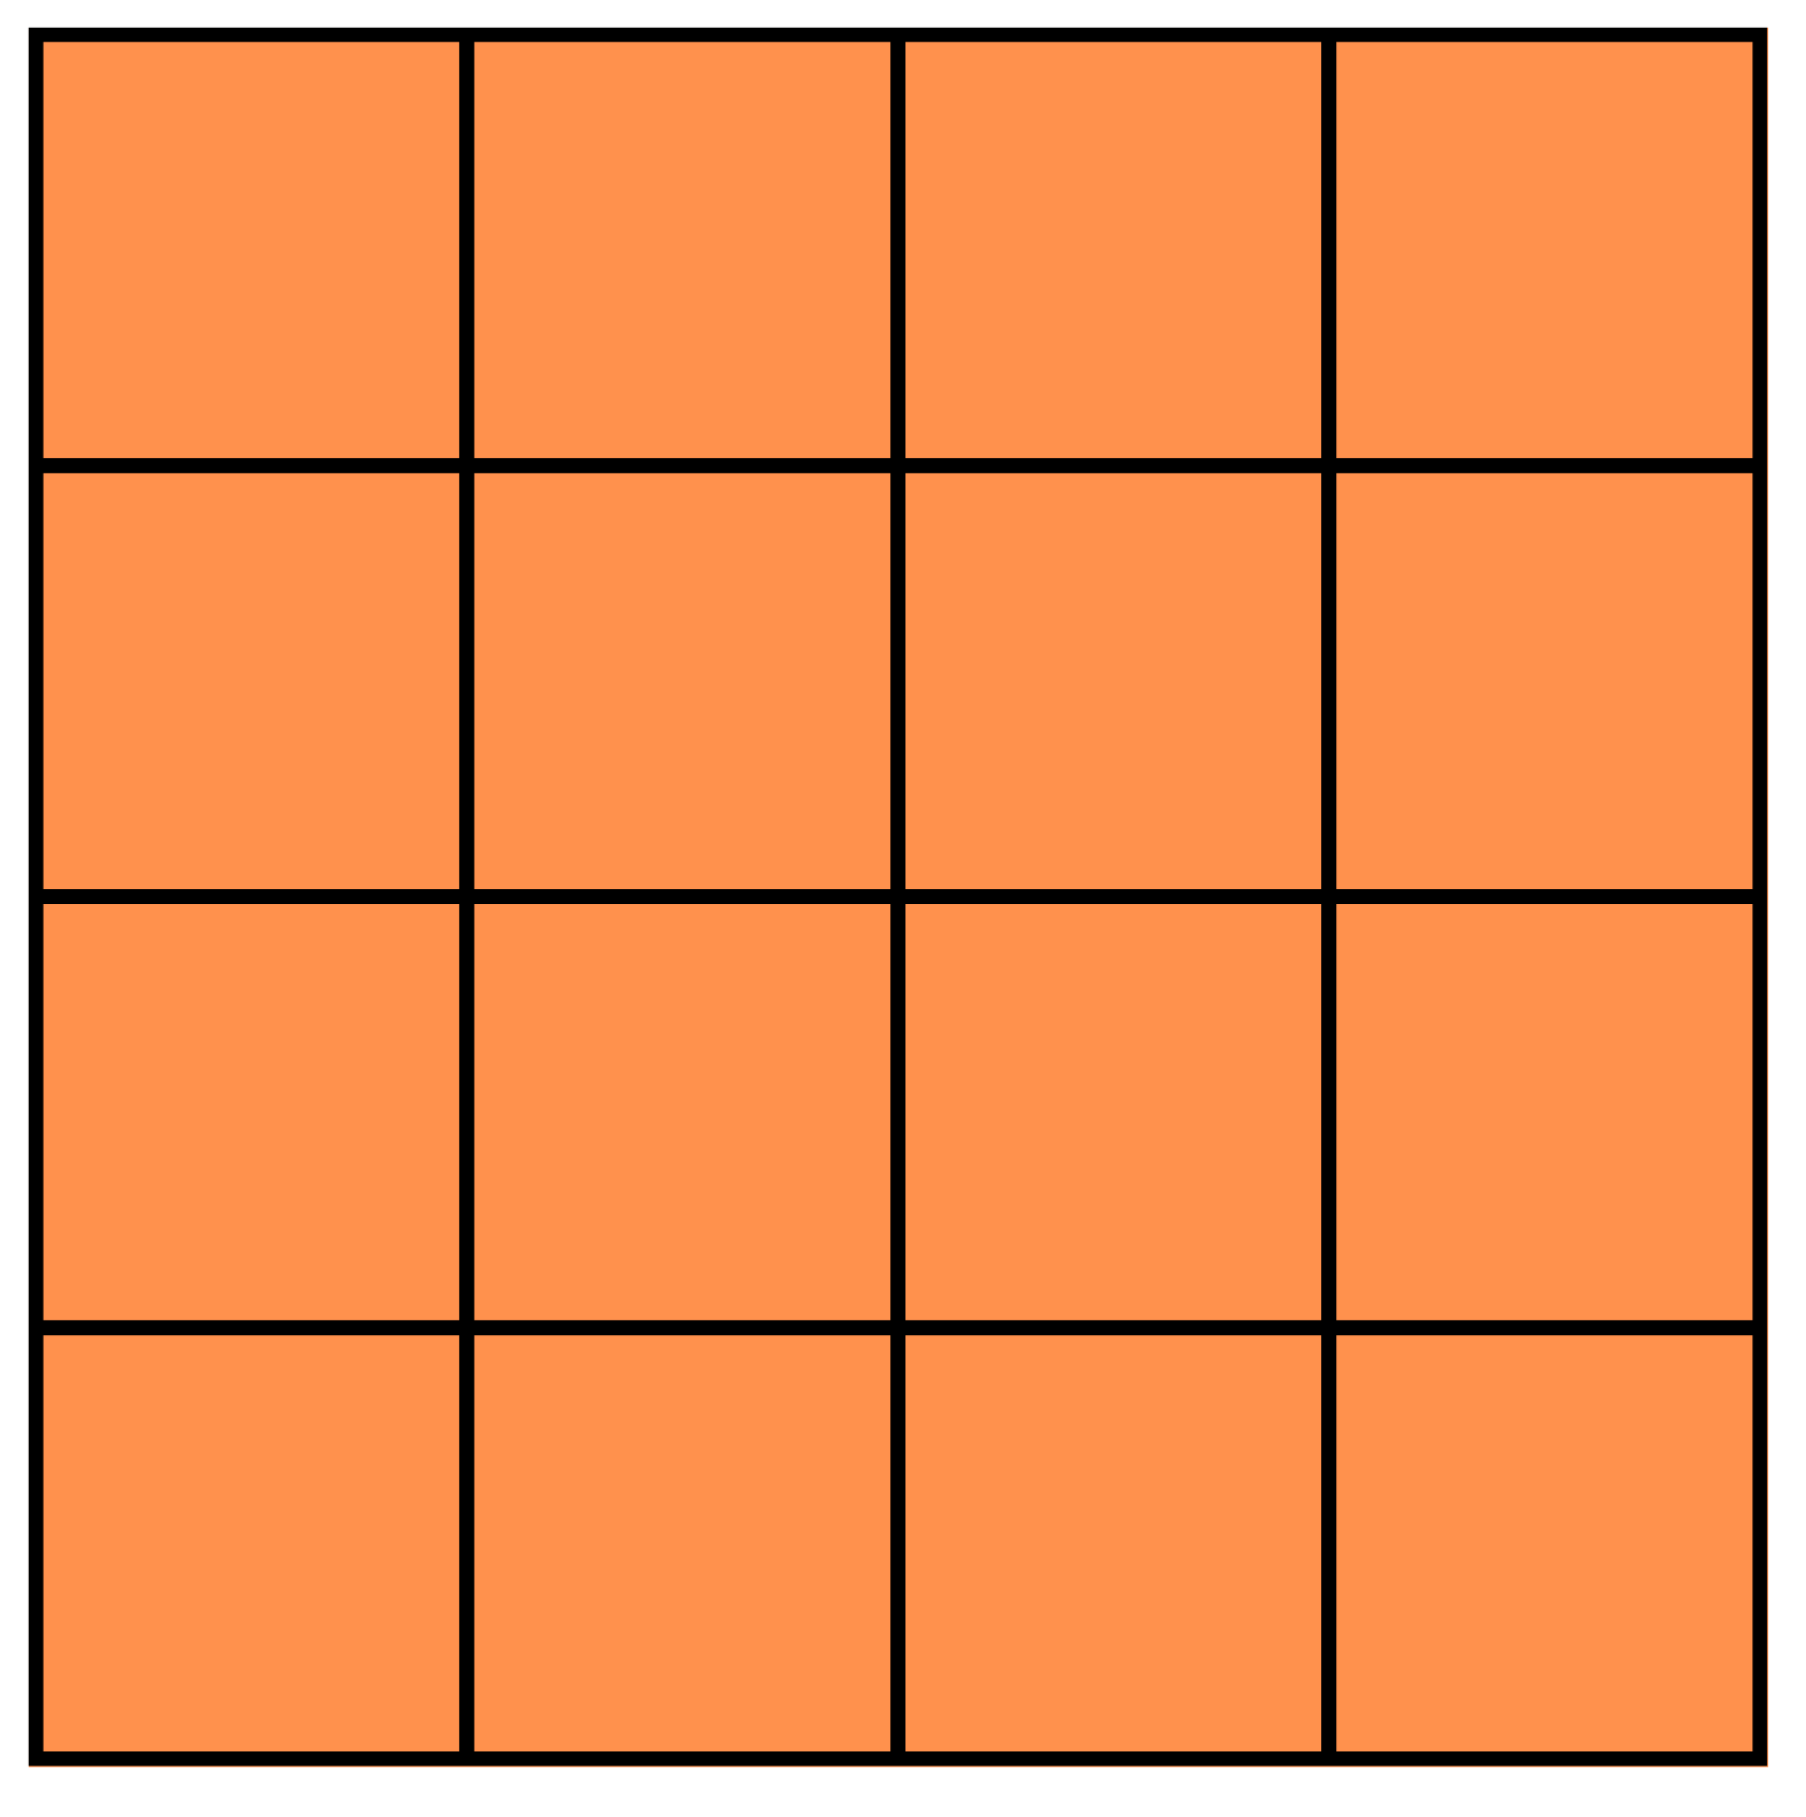
Short response (17)
This shape is made up of square metres.
What is the area of this shape?
Explain how you know.
Notes:
Short response questions provide brisk paced questions focussing on review of current and previous content to support spaced and interleaved practice.
Syllabus focus area:
Two-dimensional spatial structure A

Slide 35
Short response (18)
17 tenths
How many tenths are represented in this number?
Record this as a decimal.
Record this as a fraction.
Notes:
Short response questions provide brisk paced questions focussing on review of current and previous content to support spaced and interleaved practice.
Syllabus focus area:
Representing numbers using place value B

Slide 36
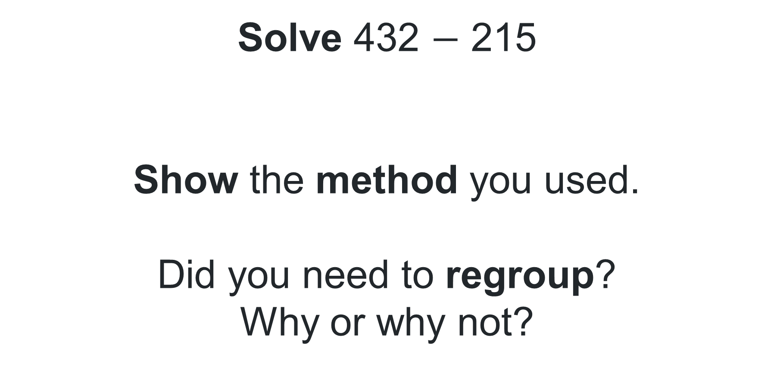
Short response (19)
Solve 432 $−$ 215
Show the method you used.
Did you need to regroup?
Why or why not?
Notes:
Short response questions provide brisk paced questions focussing on review of current and previous content to support spaced and interleaved practice.
Syllabus focus area:
Additive relations B

Slide 37
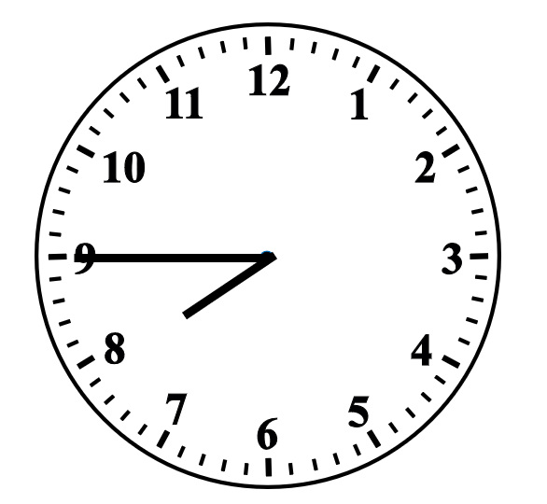
Short response (20)
After his breakfast, Phil checked the clock.
Write down the time in digital form. Remember to include am or pm notation.
Notes:
Short response questions provide brisk paced questions focussing on review of current and previous content to support spaced and interleaved practice.
Syllabus focus area:
Non-spatial measure B: Time

Slide 38
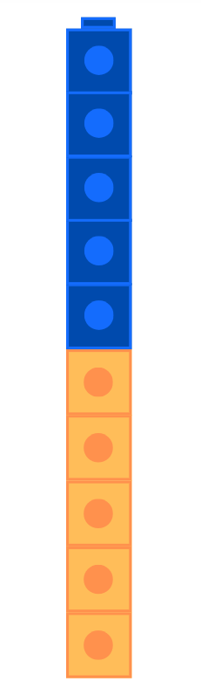

Activity 5 – benchmark fractions
Notes:
This is a developing number sense activity.
Number sense refers to a deep understanding of numbers, including their magnitude, relationships, and the effects of operations on them. It supports fluency and understanding, estimation, flexible thinking, and efficient problem-solving. Number sense activities 1–4 ‘activate’ prior number knowledge and support the learning of new content in the unit. Number sense activities 5–8 ‘loop’ back and provide opportunity for spaced practice with concepts and procedures covered in previous units.
Syllabus focus area:
Representing numbers using place value B
Ask the following questions:
What fractions can be seen?
Could we use interlocking cubes to represent the same fraction in another way?
Model half as 5 blue cubes and 5 yellow cubes. Explain that the model shows the fraction 1/2 and 5/10.
Explain how half is written as a decimal and that we read the decimal 0.5 as ‘half’ or ‘5-tenths’
Give students interlocking cubes. Ask students to use the cubes to represent ¼ and 3/4. For example, 1/4 can be represented as 2 blue cubes connected to 6 yellow cubes or 1 blue cube connected to 3 yellow cubes.
Ask the following questions:
How did you represent 1/4?
How did you represent 3/4?
How do you know you’ve represented these fractions accurately?
Why are there so many ways of representing a fraction?
How are ¼ and 3/4 written as decimals?

Slide 39
Review of learning 6

Slide 40
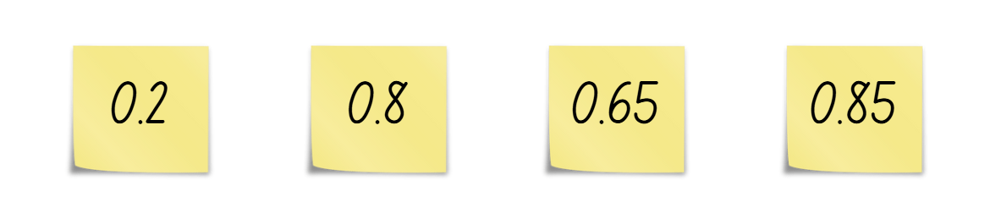
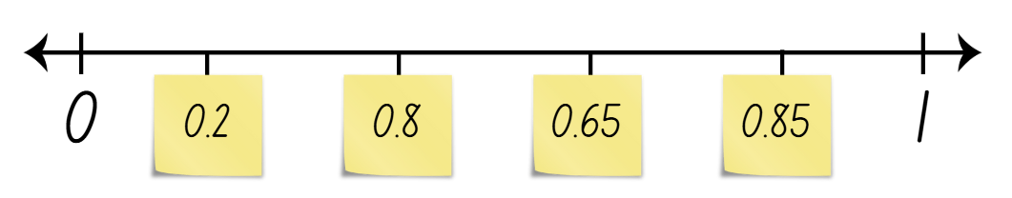
True or false (3)
These numbers have been ordered correctly.
True | False
Communicate your reasoning.
Notes:
The question on this slide connects to the content being explored in the developing number sense activity (Activity 6)
Syllabus focus area:
Representing numbers using place value B: Decimals

Slide 41
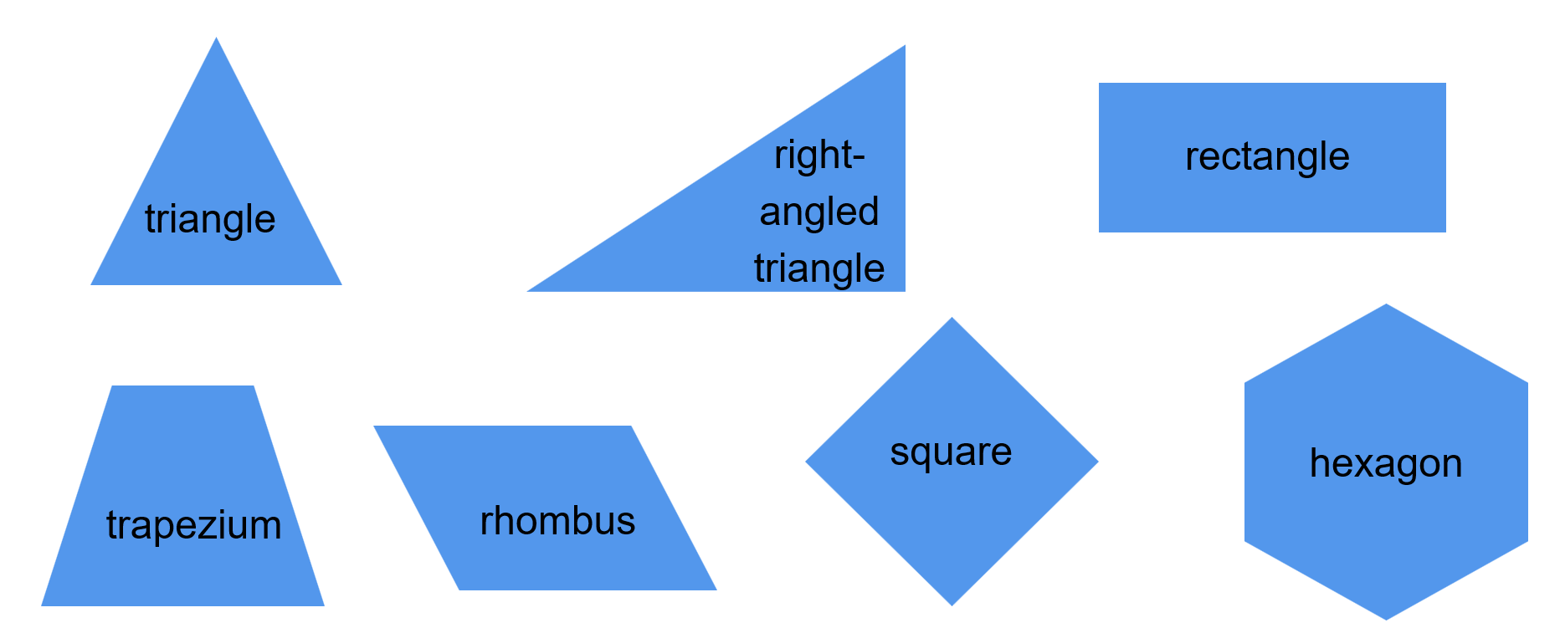
Short response (21)
Which of these shapes have right angles?
Notes:
Short response questions provide brisk paced questions focussing on review of current and previous content to support spaced and interleaved practice.
Syllabus focus area:
Two-dimensional spatial structure A

Slide 42
Short response (22)
0.70
Does this number represent 7 tenths or 7 hundredths?
Explain your thinking.
Notes:
Short response questions provide brisk paced questions focussing on review of current and previous content to support spaced and interleaved practice.
Syllabus focus area:
Representing numbers using place value B: Decimals

Slide 43
Short response (23)
How many ways could you solve
268 + 435?
Notes:
Short response questions provide brisk paced questions focussing on review of current and previous content to support spaced and interleaved practice.
Syllabus focus area:
Additive relations B

Slide 44
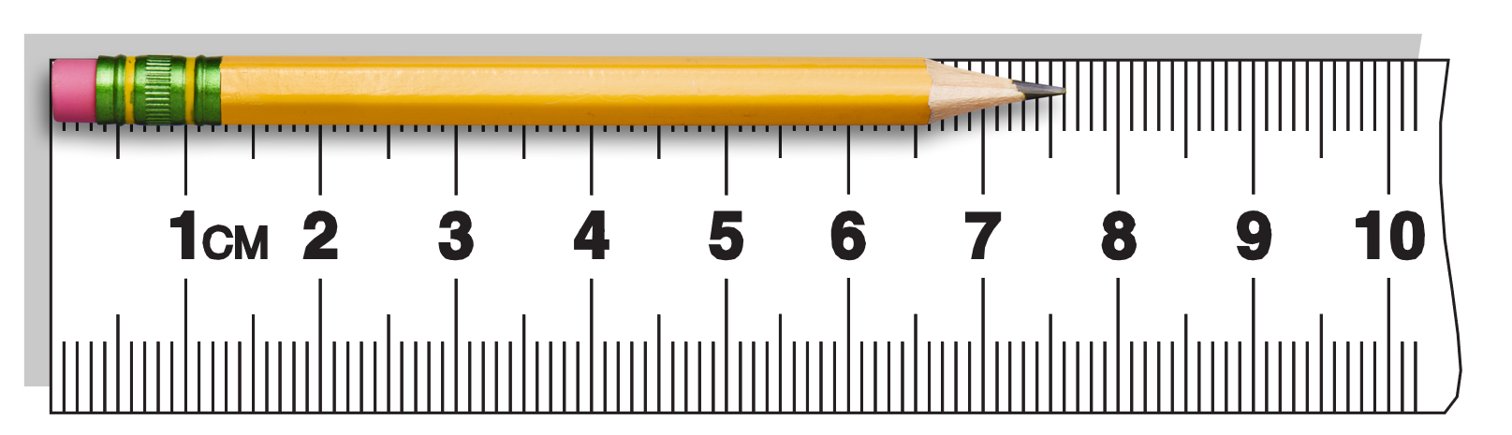
Short response (24)
What is the length of this pencil in cm?
What is the length of this pencil in mm?
Notes:
Short response questions provide brisk paced questions focussing on review of current and previous content to support spaced and interleaved practice.
Syllabus focus area:
Geometric Measure B: Length

Slide 45



Activity 6 – decimal height
I’m Rose and my
height is 1.09 metres.
I am the tallest!
I’m Martine and my
height is 1.3 metres.
I am the tallest!
Notes:
This is a developing number sense activity.
Number sense refers to a deep understanding of numbers, including their magnitude, relationships, and the effects of operations on them. It supports fluency and understanding, estimation, flexible thinking, and efficient problem-solving. Number sense activities 1–4 ‘activate’ prior number knowledge and support the learning of new content in the unit. Number sense activities 5–8 ‘loop’ back and provide opportunity for spaced practice with concepts and procedures covered in previous units.
Syllabus focus area:
Representing numbers using place value B
This resource corresponds to Resource 27 decimal height in Stage 2 Year B Unit 37.
Ask the following questions:
Who is correct? How do you know?
What misconceptions about decimals might Rose have? How could you explain this to her?
What is the difference between Martine and Rose’s height? How can you calculate this?
Revise how to read these decimals. 1.09 is read as 1 and 9 hundredths, 1.3 is read as ‘one and three-tenths’.
Note: interpreting decimals used in different contexts can change the way that we read them. In the context of measuring height, it is appropriate to read the decimal 1.3 metres as ‘one point three’ metres. Without the context, this decimal is read as ‘one and three-tenths’. The use of the place value language to read decimals supports students conceptual understanding of the size of each part and to develop a mental image of hundredths compared to tenths. When comparing these 2 decimals, it makes more sense to compare 1 and 9 hundredths to 1 and 3 tenths.
Select 4 students and record their heights in decimal notation on the board. Prompt students to order these decimals from smallest to largest.
Ask: What is the difference between the smallest and largest decimal?

Slide 46
Review of learning 7

Slide 47
Multiple choice (1)
Which of the following represents 0.75 using interlocking cubes?
A 3 blue cubes connected to 3 red cubes
B 3 blue cubes connected to 12 red cubes
C 3 blue cubes connected to 1 red cube
D 3 blue cubes connected to 6 red cubes
47
Notes:
This question connects to the content in the developing number sense activity (Activity 7)
Syllabus focus area:
Representing numbers using place value B

Slide 48
Short response (25)
Draw a rectangular prism.
Label its features using face, edge, and vertex.
Notes:
Short response questions provide brisk paced questions focussing on review of current and previous content to support spaced and interleaved practice.
Syllabus focus area:
Three-dimensional spatial structure B

Slide 49
Short response (26)
Fill in the blanks to complete this sentence:
0.25 is ___ tenths and ___ hundredths
or ___ hundredths.
Notes:
Short response questions provide brisk paced questions focussing on review of current and previous content to support spaced and interleaved practice.
Syllabus focus area:
Representing numbers using place value B: Decimals

Slide 50
Short response (27)
Miss Donlan is organising a class party for 30 students and has a budget of $300. Estimate what items would fit the budget. Explain your thinking.
Item | Cost
Face painting | $149
Outdoor cinema | $153.50
Sushi platter (serves 15) | $65.80
Party meat pies (15 pieces) | $6.80
Party sausage rolls (15 pieces) | $6.80
Chicken nuggets (15 pieces) | $4.40
Notes:
Short response questions provide brisk paced questions focussing on review of current and previous content to support spaced and interleaved practice.
Syllabus focus area:
Additive relations B

Slide 51
Short response (28)
Make list of events that are unlikely to happen in class today.
Communicate your reasoning.
Notes:
Short response questions provide brisk paced questions focussing on review of current and previous content to support spaced and interleaved practice.
Syllabus focus area:
Chance B

Slide 52
Resource 28 – decimal fraction cards
1
2
5
3
6
0.75
1
1.0
4
4
10
4
8
2
1
0.5
0.25
2
8
Notes:
This is a developing number sense activity.
Number sense refers to a deep understanding of numbers, including their magnitude, relationships, and the effects of operations on them. It supports fluency and understanding, estimation, flexible thinking, and efficient problem-solving. Number sense activities 1–4 ‘activate’ prior number knowledge and support the learning of new content in the unit. Number sense activities 5–8 ‘loop’ back and provide opportunity for spaced practice with concepts and procedures covered in previous units.
Syllabus focus area:
Representing numbers using place value B
This resource corresponds to Resource 28 – decimal fraction cards in Stage 2 Year B Unit 37.
Explain each card will be placed on the number line. Highlight that there are multiple cards showing the same value, for example: 0.5, one half and five tenths.
Students to take turns stating what value the card represents and place the card on the number line to show its value. Students share their reasoning.
Monitor students use of language when reading fractions and decimals, providing feedback and modelling correct reading and comparing.
Discuss the completed number line to compare the decimal values and connect the fractions to the decimals.

Slide 53
Review of learning 8

Slide 54
True or false (4)
0.5 is twice as large as 0.25
True | False
Communicate your reasoning.
Notes:
The question on this slide connects to the content being explored in the developing number sense activity (Activity 8)
Syllabus focus area:
Representing numbers using place value B: Decimals

Slide 55
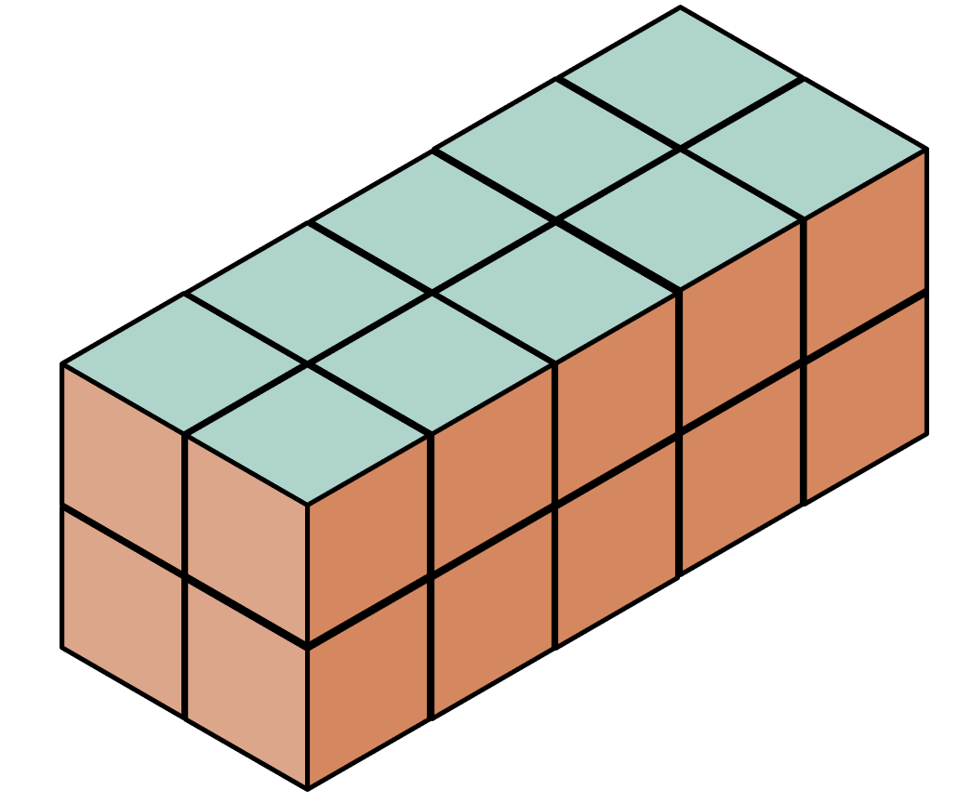
Short response (31)
This prism has been made using cubic-centimetre blocks.
Describe this prism using the term layers.
What is the volume of this prism in cubic centimetres?
Notes:
Short response questions provide brisk paced questions focussing on review of current and previous content to support spaced and interleaved practice.
Syllabus focus area:
Three-dimensional spatial structure A

Slide 56
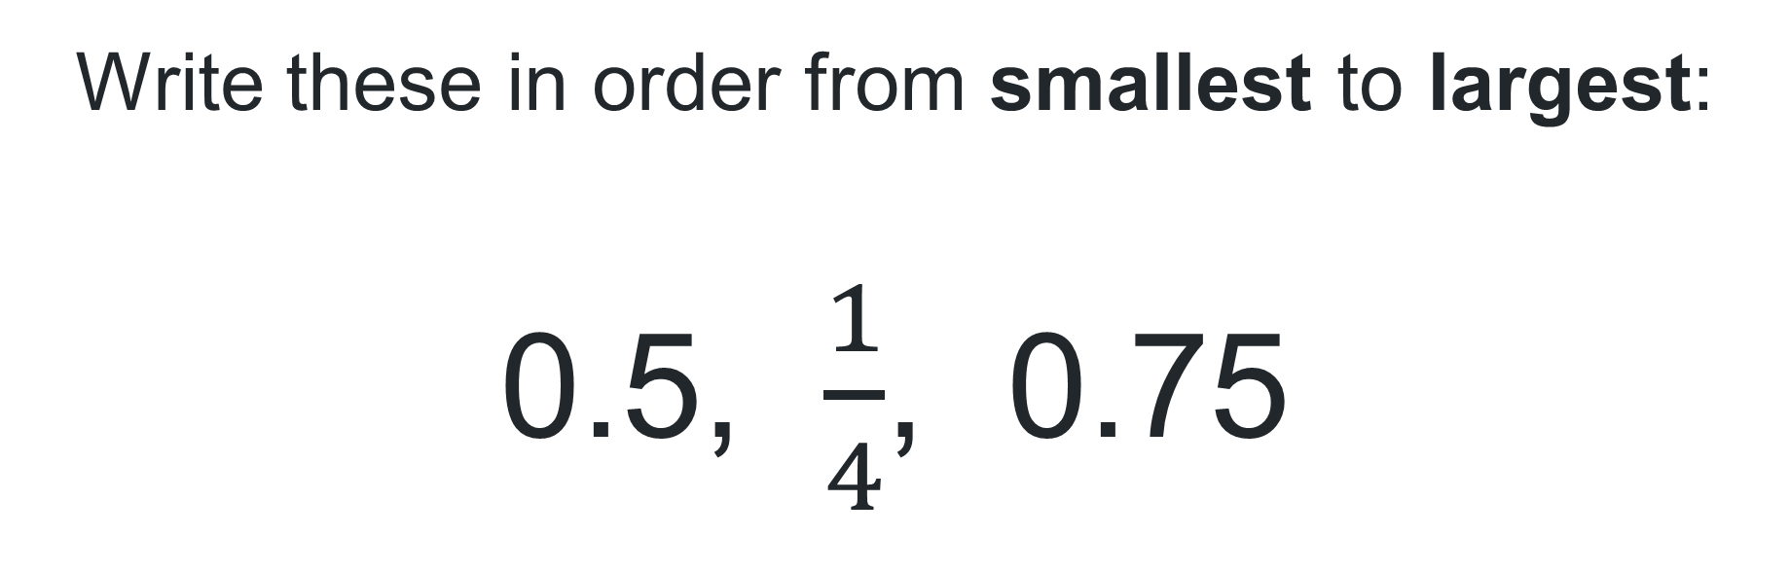
Short response (26)
Write these in order from smallest to largest:
0.5, $\frac{1}{4}$, 0.75
Notes:
Short response questions provide brisk paced questions focussing on review of current and previous content to support spaced and interleaved practice.
Syllabus focus area:
Representing numbers using place value B

Slide 57
Short response (33)
Jay has $5.00 for the canteen. Sushi costs $2.50, a smoothie costs $2.20 and baklava costs 50 cents. Does he have enough money to buy them all?
Explain your thinking.
Notes:
Short response questions provide brisk paced questions focussing on review of current and previous content to support spaced and interleaved practice.
Syllabus focus area:
Additive relations B

Slide 58

Short response (34)
Describe how the triangles have been rotated to create this design.
Shape B
Notes:
Short response questions provide brisk paced questions focussing on review of current and previous content to support spaced and interleaved practice.
Syllabus focus area:
Two-dimensional spatial structure B: 2D shapes

Slide 59
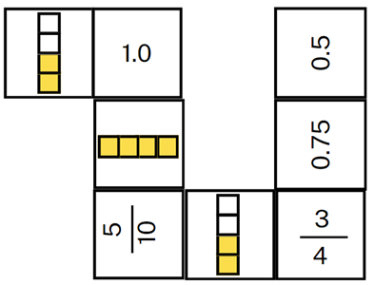
Activity 8 – decimal fraction chains
Aim of the game
To identify equivalent fractions and decimals.
Rules:
work with your partner to create one long domino chain or 2 smaller chains
you must match the dominos, so the touching ends have equal values
take turns to add a domino to the chain
discuss your decision of where to place the domino
Notes:
This is a developing number sense activity.
Number sense refers to a deep understanding of numbers, including their magnitude, relationships, and the effects of operations on them. It supports fluency and understanding, estimation, flexible thinking, and efficient problem-solving. Number sense activities 1–4 ‘activate’ prior number knowledge and support the learning of new content in the unit. Number sense activities 5–8 ‘loop’ back and provide opportunity for spaced practice with concepts and procedures covered in previous units.
Syllabus focus area:
Representing numbers using place value B
This activity is an adaptation of Doughnut Percents from NRICH by the University of Cambridge.
Prior to the lesson print and cut Resource 20 – decimal chains ensuring there is one set between each pair of students.
Explain that students will work together to create one long domino chain or 2 smaller chains. Touching ends need to have equal values (see Figure 5).
Teamwork and collaboration are the key to this task. Explain that:
all dominoes are face up and visible to both players
players take turns to place a domino to add to the chain
players discuss their moves, communicating their reasoning connecting fractions and decimals.
Reflect on the activity, asking questions such as:
Which dominoes were the hardest to match? Why?
Were there any that you didn’t know? Were you still able to match them? What strategy did you use?

Slide 60
Double Venn diagram
Object 1
Object 2
Features similar to both objects
Features of object 1
Features of object 2

Slide 61
Frayer
Definition
Facts/Characteristics
Word, term, concept
Examples
Non-examples

Slide 62
Spider map
Idea
Subject

Slide 63
Cline
Concept 1
Concept 2
Word
Word
Word
Word
Word
Word
Word
Word
Word
Word
Word

Slide 64

Compare and contrast
Notes:
Use the arrows to navigate between related activities.
Hyperlink each arrow to compare between related slides.

Slide 65
Multiple choice (1)
A
B
C
D
Notes:
This question connects to the content in the developing number sense activity (Activity 1)
This question can:
support spaced and interleaved practice
help identify and address common misconceptions
support active recall and immediate feedback
support whole class participation
identify areas requiring reteach
Teachers are encouraged to adapt and contextualise for their contexts.

Slide 66
Multiple choice (2)
A
B
C
D
Notes:
This question connects to the content in the developing number sense activity (Activity 1)
Syllabus focus area:
Multiplicative relations A
This question can:
support spaced and interleaved practice
help identify and address common misconceptions
support active recall and immediate feedback
support whole class participation
identify areas requiring reteach
Teachers are encouraged to adapt and contextualise for their contexts.

Slide 67
References
This presentation contains NSW Curriculum and syllabus content. The NSW Curriculum is developed by the NSW Education Standards Authority. This content is prepared by NESA for and on behalf of the Crown in the right of the State of New South Wales. The material is protected by Crown copyright.
Please refer to the NESA Copyright Disclaimer for more information https://educationstandards.nsw.edu.au/wps/portal/nesa/mini-footer/copyright.
NESA holds the only official and up-to-date versions of the NSW Curriculum and syllabus documents. Please visit the NSW Education Standards Authority (NESA) website https://educationstandards.nsw.edu.au/wps/portal/nesa/home and the NSW Curriculum website https://curriculum.nsw.edu.au.
Mathematics K–10 Syllabus © NSW Education Standards Authority (NESA) for and on behalf of the Crown in right of the State of New South Wales, 2022.
AAMT (The Australian Association of Mathematics Teachers) (n.d.) Partial Arrays, Top Drawer Teachers website, accessed 3 April 2024.
New Zealand Ministry of Education (n.d.) ‘Simple fractions as percentages’, Resource Finder, NZ Maths website, accessed 9 April 2024.
State of New South Wales (Department of Education) (2023) ‘Array Bingo – Partially Covered Arrays’, Mathematics K–6 resources, NSW Department of Education website, accessed 3 April 2024.
University of Cambridge (n.d.c) Doughnut Percents, NRICH website, accessed 3 April 2024.

Slide 68
Copyright
© State of New South Wales (Department of Education), 2025
The copyright material published in this resource is subject to the Copyright Act 1968 (Cth) and is owned by the NSW Department of Education or, where indicated, by a party other than the NSW Department of Education (third-party material).
Copyright material available in this resource and owned by the NSW Department of Education is licensed under a Creative Commons Attribution 4.0 International (CC BY 4.0) license.
This license allows you to share and adapt the material for any purpose, even commercially.
Attribution should be given to © State of New South Wales (Department of Education), 2025.
Material in this resource not available under a Creative Commons license:
the NSW Department of Education logo, other logos and trademark-protected material
Material owned by a third party that has been reproduced with permission. You will need to obtain permission from the third party to reuse its material.
Links to third-party material and websites
Please note that the provided (reading/viewing material/list/links/texts) are a suggestion only and implies no endorsement, by the New South Wales Department of Education, of any author, publisher, or book title. School principals and teachers are best placed to assess the suitability of resources that would complement the curriculum and reflect the needs and interests of their students.
If you use the links provided in this document to access a third party’s website, you acknowledge that the terms of use, including licence terms set out on the third-party’s website apply to the use which may be made of the materials on that third-party website or where permitted by the Copyright Act 1968 (Cth). The department accepts no responsibility for content on third-party websites.

