Slide 1
Instructions for use
This resource aligns to the learning in Stage 2 Year B Unit 26 and revisits content from earlier sample units.
Classroom teachers are encouraged to add, edit and adapt to meet the needs of their students.
Save a copy of the file to make changes to the slide deck. Go to File > Download a Copy (this downloads a copy to the computer to edit in the PowerPoint app).
To convert the PowerPoint to Google Slides:
  Upload the file into Google Drive and open it.
  Go to File > Save as Google Slides.
  (Note – conversion may cause formatting changes in the slides.)

Slide 2

Review of Learning
Mathematics Stage 2 – Unit 26
Notes:
Reviews may include a combination of question types, requiring students to recall facts and key ideas, as well as apply their knowledge to solve problems and answer questions. To support active engagement, a mix of techniques should be employed.” (AERO, 2024).
This Review of Learning slide deck revisits key concepts from the following units:
Stage 2 Year B Unit 26
Stage 2 Year B Unit 25
Stage 2 Year B Unit 24
It also includes opportunities to review prior learning in non-number content, supporting consolidation across focus areas.
The review of learning resources include three key task types that support the development of mathematical proficiency through retrieval, spaced practice, and active participation. These practices complement the review phase (activating prior knowledge) embedded within the beginning of each lesson.
1.
Multiple-choice questions/True or false: Designed to promote active retrieval of key concepts and identify common misconceptions in number, supporting consolidation, understanding and fluency.
These questions:
support spaced and interleaved practice
help identify and address common misconceptions
support active recall and immediate feedback
support whole class participation
identify areas requiring reteach
2.
Short-response question sets: Carefully grouped questions that encourage spaced and interleaved practice across multiple focus areas, helping students revisit and apply knowledge from different points in time.
These questions:
have a combination of question types
address a range of focus areas
build automaticity and fluency
support active recall
allow for immediate feedback
identify content requiring reteach
3.
Developing number sense activities: A variety of practical, purposeful tasks that reinforce current learning and build on prior knowledge. These activities promote reasoning, problem-solving and conceptual understanding.
The review of learning resources are designed to work support teaching and learning in mathematics. For the most effective implementation, use the resources flexibly, adapting to meet student learning needs and individual classroom contexts.

Slide 3
Lessons
1
Review of learning 1
5
Review of learning 5
2
Review of learning 2
6
Review of learning 6
3
Review of learning 3
7
Review of learning 7
4
Review of learning 4
8
Review of learning 8
Notes:
Teacher notes:
Click lesson numbers to go to specific lessons
Interactive features can be viewed in slide show

Slide 4
Review of learning 1

Slide 5

Multiple choice (1)
Which number is closest to 9 999?
A
B
C
D
9 899
9 099
9 990
9 909
Notes:
This question connects to the content in the developing number sense activity (Activity 1)
Syllabus focus area:
Representing numbers using place value B: Decimals

Slide 6

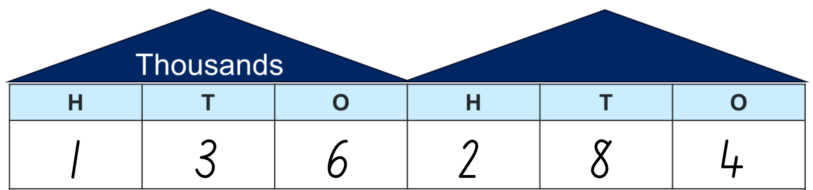
Short response (1)
Read the following number aloud.
Next record this number in expanded notation.
Notes:
Short response questions provide brisk paced questions focussing on review of current and previous content to support spaced and interleaved practice. ​
Syllabus focus area:
Representing numbers using place value A

Slide 7
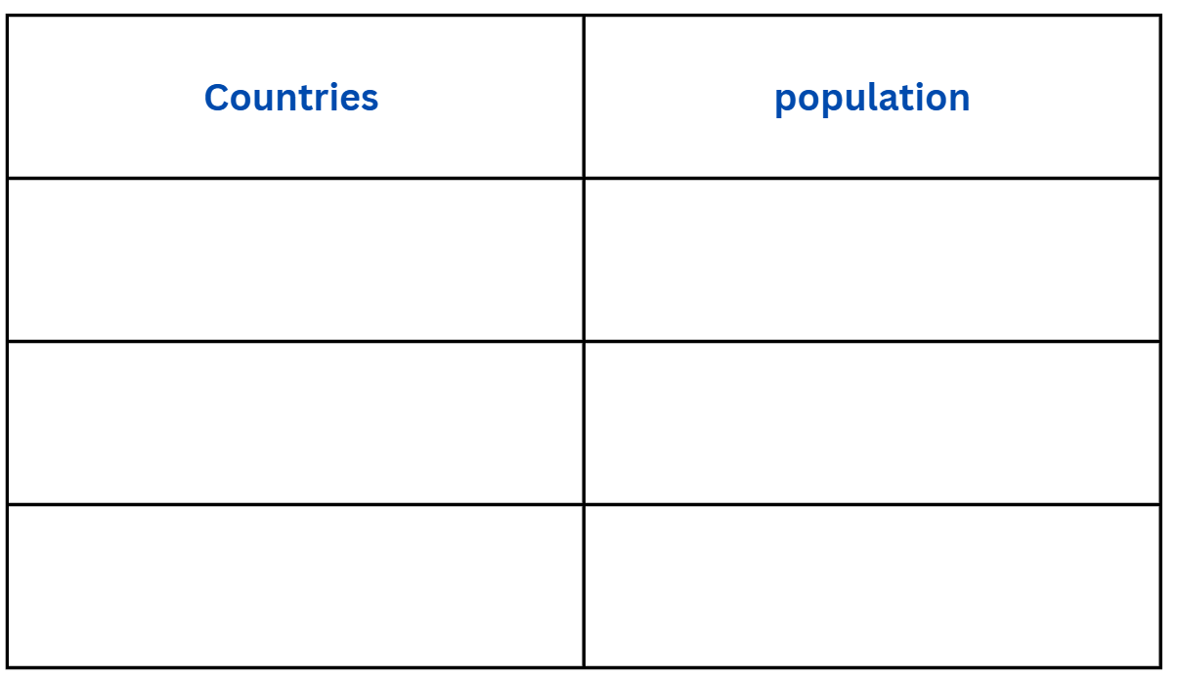
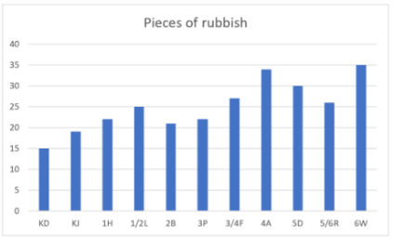
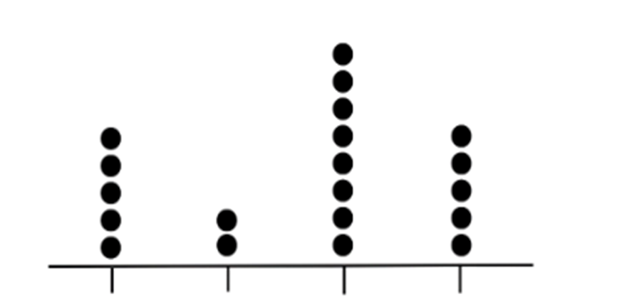
Short response (2)
What is the best way to display data involving large numbers, such as populations?
Tally table? Column graph? Or dot plot?
Communicate your reasoning.
Notes:
Short response questions provide brisk paced questions focussing on review of current and previous content to support spaced and interleaved practice.
Syllabus focus area:
Data A

Slide 8
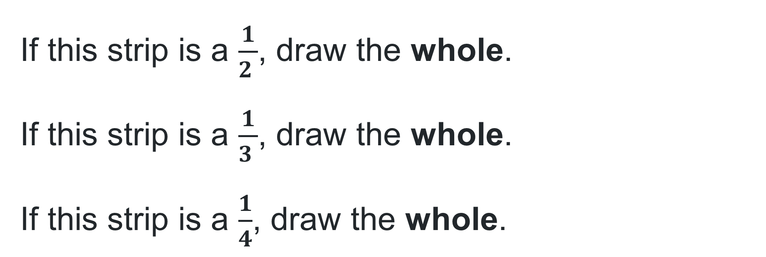
Short response (3)
Draw a strip, like this:
If this strip is a $\frac{1}{2 }$, draw the whole.
If this strip is a $\frac{1}{3 }$, draw the whole.
If this strip is a $\frac{1}{4}$, draw the whole.
Notes:
Short response questions provide brisk paced questions focussing on review of current and previous content to support spaced and interleaved practice.
Syllabus focus area:
Partitioned fractions A

Slide 9
Short response (4)
Create a list of categories for a matter of interest about favourite ice-cream flavours.
Communicate your reasoning.
Notes:
Short response questions provide brisk paced questions focussing on review of current and previous content to support spaced and interleaved practice.
Syllabus focus area:
Data A

Slide 10

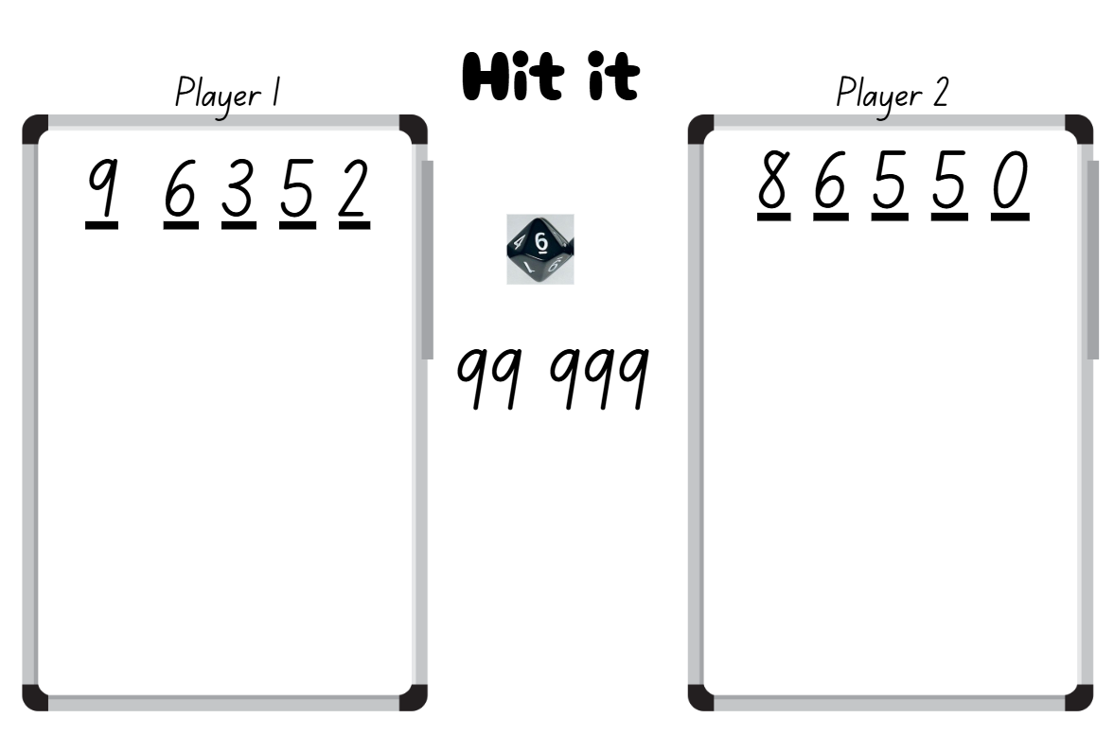
Activity 1 – 5-digit numbers 1
Notes:
Note: This slide is designed to be used in presentation mode.
This is a developing number sense activity.
Number sense refers to a deep understanding of numbers, including their magnitude, relationships, and the effects of operations on them. It supports fluency and understanding, estimation, flexible thinking, and efficient problem-solving. Number sense activities 1–4 ‘activate’ prior number knowledge and support the learning of new content in the unit. Number sense activities 5–8 ‘loop’ back and provide opportunity for spaced practice with concepts and procedures covered in previous units.
Syllabus focus area:
Representing numbers using place value B
5-digit numbers 1
This activity is an adaptation of ‘Hit it (3-digit numbers)’ from Thinking mathematically resources by State of New South Wales (Department of Education).
Provide pairs with markers, a whiteboard and a 10-sided dice.
Students draw a gameboard on their whiteboard with 5 lines to represent the 5-digits.
The aim of the game is to make numbers as close to 99 999 as possible, with the closest number winning a point. The player with the most points after 5 rounds is declared the winner.
Students take turns to roll the dice. After each roll, place the number on one of the lines to begin forming a 5-digit number.
Once the 5 blank lines are full, players read their numbers and explain which they think is the closest to 99 999. The winner gets one point.

Slide 11
Review of learning 2

Slide 12
True or false (1)
If I rearrange the digits in 546 433, the largest number I can make is 654 433.
True | False
Notes:
This question connects to the content in the developing number sense activity (Activity 2)
Syllabus focus area:
Represent numbers using place value B

Slide 13
Short response (5)
Record 48 356 in expanded notation.
Notes:
Short response questions provide brisk paced questions focussing on review of current and previous content to support spaced and interleaved practice.
Syllabus focus area:
Represent numbers using place value B

Slide 14
Short response (6)
Create a question that would involve collecting data in categories.
Communicate your reasoning.
Notes:
Short response questions provide brisk paced questions focussing on review of current and previous content to support spaced and interleaved practice.
Syllabus focus area:
Data B

Slide 15
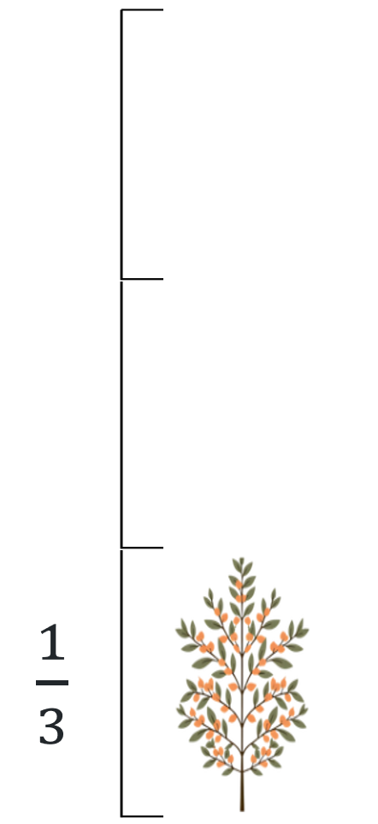
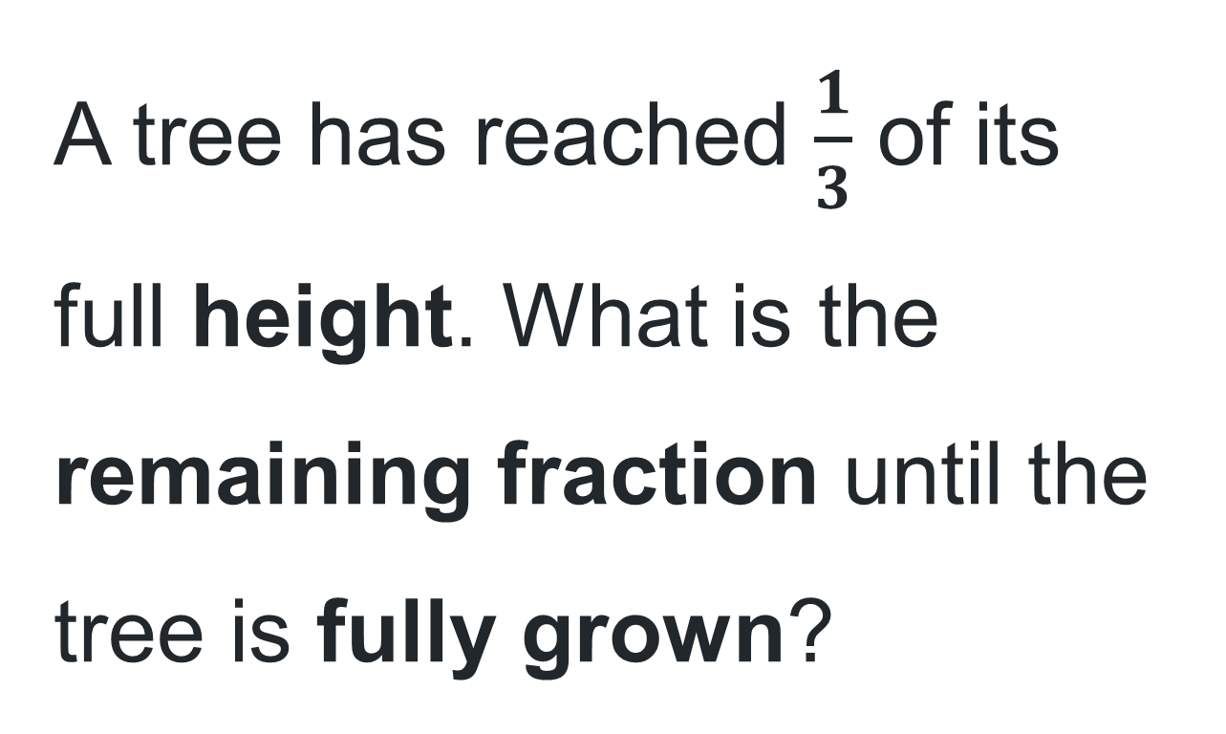
Short response (7)
A tree has reached $\frac{1}{3}$ of its full height. What is the remaining fraction until the tree is fully grown?
Notes:
Short response questions provide brisk paced questions focussing on review of current and previous content to support spaced and interleaved practice.
Syllabus focus area:
Partitioned fractions A

Slide 16
Short response (8)
Which 3D objects have faces that are all rectangles or squares and two identical parallel bases?
Is it a prism, a pyramid, or a cylinder?
Draw the object and justify your answer.
Notes:
Short response questions provide brisk paced questions focussing on review of current and previous content to support spaced and interleaved practice.
Syllabus focus area:
Three-dimensional spatial structure A

Slide 17
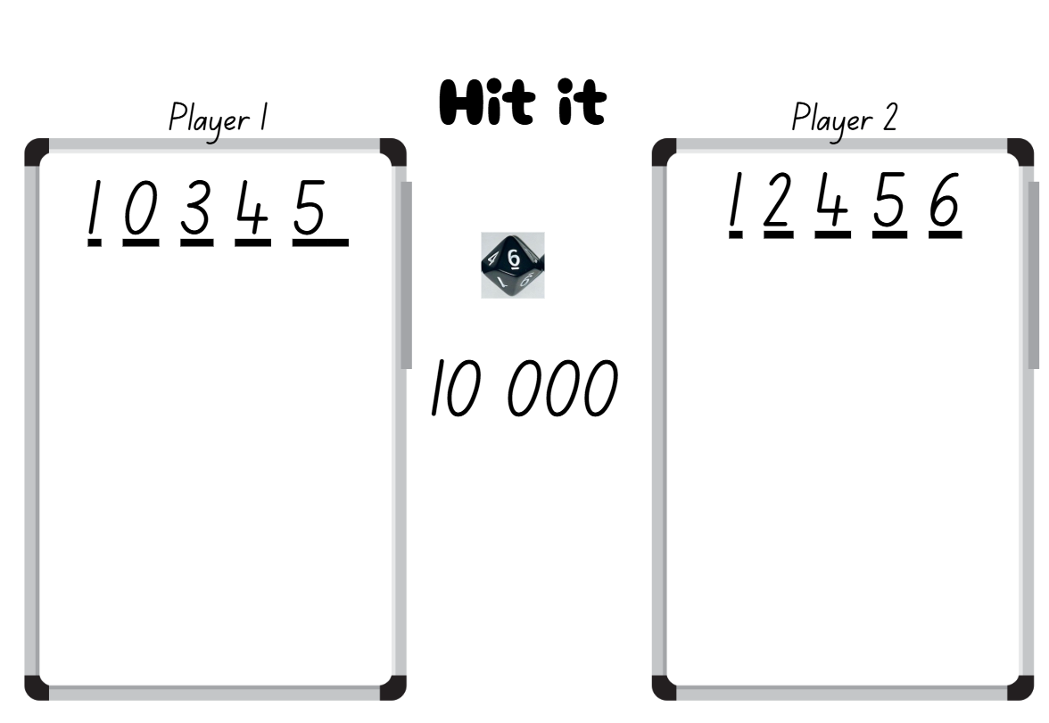
Activity 2 – 5-digit numbers 2
Notes:
This is a developing number sense activity.
Number sense refers to a deep understanding of numbers, including their magnitude, relationships, and the effects of operations on them. It supports fluency and understanding, estimation, flexible thinking, and efficient problem-solving. Number sense activities 1–4 ‘activate’ prior number knowledge and support the learning of new content in the unit. Number sense activities 5–8 ‘loop’ back and provide opportunity for spaced practice with concepts and procedures covered in previous units.
Syllabus focus area:
Representing numbers using place value B
5-digit numbers 2
This activity is an adaptation of ‘Hit it (3-digit numbers)’ from Thinking mathematically resources by State of New South Wales (Department of Education).
Provide pairs with markers, a whiteboard and a 10-sided dice.
Students draw a gameboard on their whiteboard with 5 lines to represent the 5-digits .
The aim of the game is to make numbers as close to 10 000 as possible, with the closest number winning a point. The player with the most points after 5 rounds is declared the winner.
Students take turns to roll the dice. After each roll, place the number on one of the lines to begin forming a 5-digit number.
Once the 5 blank lines are full, players read their numbers and explain which they think is the closest to 10 000. The winner gets one point.

Slide 18
Review of learning 3

Slide 19
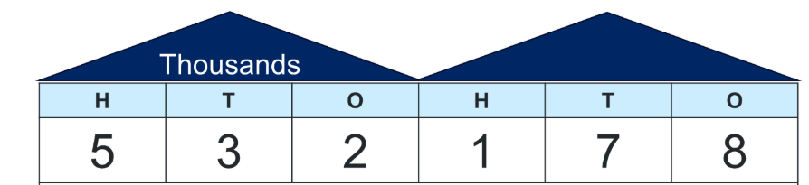
Multiple choice (2)
This number in non-standard partitioning is:
A
520 000 + 178
B
400 000 + 130 000 + 2100 + 70 + 8
C
500 000 + 30 000 + 2000 + 100 + 70 + 8
D
5000 + 3000 + 2000 + 178
Notes:
The question on this slide connects to the content being explored in the developing number sense activity (Activity 3)
Syllabus focus area :
Represents numbers using place value B

Slide 20
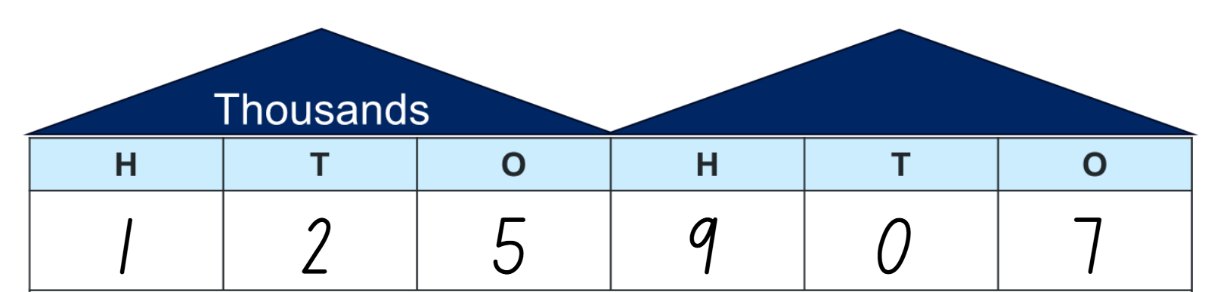
Short response (9)
Partition this number in a non-standard way.
How many 100s are there in this number?
Notes:
Short response questions provide brisk paced questions focussing on review of current and previous content to support spaced and interleaved practice.
Syllabus focus area:
Representing numbers using place value B

Slide 21
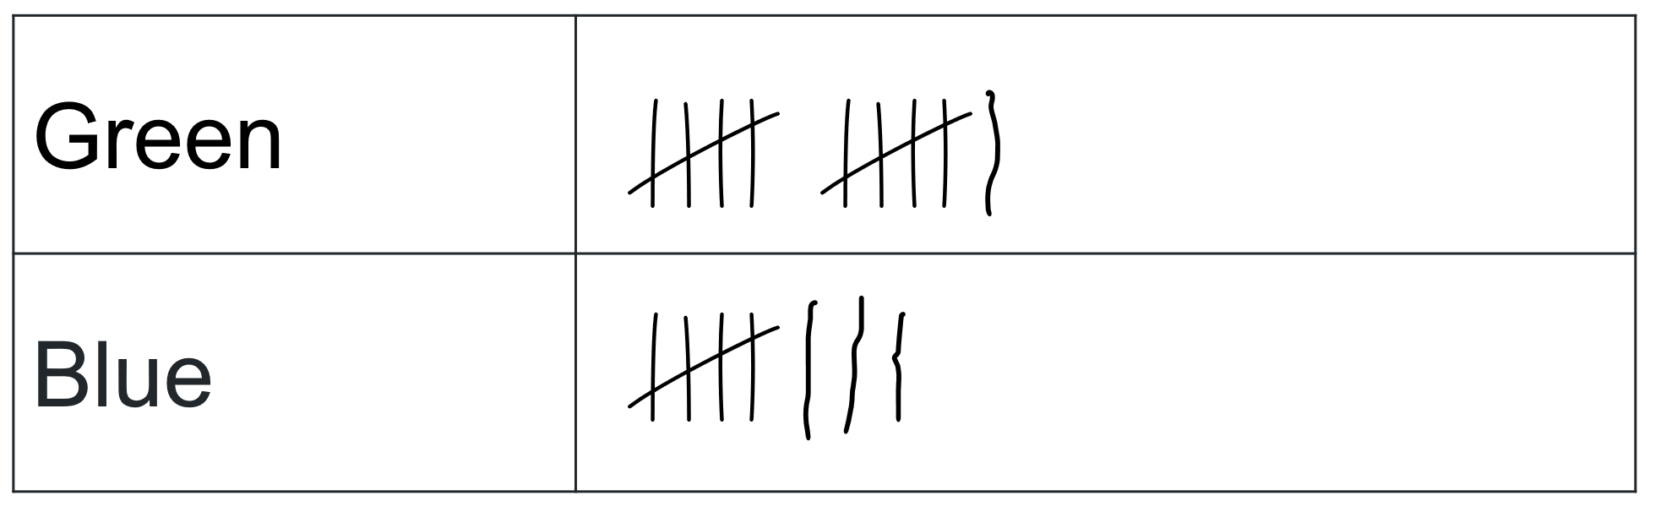
Short response (10)
Here are the results from a survey.
What might the survey have been about?
Communicate your reasoning.
Notes:
Short response questions provide brisk paced questions focussing on review of current and previous content to support spaced and interleaved practice.
Syllabus focus area:
Data A
This activity was adapted from Sullivan and Lilburn, Open-ended Maths Activities.

Slide 22

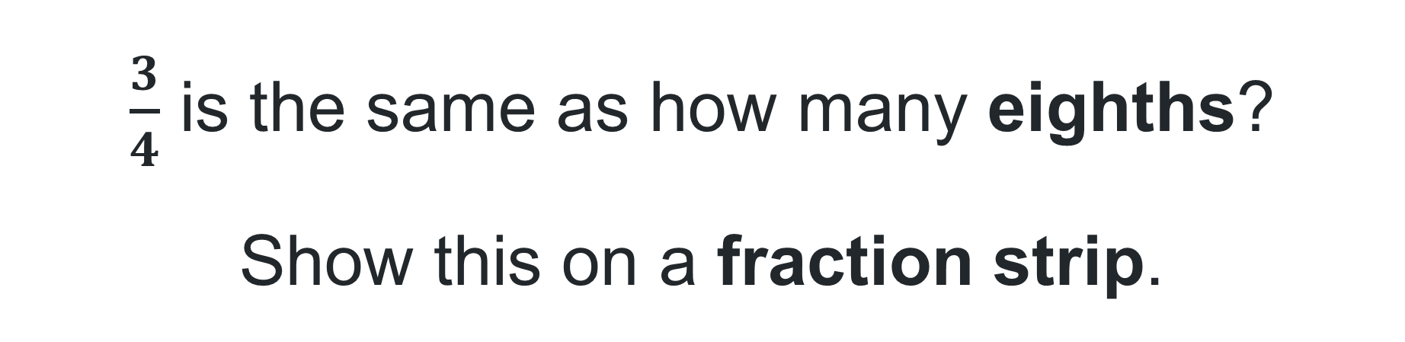
Short response (11)
$\frac{3}{4}$ is the same as how many eighths?
Show this on a fraction strip.
Notes:
Short response questions provide brisk paced questions focussing on review of current and previous content to support spaced and interleaved practice.
Syllabus focus area:
Partitioned fractions B

Slide 23

Short response (12)
Record the time shown on the clock in words.
Notes:
Short response questions provide brisk paced questions focussing on review of current and previous content to support spaced and interleaved practice.
Syllabus focus area:
Non-spatial measure A: Time

Slide 24
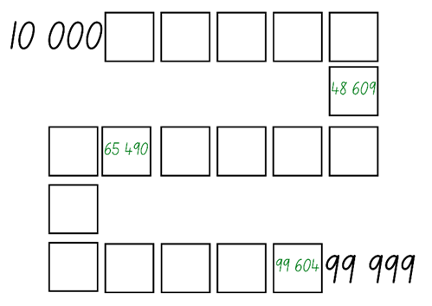
Activity 3 – arranging numbers in ascending order
Notes:
This is a developing number sense activity.
Number sense refers to a deep understanding of numbers, including their magnitude, relationships, and the effects of operations on them. It supports fluency and understanding, estimation, flexible thinking, and efficient problem-solving. Number sense activities 1–4 ‘activate’ prior number knowledge and support the learning of new content in the unit. Number sense activities 5–8 ‘loop’ back and provide opportunity for spaced practice with concepts and procedures covered in previous units.
Syllabus focus area:
Representing numbers using place value B
Arranging numbers in ascending order
This resource corresponds to Resource 23 – ascending order gameboard in Stage 2 Year B Unit 26.
Explain that the aim of the game is to position 5-digit numbers in sequence on the gameboard. Provide pairs with four 10-sided dice and a gameboard.
Students roll the dice and create a 5-digit number. For example, 4, 6, 9, 8 and zero could be recorded as 46 089, 64 890 or 98 604. Players record their chosen number in an appropriate position between 10 000 and 99 999 in ascending order on Resource 23 – ascending order.
If numbers cannot be placed, students miss their turn. Play continues until all boxes are filled.
Note: the game can also be played as whole class. Use dice that have a zero as it is important for students to understand that the zero is a placeholder and does not have a value. Using a reusable sleeve for the gameboard will allow students to play multiple games.

Slide 25
Review of learning 4

Slide 26
True or false (2)
Thousands
H | T | O | H | T | O
4 | 7 | 3 | 0 | 3 | 2
This number in non-standard partitioning is the same as:
4 | 5 | 23 | 0 | 0 | 32
True | False
Notes:
This question connects to the content in the developing number sense activity (Activity 4)
Syllabus focus area:
Represents numbers using place value B

Slide 27
Short Response (13)
Partition this number in
non-standard forms:
526 342
Notes:
Short response questions provide brisk paced questions focussing on review of current and previous content to support spaced and interleaved practice.
Syllabus focus area:
Representing numbers using place value B

Slide 28
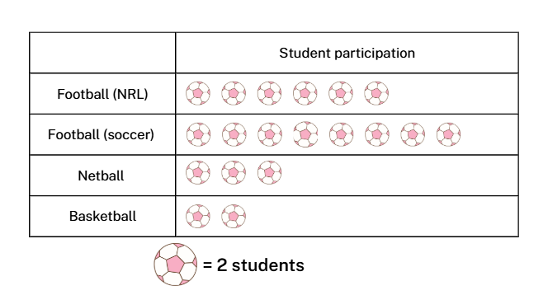
Short response (14)
How many students play soccer?
How many students play NRL?
How many more students play soccer than NRL?
Notes:
Short response questions provide brisk paced questions focussing on review of current and previous content to support spaced and interleaved practice.
Syllabus focus area:
Data A

Slide 29
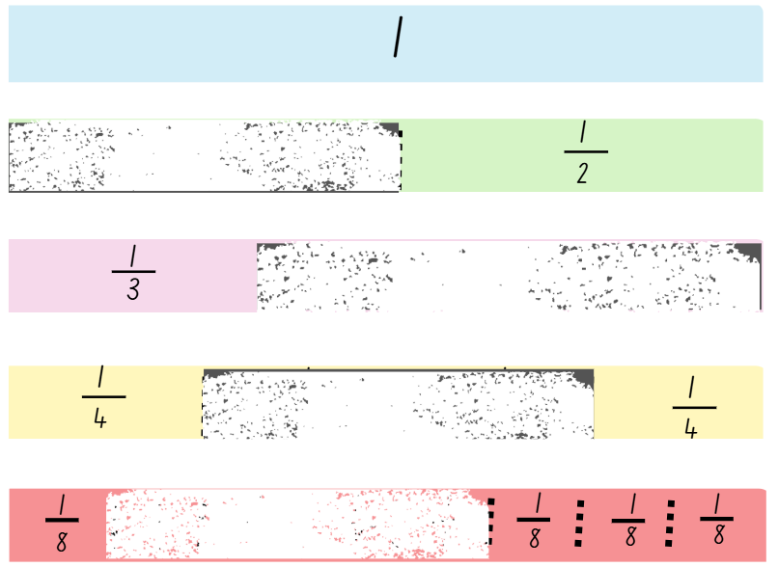


Short response (15)
Record the missing fraction parts.
What is the relationship between halves, quarters and eighths?
Notes:
Short response questions provide brisk paced questions focussing on review of current and previous content to support spaced and interleaved practice.
Syllabus focus area:
Partitioned fractions B

Slide 30
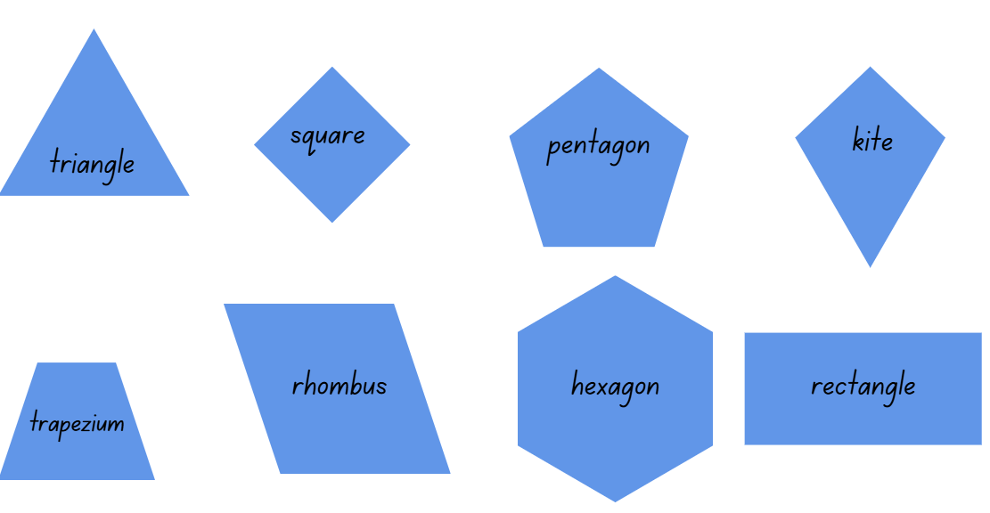
Short response (16)
Record the shapes that have parallel sides.
Notes:
Short response questions provide brisk paced questions focussing on review of current and previous content to support spaced and interleaved practice.
Syllabus focus area:
Two-dimensional spatial structure A: 2D shapes

Slide 31
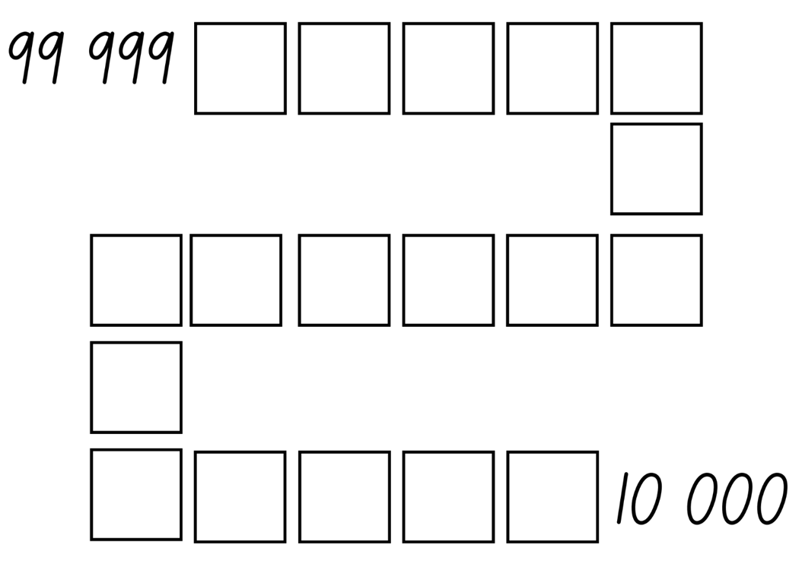
Activity 4 – descending order
Notes:
This is a developing number sense activity.
Number sense refers to a deep understanding of numbers, including their magnitude, relationships, and the effects of operations on them. It supports fluency and understanding, estimation, flexible thinking, and efficient problem-solving. Number sense activities 1–4 ‘activate’ prior number knowledge and support the learning of new content in the unit. Number sense activities 5–8 ‘loop’ back and provide opportunity for spaced practice with concepts and procedures covered in previous units.
Syllabus focus area:
Representing numbers using place value B: Whole numbers
Arranging numbers in descending order
This resource corresponds to Resource 24 descending order gameboard and figure 16 in Stage 2 Year B Unit 26
Explain that the aim of the game is to position 5-digit numbers in sequence on the gameboard. Provide pairs with four 10-sided dice and a copy of Resource 24 – descending order gameboard to each player.
Students roll the dice and create a 5-digit number. For example, 4, 6, 9, 8 and zero could be recorded as 46 089, 64 890 or 98 604. Players record their chosen number in appropriate position between 99 999 and 10 000 in descending order (see Figure 16)
If numbers cannot be placed, students miss their turn. Play continues until all boxes are filled.

Slide 32
Review of learning 5

Slide 33
Multiple choice (3)
Which of the following are the same as 94 – 65 ?
You may choose more than one answer.
A
84 – 55
B
34 – 5
C
84 + 55
D
90 – 60
Notes:
This question connects to the content in the developing number sense activity (Activity 5)
Syllabus focus area:
Additive relations A

Slide 34
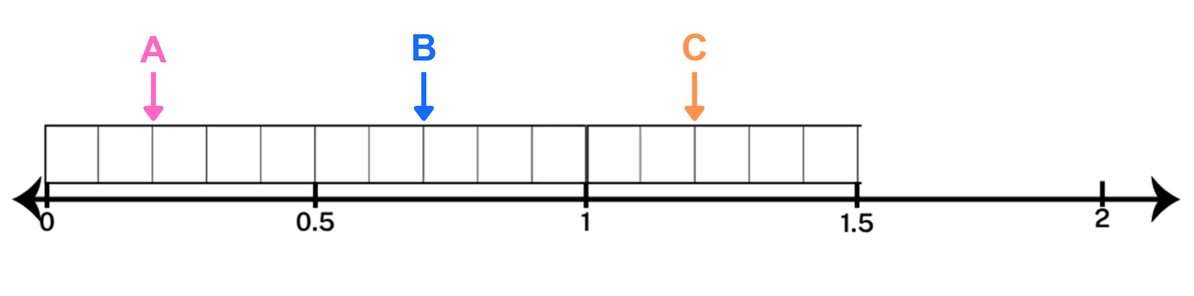
Short response (17)
Which letter represents 1.2?
Communicate your reasoning.
Notes:
Short response questions provide brisk paced questions focussing on review of current and previous content to support spaced and interleaved practice.
Syllabus focus area:
Representing numbers using place value B

Slide 35
Short response (18)
Year 4 have money to spend on sports equipment and would like to collect data to decide what to purchase.
Write a question to collect the data.
Write four categories to use for data collection.
Notes:
Short response questions provide brisk paced questions focussing on review of current and previous content to support spaced and interleaved practice.
Syllabus focus area:
Data B

Slide 36
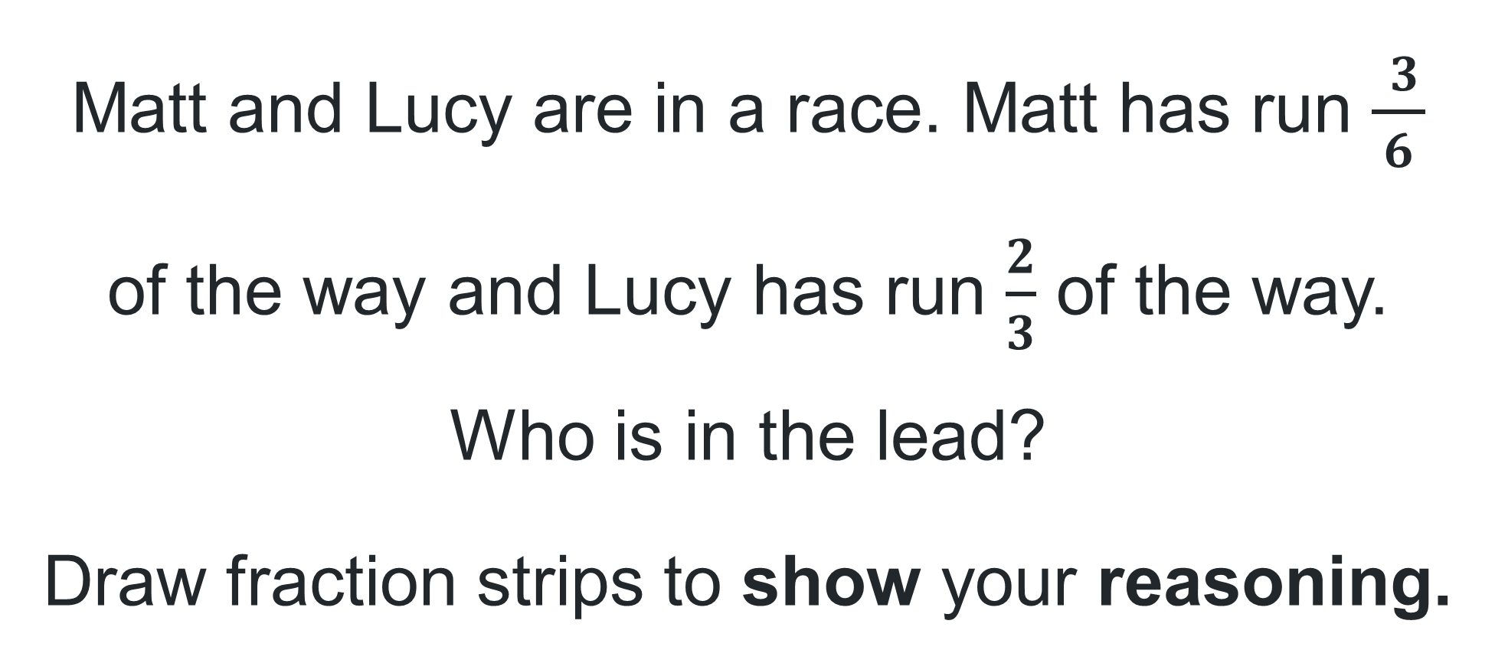
Short answer (19)
Matt and Lucy are in a race. Matt has run $\frac{ 3}{ 6 }$ of the way and Lucy has run $\frac{2}{3}$ of the way.
Who is in the lead?
Draw fraction strips to show your reasoning.
Notes:
Short response questions provide brisk paced questions focussing on review of current and previous content to support spaced and interleaved practice.
Syllabus focus area:
Partitioned fractions B

Slide 37

Short response (20)
Write the time shown on the clock in words.
Notes:
Short response questions provide brisk paced questions focussing on review of current and previous content to support spaced and interleaved practice.
Syllabus focus area:
Non-spatial measure A

Slide 38
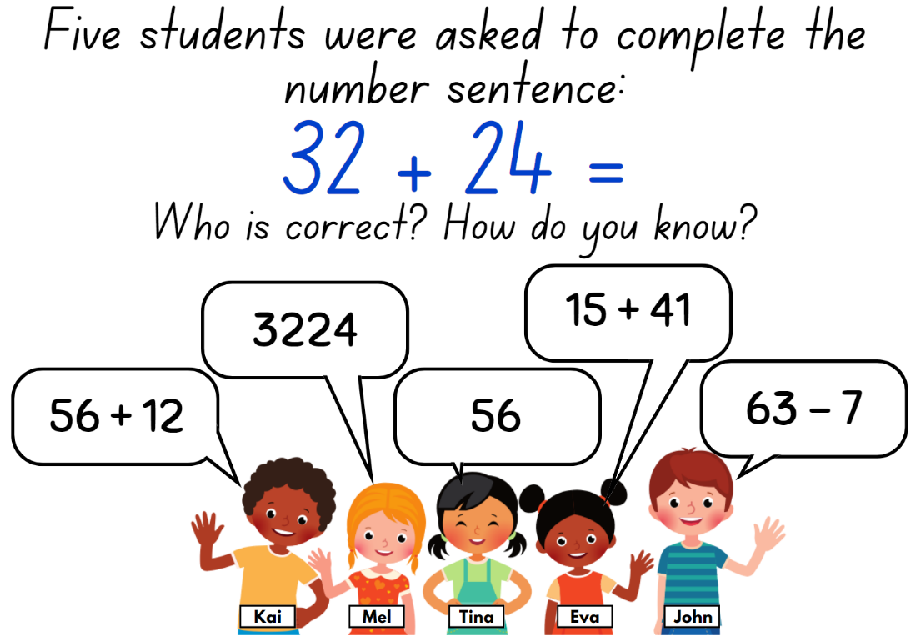
Activity 5 – equal difference
Notes:
This is a developing number sense activity.
Number sense refers to a deep understanding of numbers, including their magnitude, relationships, and the effects of operations on them. It supports fluency and understanding, estimation, flexible thinking, and efficient problem-solving. Number sense activities 1–4 ‘activate’ prior number knowledge and support the learning of new content in the unit. Number sense activities 5–8 ‘loop’ back and provide opportunity for spaced practice with concepts and procedures covered in previous units.
Syllabus focus area:
Additive relations A
Equal difference
This resource corresponds to Resource 25 – equal difference in Stage 2 Year B Unit 26.
Read the scenario to the students.
Independently or in pairs, students work on whiteboards to determine who has the correct answer to the number sentence. They must provide justification for their answer, for example, 32 + 24 = 56. 15 + 41 = 56. Eva has the correct answer because her answer is the same as the answer to the number sentence.
Discuss student answers as a class.
Ask:
How did you determine the correct answer?
Was there more than one correct answer?
Was there an answer you could rule out right away? Why?
Ask students if there are any other correct answers to the number sentence that are not on the display.
Give students an opportunity to write as many different answers to the number sentence as they can on their whiteboards.
Students share their ideas with a partner, justifying their answers.

Slide 39
Review of learning 6

Slide 40
True or false(3)
507 + 599 = 500 + 606
True | False
Notes:
The question on this slide connects to the content being explored in the developing number sense (Activity 6).
Syllabus focus area:
Additive relations A

Slide 41
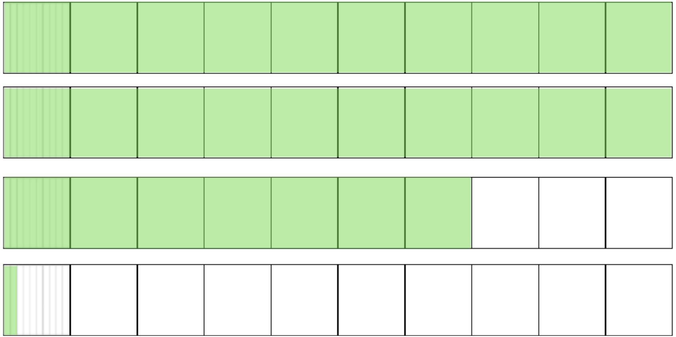
Short response (21)
Record the number shown.
Notes:
Short response questions provide brisk paced questions focussing on review of current and previous content to support spaced and interleaved practice.
Syllabus focus area:
Representing numbers using place value B: Decimals

Slide 42
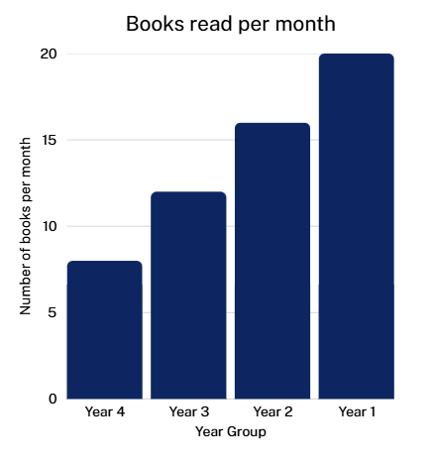
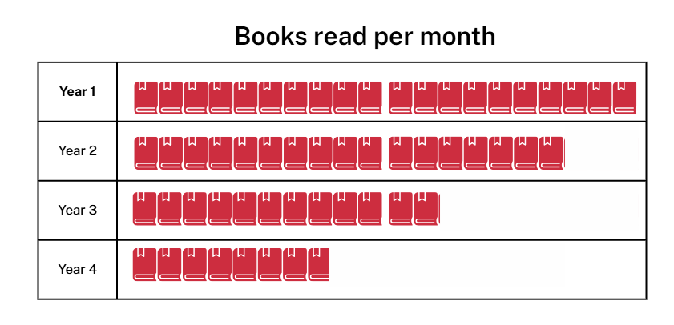
Short response (22)
Which graph is easier to understand and why?
Notes:
Short response questions provide brisk paced questions focussing on review of current and previous content to support spaced and interleaved practice.
Syllabus focus area:
Data A

Slide 43
Short response (23)
The blue fraction strip is equal to one whole.
What is the fractional quantity of the pink strip?
Can you write this in another way?
Notes:
Short response questions provide brisk paced questions focussing on review of current and previous content to support spaced and interleaved practice.
Syllabus focus area:
Partitioned fractions B

Slide 44

Short response (24)
Which of the angles indicated with a red dot are right angles?
Notes:
Short response questions provide brisk paced questions focussing on review of current and previous content to support spaced and interleaved practice.
Syllabus focus area:
Geometric measure A: Angles

Slide 45
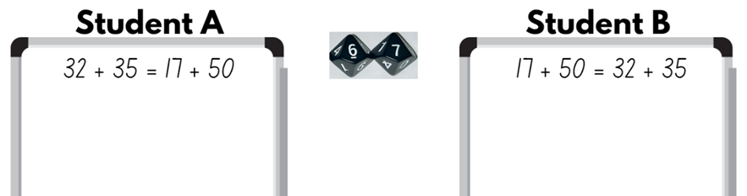
Activity 6 – equivalent number sentences 1
Notes:
This is a developing number sense activity.
Number sense refers to a deep understanding of numbers, including their magnitude, relationships, and the effects of operations on them. It supports fluency and understanding, estimation, flexible thinking, and efficient problem-solving. Number sense activities 1–4 ‘activate’ prior number knowledge and support the learning of new content in the unit. Number sense activities 5–8 ‘loop’ back and provide opportunity for spaced practice with concepts and procedures covered in previous units.
Syllabus focus area:
Additive relations A
Equivalent number sentences 1
In pairs, students roll two 10-sided dice.
Students arrange the dice to make a 2-digit number.
Each student records a number sentence on their whiteboard that would have the 2-digit number as the answer.
Students check their partners number sentence and record it as the answer to their number sentence.

Slide 46
Review of learning 7

Slide 47
Multiple choice (4)
Which of these number sentences is correct. You may select more than one.
59 - 13 = 60 - 14
A
B
49 - 19 = 50 - 18
C
68 + 35 = 70 + 37
D
155 + 75 = 160 + 80
Notes:
This question connects to the content in the developing number sense activity (Activity 7)
Syllabus focus area:
Additive relations: Use the principle of equality

Slide 48
Short response (25)
Record the role of zero in these decimals:
0.05
0.50
0.005
Notes:
Short response questions provide brisk paced questions focussing on review of current and previous content to support spaced and interleaved practice.
Syllabus focus area:
Representing numbers using place value B: Decimals

Slide 49
Short response (26)
Our class wants to create a data display on their favourite fruit. To collect the data, Group 1 conducts a survey and Group 2 makes observations.
What question might Group 1 have asked?
What might Group 2 observe?
Notes:
Short response questions provide brisk paced questions focussing on review of current and previous content to support spaced and interleaved practice.
Syllabus focus area:
Data B

Slide 50
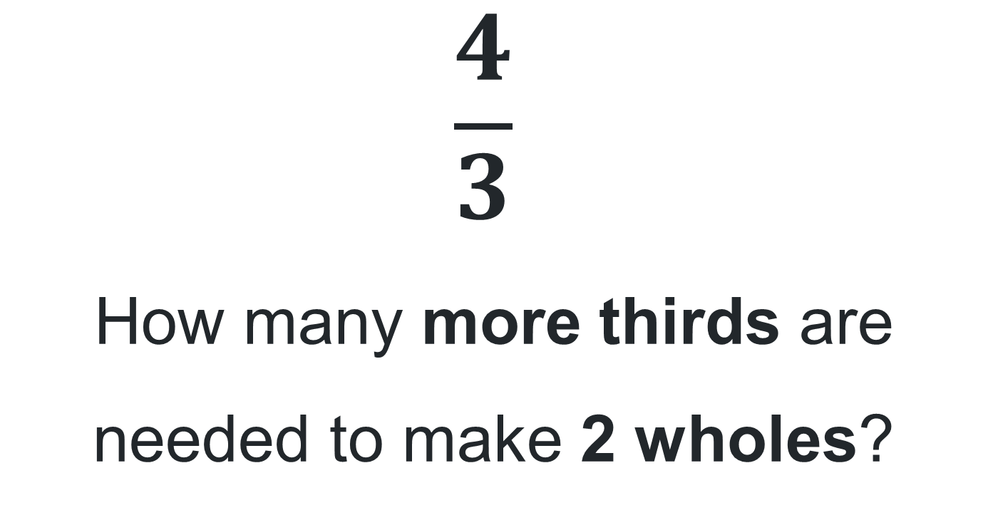
Short response (27)
$$\frac{4}{3}$$
How many more thirds are needed to make 2 wholes?
Notes:
Short response questions provide brisk paced questions focussing on review of current and previous content to support spaced and interleaved practice.
Syllabus focus area:
Partitioned fractions B

Slide 51
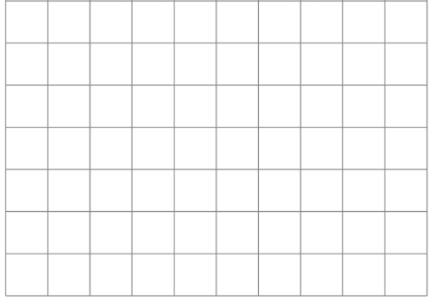
Short response (28)
What is the area of this rectangle drawn onto 1 cm grid paper?
Notes:
Short response questions provide brisk paced questions focussing on review of current and previous content to support spaced and interleaved practice.
Syllabus focus area:
Two-dimensional spatial structure A: Area

Slide 52
Activity 7– equivalent number sentences 2
Notes:
This is a developing number sense activity.
Number sense refers to a deep understanding of numbers, including their magnitude, relationships, and the effects of operations on them. It supports fluency and understanding, estimation, flexible thinking, and efficient problem-solving. Number sense activities 1–4 ‘activate’ prior number knowledge and support the learning of new content in the unit. Number sense activities 5–8 ‘loop’ back and provide opportunity for spaced practice with concepts and procedures covered in previous units.
Syllabus focus area:
Additive relations A
Equivalent number sentences 2
In pairs, students roll two 10-sided dice.
Students arrange the dice to make a 2-digit number. Each student records a number sentence on their whiteboard that would have the 2-digit number as the answer.
Students check their partners number sentence and record it as the answer to their number sentence

Slide 53
Review of learning 8

Slide 54
True or false(4)
This number sentence shows equal difference.
68 + 35 = 70 + 37
True | False
Notes:
This question connects to the content in the developing number sense activity (Activity 8)
Syllabus focus area:
Additive relations A

Slide 55
Short response (29)
Solve this using standard or non-standard partitioning:
673 – 27 =
Communicate your reasoning.
Notes:
Short response questions provide brisk paced questions focussing on review of current and previous content to support spaced and interleaved practice.
Syllabus focus area:
Additive relations A

Slide 56
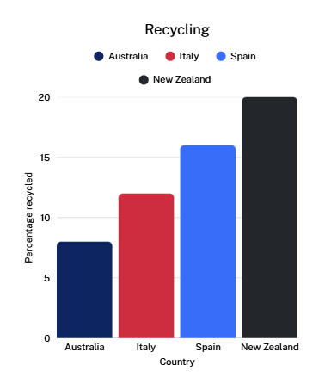
Short response (30)
Which country recycles the highest percentage of waste?
What percentage of rubbish is recycled in Italy?
Has Australia achieved its goal to recycle 20% of its rubbish?
Notes:
Short response questions provide brisk paced questions focussing on review of current and previous content to support spaced and interleaved practice.
Syllabus focus area:
Data A: interpret and compare data

Slide 57
Short response (31)
Record the answers:
How many eighths are equal to one whole?
How many quarters make 2 wholes?
How many wholes do 6-thirds make?
Notes:
Short response questions provide brisk paced questions focussing on review of current and previous content to support spaced and interleaved practice.
Syllabus focus area:
Partitioned fractions B

Slide 58
Short response (32)
Milla is going fishing. She needs to choose the shortest rod. Which rod should she choose?
Rod A: 1 m and 30 cm
Rod C:118 cm
Rod B: 120 cm
Rod D: 1 m 50 cm
Communicate your reasoning.
Notes:
Short response questions provide brisk paced questions focussing on review of current and previous content to support spaced and interleaved practice.
Syllabus focus area:
Geometric measure A: Length

Slide 59
Activity 8 – target number sentence
52 – 21 = 63 - 32
Notes:
This is a developing number sense activity.
Number sense refers to a deep understanding of numbers, including their magnitude, relationships, and the effects of operations on them. It supports fluency and understanding, estimation, flexible thinking, and efficient problem-solving. Number sense activities 1–4 ‘activate’ prior number knowledge and support the learning of new content in the unit. Number sense activities 5–8 ‘loop’ back and provide opportunity for spaced practice with concepts and procedures covered in previous units.
Syllabus focus area:
Additive relations A
Target number sentence
This activity is an adaptation of ‘Target number’ from Math for Love by Finkel.
Write a target number sentence on the board.
Using whiteboards, students write down as many different number sentences as they can that have the same answer as the target number sentence. Students must write number sentences to identify equal differences. For example, 50 -19= 61-30.
Students turn and talk to a partner to share one of their number sentences, describe the strategies they used to create it and how they know it is correct.

Slide 60
Double Venn diagram
Object 1
Object 2
Features similar to both objects
Features of object 1
Features of object 2

Slide 61
Frayer
Definition
Facts/Characteristics
Word, term, concept
Examples
Non-examples

Slide 62
Spider map
Idea
Subject

Slide 63
Cline
Concept 1
Concept 2
Word
Word
Word
Word
Word
Word
Word
Word
Word
Word
Word

Slide 64

Compare and contrast

Slide 65
Multiple choice (5)
A
B
C
D

Slide 66
Multiple choice
A
B
C
D
Notes:
This question connects to the content in the developing number sense activity (Activity 3)
Syllabus focus area:
[Focus area A/B]

Slide 67
References 1
This presentation contains NSW Curriculum and syllabus content. The NSW Curriculum is developed by the NSW Education Standards Authority. This content is prepared by NESA for and on behalf of the Crown in the right of the State of New South Wales. The material is protected by Crown copyright.
Please refer to the NESA Copyright Disclaimer for more information https://educationstandards.nsw.edu.au/wps/portal/nesa/mini-footer/copyright.
NESA holds the only official and up-to-date versions of the NSW Curriculum and syllabus documents. Please visit the NSW Education Standards Authority (NESA) website https://educationstandards.nsw.edu.au/wps/portal/nesa/home and the NSW Curriculum website https://curriculum.nsw.edu.au.
Mathematics K–10 © Syllabus NSW Education Standards Authority (NESA) for and on behalf of the Crown in right of the State of New South Wales 2021
National Numeracy Learning Progression © Australian Curriculum, Assessment and Reporting Authority (ACARA) 2010 to present, unless otherwise indicated. This material was downloaded from the Australian Curriculum website (National Numeracy Learning Progression) (accessed 23 August 2025) and was not modified.
Finkel D (2020) ‘Target Number’, Free Lessons, Math for Love website, accessed 18 December 2025.
Siemon, D., Warren, E., Beswick, K., Faragher, R., & Miller, J. (2020). Teaching Mathematics: Foundations to Middle Years (3rd ed.). Oxford University Press ANZ. ISBN 9780190311537.

Slide 68
References 2
This presentation contains NSW Curriculum and syllabus content. The NSW Curriculum is developed by the NSW Education Standards Authority. This content is prepared by NESA for and on behalf of the Crown in the right of the State of New South Wales. The material is protected by Crown copyright.
Please refer to the NESA Copyright Disclaimer for more information https://educationstandards.nsw.edu.au/wps/portal/nesa/mini-footer/copyright.
NESA holds the only official and up-to-date versions of the NSW Curriculum and syllabus documents. Please visit the NSW Education Standards Authority (NESA) website https://educationstandards.nsw.edu.au/wps/portal/nesa/home and the NSW Curriculum website https://curriculum.nsw.edu.au.
Small, M. (2009). Good questions: Great ways to differentiate mathematics instruction. Teachers College, Columbia University.
Sullivan, P., & Lilburn, P. (2009). Open-ended Maths Activities (revised ed.). Oxford University Press.
Van de Walle J, Karp K, Bay-Williams JM, Brass A, Bentley B, Ferguson S, Goff W, Livy S, Marshman M, Martin D, Pearn C, Prodromou T, Symons D and Wilkie K (2019) Primary and Middle Years Mathematics: Teaching Developmentally, 1st Australian edn, Pearson Education Australia, Melbourne.

Slide 69
Copyright
© State of New South Wales (Department of Education), 2025
The copyright material published in this resource is subject to the Copyright Act 1968 (Cth) and is owned by the NSW Department of Education or, where indicated, by a party other than the NSW Department of Education (third-party material).
Copyright material available in this resource and owned by the NSW Department of Education is licensed under a Creative Commons Attribution 4.0 International (CC BY 4.0) license.
This license allows you to share and adapt the material for any purpose, even commercially.
Attribution should be given to © State of New South Wales (Department of Education), 2025.
Material in this resource not available under a Creative Commons license:
the NSW Department of Education logo, other logos and trademark-protected material
Material owned by a third party that has been reproduced with permission. You will need to obtain permission from the third party to reuse its material.
Links to third-party material and websites
Please note that the provided (reading/viewing material/list/links/texts) are a suggestion only and implies no endorsement, by the New South Wales Department of Education, of any author, publisher, or book title. School principals and teachers are best placed to assess the suitability of resources that would complement the curriculum and reflect the needs and interests of their students.
If you use the links provided in this document to access a third party’s website, you acknowledge that the terms of use, including licence terms set out on the third-party’s website apply to the use which may be made of the materials on that third-party website or where permitted by the Copyright Act 1968 (Cth). The department accepts no responsibility for content on third-party websites.

