Slide 1
Instructions for use
This resource aligns to the learning in Stage 2 Year B Unit 27 and revisits content from earlier sample units.
Classroom teachers are encouraged to add, edit and adapt to meet the needs of their students.
Save a copy of the file to make changes to the slide deck. Go to File > Download a Copy (this downloads a copy to the computer to edit in the PowerPoint app).
To convert the PowerPoint to Google Slides:
  Upload the file into Google Drive and open it.
  Go to File > Save as Google Slides.
  (Note – conversion may cause formatting changes in the slides.)

Slide 2

Review of Learning
Mathematics Stage 2 – Unit 27
Notes:
Reviews may include a combination of question types, requiring students to recall facts and key ideas, as well as apply their knowledge to solve problems and answer questions. To support active engagement, a mix of techniques should be employed.” (AERO, 2024).
This Review of Learning slide deck revisits key concepts from the following units:
Stage 2 Year B Unit 27
Stage 2 Year B Unit 26
Stage 2 Year B Unit 25
It also includes opportunities to review prior learning in non-number content, supporting consolidation across focus areas.
The review of learning resources include three key task types that support the development of mathematical proficiency through retrieval, spaced practice, and active participation. These practices complement the review phase (activating prior knowledge) embedded within the beginning of each lesson.
1.
Multiple-choice questions/True or false: Designed to promote active retrieval of key concepts and identify common misconceptions in number, supporting consolidation, understanding and fluency.
These questions:
support spaced and interleaved practice
help identify and address common misconceptions
support active recall and immediate feedback
support whole class participation
identify areas requiring reteach
2.
Short-response question sets: Carefully grouped questions that encourage spaced and interleaved practice across multiple focus areas, helping students revisit and apply knowledge from different points in time.
These questions:
have a combination of question types
address a range of focus areas
build automaticity and fluency
support active recall
allow for immediate feedback
identify content requiring reteach
3.
Developing number sense activities: A variety of practical, purposeful tasks that reinforce current learning and build on prior knowledge. These activities promote reasoning, problem-solving and conceptual understanding.
The review of learning resources are designed to work support teaching and learning in mathematics. For the most effective implementation, use the resources flexibly, adapting to meet student learning needs and individual classroom contexts.

Slide 3
Lessons
1
Review of learning 1
5
Review of learning 5
2
Review of learning 2
6
Review of learning 6
3
Review of learning 3
7
Review of learning 7
4
Review of learning 4
8
Review of learning 8
Notes:
Teacher notes:
Click lesson numbers to go to specific lessons
Interactive features can be viewed in slide show

Slide 4
Review of learning 1

Slide 5

Multiple choice (1)
Which number is not a multiple of 4?
A
B
C
D
4
10
12
24
Notes:
This question connects to the content in the developing number sense activity (Activity 1)
Syllabus focus area:
Multiplicative relations B

Slide 6

Short response (1)
How can doubling the answer help to generate a x8 fact.
4 x 3 = ?
4 x 5 = ?
4 x 10 = ?
Communicate your reasoning.
Notes:
Short response questions provide brisk paced questions focussing on review of current and previous content to support spaced and interleaved practice.
Syllabus focus area:
Multiplicative relations B

Slide 7
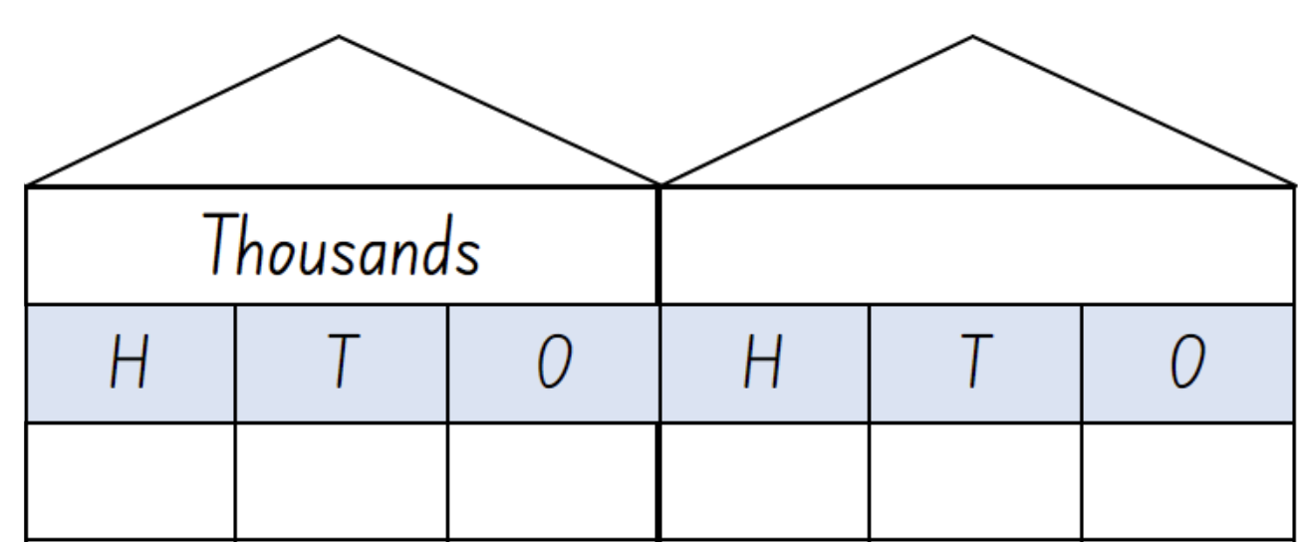
Short response (2)
Record the number 459 062 on the place value house.
Record 459 062 using expanded notation.
Notes:
Short response questions provide brisk paced questions focussing on review of current and previous content to support spaced and interleaved practice.
Syllabus focus area:
Represent numbers using place value B

Slide 8
Short response (3)
Write a question to get information about this matter of interest:
school subjects
Notes:
Short response questions provide brisk paced questions focussing on review of current and previous content to support spaced and interleaved practice.
Syllabus focus area:
Data A

Slide 9



Short response (4)
Read and record the analog times:
clock A
clock B
clock C
Notes:
Short response questions provide brisk paced questions focussing on review of current and previous content to support spaced and interleaved practice.
Syllabus focus area:
Non-spatial measure A: Time

Slide 10

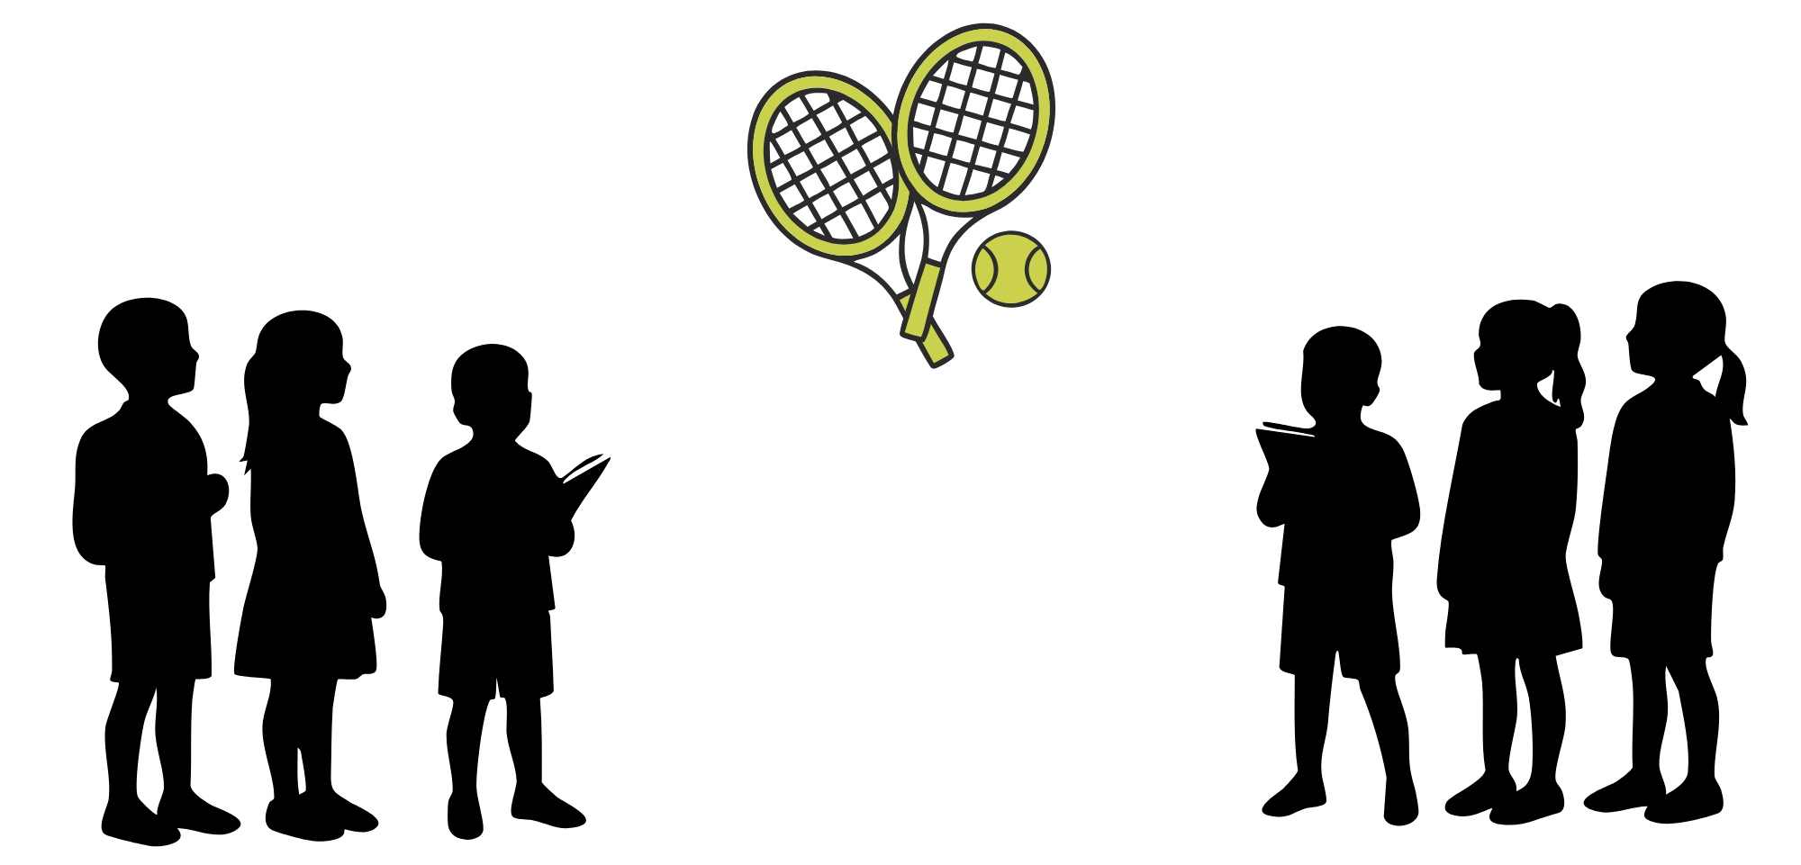
Activity 1 – doubling to connect multiples (1)
What number facts and strategies do you know to help multiply numbers?
Notes:
This is a developing number sense activity.
Number sense refers to a deep understanding of numbers, including their magnitude, relationships, and the effects of operations on them. It supports fluency and understanding, estimation, flexible thinking, and efficient problem-solving. Number sense activities 1–4 ‘activate’ prior number knowledge and support the learning of new content in the unit. Number sense activities 5–8 ‘loop’ back and provide opportunity for spaced practice with concepts and procedures covered in previous units.
Syllabus focus area:
Multiplicative relations B
Doubling to connect multiples
Explain that students will play a game where they use known number facts and strategies to help multiply numbers. Model how to play the game to the class and choose volunteers to make 2 teams of 3 students in each.
Introduce the game as being like tennis, where players take turns to serve a number over a pretend tennis net.
Note: during the demonstration, pause and ask students to explain the strategies they used to find the answer.
The rules of the game are:
- The number is the tennis ball. Teams consist of 3 students on either side.
- Each time the number is hit over the net, it increases by an agreed amount. For example, the first volley starts with the number 3 and doubles each time it is hit over the net.
- Students from each team raise their hand if they would like to hit the number back over the net. If yes, and students say the correct answer, the number returns over the net for the other team. Students cannot hit the number again until everyone on their team has had a turn.
- After 10 multiples have been returned correctly, the team that served the number first gets a point.
A student from one team serves first, by saying the number to be multiplied or doubled.
Remind students to use known number facts and strategies to help them as they play.
Start the first round of the game, focusing on multiples of 2, 3, 4, 5 and 10.

Slide 11
Review of learning 2

Slide 12
True or false (1)
32 is double 8.
True | False
Communicate your reasoning.
Notes:
The question on this slide connects to the content being explored in the developing number sense activity (Activity 2)
Syllabus focus area:
Multiplicative relations B

Slide 13
Short response (5)
Record the multiples for 3 and 6.
How are the multiples of 3 and 6 connected?
Communicate your reasoning.
Notes:
Short response questions provide brisk paced questions focussing on review of current and previous content to support spaced and interleaved practice.
Syllabus focus area:
Multiplicative relations B

Slide 14
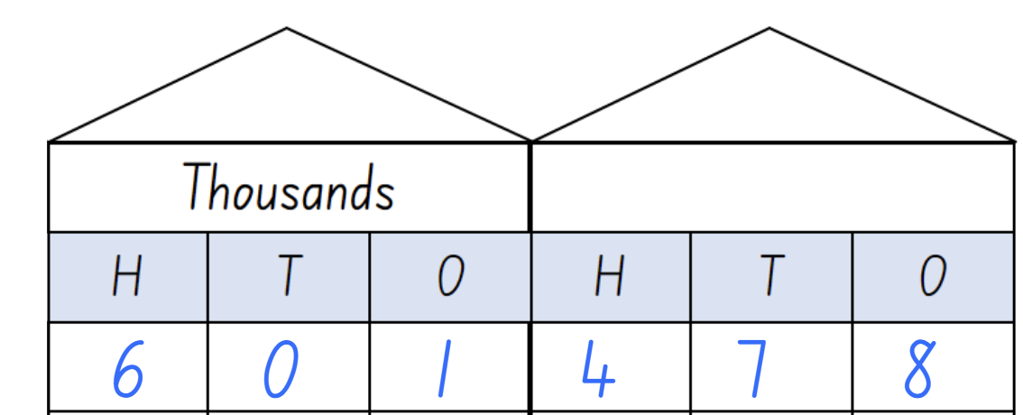
Short response (6)
Partition the number 601 478 in two different ways using non-standard forms.
Notes:
Short response questions provide brisk paced questions focussing on review of current and previous content to support spaced and interleaved practice.
Syllabus focus area:
Represents number using place value B

Slide 15
Short response (7)
Write a list of categories for the survey question:
How often should we have school sport?
Notes:
Short response questions provide brisk paced questions focussing on review of current and previous content to support spaced and interleaved practice.
Syllabus focus area:
Data B

Slide 16
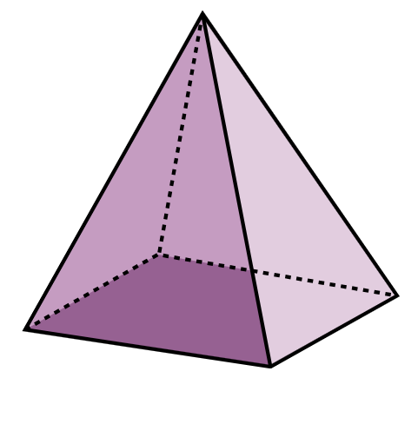
Short response (8)
Draw the top view of this 3D object.
Notes:
Short response questions provide brisk paced questions focussing on review of current and previous content to support spaced and interleaved practice.
Syllabus focus area:
Three-dimensional spatial structure B: 3D objects

Slide 17
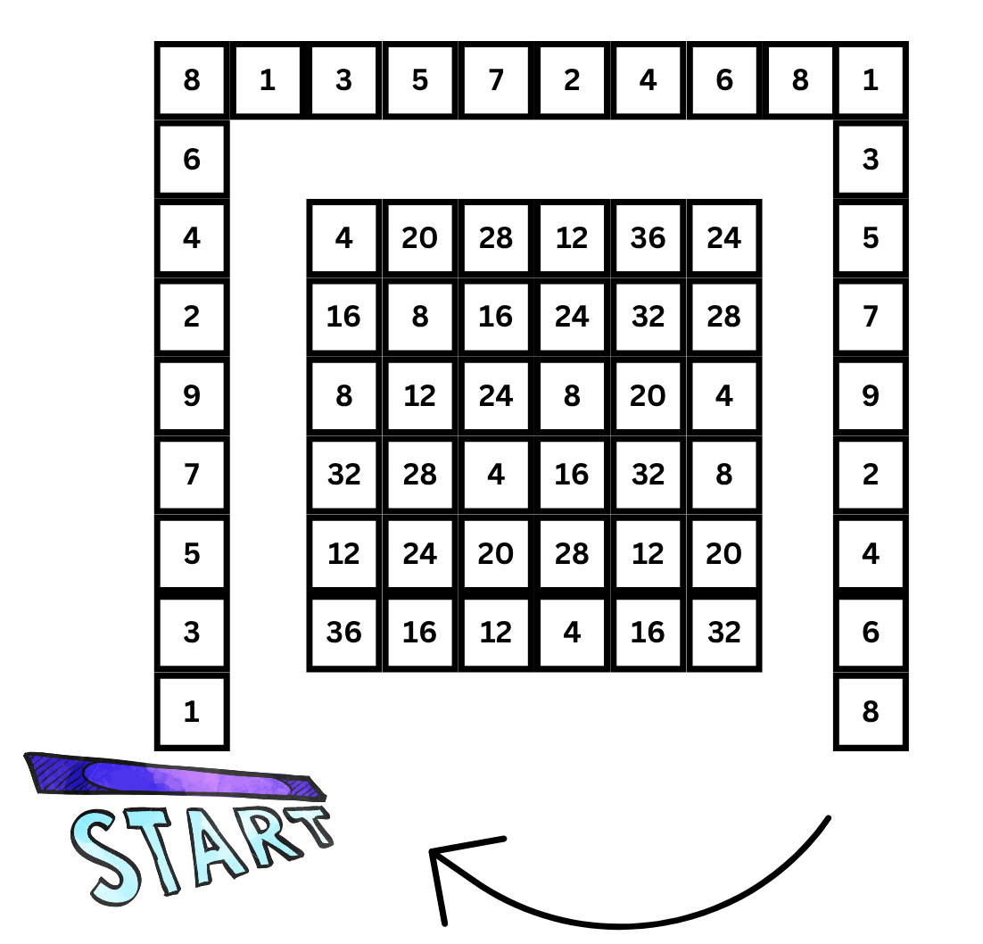
Activity 2 – doubling numbers
Notes:
This is a developing number sense activity.
Number sense refers to a deep understanding of numbers, including their magnitude, relationships, and the effects of operations on them. It supports fluency and understanding, estimation, flexible thinking, and efficient problem-solving. Number sense activities 1–4 ‘activate’ prior number knowledge and support the learning of new content in the unit. Number sense activities 5–8 ‘loop’ back and provide opportunity for spaced practice with concepts and procedures covered in previous units.
Syllabus focus area:
Multiplicative relations B
Doubling numbers
This resource corresponds to Resource 27 – Double Double Up in Stage 2 Year B Unit 27.
This activity is an adaptation from ‘Double Double Up’ from Dr Paul Swan Board Game Pack Years 3–4 by Swan.
In pairs, provide students a copy of Resource 27 – Double Double Up and a 6-sided dice.
Explain that the aim of the game is to place 4 counters in a row, column or diagonally within the box of numbers in the centre of the board game. To play the game, partners take turns to:
- roll the dice and move along the outside track
- double the number they land on, then double the number again. Students use mental strategies and individual whiteboards to work out the answer
- place a counter on the answer in the box of numbers in the centre square.
The first player with 4 counters in a row wins the game.

Slide 18
Review of learning 3

Slide 19
Multiple choice (2)
Which would create the largest array?
A
6 x 3
B
4 eights
C
2 tens
D
3 x 9
Notes:
This question connects to the content in the developing number sense activity (Activity 3)
Syllabus focus area:
Multiplicative relations B

Slide 20
Short response (9)
The number sentence 2 x 12 can be rewritten
as 2 x (2 x 6).
Rewrite the number sentence in as many ways as possible using regrouping.
Which grouping is easiest to solve and why?
Notes:
Short response questions provide brisk paced questions focussing on review of current and previous content to support spaced and interleaved practice.
Syllabus focus area:
Multiplicative relations B

Slide 21
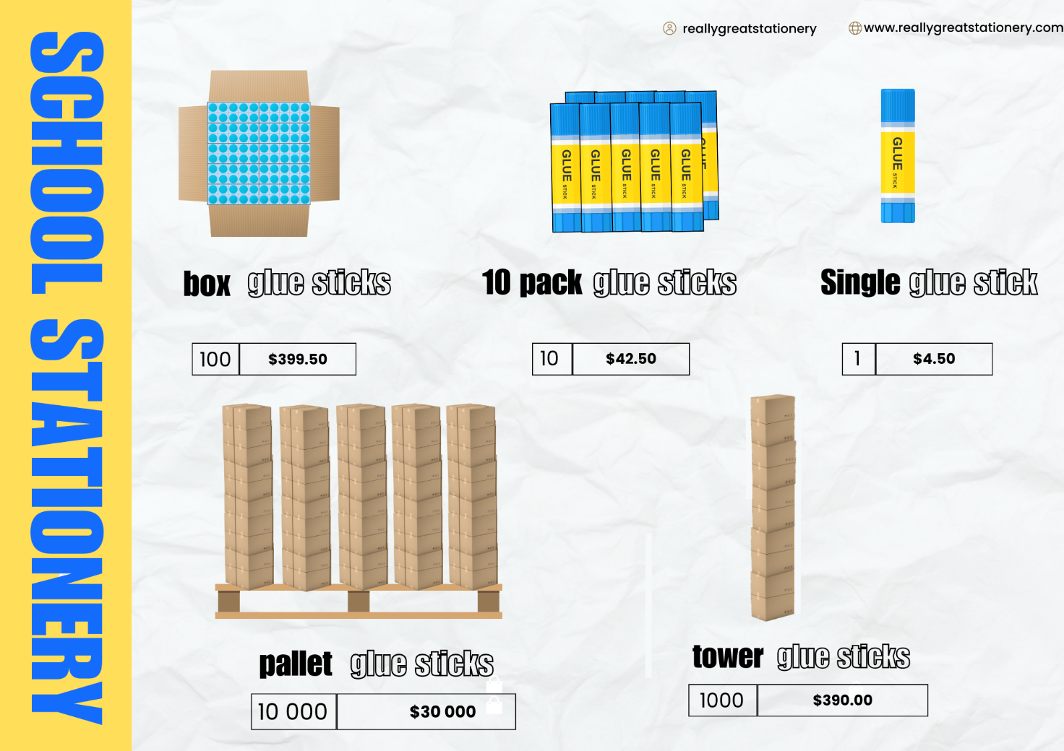
Short response (10)
Use partitioning to represent 3 different number combinations for ordering 12 600 glue sticks.
Notes:
Short response questions provide brisk paced questions focussing on review of current and previous content to support spaced and interleaved practice.
Syllabus focus area:
Represents number using place value B

Slide 22




Short response (11)
What other ways of presenting this data would be effective?
Survey Question | Categories and Responses
What is your favourite type of movie or TV show? | animation | comedy | action | documentary
Communicate your reasoning.
Notes:
Short response questions provide brisk paced questions focussing on review of current and previous content to support spaced and interleaved practice.
Syllabus focus area:
Data A

Slide 23

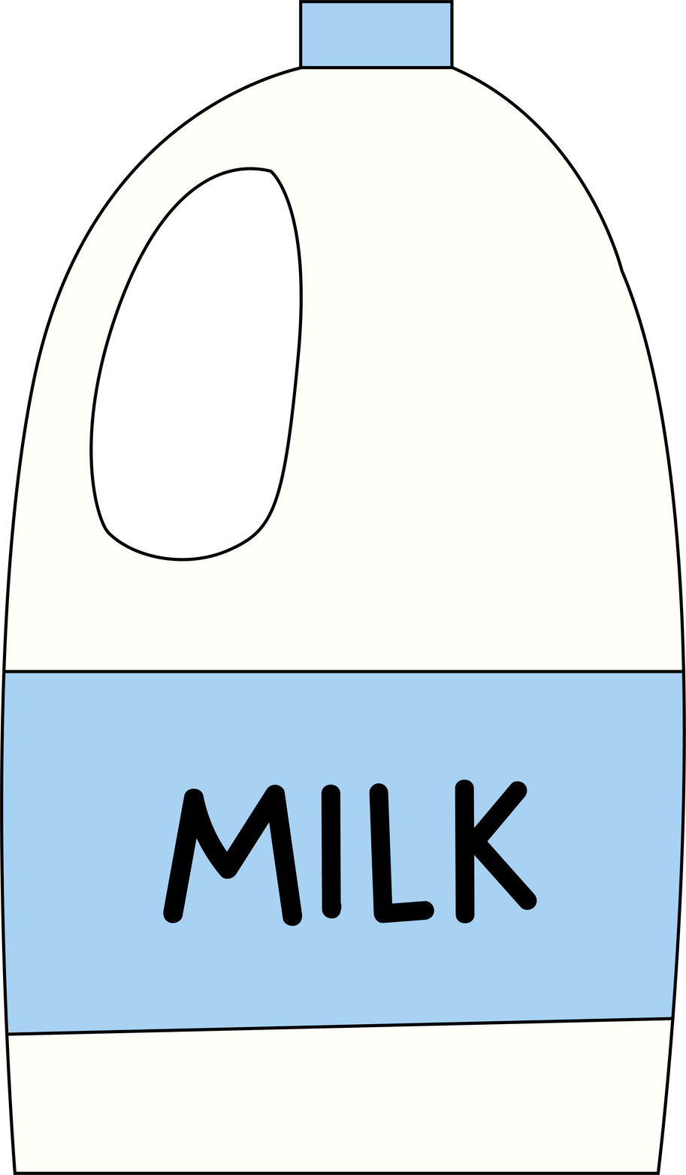

Short response (12)
Match the container to the correct capacity:
A. B. C.
1250 mL
2 L
1500 mL
1 litre 500 mL
1 litre 250 mL
2000 mL
Notes:
Short response questions provide brisk paced questions focussing on review of current and previous content to support spaced and interleaved practice.
Syllabus focus area:
Three-dimensional spatial structure B: Volume

Slide 24
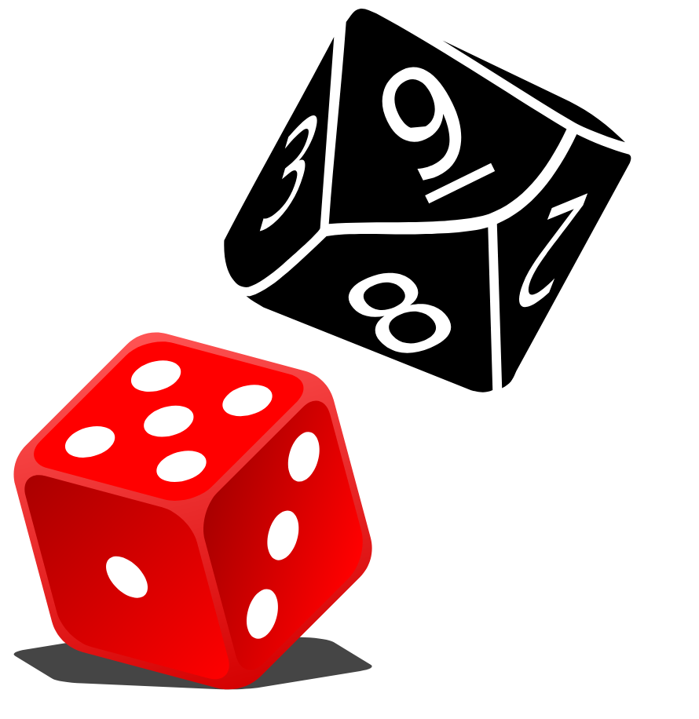
Activity 3 – multiples to create arrays
Notes:
This is a developing number sense activity.
Number sense refers to a deep understanding of numbers, including their magnitude, relationships, and the effects of operations on them. It supports fluency and understanding, estimation, flexible thinking, and efficient problem-solving. Number sense activities 1–4 ‘activate’ prior number knowledge and support the learning of new content in the unit. Number sense activities 5–8 ‘loop’ back and provide opportunity for spaced practice with concepts and procedures covered in previous units.
Syllabus focus area:
Multiplicative relations B
Multiples to create arrays
This activity is an adaptation of ‘Arrays Games’ from Dr Paul Swan Board Game Pack Years 3–4 by Swan.
This can be played between students in pairs or by dividing the class into 2 teams.
Students share a piece of grid paper if they are playing the game in pairs. Explain that the aim of the game is to capture the greatest area of the grid.
To play the game, each player or team takes turns to:
- Roll a 6-sided and a 10-sided dice.
- Use the 2 numbers rolled to create an array on the grid. The player shades the inside of the rectangle and writes the calculation inside the array. Mental strategies and individual whiteboards can be used to calculate the answer. Encourage students to use known facts and doubling strategies to determine the answer.
The winner is the team or player who captures the greatest area in a set time.

Slide 25
Review of learning 4

Slide 26
True or false (2)
Starting number | 55 | Target Number | 63
I roll a 9-sided dice. I must either double or halve my roll before adding it to the starting number.
The only way to reach the target number is by rolling a 9.
True | False
Communicate your reasoning.
Notes:
The question on this slide connects to the content being explored in the developing number sense activity (Activity 4)
Syllabus focus area:
Multiplicative relations B

Slide 27
Short response (13)
Find the total of the partially covered area model.
Notes:
Short response questions provide brisk paced questions focussing on review of current and previous content to support spaced and interleaved practice.
Syllabus focus area:
Multiplicative relations A

Slide 28
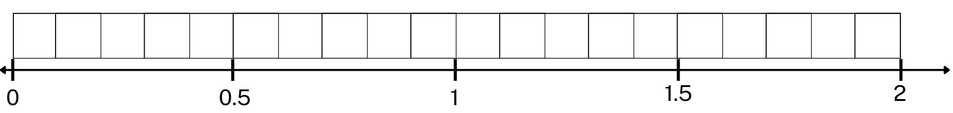
Short response (14)
On the number line and tenths strip, which of the following would be closer to 1.
14 tenths
6 tenths
11 tenths
Notes:
Short response questions provide brisk paced questions focussing on review of current and previous content to support spaced and interleaved practice.
Syllabus focus area:
Representing numbers using place value B

Slide 29
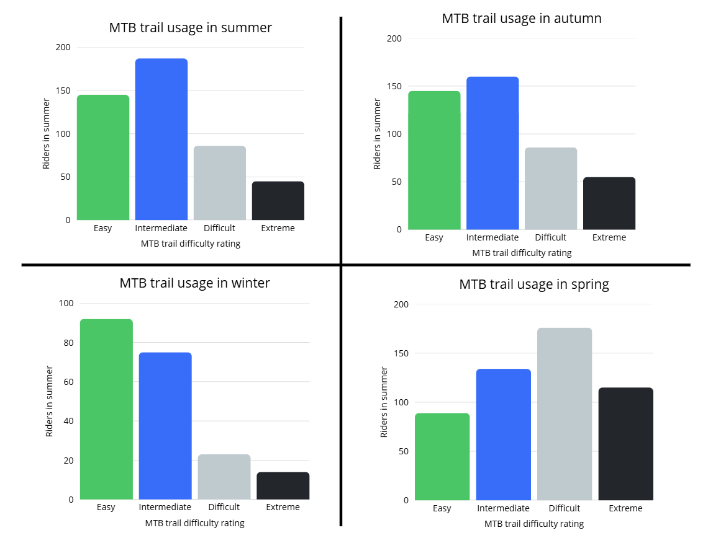
Short response (15)
The graphs show mountain bike trail usage. Which season had the busier trails?
Riders in winter
Riders in summer
Notes:
Short response questions provide brisk paced questions focussing on review of current and previous content to support spaced and interleaved practice.
Syllabus focus area:
Data A

Slide 30



Short response (16)
Which ribbon is the longest?
Write its length using metres and centimetres.
Ribbon A: 125 cm
Ribbon B: 1 m 30 cm
Ribbon C: 140 cm
Notes:
Short response questions provide brisk paced questions focussing on review of current and previous content to support spaced and interleaved practice.
Syllabus focus area:
Geometric measure length A: Length

Slide 31

Activity 4 – double or halve (1)
Choose a target number and double or halve.
Notes:
This is a developing number sense activity.
Number sense refers to a deep understanding of numbers, including their magnitude, relationships, and the effects of operations on them. It supports fluency and understanding, estimation, flexible thinking, and efficient problem-solving. Number sense activities 1–4 ‘activate’ prior number knowledge and support the learning of new content in the unit. Number sense activities 5–8 ‘loop’ back and provide opportunity for spaced practice with concepts and procedures covered in previous units.
Syllabus focus area:
Multiplicative relations B
Double or halve
This resource corresponds to Activity 4 – double or halve in Stage 2 Year B Unit 27.
This activity is an adaptation of ‘Double and Halve?’ from NRICH by the University of Cambridge.
Explain the rules of the game, ‘Double or Halve’. This is a game for two players. You will need a 6- or 9-sided dice
Explain that the aim of the game is to reach the target number. To play the game, in pairs, each player takes turns to:
- Decide on a target number. This is the total that both players are trying to make.
- Player 1 throws the dice. They can choose whether to double the number shown or halve the number shown.
- Player 2 throws the dice. In the same way, they can choose whether to double the number shown or halve the number shown.
- Player 2 adds their number onto Player 1's number to make a running total.
- Play continues like this with each player rolling the dice, halving or doubling the number, and adding the result onto the running total.
The winner is the player who reaches the agreed target exactly.
After the game has been played, ask:
- Must each player always take a turn? Does it matter if you go first or second?
- Are there any particularly good numbers to choose as your target? Why or why not?
- What are you thinking about in order to try to win the game?

Slide 32
Review of learning 5

Slide 33
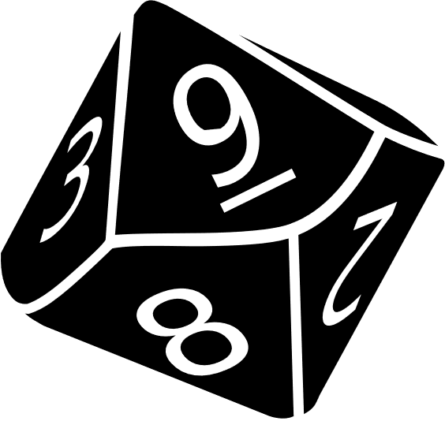
Multiple choice (3)
Find the numbers that are 10, 100 and 1000 times larger than the number rolled ‘9’.
A
9, 90, 9000
B
90, 900, 9000
C
10, 100, 1000
D
99, 990, 9900
Notes:
This question connects to the content in the developing number sense activity (Activity 5)
Syllabus focus area:
Representing numbers using place value B

Slide 34
Short response (17)
Write the related multiplication and division number sentences for:
42, 6 and 7
Notes:
Short response questions provide brisk paced questions focussing on review of current and previous content to support spaced and interleaved practice.
Syllabus focus area:
Multiplicative relations A

Slide 35
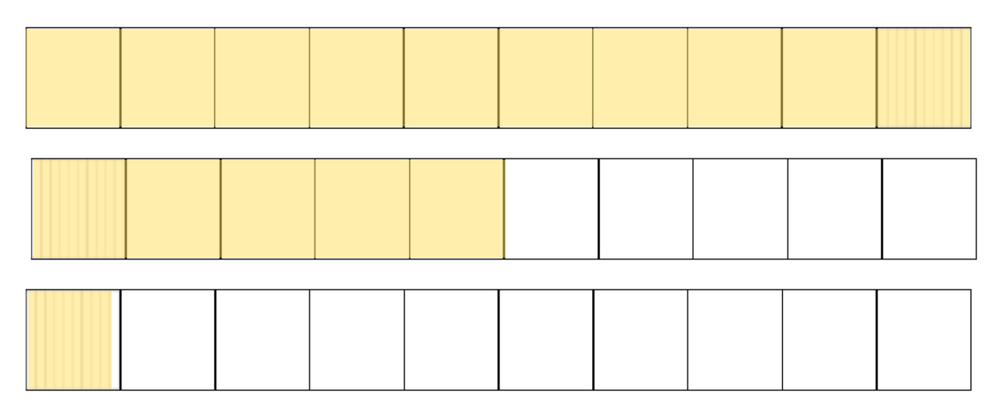
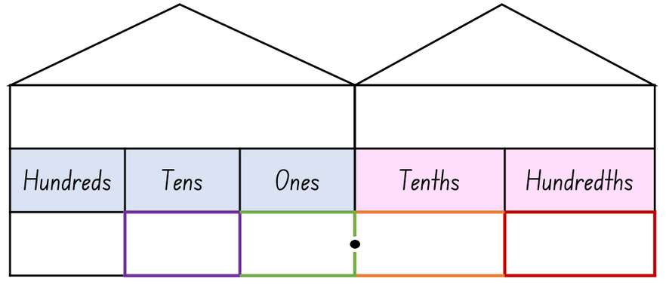
Short response (18)
Determine the decimal number presented here.
Record this number in a decimal place value house.
Notes:
Short response questions provide brisk paced questions focussing on review of current and previous content to support spaced and interleaved practice.
Syllabus focus area:
Representing numbers using place value B

Slide 36

Short response (19)
How are the representations of data similar and different?
Which one is easier to interpret and why?
Class | Pieces of rubbish
KD | 15
KJ | 19
1H | 22
1/2L | 25
2B | 21
3P | 22
3/4F | 27
4A | 34
5D | 30
5/6R | 26
6W | 35
Column Graph
Table
Notes:
Short response questions provide brisk paced questions focussing on review of current and previous content to support spaced and interleaved practice.
Syllabus focus area:
Data B

Slide 37


Short response (20)
Write each mass using the abbreviation for kilogram.
A pumpkin has a mass of
3 kilograms
A watermelon has a mass of 7 kilograms
Notes:
Short response questions provide brisk paced questions focussing on review of current and previous content to support spaced and interleaved practice.
Syllabus focus area:
Non-spatial measure A: Mass

Slide 38
Activity 5 – 10, 100 or 1000 times as large
 | X 1 | X 10 | X 100 | X 1000
Example | 3 | 30 | 300 | 3000
1st roll
2nd roll
3rd roll
4th roll
5th roll
Notes:
This is a developing number sense activity.
Number sense refers to a deep understanding of numbers, including their magnitude, relationships, and the effects of operations on them. It supports fluency and understanding, estimation, flexible thinking, and efficient problem-solving. Number sense activities 1–4 ‘activate’ prior number knowledge and support the learning of new content in the unit. Number sense activities 5–8 ‘loop’ back and provide opportunity for spaced practice with concepts and procedures covered in previous units.
Syllabus focus area:
Representing numbers using place value B
10, 100 or 1000 times as large
This resource corresponds to Resource 25 – 1s, 10s, 100s and 1000s in Stage 2 Year B Unit 27.
Provide students with Resource 28 – 1s, 10s, 100s and 1000s and a 9-sided die.
Students roll the dice and record the number rolled. Students then record the numbers that are 10, 100 and 1000 times larger than the number rolled.
Students repeat 4 more times.
Note: a 20-sided die may be used to make the activity more challenging.

Slide 39
Review of learning 6

Slide 40
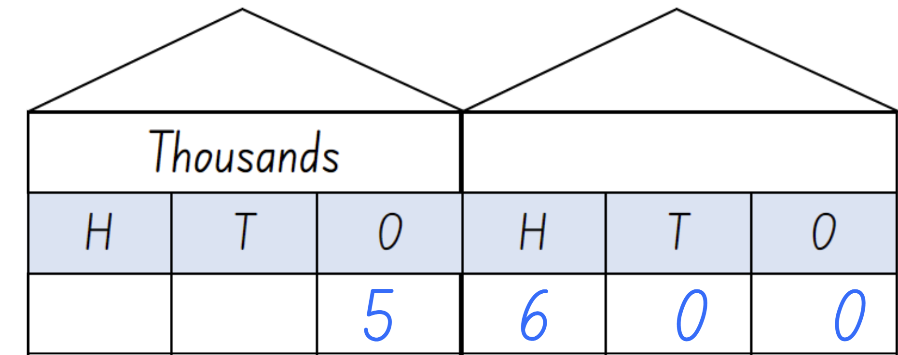
True or false (3)
The number is 56. The number shown in the place value house is 100 times larger than 56.
True | False
Notes:
The question on this slide connects to the content being explored in the developing number sense activity (Activity 6)
Syllabus focus area:
Representing numbers using place value B

Slide 41
Short response (21)
Which equation is not in the fact family for:
32
32 ÷ 8
32 ÷ 7
32 ÷ 4
32 ÷ 2
Communicate your reasoning
Notes:
Short response questions provide brisk paced questions focussing on review of current and previous content to support spaced and interleaved practice.
Syllabus focus area:
Multiplicative relations B

Slide 42
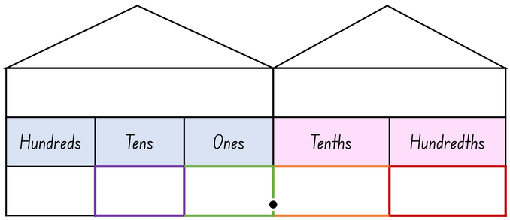
Short response (22)
Use the place value house to record:
6 wholes as a decimal
6-tenths as a decimal
6-hundredths as a decimal
Is the decimal point and zero necessary? Why/why not?
Notes:
Short response questions provide brisk paced questions focussing on review of current and previous content to support spaced and interleaved practice.
Syllabus focus area:
Representing numbers using place value B

Slide 43
Short response (23)
What is missing from this graph?
Notes:
Short response questions provide brisk paced questions focussing on review of current and previous content to support spaced and interleaved practice.
Syllabus focus area:
Data A

Slide 44
Short response (24)
Explain the term equally likely
and give an example?
Notes:
Short response questions provide brisk paced questions focussing on review of current and previous content to support spaced and interleaved practice.
Syllabus focus area:
Chance B

Slide 45
Activity 6 – changing place value
Thousands
H | T | O
H | T | O
Notes:
This is a developing number sense activity.
Number sense refers to a deep understanding of numbers, including their magnitude, relationships, and the effects of operations on them. It supports fluency and understanding, estimation, flexible thinking, and efficient problem-solving. Number sense activities 1–4 ‘activate’ prior number knowledge and support the learning of new content in the unit. Number sense activities 5–8 ‘loop’ back and provide opportunity for spaced practice with concepts and procedures covered in previous units.
Syllabus focus area:
Representing numbers using place value B
Changing place value
This resource corresponds to Activity 6 – changing place value in Stage 2 Year B Unit 27.
Draw a place value house on the whiteboard, large enough for students to stand in front of each column.
Ask 6 students to represent numbers by standing or squatting in front of the place value house. A student stands to represent the number one and squats to represent zero.
Allocate a student to each write a number on the board.
Ask students to represent 101. The student in the hundreds place and the student in the ones place will stand. All others must squat.
Note: initial numbers must be limited to a maximum of 111 to ensure larger numbers will fit inside the place value house.
Ask students to represent the number 100 times larger than 101. To represent the number 10 100, only the ten thousands and hundreds place students remain standing. All others squat.
Continue providing numbers with ones and zeros and numbers that are 10, 100 and 1000 times larger.
Rotate students regularly to ensure all are involved.
Note: an alternative is to form teams of 6 students. Provide a number and have students allocate themselves to a place value and the teams create their number representations.

Slide 46
Review of learning 7

Slide 47
Multiple choice (4)
Starting at 804, what are the numbers 10, 100 and 1000 times larger?
A
B
C
D
x 10 = 4 800
x 100 = 48 000
x 1000 = 480 000
x 10 = 840
x 100 = 8 400
x 1000 = 84 000
x 10 = 8 040
x 100 = 80 400
x 1000 = 804 000
x 10 = 8 400
x 100 = 84 000
x 1000 = 840 000
Notes:
This question connects to the content in the developing number sense activity (Activity 7)
Syllabus focus area:
Representing numbers using place value B

Slide 48
Short response (25)
Apply the associative property to find the pair of number sentences that have the same total.
7 x 2 X 2
7 x 2 x 4
4 x 7 x 2
Communicate your reasoning.
Notes:
Short response questions provide brisk paced questions focussing on review of current and previous content to support spaced and interleaved practice.
Syllabus focus area:
Multiplicative relations B

Slide 49
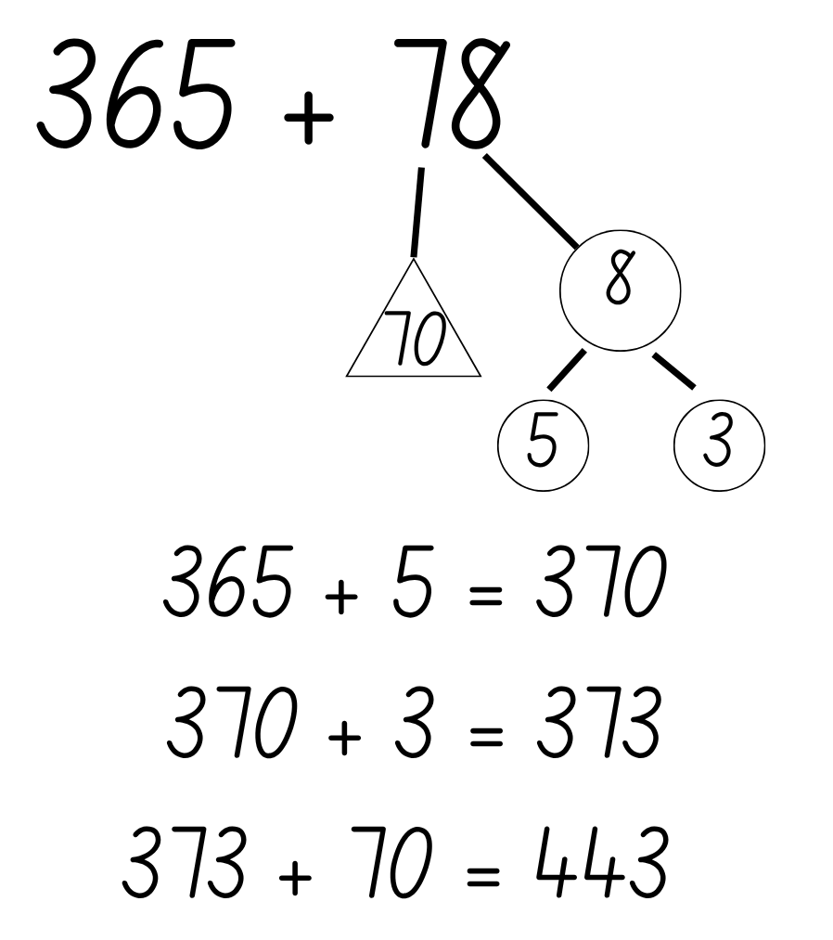
Short response (26)
Partition using quantity values and bridge to the nearest decade to solve:
149 + 63
465 + 156
244 + 87
Notes:
Short response questions provide brisk paced questions focussing on review of current and previous content to support spaced and interleaved practice.
Syllabus focus area:
Additive relations A

Slide 50
Short response (27)
Class 4P asked the survey question:
What do you like about lunch?
Responses included: sandwiches, playing outside, juice, talking with friends, ice cream.
Refine this question so students only give answers about food.
Notes:
Short response questions provide brisk paced questions focussing on review of current and previous content to support spaced and interleaved practice.
Syllabus focus area:
Data B

Slide 51
Short response (28)
Which of these polygons have parallel sides?
Communicate your reasoning.
Notes:
Short response questions provide brisk paced questions focussing on review of current and previous content to support spaced and interleaved practice.
Syllabus focus area:
Two-dimensional spatial structure A: 2D shapes

Slide 52
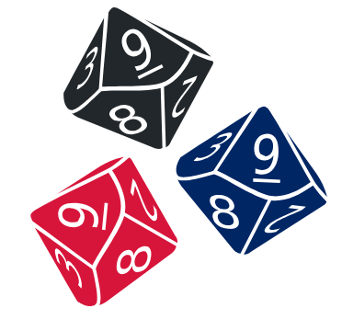
Activity 7 – exploring place value and multiplication
Thousands
H | T | O
H | T | O
Notes:
This is a developing number sense activity.
Number sense refers to a deep understanding of numbers, including their magnitude, relationships, and the effects of operations on them. It supports fluency and understanding, estimation, flexible thinking, and efficient problem-solving. Number sense activities 1–4 ‘activate’ prior number knowledge and support the learning of new content in the unit. Number sense activities 5–8 ‘loop’ back and provide opportunity for spaced practice with concepts and procedures covered in previous units.
Syllabus focus area:
Representing numbers using place value B
Exploring place value and multiplication
This resource corresponds to Activity 7 – exploring place value and multiplication in Stage 2 Year B Unit 27.
Provide pairs of students three 9-sided dice and an individual whiteboard.
Ask students to draw a place value chart on their whiteboard.
Students roll the dice and arrange the dice to form the smallest number possible. For example, rolling a 5, 1 and 9, the dice could be arranged to form the number 159.
Students record the number that is 10 times larger.
On the second roll of the dice, students form the largest number possible and record the number that is 100 times larger.
On the third roll of the dice, students form any number and record the number that is 1000 times larger.
Repeat this 3 times so that students can practice numbers 10, 100 and 1000 times larger.
Vary the task by asking students to select specific numbers, such as those that have an even hundreds digit, or an odd unit digit, or a number with even thousands and tens digits.

Slide 53
Review of learning 8

Slide 54
True or false (4)
In the number 4 873, there are:
4 thousands, 8 tens and 3 ones
True | False
Communicate your reasoning.
Notes:
The question on this slide connects to the content being explored in the developing number sense activity (Activity 8)
Syllabus focus area:
Representing numbers using place value B

Slide 55
Short response (29)
Solve:
40 x 6
Communicate your strategy.
Notes:
Short response questions provide brisk paced questions focussing on review of current and previous content to support spaced and interleaved practice.
Syllabus focus area:
Multiplicative relations B

Slide 56
Short response (30)
Use standard partitioning to solve:
574 - 68
Use non-standard partitioning to solve:
473 - 28
400
60
13
20
8
Why do you think non-standard partitioning has been used?
Notes:
Short response questions provide brisk paced questions focussing on review of current and previous content to support spaced and interleaved practice.
Syllabus focus area:
Additive relations A

Slide 57

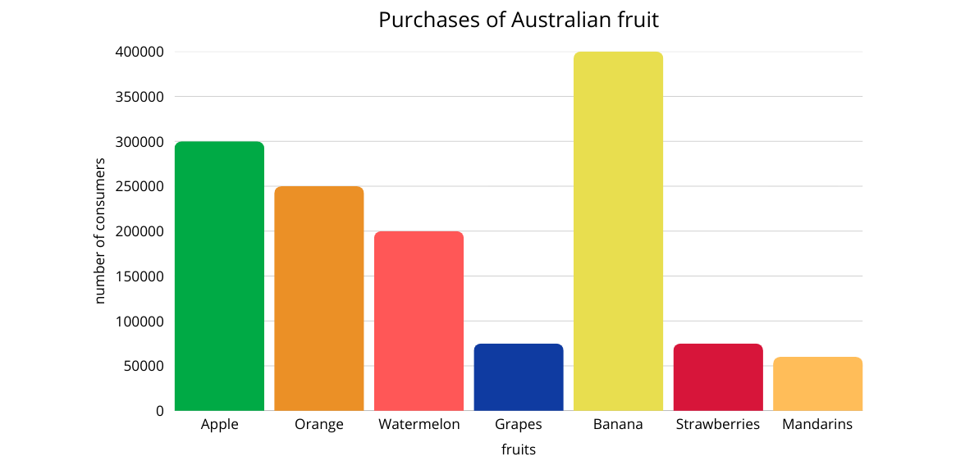
Short response (31)
Would it be efficient to represent this data in a tally table? Why or why not?
Notes:
Short response questions provide brisk paced questions focussing on review of current and previous content to support spaced and interleaved practice.
Syllabus focus area:
Data A

Slide 58

Short response (32)
Draw this shape after a 3-quarter turn.
Communicate your thinking.
Notes:
Short response questions provide brisk paced questions focussing on review of current and previous content to support spaced and interleaved practice.
Syllabus focus area:
Two-dimensional spatial structure A: 2D shapes

Slide 59
Activity 8 – multiplying whole numbers by 10, 100 or 1000
7
25
304
2066
Millions
H | T | O
Thousands
H | T | O
Ones
H | T | O
Notes:
This is a developing number sense activity.
Number sense refers to a deep understanding of numbers, including their magnitude, relationships, and the effects of operations on them. It supports fluency and understanding, estimation, flexible thinking, and efficient problem-solving. Number sense activities 1–4 ‘activate’ prior number knowledge and support the learning of new content in the unit. Number sense activities 5–8 ‘loop’ back and provide opportunity for spaced practice with concepts and procedures covered in previous units.
Syllabus focus area:
Representing numbers using place value B
Multiplying whole numbers by 10, 100 or 1000
This resource corresponds to Activity 8 – multiplying whole numbers by 10, 100 or 1000 in Stage 2 Year B Unit 27.
Display a set of numbers up to 4 digits. For example, 7, 25, 304 and 2066.
Students draw a place value chart to show each number.
Challenge students to show what happens when their number is made 10, 100, and 1000 times as large by multiplying, then placing the new digits on the chart.
In pairs, students record the new numbers and explain:
- How many tens/hundreds/thousands are in the new number?
- What happened to each digit’s place value when multiplied by 10, 100, or 1000?
Discuss any patterns noticed when numbers are multiplied by 10, 100, or 1000.
Students create a mystery number for a partner. For example, ‘I have a number with 2 tens. When I multiply it by 10, I get a number with 2 hundreds. What is my number?’
Students decide what the mystery number is, explaining their solutions.

Slide 60
Double Venn diagram
Object 1
Object 2
Features similar to both objects
Features of object 1
Features of object 2

Slide 61
Frayer
Definition
Facts/Characteristics
Word, term, concept
Examples
Non-examples

Slide 62
Spider map
Idea
Subject

Slide 63
Cline
Concept 1
Concept 2
Word
Word
Word
Word
Word
Word
Word
Word
Word
Word
Word

Slide 64

Compare and contrast

Slide 65
Multiple choice (5)
A
B
C
D

Slide 66
Multiple choice
A
B
C
D
Notes:
This question connects to the content in the developing number sense activity (Activity 3)
Syllabus focus area:
[Focus area A/B]

Slide 67
References
This presentation contains NSW Curriculum and syllabus content. The NSW Curriculum is developed by the NSW Education Standards Authority. This content is prepared by NESA for and on behalf of the Crown in the right of the State of New South Wales. The material is protected by Crown copyright.
Please refer to the NESA Copyright Disclaimer for more information https://educationstandards.nsw.edu.au/wps/portal/nesa/mini-footer/copyright.
NESA holds the only official and up-to-date versions of the NSW Curriculum and syllabus documents. Please visit the NSW Education Standards Authority (NESA) website https://educationstandards.nsw.edu.au/wps/portal/nesa/home and the NSW Curriculum website https://curriculum.nsw.edu.au.
Mathematics K–10 Syllabus © NSW Education Standards Authority (NESA) for and on behalf of the Crown in right of the State of New South Wales, 2022.
National Numeracy Learning Progression © Australian Curriculum, Assessment and Reporting Authority (ACARA) 2010 to present, unless otherwise indicated. This material was downloaded from the Australian Curriculum website (National Numeracy Learning Progression) (accessed 23 August 2025) and was not modified.
NESA (NSW Education Standards Authority) (2022b) ‘Teaching advice for Multiplicative relations B’, Stage 2, NSW Curriculum website, accessed 10 December 2025.
Swan P (2021) ‘Dr Paul Swan Board Game Pack Years 3–4’, Games & Puzzles, Dr Paul Swan website, accessed 11 July 2023.
University of Cambridge (n.d.) Double or halve?, NRICH website, accessed 10 December 2025.

Slide 68
Copyright
© State of New South Wales (Department of Education), 2025
The copyright material published in this resource is subject to the Copyright Act 1968 (Cth) and is owned by the NSW Department of Education or, where indicated, by a party other than the NSW Department of Education (third-party material).
Copyright material available in this resource and owned by the NSW Department of Education is licensed under a Creative Commons Attribution 4.0 International (CC BY 4.0) license.
This license allows you to share and adapt the material for any purpose, even commercially.
Attribution should be given to © State of New South Wales (Department of Education), 2025.
Material in this resource not available under a Creative Commons license:
the NSW Department of Education logo, other logos and trademark-protected material
Material owned by a third party that has been reproduced with permission. You will need to obtain permission from the third party to reuse its material.
Links to third-party material and websites
Please note that the provided (reading/viewing material/list/links/texts) are a suggestion only and implies no endorsement, by the New South Wales Department of Education, of any author, publisher, or book title. School principals and teachers are best placed to assess the suitability of resources that would complement the curriculum and reflect the needs and interests of their students.
If you use the links provided in this document to access a third party’s website, you acknowledge that the terms of use, including licence terms set out on the third-party’s website apply to the use which may be made of the materials on that third-party website or where permitted by the Copyright Act 1968 (Cth). The department accepts no responsibility for content on third-party websites.

