Slide 1
Instructions for use
This resource is not a teaching and learning program. It should be used in conjunction with Stage 2 Year B Unit 28.
Classroom teachers are encouraged to add and adapt slides as required to meet the needs of their students.
Save a copy of the file to make changes to the slide deck. Go to File > Download a Copy (this downloads a copy to the computer to edit in the PowerPoint app).
To convert the PowerPoint to Google Slides:
  Upload the file into Google Drive and open it.
  Go to File > Save as Google Slides.
  (Note – conversion may cause formatting changes in the slides.)

Slide 2
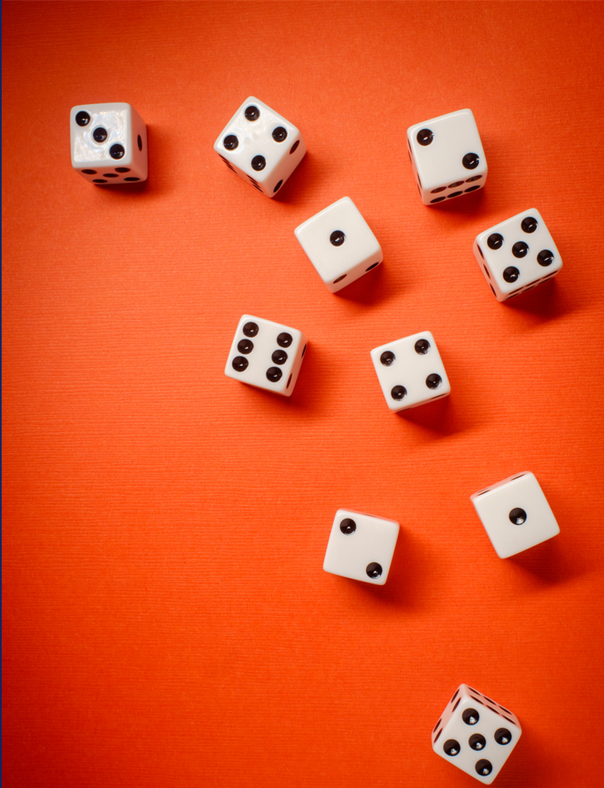
Review of Learning
Mathematics Stage 2 – Unit 28
Notes:
Reviews may include a combination of question types, requiring students to recall facts and key ideas, as well as apply their knowledge to solve problems and answer questions. To support active engagement, a mix of techniques should be employed.” (AERO, 2024).
This Review of Learning slide deck revisits key concepts from the following units:
Stage 2 Year B Unit 28
Stage 2 Year B Unit 27
Stage 2 Year B Unit 26
It also includes opportunities to review prior learning in non-number content, supporting consolidation across focus areas.
The review of learning resources include three key task types that support the development of mathematical proficiency through retrieval, spaced practice, and active participation. These practices complement the review phase (activating prior knowledge) embedded within the beginning of each lesson.
1.
Multiple-choice questions/True or false: Designed to promote active retrieval of key concepts and identify common misconceptions in number, supporting consolidation, understanding and fluency.
These questions:
support spaced and interleaved practice
help identify and address common misconceptions
support active recall and immediate feedback
support whole class participation
identify areas requiring reteach
2.
Short-response question sets: Carefully grouped questions that encourage spaced and interleaved practice across multiple focus areas, helping students revisit and apply knowledge from different points in time.
These questions:
have a combination of question types
address a range of focus areas
build automaticity and fluency
support active recall
allow for immediate feedback
identify content requiring reteach
3.
Developing number sense activities: A variety of practical, purposeful tasks that reinforce current learning and build on prior knowledge. These activities promote reasoning, problem-solving and conceptual understanding.
The review of learning resources are designed to work support teaching and learning in mathematics. For the most effective implementation, use the resources flexibly, adapting to meet student learning needs and individual classroom contexts.

Slide 3
Lessons
1
Review of learning 1
5
Review of learning 5
2
Review of learning 2
6
Review of learning 6
3
Review of learning 3
7
Review of learning 7
4
Review of learning 4
8
Review of learning 8
Notes:
Teacher notes:
Click lesson numbers to go to specific lessons
Interactive features can be viewed in slide show

Slide 4
Review of learning 1

Slide 5




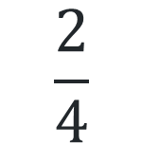
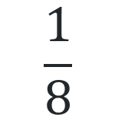
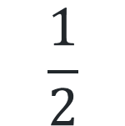
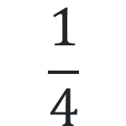
Multiple choice (1)
What is the missing fraction?
one whole
?
A
B
C
D
$$\frac{1}{4}$$
$$\frac{1}{2}$$
$$\frac{1}{8}$$
$$\frac{2}{4}$$
Notes:
This question connects to the content in the developing number sense activity (Activity 1)
Syllabus focus area:
Partitioned fractions B

Slide 6

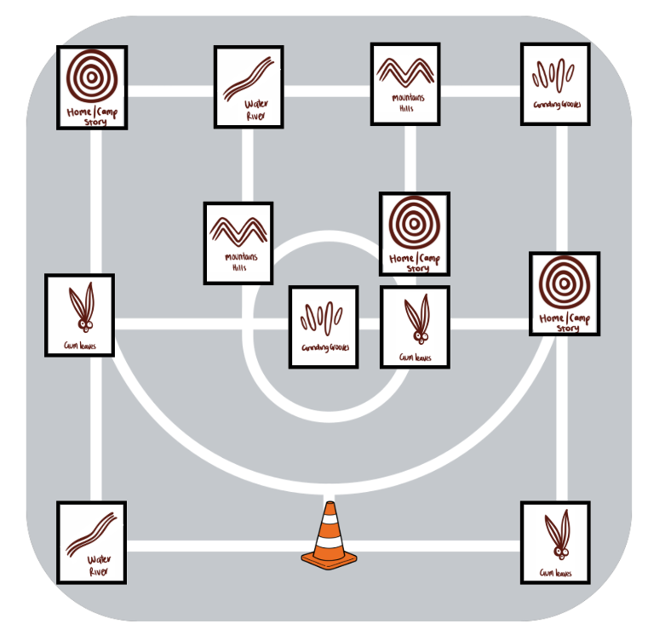
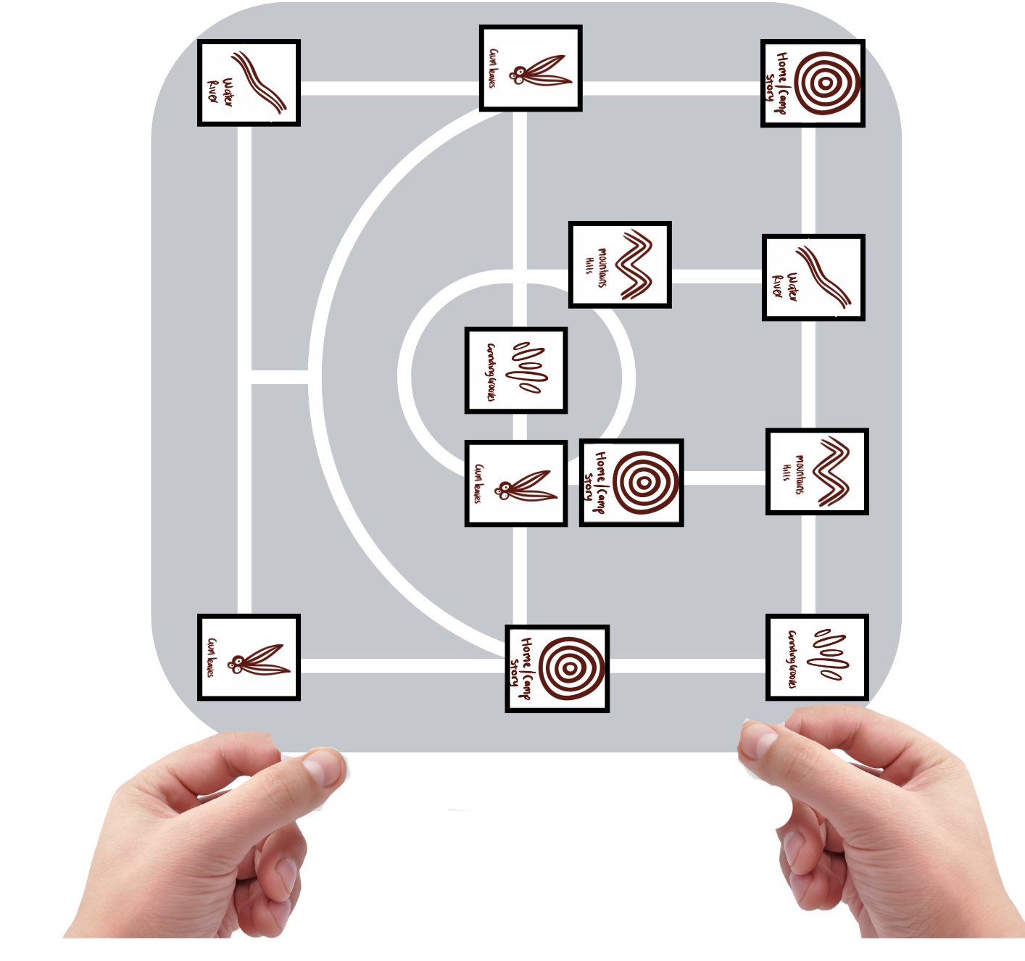
Short response (1)
When orienting a map, we may t_____ the map so that it faces the same way as the ground it represents.
I am standing at the cone. To orientate this map, I could turn it to the ________________.
Notes:
Short response questions provide brisk paced questions focussing on review of current and previous content to support spaced and interleaved practice.
Syllabus focus area:
Geometric measure A

Slide 7
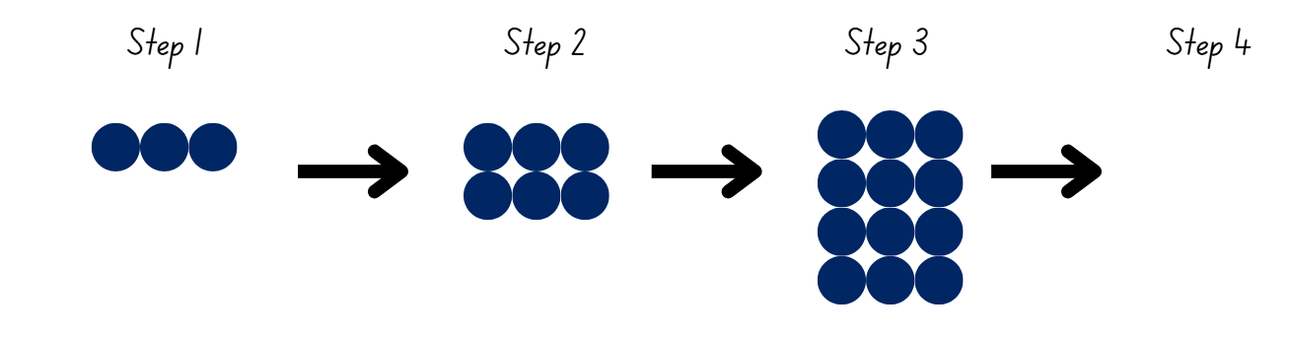
Short response (2)
Draw the array for step 4.
Write a number sentence for each array.
Notes:
Short response questions provide brisk paced questions focussing on review of current and previous content to support spaced and interleaved practice.
Syllabus focus area:
Multiplicative relations B

Slide 8
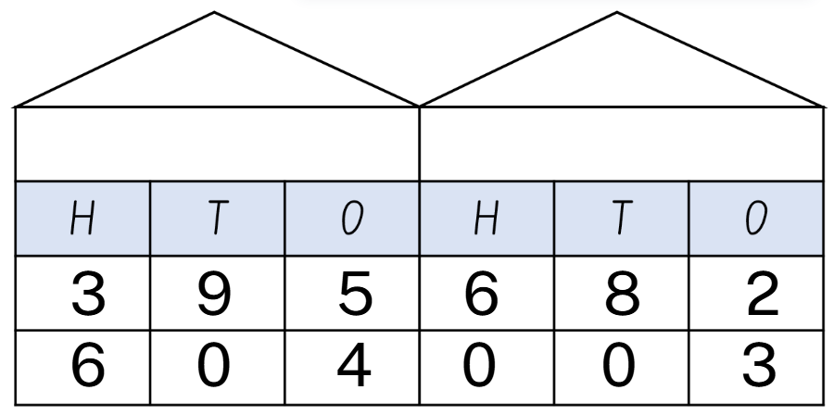
Short response (3)
Write the numbers in expanded notation.
Notes:
Short response questions provide brisk paced questions focussing on review of current and previous content to support spaced and interleaved practice.
Syllabus focus area:
Representing numbers using place value B

Slide 9

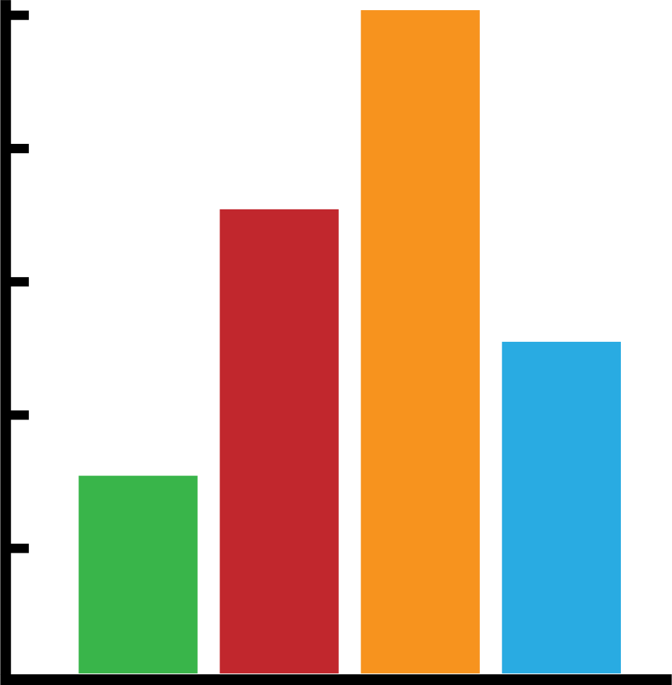
Short response (4)
Athletics Carnival House Points
1000
How many house points were awarded to each house in the athletics carnival?
800
House Points
600
400
200
Bradman
Goolagong
Alcott
Thorpe
Houses
Notes:
Short response questions provide brisk paced questions focussing on review of current and previous content to support spaced and interleaved practice.
Syllabus focus area:
Data A

Slide 10

Activity 1 – representing equivalent fractions for halves, quarters and eighths
one whole
Notes:
This is a developing number sense activity.
Number sense refers to a deep understanding of numbers, including their magnitude, relationships, and the effects of operations on them. It supports fluency and understanding, estimation, flexible thinking, and efficient problem-solving. Number sense activities 1–4 ‘activate’ prior number knowledge and support the learning of new content in the unit. Number sense activities 5–8 ‘loop’ back and provide opportunity for spaced practice with concepts and procedures covered in previous units.
Syllabus focus area:
Partitioned fractions B
Representing equivalent fractions for halves, quarters and eighths
Note: Students need opportunities to partition linear representations of fractions (eg creating fraction strips) to develop an appreciation of the relationship between parts and the whole arising from the process of division. The adjustments needed to create equal parts emphasise both the equality of the parts and that all the parts must form the whole (Wing and Beal 2004). (Stage 2 Teaching advice for Partitioned fractions A)
Prior to the lesson, prepare 4 identical strips of card or paper per student.
Ask students to label one of the strips as one whole.
Discuss the need to have equal wholes to compare partitioned fractions.
Prompt students to fold one of the strips into halves and to label each half using fraction notation $\frac{1}{2}$. If needed, revise the meaning of fractional notation.
Prompt students to fold one of the strips into quarters using repeated halving and to label the parts using fraction notation $\frac{1}{4}$.
Prompt students to fold the remaining strip into eighths using repeated halving and to label using fraction notation $\frac{1}{8}$.
Explain that equivalent fractions are fractions that are different representations of the same value.
Ask students to identify equivalent fractions with their fraction strips stacked vertically like a fraction wall.
Prompt students to cut the strips into their fractional parts and to use them to represent equivalent fractions for the following:
One half
One quarter
3 quarters
As students share their equivalent fractions, sketch them on the board using a bar model (see next slide)

Slide 11
Activity 1 – representing equivalent fractions for halves, quarters and eighths (2)
one whole
1/2
Notes:
This is a developing number sense activity.
Number sense refers to a deep understanding of numbers, including their magnitude, relationships, and the effects of operations on them. It supports fluency and understanding, estimation, flexible thinking, and efficient problem-solving. Number sense activities 1–4 ‘activate’ prior number knowledge and support the learning of new content in the unit. Number sense activities 5–8 ‘loop’ back and provide opportunity for spaced practice with concepts and procedures covered in previous units.
Syllabus focus area:
Partitioned fractions B
Representing equivalent fractions for halves, quarters and eighths
Note: Students need opportunities to partition linear representations of fractions (eg creating fraction strips) to develop an appreciation of the relationship between parts and the whole arising from the process of division. The adjustments needed to create equal parts emphasise both the equality of the parts and that all the parts must form the whole (Wing and Beal 2004). (Stage 2 Teaching advice for Partitioned fractions A)
Prior to the lesson, prepare 4 identical strips of card or paper per student.
Ask students to label one of the strips as one whole.
Discuss the need to have equal wholes to compare partitioned fractions.
Prompt students to fold one of the strips into halves and to label each half using fraction notation $\frac{1}{2}$. If needed, revise the meaning of fractional notation.
Prompt students to fold one of the strips into quarters using repeated halving and to label the parts using fraction notation $\frac{1}{4}$.
Prompt students to fold the remaining strip into eighths using repeated halving and to label using fraction notation $\frac{1}{8}$.
Explain that equivalent fractions are fractions that are different representations of the same value.
Ask students to identify equivalent fractions with their fraction strips stacked vertically like a fraction wall.
Prompt students to cut the strips into their fractional parts and to use them to represent equivalent fractions for the following:
As students share their equivalent fractions, sketch them on the board using a bar model
Prompt students to collect and keep their fraction pieces in an envelope. They will be used again in Activity 2.

Slide 12
Review of learning 2

Slide 13
True or false (1)
Two sixths are equivalent to one third.
True | False
Notes:
The question on this slide connects to the content being explored in the developing number sense activity (Activity 2)
Syllabus focus area:
Partitioned fractions B

Slide 14
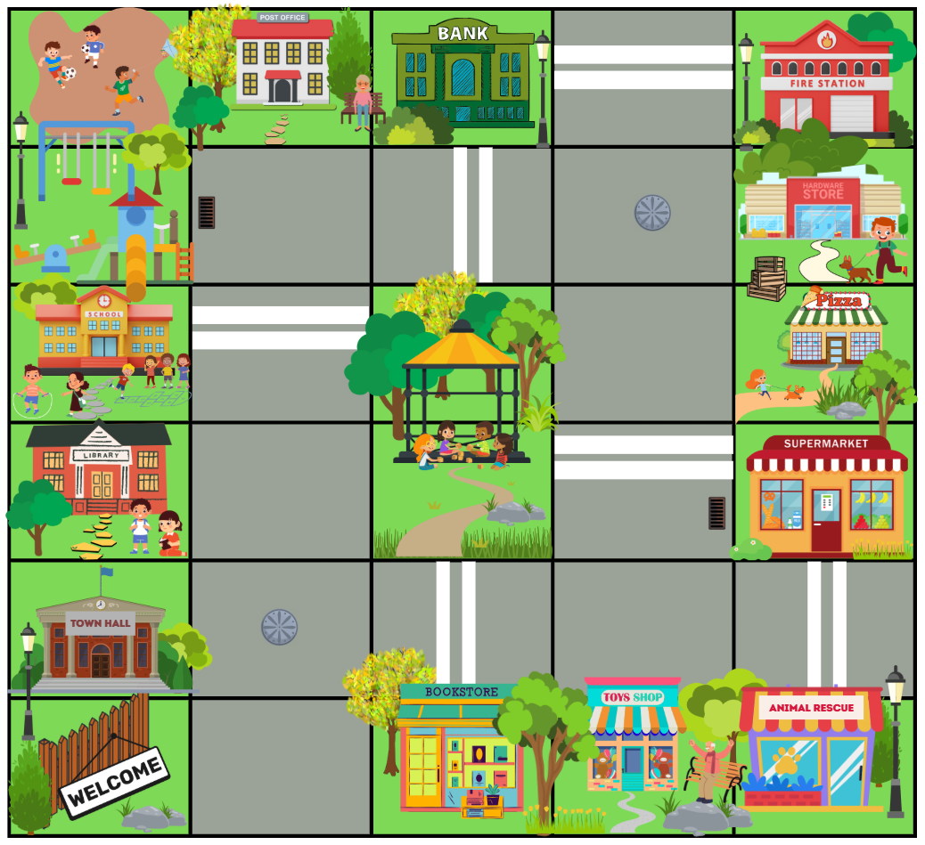
Short response (5)
Record a journey from the supermarket to the bank.
Use directional language to describe your route.
Notes:
Short response questions provide brisk paced questions focussing on review of current and previous content to support spaced and interleaved practice.
Syllabus focus area:
Geometric measure B

Slide 15
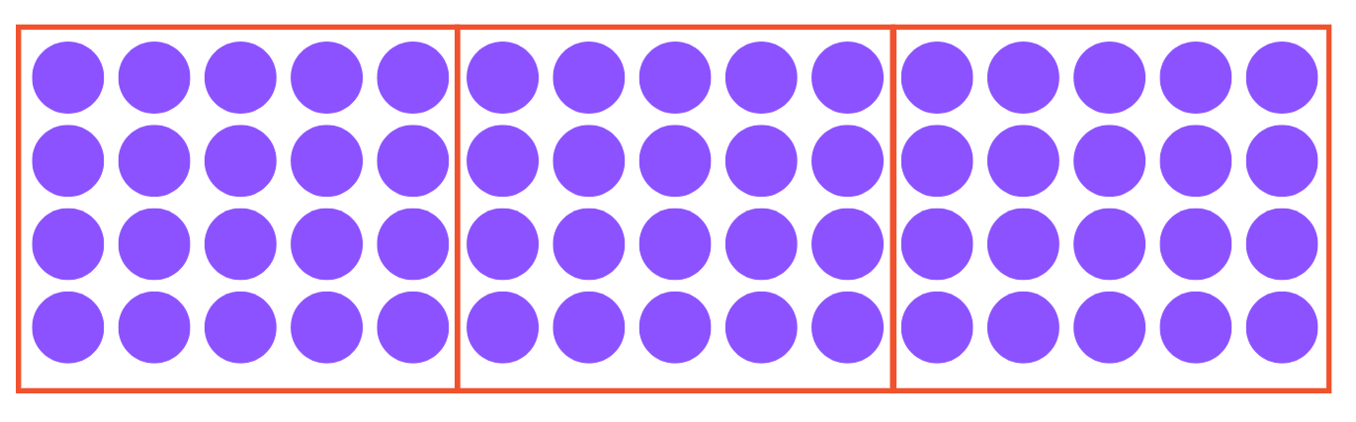
Short response (6)
Mel has used the associative property to regroup 4 × 15.
Write the new number sentence and the solution.
Notes:
Short response questions provide brisk paced questions focussing on review of current and previous content to support spaced and interleaved practice.
Syllabus focus area:
Multiplicative relations B

Slide 16
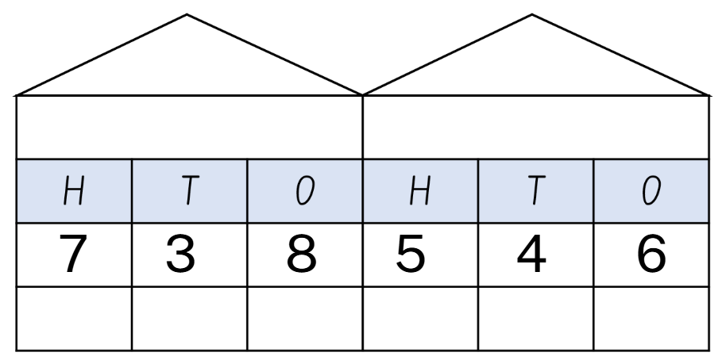
Short response (7)
Partition the number in non-standard form.
Notes:
Short response questions provide brisk paced questions focussing on review of current and previous content to support spaced and interleaved practice.
Syllabus focus area:
Representing numbers using place value B

Slide 17
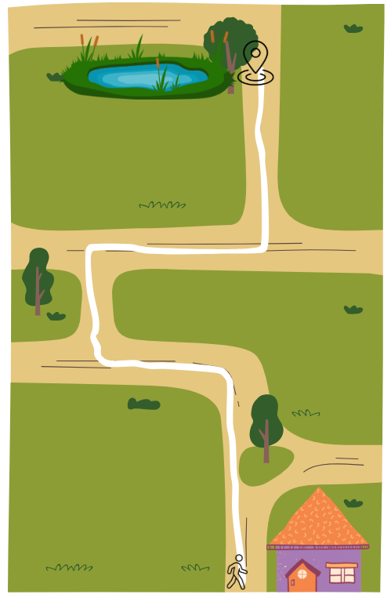
Short response (8)
Give directions from the house to the pond. Fill in the blanks with directional language.
Walk _________ past the tree.
Turn _______ and walk 10 steps.
Turn _______ and walk 10 steps.
Turn _______ and walk 10 steps.
Turn__________ and walk 10 steps.
The pond is on your _______.
Notes:
Short response questions provide brisk paced questions focussing on review of current and previous content to support spaced and interleaved practice.
Syllabus focus area:
Geometric measure A

Slide 18
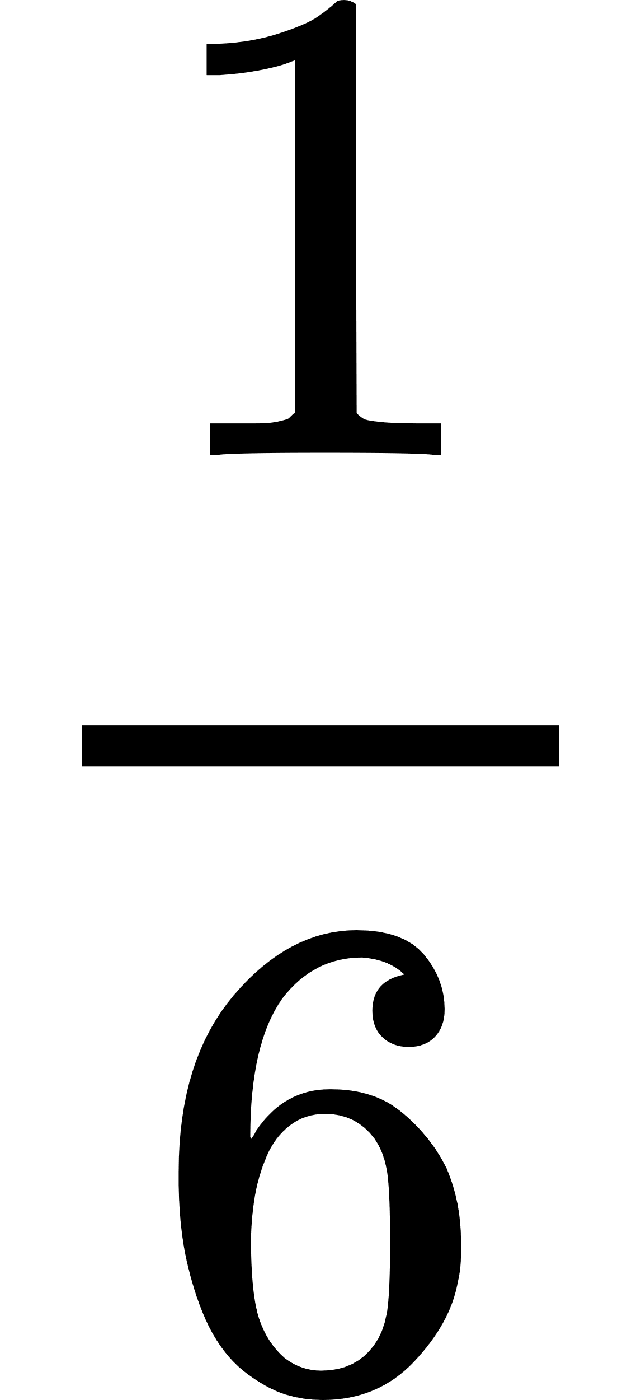

Activity 2 – representing equivalent fractions for thirds and sixths
one whole
1/2
Notes:
Note: this slide is designed to be used in presentation mode.
This is a developing number sense activity.
Number sense refers to a deep understanding of numbers, including their magnitude, relationships, and the effects of operations on them. It supports fluency and understanding, estimation, flexible thinking, and efficient problem-solving. Number sense activities 1–4 ‘activate’ prior number knowledge and support the learning of new content in the unit. Number sense activities 5–8 ‘loop’ back and provide opportunity for spaced practice with concepts and procedures covered in previous units.
Syllabus focus area:
Partitioned fractions B
Representing equivalent fractions for thirds and sixths
Prior to the lesson, prepare 2 identical strips of construction paper per student. The strips should be the same size as those used in Activity 1.
Provide student envelopes from Activity 1.
Remind students of the need to have equal wholes to compare partitioned fractions.
Prompt students to fold one of the strips into thirds and to label the strips using notation one third. Share student strategies for folding in thirds.
Ask: How do you know the parts are thirds?
Prompt students to fold the remaining strip into sixths by folding into thirds, then halving. Students are to label using notation one sixth.
Ask: How do you know the parts are sixths?
Prompt students to cut the strips into their fractional parts and to use them to represent equivalent fractions for the following:
one half
one third
two thirds
As students share their equivalent fractions, sketch them on the board using a bar model

Slide 19
Review of learning 3

Slide 20
Multiple choice (2)
Which is equivalent to one half?
2 thirds
A
3 quarters
B
2 sixths
C
4 eighths
D
Notes:
This question connects to the content in the developing number sense activity (Activity 3)
Syllabus focus area:
Partitioned fractions B

Slide 21
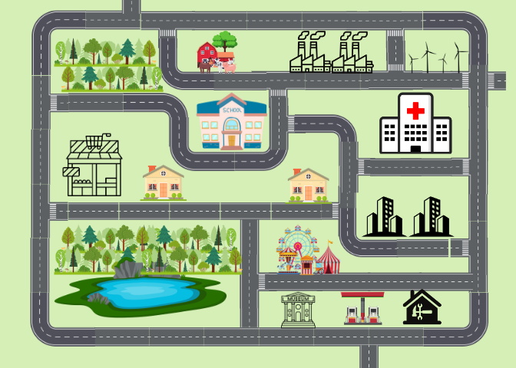
Short response (9)
Use landmarks and directional language to describe a route from the farm to the hospital.
Notes:
Short response questions provide brisk paced questions focussing on review of current and previous content to support spaced and interleaved practice.
Syllabus focus area:
Geometric measure A

Slide 22

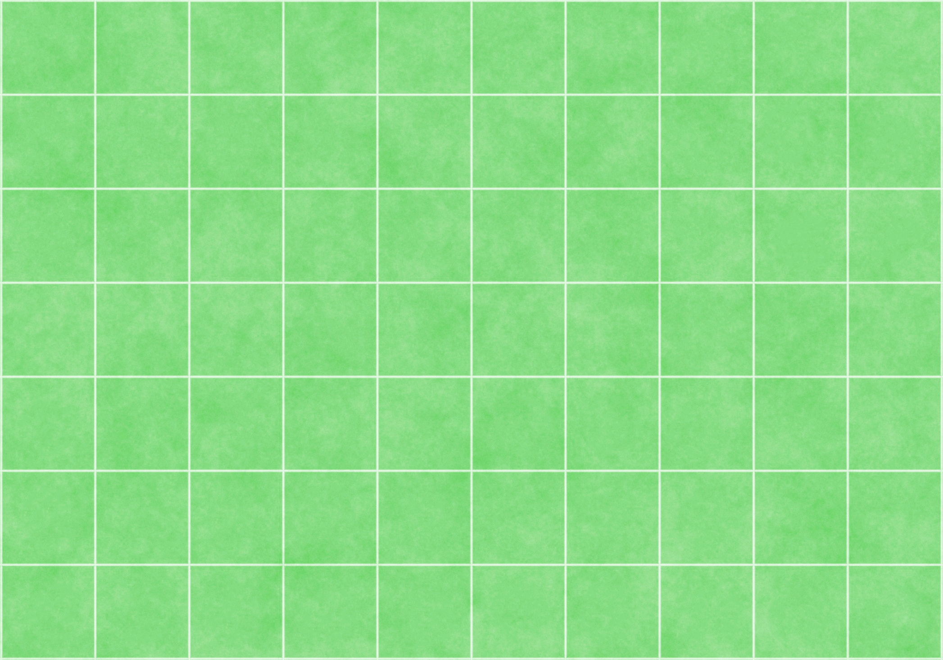
Short response (10)
Tanvi the tiler has started paving the courtyard.
She has finished the edges but hasn’t finished filling the rest.
How many tiles will cover the whole rectangle when she is finished?
Notes:
Short response questions provide brisk paced questions focussing on review of current and previous content to support spaced and interleaved practice.
Syllabus focus area:
Multiplicative relations B

Slide 23
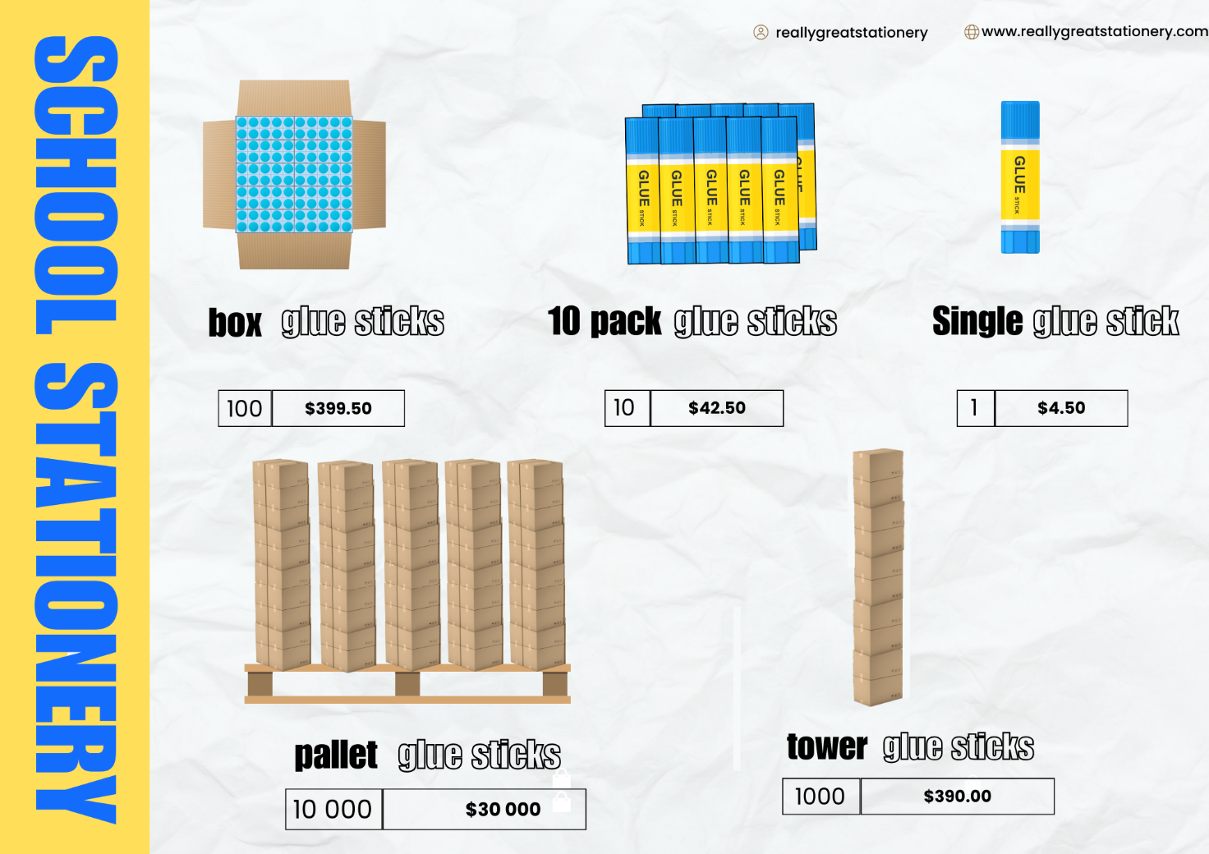
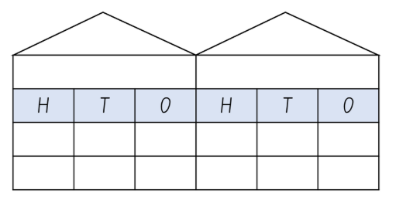
Short response (11)
A school needs to order 14 780 glue sticks. There are no boxes available from the supplier. Record 2 ways they can order this amount using non- standard partitioning.
Notes:
Short response questions provide brisk paced questions focussing on review of current and previous content to support spaced and interleaved practice.
Syllabus focus area:
Representing numbers using place value B

Slide 24
Short response (12)
How many millimetres (mm) are in 1cm?
Notes:
Short response questions provide brisk paced questions focussing on review of current and previous content to support spaced and interleaved practice.
Syllabus focus area:
Geometric measure A

Slide 25
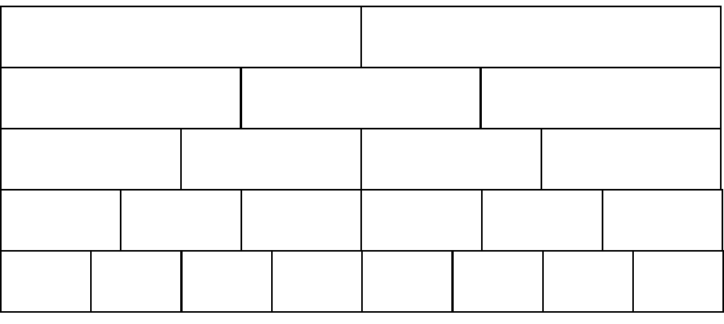
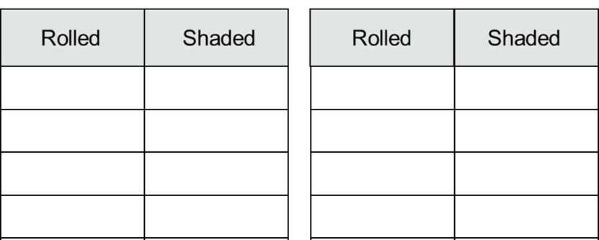
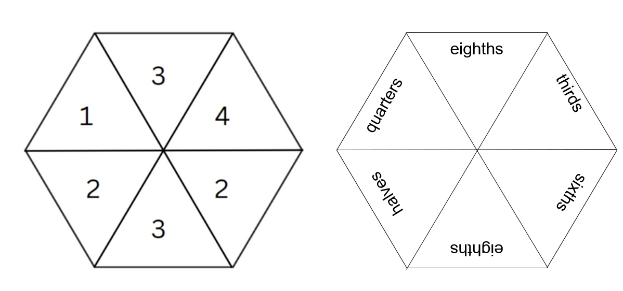
Activity 3 – colour in fractions
Notes:
This is a developing number sense activity.
Number sense refers to a deep understanding of numbers, including their magnitude, relationships, and the effects of operations on them. It supports fluency and understanding, estimation, flexible thinking, and efficient problem-solving. Number sense activities 1–4 ‘activate’ prior number knowledge and support the learning of new content in the unit. Number sense activities 5–8 ‘loop’ back and provide opportunity for spaced practice with concepts and procedures covered in previous units.
Syllabus focus area:
Partitioned fractions B
Colour in fractions
This resource corresponds to Resource 23 – colour in fractions and Resource 24 – fraction spinners in Stage 2 Year B Unit 28.
This activity is an adaption of ‘Colour in fractions’ from Engaging Maths: 25 favourite lessons by Clarke and Roche. An example of this game being played can be viewed at Colour in fractions on the NSW Department of Education website.
Highlight the fraction wall part of the resource.
Note that the fractional parts in the wall each combine to a whole of the same size.
Provide the fraction pieces from Activity 1 and Activity 2.
Prompt students to replicate the fraction wall using the fraction pieces.
Explain how to use the spinners to colour pieces from the fraction wall.
Provide students one die labelled 1, 2, 2, 3, 3, 4 in one colour and another die labelled one half, one third, one quarter, one sixth, one eighth in another colour or use Resource 24 – fraction spinners. Also provide each student with Resource 23 – colour in fractions.
Players take turns to throw both dice or spin their spinners. Students make a fraction using the first die or spinner to determine the numerator and the second determines the denominator. Students then colour the equivalent of the fraction shown. For example, if a player spins 2 quarters they can colour in:
Two quarters of one line
Four eighths of one line
One quarter of one line and 2 eighths of another
any other combination that is the same as 2 quarters.
For each roll or spin, students should use a different colour pencil or marker. If a player is unable to use their turn they ‘pass’. (See next slide)
Players take it in turns to roll or spin and make fractions, marking them on their fraction wall. If the fraction rolled or its equivalence cannot be shaded, that player misses a turn. This becomes more frequent later in the game.
The first player to colour in their whole wall is the winner. They should encourage the other player to keep filling their fraction wall or make the greatest number of wholes. If after 14 turns neither player has coloured in their whole wall, the player with the most wholes coloured wins.

Slide 26
Activity 3 – colour in fractions (2)
one whole
Notes:
This is a developing number sense activity.
Number sense refers to a deep understanding of numbers, including their magnitude, relationships, and the effects of operations on them. It supports fluency and understanding, estimation, flexible thinking, and efficient problem-solving. Number sense activities 1–4 ‘activate’ prior number knowledge and support the learning of new content in the unit. Number sense activities 5–8 ‘loop’ back and provide opportunity for spaced practice with concepts and procedures covered in previous units.
Syllabus focus area:
Partitioned fractions B
Colour in fractions
This resource corresponds to Resource 23 – colour in fractions and Resource 24 – fraction spinners in Stage 2 Year B Unit 28.
This activity is an adaption of ‘Colour in fractions’ from Engaging Maths: 25 favourite lessons by Clarke and Roche. An example of this game being played can be viewed at Colour in fractions on the NSW Department of Education website.
(Previous slide)
Highlight the fraction wall part of the resource.
Note that the fractional parts in the wall each combine to a whole of the same size.
Provide the fraction pieces from Activity 1 and Activity 2.
Prompt students to replicate the fraction wall using the fraction pieces.
Explain how to use the spinners to colour pieces from the fraction wall.
Provide students one die labelled 1, 2, 2, 3, 3, 4 in one colour and another die labelled one half, one third, one quarter, one sixth, one eighth in another colour or use Resource 24 – fraction spinners. Also provide each student with Resource 23 – colour in fractions.
Players take turns to throw both dice or spin their spinners. Students make a fraction using the first die or spinner to determine the numerator and the second determines the denominator. Students then colour the equivalent of the fraction shown. For example, if a player spins 2 quarters they can colour in:
Two quarters of one line
Four eighths of one line
One quarter of one line and 2 eighths of another
any other combination that is the same as 2 quarters.
For each roll or spin, students should use a different colour pencil or marker. If a player is unable to use their turn they ‘pass’.
(This slide)
Players take it in turns to roll or spin and make fractions, marking them on their fraction wall. If the fraction rolled or its equivalence cannot be shaded, that player misses a turn. This becomes more frequent later in the game.
The first player to colour in their whole wall is the winner. They should encourage the other player to keep filling their fraction wall or make the greatest number of wholes. If after 14 turns neither player has coloured in their whole wall, the player with the most wholes coloured wins.

Slide 27
Review of learning 4

Slide 28
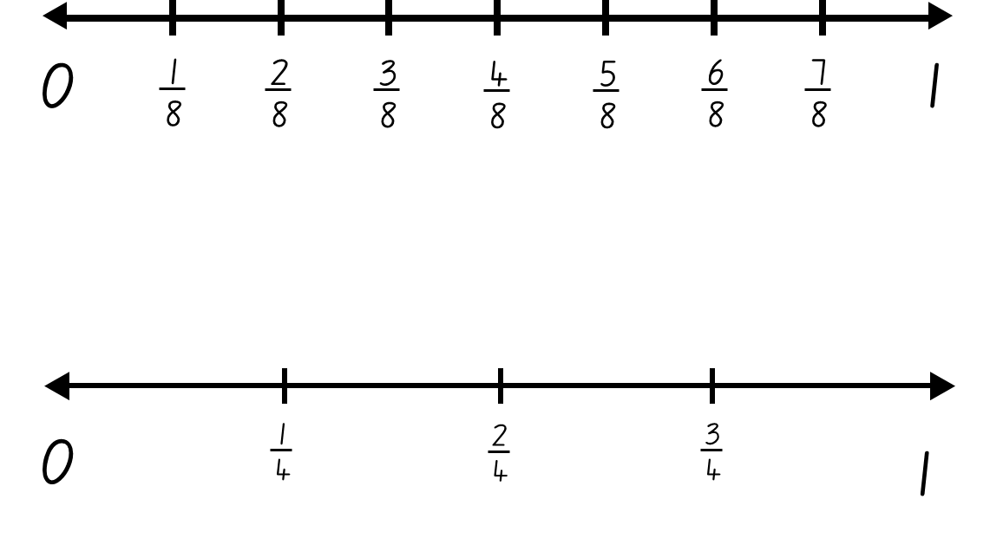
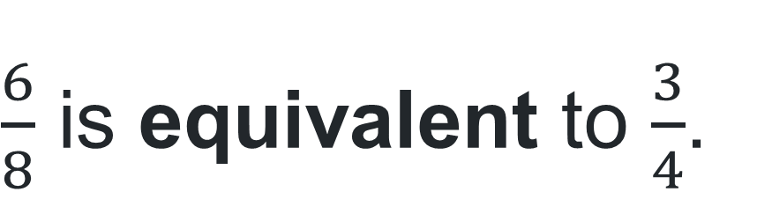
True or false (2)
$\frac{6}{8}$ is equivalent to $\frac{3}{4}$.
True | False
Notes:
The question on this slide connects to the content being explored in the developing number sense activity (Activity 4)
Syllabus focus area:
Partitioned fractions B

Slide 29
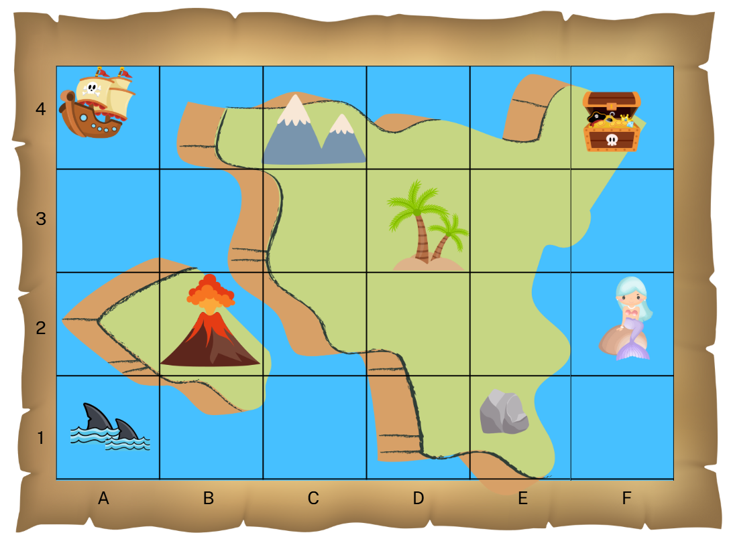
Short response (13)
Record the landmarks at the following positions on the map:
C4
D3
B2
Notes:
Short response questions provide brisk paced questions focussing on review of current and previous content to support spaced and interleaved practice.
Syllabus focus area:
Geometric measure A

Slide 30
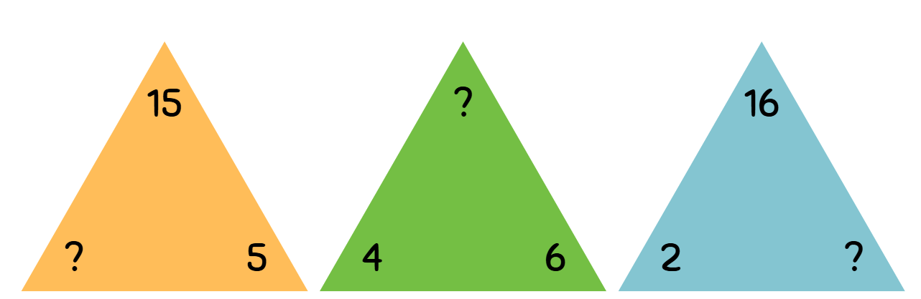
Short response (14)
Write the missing number from each fact family triangle.
Notes:
Short response questions provide brisk paced questions focussing on review of current and previous content to support spaced and interleaved practice.
Syllabus focus area:
Multiplicative relations B

Slide 31
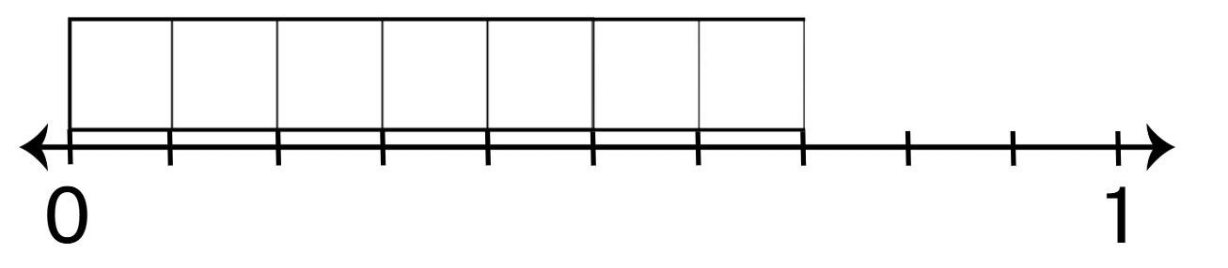
Short response (15)
What decimal would be placed here on the number line?
Communicate your thinking?
Notes:
Short response questions provide brisk paced questions focussing on review of current and previous content to support spaced and interleaved practice.
Syllabus focus area:
Representing numbers using place value B

Slide 32
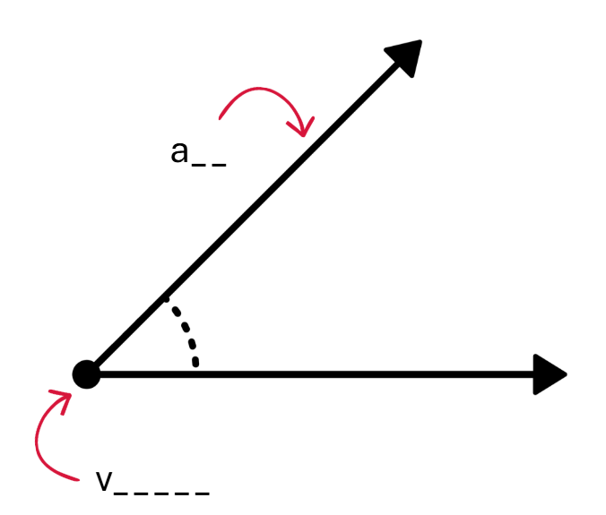
Short response (16)
Name these parts of an angle.
Notes:
Short response questions provide brisk paced questions focussing on review of current and previous content to support spaced and interleaved practice.
Syllabus focus area:
Geometric measure A

Slide 33


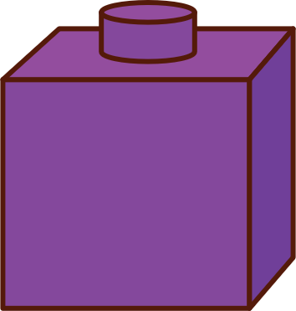
Activity 4 – equivalent fractions on a number line
0
1
2
3
4
5
6
7
1
8
8
8
8
8
8
8
0
1
2
3
1
4
4
4
Notes:
This is a developing number sense activity.
Number sense refers to a deep understanding of numbers, including their magnitude, relationships, and the effects of operations on them. It supports fluency and understanding, estimation, flexible thinking, and efficient problem-solving. Number sense activities 1–4 ‘activate’ prior number knowledge and support the learning of new content in the unit. Number sense activities 5–8 ‘loop’ back and provide opportunity for spaced practice with concepts and procedures covered in previous units.
Syllabus focus area:
Partitioned fractions B
Equivalent fractions on a number line
Create a tower using interconnecting cubes and 3 different colours (4 cubes, 2 cubes and 2 cubes).
Explain that the fractions shown in the tower can be represented using a number line and coloured tape diagram.
Instruct students to draw a number line and mark it with 8 equally spaced intervals. Students label eighths on the number line.
Prompt students to use coloured markers to represent the fractional parts of the tower on the number line as a tape diagram.
Instruct students to draw a number line and mark it with 4 equally spaced intervals. Students label quarters on the number line.
Prompt students to represent the equivalent fractional parts on the new number line as a tape diagram.
Ask:
What fraction is represented by 4 cubes? (4 eighths)
What are the equivalent fractions of 4 eighths? (2 quarters and one half)
What fraction is represented by 2 cubes? (2 eighths)
What is the equivalent fraction of 2 eighths? (One quarter)

Slide 34
Review of learning 5

Slide 35
Multiple choice (3)
$10 + $20 + 50c + 20c + 10c + 5c =
A
B
C
D
$30.95
$20.85
$30.85
$30.65
Notes:
This question connects to the content in the developing number sense activity (Activity 5)
Syllabus focus area:
Additive relations B

Slide 36
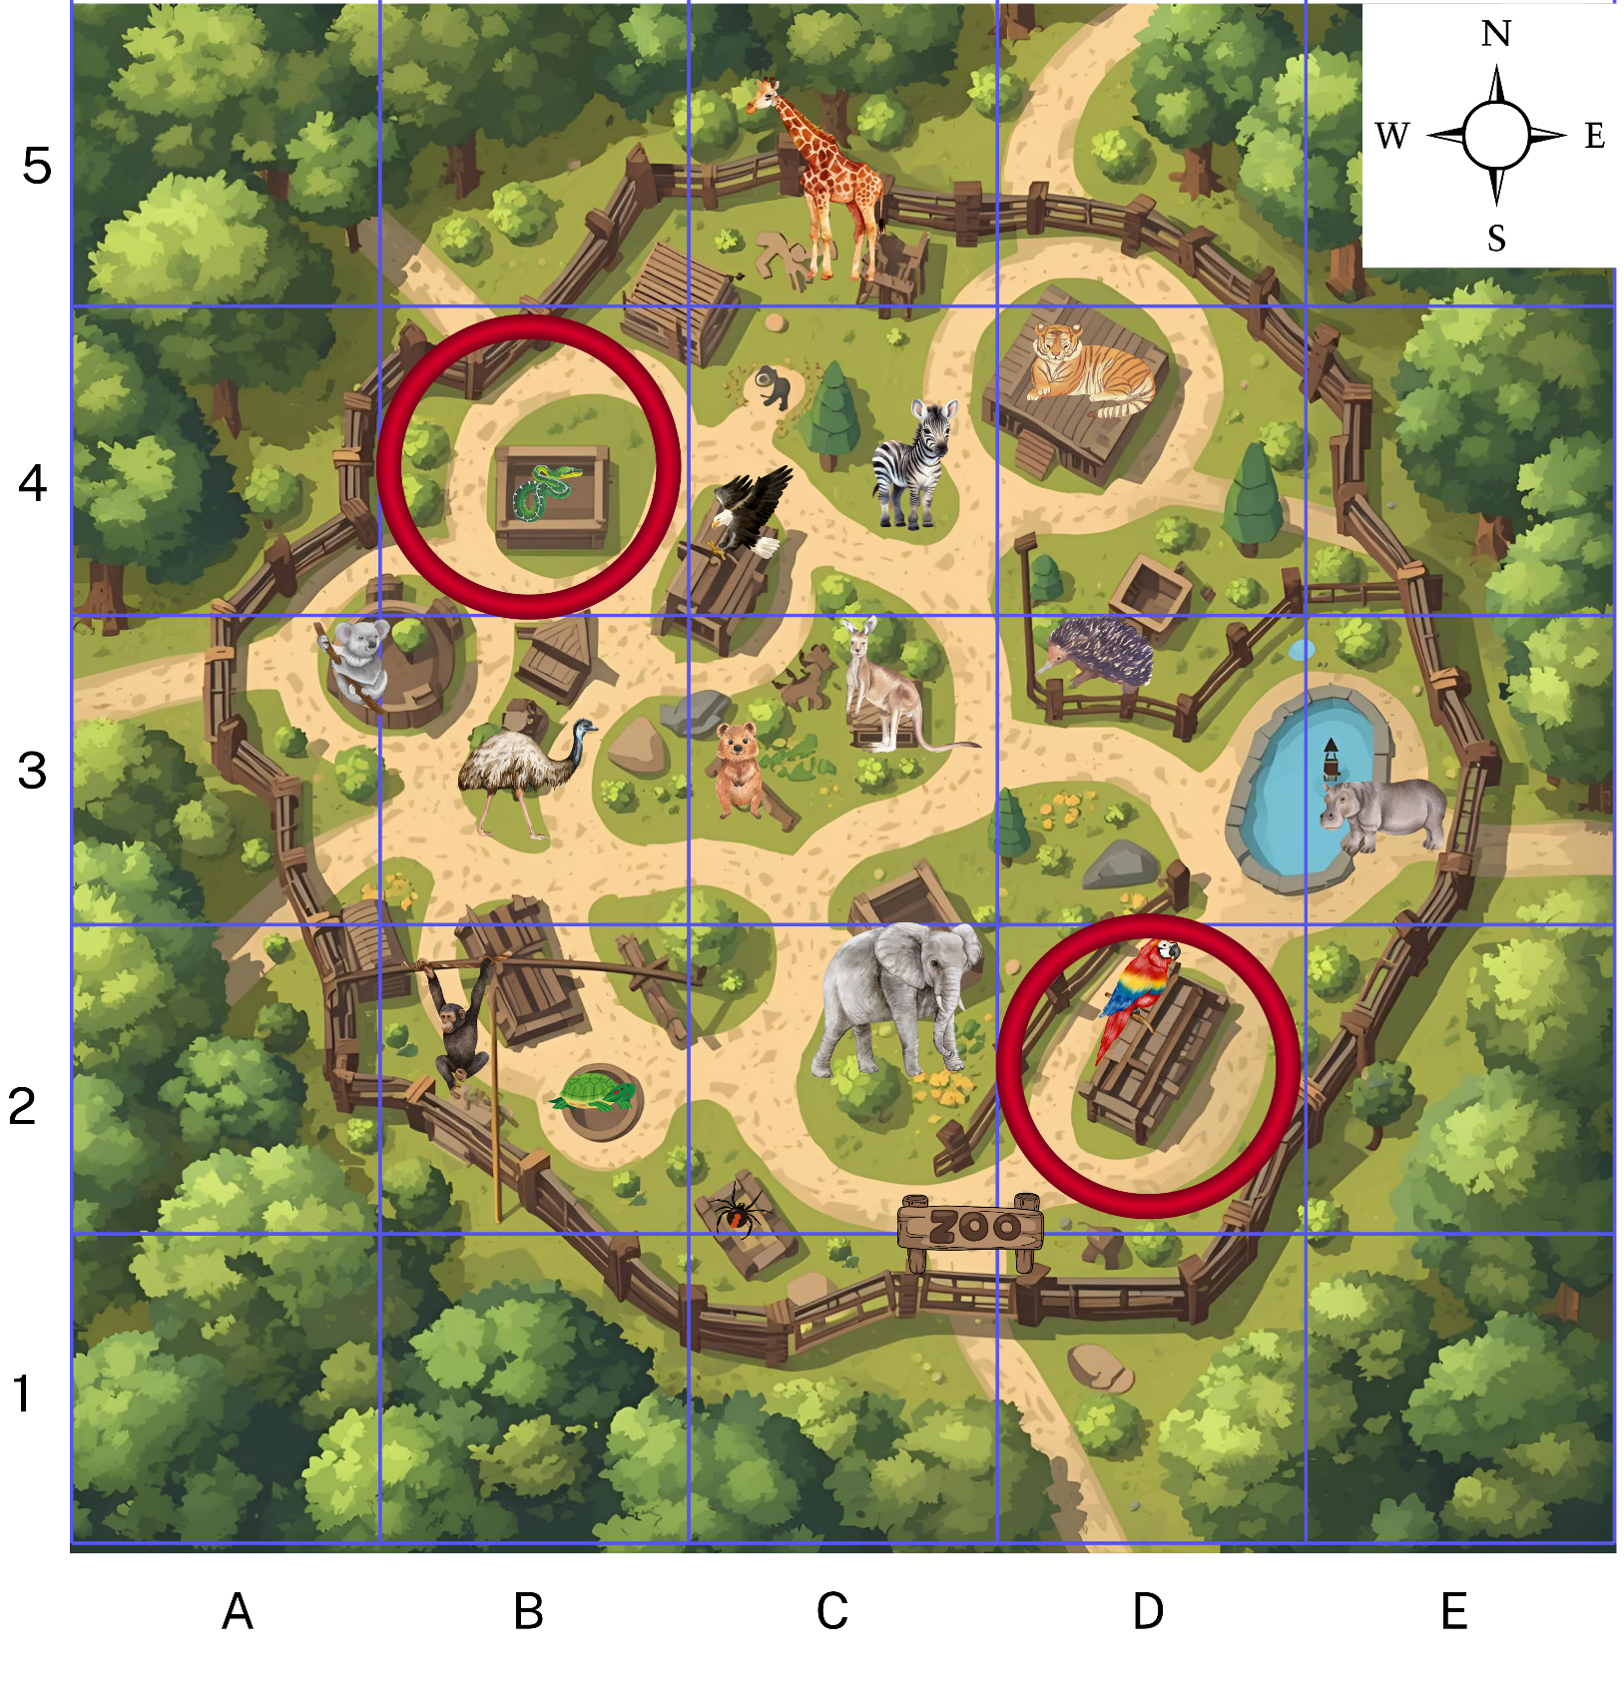
Short response (17)
Record a route from the parrots to the snakes.
Use compass directions and grid references to describe your route.
Notes:
Short response questions provide brisk paced questions focussing on review of current and previous content to support spaced and interleaved practice.
Syllabus focus area:
Geometric measure B

Slide 37
Short response (18)
There are 54 beads in a bowl, and I need to make 6 bracelets with an equal number of beads.
How many beads go on each bracelet?
Notes:
Short response questions provide brisk paced questions focussing on review of current and previous content to support spaced and interleaved practice.
Syllabus focus area:
Multiplicative relations B

Slide 38
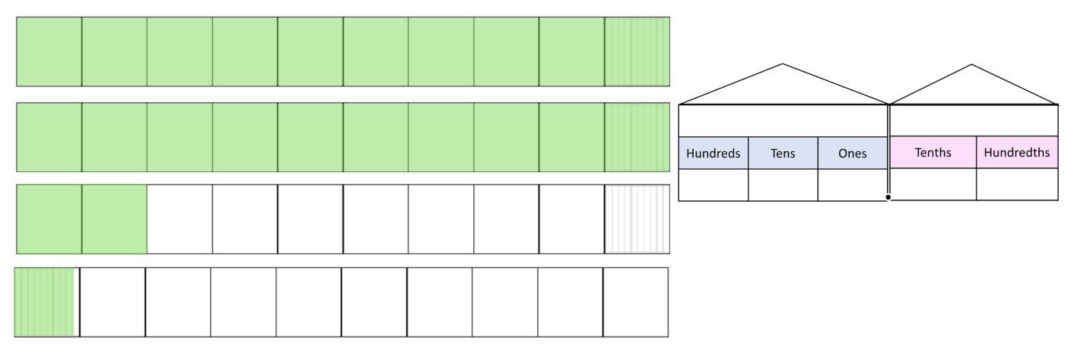
Short response (19)
Record this representation using decimal notation.
Notes:
Short response questions provide brisk paced questions focussing on review of current and previous content to support spaced and interleaved practice.
Syllabus focus area:
Representing numbers using place value B

Slide 39
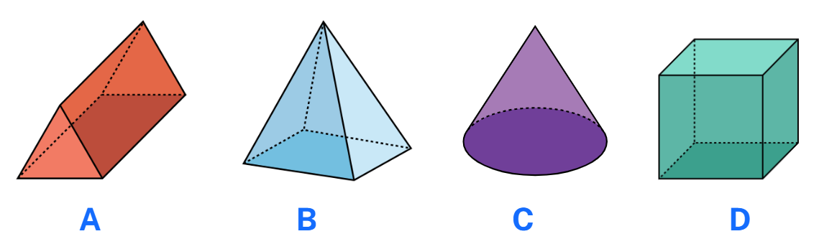
Short response (20)
Which of these 3D objects are prisms?
Communicate your reasoning.
Notes:
Short response questions provide brisk paced questions focussing on review of current and previous content to support spaced and interleaved practice.
Syllabus focus area:
Three-dimensional spatial structure A

Slide 40

Activity 5 – problem solving involving money
A father bought balloons for his 4 children at the community fair.
He paid for the balloons using 2 notes and 4 coins.
Notes:
This is a developing number sense activity.
Number sense refers to a deep understanding of numbers, including their magnitude, relationships, and the effects of operations on them. It supports fluency and understanding, estimation, flexible thinking, and efficient problem-solving. Number sense activities 1–4 ‘activate’ prior number knowledge and support the learning of new content in the unit. Number sense activities 5–8 ‘loop’ back and provide opportunity for spaced practice with concepts and procedures covered in previous units.
Syllabus focus area:
Additive relations B
Problem solving involving money
This lesson is an adaption of Buying a Balloon from NRICH by University of Cambridge.
(Next slide)
In pairs, students record their solutions on whiteboards to the following questions. Ask:
How much might the balloons have cost?
What is the largest amount the father could have paid?
What is the smallest amount the father could have paid?
Imagine that he used 2 different notes and 2 different coins?
How much might the balloons cost now?
Can you find all the possible prices?
How do you know you have found them all?
Which of your answers seems a reasonable amount to pay for a balloon?
As a class share student results and reasoning for each question.

Slide 41
Activity 5 – problem solving involving money (2)
How much might the balloons have cost?
What is the largest amount the father could have paid?
What is the smallest amount the father could have paid?
Imagine that he used 2 different notes and 2 different coins? How much might the balloons cost now?
Can you find all the possible prices?
Notes:
This is a developing number sense activity.
Number sense refers to a deep understanding of numbers, including their magnitude, relationships, and the effects of operations on them. It supports fluency and understanding, estimation, flexible thinking, and efficient problem-solving. Number sense activities 1–4 ‘activate’ prior number knowledge and support the learning of new content in the unit. Number sense activities 5–8 ‘loop’ back and provide opportunity for spaced practice with concepts and procedures covered in previous units.
Syllabus focus area:
Additive relations B
Problem solving involving money
This lesson is an adaption of Buying a Balloon from NRICH by University of Cambridge.
(Previous slide: Scenario: A father bought balloons for his 4 children at the community fair. He paid for the balloons using 2 notes and 4 coins. )
In pairs, students record their solutions on whiteboards to the following questions. Ask:
How much might the balloons have cost?
What is the largest amount the father could have paid?
What is the smallest amount the father could have paid?
Imagine that he used 2 different notes and 2 different coins?
How much might the balloons cost now?
Can you find all the possible prices?
How do you know you have found them all?
Which of your answers seems a reasonable amount to pay for a balloon?
As a class share student results and reasoning for each question.

Slide 42
Review of learning 6

Slide 43
True or false (3)
Harry has $15.
He has enough money to buy a sandwich for $8.50, cookie $3.50 and a drink $3.50 for lunch.
True | False
Notes:
The question on this slide connects to the content being explored in the developing number sense activity (Activity 6)
Syllabus focus area:
Additive relations B

Slide 44
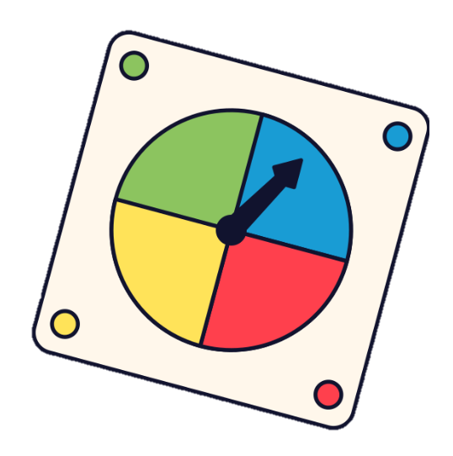
Short response (21)
Record the possible outcomes in a chance experiment using this spinner.
Notes:
Short response questions provide brisk paced questions focussing on review of current and previous content to support spaced and interleaved practice.
Syllabus focus area:
Chance A

Slide 45
Short response (22)
Which two number sentences represent the commutative property of multiplication?
3 × 2 × 5
4 × 5 × 3
5 × 2 × 3
Communication your reasoning.
Notes:
Short response questions provide brisk paced questions focussing on review of current and previous content to support spaced and interleaved practice.
Syllabus focus area:
Multiplicative relations B

Slide 46
Short response (23)
Explain the role of the zero in this decimal.
0.06
Notes:
Short response questions provide brisk paced questions focussing on review of current and previous content to support spaced and interleaved practice.
Syllabus focus area:
Representing numbers using place value B

Slide 47
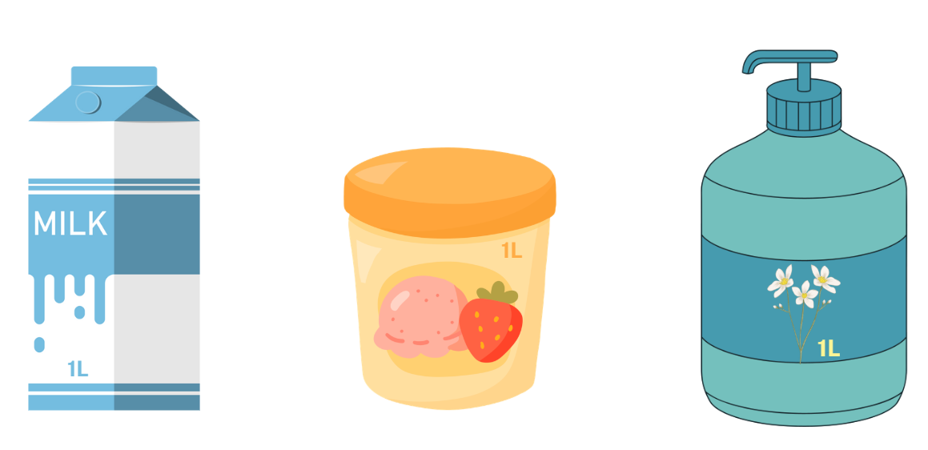
Short response (24)
What is the volume of each of these containers?
Notes:
Short response questions provide brisk paced questions focussing on review of current and previous content to support spaced and interleaved practice.
Syllabus focus area:
Three-dimensional spatial structure A

Slide 48
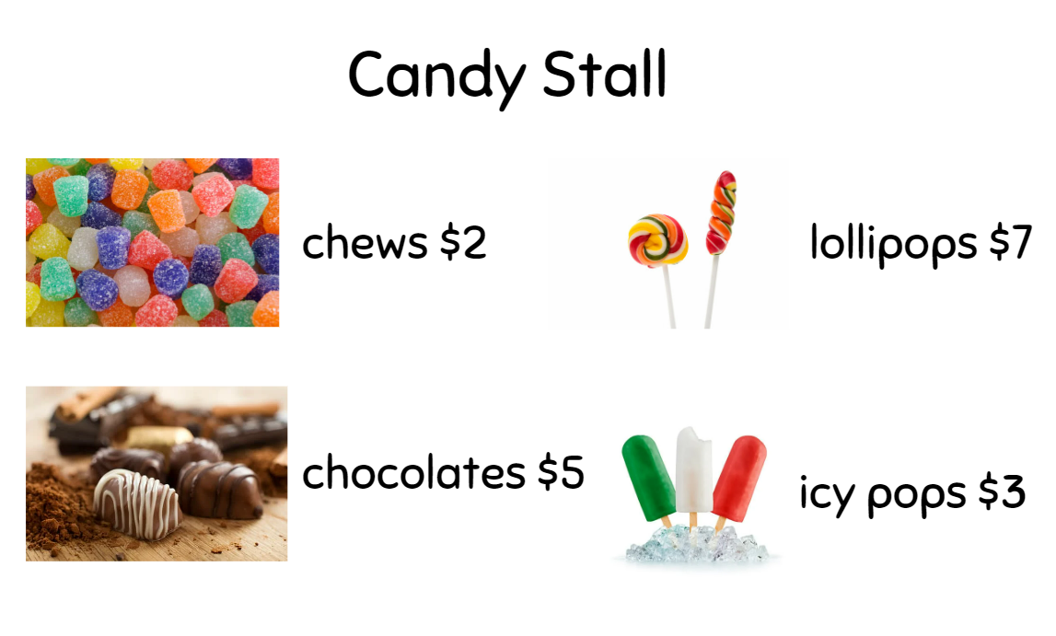
Activity 6 – using estimation to solve problems involving money
Rosie had $10 to spend. What could Rosie buy if she wanted to spend all her money?
James, Katie and Henry each spent $20.
James spent his money on just one kind of sweet, but he does not like chews. Which sweets did he buy?
Katie bought the same number of sweets as James, but she had 3 different kinds. Which sweets did she buy?
Henry chose 8 sweets. What could he have bought?
Notes:
This is a developing number sense activity.
Number sense refers to a deep understanding of numbers, including their magnitude, relationships, and the effects of operations on them. It supports fluency and understanding, estimation, flexible thinking, and efficient problem-solving. Number sense activities 1–4 ‘activate’ prior number knowledge and support the learning of new content in the unit. Number sense activities 5–8 ‘loop’ back and provide opportunity for spaced practice with concepts and procedures covered in previous units.
Syllabus focus area:
Additive relations B
Using estimation to solve problems involving money
This lesson is an adaptation of The Puzzling Sweet Shop from NRICH by University of Cambridge.
This resource corresponds to Resource 25 – candy stall in Stage 2 Year B Unit 28.
In pairs, students solve the following problems on individual whiteboards using estimation to check the validity of their solutions:
Rosie went to the candy stall at the community fair with $10 to spend. What could Rosie buy if she wanted to spend all her money?
James, Katie and Henry went into the shop too. They each had $20 to spend and they all spent all their money as follows:
James spent his money on just one kind of sweet, but he does not like chews. Which sweets did he buy?
Katie bought the same number of sweets as James, but she had 3 different kinds. Which sweets did she buy?
Henry chose 8 sweets. What could he have bought?
Ask: How did estimation help you solve the problems?
Select students to share their responses and communicate their reasoning.

Slide 49
Review of learning 7

Slide 50
Multiple choice (4)
$10.80 + $5.60 + $2.20 + $11.40 =
A
B
C
D
$29.00
$28.40
$30.20
$30.00
Notes:
This question connects to the content in the developing number sense activity (Activity 7)
Syllabus focus area:
Additive relations B

Slide 51
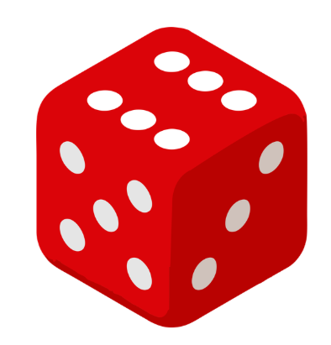
Short response (25)
Cameron rolled a 6.
Does the outcome of this one roll change the likelihood of him getting a 6 on the next roll?
Why or why not?
Notes:
Short response questions provide brisk paced questions focussing on review of current and previous content to support spaced and interleaved practice.
Syllabus focus area:
Chance B

Slide 52
Short response (26)
Use the associative property to multiply, thinking about multiples of 10 to regroup:
30 × 7
Write the new number sentence and the solution.
Notes:
Short response questions provide brisk paced questions focussing on review of current and previous content to support spaced and interleaved practice.
Syllabus focus area:
Multiplicative relations B

Slide 53
Short response (27)
468 + 253 =
What strategy did you use to solve the problem?
Notes:
Short response questions provide brisk paced questions focussing on review of current and previous content to support spaced and interleaved practice.
Syllabus focus area:
Additive relations A

Slide 54
Short response (28)
Which house won the carnival?
Which house received the least number of house points?
How many more points did Alcott receive than Bradman?
Athletics Carnival House Points
1000
800
House Points
600
400
200
Bradman
Goolagong
Alcott
Thorpe
Houses
Notes:
Short response questions provide brisk paced questions focussing on review of current and previous content to support spaced and interleaved practice.
Syllabus focus area:
Data A

Slide 55
Activity 7 – reflecting on additive strategies
Alex, Bertie and Chris have sums of money totalling $150.
Alex has the most money and Chris has the least amount of money.
What amounts might Alex, Bertie and Chris each have?
List at least 3 possibilities.
Notes:
This is a developing number sense activity.
Number sense refers to a deep understanding of numbers, including their magnitude, relationships, and the effects of operations on them. It supports fluency and understanding, estimation, flexible thinking, and efficient problem-solving. Number sense activities 1–4 ‘activate’ prior number knowledge and support the learning of new content in the unit. Number sense activities 5–8 ‘loop’ back and provide opportunity for spaced practice with concepts and procedures covered in previous units.
Syllabus focus area:
Additive relations B
Reflecting on additive strategies
This lesson is an adaptation of Monetary Difference from NRICH by University of Cambridge.
Ask:
What strategies did you use to solve the problem?
Did you have any challenges? How did you overcome them?
Note: increase the difficulty of the task by adding this information. Alex and Bertie have $55 between them, and Alex and Chris have $65 between them. Students record possible solutions on their whiteboard.
Students share their responses and reflect on the most efficient strategy used to solve the problem.

Slide 56
Review of learning 8

Slide 57
True or false (4)
I have $10 and want to buy a toy for $7.70.
My change will be $3.30.
True | False
Notes:
The question on this slide connects to the content being explored in the developing number sense activity (Activity 8)
Syllabus focus area:
Additive relations B

Slide 58
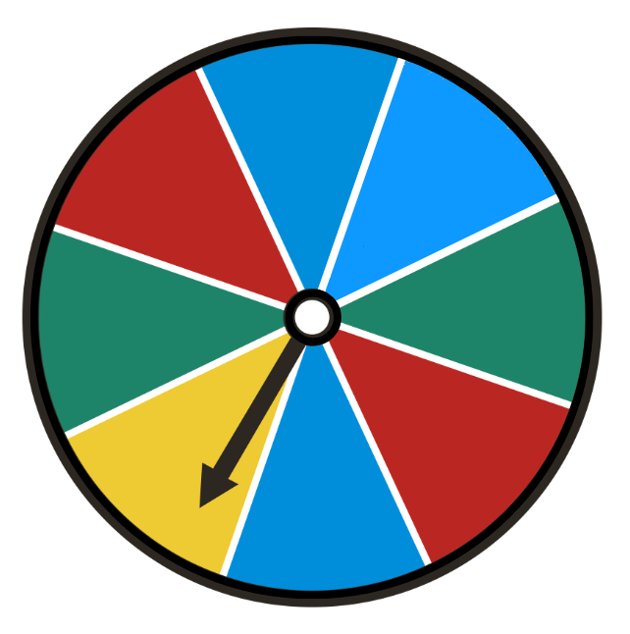
Short response (29)
Finish these statements to describe the likelihood of an outcome when using this spinner.
It is likely I will spin…
It is unlikely I will spin…
It is equally likely I will spin…
Notes:
Short response questions provide brisk paced questions focussing on review of current and previous content to support spaced and interleaved practice.
Syllabus focus area:
Chance B

Slide 59
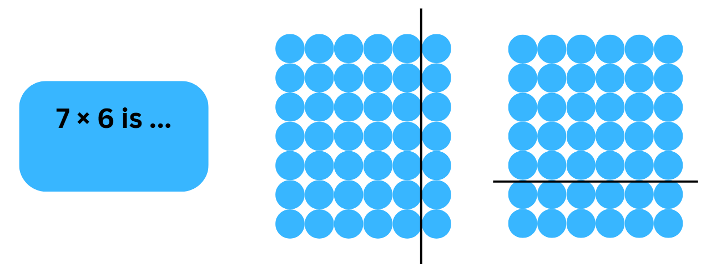
Short response (30)
Record the number sentences to match each partitioning of the array.
Notes:
Short response questions provide brisk paced questions focussing on review of current and previous content to support spaced and interleaved practice.
Syllabus focus area:
Multiplicative relations B

Slide 60
Short response (31)
463 - 48 =
What strategy did you use to solve the problem?
Notes:
Short response questions provide brisk paced questions focussing on review of current and previous content to support spaced and interleaved practice.
Syllabus focus area:
Additive relations A

Slide 61
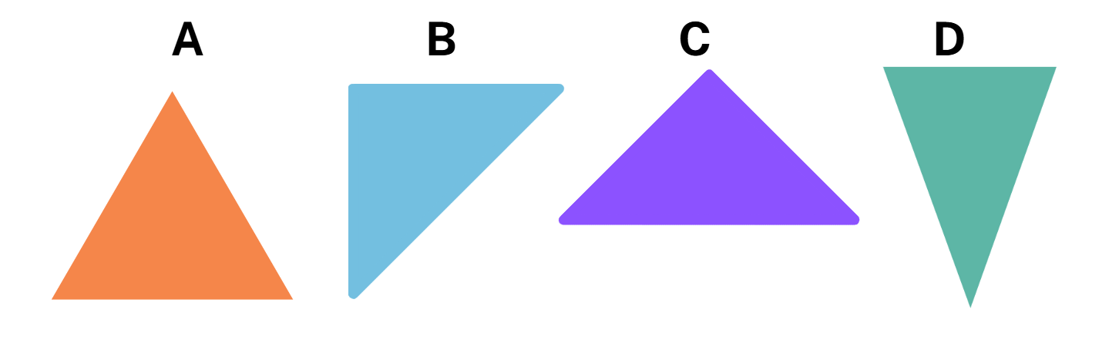
Short response (32)
Record the triangles that have a right angle?
Notes:
Short response questions provide brisk paced questions focussing on review of current and previous content to support spaced and interleaved practice.
Syllabus focus area:
Two-dimensional spatial structure A

Slide 62
Activity 8 – word problems requiring addition and subtraction
Noah had $10 to spend at the school canteen. He spent $3.20 on a sandwich and $2.50 on a juice. Afterwards, he was still feeling hungry.
Does he have enough money to buy another sandwich?
Notes:
This is a developing number sense activity.
Number sense refers to a deep understanding of numbers, including their magnitude, relationships, and the effects of operations on them. It supports fluency and understanding, estimation, flexible thinking, and efficient problem-solving. Number sense activities 1–4 ‘activate’ prior number knowledge and support the learning of new content in the unit. Number sense activities 5–8 ‘loop’ back and provide opportunity for spaced practice with concepts and procedures covered in previous units.
Syllabus focus area:
Additive relations B
Word problems requiring addition and subtraction
Display the following scenario: Noah had $10 to spend at the school canteen. He spent $3.20 on a sandwich and $2.50 on a juice. Afterwards, he was still feeling hungry. Does he have enough money to buy another sandwich?
Ask:
What is the total amount he spent on the sandwich and juice?
What strategy did you use to solve this?
How much change does he get back from the canteen?
What strategy did you use to solve this step?
Does he have enough money to buy another sandwich? How do you know?

Slide 63
Double Venn diagram
Object 1
Object 2
Features similar to both objects
Features of object 1
Features of object 2

Slide 64
Frayer
Definition
Facts/Characteristics
Word, term, concept
Examples
Non-examples

Slide 65
Spider map
Idea
Subject

Slide 66
Cline
Concept 1
Concept 2
Word
Word
Word
Word
Word
Word
Word
Word
Word
Word
Word

Slide 67

Compare and contrast

Slide 68
Multiple choice (5)
A
B
C
D

Slide 69
Multiple choice
A
B
C
D
Notes:
This question connects to the content in the developing number sense activity (Activity 3)
Syllabus focus area:
[Focus area A/B]

Slide 70
References
This presentation contains NSW Curriculum and syllabus content. The NSW Curriculum is developed by the NSW Education Standards Authority. This content is prepared by NESA for and on behalf of the Crown in the right of the State of New South Wales. The material is protected by Crown copyright.
Please refer to the NESA Copyright Disclaimer for more information https://educationstandards.nsw.edu.au/wps/portal/nesa/mini-footer/copyright.
NESA holds the only official and up-to-date versions of the NSW Curriculum and syllabus documents. Please visit the NSW Education Standards Authority (NESA) website https://educationstandards.nsw.edu.au/wps/portal/nesa/home and the NSW Curriculum website https://curriculum.nsw.edu.au.
Mathematics K–10 Syllabus © NSW Education Standards Authority (NESA) for and on behalf of the Crown in right of the State of New South Wales, 2022.
National Numeracy Learning Progression © Australian Curriculum, Assessment and Reporting Authority (ACARA) 2010 to present, unless otherwise indicated. This material was downloaded from the Australian Curriculum website (National Numeracy Learning Progression) (accessed 26 September 2025) and was not modified.
Clarke D and Roche A (2014) Engaging Maths: 25 favourite lessons, 2nd edn, published by the authors.
University of Cambridge (n.d) Buying a Balloon, NRICH website, accessed 26 September 2025.
University of Cambridge (n.d) The Puzzling Sweet Shop, NRICH website, accessed 26 September 2025.
University of Cambridge (n.d) Monetary Difference, NRICH website, accessed 26 September 2025.

Slide 71
Copyright
© State of New South Wales (Department of Education), 2025
The copyright material published in this resource is subject to the Copyright Act 1968 (Cth) and is owned by the NSW Department of Education or, where indicated, by a party other than the NSW Department of Education (third-party material).
Copyright material available in this resource and owned by the NSW Department of Education is licensed under a Creative Commons Attribution 4.0 International (CC BY 4.0) license.
This license allows you to share and adapt the material for any purpose, even commercially.
Attribution should be given to © State of New South Wales (Department of Education), 2025.
Material in this resource not available under a Creative Commons license:
the NSW Department of Education logo, other logos and trademark-protected material
Material owned by a third party that has been reproduced with permission. You will need to obtain permission from the third party to reuse its material.
Links to third-party material and websites
Please note that the provided (reading/viewing material/list/links/texts) are a suggestion only and implies no endorsement, by the New South Wales Department of Education, of any author, publisher, or book title. School principals and teachers are best placed to assess the suitability of resources that would complement the curriculum and reflect the needs and interests of their students.
If you use the links provided in this document to access a third party’s website, you acknowledge that the terms of use, including licence terms set out on the third-party’s website apply to the use which may be made of the materials on that third-party website or where permitted by the Copyright Act 1968 (Cth). The department accepts no responsibility for content on third-party websites.

