Slide 1
Instructions for use
This resource aligns to the learning in Stage 3 Year B Unit 31 and revisits content from earlier sample units.
Classroom teachers are encouraged to add and adapt slides as required to meet the needs of their students.
Save a copy of the file to make changes to the slide deck. Go to File > Download a Copy (this downloads a copy to the computer to edit in the PowerPoint app).
To convert the PowerPoint to Google Slides:
  Upload the file into Google Drive and open it.
  Go to File > Save as Google Slides.
  (Note – conversion may cause formatting changes in the slides.)

Slide 2

Review of Learning
Mathematics Stage 3 – Unit 31
Notes:
Reviews may include a combination of question types, requiring students to recall facts and key ideas, as well as apply their knowledge to solve problems and answer questions. To support active engagement, a mix of techniques should be employed.” (AERO, 2024).
This Review of Learning slide deck revisits key concepts from the following units:
Stage 3 Year B Unit 31
Stage 3 Year B Unit 30
Stage 3 Year B Unit 29
It also includes opportunities to review prior learning in non-number content, supporting consolidation across focus areas.
The review of learning resources include three key task types that support the development of mathematical proficiency through retrieval, spaced practice, and active participation. These practices complement the review phase (activating prior knowledge) embedded within the beginning of each lesson.
1.
Multiple-choice questions/True or false: Designed to promote active retrieval of key concepts and identify common misconceptions in number, supporting consolidation, understanding and fluency.
These questions:
support spaced and interleaved practice
help identify and address common misconceptions
support active recall and immediate feedback
support whole class participation
identify areas requiring reteach
2.
Short-response question sets: Carefully grouped questions that encourage spaced and interleaved practice across multiple focus areas, helping students revisit and apply knowledge from different points in time.
These questions:
have a combination of question types
address a range of focus areas
build automaticity and fluency
support active recall
allow for immediate feedback
identify content requiring reteach
3.
Developing number sense activities: A variety of practical, purposeful tasks that reinforce current learning and build on prior knowledge. These activities promote reasoning, problem-solving and conceptual understanding.
The review of learning resources are designed to work support teaching and learning in mathematics. For the most effective implementation, use the resources flexibly, adapting to meet student learning needs and individual classroom contexts.

Slide 3
Lessons
1
Review of learning 1
5
Review of learning 5
2
Review of learning 2
6
Review of learning 6
3
Review of learning 3
7
Review of learning 7
4
Review of learning 4
8
Review of learning 8
Notes:
Teacher notes:
Click lesson numbers to go to specific lessons
Interactive features can be viewed in slide show

Slide 4
Review of learning 1

Slide 5

Multiple choice (1)
An inverse operation of 21 x 15 = 315 is:
A
15 x 21 = 315
B
315 = 21 x 15
C
315 ÷ 21 = 15
D
315 ÷ 15 = 15
Notes:
This question connects to the content in the developing number sense activity (Activity 3)
Syllabus focus area:
Multiplicative Relations B

Slide 6

Short response (1)
What number can be grouped as:
5 millions, 467 thousands, 8 hundreds, 7 tens and 9 ones.
Notes:
Short response questions provide brisk paced questions focussing on review of current and previous content to support spaced and interleaved practice.
Syllabus focus area:
Represents numbers A

Slide 7
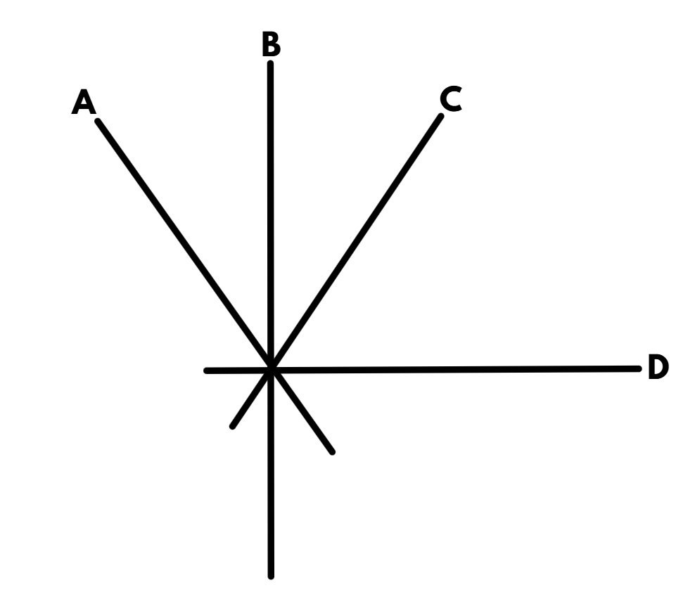
Short response (2)
Which 2 lines are perpendicular?
Notes:
Short response questions provide brisk paced questions focussing on review of current and previous content to support spaced and interleaved practice.
Syllabus focus area:
Geometric Measure B

Slide 8
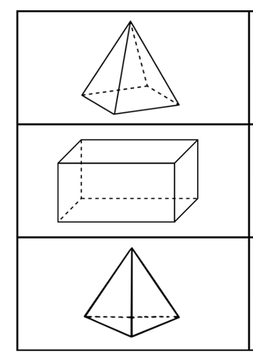
Short response (3)
Name the three- dimensional objects according to their base.
A
B
C
Notes:
Short response questions provide brisk paced questions focussing on review of current and previous content to support spaced and interleaved practice.
Syllabus focus area:
Three- dimensional spatial structure A

Slide 9
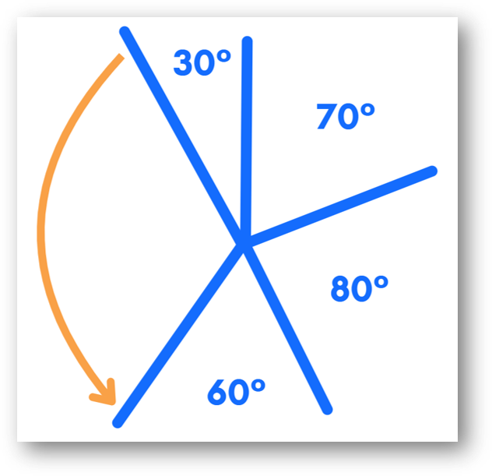
Short response (4)
Record the size of the orange angle.​
Communicate your reasoning.
Notes:
Short response questions provide brisk paced questions focussing on review of current and previous content to support spaced and interleaved practice.
Syllabus focus area:
Geometric measure B

Slide 10

Activity 1 – inverse operations (part 1)(Part 1)
Ava had 315 trees in her family’s apple orchard. If the trees were planted in 21 rows. How many trees were in each row?
Notes:
This is a developing number sense activity.
Number sense refers to a deep understanding of numbers, including their magnitude, relationships, and the effects of operations on them. It supports fluency and understanding, estimation, flexible thinking, and efficient problem-solving. Number sense activities 1–4 ‘activate’ prior number knowledge and support the learning of new content in the unit. Number sense activities 5–8 ‘loop’ back and provide opportunity for spaced practice with concepts and procedures covered in previous units.
Syllabus focus area:
Multiplicative relations B
Inverse operations Part 1
In pairs students discuss the problem and how they would solve it.
Ask:
What are the number sentences you could use to solve this problem?
How could inverse operations support us to find the answer?
Students share their thinking with the class.
Students solve the problem.

Slide 11
Review of learning 2

Slide 12
True or false (1)
8 x ___ = 112
This missing number is 14.
True | False
Communicate your reasoning.
Notes:
The question on this slide connects to the content being explored in the developing number sense activity (Activity 2)
Syllabus focus area:
Multiplicative Relations B

Slide 13
Short response (5)
Regroup these numbers in 2 different forms:
67 543 980
736 443 211
Notes:
Short response questions provide brisk paced questions focussing on review of current and previous content to support spaced and interleaved practice.
Syllabus focus area:
Represents numbers A

Slide 14
Short response (6)
Finish this sentence:
When 2 adjacent angles form a right angle, the sum of their angles equal ____ °
Communicate your reasoning.
Notes:
Short response questions provide brisk paced questions focussing on review of current and previous content to support spaced and interleaved practice.
Syllabus focus area:
Geometric measure B

Slide 15
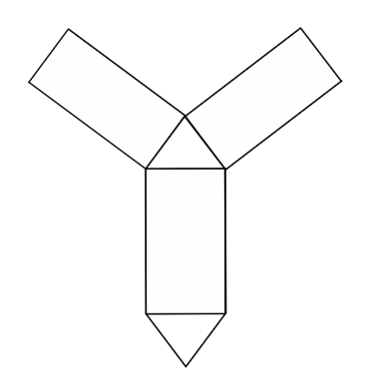
Short response (7)
Name the object this net would create.
Communicate your reasoning.
Notes:
Short response questions provide brisk paced questions focussing on review of current and previous content to support spaced and interleaved practice.
Syllabus focus area:
Three- dimensional spatial structure A

Slide 16
Short response (8)
15.5 cm is ___ centimetres and ___ millimetres.
Notes:
Short response questions provide brisk paced questions focussing on review of current and previous content to support spaced and interleaved practice.
Syllabus focus area:
Geometric measure B

Slide 17
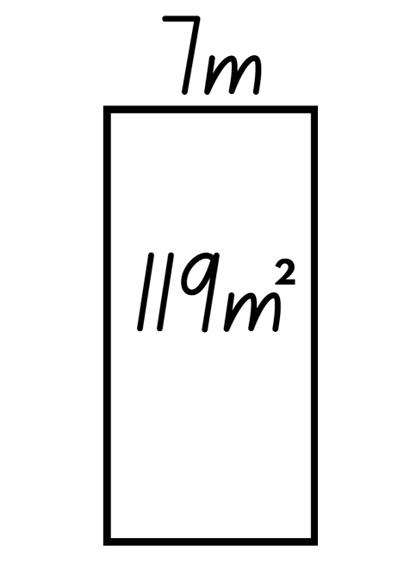
Activity 2 – Inverse operations (part 2)((Part 2)
7 m × __ m = 119 m²
Notes:
This is a developing number sense activity.
Number sense refers to a deep understanding of numbers, including their magnitude, relationships, and the effects of operations on them. It supports fluency and understanding, estimation, flexible thinking, and efficient problem-solving. Number sense activities 1–4 ‘activate’ prior number knowledge and support the learning of new content in the unit. Number sense activities 5–8 ‘loop’ back and provide opportunity for spaced practice with concepts and procedures covered in previous units.
Syllabus focus area:
Multiplicative relations B
Inverse operations Part 2
Ask:
Which operation would you use to help solve this problem?
What is the answer?
Allow students time to Think-Pair-Share. Explain that division is needed to solve the problem.
In pairs, students create a word problem to go with Figure 13. For example, the rectangular playground has an area of 119 m² and one side is 7 m long. How long is the other side?
Students write another problem with the same playground area context where the inverse operation (multiplication) is required.

Slide 18
Review of learning 3

Slide 19
Multiple choice (2)
3 x 6 = ___÷ 4
A
72
B
84
C
76
D
24
Notes:
This question connects to the content in the developing number sense activity (Activity 3)
Syllabus focus area:
Multiplicative relations B

Slide 20
Short response (9)
Record the following using decimal notation:
754 thousandths
609 thousandths
980 thousandths
Notes:
Short response questions provide brisk paced questions focussing on review of current and previous content to support spaced and interleaved practice.
Syllabus focus area:
Representing numbers A

Slide 21
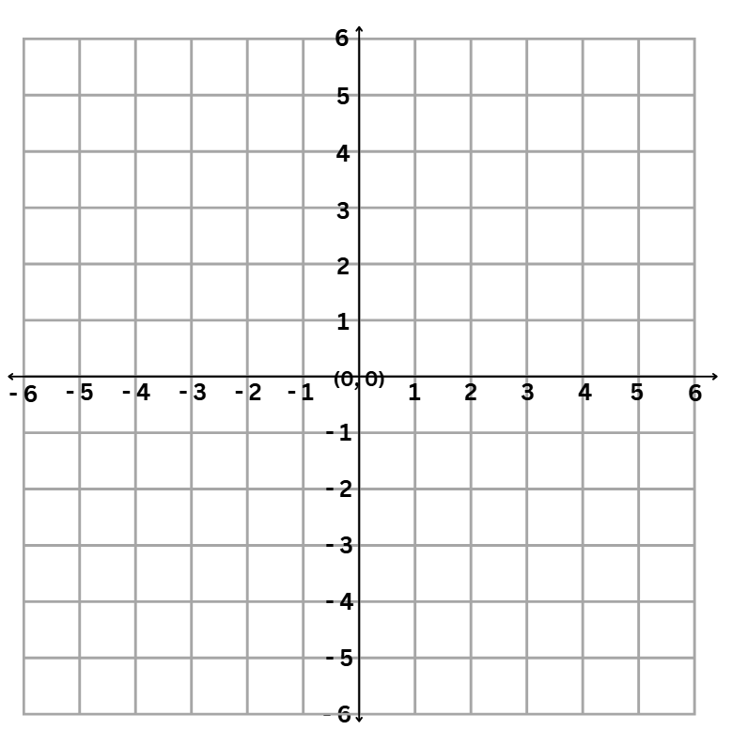
Short response (10)3)
Record the coordinates of:
a.
b.
c.
Notes:
Short response questions provide brisk paced questions focussing on review of current and previous content to support spaced and interleaved practice.
Syllabus focus area:
Geometric measure B

Slide 22

Short response (11)
Sketch this rectangular prism from its:
top view
side view
Notes:
Short response questions provide brisk paced questions focussing on review of current and previous content to support spaced and interleaved practice.
Syllabus focus area:
Three- dimensional spatial structure A

Slide 23
Short response (12)
Use decimal notation to complete the following:
3400 m is _____ km
7900 m is ____ km.
Notes:
Short response questions provide brisk paced questions focussing on review of current and previous content to support spaced and interleaved practice.
Syllabus focus area:
Geometric Measure B

Slide 24

Activity 3 – multiply and divide
Notes:
This is a developing number sense activity.
Number sense refers to a deep understanding of numbers, including their magnitude, relationships, and the effects of operations on them. It supports fluency and understanding, estimation, flexible thinking, and efficient problem-solving. Number sense activities 1–4 ‘activate’ prior number knowledge and support the learning of new content in the unit. Number sense activities 5–8 ‘loop’ back and provide opportunity for spaced practice with concepts and procedures covered in previous units.
Syllabus focus area:
Multiplicative relations B
Multiply and divide
This activity is an adaptation of Multiply and Divide Within a Hundred 1 from Open Middle by Kaplinsky.
In pairs, students use digits 2–9 (only once each), placing a digit in each box to make 2 correct and equal equations. For example, 3 × 6 = 72 ÷ 4.
As a class, share and compare solutions. Ask to identify the strategies they used and justify their choices.

Slide 25
Review of learning 4

Slide 26
True or false (2)
8 x 4 = 32 ÷ 2
True | False
Communicate your reasoning.
Notes:
The question on this slide connects to the content being explored in the developing number sense activity (Activity 4)
Syllabus focus area:
Multiplicative relations B

Slide 27
Short response (13)
Calculate 10% of 350.
Communicate your reasoning.
Notes:
Short response questions provide brisk paced questions focussing on review of current and previous content to support spaced and interleaved practice.
Syllabus focus area:
Represents numbers B

Slide 28
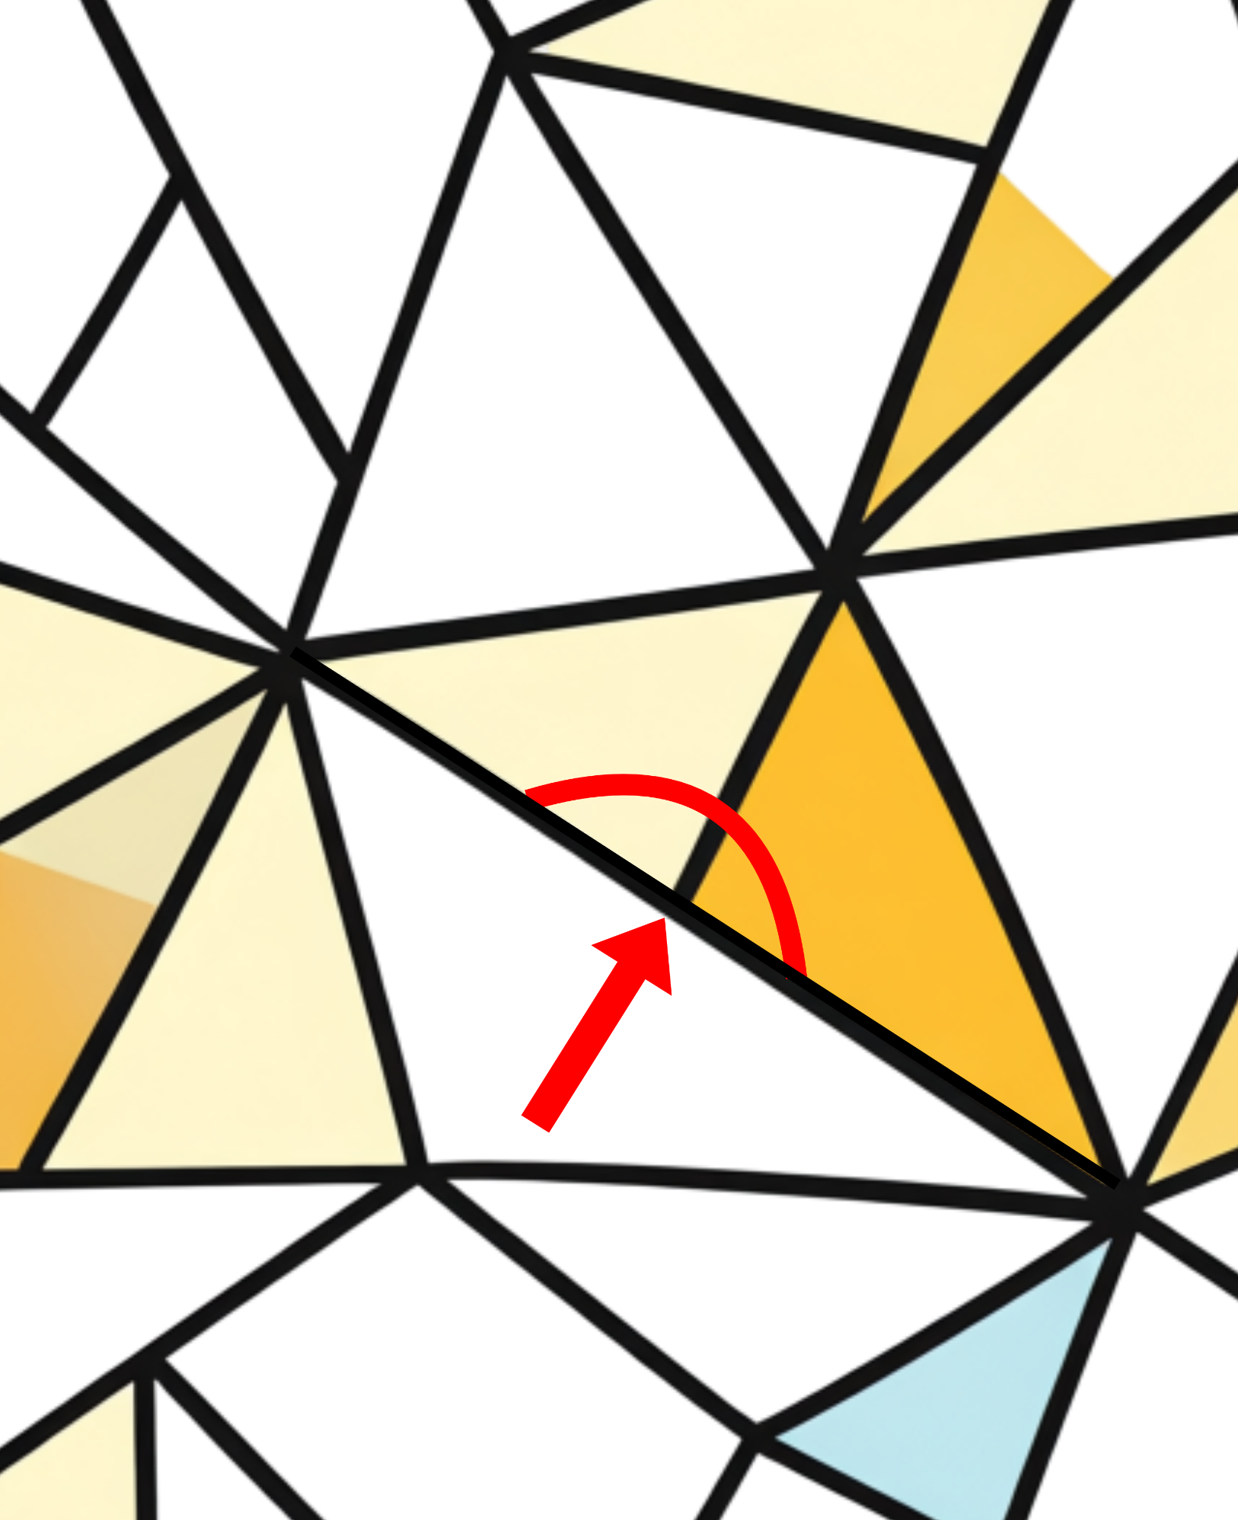
Short response (14)
Identify whether
this is a
right angle, an angle on a straight line or an angle at a point.
Notes:
Short response questions provide brisk paced questions focussing on review of current and previous content to support spaced and interleaved practice.
Syllabus focus area:
Geometric measure B

Slide 29
Short response (15)
I am a three-dimensional object .
I have a triangle base.
I have 4 faces.
What am I?
Notes:
Short response questions provide brisk paced questions focussing on review of current and previous content to support spaced and interleaved practice.
Syllabus focus area:
Three-dimensional spatial structure A

Slide 30
Short response (16)
These eight balls are placed in a bag.
One ball is selected from the bag.
​Record the probability of each outcome using a fraction.
Notes:
Short response questions provide brisk paced questions focussing on review of current and previous content to support spaced and interleaved practice.
Syllabus focus area:
Chance B

Slide 31
Activity 4 – find the area (1)
Joan wrote the number sentence:
7 x 4 = 86 ÷ 3
Is she correct or incorrect?
Communicate your reasoning.
Notes:
This is a developing number sense activity.
Number sense refers to a deep understanding of numbers, including their magnitude, relationships, and the effects of operations on them. It supports fluency and understanding, estimation, flexible thinking, and efficient problem-solving. Number sense activities 1–4 ‘activate’ prior number knowledge and support the learning of new content in the unit. Number sense activities 5–8 ‘loop’ back and provide opportunity for spaced practice with concepts and procedures covered in previous units.
Syllabus focus area:
Multiplicative relations B
Find the area
Discuss whether Joan was correct or incorrect and justify your reasoning.
Next slide
Display: Gabby wrote the number sentence 4 x 4 = 96 ÷ 5.
Students record responses on a whiteboard and explain their thinking.
Ask:
How did you know both number sentences were incorrect?
Did your knowledge of inverse operations assist you to identify the misconceptions?

Slide 32
Activity 4 – find the area (2)
Gabby wrote the number sentence
4 x 4 = 96 ÷ 5
Is she correct or incorrect?
Communicate your reasoning.
Notes:
This is a developing number sense activity.
Number sense refers to a deep understanding of numbers, including their magnitude, relationships, and the effects of operations on them. It supports fluency and understanding, estimation, flexible thinking, and efficient problem-solving. Number sense activities 1–4 ‘activate’ prior number knowledge and support the learning of new content in the unit. Number sense activities 5–8 ‘loop’ back and provide opportunity for spaced practice with concepts and procedures covered in previous units.
Syllabus focus area:
Multiplicative relations B
Find the area
Students record responses on a whiteboard and explain their thinking.
Ask:
How did you know both number sentences were incorrect?
Did your knowledge of inverse operations assist you to identify the misconceptions?

Slide 33
Review of learning 5

Slide 34
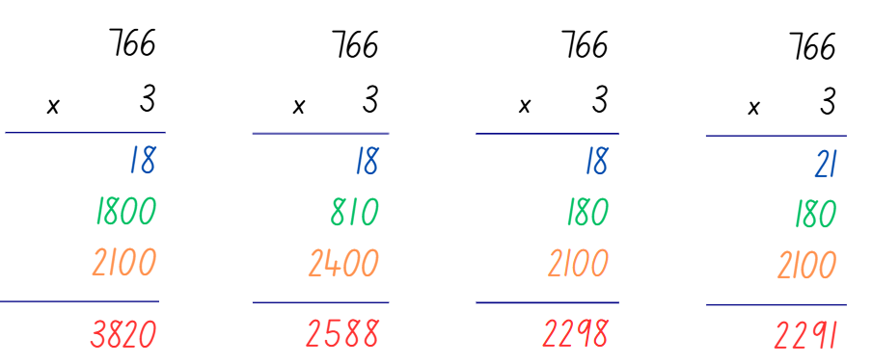
Multiple choice (3)
Which algorithm is correct?
A
B
C
D
Notes:
This question connects to the content in the developing number sense activity (Activity 7)
Syllabus focus area:
Multiplicative relations A

Slide 35
Short response (17)
Record the numbers that complete the table of values.
Number of shapes | 1 | 2 | 3 | 4 | 5
Number of sides | 6 | 12 | 18
Notes:
Short response questions provide brisk paced questions focussing on review of current and previous content to support spaced and interleaved practice.
Syllabus focus area:
Multiplicative relations B

Slide 36
Short response (18)
How many degrees is:
an acute angle
an obtuse angle
a reflex angle
Notes:
Short response questions provide brisk paced questions focussing on review of current and previous content to support spaced and interleaved practice.
Syllabus focus area:
Geometric measure B

Slide 37
Short response (19)
What are the equivalent measurements in millilitres?
0.1 L
0.25 L
Notes:
Short response questions provide brisk paced questions focussing on review of current and previous content to support spaced and interleaved practice.
Syllabus focus area:
Three-dimensional spatial structure A

Slide 38
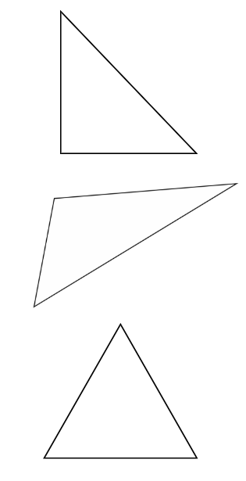
Short response (20)
A
Identify the:
isosceles triangle
scalene triangle
equilateral triangle
B
C
Notes:
Short response questions provide brisk paced questions focussing on review of current and previous content to support spaced and interleaved practice.
Syllabus focus area:
Two-dimensional spatial structure A

Slide 39
Activity 5 – area models and formal algorithms
368 × 4 =
Notes:
This is a developing number sense activity.
Number sense refers to a deep understanding of numbers, including their magnitude, relationships, and the effects of operations on them. It supports fluency and understanding, estimation, flexible thinking, and efficient problem-solving. Number sense activities 1–4 ‘activate’ prior number knowledge and support the learning of new content in the unit. Number sense activities 5–8 ‘loop’ back and provide opportunity for spaced practice with concepts and procedures covered in previous units.
Syllabus focus area:
Multiplicative Relations A
Area models and formal algorithms
Prompt students to recall that the area model can help us record the product of multiplying by a one-digit number using a formal algorithm.
Ask students to use an area model to complete the problem and record their thinking on whiteboards. (See Figure 15).
Prompt students to use this knowledge to solve the problem using a formal algorithm.
Ask:
Did you start with multiplying the ones, then the tens? Why or why not?
Was it difficult to add the place holder zero in the one’s column when multiplying by tens? Why or why not?

Slide 40
Review of learning 6

Slide 41
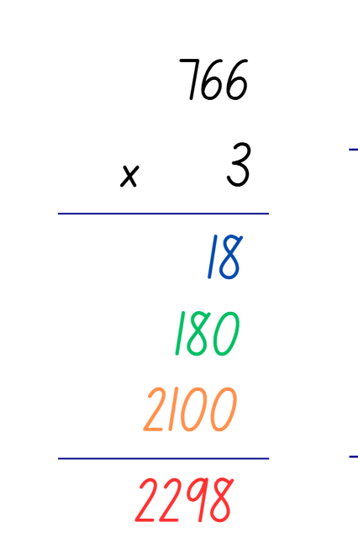
True or false (3)
Meg correctly used the formal algorithm.
True | False
Notes:
The question on this slide connects to the content being explored in the developing number sense activity (Activity 6)
Syllabus focus area:
Multiplicative relations A

Slide 42
Short response (21)
Solve 45 x 45 using an area model.
Notes:
Short response questions provide brisk paced questions focussing on review of current and previous content to support spaced and interleaved practice.
Syllabus focus area:
Multiplicative relations A

Slide 43
Short response (22)
Calculate the elapsed time from 9:15 am to 11:10 am.
Communicate your reasoning.
Notes:
Short response questions provide brisk paced questions focussing on review of current and previous content to support spaced and interleaved practice.
Syllabus focus area:
Non-spatial measure B

Slide 44
Short response (23)
0.750 mL can also be represented as _______L.
0.980 L can also be represented as ______mL.
Notes:
Short response questions provide brisk paced questions focussing on review of current and previous content to support spaced and interleaved practice.
Syllabus focus area:
Three-dimensional spatial structure A

Slide 45
Short response (24)
What three-dimensional object has a square base and 4 vertices?
Sketch the shape.
Notes:
Short response questions provide brisk paced questions focussing on review of current and previous content to support spaced and interleaved practice.
Syllabus focus area:
Three-dimensional spatial structure A

Slide 46
Activity 6 – formal algorithms
345 x 7 =
Notes:
This is a developing number sense activity.
Number sense refers to a deep understanding of numbers, including their magnitude, relationships, and the effects of operations on them. It supports fluency and understanding, estimation, flexible thinking, and efficient problem-solving. Number sense activities 1–4 ‘activate’ prior number knowledge and support the learning of new content in the unit. Number sense activities 5–8 ‘loop’ back and provide opportunity for spaced practice with concepts and procedures covered in previous units.
Syllabus focus area:
Multiplicative relations A
Formal algorithms
This activity is an adaptation of Tens Time from NZ Maths by the New Zealand Ministry of Education.
Ask students to independently complete the problem using a formal algorithm and their share their process and solution with a partner.
Ask:
How did place value understanding help you to complete the task?
How did you ensure that the regrouping and alignment of place value columns was correct?

Slide 47
Review of learning 7

Slide 48
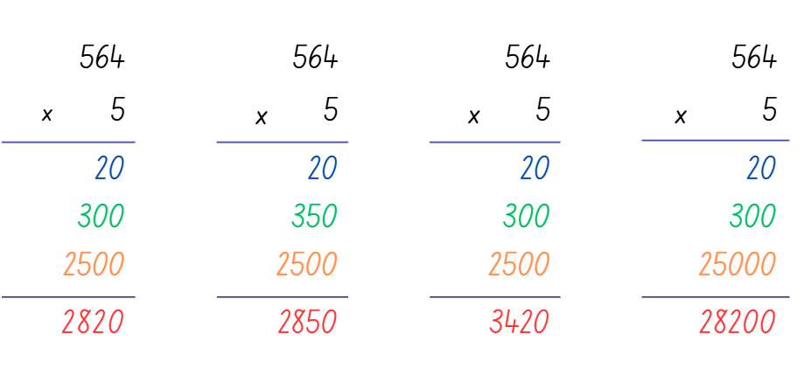
Multiple choice (4)
Which algorithm is correct?
A
B
C
D
Notes:
This question connects to the content in the developing number sense activity (Activity 7)
Syllabus focus area:
Multiplicative relations A

Slide 49
Short response (25)
If 4 identical bikes cost $1648, what is the cost of one bike?
Notes:
Short response questions provide brisk paced questions focussing on review of current and previous content to support spaced and interleaved practice.
Syllabus focus area:
Multiplicative relations A

Slide 50
Short response (26)
Nadia drove for 5 hours and 50 minutes. She arrived at 17:45.
Use a bridging strategy to calculate the time she left.
Notes:
Short response questions provide brisk paced questions focussing on review of current and previous content to support spaced and interleaved practice.
Syllabus focus area:
Non-spatial measure B

Slide 51
Short response (27)
Record 1256 mL using decimal notation.
Notes:
Short response questions provide brisk paced questions focussing on review of current and previous content to support spaced and interleaved practice.
Syllabus focus area:
Three-dimensional spatial structure A

Slide 52
Short response (28)
2.45 kg is the same as _____ kilograms and _____ grams.
Notes:
Short response questions provide brisk paced questions focussing on review of current and previous content to support spaced and interleaved practice.
Syllabus focus area:
Non-spatial measure A

Slide 53
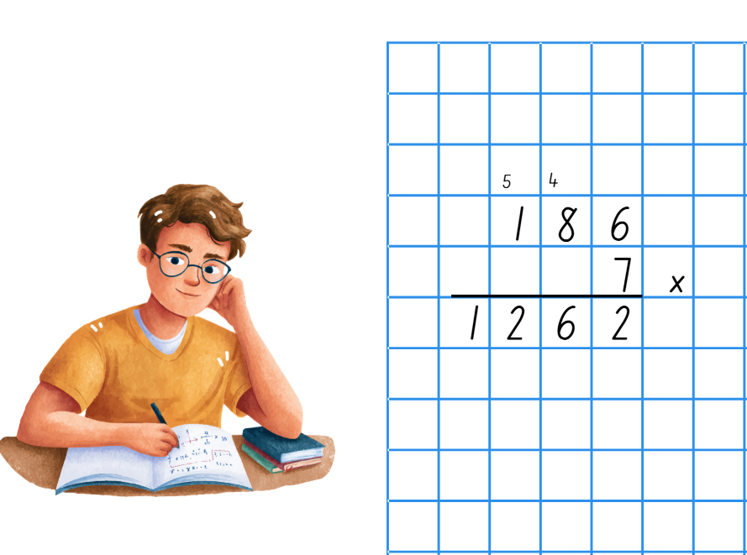
Activity 7 – Jordan’s algorithm
Notes:
This is a developing number sense activity.
Number sense refers to a deep understanding of numbers, including their magnitude, relationships, and the effects of operations on them. It supports fluency and understanding, estimation, flexible thinking, and efficient problem-solving. Number sense activities 1–4 ‘activate’ prior number knowledge and support the learning of new content in the unit. Number sense activities 5–8 ‘loop’ back and provide opportunity for spaced practice with concepts and procedures covered in previous units.
Syllabus focus area:
Multiplicative Relations A
Jordans algorithm
This resource corresponds to Resource 18 – Jordans algorithm in Stage 3 Year B Unit 31.
Display Resource 18 – Jordans algorithm
Ask:
What error/s did Jordan make?
Can you solve the algorithm?
Students correct the errors in the algorithm, recording their thinking on a whiteboard.
Select students to share their thinking with the class.

Slide 54
Review of learning 8

Slide 55
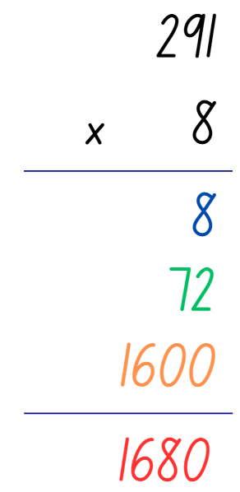
True or false (4)
Tim correctly used a formal algorithm.
True | False
Notes:
The question on this slide connects to the content being explored in the developing number sense activity (Activity 8)
Syllabus focus area:
Multiplicative relations A

Slide 56
Short response (29)
Multiply 0.75 by:
10
100
1000
Notes:
Short response questions provide brisk paced questions focussing on review of current and previous content to support spaced and interleaved practice.
Syllabus focus area:
Multiplicative relations B

Slide 57
Short response (30)
Steph played video games from
7:45 pm – 9:05 pm.
Calculate the time she spent playing video games.
Notes:
Short response questions provide brisk paced questions focussing on review of current and previous content to support spaced and interleaved practice.
Syllabus focus area:
Non-spatial measure B

Slide 58
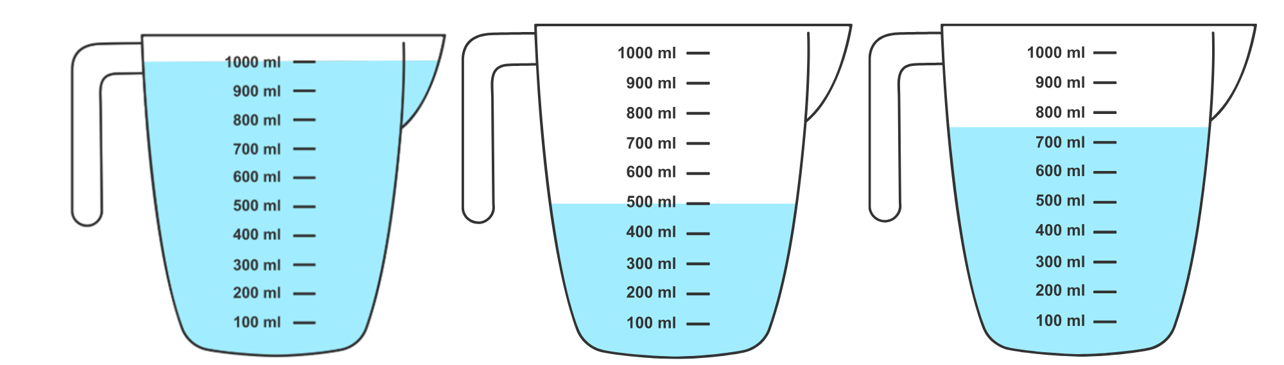
Short response (31)
Record the capacities of these containers in mL in order from smallest to largest.
A
B
C
Notes:
Short response questions provide brisk paced questions focussing on review of current and previous content to support spaced and interleaved practice.
Syllabus focus area:
Three-dimensional spatial structure B

Slide 59
Short response (32)
Jane arrived at her friend’s house at 14:30. She left at 17:15.
How long did she stay there?
Notes:
Short response questions provide brisk paced questions focussing on review of current and previous content to support spaced and interleaved practice.
Syllabus focus area:
Non-spatial measure B

Slide 60
Activity 8 – completing formal algorithms
278 x 9 =
Notes:
This is a developing number sense activity.
Number sense refers to a deep understanding of numbers, including their magnitude, relationships, and the effects of operations on them. It supports fluency and understanding, estimation, flexible thinking, and efficient problem-solving. Number sense activities 1–4 ‘activate’ prior number knowledge and support the learning of new content in the unit. Number sense activities 5–8 ‘loop’ back and provide opportunity for spaced practice with concepts and procedures covered in previous units.
Syllabus focus area:
Multiplicative relations A
Completing formal algorithms
Prompt students to use their knowledge of a multiplication algorithm to determine the answer.
Select students to discuss the answer they selected and discuss their thinking.
Ask:
What was the first step you took to solve the problem?
Where in the algorithm do you see 200 × 9?
Where in the algorithm do you see 70 × 9?
Where in the algorithm do you see 8 × 9?
What are the benefits and limitations of using only the area model or algorithm?

Slide 61
Double Venn diagram
Object 1
Object 2
Features similar to both objects
Features of object 1
Features of object 2

Slide 62
Frayer
Definition
Facts/Characteristics
Word, term, concept
Examples
Non-examples

Slide 63
Spider map
Idea
Subject

Slide 64
Cline
Concept 1
Concept 2
Word
Word
Word
Word
Word
Word
Word
Word
Word
Word
Word

Slide 65
Compare and contrast

Slide 66
Multiple choice (5)
A
B
C
D

Slide 67
Multiple choice
A
B
C
D
Notes:
This question connects to the content in the developing number sense activity (Activity 3)
Syllabus focus area:
[Focus area A/B]

Slide 68
References (1)
This presentation contains NSW Curriculum and syllabus content. The NSW Curriculum is developed by the NSW Education Standards Authority. This content is prepared by NESA for and on behalf of the Crown in the right of the State of New South Wales. The material is protected by Crown copyright.
Please refer to the NESA Copyright Disclaimer for more information https://educationstandards.nsw.edu.au/wps/portal/nesa/mini-footer/copyright.
NESA holds the only official and up-to-date versions of the NSW Curriculum and syllabus documents. Please visit the NSW Education Standards Authority (NESA) website https://educationstandards.nsw.edu.au/wps/portal/nesa/home and the NSW Curriculum website https://curriculum.nsw.edu.au.
Mathematics K–10 Syllabus © NSW Education Standards Authority (NESA) for and on behalf of the Crown in right of the State of New South Wales, 2022.
National Numeracy Learning Progression © Australian Curriculum, Assessment and Reporting Authority (ACARA) 2010 to present, unless otherwise indicated. This material was downloaded from the Australian Curriculum website (National Numeracy Learning Progression) (accessed 11 October 2023) and was not modified.
APSMO (Australasian Problem Solving Mathematical Olympiads) (2021) ‘Eclairs and Doughnuts’, Problems, APSMO website, accessed 26 September 2023.
Kaplinsky R (2016–2023) ‘Multiply and Divide Within a Hundred 1’, Grade 3, Open Middle website, accessed 11 October 2023.
New Zealand Ministry of Education (n.d.) ‘Tens Time’, Resources, NZ Maths website, accessed 11 October 2023.
Online Calculator (2023) Full Screen Calculator, Online Calculator website, accessed 11 October 2023.

Slide 69
References (2)
This presentation contains NSW Curriculum and syllabus content. The NSW Curriculum is developed by the NSW Education Standards Authority. This content is prepared by NESA for and on behalf of the Crown in the right of the State of New South Wales. The material is protected by Crown copyright.
Please refer to the NESA Copyright Disclaimer for more information https://educationstandards.nsw.edu.au/wps/portal/nesa/mini-footer/copyright.
NESA holds the only official and up-to-date versions of the NSW Curriculum and syllabus documents. Please visit the NSW Education Standards Authority (NESA) website https://educationstandards.nsw.edu.au/wps/portal/nesa/home and the NSW Curriculum website https://curriculum.nsw.edu.au.
Siemon D (1993) Target practice, Resources and Workbook for Primary Mathematics and Science Specialists (PMSS) (PDF 4.5 MB), Department of Education Victoria, accessed 26 September 2023
State of New South Wales (Department of Education) (2023) Benchmark problems, Part 2: Proportional thinking with fractions, decimals and percentages (PDF 1.2 MB), NSW Department of Education website, accessed 26 September 2023.
State of New South Wales (Department of Education) (2023) Dividing with Decimals, Multiplying and dividing decimals (DOCX 687 KB), NSW Department of Education website, accessed 26 September 2023
State of New South Wales through the NSW Department of Education and Training (2010) Houses, Talking about Patterns & Algebra: Early Stage 1 to Stage 3, NSW Department of Education website, accessed 26 September 2023.
Sullivan P (2018) Challenging mathematical tasks: Unlocking the potential of all students, Oxford University Press Australia and New Zealand, Great Britain.

Slide 70
References (3)
This presentation contains NSW Curriculum and syllabus content. The NSW Curriculum is developed by the NSW Education Standards Authority. This content is prepared by NESA for and on behalf of the Crown in the right of the State of New South Wales. The material is protected by Crown copyright.
Please refer to the NESA Copyright Disclaimer for more information https://educationstandards.nsw.edu.au/wps/portal/nesa/mini-footer/copyright.
NESA holds the only official and up-to-date versions of the NSW Curriculum and syllabus documents. Please visit the NSW Education Standards Authority (NESA) website https://educationstandards.nsw.edu.au/wps/portal/nesa/home and the NSW Curriculum website https://curriculum.nsw.edu.au.
Sullivan P and Lilburn P (2017) Open-ended maths activities: Using ‘Good’ Questions to Enhance Learning in Mathematics, Revised edn, Oxford University Press Australia and New Zealand, Great Britain.
Topmarks Online Ltd (1998–2024) Moving Digit Cards, Topmarks website, accessed 11 October 2023.

Slide 71
Copyright
© State of New South Wales (Department of Education), 2025
The copyright material published in this resource is subject to the Copyright Act 1968 (Cth) and is owned by the NSW Department of Education or, where indicated, by a party other than the NSW Department of Education (third-party material).
Copyright material available in this resource and owned by the NSW Department of Education is licensed under a Creative Commons Attribution 4.0 International (CC BY 4.0) license.
This license allows you to share and adapt the material for any purpose, even commercially.
Attribution should be given to © State of New South Wales (Department of Education), 2025.
Material in this resource not available under a Creative Commons license:
the NSW Department of Education logo, other logos and trademark-protected material
Material owned by a third party that has been reproduced with permission. You will need to obtain permission from the third party to reuse its material.
Links to third-party material and websites
Please note that the provided (reading/viewing material/list/links/texts) are a suggestion only and implies no endorsement, by the New South Wales Department of Education, of any author, publisher, or book title. School principals and teachers are best placed to assess the suitability of resources that would complement the curriculum and reflect the needs and interests of their students.
If you use the links provided in this document to access a third party’s website, you acknowledge that the terms of use, including licence terms set out on the third-party’s website apply to the use which may be made of the materials on that third-party website or where permitted by the Copyright Act 1968 (Cth). The department accepts no responsibility for content on third-party websites.

