Slide 1
Instructions for use
This resource aligns to the learning in Stage 3 Year B Unit 32 and revisits content from earlier sample units.
Classroom teachers are encouraged to add and adapt slides as required to meet the needs of their students.
Save a copy of the file to make changes to the slide deck. Go to File > Download a Copy (this downloads a copy to the computer to edit in the PowerPoint app).
To convert the PowerPoint to Google Slides:
  Upload the file into Google Drive and open it.
  Go to File > Save as Google Slides.
  (Note – conversion may cause formatting changes in the slides.)

Slide 2

Review of Learning
Mathematics Stage 3 – Unit 32
Notes:
Reviews may include a combination of question types, requiring students to recall facts and key ideas, as well as apply their knowledge to solve problems and answer questions. To support active engagement, a mix of techniques should be employed.” (AERO, 2024).
This Review of Learning slide deck revisits key concepts from the following units:
Stage 3 Year B Unit 32
Stage 3 Year B Unit 31
Stage 3 Year B Unit 30
It also includes opportunities to review prior learning in non-number content, supporting consolidation across focus areas.
The review of learning resources include three key task types that support the development of mathematical proficiency through retrieval, spaced practice, and active participation. These practices complement the review phase (activating prior knowledge) embedded within the beginning of each lesson.
1.
Multiple-choice questions/True or false: Designed to promote active retrieval of key concepts and identify common misconceptions in number, supporting consolidation, understanding and fluency.
These questions:
support spaced and interleaved practice
help identify and address common misconceptions
support active recall and immediate feedback
support whole class participation
identify areas requiring reteach
2.
Short-response question sets: Carefully grouped questions that encourage spaced and interleaved practice across multiple focus areas, helping students revisit and apply knowledge from different points in time.
These questions:
have a combination of question types
address a range of focus areas
build automaticity and fluency
support active recall
allow for immediate feedback
identify content requiring reteach
3.
Developing number sense activities: A variety of practical, purposeful tasks that reinforce current learning and build on prior knowledge. These activities promote reasoning, problem-solving and conceptual understanding.
The review of learning resources are designed to work support teaching and learning in mathematics. For the most effective implementation, use the resources flexibly, adapting to meet student learning needs and individual classroom contexts.

Slide 3
Lessons
1
Review of learning 1
5
Review of learning 5
2
Review of learning 2
6
Review of learning 6
3
Review of learning 3
7
Review of learning 7
4
Review of learning 4
8
Review of learning 8
Notes:
Teacher notes:
Click lesson titles to go to specific lessons
Interactive features can be viewed in slide show

Slide 4
Review of learning 1

Slide 5

Multiple choice (1)
Following the pattern, what number would go in the green box?
No. of squares | 1 | 2 | 3 | 4
No. of sides | 4 | 8 | 12
A
B
C
D
18
16
20
24
Notes:
This question connects to the content in the developing number sense activity (Activity 1)
Syllabus focus area:
Multiplicative relations B

Slide 6

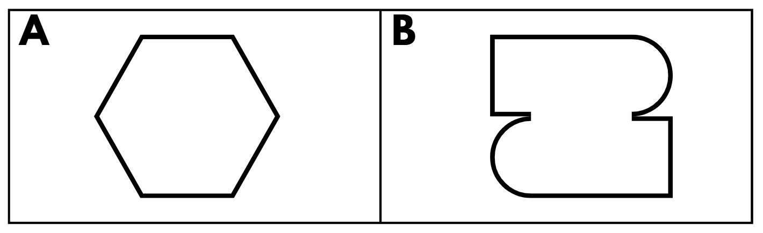
Short response (1)
Identify which is a regular polygon and which is an irregular polygon.
Communicate your reasoning.
Notes:
Short response questions provide brisk paced questions focussing on review of current and previous content to support spaced and interleaved practice.
Syllabus focus area:
Two-dimensional spatial structure A: 2D shapes

Slide 7
Short response (2)
What number am I?
I can be grouped as:
7 millions, 2 thousands, 14 hundreds, 2 tens and 26 ones.
Notes:
Short response questions provide brisk paced questions focussing on review of current and previous content to support spaced and interleaved practice.
Syllabus focus area:
Represents numbers A

Slide 8
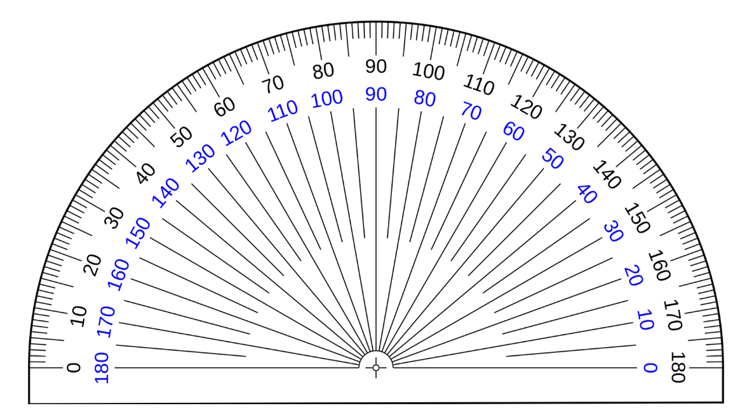
Short response (3)
Explain how to use a protractor to measure an angle.
Notes:
Short response questions provide brisk paced questions focussing on review of current and previous content to support spaced and interleaved practice.
Syllabus focus area:
Geometric measure A: Angles

Slide 9
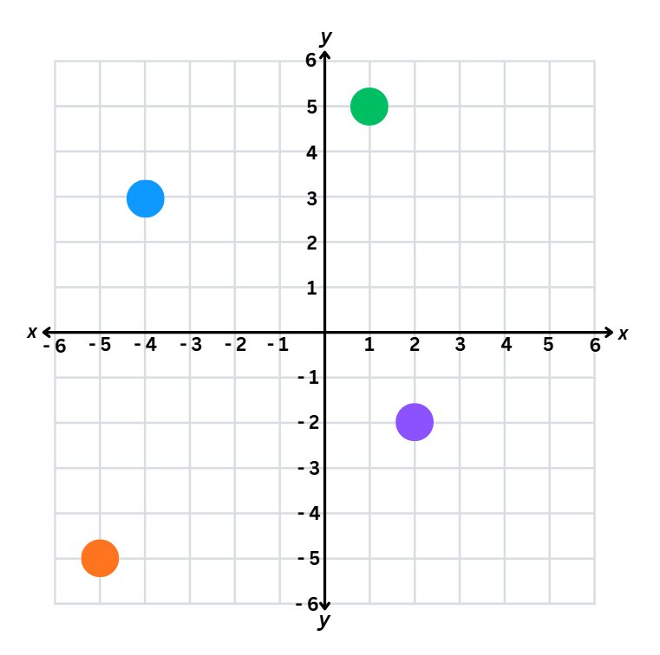
Short response (4)
Record the coordinates of each dot on the Cartesian plane.​
Notes:
Short response questions provide brisk paced questions focussing on review of current and previous content to support spaced and interleaved practice.
Syllabus focus area:
Geometric measure B: Position

Slide 10

Activity 1 – determine the rule that describes the relationship between the bottom number and the top number in the table
Number of shapes | 1 | 2 | 3 | 4 | 5
Number of sides | 12 | 24 | 36 | 48 | 60
Notes:
This is a developing number sense activity.
Number sense refers to a deep understanding of numbers, including their magnitude, relationships, and the effects of operations on them. It supports fluency and understanding, estimation, flexible thinking, and efficient problem-solving. Number sense activities 1–4 ‘activate’ prior number knowledge and support the learning of new content in the unit. Number sense activities 5–8 ‘loop’ back and provide opportunity for spaced practice with concepts and procedures covered in previous units.
Syllabus focus area:
Multiplicative relations B
Determine the rule that describes the relationship between the bottom number and the top number in the table
In pairs, students discuss and identify the rule to determine the number of sides for any value in the top row. For example, students may use wording such as ‘to determine the number of sides, you need to multiply the number of shapes by 12'. Remind students that the multiplication rule needs to describe the relationship between the top number and the bottom number in the table.
Select students to share the rule and apply it to a value not displayed in the table. For example, if the number of shapes is 10, the number of sides is 120.
In their workbooks, students draw possible shapes that could represent the sequence in the table. For example, see Figure 23.
Students describe the geometric pattern they have drawn.
Ask:
How many sides would there be if there were 10 shapes? How did you work out the answer?
If there were 96 sides, how many shapes would there be? How did you work out your answer?
How does the table help determine the relationship between the number of shapes and the number of sides?

Slide 11
Review of learning 2

Slide 12
True or false (1)
This rule describes what is happening in the pattern: There are 3 times as many sides as there are triangles.
True | False
Notes:
The question on this slide connects to the content being explored in the developing number sense activity (Activity 2)
Syllabus focus area:
Multiplicative relations B

Slide 13
Short response (5)
Identify whether this quadrilateral has line symmetry, rotational symmetry, or both.
Notes:
Short response questions provide brisk paced questions focussing on review of current and previous content to support spaced and interleaved practice.
Syllabus focus area:
Two-dimensional spatial structure A: 2D shapes

Slide 14
Short response (6)
Record the following using decimal notation:
678 thousandths
213 thousandths
42 thousandths
Notes:
Short response questions provide brisk paced questions focussing on review of current and previous content to support spaced and interleaved practice.
Syllabus focus area:
Represents numbers A

Slide 15
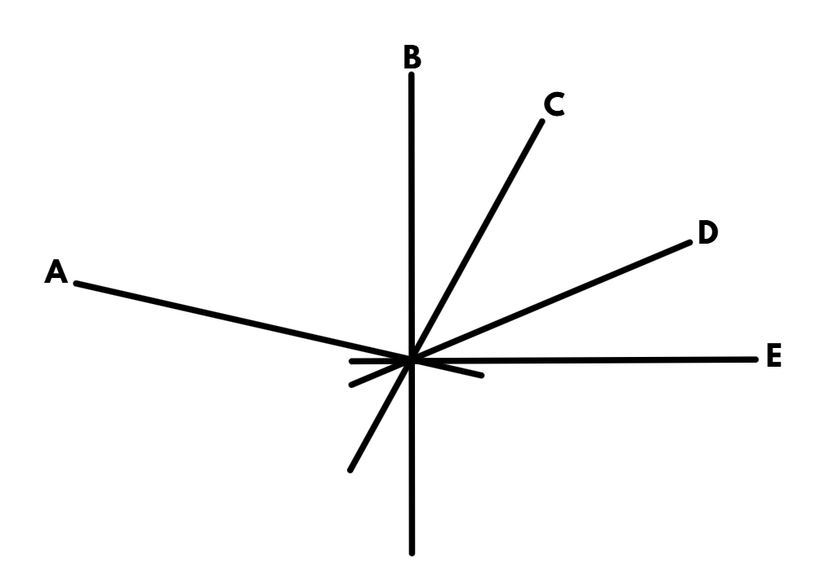
Short response (7)
Which of these lines are perpendicular?​
Notes:
Short response questions provide brisk paced questions focussing on review of current and previous content to support spaced and interleaved practice.
Syllabus focus area:
Geometric measure B: Angles

Slide 16
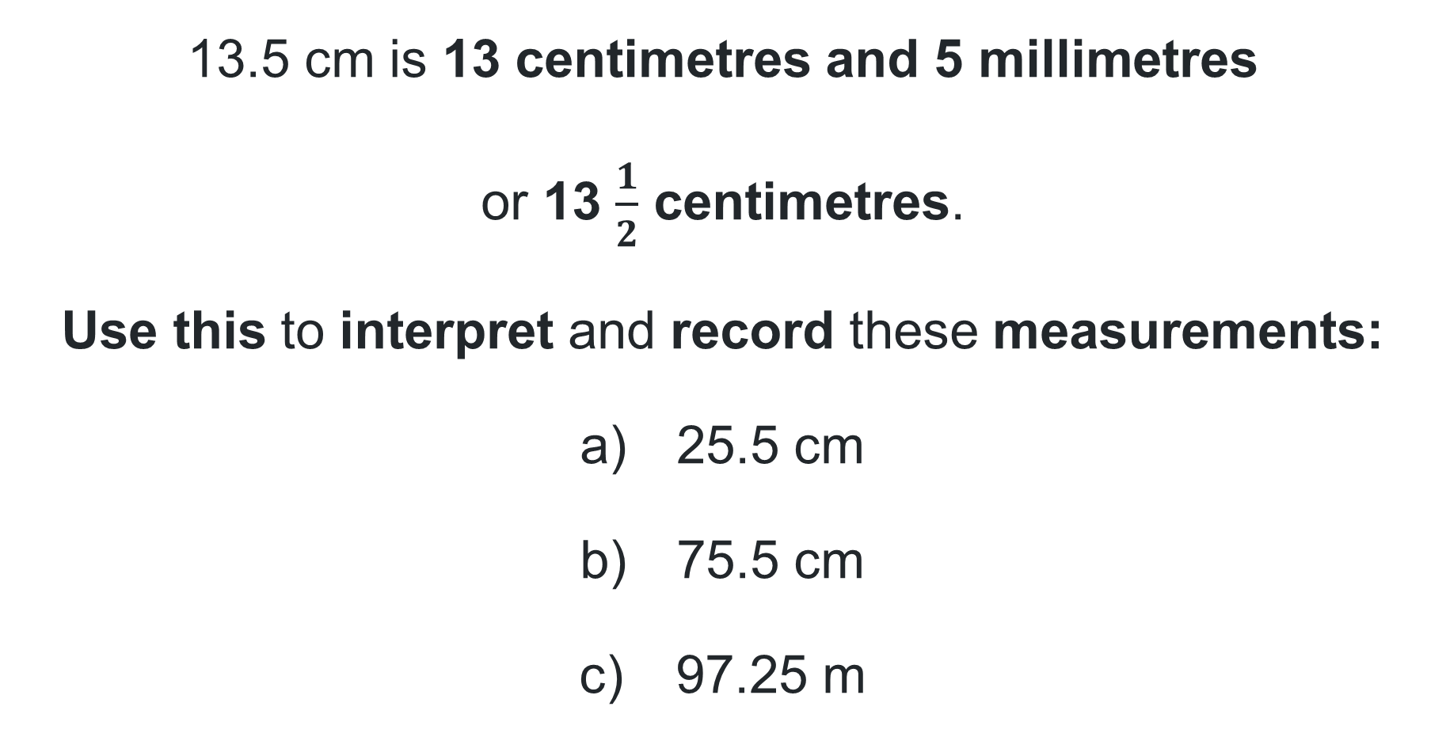
Short response (8)
13.5 cm is 13 centimetres and 5 millimetres
or 13 $\frac{1}{2}$ centimetres.
Use this to interpret and record these measurements:
25.5 cm
75.5 cm
97.25 m
Notes:
Short response questions provide brisk paced questions focussing on review of current and previous content to support spaced and interleaved practice.
Syllabus focus area:
Geometric measure B:

Slide 17
Activity 2 – describe number patterns formed by multiples
Activity 1:
Number of shapes | 1 | 2 | 3 | 4 | 5
Number of sides | 12 | 24 | 36 | 48 | 60
Number of shapes | 1 | 2 | 3 | 4 | 5
Number of sides
Notes:
This is a developing number sense activity.
Number sense refers to a deep understanding of numbers, including their magnitude, relationships, and the effects of operations on them. It supports fluency and understanding, estimation, flexible thinking, and efficient problem-solving. Number sense activities 1–4 ‘activate’ prior number knowledge and support the learning of new content in the unit. Number sense activities 5–8 ‘loop’ back and provide opportunity for spaced practice with concepts and procedures covered in previous units.
Syllabus focus area:
Multiplicative relations B
Describe number patterns formed by multiples
Highlight the completed table from Activity 1.
Ask:
What was the relationship between the number of shapes and the number of sides?
How did we use the table to identify the rule?
Indicate the table of values (above) on the board:
Explain that today students will be working in pairs, taking turns to complete the bottom row of the table. Student A completes the first 3 boxes in the bottom row of the table. Student B completes the row and draws shapes that would follow that rule. Student B describes the rule to Student A using wording such as ‘to determine the pattern, I had to multiply the number of shapes by the number in the first box'. Remind students that the multiplication rule needs to describe the relationship between the top number and the bottom number in the table.
Students repeat, swapping roles.

Slide 18
Review of learning 3

Slide 19
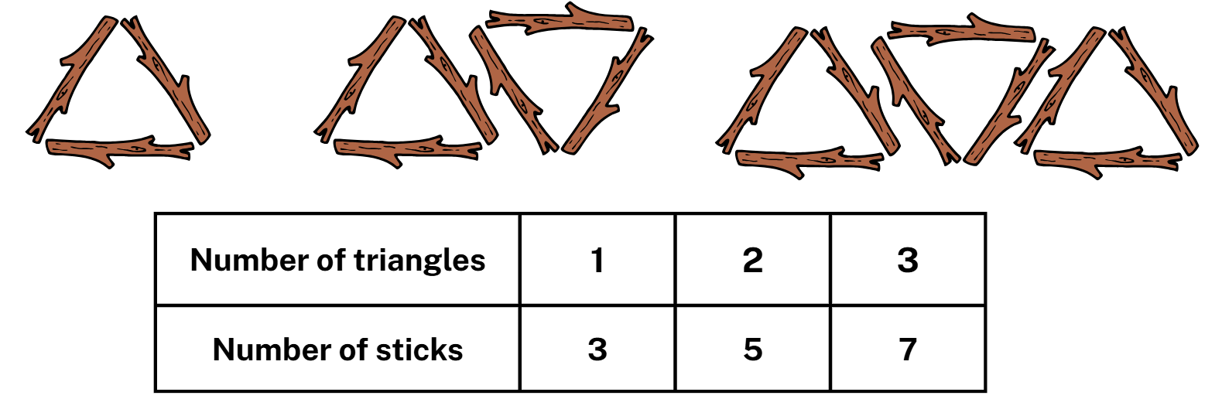
Multiple choice (2)
Which rule describes what is happening in the pattern and the table of values?
A
There are 3 times as many sticks as triangles.
B
There are 2 more sticks than triangles.
C
There are twice as many sticks as triangles plus 1 more.
D
There are 2 times as many sticks as triangles.
Notes:
This question connects to the content in the developing number sense activity (Activity 3)
Syllabus focus area:
Multiplicative relations B

Slide 20
Short response (9)
Has this shape only been translated?
Communicate your reasoning.
Notes:
Short response questions provide brisk paced questions focussing on review of current and previous content to support spaced and interleaved practice.
Syllabus focus area:
Two-dimensional spatial structure B: 2D shapes

Slide 21
Short response (10)
Calculate 10% of 520.
Communicate your thinking.
Notes:
Short response questions provide brisk paced questions focussing on review of current and previous content to support spaced and interleaved practice.
Syllabus focus area:
Represents numbers B

Slide 22
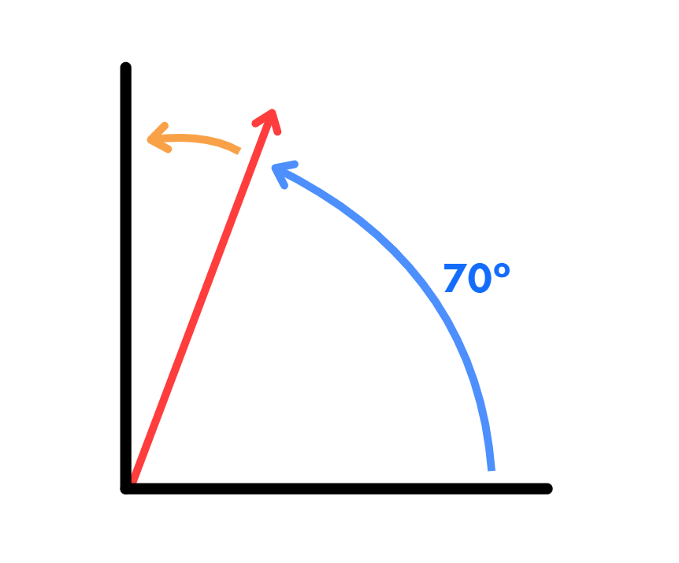
Short response (11)
Record the size of the orange angle.
Communicate your reasoning.
Notes:
Short response questions provide brisk paced questions focussing on review of current and previous content to support spaced and interleaved practice.
Syllabus focus area:
Geometric measure B: Angles

Slide 23
Short response (12)
Convert between metres and kilometres:
8560 m
2.75 km
525 m
Notes:
Short response questions provide brisk paced questions focussing on review of current and previous content to support spaced and interleaved practice.
Syllabus focus area:
Geometric measure B: Length

Slide 24
Activity 3 – determine a rule describing the relationship between the bottom number and the top number in a table
Length across river (metres) | 1 | 2 | 3 | 4 | 5
Length of wood need for crossing (metres) | 3 | 6 | 9 | 10 | 15
Notes:
This is a developing number sense activity.
Number sense refers to a deep understanding of numbers, including their magnitude, relationships, and the effects of operations on them. It supports fluency and understanding, estimation, flexible thinking, and efficient problem-solving. Number sense activities 1–4 ‘activate’ prior number knowledge and support the learning of new content in the unit. Number sense activities 5–8 ‘loop’ back and provide opportunity for spaced practice with concepts and procedures covered in previous units.
Syllabus focus area:
Multiplicative relations B
Determine a rule describing the relationship between the bottom number and the top number in a table
Explain that there is an error in the table of values. Students turn and talk to identify the error.
Select students to share their ideas with the class. Ask:
What value is incorrect in the table?
How did you determine the error?
What is the multiplication rule describing the relationship between the bottom number and the top number in the table?
Students record the table of values in their workbook with the error corrected.
Students describe the pattern formed by the multiples in the table.

Slide 25
Review of learning 4

Slide 26

True or false (2)
This rule describes what is happening in the pattern: There are 5 times as many sides as there are shapes.
True | False
Notes:
The question on this slide connects to the content being explored in the developing number sense activity (Activity 4)
Syllabus focus area:
Multiplicative relations B

Slide 27
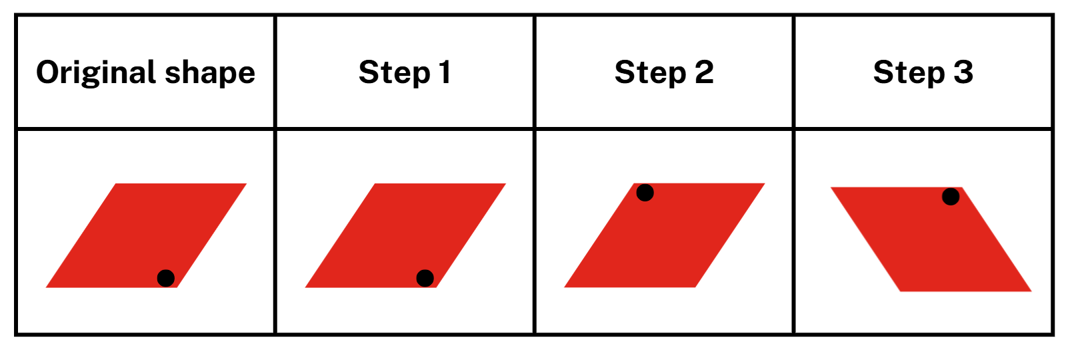
Short response (13)
Label what is happening at each step.
reflect
translate
rotate
Notes:
Short response questions provide brisk paced questions focussing on review of current and previous content to support spaced and interleaved practice.
Syllabus focus area:
Two-dimensional spatial structure B: 2D shapes

Slide 28
Short response (14)
Use this geometric pattern to complete the table of values.
No. of triangles | 1 | 2 | 3 | 4 | 5
No. of sides
Notes:
Short response questions provide brisk paced questions focussing on review of current and previous content to support spaced and interleaved practice.
Syllabus focus area:
Multiplicative relations B

Slide 29
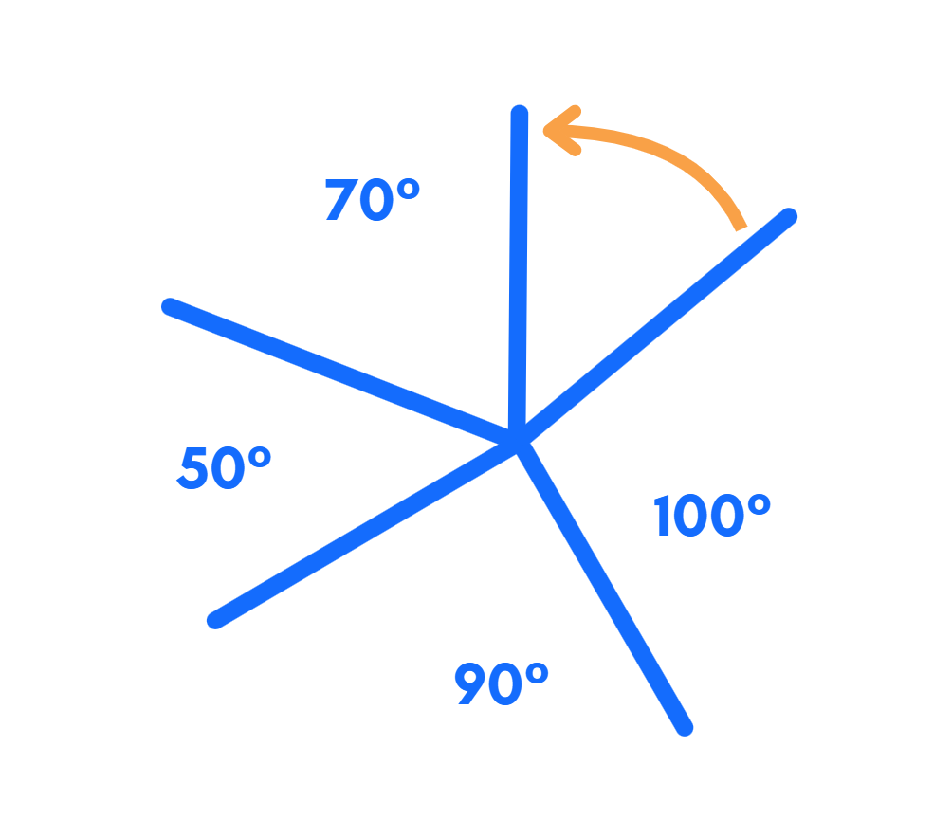
Short response (15)
Record the size of the orange angle.
Communicate your reasoning.
Notes:
Short response questions provide brisk paced questions focussing on review of current and previous content to support spaced and interleaved practice.
Syllabus focus area:
Geometric measure B: Angles

Slide 30
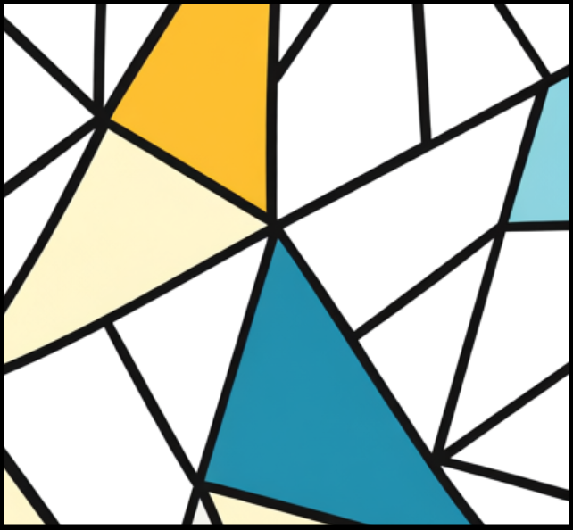
Short response (16)
What is the total of the angles at this point in the diagram?
Communicate your reasoning.
Notes:
Short response questions provide brisk paced questions focussing on review of current and previous content to support spaced and interleaved practice.
Syllabus focus area:
Geometric measure B: Angles

Slide 31
Activity 4 – design a table which shows a relationship between the bottom number and the top number
Activity 3:
Length across river (metres) | 1 | 2 | 3 | 4 | 5
Length of wood need for crossing (metres) | 3 | 6 | 9 | 10 | 15
Notes:
This is a developing number sense activity.
Number sense refers to a deep understanding of numbers, including their magnitude, relationships, and the effects of operations on them. It supports fluency and understanding, estimation, flexible thinking, and efficient problem-solving. Number sense activities 1–4 ‘activate’ prior number knowledge and support the learning of new content in the unit. Number sense activities 5–8 ‘loop’ back and provide opportunity for spaced practice with concepts and procedures covered in previous units.
Syllabus focus area:
Multiplicative relations B
Design a table which shows a relationship between the bottom number and the top number
Revise table of values from Activity 3. Ensure students understand that multiplication rules describe the relationship between the bottom number and the top number in a table.
In their workbooks, students create their own table of values with an error in it.
Students swap tables with a partner to:
identify the error
record the multiplication rule
correct the error
describe the pattern formed by the multiples in the table.
Regroup and ask:
How did you identify the error?
What is the multiplication rule describing the relationship between the bottom number and the top number in the table?
How did you determine the relationship?

Slide 32
Review of learning 5

Slide 33
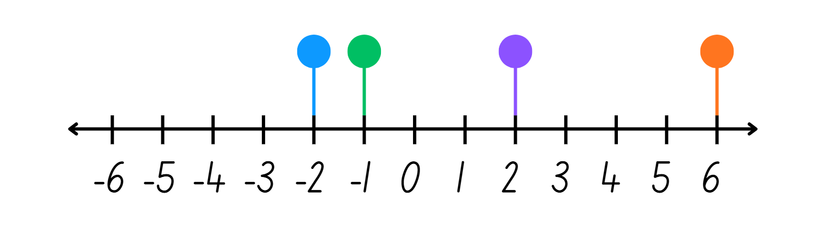
Multiple choice (3)
Which dot is closest to zero?
A
B
C
D
Notes:
This question connects to the content in the developing number sense activity (Activity 5)
Syllabus focus area:
Represents numbers B

Slide 34
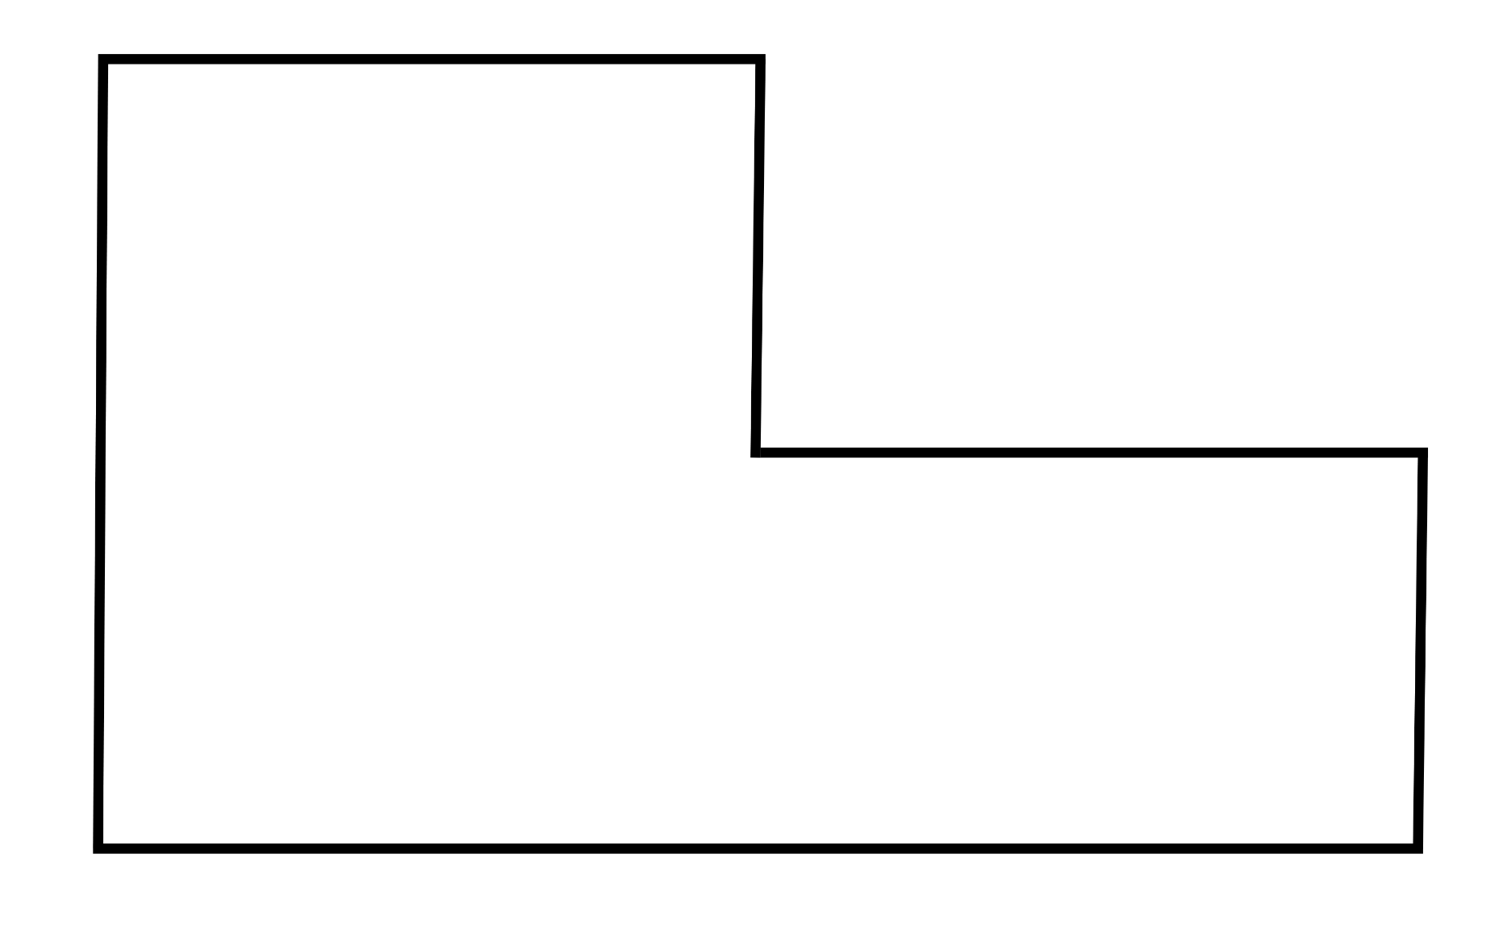
Short response (17)
Draw 3 different ways this composite L-shape could be dissected to calculate its area.
Notes:
Short response questions provide brisk paced questions focussing on review of current and previous content to support spaced and interleaved practice.
Syllabus focus area:
Two-dimensional spatial structure B: Area

Slide 35
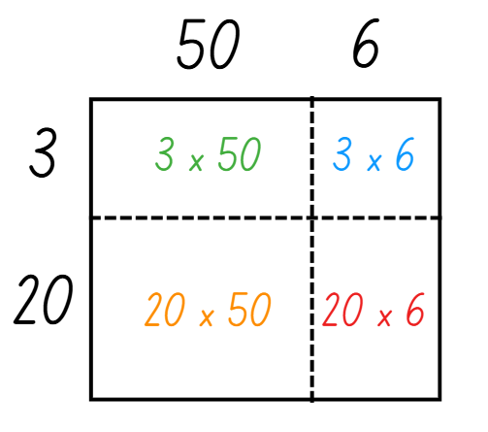
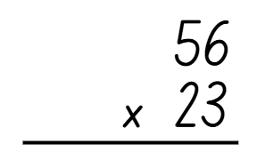
Short response (18)
Use this area model to help solve this algorithm.
Notes:
Short response questions provide brisk paced questions focussing on review of current and previous content to support spaced and interleaved practice.
Syllabus focus area:
Multiplicative relations A

Slide 36
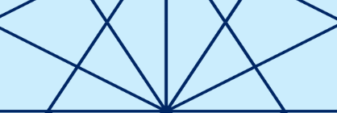
Short response (19)
What is the total of the angles at a point in this diagram?
Communicate your reasoning.
Notes:
Short response questions provide brisk paced questions focussing on review of current and previous content to support spaced and interleaved practice.
Syllabus focus area:
Geometric measure B: Angles

Slide 37
Short response (20)
A.
Identify which triangle is:
equilateral
isosceles
scalene.
B.
C.
Notes:
Short response questions provide brisk paced questions focussing on review of current and previous content to support spaced and interleaved practice.
Syllabus focus area:
Two-dimensional spatial structure A: 2D shapes

Slide 38
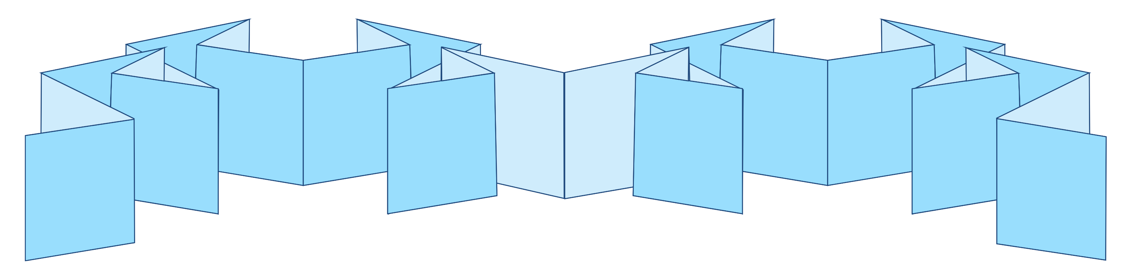
Activity 5 – integers are positive and negative whole numbers and zero
0
0
Notes:
This is a developing number sense activity.
Number sense refers to a deep understanding of numbers, including their magnitude, relationships, and the effects of operations on them. It supports fluency and understanding, estimation, flexible thinking, and efficient problem-solving. Number sense activities 1–4 ‘activate’ prior number knowledge and support the learning of new content in the unit. Number sense activities 5–8 ‘loop’ back and provide opportunity for spaced practice with concepts and procedures covered in previous units.
Syllabus focus area:
Represents numbers B
Integers are positive and negative whole numbers and zero
This activity is an adaptation of ‘Folding around zero’ from Mindset Mathematics Visualizing and Investigating Big Ideas Grade 6 by Boaler et al.
Explain that students will create a number line to explore integers.
Cut A3 paper into 20 × 420 mm strips and provide each student with a strip. Ask students to fold the strip in half and mark this mid-point as zero.
Students re-fold the strip in half at the zero and then in half 4 more times. This will make 16 segments on each side of the zero.
Students label the integer values on the fold lines to the right of the zero.
Draw students’ attention to the fold lines to the left of the zero. Ask students to point to the fold line to the left of the zero and turn and talk to a partner about the integer that might go on that point.
Through discussion, come to the agreement that the number name given to the fold immediately left of the zero is −1. This is called ‘negative one,’ which can be thought of as the opposite of one.
Students continue labelling their number line with the negative integers. Encourage students to use the pattern represented by the integers they have recorded on their strip to the right of the zero to support their thinking.
In pairs, students consider what they notice about the number line.
Re-group and record students’ observations about the number line on an anchor chart.
Note: students will use their number line in Activity 6.

Slide 39
Review of learning 6

Slide 40
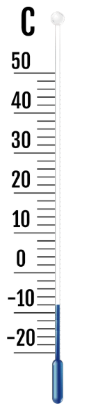
True or false (3)
This thermometer is read as -4 degrees Celsius.
True | False
Notes:
The question on this slide connects to the content being explored in the developing number sense activity (Activity 6)
Syllabus focus area:
Represents numbers B

Slide 41
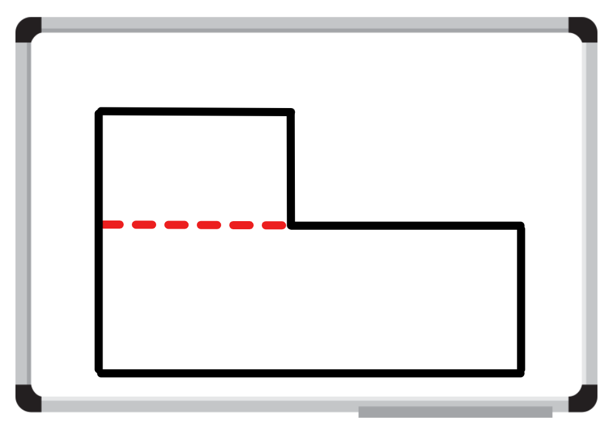
Short response (21)
A student dissected this composite L-shape to calculate its area.
Show another way this composite L-shape could be dissected.
Communicate your reasoning.
Notes:
Short response questions provide brisk paced questions focussing on review of current and previous content to support spaced and interleaved practice.
Syllabus focus area:
Two-dimensional spatial structure B: Area

Slide 42
Short response (22)
Use repeated halving to solve:
If 4 televisions cost $6842, what is the cost of one television?
Why is this an appropriate strategy? Communicate your reasoning.
Notes:
Short response questions provide brisk paced questions focussing on review of current and previous content to support spaced and interleaved practice.
Syllabus focus area:
Multiplicative relations A

Slide 43
Short response (23)
Match the type of angle to the definition.
A. An angle that measures between 180° and 360°
1. obtuse
2. reflex
B. An angle smaller than a right angle, between 0° and 90°
3. acute
C. An angle bigger than a right angle (90°) but smaller than a straight angle (180°).
Notes:
Short response questions provide brisk paced questions focussing on review of current and previous content to support spaced and interleaved practice.
Syllabus focus area:
Geometric measure A: Angles

Slide 44
Short response (24)
Name this object.
Notes:
Short response questions provide brisk paced questions focussing on review of current and previous content to support spaced and interleaved practice.
Syllabus focus area:
Three-dimensional spatial structure A: 3D objects

Slide 45
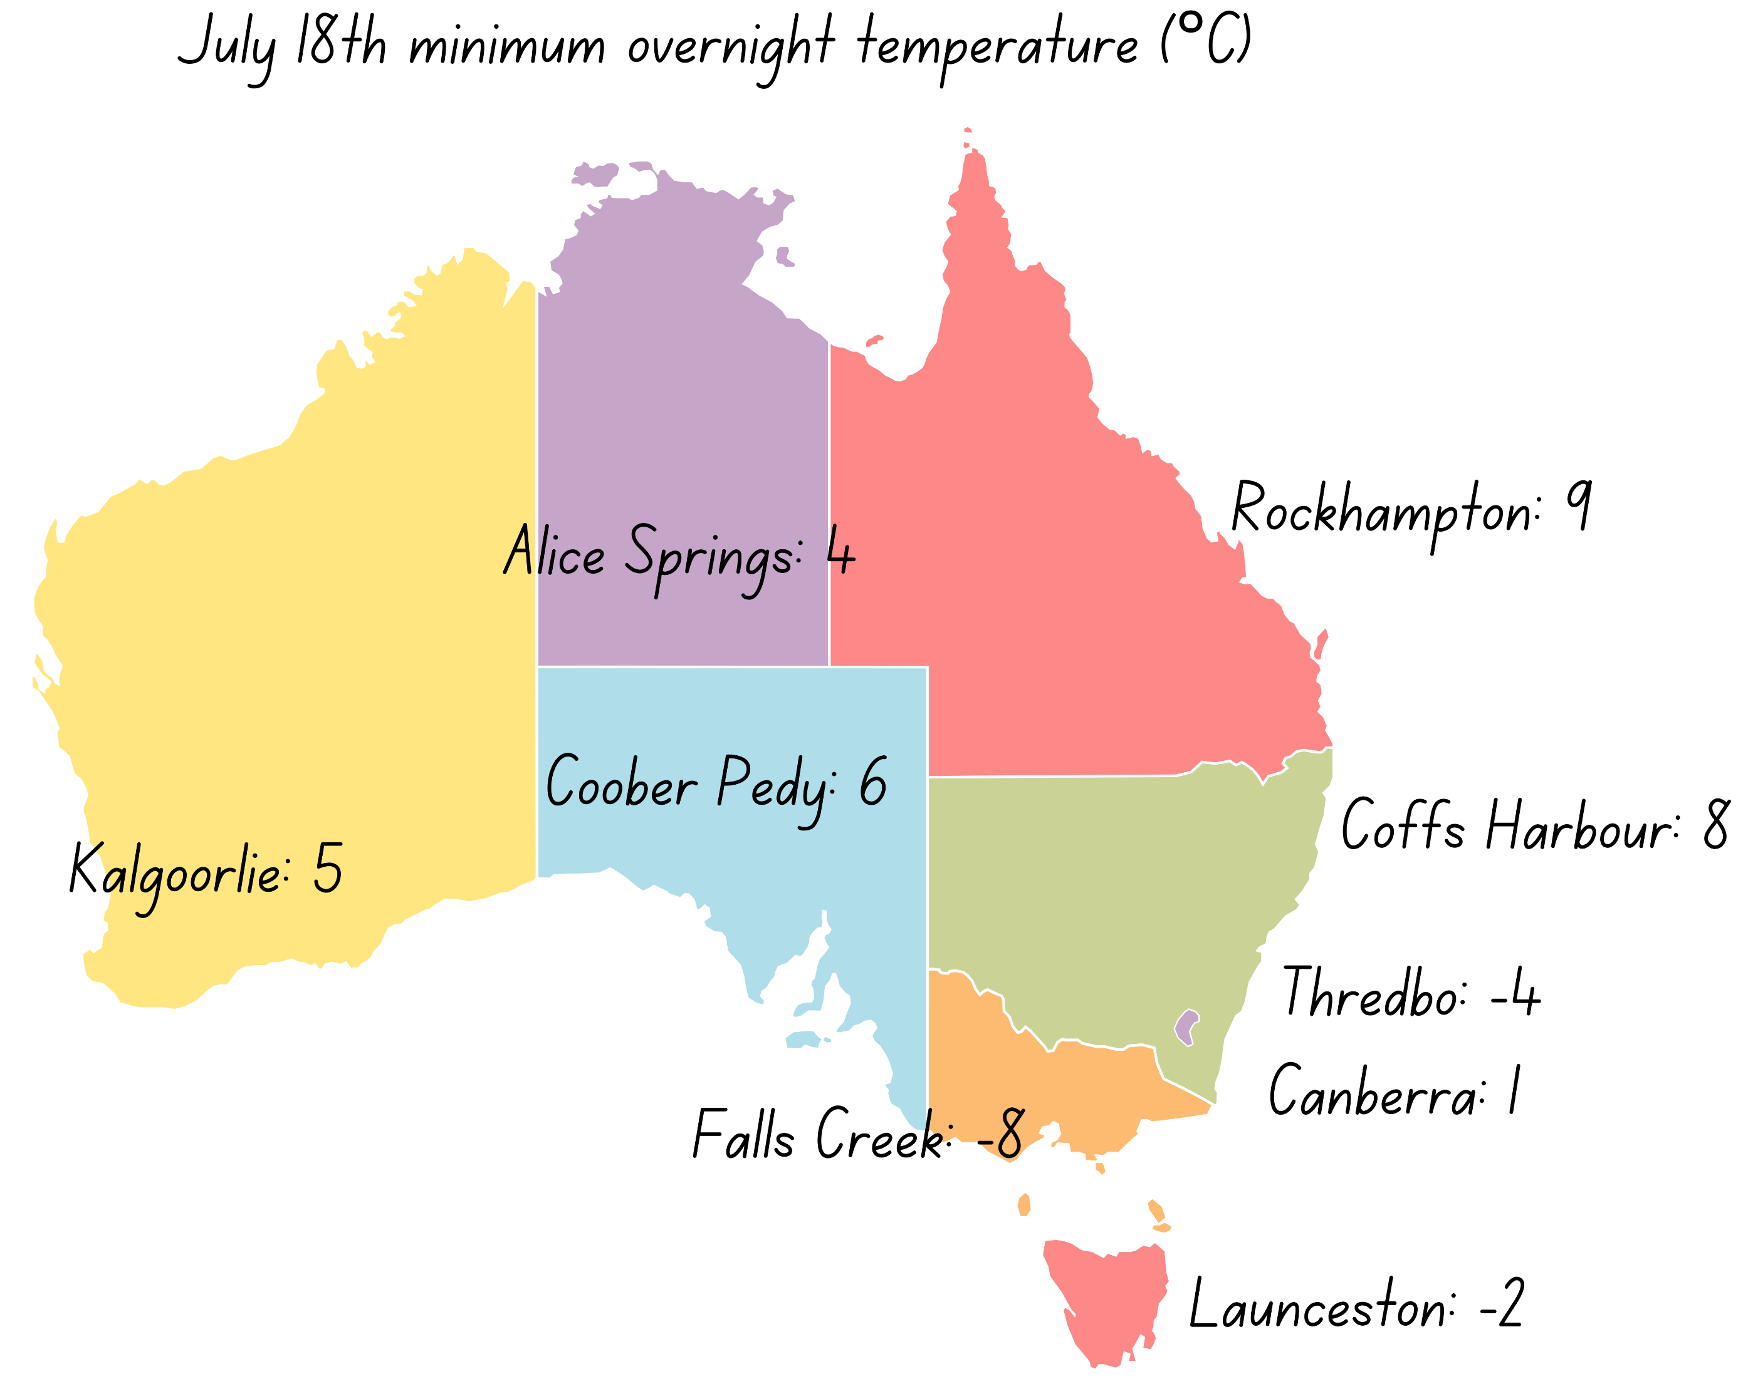
Activity 6 – interpret integers in temperatures
Notes:
This is a developing number sense activity.
Number sense refers to a deep understanding of numbers, including their magnitude, relationships, and the effects of operations on them. It supports fluency and understanding, estimation, flexible thinking, and efficient problem-solving. Number sense activities 1–4 ‘activate’ prior number knowledge and support the learning of new content in the unit. Number sense activities 5–8 ‘loop’ back and provide opportunity for spaced practice with concepts and procedures covered in previous units.
Syllabus focus area:
Represents numbers B
Interpret integers in temperatures
This resource corresponds to Resource 18 – minimum overnight temperatures in Stage 3 Year B Unit 32.
Review the integer number line from Activity 5.
Looking at the image, ask students what they notice about the temperatures displayed on the map.
Students record the temperatures and their locations on their integer number line.
Ask:
What is the highest overnight temperature?
What is the lowest overnight temperature?
Ask how the integer line can be used to calculate differences in temperatures. For example, the difference between the temperature in Rockhampton and Alice Springs. Explain that this method is useful when calculating the difference between positive and negative integers. Model, using multiple examples if required.
Ask:
What is the difference between the temperature in Rockhampton and Launceston?
How much warmer is it in Alice Springs compared to Falls Creek?
Explain that the meteorologist has left some temperatures off the map. He has provided some clues to help complete the integer number line. Ask students to record the following locations and temperatures on their integer number line:
Broken Hill, New South Wales is 7°C cooler than Rockhampton (2°C)
Mount Wellington, Tasmania is 8°C cooler than Launceston (−10°C)
Mt Gambier, South Australia is 7°C warmer than Thredbo (3°C)
In pairs, students take turns offering a clue to their partner, who attempts to guess the location. For example, this location is 7°C warmer than Canberra (Coffs Harbour).

Slide 46
Review of learning 7

Slide 47
Multiple choice (4)
Which of these results in a negative whole number?
A
15 − 9
B
8 − 8
C
7 − 12
D
18 − 4
Notes:
This question connects to the content in the developing number sense activity (Activity 3)
Syllabus focus area:
Represents numbers B

Slide 48
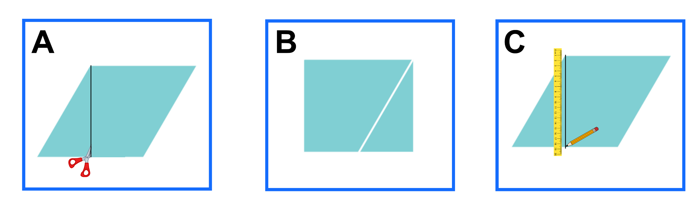
Short response (25)
Order these steps to transform a parallelogram into a rectangle to find its area.
Notes:
Short response questions provide brisk paced questions focussing on review of current and previous content to support spaced and interleaved practice.
Syllabus focus area:
Two-dimensional spatial structure B: Area

Slide 49
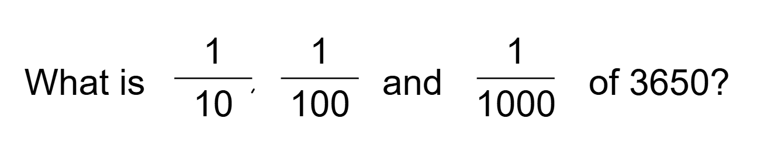
Short response (26)
Notes:
Short response questions provide brisk paced questions focussing on review of current and previous content to support spaced and interleaved practice.
Syllabus focus area:
Multiplicative relations B

Slide 50
Short response (27)
Using a bridging strategy, show how much time has elapsed from 2:45 pm to 5:00 pm.
Notes:
Short response questions provide brisk paced questions focussing on review of current and previous content to support spaced and interleaved practice.
Syllabus focus area:
Non-spatial measure B: Time

Slide 51
Short response (28)
Convert these measurements between kilograms to grams:
2.08 kg
23.75 kg
4.205 kg
Notes:
Short response questions provide brisk paced questions focussing on review of current and previous content to support spaced and interleaved practice.
Syllabus focus area:
Non-spatial measure A: Mass

Slide 52
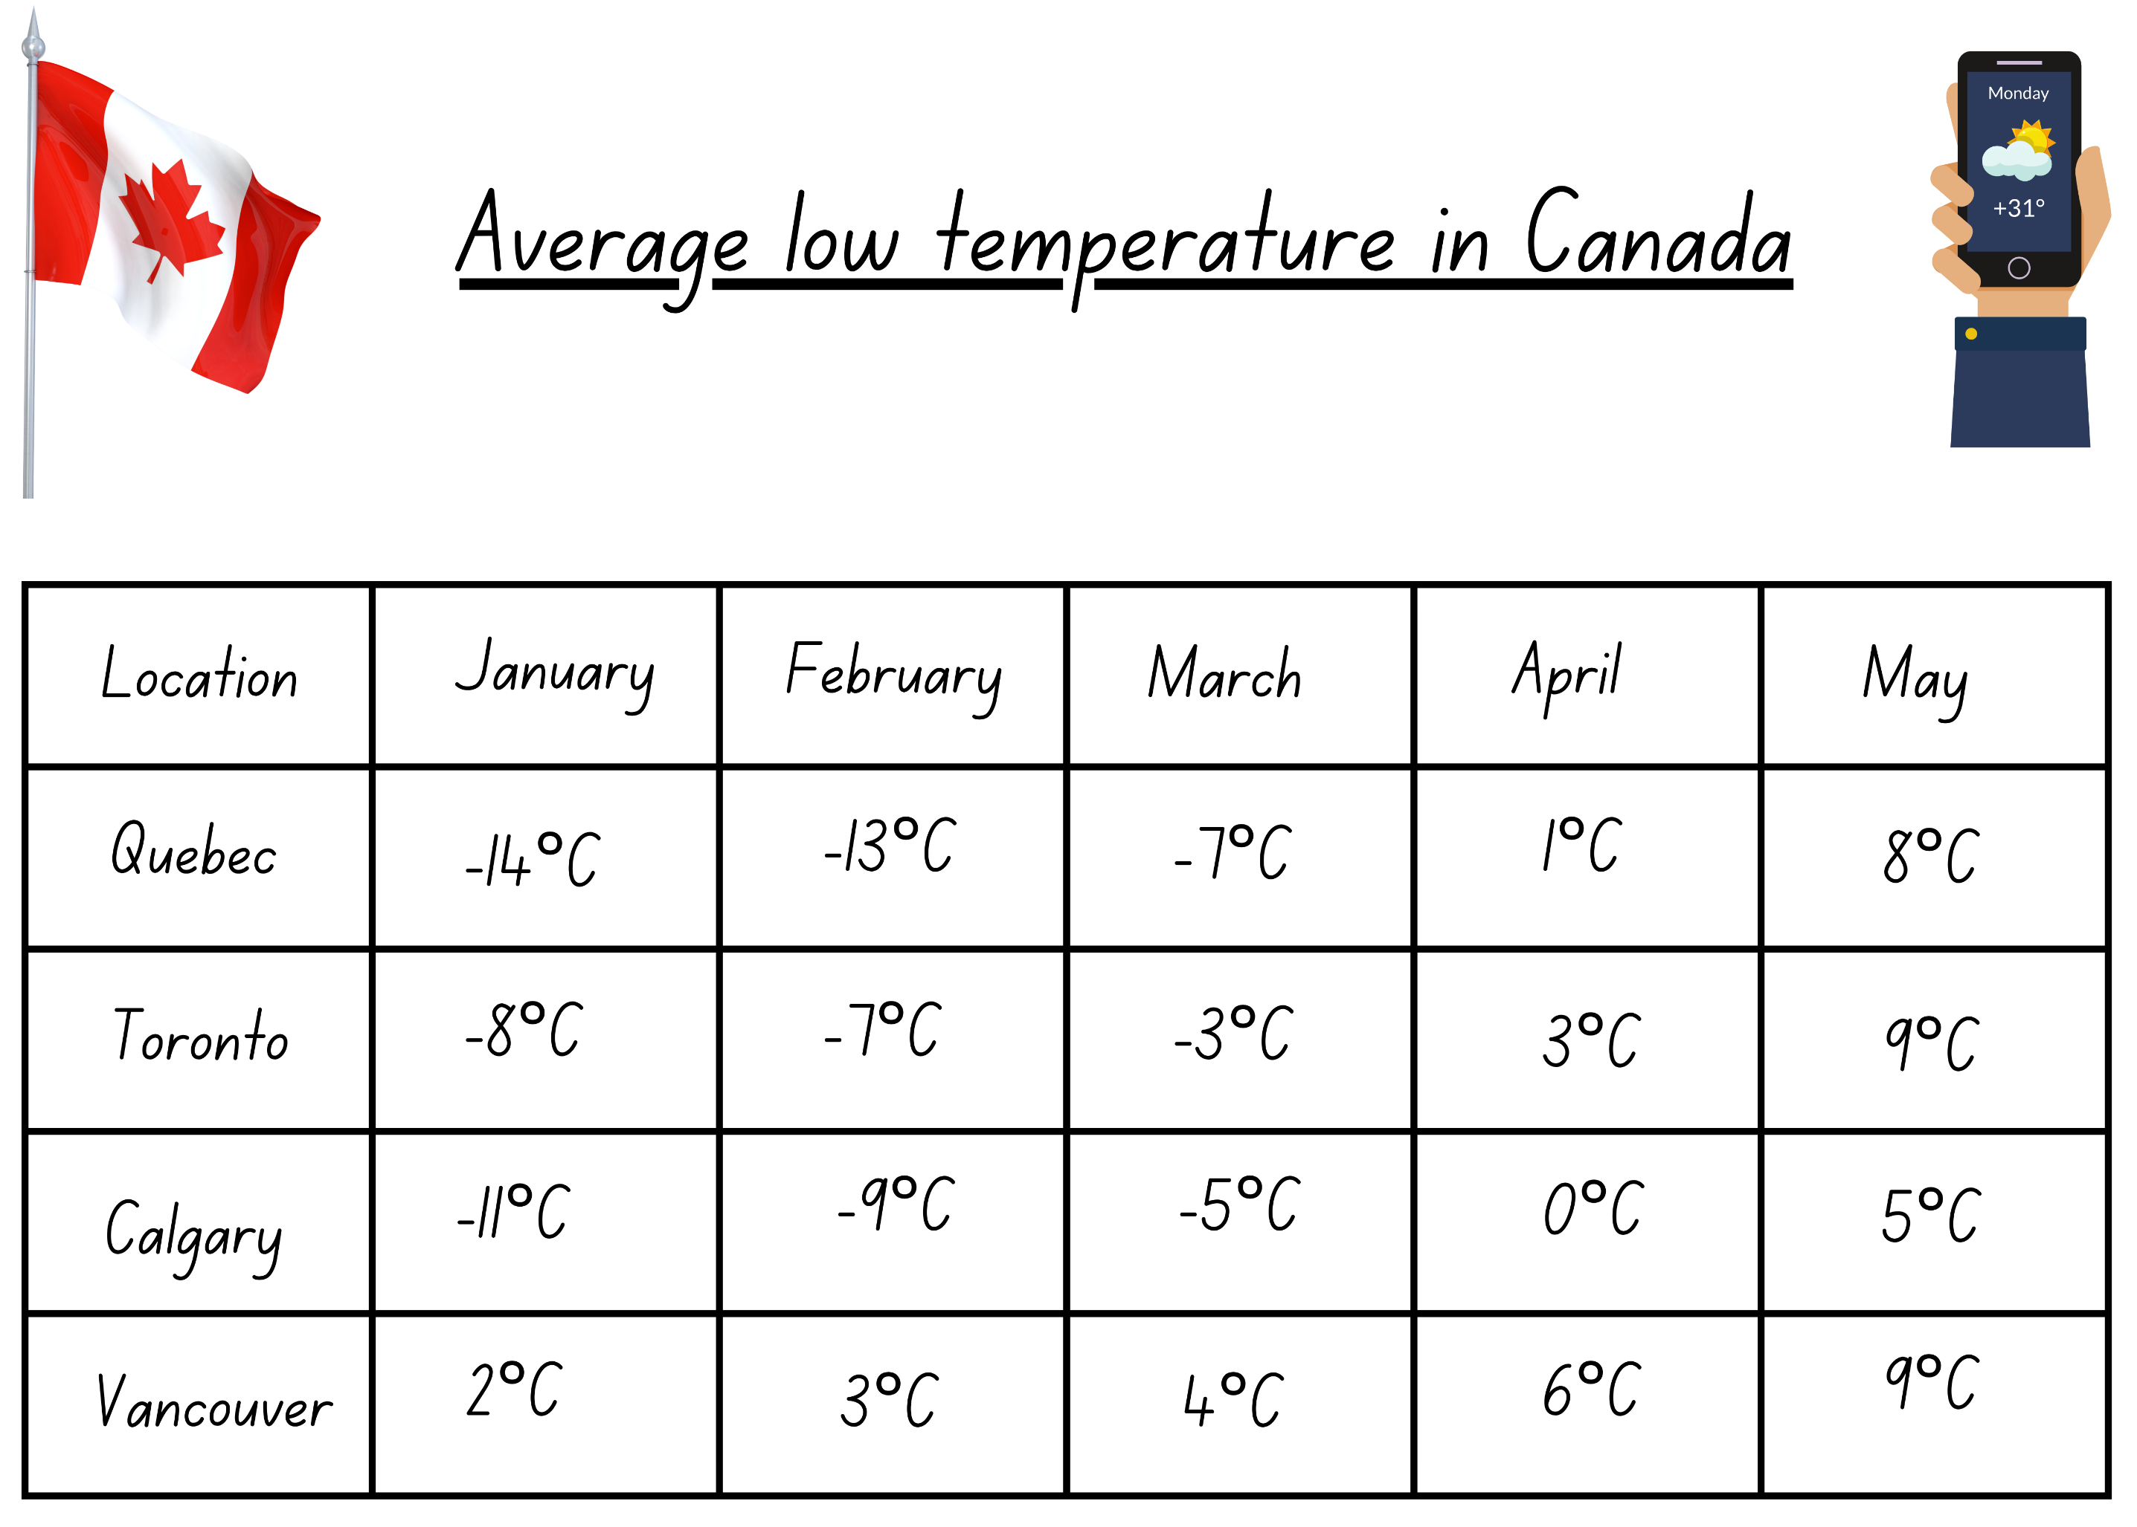
Activity 7 – interpret integers in weather
Weather wonders
Is it colder in Quebec or Calgary in January? | By how many degrees is Calgary colder in January than May? | What is the difference between Quebec and Toronto’s temperatures in January?
Find the difference between the warmest temperature and the coldest temperature. | Find the December temperatures for each city if they were 2 degrees colder than the January temperatures? | What is the difference between the temperature in Quebec in February and April?
Find the September temperature for Calgary if it was 13°C warmer than the February temperature. | Find the November temperatures for each city if they were 3 degrees warmer than the February temperatures. | Find the October temperature for Quebec if it was 12°C warmer than the March temperature.
Notes:
This is a developing number sense activity.
Number sense refers to a deep understanding of numbers, including their magnitude, relationships, and the effects of operations on them. It supports fluency and understanding, estimation, flexible thinking, and efficient problem-solving. Number sense activities 1–4 ‘activate’ prior number knowledge and support the learning of new content in the unit. Number sense activities 5–8 ‘loop’ back and provide opportunity for spaced practice with concepts and procedures covered in previous units.
Syllabus focus area:
Represents numbers B
Interpret integers in weather
This resource corresponds to Resource 19 – Canadian temperature and Resource 20 – weather wonders in Stage 3 Year B Unit 32.
Ask students if a number line would be useful when answering the questions. Students justify their answers.
Students to answer the word problems using a number line. Draw attention to the fact that negative whole numbers can result from subtraction.
Students turn and talk and discuss their thinking. Allow students to adjust their answers.
Select students to share their thinking.

Slide 53
Review of learning 8

Slide 54
True or false (4)
We can locate negative numbers on a
1- 5 number line.
True | False
Notes:
The question on this slide connects to the content being explored in the developing number sense activity (Activity 8)
Syllabus focus area:
Represents numbers B

Slide 55
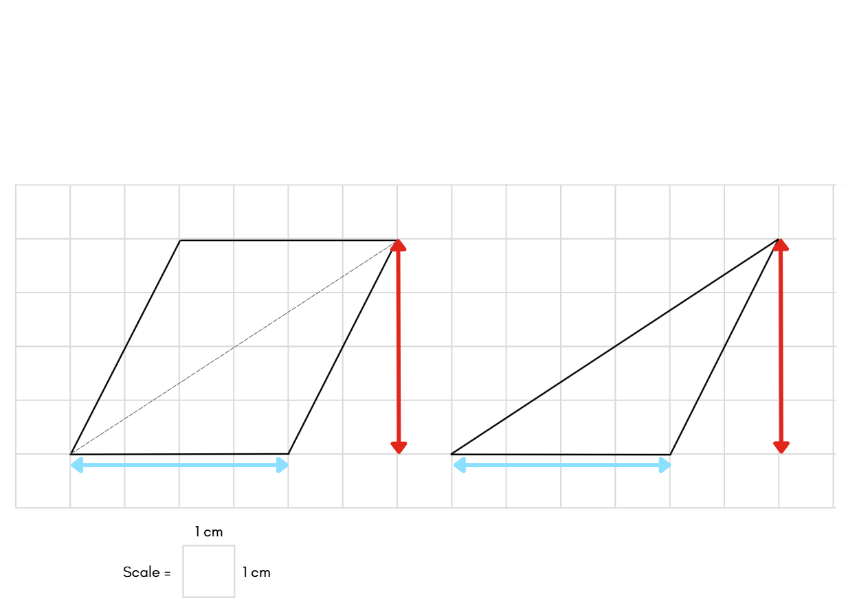
Short response (29)
If the area of this parallelogram is 16 cm², what is the area of the triangle?
Communicate your reasoning.
Notes:
Short response questions provide brisk paced questions focussing on review of current and previous content to support spaced and interleaved practice.
Syllabus focus area:
Two-dimensional spatial structure B: Area

Slide 56
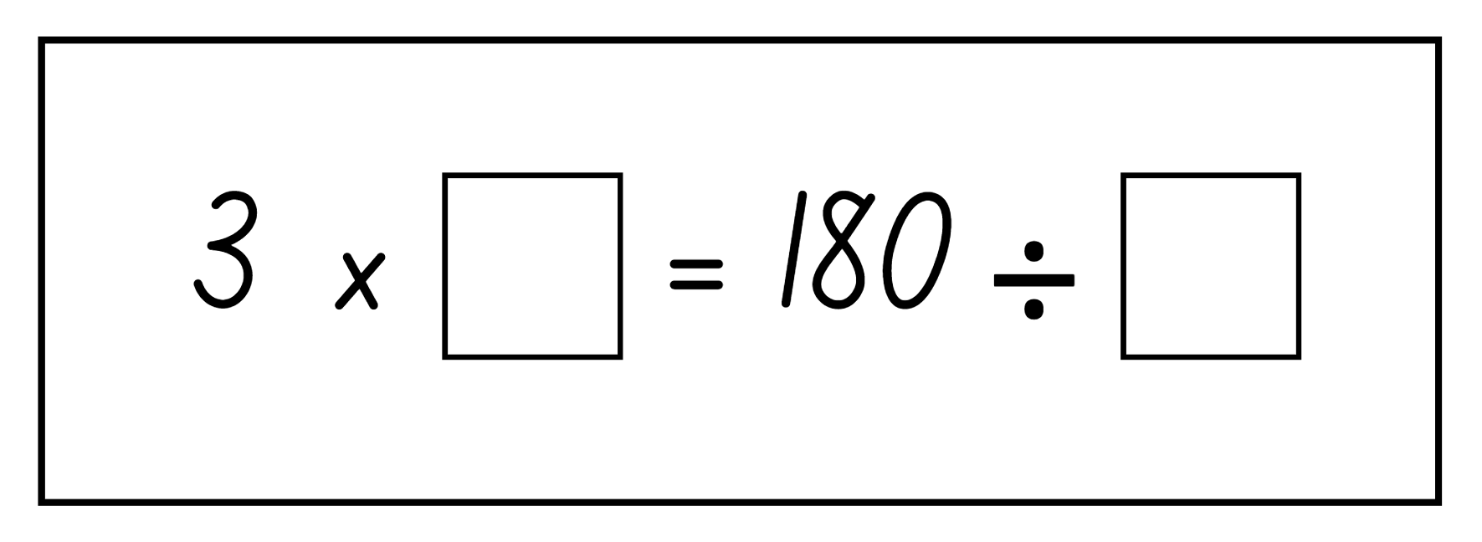
Short response (30)
Complete the number sentence by calculating the missing numbers.
Notes:
Short response questions provide brisk paced questions focussing on review of current and previous content to support spaced and interleaved practice.
Syllabus focus area:
Multiplicative relations B

Slide 57
Short response (31)
Carrie arrived at the waterpark at 8:35 am. She remained at the water park for 7 hours and 45 minutes.
Use the bridging strategy to calculate what time Carrie left the waterpark.
Notes:
Short response questions provide brisk paced questions focussing on review of current and previous content to support spaced and interleaved practice.
Syllabus focus area:
Non-spatial measure B: Time

Slide 58
Short response (32)
A movie started at 3:15 pm and finished at 6:35 pm.
How much time has elapsed?
Notes:
Short response questions provide brisk paced questions focussing on review of current and previous content to support spaced and interleaved practice.
Syllabus focus area:
Non-spatial measure B: Time

Slide 59
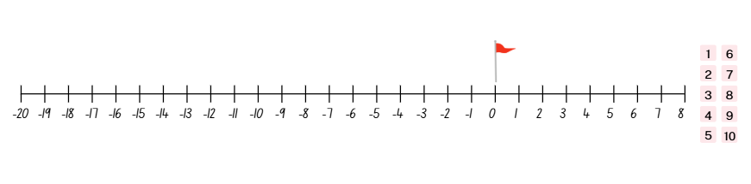
Activity 8 – integers on a number line
Notes:
This is a developing number sense activity.
Number sense refers to a deep understanding of numbers, including their magnitude, relationships, and the effects of operations on them. It supports fluency and understanding, estimation, flexible thinking, and efficient problem-solving. Number sense activities 1–4 ‘activate’ prior number knowledge and support the learning of new content in the unit. Number sense activities 5–8 ‘loop’ back and provide opportunity for spaced practice with concepts and procedures covered in previous units.
Syllabus focus area:
Represents numbers B
Integers on a number line
This resource corresponds to Resource 21 – number line golf in Stage 3 Year B Unit 32.
This activity is an adaptation of ‘Nearest the Pin’ from Bringing maths to life PDF by Think square.
In pairs, students play the game Resource 21 – number line golf. Rules:
each player starts at −20
players roll a 10-sided dice to obtain a number between 1-10
players choose to move either forwards or backwards on the number line to try to and land at the hole at 0
the hole is won immediately if someone reaches 0. Otherwise, the hole is won by the player closest to 0 after the tenth shot has been played.
if players are an equal distance from the hole, it’s a draw.
the first player to win 3 holes, wins the match, see Figure 22.

Slide 60
Double Venn diagram
Object 1
Object 2
Features similar to both objects
Features of object 1
Features of object 2

Slide 61
Frayer
Definition
Facts/Characteristics
Word, term, concept
Examples
Non-examples

Slide 62
Spider map
Idea
Subject

Slide 63
Cline
Concept 1
Concept 2
Word
Word
Word
Word
Word
Word
Word
Word
Word
Word
Word

Slide 64
Compare and contrast

Slide 65
Multiple choice (5)
A
B
C
D

Slide 66
Multiple choice
A
B
C
D
Notes:
This question connects to the content in the developing number sense activity (Activity 3)
Syllabus focus area:
[Focus area A/B]

Slide 67
References (1)
This presentation contains NSW Curriculum and syllabus content. The NSW Curriculum is developed by the NSW Education Standards Authority. This content is prepared by NESA for and on behalf of the Crown in the right of the State of New South Wales. The material is protected by Crown copyright.
Please refer to the NESA Copyright Disclaimer for more information https://educationstandards.nsw.edu.au/wps/portal/nesa/mini-footer/copyright.
NESA holds the only official and up-to-date versions of the NSW Curriculum and syllabus documents. Please visit the NSW Education Standards Authority (NESA) website https://educationstandards.nsw.edu.au/wps/portal/nesa/home and the NSW Curriculum website https://curriculum.nsw.edu.au.
[Mathematics K–10 Syllabus © NSW Education Standards Authority (NESA) for and on behalf of the Crown in right of the State of New South Wales, 2022.
National Numeracy Learning Progression © Australian Curriculum, Assessment and Reporting Authority (ACARA) 2010 to present, unless otherwise indicated. This material was downloaded from the Australian Curriculum website (National Numeracy Learning Progression) (accessed 17 December 2025) and was not modified.
Amplify Education (2024) Polygons and Shapes, Amplify Polypad website, accessed 17 December 2025.
Boaler J, Munson J and Williams C (2019) Mindset Mathematics Visualizing and Investigating Big Ideas Grade 6, Jossey-Bass, San Francisco.
Sullivan P (2018) Challenging Mathematical Tasks, Oxford University Press, South Melbourne.
Think Square (2026) Number Line Golf, Think Square website, accessed 21 April 2026.
University of Cambridge (2023) Always, Sometimes or Never? Shape, NRICH website, accessed 17 December 2025.

Slide 68
References (2)
This presentation contains NSW Curriculum and syllabus content. The NSW Curriculum is developed by the NSW Education Standards Authority. This content is prepared by NESA for and on behalf of the Crown in the right of the State of New South Wales. The material is protected by Crown copyright.
Please refer to the NESA Copyright Disclaimer for more information https://educationstandards.nsw.edu.au/wps/portal/nesa/mini-footer/copyright.
NESA holds the only official and up-to-date versions of the NSW Curriculum and syllabus documents. Please visit the NSW Education Standards Authority (NESA) website https://educationstandards.nsw.edu.au/wps/portal/nesa/home and the NSW Curriculum website https://curriculum.nsw.edu.au.
[Van de Walle J, Karp K, Bay-Williams JM, Brass A, Bentley B, Ferguson S, Goff W, Livy S, Marshman M, Martin D, Pearn C, Prodromou T, Symons D and Wilkie K (2019) Primary and Middle Years Mathematics: Teaching Developmentally, 1st Australian edn, Pearson Education Australia, Melbourne.

Slide 69
Copyright
© State of New South Wales (Department of Education), 2025
The copyright material published in this resource is subject to the Copyright Act 1968 (Cth) and is owned by the NSW Department of Education or, where indicated, by a party other than the NSW Department of Education (third-party material).
Copyright material available in this resource and owned by the NSW Department of Education is licensed under a Creative Commons Attribution 4.0 International (CC BY 4.0) license.
This license allows you to share and adapt the material for any purpose, even commercially.
Attribution should be given to © State of New South Wales (Department of Education), 2025.
Material in this resource not available under a Creative Commons license:
the NSW Department of Education logo, other logos and trademark-protected material
Material owned by a third party that has been reproduced with permission. You will need to obtain permission from the third party to reuse its material.
Links to third-party material and websites
Please note that the provided (reading/viewing material/list/links/texts) are a suggestion only and implies no endorsement, by the New South Wales Department of Education, of any author, publisher, or book title. School principals and teachers are best placed to assess the suitability of resources that would complement the curriculum and reflect the needs and interests of their students.
If you use the links provided in this document to access a third party’s website, you acknowledge that the terms of use, including licence terms set out on the third-party’s website apply to the use which may be made of the materials on that third-party website or where permitted by the Copyright Act 1968 (Cth). The department accepts no responsibility for content on third-party websites.

