Slide 1
Instructions for use
This resource aligns to the learning in Stage 3 Year B Unit 33 and revisits content from earlier sample units.
Classroom teachers are encouraged to add and adapt slides as required to meet the needs of their students.
Save a copy of the file to make changes to the slide deck. Go to File > Download a Copy (this downloads a copy to the computer to edit in the PowerPoint app).
To convert the PowerPoint to Google Slides:
  Upload the file into Google Drive and open it.
  Go to File > Save as Google Slides.
  (Note – conversion may cause formatting changes in the slides.)

Slide 2

Review of Learning
Mathematics Stage 3 – Unit 33
Notes:
Reviews may include a combination of question types, requiring students to recall facts and key ideas, as well as apply their knowledge to solve problems and answer questions. To support active engagement, a mix of techniques should be employed.” (AERO, 2024).
This Review of Learning slide deck revisits key concepts from the following units:
Stage 3 Year B Unit 33
Stage 3 Year B Unit 32
Stage 3 Year B Unit 31
It also includes opportunities to review prior learning in non-number content, supporting consolidation across focus areas.
The review of learning resources include three key task types that support the development of mathematical proficiency through retrieval, spaced practice, and active participation. These practices complement the review phase (activating prior knowledge) embedded within the beginning of each lesson.
1.
Multiple-choice questions/True or false: Designed to promote active retrieval of key concepts and identify common misconceptions in number, supporting consolidation, understanding and fluency.
These questions:
support spaced and interleaved practice
help identify and address common misconceptions
support active recall and immediate feedback
support whole class participation
identify areas requiring reteach
2.
Short-response question sets: Carefully grouped questions that encourage spaced and interleaved practice across multiple focus areas, helping students revisit and apply knowledge from different points in time.
These questions:
have a combination of question types
address a range of focus areas
build automaticity and fluency
support active recall
allow for immediate feedback
identify content requiring reteach
3.
Developing number sense activities: A variety of practical, purposeful tasks that reinforce current learning and build on prior knowledge. These activities promote reasoning, problem-solving and conceptual understanding.
The review of learning resources are designed to work support teaching and learning in mathematics. For the most effective implementation, use the resources flexibly, adapting to meet student learning needs and individual classroom contexts.

Slide 3
Lessons
1
Review of learning 1
5
Review of learning 5
2
Review of learning 2
6
Review of learning 6
3
Review of learning 3
7
Review of learning 7
4
Review of learning 4
8
Review of learning 8
Notes:
Teacher notes:
Click lesson titles to go to specific lessons
Interactive features can be viewed in slide show

Slide 4
Review of learning 1

Slide 5

Multiple choice (1)
The most efficient way to factorise 14 × 25 is:
A
10 + 4 × 25
B
7 × 2 × 25
C
7 × 5 × 5
D
7 × 5 + 10
Notes:
This question connects to the content in the developing number sense activity (Activity 1)
Syllabus focus area:
Multiplicative relations A

Slide 6

Short response (1)
Use the area model to solve:
256 x 4
Notes:
Short response questions provide brisk paced questions focussing on review of current and previous content to support spaced and interleaved practice.
Syllabus focus area:
Multiplicative relations A

Slide 7
Short response (2)
Is this statement always true, sometimes true or never true?
A regular octagon has 8 lines of symmetry and rotational symmetry.
Notes:
Short response questions provide brisk paced questions focussing on review of current and previous content to support spaced and interleaved practice.
Syllabus focus area:
Two-dimensional spatial structure A

Slide 8
Short response (3)
What number am I?
I can be grouped as:
2 millions, 56 thousands, 4 hundreds, 21 tens and 19 ones.
Notes:
Short response questions provide brisk paced questions focussing on review of current and previous content to support spaced and interleaved practice.
Syllabus focus area:
Represents numbers A

Slide 9
Short response (4)
Record the adjacent angle’s measurement.
40°
Notes:
Short response questions provide brisk paced questions focussing on review of current and previous content to support spaced and interleaved practice.
Syllabus focus area:
Geometric measure B

Slide 10

Activity 1 – factorising for mental multiplication
25 × 48 =
Notes:
This is a developing number sense activity.
Number sense refers to a deep understanding of numbers, including their magnitude, relationships, and the effects of operations on them. It supports fluency and understanding, estimation, flexible thinking, and efficient problem-solving. Number sense activities 1–4 ‘activate’ prior number knowledge and support the learning of new content in the unit. Number sense activities 5–8 ‘loop’ back and provide opportunity for spaced practice with concepts and procedures covered in previous units.
Syllabus focus area:
Multiplication relations A
Factorising for mental multiplication
Revise that factorising is a strategy that can be useful when multiplying 2-digit by 2-digit numbers when partitioning one factor into smaller factors creates an easier mental multiplication, especially when it makes benchmark numbers.
Ask:
- What are the factors of 25 and 48?
- Can you use any of the factors to make a benchmark number that simplifies the multiplication?
Seek input from students and demonstrate their thinking on the board. If a response is not drawn from the students, demonstrate 25 × 48 can be factorised to 25 × 4 × 12. The associative property can be used to regroup the factors to make the calculation easier. For example, 25 × 4 × 12 = (4 × 25) × 12 = 100 × 12 = 1200.
Display the following word problem: A nursery prepares 25 seedling trays. Each tray holds 36 plants. How many plants are there altogether?
Prompt students to use the strategy of factorising to solve the problem in their workbooks.
Students turn and talk to share and give peer feedback on their solutions.

Slide 11
Review of learning 2

Slide 12
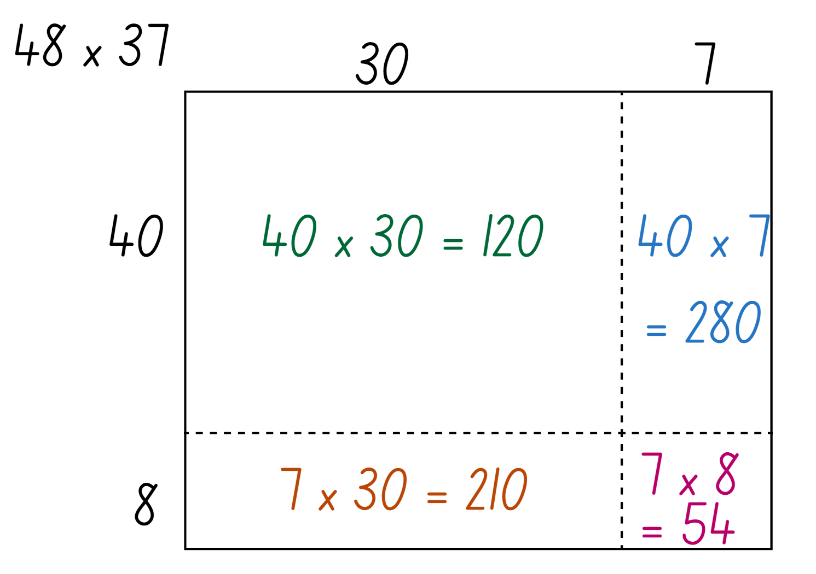
True or false (1)
The partial products for this area model to solve 48 × 37 have been calculated correctly.
True | False
Notes:
The question on this slide connects to the content being explored in the developing number sense activity (Activity 2)
Syllabus focus area:
Multiplicative relations A

Slide 13
Short response (5)
Select an efficient multiplicative strategy to solve:
18 x 500
Communicate your reasoning.
Notes:
Short response questions provide brisk paced questions focussing on review of current and previous content to support spaced and interleaved practice.
Syllabus focus area:
Multiplicative relations B

Slide 14
Short response (6)
Visualise this trapezium rotated a half-turn.
Record:
What changed?
What stayed the same?
Notes:
Short response questions provide brisk paced questions focussing on review of current and previous content to support spaced and interleaved practice.
Syllabus focus area:
Two-dimensional spatial structure B

Slide 15
Short response (7)
Record the following using decimal notation:
89 thousandths
109 thousandths
2 thousandths
Notes:
Short response questions provide brisk paced questions focussing on review of current and previous content to support spaced and interleaved practice.
Syllabus focus area:
Represents numbers A

Slide 16
Short response (8)
Record the adjacent angle’s measurement.
100°
Notes:
Short response questions provide brisk paced questions focussing on review of current and previous content to support spaced and interleaved practice.
Syllabus focus area:
Geometric measure B

Slide 17
Activity 2 – area model for 2-digit by 2-digit multiplication (1)
30
2
20 x 2 = 40
20 x 30 = 600
20
3
3 x 30 = 90
3 x 2 = 6
600 + 90 + 40 + 6 = 736
Notes:
Note: this slide is designed to be viewed in presentation mode.
This is a developing number sense activity.
Number sense refers to a deep understanding of numbers, including their magnitude, relationships, and the effects of operations on them. It supports fluency and understanding, estimation, flexible thinking, and efficient problem-solving. Number sense activities 1–4 ‘activate’ prior number knowledge and support the learning of new content in the unit. Number sense activities 5–8 ‘loop’ back and provide opportunity for spaced practice with concepts and procedures covered in previous units.
Syllabus focus area:
Multiplication relations A
Area model for 2-digit by 2-digit multiplication
Revise that 23 × 32 can be solved using an area model where every place value part of a number multiplies by each place value part of the other number to produce 4 partial products. For example, in 23 × 32:
—3 × 2 = 6
—3 × 30 = 90
—20 × 2 = 40
—20 × 30 = 600.
The 4 partial products are then added together, 600 + 40 + 90 + 6 = 736.
(Next slide).
Display the following word problem: A music app tracks playlist downloads. One playlist that contains 36 songs has been downloaded 25 times. How many songs were downloaded altogether?
Prompt students to use an area model to solve the problem in their workbooks.
Students turn and talk to share and give peer feedback on their solutions.

Slide 18
Activity 2 – area model for 2-digit by 2-digit multiplication (2) (2)
A music app tracks playlist downloads. One playlist that contains 36 songs has been downloaded 25 times.
How many songs were downloaded altogether?
Notes:
This is a developing number sense activity.
Number sense refers to a deep understanding of numbers, including their magnitude, relationships, and the effects of operations on them. It supports fluency and understanding, estimation, flexible thinking, and efficient problem-solving. Number sense activities 1–4 ‘activate’ prior number knowledge and support the learning of new content in the unit. Number sense activities 5–8 ‘loop’ back and provide opportunity for spaced practice with concepts and procedures covered in previous units.
Syllabus focus area:
Multiplication relations A
Area model for 2-digit by 2-digit multiplication
Prompt students to use an area model to solve the problem in their workbooks.
Students turn and talk to share and give peer feedback on their solutions.

Slide 19
Review of learning 3

Slide 20
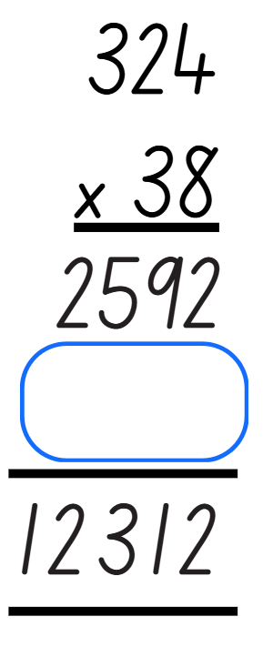
Multiple choice (2)
The missing partial product is:
A
9620
B
962
C
9720
D
972
Notes:
This question connects to the content in the developing number sense activity (Activity 3)
Syllabus focus area:
Multiplicative relations A

Slide 21
Short response (9)
To make smoothies, 4 bananas are needed for 3 smoothies.
How many bananas are needed for 18 smoothies?
Notes:
Short response questions provide brisk paced questions focussing on review of current and previous content to support spaced and interleaved practice.
Syllabus focus area:
Multiplicative relations B

Slide 22
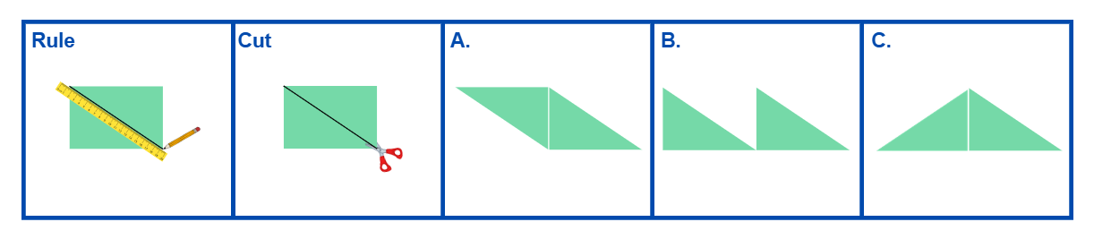
Short response (10)
Record the transformations that have occurred at A, B and C.
Notes:
Short response questions provide brisk paced questions focussing on review of current and previous content to support spaced and interleaved practice.
Syllabus focus area:
Two-dimensional spatial structure B

Slide 23
Short response (11)
Calculate 10% of:
20
660
20 000
Communicate your reasoning.
Notes:
Short response questions provide brisk paced questions focussing on review of current and previous content to support spaced and interleaved practice.
Syllabus focus area:
Represents numbers B

Slide 24
Short response (12)
An assembly begins at 9:15 am and ends at 11:30 am.
How long is the assembly?
Round the duration to the nearest hour.
Notes:
Short response questions provide brisk paced questions focussing on review of current and previous content to support spaced and interleaved practice.
Syllabus focus area:
Non-spatial measure B

Slide 25
Activity 3 – algorithm for 3-digit by 2-digit multiplication (1)
278
x 29
Notes:
This is a developing number sense activity.
Number sense refers to a deep understanding of numbers, including their magnitude, relationships, and the effects of operations on them. It supports fluency and understanding, estimation, flexible thinking, and efficient problem-solving. Number sense activities 1–4 ‘activate’ prior number knowledge and support the learning of new content in the unit. Number sense activities 5–8 ‘loop’ back and provide opportunity for spaced practice with concepts and procedures covered in previous units.
Syllabus focus area:
Multiplicative relations A
Algorithm for 3-digit by 2-digit multiplication
Revise that the formal algorithm can be used as a more efficient way of recording multiplication with 3-digit by 2-digit numbers.
Revise that when recording the equation, the numbers need to be lined up correctly in their place value parts.
Model solving 278 × 29 using the formal algorithm.
(Next slide).
Display the following word problem: A theme park records 348 visitors per day over 27 days. How many visitors attended in total?
Prompt students to use the formal algorithm to solve the problem in their workbooks.
Students turn and talk to share and give peer feedback on their solutions.

Slide 26
Activity 3 – algorithm for 3-digit by 2-digit multiplication (2) (2)
A theme park records 348 visitors per day over 27 days.
How many visitors attended in total?
Notes:
This is a developing number sense activity.
Number sense refers to a deep understanding of numbers, including their magnitude, relationships, and the effects of operations on them. It supports fluency and understanding, estimation, flexible thinking, and efficient problem-solving. Number sense activities 1–4 ‘activate’ prior number knowledge and support the learning of new content in the unit. Number sense activities 5–8 ‘loop’ back and provide opportunity for spaced practice with concepts and procedures covered in previous units.
Syllabus focus area:
Multiplicative relations A
Algorithm for 3-digit by 2-digit multiplication
Prompt students to use the formal algorithm to solve the problem in their workbooks.
Students turn and talk to share and give peer feedback on their solutions.

Slide 27
Review of learning 4

Slide 28
True or false (2)
The equation to solve this word problem is:
32 x 15
There are 32 rows of chairs in a hall, and each row has 15 chairs.
How many chairs are there in total?
True | False
Notes:
Note: this slide is designed to be viewed in presentation mode.
The question on this slide connects to the content being explored in the developing number sense activity (Activity 4)
Syllabus focus area:
Multiplicative relations A

Slide 29
Short response (13)
An alarm beeps 8 times every 4 seconds.
How many times does it beep in 2 minutes?
Notes:
Short response questions provide brisk paced questions focussing on review of current and previous content to support spaced and interleaved practice.
Syllabus focus area:
Multiplicative relations B

Slide 30
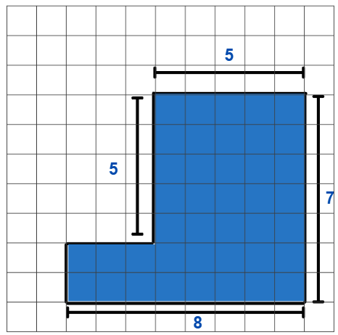
Short response (14)
Calculate the area of the composite L-shape figure in square centimetres.
Notes:
Short response questions provide brisk paced questions focussing on review of current and previous content to support spaced and interleaved practice.
Syllabus focus area:
Two-dimensional spatial structure B

Slide 31
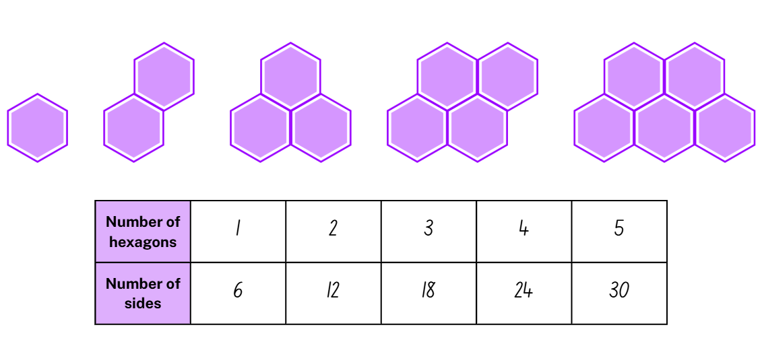
Short response (15)
Using this geometric pattern and table, what would the number of sides be for:
6 hexagons
10 hexagons
12 hexagons
Notes:
Short response questions provide brisk paced questions focussing on review of current and previous content to support spaced and interleaved practice.
Syllabus focus area:
Multiplicative relations B

Slide 32
Short response (16)
Write the following times as decimals:
1 hour and 30 minutes
2 hours and 15 minutes
3 hours and 45 minutes
Notes:
Short response questions provide brisk paced questions focussing on review of current and previous content to support spaced and interleaved practice.
Syllabus focus area:
Non-spatial measure B

Slide 33
Activity 4 – selecting and applying strategies to multiply
How many days old will Elyssa be on her 20th birthday?
365 × 20 =
Notes:
Note: this slide is designed to be viewed in presentation mode.
This is a developing number sense activity.
Number sense refers to a deep understanding of numbers, including their magnitude, relationships, and the effects of operations on them. It supports fluency and understanding, estimation, flexible thinking, and efficient problem-solving. Number sense activities 1–4 ‘activate’ prior number knowledge and support the learning of new content in the unit. Number sense activities 5–8 ‘loop’ back and provide opportunity for spaced practice with concepts and procedures covered in previous units.
Syllabus focus area:
Multiplicative relations A
Selecting and applying strategies to multiply
Revise the strategies in Activities 1–3 and remind students that different multiplication strategies are more appropriate depending on the structure of the numbers.
Ask: What is the equation that would solve this problem?
Display 365 × 20 = on the board.
Prompt students to turn and talk and decide on a strategy that would be most effective in solving the problem. Students show their working out on individual whiteboards.
Regroup and share response ensuring students can justify their choice of strategy.
Change the word problem to: How many days old will Elyssa be on her 5th birthday?
Repeat steps 3–6 with the new problem.
Change the word problem a final time to: How many days old will Elyssa be on her 23rd birthday?
Repeat steps 3–6 with the new problem.
Ask:
- Did you use the same strategy for all 3 problems?
- How did you choose which strategy to use?
- Which problem was more challenging? Why?
- Did you see a strategy someone else used that you’d like to try next time?

Slide 34
Review of learning 5

Slide 35
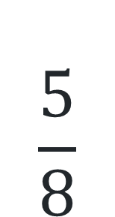
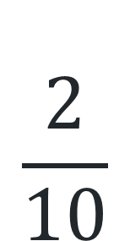
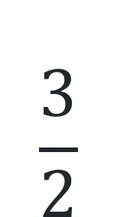
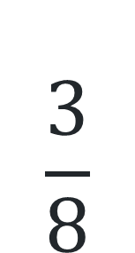
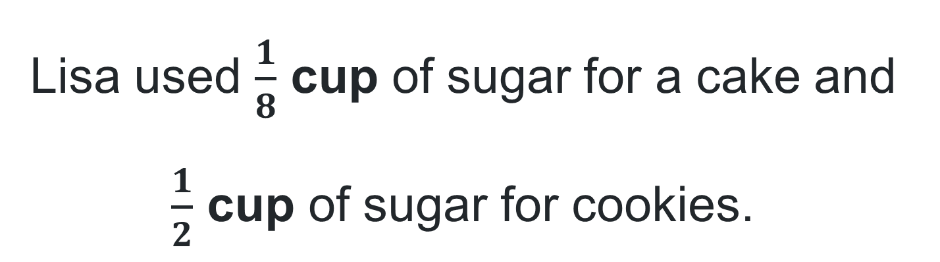
Multiple choice (3)
Lisa used $\frac{1}{8}$ cup of sugar for a cake and $\frac{1}{2}$ cup of sugar for cookies.
How much sugar did Lisa use altogether?
A
B
C
D
$$\frac{3}{8}$$
$$\frac{3}{2}$$
$$\frac{2}{10}$$
$$\frac{5}{8}$$
Notes:
This question connects to the content in the developing number sense activity (Activity 5)
Syllabus focus area:
Representing quantity fractions B

Slide 36
Short response (17)
63.85 × 10 =
1.208 × 100 =
2.9 ÷ 10 =
7.2 ÷ 100 =
Notes:
Short response questions provide brisk paced questions focussing on review of current and previous content to support spaced and interleaved practice.
Syllabus focus area:
Multiplicative relations B

Slide 37
Short response (18)
A composite L-shaped figure has an area of 48 cm².
What are some possible dimensions of the composite L-shaped figure?
Notes:
Short response questions provide brisk paced questions focussing on review of current and previous content to support spaced and interleaved practice.
Syllabus focus area:
Two-dimensional spatial structure B

Slide 38
Short response (19)
Use the area model to solve:
23 × 56
Notes:
Short response questions provide brisk paced questions focussing on review of current and previous content to support spaced and interleaved practice.
Syllabus focus area:
Multiplicative relations A

Slide 39
Short response (20)
You need to make a spinner for a board game that is more likely to land on green than orange or purple.
Draw and label a spinner that would make this happen?
Notes:
Short response questions provide brisk paced questions focussing on review of current and previous content to support spaced and interleaved practice.
Syllabus focus area:
Chance B

Slide 40
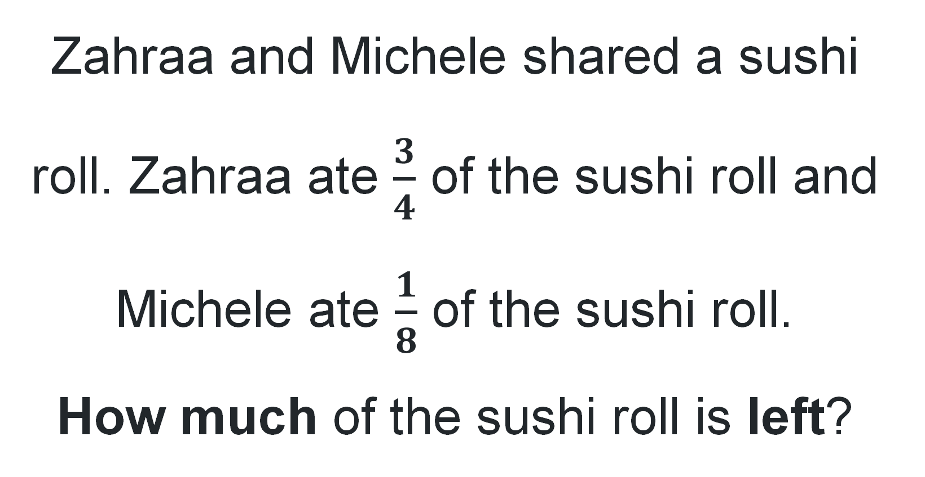
Activity 5 – using equivalence to solve word problems
Zahraa and Michele shared a sushi roll. Zahraa ate $\frac{3}{4}$ of the sushi roll and Michele ate $\frac{1}{8}$ of the sushi roll.
How much of the sushi roll is left?
Notes:
This is a developing number sense activity.
Number sense refers to a deep understanding of numbers, including their magnitude, relationships, and the effects of operations on them. It supports fluency and understanding, estimation, flexible thinking, and efficient problem-solving. Number sense activities 1–4 ‘activate’ prior number knowledge and support the learning of new content in the unit. Number sense activities 5–8 ‘loop’ back and provide opportunity for spaced practice with concepts and procedures covered in previous units.
Syllabus focus area:
Representing quantity fractions B
Using equivalence to solve word problems
In pairs, students record their ideas on individual whiteboards using diagrams and numerals to represent their thinking.
Ask:
- What strategy did you use to find how much of the sushi roll is left?
- Is three quarters larger than one eighth? How do you know?
- Did building up to the whole or taking away from the whole make this task easier? Why or why not?

Slide 41
Review of learning 6

Slide 42
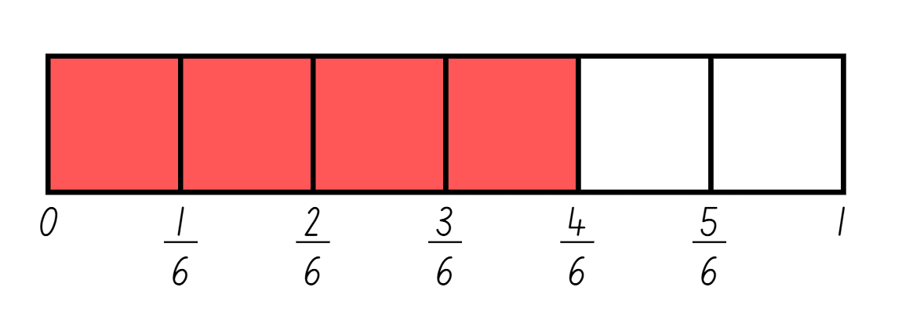
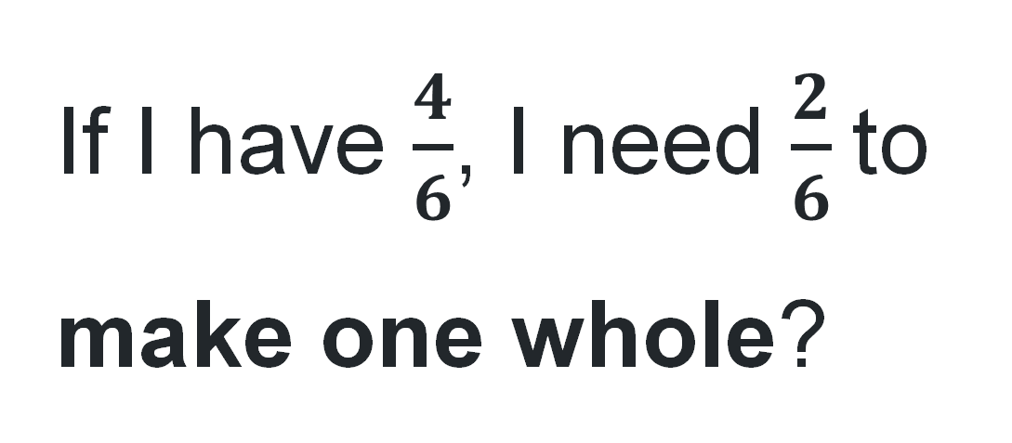
True or false (3)
If I have $\frac{4}{6}$, I need $\frac{2}{6}$to make one whole?
True | False
Notes:
The question on this slide connects to the content being explored in the developing number sense activity (Activity 6)
Syllabus focus area:
Representing quantity fractions B

Slide 43
Short response (21)
Identify if grouping symbols are needed to make the number sentences true. Record the number sentence, adding grouping symbols if needed.
4 × 9 - 3 = 24
40 ÷ 5 × 2 = 4
2 + 4 × 9 = 38
11 - 7 × 6 + 2 = 32
Notes:
Short response questions provide brisk paced questions focussing on review of current and previous content to support spaced and interleaved practice.
Syllabus focus area:
Multiplicative relations B

Slide 44
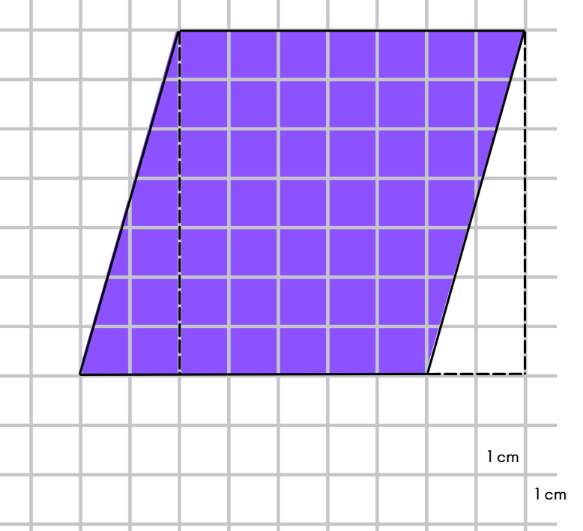
Short response (22)
Calculate the area of the parallelogram.
Notes:
Short response questions provide brisk paced questions focussing on review of current and previous content to support spaced and interleaved practice.
Syllabus focus area:
Two-dimensional spatial structure B

Slide 45
Short response (23)
A sports store has 8674 tennis balls and packs them equally into 12 containers.
How many tennis balls go into each container?
How many are left over?
Notes:
Short response questions provide brisk paced questions focussing on review of current and previous content to support spaced and interleaved practice.
Syllabus focus area:
Multiplicative relations A

Slide 46
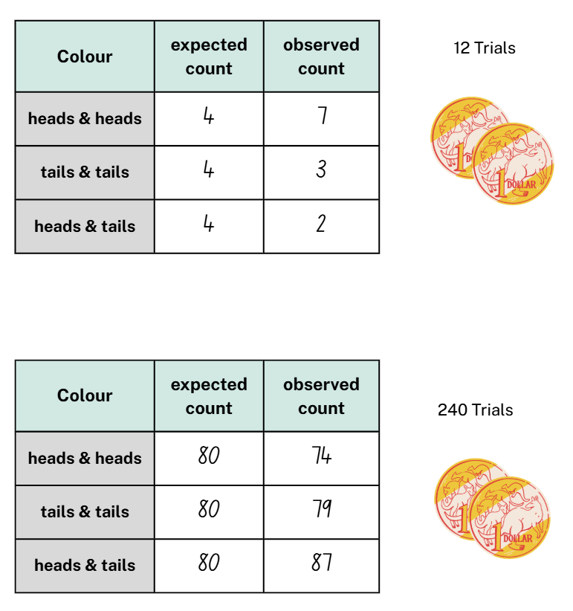
Short response (24)
Discuss the differences between the expected probabilities and the observed probabilities of both coin toss trials.
Notes:
Short response questions provide brisk paced questions focussing on review of current and previous content to support spaced and interleaved practice.
Syllabus focus area:
Chance B

Slide 47
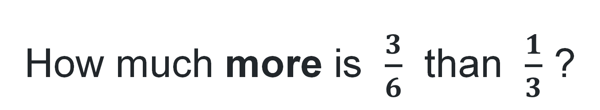
Activity 6 – representing fractional quantities – thirds and sixths (1)
How much more is $\frac{3}{6}$ than $\frac{1}{3}$ ?
Notes:
This is a developing number sense activity.
Number sense refers to a deep understanding of numbers, including their magnitude, relationships, and the effects of operations on them. It supports fluency and understanding, estimation, flexible thinking, and efficient problem-solving. Number sense activities 1–4 ‘activate’ prior number knowledge and support the learning of new content in the unit. Number sense activities 5–8 ‘loop’ back and provide opportunity for spaced practice with concepts and procedures covered in previous units.
Syllabus focus area:
Representing quantity fractions B
Representing fractional quantities – thirds and sixths
Pose the following question: How much more is three sixths than one third?
Students compare the fractions using fractions strips or diagrams in their workbook.
Students turn and talk to compare and justify their answer.
(Next slide).
Display Resource 26 – student workbook example. Ask:
- Does it matter if the length of your fraction strip is different in each representation? Why or why not?
- What do you notice about the denominators in this task?
- If I have one third, how many thirds need to be added to make the equal whole?
- If I have three sixths, how many sixths need to be subtracted to make one sixth?
- If I have one third and I add two sixths, what fraction quantity would I have? Is there more than one way to record this?

Slide 48
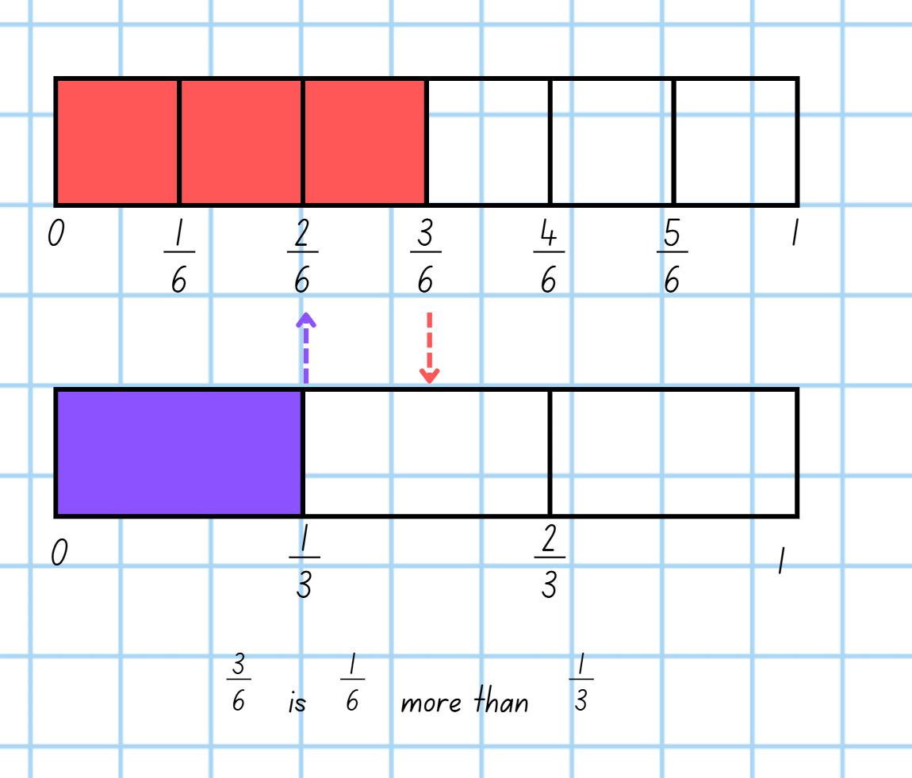
Activity 6 – representing fractional quantities – thirds and sixths (2) (2)
Notes:
This is a developing number sense activity.
Number sense refers to a deep understanding of numbers, including their magnitude, relationships, and the effects of operations on them. It supports fluency and understanding, estimation, flexible thinking, and efficient problem-solving. Number sense activities 1–4 ‘activate’ prior number knowledge and support the learning of new content in the unit. Number sense activities 5–8 ‘loop’ back and provide opportunity for spaced practice with concepts and procedures covered in previous units.
Syllabus focus area:
Representing quantity fractions B
Representing fractional quantities – thirds and sixths
This resource corresponds to Resource 26 – student workbook example in Stage 3 Year B Unit 33.
- Does it matter if the length of your fraction strip is different in each representation? Why or why not?
- What do you notice about the denominators in this task?
- If I have one third, how many thirds need to be added to make the equal whole?
- If I have three sixths, how many sixths need to be subtracted to make one sixth?
- If I have one third and I add two sixths, what fraction quantity would I have? Is there more than one way to record this?

Slide 49
Review of learning 7

Slide 50
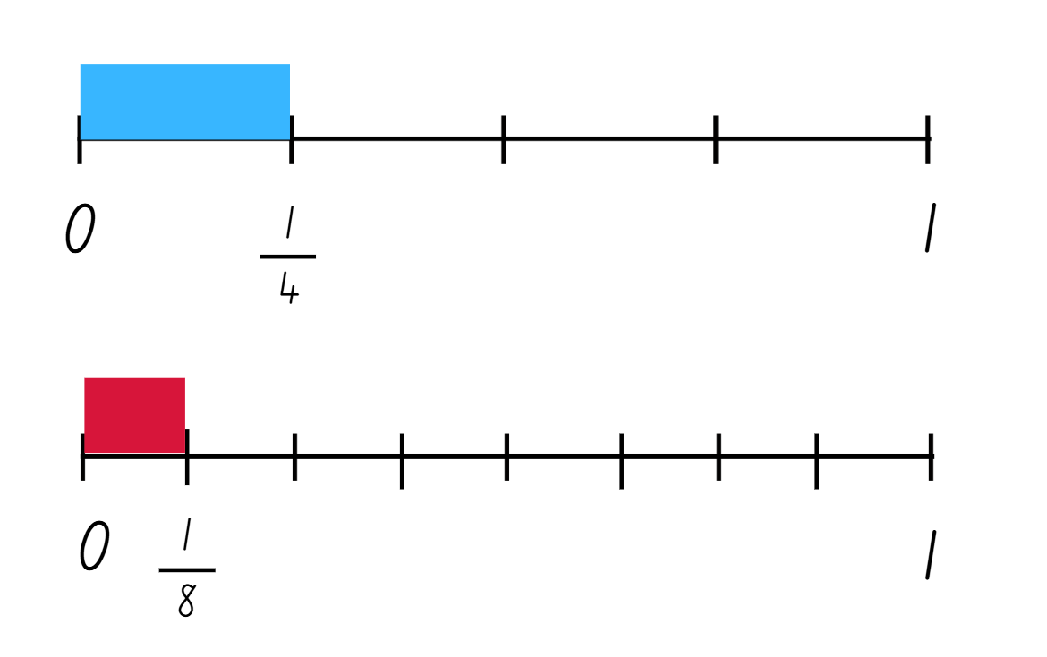
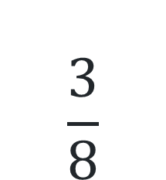
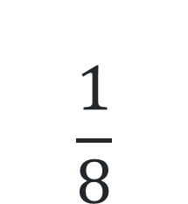
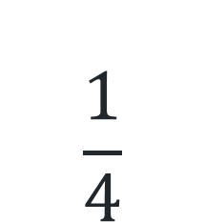
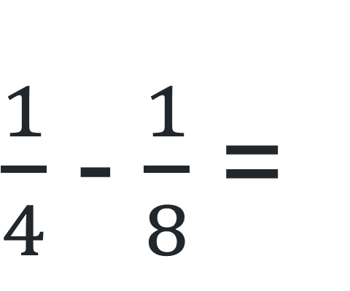
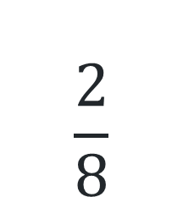
Multiple choice (4)
$\frac{1}{4}$ - $\frac{1}{8}$ =
A
B
C
D
$$\frac{1}{4}$$
$$\frac{1}{8}$$
$$\frac{3}{8}$$
$$\frac{2}{8}$$
Notes:
This question connects to the content in the developing number sense activity (Activity 7)
Syllabus focus area:
Representing quantity fractions B

Slide 51
Short response (25)
The P & C ordered lunch boxes for the teachers on World Teachers Day. Each box contained a wrap costing $11, a piece of fruit costing $3, and a drink costing $4. There are 58 teacher on staff. How much did the lunch cost?
Do you need grouping symbols when writing the number sentence?
Record the number sentence and solve it.
Notes:
Note: this slide is designed to be viewed in presentation mode.
Short response questions provide brisk paced questions focussing on review of current and previous content to support spaced and interleaved practice.
Syllabus focus area:
Multiplicative relations B

Slide 52
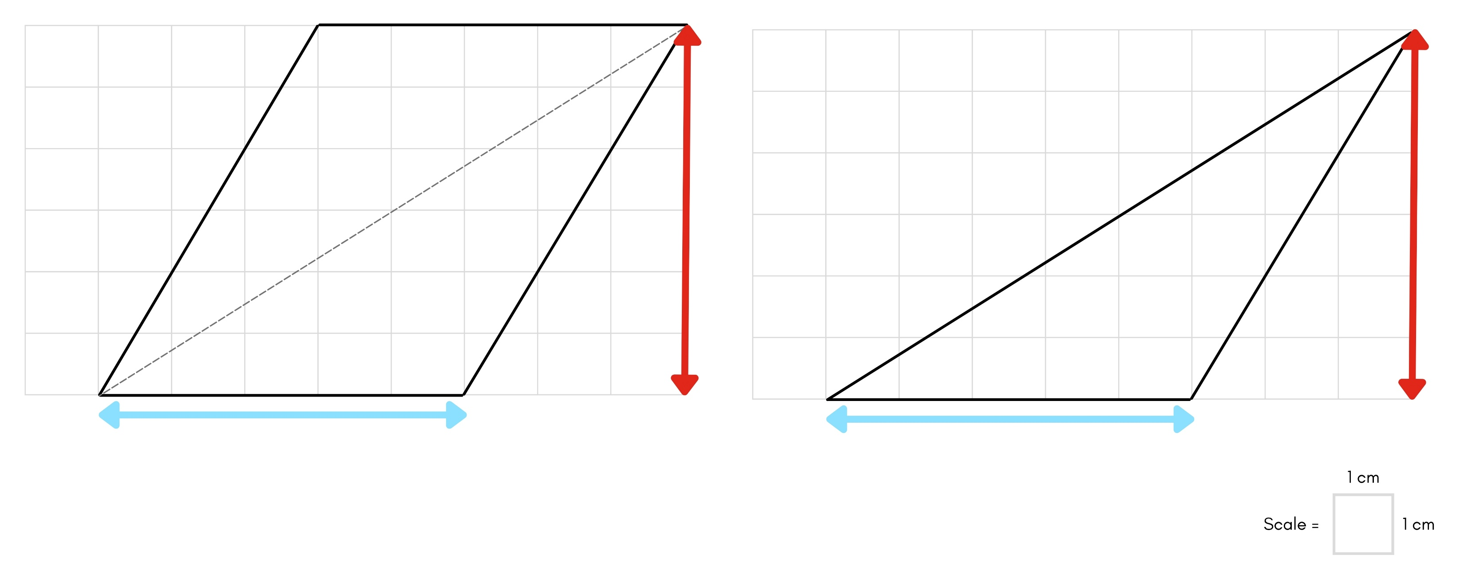
Short response (26)
If the area of this parallelogram is 30 cm², what is the area of the triangle?
Notes:
Short response questions provide brisk paced questions focussing on review of current and previous content to support spaced and interleaved practice.
Syllabus focus area:
Two-dimensional spatial structure B

Slide 53
Short response (27)
Divide 7 by:
10
100
1000
Notes:
Short response questions provide brisk paced questions focussing on review of current and previous content to support spaced and interleaved practice.
Syllabus focus area:
Multiplicative relations B

Slide 54
Short response (28)
Write each mass using kilograms (kg) and grams (g):
6.55 kg
9.02 kg
12.75 kg
Notes:
Short response questions provide brisk paced questions focussing on review of current and previous content to support spaced and interleaved practice.
Syllabus focus area:
Non-spatial measure A

Slide 55
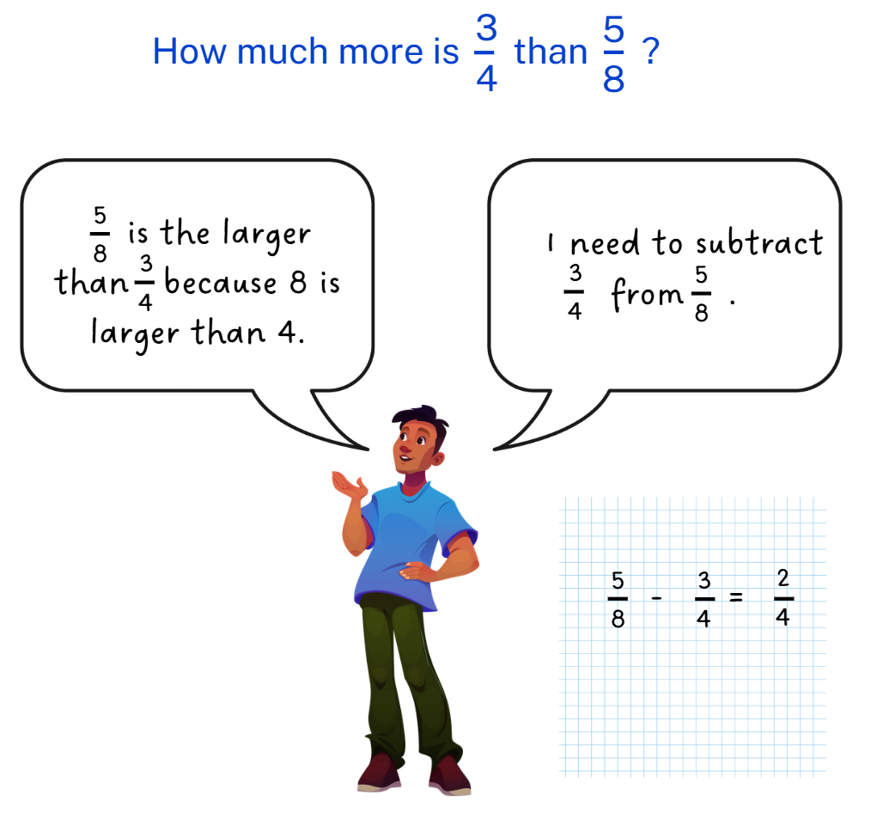
Activity 7 – representing fractional quantities – quarters and eighths
Notes:
This is a developing number sense activity.
Number sense refers to a deep understanding of numbers, including their magnitude, relationships, and the effects of operations on them. It supports fluency and understanding, estimation, flexible thinking, and efficient problem-solving. Number sense activities 1–4 ‘activate’ prior number knowledge and support the learning of new content in the unit. Number sense activities 5–8 ‘loop’ back and provide opportunity for spaced practice with concepts and procedures covered in previous units.
Syllabus focus area:
Representing quantity fractions B
Representing fractional quantities – quarters and eighths
This resource corresponds to Resource 27 – Jeff’s answer in Stage 3 Year B Unit 33.
Explain that this is Jeff’s reasoning when asked the question: How much more is three quarters than five eighths?
Ask:
- What is Jeff’s misconception(s)?
- How could you use a diagram, model or explanation to help Jeff see his mistake and understand the correct relationship between the fractions?
Students use fractions strips or diagrams in their workbook to represent their solution to: How much more is three quarters than five eighths?
Students turn and talk and justify their reasoning.
Ask:
- What do you notice about the denominators in this task?
- If I have six eighths, how many eighths and quarters need to be added to make the equal whole?
- If I have five eighths, how many eighths and quarters need to be subtracted to make one eighth?
- If I have one eighth and I add three eighths, what fraction quantity would I have? Is there more than one way to record this?

Slide 56
Review of learning 8

Slide 57
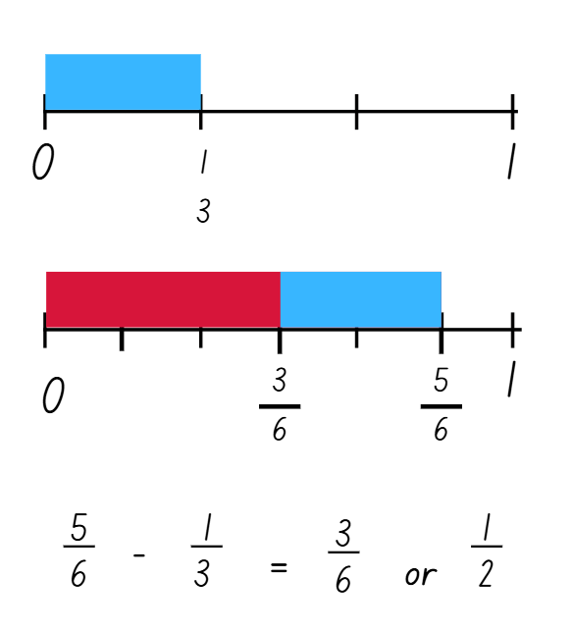
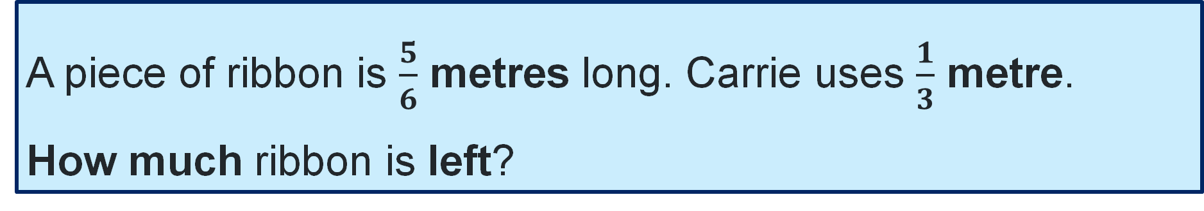
True or false (4)
This representation can be used to solve the following word problem:
A piece of ribbon is $\frac{5}{6}$ metres long. Carrie uses $\frac{1}{3}$ metre.
How much ribbon is left?
True | False
Notes:
The question on this slide connects to the content being explored in the developing number sense activity (Activity 8)
Syllabus focus area:
Representing quantity fractions B

Slide 58
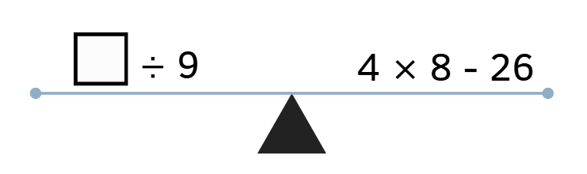
Short response (29)
Balance the scales by filling in the missing number.
Notes:
Short response questions provide brisk paced questions focussing on review of current and previous content to support spaced and interleaved practice.
Syllabus focus area:
Multiplicative relations B

Slide 59
Short response (30)
Explain how the area of a triangle is related to the area of a parallelogram with the same base length and height.
Notes:
Short response questions provide brisk paced questions focussing on review of current and previous content to support spaced and interleaved practice.
Syllabus focus area:
Two-dimensional spatial structure B

Slide 60
Short response (31)
8 × _ = 64 ÷ _
Notes:
Short response questions provide brisk paced questions focussing on review of current and previous content to support spaced and interleaved practice.
Syllabus focus area:
Multiplicative relations B

Slide 61
Short response (32)
Record the following measurements in kilograms:
3 kg 250 g
300 g
9kg 35 g
Notes:
Short response questions provide brisk paced questions focussing on review of current and previous content to support spaced and interleaved practice.
Syllabus focus area:
Non-spatial measure A

Slide 62
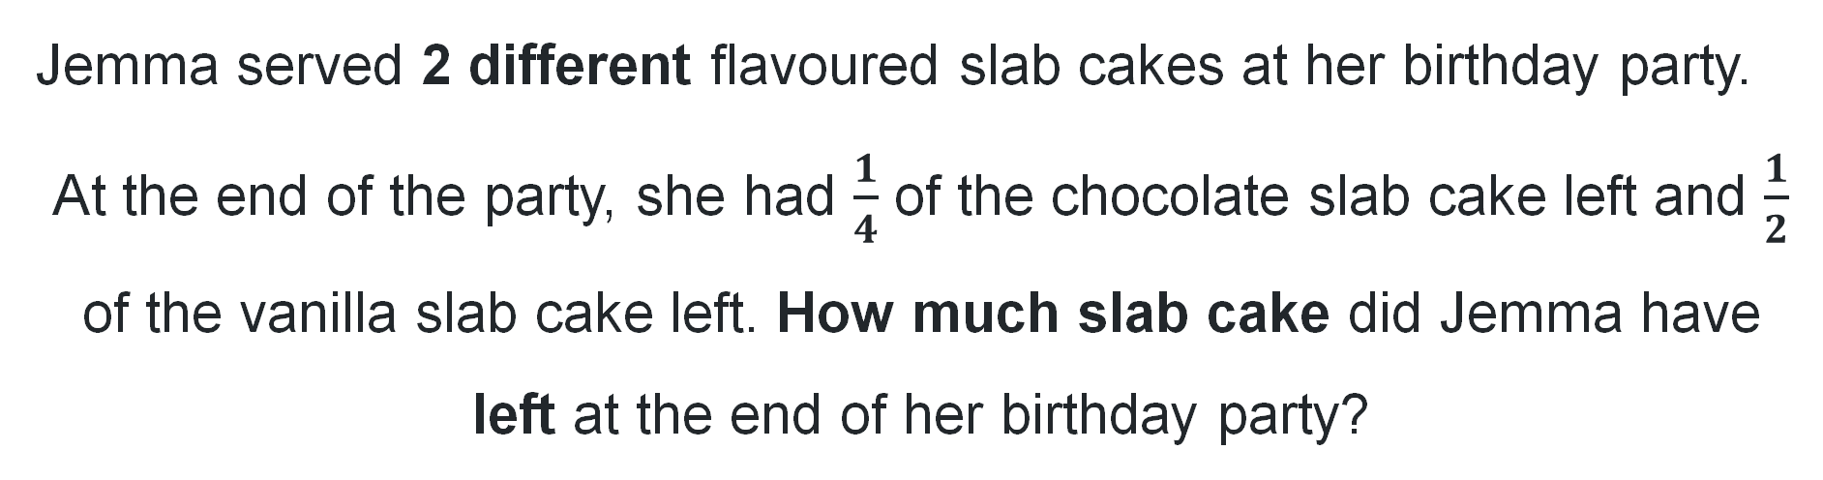
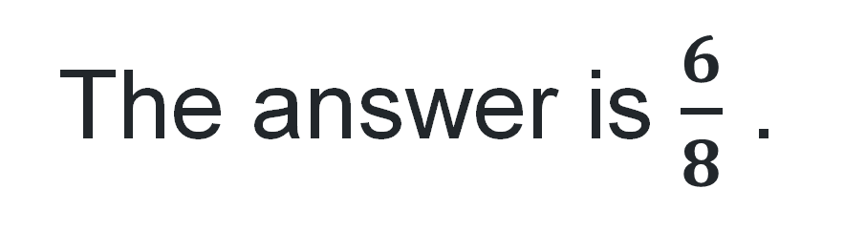
Activity 8 – creating word problems with fractional quantities
The answer is $\frac{6}{8}$ .
Jemma served 2 different flavoured slab cakes at her birthday party.
At the end of the party, she had $\frac{1}{4}$ of the chocolate slab cake left and $\frac{1}{2}$ of the vanilla slab cake left. How much slab cake did Jemma have left at the end of her birthday party?
Notes:
Note: this slide is designed to be viewed in presentation mode.
This is a developing number sense activity.
Number sense refers to a deep understanding of numbers, including their magnitude, relationships, and the effects of operations on them. It supports fluency and understanding, estimation, flexible thinking, and efficient problem-solving. Number sense activities 1–4 ‘activate’ prior number knowledge and support the learning of new content in the unit. Number sense activities 5–8 ‘loop’ back and provide opportunity for spaced practice with concepts and procedures covered in previous units.
Syllabus focus area:
Representing quantity fractions B
Creating word problems with fractional quantities
Students write a real-world problem using addition or subtraction to match the answer. For example, Jemma served 2 different flavoured slab cakes at her birthday party. At the end of the party, she had one quarter of the chocolate slab cake left and half of the vanilla slab cake left. How much slab cake did Jemma have left at the end of her birthday party?
In pairs, students create problems to reflect the answer six eighths. Encourage students to create both addition and subtraction problems.
Students share the word problems created with another pair.

Slide 63
Double Venn diagram
Object 1
Object 2
Features similar to both objects
Features of object 1
Features of object 2

Slide 64
Frayer
Definition
Facts/Characteristics
Word, term, concept
Examples
Non-examples

Slide 65
Spider map
Idea
Subject

Slide 66
Cline
Concept 1
Concept 2
Word
Word
Word
Word
Word
Word
Word
Word
Word
Word
Word

Slide 67
Compare and contrast

Slide 68
Multiple choice (5)
A
B
C
D

Slide 69
Multiple choice
A
B
C
D
Notes:
This question connects to the content in the developing number sense activity (Activity 3)
Syllabus focus area:
[Focus area A/B]

Slide 70
References
This presentation contains NSW Curriculum and syllabus content. The NSW Curriculum is developed by the NSW Education Standards Authority. This content is prepared by NESA for and on behalf of the Crown in the right of the State of New South Wales. The material is protected by Crown copyright.
Please refer to the NESA Copyright Disclaimer for more information https://educationstandards.nsw.edu.au/wps/portal/nesa/mini-footer/copyright.
NESA holds the only official and up-to-date versions of the NSW Curriculum and syllabus documents. Please visit the NSW Education Standards Authority (NESA) website https://educationstandards.nsw.edu.au/wps/portal/nesa/home and the NSW Curriculum website https://curriculum.nsw.edu.au.
Mathematics K–10 Syllabus © NSW Education Standards Authority (NESA) for and on behalf of the Crown in right of the State of New South Wales, 2022.
National Numeracy Learning Progression © Australian Curriculum, Assessment and Reporting Authority (ACARA) 2010 to present, unless otherwise indicated. This material was downloaded from the Australian Curriculum website (National Numeracy Learning Progression) (accessed 8 April 2026) and was not modified.
APSMO (2026) Australasian Problem Solving Mathematical Olympiads (APSMO) (2008–2015), APSMO website, accessed 22 April 2026.
Mathematics Hub (2026) Multiplication: 2 digit by 2 digit numbers: Video and teaching guide, Mathematics Hub website, accessed 22 April 2026.
University of Cambridge (2026) Thunder and Lightning, NRICH website, accessed 22 April 2026.

Slide 71
Copyright
© State of New South Wales (Department of Education), 2025
The copyright material published in this resource is subject to the Copyright Act 1968 (Cth) and is owned by the NSW Department of Education or, where indicated, by a party other than the NSW Department of Education (third-party material).
Copyright material available in this resource and owned by the NSW Department of Education is licensed under a Creative Commons Attribution 4.0 International (CC BY 4.0) license.
This license allows you to share and adapt the material for any purpose, even commercially.
Attribution should be given to © State of New South Wales (Department of Education), 2025.
Material in this resource not available under a Creative Commons license:
the NSW Department of Education logo, other logos and trademark-protected material
Material owned by a third party that has been reproduced with permission. You will need to obtain permission from the third party to reuse its material.
Links to third-party material and websites
Please note that the provided (reading/viewing material/list/links/texts) are a suggestion only and implies no endorsement, by the New South Wales Department of Education, of any author, publisher, or book title. School principals and teachers are best placed to assess the suitability of resources that would complement the curriculum and reflect the needs and interests of their students.
If you use the links provided in this document to access a third party’s website, you acknowledge that the terms of use, including licence terms set out on the third-party’s website apply to the use which may be made of the materials on that third-party website or where permitted by the Copyright Act 1968 (Cth). The department accepts no responsibility for content on third-party websites.

