Slide 1
Instructions for use
This resource aligns to the learning in Stage 3 Year B Unit 34 and revisits content from earlier sample units.
Classroom teachers are encouraged to add and adapt slides as required to meet the needs of their students.
Save a copy of the file to make changes to the slide deck. Go to File > Download a Copy (this downloads a copy to the computer to edit in the PowerPoint app).
To convert the PowerPoint to Google Slides:
  Upload the file into Google Drive and open it.
  Go to File > Save as Google Slides.
  (Note – conversion may cause formatting changes in the slides.)

Slide 2

Review of Learning
Mathematics Stage 3 – Unit 34
Notes:
Reviews may include a combination of question types, requiring students to recall facts and key ideas, as well as apply their knowledge to solve problems and answer questions. To support active engagement, a mix of techniques should be employed.” (AERO, 2024).
This Review of Learning slide deck revisits key concepts from the following units:
Stage 3 Year B Unit 34
Stage 3 Year B Unit 33
Stage 3 Year B Unit 32
It also includes opportunities to review prior learning in non-number content, supporting consolidation across focus areas.
The review of learning resources include three key task types that support the development of mathematical proficiency through retrieval, spaced practice, and active participation. These practices complement the review phase (activating prior knowledge) embedded within the beginning of each lesson.
1.
Multiple-choice questions/True or false: Designed to promote active retrieval of key concepts and identify common misconceptions in number, supporting consolidation, understanding and fluency.
These questions:
support spaced and interleaved practice
help identify and address common misconceptions
support active recall and immediate feedback
support whole class participation
identify areas requiring reteach
2.
Short-response question sets: Carefully grouped questions that encourage spaced and interleaved practice across multiple focus areas, helping students revisit and apply knowledge from different points in time.
These questions:
have a combination of question types
address a range of focus areas
build automaticity and fluency
support active recall
allow for immediate feedback
identify content requiring reteach
3.
Developing number sense activities: A variety of practical, purposeful tasks that reinforce current learning and build on prior knowledge. These activities promote reasoning, problem-solving and conceptual understanding.
The review of learning resources are designed to work support teaching and learning in mathematics. For the most effective implementation, use the resources flexibly, adapting to meet student learning needs and individual classroom contexts.

Slide 3
Lessons
1
Review of learning 1
5
Review of learning 5
2
Review of learning 2
6
Review of learning 6
3
Review of learning 3
7
Review of learning 7
4
Review of learning 4
8
Review of learning 8
Notes:
Teacher notes:
Click lesson titles to go to specific lessons
Interactive features can be viewed in slide show

Slide 4
Review of learning 1

Slide 5

Multiple choice (1)
0.75 is equivalent to:
A
B
C
D
25%
50%
75%
45%
Notes:
This question connects to the content in the developing number sense activity (Activity 1)
Syllabus focus area:
Represents numbers B

Slide 6

Short response (1)
The distance between Sydney and Melbourne is best measured in:
a) kilometres
b) metres
Communicate your reasoning.
Notes:
Short response questions provide brisk paced questions focussing on review of current and previous content to support spaced and interleaved practice.
Syllabus focus area:
Geometric measure A

Slide 7
Short response (2)
Select an efficient multiplicative strategy to solve:
15 x 800
Communicate your reasoning
Notes:
Short response questions provide brisk paced questions focussing on review of current and previous content to support spaced and interleaved practice.
Syllabus focus area:
Multiplicative relations B

Slide 8
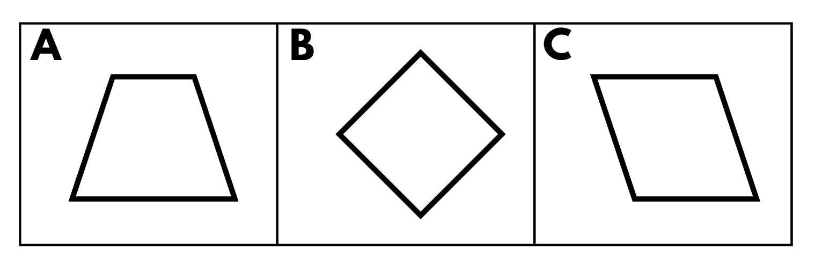
Short response (3)
Which of these quadrilaterals have diagonals as lines of symmetry?
You may select more than one answer.
Notes:
Short response questions provide brisk paced questions focussing on review of current and previous content to support spaced and interleaved practice.
Syllabus focus area:
Two-dimensional spatial structure A

Slide 9
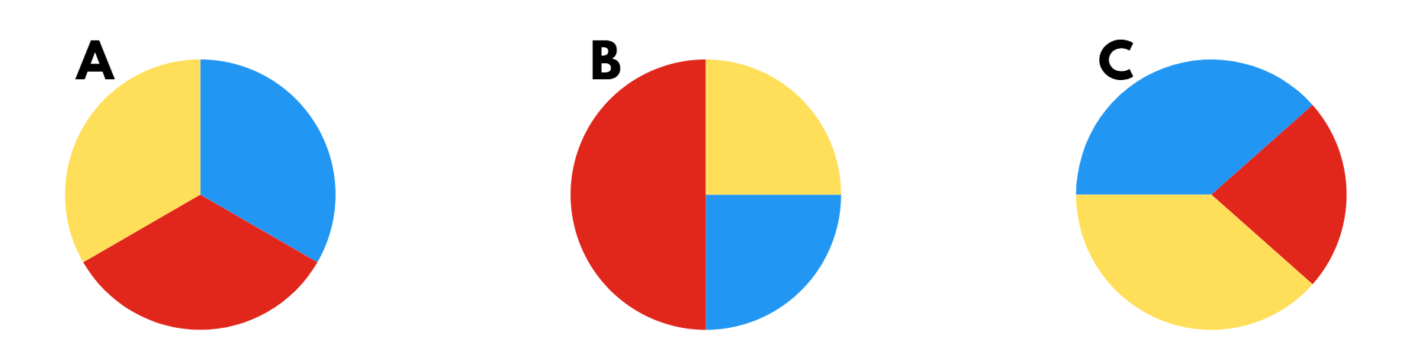
Short response (4)
Which spinner shows red as more likely to be spun?
Communicate your reasoning.
Notes:
Short response questions provide brisk paced questions focussing on review of current and previous content to support spaced and interleaved practice.
Syllabus focus area:
Chance B

Slide 10

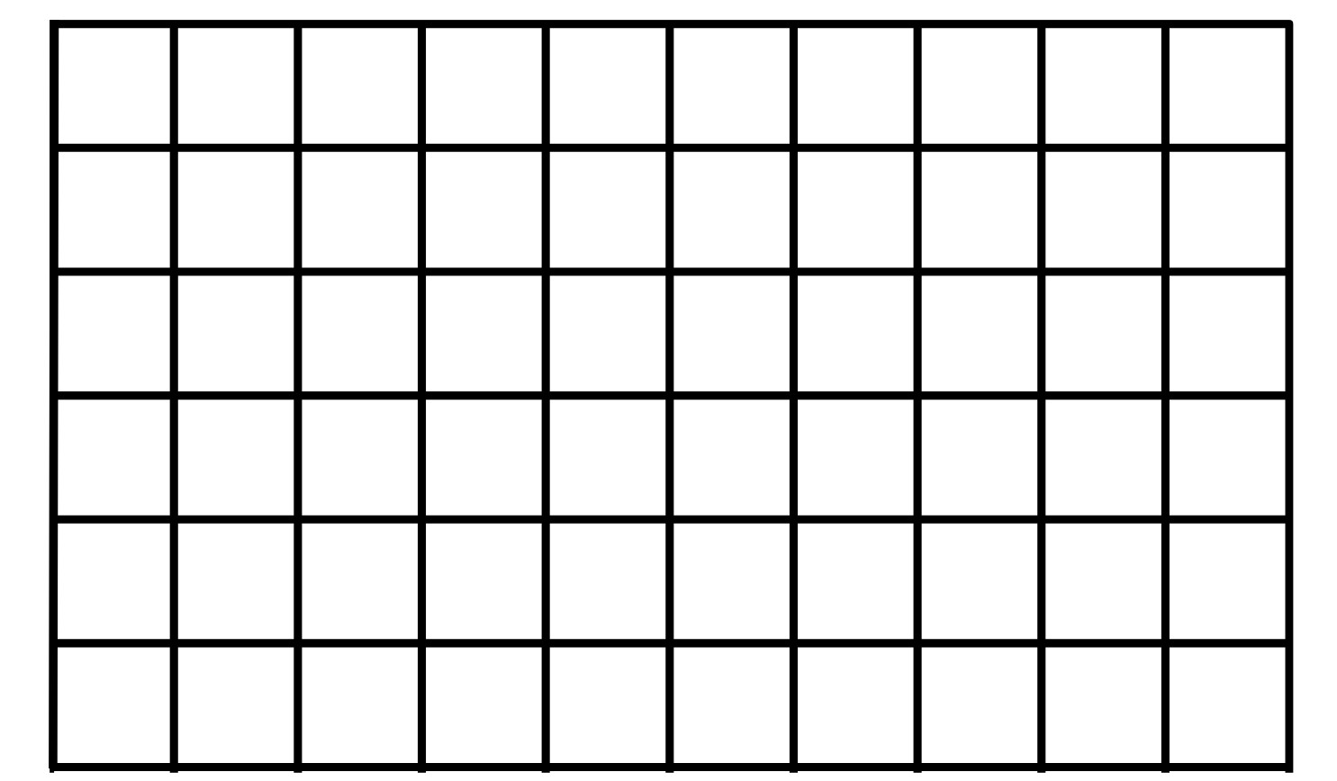
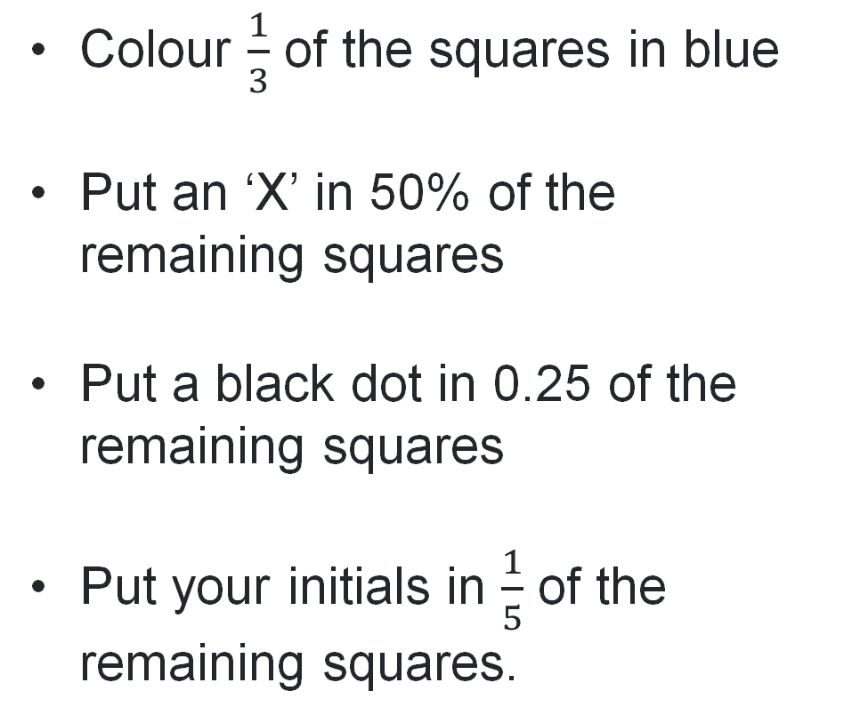
Activity 1 – fractions, decimals and percentages
Colour $\frac{1}{3}$ of the squares in blue
Put an ‘X’ in 50% of the remaining squares
Put a black dot in 0.25 of the remaining squares
Put your initials in $\frac{1}{5}$ of the remaining squares.
Notes:
This is a developing number sense activity.
Number sense refers to a deep understanding of numbers, including their magnitude, relationships, and the effects of operations on them. It supports fluency and understanding, estimation, flexible thinking, and efficient problem-solving. Number sense activities 1–4 ‘activate’ prior number knowledge and support the learning of new content in the unit. Number sense activities 5–8 ‘loop’ back and provide opportunity for spaced practice with concepts and procedures covered in previous units.
Syllabus focus area:
Represents numbers B
Fractions, decimals and percentages
This resource corresponds to Resource 15 – grid paper in Stage 3 Year B Unit 34.
Provide students with Resource 15 – grid paper and writing materials.
Ask students to turn and talk with a partner estimating how many squares there are all together.
Display instructions on the board such as:
Colour one third of the squares in blue.
Put an ‘X’ in 50% of the remaining squares.
Put a black dot in 0.25 of the remaining squares.
Put your initials in one fifth of the remaining squares.
Students can record solutions in various ways, such as in Figure 4.
Regroup as a class. Ask:
How many squares did you start off with?
How did you work out 0.25 of the remaining squares?
How many squares are still blank?
Display a student’s representation. Ask: If there are 12 blank squares, how can you represent that as a fraction of the whole you started with? (twelve sixtieths or two tenths or one fifth.)
Model solutions displaying various strategies. For example, if both the numerator and denominator are even numbers, repeated division by 2 can be used to simplify both the numerator and denominator (12 ÷ 2 and 60 ÷ 2 and so on).
Ask students if there are other factors that can be used to divide both the numerator and denominator, such as 12 ÷ 6 and 60 ÷ 6; 12 ÷ 4 and 60 ÷ 4; 12 ÷ 3 and 60 ÷ 3 and so on.
Ask: How can we represent two tenths as a decimal? (0.2.) Select students to share solutions.

Slide 11
Review of learning 2

Slide 12
True or false (1)
#
This symbol means percentage.
True | False
Notes:
The question on this slide connects to the content being explored in the developing number sense activity (Activity 2)
Syllabus focus area:
Represents numbers B

Slide 13
Short response (5)
Convert the following distances:
100 m is equivalent to __ km.
10 m is equivalent to __ km.
1250 m is equal to __ kilometres.
Notes:
Short response questions provide brisk paced questions focussing on review of current and previous content to support spaced and interleaved practice.
Syllabus focus area:
Geometric Measure A

Slide 14
Short response (6)
9 slices of pepperoni are needed to for 3 pizza slices.
How many slices of pepperoni are needed for 24 pizza slices?
Notes:
Short response questions provide brisk paced questions focussing on review of current and previous content to support spaced and interleaved practice.
Syllabus focus area:
Multiplicative relations B

Slide 15
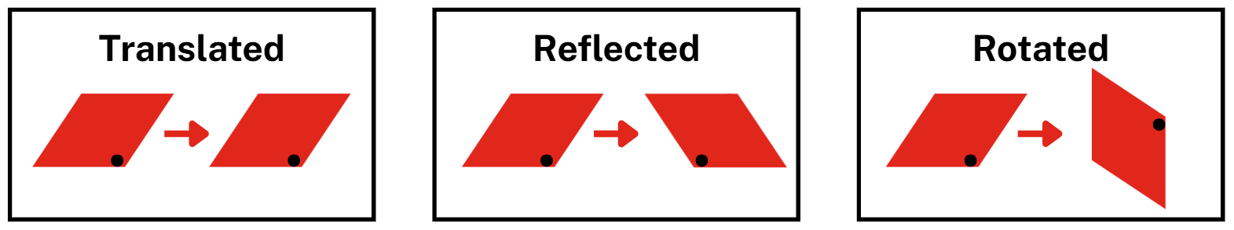
Short response (7)
The shape has been translated, reflected and rotated.
What has changed about the shape?
What has stayed the same?
Notes:
Short response questions provide brisk paced questions focussing on review of current and previous content to support spaced and interleaved practice.
Syllabus focus area:
Two-dimensional spatial structure B

Slide 16
Short response (8)
The expected probability of rolling a 6 is 1 out of 6.
Which observed result is more reasonable?
2 sixes in 13 rolls
17 sixes in 18 rolls
Communicate your reasoning.
Notes:
Short response questions provide brisk paced questions focussing on review of current and previous content to support spaced and interleaved practice.
Syllabus focus area:
Chance B

Slide 17
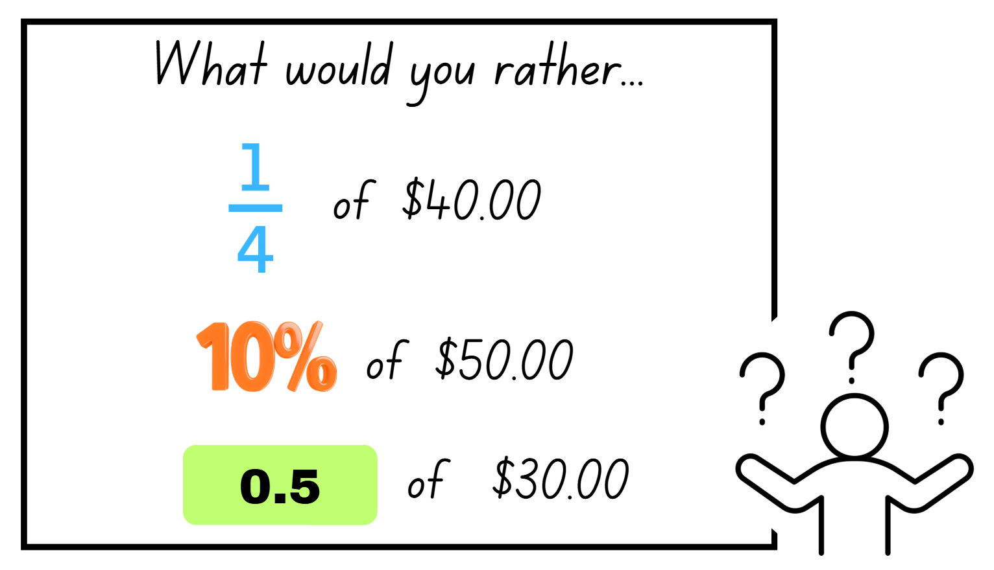
Activity 2 – connections between benchmark fractions, decimals and percentages
Notes:
This is a developing number sense activity.
Number sense refers to a deep understanding of numbers, including their magnitude, relationships, and the effects of operations on them. It supports fluency and understanding, estimation, flexible thinking, and efficient problem-solving. Number sense activities 1–4 ‘activate’ prior number knowledge and support the learning of new content in the unit. Number sense activities 5–8 ‘loop’ back and provide opportunity for spaced practice with concepts and procedures covered in previous units.
Syllabus focus area:
Represents numbers B
Connections between benchmark fractions, decimals and percentages
This resource corresponds to Resource 16 – solving problems in Stage 3 Year B Unit 34.
Ask students to turn and talk to discuss ideas and strategies for finding out the solution. Ask:
What is the problem asking you to find out?
What is a strategy you could use to work out the answer?
How will you know you have the correct answer?
Provide students with writing materials to solve the problem.
Select students to share and justify their thinking.

Slide 18
Review of learning 3

Slide 19
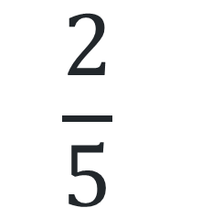
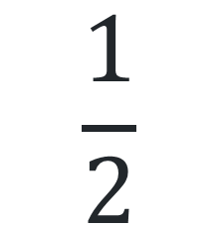
Multiple choice (2)
25% is equivalent to:
A
B
C
D
$$\frac{2}{5}$$
0.25
2.5
$$\frac{1}{2}$$
Notes:
This question connects to the content in the developing number sense activity (Activity 3)
Syllabus focus area:
Represents numbers B

Slide 20
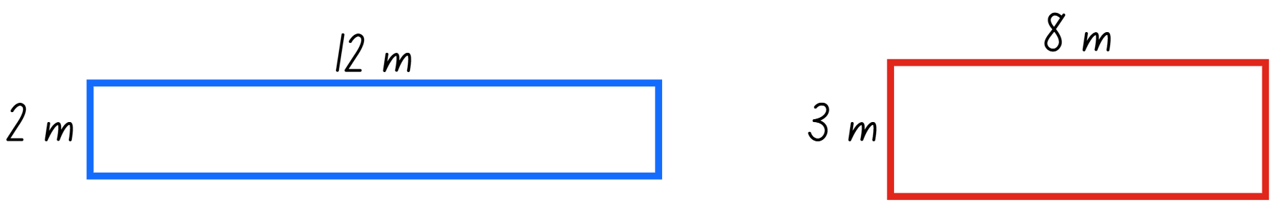
Short response (9)
Both rectangles have an area of 24 m².
Which rectangle has the largest perimeter?
Communicate your reasoning.
Notes:
Short response questions provide brisk paced questions focussing on review of current and previous content to support spaced and interleaved practice.
Syllabus focus area:
Geometric Measure B

Slide 21
Short response (10)
A printer prints 15 pages every 5 seconds.
How many pages does it print in 1 minute?
Notes:
Short response questions provide brisk paced questions focussing on review of current and previous content to support spaced and interleaved practice.
Syllabus focus area:
Multiplicative relations B

Slide 22
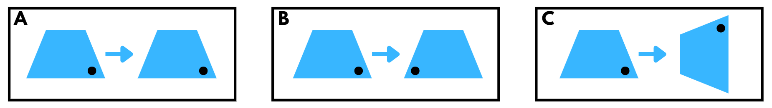
Short response (11)
Label what is happening to the shape in each box.
reflect
translate
rotate
Notes:
Short response questions provide brisk paced questions focussing on review of current and previous content to support spaced and interleaved practice.
Syllabus focus area:
Two-dimensional spatial structure B

Slide 23
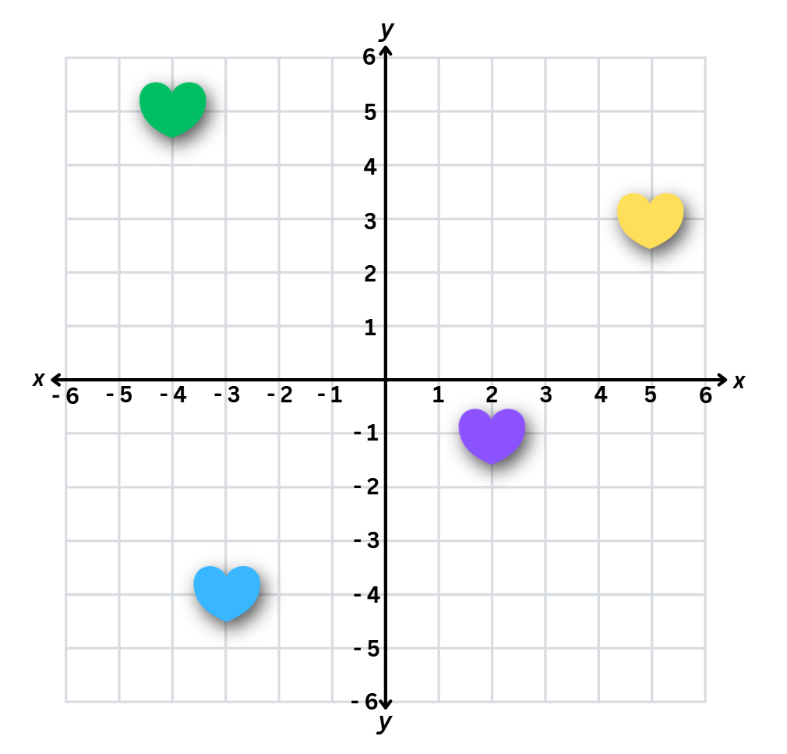
Short response (12)
Record the coordinates of each heart on the Cartesian plane.​
Notes:
Short response questions provide brisk paced questions focussing on review of current and previous content to support spaced and interleaved practice.
Syllabus focus area:
Geometric measure B

Slide 24

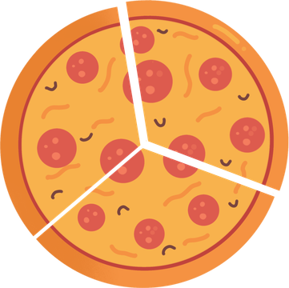

Activity 3 – equivalent percentages, decimals and fractions
1
8
0.75
0.1
0.25
Notes:
This is a developing number sense activity.
Number sense refers to a deep understanding of numbers, including their magnitude, relationships, and the effects of operations on them. It supports fluency and understanding, estimation, flexible thinking, and efficient problem-solving. Number sense activities 1–4 ‘activate’ prior number knowledge and support the learning of new content in the unit. Number sense activities 5–8 ‘loop’ back and provide opportunity for spaced practice with concepts and procedures covered in previous units.
Syllabus focus area:
Represents numbers B
Equivalent percentages, decimals and fractions
This resource corresponds to Resource 17 – odd one out in Stage 3 Year B Unit 34.
Provide pairs of students with Resource 17 – odd one out and writing materials.
Explain that students need to find pairs and match up fractions, decimals and/or percentages to determine which is the odd one out after they have all been paired up.
As a class ask:
What was an easy pair to identify? Why?
Which pair was the most challenging and how did you solve it?
Are there any pairs that you are still wondering about?
Which fraction and decimal were easy to pair up? Why?
Which decimal and percentage were easy to pair up? Why?

Slide 25
Review of learning 4

Slide 26

True or false (2)
75%, 0.75 and $\frac{2}{4}$ are equivalent.
True | False
Notes:
The question on this slide connects to the content being explored in the developing number sense activity (Activity 4)
Syllabus focus area:
Represents numbers B

Slide 27
Short response (13)
Convert these measurements between metres and kilometres:
967 m
8.24 km
7308 m
Notes:
Short response questions provide brisk paced questions focussing on review of current and previous content to support spaced and interleaved practice.
Syllabus focus area:
Geometric Measure B

Slide 28
Short response (14)
Calculate:
24.15 × 10 =
3.106 × 100 =
7.8 ÷ 10 =
9.1 ÷ 100 =
Notes:
Short response questions provide brisk paced questions focussing on review of current and previous content to support spaced and interleaved practice.
Syllabus focus area:
Multiplicative relations B

Slide 29
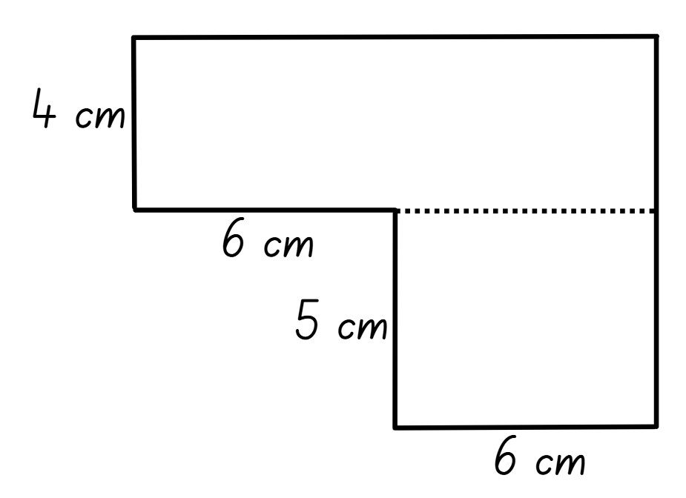
Short response (15)
This is one way this composite L-shape could be dissected to calculate its area.
Draw a different way it may be dissected and calculate the area.
Notes:
Short response questions provide brisk paced questions focussing on review of current and previous content to support spaced and interleaved practice.
Syllabus focus area:
Two-dimensional spatial structure B

Slide 30
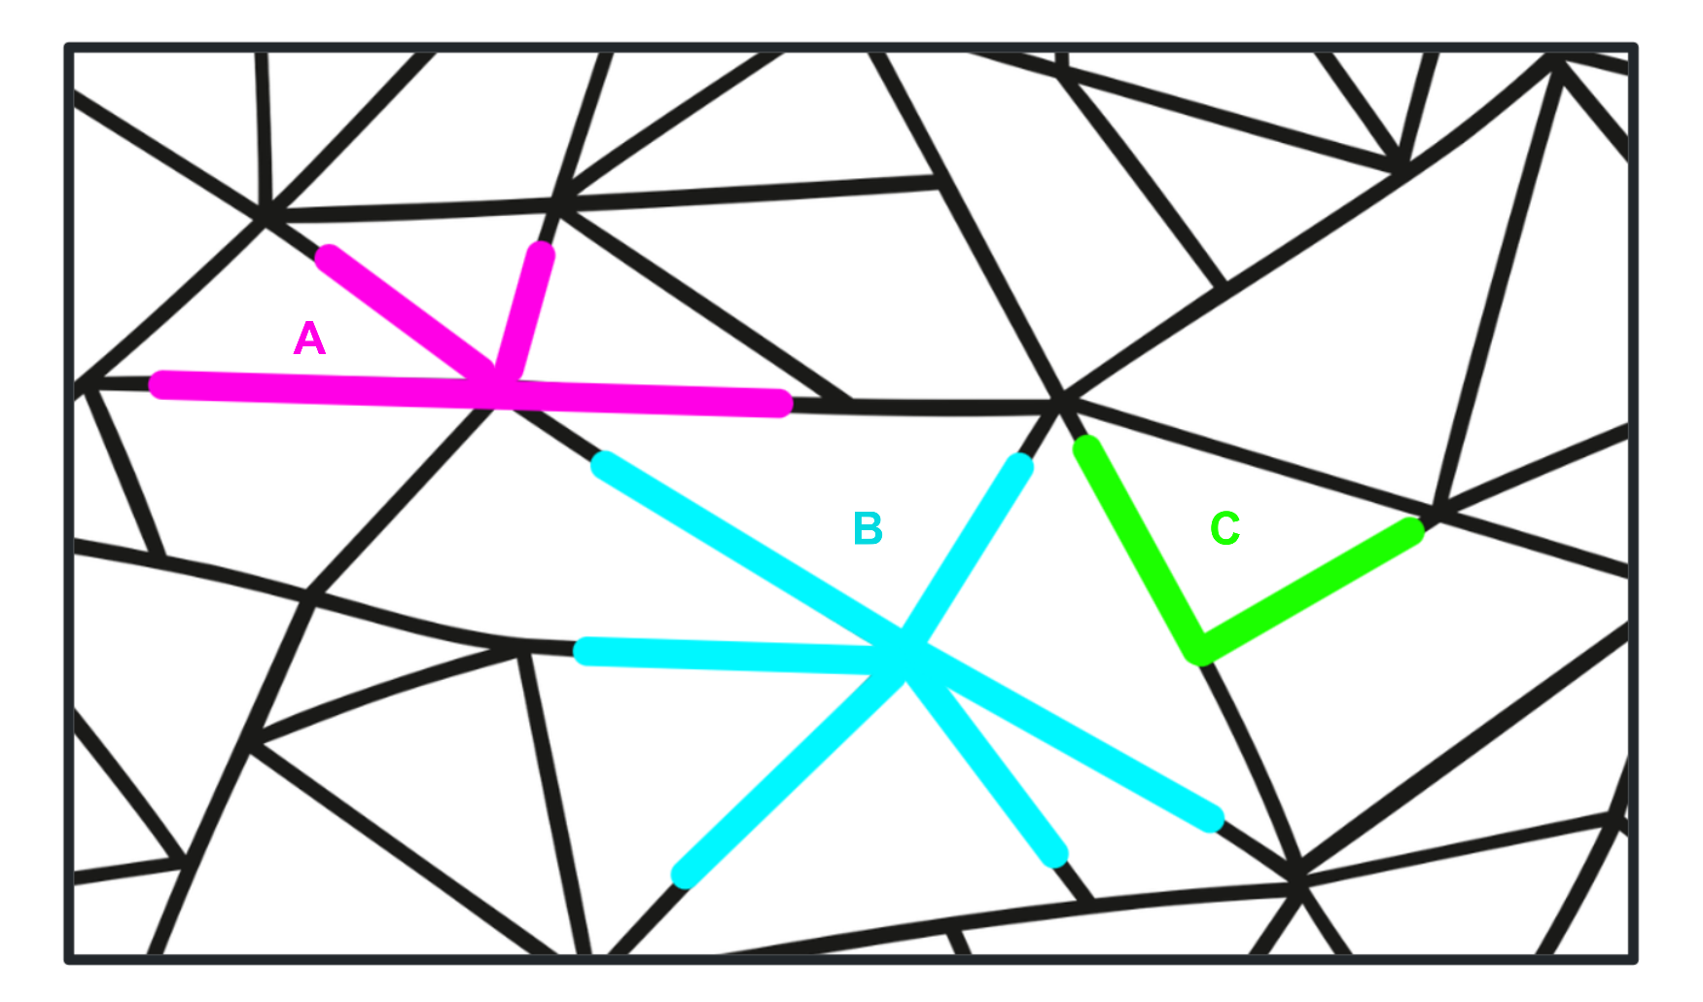
Short response (16)
Identify:
right angle
angles on a straight line
angles embedded at a point
Notes:
Short response questions provide brisk paced questions focussing on review of current and previous content to support spaced and interleaved practice.
Syllabus focus area:
Geometric Measure B

Slide 31
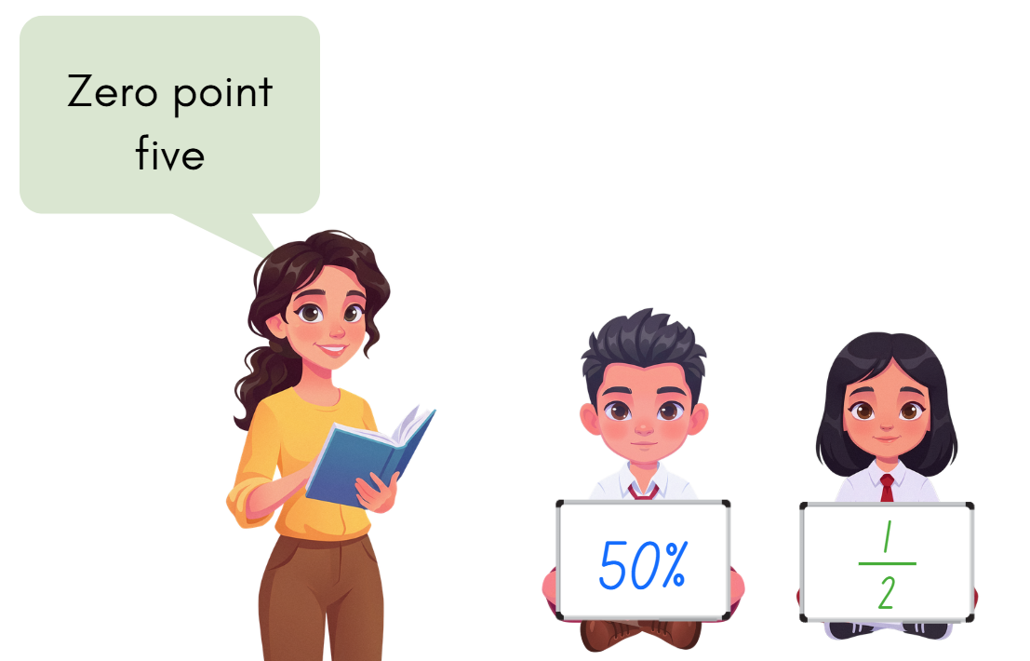
Activity 4 – recall commonly used equivalent percentages, decimals and fractions
Notes:
This is a developing number sense activity.
Number sense refers to a deep understanding of numbers, including their magnitude, relationships, and the effects of operations on them. It supports fluency and understanding, estimation, flexible thinking, and efficient problem-solving. Number sense activities 1–4 ‘activate’ prior number knowledge and support the learning of new content in the unit. Number sense activities 5–8 ‘loop’ back and provide opportunity for spaced practice with concepts and procedures covered in previous units.
Syllabus focus area:
Represents numbers B
Recall commonly used equivalent percentages, decimals and fractions
Provide students with whiteboards and markers.
Explain that you are going to call out a percentage, decimal or factional value and the students will need to record the equal values in the other representations on their whiteboard. For example, if the value of 0.5 was called out, the students would record one half and 50%.
Students display their whiteboard for a quick check and then the next value is called out.

Slide 32
Review of learning 5

Slide 33
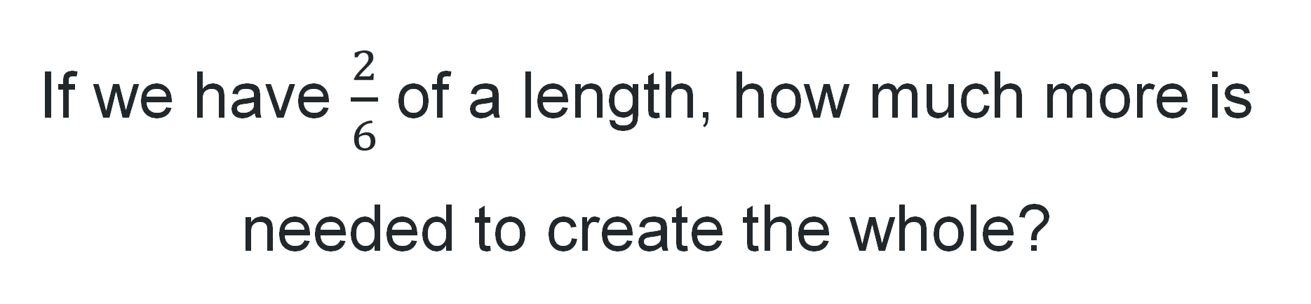
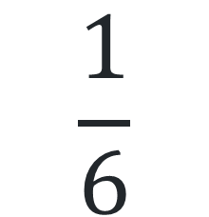
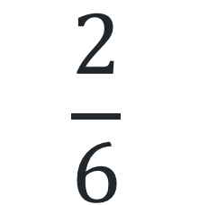
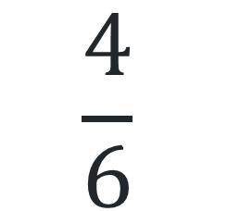
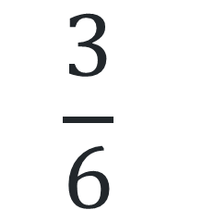
Multiple choice (3)
If we have $\frac{2}{6}$ of a length, how much more is needed to create the whole?
A
B
C
D
$$\frac{3}{6}$$
$$\frac{4}{6}$$
$$\frac{2}{6}$$
$$\frac{1}{6}$$
Notes:
This question connects to the content in the developing number sense activity (Activity 5)
Syllabus focus area:
Representing quantity fractions B

Slide 34
Short response (17)
Record these equivalent measurements using decimal notation.
215 mm = ____ centimetres
625 cm = ____ metres
3475 m = ____ kilometres
Notes:
Short response questions provide brisk paced questions focussing on review of current and previous content to support spaced and interleaved practice.
Syllabus focus area:
Geometric Measure B

Slide 35
Short response (18)
Record this number sentence with brackets to make this equation correct.
3 + 5 × 9 = 72
Notes:
Short response questions provide brisk paced questions focussing on review of current and previous content to support spaced and interleaved practice.
Syllabus focus area:
Multiplicative relations B

Slide 36
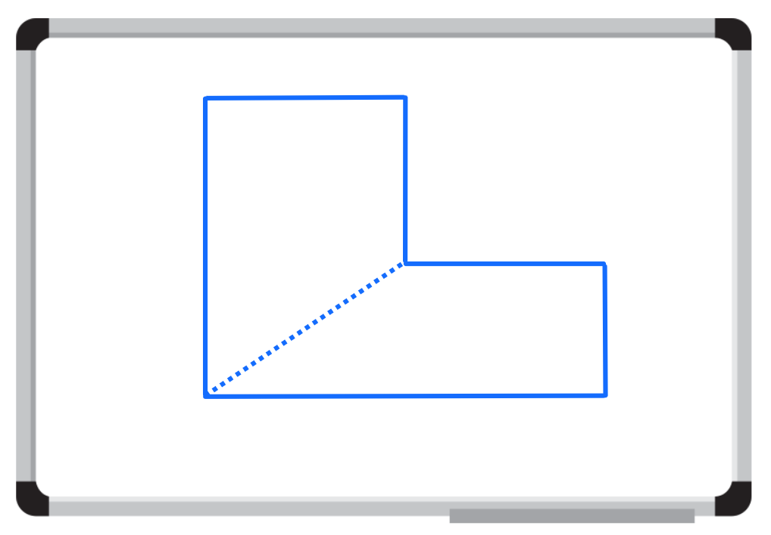
Short response (19)
A student dissected this composite L-shape to calculate its area.
Is this an effective way to dissect the shape?
Communicate your reasoning
Draw how you would dissect the composite L-shape to calculate its area.
Notes:
Short response questions provide brisk paced questions focussing on review of current and previous content to support spaced and interleaved practice.
Syllabus focus area:
Two-dimensional spatial structure B

Slide 37
Short response (20)
Match the triangle to the classification.
equilateral
A. no equal sides and no equal angles
isosceles
B. 3 equal sides and 3 equal angles
scalene
C. 2 equal sides and 2 equal angles
Notes:
Short response questions provide brisk paced questions focussing on review of current and previous content to support spaced and interleaved practice.
Syllabus focus area:
Two-dimensional spatial structure A

Slide 38
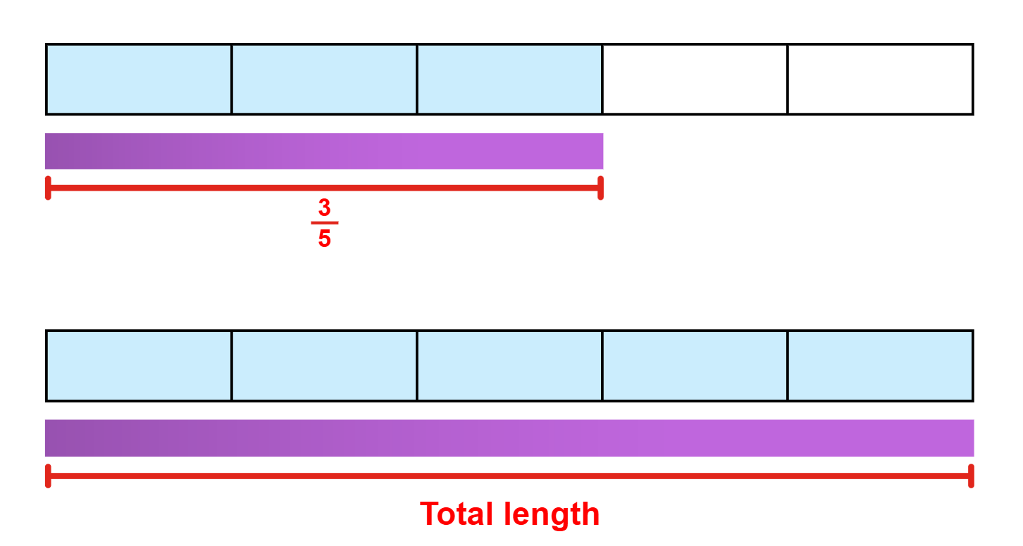
Activity 5 – build up to the whole 1
Notes:
This is a developing number sense activity.
Number sense refers to a deep understanding of numbers, including their magnitude, relationships, and the effects of operations on them. It supports fluency and understanding, estimation, flexible thinking, and efficient problem-solving. Number sense activities 1–4 ‘activate’ prior number knowledge and support the learning of new content in the unit. Number sense activities 5–8 ‘loop’ back and provide opportunity for spaced practice with concepts and procedures covered in previous units.
Syllabus focus area:
Representing quantity fractions B
Build up to the whole 1
Ask students: If you are given 3-fifths of a length of ribbon, how can you find the total length?
Provide students with whiteboards. Allow time for students to think and then turn and talk to discuss how they could find the total length.
Select students to share and explain their strategy. Record and test student responses. Ask:
Does it matter what fraction of the length of ribbon you are given?
How did the fraction of the length of ribbon determine what strategy you used?
Can you use the same strategy to find the total length if you are given five sixths of a length? Select students to test and justify strategies used.

Slide 39
Review of learning 6

Slide 40
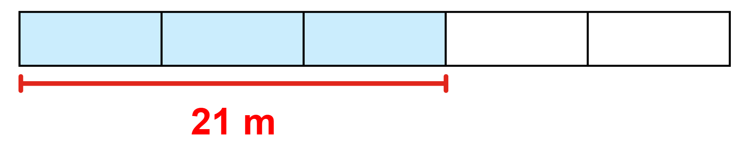
True or false (3)
The total length is 30 m.
True | False
Notes:
The question on this slide connects to the content being explored in the developing number sense activity (Activity 6)
Syllabus focus area:
Representing quantity fractions B

Slide 41
Short response (21)
Convert these measurements between grams and kilograms:
480 g
86.25 kg
3508 g
Notes:
Short response questions provide brisk paced questions focussing on review of current and previous content to support spaced and interleaved practice.
Syllabus focus area:
Non-spatial measure B

Slide 42
Short response (22)
Solve:
(24 ÷ 3) × 2 =
11 + (16 ÷ 4) =
(4 × 9) + (15 ÷ 3) =
Notes:
Short response questions provide brisk paced questions focussing on review of current and previous content to support spaced and interleaved practice.
Syllabus focus area:
Multiplicative relations B

Slide 43
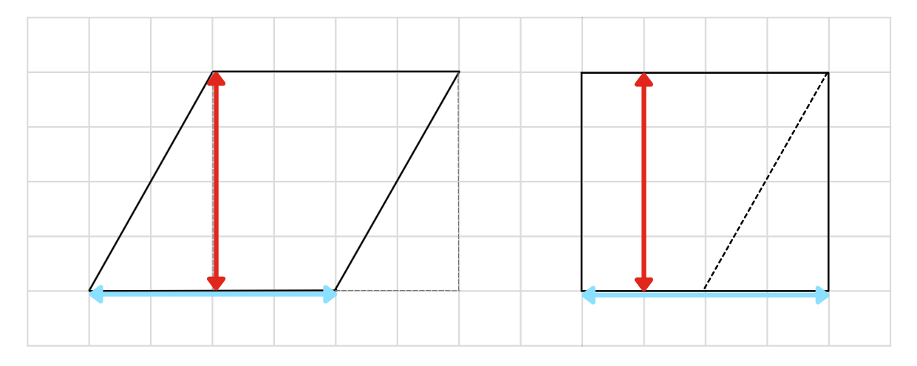
Short response (23)
Nat is calculating the area of a parallelogram. Explain what she is doing in each step.
step 1
step 2
Notes:
Short response questions provide brisk paced questions focussing on review of current and previous content to support spaced and interleaved practice.
Syllabus focus area:
Two-dimensional spatial structure B

Slide 44
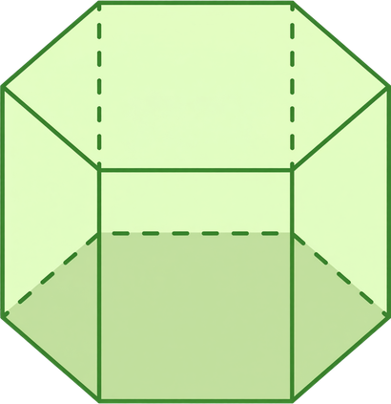
Short response (24)
Name this object.
Notes:
Short response questions provide brisk paced questions focussing on review of current and previous content to support spaced and interleaved practice.
Syllabus focus area:
Three-dimensional spatial structure A

Slide 45
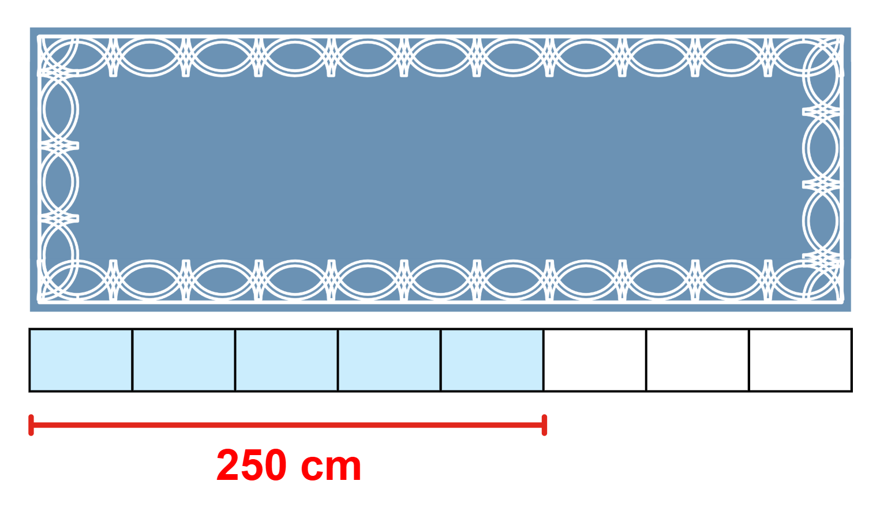
Activity 6 – build up to the whole 2
Notes:
This is a developing number sense activity.
Number sense refers to a deep understanding of numbers, including their magnitude, relationships, and the effects of operations on them. It supports fluency and understanding, estimation, flexible thinking, and efficient problem-solving. Number sense activities 1–4 ‘activate’ prior number knowledge and support the learning of new content in the unit. Number sense activities 5–8 ‘loop’ back and provide opportunity for spaced practice with concepts and procedures covered in previous units.
Syllabus focus area:
Representing quantity fractions B
Build up to the whole 2
Remind students that if a fraction of a total is known it can be used to find the total amount.
Explain that you want to buy a rug for your living room. The website states that five eighths of the rug is 250 cm. Ask how long the whole rug is.
Ask students how they could find the total length of a rug if they know five eighths of the length.
Allow time for students to think and then turn and talk to discuss how they could find the total length.
Select students to share and explain their strategy. Record and test student responses.
Tell students that there is another rug you like, but five eighths of the rug is 260 cm. Ask what the total length of this rug would be.
Select students to share their findings and explain their strategy. Record and test student responses.
The prompts below outlines stimulus prompts to generate conversation about the topic, along with anticipated responses from students.
Prompt
How can you find the total length of the rug if five eighths of the rug is 260 cm?
Anticipated student responses
We would find out how long one-eighth of the rug is first, then build it up to have all 8 of those amounts for the total length.
260 cm divided by 5 equals 52 cm.
One eighth is 52 cm long, so the total length of the rug is 416 cm long.
416 cm is the same as 4 metres and 16 centimetres or 4.16 m.

Slide 46
Review of learning 7

Slide 47
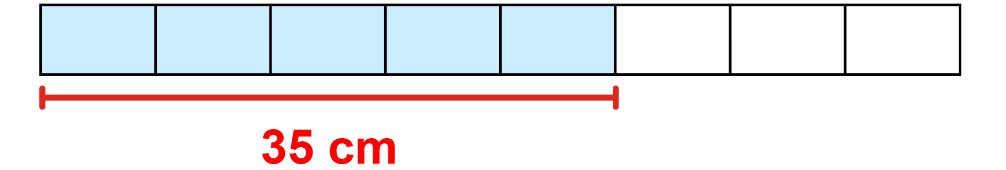
Multiple choice (4)
The remaining part of the length equals:
A
B
C
D
56 cm
15 cm
35 cm
21 cm
Notes:
This question connects to the content in the developing number sense activity (Activity 7)
Syllabus focus area:
Representing quantity fractions B

Slide 48
Short response (25)
Record these measurements using tonnes and kilograms:
4.5 t
37.05 t
61.90 t
Notes:
Short response questions provide brisk paced questions focussing on review of current and previous content to support spaced and interleaved practice.
Syllabus focus area:
Non-spatial measure B

Slide 49
Short response (26)
Complete these number sentences by recording the missing numbers:
7 × __ = 14 + 21
__ × 8 = 2 × 32
4 × __ = 70 − 10
Notes:
Short response questions provide brisk paced questions focussing on review of current and previous content to support spaced and interleaved practice.
Syllabus focus area:
Multiplicative relations B

Slide 50
Short response (31)
Record the missing words:
half
height
base length
parallelogram
The area of a triangle is ______ the area of a ______________ with the same _______ and __________.
a)
b)
c)
d)
Notes:
Short response questions provide brisk paced questions focussing on review of current and previous content to support spaced and interleaved practice.
Syllabus focus area:
Two-dimensional spatial structure B

Slide 51
Short response (28)
Record these measurements using decimal notation:
6 kilograms and 80 grams
23 kilograms and 150 grams
42 kilograms and 500 grams
Notes:
Short response questions provide brisk paced questions focussing on review of current and previous content to support spaced and interleaved practice.
Syllabus focus area:
Non-spatial measure A

Slide 52
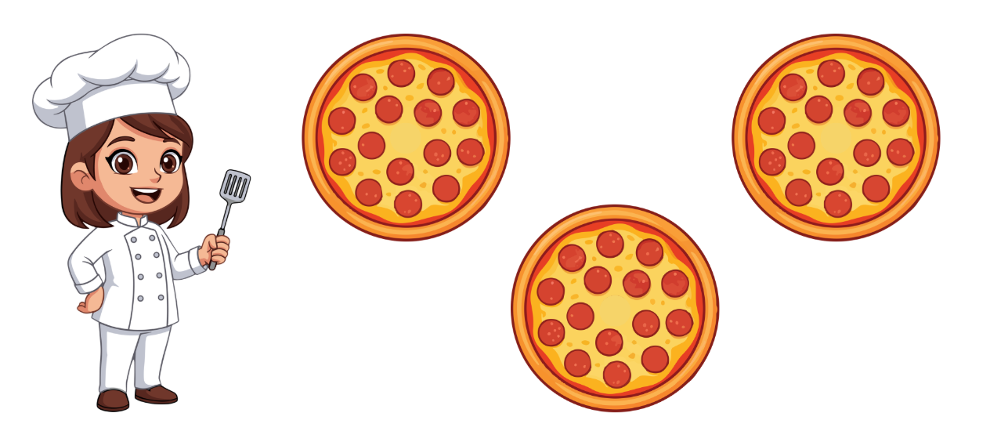
Activity 7 – given fractional parts 1
Notes:
This is a developing number sense activity.
Number sense refers to a deep understanding of numbers, including their magnitude, relationships, and the effects of operations on them. It supports fluency and understanding, estimation, flexible thinking, and efficient problem-solving. Number sense activities 1–4 ‘activate’ prior number knowledge and support the learning of new content in the unit. Number sense activities 5–8 ‘loop’ back and provide opportunity for spaced practice with concepts and procedures covered in previous units.
Syllabus focus area:
Representing quantity fractions B
Given fractional parts 1
Note: to further support students, revise number sense activities 5 and 6, drawing on students thinking and strategies used to solve each task.
Remind students that if a fraction of a total is known it can be used to find the total amount.
Explain that a chef is preparing 12 pizzas for a party. So far, she has topped 3 pizzas and has already used 45 slices of pepperoni. Each pizza needs the same number of pepperoni slices. The chef wants to know the number of pepperoni slices she will need for all 12 pizzas.
Ask students how they could find the total number of objects if they were given 4-tenths of a collection.
Allow time for students to think and then turn and talk to discuss how they could find the total number.
Select students to share and explain their strategy. Record and test student responses.

Slide 53
Review of learning 8

Slide 54
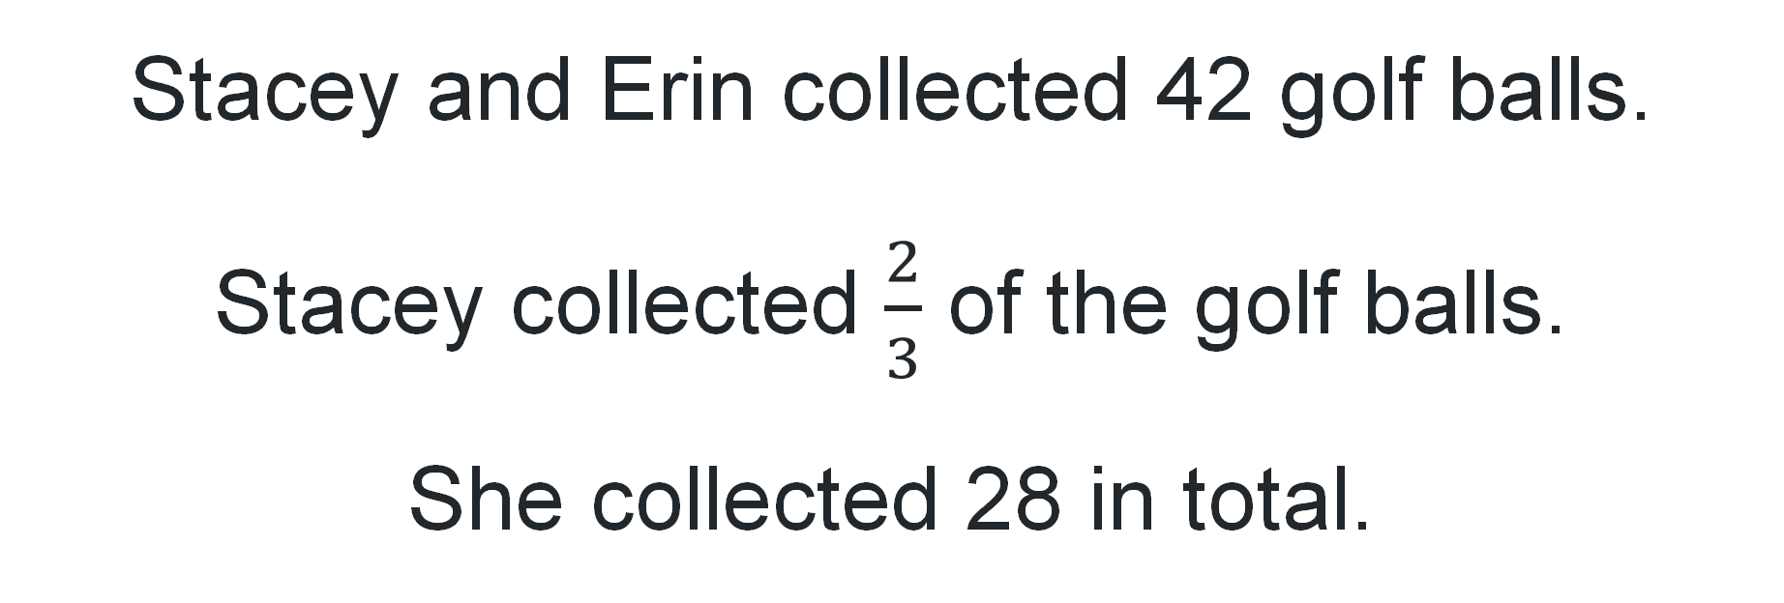
True or false (4)
Stacey and Erin collected 42 golf balls.
Stacey collected $\frac{2}{3}$ of the golf balls.
She collected 28 in total.
True | False
Notes:
The question on this slide connects to the content being explored in the developing number sense activity (Activity 8)
Syllabus focus area:
Representing quantity fractions B

Slide 55
Short response (29)
A chef places 3.75 kg of flour, 300 g of butter and 1 kg 125 g of sugar in a bowl.
What is the total mass of all ingredients?
Record your answer in grams and kilograms.
Notes:
Short response questions provide brisk paced questions focussing on review of current and previous content to support spaced and interleaved practice.
Syllabus focus area:
Non-spatial measure B

Slide 56
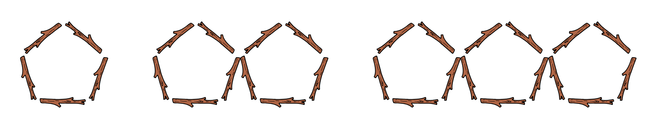
Short response (30)
Describe the pattern of multiples using words.
,
,
Notes:
Short response questions provide brisk paced questions focussing on review of current and previous content to support spaced and interleaved practice.
Syllabus focus area:
Multiplicative relations B

Slide 57
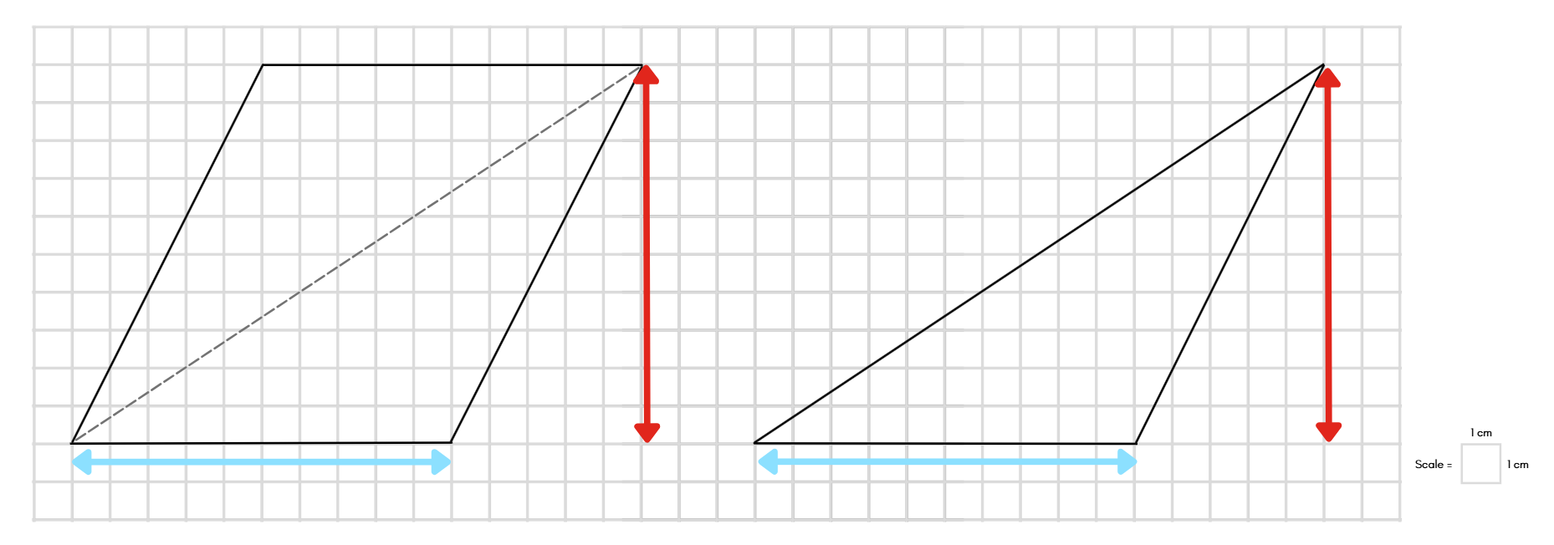
Short response (27)
If the area of this parallelogram is 100 cm², what is the area of the triangle?
Communicate your reasoning.
Notes:
Short response questions provide brisk paced questions focussing on review of current and previous content to support spaced and interleaved practice.
Syllabus focus area:
Two-dimensional spatial structure B

Slide 58
Short response (32)
A bush hike started at 8:15 am and finished at 3:25 pm.
How much time has elapsed?
Notes:
Short response questions provide brisk paced questions focussing on review of current and previous content to support spaced and interleaved practice.
Syllabus focus area:
Non-spatial measure B

Slide 59
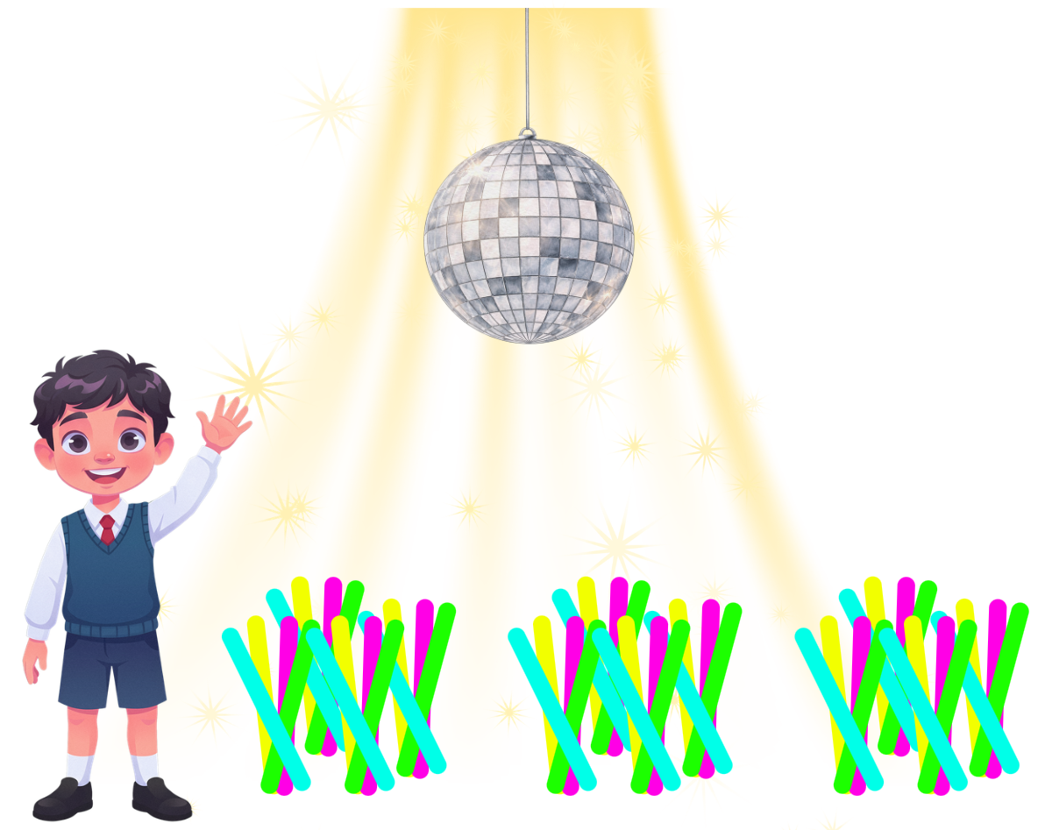
Activity 8 – given fractional parts 2
Notes:
This is a developing number sense activity.
Number sense refers to a deep understanding of numbers, including their magnitude, relationships, and the effects of operations on them. It supports fluency and understanding, estimation, flexible thinking, and efficient problem-solving. Number sense activities 1–4 ‘activate’ prior number knowledge and support the learning of new content in the unit. Number sense activities 5–8 ‘loop’ back and provide opportunity for spaced practice with concepts and procedures covered in previous units.
Syllabus focus area:
Representing quantity fractions B
Given fractional parts 2
Revise the idea that if a fraction of a total is known it can be used to find the total amount.
Pose the scenario: Liam ordered 128 glow sticks for the school disco. Three-eighths were delivered. Ask:
How many glow sticks were delivered?
How many glow sticks still need to be delivered?
Students solve the problem in their workbooks.
Select students to share and explain their strategy.

Slide 60
Double Venn diagram
Object 1
Object 2
Features similar to both objects
Features of object 1
Features of object 2

Slide 61
Frayer
Definition
Facts/Characteristics
Word, term, concept
Examples
Non-examples

Slide 62
Spider map
Idea
Subject

Slide 63
Cline
Concept 1
Concept 2
Word
Word
Word
Word
Word
Word
Word
Word
Word
Word
Word

Slide 64
Compare and contrast

Slide 65
Multiple choice (5)
A
B
C
D

Slide 66
Multiple choice
A
B
C
D
Notes:
This question connects to the content in the developing number sense activity (Activity 3)
Syllabus focus area:
[Focus area A/B]

Slide 67
References
This presentation contains NSW Curriculum and syllabus content. The NSW Curriculum is developed by the NSW Education Standards Authority. This content is prepared by NESA for and on behalf of the Crown in the right of the State of New South Wales. The material is protected by Crown copyright.
Please refer to the NESA Copyright Disclaimer for more information https://educationstandards.nsw.edu.au/wps/portal/nesa/mini-footer/copyright.
NESA holds the only official and up-to-date versions of the NSW Curriculum and syllabus documents. Please visit the NSW Education Standards Authority (NESA) website https://educationstandards.nsw.edu.au/wps/portal/nesa/home and the NSW Curriculum website https://curriculum.nsw.edu.au.
Mathematics K–10 Syllabus © NSW Education Standards Authority (NESA) for and on behalf of the Crown in right of the State of New South Wales, 2022.
National Numeracy Learning Progression © Australian Curriculum, Assessment and Reporting Authority (ACARA) 2010 to present, unless otherwise indicated. This material was downloaded from the Australian Curriculum website (National Numeracy Learning Progression) (accessed 9 March 2026) and was not modified.
Behind the News (6 August 2023) ‘Australia's Plastic Waste Problem – Behind the News’ [video], Behind the News, YouTube, accessed 9 March 2026.
Clarke D (1996) The Case of the Mystery Bone: A Unit of Work on Measurement for Grades 5 to 8, Australian Association of Mathematics Teachers Inc, Australia.
Clean Up Australia (2024) Clean Up Our Waste, Clean Up Australia website, accessed 9 March 2026.
Grant J, Lewis E and Woods A (2007) Maths-in-a-Box 3, Cambridge University Press, Australia.
Sullivan P and Lilburn P (2017) Open-ended Maths Activities: Using ‘Good’ Questions to Enhance Learning in Mathematics, Revised edn, Oxford University Press ANZ, Great Britain.

Slide 68
Copyright
© State of New South Wales (Department of Education), 2025
The copyright material published in this resource is subject to the Copyright Act 1968 (Cth) and is owned by the NSW Department of Education or, where indicated, by a party other than the NSW Department of Education (third-party material).
Copyright material available in this resource and owned by the NSW Department of Education is licensed under a Creative Commons Attribution 4.0 International (CC BY 4.0) license.
This license allows you to share and adapt the material for any purpose, even commercially.
Attribution should be given to © State of New South Wales (Department of Education), 2025.
Material in this resource not available under a Creative Commons license:
the NSW Department of Education logo, other logos and trademark-protected material
Material owned by a third party that has been reproduced with permission. You will need to obtain permission from the third party to reuse its material.
Links to third-party material and websites
Please note that the provided (reading/viewing material/list/links/texts) are a suggestion only and implies no endorsement, by the New South Wales Department of Education, of any author, publisher, or book title. School principals and teachers are best placed to assess the suitability of resources that would complement the curriculum and reflect the needs and interests of their students.
If you use the links provided in this document to access a third party’s website, you acknowledge that the terms of use, including licence terms set out on the third-party’s website apply to the use which may be made of the materials on that third-party website or where permitted by the Copyright Act 1968 (Cth). The department accepts no responsibility for content on third-party websites.

