Slide 1
Instructions for use
This resource aligns to the learning in Stage 3 Year B Unit 35 and revisits content from earlier sample units.
Classroom teachers are encouraged to add and adapt slides as required to meet the needs of their students.
Save a copy of the file to make changes to the slide deck. Go to File > Download a Copy (this downloads a copy to the computer to edit in the PowerPoint app).
To convert the PowerPoint to Google Slides:
  Upload the file into Google Drive and open it.
  Go to File > Save as Google Slides.
  (Note – conversion may cause formatting changes in the slides.)

Slide 2

Review of Learning
Mathematics Stage 3 – Unit 35
Notes:
Reviews may include a combination of question types, requiring students to recall facts and key ideas, as well as apply their knowledge to solve problems and answer questions. To support active engagement, a mix of techniques should be employed.” (AERO, 2024).
This Review of Learning slide deck revisits key concepts from the following units:
Stage 3 Year B Unit 35
Stage 3 Year B Unit 34
Stage 3 Year B Unit 33
It also includes opportunities to review prior learning in non-number content, supporting consolidation across focus areas.
The review of learning resources include three key task types that support the development of mathematical proficiency through retrieval, spaced practice, and active participation. These practices complement the review phase (activating prior knowledge) embedded within the beginning of each lesson.
1.
Multiple-choice questions/True or false: Designed to promote active retrieval of key concepts and identify common misconceptions in number, supporting consolidation, understanding and fluency.
These questions:
support spaced and interleaved practice
help identify and address common misconceptions
support active recall and immediate feedback
support whole class participation
identify areas requiring reteach
2.
Short-response question sets: Carefully grouped questions that encourage spaced and interleaved practice across multiple focus areas, helping students revisit and apply knowledge from different points in time.
These questions:
have a combination of question types
address a range of focus areas
build automaticity and fluency
support active recall
allow for immediate feedback
identify content requiring reteach
3.
Developing number sense activities: A variety of practical, purposeful tasks that reinforce current learning and build on prior knowledge. These activities promote reasoning, problem-solving and conceptual understanding.
The review of learning resources are designed to work support teaching and learning in mathematics. For the most effective implementation, use the resources flexibly, adapting to meet student learning needs and individual classroom contexts.

Slide 3
Lessons
1
Review of learning 1
5
Review of learning 5
2
Review of learning 2
6
Review of learning 6
3
Review of learning 3
7
Review of learning 7
4
Review of learning 4
8
Review of learning 8
Notes:
Teacher notes:
Click lesson titles to go to specific lessons
Interactive features can be viewed in slide show

Slide 4
Review of learning 1

Slide 5

Multiple choice (1)
2.09 + 2.45
A
4.45
B
4.54
C
4.44
D
5.06
Notes:
This question connects to the content in the developing number sense activity (Activity 1)
Syllabus focus area:
Additive relations B

Slide 6

Short response (1)
4.578
What is the value of the digit in the
a) hundredths place?
b) tenths place?
c) thousandths place?
Notes:
Short response questions provide brisk paced questions focussing on review of current and previous content to support spaced and interleaved practice.
Syllabus focus area:
Represents numbers A

Slide 7
Short response (2)
10 times 100 metres =
_______ kilometres.
Notes:
Short response questions provide brisk paced questions focussing on review of current and previous content to support spaced and interleaved practice.
Syllabus focus area:
Geometric measure A

Slide 8
Short response (3)
Solve 9 × 500 using an efficient strategy.
Communicate your reasoning.
Notes:
Short response questions provide brisk paced questions focussing on review of current and previous content to support spaced and interleaved practice.
Syllabus focus area:
Multiplicative relations B

Slide 9
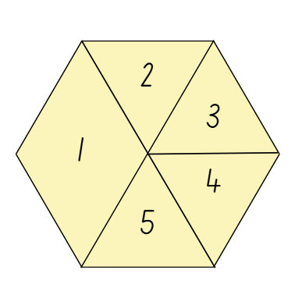
Short response (4)
What would be the expected frequency of landing on 1?
What would be the expected frequency of landing on 5?
Steph spun the spinner 10 times. She landed on 1 four times and 5 two times. How does the observed frequency compare to the expected frequency?
Notes:
Short response questions provide brisk paced questions focussing on review of current and previous content to support spaced and interleaved practice.
Syllabus focus area:
Chance B

Slide 10

Activity 1 – addition and subtraction with decimals
Determine if the following statements are true or false.
The total cost of the shopping trip is $39.80 before the loyalty discount.
The total mass of the top 2 items on the receipt is 1.228 kg.
The total mass of the broccoli, Brussels sprouts, grapes and peas is 2.522 kg.
If you ate 0.550 kg of the grapes on your way home, only 0.885 kgs is left for your family.
You were over-charged on the 3 special items if you paid $4.98.
You paid using a $50 note and received $11.20 change.
Big Fruit Barn shopping receipt
Items | Cost
Zucchini 0.778kg NET @ $5.99/kg | $4.66
Bananas 0.442kg NET @ $2.99/kg | $1.32
Special | $0.99
Special | $1.50
Potatoes 1.328kg NET @ $2.99/kg | $3.97
Brussel sprouts 0.322kg NET @ $15.99/kg | $5.15
Broccoli 0.808kg NET @ $5.99 | $4.84
Special | $0.99
Grapes green 1.174kg NET @ $5.99/kg | $7.03
Snow peas 0.218kg NET @ $14.99 | $3.27
Cherry tomatoes | $2.99
Lettuce Iceberg | $2.49
Subtotal | $39.20
Loyalty card discount | -$15.00
Total | $24.20
Cash | $50.00
Change | $25.80
Notes:
This is a developing number sense activity.
Number sense refers to a deep understanding of numbers, including their magnitude, relationships, and the effects of operations on them. It supports fluency and understanding, estimation, flexible thinking, and efficient problem-solving. Number sense activities 1–4 ‘activate’ prior number knowledge and support the learning of new content in the unit. Number sense activities 5–8 ‘loop’ back and provide opportunity for spaced practice with concepts and procedures covered in previous units.
Syllabus focus area:
Additive relations B
Addition and subtraction with decimals
This resource corresponds to Resource 19 – shopping receipt in Stage 3 Year B Unit 35.
Demonstrate how to read the figures on the receipt.
Read aloud one true or false statement at a time:
- The total cost of the shopping trip is $39.80 before the loyalty discount. (False: $39.20.)
- The total mass of the top 2 items on the receipt is 1.228 kg. (False: 1.22 kg.)
- The total mass of the broccoli, Brussels sprouts, grapes and peas is 2.522 kg. (True.)
- If you ate 0.550 kg of the grapes on your way home, only 0.885 kgs is left for your family. (False: 0.624 kg.)
- You were over-charged on the 3 special items if you paid $4.98. (False: $3.48.)
- You paid using a $50 note and received $11.20 change. (False: $10.80.)
Students solve the true or false statements using the information on the receipt.
Regroup as a class and select students to share their answers.
Discuss the efficiency and accuracy of the various strategies used by students.

Slide 11
Review of learning 2

Slide 12
True or false (1)
2.25 − 4.50 = 6.75
True | False
Communicate your reasoning.
Notes:
The question on this slide connects to the content being explored in the developing number sense activity (Activity 2)
Syllabus focus area:
Additive relations B

Slide 13
Short response (5)
Solve 6.105 − 2.02
Communicate your strategy.
Notes:
Short response questions provide brisk paced questions focussing on review of current and previous content to support spaced and interleaved practice.
Syllabus focus area:
Additive relations A

Slide 14
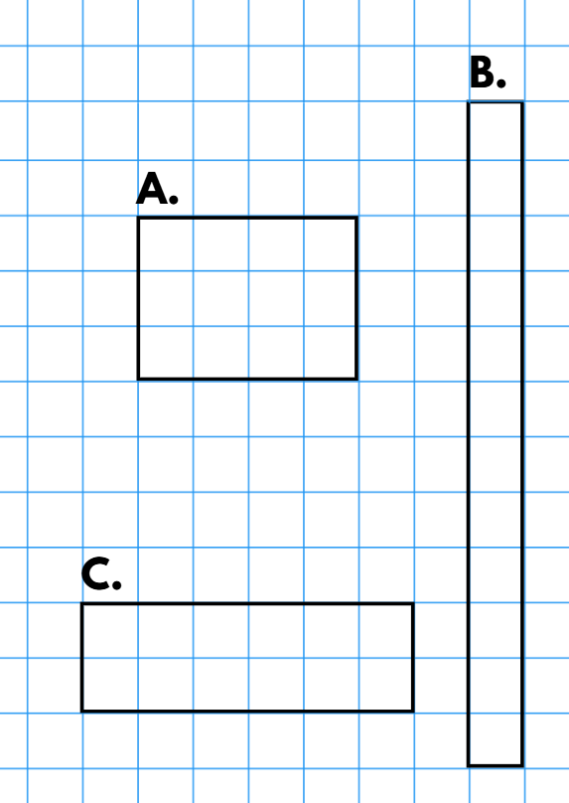
Short response (6)
Which 2 rectangles have the same perimeter?
Communicate your reasoning.
Notes:
Short response questions provide brisk paced questions focussing on review of current and previous content to support spaced and interleaved practice.
Syllabus focus area:
Geometric measure B

Slide 15
Short response (7)
A school uses 12 chairs for 3 tables at an event.
How many chairs are needed for 15 tables?
Notes:
Short response questions provide brisk paced questions focussing on review of current and previous content to support spaced and interleaved practice.
Syllabus focus area:
Multiplicative relations B

Slide 16

Short response (8)
Is the game ‘Scissors, Paper, Rock’ fair?’
Communicate your reasoning.
Notes:
Short response questions provide brisk paced questions focussing on review of current and previous content to support spaced and interleaved practice.
Syllabus focus area:
Chance B

Slide 17
Activity 2 – addition and subtraction word problems
Fruits – serving size 100 grams | Carbohydrates (g) | Protein (g) | Fruits – serving size 100 grams | Carbohydrates (g) | Protein (g)
Apples | 13.81 | 2.26 | Figs | 19.38 | 2.75
Apricots | 11.12 | 1.45 | Grapes | 16.26 | 0.67
Bananas | 88.28 | 3.89 | Lemons | 16 | 1.5
Blackberries | 23.1 | 1.31 | Oranges | 11.75 | 0.94
Blueberries | 22.06 | 0.65 | Peaches | 9.54 | 0.91
Cherries | 12.18 | 1.36 | Plums | 11.89 | 0.705
Figs | 19.38 | 2.75 | Strawberries | 7.907 | 0.608
Notes:
This is a developing number sense activity.
Number sense refers to a deep understanding of numbers, including their magnitude, relationships, and the effects of operations on them. It supports fluency and understanding, estimation, flexible thinking, and efficient problem-solving. Number sense activities 1–4 ‘activate’ prior number knowledge and support the learning of new content in the unit. Number sense activities 5–8 ‘loop’ back and provide opportunity for spaced practice with concepts and procedures covered in previous units.
Syllabus focus area:
Additive relations B
Addition and subtraction word problems
This resource corresponds to Resource 20 – nutrition in fruit in Stage 3 Year B Unit 35.
Discuss and list the strategies students use when reading and solving word problems.
Pose the scenario: You and a friend made a berry smoothie to share, using 100 grams of each berry. Can you calculate the total carbohydrates and protein each person consumed from the berries after drinking the smoothie?
Guide students in reading and recording a number sentence to solve the word problem.
In small groups, students create 2 addition and/or subtraction word problems using Resource 20 – nutrition in fruit. For example, On Thursday, Mina ate an orange for breakfast and had a peach and figs for afternoon tea. How much protein did Mina eat?
Once complete, groups swap problems and solve them.
Prompt students to consider the most efficient and fluent additive strategies for the problems presented.
Regroup as a class and select students to share strategies used to solve the word problems.

Slide 18
Review of learning 3

Slide 19
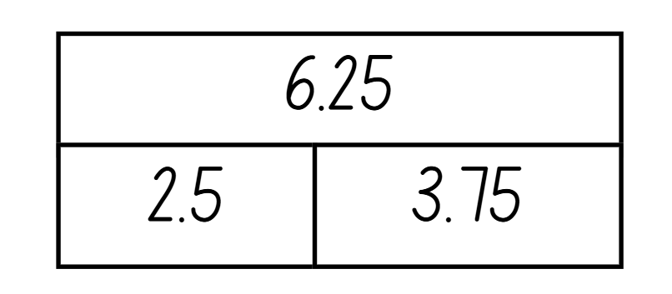
Multiple choice (2)
Which number sentence matches this bar model?
You may choose more than one answer.
A
6.25 − 2.5 = 3.75
B
3.75 − 2.5 = 6.25
C
6.25 + 2.5 = 3.75
D
2.5 + 3.75 = 6.25
Notes:
This question connects to the content in the developing number sense activity (Activity 3)
Syllabus focus area:
Additive relations B

Slide 20
Short response (9)
A garden bed measures 6.54 metres and is extended by 2.99 metres.
What is the total length of the garden bed?
Communicate your reasoning.
Notes:
Short response questions provide brisk paced questions focussing on review of current and previous content to support spaced and interleaved practice.
Syllabus focus area:
Represents numbers A

Slide 21
Short response (10)
6250 metres is the same as _____ kilometres.
Notes:
Short response questions provide brisk paced questions focussing on review of current and previous content to support spaced and interleaved practice.
Syllabus focus area:
Geometric measure B

Slide 22
Short response (11)
An alarm beeps 6 times every 8 seconds.
How many times does the beep sound in 2 minutes?
Notes:
Short response questions provide brisk paced questions focussing on review of current and previous content to support spaced and interleaved practice.
Syllabus focus area:
Multiplicative relations B

Slide 23
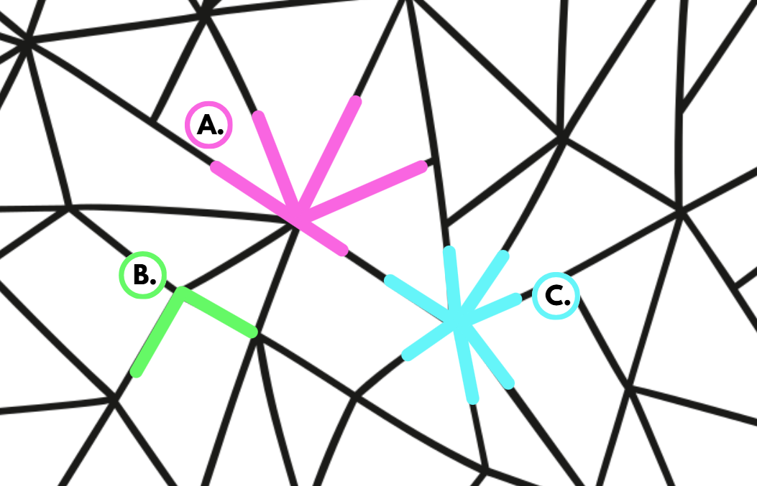
Short response (12)
Identify a right angle, an angle on a straight line and an angle at a point in the picture.
Notes:
Short response questions provide brisk paced questions focussing on review of current and previous content to support spaced and interleaved practice.
Syllabus focus area:
Geometric measure B

Slide 24
Activity 3 – addition and subtraction using representations 1 (1)
Sam solved the decimal number sentence, 3.25 − 1.5 and got the answer 3.10. The answer is incorrect.
Notes:
This is a developing number sense activity.
Number sense refers to a deep understanding of numbers, including their magnitude, relationships, and the effects of operations on them. It supports fluency and understanding, estimation, flexible thinking, and efficient problem-solving. Number sense activities 1–4 ‘activate’ prior number knowledge and support the learning of new content in the unit. Number sense activities 5–8 ‘loop’ back and provide opportunity for spaced practice with concepts and procedures covered in previous units.
Syllabus focus area:
Additive relations B
Addition and subtraction using representations 1
This activity is an adaptation of ‘Work samples (Additive relations)’ by the NSW Education Standards Authority (NESA).
Ask:
- Can you explain why Sam’s solution is incorrect? How do you know?
- What error or misconception has Sam made? (Sam has considered 1.5 as a whole unit after the decimal point. He has solved the question as follows 3.25 − 0.15).
Guide students in solving the problem. Record the solution on the board.
(Next slide).
Display the following scenarios:
- Jeremy got the answer 2.20. What error or misconception has he made? (Jeremy has not considered the correct place value for 1.5 and the role of zero. He solved the problem as follows 3.25 − 1.05).
- Charlotte got the answer 2.35. What error or misconception has she made? (Charlotte has not considered the correct place value for 1.5. She solved the problem as follows 3.25 − 1 and then added 0.10).
- What might the subtraction question have been if the correct answer was 2.10?
In pairs, students record the misconceptions present in each scenario.
As a class, use a visual representation to show the relationship between the numbers 3.25 and 1.5 (see Figure 5 – visual representations in Stage 3 Year B Unit 35).

Slide 25
Activity 3 – addition and subtraction using representations 1 (2)
Jeremy got the answer 2.20. What error or misconception has he made?
Charlotte got the answer 2.35. What error or misconception has she made?
Notes:
This is a developing number sense activity.
Number sense refers to a deep understanding of numbers, including their magnitude, relationships, and the effects of operations on them. It supports fluency and understanding, estimation, flexible thinking, and efficient problem-solving. Number sense activities 1–4 ‘activate’ prior number knowledge and support the learning of new content in the unit. Number sense activities 5–8 ‘loop’ back and provide opportunity for spaced practice with concepts and procedures covered in previous units.
Syllabus focus area:
Additive relations B
Addition and subtraction using representations 1
This activity is an adaptation of ‘Work samples (Additive relations)’ by the NSW Education Standards Authority (NESA).
- What might the subtraction question have been if the correct answer was 2.10?
In pairs, students record the misconceptions present in each scenario.
As a class, use a visual representation to show the relationship between the numbers 3.25 and 1.5 1.5 (see Figure 5 – visual representations in Stage 3 Year B Unit 35).

Slide 26
Review of learning 4

Slide 27
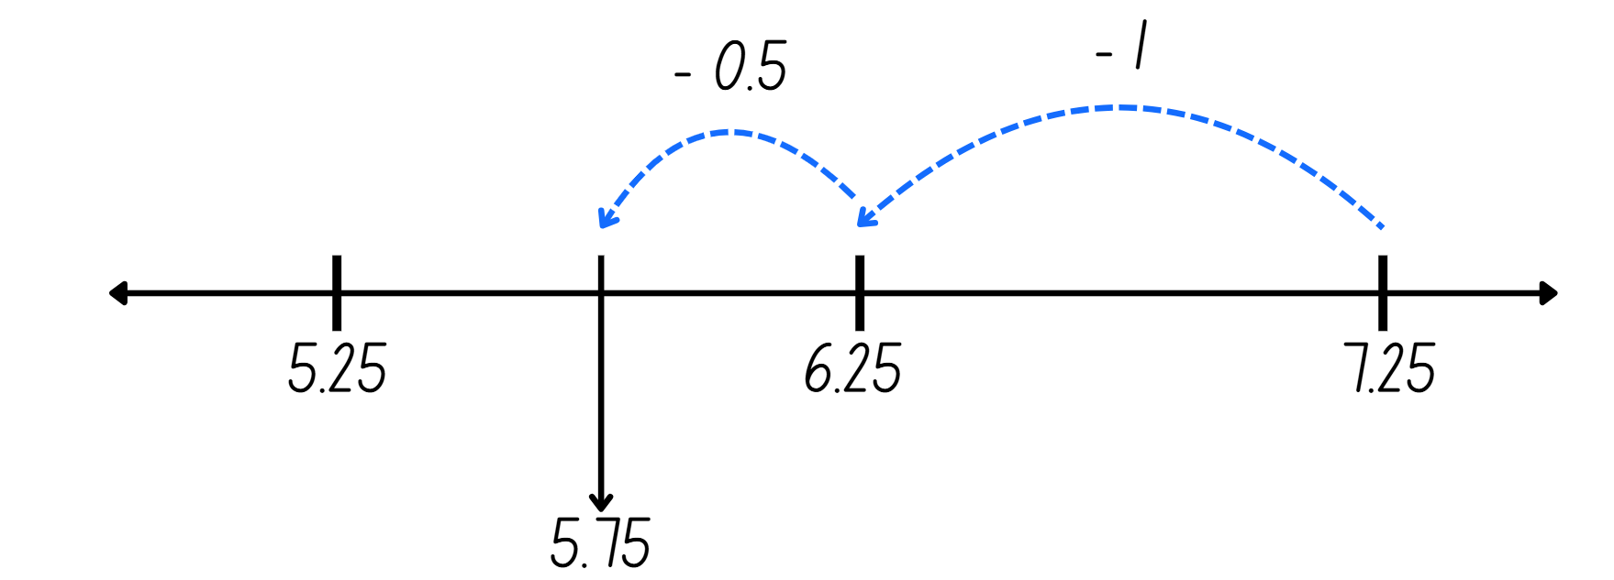
True or false (2)
7.25 − 1.5 = 5.75
True | False
Notes:
The question on this slide connects to the content being explored in the developing number sense activity (Activity 4)
Syllabus focus area:
Additive relations B

Slide 28
Short response (13)
A shopper visits a tech store to buy 3 portable speakers.
At the checkout, the sales assistant gives them a $50 discount and then tells them that the total is $147.75.
Calculate the price of each potable speaker.
Notes:
Short response questions provide brisk paced questions focussing on review of current and previous content to support spaced and interleaved practice.
Syllabus focus area:
Additive relations B

Slide 29
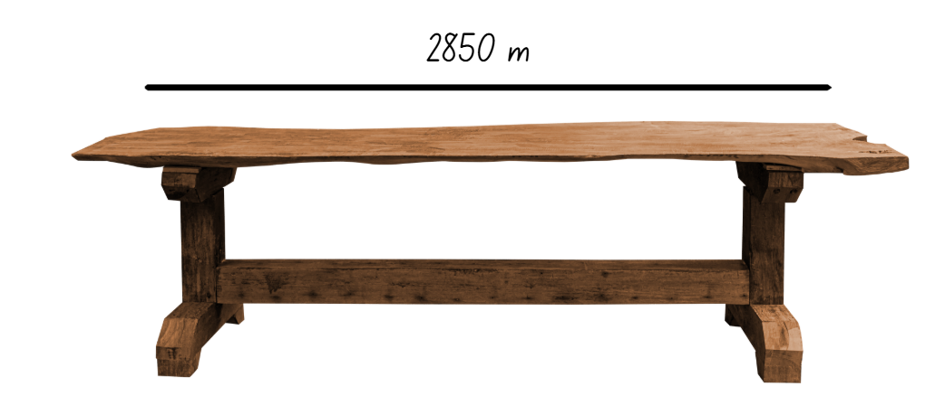
Short response (14)
Record the length of the table using decimal notation.
Notes:
Short response questions provide brisk paced questions focussing on review of current and previous content to support spaced and interleaved practice.
Syllabus focus area:
Geometric measure B

Slide 30
Short response (15)
If 4.2 × 10 is 42,
what is 4.2 × 100 ?
Communicate your reasoning.
Notes:
Short response questions provide brisk paced questions focussing on review of current and previous content to support spaced and interleaved practice.
Syllabus focus area:
Multiplicative relations B

Slide 31
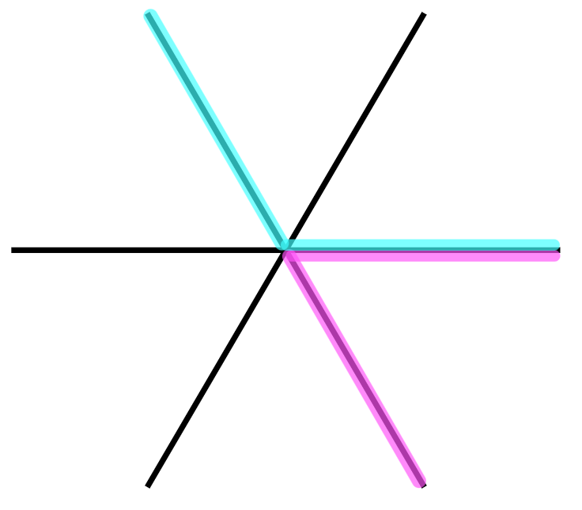
Short response (16)
One angle is 120 degrees.
The other angle is 60 degrees.
Record the total of both angles.
Notes:
Short response questions provide brisk paced questions focussing on review of current and previous content to support spaced and interleaved practice.
Syllabus focus area:
Two-dimensional spatial structure B

Slide 32
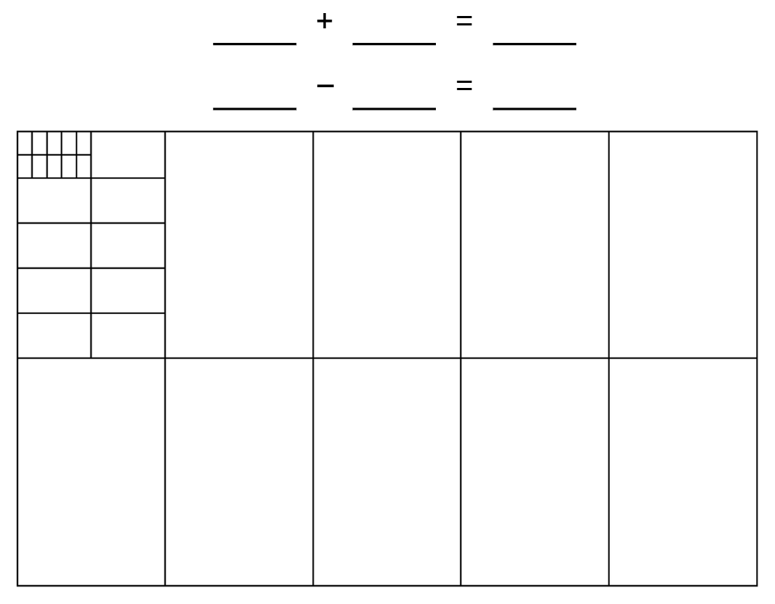
Activity 4 – addition and subtraction using representations 2
0.31 + 0.34
0.77 − 0.2
Notes:
This is a developing number sense activity.
Number sense refers to a deep understanding of numbers, including their magnitude, relationships, and the effects of operations on them. It supports fluency and understanding, estimation, flexible thinking, and efficient problem-solving. Number sense activities 1–4 ‘activate’ prior number knowledge and support the learning of new content in the unit. Number sense activities 5–8 ‘loop’ back and provide opportunity for spaced practice with concepts and procedures covered in previous units.
Syllabus focus area:
Additive relations B
Addition and subtraction using representations 2
This resource corresponds to Resource 21 – adding and subtracting decimals in Stage 3 Year B Unit 35.
Using Resource 21 – adding and subtracting decimals, demonstrate how to solve the addition number sentence.
Explain that each small square on the hundreds grid represents 0.01 (one hundredth), so shading 31 squares represents 0.31.
Ask: How many squares will I need to shade to represent adding 0.34?
Model shading and counting the total shaded squares together to find the sum.
As a class, use the hundreds grid to solve the subtraction number sentence, demonstrating how adding and removing shading illustrates the subtraction process.
Organise students into pairs and provide each student with Resource 21 – adding and subtracting decimals.
Students record one addition and one subtraction number sentence using numbers with up to 3 decimal places. They then swap with their partner and solve each other’s number sentences, representing the solutions using the hundreds grid.
Select pairs to share one of their modelled problems with the class, explaining how using the hundreds grid helped them understand the addition or subtraction of decimals.

Slide 33
Review of learning 5

Slide 34
Multiple choice (3)
If 7 × 8 = 56, then 56 ÷ 8=
A
B
C
D
7
8
6
9
Notes:
This question connects to the content in the developing number sense activity (Activity 5)
Syllabus focus area:
Multiplicative relations B

Slide 35

Short response (17)
Calculate the following discounts:
10%
25%
50%
Notes:
Short response questions provide brisk paced questions focussing on review of current and previous content to support spaced and interleaved practice.
Syllabus focus area:
Represents numbers B

Slide 36
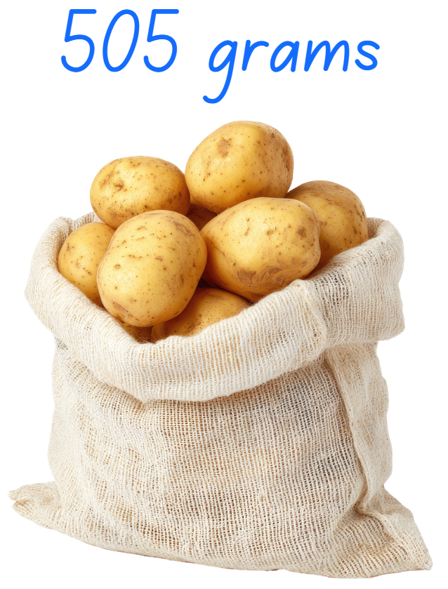
Short response (18)
Convert to record the mass in kilograms.
Notes:
Short response questions provide brisk paced questions focussing on review of current and previous content to support spaced and interleaved practice.
Syllabus focus area:
Non-spatial measure B

Slide 37
Short response (19)
Use grouping symbols to make this sentence true:
18 − 6 × 2 + 4 = 72
Notes:
Short response questions provide brisk paced questions focussing on review of current and previous content to support spaced and interleaved practice.
Syllabus focus area:
Multiplicative relations B

Slide 38
Short response (20)
Identify a situation where we would
measure area in:
square kilometres
hectares
Notes:
Short response questions provide brisk paced questions focussing on review of current and previous content to support spaced and interleaved practice.
Syllabus focus area:
Two-dimensional spatial structure B

Slide 39
Activity 5 – inverse operations (2)
Jason arranged 34 shelves in his bookstore, and each shelf held 12 books.
How many books did he arrange in total?
Notes:
This is a developing number sense activity.
Number sense refers to a deep understanding of numbers, including their magnitude, relationships, and the effects of operations on them. It supports fluency and understanding, estimation, flexible thinking, and efficient problem-solving. Number sense activities 1–4 ‘activate’ prior number knowledge and support the learning of new content in the unit. Number sense activities 5–8 ‘loop’ back and provide opportunity for spaced practice with concepts and procedures covered in previous units.
Syllabus focus area:
Multiplicative relations B
Inverse operations
Discuss:
- How would you solve this problem?
- How would you check your answer?
Record and display the strategies students would use to solve and check solutions to mathematical problems.
Seek input from students to highlight that the problem requires multiplying 34 and 12 and the answer is 408. Ask:
- What is the inverse operation to multiplication?
- How can this problem be changed so that division instead of multiplication is required to solve it?
Ask pairs of students to use the 408 books to create a division problem, reminding them that if 34 times 12 is 408, using the inverse operation can help to create this new problem.
Students share their new problem with the class. Answers might include:
- Jason arranged 408 books on 34 shelves. How many books were on each shelf?
- Jason arranged 408 books so that each shelf contained 12 books. How many shelves were there?
- Jason arranged 408 books on some shelves. What other combinations of books and shelves can you make? Use a pattern to explore as many combinations as possible. For example, one shelf with 408 books, 2 shelves with 204 books, 3 shelves with ... and so on.

Slide 40
Review of learning 6

Slide 41
True or false (3)
224 ÷ 4 = 4 × 14
True | False
Notes:
The question on this slide connects to the content being explored in the developing number sense activity (Activity 6)
Syllabus focus area:
Multiplicative relations B

Slide 42

Short response (21)
Estimate a 25% discount from the original sale price of this computer. Communicate your reasoning.
Notes:
Short response questions provide brisk paced questions focussing on review of current and previous content to support spaced and interleaved practice.
Syllabus focus area:
Represents numbers B

Slide 43
Short response (22)
Record 6.079 kg in kilograms and grams.
Notes:
Short response questions provide brisk paced questions focussing on review of current and previous content to support spaced and interleaved practice.
Syllabus focus area:
Non-spatial measure A

Slide 44
Short response (23)
Solve:
48 + (35 × 6)
Notes:
Short response questions provide brisk paced questions focussing on review of current and previous content to support spaced and interleaved practice.
Syllabus focus area:
Multiplicative relations B

Slide 45

Short response (24)
List in the correct sequence the steps used to transform a parallelogram into a rectangle to find its area.​
A.
B.
C.
Notes:
Short response questions provide brisk paced questions focussing on review of current and previous content to support spaced and interleaved practice.
Syllabus focus area:
Two-dimensional spatial structure B

Slide 46
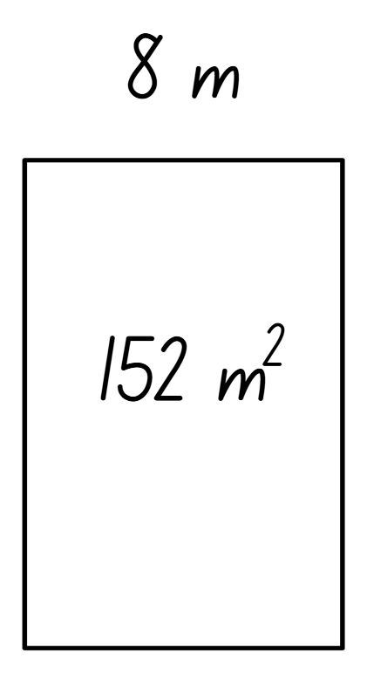
Activity 6 – number sentences with missing numbers
8 m × __ m = 152 m²
Notes:
This is a developing number sense activity.
Number sense refers to a deep understanding of numbers, including their magnitude, relationships, and the effects of operations on them. It supports fluency and understanding, estimation, flexible thinking, and efficient problem-solving. Number sense activities 1–4 ‘activate’ prior number knowledge and support the learning of new content in the unit. Number sense activities 5–8 ‘loop’ back and provide opportunity for spaced practice with concepts and procedures covered in previous units.
Syllabus focus area:
Multiplicative relations B
Number sentences with missing numbers
Ask:
- What strategy can be used to solve the problem?
- Which operation would you use to help solve this problem? What is the answer?
Allow students time to think-pair-share. Discuss how division can be used to solve the problem.
Note: a mental strategy for division that uses the inverse relationship is ‘think of multiplication’ or ‘what do I multiply by?’. In this example, students could estimate by multiplying 8 by 20, then adjust to 8 by 19 (Siemon et al. 2021).
Seek input from students to create a word problem to match the rectangle displayed. For example, the rectangular playground had an area of 152 m² and one side was 8 m long. How long was the other side?
In pairs, students create a word problem to match the rectangle displayed on the board Students write another problem with the same playground area context where multiplication and division are required.

Slide 47
Review of learning 7

Slide 48
Multiple choice (4)
If 783 ÷ 9 = 87 then 9 × ____ = 783
A
82
B
87
C
88
D
89
Notes:
This question connects to the content in the developing number sense activity (Activity 3)
Syllabus focus area:
Multiplicative relations B

Slide 49
Short response (25)
Solve 8678 + 6654 using an efficient strategy.
Communicate your reasoning.
Notes:
Short response questions provide brisk paced questions focussing on review of current and previous content to support spaced and interleaved practice.
Syllabus focus area:
Additive relations B

Slide 50
Short response (26)
Dan placed 4 shopping items in a bag. Calculate the total mass in kilograms:
2005 g, 8.20 kg, 2380 g and 4.05 kg.
Notes:
Short response questions provide brisk paced questions focussing on review of current and previous content to support spaced and interleaved practice.
Syllabus focus area:
Non-spatial measure B

Slide 51
Short response (27)
Solve:
___ × 7 = (1000 - 160) ÷ 8
Notes:
Short response questions provide brisk paced questions focussing on review of current and previous content to support spaced and interleaved practice.
Syllabus focus area:
Multiplicative relations B

Slide 52
Short response (28)
Describe the arrangement of
cubic-centimetre blocks in terms of layers.
Notes:
Short response questions provide brisk paced questions focussing on review of current and previous content to support spaced and interleaved practice.
Syllabus focus area:
Three-dimensional spatial structure B

Slide 53
Activity 7 – calculating missing numbers using inverse operations (1)
8 × __ = 32
Notes:
This is a developing number sense activity.
Number sense refers to a deep understanding of numbers, including their magnitude, relationships, and the effects of operations on them. It supports fluency and understanding, estimation, flexible thinking, and efficient problem-solving. Number sense activities 1–4 ‘activate’ prior number knowledge and support the learning of new content in the unit. Number sense activities 5–8 ‘loop’ back and provide opportunity for spaced practice with concepts and procedures covered in previous units.
Syllabus focus area:
Multiplicative relations B
Calculating missing numbers using inverse operations
Ask: How can we calculate the missing number?
Students turn and talk to solve the number sentence. Select students to share their solutions and the strategies they used.
Discuss how inverse operations can help solve number sentences with missing numbers. For example, division being the inverse of multiplication.
(Next slide).
Display the number sentence 4 x _ = 30 – 10. Ask: When solving number sentences, what role does the equal sign play in balancing the equation?
Revise that whenever there is an equal sign, we need to make sure that the value of the expressions on each side are the same.
Students solve the number sentence using inverse operations, ensuring the values on each side of the equal sign are the same.
Students write their own number sentences with a missing number, swap with a partner and solve each other's sentences using inverse operations.
Regroup as a class and discuss:
- How did using the inverse operation help you find the missing number?
- What happens if the values on each side of the equal sign are not the same?
- Can you explain why the equal sign means “the same as”?
- How can you check your answer to make sure the number sentence is correct?

Slide 54
Activity 7 – calculating missing numbers using inverse operations (2)
4 × _ = 30 - 10
Notes:
This is a developing number sense activity.
Number sense refers to a deep understanding of numbers, including their magnitude, relationships, and the effects of operations on them. It supports fluency and understanding, estimation, flexible thinking, and efficient problem-solving. Number sense activities 1–4 ‘activate’ prior number knowledge and support the learning of new content in the unit. Number sense activities 5–8 ‘loop’ back and provide opportunity for spaced practice with concepts and procedures covered in previous units.
Syllabus focus area:
Multiplicative relations B
Calculating missing numbers using inverse operations
Ask: When solving number sentences, what role does the equal sign play in balancing the equation?
Revise that whenever there is an equal sign, we need to make sure that the value of the expressions on each side are the same.
Students solve the number sentence using inverse operations, ensuring the values on each side of the equal sign are the same.
Students write their own number sentences with a missing number, swap with a partner and solve each other's sentences using inverse operations.
Regroup as a class and discuss:
- How did using the inverse operation help you find the missing number?
- What happens if the values on each side of the equal sign are not the same?
- Can you explain why the equal sign means “the same as”?
- How can you check your answer to make sure the number sentence is correct?

Slide 55
Review of learning 8

Slide 56
True or false (4)
28 ÷ 2 = ___ × 2
The missing number is 14.
True | False
Communicate your reasoning.
Notes:
The question on this slide connects to the content being explored in the developing number sense activity (Activity 8)
Syllabus focus area:
Multiplicative relations B

Slide 57

Short response (29)
Calculate the duration of the guided tour.
Notes:
Short response questions provide brisk paced questions focussing on review of current and previous content to support spaced and interleaved practice.
Syllabus focus area:
Non-spatial measure B

Slide 58
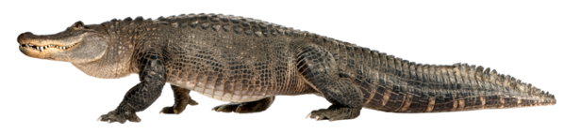
Short response (30)
Record the length of the crocodile using decimal notation.
4 metres 356 cm
Notes:
Short response questions provide brisk paced questions focussing on review of current and previous content to support spaced and interleaved practice.
Syllabus focus area:
Geometric measure B

Slide 59
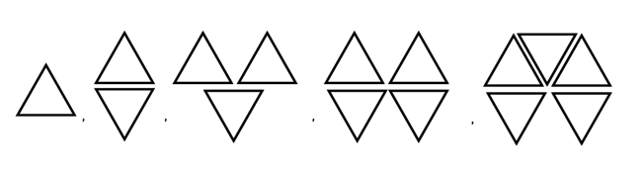
Short response (31)
Describe this pattern formed by multiples.
3, ____, ____, ____, ____.
Notes:
Short response questions provide brisk paced questions focussing on review of current and previous content to support spaced and interleaved practice.
Syllabus focus area:
Multiplicative relations B

Slide 60
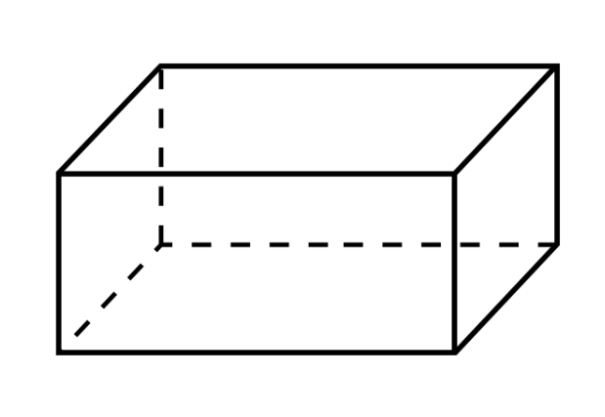
Short response (32)
Explain how to find the volume of a rectangular prism.
Notes:
Short response questions provide brisk paced questions focussing on review of current and previous content to support spaced and interleaved practice.
Syllabus focus area:
Three-dimensional spatial structure B

Slide 61

Activity 8 – equivalent number sentences
Notes:
This is a developing number sense activity.
Number sense refers to a deep understanding of numbers, including their magnitude, relationships, and the effects of operations on them. It supports fluency and understanding, estimation, flexible thinking, and efficient problem-solving. Number sense activities 1–4 ‘activate’ prior number knowledge and support the learning of new content in the unit. Number sense activities 5–8 ‘loop’ back and provide opportunity for spaced practice with concepts and procedures covered in previous units.
Syllabus focus area:
Multiplicative relations B
Equivalent number sentences
This activity is an adaptation of ‘Multiply and Divide Within A Hundred 1’ by Kaplinsky from the Open Middle website.
Discuss how to use equivalent number sentences to find unknown quantities.
Select a digit from 2 to 9, placing a digit in each box to make an equation. For example, 3 × 6 = 72 ÷ 4.
Discuss how using division, the inverse of multiplication, assists in calculating the missing numbers.
In pairs, students place a digit from 2 to 9 (only once each) in each box to make an equation.
Note: the task can be made easier by allowing students to use digits more than once.
As a class, share and compare solutions. Ask students to identify the strategies they used and justify their choices.

Slide 62
Double Venn diagram
Object 1
Object 2
Features similar to both objects
Features of object 1
Features of object 2

Slide 63
Frayer
Definition
Facts/Characteristics
Word, term, concept
Examples
Non-examples

Slide 64
Spider map
Idea
Subject

Slide 65
Cline
Concept 1
Concept 2
Word
Word
Word
Word
Word
Word
Word
Word
Word
Word
Word

Slide 66
Compare and contrast

Slide 67
Multiple choice (5)
A
B
C
D

Slide 68
Multiple choice
A
B
C
D
Notes:
This question connects to the content in the developing number sense activity (Activity 3)
Syllabus focus area:
[Focus area A/B]

Slide 69
References (1)
This presentation contains NSW Curriculum and syllabus content. The NSW Curriculum is developed by the NSW Education Standards Authority. This content is prepared by NESA for and on behalf of the Crown in the right of the State of New South Wales. The material is protected by Crown copyright.
Please refer to the NESA Copyright Disclaimer for more information https://educationstandards.nsw.edu.au/wps/portal/nesa/mini-footer/copyright.
NESA holds the only official and up-to-date versions of the NSW Curriculum and syllabus documents. Please visit the NSW Education Standards Authority (NESA) website https://educationstandards.nsw.edu.au/wps/portal/nesa/home and the NSW Curriculum website https://curriculum.nsw.edu.au.
Mathematics K–10 Syllabus © NSW Education Standards Authority (NESA) for and on behalf of the Crown in right of the State of New South Wales, 2022.
National Numeracy Learning Progression © Australian Curriculum, Assessment and Reporting Authority (ACARA) 2010 to present, unless otherwise indicated. This material was downloaded from the Australian Curriculum website (National Numeracy Learning Progression) (accessed 11 March 2026) and was not modified.
Commonwealth of Australia (2021) Average annual, seasonal and monthly rainfall maps, Bureau of Meteorology website, accessed 10 March 2026.
Conway IV BM, Id-Deen L, Raygoza MC, Ruiz A, Staley JW and Thanheiser E (2023) Middle School Mathematics Lessons to Explore, Understand, and Respond to Social Injustice, Corwin Press Inc, USA.
JustMaths (2013) Decimals, STEM Learning website, assessed 10 March 2026.
Kaplinsky R (n.d.) Multiply and Divide Within A Hundred 1, Open Middle website, accessed 10 March 2026.

Slide 70
References (2)
This presentation contains NSW Curriculum and syllabus content. The NSW Curriculum is developed by the NSW Education Standards Authority. This content is prepared by NESA for and on behalf of the Crown in the right of the State of New South Wales. The material is protected by Crown copyright.
Please refer to the NESA Copyright Disclaimer for more information https://educationstandards.nsw.edu.au/wps/portal/nesa/mini-footer/copyright.
NESA holds the only official and up-to-date versions of the NSW Curriculum and syllabus documents. Please visit the NSW Education Standards Authority (NESA) website https://educationstandards.nsw.edu.au/wps/portal/nesa/home and the NSW Curriculum website https://curriculum.nsw.edu.au.
Liljedahl P (n.d.) Celebrity Travel Planning, Peter Liljedahl website, accessed 10 March 2026.
NSW Education Standards Authority (NESA) (2022) Mathematics Stage 3: Activity 2 – Work samples (Additive relations), NESA website, accessed 10 March 2026.
Richter F (2023) 2023 Women’s World Cup Sets Attendance Record, Statista website, accessed 10 March 2026.
Siemon D, Warren E, Beswick K, Faragher R, Miller J, Horne M, Jazby D, Breed M, Clark J and Brady K (2021) Teaching Mathematics Foundations to Middle Years, 3rd edn, Oxford University Press, Australia and New Zealand.
State of New South Wales (Department of Education) (2023) Applications with decimals, Universal Resources Hub website, accessed 10 March 2026.
——(2023) 2023 Results for NSWPSSA - Athletics - Championship, School Sport Unit website, accessed 10 March 2026.

Slide 71
References (3)
This presentation contains NSW Curriculum and syllabus content. The NSW Curriculum is developed by the NSW Education Standards Authority. This content is prepared by NESA for and on behalf of the Crown in the right of the State of New South Wales. The material is protected by Crown copyright.
Please refer to the NESA Copyright Disclaimer for more information https://educationstandards.nsw.edu.au/wps/portal/nesa/mini-footer/copyright.
NESA holds the only official and up-to-date versions of the NSW Curriculum and syllabus documents. Please visit the NSW Education Standards Authority (NESA) website https://educationstandards.nsw.edu.au/wps/portal/nesa/home and the NSW Curriculum website https://curriculum.nsw.edu.au.
The Australian Nutrition Foundation (2021) Australian Dietary Guidelines: Standard serves [PDF 599 KB], Nutrition Australia website, accessed 10 March 2026.
University of Cambridge (n.d.) Matching Fractions, Decimals and Percentages, NRICH website, accessed 10 March 2026.
——(n.d.) Shopping Basket, NRICH website, accessed 10 March 2026.
Van de Walle J, Karp K, Bay-Williams JM, Brass A, Bentley B, Ferguson S, Goff W, Livy S, Marshman M, Martin D, Pearn C, Prodromou T, Symons D and Wilkie K (2019) Primary and Middle Years Mathematics: Teaching Developmentally, 1st Australian edn, Pearson Education Australia, Melbourne.

Slide 72
Copyright
© State of New South Wales (Department of Education), 2025
The copyright material published in this resource is subject to the Copyright Act 1968 (Cth) and is owned by the NSW Department of Education or, where indicated, by a party other than the NSW Department of Education (third-party material).
Copyright material available in this resource and owned by the NSW Department of Education is licensed under a Creative Commons Attribution 4.0 International (CC BY 4.0) license.
This license allows you to share and adapt the material for any purpose, even commercially.
Attribution should be given to © State of New South Wales (Department of Education), 2025.
Material in this resource not available under a Creative Commons license:
the NSW Department of Education logo, other logos and trademark-protected material
Material owned by a third party that has been reproduced with permission. You will need to obtain permission from the third party to reuse its material.
Links to third-party material and websites
Please note that the provided (reading/viewing material/list/links/texts) are a suggestion only and implies no endorsement, by the New South Wales Department of Education, of any author, publisher, or book title. School principals and teachers are best placed to assess the suitability of resources that would complement the curriculum and reflect the needs and interests of their students.
If you use the links provided in this document to access a third party’s website, you acknowledge that the terms of use, including licence terms set out on the third-party’s website apply to the use which may be made of the materials on that third-party website or where permitted by the Copyright Act 1968 (Cth). The department accepts no responsibility for content on third-party websites.

