Slide 1
Instructions for use
This resource is not a teaching and learning program. It should be used in conjunction with Stage 3 Year A Unit 3.
Classroom teachers are encouraged to add and adapt slides as required to meet the needs of their students.
Save a copy of the file to make changes to the slide deck. Go to File > Download a Copy (this downloads a copy to the computer to edit in the PowerPoint app).
To convert the PowerPoint to Google Slides:
  Upload the file into Google Drive and open it.
  Go to File > Save as Google Slides.
  (Note – conversion may cause formatting changes in the slides.)

Slide 2

Review of Learning
Mathematics Stage 3 – Unit 3
Notes:
Reviews may include a combination of question types, requiring students to recall facts and key ideas, as well as apply their knowledge to solve problems and answer questions. To support active engagement, a mix of techniques should be employed.” (AERO, 2024).
This Review of Learning slide deck revisits key concepts from the following units:
Stage 3 Year A Unit 3
Stage 3 Year A Unit 2
Stage 3 Year A Unit 1
It also includes opportunities to review prior learning in non-number content, supporting consolidation across focus areas.
The review of learning resources include three key task types that support the development of mathematical proficiency through retrieval, spaced practice, and active participation. These practices complement the review phase (activating prior knowledge) embedded within the beginning of each lesson.
1.
Multiple-choice questions/True or false: Designed to promote active retrieval of key concepts and identify common misconceptions in number, supporting consolidation, understanding and fluency.
These questions:
support spaced and interleaved practice
help identify and address common misconceptions
support active recall and immediate feedback
support whole class participation
identify areas requiring reteach
2.
Short-response question sets: Carefully grouped questions that encourage spaced and interleaved practice across multiple focus areas, helping students revisit and apply knowledge from different points in time.
These questions:
have a combination of question types
address a range of focus areas
build automaticity and fluency
support active recall
allow for immediate feedback
identify content requiring reteach
3.
Developing number sense activities: A variety of practical, purposeful tasks that reinforce current learning and build on prior knowledge. These activities promote reasoning, problem-solving and conceptual understanding.
The review of learning resources are designed to work support teaching and learning in mathematics. For the most effective implementation, use the resources flexibly, adapting to meet student learning needs and individual classroom contexts.

Slide 3
Lessons
1
Review of learning 1
5
Review of learning 5
2
Review of learning 2
6
Review of learning 6
3
Review of learning 3
7
Review of learning 7
4
Review of learning 4
8
Review of learning 8
Notes:
Teacher notes:
Click lesson numbers to go to specific lessons
Interactive features can be viewed in slide show

Slide 4
Review of learning 1

Slide 5

Multiple choice (1)
3234 – 2999
A
B
C
D
234
235
2335
236
Communicate your strategy.

Slide 6

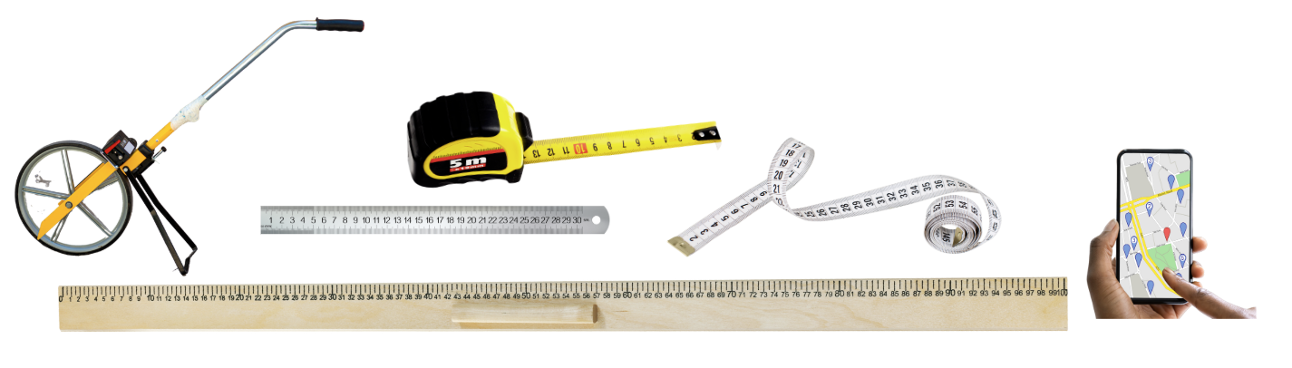
Short response (1)
Which measuring tool would be best to measure the length of your desk?
You can choose more than one.
Notes:
Short response questions provide brisk paced questions focussing on review of current and previous content to support spaced and interleaved practice.
Syllabus focus area:
Geometric Measure A: Length

Slide 7
Short response (2)
Use partitioning to solve the following problem
5780 + 9431 =
Notes:
Short response questions provide brisk paced questions focussing on review of current and previous content to support spaced and interleaved practice.
Syllabus focus area:
Additive relations A

Slide 8
Short response (3)
Place these numbers in ascending order:
6 302 095
5 671 210
6 219 305
5 842 199
Notes:
Short response questions provide brisk paced questions focussing on review of current and previous content to support spaced and interleaved practice.
Syllabus focus area:
Represents numbers A

Slide 9
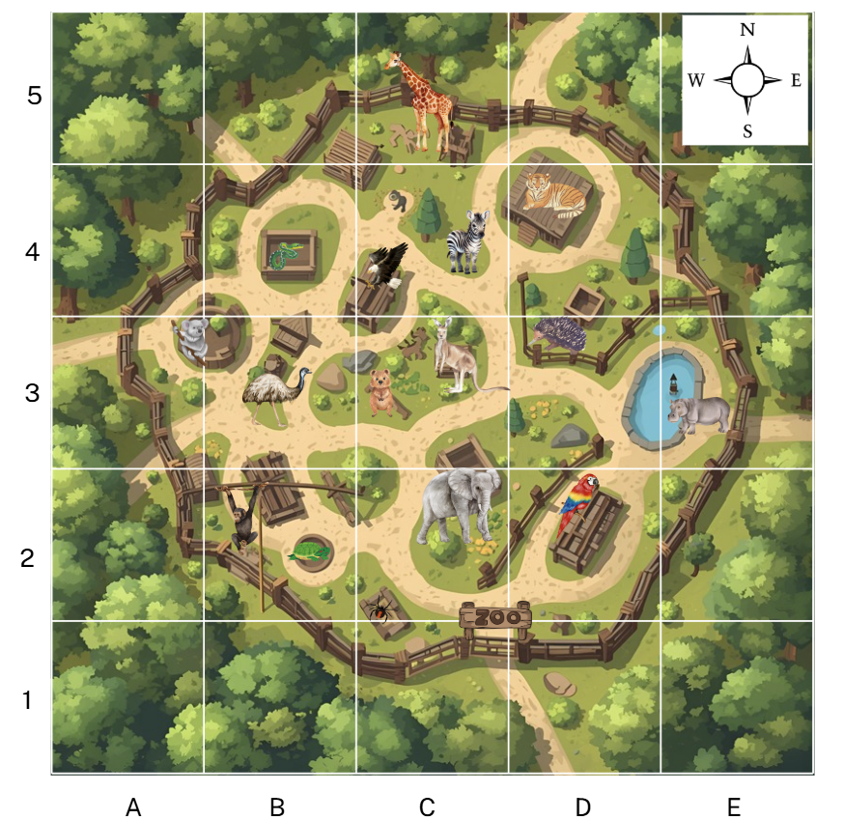
Short response (4)
After visiting the elephant in C2, I turn and face East.
Which animal do I see?
What is the grid reference for this animal?
Notes:
Short response questions provide brisk paced questions focussing on review of current and previous content to support spaced and interleaved practice.
Syllabus focus area:
Geometric measure B: Position (Note: Stage 2 content reviewed)

Slide 10

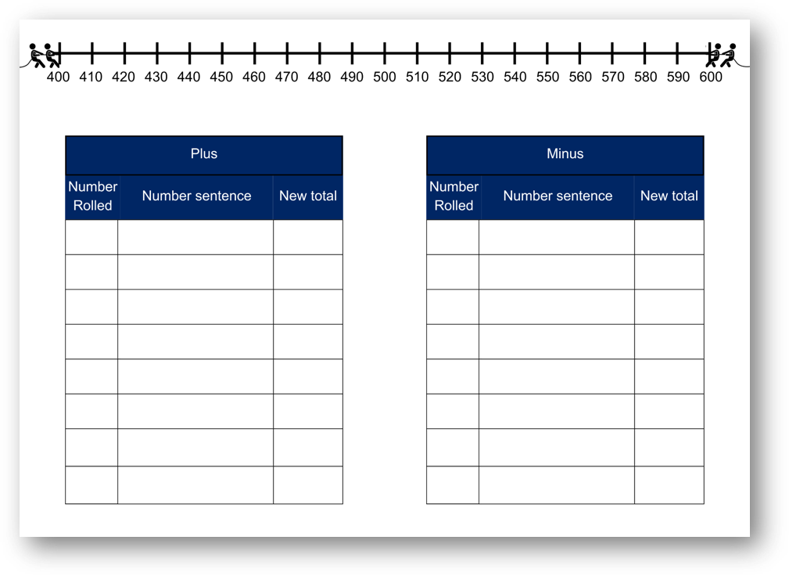
Activity 1 – back and forth, adding and subtracting
Notes:
This is a developing number sense activity.
Number sense refers to a deep understanding of numbers, including their magnitude, relationships, and the effects of operations on them. It supports fluency and understanding, estimation, flexible thinking, and efficient problem-solving. Number sense activities 1–4 ‘activate’ prior number knowledge and support the learning of new content in the unit. Number sense activities 5–8 ‘loop’ back and provide opportunity for spaced practice with concepts and procedures covered in previous units.
Syllabus focus area:
Additive Relations A
Back and Forth
This resource corresponds to Resource 22 – back and forth in Stage 3 Year A Unit 3.
Provide pairs of students two 9-sided dice, a coloured counter and an A3 copy of Resource 17 – back and forth.​
One student is the ‘Plus’ and the other student is the ‘Minus’. The Plus will move right and Minus will move left.​
Students place the counter on the number 500 and take turns to roll the dice.​
Students form a two-digit number to add or take away. They move the counter along the number line and mark it with the new total.​
Students record their number sentence, discussing which strategies they chose to use.​
Students keep rolling the dice and moving until the counter either reaches 400 or 600. If it gets to 400, Minus wins and if it gets to 600, Plus wins.​
Alternatively, after 8 turns each, the player closest to their target number is the winner.​
​
​

Slide 11
Review of learning 2

Slide 12
True or false (1)
6321 + 145 + 33 = 6499
True | False
Notes:
The question on this slide connects to the content being explored in the developing number sense activity (Activity 2) - closest to 500
Syllabus focus area:
Additive relations A

Slide 13
Short response (5)
Record 3 items that would be measured in metres.
Record 3 items that would not be recorded using metres.
Notes:
Short response questions provide brisk paced questions focussing on review of current and previous content to support spaced and interleaved practice.
Syllabus focus area:
Geometric Measure A: Length

Slide 14
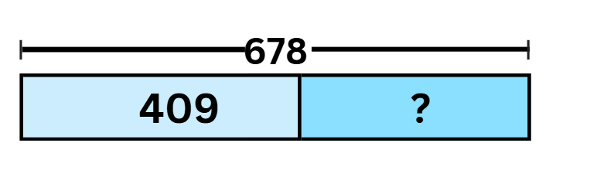
Short response (6)
This bar model shows a subtraction problem.
Record the subtraction problem and find the missing number.
Communicate your reasoning.
Notes:
Short response questions provide brisk paced questions focussing on review of current and previous content to support spaced and interleaved practice.
Syllabus focus area:
Additive relations A

Slide 15
Short response (7)
Regroup this number in standard and non-standard forms
50 678 912
Notes:
Short response questions provide brisk paced questions focussing on review of current and previous content to support spaced and interleaved practice.
Syllabus focus area:
Represents numbers A

Slide 16
Short response (8)
Convert
560 m to centimetres
432 cm to millimetres
Notes:
Short response questions provide brisk paced questions focussing on review of current and previous content to support spaced and interleaved practice.
Syllabus focus area:
Geometric measure B: Length (Note: Stage 2 content reviewed)

Slide 17
Activity 2 – closest to 500
__ __ __ + __ __+ __ =
Notes:
This is a developing number sense activity.
Number sense refers to a deep understanding of numbers, including their magnitude, relationships, and the effects of operations on them. It supports fluency and understanding, estimation, flexible thinking, and efficient problem-solving. Number sense activities 1–4 ‘activate’ prior number knowledge and support the learning of new content in the unit. Number sense activities 5–8 ‘loop’ back and provide opportunity for spaced practice with concepts and procedures covered in previous units.
Syllabus focus area:
Additive Relations A
Closest to 500
Provide pairs of students with three 6-sided dice and 2 pieces of paper or 2 individual whiteboards.​
Students take turns to roll the dice and chose a position in the number sentence to place the rolled digit.​
Students continue until all lines are filled.​
Students add the 3 numbers using mental or written strategies and record the total. ​
The winner is the student whose total is closest to 500 without going higher.​
Students turn and task, discussing which numbers would have been better placed in different place value positions.​
Challenge students to rearrange the digits and find a better solution to get closest to 500.​
Students play multiple rounds.​
​

Slide 18
Review of learning 3

Slide 19
Multiple choice (2)
Which strategy has been used to solve 338 + 57?
338 + 2 = 340, plus 55 is 395
A
B
C
D
Constant difference
Addition for subtraction
Levelling
Bridging
Notes:
This question connects to the content in the developing number sense activity (Activity 3).
Syllabus focus area:
Additive relations A

Slide 20
Short response (9)
How many metres are there in 7 kilometres?
Notes:
Short response questions provide brisk paced questions focussing on review of current and previous content to support spaced and interleaved practice.
Syllabus focus area:
Geometric Measure A: Length

Slide 21

Short response (10)
Which strategy is this student explaining?
To work out 4998 + 955 = more easily,
I can take 2 from 955 and add it to 4998. The equation becomes 5000 + 953 =
Notes:
Short response questions provide brisk paced questions focussing on review of current and previous content to support spaced and interleaved practice.
Syllabus focus area:
Additive relations A

Slide 22
Short response (11)
Use place value to partition these decimals
4.39
6.70
1.295
Notes:
Short response questions provide brisk paced questions focussing on review of current and previous content to support spaced and interleaved practice.
Syllabus focus area:
Represents numbers A

Slide 23
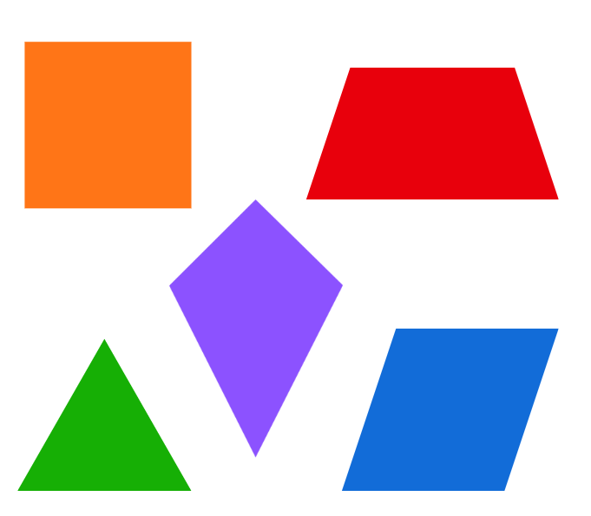
Short response (12)
Combine 2 of the shapes below to create another shape.
Notes:
Short response questions provide brisk paced questions focussing on review of current and previous content to support spaced and interleaved practice.
Syllabus focus area:
Two-dimensional spatial structure B: 2D shapes (Note: Stage 2 content reviewed)

Slide 24


Activity 3 – snake eyes (addition)
Notes:
This is a developing number sense activity.
Number sense refers to a deep understanding of numbers, including their magnitude, relationships, and the effects of operations on them. It supports fluency and understanding, estimation, flexible thinking, and efficient problem-solving. Number sense activities 1–4 ‘activate’ prior number knowledge and support the learning of new content in the unit. Number sense activities 5–8 ‘loop’ back and provide opportunity for spaced practice with concepts and procedures covered in previous units.
Syllabus focus area:
Additive relations A
Snake eyes (addition)
Provide pairs of students with three 9-sided dice and individual whiteboards.
Introduce the game ‘snake eyes’. Explain that students will be using a range of strategies to add 3-digit numbers. The aim of the game is to be the first to get to 10 000.
Students take turns to roll the three dice, make a 3-digit number and then choose an additive strategy to add it to a running total on an individual whiteboard.
Students select a ‘venomous’ number, for example, 6. If the ‘venomous’ number is rolled on any of the dice, the player misses a turn
If a ‘triple one’ (snake eyes) is rolled, that player loses all their points and returns to zero.
Play continues until a player ‘wins’ by reaching 10 000.
Regroup as a class and ask:
What different strategies did you choose to use to solve the problems?
What strategy did you use the most and why?
What strategy did you use the least and why?

Slide 25
Review of learning 4

Slide 26
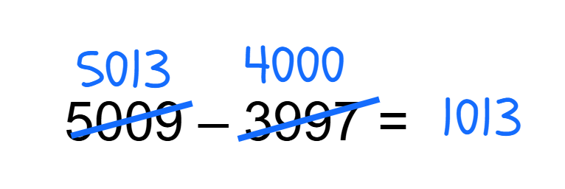
True or false (2)
Constant difference has been used to solve 5009 – 3997.
True | False
Notes:
The question on this slide connects to the content being explored in the developing number sense activity (Activity 4)- snake eyes (subtraction)
Syllabus focus area:
Additive relations A

Slide 27
Short response (13)
The school office is 20 m long.
Calculate how many school offices would fit along a 100 m length. Then along a 1 km length.
Notes:
Short response questions provide brisk paced questions focussing on review of current and previous content to support spaced and interleaved practice.
Syllabus focus area:
Geometric Measure A: Length

Slide 28
Short response (14)
Use the levelling strategy to solve
3997 + 988 =
Notes:
Short response questions provide brisk paced questions focussing on review of current and previous content to support spaced and interleaved practice.
Syllabus focus area:
Additive relations A

Slide 29
Short response (15)
Order these decimals from smallest to largest:
1.391
1.45
1.90
Notes:
Short response questions provide brisk paced questions focussing on review of current and previous content to support spaced and interleaved practice.
Syllabus focus area:
Represents numbers A

Slide 30
Short response (16)
Explain a strategy that can be used to estimate an area in square centimetres.
Notes:
Short response questions provide brisk paced questions focussing on review of current and previous content to support spaced and interleaved practice.
Syllabus focus area:
Two-dimensional spatial structure B: Area (Note: Stage 2 content reviewed)

Slide 31
Activity 4 – snake eyes (Subtraction)
Notes:
This is a developing number sense activity.
Number sense refers to a deep understanding of numbers, including their magnitude, relationships, and the effects of operations on them. It supports fluency and understanding, estimation, flexible thinking, and efficient problem-solving. Number sense activities 1–4 ‘activate’ prior number knowledge and support the learning of new content in the unit. Number sense activities 5–8 ‘loop’ back and provide opportunity for spaced practice with concepts and procedures covered in previous units.
Syllabus focus area:
Additive Relations A
Snake Eyes- Subtraction
Provide pairs of students with three 9-sided dice and individual whiteboards.
Revise the game ‘snake eyes’. Explain that students will be using a range of strategies to subtract 3-digit numbers. The aim of the game is to be the first to get from 10 000 to 0.
Students take turns to roll the three dice, make a 3-digit number and then choose an additive strategy to subtract it from a running total on an individual whiteboard.
Students select a ‘venomous’ number, for example, 6. If the ‘venomous’ number is rolled on any of the dice, the player misses a turn
If a ‘triple one’ (snake eyes) is rolled, that player loses all their points and returns to zero.
Play continues until a player ‘wins’ by reaching 0.
Regroup as a class and ask:
What different strategies did you choose to use to solve the problems?
What strategy did you use the most and why?
What strategy did you use the least and why?

Slide 32
Review of learning 5

Slide 33
Multiple choice (3)
28 x _ = 84
A
B
C
D
1
2
3
4
Notes:
This question connects to the content in the developing number sense activity (Activity 5) - three strikes and your out
Syllabus focus area:
Multiplicative relations B

Slide 34
Short response (17)
Convert 2.7 km into metres.
Communicate your reasoning.
Notes:
Short response questions provide brisk paced questions focussing on review of current and previous content to support spaced and interleaved practice.
Syllabus focus area:
Geometric Measure A: Length

Slide 35
Short response (18)
Is using a vertical algorithm an efficient strategy to solve the following?
1232 – 698 =
Communicate your reasoning.
Notes:
Short response questions provide brisk paced questions focussing on review of current and previous content to support spaced and interleaved practice.
Syllabus focus area:
Additive relations A

Slide 36
Short response (19)
Record the definition of a product.
Record the definition of a factor.
Notes:
Short response questions provide brisk paced questions focussing on review of current and previous content to support spaced and interleaved practice.
Syllabus focus area:
Multiplicative relations A

Slide 37
Short response (20)
The time is 6:42 pm.
How much time until the next hour?
Record your thinking.
Notes:
Short response questions provide brisk paced questions focussing on review of current and previous content to support spaced and interleaved practice.
Syllabus focus area:
Non-spatial measure B: Time (Note: Stage 2 content reviewed)

Slide 38
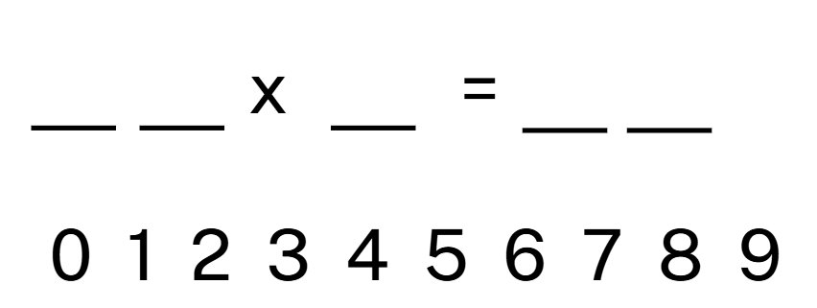
Activity 5 – three strikes and you’re out!
Notes:
This is a developing number sense activity.
Number sense refers to a deep understanding of numbers, including their magnitude, relationships, and the effects of operations on them. It supports fluency and understanding, estimation, flexible thinking, and efficient problem-solving. Number sense activities 1–4 ‘activate’ prior number knowledge and support the learning of new content in the unit. Number sense activities 5–8 ‘loop’ back and provide opportunity for spaced practice with concepts and procedures covered in previous units.
Syllabus focus area:
Multiplicative Relations B
Three strikes and you’re out!
Provide pairs of students with an individual whiteboard and instruct Player 1 to copy down what is displayed here.
Player 1 records a multiplication equation on a sticky note or piece of paper and keeps it hidden.​
Player 2 guesses numbers between 0-9 to try and reveal the equation. ​
If the number is within the equation, Player 1 records it in the corresponding space (see Figure 13)​
If the number is not in the equation, it is a ‘strike’. ​
Figure 13 – Three strikes and you’re out work sample​
To win, students need to determine all the numbers in the equation before they get 3 strikes.​
Players swap roles and continue with multiple rounds.​
This activity can be differentiated by increasing or decreasing the numbers within the equation to multiply, for example a 2-digit number with another 2-digit number.

Slide 39
Review of learning 6

Slide 40
True or false (3)
98 ÷ __ = 7
The missing number is 12.
True | False
Notes:
The question on this slide connects to the content being explored in the developing number sense activity (Activity 6) - missing numbers
Syllabus focus area:
Multiplicative relations B

Slide 41
Short response (21)
Write a definition for the term ‘perimeter’.
Notes:
Short response questions provide brisk paced questions focussing on review of current and previous content to support spaced and interleaved practice.
Syllabus focus area:
Geometric Measure A: Length:

Slide 42
Short response (22)
Is using a vertical algorithm an efficient strategy to solve the following?
876 – 698 =
Communicate your reasoning.
Notes:
Short response questions provide brisk paced questions focussing on review of current and previous content to support spaced and interleaved practice.
Syllabus focus area:
Additive relations A

Slide 43
Short response (23)
Using place value partitioning solve:
4 x 412 =
Notes:
Short response questions provide brisk paced questions focussing on review of current and previous content to support spaced and interleaved practice.
Syllabus focus area:
Multiplicative relations A

Slide 44

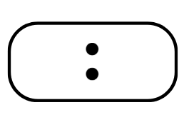

Short response (24)
Write the following as digital times:
Notes:
Short response questions provide brisk paced questions focussing on review of current and previous content to support spaced and interleaved practice.
Syllabus focus area:
Non-spatial measure B: Time (Note: Stage 2 content reviewed)

Slide 45
Activity 6 – missing numbers
x​ | 5​ | 8​ | ​ | 2​
​ | ​ | 32​ | ​ | ​
6​ | ​ | ​ | 18​ | ​
​ | ​ | ​ | ​ | 2​
​ | 45​ | ​ | ​ | ​
Notes:
This is a developing number sense activity.
Number sense refers to a deep understanding of numbers, including their magnitude, relationships, and the effects of operations on them. It supports fluency and understanding, estimation, flexible thinking, and efficient problem-solving. Number sense activities 1–4 ‘activate’ prior number knowledge and support the learning of new content in the unit. Number sense activities 5–8 ‘loop’ back and provide opportunity for spaced practice with concepts and procedures covered in previous units.
Syllabus focus area:
Multiplicative Relations B
Missing Numbers
This resource corresponds to Resource 23 – Missing Numbers in Stage 3 Year A Unit 3.
Provide students with a copy of Resource 18 – missing numbers. ​
Explain that students can use the existing numbers to fill in all the missing numbers on the grid.​
Highlight the number 32 on the grid. Demonstrate that the missing number in the first column can be represented as 8 × _ = 32 or 32 ÷ 8 = _.​
Write 4 in the first column and model how 4 × 5 and 4 × 2 can now be solved.​
Highlight the number 18 on the grid. Demonstrate that the missing number in the first row can be represented as 6 × _ = 18 or 18 ÷ 6 = _.​
Write 3 in the first row.​
Students complete the grid, calculating the missing numbers.​
Regroup and select students to share their solutions.​
As students share, record the number sentences with the missing number, demonstrating the inverse relationship of multiplication and division.​

Slide 46
Review of learning 7

Slide 47
Multiple choice (4)(5)
Sarah arranges 24 rows of chairs, with 8 chairs in each row.
How many chairs does Sarah set up in total?
A
B
C
D
192
96
32
240

Slide 48
Short response (25)
What are the possible dimensions of a rectangle with a perimeter of 42 cm?
Notes:
Short response questions provide brisk paced questions focussing on review of current and previous content to support spaced and interleaved practice.
Syllabus focus area:
Geometric Measure A: Length

Slide 49
Short response (26)
A farmer picked 2188 tomatoes in the morning, 3122 in the afternoon and 1542 the next day.
How many tomatoes were picked altogether?
Notes:
Short response questions provide brisk paced questions focussing on review of current and previous content to support spaced and interleaved practice.
Syllabus focus area:
Additive relations A

Slide 50
Short response (27)
Use your knowledge of multiplying one-digit numbers by multiples of 100 to estimate:
94 x 8
Communicate your reasoning.
Notes:
Short response questions provide brisk paced questions focussing on review of current and previous content to support spaced and interleaved practice.
Syllabus focus area:
Multiplicative relations A

Slide 51

Short response (28)
Draw the top, front and side views of this object.
Notes:
Short response questions provide brisk paced questions focussing on review of current and previous content to support spaced and interleaved practice.
Syllabus focus area:
Three-dimensional spatial structure B: 3D objects (Note: Stage 2 content reviewed)

Slide 52
Activity 7 – solving word problems involving multiplication
Oscar bought 6 pens and the total cost was $24. What was the cost of each pen?​
At work, Carrie took 15 minutes for lunch each day. If she took a total of 75 minutes for lunch in a week, how many days did she work?​
Dala invited 11 children to her birthday party. Each child drank 2 cans of lemonade at the party. How many cans were consumed in total?​
A radio station gave every 4th caller a prize. If 28 people called the station, how many got a prize?​
Elyssa’s gymnastic training goes for 3 hours in the afternoon. If she trains for 18 hours per week, how many afternoons does she train?
Notes:
This is a developing number sense activity.
Number sense refers to a deep understanding of numbers, including their magnitude, relationships, and the effects of operations on them. It supports fluency and understanding, estimation, flexible thinking, and efficient problem-solving. Number sense activities 1–4 ‘activate’ prior number knowledge and support the learning of new content in the unit. Number sense activities 5–8 ‘loop’ back and provide opportunity for spaced practice with concepts and procedures covered in previous units.
Syllabus focus area:
Multiplicative Relations B
Solving word problems involving multiplication
This resource corresponds to Resource 24 – word problems 1 in Stage 3 Year A Unit 3.
Read the first question.​
Demonstrate that the problem can be represented as 6 × _ = 24 or 24 ÷ 6 = _​
Students record and complete both equations.​
Provide students with Resource 24 – word problems 1
Students solve the problems, recording the equations in their workbooks.​
Regroup and select students to share their solutions.​
As students share, record the equations and provide feedback and corrections as necessary.​
​

Slide 53
Review of learning 8

Slide 54
True or false (4)
A librarian wants to place 96 books equally onto 6 shelves.
Each shelf will have 8 books.
True | False
Notes:
The question on this slide connects to the content being explored in the developing number sense activity (Activity 8)
Syllabus focus area:
Multiplicative relations B

Slide 55
Short response (29)
Convert 4:30 pm to 24-hour time.
Convert 22:00 to 12-hour time.
Notes:
Short response questions provide brisk paced questions focussing on review of current and previous content to support spaced and interleaved practice.
Syllabus focus area:
Non- spatial measure A: Time

Slide 56
Short response (30)
A museum recorded its visitor numbers. On Monday 9789 people visited, on Tuesday 4214 people visited and on Wednesday there were 5673 visitors. What is the difference between the amount of people who attended on Monday and Tuesday compared to Wednesday?
Notes:
Short response questions provide brisk paced questions focussing on review of current and previous content to support spaced and interleaved practice.
Syllabus focus area:
Additive relations A

Slide 57
Short response (31)
Use the area model and the distributive property to show:
32 x 4
Notes:
Short response questions provide brisk paced questions focussing on review of current and previous content to support spaced and interleaved practice.
Syllabus focus area:
Multiplicative relations A

Slide 58

Short response (32)
This rhombus has been made by combining 2 triangles.
Draw a hexagon that is made by combining triangles.
Notes:
Short response questions provide brisk paced questions focussing on review of current and previous content to support spaced and interleaved practice.
Syllabus focus area:
Two-dimensional spatial structure B: 2D shapes (Note: Stage 2 content reviewed)

Slide 59
Activity 8 – solving word problems involving division
48 pencils are to be sorted into boxes of 6. How many boxes are needed?​
Jo had a packet of 90 beads. She made bracelets with 10 beads on each one. How many bracelets did she make?​
Marilyn planted 45 sunflower seeds in the garden. If she planted the seeds in 5 rows, how many were in each row?​
Ahmed took 9 days to read a 180 page book. If he read the same number of pages each day, how many pages did he read per day?​
Jessie bought 72 balloons for the gala. If 6 balloons fit into a bundle, how many bundles will there be to decorate the room?
Notes:
This is a developing number sense activity.
Number sense refers to a deep understanding of numbers, including their magnitude, relationships, and the effects of operations on them. It supports fluency and understanding, estimation, flexible thinking, and efficient problem-solving. Number sense activities 1–4 ‘activate’ prior number knowledge and support the learning of new content in the unit. Number sense activities 5–8 ‘loop’ back and provide opportunity for spaced practice with concepts and procedures covered in previous units.
Syllabus focus area:
Multiplicative Relations B
Solving word problems involving division
This resource corresponds to Resource 25 – word problems 2 in Stage 3 Year A Unit 3.
Read the first question.​
Demonstrate that the problem can be represented as 48 ÷ 6 = _ or 6 × _ = 48. Students record and complete both equations.​
Provide students with Resource 25 – word problems 2.
Students solve the problems, recording the equations in their workbooks.​
Regroup and select students to share their solutions.​
As students share, record the equations and provide feedback and corrections as necessary.​
​

Slide 60
Double Venn diagram
Object 1
Object 2
Features similar to both objects
Features of object 1
Features of object 2

Slide 61
Frayer
Definition
Facts/Characteristics
Word, term, concept
Examples
Non-examples

Slide 62
Spider map
Idea
Subject

Slide 63
Cline
Concept 1
Concept 2
Word
Word
Word
Word
Word
Word
Word
Word
Word
Word
Word

Slide 64

Compare and contrast

Slide 65
Multiple choice (5)
A
B
C
D

Slide 66
Multiple choice (6)
A
B
C
D

Slide 67
References
This presentation contains NSW Curriculum and syllabus content. The NSW Curriculum is developed by the NSW Education Standards Authority. This content is prepared by NESA for and on behalf of the Crown in the right of the State of New South Wales. The material is protected by Crown copyright.
Please refer to the NESA Copyright Disclaimer for more information https://educationstandards.nsw.edu.au/wps/portal/nesa/mini-footer/copyright.
NESA holds the only official and up-to-date versions of the NSW Curriculum and syllabus documents. Please visit the NSW Education Standards Authority (NESA) website https://educationstandards.nsw.edu.au/wps/portal/nesa/home and the NSW Curriculum website https://curriculum.nsw.edu.au.
Mathematics K–10 Syllabus © NSW Education Standards Authority (NESA) for and on behalf of the Crown in right of the State of New South Wales, 2022.
National Numeracy Learning Progression © Australian Curriculum, Assessment and Reporting Authority (ACARA) 2010 to present, unless otherwise indicated. This material was downloaded from the Australian Curriculum website (National Numeracy Learning Progression) (accessed 22 July 2025) and was not modified.
Burns M (17 August 2015) ‘Four Strikes and You’re Out’, MB Math, accessed 3 October 2025.
State of New South Wales (Department of Education) (n.d.) Coordinating groups: Snake eyes [PDF 8.0 MB] in Developing Efficient Numeracy Strategies: Stage 2, NSW Department of Education, accessed 14 July 2025
State of New South Wales (Department of Education) (n.d.) Four strikes and you’re out, Stage 3 – Additive thinking teaching strategies, NSW Department of Education, accessed 14 July 2025.
University of Cambridge (n.d) Tug of War, NRICH website, accessed 14 July 2025.——(n.d.) Dicey Operations, NRICH website, accessed 14 July 2025.

Slide 68
Copyright
© State of New South Wales (Department of Education), 2025
The copyright material published in this resource is subject to the Copyright Act 1968 (Cth) and is owned by the NSW Department of Education or, where indicated, by a party other than the NSW Department of Education (third-party material).
Copyright material available in this resource and owned by the NSW Department of Education is licensed under a Creative Commons Attribution 4.0 International (CC BY 4.0) license.
This license allows you to share and adapt the material for any purpose, even commercially.
Attribution should be given to © State of New South Wales (Department of Education), 2025.
Material in this resource not available under a Creative Commons license:
the NSW Department of Education logo, other logos and trademark-protected material
Material owned by a third party that has been reproduced with permission. You will need to obtain permission from the third party to reuse its material.
Links to third-party material and websites
Please note that the provided (reading/viewing material/list/links/texts) are a suggestion only and implies no endorsement, by the New South Wales Department of Education, of any author, publisher, or book title. School principals and teachers are best placed to assess the suitability of resources that would complement the curriculum and reflect the needs and interests of their students.
If you use the links provided in this document to access a third party’s website, you acknowledge that the terms of use, including licence terms set out on the third-party’s website apply to the use which may be made of the materials on that third-party website or where permitted by the Copyright Act 1968 (Cth). The department accepts no responsibility for content on third-party websites.

