Slide 1
Instructions for use
This resource is not a teaching and learning program. It should be used in conjunction with Stage 3 Year A Unit 4.
Classroom teachers are encouraged to add and adapt slides as required to meet the needs of their students.
Save a copy of the file to make changes to the slide deck. Go to File > Download a Copy (this downloads a copy to the computer to edit in the PowerPoint app).
To convert the PowerPoint to Google Slides:
  Upload the file into Google Drive and open it.
  Go to File > Save as Google Slides.
  (Note – conversion may cause formatting changes in the slides.)

Slide 2

Review of Learning
Mathematics Stage 3 – Unit 4
Notes:
Reviews may include a combination of question types, requiring students to recall facts and key ideas, as well as apply their knowledge to solve problems and answer questions. To support active engagement, a mix of techniques should be employed.” (AERO, 2024).
This Review of Learning slide deck revisits key concepts from the following units:
Stage 3 Year A Unit 4
Stage 3 Year A Unit 3
Stage 3 Year A Unit 2
It also includes opportunities to review prior learning in non-number content, supporting consolidation across focus areas.
The review of learning resources include three key task types that support the development of mathematical proficiency through retrieval, spaced practice, and active participation. These practices complement the review phase (activating prior knowledge) embedded within the beginning of each lesson.
1.
Multiple-choice questions/True or false: Designed to promote active retrieval of key concepts and identify common misconceptions in number, supporting consolidation, understanding and fluency.
These questions:
support spaced and interleaved practice
help identify and address common misconceptions
support active recall and immediate feedback
support whole class participation
identify areas requiring reteach
2.
Short-response question sets: Carefully grouped questions that encourage spaced and interleaved practice across multiple focus areas, helping students revisit and apply knowledge from different points in time.
These questions:
have a combination of question types
address a range of focus areas
build automaticity and fluency
support active recall
allow for immediate feedback
identify content requiring reteach
3.
Developing number sense activities: A variety of practical, purposeful tasks that reinforce current learning and build on prior knowledge. These activities promote reasoning, problem-solving and conceptual understanding.
The review of learning resources are designed to work support teaching and learning in mathematics. For the most effective implementation, use the resources flexibly, adapting to meet student learning needs and individual classroom contexts.

Slide 3
Lessons
1
Review of learning 1
5
Review of learning 5
2
Review of learning 2
6
Review of learning 6
3
Review of learning 3
7
Review of learning 7
4
Review of learning 4
8
Review of learning 8
Notes:
Teacher notes:
Click lesson numbers to go to specific lessons
Interactive features can be viewed in slide show

Slide 4
Review of learning 1

Slide 5

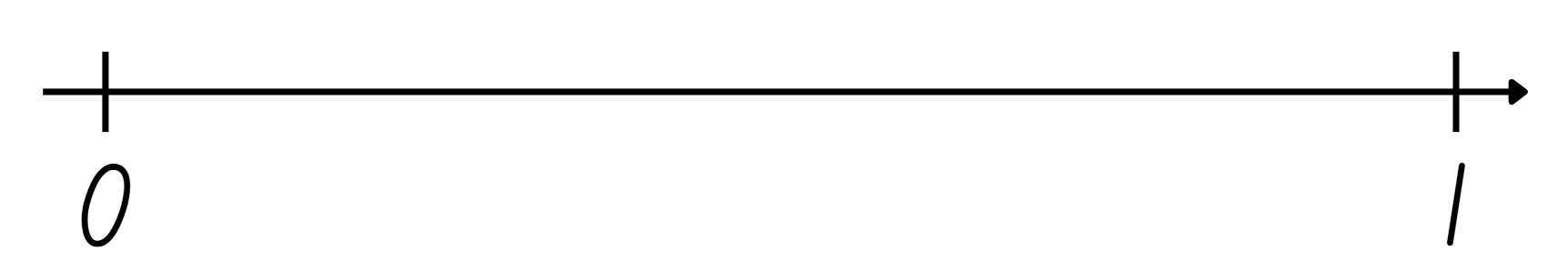

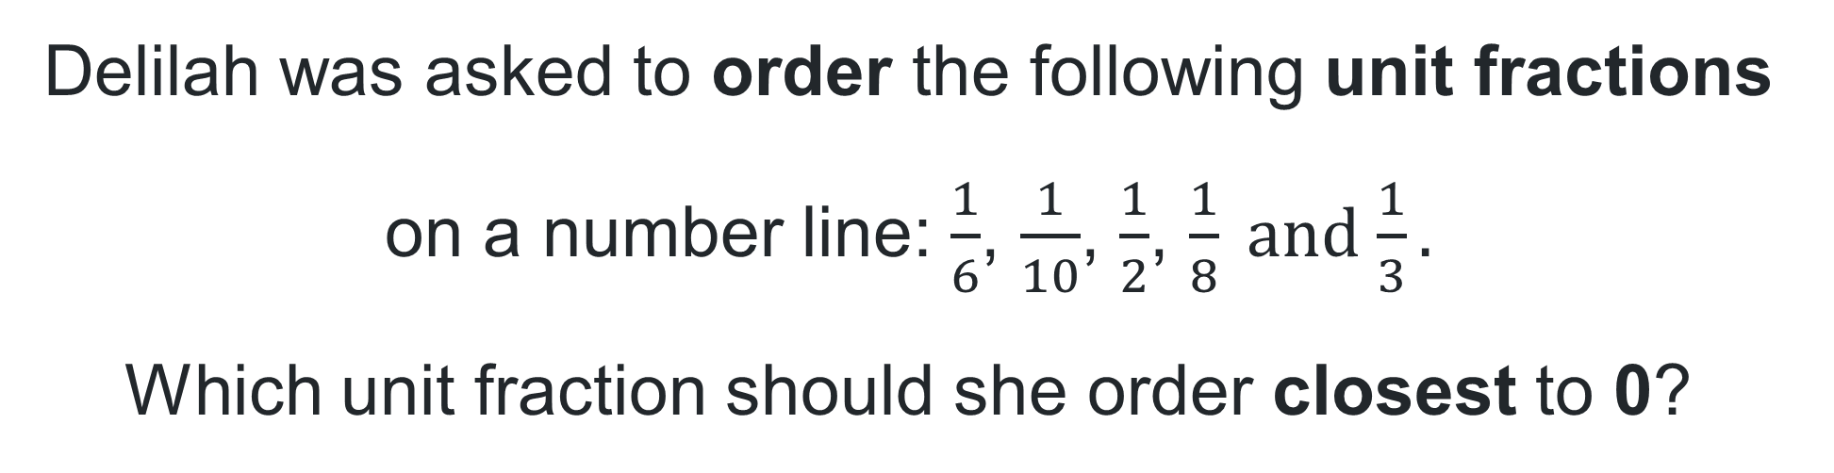



Multiple choice (1)
Delilah was asked to order the following unit fractions on a number line: $\frac{1}{6}$, $\frac{1}{10}$, $\frac{1}{2}$, $\frac{1}{8} and$ $\frac{1}{3}.$
Which unit fraction should she order closest to 0?
A
$$\frac{1}{8}$$
B
$$\frac{1}{6}$$
C
$$\frac{1}{3}$$
D
$$\frac{1}{10}$$
Notes:
This question connects to the content in the developing number sense activity (Activity 1)
Syllabus focus area:
Representing quantity fractions A

Slide 6

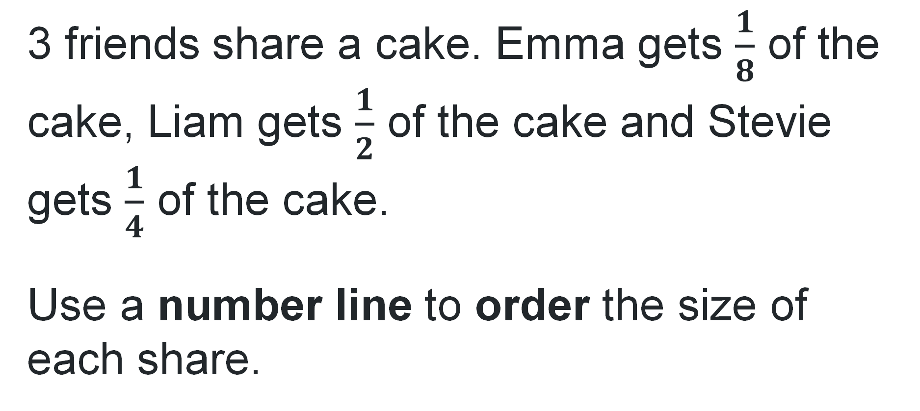
Short response (1)
3 friends share a cake. Emma gets $\frac{1}{8}$ of the cake, Liam gets $\frac{1}{2}$ of the cake and Stevie gets $\frac{1}{4}$ of the cake.
Use a number line to order the size of each share.
Notes:
Short response questions provide brisk paced questions focussing on review of current and previous content to support spaced and interleaved practice.
Syllabus focus area:
Representing quantity fractions A

Slide 7
Short response (2)
Record a measuring device suitable for measuring the length of a swimming pool, football field and school hall.
Communicate your reasoning.
Notes:
Short response questions provide brisk paced questions focussing on review of current and previous content to support spaced and interleaved practice.
Syllabus focus area:
Geometric Measure A: Length

Slide 8
Short response (3)
Use partitioning to solve
36 000 + 2 712 + 384
Notes:
Short response questions provide brisk paced questions focussing on review of current and previous content to support spaced and interleaved practice.
Syllabus focus area:
Additive relations A

Slide 9
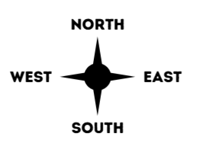
Short response (4)
Sammy is facing East and makes a quarter turn to face North.
She is now facing North. How much does she need to turn to face South?
Notes:
Short response questions provide brisk paced questions focussing on review of current and previous content to support spaced and interleaved practice.
Syllabus focus area:
Geometric measure B: Position (Note: Stage 2 content reviewed)

Slide 10

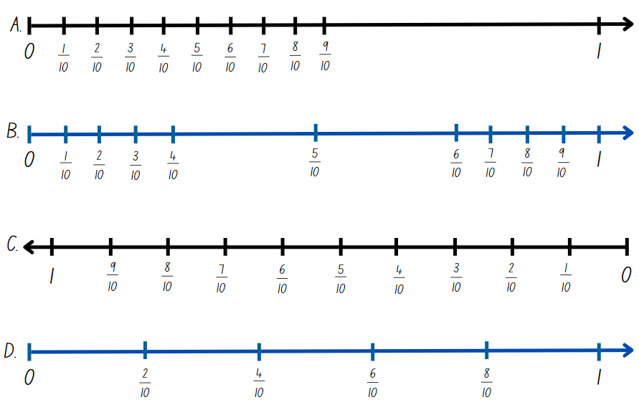
Activity 1 – fraction number lines
Notes:
This is a developing number sense activity.
Number sense refers to a deep understanding of numbers, including their magnitude, relationships, and the effects of operations on them. It supports fluency and understanding, estimation, flexible thinking, and efficient problem-solving. Number sense activities 1–4 ‘activate’ prior number knowledge and support the learning of new content in the unit. Number sense activities 5–8 ‘loop’ back and provide opportunity for spaced practice with concepts and procedures covered in previous units.
Syllabus focus area:
Representing quantity fractions A
Activity 1 – Fraction number lines
This resource corresponds to Resource 21 – funny fraction lines in Stage 3 Year A Unit 4.
What do you notice about these funny fraction lines?
Do you think any of these fraction lines would be useful? Why or why not?
Which fraction line do you think would be the least useful and why?
The table below outlines stimulus prompts to generate conversation about the topic, along with anticipated responses from students.
Refer to example C in Resource 21 – funny fraction lines. Highlight the equally spaced parts representing tenths. Model a number line with the fractions placed correctly as tenths on a number line. Identify where the unit fraction one tenth is placed.
Students use individual whiteboards to place other known unit fractions on a number line.
Ask students to use their number lines to compare the size of unit fractions. For example, explain how you know one quarter is larger than one tenth.

Slide 11
Review of learning 2

Slide 12
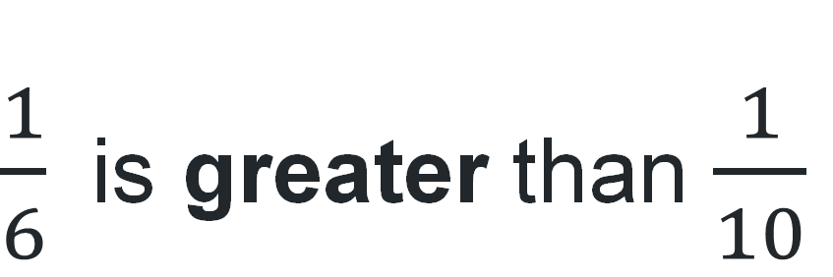
True or false (1)
$\frac{1}{6}$ is greater than $\frac{1}{10}$
True | False
Notes:
The question on this slide connects to the content being explored in the developing number sense activity (Activity 2)
Syllabus focus area:
Representing quantity fractions A

Slide 13
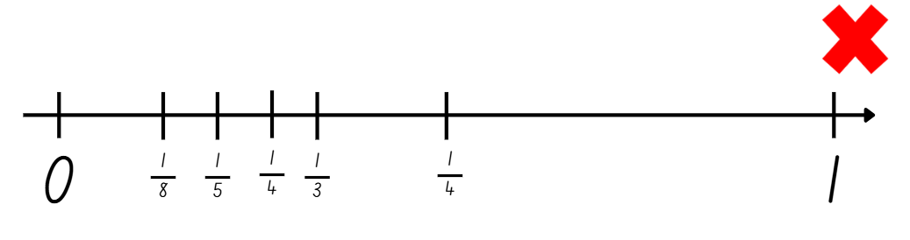
Short response (5)
Zali has placed fractions on a number line but has made mistakes.
Identify Zali’s error and correctly order the fractions on a number line.
Notes:
Short response questions provide brisk paced questions focussing on review of current and previous content to support spaced and interleaved practice.
Syllabus focus area:
Representing quantity fractions A

Slide 14
Short response (6)
Estimate the length of the classroom using an appropriate unit.
Justify your estimation and choice of unit.
Notes:
Short response questions provide brisk paced questions focussing on review of current and previous content to support spaced and interleaved practice.
Syllabus focus area:
Geometric Measure A: Length

Slide 15
Short response (7)
Would partitioning be an efficient strategy for solving
4 005 – 3 998?
Communicate your reasoning.
Notes:
Short response questions provide brisk paced questions focussing on review of current and previous content to support spaced and interleaved practice.
Syllabus focus area:
Additive relations A

Slide 16
Short response (8)
Which side lengths are needed to calculate the perimeter of this shape?
Explain your reasoning.
side B
side A
side C
side D
Notes:
Short response questions provide brisk paced questions focussing on review of current and previous content to support spaced and interleaved practice.
Syllabus focus area:
Geometric measure A: Length

Slide 17
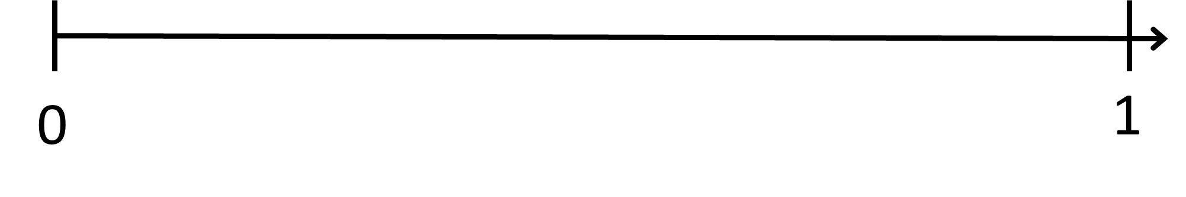
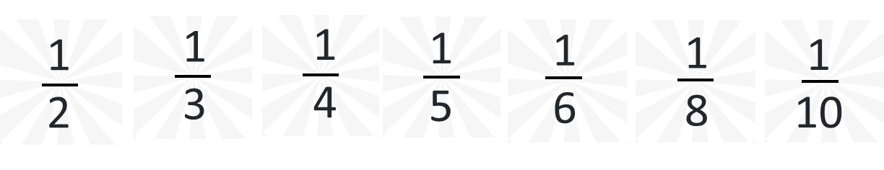
Activity 2 – number lines to represent fractions
Notes:
This is a developing number sense activity.
Number sense refers to a deep understanding of numbers, including their magnitude, relationships, and the effects of operations on them. It supports fluency and understanding, estimation, flexible thinking, and efficient problem-solving. Number sense activities 1–4 ‘activate’ prior number knowledge and support the learning of new content in the unit. Number sense activities 5–8 ‘loop’ back and provide opportunity for spaced practice with concepts and procedures covered in previous units.
Syllabus focus area:
Representing quantity fractions A
Activity 2 – Number lines to represent fractions
This resource corresponds to Resource 22 – finding fractions in Stage 3 Year A Unit 4.
Explain that students are going to use a number line to order these fractions from smallest to largest. Ask:
Which fraction cards might you place first? Explain your thinking.
What are the challenges of placing them all on the same number line?
Provide small groups with Resource 22 – finding fractions, pegs and string. Students place their fractions on the number line. Observe student strategies, supporting students to record zero and one on the number line first.
If necessary, model using a half and a quarter as benchmark fractions to assist in placing other fractions on the number line.
Regroup and ask:
Which fractions were easiest to place and which were more challenging? Why?
Did you group any fractions to make them easier to place? For example, halves, quarters and eighths.
How can you prove that one fifth is smaller than one half? Explain your thinking.

Slide 18
Review of learning 3

Slide 19
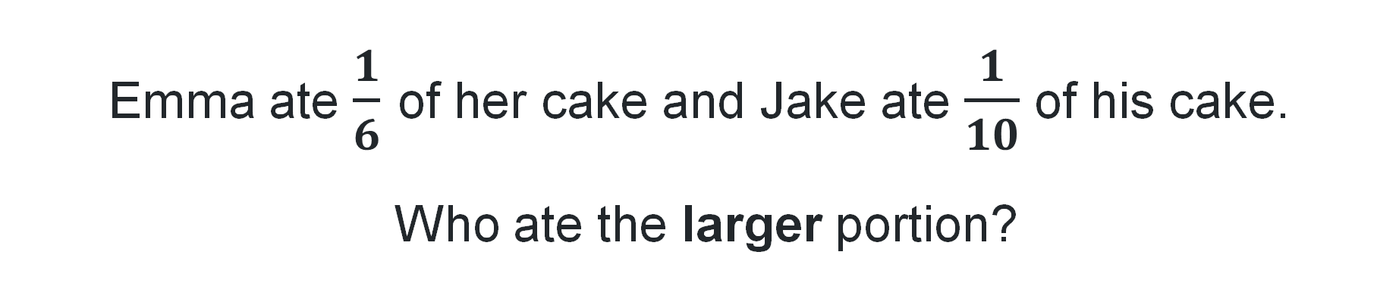
Multiple choice (2)
Emma ate $\frac{1}{6}$ of her cake and Jake ate $\frac{1}{10}$ of his cake.
Who ate the larger portion?
A
Emma ate the larger portion because $\frac{1}{6}$ is greater than $\frac{1}{10}$ .
B
Jake ate the larger portion because $\frac{1}{10}$ is greater than $\frac{1}{6}$ .
C
They ate the same amount because they both ate 1 slice.
D
It depends on the size of the cakes.
Notes:
This question connects to the content in the developing number sense activity (Activity 3)
Syllabus focus area:
Representing quantity fractions A

Slide 20
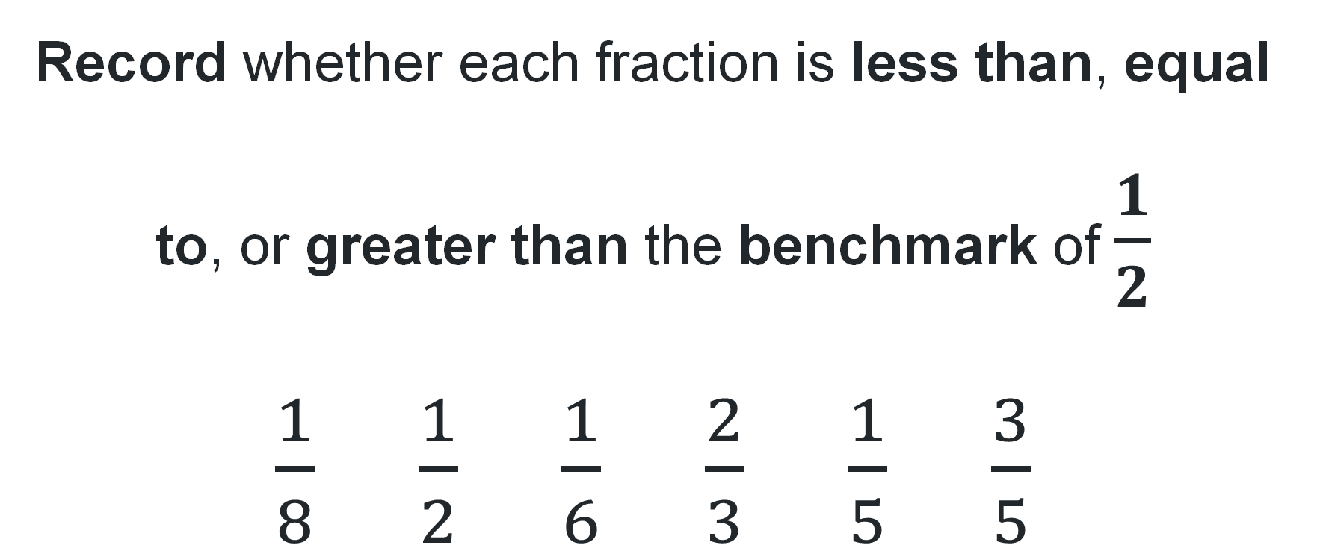
Short response (9)
Record whether each fraction is less than, equal to, or greater than the benchmark of $\frac{1}{2}$
$\frac{1}{8}$ $\frac{1}{2}$ $\frac{1}{6}$ $\frac{2}{3}$ $\frac{1}{5}$ $\frac{3}{5}$
Notes:
Short response questions provide brisk paced questions focussing on review of current and previous content to support spaced and interleaved practice.
Syllabus focus area:
Representing quantity fractions A

Slide 21
Short response (10)
The teacher asks you to mark out a 1 km running track.
How many times will you need to measure 100 metres to complete the 1 km track?
Communicate your reasoning.
Notes:
Short response questions provide brisk paced questions focussing on review of current and previous content to support spaced and interleaved practice.
Syllabus focus area:
Geometric Measure A: Length

Slide 22
Short response (11)
Complete the sentence to explain the levelling strategy.
Levelling is when…
Notes:
Short response questions provide brisk paced questions focussing on review of current and previous content to support spaced and interleaved practice.
Syllabus focus area:
Additive relations A

Slide 23
Short response (12)
Describe any similarities or differences you notice between these 2 triangles focusing on their side lengths, angle measures, and lines of symmetry.
Equilateral triangle
Isosceles triangle
Notes:
Short response questions provide brisk paced questions focussing on review of current and previous content to support spaced and interleaved practice.
Syllabus focus area:
Two-dimensional spatial structure A: 2D shapes

Slide 24
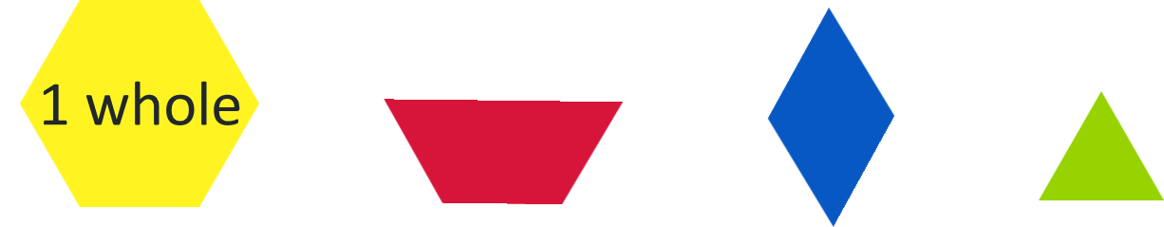
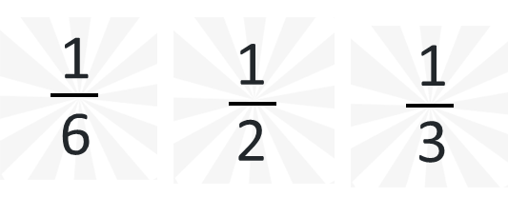
Activity 3 – pattern block fractions
Notes:
This is a developing number sense activity.
Number sense refers to a deep understanding of numbers, including their magnitude, relationships, and the effects of operations on them. It supports fluency and understanding, estimation, flexible thinking, and efficient problem-solving. Number sense activities 1–4 ‘activate’ prior number knowledge and support the learning of new content in the unit. Number sense activities 5–8 ‘loop’ back and provide opportunity for spaced practice with concepts and procedures covered in previous units.
Syllabus focus area:
Representing quantity fractions A
Activity 3 – pattern block fractions
Note: representing quantity fractions on the number line as numbers, rather than parts of a set of discrete items, relies on identifying ‘1’ as the abstract numerical unit that all numbers, including fractions, reference.
Select a yellow hexagonal pattern block and state that for this task, the yellow hexagon represents one whole. One whole is always represented as ‘1’ on the number line.
Provide pairs with a collection of pattern blocks and have them determine the fractional part of the red, blue and green blocks in relation to the yellow hexagon, one whole. (red = one half, blue = one third and green =one sixth).
Model recording these fractions on a number line.
Ask students to place a blue block on top of a yellow block and a green block on a red block. Students think-pair-share what they notice and what they wonder about these fractional representations.
Anticipated students’ responses:
What did you notice
Both show one-third of a whole.
I can see each represents one-third of the whole block because if I had 3 blue rhombuses, I would cover the whole yellow block.
The third represented by the blue rhombus is larger than the third represented by the green triangle.
If I placed the blue rhombus in a different position on the yellow hexagon, or the green triangle in a different position on the red trapezium, it would still represent a third.
What did you wonder?
I wonder if these representations show equivalent fractions?
I wonder if I placed a blue rhombus on the red trapezium, would it still represent one-third of the whole?

Slide 25
Review of learning 4

Slide 26

True or false (2)
If the yellow hexagon represents the whole, the red trapezium represents half.
True | False
Notes:
The question on this slide connects to the content being explored in the developing number sense activity (Activity 4)
Syllabus focus area:
Representing quantity fractions A

Slide 27
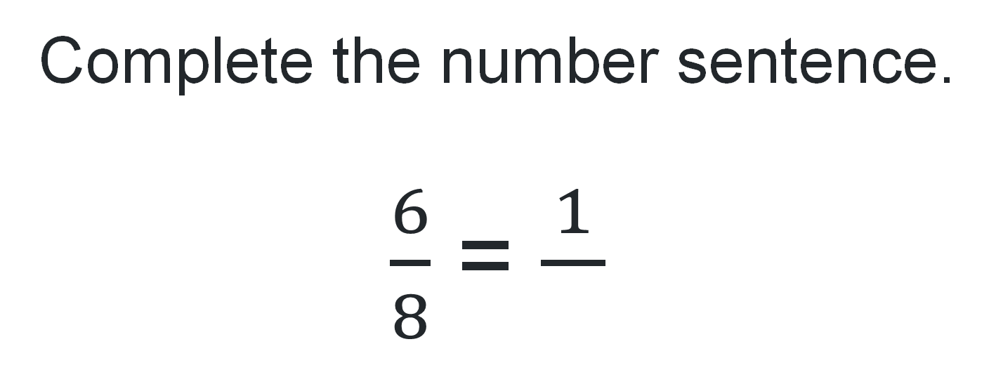
Short response (13)
Complete the number sentence.
$\frac{6}{8}$ = $\frac{1}{}$
Notes:
Short response questions provide brisk paced questions focussing on review of current and previous content to support spaced and interleaved practice.
Syllabus focus area:
Representing quantity fractions B

Slide 28
Short response (14)
Complete the following:
1 km = ? m
4 km = ? m
2000 m = ? km
5000m = ? km
Notes:
Short response questions provide brisk paced questions focussing on review of current and previous content to support spaced and interleaved practice.
Syllabus focus area:
Geometric Measure A: Length

Slide 29
Short response (15)
Havannah was asked to explain how she solved 4998 + 955.
Read her explanation and record the strategy she used.
“I had an addition number sentence and one of the numbers was close to 5000.
So, I took 2 from 955 and added that to 4998 to make that 5000.
That means 955 became 953.
My number sentence became 5000 + 953 = 5 953”.
Notes:
Short response questions provide brisk paced questions focussing on review of current and previous content to support spaced and interleaved practice.
Syllabus focus area:
Additive relations A

Slide 30
Short response (16)
Emilia said that rectangles with different side lengths can have the same area.
Prove her statement by recording the side lengths of 2 different rectangles with the same area.
Notes:
Short response questions provide brisk paced questions focussing on review of current and previous content to support spaced and interleaved practice.
Syllabus focus area:
Two-dimensional spatial structure B: Area (Note: Stage 2 content reviewed)

Slide 31
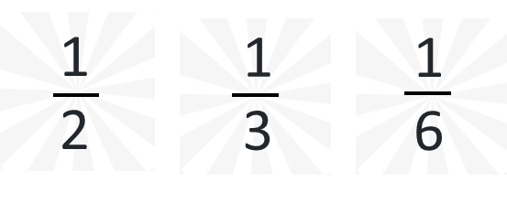
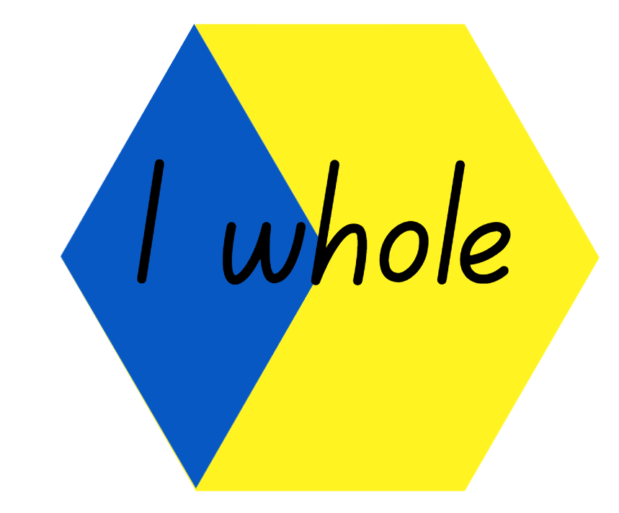


Activity 4 – pattern block fractions challenge
Notes:
This is a developing number sense activity.
Number sense refers to a deep understanding of numbers, including their magnitude, relationships, and the effects of operations on them. It supports fluency and understanding, estimation, flexible thinking, and efficient problem-solving. Number sense activities 1–4 ‘activate’ prior number knowledge and support the learning of new content in the unit. Number sense activities 5–8 ‘loop’ back and provide opportunity for spaced practice with concepts and procedures covered in previous units.
Syllabus focus area:
Representing quantity fractions A
Activity 4 – pattern block fractions challenge
Revise Activity 3 using a range of pattern blocks. Select a pattern block and explain that it represents one whole. Revise that one whole is always represented as one on the number line.
Provide pairs of students with a collection of pattern blocks. Explain the activity:
the first student chooses a large pattern block to represent the whole
the first student covers part of the shape with a smaller pattern block. This represents a fraction of the whole
the second student covers the rest of the whole with different pattern blocks
The student records this as a number sentence, using fractions with the same denominator (for example, 4-sixths plus one-third equals 4-sixths plus 2-sixths
together, students determine and record both fractional parts represented
students record these fractions on a number line, showing that they make a common whole.
Students repeat the activity.

Slide 32
Review of learning 5

Slide 33
Multiple choice (3)
Which number is not a factor of 24?
A
B
C
D
8
6
7
4
Notes:
This question connects to the content in the developing number sense activity (Activity 5)
Syllabus focus area:
Multiplicative relations A

Slide 34
Short response (17)
Luka cut a paper strip in half.
Arlo cut a different paper strip in quarters.
One of Arlo’s quarters is longer than Luka’s half.
Draw a representation to show how this statement can be true.
Communicate your reasoning.
Notes:
Short response questions provide brisk paced questions focussing on review of current and previous content to support spaced and interleaved practice.
Syllabus focus area:
Representing quantity fractions A

Slide 35
Short response (18)
Calculate the perimeter of these shapes.
9 cm
1 cm
8 cm
10 cm
5 cm
4 cm
6 cm
10 cm
Notes:
Short response questions provide brisk paced questions focussing on review of current and previous content to support spaced and interleaved practice.
Syllabus focus area:
Geometric Measure A: Length

Slide 36
Short response (19)
Use partitioning to solve:
2 245 + 328 + 48 =
Communicate your thinking.
Notes:
Short response questions provide brisk paced questions focussing on review of current and previous content to support spaced and interleaved practice.
Syllabus focus area:
Additive relations A

Slide 37
Short response (20)
The timetable says that Sasha’s train leaves the station at 14:45.
She wants to tell her friend the time in 12-hour format.
Record the time she should tell her friend.
Notes:
Short response questions provide brisk paced questions focussing on review of current and previous content to support spaced and interleaved practice.
Syllabus focus area:
Non-spatial measure A: Time

Slide 38

Activity 5 – factors and multiples game
Factors and Multiples
Notes:
This is a developing number sense activity.
Number sense refers to a deep understanding of numbers, including their magnitude, relationships, and the effects of operations on them. It supports fluency and understanding, estimation, flexible thinking, and efficient problem-solving. Number sense activities 1–4 ‘activate’ prior number knowledge and support the learning of new content in the unit. Number sense activities 5–8 ‘loop’ back and provide opportunity for spaced practice with concepts and procedures covered in previous units.
Syllabus focus area:
Multiplicative relations A
Activity 5 – factors and multiples game
This activity is an adaptation of Factors and Multiples Game from NRICH by University of Cambridge.
Model the interactive game Factors and Multiples. Choose an even number less than 50 and cross it out on the grid. Then choose a number to cross out that is a factor or multiple of the first number.
Continue to play, modelling the language of factors and multiples. See how many numbers can be crossed out in the time available. Keep a record of this number as students will probably want to play this game multiple times.
Some students may enjoy the challenge of playing the game in pairs, with the last person able to cross out a number being the winner.

Slide 39
Review of learning 6

Slide 40
True or false (3)
The numbers that are multiplied are called the product.
True | False
Notes:
The question on this slide connects to the content being explored in the developing number sense activity (Activity 6)
Syllabus focus area:
Multiplicative relations A

Slide 41
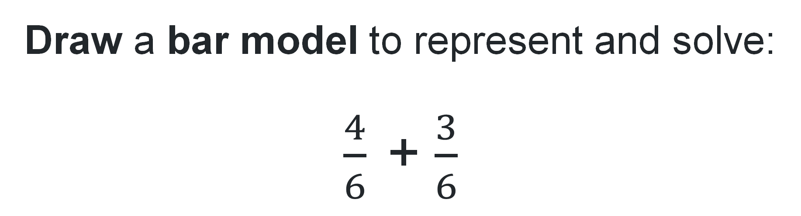
Short response (21)
Draw a bar model to represent and solve:
$\frac{4}{6}$+ $\frac{3}{6}$
Notes:
Short response questions provide brisk paced questions focussing on review of current and previous content to support spaced and interleaved practice.
Syllabus focus area:
Representing quantity fractions A

Slide 42
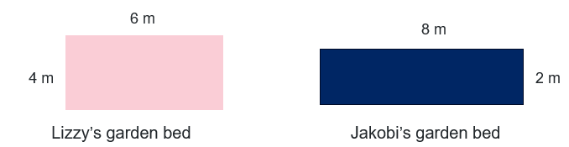
Short response (22)
Lizzy and Jakobi have built garden beds.
Both these garden beds have a perimeter of 20 m.
How is that possible? Explain your answer.
Notes:
Short response questions provide brisk paced questions focussing on review of current and previous content to support spaced and interleaved practice.
Syllabus focus area:
Geometric Measure A: Length

Slide 43
Short response (23)
Use partitioning to solve
2 545 - 328 - 14 =
Communicate your thinking.
Notes:
Short response questions provide brisk paced questions focussing on review of current and previous content to support spaced and interleaved practice.
Syllabus focus area:
Additive relations A

Slide 44
Short response (24)
Explain why 24-hour time is used.
Provide 2 real-life examples of where or when it is used.
Notes:
Short response questions provide brisk paced questions focussing on review of current and previous content to support spaced and interleaved practice.
Syllabus focus area:
Non-spatial measure A: Time

Slide 45
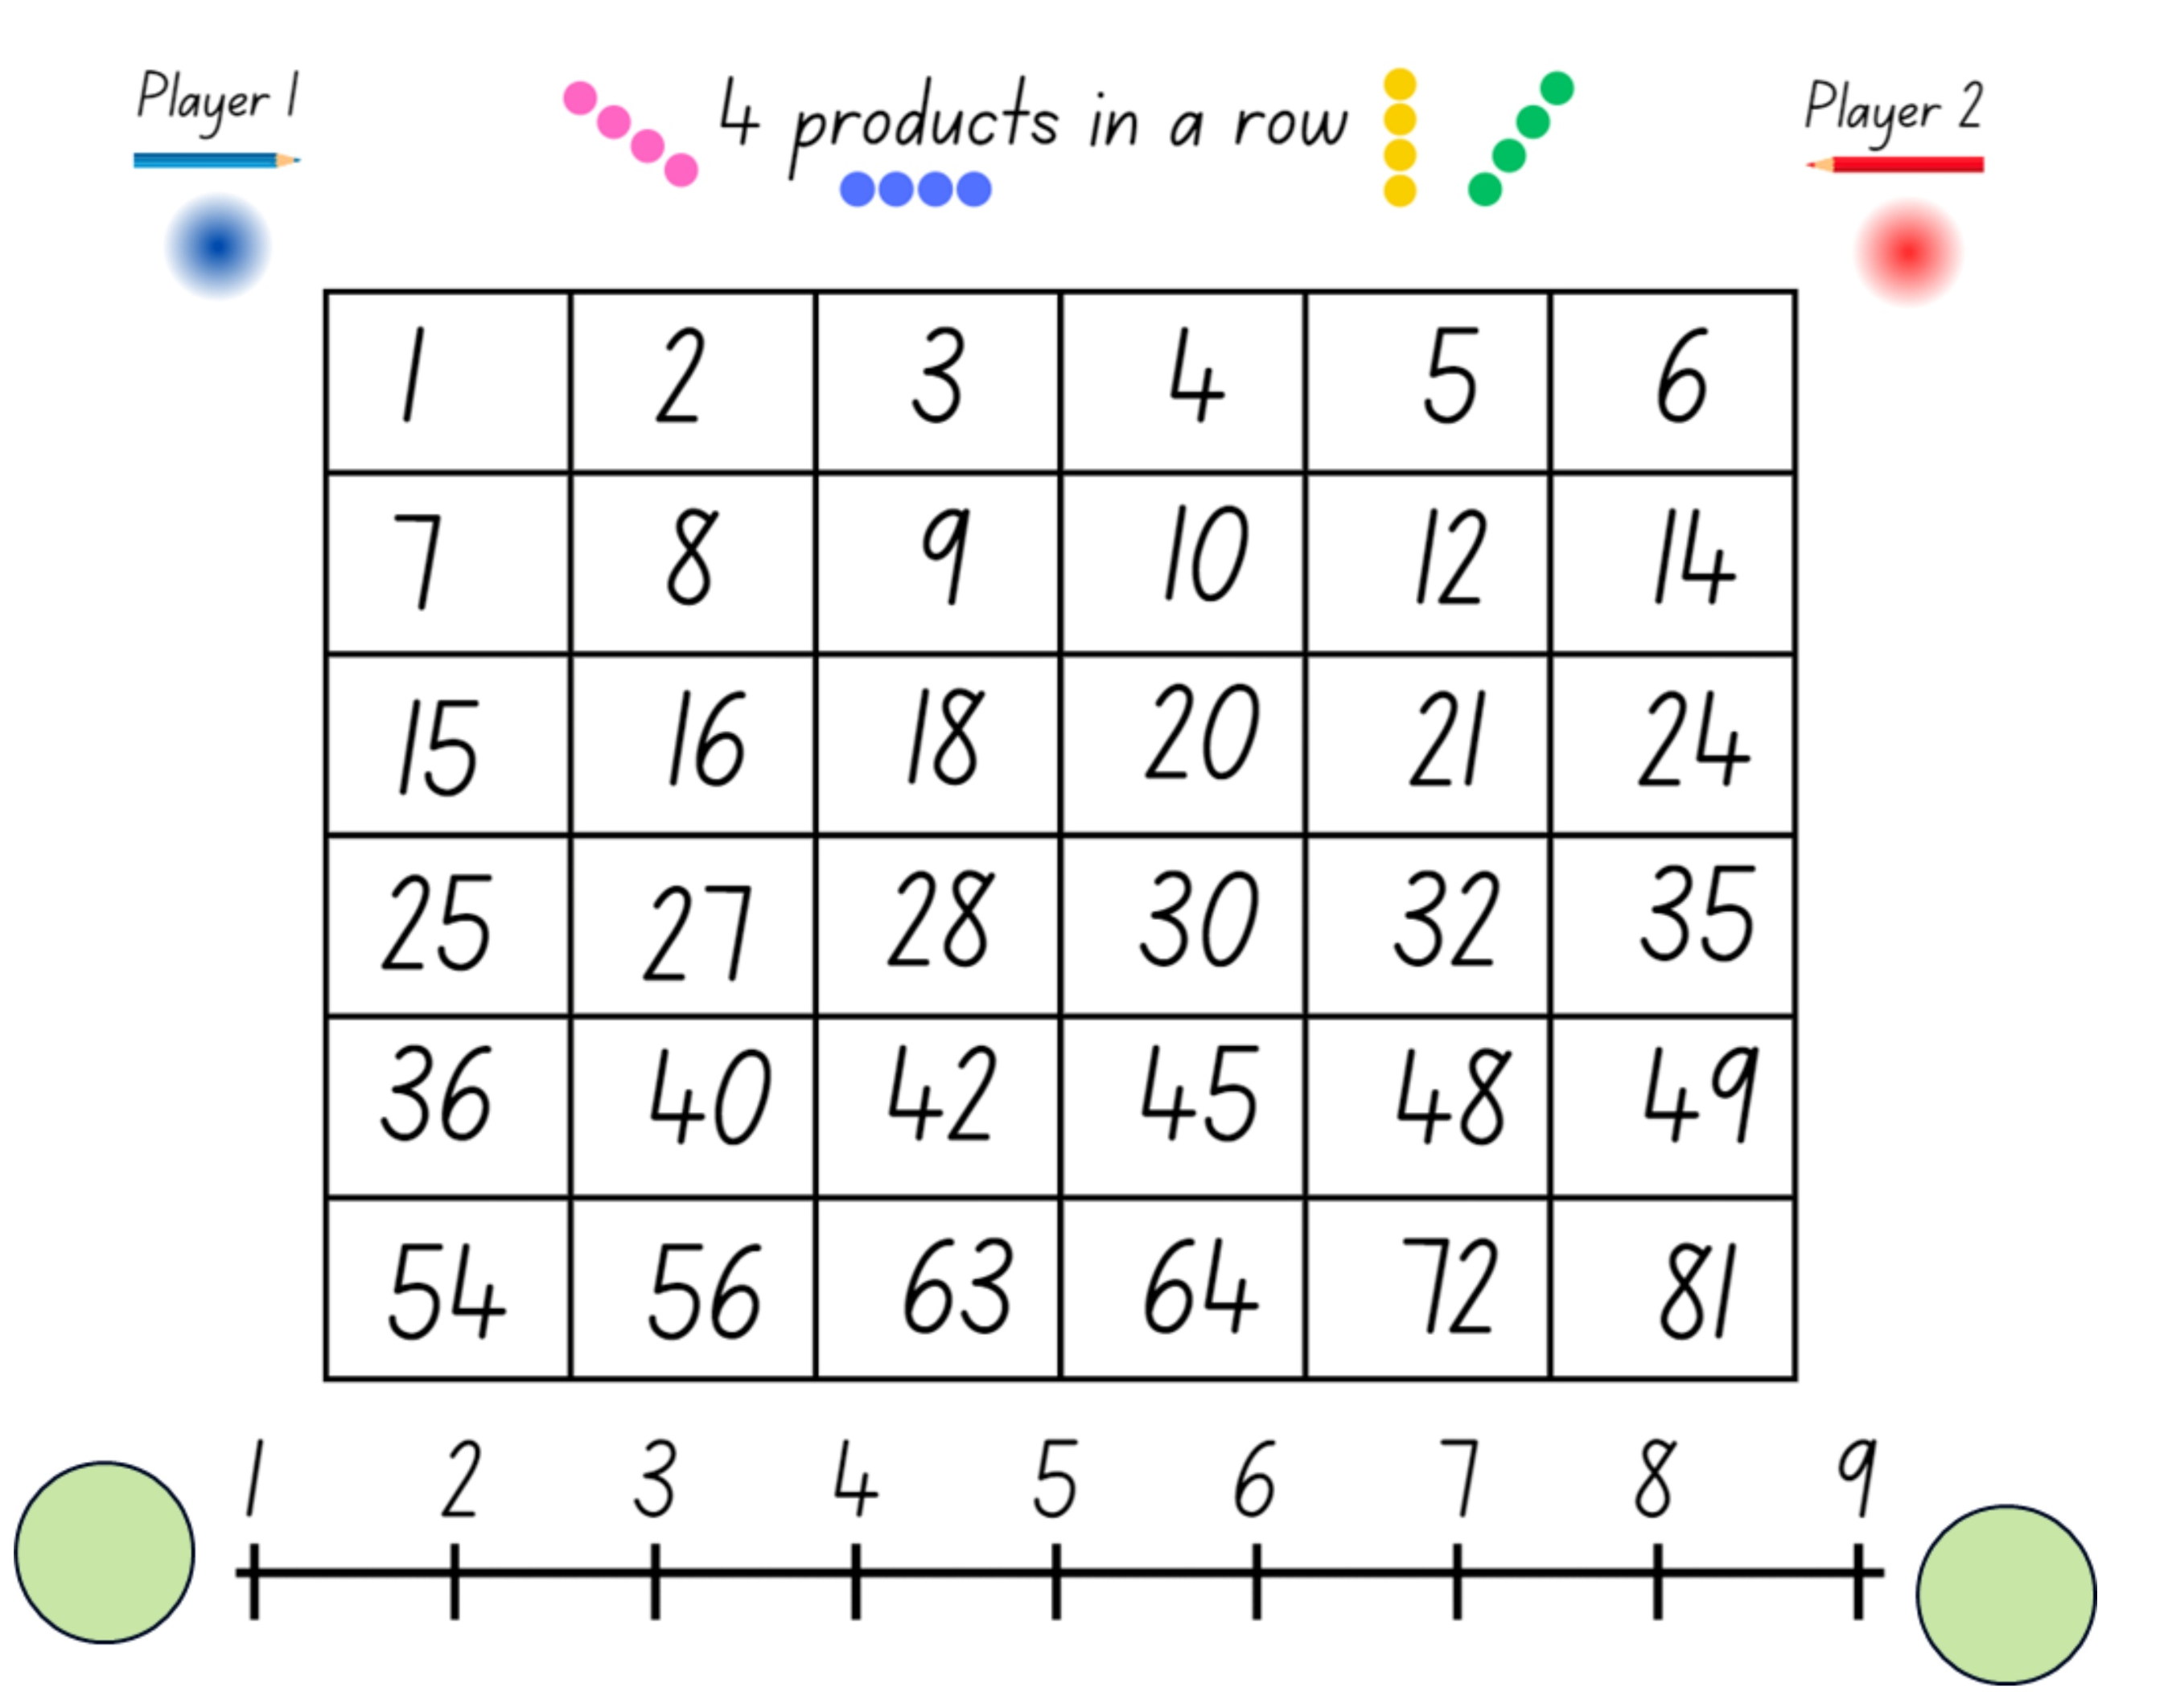

Activity 6 – 4 products in a row (1)
Product Game
Notes:
This is a developing number sense activity.
Number sense refers to a deep understanding of numbers, including their magnitude, relationships, and the effects of operations on them. It supports fluency and understanding, estimation, flexible thinking, and efficient problem-solving. Number sense activities 1–4 ‘activate’ prior number knowledge and support the learning of new content in the unit. Number sense activities 5–8 ‘loop’ back and provide opportunity for spaced practice with concepts and procedures covered in previous units.
Syllabus focus area:
Multiplicative relations A
Activity 6 – 4 products in a row
This resource corresponds to Resource 23 – ‘Product game’ in Stage 3 Year A Unit 4.
Explain that the aim is to get 4 squares in a row vertically, horizontally, or diagonally by multiplying 2 numbers each time to find a product. Explain that the term product is used to describe the result (answer) of multiplying 2 or more numbers.
Model the game as Player 1 and the computer as Player 2.
To begin the game:
Player 1 moves a marker (a green square) to a number in the factor list from 1–9 along the bottom of the screen.
Player 2 moves the other marker (also a green square) to any number in the factor list. This includes the number marked by Player 1. Player 2 determines the product of the 2 marked numbers and colours them red.
Player 1 moves a marker to another number and colours the new product blue.
Players take turns moving a marker. Each product is marked red or blue, depending on the player. Note, if a product is already coloured, the player does not get a square for that turn.
Play continues until one player finds 4 products in a vertical, horizontal or diagonal row, or until all squares have been coloured.
Note: if there is no access to the interactive gameboard, play the game using Resource 23 – ‘Product game’ and transparent counters.
Distribute devices to students to play the game in pairs. Some students may enjoy playing a more challenging version of the game using Resource 24 – modified ‘Product game’ (see slide 46).
Display Resource 25 – ‘Product game’ questions, for students to discuss as they finish their game (see slide 47).

Slide 46
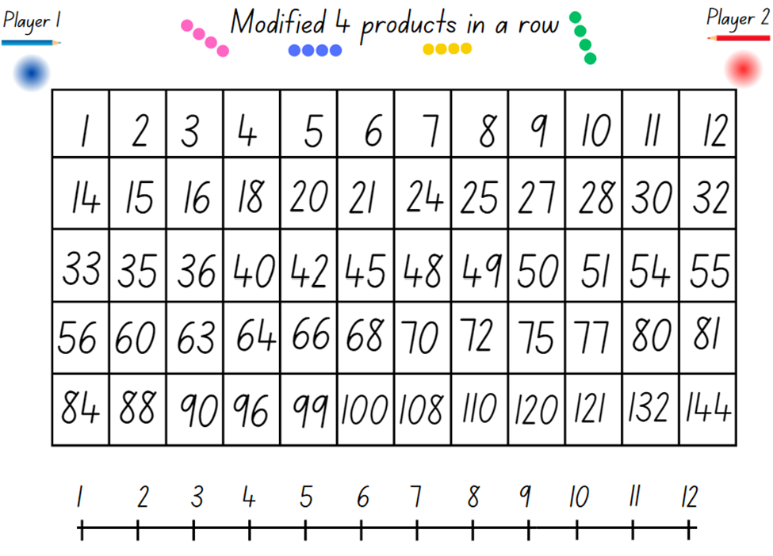
Activity 6 – 4 products in a row (2)
Challenge
Notes:
Activity 6 – 4 products in a row (continued)
This resource corresponds to Resource 24 – modified ‘Product game’ in Stage 3 Year A Unit 4 and provides a more challenging version of the game.

Slide 47
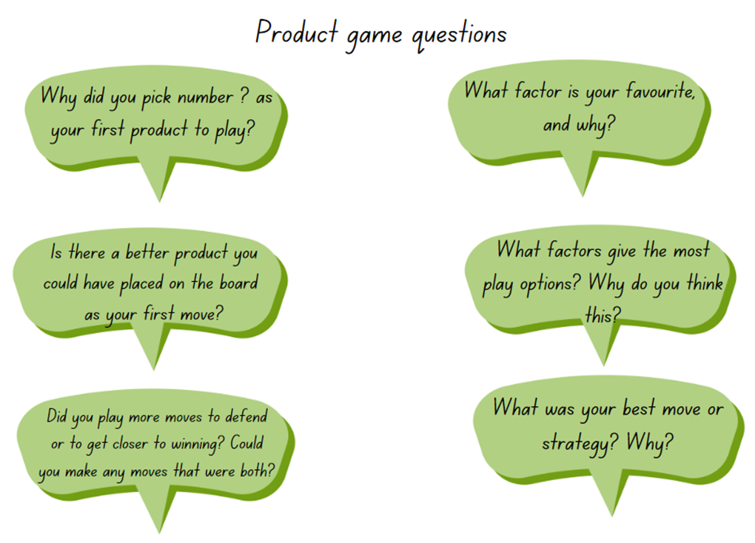
Activity 6 – 4 products in a row (3)
Notes:
Activity 6 – 4 products in a row (continued)
This resource corresponds to Resource 25 – modified ‘Product game’ questions in Stage 3 Year A Unit 4.

Slide 48
Review of learning 7

Slide 49
Multiple choice (4)
What is the product of 7 and 6?
A
B
C
D
36
42
58
45
Notes:
This question connects to the content in the developing number sense activity (Activity 7)
Syllabus focus area:
Multiplicative relations A

Slide 50
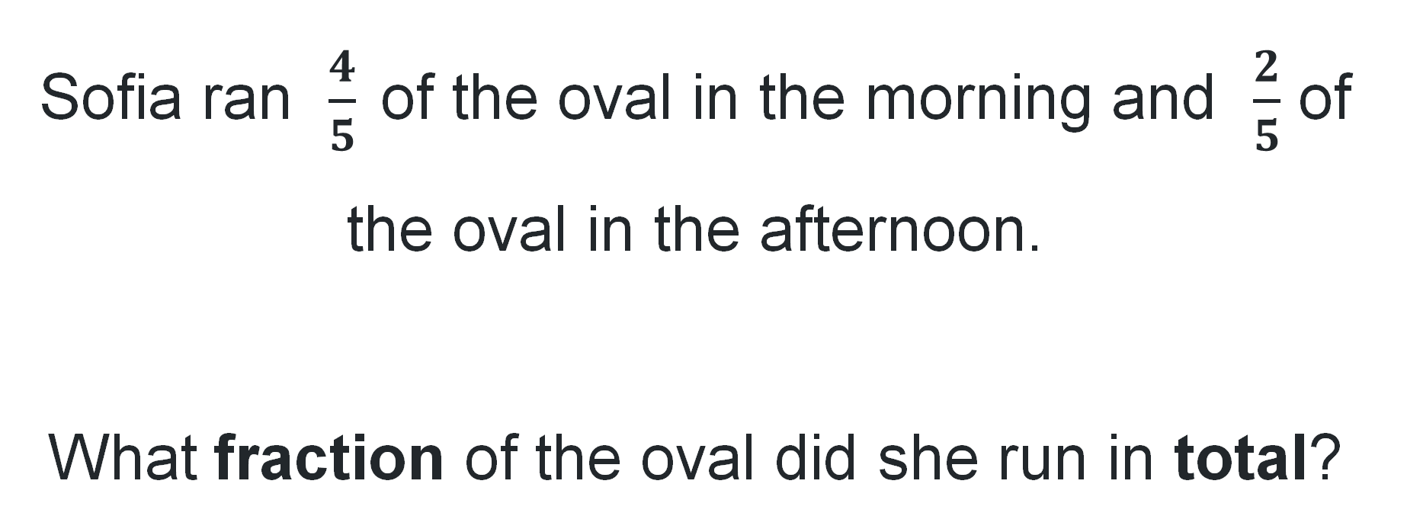
Short response (25)
Sofia ran $\frac{4}{5}$of the oval in the morning and $\frac{2}{5}$ of the oval in the afternoon.
What fraction of the oval did she run in total?
Notes:
Short response questions provide brisk paced questions focussing on review of current and previous content to support spaced and interleaved practice.
Syllabus focus area:
Representing quantity fractions A

Slide 51
Short response (26)
Convert the following to 12-hour time:
18:00
06:00
12:00
21:00
Notes:
Short response questions provide brisk paced questions focussing on review of current and previous content to support spaced and interleaved practice.
Syllabus focus area:
Non- spatial measure A: Time

Slide 52
Short response (27)
There were 850 students at a school assembly.
234 students left early to go to a sports event.
Later, 127 more students arrived from another grade.
How many students were at the assembly in the end?
Notes:
Short response questions provide brisk paced questions focussing on review of current and previous content to support spaced and interleaved practice.
Syllabus focus area:
Additive relations A

Slide 53
Short response (28)
Sketch a rectangular prism showing depth.
Notes:
Short response questions provide brisk paced questions focussing on review of current and previous content to support spaced and interleaved practice.
Syllabus focus area:
Three-dimensional spatial structure B: 3D objects (Note: Stage 2 content reviewed)

Slide 54
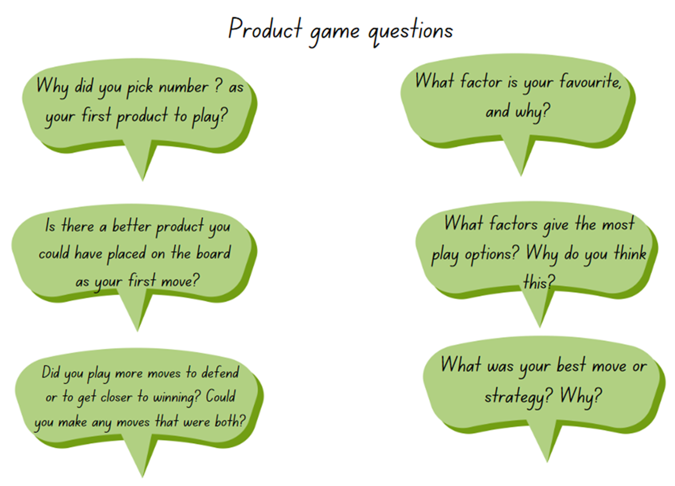

Activity 7 – improve your strategies
Product Game
Notes:
This is a developing number sense activity.
Number sense refers to a deep understanding of numbers, including their magnitude, relationships, and the effects of operations on them. It supports fluency and understanding, estimation, flexible thinking, and efficient problem-solving. Number sense activities 1–4 ‘activate’ prior number knowledge and support the learning of new content in the unit. Number sense activities 5–8 ‘loop’ back and provide opportunity for spaced practice with concepts and procedures covered in previous units.
Syllabus focus area:
Multiplicative relations A
Activity 7 – improve your strategies
This resource corresponds to Resource 25 – ‘Product Game’ questions in Stage 3 Year A Unit 4.
Revise how to play the ‘Product Game’ from Activity 6.
Use the questions on this slide to support students to improve the strategies they use to try and win the game.
Students play the game again, trying to improve their use of strategies.
As students finish, ask them to explain how they tried to improve their strategies from the previous game. This includes discussing what worked, what didn’t and why.

Slide 55
Review of learning 8

Slide 56


True or false (4)
Both these arrays model 24 as a product.
True | False
Notes:
The question on this slide connects to the content being explored in the developing number sense activity (Activity 8)
Syllabus focus area:
Multiplicative relations A

Slide 57
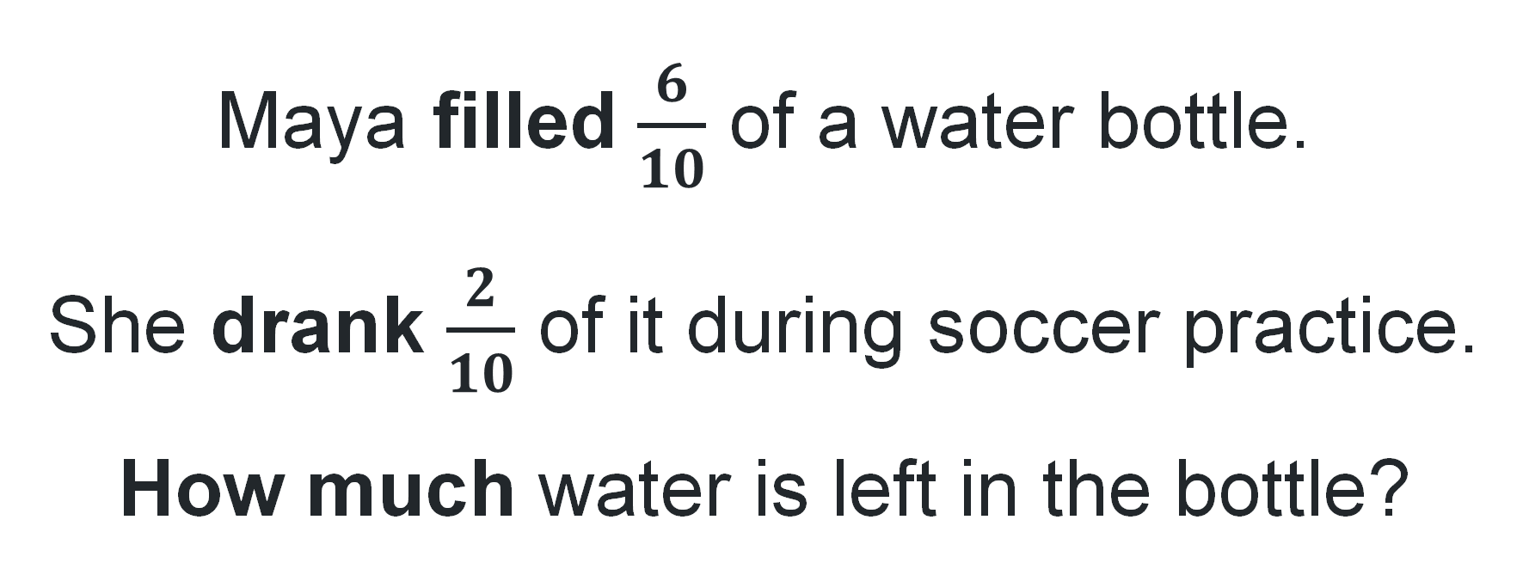
Short response (29)
Maya filled $\frac{6}{10}$ of a water bottle.
She drank $\frac{2}{10}$ of it during soccer practice.
How much water is left in the bottle?
Notes:
Short response questions provide brisk paced questions focussing on review of current and previous content to support spaced and interleaved practice.
Syllabus focus area:
Representing quantity fractions A

Slide 58
Short response (30)
Read the following times aloud using appropriate 24-hour time language:
08:00
16:00
23:30
13:40
Notes:
Short response questions provide brisk paced questions focussing on review of current and previous content to support spaced and interleaved practice.
Syllabus focus area:
Non- spatial measure A: Time

Slide 59
Short response (31)
A wildlife reserve is tracking the number of deer in an area of the forest.
On Monday, rangers count 462 deer.
On Tuesday, they spot 125 more deer that were not seen the day before.
On Wednesday, 89 deer are moved to a different part of the reserve.
How many deer are in that area by the end of Wednesday?
Notes:
Short response questions provide brisk paced questions focussing on review of current and previous content to support spaced and interleaved practice.
Syllabus focus area:
Additive relations A

Slide 60

Short response (32)
2 trapeziums can be combined to create a hexagon.
Draw two or more 2D shapes showing how they can be combined to create a new shape.
Label the shapes you used and the new shape you formed.
Notes:
Short response questions provide brisk paced questions focussing on review of current and previous content to support spaced and interleaved practice.
Syllabus focus area:
Two-dimensional spatial structure B: 2D shapes (Note: Stage 2 content reviewed)

Slide 61
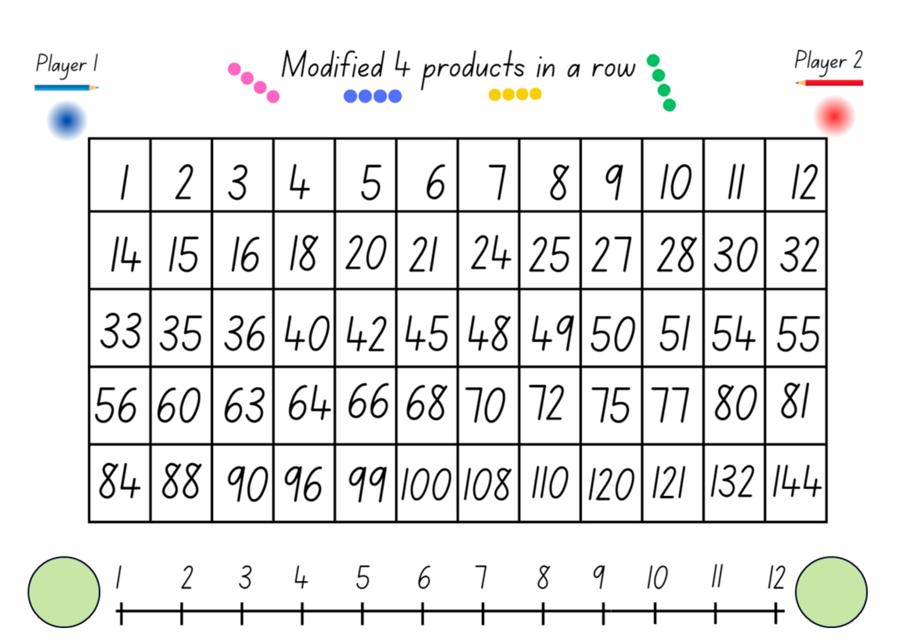
Activity 8 – product strategies
Product Game
Notes:
This is a developing number sense activity.
Number sense refers to a deep understanding of numbers, including their magnitude, relationships, and the effects of operations on them. It supports fluency and understanding, estimation, flexible thinking, and efficient problem-solving. Number sense activities 1–4 ‘activate’ prior number knowledge and support the learning of new content in the unit. Number sense activities 5–8 ‘loop’ back and provide opportunity for spaced practice with concepts and procedures covered in previous units.
Syllabus focus area:
Multiplicative relations A
Activity 8 – product strategies
This resource corresponds to Resource 24 – modified ‘Product game’ in Stage 3 Year A Unit 4.
Revise the ‘Product Game’ from Activity 6. Review the strategies they used to pick a product to win the game or win the game in less moves.
Provide pairs of students with copies of Resource 24 – modified ‘Product game’. Explain that this activity includes numbers up to 144.
As they play, students aim to improve the strategies they use.
As students finish, ask them to explain how they improved their strategies from the previous game. Discussing which strategies worked, which didn’t and why.

Slide 62
Double Venn diagram
Object 1
Object 2
Features similar to both objects
Features of object 1
Features of object 2

Slide 63
Frayer
Definition
Facts/Characteristics
Word, term, concept
Examples
Non-examples

Slide 64
Spider map
Idea
Subject

Slide 65
Cline
Concept 1
Concept 2
Word
Word
Word
Word
Word
Word
Word
Word
Word
Word
Word

Slide 66

Compare and contrast

Slide 67
Multiple choice (5)
A
B
C
D

Slide 68
Multiple choice (6)
A
B
C
D

Slide 69
References (1)
This presentation contains NSW Curriculum and syllabus content. The NSW Curriculum is developed by the NSW Education Standards Authority. This content is prepared by NESA for and on behalf of the Crown in the right of the State of New South Wales. The material is protected by Crown copyright.
Please refer to the NESA Copyright Disclaimer for more information https://educationstandards.nsw.edu.au/wps/portal/nesa/mini-footer/copyright.
NESA holds the only official and up-to-date versions of the NSW Curriculum and syllabus documents. Please visit the NSW Education Standards Authority (NESA) website https://educationstandards.nsw.edu.au/wps/portal/nesa/home and the NSW Curriculum website https://curriculum.nsw.edu.au.
Mathematics K–10 Syllabus © NSW Education Standards Authority (NESA) for and on behalf of the Crown in right of the State of New South Wales, 2022.
National Numeracy Learning Progression © Australian Curriculum, Assessment and Reporting Authority (ACARA) 2010 to present, unless otherwise indicated. This material was downloaded from the Australian Curriculum website (National Numeracy Learning Progression) (accessed 28 August 2025) and was not modified.
NSW Education Standards Authority (NESA) (2022) ‘Teaching advice for Representing quantity fractions A’, Stage 3, NSW Curriculum website, accessed 13 October 2025.
State of New South Wales (Department of Education) (2023) Equivalent number sentences, Universal Resource Hub website, accessed 26 June 2023.
University of Cambridge (n.d.) Factors and multiples game, NRICH website, accessed 5 February 2024.

Slide 70
References (2)
This presentation contains NSW Curriculum and syllabus content. The NSW Curriculum is developed by the NSW Education Standards Authority. This content is prepared by NESA for and on behalf of the Crown in the right of the State of New South Wales. The material is protected by Crown copyright.
Please refer to the NESA Copyright Disclaimer for more information https://educationstandards.nsw.edu.au/wps/portal/nesa/mini-footer/copyright.
NESA holds the only official and up-to-date versions of the NSW Curriculum and syllabus documents. Please visit the NSW Education Standards Authority (NESA) website https://educationstandards.nsw.edu.au/wps/portal/nesa/home and the NSW Curriculum website https://curriculum.nsw.edu.au.
New Zealand Ministry of Education (n.d) Problems to solve, NZ Maths website, accessed 26 June 2023.
State of New South Wales (Department of Education) (2023) Equivalent number sentences, Universal Resource Hub website, accessed 26 June 2023.
Sullivan P (2018) Challenging Mathematical Tasks: Unlocking the potential of all students, Oxford University Press, Australia and New Zealand.
Sullivan P and Lilburn P (2017) Open-Ended Maths Activities, 2nd edn, Oxford University Press, Australia and New Zealand.

Slide 71
Copyright
© State of New South Wales (Department of Education), 2025
The copyright material published in this resource is subject to the Copyright Act 1968 (Cth) and is owned by the NSW Department of Education or, where indicated, by a party other than the NSW Department of Education (third-party material).
Copyright material available in this resource and owned by the NSW Department of Education is licensed under a Creative Commons Attribution 4.0 International (CC BY 4.0) license.
This license allows you to share and adapt the material for any purpose, even commercially.
Attribution should be given to © State of New South Wales (Department of Education), 2025.
Material in this resource not available under a Creative Commons license:
the NSW Department of Education logo, other logos and trademark-protected material
Material owned by a third party that has been reproduced with permission. You will need to obtain permission from the third party to reuse its material.
Links to third-party material and websites
Please note that the provided (reading/viewing material/list/links/texts) are a suggestion only and implies no endorsement, by the New South Wales Department of Education, of any author, publisher, or book title. School principals and teachers are best placed to assess the suitability of resources that would complement the curriculum and reflect the needs and interests of their students.
If you use the links provided in this document to access a third party’s website, you acknowledge that the terms of use, including licence terms set out on the third-party’s website apply to the use which may be made of the materials on that third-party website or where permitted by the Copyright Act 1968 (Cth). The department accepts no responsibility for content on third-party websites.

