Slide 1
Instructions for use
This resource is not a teaching and learning program. It should be used in conjunction with Stage 3 Year A Unit 5.
Classroom teachers are encouraged to add and adapt slides as required to meet the needs of their students.
Save a copy of the file to make changes to the slide deck. Go to File > Download a Copy (this downloads a copy to the computer to edit in the PowerPoint app).
To convert the PowerPoint to Google Slides:
  Upload the file into Google Drive and open it.
  Go to File > Save as Google Slides.
  (Note – conversion may cause formatting changes in the slides.)

Slide 2

Review of Learning
Mathematics Stage 3 – Unit 5
Notes:
Reviews may include a combination of question types, requiring students to recall facts and key ideas, as well as apply their knowledge to solve problems and answer questions. To support active engagement, a mix of techniques should be employed.” (AERO, 2024).
This Review of Learning slide deck revisits key concepts from the following units:
Stage 3 Year A Unit 5
Stage 3 Year A Unit 4
Stage 3 Year A Unit 3
It also includes opportunities to review prior learning in non-number content, supporting consolidation across focus areas.
The review of learning resources include three key task types that support the development of mathematical proficiency through retrieval, spaced practice, and active participation. These practices complement the review phase (activating prior knowledge) embedded within the beginning of each lesson.
1.
Multiple-choice questions/True or false: Designed to promote active retrieval of key concepts and identify common misconceptions in number, supporting consolidation, understanding and fluency.
These questions:
support spaced and interleaved practice
help identify and address common misconceptions
support active recall and immediate feedback
support whole class participation
identify areas requiring reteach
2.
Short-response question sets: Carefully grouped questions that encourage spaced and interleaved practice across multiple focus areas, helping students revisit and apply knowledge from different points in time.
These questions:
have a combination of question types
address a range of focus areas
build automaticity and fluency
support active recall
allow for immediate feedback
identify content requiring reteach
3.
Developing number sense activities: A variety of practical, purposeful tasks that reinforce current learning and build on prior knowledge. These activities promote reasoning, problem-solving and conceptual understanding.
The review of learning resources are designed to work support teaching and learning in mathematics. For the most effective implementation, use the resources flexibly, adapting to meet student learning needs and individual classroom contexts.

Slide 3
Lessons
1
Review of learning 1
5
Review of learning 5
2
Review of learning 2
6
Review of learning 6
3
Review of learning 3
7
Review of learning 7
4
Review of learning 4
8
Review of learning 8
Notes:
Teacher notes:
Click lesson numbers to go to specific lessons
Interactive features can be viewed in slide show

Slide 4
Review of learning 1

Slide 5

Multiple choice (1)
What is three million, four hundred and eighty-seven thousand, two hundred and nine written as a number?
A
3 784 902
C
3 847 290
B
3 748 029
D
3 487 209
Notes:
This question connects to the content in the developing number sense activity (Activity 1)
Syllabus focus area:
Represents numbers A

Slide 6

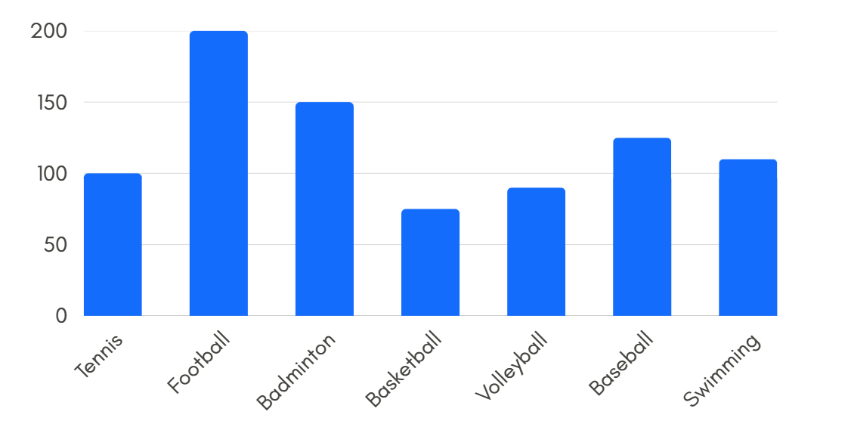
Short response (1)
Write a question that can be answered
using this data.
Notes:
Short response questions provide brisk paced questions focussing on review of current and previous content to support spaced and interleaved practice.
Syllabus focus area:
Data A

Slide 7
Short response (2)
Record these fractions on a number line:
2-quarters
6-quarters
2-thirds
4-thirds.
Notes:
Short response questions provide brisk paced questions focussing on review of current and previous content to support spaced and interleaved practice.
Syllabus focus area:
Representing quantity fractions A

Slide 8
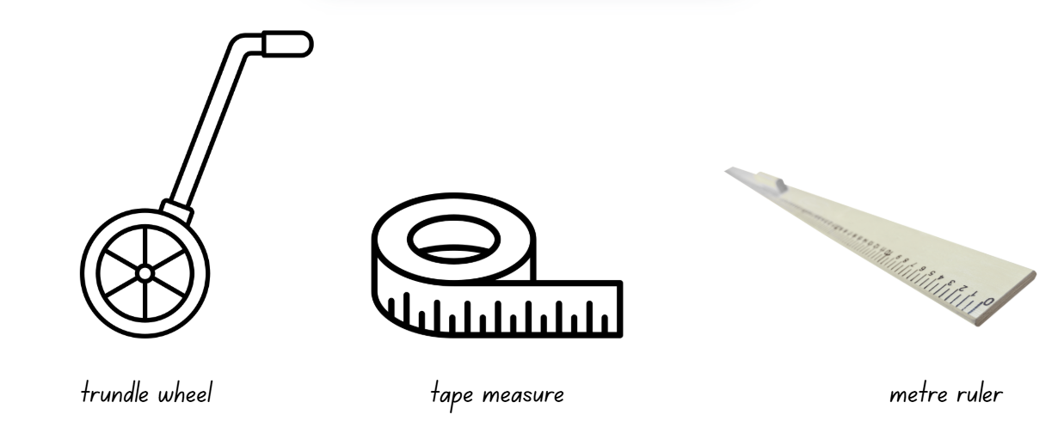
Short response (3)
Which instrument is most effective for measuring the perimeter of the school playground?
Notes:
Short response questions provide brisk paced questions focussing on review of current and previous content to support spaced and interleaved practice.
Syllabus focus area:
Geometric measure A: Length

Slide 9
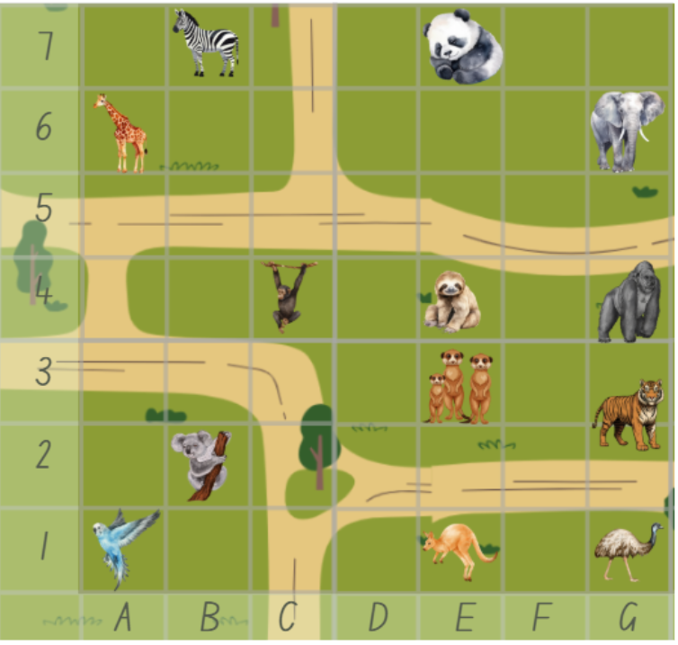
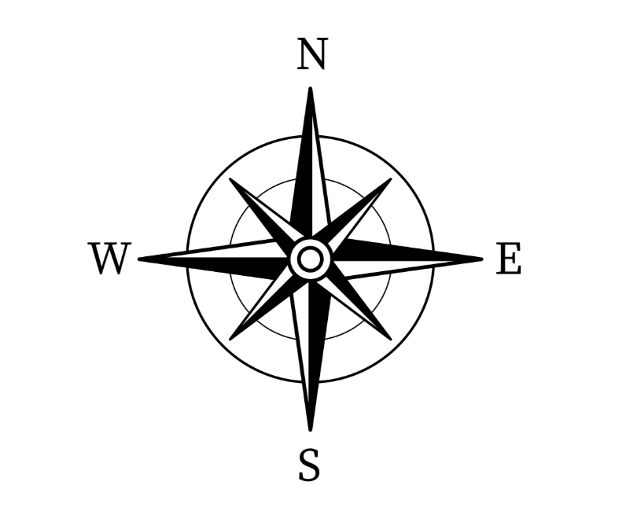
Short response (4)
Use directional language to plan a route from the birds to the pandas.
Notes:
Short response questions provide brisk paced questions focussing on review of current and previous content to support spaced and interleaved practice.
Syllabus focus area:
Geometric measure B: Position (Note: Stage 2 content reviewed)

Slide 10

Activity 1 – naming numbers in the millions
it is larger than 10 million
the first 3 digits add to a number greater than 5
the digit in the 10 thousands is smaller than 4
the thousand digit is even
the hundreds digit is larger than the ones digit
the tens digit is larger than the hundreds digit and is odd
the number is a multiple of 5.
What could my number be?
Notes:
This is a developing number sense activity.
Number sense refers to a deep understanding of numbers, including their magnitude, relationships, and the effects of operations on them. It supports fluency and understanding, estimation, flexible thinking, and efficient problem-solving. Number sense activities 1–4 ‘activate’ prior number knowledge and support the learning of new content in the unit. Number sense activities 5–8 ‘loop’ back and provide opportunity for spaced practice with concepts and procedures covered in previous units.
Syllabus focus area:
Represents numbers A
Activity 1- naming numbers in the millions 1
1. Prompt students that you are thinking of a number. Give the following clues:
the number is larger than 10 million
the first 3 digits add to a number greater than 5
the digit in the tens of thousands place is smaller than 4
the thousands digit is even
the hundreds digit is larger than the units digit
the tens digit is larger than the hundreds digit and is odd
the number is a multiple of 5.
2. Instruct students to use the clues to record the number on individual whiteboards.
3. Students share their answer with a partner and justify their thinking. Allow time for students to refine their answers.
4. As a class, discuss student thinking. Ask:
What is your number?
Can you explain why your number could be correct?
Is your number larger or smaller than your partner’s?
Can you think of another possible number?
This activity is an adaptation from Open-ended Maths Activities: Using ‘Good’ Questions to Enhance Learning in Mathematics, Revised edn by Sullivan and Lilburn.

Slide 11
Review of learning 2

Slide 12
True or false (1)
10 502 896 comes after 10 205 689.
True | False
Notes:
The question on this slide connects to the content being explored in the developing number sense activity (Activity 2)
Syllabus focus area:
Represents numbers A

Slide 13
Short response (5)
Write a survey question using the
Likert scale to find out how much
Stage 3 students enjoy playing
soccer during sport time.
Notes:
Short response questions provide brisk paced questions focussing on review of current and previous content to support spaced and interleaved practice.
Syllabus focus area:
Data A

Slide 14
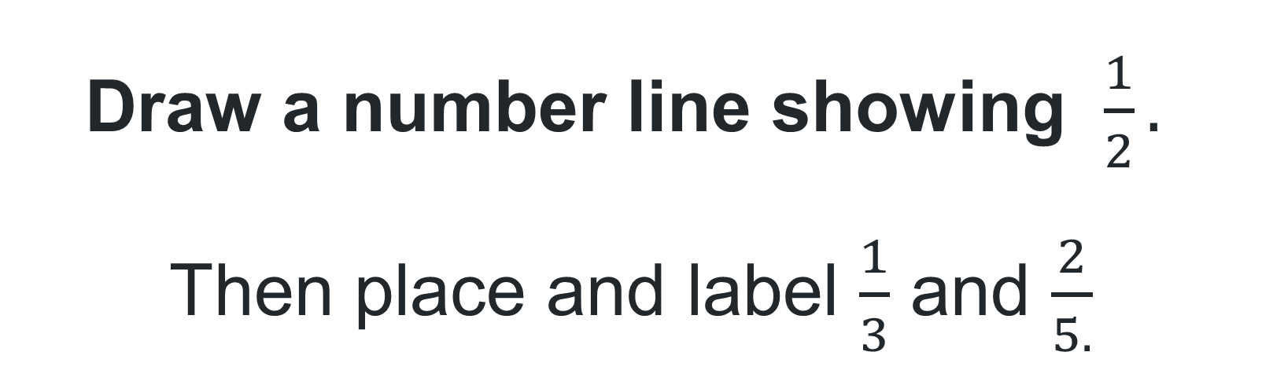
Short response
Draw a number line showing $\frac{1}{2}.$
Then place and label $\frac{1}{3}$ and $\frac{2}{5.}$
Notes:
Short response questions provide brisk paced questions focussing on review of current and previous content to support spaced and interleaved practice.
Syllabus focus area:
Representing quantity fractions A

Slide 15
Short response (7)
Record something that is
approximately 100 metres away
from where you are.
Notes:
Short response questions provide brisk paced questions focussing on review of current and previous content to support spaced and interleaved practice.
Syllabus focus area:
Geometric measure A: Length

Slide 16
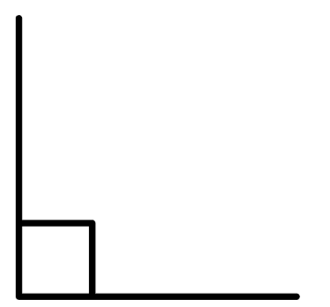
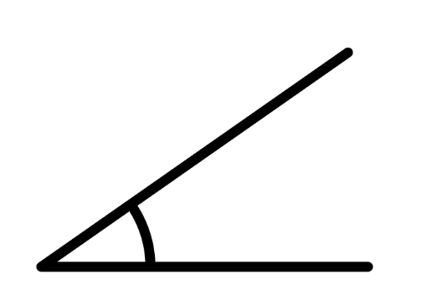

Short response (8)
Record the names of the angles shown:
Angle A
Angle B
Angle C
16
Notes:
Short response questions provide brisk paced questions focussing on review of current and previous content to support spaced and interleaved practice.
Syllabus focus area:
Geometric measure B: Angles (Note: Stage 2 content reviewed)

Slide 17





Activity 2 – ordering numbers in the millions 1
As a team, arrange yourselves into ascending order based on the given numbers.
For example,
3803
13 207 913
38 380 689
71 149 000
Notes:
This is a developing number sense activity.
Number sense refers to a deep understanding of numbers, including their magnitude, relationships, and the effects of operations on them. It supports fluency and understanding, estimation, flexible thinking, and efficient problem-solving. Number sense activities 1–4 ‘activate’ prior number knowledge and support the learning of new content in the unit. Number sense activities 5–8 ‘loop’ back and provide opportunity for spaced practice with concepts and procedures covered in previous units.
Syllabus focus area:
Represents numbers A
Activity 2 – ordering numbers in the millions 1
This resource corresponds to Resource 27 – number cards in Stage 3 Year A Unit 5.
1. Divide the class into equal teams and provide each student with a number card from Resource 27 – number cards. Instruct them not to look at the number
2. Explain that students will be playing a game where they will need to arrange themselves in ascending order according to their number card.
3. Give a prearranged signal to start the game.
4. Students look at their number and teams arrange themselves in ascending order, displaying their number cards.
5. When all teams have finished, check each team’s order by asking students to read out the numbers.
6. Repeat using different number cards.
7. Variations could include:
- the first team to arrange themselves in the correct order scores a point
- teams arrange themselves in descending order
- in pairs, students arrange all the numbers from Resource 27 – number cards. in ascending order.

Slide 18
Review of learning 3

Slide 19
Multiple choice (2)
Which number is between 3 691 104 and 3 691 604?
A
3 691 512
3 691 645
B
3 691 102
C
3 691 640
D
Notes:
This question connects to the content in the developing number sense activity (Activity 3)
Syllabus focus area:
Represents numbers A

Slide 20
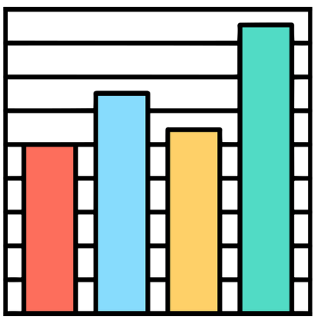
Short response (9)
What information
is missing to interpret
this column graph?
Notes:
Short response questions provide brisk paced questions focussing on review of current and previous content to support spaced and interleaved practice.
Syllabus focus area:
Data A

Slide 21
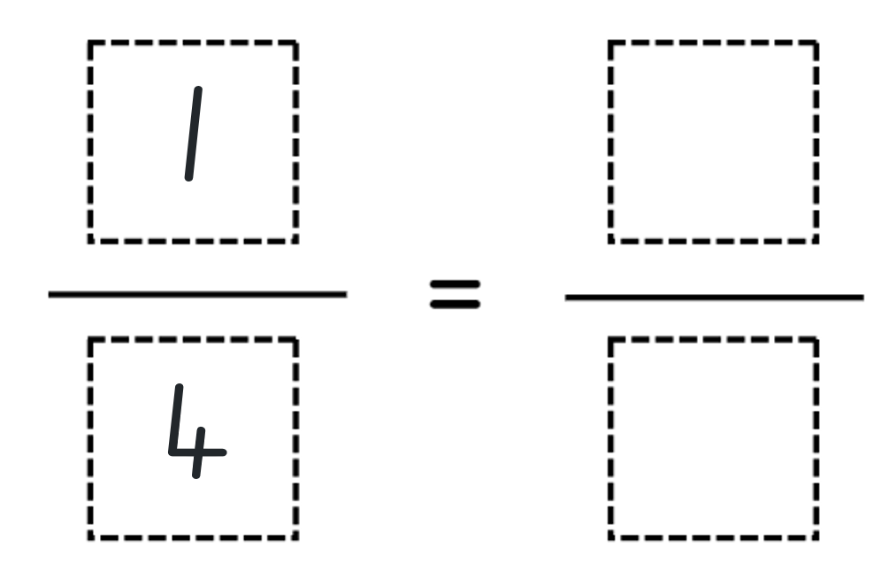
Short response (10)
Record an equivalent fraction.
Notes:
Short response questions provide brisk paced questions focussing on review of current and previous content to support spaced and interleaved practice.
Syllabus focus area:
Representing quantity fractions B

Slide 22

Short response (11)
If all sides of this triangle are equal, what is its perimeter?
6 cm
Notes:
Short response questions provide brisk paced questions focussing on review of current and previous content to support spaced and interleaved practice.
Syllabus focus area:
Geometric measure A: Length

Slide 23
Short response (12)
List 3 items in the classroom that
have one or more right angles.
Notes:
Short response questions provide brisk paced questions focussing on review of current and previous content to support spaced and interleaved practice.
Syllabus focus area:
Geometric measure B: Angles (Note: Stage 2 content reviewed)

Slide 24
Activity 3 – ordering numbers in the millions 2
As a pair, arrange the drawn cards in ascending order, using the fewest moves as possible.
For example,
We could order these four cards in 2 moves.
13 207 913
3803
71 149 000
38 380 689
Notes:
This is a developing number sense activity.
Number sense refers to a deep understanding of numbers, including their magnitude, relationships, and the effects of operations on them. It supports fluency and understanding, estimation, flexible thinking, and efficient problem-solving. Number sense activities 1–4 ‘activate’ prior number knowledge and support the learning of new content in the unit. Number sense activities 5–8 ‘loop’ back and provide opportunity for spaced practice with concepts and procedures covered in previous units.
Syllabus focus area:
Represents numbers A
Activity 3 – ordering numbers in the millions 2
This activity is an adaptation of ‘Order! Order! (four-digit numbers)’ from Thinking mathematically resources by State of New South Wales (Department of Education).
This resource corresponds to Resource 27 – number cards in Stage 3 Year A Unit 5.
Place Resource 27 – number cards in a pile face down.
In pairs, players draw 4 cards each and place them facing up in front of them.
Players are to rearrange the cards so that the numbers are in ascending order.
The aim of the game is to order the cards in the fewest moves possible, moving adjacent cards only.
Players take turns rearranging their cards and recording the number of moves it takes to order them.
The winner is the player who uses the fewest moves possible.
Observe students as they play and ask:
What will your next move be? Why?
What is the largest number?
What is the smallest number?
How many moves have you made so far?
Repeat with 4 new numbers and order these in descending order.

Slide 25
Review of learning 4

Slide 26
True or false (2)
5 420 231 comes before 5 402 319.
True | False
Notes:
The question on this slide connects to the content being explored in the developing number sense activity (Activity 4)
Syllabus focus area:
Represents numbers A

Slide 27
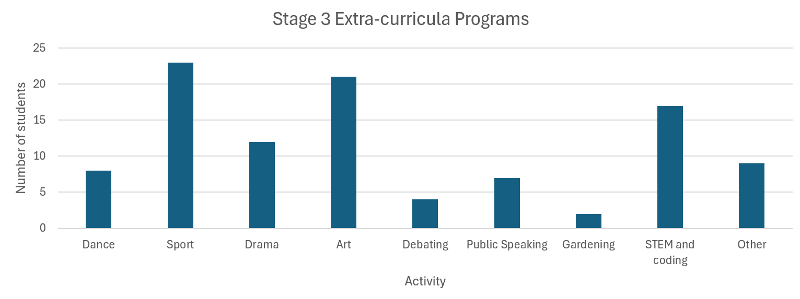
Short response (13)
Write the range and the mode for the
following data display.
Notes:
Short response questions provide brisk paced questions focussing on review of current and previous content to support spaced and interleaved practice.
Syllabus focus area:
Data B

Slide 28
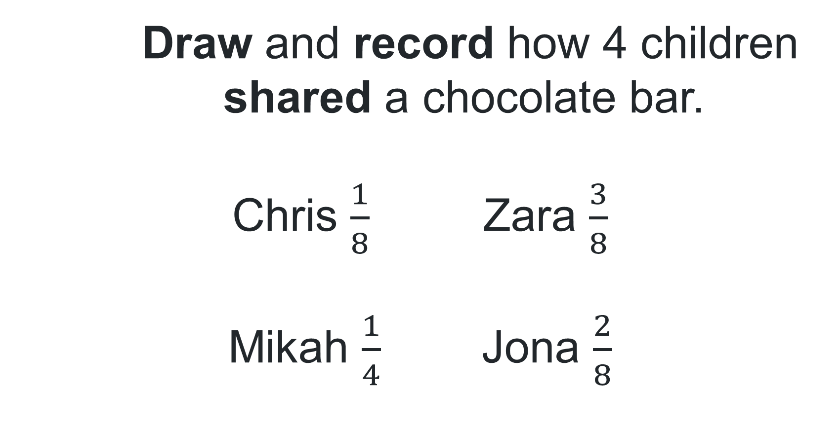
Short response (14)
Draw and record how 4 children
shared a chocolate bar.
Chris $\frac{1}{8}$ Zara $\frac{3}{8}$
Mikah $\frac{1}{4}$ Jona $\frac{2}{8}$
Notes:
Short response questions provide brisk paced questions focussing on review of current and previous content to support spaced and interleaved practice.
Syllabus focus area:
Representing quantity fractions A

Slide 29
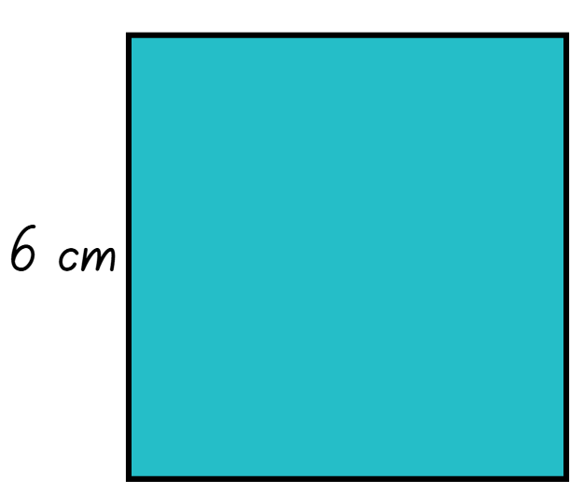
Short response (15)
What is the perimeter of this square?
Notes:
Short response questions provide brisk paced questions focussing on review of current and previous content to support spaced and interleaved practice.
Syllabus focus area:
Geometric measure A: Length

Slide 30
Short response (16)
Draw a trapezium and record the:
number of sides
number of angles
types of angles
number of pairs of parallel sides.
Notes:
Short response questions provide brisk paced questions focussing on review of current and previous content to support spaced and interleaved practice.
Syllabus focus area:
Two-dimensional spatial structure A: 2D shapes (Note: Stage 2 content reviewed)

Slide 31
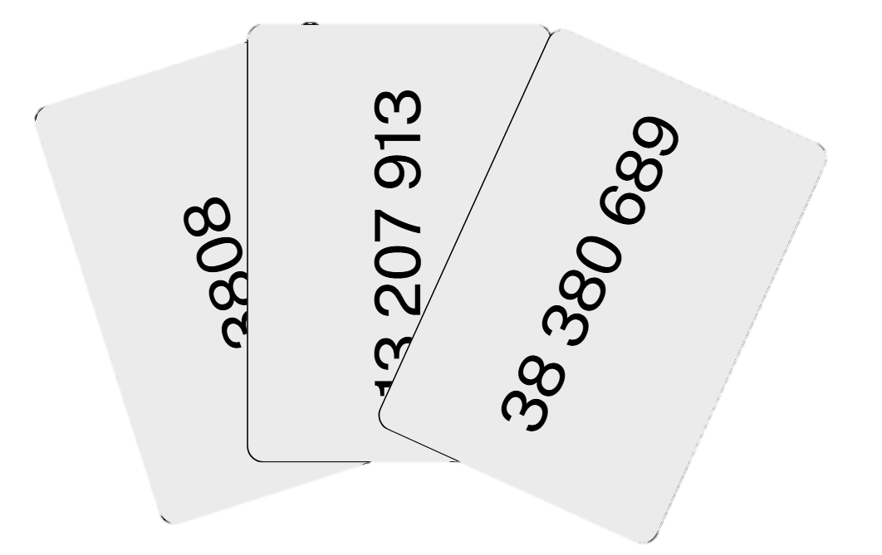
Activity 4 – ordering numbers in the millions 3
Discard your dealt 5 cards by taking turns to
place down on the pile, from smallest to largest.
Notes:
This is a developing number sense activity.
Number sense refers to a deep understanding of numbers, including their magnitude, relationships, and the effects of operations on them. It supports fluency and understanding, estimation, flexible thinking, and efficient problem-solving. Number sense activities 1–4 ‘activate’ prior number knowledge and support the learning of new content in the unit. Number sense activities 5–8 ‘loop’ back and provide opportunity for spaced practice with concepts and procedures covered in previous units.
Syllabus focus area:
Represents numbers A
Activity 4 - ordering numbers in the millions 3
This resource corresponds to Resource 27 – number cards in Stage 3 Year A Unit 5.
Provide pairs of students (or small groups) with Resource 27 – number cards.
Deal 5 cards to each player and place the rest of the cards face down in a pile.
3. Player 1 starts by putting down their smallest number.
4. Player 2 then puts down a number that is larger.
5. Players take turns putting down numbers in ascending order.
6. Players can choose to miss a turn, discard one of their cards and swap it with a card from the pile.
7. The winner is the first player to put down all the cards in their hand.

Slide 32
Review of learning 5

Slide 33
Multiple choice (3)
What is 13 x 2?
A
B
C
D
23
25
26
29
Notes:
This question connects to the content in the developing number sense activity (Activity 5)
Syllabus focus area:
Multiplicative relations A

Slide 34
Short response (17)
Draw a timeline with the following years
as points on a number line.
2015 1985 2005 1995 2025
Notes:
Short response questions provide brisk paced questions focussing on review of current and previous content to support spaced and interleaved practice.
Syllabus focus area:
Data B

Slide 35
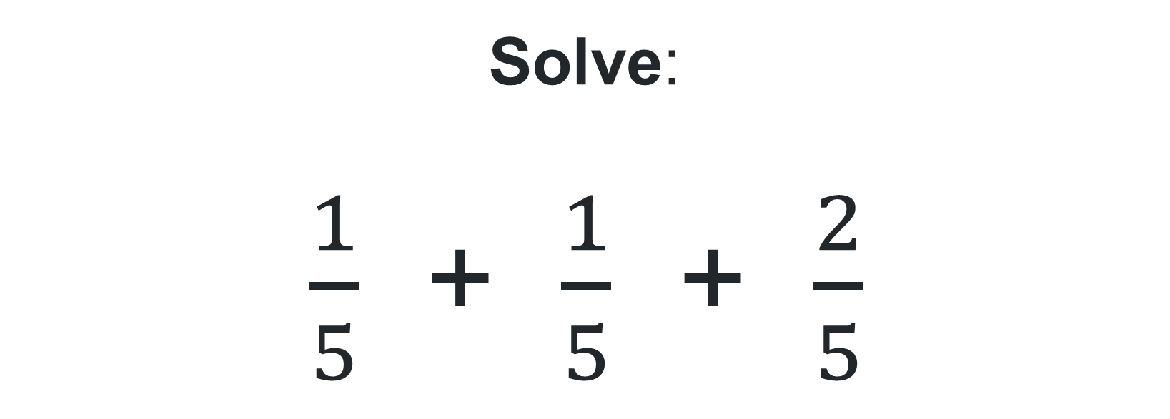
Short response (18)
Solve:
$\frac{1}{5}$ + $\frac{1}{5}$ + $\frac{2}{5}$
Notes:
Short response questions provide brisk paced questions focussing on review of current and previous content to support spaced and interleaved practice.
Syllabus focus area:
Representing quantity fractions A

Slide 36
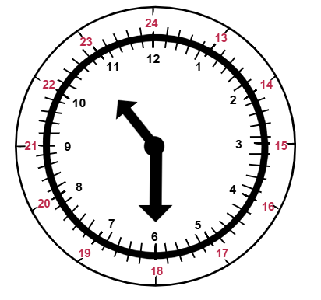
Short response (19)
What is 10:30 pm
in 24-hour time?
Notes:
Short response questions provide brisk paced questions focussing on review of current and previous content to support spaced and interleaved practice.
Syllabus focus area:
Non spatial measure A: Time

Slide 37
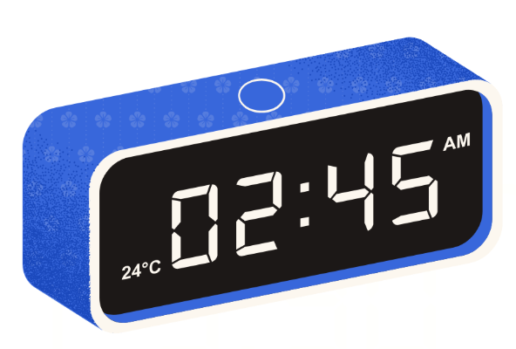
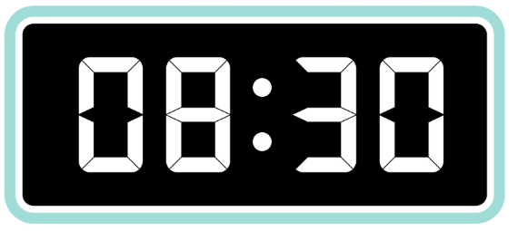

Short response (20)
Record in words, the time displayed on each digital clock.
clock A
clock B
clock C
Notes:
Short response questions provide brisk paced questions focussing on review of current and previous content to support spaced and interleaved practice.
Syllabus focus area:
Non-spatial measure B: Time (Note: Stage 2 content reviewed)

Slide 38

Activity 5 – multiplicative number talk
Let's talk 2: number talk (15 x 9) Stage 3 (6:15)
Record 2 strategies to solve:
15 x 9
Notes:
This is a developing number sense activity.
Number sense refers to a deep understanding of numbers, including their magnitude, relationships, and the effects of operations on them. It supports fluency and understanding, estimation, flexible thinking, and efficient problem-solving. Number sense activities 1–4 ‘activate’ prior number knowledge and support the learning of new content in the unit. Number sense activities 5–8 ‘loop’ back and provide opportunity for spaced practice with concepts and procedures covered in previous units.
Syllabus focus area:
Multiplicative relations A
Activity 5 – multiplicative number talk
This activity is an adaptation of ‘Let's talk 2 – number talk (15 x 9) Stage 3’ from Mathematics K-6 resources by the New South Wales (Department of Education).
1. Watch Let's talk 2: number talk (15 x 9) Stage 3 (6:15) as a class.
2. Prompt students to record at least 2 other strategies that could be used to solve 15 × 9.
3. Select students to share their thinking. Ask:
- Why did you choose that strategy?
- Are there any other strategies that are like this one?
- Have you used any of these strategies before?
- Which strategy do you think is the most efficient? Why?
4. Ask students if any of the strategies shared in the video could be used to solve 16 × 25.
5. Select students to share their thinking. Ask:
- What makes this strategy suitable for both problems?
- What other problems could this strategy be used for?

Slide 39
Review of learning 6

Slide 40
True or false (3)
15 x 4
can be represented as
15 x 2 + 15 x 2
True | False
Notes:
The question on this slide connects to the content being explored in the developing number sense activity (Activity 6)
Syllabus focus area:
Multiplicative relations A

Slide 41
Short response (21)
Order the following decimals from
smallest to largest:
0.34
0.4
0.0043
Notes:
Short response questions provide brisk paced questions focussing on review of current and previous content to support spaced and interleaved practice.
Syllabus focus area:
Represents numbers A

Slide 42
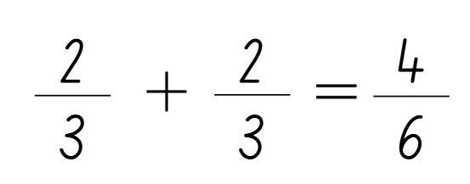
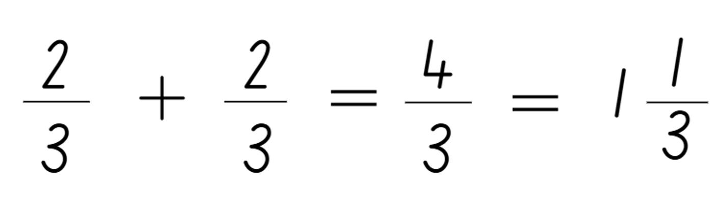
Short response (22)
Which fraction addition problem is correct?
or
Notes:
Short response questions provide brisk paced questions focussing on review of current and previous content to support spaced and interleaved practice.
Syllabus focus area:
Representing quantity fractions A

Slide 43
Short response (23)
Record the following 12-hour
times in 24-hour time:
3:15 pm
6:30 pm
9:25 pm
Notes:
Short response questions provide brisk paced questions focussing on review of current and previous content to support spaced and interleaved practice.
Syllabus focus area:
Non spatial measure A: Time

Slide 44
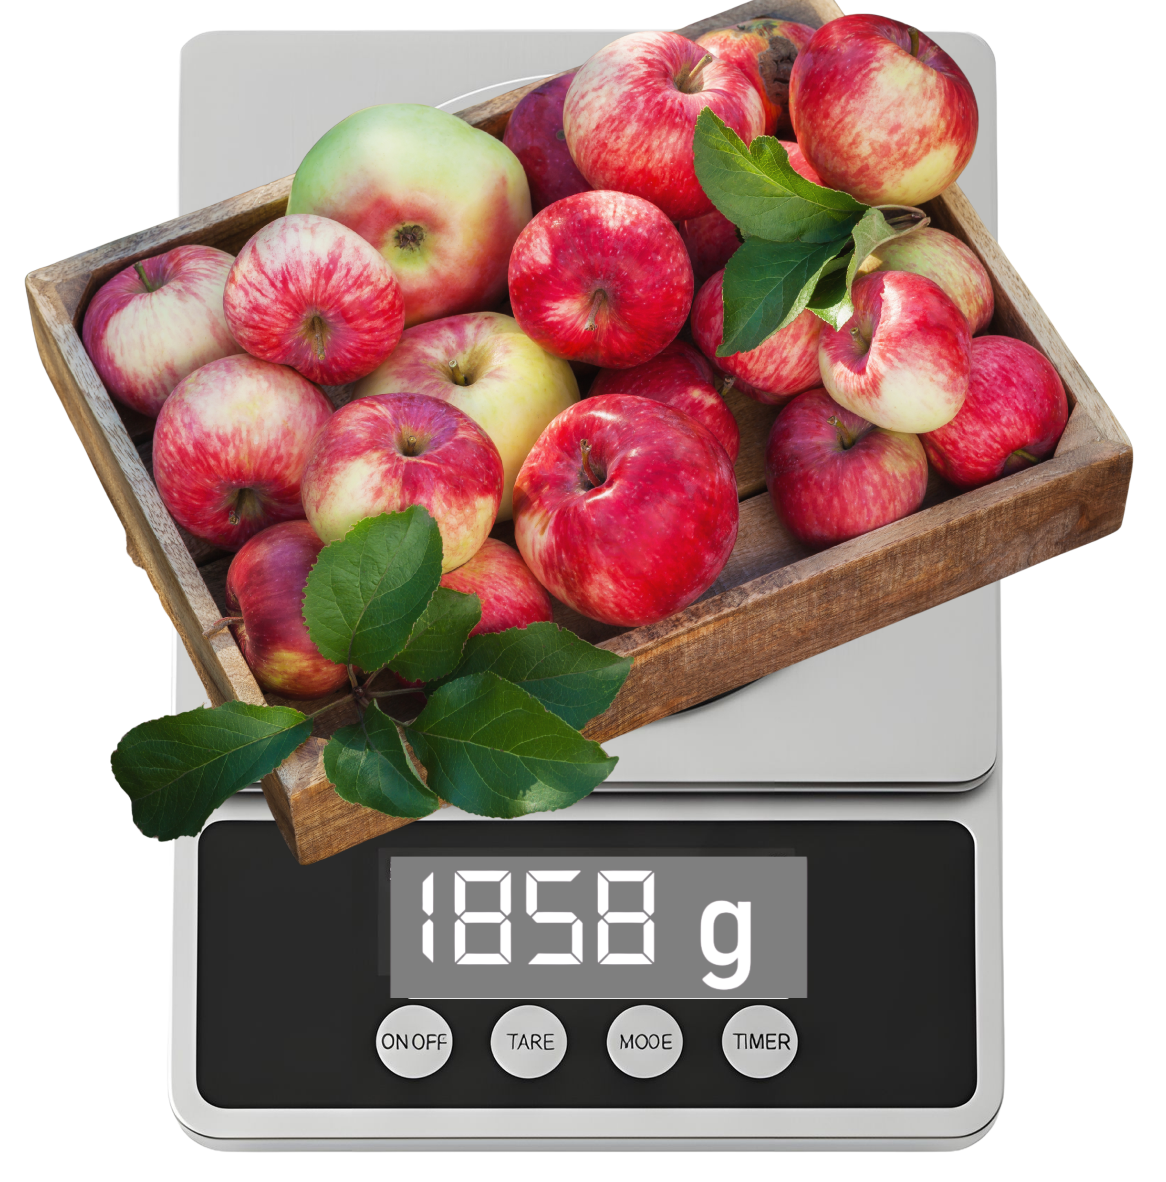
Short response (24)
Record the mass of the apples in grams and kilograms.
Notes:
Short response questions provide brisk paced questions focussing on review of current and previous content to support spaced and interleaved practice.
Syllabus focus area:
Non-spatial measure B: Mass (Note: Stage 2 content reviewed)

Slide 45

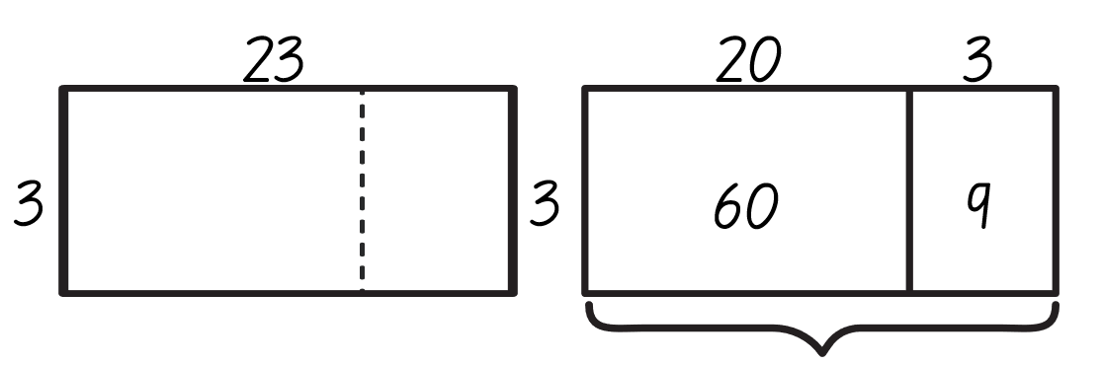
Activity 6 – using the area model for multiplication
23 x 3
Goat busters
45
Notes:
This is a developing number sense activity.
Number sense refers to a deep understanding of numbers, including their magnitude, relationships, and the effects of operations on them. It supports fluency and understanding, estimation, flexible thinking, and efficient problem-solving. Number sense activities 1–4 ‘activate’ prior number knowledge and support the learning of new content in the unit. Number sense activities 5–8 ‘loop’ back and provide opportunity for spaced practice with concepts and procedures covered in previous units.
Syllabus focus area:
Multiplicative relations A
Activity 6 – using the area model for multiplication
1. Connect back to Stage 3 unit 1 and remind students how to use the area model to multiply a one-digit number by a 2-digit number.
2. Model partitioning 23 into tens and ones before multiplying.
3. Provide students with digital devices and prompt them to play Goat busters level 1.

Slide 46
Review of learning 7

Slide 47
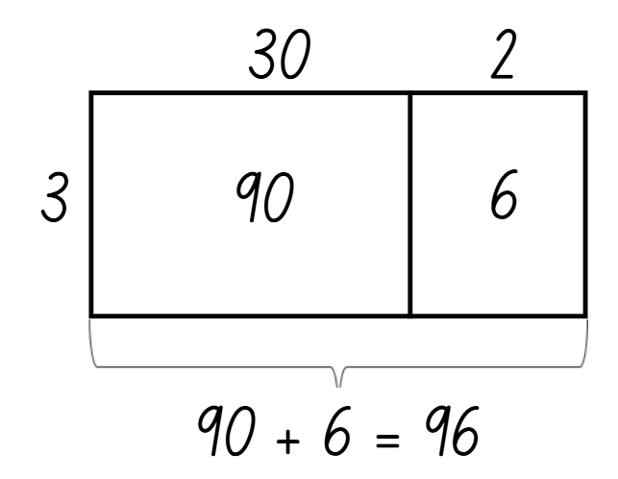
Multiple choice (4)
Which problem matches this area model?
A
B
C
D
30 x 2
32 x 3
302 x 3
3 x 302
Notes:
This question connects to the content in the developing number sense activity (Activity 7)
Syllabus focus area:
Multiplicative relations A

Slide 48
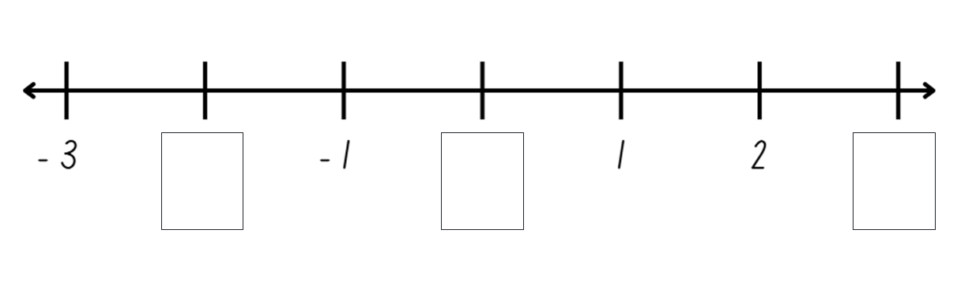
Short response (25)
Record the missing numbers.
Notes:
Short response questions provide brisk paced questions focussing on review of current and previous content to support spaced and interleaved practice.
Syllabus focus area:
Represents numbers B

Slide 49
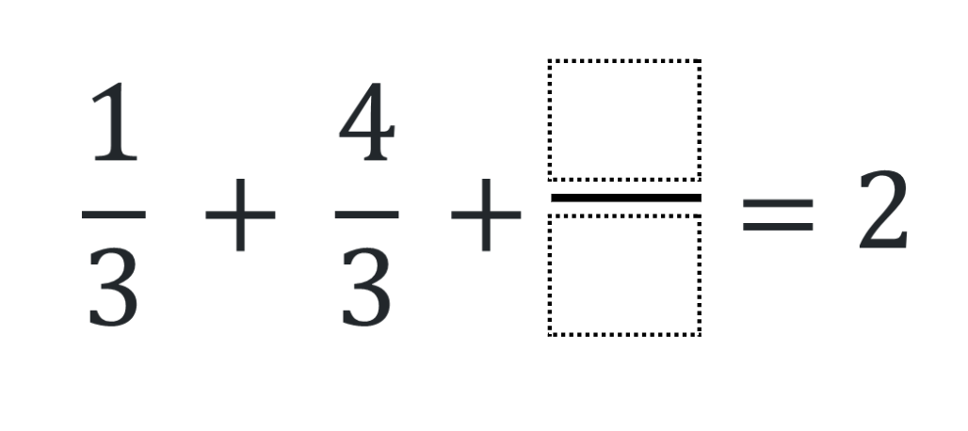
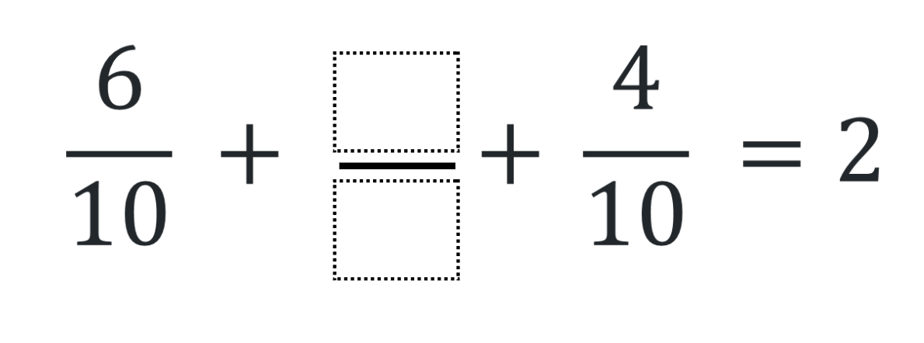
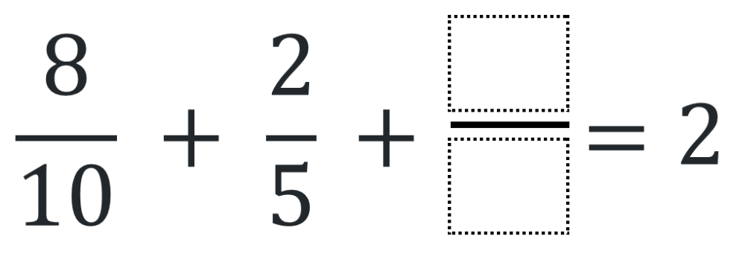
Short response (26)
What are the missing fractions?
Notes:
Short response questions provide brisk paced questions focussing on review of current and previous content to support spaced and interleaved practice.
Syllabus focus area:
Representing quantity fractions A

Slide 50
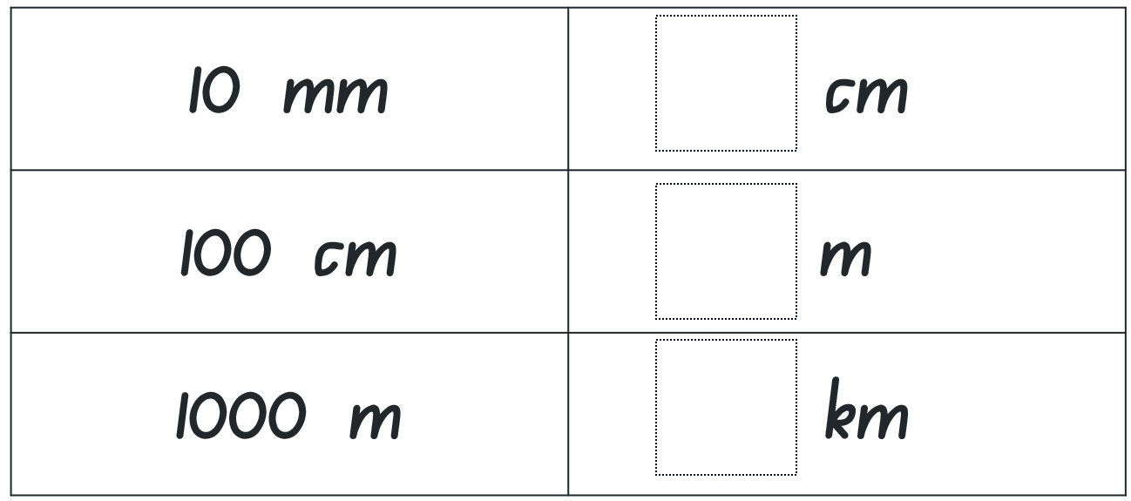
Short response (27)
Complete this conversion table:
Notes:
Short response questions provide brisk paced questions focussing on review of current and previous content to support spaced and interleaved practice.
Syllabus focus area:
Geometric measure B: Length

Slide 51
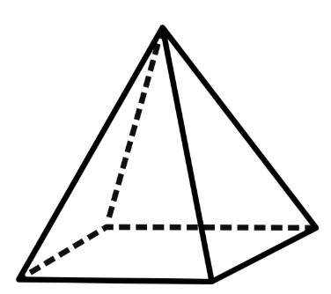
Short response (28)
Record the number of faces, vertices and edges of a square-based pyramid.
Notes:
Short response questions provide brisk paced questions focussing on review of current and previous content to support spaced and interleaved practice.
Syllabus focus area:
Three-dimensional spatial structure B: 3D objects (Note: Stage 2 content reviewed)

Slide 52
Activity 7 – multiplicative strategies
A
B
26 x 9
83 x 9
Which one doesn’t belong?
C
D
132 x 4
88 x 8
Notes:
This is a developing number sense activity.
Number sense refers to a deep understanding of numbers, including their magnitude, relationships, and the effects of operations on them. It supports fluency and understanding, estimation, flexible thinking, and efficient problem-solving. Number sense activities 1–4 ‘activate’ prior number knowledge and support the learning of new content in the unit. Number sense activities 5–8 ‘loop’ back and provide opportunity for spaced practice with concepts and procedures covered in previous units.
Syllabus focus area:
Multiplicative relations A
Activity 7 – multiplicative strategies
This resource corresponds to Resource 28 – which one doesn’t belong? in Stage 3 Year A Unit 5.
Prompt students to solve each equation, then determine which one doesn’t belong and why.
Remind students that they can use a range of mental or written strategies, such as using multiples of 10 or partitioning using the distributive property with the area model.
Explain that there are no wrong answers in this activity as there is a case to be made for each of the equations being different to the others.
Students think-pair-share their solution, justifying their reasoning.
Solutions include:
A is the only equation where the digits in the answer add to a number less than 10.
A is the only equation where the digits in the answer are consecutive.
B is the only equation where both numbers in the question are odd.
B is the only equation where the answer is a palindrome.
C is the only equation where a number in the question has 3 digits.
C is the only equation where the answer does not contain a 4.
D is the only equation where all the digits in the question are the same.
D is the only equation where there is a zero in the answer.
Discuss and compare strategies that students used to solve the equations.

Slide 53
Review of learning 8

Slide 54
True or false (4)
40 x 5 = 20 x 10
True | False
Communicate your reasoning.
Notes:
The question on this slide connects to the content being explored in the developing number sense activity (Activity 8)
Syllabus focus area:
Multiplicative relations A

Slide 55
Short response (29)
What is the most effective data display (column or line graph) for:
Monitoring the daily sales in a bakery
Recording the number of students attending choir each week
Tracking the height growth of a sunflower.
Notes:
Short response questions provide brisk paced questions focussing on review of current and previous content to support spaced and interleaved practice.
Syllabus focus area:
Data B

Slide 56
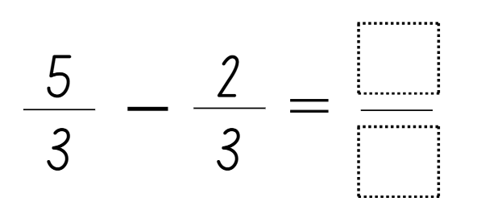
Short response (30)
Write a real-life mathematical problem for this equation and then solve it.
Notes:
Short response questions provide brisk paced questions focussing on review of current and previous content to support spaced and interleaved practice.
Syllabus focus area:
Representing quantity fractions A

Slide 57
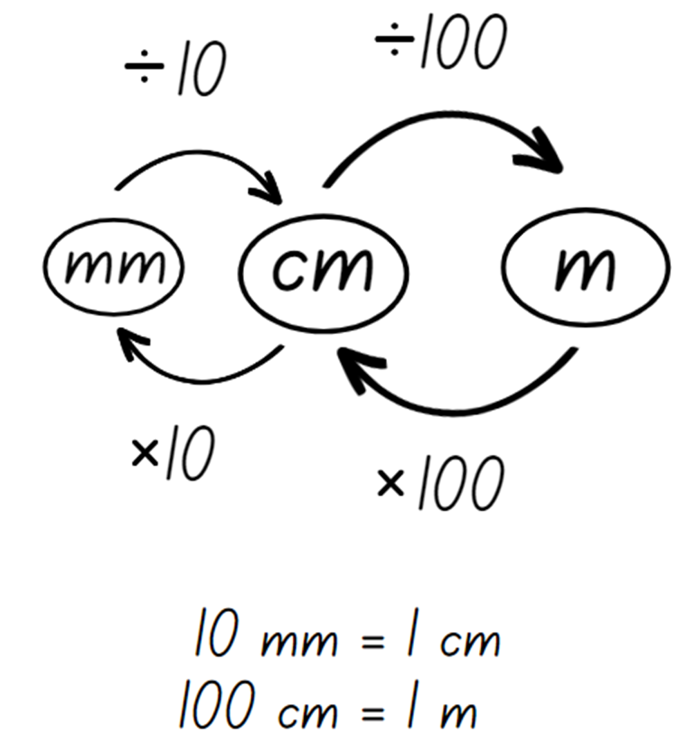
Short response (31)
Use the conversion graphic to solve:
40 m is the same as
cm
km
Notes:
Short response questions provide brisk paced questions focussing on review of current and previous content to support spaced and interleaved practice.
Syllabus focus area:
Geometric measure B: Length

Slide 58
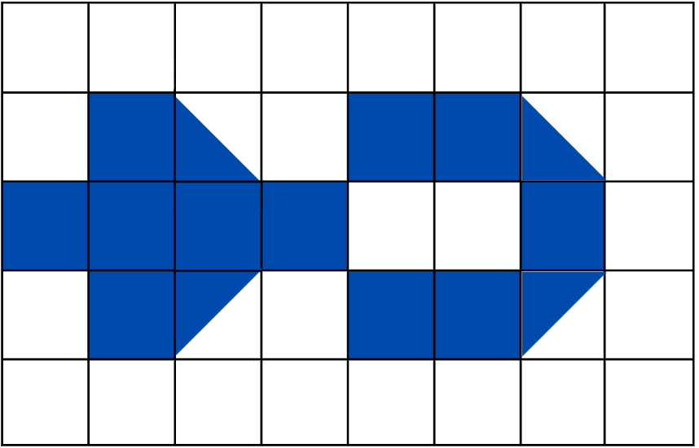
Short response (32)
Record the area of the blue shape:
Notes:
Short response questions provide brisk paced questions focussing on review of current and previous content to support spaced and interleaved practice.
Syllabus focus area:
Two-dimensional spatial structure B: Area (Note: Stage 2 content reviewed)

Slide 59
Activity 8 – multiplying by 10 and 100
What are some ways we can
balance the equations:
_0 × _ = _0 × _
_00 × _ = _00 × _
Notes:
This is a developing number sense activity.
Number sense refers to a deep understanding of numbers, including their magnitude, relationships, and the effects of operations on them. It supports fluency and understanding, estimation, flexible thinking, and efficient problem-solving. Number sense activities 1–4 ‘activate’ prior number knowledge and support the learning of new content in the unit. Number sense activities 5–8 ‘loop’ back and provide opportunity for spaced practice with concepts and procedures covered in previous units.
Syllabus focus area:
Multiplicative relations A
Activity 8 – multiplying by 10 and 100
1. Display _0 × _ = _0 × _.
2. Explain that each _ represents a missing digit and that students need to work out different ways to balance the equation.
3. Prompt students to write as many equations as possible on individual whiteboards.
4. Students turn and talk and share their equations. Ask:
- What patterns did you notice?
- How did you use multiplication facts and place value to help create different equations?
5. Repeat the process with the equation _00 × _ = _00 × _.
This activity is an adaptation of Multiply Multiples 1 from NRICH by University of Cambridge (Faculty of Mathematics).

Slide 60
Double Venn diagram
Object 1
Object 2
Features similar to both objects
Features of object 1
Features of object 2

Slide 61
Frayer
Definition
Facts/Characteristics
Word, term, concept
Examples
Non-examples

Slide 62
Spider map
Idea
Subject

Slide 63
Cline
Concept 1
Concept 2
Word
Word
Word
Word
Word
Word
Word
Word
Word
Word
Word

Slide 64

Compare and contrast

Slide 65
Multiple choice (5)
A
B
C
D

Slide 66
Multiple choice (6)
A
B
C
D

Slide 67
References 1
This presentation contains NSW Curriculum and syllabus content. The NSW Curriculum is developed by the NSW Education Standards Authority. This content is prepared by NESA for and on behalf of the Crown in the right of the State of New South Wales. The material is protected by Crown copyright.
Please refer to the NESA Copyright Disclaimer for more information https://educationstandards.nsw.edu.au/wps/portal/nesa/mini-footer/copyright.
NESA holds the only official and up-to-date versions of the NSW Curriculum and syllabus documents. Please visit the NSW Education Standards Authority (NESA) website https://educationstandards.nsw.edu.au/wps/portal/nesa/home and the NSW Curriculum website https://curriculum.nsw.edu.au.
Mathematics K–10 Syllabus © NSW Education Standards Authority (NESA) for and on behalf of the Crown in right of the State of New South Wales, 2022.
National Numeracy Learning Progression © Australian Curriculum, Assessment and Reporting Authority (ACARA) 2010 to present, unless otherwise indicated. This material was downloaded from the Australian Curriculum website (National Numeracy Learning Progression) (accessed 13 August 2025) and was not modified.
NSW Education Standards Authority (NESA) (2022a) ‘Teaching advice for Data A’, Stage 3, NSW Curriculum website, accessed 14 October 2025.
NSW Education Standards Authority (NESA) (2022b) ‘Teaching advice for Data B’, Stage 3, NSW Curriculum website, accessed 14 October 2025.
NSW Education Standards Authority (NESA) (2022c) ‘Teaching advice for Represents numbers B’, Stage 3, NSW Curriculum website, accessed 14 October 2025.
New Zealand Ministry of Education (n.d.) ‘Data Distortion’, Figure It Out, Tāhūrangi - New Zealand Curriculum website, accessed 16 June 2023.
New Zealand Ministry of Education (n.d.) ‘Discussing Data’, Figure It Out, Tāhūrangi - New Zealand Curriculum website, accessed 15 June 2023.

Slide 68
References 2
This presentation contains NSW Curriculum and syllabus content. The NSW Curriculum is developed by the NSW Education Standards Authority. This content is prepared by NESA for and on behalf of the Crown in the right of the State of New South Wales. The material is protected by Crown copyright.
Please refer to the NESA Copyright Disclaimer for more information https://educationstandards.nsw.edu.au/wps/portal/nesa/mini-footer/copyright.
NESA holds the only official and up-to-date versions of the NSW Curriculum and syllabus documents. Please visit the NSW Education Standards Authority (NESA) website https://educationstandards.nsw.edu.au/wps/portal/nesa/home and the NSW Curriculum website https://curriculum.nsw.edu.au.
ABC Education. (n.d.). Goat Busters [Online game]. Australian Broadcasting Corporation. Retrieved April 27, 2024, from https://games.abc.net.au/education/goat-busters/.
Australian Government Department of Education (2020) ‘Data: Making Decisions’, Teaching resources, reSolve: Maths by Inquiry website, accessed 18 June 2023.
State of New South Wales (Department of Education) (n.d.) ‘Let's talk 2 – number talk (15 x 9) Stage 3’, Mathematics K-6 resources, NSW Department of Education website, accessed 15 June 2023.
——(n.d.) ‘Order! Order! (four-digit numbers)’, Thinking mathematically resources, NSW Department of Education website, accessed 14 June 2023.
Sullivan P and Lilburn P (2017) Open-ended Maths Activities: Using ‘Good’ Questions to Enhance Learning in Mathematics, Revised edn, Oxford University Press ANZ, Great Britain.

Slide 69
Copyright
© State of New South Wales (Department of Education), 2025
The copyright material published in this resource is subject to the Copyright Act 1968 (Cth) and is owned by the NSW Department of Education or, where indicated, by a party other than the NSW Department of Education (third-party material).
Copyright material available in this resource and owned by the NSW Department of Education is licensed under a Creative Commons Attribution 4.0 International (CC BY 4.0) license.
This license allows you to share and adapt the material for any purpose, even commercially.
Attribution should be given to © State of New South Wales (Department of Education), 2025.
Material in this resource not available under a Creative Commons license:
the NSW Department of Education logo, other logos and trademark-protected material
Material owned by a third party that has been reproduced with permission. You will need to obtain permission from the third party to reuse its material.
Links to third-party material and websites
Please note that the provided (reading/viewing material/list/links/texts) are a suggestion only and implies no endorsement, by the New South Wales Department of Education, of any author, publisher, or book title. School principals and teachers are best placed to assess the suitability of resources that would complement the curriculum and reflect the needs and interests of their students.
If you use the links provided in this document to access a third party’s website, you acknowledge that the terms of use, including licence terms set out on the third-party’s website apply to the use which may be made of the materials on that third-party website or where permitted by the Copyright Act 1968 (Cth). The department accepts no responsibility for content on third-party websites.

