Slide 1
Instructions for use
This resource aligns to the learning in Stage 3 Year A Unit 19 and revisits content from earlier sample units.
Classroom teachers are encouraged to add, edit and adapt to meet the needs of their students.
Save a copy of the file to make changes to the slide deck. Go to File > Download a Copy (this downloads a copy to the computer to edit in the PowerPoint app).
To convert the PowerPoint to Google Slides:
  Upload the file into Google Drive and open it.
  Go to File > Save as Google Slides.
  (Note – conversion may cause formatting changes in the slides.)

Slide 2

Review of Learning
Mathematics Stage 3 – Unit 19
Notes:
Reviews may include a combination of question types, requiring students to recall facts and key ideas, as well as apply their knowledge to solve problems and answer questions. To support active engagement, a mix of techniques should be employed.” (AERO, 2024).
This Review of Learning slide deck revisits key concepts from the following units:
Stage 3 Year A Unit 19
Stage 3 Year A Unit 18
Stage 3 Year A Unit 17
It also includes opportunities to review prior learning in non-number content, supporting consolidation across focus areas.
The review of learning resources include three key task types that support the development of mathematical proficiency through retrieval, spaced practice, and active participation. These practices complement the review phase (activating prior knowledge) embedded within the beginning of each lesson.
1.
Multiple-choice questions/True or false: Designed to promote active retrieval of key concepts and identify common misconceptions in number, supporting consolidation, understanding and fluency.
These questions:
support spaced and interleaved practice
help identify and address common misconceptions
support active recall and immediate feedback
support whole class participation
identify areas requiring reteach
2.
Short-response question sets: Carefully grouped questions that encourage spaced and interleaved practice across multiple focus areas, helping students revisit and apply knowledge from different points in time.
These questions:
have a combination of question types
address a range of focus areas
build automaticity and fluency
support active recall
allow for immediate feedback
identify content requiring reteach
3.
Developing number sense activities: A variety of practical, purposeful tasks that reinforce current learning and build on prior knowledge. These activities promote reasoning, problem-solving and conceptual understanding.
The review of learning resources are designed to work support teaching and learning in mathematics. For the most effective implementation, use the resources flexibly, adapting to meet student learning needs and individual classroom contexts.

Slide 3
Lessons
1
Review of learning 1
5
Review of learning 5
2
Review of learning 2
6
Review of learning 6
3
Review of learning 3
7
Review of learning 7
4
Review of learning 4
8
Review of learning 8
Notes:
Teacher notes:
Click lesson numbers to go to specific lessons
Interactive features can be viewed in slide show

Slide 4
Review of learning 1

Slide 5

Multiple choice (1)
Which of the following is not an accurate representation of 45 982 432?
A
40 000 000 + 5 000 000 + 982 000 + 432
B
45 000 000 + 900 000 + 82 000 + 400 + 32
C
45 000 000 + 900 000 + 80 000 + 200 + 432
D
45 000 000 + 900 000 + 82 000 + 430 + 2
Notes:
This question connects to the content in the developing number sense activity (Activity 1)
Syllabus focus area:
Represent numbers A

Slide 6

Short response (1)
Record a short definition for each of the following:
Equilateral triangle
Isoceles triangle
Scalene triangle
Notes:
Short response questions provide brisk paced questions focussing on review of current and previous content to support spaced and interleaved practice.
Syllabus focus area:
Two-dimensional spatial structure A: 2D shapes

Slide 7
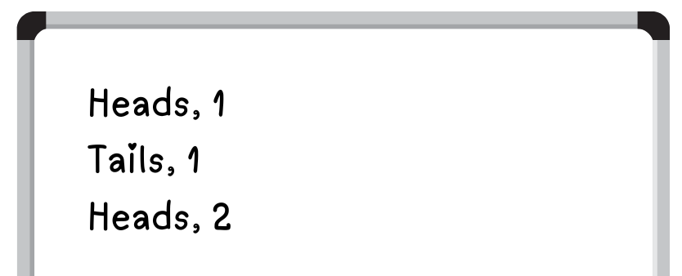
Short response (2)
Amelia flipped a coin and rolled a 6-sided dice. She listed some of the possible outcomes.
Complete Amelia’s list to show all possible outcomes.
Notes:
Short response questions provide brisk paced questions focussing on review of current and previous content to support spaced and interleaved practice.
Syllabus focus area:
Chance A

Slide 8
Short response (3)
Estimate the product of 589 x 6.
Justify your estimate by communicating your reasoning.
Notes:
Short response questions provide brisk paced questions focussing on review of current and previous content to support spaced and interleaved practice.
Syllabus focus area:
Multiplicative relations A

Slide 9
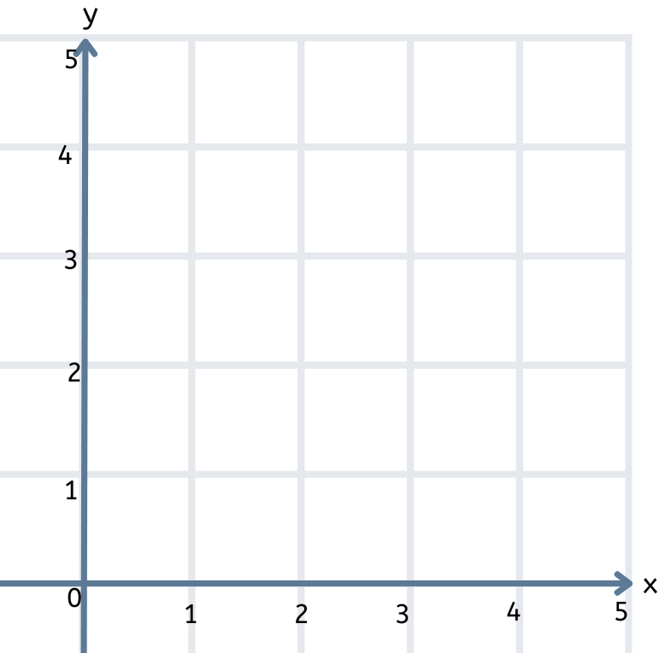
Short response (4)
Identify and record the coordinates for:
Point A
Point B
Point C
C
A
B
Notes:
Short response questions provide brisk paced questions focussing on review of current and previous content to support spaced and interleaved practice.
Syllabus focus area:
Geometric measure A: Position

Slide 10

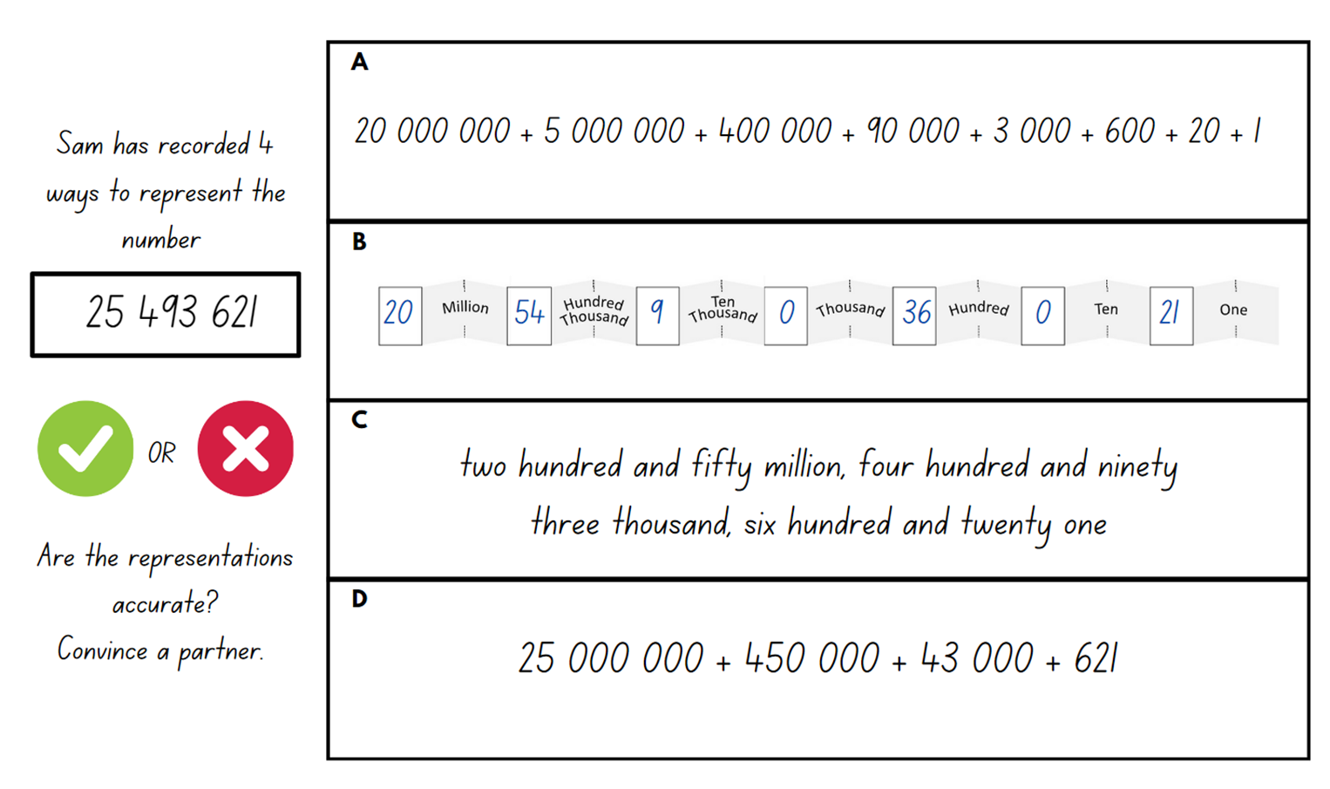
Activity 1 – place value representations
.
Notes:
This is a developing number sense activity.
Number sense refers to a deep understanding of numbers, including their magnitude, relationships, and the effects of operations on them. It supports fluency and understanding, estimation, flexible thinking, and efficient problem-solving. Number sense activities 1–4 ‘activate’ prior number knowledge and support the learning of new content in the unit. Number sense activities 5–8 ‘loop’ back and provide opportunity for spaced practice with concepts and procedures covered in previous units.
Syllabus focus area:
Represents numbers A
Place value representations
Note: number expanders or place values houses, such as Resource 22 – place value houses from Stage 3 Unit 19, can be used to assist students to rename and partition numbers into non-standard forms. When applying place value understanding, it is important to start at the ones column, as ones are the building blocks of whole numbers. The next place value column to the left of the ones column is created by grouping 10 ones together. This process is repeated through more place value columns to the left as the number increases.
Display Resource 23 – place value representations from Stage 3 Unit 19.
Students turn and talk to determine the accuracy of each representation, communicating and justifying their thinking.
Discuss each representation as a class, selecting students to share their reasoning.

Slide 11
Review of learning 2

Slide 12
True or false (1)
935 216 can be regrouped as
900 000 + 30 000 + 200 + 10 + 6.
True | False
Notes:
The question on this slide connects to the content being explored in the developing number sense activity (Activity 2)
Syllabus focus area:
Represent numbers A

Slide 13
Short response (5)
Record the side and angle properties of this triangle.
Notes:
Short response questions provide brisk paced questions focussing on review of current and previous content to support spaced and interleaved practice.
Syllabus focus area:
Two-dimensional spatial structure A

Slide 14
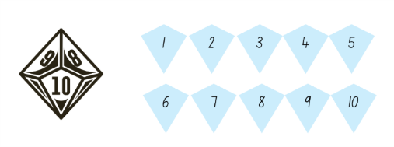
Short response (6)
What is the probability of rolling two 7’s in a row?
What is the probability of rolling any number except a 10?
Notes:
Short response questions provide brisk paced questions focussing on review of current and previous content to support spaced and interleaved practice.
Syllabus focus area:
Chance A

Slide 15
Short response (7)
Liam is making a poster that has an area of 80 square centimetres.
What could be the length and width of his poster?
Notes:
Short response questions provide brisk paced questions focussing on review of current and previous content to support spaced and interleaved practice.
Syllabus focus area:
Two-dimensional spatial structure A: Area

Slide 16
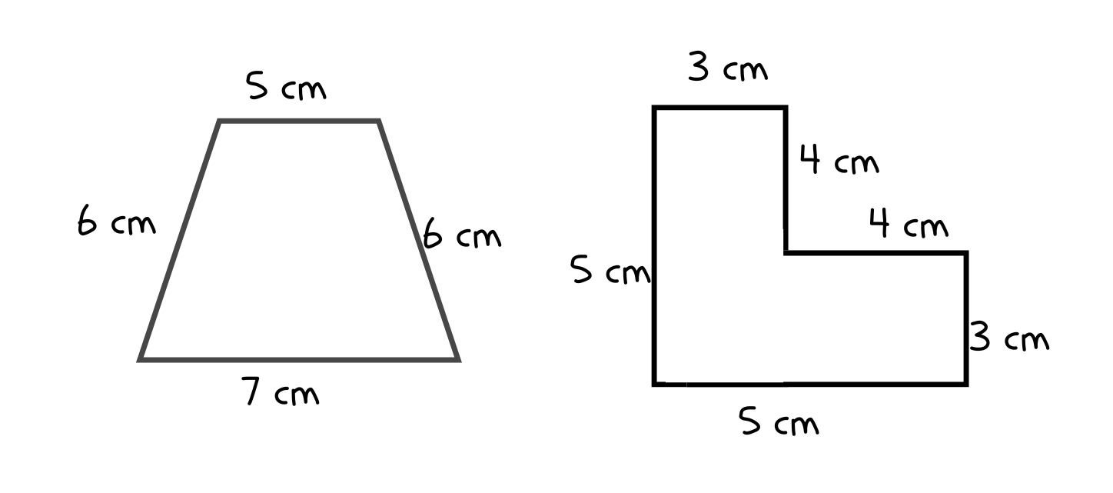
Short response (8)
Calculate the perimeter of these shapes.
Notes:
Short response questions provide brisk paced questions focussing on review of current and previous content to support spaced and interleaved practice.
Syllabus focus area:
Geometric measure A: Length

Slide 17
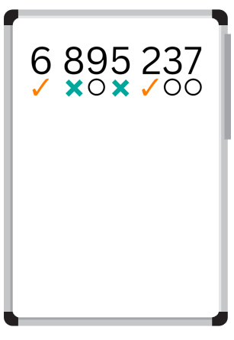

Activity 2 – Mastermind 1
6 719 243
Notes:
This is a developing number sense activity.
Number sense refers to a deep understanding of numbers, including their magnitude, relationships, and the effects of operations on them. It supports fluency and understanding, estimation, flexible thinking, and efficient problem-solving. Number sense activities 1–4 ‘activate’ prior number knowledge and support the learning of new content in the unit. Number sense activities 5–8 ‘loop’ back and provide opportunity for spaced practice with concepts and procedures covered in previous units.
Syllabus focus area:
Represents numbers A
Mastermind 1
This activity is an adaptation of Mastermind from Mathematics K-6 Resources by State of New South Wales (Department of Education).
Explain the game instructions for ‘Mastermind’:
In pairs, students write down a 7-digit number without showing the other player.
Players take turns to guess their opponent’s 7-digit number. Guessed numbers should be written down and read aloud using correct place value language. For example, 6 719 243 would be read ‘six million, seven hundred and nineteen thousand, two hundred and forty-three'.
After each guess, the player’s opponent identifies which digits are correct, which digits are correct but in the wrong place, and which digits are incorrect, by using symbols underneath the number. Players use a tick for the correct digit, place a circle for the correct digit but incorrect place, and a cross for the incorrect digit. For example, for the number 6 719 243, if the guess was 6 895 237, there are 2 correct digits in the correct place, 3 correct digits but in the incorrect place and 2 incorrect digits.
Players use this information to refine their guesses.
The player to correctly guess their opponent’s number using the fewest guesses is the winner.
Note: the level of difficulty can be changed by using numbers with fewer or more digits and by using numbers with internal zeros.
After the winner is determined, students writing the number in expanded notation. Number expanders or place values houses, such as Resource 22 – place value houses from Stage 3 Unit 19, can be used to assist students.

Slide 18
Review of learning 3

Slide 19
Multiple choice (2)
Which of the following shows an accurate regrouping of 67 304 256?
A | 60 000 000 + 7 000 000 + 300 000 + 40 000 + 2000 + 56
B | 67 000 000 + 30 000 + 4000 + 200 + 50 + 6
C | 60 000 000 + 7 000 000 + 300 000 + 400 + 200 + 50 + 6
D | 60 000 000 + 7 000 000 + 300 000 + 4000 + 200 + 50 + 6
Notes:
This question connects to the content in the developing number sense activity (Activity 3)
Syllabus focus area:
Represent numbers A

Slide 20
Short response (9)
Complete the table.
Shape | Properties of sides | Properties of angles | Line symmetry properties | Regular or irregular
Rectangle
Trapezium
Equilateral triangle
Notes:
Short response questions provide brisk paced questions focussing on review of current and previous content to support spaced and interleaved practice.
Syllabus focus area:
Two-dimensional spatial structure A: 2D shapes

Slide 21
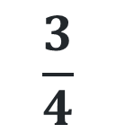
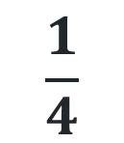
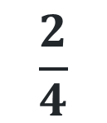
Short response (10)
Sam has 4 different coloured t-shirts in a bag, a green, a red, a blue and a yellow. Which fraction describes the probability of him randomly selecting the blue shirt. Explain your reasoning.
$$\frac{1}{4}$$
$$\frac{2}{4}$$
$$\frac{3}{4}$$
0 1
Notes:
Short response questions provide brisk paced questions focussing on review of current and previous content to support spaced and interleaved practice.
Syllabus focus area:
Chance A

Slide 22

Short response (11)
Record as many ways as possible to calculate the area of this shape.
Notes:
Short response questions provide brisk paced questions focussing on review of current and previous content to support spaced and interleaved practice.
Syllabus focus area:
Two-dimensional spatial structure B: Area

Slide 23
Short response (12)
Record a short definition for each of the following:
Probability
Unlikely
Equally likely
Notes:
Short response questions provide brisk paced questions focussing on review of current and previous content to support spaced and interleaved practice.
Syllabus focus area:
Chance A

Slide 24
Activity 3 – Mastermind 2
6 719 243
Notes:
This is a developing number sense activity.
Number sense refers to a deep understanding of numbers, including their magnitude, relationships, and the effects of operations on them. It supports fluency and understanding, estimation, flexible thinking, and efficient problem-solving. Number sense activities 1–4 ‘activate’ prior number knowledge and support the learning of new content in the unit. Number sense activities 5–8 ‘loop’ back and provide opportunity for spaced practice with concepts and procedures covered in previous units.
Syllabus focus area:
Represents numbers A
Mastermind 2
This activity is an adaptation of Mastermind from Mathematics K-6 resources by State of New South Wales (Department of Education).
Explain the game instructions for ‘Mastermind’:
In pairs, students write down a 7-digit number without showing the other player.
Players take turns to guess their opponent’s 7-digit number. Guessed numbers should be written down and read aloud using correct place value language. For example, 6 719 243 would be read ‘six million, seven hundred and nineteen thousand, two hundred and forty-three'.
After each guess, the player’s opponent identifies which digits are correct, which digits are correct but in the wrong place, and which digits are incorrect, by using symbols underneath the number. Players use a tick for the correct digit, place a circle for the correct digit but incorrect place, and a cross for the incorrect digit. For example, for the number 6 719 243, if the guess was 6 895 237, there are 2 correct digits in the correct place, 3 correct digits but in the incorrect place and 2 incorrect digits.
Players use this information to refine their guesses.
The player to correctly guess their opponent’s number using the fewest guesses is the winner.
Note: the level of difficulty can be changed by using numbers with fewer or more digits and by using numbers with internal zeros.
After the winner is determined, students writing the number in expanded notation. Number expanders or place values houses can be used to assist students.

Slide 25
Review of learning 4

Slide 26
True or false (2)
69 357 821 can be partitioned in non-standard form as
49 000 000 + 20 000 000 + 300 000 + 570 + 821.
True | False
Notes:
The question on this slide connects to the content being explored in the developing number sense activity (Activity 4)
Syllabus focus area:
Represent numbers A

Slide 27
Short response (13)
Record the name and symbol of the
unit of measure used to measure the size of an angle.
Notes:
Short response questions provide brisk paced questions focussing on review of current and previous content to support spaced and interleaved practice.
Syllabus focus area:
Geometric measure A: Angles

Slide 28
Short response (14)
A bag contains 3 red marbles, 2 blue marbles, and 1 green marble. One marble is picked at random.
What is the probability of picking a blue marble? Represent your answer as a fraction.
Notes:
Short response questions provide brisk paced questions focussing on review of current and previous content to support spaced and interleaved practice.
Syllabus focus area:
Chance A

Slide 29
Short response (15)
The area of the floor of a rectangular tent is 72 m² and the length is 9 metres.
What is the width of the tent?
Notes:
Short response questions provide brisk paced questions focussing on review of current and previous content to support spaced and interleaved practice.
Syllabus focus area:
Two-dimensional spatial structure A: Area

Slide 30
Short response (16)
Record the following masses in decimal notation:
2 kg 250 g
32 kg 705 g
16 kg 400 g
Notes:
Short response questions provide brisk paced questions focussing on review of current and previous content to support spaced and interleaved practice.
Syllabus focus area:
Non-spatial measure A: Mass

Slide 31

Activity 4 – partitioning numbers to 1 billion
277 534 122
277
5
3
4
1
2
2
277 millions 534 thousands 1 hundreds 2 tens 2 ones
Can this number be partitioned without using thousands?
Population by Country
https://www.worldometers.info/world-population/population-by-country/
Can this number be partitioned without using hundreds?
Notes:
This is a developing number sense activity.
Number sense refers to a deep understanding of numbers, including their magnitude, relationships, and the effects of operations on them. It supports fluency and understanding, estimation, flexible thinking, and efficient problem-solving. Number sense activities 1–4 ‘activate’ prior number knowledge and support the learning of new content in the unit. Number sense activities 5–8 ‘loop’ back and provide opportunity for spaced practice with concepts and procedures covered in previous units.
Syllabus focus area:
Represents numbers A
Partitioning numbers to 1 billion
Note: this slide has an interactive function. A click of a mouse will trigger the strike through to suggest a partitioning without using thousands.
Use the population of Indonesia as an example to demonstrate standard partitioning of a number up to 1 billion. For example, 277 534 122 can be partitioned as 277 millions, 534 thousands, 1 hundreds, 2 tens and 2 ones.
Note: according to Population by Country, it was reported that in July 2023, the population of Indonesia was 277 534 122 (Worldometer 2023).
Ask the following questions:
Can this number be partitioned without using thousands?
How can you work this out?
Demonstrate regrouping thousands into hundreds. By regrouping 277 534 122, the population of Indonesia can be partitioned into 277 millions, 5341 hundreds, 2 tens and 2 ones or 22 ones.
Ask the following questions:
Can this number be partitioned without using hundreds?
How can you work this out?
Access Population by Country to retrieve current population data for Vietnam and Mexico. Write the populations for both countries on the board.
Students write each number in standard and non-standard partitioning on individual whiteboards.
Students share their answers, explaining and checking the accuracy of the non-standard partitioning.
Students turn and talk to discuss possible ways to regroup 1 million and 1 billion. For example, 1 million is the same as 1000 thousand. 1 billion is the same as 1000 million

Slide 32
Review of learning 5

Slide 33
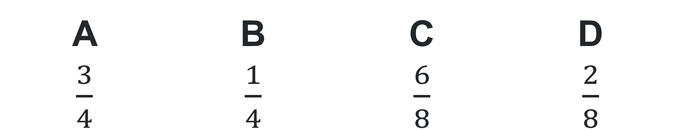

Multiple choice (3)
$\frac{4}{8}$ + $\frac{2}{8}$ is the same as…
A | B | C | D
$\frac{3}{4}$ | $\frac{1}{4}$ | $\frac{6}{8}$ | $\frac{2}{8}$
Notes:
This question connects to the content in the developing number sense activity (Activity 5)
Syllabus focus area:
Represents quantity fractions A

Slide 34
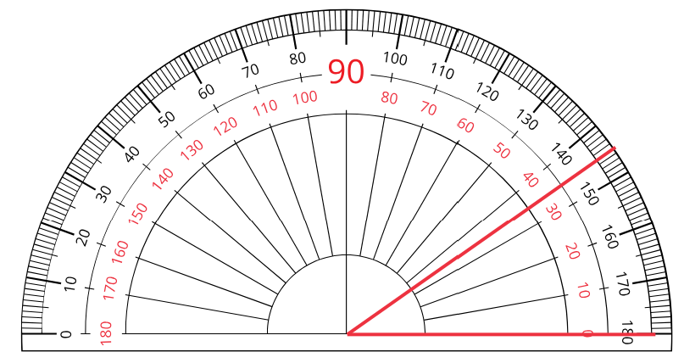
Short response (17)
Record the internal angle. Calculate the external angle.
Notes:
Short response questions provide brisk paced questions focussing on review of current and previous content to support spaced and interleaved practice.
Syllabus focus area:
Geometric measure A: Angles

Slide 35
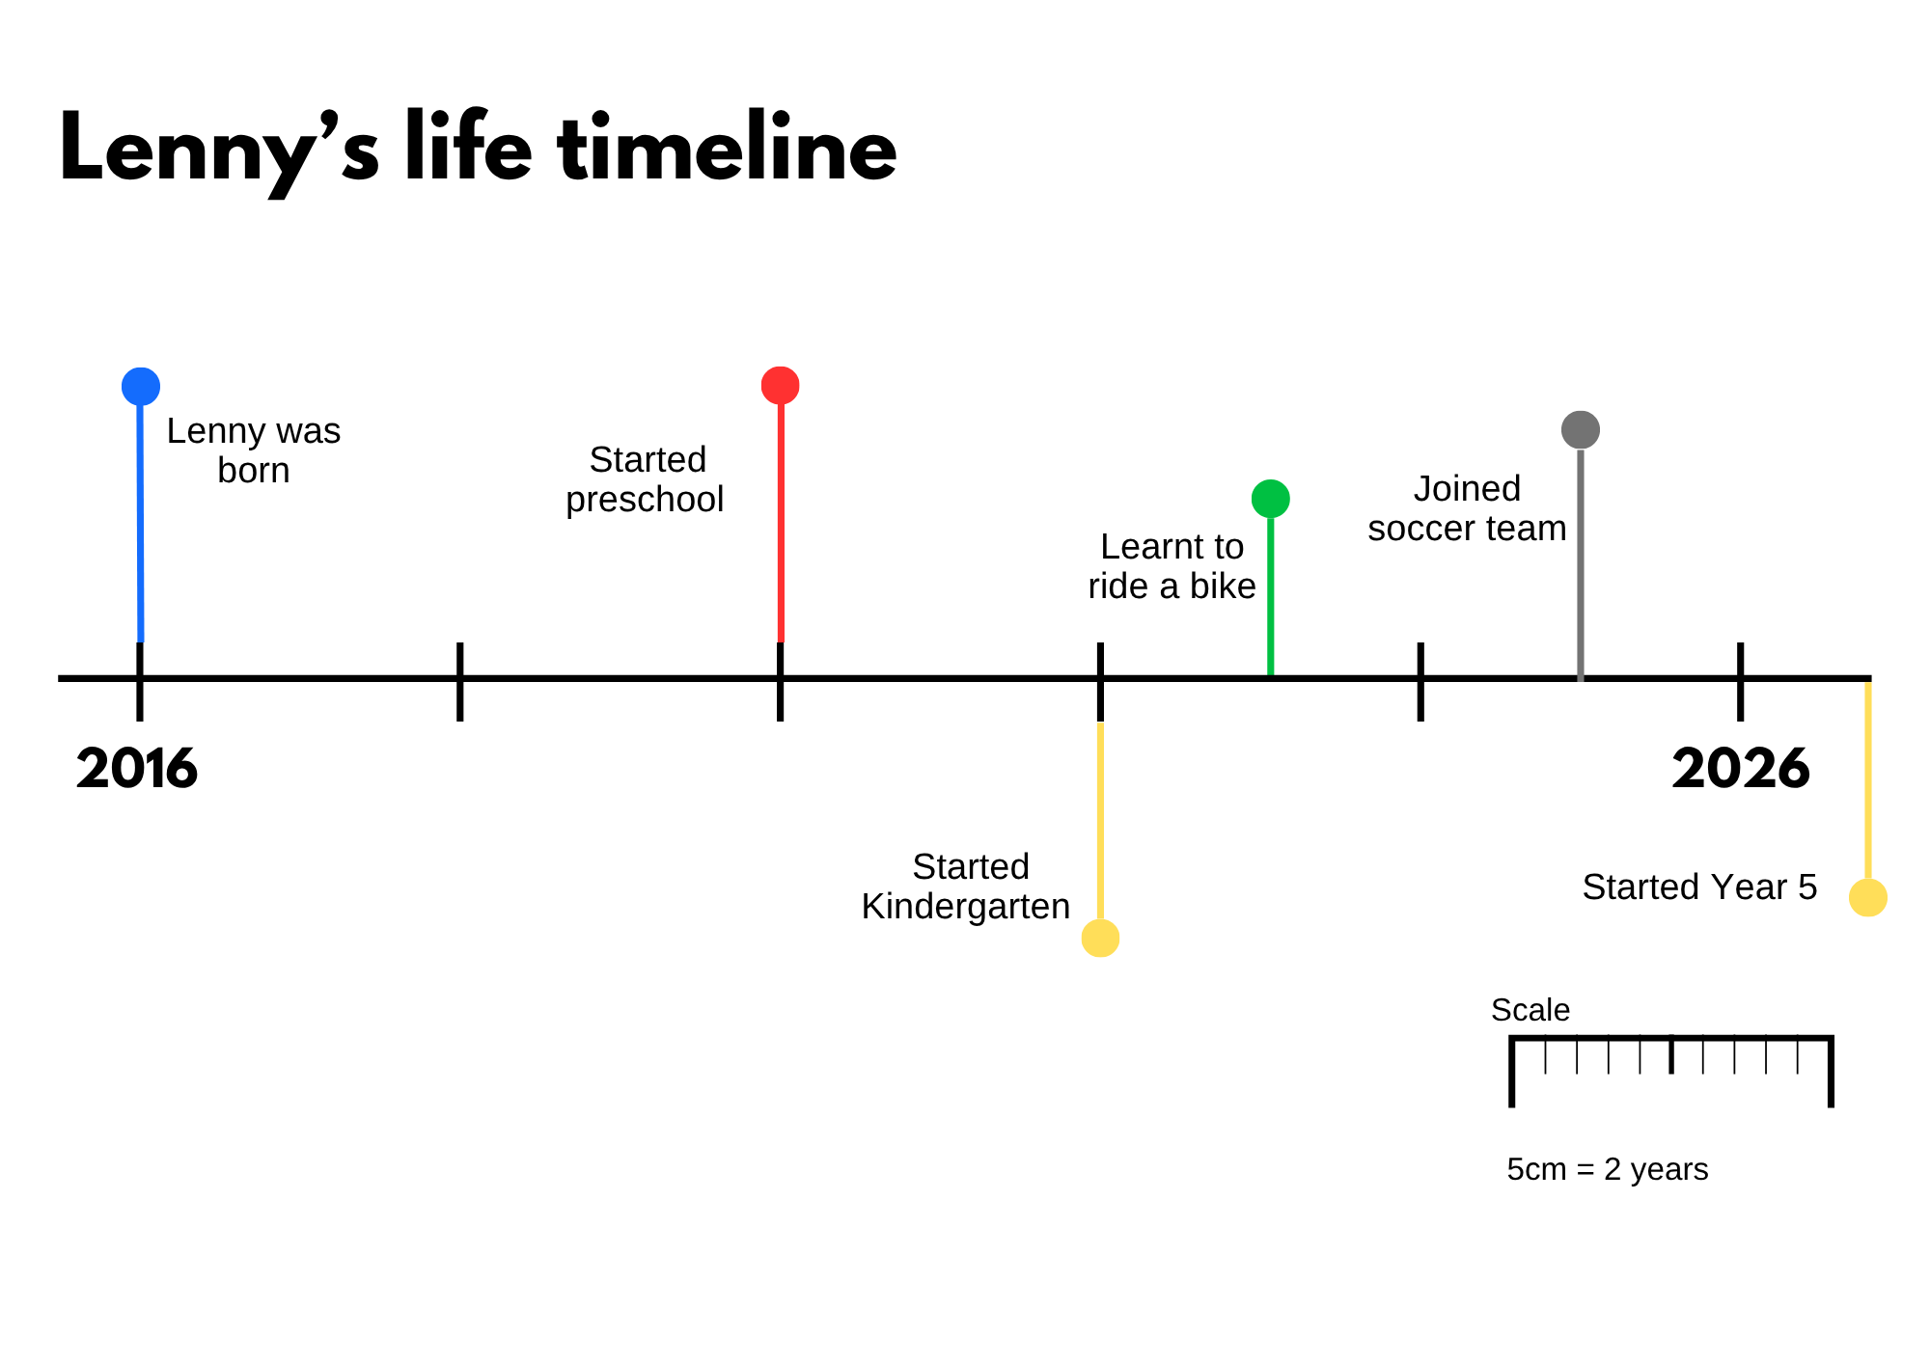
Short response (18)
Use the scale to answer the following questions:
What year did Lenny start Kindergarten?
How many years after starting Kindergarten did Lenny join the soccer team?
5 cm
Notes:
Short response questions provide brisk paced questions focussing on review of current and previous content to support spaced and interleaved practice.
Syllabus focus area:
Data B

Slide 36
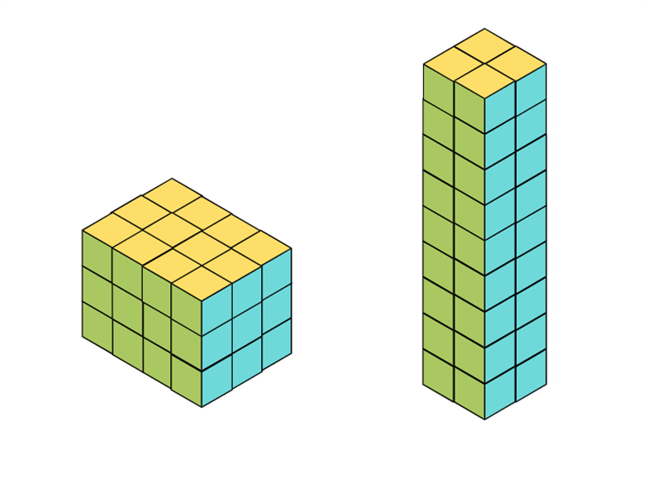
Short response (19)
Nellie built two different prisms with the same volume of 36 cm³.
The first prism consisted of 4 cubes in the base layer x 9 layers.
Complete the sentence to determine what the second prism could have looked like.
_____ cubes in the base layer x _____ layers.
Notes:
Short response questions provide brisk paced questions focussing on review of current and previous content to support spaced and interleaved practice.
Syllabus focus area:
Three-dimensional spatial structure B: Volume

Slide 37
Short response (20)
What is the volume of this prism?
Notes:
Short response questions provide brisk paced questions focussing on review of current and previous content to support spaced and interleaved practice.
Syllabus focus area:
Three-dimensional spatial structure B: Volume

Slide 38
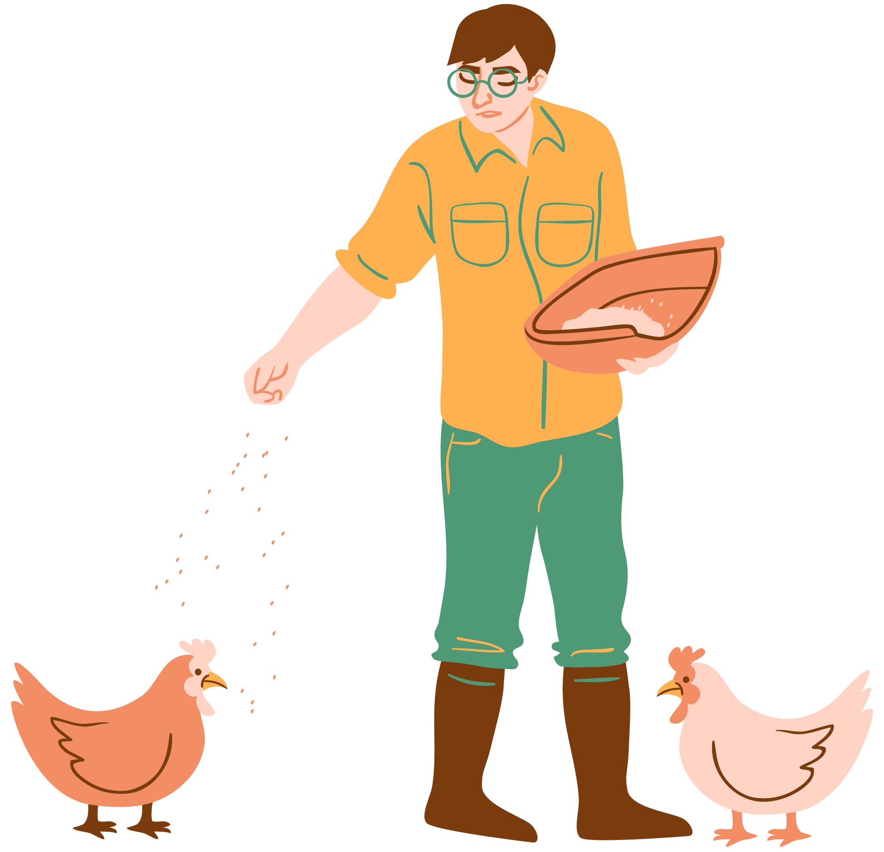

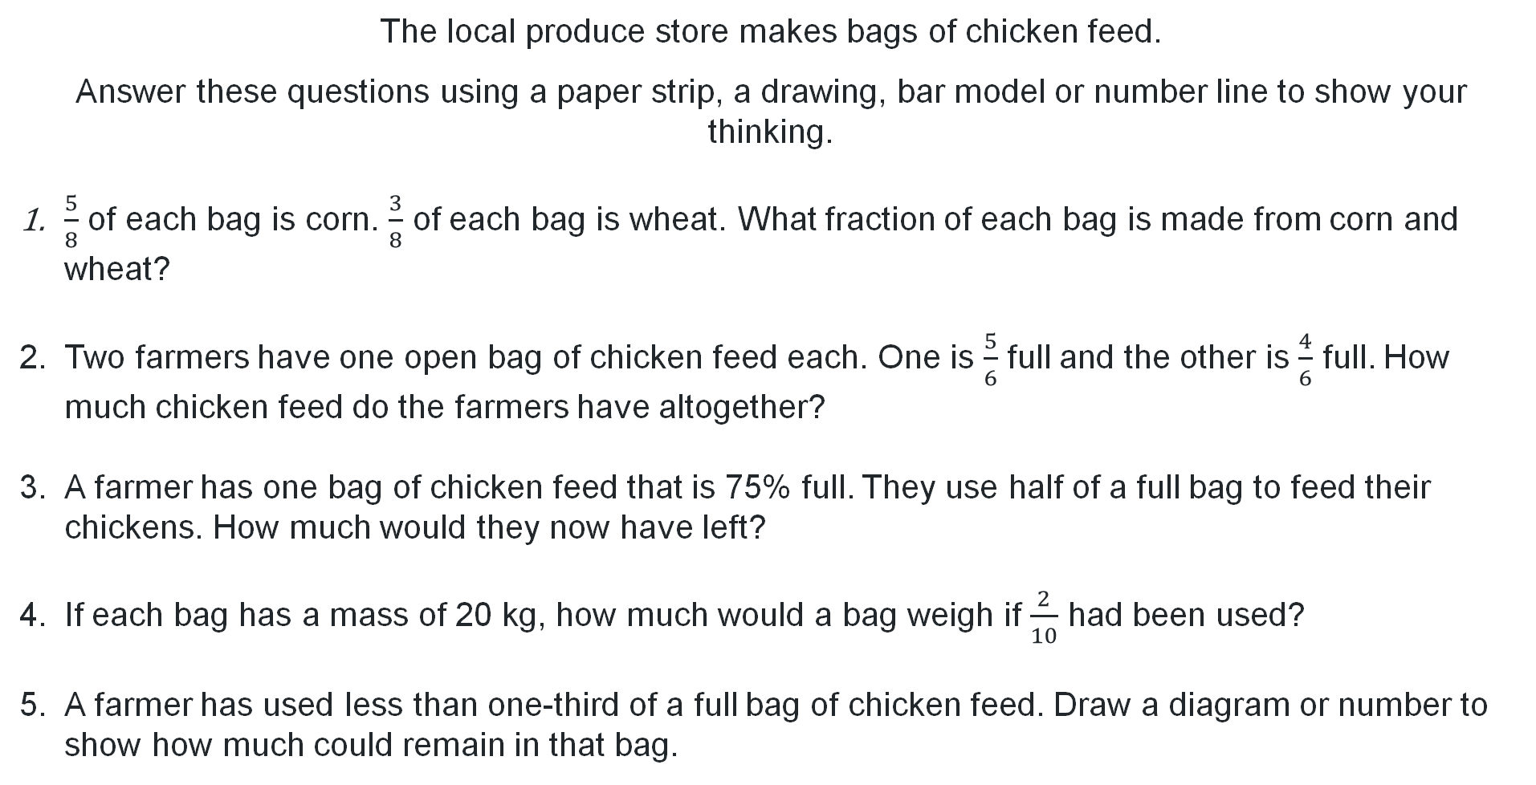
Activity 5 – same denominator word problems 1
The local produce store makes bags of chicken feed.
Answer these questions using a paper strip, a drawing, bar model or number line to show your thinking.
$\frac{5}{8}$ of each bag is corn. $\frac{3}{8}$ of each bag is wheat. What fraction of each bag is made from corn and wheat?
Two farmers have one open bag of chicken feed each. One is $\frac{5}{6}$ full and the other is $\frac{4}{6}$ full. How much chicken feed do the farmers have altogether?
A farmer has one bag of chicken feed that is 75% full. They use half of a full bag to feed their chickens. How much would they now have left?
If each bag has a mass of 20 kg, how much would a bag weigh if $\frac{2}{10}$ had been used?
A farmer has used less than one-third of a full bag of chicken feed. Draw a diagram or number to show how much could remain in that bag.
Notes:
This is a developing number sense activity.
Number sense refers to a deep understanding of numbers, including their magnitude, relationships, and the effects of operations on them. It supports fluency and understanding, estimation, flexible thinking, and efficient problem-solving. Number sense activities 1–4 ‘activate’ prior number knowledge and support the learning of new content in the unit. Number sense activities 5–8 ‘loop’ back and provide opportunity for spaced practice with concepts and procedures covered in previous units.
Syllabus focus area:
Representing quantity fractions A
Same denominator word problems 1
Display and read Resource 24 – stock feed store from Stage 3 Unit 19. Support student understanding of the context words.
Use the think-aloud to model a solution for problem one.
Note: questions 3 and 4 from Resource 24 – stock feed store have more than one step.
Students complete each question in Resource 24 – stock feed store, recording answers and representations in their workbook.
Select students to share and justify their solutions. Record representations of strategies on the board.

Slide 39
Review of learning 6

Slide 40
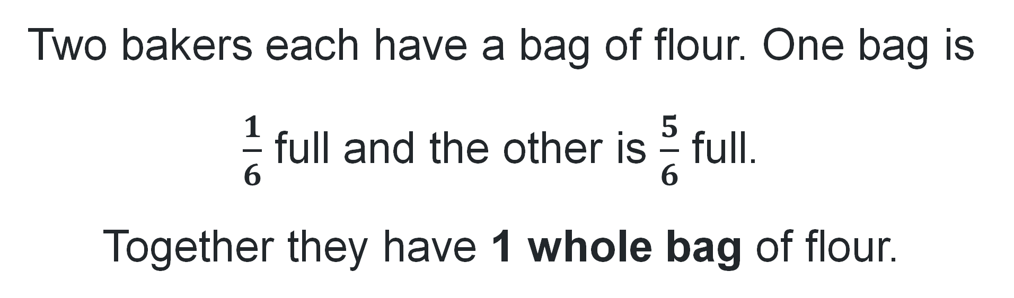
True or false (3)
Two bakers each have a bag of flour. One bag is $\frac{1}{6}$ full and the other is $\frac{5}{6}$ full.
Together they have 1 whole bag of flour.
True | False
Communicate your reasoning.
Notes:
The question on this slide connects to the content being explored in the developing number sense activity (Activity 6)
Syllabus focus area:
Represents quantity fractions A

Slide 41
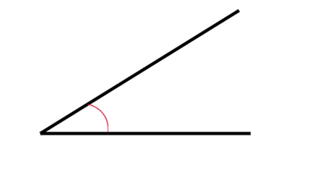
Short response (21)
Use a known angle to estimate and record the size of this angle.
Notes:
Short response questions provide brisk paced questions focussing on review of current and previous content to support spaced and interleaved practice.
Syllabus focus area:
Geometric measure A: Angles

Slide 42
Short response (22)
Fletcher wants to collect data about how students in his class travel to school.
Pose 2 survey questions he could use to obtain categorical data.
Notes:
Short response questions provide brisk paced questions focussing on review of current and previous content to support spaced and interleaved practice.
Syllabus focus area:
Data A

Slide 43
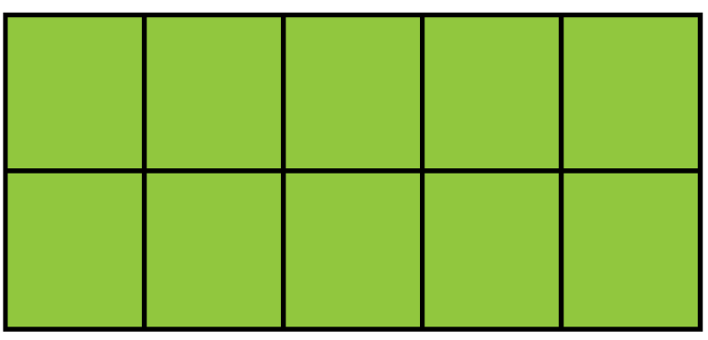
Short response (23)
Determine the volume of prism 2 and prism 3.
 | Prism 1 | Prism 2 | Prism 3
Base | 2 layers | 4 layers | 9 layers
 | 20 cm³
Notes:
Short response questions provide brisk paced questions focussing on review of current and previous content to support spaced and interleaved practice.
Syllabus focus area:
Three-dimensional spatial structure B: Volume

Slide 44
Short response (24)
Record the dimensions of two different rectangles each with an area of 32 cm^{2.}
Notes:
Short response questions provide brisk paced questions focussing on review of current and previous content to support spaced and interleaved practice.
Syllabus focus area:
Two-dimensional spatial structure A: Area

Slide 45
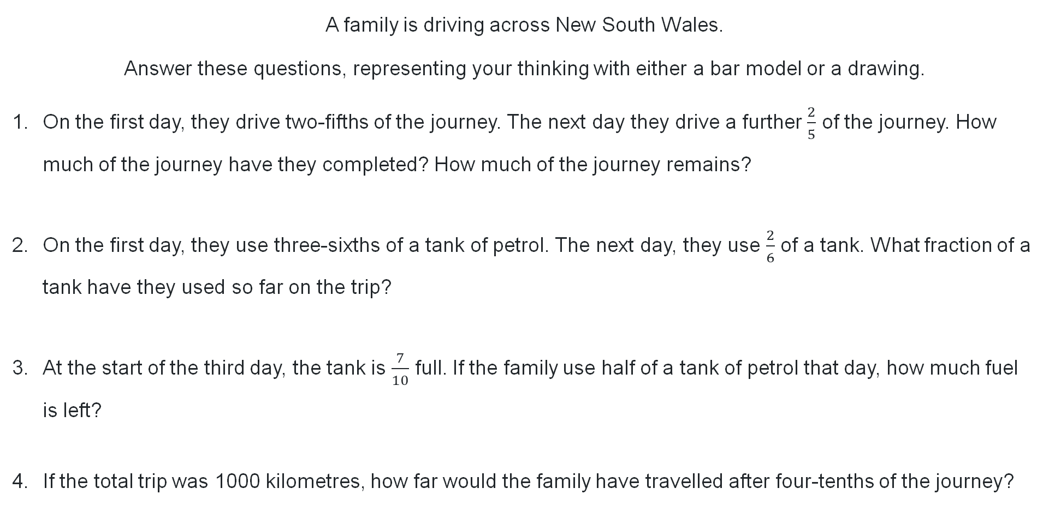
Activity 6 – same denominator word problems 1
A family is driving across New South Wales.
Answer these questions, representing your thinking with either a bar model or a drawing.
On the first day, they drive two-fifths of the journey. The next day they drive a further $\frac{2}{5}$ of the journey. How much of the journey have they completed? How much of the journey remains?
On the first day, they use three-sixths of a tank of petrol. The next day, they use $\frac{2}{6}$ of a tank. What fraction of a tank have they used so far on the trip?
At the start of the third day, the tank is $\frac{7}{10}$ full. If the family use half of a tank of petrol that day, how much fuel is left?
If the total trip was 1000 kilometres, how far would the family have travelled after four-tenths of the journey?
Notes:
This is a developing number sense activity.
Number sense refers to a deep understanding of numbers, including their magnitude, relationships, and the effects of operations on them. It supports fluency and understanding, estimation, flexible thinking, and efficient problem-solving. Number sense activities 1–4 ‘activate’ prior number knowledge and support the learning of new content in the unit. Number sense activities 5–8 ‘loop’ back and provide opportunity for spaced practice with concepts and procedures covered in previous units.
Syllabus focus area:
Representing quantity fractions A
Same denominator word problems 1
Display and read Resource 25 – road trip problems from Stage 3 Unit 19. Support student understanding of the context words.
Provide students with Resource 25 – road trip problems from Stage 3 Unit 19. Students complete each question, recording solutions using a bar model or drawing.
Select students to share, justifying their solutions and strategies to the problems.
Record representations of solutions on the board and discuss.

Slide 46
Review of learning 7

Slide 47
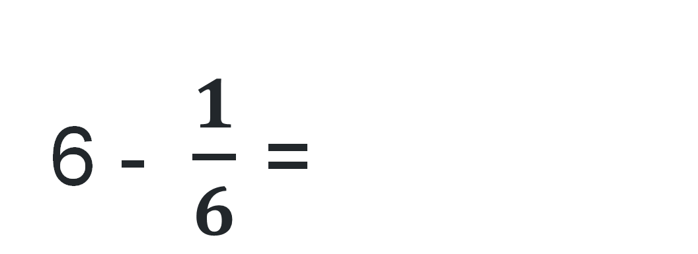
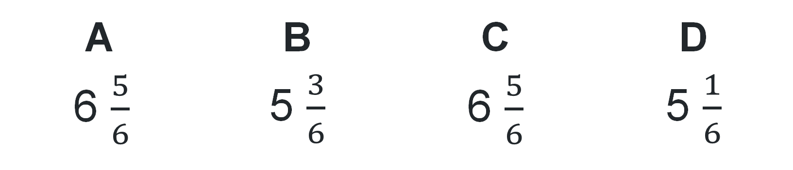
Multiple choice (4)
6 - $\frac{1}{6}$ =
A | B | C | D
6 $\frac{5}{6}$ | 5 $\frac{3}{6}$ | 6 $\frac{5}{6}$ | 5 $\frac{1}{6}$
Notes:
This question connects to the content in the developing number sense activity (Activity 7)
Syllabus focus area:
Represents quantity fractions A

Slide 48
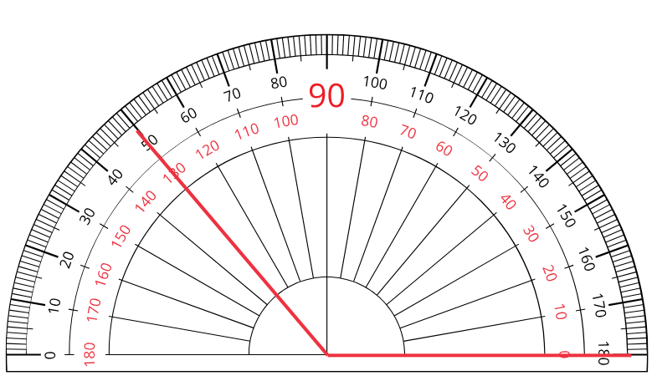
Short response (25)
Record the angle in degrees.
Notes:
Short response questions provide brisk paced questions focussing on review of current and previous content to support spaced and interleaved practice.
Syllabus focus area:
Geometric measure A: Angles

Slide 49
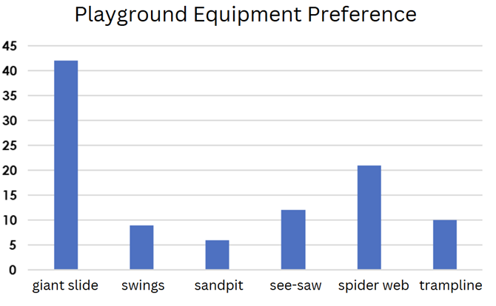
Short response (26)
Jett asked his classmates to choose one piece of playground equipment for the new park.
Use the graph to determine how many students are in Jett’s grade.
Notes:
Short response questions provide brisk paced questions focussing on review of current and previous content to support spaced and interleaved practice.
Syllabus focus area:
Data A

Slide 50
Short response (27)
A large storage box is 3 m long, 1 m wide, and 2 m high.
Estimate its volume in cubic metres.
Notes:
Short response questions provide brisk paced questions focussing on review of current and previous content to support spaced and interleaved practice.
Syllabus focus area:
Three-dimensional spatial structure B: Volume

Slide 51
Short response (28)
Covert the following times to 24-hour time:
6:00 am
10:15 am
1:55 pm
8:47 pm
Notes:
Short response questions provide brisk paced questions focussing on review of current and previous content to support spaced and interleaved practice.
Syllabus focus area:
Non-spatial measure A: Time

Slide 52
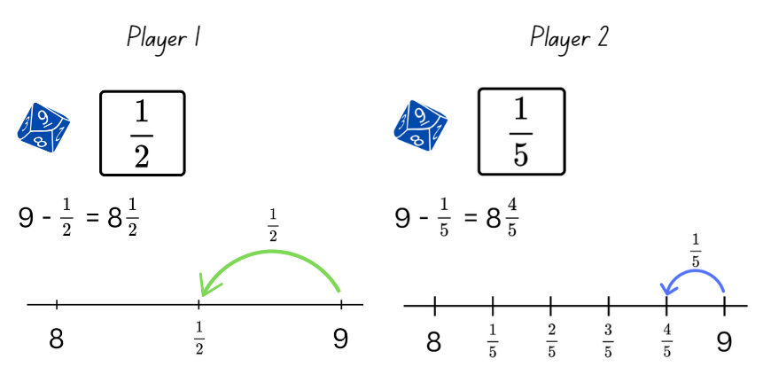
Activity 7 – subtracting unit fractions 1
Notes:
This is a developing number sense activity.
Number sense refers to a deep understanding of numbers, including their magnitude, relationships, and the effects of operations on them. It supports fluency and understanding, estimation, flexible thinking, and efficient problem-solving. Number sense activities 1–4 ‘activate’ prior number knowledge and support the learning of new content in the unit. Number sense activities 5–8 ‘loop’ back and provide opportunity for spaced practice with concepts and procedures covered in previous units.
Syllabus focus area:
Representing quantity fractions A
Subtracting unit fractions 1
Note: fraction cards on Resource 26 – fractions from Stage 3 Unit 19 require cutting out prior to starting the game.
Provide pairs with Resource 26 – fractions from Stage 3 Unit 19, a 9-sided dice and 2 individual whiteboards.
Note: if the 9-sided dice have zero, explain to students that it will represent 10 for this game.
In pairs, students roll the dice to get the starting whole number. Both players flip a card from Resource 26 – fractions from Stage 3 Unit 19. The card determines the unit fraction that will be subtracted from the whole number.
Each student draws a number line on their whiteboard, marking the fractional parts and recording the solution as a subtraction (see Figure 14).
Students swap to check each other’s subtraction and provide peer feedback.
Repeat the process multiple times for practice and consolidation.

Slide 53
Review of learning 8

Slide 54
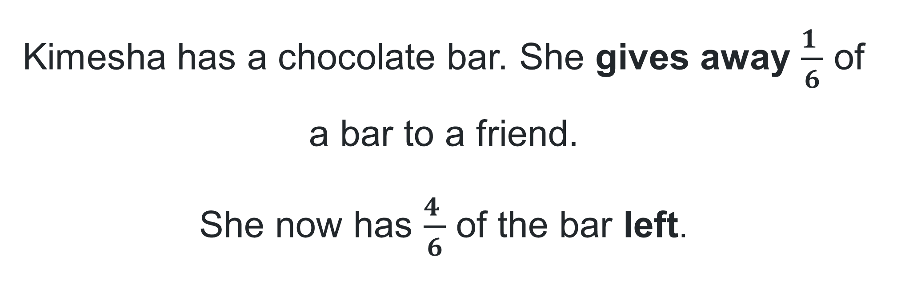
True or false (4)
Kimesha has a chocolate bar. She gives away $\frac{1 }{6}$ of a bar to a friend.
She now has $\frac{4 }{6}$ of the bar left.
True | False
Notes:
The question on this slide connects to the content being explored in the developing number sense activity (Activity 8)
Syllabus focus area:
Represents quantity fractions A

Slide 55
Short response (29)
Arlo started his coding class at 3:45 pm and finished at 5:20 pm. How much time elapsed while he was in class?
Notes:
Short response questions provide brisk paced questions focussing on review of current and previous content to support spaced and interleaved practice.
Syllabus focus area:
Non-spatial measure B: Time

Slide 56
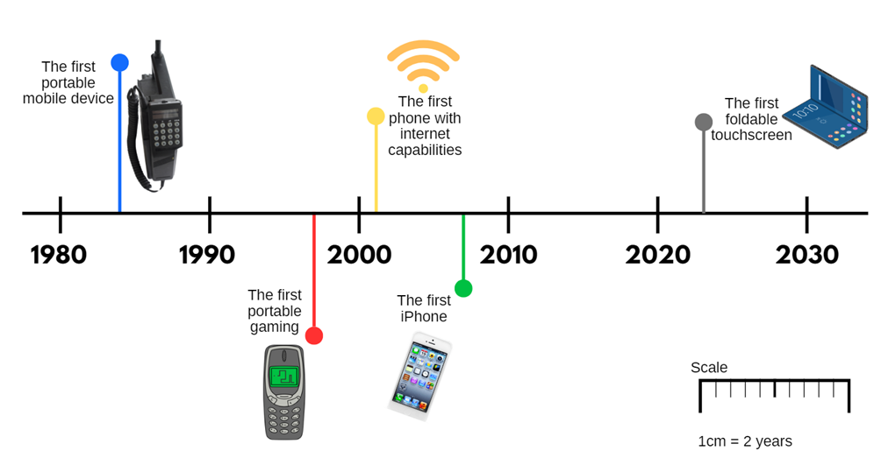
Short response (30)
If there is 10 cm between 1980 and 2000, what would be an appropriate scale for this timeline?
___ cm = ___ years
Notes:
Short response questions provide brisk paced questions focussing on review of current and previous content to support spaced and interleaved practice.
Syllabus focus area:
Data A

Slide 57
Short response (31)
Estimate the volume of the classroom using cubic metres.
Explain your reasoning.
Notes:
Short response questions provide brisk paced questions focussing on review of current and previous content to support spaced and interleaved practice.
Syllabus focus area:
Three-dimensional spatial structure B: Volume

Slide 58
Short response (32)
How many lines of symmetry does each shape have?
Shape B
Shape A Shape B Shape C
Notes:
Short response questions provide brisk paced questions focussing on review of current and previous content to support spaced and interleaved practice.
Syllabus focus area:
Two-dimensional spatial structure A: 2D Shapes

Slide 59
Activity 8 – subtracting unit fractions 2
Notes:
This is a developing number sense activity.
Number sense refers to a deep understanding of numbers, including their magnitude, relationships, and the effects of operations on them. It supports fluency and understanding, estimation, flexible thinking, and efficient problem-solving. Number sense activities 1–4 ‘activate’ prior number knowledge and support the learning of new content in the unit. Number sense activities 5–8 ‘loop’ back and provide opportunity for spaced practice with concepts and procedures covered in previous units.
Syllabus focus area:
Representing quantity fractions A
Subtracting unit fractions 2
Note: fraction cards on Resource 26 – fractions from Stage 3 Unit 19 require cutting out prior to starting the game.
Provide pairs with Resource 26 – fractions from Stage 3 Unit 19, a 9-sided dice and 2 individual whiteboards.
Note: if the 9-sided dice have zero, explain to students that it will represent 10 for this game.
Revise the instructions, with the extra step to decide which player is closest to the whole number.
One player rolls the die to get the starting whole number. Both players flip a card from Resource 26 – fractions from Stage 3 Unit 19, . The card determines the unit fraction that will be subtracted from the whole number.
Each player draws a number line on their whiteboard, marking the fractional parts and recording the solution as a subtraction.
Players identify which answer is closest to the starting whole number and award that player a point.
Repeat until a player reaches 11 points and is declared the winner.

Slide 60
Double Venn diagram
Object 1
Object 2
Features similar to both objects
Features of object 1
Features of object 2

Slide 61
Frayer
Definition
Facts/Characteristics
Word, term, concept
Examples
Non-examples

Slide 62
Spider map
Idea
Subject

Slide 63
Cline
Concept 1
Concept 2
Word
Word
Word
Word
Word
Word
Word
Word
Word
Word
Word

Slide 64

Compare and contrast
Notes:
Use the arrows to navigate between related activities.
Hyperlink each arrow to compare between related slides.

Slide 65
Multiple choice (5)
A
B
C
D
Notes:
This question connects to the content in the developing number sense activity (Activity 1)
Syllabus focus area:
This question can:
support spaced and interleaved practice
help identify and address common misconceptions
support active recall and immediate feedback
support whole class participation
identify areas requiring reteach
Teachers are encouraged to adapt and contextualise for their contexts.

Slide 66
Multiple choice (6)
A
B
C
D
Notes:
This question connects to the content in the developing number sense activity (Activity 1)
Syllabus focus area:
This question can:
support spaced and interleaved practice
help identify and address common misconceptions
support active recall and immediate feedback
support whole class participation
identify areas requiring reteach
Teachers are encouraged to adapt and contextualise for their contexts.

Slide 67
References (1)
This presentation contains NSW Curriculum and syllabus content. The NSW Curriculum is developed by the NSW Education Standards Authority. This content is prepared by NESA for and on behalf of the Crown in the right of the State of New South Wales. The material is protected by Crown copyright.
Please refer to the NESA Copyright Disclaimer for more information https://educationstandards.nsw.edu.au/wps/portal/nesa/mini-footer/copyright.
NESA holds the only official and up-to-date versions of the NSW Curriculum and syllabus documents. Please visit the NSW Education Standards Authority (NESA) website https://educationstandards.nsw.edu.au/wps/portal/nesa/home and the NSW Curriculum website https://curriculum.nsw.edu.au.
athematics K–10 Syllabus © NSW Education Standards Authority (NESA) for and on behalf of the Crown in right of the State of New South Wales, 2022.​
National literacy and numeracy progressions © Australian Curriculum, Assessment and Reporting Authority (ACARA) 2010 to present, unless otherwise indicated. This material was downloaded from the Australian Curriculum website (National Numeracy Learning Progression) (accessed 23 May 2024) and was not modified.​
Askew M (2016) A Practical Guide to Transforming Primary Mathematics: Activities and tasks that really work, 1st edn, Routledge, Oxon.​
Francome T (2016) ‘Empty protractor’, Mathematics Teaching, Association of Teachers of Mathematics, accessed 2 August 2024.​
NESA (NSW Education Standards Authority) (2022) ‘Stage 3 – Teaching advice for Two-dimensional spatial structure A: 2D shapes’, Mathematics K–10 Syllabus: Content, NESA website, accessed 7 August 2024.​

Slide 68
References (2)
This presentation contains NSW Curriculum and syllabus content. The NSW Curriculum is developed by the NSW Education Standards Authority. This content is prepared by NESA for and on behalf of the Crown in the right of the State of New South Wales. The material is protected by Crown copyright.
Please refer to the NESA Copyright Disclaimer for more information https://educationstandards.nsw.edu.au/wps/portal/nesa/mini-footer/copyright.
NESA holds the only official and up-to-date versions of the NSW Curriculum and syllabus documents. Please visit the NSW Education Standards Authority (NESA) website https://educationstandards.nsw.edu.au/wps/portal/nesa/home and the NSW Curriculum website https://curriculum.nsw.edu.au.
State of New South Wales (Department of Education) (2024) ‘Mastermind’, Thinking mathematically resources, NSW Department of Education website, accessed 23 May 2024.​
Van de Walle J, Karp K, Bay-Williams JM, Brass A, Bentley B, Ferguson S, Goff W, Livy S, Marshman M, Martin D, Pearn C, Prodromou T, Symons D and Wilkie K (2019) Primary and Middle Years Mathematics: Teaching Developmentally, 1st Australian edn, Pearson Education Australia, Melbourne.​
Worldometer (2023) ‘Population by Country’, Population, Worldometer website, accessed 5 August 2024.​

Slide 69
Copyright
© State of New South Wales (Department of Education), 2025
The copyright material published in this resource is subject to the Copyright Act 1968 (Cth) and is owned by the NSW Department of Education or, where indicated, by a party other than the NSW Department of Education (third-party material).
Copyright material available in this resource and owned by the NSW Department of Education is licensed under a Creative Commons Attribution 4.0 International (CC BY 4.0) license.
This license allows you to share and adapt the material for any purpose, even commercially.
Attribution should be given to © State of New South Wales (Department of Education), 2025.
Material in this resource not available under a Creative Commons license:
the NSW Department of Education logo, other logos and trademark-protected material
Material owned by a third party that has been reproduced with permission. You will need to obtain permission from the third party to reuse its material.
Links to third-party material and websites
Please note that the provided (reading/viewing material/list/links/texts) are a suggestion only and implies no endorsement, by the New South Wales Department of Education, of any author, publisher, or book title. School principals and teachers are best placed to assess the suitability of resources that would complement the curriculum and reflect the needs and interests of their students.
If you use the links provided in this document to access a third party’s website, you acknowledge that the terms of use, including licence terms set out on the third-party’s website apply to the use which may be made of the materials on that third-party website or where permitted by the Copyright Act 1968 (Cth). The department accepts no responsibility for content on third-party websites.

