Slide 1
Instructions for use
This resource is not a teaching and learning program. It should be used in conjunction with Stage 3 Year A Unit 20.
Classroom teachers are encouraged to add and adapt slides as required to meet the needs of their students.
Save a copy of the file to make changes to the slide deck. Go to File > Download a Copy (this downloads a copy to the computer to edit in the PowerPoint app).
To convert the PowerPoint to Google Slides:
  Upload the file into Google Drive and open it.
  Go to File > Save as Google Slides.
  (Note – conversion may cause formatting changes in the slides.)

Slide 2

Review of Learning
Mathematics Stage 3 – Unit 20
Notes:
Reviews may include a combination of question types, requiring students to recall facts and key ideas, as well as apply their knowledge to solve problems and answer questions. To support active engagement, a mix of techniques should be employed.” (AERO, 2024).
This Review of Learning slide deck revisits key concepts from the following units:
Stage 3 Year A Unit 20
Stage 3 Year A Unit 19
Stage 3 Year A Unit 18
It also includes opportunities to review prior learning in non-number content, supporting consolidation across focus areas.
The review of learning resources include three key task types that support the development of mathematical proficiency through retrieval, spaced practice, and active participation. These practices complement the review phase (activating prior knowledge) embedded within the beginning of each lesson.
1.
Multiple-choice questions/True or false: Designed to promote active retrieval of key concepts and identify common misconceptions in number, supporting consolidation, understanding and fluency.
These questions:
support spaced and interleaved practice
help identify and address common misconceptions
support active recall and immediate feedback
support whole class participation
identify areas requiring reteach
2.
Short-response question sets: Carefully grouped questions that encourage spaced and interleaved practice across multiple focus areas, helping students revisit and apply knowledge from different points in time.
These questions:
have a combination of question types
address a range of focus areas
build automaticity and fluency
support active recall
allow for immediate feedback
identify content requiring reteach
3.
Developing number sense activities: A variety of practical, purposeful tasks that reinforce current learning and build on prior knowledge. These activities promote reasoning, problem-solving and conceptual understanding.
The review of learning resources are designed to work support teaching and learning in mathematics. For the most effective implementation, use the resources flexibly, adapting to meet student learning needs and individual classroom contexts.

Slide 3
Lessons
1
Review of learning 1
5
Review of learning 5
2
Review of learning 2
6
Review of learning 6
3
Review of learning 3
7
Review of learning 7
4
Review of learning 4
8
Review of learning 8
Notes:
Teacher notes:
Click lesson numbers to go to specific lessons
Interactive features can be viewed in slide show

Slide 4
Review of learning 1

Slide 5

Multiple choice (1)
Which decimal is the largest?
A
0.12
B
0.03
C
0.126
D
0.036
Notes:
This question connects to the content in the developing number sense activity (Activity 1)
Syllabus focus area:
Represents numbers A: Decimals and percentages

Slide 6

Short response (1)
Make the largest and smallest number using all of the following digits:
7, 2, 3, 0, 4
Identify the nearest 10 thousand to the largest number.
Notes:
Short response questions provide brisk paced questions focussing on review of current and previous content to support spaced and interleaved practice.
Syllabus focus area:
Represents numbers B: Whole numbers

Slide 7

Short response (2)
Name and describe the triangles below:
Notes:
Short response questions provide brisk paced questions focussing on review of current and previous content to support spaced and interleaved practice.
Syllabus focus area:
Two-dimensional spatial structure A: 2D shapes

Slide 8
Short response (3)
A six-sided die is rolled once. What is the probability of rolling a 4? Use the term probability in your answer to describe the likelihood of this outcome.
Notes:
Short response questions provide brisk paced questions focussing on review of current and previous content to support spaced and interleaved practice.
Syllabus focus area:
Chance A

Slide 9
Short response (4)
Identify the following times as either
12-hour or 24-hour time:
  3:30 pm
  9:47 am
  1338
  0642
Notes:
Short response questions provide brisk paced questions focussing on review of current and previous content to support spaced and interleaved practice.
Syllabus focus area:
Non-spatial measure A: Time

Slide 10

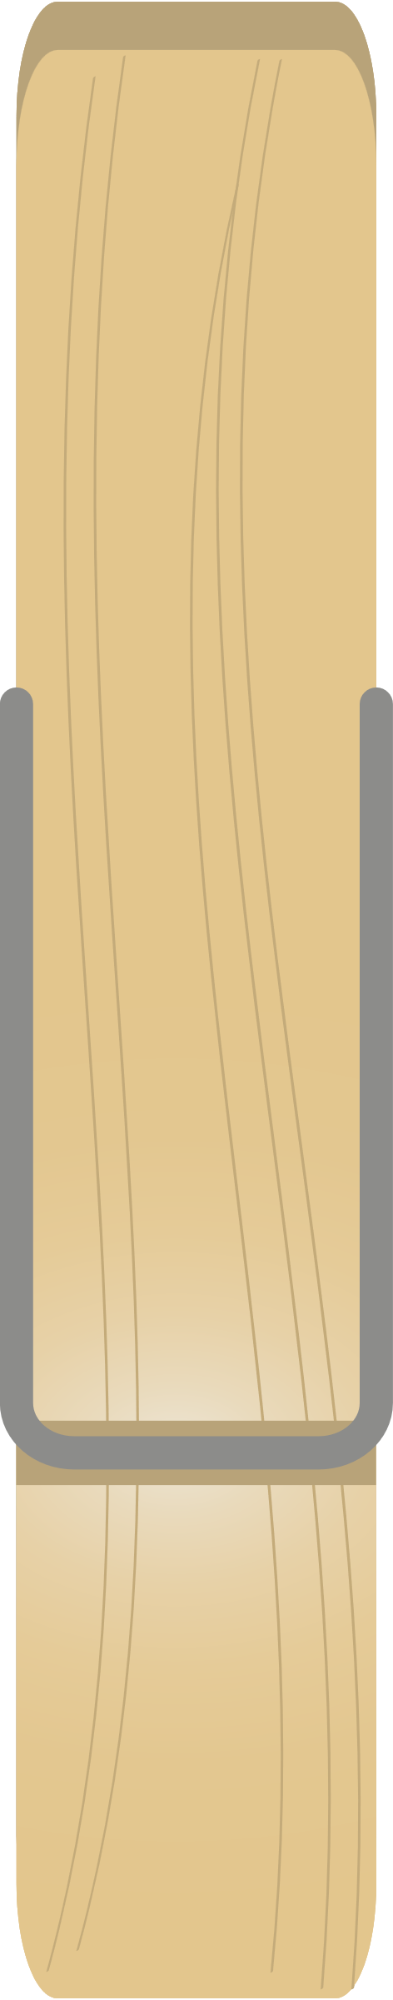

Activity 1 – compare and order decimals
0.01
0
0.899
0.56
1
0.21
0.36
0.5
0.204
0
1
Notes:
This is a developing number sense activity.
Number sense refers to a deep understanding of numbers, including their magnitude, relationships, and the effects of operations on them. It supports fluency and understanding, estimation, flexible thinking, and efficient problem-solving. Number sense activities 1–4 ‘activate’ prior number knowledge and support the learning of new content in the unit. Number sense activities 5–8 ‘loop’ back and provide opportunity for spaced practice with concepts and procedures covered in previous units.
Syllabus focus area:
Represents numbers A
Compare and order decimals
This resource corresponds to Resource 33 – decimal mix-up in Stage 3 Year A Unit 20.
Display Resource 33 – decimal mix-up (this resource corresponds to Resource 33 – decimal mix-up in Stage 3 Year A Unit 20).
Explain that the decimals have been all mixed up on the number line.
Students discuss the correct placement of each decimal.
Ask the following questions:
- Harriet says that 0.204 is larger than 0.21 because it has 3 digits after the decimal point. Is this correct?
- Why do you think that some students might place 0.01 before the zero on the number line?
Students draw the number line on individual whiteboards and record each decimal at the correct point on the number line. Encourage students to provide justification to explain their placement of the decimals.
Discuss as a class:
- Which decimal did you place on the number line first? Why?
- How did you know where to place 0.899?
- Which decimal is the smallest? How close is it to 0?
Draw the 0–1 number line on the board and model recording the decimals at the correct point on the number line. Allow students to check that their placement of the decimals is correct.
Students share their work with a partner for peer assessment using the success criteria to guide their feedback.

Slide 11
Review of learning 2

Slide 12
True or false (1)
The following decimals are in descending order:
0.12, 0.03, 0.126, 0.036
True | False
Notes:
The question on this slide connects to the content being explored in the developing number sense activity (Activity 2)
Syllabus focus area:
Represents numbers A: Decimals and percentages

Slide 13
Short response (5)
Record the following integers on
a number line:
1.5 -5 0 5.5 12 4 -2
Explain your reasoning.
Notes:
Short response questions provide brisk paced questions focussing on review of current and previous content to support spaced and interleaved practice.
Syllabus focus area:
Represents numbers B: Whole numbers

Slide 14
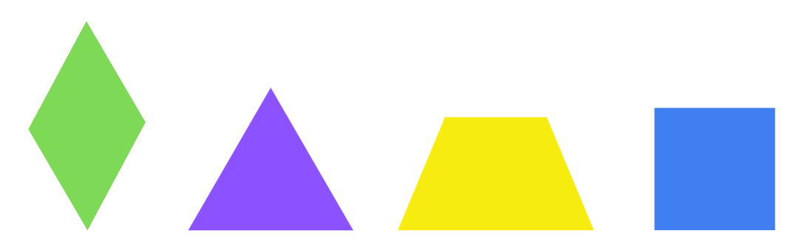
Short response (6)
Draw the lines of symmetry for the rhombus, equilateral triangle, trapezium and square.
Notes:
Short response questions provide brisk paced questions focussing on review of current and previous content to support spaced and interleaved practice.
Syllabus focus area:
Two-dimensional spatial structure A: 2D shapes

Slide 15
Short response (7)
A bag contains 5 red counters, 3 blue counters, and 2 green counters. One counter is picked at random. What is the probability of selecting a blue counter?
Notes:
Short response questions provide brisk paced questions focussing on review of current and previous content to support spaced and interleaved practice.
Syllabus focus area:
Chance A

Slide 16
Short response (8)
Draw an irregular octagon.
Explain why it is an octagon.
Notes:
Short response questions provide brisk paced questions focussing on review of current and previous content to support spaced and interleaved practice.
Syllabus focus area:
Two-dimensional spatial structure A: 2D Shape

Slide 17
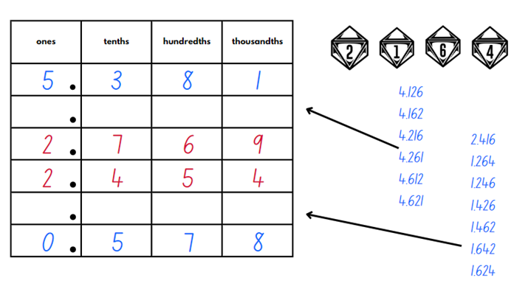
Activity 2 – decimals in descending order
Notes:
This is a developing number sense activity.
Number sense refers to a deep understanding of numbers, including their magnitude, relationships, and the effects of operations on them. It supports fluency and understanding, estimation, flexible thinking, and efficient problem-solving. Number sense activities 1–4 ‘activate’ prior number knowledge and support the learning of new content in the unit. Number sense activities 5–8 ‘loop’ back and provide opportunity for spaced practice with concepts and procedures covered in previous units.
Syllabus focus area:
Represents numbers A
Decimals in descending order
This resource corresponds to Figure 10 – gameplay example in Stage 3 Year A Unit 20.
This task is an adaptation of ‘Greater Than’ from Love Maths by Minas.
Provide pairs with four 10-sided (0–9) dice and writing materials.
Students draw up one shared gameboard grid with 4 columns and 7 rows. Label each column: ones, tenths, hundredths and thousandths. A decimal point should be placed at the right-hand side of each cell in the ones column (see Figure 3).
Explain the rules of the game:
Students take turns to complete the table by arranging numbers with 3 decimal places in descending order from the top of the table to the bottom.
Student A rolls four 10 sided-dice (0–9) and arranges the digits in any order. For example, if 3, 5, 2 and 0 are rolled, the numbers 3.520, 0.235 or 5.023 could all be created.
Student A records a number in a row of their choice and reads the decimal aloud. For example, 5.023 would be read as 5 and 23 thousandths.
Student B rolls the dice and records a new decimal number in the table in a row above or below their partner’s number, ensuring the decimals are in descending order (see Figure 4).
During each turn, students communicate their reasoning about the number they made and the placement of the number within the table.
Students continue to take turns to fill the table and read their decimal aloud. If a student cannot place their number in the table in descending order, they miss their turn.

Slide 18
Review of learning 3

Slide 19
Multiple choice (2)
Which sequence shows decimals in ascending order?
A
0.12, 0.03, 0.126, 0.036
B
0.03, 0.126, 0.12, 0.36
C
0.03, 0.036, 0.12, 0.126
D
0.036, 0.03, 0.12, 0.126
Notes:
This question connects to the content in the developing number sense activity (Activity 3)
Syllabus focus area:
Represents numbers A: Decimals and percentages

Slide 20
Short response (9)
Use rounding and estimation to solve
4437 + 2988 =
272 + 149 =
39 + 43 =
Notes:
Short response questions provide brisk paced questions focussing on review of current and previous content to support spaced and interleaved practice.
Syllabus focus area:
Additive relations A

Slide 21
Short response (10)
Complete the following missing words.
Angles are measured in _______.
There are ____ degrees in a revolution.
There are ____ degrees in a straight line.
Notes:
Short response questions provide brisk paced questions focussing on review of current and previous content to support spaced and interleaved practice.
Syllabus focus area:
Two-dimensional spatial structure A: 2D shapes

Slide 22
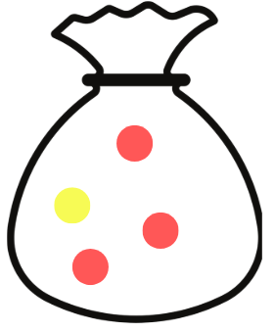
Short response (11)
Ali has a three out of four chance of picking a red counter from the bag. Record this probability as a fraction.
Notes:
Short response questions provide brisk paced questions focussing on review of current and previous content to support spaced and interleaved practice.
Syllabus focus area:
Chance A

Slide 23
Short response (12)
Christian visualises and sketches the net for a 3-dimensional object. It has 4 triangles. Draw the 3D object Christian was visualising.
Notes:
Short response questions provide brisk paced questions focussing on review of current and previous content to support spaced and interleaved practice.
Syllabus focus area:
Three-dimensional spatial structure A: 3DS Objects

Slide 24
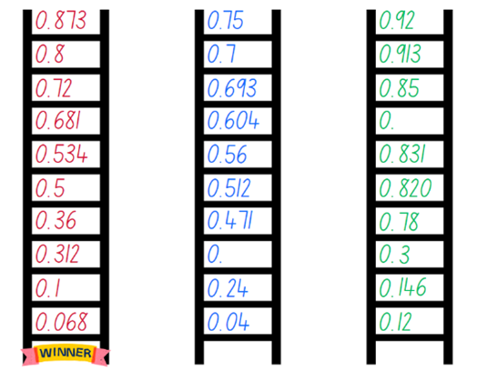
Activity 3 – decimals in ascending order
Notes:
This is a developing number sense activity.
Number sense refers to a deep understanding of numbers, including their magnitude, relationships, and the effects of operations on them. It supports fluency and understanding, estimation, flexible thinking, and efficient problem-solving. Number sense activities 1–4 ‘activate’ prior number knowledge and support the learning of new content in the unit. Number sense activities 5–8 ‘loop’ back and provide opportunity for spaced practice with concepts and procedures covered in previous units.
Syllabus focus area:
Represents numbers A
Decimals in ascending order
This resource corresponds to Figure 12 – gameplay example with 3 players in Stage 3 Year A Unit 20.
This task is an adaptation of Place Value Pickle: Decimals from MMMathMania.
Note: if playing cards are not available, students may like to use interactive playing cards for this game.
Provide groups of 2 or 3 students with writing materials and playing cards with the tens, Kings and Jacks removed. Aces are assigned the value of one and Queens are zero.
Model a demonstration game against 2 students to explain the rules. To set up the gameboard:
- Each player draws a ladder with 10 rungs on their whiteboard.
- On each rung, record a zero and decimal point on the left-hand side (see Figure 11 – ladder example in Stage 3 Year A Unit 20).
State that the aim of the game is to record decimal numbers on each ladder rung, in order, from smallest (bottom rung) to largest (top rung).
Explain that during each round, players may turn over a maximum of 3 cards to make a decimal number between zero and one. If a red card is drawn; however, the player does not draw any further cards for that turn. For example, if a black 3 of spades was drawn, followed by a red 6 of hearts, the player does not draw any further cards. The player then decides whether to make and record the decimal 0.36 or 0.63. If 3 black cards were drawn, all 3 numbers would be used to create a number with 3 decimal places.
Demonstrate turning over the cards, deciding how to order the numerals and strategically place the decimal number on the ladder. When the decimal number is placed on the ladder, the decimal number is read aloud. For example, 0.53 is read as 53 hundredths.
Students take turns to draw cards, create and read the decimal number and decide where to record it on their ladders.
If a student cannot place their decimal number on an appropriate rung, they miss their turn and play passes to the next player.
The first player to order and record a decimal number on all 10 ladder rungs is the winner
Groups of 2 or 3 students play the game and take turns recording decimal numbers on their ladders.

Slide 25
Review of learning 4

Slide 26
True or false (2)
Ava believes 0.6 is smaller than 0.68.
True | False
Communicate your thinking.
Notes:
The question on this slide connects to the content being explored in the developing number sense activity (Activity 4)
Syllabus focus area:
Represents numbers A: Decimals and percentages

Slide 27
Short response (13)
Using a subtraction strategy solve:
5309 – 2006 =
Explain why you chose that strategy.
Notes:
Short response questions provide brisk paced questions focussing on review of current and previous content to support spaced and interleaved practice.
Syllabus focus area:
Additive relations A

Slide 28
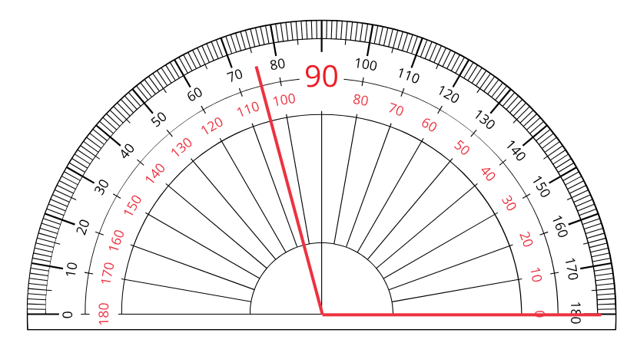
Short response (14)
Record the following degrees.
Notes:
Short response questions provide brisk paced questions focussing on review of current and previous content to support spaced and interleaved practice.
Syllabus focus area:
Geometric measure A: Angles

Slide 29
Short response (15)
A coin is tossed once. Are the outcomes “heads” and “tails” equally likely?
What if it was tossed twice?
Communicate your reasoning.
Notes:
Short response questions provide brisk paced questions focussing on review of current and previous content to support spaced and interleaved practice.
Syllabus focus area:
Chance A

Slide 30
Short response (16)
Nonna’s rose garden has an area of 20 m². Is it possible for the length to be and 4 metres and the width to be 6 metres.
Why or why not?
Notes:
Short response questions provide brisk paced questions focussing on review of current and previous content to support spaced and interleaved practice.
Syllabus focus area:
Two-dimensional spatial structure A: Area

Slide 31
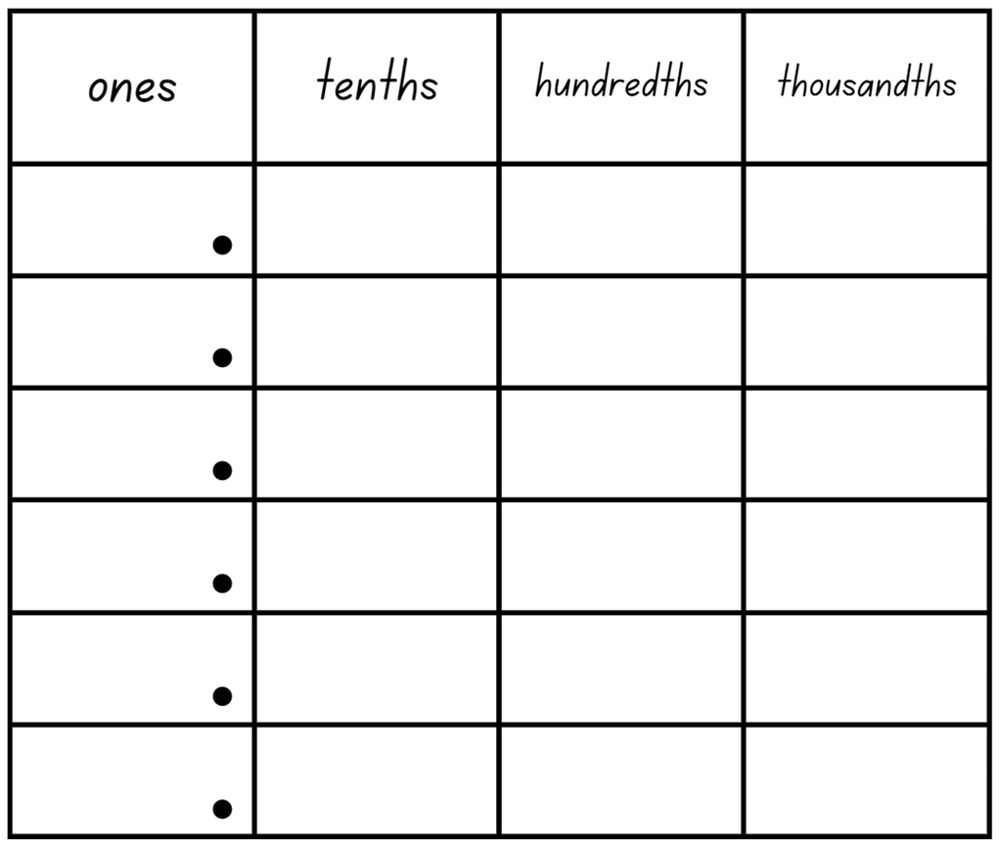
Activity 4 – the smallest number
Notes:
This is a developing number sense activity.
Number sense refers to a deep understanding of numbers, including their magnitude, relationships, and the effects of operations on them. It supports fluency and understanding, estimation, flexible thinking, and efficient problem-solving. Number sense activities 1–4 ‘activate’ prior number knowledge and support the learning of new content in the unit. Number sense activities 5–8 ‘loop’ back and provide opportunity for spaced practice with concepts and procedures covered in previous units.
Syllabus focus area:
Represents numbers A
The smallest number
This resource corresponds to Resource 34 – place value chart in Stage 3 Year A Unit 20.
Display Resource 34 – place value chart (this resource corresponds to Resource 34 – place value chart in Stage 3 Year A Unit 20). Students draw this grid in their own workbooks.
Using one interactive 10-sided dice.
Aim: to make the smallest number
Each time the dice is rolled each student decides which place value position they will write the number.
Repeat until each of the places is filled.
Ask: Who thinks they have the smallest number? Students decide if they think they have the smallest number and put their hand up. The class discusses whether there might be a smaller number possible.
Repeat the game for 4-5 rounds. A variation is to change the aim to make the largest number.

Slide 32
Review of learning 5

Slide 33
Multiple choice (3)
Which number is not a factor of 56?
A
B
C
D
8
7
6
2
Notes:
This question connects to the content in the developing number sense activity (Activity 5)
Syllabus focus area:
Multiplicative relations A

Slide 34

Short response (17)
Complete the missing values:
Fraction | Decimal | Percentage
 | 0.5
 |  | 75%
$\frac{1}{10}$
Notes:
Short response questions provide brisk paced questions focussing on review of current and previous content to support spaced and interleaved practice.
Syllabus focus area:
Represents numbers B: Decimals and percentages

Slide 35
Short response (18)
Record the name of the angle that is:
90°
180°
270°
360°
Notes:
Short response questions provide brisk paced questions focussing on review of current and previous content to support spaced and interleaved practice.
Syllabus focus area:
Geometric measure A: Angles

Slide 36
Short response (19)
Is there another type of graph that would best display this information?
What could the title be?
Notes:
Short response questions provide brisk paced questions focussing on review of current and previous content to support spaced and interleaved practice.
Syllabus focus area:
Data A

Slide 37
Short response (20)
Which spinner gives you an equally likely chance of landing on a red or green section?
A 4 red sections, 2 blue sections, 2 green sections
B 3 red sections, 3 blue sections, 2 green sections
C 2 red sections, 5 blue sections, 2 green sections
Notes:
Short response questions provide brisk paced questions focussing on review of current and previous content to support spaced and interleaved practice.
Syllabus focus area:
Chance A

Slide 38
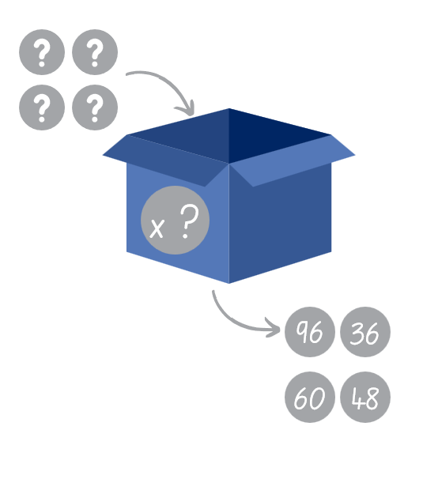
Activity 5 – mystery factors
I placed 4 numbers into a box. The mystery number inside the box multiplied my numbers and 4 new numbers came out. The new numbers that came out were :
96, 36, 60 and 48
What four numbers were placed in the box to begin with?
What is the mystery number in the box that is multiplying all the numbers?
Notes:
This is a developing number sense activity.
Number sense refers to a deep understanding of numbers, including their magnitude, relationships, and the effects of operations on them. It supports fluency and understanding, estimation, flexible thinking, and efficient problem-solving. Number sense activities 1–4 ‘activate’ prior number knowledge and support the learning of new content in the unit. Number sense activities 5–8 ‘loop’ back and provide opportunity for spaced practice with concepts and procedures covered in previous units.
Syllabus focus area:
Multiplicative relations A
Myster factors
This resource corresponds to Resource 35 – multiplication box in Stage 3 Year A Unit 20.
Display to Resource 35 – multiplication box (this resource corresponds to Resource 35 – multiplication box in Stage 3 Year A Unit 20). Pose the scenario: I placed 4 numbers into a box. The mystery number inside the box multiplied my numbers and 4 new numbers came out. The new numbers that came out were 96, 36, 60 and 48.
Ask: What were my 4 numbers?
Students turn and talk to a partner to explain what they understand about the problem and strategies they would use to solve it.
Students record the 4 numbers on individual whiteboards.
Discuss as a class:
What was the mystery number?
Are there any other possibilities? How do you know?
Could you check your answer using division?
Can you generate a multiplicative fact family triangle for each of the numbers?
In pairs, students create a similar problem. Students choose a set of 4 numbers that will be placed in a box and a new mystery number as the multiplier.
Swap with another pair to solve the problem.

Slide 39
Review of learning 6

Slide 40
True or false (3)
The factors of 35 are:
1, 2, 3, 5, 7, 35
True | False
Notes:
The question on this slide connects to the content being explored in the developing number sense activity (Activity 6)
Syllabus focus area:
Multiplicative relations A

Slide 41
Short response (21)
Tara went shopping for a new laptop. There was a 25% sale on. The ticket price was marked $300. What is the amount Tara will pay?
Communicate your reasoning.
Notes:
Short response questions provide brisk paced questions focussing on review of current and previous content to support spaced and interleaved practice.
Syllabus focus area:
Represents numbers B: Decimals and percentages

Slide 42
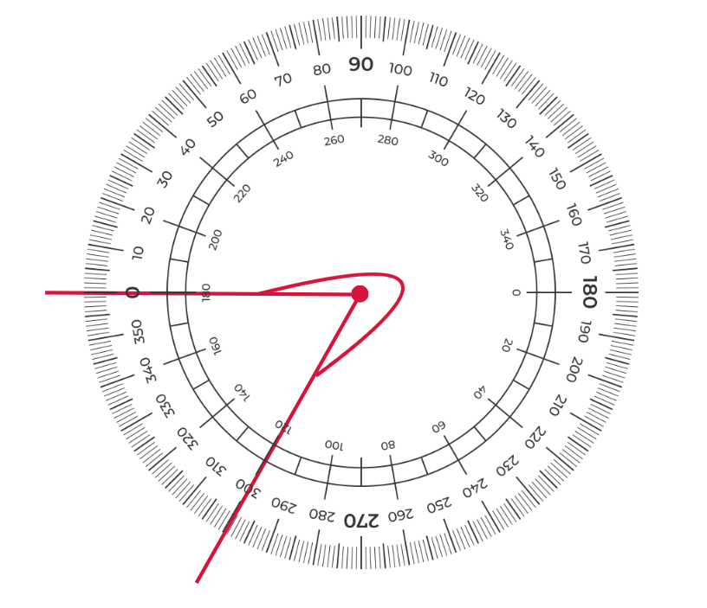
Short response (22)
Using the protractor, measure how many degrees are in this angle.
Notes:
Short response questions provide brisk paced questions focussing on review of current and previous content to support spaced and interleaved practice.
Syllabus focus area:
Geometric measure A: Angles

Slide 43
Short response (23)
6S were surveying 6W about their interests outside school. Design a question to ask that will identify data on 6W’s interests.
Notes:
Short response questions provide brisk paced questions focussing on review of current and previous content to support spaced and interleaved practice.
Syllabus focus area:
Data A

Slide 44
Short response (24)
Record the equivalent capacity using decimal representations:
half a litre
500 ml
750 ml
250 ml
Notes:
Short response questions provide brisk paced questions focussing on review of current and previous content to support spaced and interleaved practice.
Syllabus focus area:
Three-dimensional spatial structure A: Volume

Slide 45
Activity 6 – determining factors (1)
A rectangular space has an area of 48 m².
What are all the possible lengths and
widths of this space?
Notes:
This is a developing number sense activity.
Number sense refers to a deep understanding of numbers, including their magnitude, relationships, and the effects of operations on them. It supports fluency and understanding, estimation, flexible thinking, and efficient problem-solving. Number sense activities 1–4 ‘activate’ prior number knowledge and support the learning of new content in the unit. Number sense activities 5–8 ‘loop’ back and provide opportunity for spaced practice with concepts and procedures covered in previous units.
Syllabus focus area:
Multiplicative relations A
Two-dimensional spatial structure A
Determining factors
Review the terms factor and product.
Factor: a number which divides another number without a remainder. For example, 1, 2, 3 and 6 are factors of 6 but 4 and 5 are not.
Product: the result of multiplying 2 or more numbers together, for example, 12 is the product of 4 × 3.
Pose the question: A rectangular space has an area of 48 m². Ask: What might be all the possible lengths and widths of this space?
Students turn and talk and record possible solutions on an individual whiteboard. For example, 48 m² as 6 m by 8 m, 12 m by 4 m or 2 m by 24 m.
Select students to share their thinking with the class.
Discuss:
- How many possibilities are there?
- How did multiplication or division help you with this problem?
- How could the words ‘product’ and ‘factor’ describe the numbers you have used and their relationship with each other?
Explain that the factors of 48 are 1, 2, 3, 4, 6, 8, 12, 16, 24 and 48. For example, 48 is a product of 6 × 8 and 12 × 4.
Pose the question: A farmer has enough sheep to fit inside a paddock of 24 m². What might be all the possible lengths and widths of this space?
Students list all the possibilities on their individual whiteboards, listing all factors of 24.
Students show their answers. Scan student work to check for understanding of using factors of numbers to aid mental multiplication. Revisit this learning if required.

Slide 46
Activity 6 – determining factors (2)
A farmer has enough sheep to fit inside a
paddock of 24 m².
What might be all the possible lengths and
widths of this space?
Notes:
This is a developing number sense activity.
Number sense refers to a deep understanding of numbers, including their magnitude, relationships, and the effects of operations on them. It supports fluency and understanding, estimation, flexible thinking, and efficient problem-solving. Number sense activities 1–4 ‘activate’ prior number knowledge and support the learning of new content in the unit. Number sense activities 5–8 ‘loop’ back and provide opportunity for spaced practice with concepts and procedures covered in previous units.
Syllabus focus area:
Multiplicative relations A
Two-dimensional spatial structure A
Determining factors
Review the terms factor and product.
Factor: a number which divides another number without a remainder. For example, 1, 2, 3 and 6 are factors of 6 but 4 and 5 are not.
Product: the result of multiplying 2 or more numbers together, for example, 12 is the product of 4 × 3.
Pose the question: A rectangular space has an area of 48 m². Ask: What might be all the possible lengths and widths of this space?
Students turn and talk and record possible solutions on an individual whiteboard. For example, 48 m² as 6 m by 8 m, 12 m by 4 m or 2 m by 24 m.
Select students to share their thinking with the class.
Discuss:
- How many possibilities are there?
- How did multiplication or division help you with this problem?
- How could the words ‘product’ and ‘factor’ describe the numbers you have used and their relationship with each other?
Explain that the factors of 48 are 1, 2, 3, 4, 6, 8, 12, 16, 24 and 48. For example, 48 is a product of 6 × 8 and 12 × 4.
Pose the question: A farmer has enough sheep to fit inside a paddock of 24 m². What might be all the possible lengths and widths of this space?
Students list all the possibilities on their individual whiteboards, listing all factors of 24.
Students show their answers. Scan student work to check for understanding of using factors of numbers to aid mental multiplication. Revisit this learning if required.

Slide 47
Review of learning 7

Slide 48
Multiple choice (4)
Which number is not a factor of 80?
A
B
C
D
40
8
6
16
Notes:
This question connects to the content in the developing number sense activity (Activity 7)
Syllabus focus area:
Multiplicative relations A

Slide 49
Short response (25)
Class 6W are going to an aquarium. The cost is $35 per student for entry plus $10 each for a photograph with a seal. There are 30 students in 6W.
What is the total cost of the excursion ?
Explain the strategy used to find a solution.
Notes:
Short response questions provide brisk paced questions focussing on review of current and previous content to support spaced and interleaved practice.
Syllabus focus area:
Multiplicative relations A

Slide 50
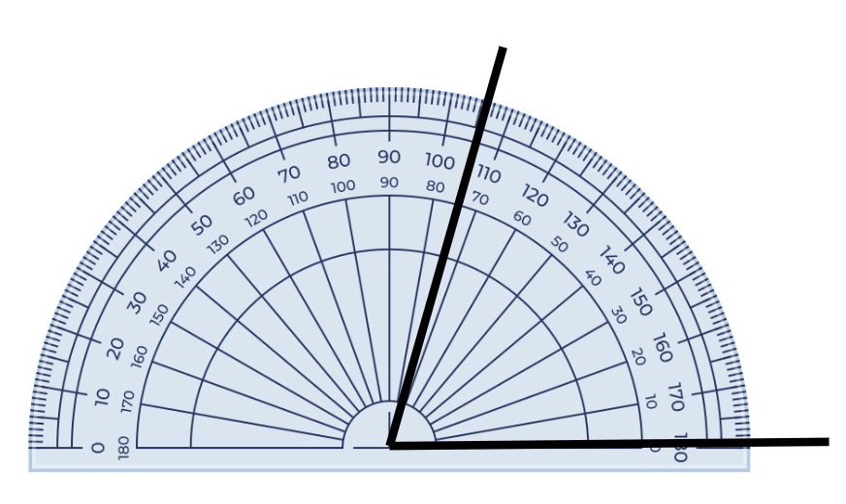
Short response (26)
Measure, record and name the angle:
Notes:
Short response questions provide brisk paced questions focussing on review of current and previous content to support spaced and interleaved practice.
Syllabus focus area:
Geometric measure A: Angles

Slide 51
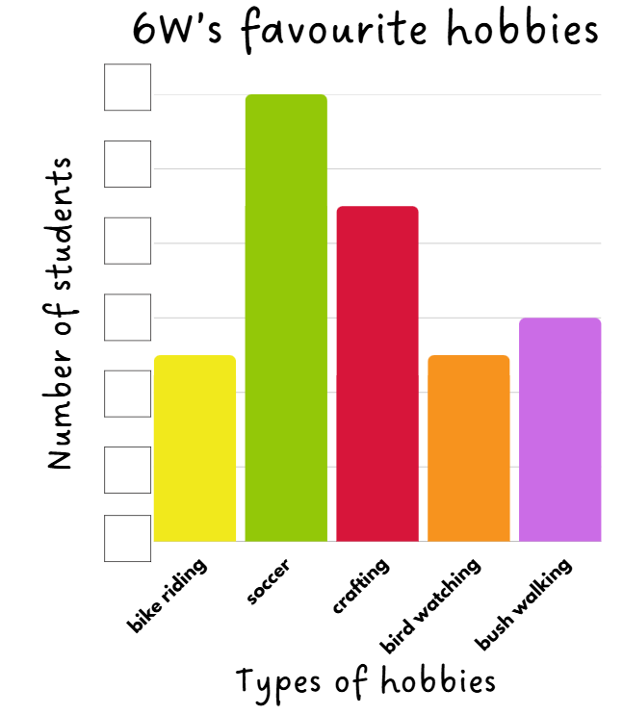
Short response (27)
What is an appropriate vertical scale to represent the 6W’s data about their favourite hobby?
  bike riding - 5
  soccer - 12
  crafting - 9
  bird watching - 5
  bush walking - 6
Notes:
Short response questions provide brisk paced questions focussing on review of current and previous content to support spaced and interleaved practice.
Syllabus focus area:
Data A

Slide 52
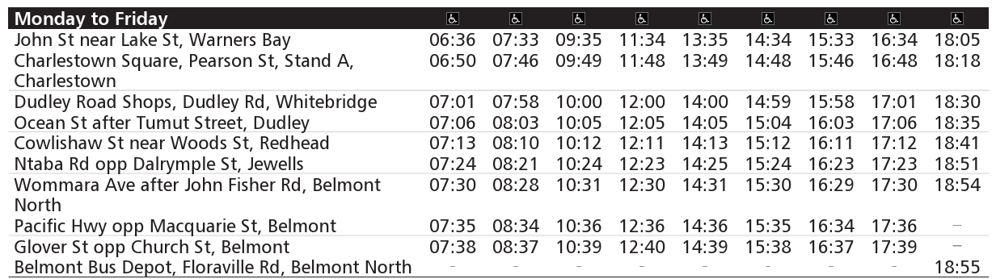
Short response (28)
Rosie catches the 14:48 bus and gets off at 15:30. Where is her start and end location?
Notes:
Short response questions provide brisk paced questions focussing on review of current and previous content to support spaced and interleaved practice.
Syllabus focus area:
Non-spatial measure A: Time transportnsw.info/routes/details/hunter-buses-network/48/73048

Slide 53
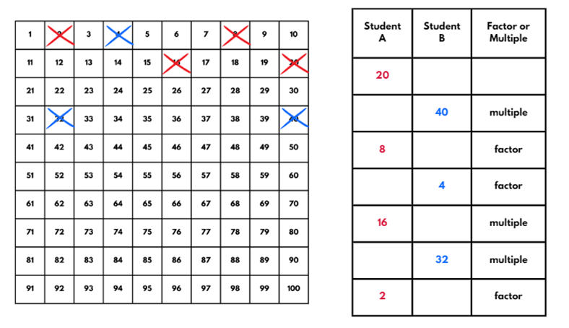
Activity 7 – determine products and factors
Notes:
This is a developing number sense activity.
Number sense refers to a deep understanding of numbers, including their magnitude, relationships, and the effects of operations on them. It supports fluency and understanding, estimation, flexible thinking, and efficient problem-solving. Number sense activities 1–4 ‘activate’ prior number knowledge and support the learning of new content in the unit. Number sense activities 5–8 ‘loop’ back and provide opportunity for spaced practice with concepts and procedures covered in previous units.
Syllabus focus area:
Multiplicative relations A
Determine products and factor
This resource corresponds to Resource 36 – 100 grid in Stage 3 Year A Unit 20.
This activity is an adaptation of ‘Factors and multiples game’ from NRICH by the University of Cambridge.
Note: this game can be played on the Factors and Multiples Game interactive gameboard if digital devices are available.
Provide pairs of students with Resource 36 – 100 grid (this resource corresponds to Resource 36 – 100 grid in Stage 3 Year A Unit 20).
Explain that the aim of the game is to try and make it a challenge for the other player to pick a number that is a factor or multiple of the number given.
Player A chooses an even number that is less than 50 and crosses it out on the grid.
Player B chooses a number that is a factor or multiple of their partner’s number.
Players continue to take turns to cross out numbers, at each stage choosing a number that is a factor or multiple of the number just crossed out by the other player.
The first player who is unable to cross out a number ends the game.
Discuss as a class any elements of this game that made it difficult or any strategies that were used to attempt to defeat their opponent.

Slide 54
Review of learning 8

Slide 55
True or false (4)
48 has 10 factors.
True | False
Notes:
The question on this slide connects to the content being explored in the developing number sense activity (Activity 8)
Syllabus focus area:
Multiplicative relations A

Slide 56
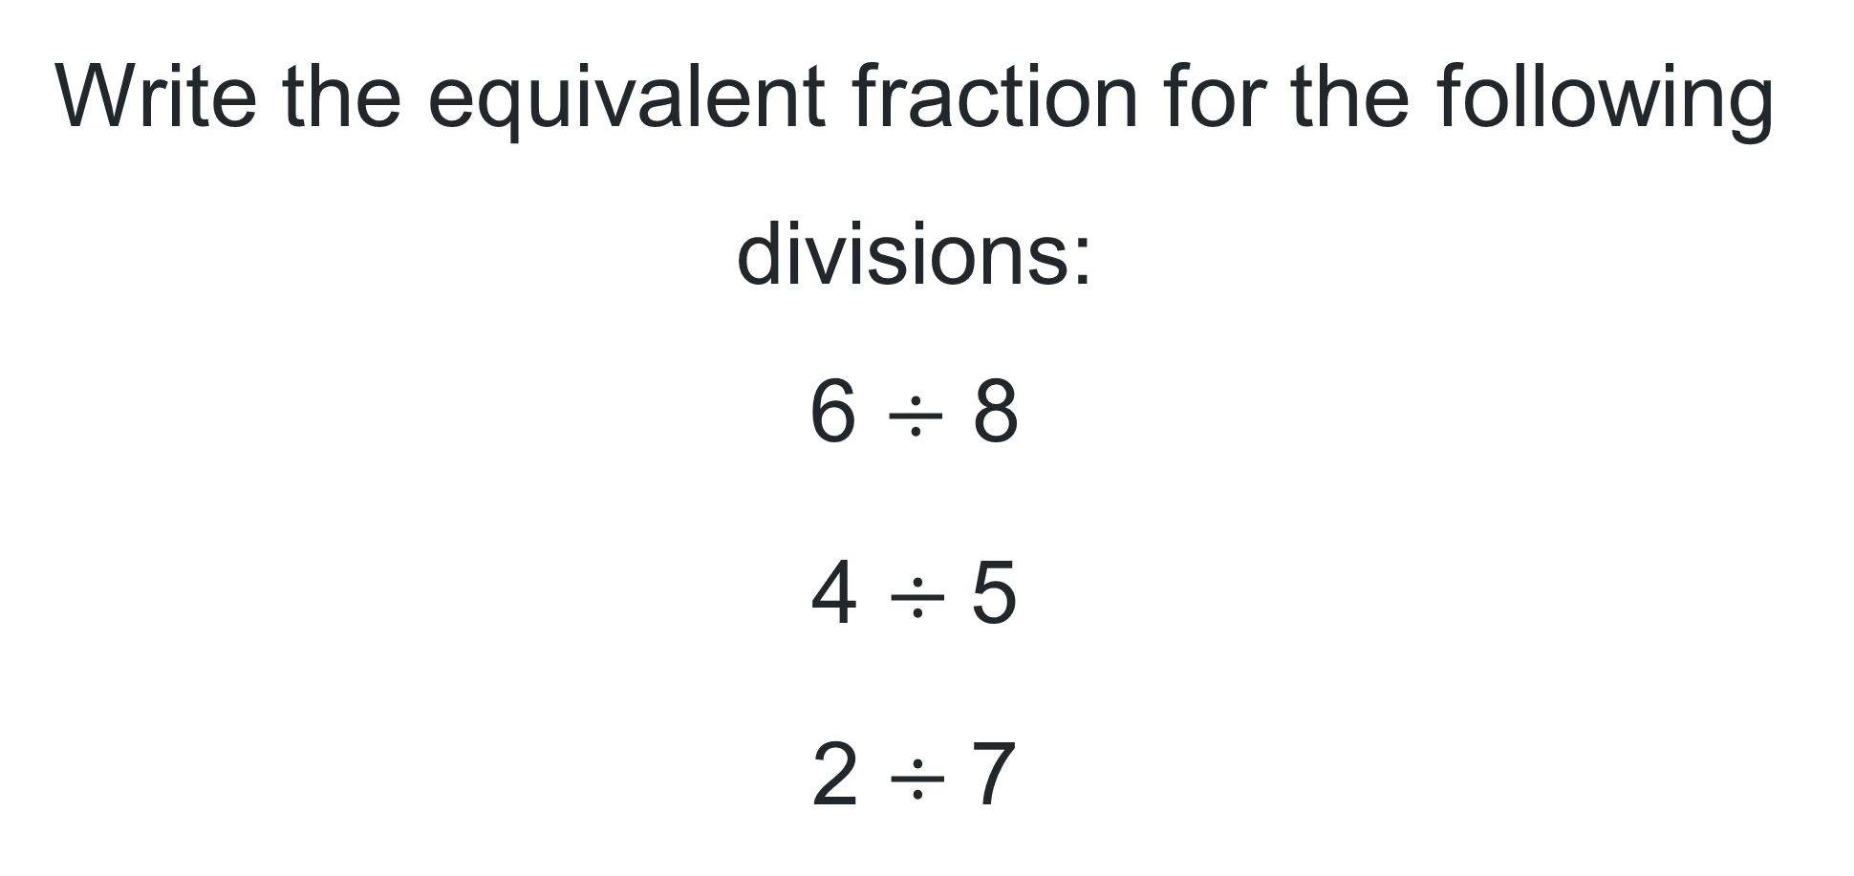
Short response (29)
Write the equivalent fraction for the following divisions:
6 $÷$ 8
4 $÷$5
2 $÷$7
Notes:
Short response questions provide brisk paced questions focussing on review of current and previous content to support spaced and interleaved practice.
Syllabus focus area:
Multiplicative relations B

Slide 57
Short response (30)
Destination | Departure time
Sydney | 07:00
Gosford | 08:30
Newcastle | 10:00
Gloucester | 12:00
Wauchope | 14:30
Kempsey | 15:30
Coffs Harbour | 17:00
Grafton | 18:15
Casino | 19:45
Nichole caught the train from Gosford to Grafton. How long was she on the train?
Notes:
Short response questions provide brisk paced questions focussing on review of current and previous content to support spaced and interleaved practice.
Syllabus focus area:
Non-spatial measure B: Time:

Slide 58
Short response (31)
A class survey shows the number of books students read in a month: 4, 6, 5, 8, 7, 5, 6, 4. Identify a suitable scale for the vertical axis.
Explain why your chosen scale is appropriate.
Notes:
Short response questions provide brisk paced questions focussing on review of current and previous content to support spaced and interleaved practice.
Syllabus focus area:
Data B

Slide 59
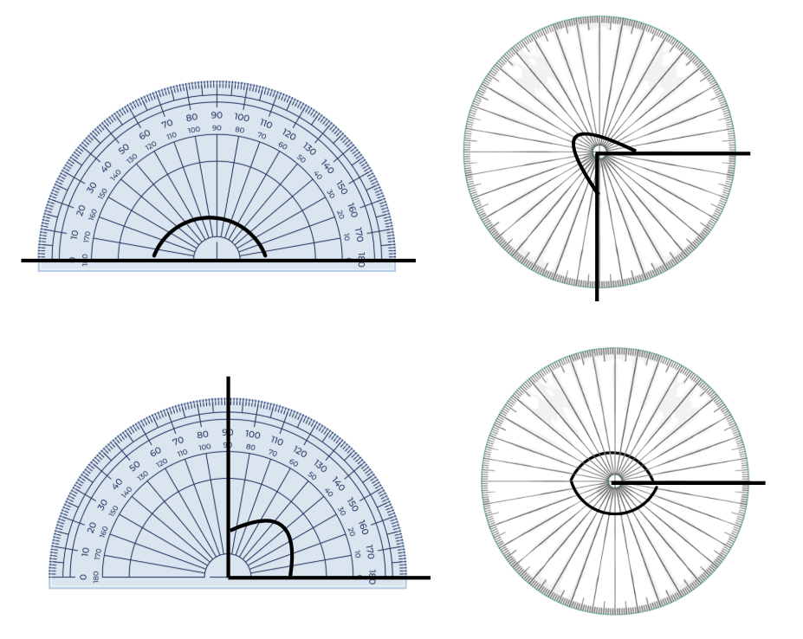
Short response (32)
Use the protractors to measure and identify the angles.
Notes:
Short response questions provide brisk paced questions focussing on review of current and previous content to support spaced and interleaved practice.
Syllabus focus area:
Geometric measure A: Angles

Slide 60
Activity 8 – finding factors (1)
36
Notes:
This is a developing number sense activity.
Number sense refers to a deep understanding of numbers, including their magnitude, relationships, and the effects of operations on them. It supports fluency and understanding, estimation, flexible thinking, and efficient problem-solving. Number sense activities 1–4 ‘activate’ prior number knowledge and support the learning of new content in the unit. Number sense activities 5–8 ‘loop’ back and provide opportunity for spaced practice with concepts and procedures covered in previous units.
Syllabus focus area:
Multiplicative relations A
Finding factors
Write the number 36 on the board.
Ask students to list all the numbers that multiply together to make 36.
Explain that each of these pairs of numbers is a factor of 36. List the factors of 36 on the board as the students share them.
Write the number 56 on the board.
Students work with a partner to find all the factors of 56 using factor pairs as in the previous example.
Ask:
- How do you know if you have missed a factor?
- Did you have a system to work out all the factors?
- Is there a number that is always a factor?
What kind of number has only itself and 1 as factors? (prime number)
Discuss as a class using examples to support student understanding of factors.

Slide 61
Activity 8 – finding factors (2)
56
Notes:
This is a developing number sense activity.
Number sense refers to a deep understanding of numbers, including their magnitude, relationships, and the effects of operations on them. It supports fluency and understanding, estimation, flexible thinking, and efficient problem-solving. Number sense activities 1–4 ‘activate’ prior number knowledge and support the learning of new content in the unit. Number sense activities 5–8 ‘loop’ back and provide opportunity for spaced practice with concepts and procedures covered in previous units.
Syllabus focus area:
Multiplicative relations A
See slide 60 for instructions.

Slide 62
Double Venn diagram
Object 1
Object 2
Features similar to both objects
Features of object 1
Features of object 2

Slide 63
Frayer
Definition
Facts/Characteristics
Word, term, concept
Examples
Non-examples

Slide 64
Spider map
Idea
Subject

Slide 65
Cline
Concept 1
Concept 2
Word
Word
Word
Word
Word
Word
Word
Word
Word
Word
Word

Slide 66

Compare and contrast

Slide 67
Multiple choice (5)
A
B
C
D

Slide 68
Multiple choice (6)
A
B
C
D

Slide 69
References
This presentation contains NSW Curriculum and syllabus content. The NSW Curriculum is developed by the NSW Education Standards Authority. This content is prepared by NESA for and on behalf of the Crown in the right of the State of New South Wales. The material is protected by Crown copyright.
Please refer to the NESA Copyright Disclaimer for more information https://educationstandards.nsw.edu.au/wps/portal/nesa/mini-footer/copyright.
NESA holds the only official and up-to-date versions of the NSW Curriculum and syllabus documents. Please visit the NSW Education Standards Authority (NESA) website https://educationstandards.nsw.edu.au/wps/portal/nesa/home and the NSW Curriculum website https://curriculum.nsw.edu.au.
Mathematics K-10 © Syllabus NSW Education Standards Authority (NESA) for and on behalf of the Crown in right of the State of New South Wales, 2022.
Math Salamanders Limited (2010-2024) Salamander Shoot Out from Math Salamanders, accessed 13 June 2024.
MMMathMania (2021) Place Value Pickle: Decimals from MMMathMania website, accessed 13 June 2024.
Michael Minas (2024) Greater than from Love maths website, accessed 13 June 2024.
Toy Theatre (2001-2024) interactive dice, Toy Theatre website, accessed 13 June 2024.
University of Cambridge (Faculty of Mathematics) (1997–2023) Factors and Multiples NRICH website, accessed 13 June 2024.
University of Cambridge (Faculty of Mathematics) (1997–2023) What’s in the box? NRICH maths website, accessed 13 June 2024.
University of Cambridge (Faculty of Mathematics) (2023) ‘Factors and Multiples Game’, NRICH website, accessed 30 May 2025.

Slide 70
Copyright
© State of New South Wales (Department of Education), 2025
The copyright material published in this resource is subject to the Copyright Act 1968 (Cth) and is owned by the NSW Department of Education or, where indicated, by a party other than the NSW Department of Education (third-party material).
Copyright material available in this resource and owned by the NSW Department of Education is licensed under a Creative Commons Attribution 4.0 International (CC BY 4.0) license.
This license allows you to share and adapt the material for any purpose, even commercially.
Attribution should be given to © State of New South Wales (Department of Education), 2025.
Material in this resource not available under a Creative Commons license:
the NSW Department of Education logo, other logos and trademark-protected material
Material owned by a third party that has been reproduced with permission. You will need to obtain permission from the third party to reuse its material.
Links to third-party material and websites
Please note that the provided (reading/viewing material/list/links/texts) are a suggestion only and implies no endorsement, by the New South Wales Department of Education, of any author, publisher, or book title. School principals and teachers are best placed to assess the suitability of resources that would complement the curriculum and reflect the needs and interests of their students.
If you use the links provided in this document to access a third party’s website, you acknowledge that the terms of use, including licence terms set out on the third-party’s website apply to the use which may be made of the materials on that third-party website or where permitted by the Copyright Act 1968 (Cth). The department accepts no responsibility for content on third-party websites.

