Slide 1
Instructions for use
This resource is not a teaching and learning program. It should be used in conjunction with Stage 3 Year B Unit 21.
Classroom teachers are encouraged to add and adapt slides as required to meet the needs of their students.
Save a copy of the file to make changes to the slide deck. Go to File > Download a Copy (this downloads a copy to the computer to edit in the PowerPoint app).
To convert the PowerPoint to Google Slides:
  Upload the file into Google Drive and open it.
  Go to File > Save as Google Slides.
  (Note – conversion may cause formatting changes in the slides.)

Slide 2

Review of Learning
Mathematics Stage 3 – Unit 21
Notes:
Reviews may include a combination of question types, requiring students to recall facts and key ideas, as well as apply their knowledge to solve problems and answer questions. To support active engagement, a mix of techniques should be employed.” (AERO, 2024).
This Review of Learning slide deck revisits key concepts from the following units:
Stage 3 Year B Unit 21
Stage 3 Year A Unit 20
Stage 3 Year A Unit 19
It also includes opportunities to review prior learning in non-number content, supporting consolidation across focus areas.
The review of learning resources include three key task types that support the development of mathematical proficiency through retrieval, spaced practice, and active participation. These practices complement the review phase (activating prior knowledge) embedded within the beginning of each lesson.
1.
Multiple-choice questions/True or false: Designed to promote active retrieval of key concepts and identify common misconceptions in number, supporting consolidation, understanding and fluency.
These questions:
support spaced and interleaved practice
help identify and address common misconceptions
support active recall and immediate feedback
support whole class participation
identify areas requiring reteach
2.
Short-response question sets: Carefully grouped questions that encourage spaced and interleaved practice across multiple focus areas, helping students revisit and apply knowledge from different points in time.
These questions:
have a combination of question types
address a range of focus areas
build automaticity and fluency
support active recall
allow for immediate feedback
identify content requiring reteach
3.
Developing number sense activities: A variety of practical, purposeful tasks that reinforce current learning and build on prior knowledge. These activities promote reasoning, problem-solving and conceptual understanding.
The review of learning resources are designed to work support teaching and learning in mathematics. For the most effective implementation, use the resources flexibly, adapting to meet student learning needs and individual classroom contexts.

Slide 3
Lessons
1
Review of learning 1
5
Review of learning 5
2
Review of learning 2
6
Review of learning 6
3
Review of learning 3
7
Review of learning 7
4
Review of learning 4
8
Review of learning 8
Notes:
Teacher notes:
Click lesson numbers to go to specific lessons
Interactive features can be viewed in slide show

Slide 4
Review of learning 1

Slide 5

Multiple choice (1)
Which decimal number has
the smallest value?
Explain your reasoning.
0.5 0.125 0.25 0.49
A
B
C
D
Notes:
This question connects to the content in the developing number sense activity (Activity 1)
Syllabus focus area:
Represents numbers A: Decimals and percentages

Slide 6

Short response (1)
Write the number 3 198 342 in words.
Notes:
Short response questions provide brisk paced questions focussing on review of current and previous content to support spaced and interleaved practice.
Syllabus focus area:
Represents numbers A: Whole numbers

Slide 7
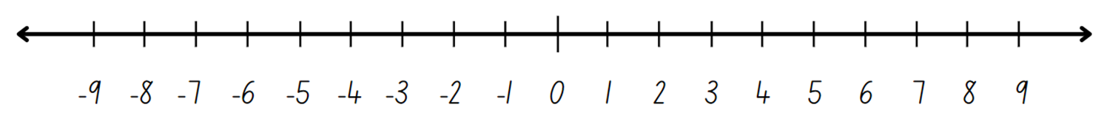
Short response (2)
Use the number line to solve
4 - 5 =
Notes:
Short response questions provide brisk paced questions focussing on review of current and previous content to support spaced and interleaved practice.
Syllabus focus area:
Represents numbers B: Whole numbers

Slide 8
Short response (3)
Identify the type of triangle.
Explain your reasoning.
Notes:
Short response questions provide brisk paced questions focussing on review of current and previous content to support spaced and interleaved practice.
Syllabus focus area:
Two-dimensional spatial structure A: 2D shapes

Slide 9
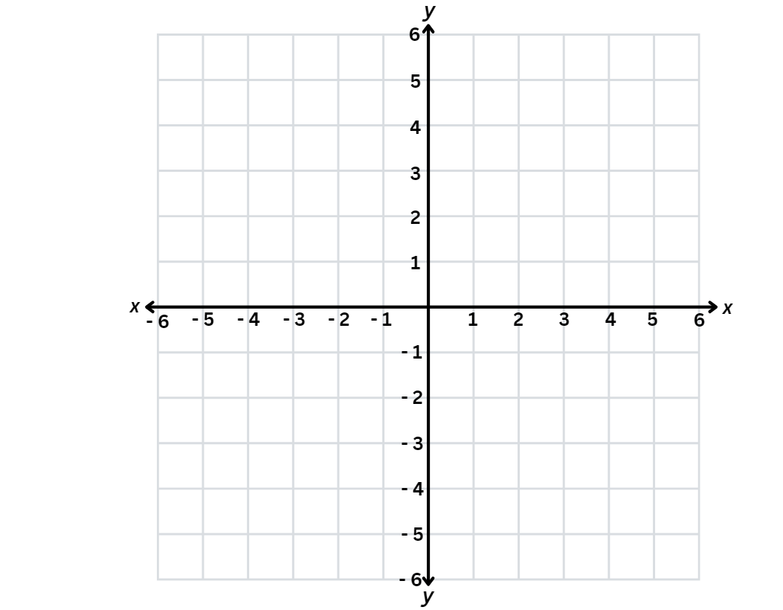
Short response (4)
Record the points for the letters on
the Cartesian plane.
A =
B =
Notes:
Short response questions provide brisk paced questions focussing on review of current and previous content to support spaced and interleaved practice.
Syllabus focus area:
Geometric measure A: Position

Slide 10

Activity 1 – comparing decimals (1)
decimals
0.355 0.35
Notes:
This is a developing number sense activity.
Number sense refers to a deep understanding of numbers, including their magnitude, relationships, and the effects of operations on them. It supports fluency and understanding, estimation, flexible thinking, and efficient problem-solving. Number sense activities 1–4 ‘activate’ prior number knowledge and support the learning of new content in the unit. Number sense activities 5–8 ‘loop’ back and provide opportunity for spaced practice with concepts and procedures covered in previous units.
Syllabus focus area:
Represents numbers A: Decimals and percentages
Activity 1 – comparing decimals
This resource corresponds to Resource 18 – decimal comparisons in Stage 3 Year B Unit 21.
This activity is an adaptation of ‘Colour in Decimals’ from Engaging Maths: 25 Favourite Lessons, 2nd edn by Clarke and Roche.
Display the word ‘decimals’ and the examples ‘0.355’ and ‘0.35’.
Students turn and talk to discuss and record their prior knowledge of decimals. Encourage students to determine which is the largest decimal, recording their reasoning on whiteboards.
Students share their ideas with the class. Check for understanding and clarify any misconceptions.

Slide 11
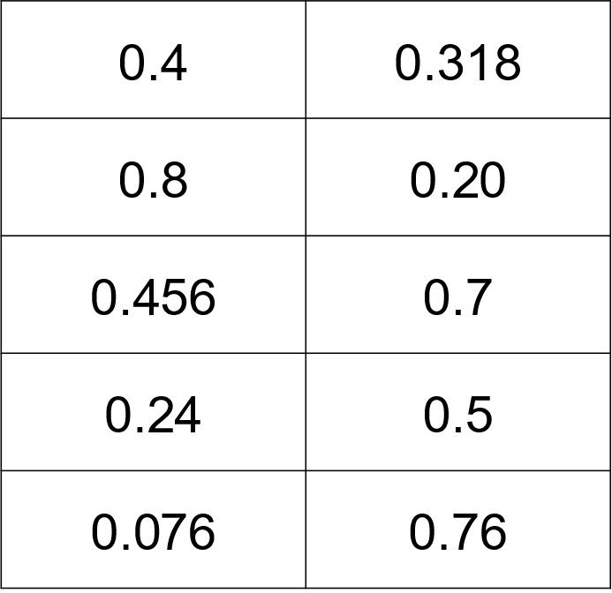
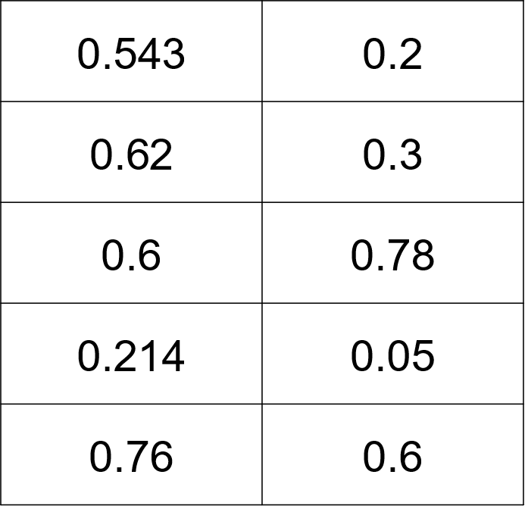
Activity 1 – comparing decimals (2)
Circle the largest number in each pair.
Notes:
This is a developing number sense activity.
Number sense refers to a deep understanding of numbers, including their magnitude, relationships, and the effects of operations on them. It supports fluency and understanding, estimation, flexible thinking, and efficient problem-solving. Number sense activities 1–4 ‘activate’ prior number knowledge and support the learning of new content in the unit. Number sense activities 5–8 ‘loop’ back and provide opportunity for spaced practice with concepts and procedures covered in previous units.
Syllabus focus area:
Represents numbers A: Decimals and percentages
Activity 1 – comparing decimals
This resource corresponds to Resource 18 – decimal comparisons in Stage 3 Year B Unit 21.
This activity is an adaptation of ‘Colour in Decimals’ from Engaging Maths: 25 Favourite Lessons, 2nd edn by Clarke and Roche.
Distribute Resource 18 – decimal comparisons. Read the instructions and explain that students will have 5 minutes to circle the largest decimal in each pair.
Note: Resource 18 – decimal comparisons is a screening tool adapted from Clarke and Roche (2014) to identify 2 common misconceptions with decimals. The first misconception is sometimes called ‘Longer is Larger’, where students consider that the number with more decimal places is larger. The second misconception is sometimes called ‘Shorter is Larger’, where students consider that the number with fewer decimal places is larger. Use the data from the completed task to identify student misconceptions about decimals in preparation for developing number sense Activity 2.

Slide 12
Review of learning 2

Slide 13
True or false (1)
0.270 has the same value as 0.27
True | False
Notes:
The question on this slide connects to the content being explored in the developing number sense activity (Activity 2)
Syllabus focus area:
Represents numbers A: Decimals and percentages

Slide 14
Short response (5)
Record the following numbers in ascending order:
1 045 054
1 010 698
1 909 987
1 949 888
Notes:
Short response questions provide brisk paced questions focussing on review of current and previous content to support spaced and interleaved practice.
Syllabus focus area:
Represents numbers A: Whole numbers

Slide 15
Short response (6)
Liam needs to buy a present for $16.
He only has $7. Use the number line to find how much he needs to borrow.
Notes:
Short response questions provide brisk paced questions focussing on review of current and previous content to support spaced and interleaved practice.
Syllabus focus area:
Represents numbers B: Whole numbers

Slide 16
Short response (7)
Which polygon doesn’t belong?
Record your reasoning.
A
B
C
D
Notes:
Short response questions provide brisk paced questions focussing on review of current and previous content to support spaced and interleaved practice.
Syllabus focus area:
Two-dimensional spatial structure A: 2D shapes

Slide 17
Short response (8)
Both regular polygons have
a perimeter of 24 cm. Find the length of one side for each polygon.
A
B
Notes:
Short response questions provide brisk paced questions focussing on review of current and previous content to support spaced and interleaved practice.
Syllabus focus area:
Geometric measure A: Length

Slide 18
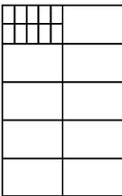
Activity 2 – decimal place value to hundredths (1)
Notes:
This is a developing number sense activity.
Number sense refers to a deep understanding of numbers, including their magnitude, relationships, and the effects of operations on them. It supports fluency and understanding, estimation, flexible thinking, and efficient problem-solving. Number sense activities 1–4 ‘activate’ prior number knowledge and support the learning of new content in the unit. Number sense activities 5–8 ‘loop’ back and provide opportunity for spaced practice with concepts and procedures covered in previous units.
Syllabus focus area:
Represents numbers A: Decimals and percentages
Activity 2 – decimal place value to hundredths
This resource corresponds to Resource 19 – colour in decimats and Resource 20 – decimat record table in Stage 3 Year B Unit 21.
This activity is an adaptation of Decimats (understanding fractions) from Mathematics K-6 resources by State of New South Wales (Department of Education). Watch videos prior to the activity for instructions on how to prepare and play the game. A tenth is a benchmark fraction for Stage 3 students. Students need a clear understanding of its size relative to a whole, a hundredth and a thousandth.
Display the large decimat from Resource 19 – colour in decimats. Explain that it is partitioned into 10 equal parts called tenths, each of which can be represented as a fraction ($\frac{1}{10}$) or a decimal (0.1).
Guide students on how to draw a decimat showing 10 tenths and then partition one tenth into 10 hundredths in their workbooks. Explain that the fraction $\frac{1}{100}$ can be written as a decimal (0.01).

Slide 19
Activity 2 – decimal place value to hundredths (2)
What I rolled or spun |  |  | How much is shaded altogether?
Fraction | Decimal | Words | Decimal
Notes:
This is a developing number sense activity.
Number sense refers to a deep understanding of numbers, including their magnitude, relationships, and the effects of operations on them. It supports fluency and understanding, estimation, flexible thinking, and efficient problem-solving. Number sense activities 1–4 ‘activate’ prior number knowledge and support the learning of new content in the unit. Number sense activities 5–8 ‘loop’ back and provide opportunity for spaced practice with concepts and procedures covered in previous units.
Syllabus focus area:
Represents numbers A: Decimals and percentages
Activity 2 – decimal place value to hundredths
Model how to play the game ‘Colour in decimats’.
Note: for this game, thousandths are not required, but the gameboard is readily extended to thousandths by partitioning a hundredth into 10 equal parts. Refer to Resource 19 – colour in decimats.
Demonstrate spinning the spinners on Resource 19 – colour in decimats. For example, 1 and tenths.
Model recording spins on Resource 20 – decimat record table.
Proceed with the game, selecting students to spin the spinners and complete the recording table. All students colour the decimat in their workbooks
Repeat steps, discussing the way to correctly record fractions, decimals and words.
Model strategies for adding decimals in the total column. Check for understanding as students colour in each fraction on their board.
After a few turns, write two of the decimals from the recording chart next to each other, such as 0.2 and 0.06. Ask:
Which decimal number is larger?
How can you prove your response is correct?

Slide 20
Review of learning 3

Slide 21
Multiple choice (2)
Which decimal number has the
value closest to 1.0?
0.99 1.1 0.9 2.0
A
B
C
D
Notes:
This question connects to the content in the developing number sense activity (Activity 3)
Syllabus focus area:
Represents numbers A: Decimals and percentages

Slide 22
Short response (9)
Show one way of regrouping 3 463 485 using non-standard partitioning.
Notes:
Short response questions provide brisk paced questions focussing on review of current and previous content to support spaced and interleaved practice.
Syllabus focus area:
Represents numbers A: Whole numbers

Slide 23
Short response (10)
Use rounding to estimate a
reasonable estimate to 1238 + 329.
Be prepared to justify your solution.
Notes:
Short response questions provide brisk paced questions focussing on review of current and previous content to support spaced and interleaved practice.
Syllabus focus area:
Additive relations A

Slide 24
Short response (11)
Identify the lines of symmetry in
the polygons. Which polygon doesn’t belong? Explain your reasoning.
A
B
C
D
Notes:
Short response questions provide brisk paced questions focussing on review of current and previous content to support spaced and interleaved practice.
Syllabus focus area:
Two-dimensional spatial structure A: 2D shapes

Slide 25
Short response (12)
The angles in this regular pentagon
are all the same size.
Estimate and describe the size of the angles.
Explain your reasoning.
Notes:
Short response questions provide brisk paced questions focussing on review of current and previous content to support spaced and interleaved practice.
Syllabus focus area:
Geometric measure A: Angles

Slide 26
Activity 3 – decimal place value to thousandths (1)
0.456 vs 0.462
Compare these 2 decimals using
place value names.
Play ‘colour in decimats’ in a small group.
Notes:
This is a developing number sense activity.
Number sense refers to a deep understanding of numbers, including their magnitude, relationships, and the effects of operations on them. It supports fluency and understanding, estimation, flexible thinking, and efficient problem-solving. Number sense activities 1–4 ‘activate’ prior number knowledge and support the learning of new content in the unit. Number sense activities 5–8 ‘loop’ back and provide opportunity for spaced practice with concepts and procedures covered in previous units.
Syllabus focus area:
Represents numbers A: Decimals and percentages
Activity 3 – decimal place value to thousandths
This resource corresponds to Resource 19 – colour in decimats and Resource 20 – decimat record table in Stage 3 Year B Unit 21.
Note: prior to this lesson, prepare student copies of Resource 19 – colour in decimats.
Display 2 decimal numbers from Activity 2 – decimal place value to hundredths. Using a think-aloud, compare their relative size using place value names.
Using a think aloud, demonstrate comparing the relative size of decimals into the thousandths. For example, using the decimal numbers 0.456 and 0.462, I know:
in the tenths place, both have 4. They are equal.
in the hundredths place, 0.456 has 5, and 0.462 has 6. Since 5 is less than 6, 0.456 is smaller
in the thousandths place, 0.456 has 6, and 0.462 has 2, but we already know 0.456 is smaller
therefore, 0.456 < 0.462. It’s important to compare each place value from left to right.

Slide 27
Activity 3 – decimal place value to thousandths (2)
What I rolled or spun |  |  | How much is shaded altogether?
Fraction | Decimal | Words | Decimal
Notes:
This is a developing number sense activity.
Number sense refers to a deep understanding of numbers, including their magnitude, relationships, and the effects of operations on them. It supports fluency and understanding, estimation, flexible thinking, and efficient problem-solving. Number sense activities 1–4 ‘activate’ prior number knowledge and support the learning of new content in the unit. Number sense activities 5–8 ‘loop’ back and provide opportunity for spaced practice with concepts and procedures covered in previous units.
Syllabus focus area:
Represents numbers A: Decimals and percentages
Activity 3 – decimal place value to thousandths
This resource corresponds to Resource 19 – colour in decimats and Resource 20 – decimat record table in Stage 3 Year B Unit 21.
Revise the rules of Colour in decimats from Activity 2 – decimal place value.
In small groups, students use Resource 20 – decimat record table and play Colour in decimats.
Note: for this version of the game, thousandths are required, the gameboard is readily extended to thousandths by partitioning a hundredth into 10 equal parts.
Encourage students to check each of their records for equivalent fractions and the cumulative total.

Slide 28
Review of learning 4

Slide 29
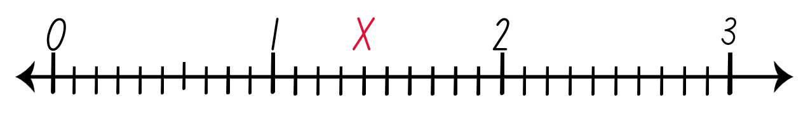
True or false (2)
The X on the number line represents 1.40
True | False
Notes:
The question on this slide connects to the content being explored in the developing number sense activity (Activity 4)
Syllabus focus area:
Represents numbers A: Decimals and percentages

Slide 30
Short response (13)
Which number is 10 times larger than 0.7?
Which number is 10 times smaller than 0.7?
Explain your reasoning.
Notes:
Short response questions provide brisk paced questions focussing on review of current and previous content to support spaced and interleaved practice.
Syllabus focus area:
Represents Numbers A: Decimals and percentages

Slide 31
Short response (14)
Use rounding to estimate a
reasonable solution to 12 238 + 2 104.
Be prepared to justify your thinking.
Notes:
Short response questions provide brisk paced questions focussing on review of current and previous content to support spaced and interleaved practice.
Syllabus focus area:
Additive relations A

Slide 32
Short response (15)
A class was lined up but had to change rooms. They turned and faced the opposite direction.
Approximately how many degrees did the students turn?
Notes:
Short response questions provide brisk paced questions focussing on review of current and previous content to support spaced and interleaved practice.
Syllabus focus area:
Geometric measure A: Angles

Slide 33
Short response (16)
Triangles can be classified and compared by their angles. Which of the triangles below doesn’t belong? Record your reasoning.
A
C
D
B
Notes:
Short response questions provide brisk paced questions focussing on review of current and previous content to support spaced and interleaved practice.
Syllabus focus area:
Two-dimensional spatial structure A: 2D shapes

Slide 34
Activity 4 – decimals on a number line
Notes:
This is a developing number sense activity.
Number sense refers to a deep understanding of numbers, including their magnitude, relationships, and the effects of operations on them. It supports fluency and understanding, estimation, flexible thinking, and efficient problem-solving. Number sense activities 1–4 ‘activate’ prior number knowledge and support the learning of new content in the unit. Number sense activities 5–8 ‘loop’ back and provide opportunity for spaced practice with concepts and procedures covered in previous units.
Syllabus focus area:
Represents numbers A: Decimals and percentages
Activity 4 – decimals on a number line
This resource corresponds to Activity 4 – decimals on a number line in Stage 3 Year B Unit 21.
Display a range of decimal numbers of up to 3 decimal places.
Model how to use a ruler to draw a number line.
Discuss how to label the number line and parts using decimal notation to hundredths. For example, benchmark decimals of 0.5, 1.0, 1.5, 2.0, 2.5, 3.0, 3.5, 4.0 4.5.
In pairs, students draw and label the number line in their workbooks and label with the benchmark decimals.
Students place the displayed decimals on the number line. Encourage students to compare the position of different decimals on their number line to understand their relative size.
In pairs, students turn and talk to explain their reasoning and strategies used to place decimals on a number line.
Check for understanding by having students share their number lines and mathematical reasoning.
Ask:
What strategies did you use to determine the placement of each decimal on the number line?
How did the benchmark decimals help you in placing the other numbers?

Slide 35
Review of learning 5

Slide 36
Multiple choice (3)
Which shows 184 353 rounded to the
nearest hundred?
184 400 184 440 184 300 185 000
A
B
C
D
Notes:
This question connects to the content in the developing number sense activity (Activity 5)
Syllabus focus area:
Represents numbers A: Whole numbers

Slide 37
Short response (17)
When 123 is recorded using standard partitioning it is
100 + 20 + 3.
Record the decimal number 5.429 using standard partitioning.
Notes:
Short response questions provide brisk paced questions focussing on review of current and previous content to support spaced and interleaved practice.
Syllabus focus area:
Represents Numbers A: Decimals and percentages

Slide 38
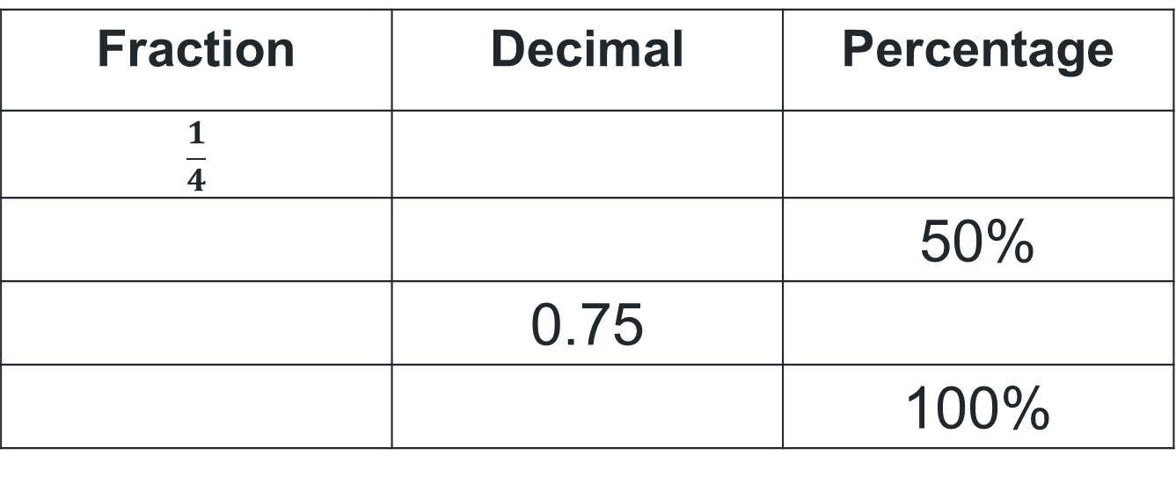
Short response (18)
Record the missing equivalent benchmark fractions, decimals and percentages.
Fraction | Decimal | Percentage
$$\frac{1}{4}$$
 |  | 50%
 | 0.75
 |  | 100%
Notes:
Short response questions provide brisk paced questions focussing on review of current and previous content to support spaced and interleaved practice.
Syllabus focus area:
Represents numbers B: Decimals and percentages

Slide 39
Short response (19)
Record the letter for each type of angle:
acute
obtuse
reflex
A
C
B
Notes:
Short response questions provide brisk paced questions focussing on review of current and previous content to support spaced and interleaved practice.
Syllabus focus area:
Geometric measure A: Angles

Slide 40
Short response (20)
Both parks have the same area. What could the dimensions of the second park be?
length = 9m
width = ?
length = ?
width = 6m
Notes:
Short response questions provide brisk paced questions focussing on review of current and previous content to support spaced and interleaved practice.
Syllabus focus area:
Two-dimensional spatial structure A: Area

Slide 41
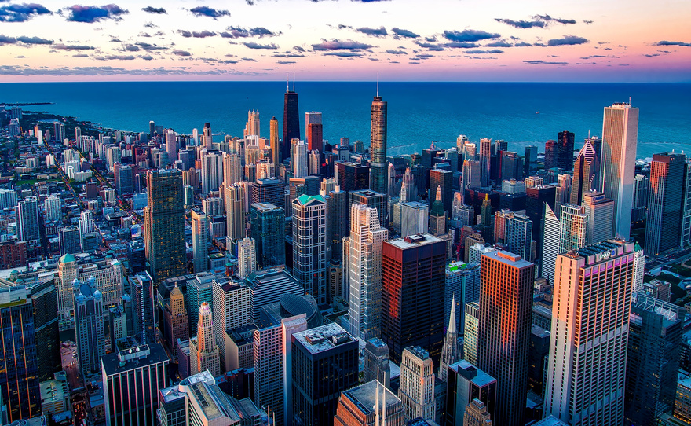
Activity 5 – place value to millions
Name | Country | Population
Shanghai | China | 28 516 000
Delhi | India | 32 065 000
Melbourne | Australia | 5 031 000
Sydney | Australia | 5 297 000
Dhaka | Bangladesh | 22 478 000
Sao Paulo | Brazil | 22 429 000
Tokyo | Japan | 37 274 000
Notes:
This is a developing number sense activity.
Number sense refers to a deep understanding of numbers, including their magnitude, relationships, and the effects of operations on them. It supports fluency and understanding, estimation, flexible thinking, and efficient problem-solving. Number sense activities 1–4 ‘activate’ prior number knowledge and support the learning of new content in the unit. Number sense activities 5–8 ‘loop’ back and provide opportunity for spaced practice with concepts and procedures covered in previous units.
Syllabus focus area:
Represents numbers A: Whole numbers
Activity 5 – place value to millions
This resource corresponds to Resource 21 – city populations 1 in Stage 3 Year B Unit 21.
This activity is an adaptation of ‘Cities of the world’ from A Practical Guide to Transforming Primary Mathematics: Activities and tasks that really work by Askew. You may wish to prepare data that is of interest to your students, for example, cities of birth for parents or grandparents. Create a table to display this data as in Resource 21 – city populations 1.
Display Resource 21 – city populations 1 or population data of interest to the class. Select students to read out each capital city and its population.
Discuss what the students notice about the numbers and when the data was prepared.
Highlight the recorded populations of Tokyo and Dhaka. Explain that the population figures provided are likely rounded estimates of the actual values.
Model rounding the population number for Shanghai.
Ask students to round the population data of Delhi to the nearest thousand and record on whiteboards.
Check for understanding on how to round numbers to the nearest thousand. Connect to prior learning, if necessary, focusing on place value positions.
In pairs, students round the remaining cities to the nearest thousand and record cities in descending order.
Record and display the list of cities and their rounded populations for Activity 6 – place value to billions.

Slide 42
Review of learning 6

Slide 43
True or false (3)
5 461 793 rounded to the nearest million
is 5 million.
True | False
Notes:
The question on this slide connects to the content being explored in the developing number sense activity (Activity 6)
Syllabus focus area:
Represents numbers A: Whole numbers

Slide 44
Short response (21)
Write the number that is
100 times larger than 5.429
Notes:
Short response questions provide brisk paced questions focussing on review of current and previous content to support spaced and interleaved practice.
Syllabus focus area:
Represents Numbers A: Decimals and percentages

Slide 45
Short response (22)
Lucas is a silver member of the football club. How much will 2 tickets cost?
Ticket price | Bronze member discount | Silver member discount | Gold member discount
$60.00 | 20% | 30% | 40%
Notes:
Short response questions provide brisk paced questions focussing on review of current and previous content to support spaced and interleaved practice.
Syllabus focus area:
Represents numbers B: Decimals and percentages

Slide 46
Short response (23)
Draw the following on your whiteboard:
an acute angle
a reflex angle
a right angle
perpendicular lines
Notes:
Short response questions provide brisk paced questions focussing on review of current and previous content to support spaced and interleaved practice.
Syllabus focus area:
Geometric measure A: Angles

Slide 47
Short response (24)
Which is heavier:
0.08 kg or 75 grams?
Be prepared to share your reasoning.
Notes:
Short response questions provide brisk paced questions focussing on review of current and previous content to support spaced and interleaved practice.
Syllabus focus area:
Non spatial measure A: Mass

Slide 48
Activity 6 – place value to billions (1)
Name | Country | Population
Shanghai | China | 28 516 000
Delhi | India | 32 065 000
Melbourne | Australia | 5 031 000
Sydney | Australia | 5 297 000
Dhaka | Bangladesh | 22 478 000
Sao Paulo | Brazil | 22 429 000
Tokyo | Japan | 37 274 000
Name | Country | Population (m)
Shanghai | China | 28.5
Delhi | India | 32.1
Melbourne | Australia | 5.0
Sydney | Australia | 5.3
Dhaka | Bangladesh | 22.5
Sao Paulo | Brazil | 22.4
Tokyo | Japan | 37.3
Notes:
This is a developing number sense activity.
Number sense refers to a deep understanding of numbers, including their magnitude, relationships, and the effects of operations on them. It supports fluency and understanding, estimation, flexible thinking, and efficient problem-solving. Number sense activities 1–4 ‘activate’ prior number knowledge and support the learning of new content in the unit. Number sense activities 5–8 ‘loop’ back and provide opportunity for spaced practice with concepts and procedures covered in previous units.
Syllabus focus area:
Represents numbers A: Whole numbers
Activity 6 – place value to billions (1)
This resource corresponds to Resource 22 – city populations 2 in Stage 3 Year B Unit 21.
This activity is an adaptation of ‘Cities of the world’ from A Practical Guide to Transforming Primary Mathematics: Activities and tasks that really work by Askew.
Revise the descending list of city populations from Activity 5 – place value in millions.
Display Resource 22 – city populations 2. Discuss how the population numbers have been rounded to a specified value.
In small groups, students discuss and record why they believe the numbers have been rounded. Students share their reasoning with the class.
Ask:
What has happened to the numbers? For example, they have been rounded and written in millions.
What are some advantages and disadvantages of each way of recording large numbers?
Which way is easiest to see the relative size of the cities? Why?
Is there a pattern that you can see that would help you convert between units?

Slide 49
Activity 6 – place value to billions (2)
Name of organisation | Budget | Details
United Nations (UN) | $3.07 billion | (2020-2021 regular budget)
National Institute of Health (NIH) | $42 billion | (2021)
World Health Organisation (WHO) | $4.8 billion | (2020-2021 biennium)
Coca-Cola | $38.7 billion | (2020 total revenue)
NASA (National Aeronautics and Space Administration) | $23.3 billion | (2021)
Notes:
This is a developing number sense activity.
Number sense refers to a deep understanding of numbers, including their magnitude, relationships, and the effects of operations on them. It supports fluency and understanding, estimation, flexible thinking, and efficient problem-solving. Number sense activities 1–4 ‘activate’ prior number knowledge and support the learning of new content in the unit. Number sense activities 5–8 ‘loop’ back and provide opportunity for spaced practice with concepts and procedures covered in previous units.
Syllabus focus area:
Represents numbers A: Whole numbers
Activity 6 – place value to billions (2)
This resource corresponds to Resource 23 – organisational budgets in Stage 3 Year B Unit 21.
This activity is an adaptation of ‘Cities of the world’ from A Practical Guide to Transforming Primary Mathematics: Activities and tasks that really work by Askew.
Explain that when working with large numbers, organisations often change the units from ones to millions or billions to save space and to make numbers easier to view. For example, in the Australian Government’s annual budget papers, money is written in millions and billions of dollars, such as $3.2 million and $4.5 billion.
Display Resource 23 – organisational budgets. Select students to read aloud the populations in both tables.
In small groups, students expand the rounded figures using their knowledge of place value and arrange in ascending order.
Students share their mathematical thinking and reasoning with the class focusing on recognising 1000 thousands is 1 million and 1000 millions is 1 billion.

Slide 50
Review of learning 7

Slide 51
Multiple choice (4)
Which shows the numbers arranged
in descending order?
A
5 861 583, 6 471 883, 7 461 837
B
7 461 583, 7 471 883, 5 461 837
C
5 861 583, 6 471 883, 7 461 837
D
6 861 583, 6 471 883, 5 461 837
Notes:
This question connects to the content in the developing number sense activity (Activity 7)
Syllabus focus area:
Represents numbers A: Whole numbers

Slide 52
Short response (25)
Kieran is measuring the growth of a plant in Science. Last week it was 12.72 cm tall.
It has grown another 1.35 cm.
How tall is the plant now?
Notes:
Short response questions provide brisk paced questions focussing on review of current and previous content to support spaced and interleaved practice.
Syllabus focus area:
Additive Relations B

Slide 53
Short response (26)
Write a number sentence to show your understanding of the following multiplicative properties:
commutative
associative
distributive
Notes:
Short response questions provide brisk paced questions focussing on review of current and previous content to support spaced and interleaved practice.
Syllabus focus area:
Multiplicative relations A

Slide 54
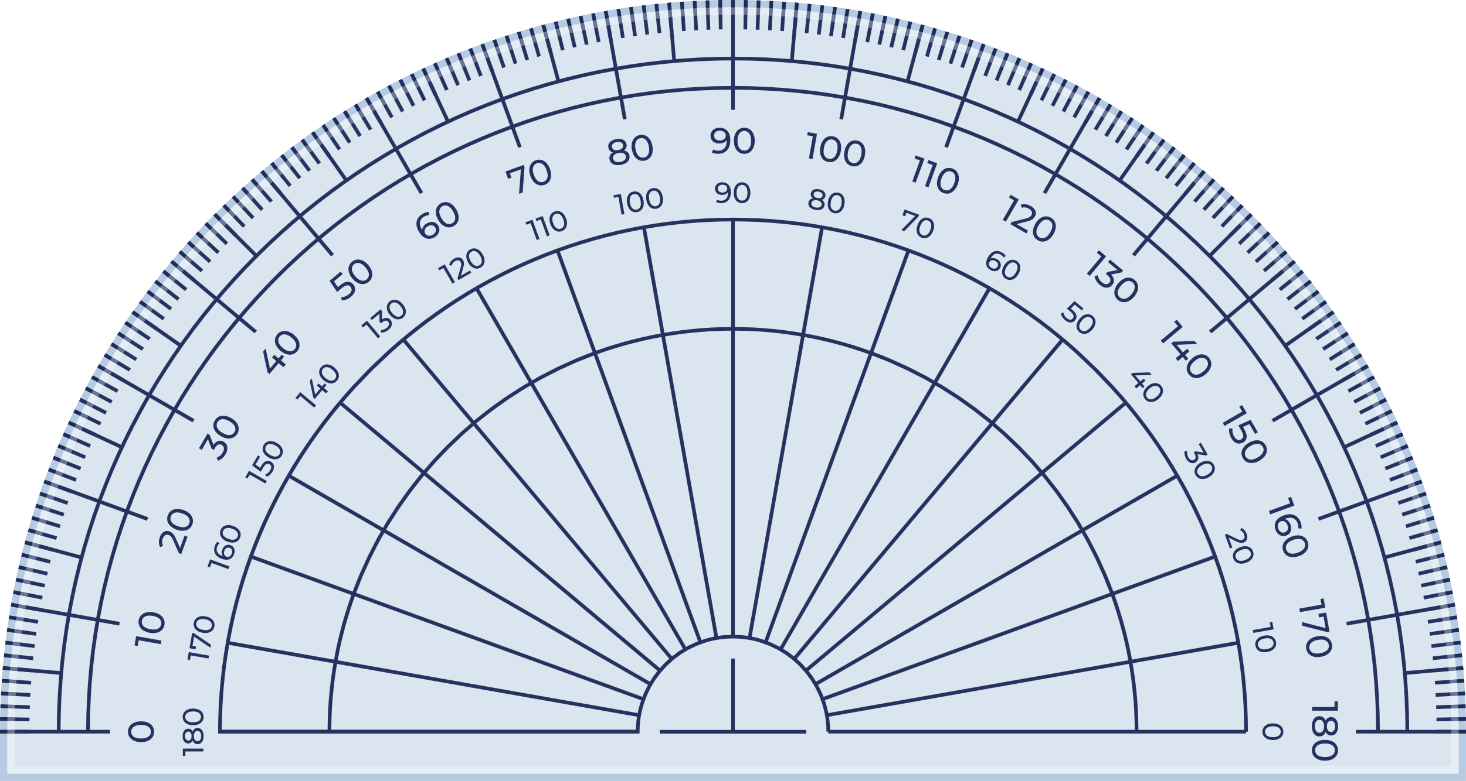

Short response (27)
Jules measured the angle to be 180°.
What is the name of the angle?
Notes:
Short response questions provide brisk paced questions focussing on review of current and previous content to support spaced and interleaved practice.
Syllabus focus area:
Geometric measure A: Angles

Slide 55

Short response (28)
Sandra went to bed at 11:15 pm.
Convert this to 24-hour time.
Notes:
Short response questions provide brisk paced questions focussing on review of current and previous content to support spaced and interleaved practice.
Syllabus focus area:
Non spatial measure A: Time

Slide 56
Activity 7 – rounding numbers to millions
Name | Country | Population
Shanghai | China | 28 516 000
Delhi | India | 32 065 000
Melbourne | Australia | 5 031 000
Sydney | Australia | 5 297 000
Dhaka | Bangladesh | 22 478 000
Sao Paulo | Brazil | 22 429 000
Tokyo | Japan | 37 274 000
Name | Country | Population (m)
Shanghai | China | 28.5
Delhi | India | 32.1
Melbourne | Australia | 5.0
Sydney | Australia | 5.3
Dhaka | Bangladesh | 22.5
Sao Paulo | Brazil | 22.4
Tokyo | Japan | 37.3
Notes:
This is a developing number sense activity.
Number sense refers to a deep understanding of numbers, including their magnitude, relationships, and the effects of operations on them. It supports fluency and understanding, estimation, flexible thinking, and efficient problem-solving. Number sense activities 1–4 ‘activate’ prior number knowledge and support the learning of new content in the unit. Number sense activities 5–8 ‘loop’ back and provide opportunity for spaced practice with concepts and procedures covered in previous units.
Syllabus focus area:
Represents numbers A: Whole numbers
Activity title
This resource corresponds to Resource 22 – city populations 2 in Stage 3 Year B Unit 21.
As a class, revise the steps for rounding numbers to a specified value. Encourage students to use words and diagrams. For example:
to round numbers to a specified value:
Step 1: Determine the place value to which you need to round. For example, nearest thousand, million, ten million.
Step 2: Find the digit in that place value
Step 3: Examine the digits to the right of the rounding digit. This will help you decide whether to round the number up or keep it the same.
Step 4: Apply the rounding rules
If the digit to the right is 5 or greater, add one to the rounding digit (round up).
If the digit to the right is less than 5, keep the rounding digit the same (round down).
Step 5: Adjust the Remaining Digits
Change all digits to the right of the rounding digit to zero, as they are not significant in the rounded number.
Display a range of 5-, 6- and 7-digit numbers. For example, the number 6 489 521 or city populations.
Check for understanding by having students round the specified number to the nearest, thousand, million and ten million.
Students record their answers on whiteboards.

Slide 57
Review of learning 8

Slide 58
True or false (4)
1000 thousands is 1 million.
True | False
Notes:
The question on this slide connects to the content being explored in the developing number sense activity (Activity 8)
Syllabus focus area:
Represents numbers A: Whole numbers

Slide 59
Short response (29)
What are 2 decimal numbers that can be
found between 1.406 and 1.411.
Show your answer on a number line.
Notes:
Short response questions provide brisk paced questions focussing on review of current and previous content to support spaced and interleaved practice.
Syllabus focus area:
Represents Numbers A: Decimals and percentages

Slide 60
Short response (30)
Record these divisions as fractions:
3 divided by 2
4 divided by 8
8 divided by 8
Notes:
Short response questions provide brisk paced questions focussing on review of current and previous content to support spaced and interleaved practice.
Syllabus focus area:
Multiplicative relations B

Slide 61
Short response (31)
The students arrived at school at 08:45am and left at 15:15 hours.
How long were students at school?
Notes:
Short response questions provide brisk paced questions focussing on review of current and previous content to support spaced and interleaved practice.
Syllabus focus area:
Non-spatial measure B: Time

Slide 62
Short response (32)
Lochie’s dog woke him up during
the night. What was the time?
Convert this to 24-hour time.
Notes:
Short response questions provide brisk paced questions focussing on review of current and previous content to support spaced and interleaved practice.
Syllabus focus area:
Non spatial measure A: Time

Slide 63
Activity 8 – rounding numbers to compare (1)
Name | Country | Population
Shanghai | China | 28 516 000
Delhi | India | 32 065 000
Melbourne | Australia | 5 031 000
Sydney | Australia | 5 297 000
Dhaka | Bangladesh | 22 478 000
Sao Paulo | Brazil | 22 429 000
Tokyo | Japan | 37 274 000
Name | Country | Population (m)
Shanghai | China | 28.5
Delhi | India | 32.1
Melbourne | Australia | 5.0
Sydney | Australia | 5.3
Dhaka | Bangladesh | 22.5
Sao Paulo | Brazil | 22.4
Tokyo | Japan | 37.3
Notes:
This is a developing number sense activity.
Number sense refers to a deep understanding of numbers, including their magnitude, relationships, and the effects of operations on them. It supports fluency and understanding, estimation, flexible thinking, and efficient problem-solving. Number sense activities 1–4 ‘activate’ prior number knowledge and support the learning of new content in the unit. Number sense activities 5–8 ‘loop’ back and provide opportunity for spaced practice with concepts and procedures covered in previous units.
Syllabus focus area:
Represents numbers A: Whole numbers
Activity title
This resource corresponds to Resource 21 – city populations 2 in Stage 3 Year B Unit 21.
This activity is an adaptation of ‘Cities of the world’ from A Practical Guide to Transforming Primary Mathematics: Activities and tasks that really work by Askew. Prior to the lesson, gather information about the population of your local government area from a reliable source, such as the Australian Government’s Centre for Population.
Display Resource 21 – city populations 2. Select students to read the numbers aloud.
Revise each of the methods of recording large numbers.

Slide 64
Activity 8 – rounding numbers to compare (2)
Local Government Area (LGA) populations
Sydney City LGA: Approximately 250,000 residents
Woollahra LGA: Around 60,000 residents
Parramatta LGA: About 250,000 residents
Northern Beaches LGA: Approximately 250,000 residents
Canterbury-Bankstown LGA: Around 360,000 residents.
Notes:
This is a developing number sense activity.
Number sense refers to a deep understanding of numbers, including their magnitude, relationships, and the effects of operations on them. It supports fluency and understanding, estimation, flexible thinking, and efficient problem-solving. Number sense activities 1–4 ‘activate’ prior number knowledge and support the learning of new content in the unit. Number sense activities 5–8 ‘loop’ back and provide opportunity for spaced practice with concepts and procedures covered in previous units.
Syllabus focus area:
Represents numbers A: Whole numbers
Activity title
This resource corresponds to Resource 21 – city populations 2 in Stage 3 Year B Unit 21.
This activity is an adaptation of ‘Cities of the world’ from A Practical Guide to Transforming Primary Mathematics: Activities and tasks that really work by Askew. Prior to the lesson, gather information about the population of your local government area from a reliable source, such as the Australian Government’s Centre for Population.
Display the population of your local government area (LGA) or town. Discuss an appropriate value to round the population figures for comparison. For example, rounding to the nearest thousand. Discuss why this may be helpful.
Display a range of local government areas and their approximate populations. For example:
Sydney City LGA: Approximately 250,000 residents
Woollahra LGA: Around 60,000 residents
Parramatta LGA: About 250,000 residents
Northern Beaches LGA: Approximately 250,000 residents
Canterbury-Bankstown LGA: Around 360,000 residents.
Divide the class into groups of 4. Allocate each group a different specified value to round the local government area figures.
Each group shares the rounded figures with the class. Display in a table on the board, adding each groups rounded figures. Check for understanding of rounding to a specified value.
Discuss how to make comparisons in populations when they have been rounded to different specified values.

Slide 65
Double Venn diagram
Object 1
Object 2
Features similar to both objects
Features of object 1
Features of object 2

Slide 66
Frayer
Definition
Facts/Characteristics
Word, term, concept
Examples
Non-examples

Slide 67
Spider map
Idea
Subject

Slide 68
Cline
Concept 1
Concept 2
Word
Word
Word
Word
Word
Word
Word
Word
Word
Word
Word

Slide 69

Compare and contrast

Slide 70
Multiple choice (5)
A
B
C
D

Slide 71
Multiple choice (6)
A
B
C
D

Slide 72
References (1)
This presentation contains NSW Curriculum and syllabus content. The NSW Curriculum is developed by the NSW Education Standards Authority. This content is prepared by NESA for and on behalf of the Crown in the right of the State of New South Wales. The material is protected by Crown copyright.
Please refer to the NESA Copyright Disclaimer for more information https://educationstandards.nsw.edu.au/wps/portal/nesa/mini-footer/copyright.
NESA holds the only official and up-to-date versions of the NSW Curriculum and syllabus documents. Please visit the NSW Education Standards Authority (NESA) website https://educationstandards.nsw.edu.au/wps/portal/nesa/home and the NSW Curriculum website https://curriculum.nsw.edu.au.
Mathematics K–10 Syllabus © NSW Education Standards Authority (NESA) for and on behalf of the Crown in right of the State of New South Wales, 2022.
National Numeracy Learning Progression © Australian Curriculum, Assessment and Reporting Authority (ACARA) 2010 to present, unless otherwise indicated. This material was downloaded from the Australian Curriculum website (National Numeracy Learning Progression) (accessed 21 August 2025) and was not modified.
Askew M (2016) A Practical Guide to Transforming Primary Mathematics: Activities and tasks that really work, Routledge, London and New York.
Chin A (2015) Make 100, 1000, 10, 1: Adding and subtracting using place value [PDF 1.10 MB], Anita Chin Mathematics Consultancy, accessed 28 June 2023.
Commonwealth of Australia (2021) ‘Population in local government areas’, Population Dashboards, Department of The Treasury: Centre for Population website, accessed 18 May 2023.
Clarke D and Roche A (2014) Engaging Maths: 25 Favourite Lessons, 2nd edn, Mathematics Teaching and Learning Centre, Australian Catholic University and Catholic Education office.

Slide 73
References (2)
This presentation contains NSW Curriculum and syllabus content. The NSW Curriculum is developed by the NSW Education Standards Authority. This content is prepared by NESA for and on behalf of the Crown in the right of the State of New South Wales. The material is protected by Crown copyright.
Please refer to the NESA Copyright Disclaimer for more information https://educationstandards.nsw.edu.au/wps/portal/nesa/mini-footer/copyright.
NESA holds the only official and up-to-date versions of the NSW Curriculum and syllabus documents. Please visit the NSW Education Standards Authority (NESA) website https://educationstandards.nsw.edu.au/wps/portal/nesa/home and the NSW Curriculum website https://curriculum.nsw.edu.au.
Hall J (n.d.) ‘Place Value Counters’, Manipulatives, MathsBot.com, accessed 18 May 2023.​
Multistopwatch (n.d.) Multistopwatch [website], accessed 20 December 2024.​
Stacey K, Steinle V, Marston K, Chambers D, Varughese N (2011) ‘Number Slides’, Teaching Number in the Middle Years: For teachers of students aged 8 to 15, University of Melbourne website, accessed 19 May 2023.
State of New South Wales (Department of Education) (2023) ‘Mathematics K-6 resources’, Mathematics curriculum resources K-12, NSW Department of Education website, accessed 18 May 2023.
State of New South Wales (Department of Education) (2023) ‘Find results: NSWPSSA Records’, Representative sport: Event information, NSW School Sport Unit website, accessed 18 May 2023.

Slide 74
References (3)
This presentation contains NSW Curriculum and syllabus content. The NSW Curriculum is developed by the NSW Education Standards Authority. This content is prepared by NESA for and on behalf of the Crown in the right of the State of New South Wales. The material is protected by Crown copyright.
Please refer to the NESA Copyright Disclaimer for more information https://educationstandards.nsw.edu.au/wps/portal/nesa/mini-footer/copyright.
NESA holds the only official and up-to-date versions of the NSW Curriculum and syllabus documents. Please visit the NSW Education Standards Authority (NESA) website https://educationstandards.nsw.edu.au/wps/portal/nesa/home and the NSW Curriculum website https://curriculum.nsw.edu.au.
University of Cambridge (Faculty of Mathematics) (n.d.) Roman Numerals [PDF 64.98 KB] NRICH website, accessed 18 May 2023.
Worldometers.info (n.d.) Worldometer [website], accessed 18 May 2023.

Slide 75
Copyright
© State of New South Wales (Department of Education), 2025
The copyright material published in this resource is subject to the Copyright Act 1968 (Cth) and is owned by the NSW Department of Education or, where indicated, by a party other than the NSW Department of Education (third-party material).
Copyright material available in this resource and owned by the NSW Department of Education is licensed under a Creative Commons Attribution 4.0 International (CC BY 4.0) license.
This license allows you to share and adapt the material for any purpose, even commercially.
Attribution should be given to © State of New South Wales (Department of Education), 2025.
Material in this resource not available under a Creative Commons license:
the NSW Department of Education logo, other logos and trademark-protected material
Material owned by a third party that has been reproduced with permission. You will need to obtain permission from the third party to reuse its material.
Links to third-party material and websites
Please note that the provided (reading/viewing material/list/links/texts) are a suggestion only and implies no endorsement, by the New South Wales Department of Education, of any author, publisher, or book title. School principals and teachers are best placed to assess the suitability of resources that would complement the curriculum and reflect the needs and interests of their students.
If you use the links provided in this document to access a third party’s website, you acknowledge that the terms of use, including licence terms set out on the third-party’s website apply to the use which may be made of the materials on that third-party website or where permitted by the Copyright Act 1968 (Cth). The department accepts no responsibility for content on third-party websites.

