Slide 1
Instructions for use
This resource is not a teaching and learning program. It should be used in conjunction with Stage 3 Year A Unit 22.
Classroom teachers are encouraged to add and adapt slides as required to meet the needs of their students.
Save a copy of the file to make changes to the slide deck. Go to File > Download a Copy (this downloads a copy to the computer to edit in the PowerPoint app).
To convert the PowerPoint to Google Slides:
  Upload the file into Google Drive and open it.
  Go to File > Save as Google Slides.
  (Note – conversion may cause formatting changes in the slides.)

Slide 2

Review of Learning
Mathematics Stage 3 – Unit 22
Notes:
Reviews may include a combination of question types, requiring students to recall facts and key ideas, as well as apply their knowledge to solve problems and answer questions. To support active engagement, a mix of techniques should be employed.” (AERO, 2024).
This Review of Learning slide deck revisits key concepts from the following units:
Stage 3 Year A Unit 22
Stage 3 Year A Unit 21
Stage 3 Year A Unit 20
It also includes opportunities to review prior learning in non-number content, supporting consolidation across focus areas.
The review of learning resources include three key task types that support the development of mathematical proficiency through retrieval, spaced practice, and active participation. These practices complement the review phase (activating prior knowledge) embedded within the beginning of each lesson.
1.
Multiple-choice questions/True or false: Designed to promote active retrieval of key concepts and identify common misconceptions in number, supporting consolidation, understanding and fluency.
These questions:
support spaced and interleaved practice
help identify and address common misconceptions
support active recall and immediate feedback
support whole class participation
identify areas requiring reteach
2.
Short-response question sets: Carefully grouped questions that encourage spaced and interleaved practice across multiple focus areas, helping students revisit and apply knowledge from different points in time.
These questions:
have a combination of question types
address a range of focus areas
build automaticity and fluency
support active recall
allow for immediate feedback
identify content requiring reteach
3.
Developing number sense activities: A variety of practical, purposeful tasks that reinforce current learning and build on prior knowledge. These activities promote reasoning, problem-solving and conceptual understanding.
The review of learning resources are designed to work support teaching and learning in mathematics. For the most effective implementation, use the resources flexibly, adapting to meet student learning needs and individual classroom contexts.

Slide 3
Lessons
1
Review of learning 1
5
Review of learning 5
2
Review of learning 2
6
Review of learning 6
3
Review of learning 3
7
Review of learning 7
4
Review of learning 4
8
Review of learning 8
Notes:
Teacher notes:
Click lesson numbers to go to specific lessons
Interactive features can be viewed in slide show

Slide 4
Review of learning 1

Slide 5

Multiple choice (1)
Using estimating and rounding a reasonable solution to 451 – 49 is:
A
450
B
500
400
C
D
550
Notes:
This question connects to the content in the developing number sense activity (Activity 1)
Syllabus focus area:
Additive relations A

Slide 6

Short response (1)
Alice has 25 banksias and 15 bottlebrushes in her garden. She picks 5 of the flowers. How many flowers are left in her garden?
Communicate your strategy.
Notes:
Short response questions provide brisk paced questions focussing on review of current and previous content to support spaced and interleaved practice.
Syllabus focus area:
Additive relations A

Slide 7
Short response (2)
How many multiples of 1000 are in
1 000 000 ?
How many multiples of 100 are in
1 000 000 ?
Notes:
Short response questions provide brisk paced questions focussing on review of current and previous content to support spaced and interleaved practice.
Syllabus focus area:
Represents numbers A: Whole numbers

Slide 8
Short response (3)
Use a number line to represent
the integers from
-6 to 6
Notes:
Short response questions provide brisk paced questions focussing on review of current and previous content to support spaced and interleaved practice.
Syllabus focus area:
Represents numbers B: Whole numbers:

Slide 9
Short response (4)
Lucy gets on the school bus at 07:50 and arrives at school at 8:45 am. What is the duration of her bus trip to school?
Notes:
Short response questions provide brisk paced questions focussing on review of current and previous content to support spaced and interleaved practice.
Syllabus focus area:
Non-spatial measure B: Time

Slide 10

Activity 1 – rounding and estimation
351 – 39 =
941 – 314 – 357 =
138 + 98 =
113 + 82 =
25 + 26 + 27 + 28 + 78 =
434 – 200 =
500 – 97 – 77 – 81 =
Notes:
This is a developing number sense activity.
Number sense refers to a deep understanding of numbers, including their magnitude, relationships, and the effects of operations on them. It supports fluency and understanding, estimation, flexible thinking, and efficient problem-solving. Number sense activities 1–4 ‘activate’ prior number knowledge and support the learning of new content in the unit. Number sense activities 5–8 ‘loop’ back and provide opportunity for spaced practice with concepts and procedures covered in previous units.
Syllabus focus area:
Additive relations A
Rounding and estimation
Ask students to estimate and determine which problems would be equivalent to 250.
Select students to share their thinking and explore the ways they may have used the value of the digits to estimate. For example, rounding to 10 and using known facts 138 + 98 = 140 + 100 = 240

Slide 11
Review of learning 2

Slide 12
True or false (1)
Tommy used estimation to solve
57 + 541 = about 600
His estimation is a reasonable solution.
True | False
Notes:
The question on this slide connects to the content being explored in the developing number sense activity (Activity 2)
Syllabus focus area:
Additive relations A

Slide 13
Short response (5)
Harry spent $1313 on concert tickets. He decided to sell his Level 1 ticket and two of his Level 4 tickets. How much did he end up spending on tickets?
Level 1 | Level 2 | Level 3 | Level 4 | Level 5 | Level 6
$119 | $159 | $199 | $239 | $309 | $379
Notes:
Short response questions provide brisk paced questions focussing on review of current and previous content to support spaced and interleaved practice.
Syllabus focus area:
Additive relations B

Slide 14
Short response (6)
Partition 407 302 015
in non-standard forms.
Notes:
Short response questions provide brisk paced questions focussing on review of current and previous content to support spaced and interleaved practice.
Syllabus focus area:
Represents numbers A: Whole numbers:

Slide 15
Short response (7)
Ava had 17 points in a game.
She lost 28 points.
What is her new score?
Communicate your reasoning.
Notes:
Short response questions provide brisk paced questions focussing on review of current and previous content to support spaced and interleaved practice.
Syllabus focus area:
Represents numbers B: Whole numbers

Slide 16
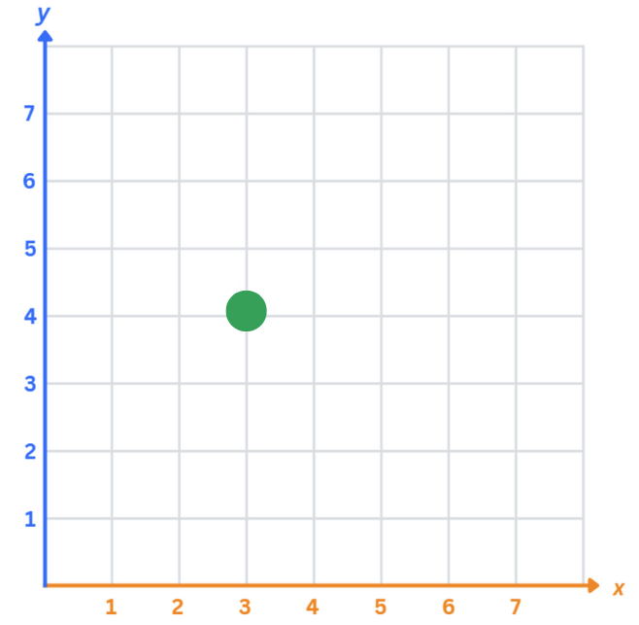
Short response (8)
Using the cartesian plane, move right 4 units and down 2.
Record your final position.
Notes:
Short response questions provide brisk paced questions focussing on review of current and previous content to support spaced and interleaved practice.
Syllabus focus area:
Geometric measure A: Position:

Slide 17
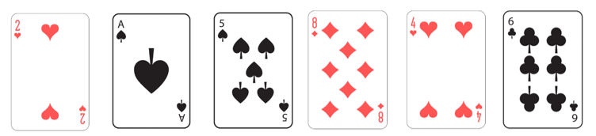
Activity 2 – flexible strategies with 3-digit numbers
Target number: 310
I made 215 + 84 + 6 = 305
Notes:
This is a developing number sense activity.
Number sense refers to a deep understanding of numbers, including their magnitude, relationships, and the effects of operations on them. It supports fluency and understanding, estimation, flexible thinking, and efficient problem-solving. Number sense activities 1–4 ‘activate’ prior number knowledge and support the learning of new content in the unit. Number sense activities 5–8 ‘loop’ back and provide opportunity for spaced practice with concepts and procedures covered in previous units.
Syllabus focus area:
Additive relations A
Flexible strategies with 3-digit numbers
This activity is an adaptation of ‘Hit the target’ from Part 3: Flexible strategies with 3-digit numbers by State of New South Wales (Department of Education).
Provide small groups of students with a whiteboard and a set of playing cards (Ace to 9) to represent numbers one to 9. Students shuffle the cards. The dealer turns over 3 cards to form a 3-digit number, which becomes the target number. The dealer deals 6 cards to each player, face up.
Players arrange their cards to form two 3-digit numbers, or a combination of 3-, 2- and 1-digit numbers, which they can add or subtract to hit the target.
The table below outlines stimulus prompts to generate conversation about the topic, along with anticipated responses from students.
Students record their estimations on individual whiteboards or paper.
Model using a vertical algorithm for students to use as a strategy to check their answers and the student closest to the target wins the round and a point.
Play continues for a few rounds.
Prompts
How can you use estimation to help solve the problem if the target number is 473 and your cards are 6, 1, 2, 3, 9 and 3?
Anticipated student responses
690 – 230 = 440 or 340 + 190 = 430
Prompts
What are some of the options you could have to get close to the target number?
Anticipated student responses
693 – 231 = 462 or 339 + 126 = 465 or 393 + 62 + 1 = 456

Slide 18
Review of learning 3

Slide 19
Multiple choice (2)
Which rounded numbers are best to solve
45 873 + 62 491
A
35 000 + 61 000
B
43 000 + 60 000
C
45 000 + 63 000
D
46 000 + 62 000
Notes:
This question connects to the content in the developing number sense activity (Activity 3)
Syllabus focus area:
Additive relations A

Slide 20
Short response (9)
Katie has $40.00 for groceries. She buys a box of ice creams for $15.95, a bottle of milk for $6.95 and a loaf of bread for $7.50.
Use rounding to estimate the total cost and how much Katie has left.
Notes:
Short response questions provide brisk paced questions focussing on review of current and previous content to support spaced and interleaved practice.
Syllabus focus area:
Additive relations A

Slide 21
Short response (10)
Order these decimals
0.4, 0.04, 0.404, 0.14
Notes:
Short response questions provide brisk paced questions focussing on review of current and previous content to support spaced and interleaved practice.
Syllabus focus area:
Represents Numbers A: Decimals and percentages:

Slide 22
Short response (11)
Round each number to the nearest hundred to estimate the answer
311 + 288 + 190 + 301 =
Notes:
Short response questions provide brisk paced questions focussing on review of current and previous content to support spaced and interleaved practice.
Syllabus focus area:
Additive relations A

Slide 23

Short response (12)
Identify and classify the triangles.
A B C
Notes:
Short response questions provide brisk paced questions focussing on review of current and previous content to support spaced and interleaved practice.
Syllabus focus area:
Two- dimensional spatial structure A: 2D shapes

Slide 24
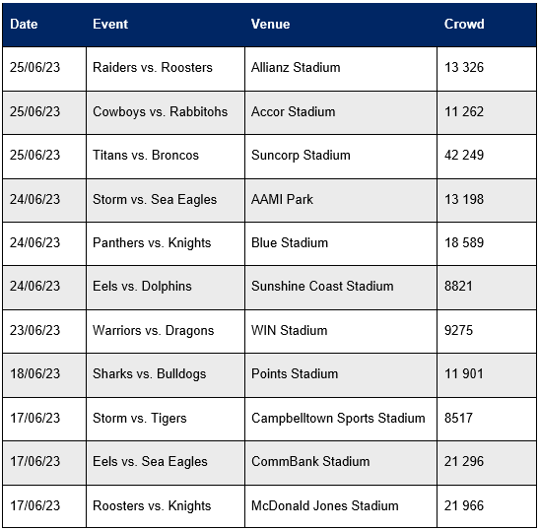
Activity 3 – rounding large numbers (1)
What was the total number of spectators at your favourite NRL team’s game?
What was the total number of spectators at your least favourite NRL team’s game?
Which stadium had the most spectators attend in the month of June?
Which stadium had the least number of spectators visit in the month of June? How does it compare with the stadium that had the most?
Notes:
This is a developing number sense activity.
Number sense refers to a deep understanding of numbers, including their magnitude, relationships, and the effects of operations on them. It supports fluency and understanding, estimation, flexible thinking, and efficient problem-solving. Number sense activities 1–4 ‘activate’ prior number knowledge and support the learning of new content in the unit. Number sense activities 5–8 ‘loop’ back and provide opportunity for spaced practice with concepts and procedures covered in previous units.
Syllabus focus area:
Additive relations A
Rounding large numbers
This resource corresponds to Resource 21 – NRL crowds in Stage 3 Year B Unit 22.
Tell students they will be rounding to the nearest thousand to help answer the questions about the NRL crowds (see Figure 7).
Provide pairs of students with their workbooks to answer the following questions:
What was the total number of spectators at your favourite NRL team’s game?
What was the total number of spectators at your least favourite NRL team’s game?
Which stadium had the most spectators attend in the month of June?
Which stadium had the least number of spectators visit in the month of June? How does it compare with the stadium that had the most?
Can you predict the crowd numbers for the next NRL game?
What game had more spectators than the June 12th long weekend game? How many more spectators were there?
What was the difference between the games with the most and least number of spectators?
How did you use estimating to help solve the problems?
What other information can you find using the NRL table?

Slide 25
Activity 3 – rounding large numbers (2)
Can you predict the crowd numbers for the next NRL game?
What game had more spectators than the June 12th long weekend game? How many more spectators were there?
What was the difference between the games with the most and least number of spectators?
How did you use estimating to help solve the problems?
What other information can you find using the NRL table?
Notes:
This is a developing number sense activity.
Number sense refers to a deep understanding of numbers, including their magnitude, relationships, and the effects of operations on them. It supports fluency and understanding, estimation, flexible thinking, and efficient problem-solving. Number sense activities 1–4 ‘activate’ prior number knowledge and support the learning of new content in the unit. Number sense activities 5–8 ‘loop’ back and provide opportunity for spaced practice with concepts and procedures covered in previous units.
Syllabus focus area:
Additive relations A
Rounding large numbers
This resource corresponds to Resource 21 – NRL crowds in Stage 3 Year B Unit 22.
This slide is a continuation of questions.

Slide 26
Review of learning 4

Slide 27
True or false (2)
The question is 42 000 + 5 123 + 246.
The answer is 47 369.
True | False
Communicate your thinking.
Notes:
The question on this slide connects to the content being explored in the developing number sense activity (Activity 4)
Syllabus focus area:
Additive relations A

Slide 28
Short response (13)
Choose an efficient strategy to solve:
3988 + 855
Communicate your strategy.
Notes:
Short response questions provide brisk paced questions focussing on review of current and previous content to support spaced and interleaved practice.
Syllabus focus area:
Additive relations A

Slide 29
Short response (14)
Record in ascending order:
25.56, 23.46, 22.99, 25.06
Notes:
Short response questions provide brisk paced questions focussing on review of current and previous content to support spaced and interleaved practice.
Syllabus focus area:
Represents Numbers A: Decimals and percentages

Slide 30
Short response (15)
Round each number to the nearest hundred to estimate the answer:
1227 + 1486
Notes:
Short response questions provide brisk paced questions focussing on review of current and previous content to support spaced and interleaved practice.
Syllabus focus area:
Additive relations A

Slide 31
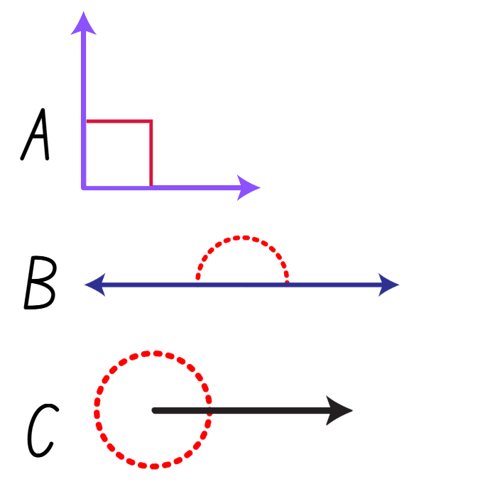
Short response (16)
Name these angles and record how many degrees each angle has.
Notes:
Short response questions provide brisk paced questions focussing on review of current and previous content to support spaced and interleaved practice.
Syllabus focus area:
Geometric measure A: Angles

Slide 32
Activity 4 – 5-digit number facts
25 356
Notes:
This is a developing number sense activity.
Number sense refers to a deep understanding of numbers, including their magnitude, relationships, and the effects of operations on them. It supports fluency and understanding, estimation, flexible thinking, and efficient problem-solving. Number sense activities 1–4 ‘activate’ prior number knowledge and support the learning of new content in the unit. Number sense activities 5–8 ‘loop’ back and provide opportunity for spaced practice with concepts and procedures covered in previous units.
Syllabus focus area:
Additive relations A
5-digit number facts
Students identify equations using two or more numbers that make a total of 25 356. For example, 12 678 + 12 678, 50 000 - 24 644, 6 000 + 7 500 + 8 200 + 3 656
Record students’ equations around the number 25 356.
Check for understanding by asking students to explain why they chose those numbers and address any misconceptions.

Slide 33
Review of learning 5

Slide 34
Multiple choice (3)
The product of 8 and 7 is:
A
B
C
D
15
1
56
70
Notes:
This question connects to the content in the developing number sense activity (Activity 5)
Syllabus focus area:
Multiplicative relations A

Slide 35
Short response (17)
Tilly works at a Sunday market stall and sold $367 worth of goods. The stall owner pays a fee of $50 and pays Tilly $60. After costs, what is the stall owner’s profit?
Notes:
Short response questions provide brisk paced questions focussing on review of current and previous content to support spaced and interleaved practice.
Syllabus focus area:
Additive relations B

Slide 36
Short response (18)
Record the role of zero in each of these numbers,
2.0
1.05
1.077
Notes:
Short response questions provide brisk paced questions focussing on review of current and previous content to support spaced and interleaved practice.
Syllabus focus area:
Represents Numbers A: Decimals and percentages:

Slide 37
Short response (19)
Phoenix has $300 for the weekend. Half of his money is for accommodation. How much of his money will he have left? What percentage of the total amount of money is that?
Notes:
Short response questions provide brisk paced questions focussing on review of current and previous content to support spaced and interleaved practice.
Syllabus focus area:
Represents Numbers B: Decimals and percentages:

Slide 38
Short response (20)
Create a survey question to collect data about recess activities that would use a scale of 1 – 5 with
1 = I don’t like to 5 = I like a lot.
Notes:
Short response questions provide brisk paced questions focussing on review of current and previous content to support spaced and interleaved practice.
Syllabus focus area:
Data A

Slide 39
Activity 5 – product target
Target: 112
 | Player 1 |  |  | Player 2
Cards | Operations | Difference from target | Cards | Operations | Difference from target
1, 4, 3, 6, 7 | 4 + 1 = 5 5 x 6 = 30 30 + 7 = 37 3 x 37 = 111 | 1 | 9, 6, 2, 2, 4 | 6 x 2 x 2 x 4 = 96 96 + 9 = 105 | 7
Notes:
This is a developing number sense activity.
Number sense refers to a deep understanding of numbers, including their magnitude, relationships, and the effects of operations on them. It supports fluency and understanding, estimation, flexible thinking, and efficient problem-solving. Number sense activities 1–4 ‘activate’ prior number knowledge and support the learning of new content in the unit. Number sense activities 5–8 ‘loop’ back and provide opportunity for spaced practice with concepts and procedures covered in previous units.
Syllabus focus area:
Multiplicative relations A
Product target
This resource corresponds to Resource 22 – recording sheet in Stage 3 Year B Unit 22.
This activity is an adaptation of ‘Target number’ from Part 3: Flexible strategies with multi-digit numbers by State of New South Wales
In pairs, provide students with playing cards (Ace to 9) and Resource 22 – recording sheet.
One student deals out 5 cards to each player and determines the 3-digit target number.
Using their 5 cards, students form any 1-, 2-, or 3-digit number.
Players find the product of 2 or more numbers, using addition and subtraction if needed, to get as close to the target number as possible.
The total of each equation is then used for the next equation. Each card can only be used once, and not all cards need to be used.

Slide 40
Review of learning 6

Slide 41
True or false (3)
Different arrays that represent 12 can be modelled as:
2 by 6
3 by 4
12 by 1
True | False
Notes:
The question on this slide connects to the content being explored in the developing number sense activity (Activity 6)
Syllabus focus area:
Multiplicative relations A

Slide 42
Short response (21)
Use place value to partition
6.82
Notes:
Short response questions provide brisk paced questions focussing on review of current and previous content to support spaced and interleaved practice.
Syllabus focus area:
Represents numbers A: Decimals and percentages

Slide 43
Short response (22)
Use a place value chart, number line or other model to show how to solve
6.82 - 3.54
Notes:
Short response questions provide brisk paced questions focussing on review of current and previous content to support spaced and interleaved practice.
Syllabus focus area:
Additive Relations B

Slide 44
Short response (23)
There’s a sale! 25% off.
The jacket is originally $70.00
How much is the jacket after the discount?
Notes:
Short response questions provide brisk paced questions focussing on review of current and previous content to support spaced and interleaved practice.
Syllabus focus area:
Represents numbers B: Decimals and percentages:

Slide 45
Short response (24)
The time is now 16:10. If it takes 15 minutes to get home, record the time you will arrive home in 12-hour notation.
Notes:
Short response questions provide brisk paced questions focussing on review of current and previous content to support spaced and interleaved practice.
Syllabus focus area:
Non- spatial measure B: Time

Slide 46
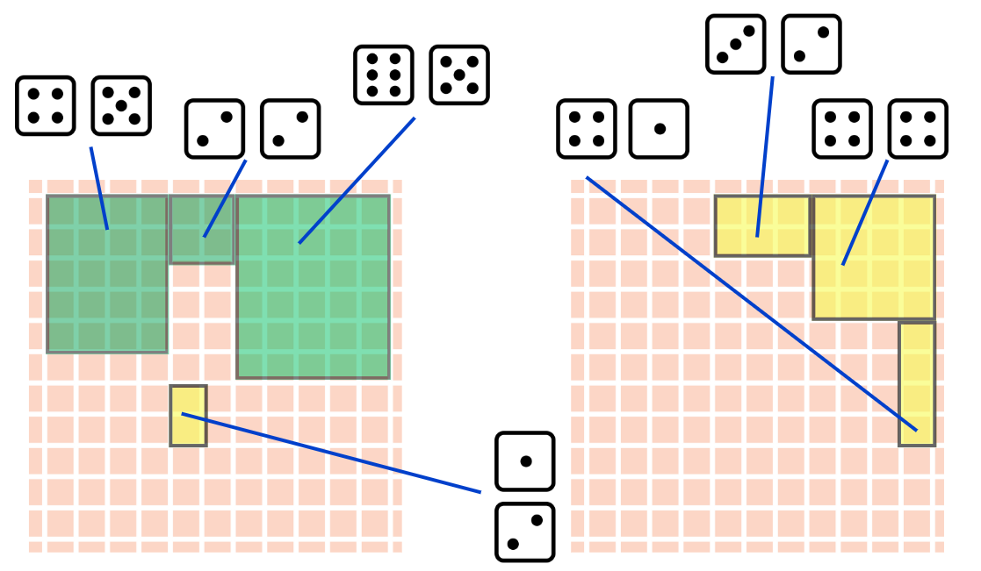
Activity 6 – products and factors (2)
Notes:
This is a developing number sense activity.
Number sense refers to a deep understanding of numbers, including their magnitude, relationships, and the effects of operations on them. It supports fluency and understanding, estimation, flexible thinking, and efficient problem-solving. Number sense activities 1–4 ‘activate’ prior number knowledge and support the learning of new content in the unit. Number sense activities 5–8 ‘loop’ back and provide opportunity for spaced practice with concepts and procedures covered in previous units.
Syllabus focus area:
Multiplicative relations A
Product and factors
This resource corresponds to Resource 22 – recording sheet in Stage 3 Year B Unit 22.
This activity is an adaptation from Math Games with Bad Drawings: 75 1/4 Simple, Challenging, Go-Anywhere Games -And Why They Matter by Orlin.
In pairs, provide students with two 6-sided dice and grid paper. The aim of the game is to fill as much of the grid as possible before the game is over.
Each player rolls the 2 dice and multiply together to make a rectangle (area model). For example, if a student rolls a 4 and a 5, they must shade in a 4 by 5 rectangle anywhere on their grid. Players can shade a different way to show a whole number as a product. For example, 4 by 5 is 20, which can be represented by 2 by 10 or one by 20 on the grid. If the rectangle does not fit on the board, the player loses a turn. When both players lose their turn, one after the other, the game ends and whoever has more squares on their grid is the winner.
If they wish, each player can play one rectangle on their opponent’s board instead of their own.

Slide 47
Review of learning 7

Slide 48
Multiple choice (4)
Which number is not a factor of 63?
A
B
C
D
9
7
63
12
Notes:
This question connects to the content in the developing number sense activity (Activity 7)
Syllabus focus area:
Multiplicative relations A

Slide 49
Short response (25)
Use a number line to solve:
A baker poured 1.25 L of milk, 0.75 L of water, and 0.375 L of oil into a large bowl.
What is the combined volume of liquid in the bowl?
Notes:
Short response questions provide brisk paced questions focussing on review of current and previous content to support spaced and interleaved practice.
Syllabus focus area:
Additive relations B

Slide 50
Short response (26)
Record in descending order:
0.54
5.40
5.04
0.45
Notes:
Short response questions provide brisk paced questions focussing on review of current and previous content to support spaced and interleaved practice.
Syllabus focus area:
Represents Numbers A: Decimals and percentages

Slide 51
Short response (27)
Use the most efficient strategy to solve
325 x 67
Communicate your strategy.
Notes:
Short response questions provide brisk paced questions focussing on review of current and previous content to support spaced and interleaved practice.
Syllabus focus area:
Multiplicative relations A

Slide 52
Short response (28)
Fadi chose to use a column graph to record the weather over a month.
Is this the best type of graph to use?
Communicate your thinking.
Notes:
Short response questions provide brisk paced questions focussing on review of current and previous content to support spaced and interleaved practice.
Syllabus focus area:
Data A

Slide 53
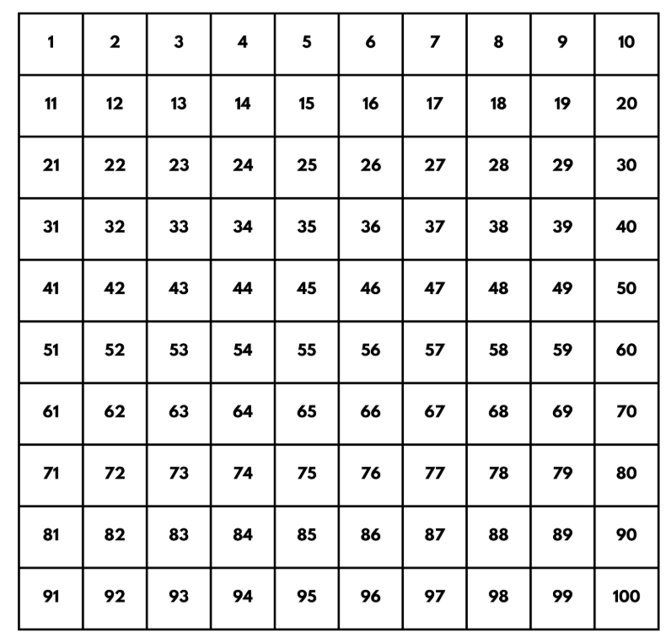
Activity 7 – Factors and multiples
Notes:
This is a developing number sense activity.
Number sense refers to a deep understanding of numbers, including their magnitude, relationships, and the effects of operations on them. It supports fluency and understanding, estimation, flexible thinking, and efficient problem-solving. Number sense activities 1–4 ‘activate’ prior number knowledge and support the learning of new content in the unit. Number sense activities 5–8 ‘loop’ back and provide opportunity for spaced practice with concepts and procedures covered in previous units.
Syllabus focus area:
Multiplicative relations A
Factors and multiples
This resource corresponds to Resource 23 – 100 grid in Stage 3 Year B Unit 22.
This activity is an adaptation of ‘Factors and multiples game’ from NRICH by the University of Cambridge (Faculty of Mathematics)..
Factor: a number that divides another number without a remainder. For example, 1, 2, 3 and 6 are factors of 6 but 4 and 5 are not.
Multiple: products formed using the same base number multiplied by different whole numbers, for example, 3, 6, 9, 12 and so on.
Provide pairs of students Resource 23 – 100 grid. The aim of the game is to try and make it a challenge for the other player to pick a number that works, that is a factor or multiple of the number given.
Player A chooses an even number that is less than 50 and crosses it out on the grid. Player B chooses a number to cross out. The number must be a factor or multiple of the first number.
Players continue to take it in turns to cross out numbers, at each stage choosing a number that is a factor or multiple of the number just crossed out by the other player. The first player who is unable to cross out a number ends the game.
Students can play a few rounds of the game.

Slide 54
Review of learning 8

Slide 55
True or false (4)
36 has 4 factors.
True | False
Notes:
The question on this slide connects to the content being explored in the developing number sense activity (Activity 8)
Syllabus focus area:
Multiplicative relations A

Slide 56
Short response (29)
Use a bar model to solve:
The Tran family need to drive 854 km. On the first day they drove 154.6 km. On the second day they drove 97.8 km.
How far did they have left to drive?
Notes:
Short response questions provide brisk paced questions focussing on review of current and previous content to support spaced and interleaved practice.
Syllabus focus area:
Additive relations B

Slide 57
Short response (30)
Compare and place in these decimal numbers descending order
0.65, 0.847, 0.3
Notes:
Short response questions provide brisk paced questions focussing on review of current and previous content to support spaced and interleaved practice.
Syllabus focus area:
Represents Numbers A: Decimals and percentages

Slide 58
Short response (31)
Record 15 ÷ 5
as a fraction.
Notes:
Short response questions provide brisk paced questions focussing on review of current and previous content to support spaced and interleaved practice.
Syllabus focus area:
Multiplicative relations B

Slide 59
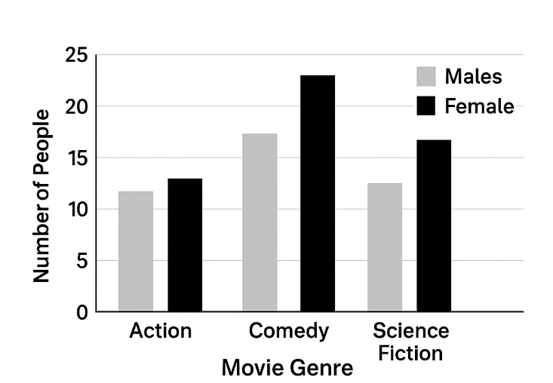
Short response (32)
What is the total number of people who like comedy?
Notes:
Short response questions provide brisk paced questions focussing on review of current and previous content to support spaced and interleaved practice.
Syllabus focus area:
Data B

Slide 60
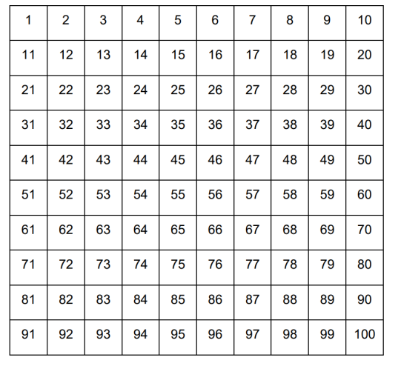


Activity 8 – multiplying numbers(1)
I rolled a 4 and a 6, then made 64. The factors of 64 are 1, 2, 4, 8, 16, 32 and 64. Let’s cross them off!
Notes:
This is a developing number sense activity.
Number sense refers to a deep understanding of numbers, including their magnitude, relationships, and the effects of operations on them. It supports fluency and understanding, estimation, flexible thinking, and efficient problem-solving. Number sense activities 1–4 ‘activate’ prior number knowledge and support the learning of new content in the unit. Number sense activities 5–8 ‘loop’ back and provide opportunity for spaced practice with concepts and procedures covered in previous units.
Syllabus focus area:
Multiplicative relations A
Multiplying numbers
This resource corresponds to Resource 23 – 100 grid in Stage 3 Year B Unit 22.
Provide pairs of students Resource 30 – 100 grid and two 0-9 dice.
Students roll the dice to make a two-digit number. This number is a product.
All factors of the two-digit product made are then crossed off the 100 grid.
The aim is to have the least number of squares crossed out on the 100 grid after 4 rounds. Alternatively, the game can be adapted to cross out four-in-a-row.

Slide 61
Double Venn diagram
Object 1
Object 2
Features similar to both objects
Features of object 1
Features of object 2

Slide 62
Frayer
Definition
Facts/Characteristics
Word, term, concept
Examples
Non-examples

Slide 63
Spider map
Idea
Subject

Slide 64
Cline
Concept 1
Concept 2
Word
Word
Word
Word
Word
Word
Word
Word
Word
Word
Word

Slide 65

Compare and contrast

Slide 66
Multiple choice (5)
A
B
C
D

Slide 67
Multiple choice (6)
A
B
C
D

Slide 68
References (1)
This presentation contains NSW Curriculum and syllabus content. The NSW Curriculum is developed by the NSW Education Standards Authority. This content is prepared by NESA for and on behalf of the Crown in the right of the State of New South Wales. The material is protected by Crown copyright.
Please refer to the NESA Copyright Disclaimer for more information https://educationstandards.nsw.edu.au/wps/portal/nesa/mini-footer/copyright.
NESA holds the only official and up-to-date versions of the NSW Curriculum and syllabus documents. Please visit the NSW Education Standards Authority (NESA) website https://educationstandards.nsw.edu.au/wps/portal/nesa/home and the NSW Curriculum website https://curriculum.nsw.edu.au.
Mathematics K–10 Syllabus © NSW Education Standards Authority (NESA) for and on behalf of the Crown in right of the State of New South Wales, 2022.
National Numeracy Learning Progression © Australian Curriculum, Assessment and Reporting Authority (ACARA) 2010 to present, unless otherwise indicated. This material was downloaded from the Australian Curriculum website (National Numeracy Learning Progression) (accessed 13 June 2025) and was not modified.
Austadium (2023) NRL Results & Crowds, Austadiums website, accessed 13 June 2025.
New Zealand Ministry of Education (n.d.) Problems to solve [PDF 599KB], NZ Maths website, accessed 13 June 2025.
NESA (2022b) ‘Stage 3: Teaching advice for Represents numbers A’, Mathematics K–10 Syllabus, NESA website, accessed 13 June 2025.
NESA (2022b) ‘Stage 3: Teaching advice for Additive relations A’, Mathematics K–10 Syllabus, NESA website, accessed 13 June 2025.

Slide 69
References (2)
This presentation contains NSW Curriculum and syllabus content. The NSW Curriculum is developed by the NSW Education Standards Authority. This content is prepared by NESA for and on behalf of the Crown in the right of the State of New South Wales. The material is protected by Crown copyright.
Please refer to the NESA Copyright Disclaimer for more information https://educationstandards.nsw.edu.au/wps/portal/nesa/mini-footer/copyright.
NESA holds the only official and up-to-date versions of the NSW Curriculum and syllabus documents. Please visit the NSW Education Standards Authority (NESA) website https://educationstandards.nsw.edu.au/wps/portal/nesa/home and the NSW Curriculum website https://curriculum.nsw.edu.au.
NESA (2022b) ‘Stage 3: Teaching advice for Additive relations B’, Mathematics K–10 Syllabus, NESA website, accessed 13 June 2025.
Number line (n.d.) The Math Learning Center [website], accessed 13 June 2025
Orlin B (2022) Math Games with Bad Drawings: 75 1/4 Simple, Challenging, Go-Anywhere Games -And Why They Matter, Black Dog & Leventhal, USA., accessed 13 June 2025.
Primary Resources (2023) Lunar Theme Park [DOCX 794KB], UK Maths website, accessed 13 June 2025.
State New South Wales (Department of Education) (2023) Adding and Subtracting Decimals, Universal Resource Hub website, accessed 13 June 2025.
State of New South Wales (Department of Education) (2023) Part 3: Flexible strategies with 3 digit numbers [DOCX 794KB], NSW Department of Education, accessed 13 June 2025.
State of New South Wales (Department of Education) (2023) Part 3: Flexible strategies with multi-digit numbers [PDF 2.97MB], NSW Department of Education, accessed 13 June 2025.

Slide 70
References (3)
This presentation contains NSW Curriculum and syllabus content. The NSW Curriculum is developed by the NSW Education Standards Authority. This content is prepared by NESA for and on behalf of the Crown in the right of the State of New South Wales. The material is protected by Crown copyright.
Please refer to the NESA Copyright Disclaimer for more information https://educationstandards.nsw.edu.au/wps/portal/nesa/mini-footer/copyright.
NESA holds the only official and up-to-date versions of the NSW Curriculum and syllabus documents. Please visit the NSW Education Standards Authority (NESA) website https://educationstandards.nsw.edu.au/wps/portal/nesa/home and the NSW Curriculum website https://curriculum.nsw.edu.au.
State of New South Wales (Department of Education) (2023) Red Dragonfly, Red dragonfly mathematics challenge website, accessed 13 June 2025.
Sullivan P (2018) Challenging Mathematical Tasks: Unlocking the potential of all students, Oxford University Press ANZ.
Sullivan P and Lilburn P (2017) Open-ended Maths activities, Revised edn, Oxford University Press, Victoria.
University of Cambridge (Faculty of Mathematics) (2023) Factors and Multiples Game, NRICH website, accessed 13 June 2025...

Slide 71
Copyright
© State of New South Wales (Department of Education), 2025
The copyright material published in this resource is subject to the Copyright Act 1968 (Cth) and is owned by the NSW Department of Education or, where indicated, by a party other than the NSW Department of Education (third-party material).
Copyright material available in this resource and owned by the NSW Department of Education is licensed under a Creative Commons Attribution 4.0 International (CC BY 4.0) license.
This license allows you to share and adapt the material for any purpose, even commercially.
Attribution should be given to © State of New South Wales (Department of Education), 2025.
Material in this resource not available under a Creative Commons license:
the NSW Department of Education logo, other logos and trademark-protected material
Material owned by a third party that has been reproduced with permission. You will need to obtain permission from the third party to reuse its material.
Links to third-party material and websites
Please note that the provided (reading/viewing material/list/links/texts) are a suggestion only and implies no endorsement, by the New South Wales Department of Education, of any author, publisher, or book title. School principals and teachers are best placed to assess the suitability of resources that would complement the curriculum and reflect the needs and interests of their students.
If you use the links provided in this document to access a third party’s website, you acknowledge that the terms of use, including licence terms set out on the third-party’s website apply to the use which may be made of the materials on that third-party website or where permitted by the Copyright Act 1968 (Cth). The department accepts no responsibility for content on third-party websites.

