Slide 1
Instructions for use
This resource is not a teaching and learning program. It should be used in conjunction with Stage 3 Year B Unit 23.
Classroom teachers are encouraged to add and adapt slides as required to meet the needs of their students.
Save a copy of the file to make changes to the slide deck. Go to File > Download a Copy (this downloads a copy to the computer to edit in the PowerPoint app).
To convert the PowerPoint to Google Slides:
  Upload the file into Google Drive and open it.
  Go to File > Save as Google Slides.
  (Note – conversion may cause formatting changes in the slides.)

Slide 2

Review of Learning
Mathematics Stage 3 – Unit 23
Notes:
Reviews may include a combination of question types, requiring students to recall facts and key ideas, as well as apply their knowledge to solve problems and answer questions. To support active engagement, a mix of techniques should be employed.” (AERO, 2024).
This Review of Learning slide deck revisits key concepts from the following units:
Stage 3 Year B Unit 23
Stage 3 Year B Unit 22
Stage 3 Year B Unit 21
It also includes opportunities to review prior learning in non-number content, supporting consolidation across focus areas.
The review of learning resources include three key task types that support the development of mathematical proficiency through retrieval, spaced practice, and active participation. These practices complement the review phase (activating prior knowledge) embedded within the beginning of each lesson.
1.
Multiple-choice questions/True or false: Designed to promote active retrieval of key concepts and identify common misconceptions in number, supporting consolidation, understanding and fluency.
These questions:
support spaced and interleaved practice
help identify and address common misconceptions
support active recall and immediate feedback
support whole class participation
identify areas requiring reteach
2.
Short-response question sets: Carefully grouped questions that encourage spaced and interleaved practice across multiple focus areas, helping students revisit and apply knowledge from different points in time.
These questions:
have a combination of question types
address a range of focus areas
build automaticity and fluency
support active recall
allow for immediate feedback
identify content requiring reteach
3.
Developing number sense activities: A variety of practical, purposeful tasks that reinforce current learning and build on prior knowledge. These activities promote reasoning, problem-solving and conceptual understanding.
The review of learning resources are designed to work support teaching and learning in mathematics. For the most effective implementation, use the resources flexibly, adapting to meet student learning needs and individual classroom contexts.

Slide 3
Lessons
1
Review of learning 1
5
Review of learning 5
2
Review of learning 2
6
Review of learning 6
3
Review of learning 3
7
Review of learning 7
4
Review of learning 4
8
Review of learning 8
Notes:
Teacher notes:
Click lesson numbers to go to specific lessons
Interactive features can be viewed in slide show

Slide 4
Review of learning 1

Slide 5

Multiple choice (1)
9256 – 5426 =
A
4321
B
4230
C
3830
D
3876
Communicate your strategy.
Notes:
This question connects to the content in the developing number sense activity (Activity 1)
Syllabus focus area:
Additive Relations B

Slide 6

Short response (1)
Record the number:
10 times larger than 0.40
100 times larger than 0.40
Notes:
Short response questions provide brisk paced questions focussing on review of current and previous content to support spaced and interleaved practice.
Syllabus focus area:
Geometric measure B

Slide 7
Short response (2)
Gabriella was hosting an event. She sold 105 Gold tickets at $9 each and 65 silver tickets at $7 each.
15 Gold ticket guests cancelled and wanted a refund.
How much money has she made from ticket sales?
Communicate your reasoning.
Notes:
Short response questions provide brisk paced questions focussing on review of current and previous content to support spaced and interleaved practice.
Syllabus focus area:
Additive relations B

Slide 8
Short response (3)
Arrange these numbers in descending order:
7 645 980
6 541 982
7 641 908
3 678 000
Notes:
Short response questions provide brisk paced questions focussing on review of current and previous content to support spaced and interleaved practice.
Syllabus focus area:
Represents numbers A

Slide 9
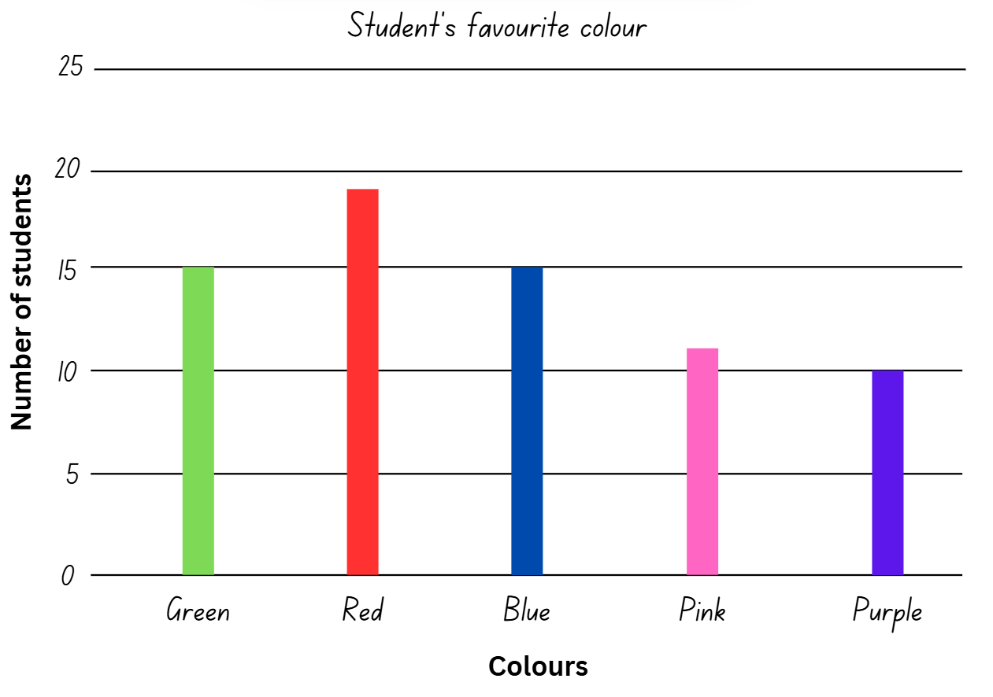
Short response (4)
How many students was this data collected from?
Communicate your thinking.
Notes:
Short response questions provide brisk paced questions focussing on review of current and previous content to support spaced and interleaved practice.
Syllabus focus area:
Data A

Slide 10

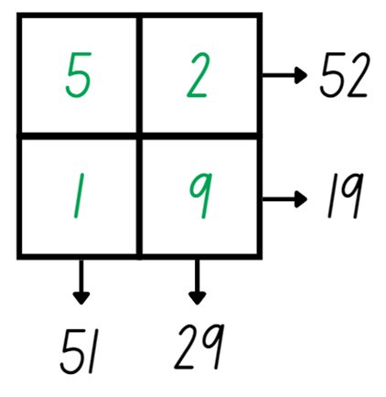
Activity 1 – efficient addition strategies
Notes:
This is a developing number sense activity.
Number sense refers to a deep understanding of numbers, including their magnitude, relationships, and the effects of operations on them. It supports fluency and understanding, estimation, flexible thinking, and efficient problem-solving. Number sense activities 1–4 ‘activate’ prior number knowledge and support the learning of new content in the unit. Number sense activities 5–8 ‘loop’ back and provide opportunity for spaced practice with concepts and procedures covered in previous units.
Syllabus focus area:
Additive Relations B
Efficient addition strategies
Explain the 2 by 2 grid has 4 different digits from 1–9 and record one in each box (see Figure 9).​
Demonstrate how reading the grid vertically and horizontally gives four 2-digit numbers: 52, 19, 51 and 29. ​
Ask students to turn and talk and discuss what strategies they could use to find the sum of the 4 digits.​
Students share and communicate their strategies with the class. For example, one student levels the numbers to make the algorithm 50 + 50 + 3 + 40 + 8. The sum of the numbers is 151.​
Explain that the challenge is to find 4 different digits within the grid that create four 2-digit numbers that add up to exactly 150.​
Provide small groups with an individual whiteboard to draw their grid and compare the strategies shared to solve the problem.​
Select groups to share the strategies they used to solve the problem.​
Seek student input to compare and evaluate different strategies selected.​
​

Slide 11
Review of learning 2

Slide 12
True or false (1)
Joe needs to travel 1876 km from Mermaid Cove to Fairy Rock. He travelled 214 km on Monday and 329 km on Tuesday.
He still has 544 km to travel?
True | False
Notes:
The question on this slide connects to the content being explored in the developing number sense activity (Activity 2)
Syllabus focus area:
Additive Relations B

Slide 13
Short response (5)
Convert:
2.378km to metres
6.21m to kilometres
Communicate your reasoning.
Notes:
Short response questions provide brisk paced questions focussing on review of current and previous content to support spaced and interleaved practice.
Syllabus focus area:
Geometric measure B: Length

Slide 14
Short response (6)
Use rounding to estimate the answer
7532 + 3219 =
Communicate your reasoning.
Notes:
Short response questions provide brisk paced questions focussing on review of current and previous content to support spaced and interleaved practice.
Syllabus focus area:
Additive relations A

Slide 15
Short response (7)
Partition these numbers in non-standard forms.
56 427
80 098
Notes:
Short response questions provide brisk paced questions focussing on review of current and previous content to support spaced and interleaved practice.
Syllabus focus area:
Represents numbers A

Slide 16
Short response (8)
Describe a chance experiment where the outcome is equally likely to occur.
Notes:
Short response questions provide brisk paced questions focussing on review of current and previous content to support spaced and interleaved practice.
Syllabus focus area:
Chance A

Slide 17
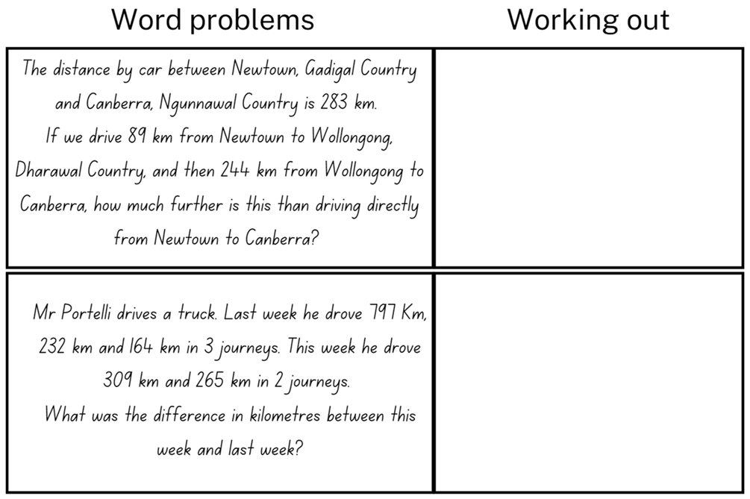
Activity 2 – multi-step word problems 1
Notes:
This is a developing number sense activity.
Number sense refers to a deep understanding of numbers, including their magnitude, relationships, and the effects of operations on them. It supports fluency and understanding, estimation, flexible thinking, and efficient problem-solving. Number sense activities 1–4 ‘activate’ prior number knowledge and support the learning of new content in the unit. Number sense activities 5–8 ‘loop’ back and provide opportunity for spaced practice with concepts and procedures covered in previous units.
Syllabus focus area:
Additive Relations B
Multi-step word problems 1
This resource corresponds to Resource 26 – distance word problems in Stage 3 Year B Unit 23.
Provide students with Resource 26 – distance word problems and their workbook.
Read the first problem and use a think aloud to highlight or list the addition and subtraction vocabulary.
Students work with a partner to solve the first problem and record the answer using the abbreviation for kilometres ‘km’.
Seek input from students to share their solution and explain the strategies implemented to the class.
Students work with a partner to highlight the addition and subtraction vocabulary and solve the second problem.
Seek input from students to share their solutions. Prompt students to discuss and compare the strategies they used.

Slide 18
Review of learning 3

Slide 19
Multiple choice (2)
Jamie drove 28 kms every day for a week. Mikali drove 19 km more than Jamie’s total. How far did Mikali drive?
A
B
C
D
256
215
196
211
Notes:
This question connects to the content in the developing number sense activity (Activity 3)
Syllabus focus area:
Additive Relations B

Slide 20
Short response (9)
Gum nut valley trail is 4.32 km.
Convert this length to:
metres
centimetres
Notes:
Short response questions provide brisk paced questions focussing on review of current and previous content to support spaced and interleaved practice.
Syllabus focus area:
Geometric measure B: Length

Slide 21
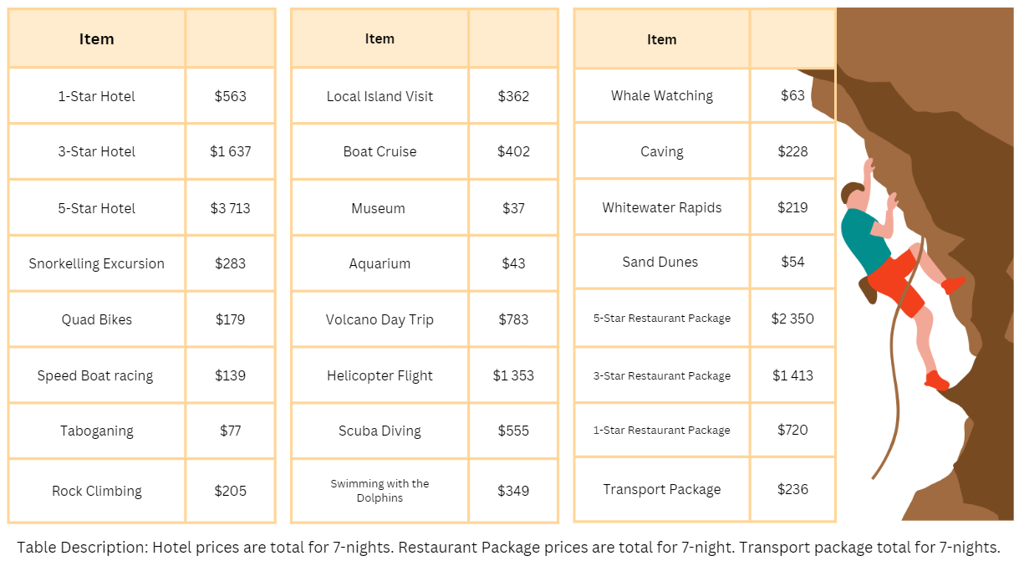
Short response (10)
Dani had $4000 to spend on a 1 week holiday.
She stayed at a 3-star hotel
and organised the 3-star
restaurant package.
She went to the aquarium
and swam with dolphins.
How much money did she have left?
Notes:
Short response questions provide brisk paced questions focussing on review of current and previous content to support spaced and interleaved practice.
Syllabus focus area:
Additive relations A

Slide 22
Short response (11)
What number is:
10 times 4.3
100 times 4.3
Communicate your thinking.
Notes:
Short response questions provide brisk paced questions focussing on review of current and previous content to support spaced and interleaved practice.
Syllabus focus area:
Represents Numbers A

Slide 23
Short response (12)
Jamie collected data on how many times he rolled the number 6 when playing a board game.
What types of data display would be appropriate to represent this data?
Notes:
Short response questions provide brisk paced questions focussing on review of current and previous content to support spaced and interleaved practice.
Syllabus focus area:
Data A

Slide 24
Activity 3 – multi-step word problem 2
Two friends ran a total distance of 18 kilometres during the week. One friend ran 6 kilometres more than the other. How far could each friend have run?
Communicate your reasoning.
Notes:
This is a developing number sense activity.
Number sense refers to a deep understanding of numbers, including their magnitude, relationships, and the effects of operations on them. It supports fluency and understanding, estimation, flexible thinking, and efficient problem-solving. Number sense activities 1–4 ‘activate’ prior number knowledge and support the learning of new content in the unit. Number sense activities 5–8 ‘loop’ back and provide opportunity for spaced practice with concepts and procedures covered in previous units.
Syllabus focus area:
Additive Relations B
Multi-step word problem 2
Pose the problem: Two friends ran a total distance of 18 kilometres during the week. One friend ran 6 kilometres more than the other. How far could each friend have run?
Identify and record the addition or subtraction vocabulary in the problem.
Students to turn and talk and discuss the most efficient strategy to solve the problem.
Allow time for students to solve the problem using their chosen strategy.
Seek input from students to share their chosen strategy and evaluate as a class the most efficient way to solve the problem.

Slide 25
Review of learning 4

Slide 26
True or false (2)
Olive sold a total of $2309 worth of produce at the farmers’ market over 5 days. Sam sold a total of $1880 over 4 days. Sam sold more per day than Olive.
True | False
Notes:
The question on this slide connects to the content being explored in the developing number sense activity (Activity 4)
Syllabus focus area:
Additive Relations B

Slide 27
Short response (13)
One side of a rectangular playground is 43.2 metres long, the other side is 21.3 metres long.
What is the perimeter of the playground?
Notes:
Short response questions provide brisk paced questions focussing on review of current and previous content to support spaced and interleaved practice.
Syllabus focus area:
Geometric measure A: Length

Slide 28
Short response (14)
A club has 1299 members. At the start of the year, 156 people leave the club and 189 new people join.
Use an efficient strategy to calculate how many members the club has now.
Notes:
Short response questions provide brisk paced questions focussing on review of current and previous content to support spaced and interleaved practice.
Syllabus focus area:
Additive Relations B

Slide 29
Short response (15)
Approximate the size of these decimals to 1 decimal place
1.26
1.59
2.61
3.48
Notes:
Short response questions provide brisk paced questions focussing on review of current and previous content to support spaced and interleaved practice.
Syllabus focus area:
Represents Numbers A

Slide 30
Short response (16)
Are rolling a 5 and rolling a 1 equally likely on a standard six-sided die?
Communicate your reasoning.
Notes:
Short response questions provide brisk paced questions focussing on review of current and previous content to support spaced and interleaved practice.
Syllabus focus area:
Chance A

Slide 31
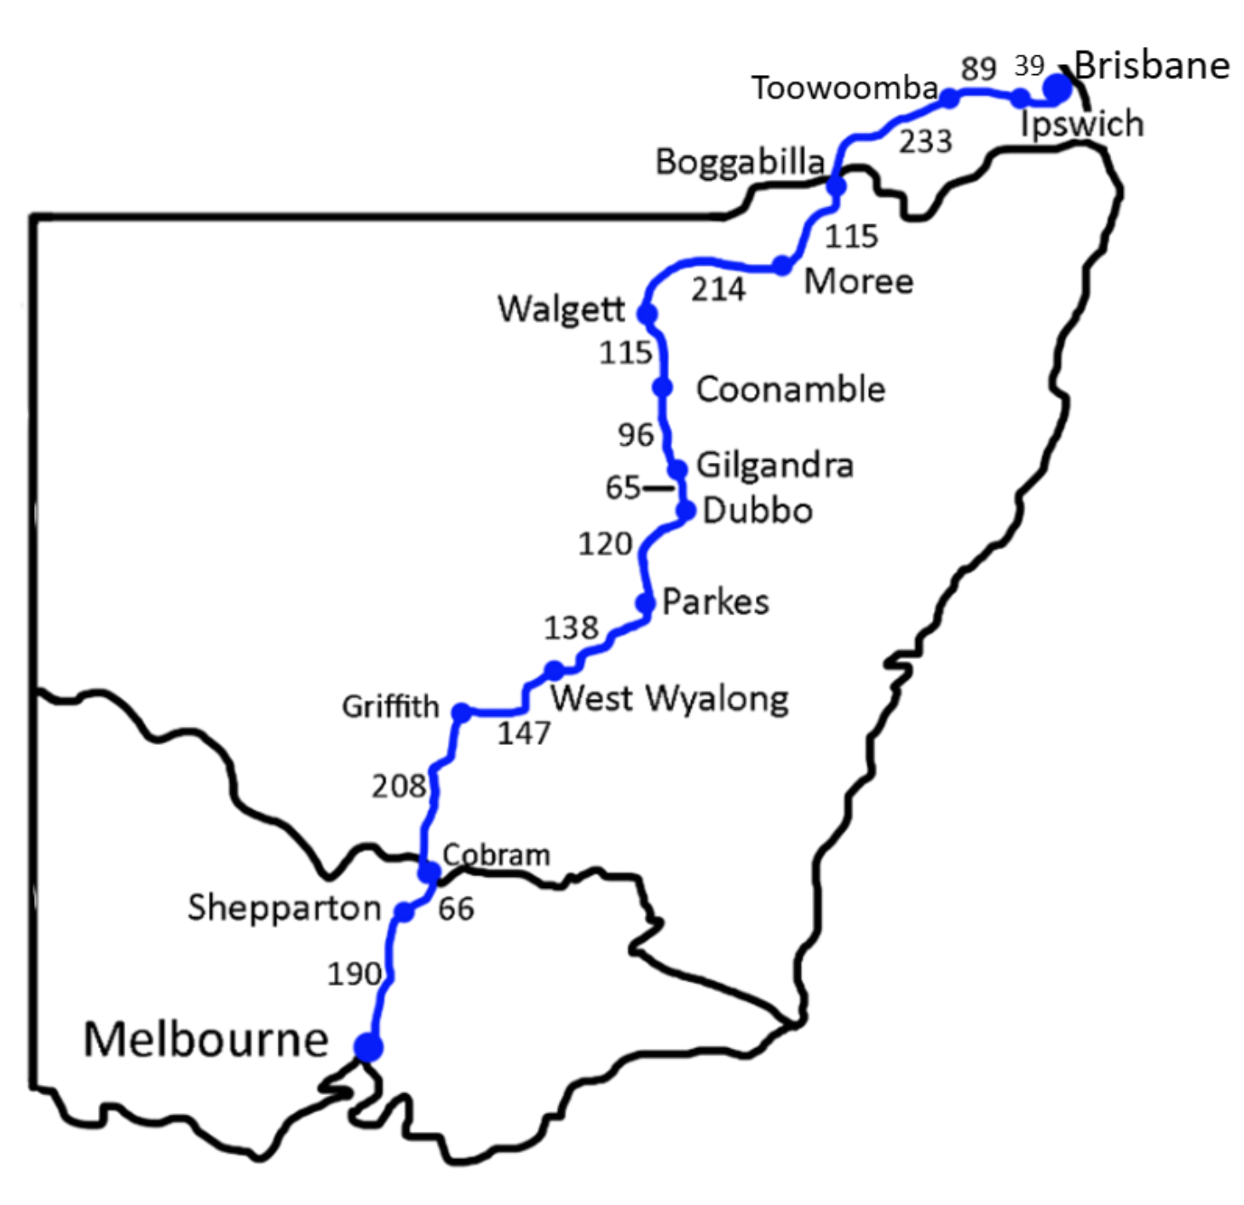
Activity 4 – multi-step word problem 3
You need to travel from Melbourne to Brisbane through the centre of New South Wales. Plan where you will stop for petrol. You can travel up to 350 km per tank of petrol.
Notes:
This is a developing number sense activity.
Number sense refers to a deep understanding of numbers, including their magnitude, relationships, and the effects of operations on them. It supports fluency and understanding, estimation, flexible thinking, and efficient problem-solving. Number sense activities 1–4 ‘activate’ prior number knowledge and support the learning of new content in the unit. Number sense activities 5–8 ‘loop’ back and provide opportunity for spaced practice with concepts and procedures covered in previous units.
Syllabus focus area:
Additive Relations B
Multi-step word problem 3
This resource corresponds to Resource 27 – travel plans calculations in Stage 3 Year B Unit 23.
Explain that students need to plan where the fuel stops will be from Melbourne to Brisbane on the Newell Highway. Explain that the car can travel up to 300 km on one tank of petrol.​
Students need to calculate the possible fuels stops, distances between fuel stops and then the total distance for the trip.​
Provide students with Resource 27 – travel plans calculations and their workbooks. Students record the travel plans in their workbook, showing their calculations (see Figure 10 – Travel plan calculations in Mathematics Stage 3 Unit 23).

Slide 32
Review of learning 5

Slide 33
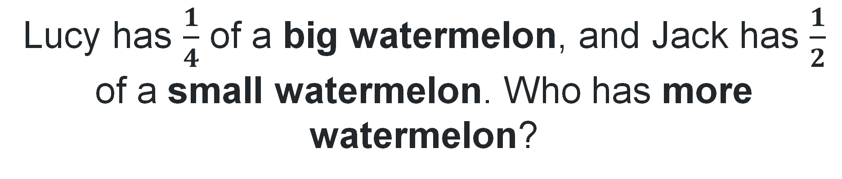
Multiple choice (3)
Lucy has $\frac{1}{4}$ of a big watermelon, and Jack has $\frac{1}{2}$ of a small watermelon. Who has more watermelon?
A
Lucy
B
Jack
C
They have exactly the same
D
It depends on the size of the watermelons.
Notes:
This question connects to the content in the developing number sense activity (Activity 5)
Syllabus focus area:
Representing quantity fractions A

Slide 34
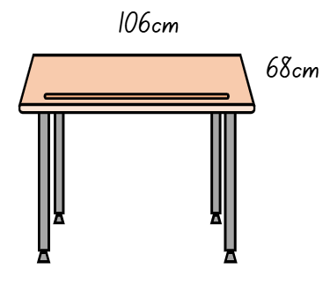
Short response (17)
Determine the perimeter of the table top in centimetres and then in metres.
Communicate your thinking.
Notes:
Short response questions provide brisk paced questions focussing on review of current and previous content to support spaced and interleaved practice.
Syllabus focus area:
Geometric measure A: Length

Slide 35
Short response (18)
Record the place value of each digit in the following number:
8.216
Notes:
Short response questions provide brisk paced questions focussing on review of current and previous content to support spaced and interleaved practice.
Syllabus focus area:
Represents numbers A

Slide 36
Short response (19)
Complete the following:
___ is 10 times 3.45
___ is 100 times 3.45
___ is 1000 times 3.45
Notes:
Short response questions provide brisk paced questions focussing on review of current and previous content to support spaced and interleaved practice.
Syllabus focus area:
Represents Numbers A

Slide 37
Short response (20)
Record 2 situations where mass would be measured in tonnes (t).
Notes:
Short response questions provide brisk paced questions focussing on review of current and previous content to support spaced and interleaved practice.
Syllabus focus area:
Non-spatial measure A: Mass

Slide 38
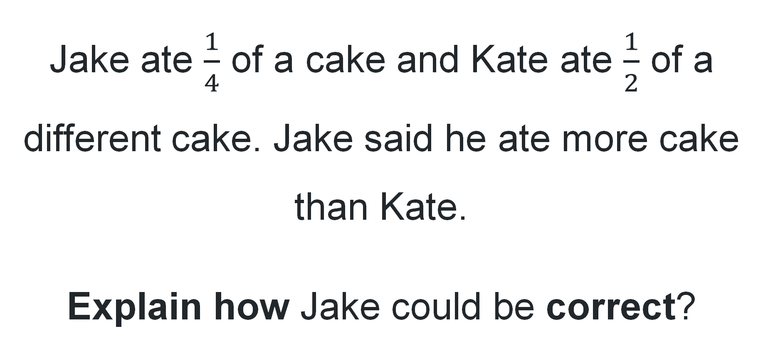
Activity 5 – different sized wholes 1
Jake ate $\frac{1}{4}$ of a cake and Kate ate $\frac{1}{2}$ of a different cake. Jake said he ate more cake than Kate.
Explain how Jake could be correct?
Notes:
This is a developing number sense activity.
Number sense refers to a deep understanding of numbers, including their magnitude, relationships, and the effects of operations on them. It supports fluency and understanding, estimation, flexible thinking, and efficient problem-solving. Number sense activities 1–4 ‘activate’ prior number knowledge and support the learning of new content in the unit. Number sense activities 5–8 ‘loop’ back and provide opportunity for spaced practice with concepts and procedures covered in previous units.
Syllabus focus area:
Representing quantity fractions
Different sized wholes 1
Pose the problem: Jake ate a quarter of a cake and Kate ate half of a different cake. Jake said he ate more than Kate. How could he be correct?
Allow students time to turn and talk and discuss the question with a partner.
Seek input from students to share and explain their thinking.
Use drawings or physical models to test and explore student reasoning.
Reinforce the idea that fractions are relative to the size of the whole.

Slide 39
Review of learning 6

Slide 40
True or false (3)
Fractional quantities can be compared if one is the common whole.
True | False
Notes:
The question on this slide connects to the content being explored in the developing number sense activity (Activity 6)
Syllabus focus area:
Representing quantity fractions A

Slide 41
Short response (21)
Find the total of the length of 3 items measured:
7 mm, 21 cm and 2.3 m
Communicate your thinking.
Notes:
Short response questions provide brisk paced questions focussing on review of current and previous content to support spaced and interleaved practice.
Syllabus focus area:
Geometric measure B: Length

Slide 42
Short response (22)
What is the combined distance that Ishaan and Maria jumped at all 3 carnivals?
Name | Carnival A | Carnival B | Carnival C
Stacey | 3.42 m | 3.64 m | 3.09 m
Stuart | 4.15 m | 4.08 m | 4.52 m
Roshan | 3.78 m | 3.74 m | 3.81 m
Xavier | 4.23 m | 3.99 m | 4.17 m
Beatrice | 5.32 m | 5.33 m | 5.42 m
Ishaan | 3.98 m | 4.12 m | 4.19 m
Maria | 4.88 m | 5.02 m | 5.14 m
Notes:
Short response questions provide brisk paced questions focussing on review of current and previous content to support spaced and interleaved practice.
Syllabus focus area:
Additive relations B

Slide 43
Short response (23)
3.043 + 5.099
Communicate your thinking.
Notes:
Short response questions provide brisk paced questions focussing on review of current and previous content to support spaced and interleaved practice.
Syllabus focus area:
Additive Relations B

Slide 44
Short response (24)
Convert:
5.43kg to grams
4kg 320 g to kilograms
Notes:
Short response questions provide brisk paced questions focussing on review of current and previous content to support spaced and interleaved practice.
Syllabus focus area:
Non-spatial measure A: Mass

Slide 45
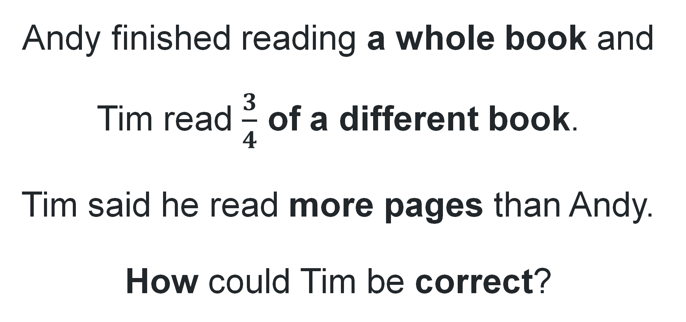
Activity 6 – different sized wholes 2
Andy finished reading a whole book and Tim read $\frac{3}{4}$ of a different book.
Tim said he read more pages than Andy.
How could Tim be correct?
Notes:
This is a developing number sense activity.
Number sense refers to a deep understanding of numbers, including their magnitude, relationships, and the effects of operations on them. It supports fluency and understanding, estimation, flexible thinking, and efficient problem-solving. Number sense activities 1–4 ‘activate’ prior number knowledge and support the learning of new content in the unit. Number sense activities 5–8 ‘loop’ back and provide opportunity for spaced practice with concepts and procedures covered in previous units.
Syllabus focus area:
Representing quantity fractions A
Different sized wholes 2
Pose the problem: Andy finished reading a whole book and Tim read 3 quarters of a different book. Tim said he read more pages than Andy. How could he be correct?
Allow students time to turn and talk and discuss the question with a partner.
Seek input from students to share and explain their thinking.
Use drawings or physical models to test and explore student reasoning.
Reinforce the idea that fractions are relative to the size of the whole.

Slide 46
Review of learning 7

Slide 47
Multiple choice (4)
Mia cuts a ribbon into 2 equal lengths.
Tom cuts an identical ribbon into 4 equal lengths. Which statement is correct?
A
Mia’s pieces are smaller
B
Tom’s pieces are bigger
C
The pieces are the same
D
Mia’s pieces are bigger
Notes:
This question connects to the content in the developing number sense activity (Activity 7)
Syllabus focus area:
Representing quantity fractions A

Slide 48
Short response (25)
Jessica started work at 14:15 and finished at 17:05. How long has she worked?
Communicate your thinking.
Notes:
Short response questions provide brisk paced questions focussing on review of current and previous content to support spaced and interleaved practice.
Syllabus focus area:
Non- spatial measure B: Time:

Slide 49
Short response (26)
Jemma lives 76.952 km from the museum. Jess lives 21.242 km away from the museum. How much further does Jemma need to travel to the museum than Jess?
Communicate your thinking.
Notes:
Short response questions provide brisk paced questions focussing on review of current and previous content to support spaced and interleaved practice.
Syllabus focus area:
Additive Relations B

Slide 50
Short response (27)
The number is 7.
Record the number that is:
10 times larger
100 times larger
one tenth the size
one tenth the size.
Notes:
Short response questions provide brisk paced questions focussing on review of current and previous content to support spaced and interleaved practice.
Syllabus focus area:
Represents Numbers B

Slide 51
Short response (28)
Convert the following to 24-hour time:
11:20 pm
7:32 am
4:19 am
9:25 pm
Notes:
Short response questions provide brisk paced questions focussing on review of current and previous content to support spaced and interleaved practice.
Syllabus focus area:
Non-spatial measure A: Time:

Slide 52
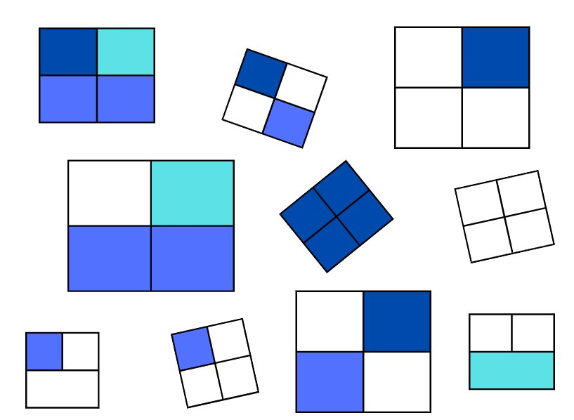
Activity 7 – comparing halves and quarters
Notes:
This is a developing number sense activity.
Number sense refers to a deep understanding of numbers, including their magnitude, relationships, and the effects of operations on them. It supports fluency and understanding, estimation, flexible thinking, and efficient problem-solving. Number sense activities 1–4 ‘activate’ prior number knowledge and support the learning of new content in the unit. Number sense activities 5–8 ‘loop’ back and provide opportunity for spaced practice with concepts and procedures covered in previous units.
Syllabus focus area:
Representing quantity fractions A
Halves and quarters
This resource corresponds to Resource 28 – halves and quarters in Stage 3 Year B Unit 23.
Ask:
What can you see?
How many halves can you see? What is the same about them and what is different?
How many quarters can you see? What is the same about them and what is different?
Students turn and talk to discuss if a half is always more than a quarter? Why/ why not?
Ask:
Which fractions from Resource 28 – halves and quarters can be added to make a whole?
How many wholes are there in total?
Students record their thinking on whiteboards.
Seek student input from students to share their responses and reasoning with the class.

Slide 53
Review of learning 8

Slide 54
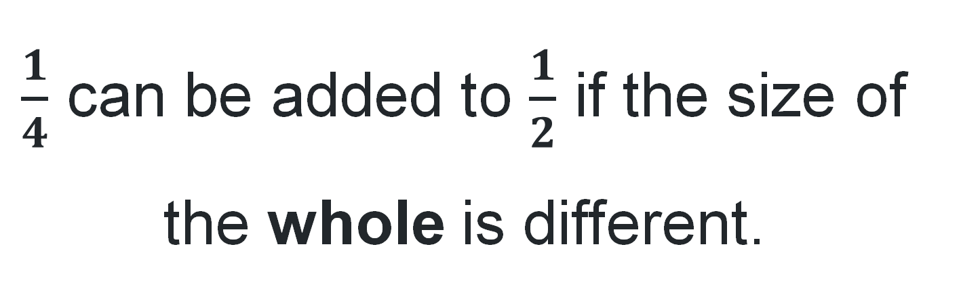
True or false (4)
$\frac{1}{4}$ can be added to $\frac{1}{2}$ if the size of the whole is different.
True | False
Notes:
The question on this slide connects to the content being explored in the developing number sense activity (Activity 8)
Syllabus focus area:
Representing quantity fractions A

Slide 55
Short response (29)
12-hour | 24-hour | Monday | Tuesday | Wednesday | Thursday | Friday
8:30 am | 08:30
9:00 am | 09:00 | English | English | English | PDHPE | Sport
9:30 am | 09:30 | English | English | English | PDHPE | Sport
10:00 am | 10:00 | English | English | English | English | English
10:30 am | 10:30 | English | English | English | English | English
11:00 am | 11:00 | Recess | Recess | Recess | Recess | Recess
11:30 am | 11:30 | Maths | Maths | Maths | Maths | Maths
12:00 pm | 12:00 | Maths | Maths | Maths | Maths | Maths
12:30 pm | 12:30 | Maths | Maths | Maths | Maths | Maths
1:00 pm | 13:00 | Lunch | Lunch | Lunch | Lunch | Lunch
1:30 pm | 13:30 | HSIE | HSIE | Creative arts | Creative arts | Science
2:00 pm | 14:00 | HSIE | Library | PDHPE | Creative arts | Science
2:30 pm | 14:30 | HSIE | Assembly | PDHPE | Creative arts | Science
3:00 pm | 15:00
How long is Creative arts on a Thursday?
How long is spent on maths over the week?
Notes:
Short response questions provide brisk paced questions focussing on review of current and previous content to support spaced and interleaved practice.
Syllabus focus area:
Non- spatial measure B: Time

Slide 56
Short response (30)
Danielle packed 28.8 kg in her suitcase. On her trip, she bought 4.3 kg of souvenirs.
Her suitcase can only weigh 32 kg for the flight home. Has she gone over the limit?
Communicate your reasoning.
Notes:
Short response questions provide brisk paced questions focussing on review of current and previous content to support spaced and interleaved practice.
Syllabus focus area:
Additive Relations B

Slide 57
Short response (31)
Draw a number line from 0 to 2.
Place these decimals in order on the number line.
0.98
1.20
1.02
0.12
Notes:
Short response questions provide brisk paced questions focussing on review of current and previous content to support spaced and interleaved practice.
Syllabus focus area:
Represents Numbers A

Slide 58
Short response (32)
Convert the following to 12-hour time:
2200 hours
0846 hours
1732 hours
1355 hours
Notes:
Short response questions provide brisk paced questions focussing on review of current and previous content to support spaced and interleaved practice.
Syllabus focus area:
Non-spatial measure A: Time

Slide 59

Activity 8 – halves and quarters fractions hunt
Which is bigger: $\frac{1}{2}$ of this or $\frac{1}{4}$ of that?
Notes:
This is a developing number sense activity.
Number sense refers to a deep understanding of numbers, including their magnitude, relationships, and the effects of operations on them. It supports fluency and understanding, estimation, flexible thinking, and efficient problem-solving. Number sense activities 1–4 ‘activate’ prior number knowledge and support the learning of new content in the unit. Number sense activities 5–8 ‘loop’ back and provide opportunity for spaced practice with concepts and procedures covered in previous units.
Syllabus focus area:
Representing quantity fractions A
Halves and quarters fractions hunt
Place a range of different-sized classroom objects around the room (e.g. a large and a small book, long and short pencils).
In pairs or groups of 3, students move around the room to pick any two different-sized items.
Ask: which is bigger: half of this or quarters of that?
Students discuss and record which fraction of which item is larger, and why. For example, half of the small pencil is smaller than quarter of the long pencil.
Regroup as a class and ask:
Did you find any times where quarters was more than half? Why?
Why is it important to know what the whole is when using fractions?

Slide 60
Double Venn diagram
Object 1
Object 2
Features similar to both objects
Features of object 1
Features of object 2

Slide 61
Frayer
Definition
Facts/Characteristics
Word, term, concept
Examples
Non-examples

Slide 62
Spider map
Idea
Subject

Slide 63
Cline
Concept 1
Concept 2
Word
Word
Word
Word
Word
Word
Word
Word
Word
Word
Word

Slide 64

Compare and contrast

Slide 65
Multiple choice (5)
A
B
C
D

Slide 66
Multiple choice (6)
A
B
C
D

Slide 67
References
This presentation contains NSW Curriculum and syllabus content. The NSW Curriculum is developed by the NSW Education Standards Authority. This content is prepared by NESA for and on behalf of the Crown in the right of the State of New South Wales. The material is protected by Crown copyright.
Please refer to the NESA Copyright Disclaimer for more information https://educationstandards.nsw.edu.au/wps/portal/nesa/mini-footer/copyright.
NESA holds the only official and up-to-date versions of the NSW Curriculum and syllabus documents. Please visit the NSW Education Standards Authority (NESA) website https://educationstandards.nsw.edu.au/wps/portal/nesa/home and the NSW Curriculum website https://curriculum.nsw.edu.au.
Mathematics K–10 Syllabus © NSW Education Standards Authority (NESA) for and on behalf of the Crown in right of the State of New South Wales, 2022.
National Numeracy Learning Progression © Australian Curriculum, Assessment and Reporting Authority (ACARA) 2010 to present, unless otherwise indicated. This material was downloaded from the Australian Curriculum website (National Numeracy Learning Progression) (accessed 22 July 2025) and was not modified.
Downton, A., Knight, R., Clarke, D., & Lewis, G. (2021). ‘Travel Plans’. In Mathematics assessment for learning: Rich tasks and work samples (3rd ed.). Australian Council for Educational Research.

Slide 68
Copyright
© State of New South Wales (Department of Education), 2025
The copyright material published in this resource is subject to the Copyright Act 1968 (Cth) and is owned by the NSW Department of Education or, where indicated, by a party other than the NSW Department of Education (third-party material).
Copyright material available in this resource and owned by the NSW Department of Education is licensed under a Creative Commons Attribution 4.0 International (CC BY 4.0) license.
This license allows you to share and adapt the material for any purpose, even commercially.
Attribution should be given to © State of New South Wales (Department of Education), 2025.
Material in this resource not available under a Creative Commons license:
the NSW Department of Education logo, other logos and trademark-protected material
Material owned by a third party that has been reproduced with permission. You will need to obtain permission from the third party to reuse its material.
Links to third-party material and websites
Please note that the provided (reading/viewing material/list/links/texts) are a suggestion only and implies no endorsement, by the New South Wales Department of Education, of any author, publisher, or book title. School principals and teachers are best placed to assess the suitability of resources that would complement the curriculum and reflect the needs and interests of their students.
If you use the links provided in this document to access a third party’s website, you acknowledge that the terms of use, including licence terms set out on the third-party’s website apply to the use which may be made of the materials on that third-party website or where permitted by the Copyright Act 1968 (Cth). The department accepts no responsibility for content on third-party websites.

