Slide 1
Instructions for use
This resource aligns to the learning in Stage 3 Year A Unit 17 and revisits content from earlier sample units.
Classroom teachers are encouraged to add, edit and adapt to meet the needs of their students.
Save a copy of the file to make changes to the slide deck. Go to File > Download a Copy (this downloads a copy to the computer to edit in the PowerPoint app).
To convert the PowerPoint to Google Slides:
  Upload the file into Google Drive and open it.
  Go to File > Save as Google Slides.
  (Note – conversion may cause formatting changes in the slides.)

Slide 2

Review of Learning
Mathematics Stage 3 – Unit 17
Notes:
Reviews may include a combination of question types, requiring students to recall facts and key ideas, as well as apply their knowledge to solve problems and answer questions. To support active engagement, a mix of techniques should be employed.” (AERO, 2024).
This Review of Learning slide deck revisits key concepts from the following units:
Stage 3 Year A Unit 17
Stage 3 Year A Unit 16
Stage 3 Year A Unit 15
It also includes opportunities to review prior learning in non-number content, supporting consolidation across focus areas.
The review of learning resources include three key task types that support the development of mathematical proficiency through retrieval, spaced practice, and active participation. These practices complement the review phase (activating prior knowledge) embedded within the beginning of each lesson.
1.
Multiple-choice questions/True or false: Designed to promote active retrieval of key concepts and identify common misconceptions in number, supporting consolidation, understanding and fluency.
These questions:
support spaced and interleaved practice
help identify and address common misconceptions
support active recall and immediate feedback
support whole class participation
identify areas requiring reteach
2.
Short-response question sets: Carefully grouped questions that encourage spaced and interleaved practice across multiple focus areas, helping students revisit and apply knowledge from different points in time.
These questions:
have a combination of question types
address a range of focus areas
build automaticity and fluency
support active recall
allow for immediate feedback
identify content requiring reteach
3.
Developing number sense activities: A variety of practical, purposeful tasks that reinforce current learning and build on prior knowledge. These activities promote reasoning, problem-solving and conceptual understanding.
The review of learning resources are designed to work support teaching and learning in mathematics. For the most effective implementation, use the resources flexibly, adapting to meet student learning needs and individual classroom contexts.

Slide 3
Lessons
1
Review of learning 1
5
Review of learning 5
2
Review of learning 2
6
Review of learning 6
3
Review of learning 3
7
Review of learning 7
4
Review of learning 4
8
Review of learning 8
Notes:
Teacher notes:
Click lesson numbers to go to specific lessons
Interactive features can be viewed in slide show

Slide 4
Review of learning 1

Slide 5

Multiple choice (1)
Which of the following has all the factors of 24?
A
1, 2, 3, 4, 6, 8, 12, 24
2, 4, 6, 10, 12, 24
B
C
1, 2, 3, 5, 6, 12, 24
D
3, 6, 8, 9, 12, 24
Notes:
This question connects to the content in the developing number sense activity (Activity 1)
Syllabus focus area:
Multiplicative relations A

Slide 6

Short response (1)
Multiply the following:
4 x 10
4 x 100
4 x 1000
Notes:
Short response questions provide brisk paced questions focussing on review of current and previous content to support spaced and interleaved practice.
Syllabus focus area:
Multiplicative relations A

Slide 7


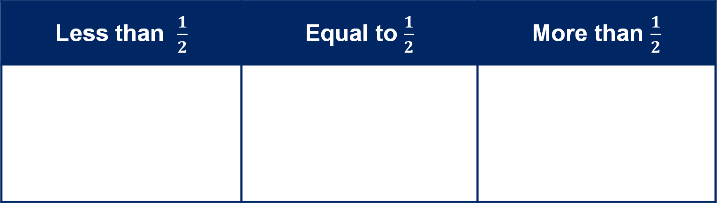





Short response (2)
Record the fractions in the table
$\frac{1}{5}$
$\frac{1}{8}$
$\frac{1}{4}$
$\frac{1}{10}$
$\frac{2}{4}$
$\frac{5}{6}$
$\frac{4}{8}$
Less than $\frac{1}{2}$ | Equal to $\frac{1}{2}$ | More than $\frac{1}{2}$
Notes:
Short response questions provide brisk paced questions focussing on review of current and previous content to support spaced and interleaved practice.
Syllabus focus area:
Representing quantity fractions A

Slide 8
Short response (3)
Ezra has 45 waratahs and 108 violets in his garden. He picks 68 of the flowers. How many flowers are left in his garden?
Notes:
Short response questions provide brisk paced questions focussing on review of current and previous content to support spaced and interleaved practice.
Syllabus focus area:
Additive relations A

Slide 9
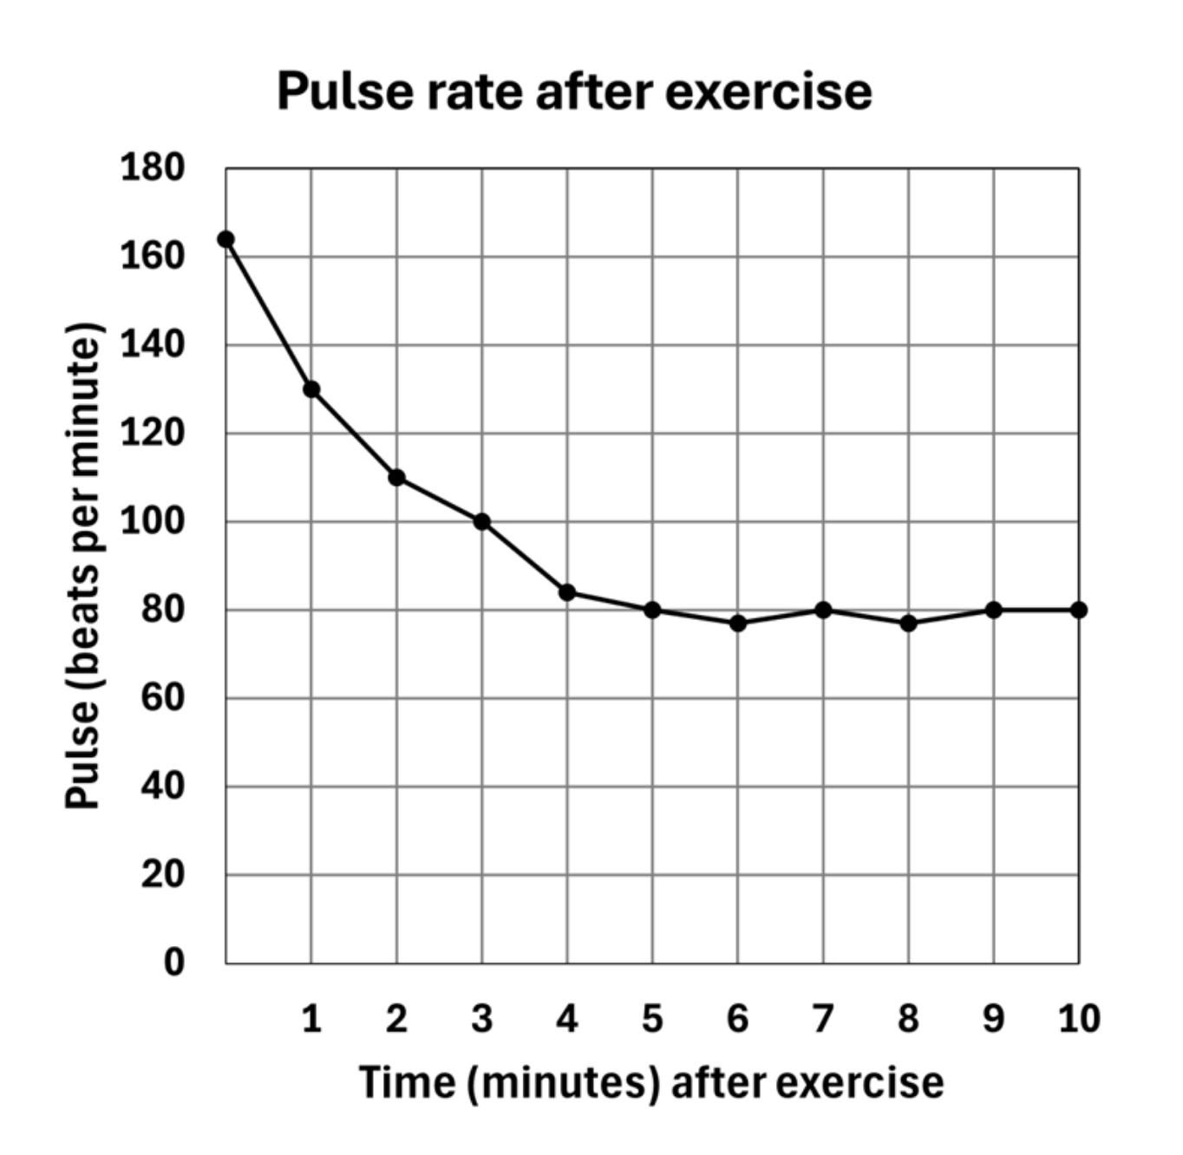
Short response (4)
What was the students approximate pulse rate 2 minutes after exercise?
What was the approximate difference between the student's pulse rate at 1 minute and 5 minutes?
What happened as the time after exercise increased?
Notes:
Short response questions provide brisk paced questions focussing on review of current and previous content to support spaced and interleaved practice.
Syllabus focus area:
Partitioned fractions A

Slide 10

Activity 1 – rearrange arrays
Question 1- I have 36 counters arranged in an array. How might they be arranged?
Record your ideas on individual whiteboards.
Question 2- I have 72 counters arranged in an array. How might they be arranged?
Notes:
This is a developing number sense activity.
Number sense refers to a deep understanding of numbers, including their magnitude, relationships, and the effects of operations on them. It supports fluency and understanding, estimation, flexible thinking, and efficient problem-solving. Number sense activities 1–4 ‘activate’ prior number knowledge and support the learning of new content in the unit. Number sense activities 5–8 ‘loop’ back and provide opportunity for spaced practice with concepts and procedures covered in previous units.
Syllabus focus area:
Multiplicative relations A
Rearrange arrays
Factor: a number which divides another number without a remainder. For example, 1, 2, 3 and 6 are factors of 6, but 4 and 5 are not.
Product: the result of multiplying 2 or more numbers together, for example, 12 is the product of 4 × 3.
Revise that 36 is a product of 9 × 4, 6 × 6, 12 × 3. The factors of 36 are 1, 2, 3, 4, 6, 9, 12, 18, 36.
Pose the following: I have 36 counters arranged in an array. How might they be arranged?
Students record their ideas on individual whiteboards. For example, 6 sixes, 9 fours, 12 threes or 36 ones. Provide counters to students who would benefit from the concrete manipulatives.
Ask the following questions:
How many possibilities are there?
How does multiplication help you with this problem?
How many possible arrays are there?
Students share their arrays. List the array combinations for the class.
Ask: If 72 is the product, what are all the factors?
Students record as number sentences where 72 is the product and identify the factors of 72.
Ask the following questions:
How many possibilities are there?
Did the factors of 36 help you work out the factors of 72? Explain your thinking.

Slide 11
Review of learning 2

Slide 12
True or false (1)
Sam drew one array to show 48. Jonah drew another, using different rows and columns. Could they both still show the number 48?
True | False
Notes:
The question on this slide connects to the content being explored in the developing number sense activity (Activity 2)
Syllabus focus area:
Multiplicative relations A

Slide 13
Short response (5)
Use factorising and then the associative property to solve 56 x 5.
Notes:
Short response questions provide brisk paced questions focussing on review of current and previous content to support spaced and interleaved practice.
Syllabus focus area:
Multiplicative relations A

Slide 14
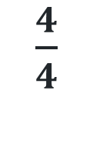
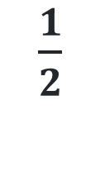
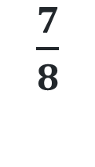
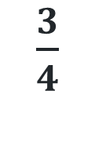
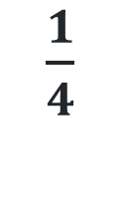
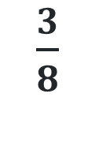
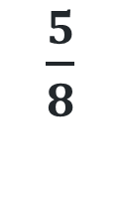
Short response (6)
Draw a number line 0-1.
Order the following fractions:
$\frac{1}{2}$
$\frac{3}{8}$
$\frac{1}{4}$
$\frac{3}{4}$
$\frac{7}{8}$
$\frac{4}{4}$
$\frac{5}{8}$
Notes:
Short response questions provide brisk paced questions focussing on review of current and previous content to support spaced and interleaved practice.
Syllabus focus area:
Representing quantity fractions B

Slide 15
Short response (7)
Use a mental strategy to solve
455 + 396
Communicate your reasoning.
Notes:
Short response questions provide brisk paced questions focussing on review of current and previous content to support spaced and interleaved practice.
Syllabus focus area:
Additive relations A

Slide 16
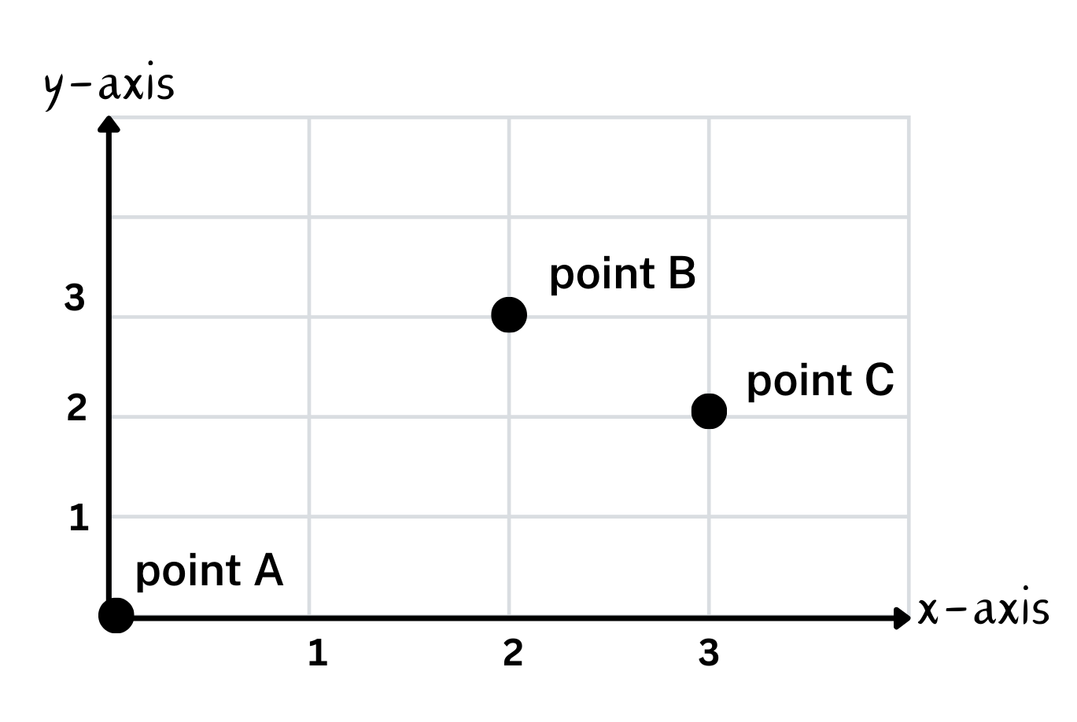
Short response (8)
Identify and record coordinates
Point A
Point B
Point C
Notes:
Short response questions provide brisk paced questions focussing on review of current and previous content to support spaced and interleaved practice.
Syllabus focus area:
Geometric measure A: Position

Slide 17
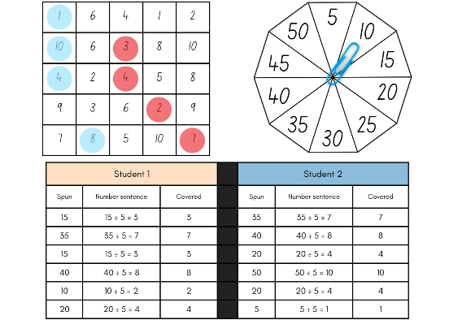
Activity 2 – determining factors
Aim of the game​
Solve division questions to get 4 counters in a row.
​
Rules:​
take it in turns to spin the spinner and divide the number by the chosen divisor.
work out the solution and explain your thinking to your partner.
your partner records your thinking and, if they agree, places one of their counters on the number on the gameboard, claiming that place.
If the number is taken, miss a turn. If there are no new counters that can be added to the gameboard, you must move an existing counter to a new place.
Notes:
This is a developing number sense activity.
Number sense refers to a deep understanding of numbers, including their magnitude, relationships, and the effects of operations on them. It supports fluency and understanding, estimation, flexible thinking, and efficient problem-solving. Number sense activities 1–4 ‘activate’ prior number knowledge and support the learning of new content in the unit. Number sense activities 5–8 ‘loop’ back and provide opportunity for spaced practice with concepts and procedures covered in previous units.
Syllabus focus area:
Multiplicative relations A
Determining factors
This lesson is an adaptation of Factors fun! from Mathematics K–6 resources by the State of New South Wales (Department of Education).
Provide pairs of students with Resource 23 – factors fun instructions, Resource 24 – factors fun gameboard, Resource 25– factors fun spinner, counters, a paperclip and pencils. Watch the Factors fun (8:25) video about the steps and reasoning used in this game.
Instructions:
Select a number, for example, 9.
Fill the spinner with multiples of your chosen number.
Take turns to spin the spinner and divide the number by the chosen divisor (for example, 9).
Players recall the multiplication fact and record the number sentence on the tracking sheet.
If correct, the player places a counter on the number on the game board, claiming that place.
If the number is taken, students miss a turn.
Players win by getting four counters in a row (in any orientation) or by making a four square.
In this version, players have many counters to place on the gameboard.
Observe student reasoning and completed gameboards

Slide 18
Review of learning 3

Slide 19
Multiple choice (2)
I am a number greater than 50. I have many factors, including 1, 2, 3, 4, 6, 8, 9, and 12.
What number am I?
A | B | C | D
64 | 70 | 72 | 81
Notes:
This question connects to the content in the developing number sense activity (Activity 3)
Syllabus focus area:
Multiplicative relations A

Slide 20
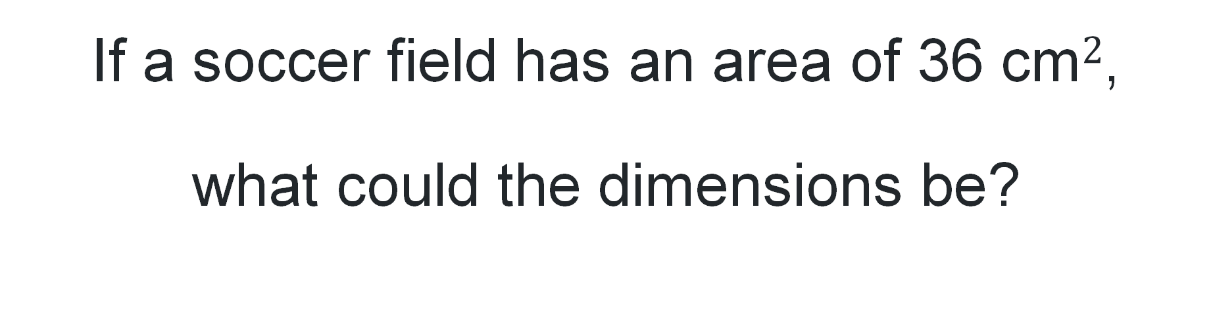
Short response (9)
If a soccer field has an area of 36 cm$2$,
what could the dimensions be?
Notes:
Short response questions provide brisk paced questions focussing on review of current and previous content to support spaced and interleaved practice.
Syllabus focus area:
Two-dimensional spatial structure: A

Slide 21
Short response (10)
Mr Wang purchased 360 pencils to share equally between his 10 students. How many pencils did each student get?
Notes:
Short response questions provide brisk paced questions focussing on review of current and previous content to support spaced and interleaved practice.
Syllabus focus area:
Represents numbers B

Slide 22
Short response (11)
Emily had 135 stickers in her collection.
She gave 28 stickers to her friend Mia and later bought 47 more at the store.
Then she used 25 stickers to decorate a poster.
How many stickers does Emily have now?
Notes:
Short response questions provide brisk paced questions focussing on review of current and previous content to support spaced and interleaved practice.
Syllabus focus area:
Additive relations A

Slide 23
Short response (12)
Liam says a triangle with 2 equal sides is an equilateral triangle.
Do you agree or disagree? Why?
Notes:
Short response questions provide brisk paced questions focussing on review of current and previous content to support spaced and interleaved practice.
Syllabus focus area:
Two-dimensional spatial structure A: 2D shapes

Slide 24
Activity 3 – determining factors
Aim of the game​
Solve division questions to get 4 counters in a row
​
Rules:​
take it in turns to spin the spinner and divide the number by the chosen divisor.
work out the solution and explain your thinking to your partner.
your partner records your thinking and, if they agree, places one of their counters on the number on the gameboard, claiming that place.
If the number is taken, miss a turn. If there are no new counters that can be added to the gameboard, you must move an existing counter to a new place.
Notes:
This is a developing number sense activity.
Number sense refers to a deep understanding of numbers, including their magnitude, relationships, and the effects of operations on them. It supports fluency and understanding, estimation, flexible thinking, and efficient problem-solving. Number sense activities 1–4 ‘activate’ prior number knowledge and support the learning of new content in the unit. Number sense activities 5–8 ‘loop’ back and provide opportunity for spaced practice with concepts and procedures covered in previous units.
Syllabus focus area:
Multiplicative relations A
This lesson is an adaptation of Factors fun! from Mathematics K–6 resources by the State of New South Wales (Department of Education).
Provide pairs of students with Resource 23 – factors fun instructions, Resource 24– factors fun gameboard, Resource 25– factors fun spinner, counters, a paperclip and pencils. Watch the Factors fun (8:25) video about the steps and reasoning used in this game.
Players win by getting 4 counters in a row (in any orientation, including a square).
If preferred, students can use 5 or 6 counters, looking for 4 in a row.
Observe student reasoning and completed gameboards.

Slide 25
Review of learning 4

Slide 26
True or false (2)
Every factor of 24 is also a multiple of 3.
True | False
Notes:
The question on this slide connects to the content being explored in the developing number sense activity (Activity 4)
Syllabus focus area:
Multiplicative relations A

Slide 27
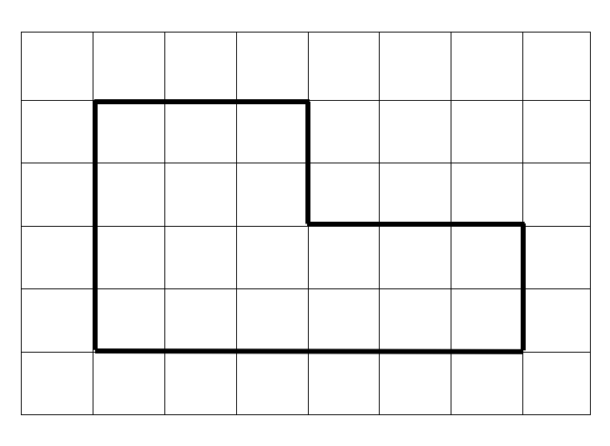
Short response (13)
Calculate the area of the following composite shape.
Notes:
Short response questions provide brisk paced questions focussing on review of current and previous content to support spaced and interleaved practice.
Syllabus focus area:
Two-dimensional spatial structure B: Area

Slide 28
Short response (14)
What is 10 % of 450?
Notes:
Short response questions provide brisk paced questions focussing on review of current and previous content to support spaced and interleaved practice.
Syllabus focus area:
Represent numbers B

Slide 29
Short response (15)
Lina is solving 504 – 298.
What mental strategy could she use to solve it efficiently?
Notes:
Short response questions provide brisk paced questions focussing on review of current and previous content to support spaced and interleaved practice.
Syllabus focus area:
Additive relations A

Slide 30
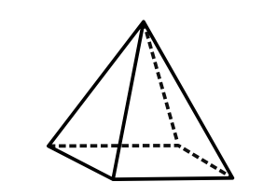
Short response (16)
Name the type of pyramid.
Notes:
Short response questions provide brisk paced questions focussing on review of current and previous content to support spaced and interleaved practice.
Syllabus focus area:
Three-dimensional spatial structure A: 3D objects

Slide 31
Activity 4 – factor multiple chains
3
6
30
90
Factor
Multiple
Factor
Multiple
Factor
Multiple
Can you see how this works?
What does the word factor mean?
What does the word multiple mean?
Can you explain the connection between the numbers in the chain?
Are there any numbers that could change to still make it a chain?
Notes:
This is a developing number sense activity.
Number sense refers to a deep understanding of numbers, including their magnitude, relationships, and the effects of operations on them. It supports fluency and understanding, estimation, flexible thinking, and efficient problem-solving. Number sense activities 1–4 ‘activate’ prior number knowledge and support the learning of new content in the unit. Number sense activities 5–8 ‘loop’ back and provide opportunity for spaced practice with concepts and procedures covered in previous units.
Syllabus focus area:
Multiplicative relations A
Factor multiple chains
Display Resource 24 – factor-multiple chains. Explain how the chain works. Ask the following questions:
What does the word factor mean?
What does the word multiple mean?
Can you explain the connection between the numbers in the chain?
This lesson is an adaptation of Factor-multiple Chains from NRICH by the University of Cambridge.
Provide students with Resource 27 – blank chains . Ask students to develop their own factor-multiple chains with numbers from 2 to 100 using one of the resources.
Students turn and talk and share their ideas. Ask the following questions:
What are the smallest numbers that will make a complete chain? (2, 4, 8, 16).
What are the largest numbers that will make a complete chain? (5, 25, 50, 100).
What numbers cannot appear in any chain? (Prime numbers larger than 12 do not work and prime numbers smaller than 12 can only appear at the start.)

Slide 32
Review of learning 5

Slide 33
Multiple choice (3)
0.560 is the same as
A | B | C | D
56 hundredths | 560 ten thousandths | 560 tenths | 56
Notes:
This question connects to the content in the developing number sense activity (Activity 5)
Syllabus focus area:
Represents numbers A: Decimals and percentages

Slide 34
Short response (17)
A rectangular classroom has an area of 288 square metres. The width of the room is 12 metres. What is the length of the classroom?
Notes:
Short response questions provide brisk paced questions focussing on review of current and previous content to support spaced and interleaved practice.
Syllabus focus area:
Two-dimensional spatial structure A: Area

Slide 35

Short response (18)
Using a bar model, solve
1 -
$\frac{3}{4}$
Notes:
Short response questions provide brisk paced questions focussing on review of current and previous content to support spaced and interleaved practice.
Syllabus focus area:
Representing quantity fractions A

Slide 36
Short response (19)
Use addition for subtraction strategy to solve
5875 - 2655
Notes:
Short response questions provide brisk paced questions focussing on review of current and previous content to support spaced and interleaved practice.
Syllabus focus area:
Additive relations A

Slide 37
Short response (20)
What is 4:00pm in 24-hour time?
Notes:
Short response questions provide brisk paced questions focussing on review of current and previous content to support spaced and interleaved practice.
Syllabus focus area:
Non-spatial measure A: Time

Slide 38
Activity 5 – decimals on a number line
Which decimal cards should be placed first to provide a benchmark for other numbers?
Notes:
This is a developing number sense activity.
Number sense refers to a deep understanding of numbers, including their magnitude, relationships, and the effects of operations on them. It supports fluency and understanding, estimation, flexible thinking, and efficient problem-solving. Number sense activities 1–4 ‘activate’ prior number knowledge and support the learning of new content in the unit. Number sense activities 5–8 ‘loop’ back and provide opportunity for spaced practice with concepts and procedures covered in previous units.
Syllabus focus area:
Represent numbers A: Decimals and percentages
Decimals on a number line
Note: pre-cut Resource 27– decimal cards before the start of the lesson
Display a large, blank number line on the board.
Give each student a card from Resource 26 – decimal cards. Ask the following question: Which decimal cards should be placed first to provide a benchmark for other numbers? For example, 0.0, 1.0, 2.0, 3.0 and 4.0.
Ask students with benchmark number cards to say their numbers aloud and place them onto the blank number line.
Remaining students say their number aloud and then decide where it should be placed on the number line
Once students have placed all numbers, ask the following questions:
Are there any numbers that need to have their position adjusted? If yes, explain why.
Which decimals are closest to the benchmark numbers?
Are there any numbers you have seen represented in more than one way? For example, 2.75 and 2.750.
Note: to support place value conceptual understanding, 3.254 would be read as three and two hundred and fifty-four thousandths. The language connects the decimal fraction with the whole number and makes a connection with common fractions.

Slide 39
Review of learning 6

Slide 40
True or false (3)
0.678 is greater than 0.8 because it has more digits.
True | False
Communicate your reasoning.
Notes:
The question on this slide connects to the content being explored in the developing number sense activity (Activity 6)
Syllabus focus area:
Represents numbers A: Decimals and percentages

Slide 41
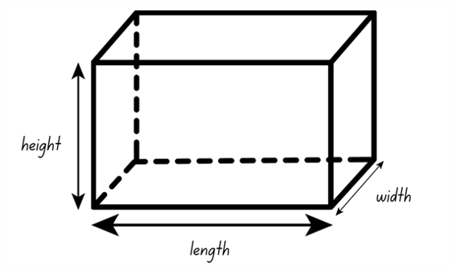
Short response (21)
A rectangular prism has a volume of 64 cubic centimetres. What dimensions could it have?
Notes:
Short response questions provide brisk paced questions focussing on review of current and previous content to support spaced and interleaved practice.
Syllabus focus area:
Three-dimensional spatial structure A: Volume

Slide 42
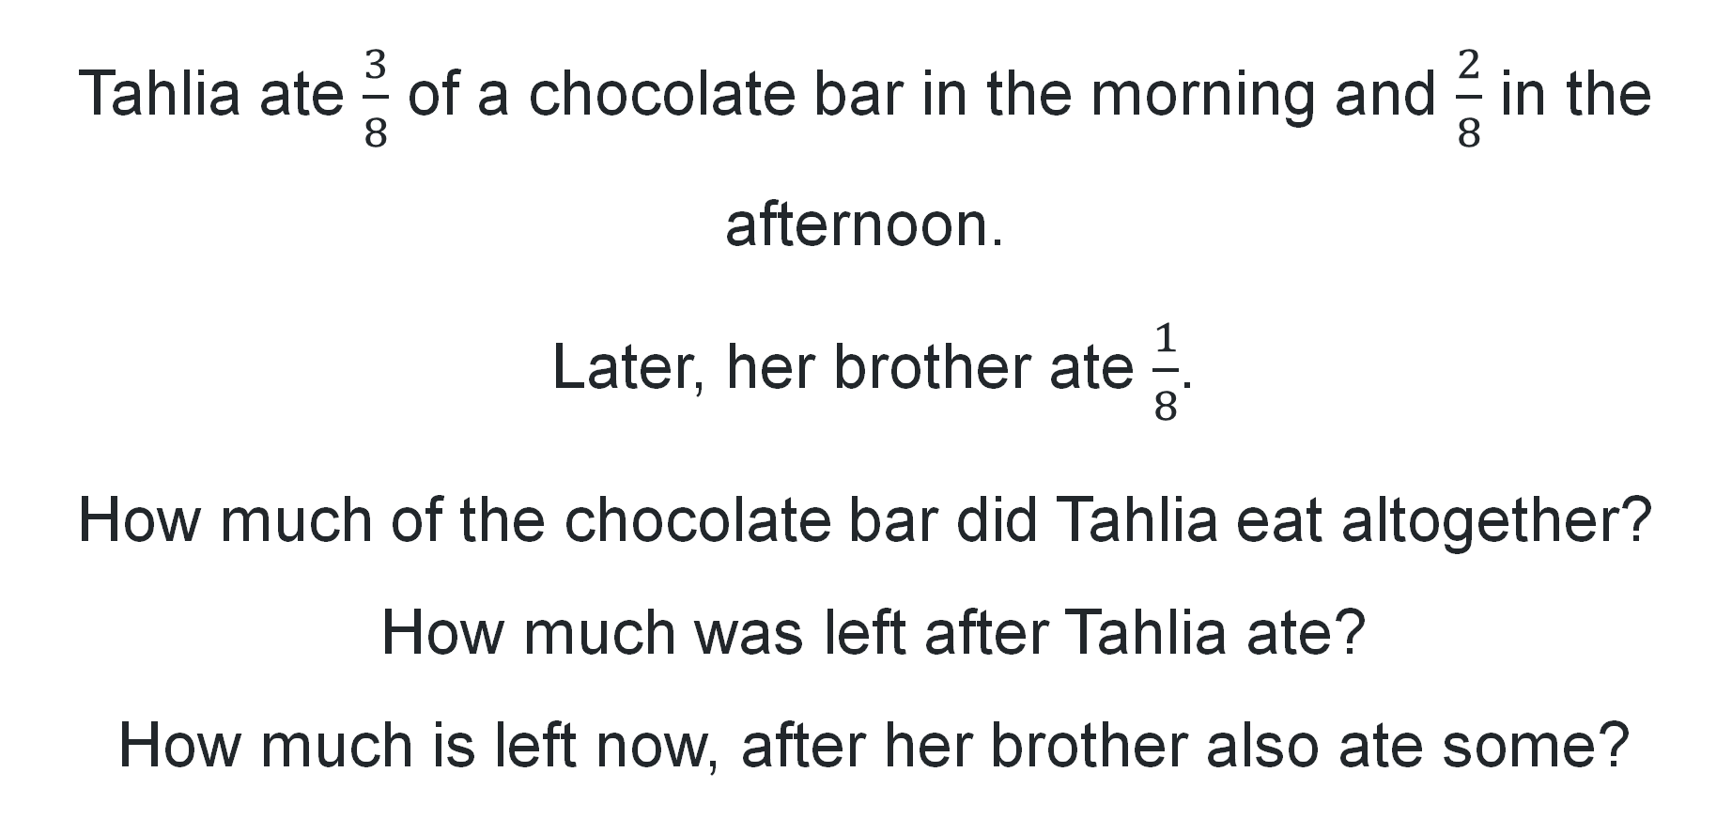
Short response (22)
Tahlia ate $\frac{3}{8}$ of a chocolate bar in the morning and $\frac{2}{8}$ in the afternoon.
Later, her brother ate $\frac{1}{8}$.
How much of the chocolate bar did Tahlia eat altogether?
How much was left after Tahlia ate?
How much is left now, after her brother also ate some?
Notes:
Short response questions provide brisk paced questions focussing on review of current and previous content to support spaced and interleaved practice.
Syllabus focus area:
Representing quantity fractions A

Slide 43

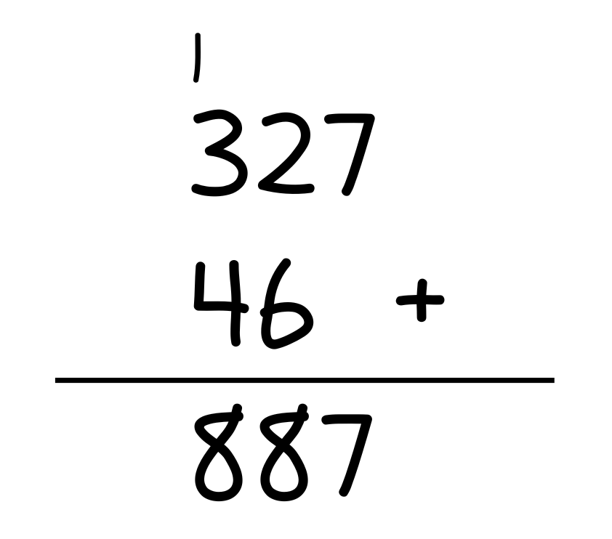
Short response (23)
What mistake did Raina make? How would you fix it?
Notes:
Short response questions provide brisk paced questions focussing on review of current and previous content to support spaced and interleaved practice.
Syllabus focus area:
Additive relations A

Slide 44
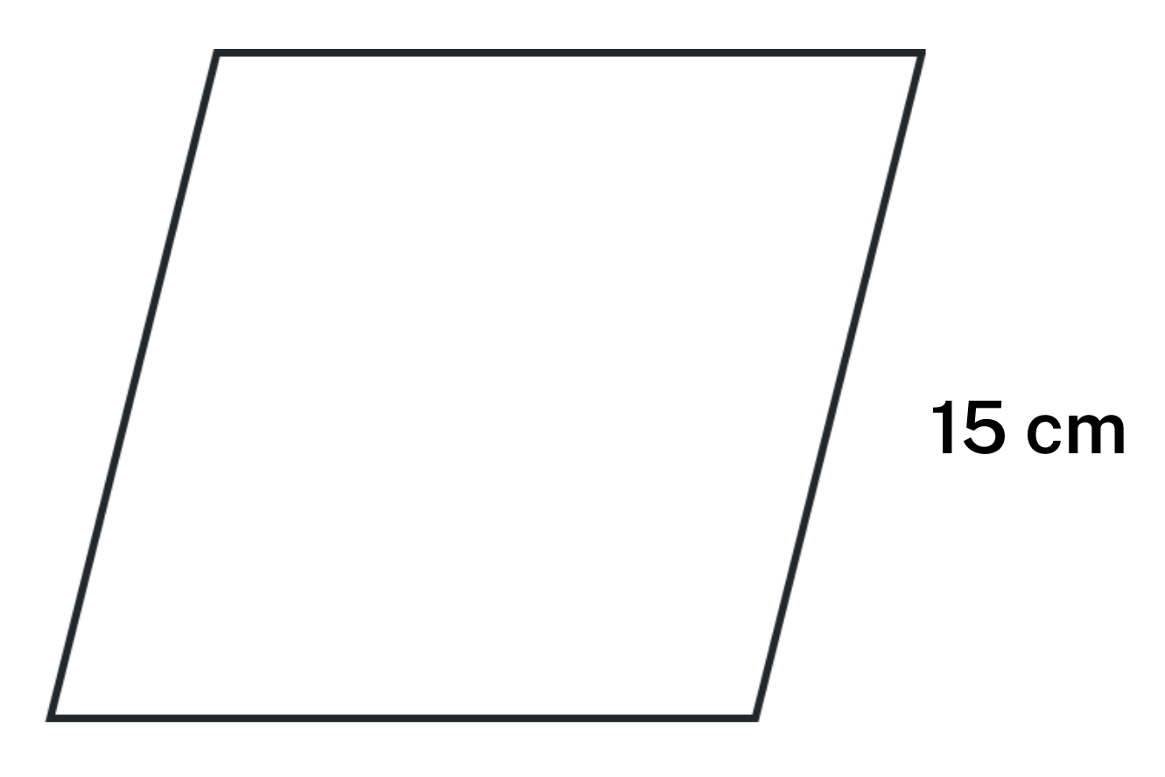
Short response (24)
Calculate the perimeter.
Notes:
Short response questions provide brisk paced questions focussing on review of current and previous content to support spaced and interleaved practice.
Syllabus focus area:
Two-dimensional spatial structure A: Length

Slide 45
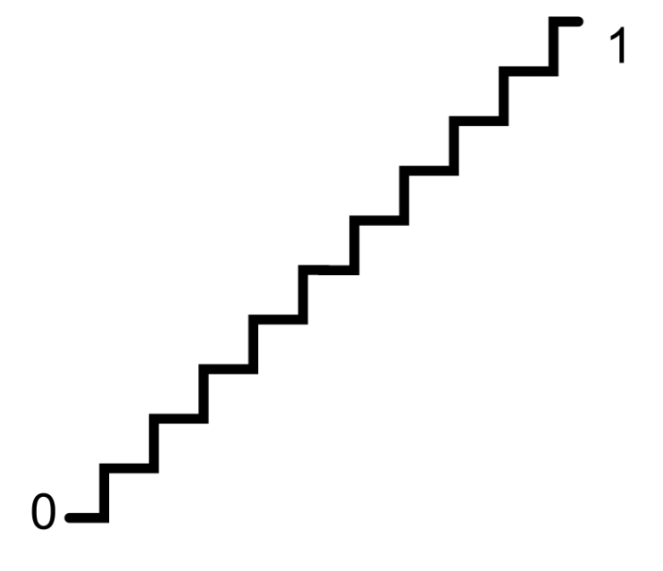
Activity 6 – ordering decimals
Notes:
This is a developing number sense activity.
Number sense refers to a deep understanding of numbers, including their magnitude, relationships, and the effects of operations on them. It supports fluency and understanding, estimation, flexible thinking, and efficient problem-solving. Number sense activities 1–4 ‘activate’ prior number knowledge and support the learning of new content in the unit. Number sense activities 5–8 ‘loop’ back and provide opportunity for spaced practice with concepts and procedures covered in previous units.
Syllabus focus area:
Represent numbers A: Decimals and percentages
Ordering decimals
This lesson is an adaptation of Fill the Stairs from Math for Love by Cook.
Provide students copies of Resource 27- ordering decimals
Explain that the numbers must increase as they go up the stairs. The number at the base of the stairs is zero and the number at the top of the stairs is one.
Small groups of students will need three 10-sided dice. One die will represent the ‘tenths’, one die will represent ‘hundredths’ and one die will be the ‘thousandths’ die. Students take turns rolling all 3 dice to make a number with 3 decimal places and write it on one of the stairs. If a number can’t be used, the number is written under the stairs and students skip a turn.
Model for students one turn of the game highlighting the strategies that can be used once the 3 dice are rolled. Discuss with students the possible combinations for the decimal number that is formed.
Ask the following questions:
Where are you going to put that number? Why?
What number are you hoping for on the next roll?
How will you know where to place the next number rolled?
How can the digits of a decimal be reordered to make sure the number can fit on the stairs?

Slide 46
Review of learning 7

Slide 47
Multiple choice (4)
Which shows 6.478 rounded to two decimal places?
6.47
A
B
6.50
C
6.48
D
6.85
Notes:
This question connects to the content in the developing number sense activity (Activity 7)
Syllabus focus area:
Represents numbers A: decimals and percentages

Slide 48
Short response (25)
A rectangular prism has a volume of 54 cubic centimetres. What dimensions could it have?
Notes:
Short response questions provide brisk paced questions focussing on review of current and previous content to support spaced and interleaved practice.
Syllabus focus area:
Three-dimensional spatial structure A: Volume

Slide 49

Short response (26)
What fraction of the squares has a star?
What fraction of the squares has a circle?
What fraction of the squares has no image?
Notes:
Short response questions provide brisk paced questions focussing on review of current and previous content to support spaced and interleaved practice.
Syllabus focus area:
Representing quantity fractions A

Slide 50
Short response (27)
1087 – 675 – 22 =
Communicate how you used place value understanding.
Notes:
Short response questions provide brisk paced questions focussing on review of current and previous content to support spaced and interleaved practice.
Syllabus focus area:
Additive relations A

Slide 51
Short response (28)
The term probability means...
Notes:
Short response questions provide brisk paced questions focussing on review of current and previous content to support spaced and interleaved practice.
Syllabus focus area:
Chance A

Slide 52
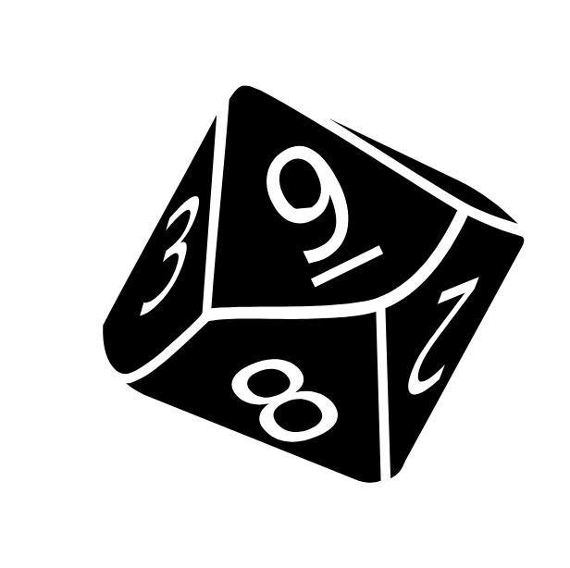
Activity 7 – approximating decimals (1)
Notes:
This is a developing number sense activity.
Number sense refers to a deep understanding of numbers, including their magnitude, relationships, and the effects of operations on them. It supports fluency and understanding, estimation, flexible thinking, and efficient problem-solving. Number sense activities 1–4 ‘activate’ prior number knowledge and support the learning of new content in the unit. Number sense activities 5–8 ‘loop’ back and provide opportunity for spaced practice with concepts and procedures covered in previous units.
Syllabus focus area:
Represent numbers A: Decimals and percentages
Approximating decimals
Explain that there are four 9-sided dice. When they are rolled they can be combined in different ways to make a number less than 10 with 3 decimal places. For example, if I roll a 2, 3, 5 and 7, I could choose to make 7.235, 3.257 or 5.327.
Students record this number and approximate the number to 2 decimal places. For example, 7.235 approximated to 2 decimal places is 7.24.
Small groups of students use four 9-sided dice to generate several decimals.
Ask students to order their approximated decimals in ascending order.
Regroup with students, discussing the following questions based on their answers on their individual whiteboards:
What happens to a decimal when there’s a 5 in the thousandths place and you approximate (round) it to 2 decimal places?
What was the largest approximated decimal you recorded?
What was the smallest approximated decimal you recorded?

Slide 53
Review of learning 8

Slide 54
True or false (4)
Luca and Mia were comparing decimals.
Luca said, “0.50 is smaller than 0.5 because it has an extra zero.”
Mia shook her head and said, “That can’t be right!”
Is Luca's statement true or false?
True | False
Notes:
The question on this slide connects to the content being explored in the developing number sense activity (Activity 8)
Syllabus focus area:
Represents numbers A: Decimals and percentages

Slide 55
Short response (29)
Give 3 examples of when you would measure volume in cubic metres.
Notes:
Short response questions provide brisk paced questions focussing on review of current and previous content to support spaced and interleaved practice.
Syllabus focus area:
Three-dimensional spatial structure A: Volume

Slide 56
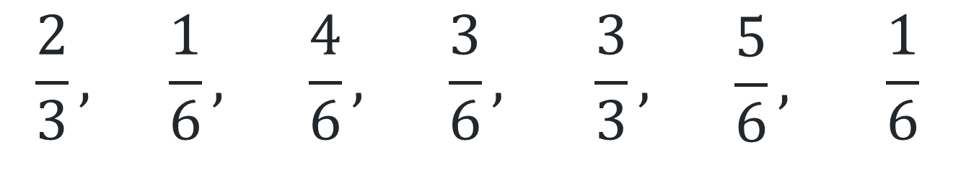
Short response (30)
Draw a number line 0-1.
Order the following fractions:
$$\frac{2}{3},$$ | $$\frac{1}{6},$$ | $$\frac{4}{6},$$ | $$\frac{3}{6},$$ | $$\frac{3}{3},$$ | $$\frac{5}{6},$$ | $$\frac{1}{6}$$
Notes:
Short response questions provide brisk paced questions focussing on review of current and previous content to support spaced and interleaved practice.
Syllabus focus area:
Representing quantity Fractions B

Slide 57
Short response (31)
Solve
9000 - 587
Notes:
Short response questions provide brisk paced questions focussing on review of current and previous content to support spaced and interleaved practice.
Syllabus focus area:
Additive relations A

Slide 58

Short response (32)
Look at these 2 shapes:
Shape A
Shape B
Which shape is the regular polygon? How do you know?
Notes:
Short response questions provide brisk paced questions focussing on review of current and previous content to support spaced and interleaved practice.
Syllabus focus area:
Two-dimensional spatial structure A: 2D Shapes

Slide 59
Activity 8 – approximating decimals (2)
Notes:
This is a developing number sense activity.
Number sense refers to a deep understanding of numbers, including their magnitude, relationships, and the effects of operations on them. It supports fluency and understanding, estimation, flexible thinking, and efficient problem-solving. Number sense activities 1–4 ‘activate’ prior number knowledge and support the learning of new content in the unit. Number sense activities 5–8 ‘loop’ back and provide opportunity for spaced practice with concepts and procedures covered in previous units.
Syllabus focus area:
Represent numbers A: Decimals and percentages
Approximating decimals
Explain that there are four 9-sided dice. When they are rolled, they can be combined in different ways to make a number less than 10 with 3 decimal places. For example, if I roll a 2, 3, 5 and 7, I could choose to make 7.235, 3.257 or 5.327.
Students record this number and approximate the number to 2 decimal places. For example, 7.235 approximated to 2 decimal places is 7.24.
Small groups of students use four 9-sided dice to generate several decimals.
Ask students to order their approximated decimals in descending order.
Regroup with students, discussing the following questions based on their answers on their individual whiteboards:
What happened to decimals when they were approximated and had 5 thousandths?
What was the largest approximated decimal you recorded?
What was the smallest approximated decimal you recorded?

Slide 60
Double Venn diagram
Object 1
Object 2
Features similar to both objects
Features of object 1
Features of object 2

Slide 61
Frayer
Definition
Facts/Characteristics
Word, term, concept
Examples
Non-examples

Slide 62
Spider map
Idea
Subject

Slide 63
Cline
Concept 1
Concept 2
Word
Word
Word
Word
Word
Word
Word
Word
Word
Word
Word

Slide 64

Compare and contrast
Notes:
Use the arrows to navigate between related activities.
Hyperlink each arrow to compare between related slides.

Slide 65
Multiple choice (1)
A
B
C
D
Notes:
This question connects to the content in the developing number sense activity (Activity 1)
This question can:
support spaced and interleaved practice
help identify and address common misconceptions
support active recall and immediate feedback
support whole class participation
identify areas requiring reteach
Teachers are encouraged to adapt and contextualise for their contexts.

Slide 66
Multiple choice (2)
A
B
C
D
Notes:
This question connects to the content in the developing number sense activity (Activity 1)
Syllabus focus area:
Multiplicative relations A
This question can:
support spaced and interleaved practice
help identify and address common misconceptions
support active recall and immediate feedback
support whole class participation
identify areas requiring reteach
Teachers are encouraged to adapt and contextualise for their contexts.

Slide 67
References
This presentation contains NSW Curriculum and syllabus content. The NSW Curriculum is developed by the NSW Education Standards Authority. This content is prepared by NESA for and on behalf of the Crown in the right of the State of New South Wales. The material is protected by Crown copyright.
Please refer to the NESA Copyright Disclaimer for more information https://educationstandards.nsw.edu.au/wps/portal/nesa/mini-footer/copyright.
NESA holds the only official and up-to-date versions of the NSW Curriculum and syllabus documents. Please visit the NSW Education Standards Authority (NESA) website https://educationstandards.nsw.edu.au/wps/portal/nesa/home and the NSW Curriculum website https://curriculum.nsw.edu.au.
Mathematics K–10 Syllabus © NSW Education Standards Authority (NESA) for and on behalf of the Crown in right of the State of New South Wales, 2022.
National Numeracy Learning Progression © Australian Curriculum, Assessment and Reporting Authority (ACARA) 2010 to present, unless otherwise indicated. This material was downloaded from the Australian Curriculum website (National Literacy Learning Progression) (accessed 8 April 2024 and was not modified.
Barton C (2019) Volume of a cuboid 1, Maths Venns Website, accessed 8 April 2024.
Finkel D (2019) Fill the Stairs, Math for Love website, accessed 8 April 2024.
NESA (NSW Education Standards Authority) (2024) ‘Teaching advice for Three-dimensional spatial structure A’, Stage 3, NESA website, accessed 30 May 2024.
State of New South Wales (Department of Education) (2023) ‘Factors fun’, Mathematics K–6 resources, NSW Department of Education website, accessed 3 April 2024.

Slide 68
References
This presentation contains NSW Curriculum and syllabus content. The NSW Curriculum is developed by the NSW Education Standards Authority. This content is prepared by NESA for and on behalf of the Crown in the right of the State of New South Wales. The material is protected by Crown copyright.
Please refer to the NESA Copyright Disclaimer for more information https://educationstandards.nsw.edu.au/wps/portal/nesa/mini-footer/copyright.
NESA holds the only official and up-to-date versions of the NSW Curriculum and syllabus documents. Please visit the NSW Education Standards Authority (NESA) website https://educationstandards.nsw.edu.au/wps/portal/nesa/home and the NSW Curriculum website https://curriculum.nsw.edu.au.
Sullivan P (2018) Challenging Mathematical Tasks, Oxford University Press Australia and New Zealand.
University of Cambridge (n.d.a) Area and Perimeter, NRICH website, accessed 4 April 2024.
——(n.d.b) Factor-multiple Chains, NRICH website, accessed 4 April 2024.
——(n.d.c) Rod Area, NRICH website, accessed 4 April 2024.
——(n.d.d) Route Product, NRICH website, accessed 4 April 2024.

Slide 69
Copyright
© State of New South Wales (Department of Education), 2025
The copyright material published in this resource is subject to the Copyright Act 1968 (Cth) and is owned by the NSW Department of Education or, where indicated, by a party other than the NSW Department of Education (third-party material).
Copyright material available in this resource and owned by the NSW Department of Education is licensed under a Creative Commons Attribution 4.0 International (CC BY 4.0) license.
This license allows you to share and adapt the material for any purpose, even commercially.
Attribution should be given to © State of New South Wales (Department of Education), 2025.
Material in this resource not available under a Creative Commons license:
the NSW Department of Education logo, other logos and trademark-protected material
Material owned by a third party that has been reproduced with permission. You will need to obtain permission from the third party to reuse its material.
Links to third-party material and websites
Please note that the provided (reading/viewing material/list/links/texts) are a suggestion only and implies no endorsement, by the New South Wales Department of Education, of any author, publisher, or book title. School principals and teachers are best placed to assess the suitability of resources that would complement the curriculum and reflect the needs and interests of their students.
If you use the links provided in this document to access a third party’s website, you acknowledge that the terms of use, including licence terms set out on the third-party’s website apply to the use which may be made of the materials on that third-party website or where permitted by the Copyright Act 1968 (Cth). The department accepts no responsibility for content on third-party websites.

