Slide 1
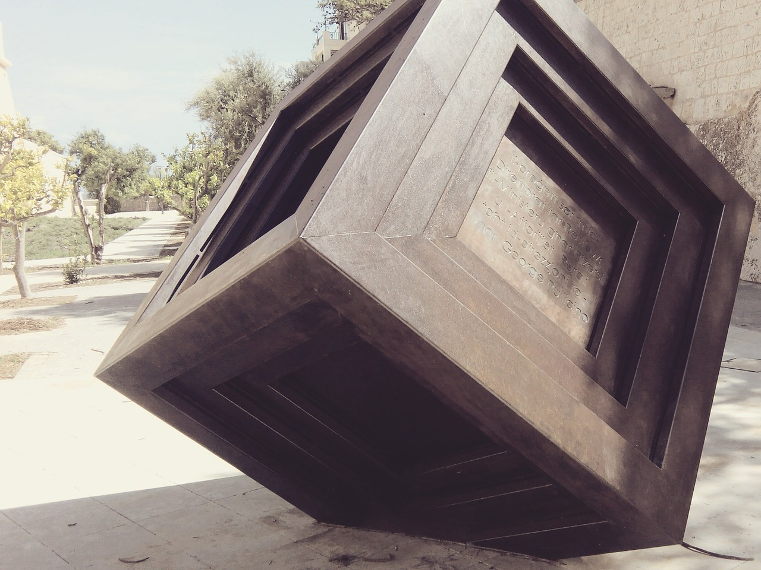
QubesOS
Jan GOETTE
Waseda NSL english seminar Nov. 13, 2018

Slide 2
QubesOS Overview
Security-focused desktop operating system
  Let's consider a desktop system's attack surface!
Compartmentalization through hypervirtualization
  Isolates devices and their drivers
  Isolates applications by domain

Slide 3
QubesOS History
Project started in 2010 by Joanna Rutkowska and Rafal Wojtczuk, two experts in x86 hypervisor security
Lead by Invisible Things Lab from Warsaw, Poland
Initial release in 2012
QubesOS 4.0 released March 2018

Slide 4
QubesOS concepts
Domain | Isolated user data container for information of the same security level. → work, personal, mail, vault, browsing, ...
Template | Base system image domains are booting into. Generally you have several templates. → fedora28, debian9, whonix, windows7, ...
AppVM | Virtual machine running with domain's data on Template image. Modifications on base system will be lost after reboot, but user data is persisted.

Slide 5
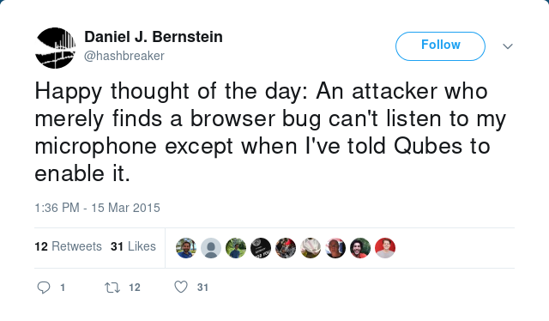
Testimonials

Slide 6
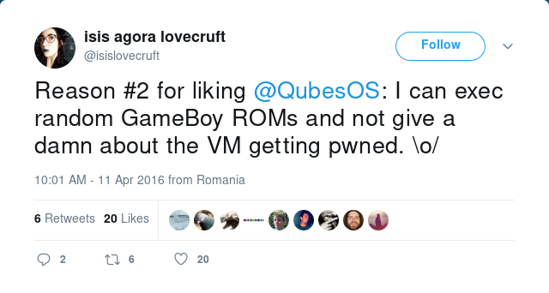
Testimonials

Slide 7
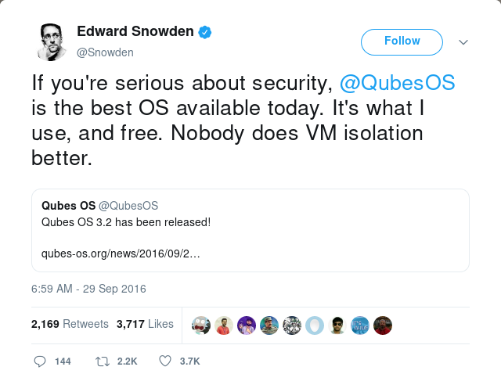
Testimonials

Slide 8
Behind the scenes: QubesRPC
Inter-VM communication must be limited to reduce attack surface
  Source and target must be controlled
  Protocols must be kept as simple as possible
QubesRPC is similar to named UNIX pipes
  Each VM exports RPC services
  RPC services invoke handlers that get I/O per pipe
  dom0 applies RPC policy rules to channel requests

Slide 9
Compartmentalization techniques
PCIe | Traditional IOMMU-based passthrough
USB | USB-over-IP over QubesRPC
Network | Xen built-in networking
GUI | Framebuffer over QubesRPC
Block devices | Xen built-in block device emulation
Speaker | PulseAudio buffers over QubesRPC
Microphone | PulseAudio buffers over QubesRPC

Slide 10
GUI isolation
dom0 drives monitor output, AppVM runs stub X server
Window manager in dom0 sees “ghosts” of AppVM windows, framebuffers mapped through QubesRPC
dom0 stub window captures input events, passed through into AppVM
Copy/Paste with separate Qubes clipboard and shortcuts

Slide 11
Application startup
What happens when the user clicks an entry in the application menu
Template image and domain data snapshots are created
Xen VM is created and booted
Mount template → / AppVM → /rw
QubesRPC server is launched via systemd
dom0 launches application via QubesRPC

Slide 12
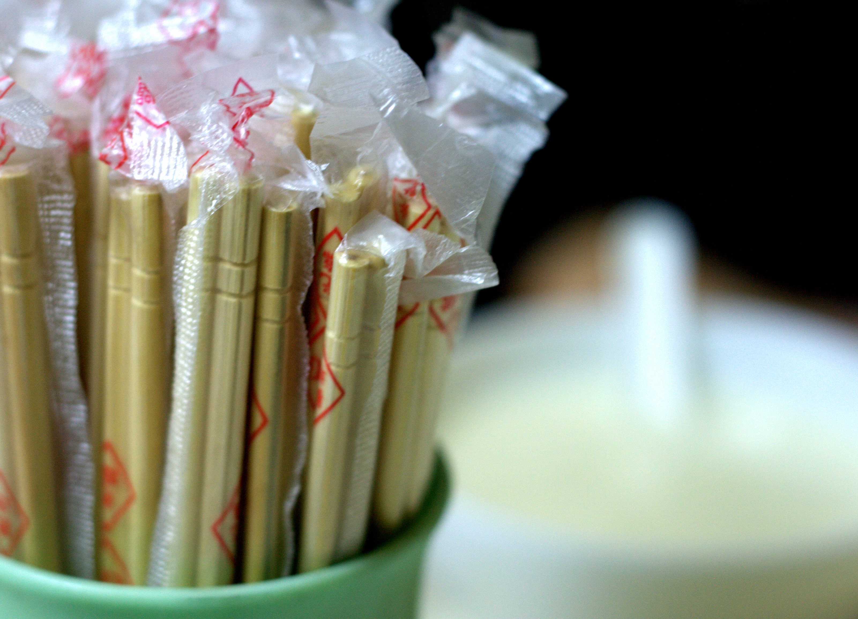
Disposable VMs
”This never happened.”
Special VM on template that is launched to run a single application, then exit
  e.g. Firefox, terminal, PDF viewer
Files can be edited inside sub-dispVM with changes copied back on exit
Picture: Vincent Huang on Wikimedia Commons

Slide 13
Demo Time!

Slide 14
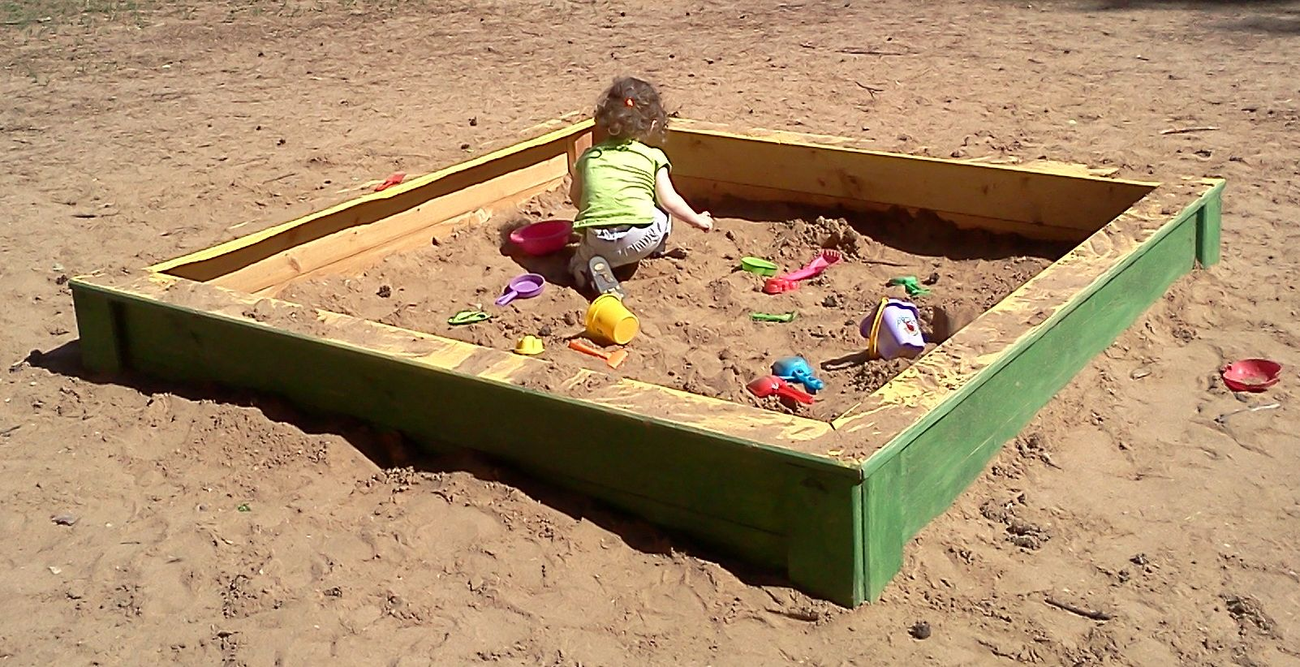
Recap: Use cases
Separating work and private life
Isolating cryptographic keys
Limiting damage during software development
Not getting owned running untrusted code, opening untrusted files
Picture: Al Silonov on Wikimedia Commons

Slide 15
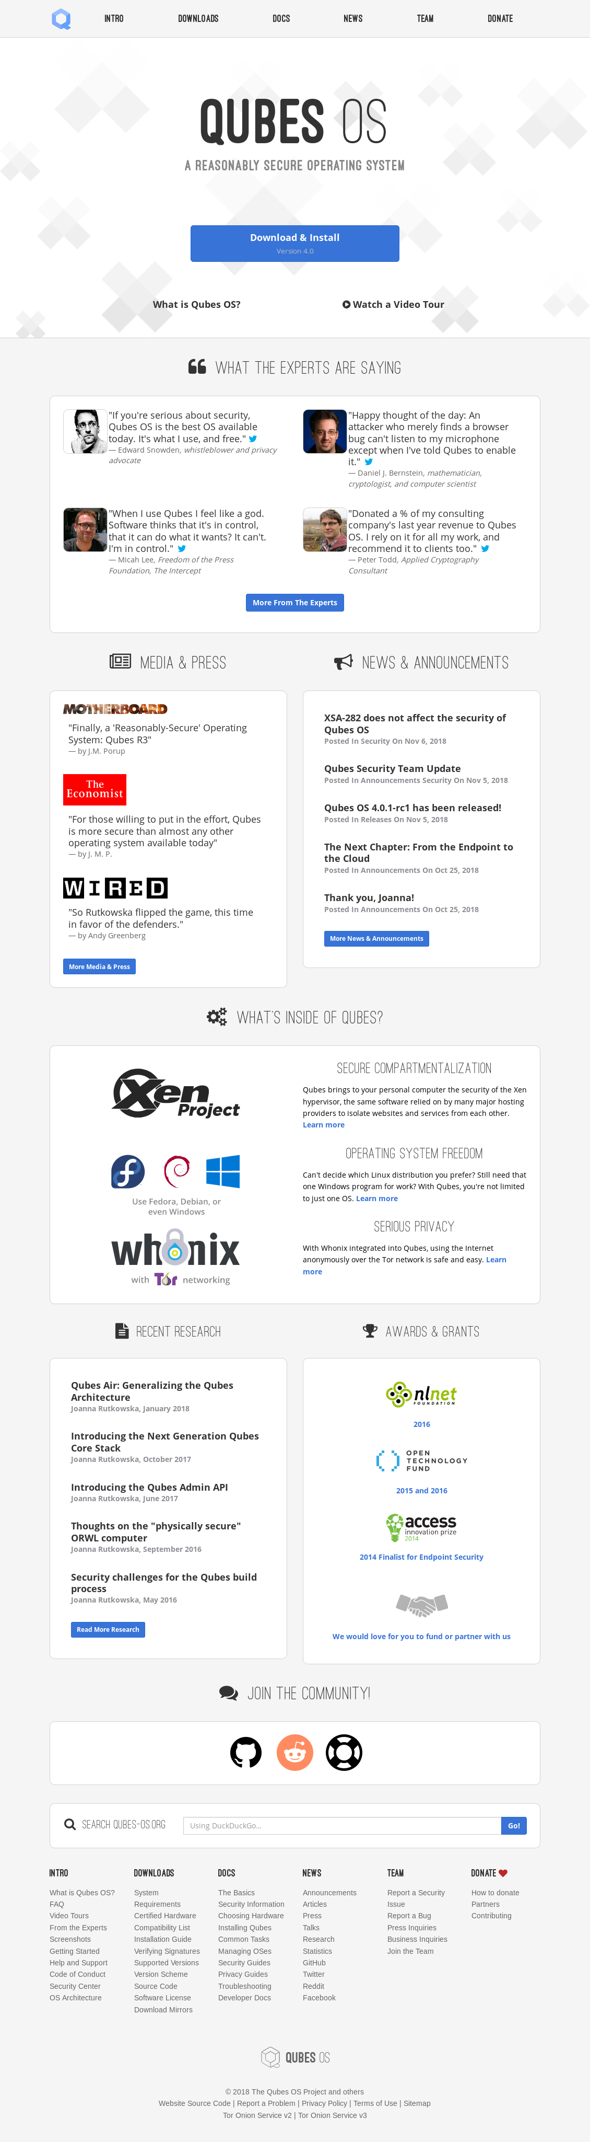
Further reading
https://qubes-os.org
Questions? qubes@jaseg.net

Slide 16
Questions?

