Slide 1


High Fidelity Security Mesh Monitoring using
Low-Cost, Embedded
Time Domain
Reflectometry
CHES 2026, Antalya • 2026-10-14 • Jan Sebastian Götte, Björn Scheuermann • research@jaseg.de

Slide 2

Introduction
CHES 2026, Antalya • 2026-10-14 • Jan Sebastian Götte, Björn Scheuermann • research@jaseg.de

Slide 3
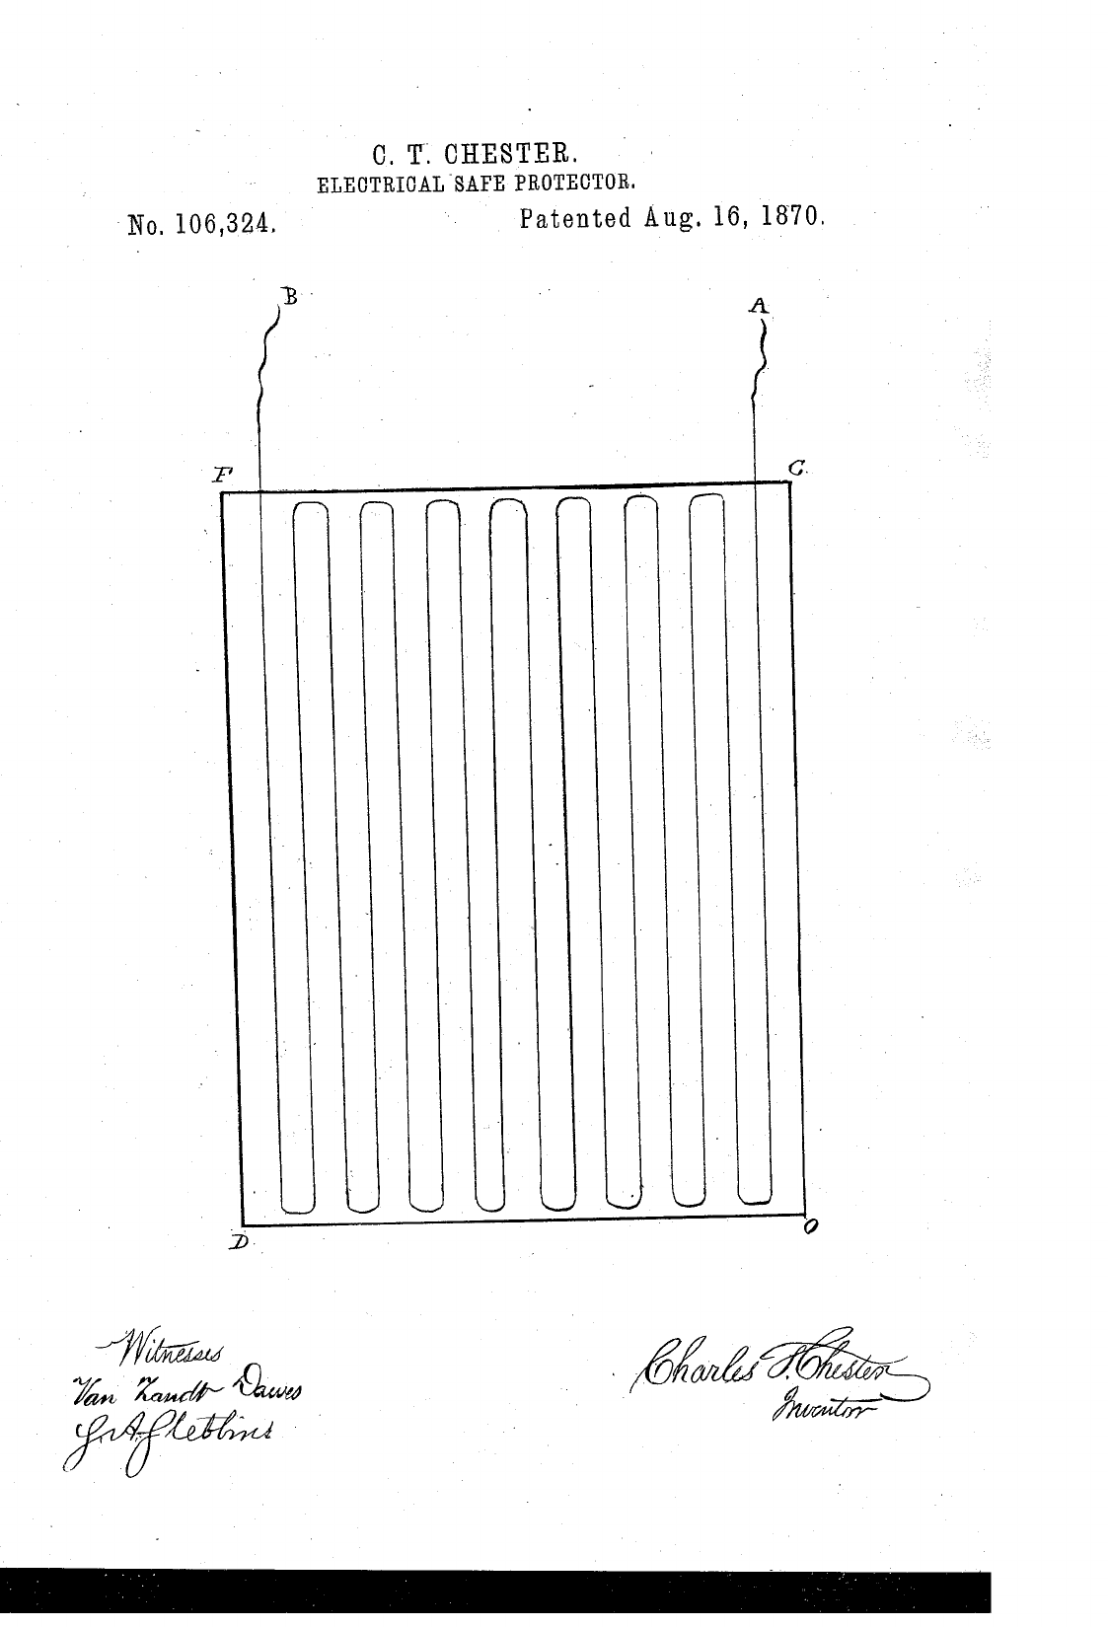

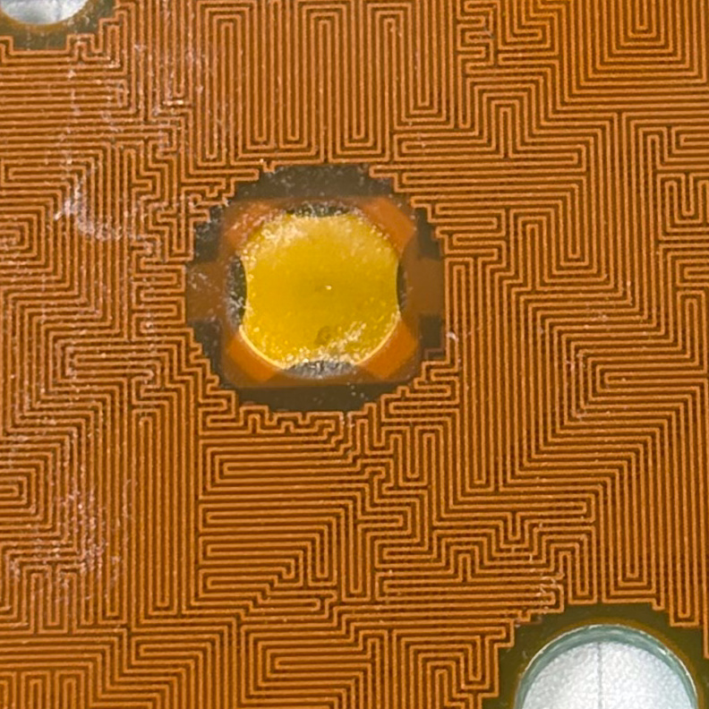
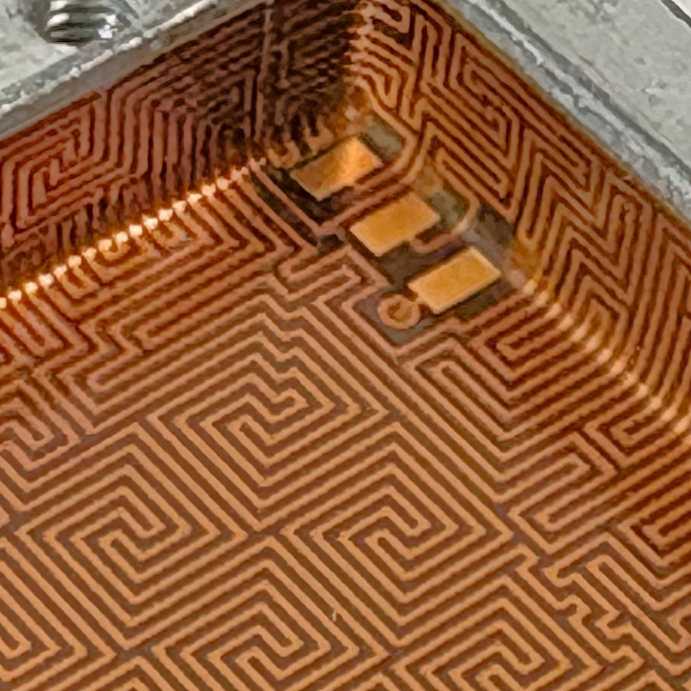
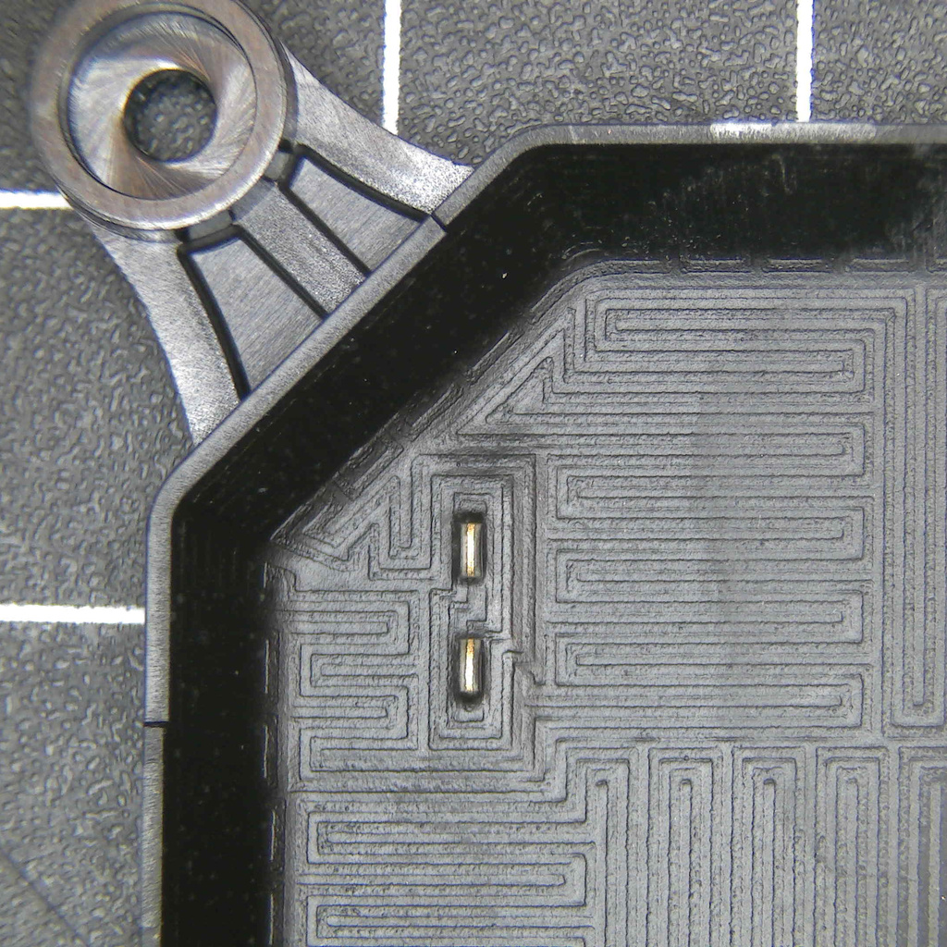
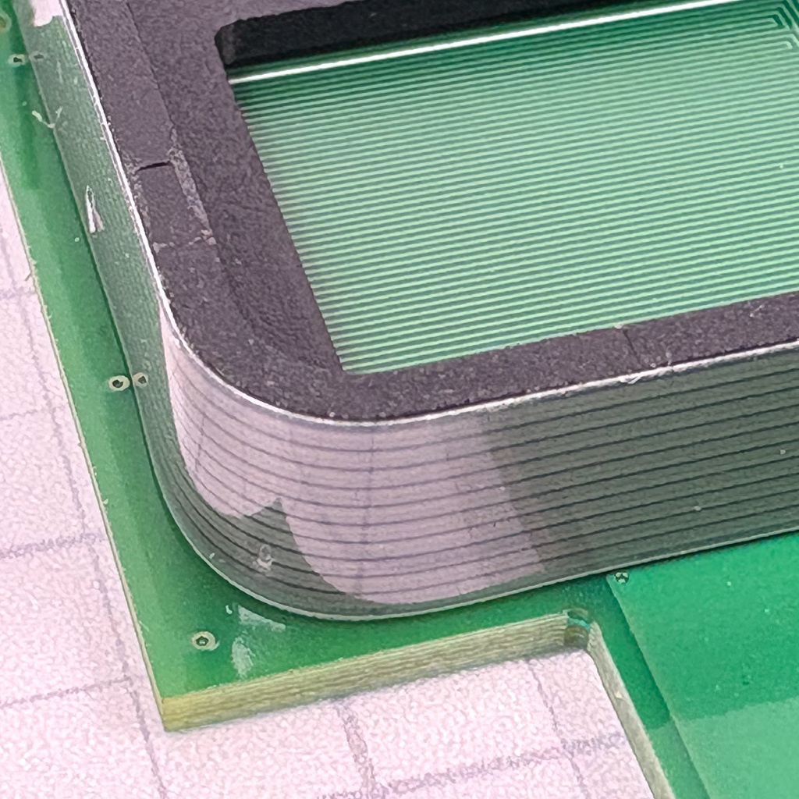
[1]
Security Meshes
a.k.a. Tamper Sensing Mesh (TSM)
Use traces to detect cuts through a surface
Basic approach dates back to the 1800s
Modern meshes usually constructed as printed circuits
Severe security / cost tradeoff

Slide 4
Security Mesh Sensing Approaches
Widespread approach: basic binary continuity sensing detects breaks → 1 bit of entropy integrity measurement
Sometimes augmented with pulsing patterns to detect short circuits
One commercial implementation measures voltage deviations using a bridge circuit → Maybe 16 bit of entropy integrity measurement
Academic approaches use capacitive sensing and frequency response among others [2, 3]
To our knowledge, no commercial approach exceeds ~16 bit of entropy total, and no academic approach has found industry adoption

Slide 5
Better Sensing With Time Domain Reflectometry (TDR)
TDR measures reflections of a fast electrical impulse traversing a conductor at speed of light
TDR on a Mesh provides a fingerprint with multiple kilobits of entropy
Sensing of reflections at any impedance discontinuity, not just breaks or short circuits
Faults locatable in space by calculating distance from speed of light
Critical challenge: Rise time determines spatial resolution

Slide 6
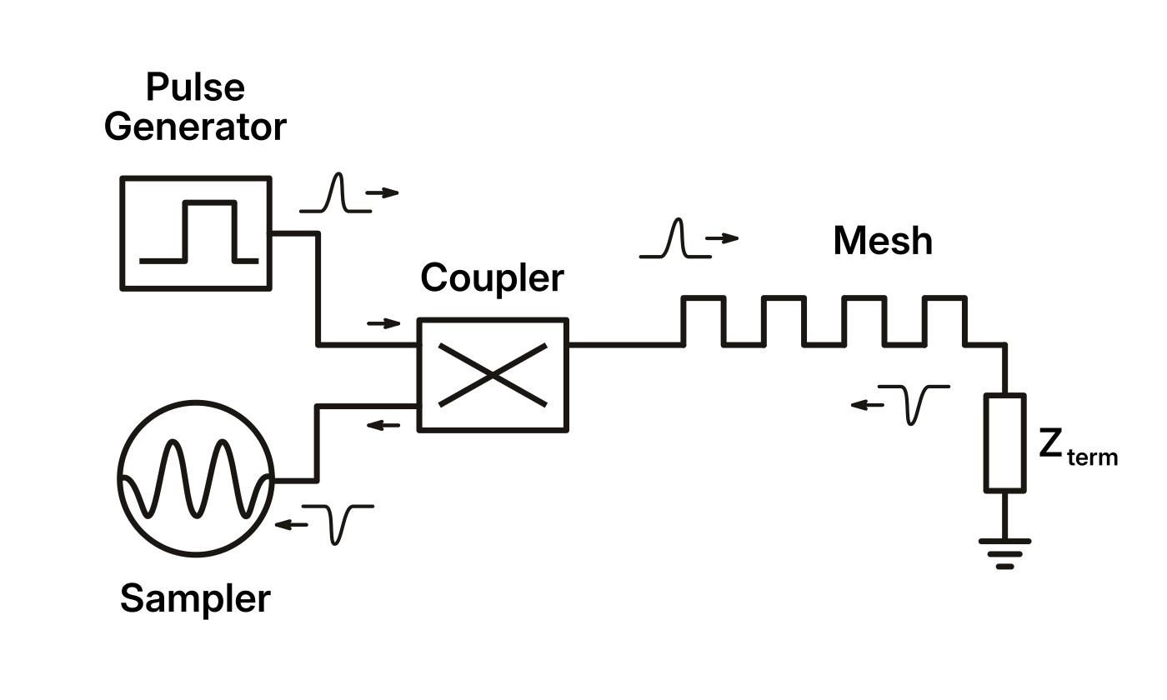
TDR Principle
Send a fast pulse through a coupler into the channel
Wait for the pulse to be reflected at a discontinuity in the channel
Couple the reflection into a sampler
Sample the reflection at a precise point in time
Usually done sampling because the pulse generator is already halfway to a sampling gate

Slide 7

Circuit Walktrough
Darmstadt • 2026-06-16 • Jan Sebastian Götte • research@jaseg.de
Darmstadt • 2026-06-16 • Jan Sebastian Götte • research@jaseg.de

Slide 8
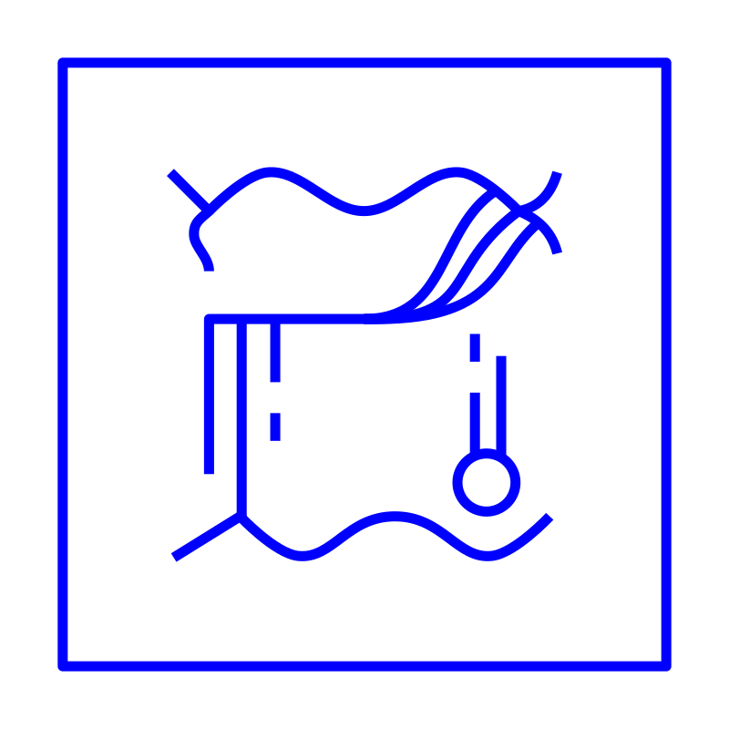
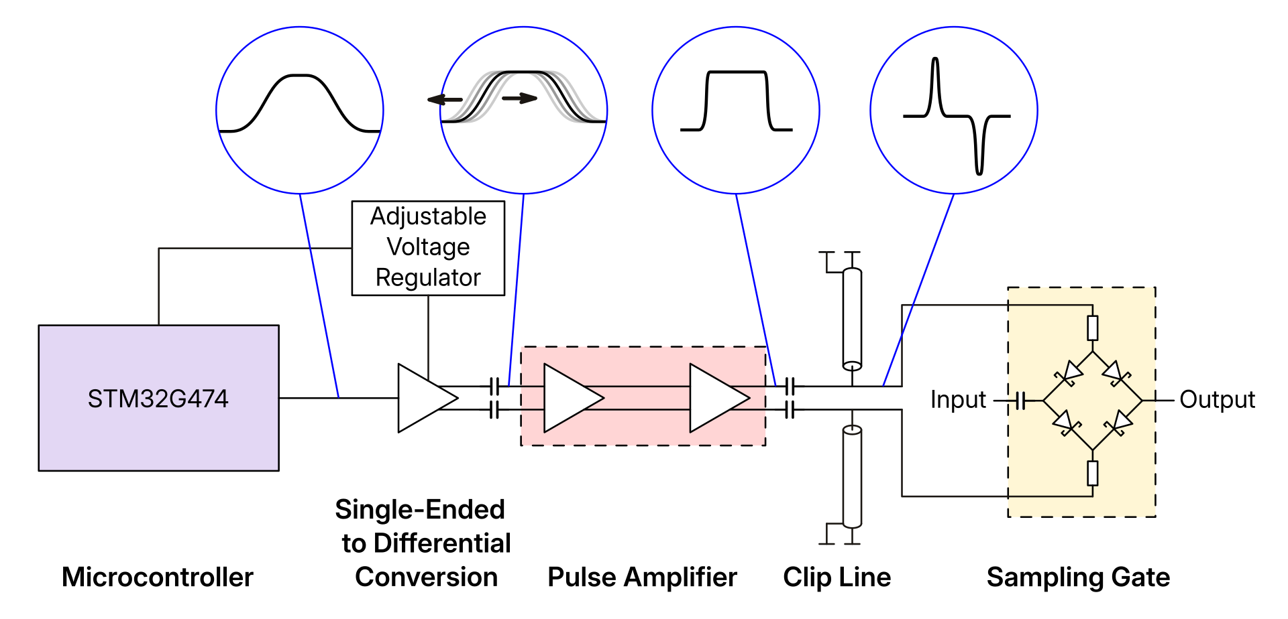
Generating Picosecond Edges

Slide 9
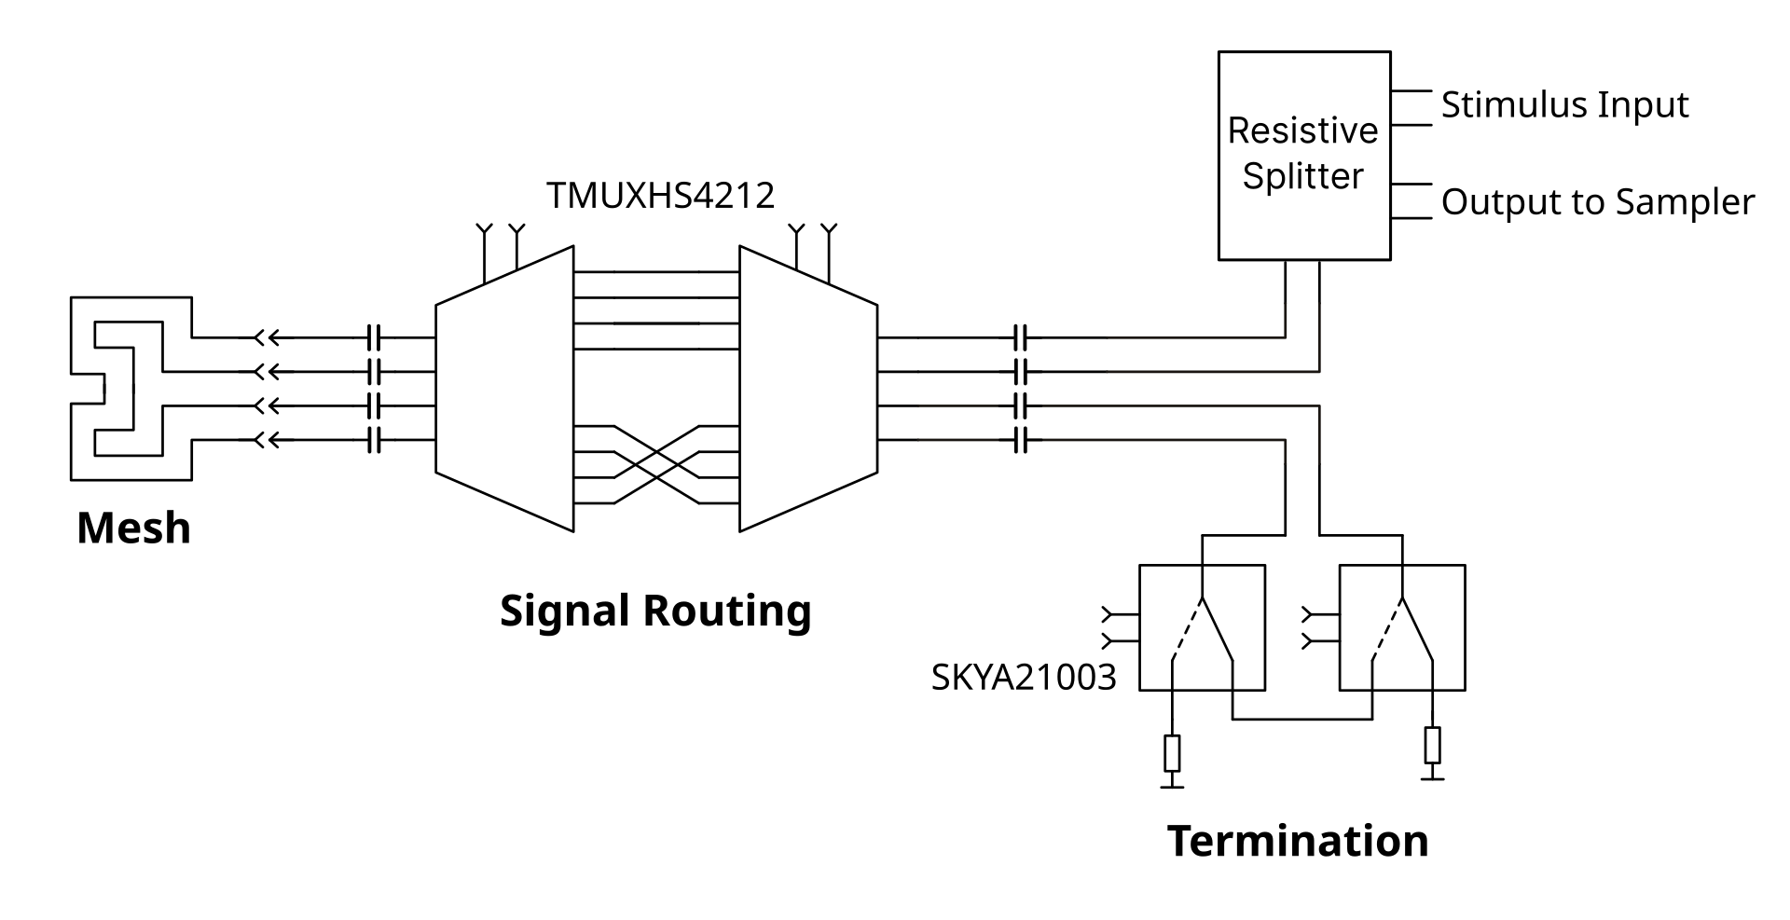
Signal Routing and Modes of Sensing
12 total sensing channels: 3 far-end termination types (matched, open, short) ⨯ 2 Polarities (positive / inverted) ⨯ 2 traversal directions (forward backwards)
Signals can be routed and
terminatedusing inexpensive
high-speed protocol
switches (DP, HDMI,
USB 3 etc.)

Slide 10

Circuit Performance
Darmstadt • 2026-06-16 • Jan Sebastian Götte • research@jaseg.de
Darmstadt • 2026-06-16 • Jan Sebastian Götte • research@jaseg.de

Slide 11

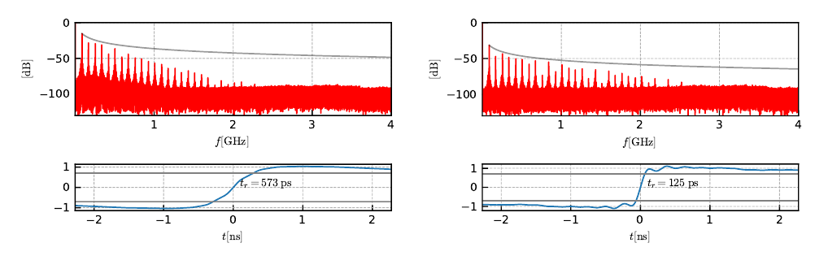
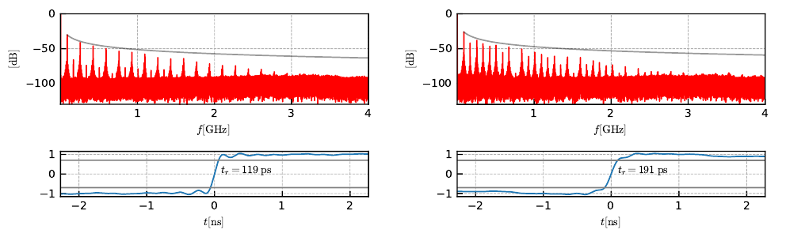
TDR Rise Time Results

Slide 12
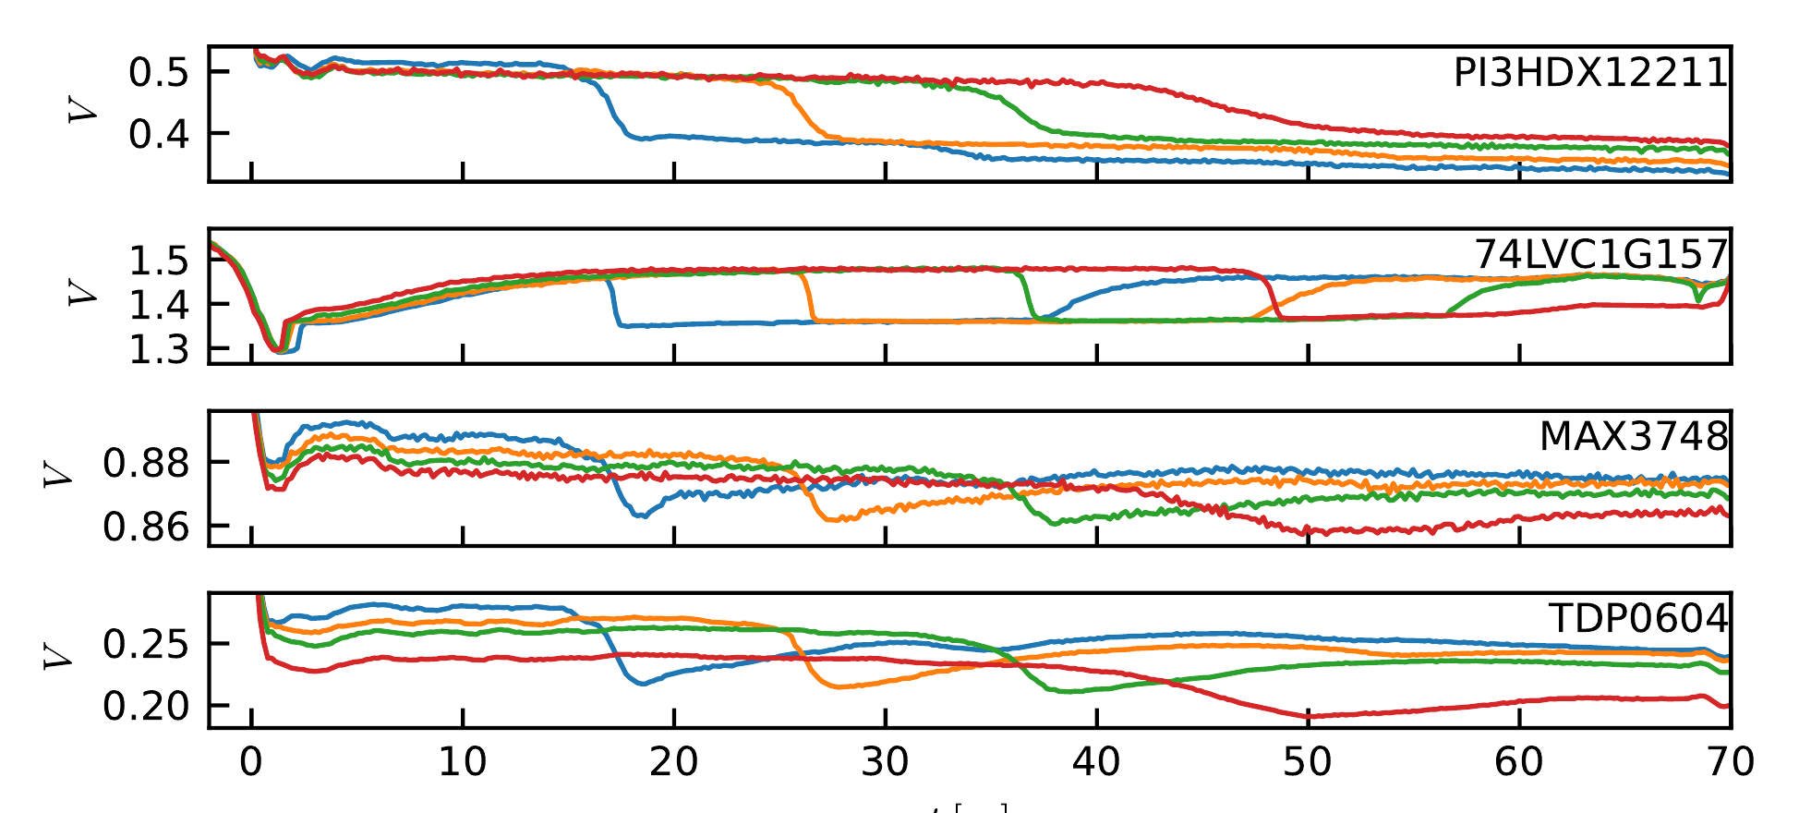
Speed of Light in a Typical TDR Response

Slide 13
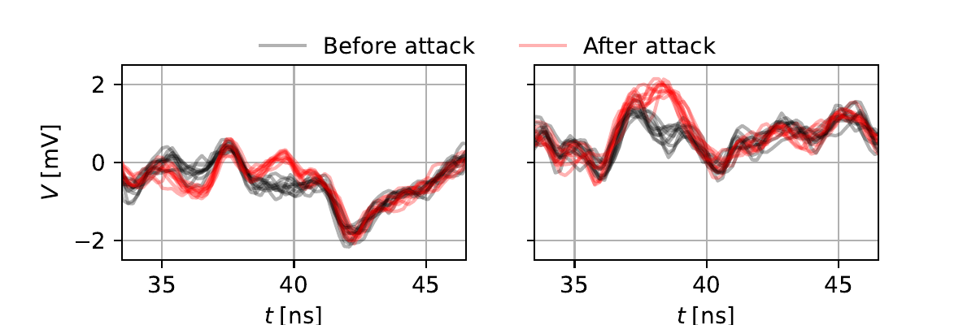
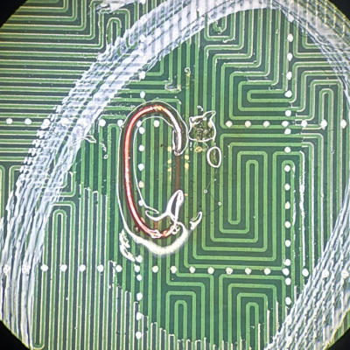
TDR Trace of a Mesh
The pictured attack causes a difference at a specific point in time along the TDR trace

Slide 14
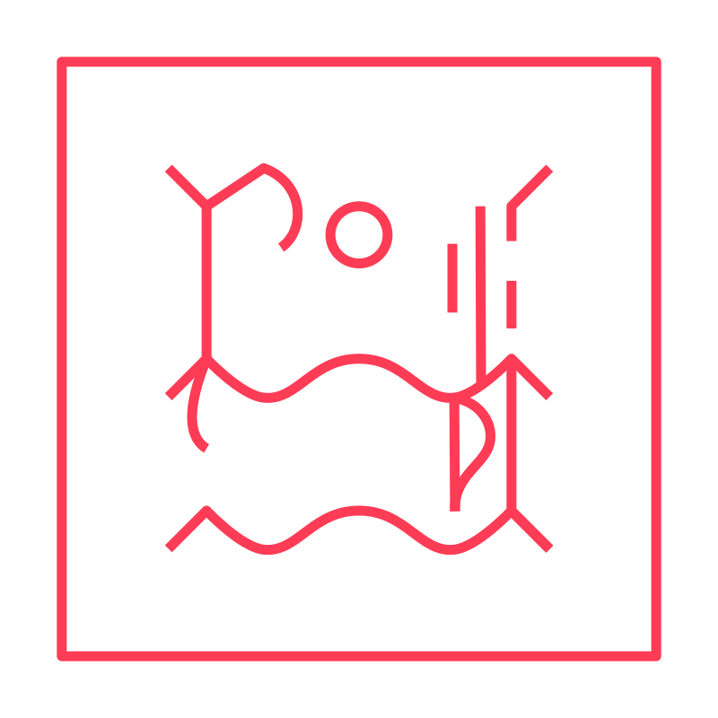
Experimental Results
Darmstadt • 2026-06-16 • Jan Sebastian Götte • research@jaseg.de
Darmstadt • 2026-06-16 • Jan Sebastian Götte • research@jaseg.de

Slide 15
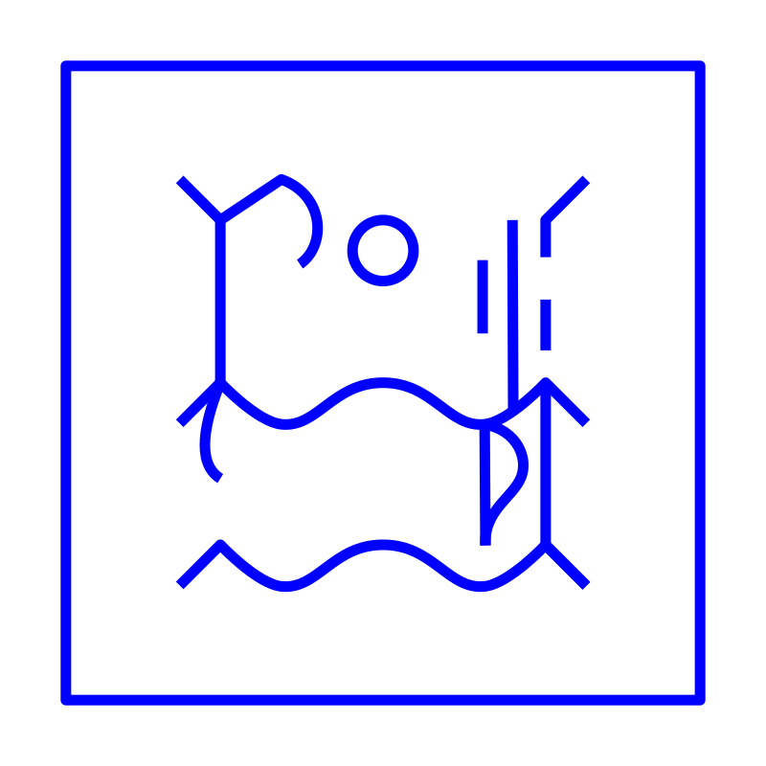
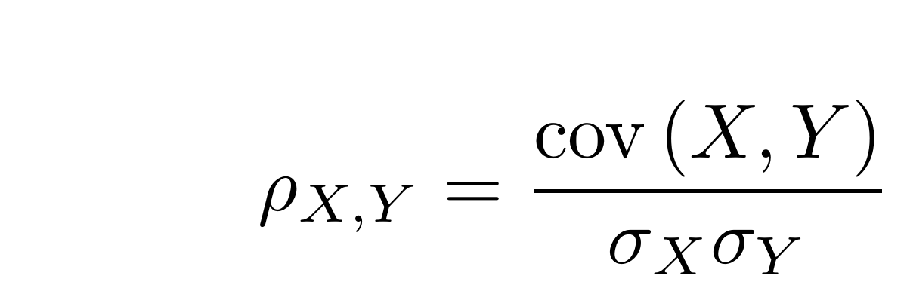
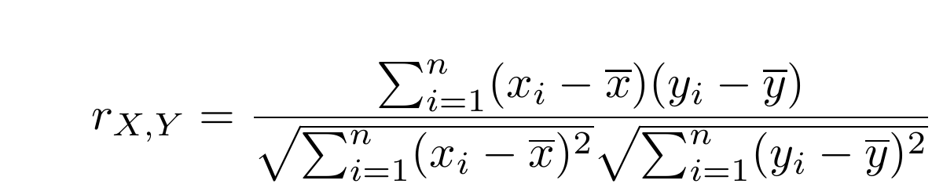
Automated Analysis Using Pearson Correlation
Pearson Correlation can be used as a simple similarity measure for TDR time vectors

Slide 16
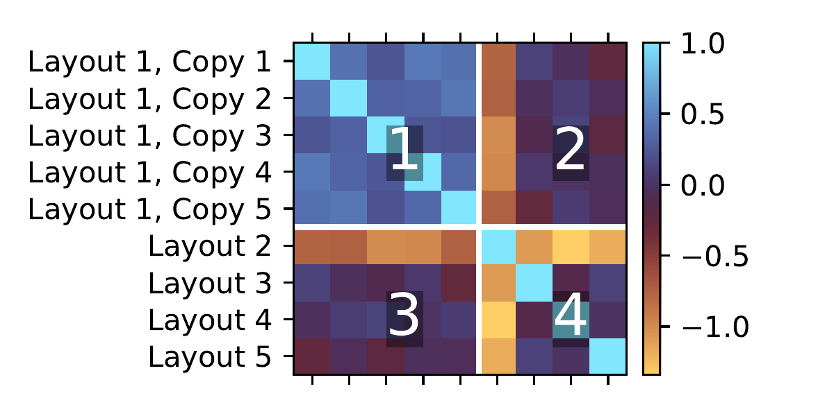
Can TDR Distinguish Mesh Patterns?
Correlation plot shows four zones
Control experiments on (1)
Experiment group on (4)
(2) and (3) show error probability
FNR 18% @ 0.1% FPR → Yes!

Slide 17
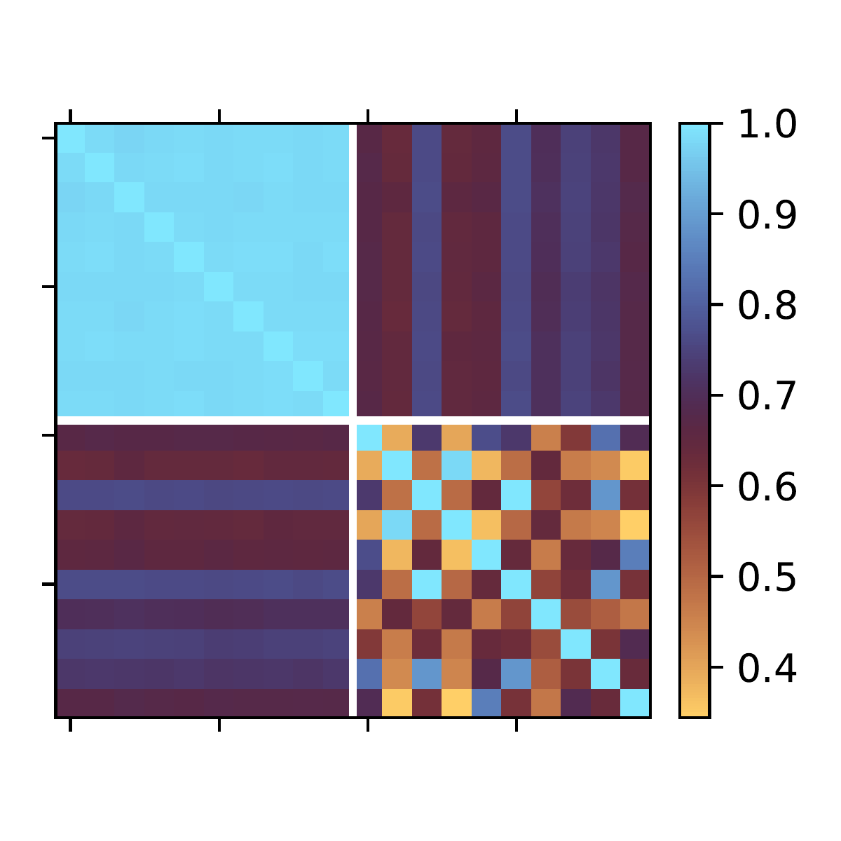
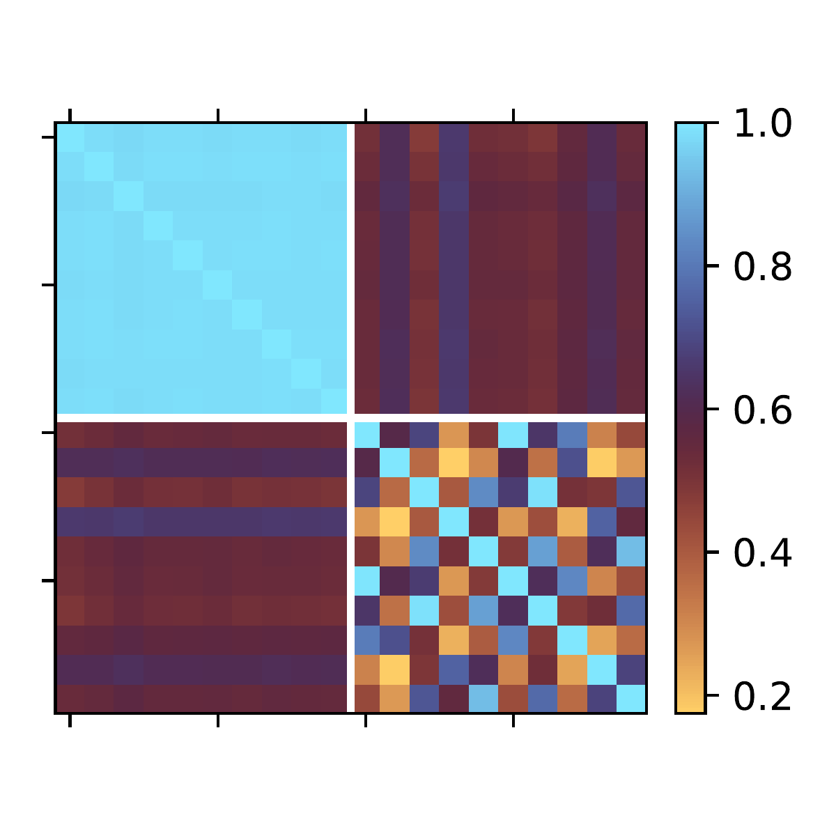
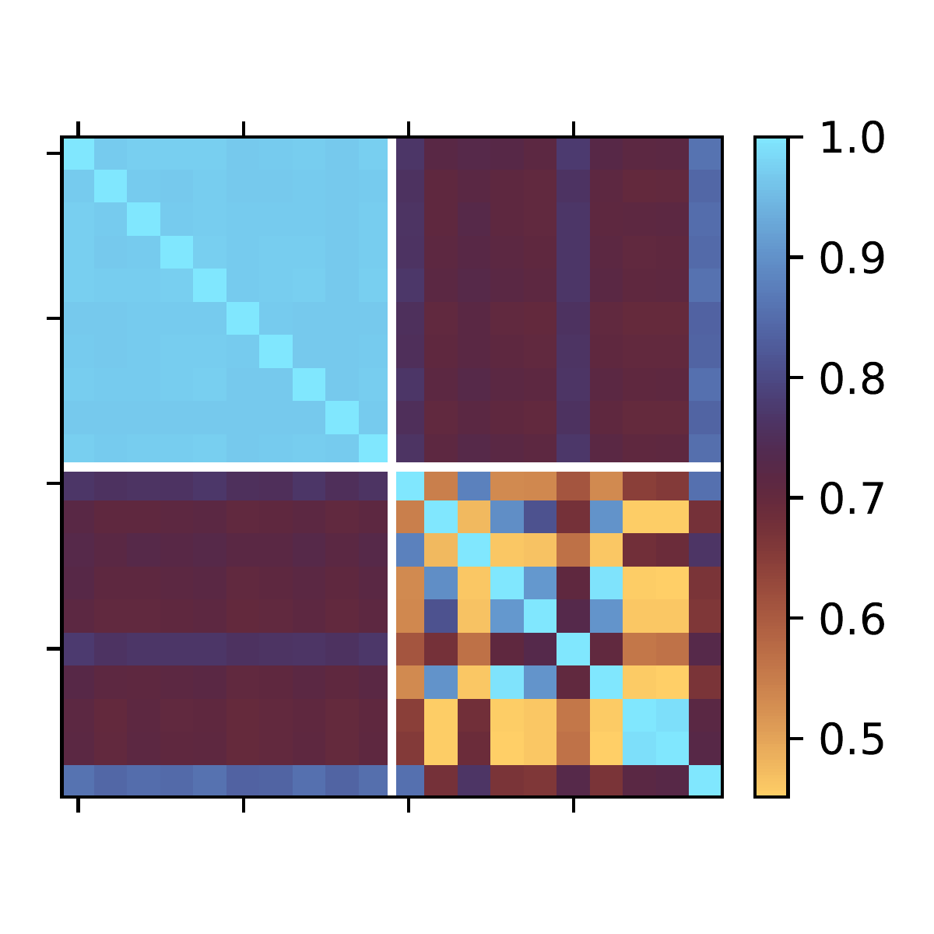
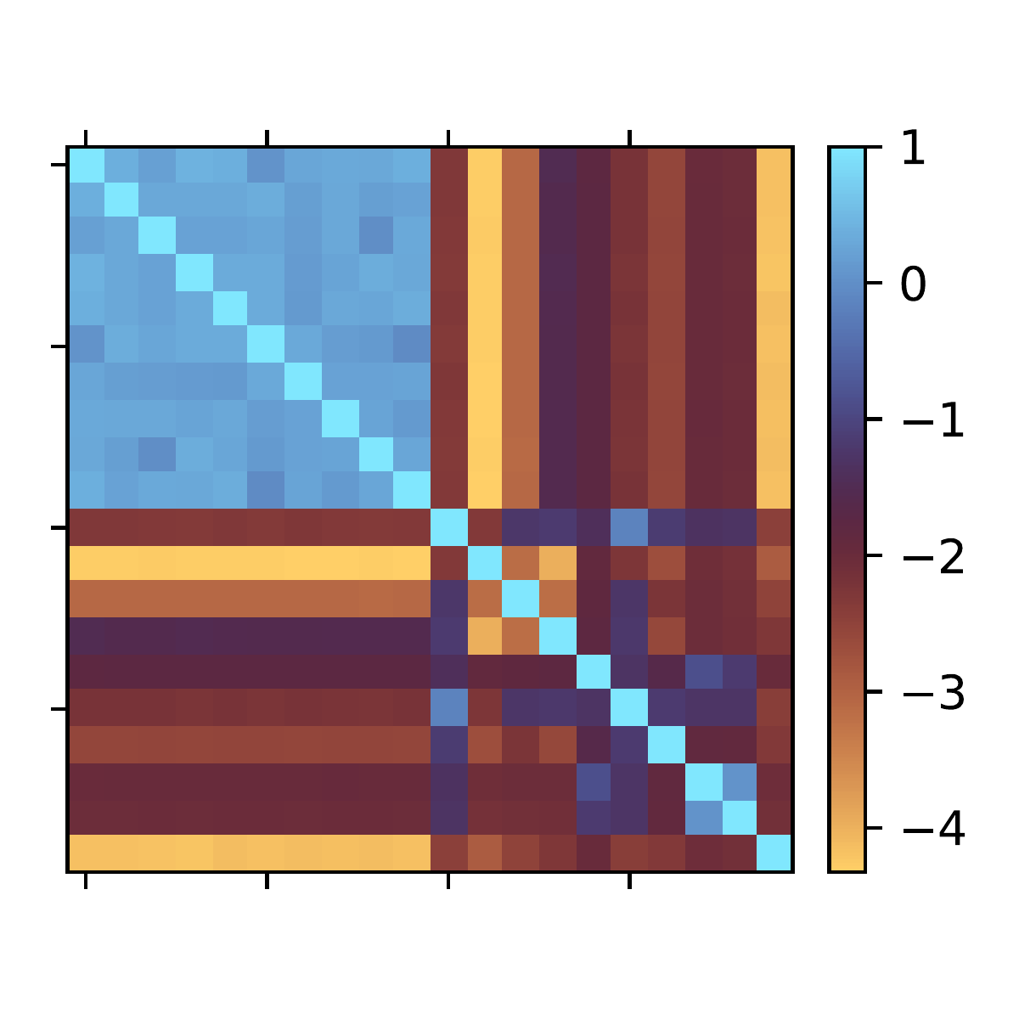
Analysis Results for Simple Attacks
No false negatives in all cases!
One Trace Interrupted
Traces Shorted
One Trace Interrupted
Traces Shorted
0.3mm pitch mesh
0.3mm pitch mesh
0.4mm pitch mesh
0.4mm pitch mesh

Slide 18
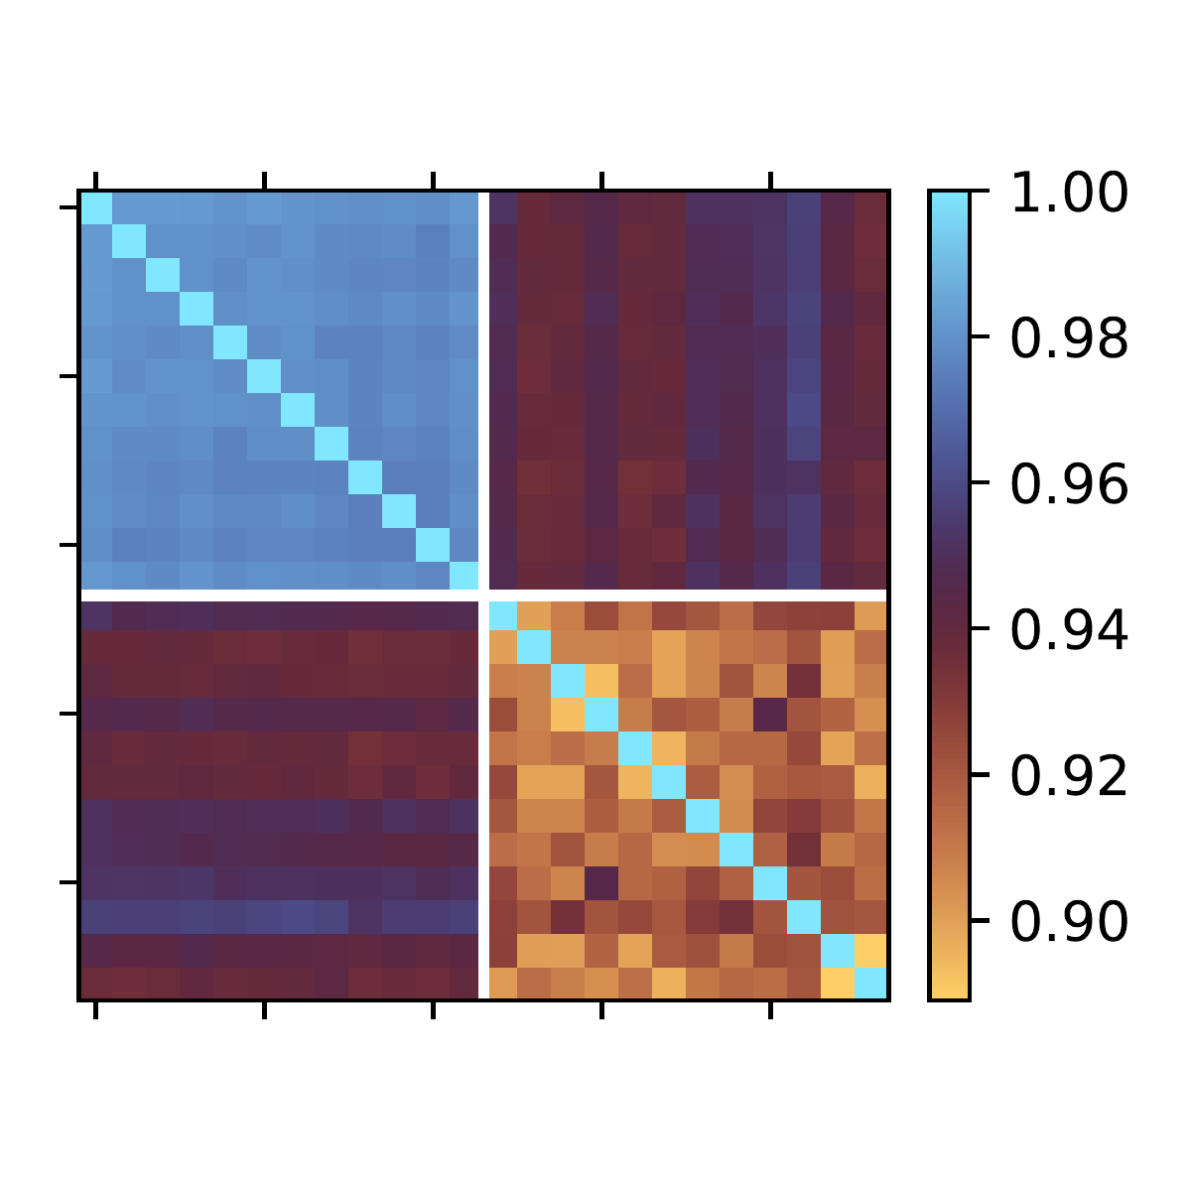
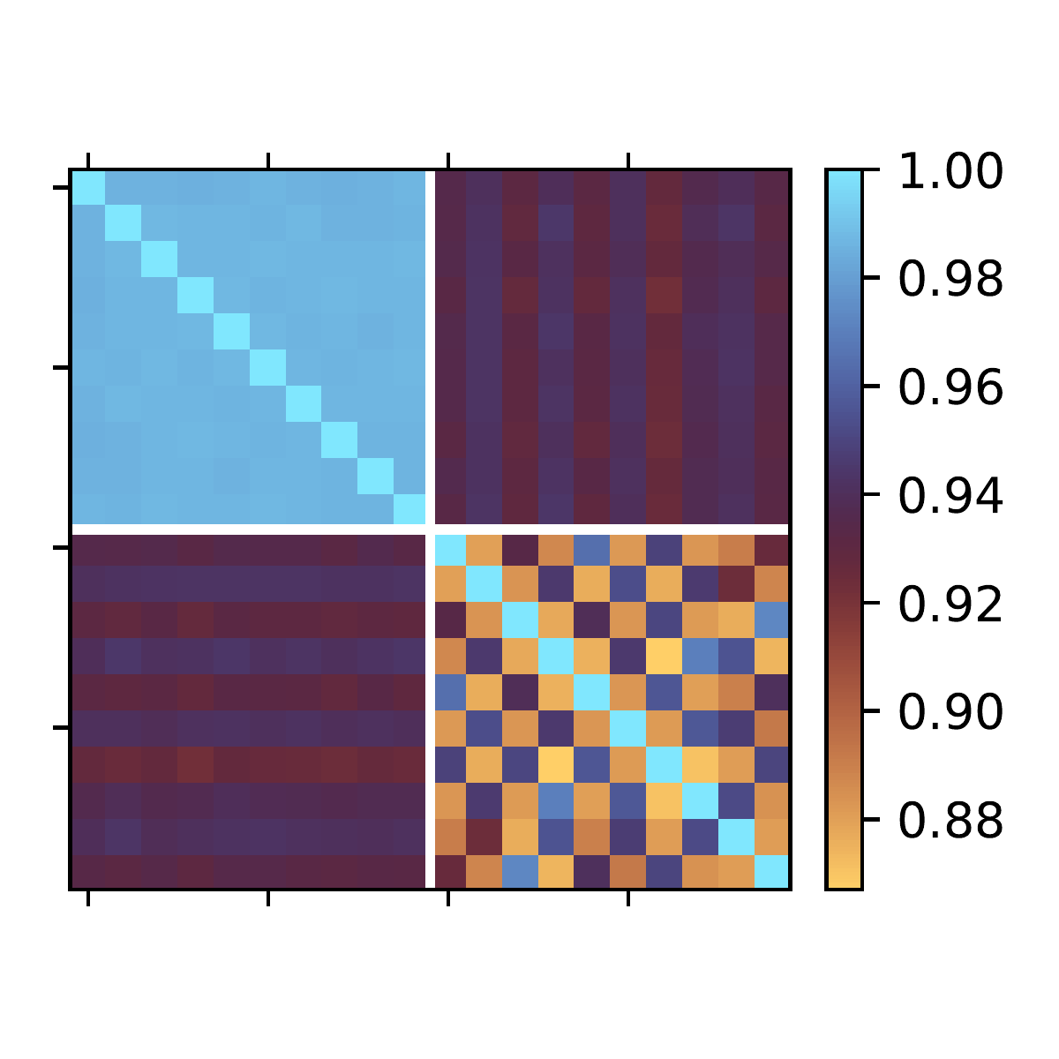
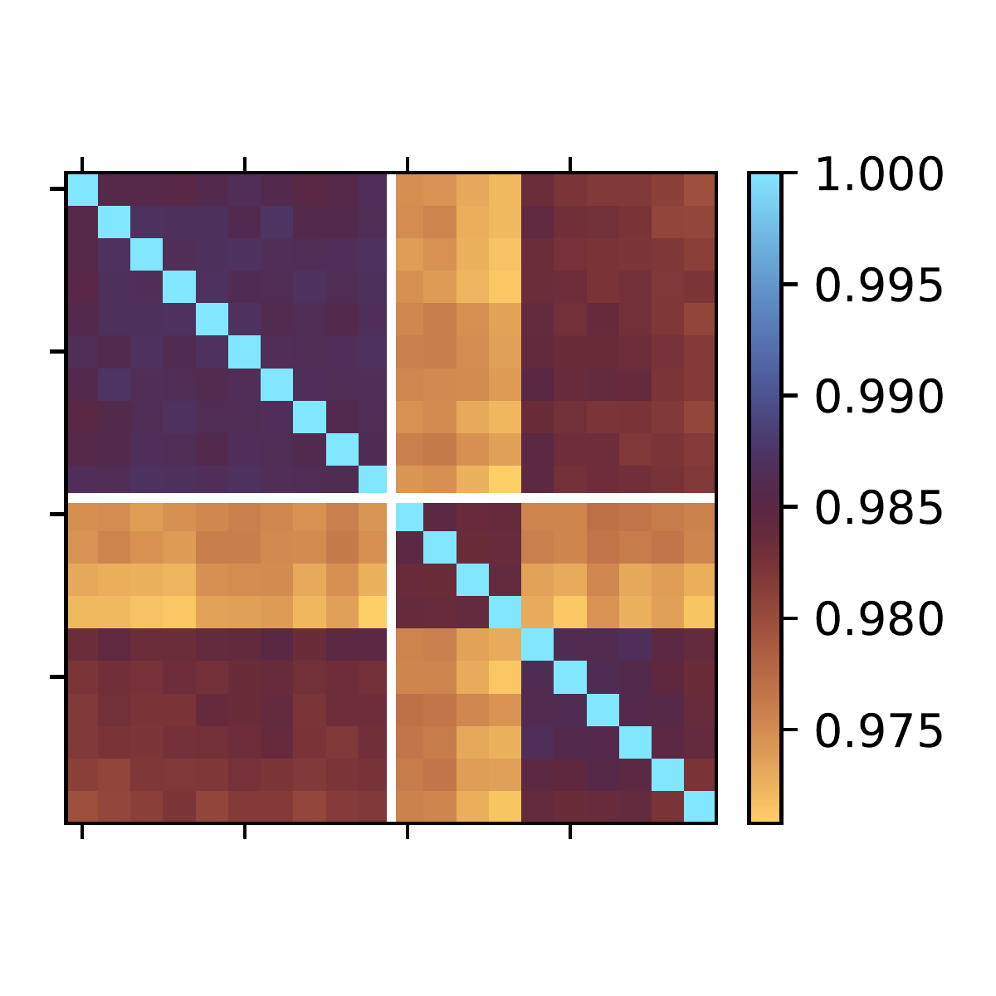
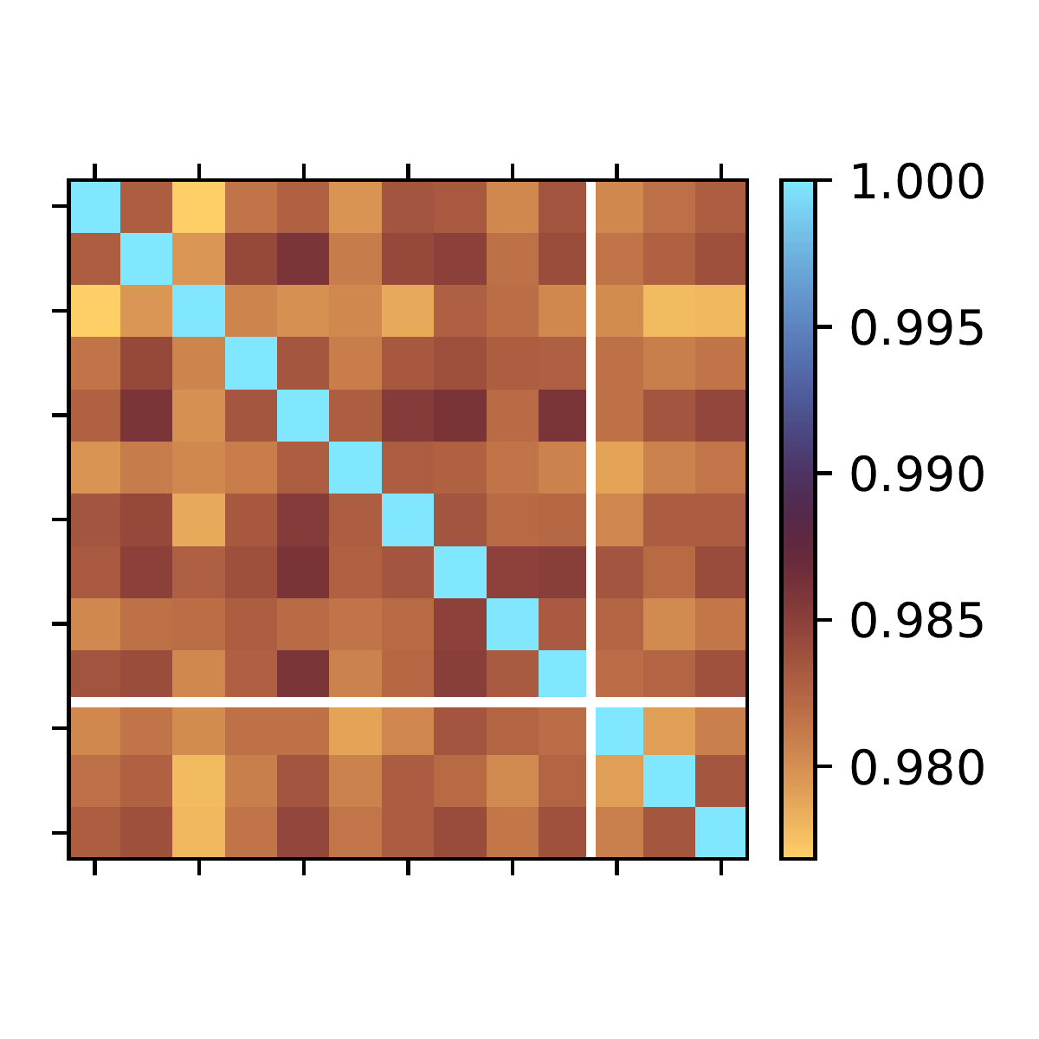
Analysis Results for Advanced Attacks
Oscilloscope Probe
Soldering Iron
30mm wire
(baseline)
FNR 0.0%
FNR 0.0%
FNR 9.6%

Slide 19
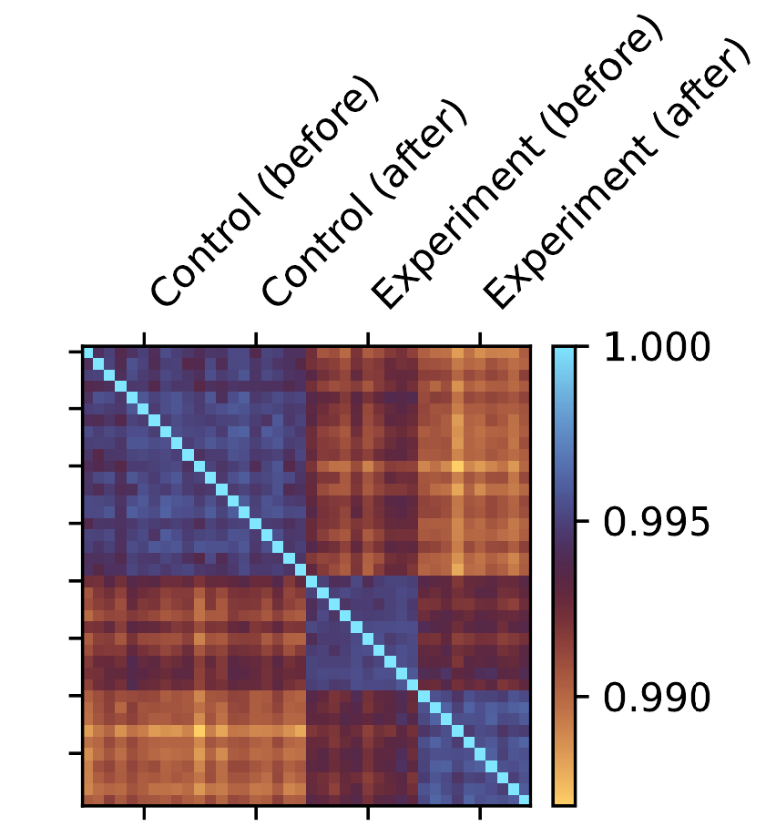
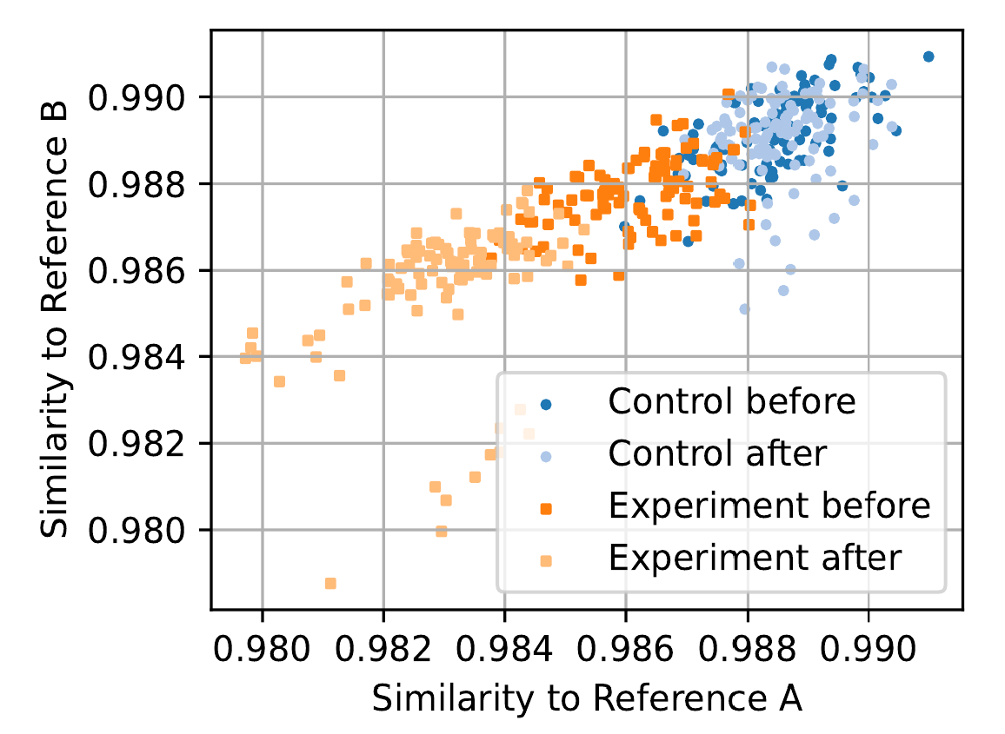
Results for a Minimal Patch Attack

Slide 20
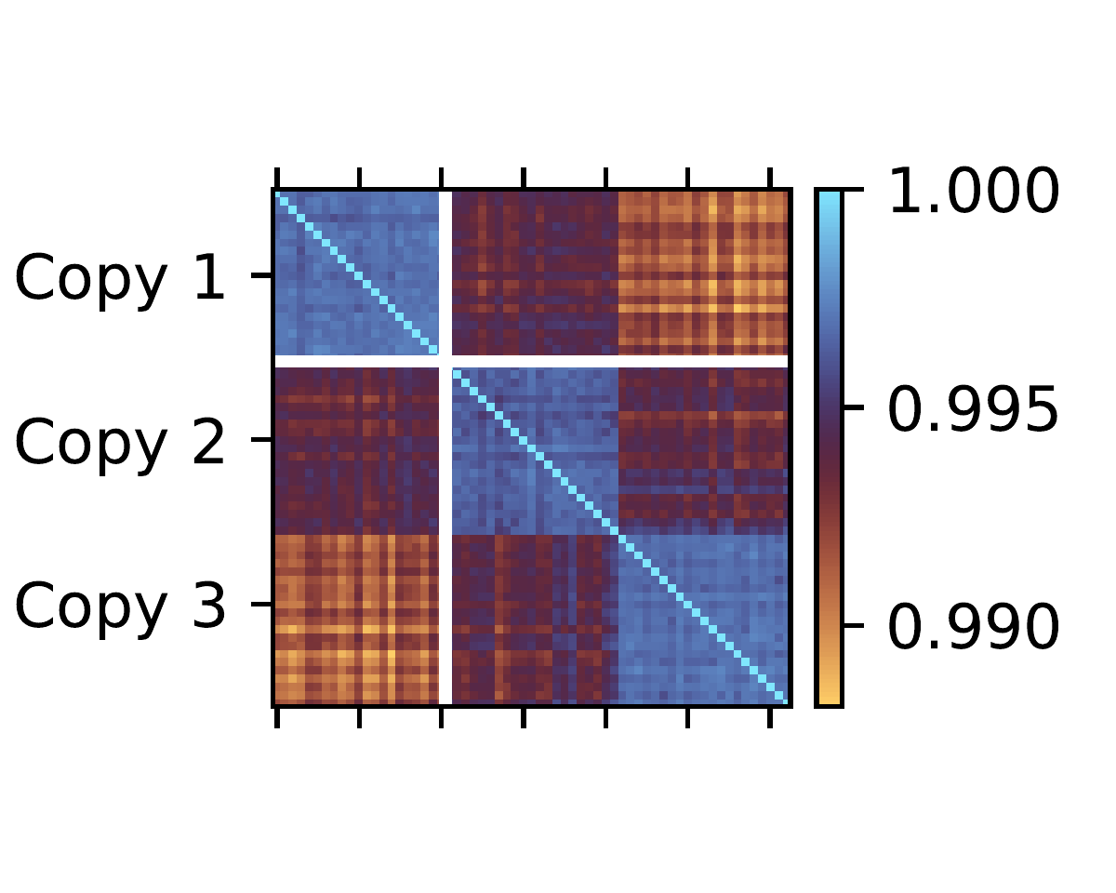
Oops, We Have Made a PUF!
It turns out the circuit can distinguish identical copies of the same mesh from manufacturing tolerances
This is a PUF
Entropy characterization and readout optimization are future work!
FNR 1.7%

Slide 21
Summary
We showed a simple, inexpensive circuit can perform Time Domain Reflectometry with better than 200 ps resolution
TDR mesh monitoring detects advanced attacks
It additionally exhibits PUF-like behavior and is capable of distinguishing identical copies of the same mesh
Prior work is more expensive, requires non-standard parts, and/or is less sensitive

Slide 22
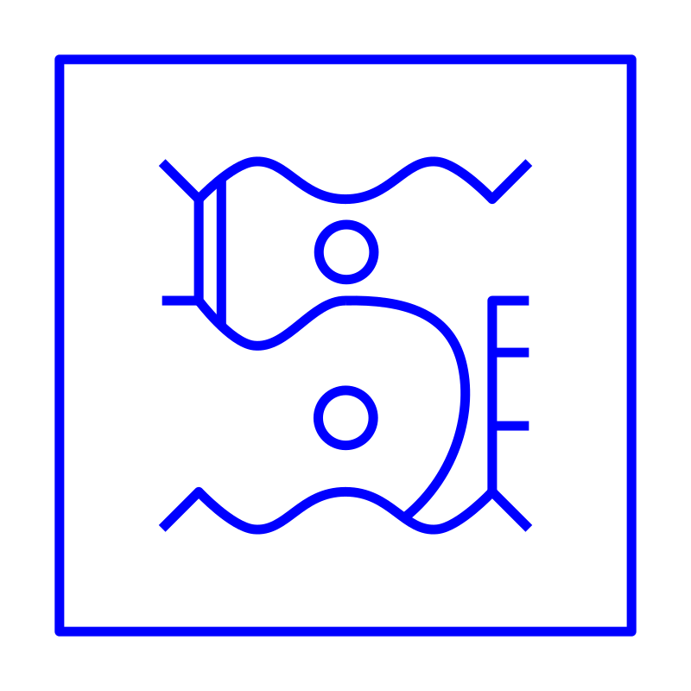
Questions &
Answers
Darmstadt • 2026-06-16 • Jan Sebastian Götte • research@jaseg.de
Darmstadt • 2026-06-16 • Jan Sebastian Götte • research@jaseg.de

Slide 23

Thank you!
research@jaseg.de

Slide 24
Related Work
Immler, V., Obermaier, J., Ng, K. K., et al. (2018). Secure physical enclosures from covers with tamper-resistance. IACR Transactions on Cryptographic Hardware and Embedded Systems 2019/1, 51–96. https://doi.org/10.46586/tches.v2019.i1.51-96
Garb, K., Obermaier, J., Ferres, E., & Künig, M. (2021). FORTRESS: Fortified tamper-resistant envelope with embedded security sensor. 18th International Conference on Privacy, Security and Trust (PST), 1–12. https://doi.org/10.1109/PST52912.2021.9647783
Tobisch, J.Tobisch, J., Zenger, C., & Paar, C. (2020). Electromagnetic enclosure PUF for tamper proofing commodity hardware and other applications. TRUDEVICE 2020: 9th Workshop on Trustworthy Manufacturing and Utilization of Secure Devices
Staat, P., Tobisch, J., Zenger, C., & Paar, C. (2022). Anti-tamper radio: System-level tamper detection for computing systems. 2022 IEEE Symposium on Security and Privacy (SP), 1722–1736. https://doi.org/10.1109/SP46214.2022.9833631
Mosavirik, T., Schaumont, P., & Tajik, S. (2023). ImpedanceVerif: On-chip impedance sensing for system-level tampering detection. IACR Transactions on Cryptographic Hardware and Embedded Systems 2023/1, 301–325. https://doi.org/10.46586/tches.v2023.i1.301-325
Tahoura Mosavirik and Shahin Tajik. “BackMon: IC Backside Tamper Detection Using On-Chip Impedance Monitoring”. CCS ’24: ACM SIGSAC Conference on Computer and Communications Security. Salt Lake City UT USA: ACM, Nov. 19, 2024, pp. 68–77. DOI: https://doi.org/10.1145/3689939.3695784
Dupont, F., Laurent, P., Montfort, F., et al. (2022). A miniaturized and ultra-low-power tamper detection sensor for portable applications. IEEE Sensors Journal, 22(5), 4524–4533. https://doi.org/10.1109/JSEN.2022.3143656

Slide 25
References
[1] Chester, C. T. (1870). Improvement in protecting safes and vaults from burglars (U.S. Patent No. 106,324). U.S. Patent and Trademark Office. https://patents.google.com/patent/US106324A/en
[2] Dupont, F., Laurent, P., Montfort, F., et al. (2022). A miniaturized and ultra-low-power tamper detection sensor for portable applications. IEEE Sensors Journal, 22(5), 4524–4533. https://doi.org/10.1109/JSEN.2022.3143656
[3] Vasile, D.-C. & Svasta, P. (2019). Protecting the secrets: Advanced technique for active tamper detection systems. 25th International Symposium for Design and Technology in Electronic Packaging (SIITME), 212–215. https://doi.org/10.1109/SIITME47687.2019.8990877

Slide 26

Bonus
Slides
Darmstadt • 2026-06-16 • Jan Sebastian Götte • research@jaseg.de
Darmstadt • 2026-06-16 • Jan Sebastian Götte • research@jaseg.de

Slide 27
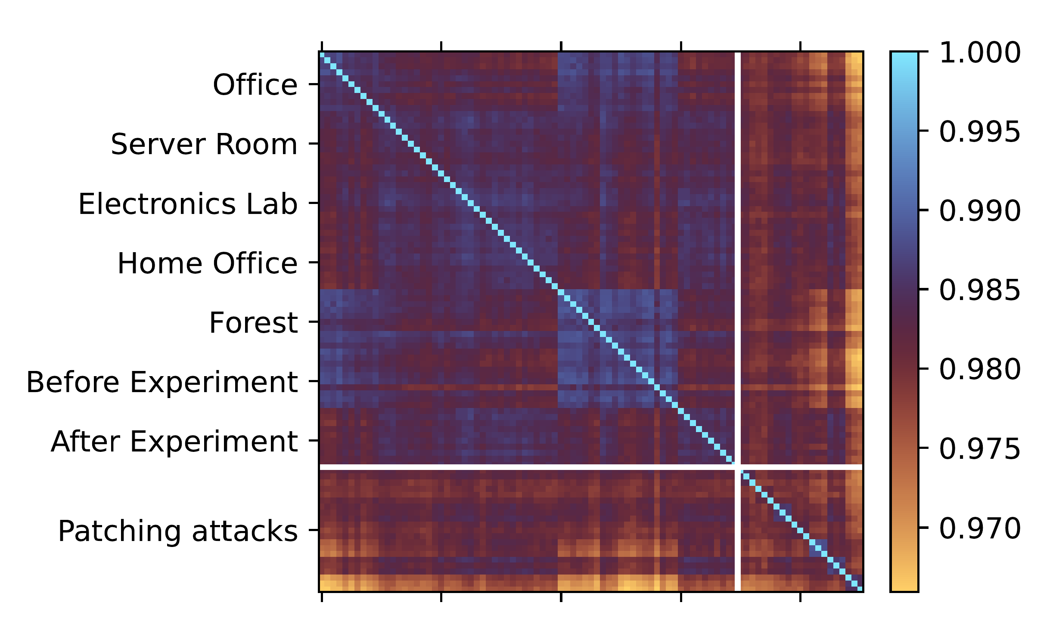
Environmental Factors in TDR Mesh Monitoring

Slide 28
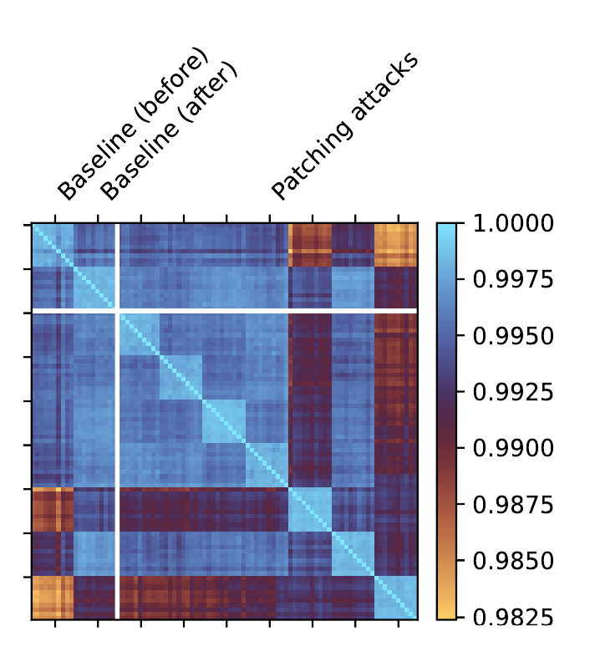
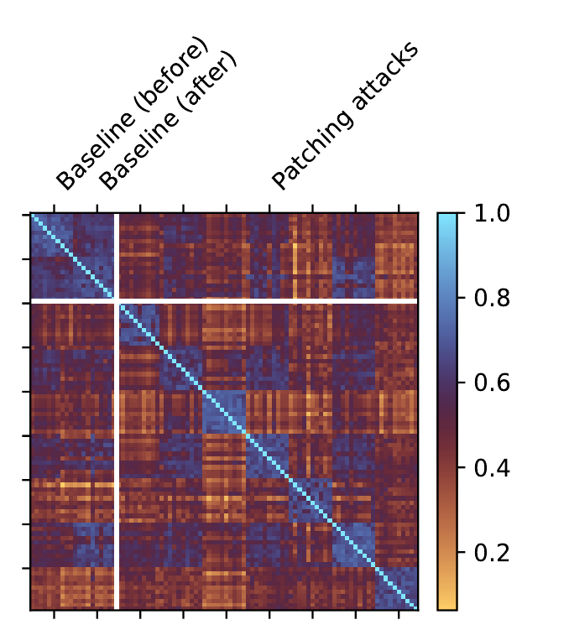
Large-Scale Microsoldering Attack Experiment
Pearson Correlation
L∞ norm

Slide 29
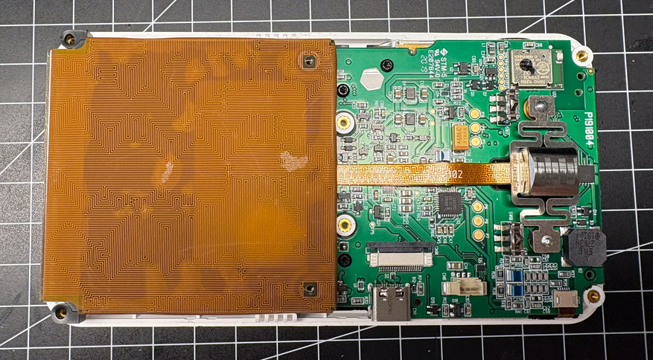
Mesh Photos

Slide 30
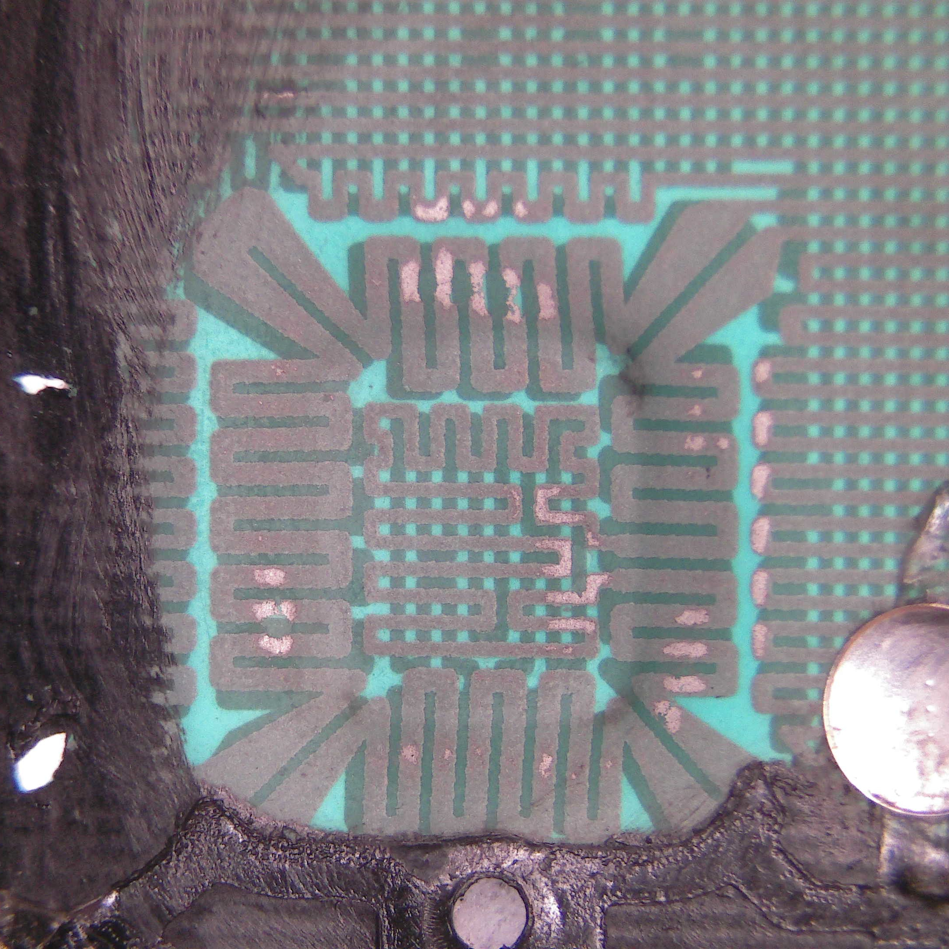
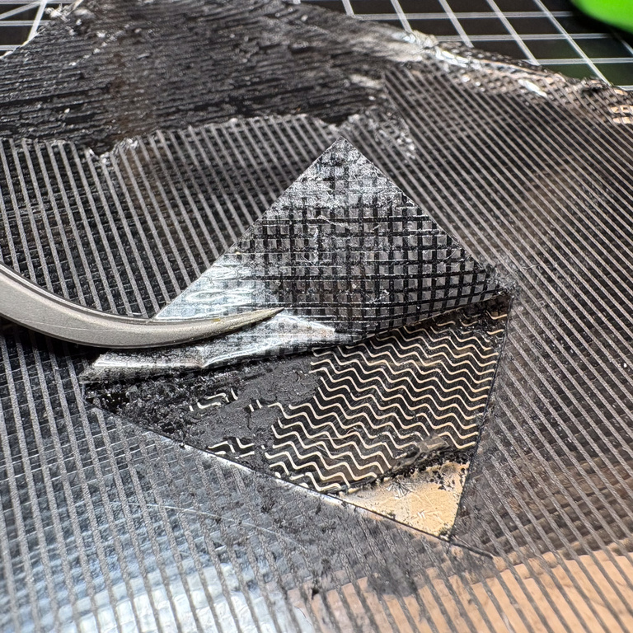
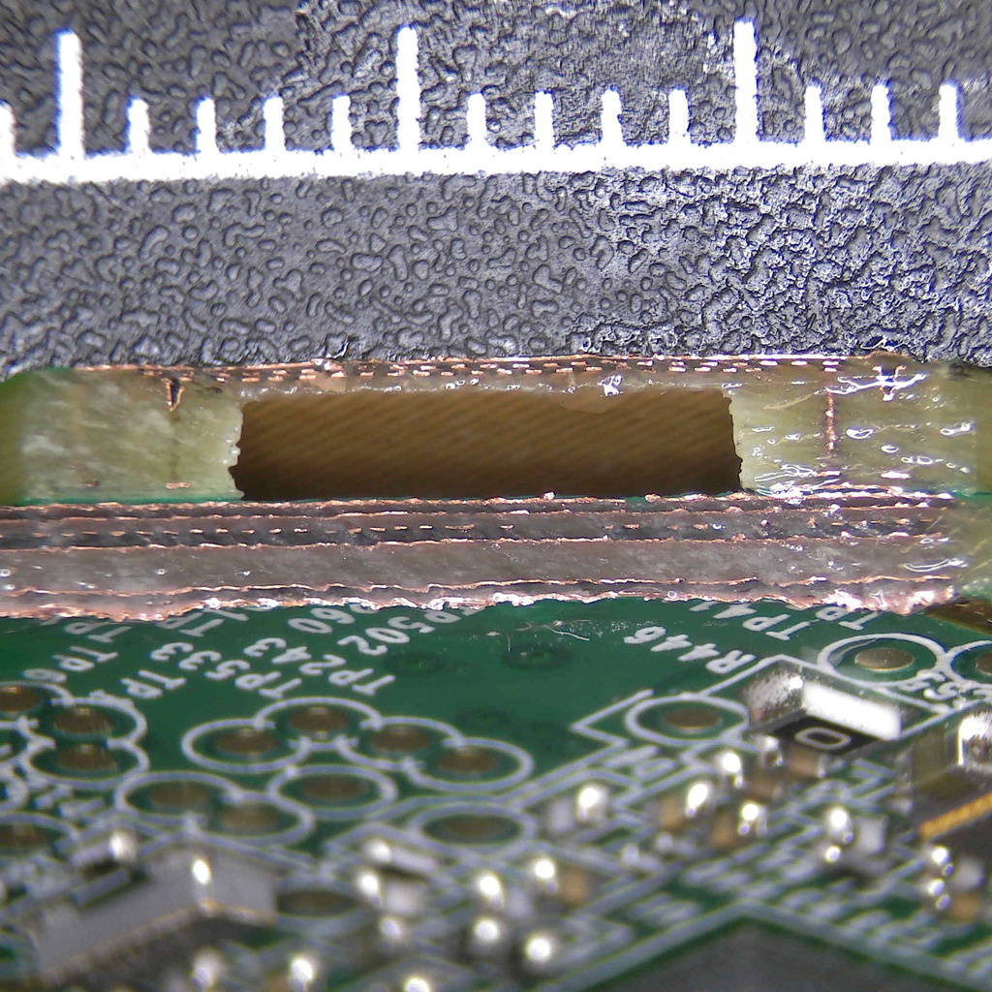
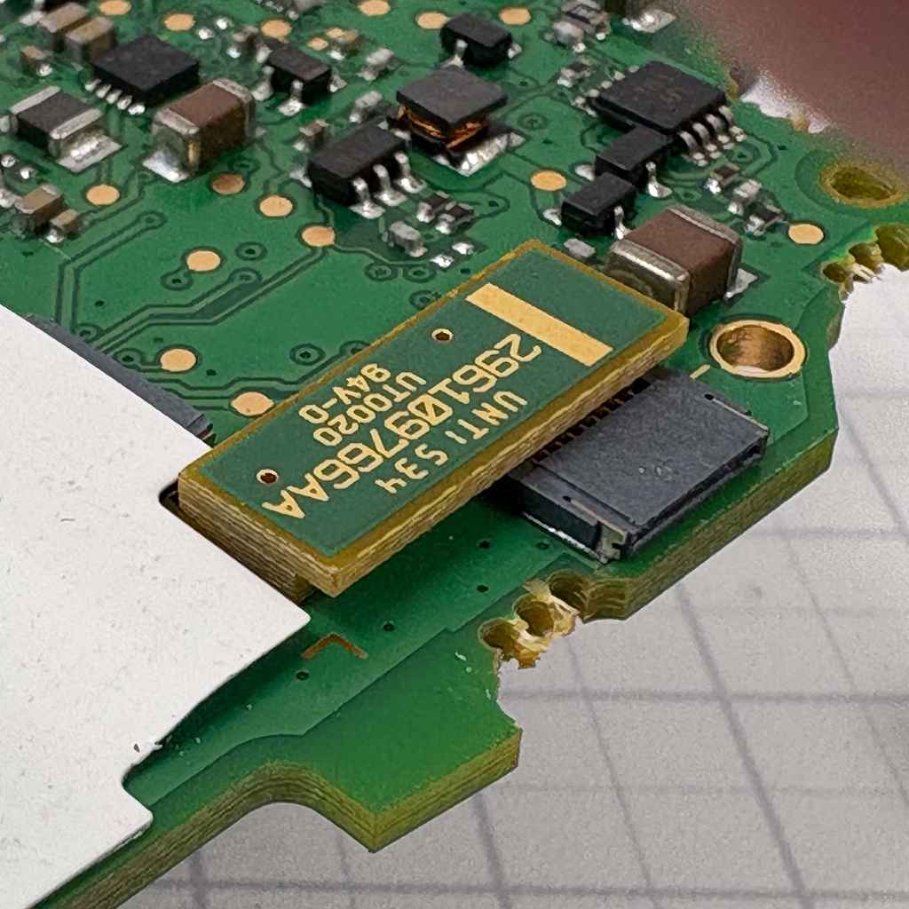
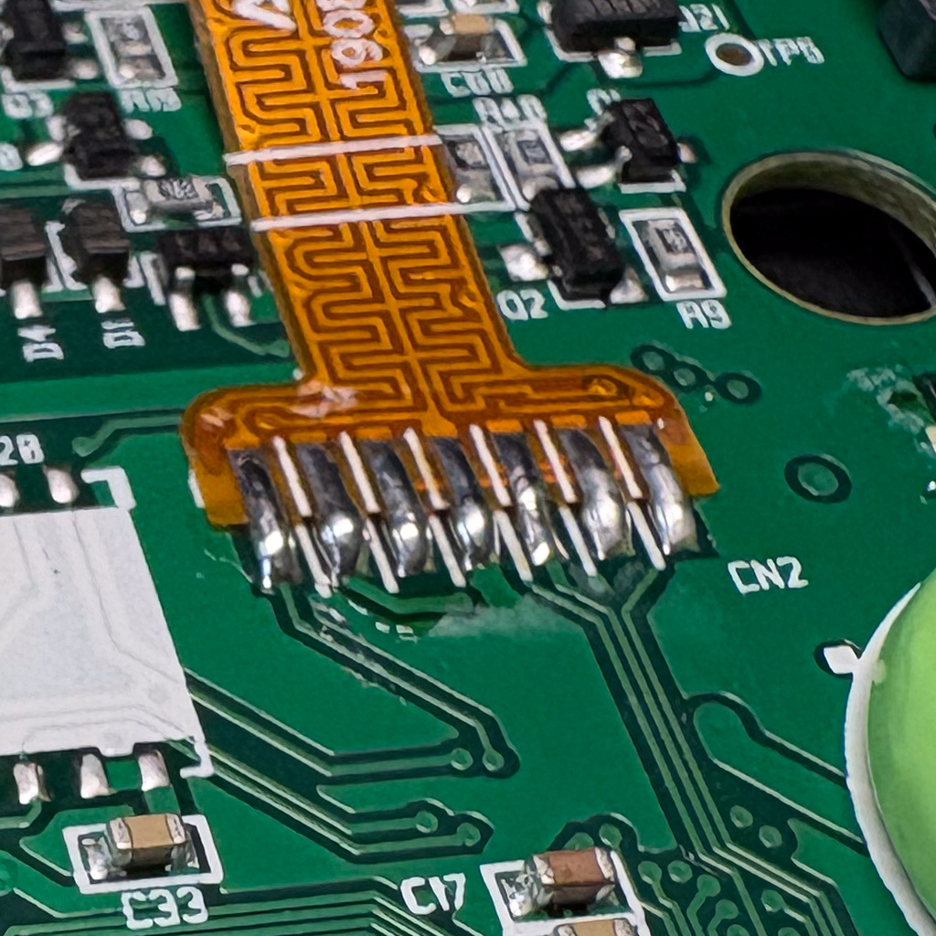
2
Mesh Photos
1
3
4
5

